Slide 1
Self-supervised learning for glitch classification

Slide 2
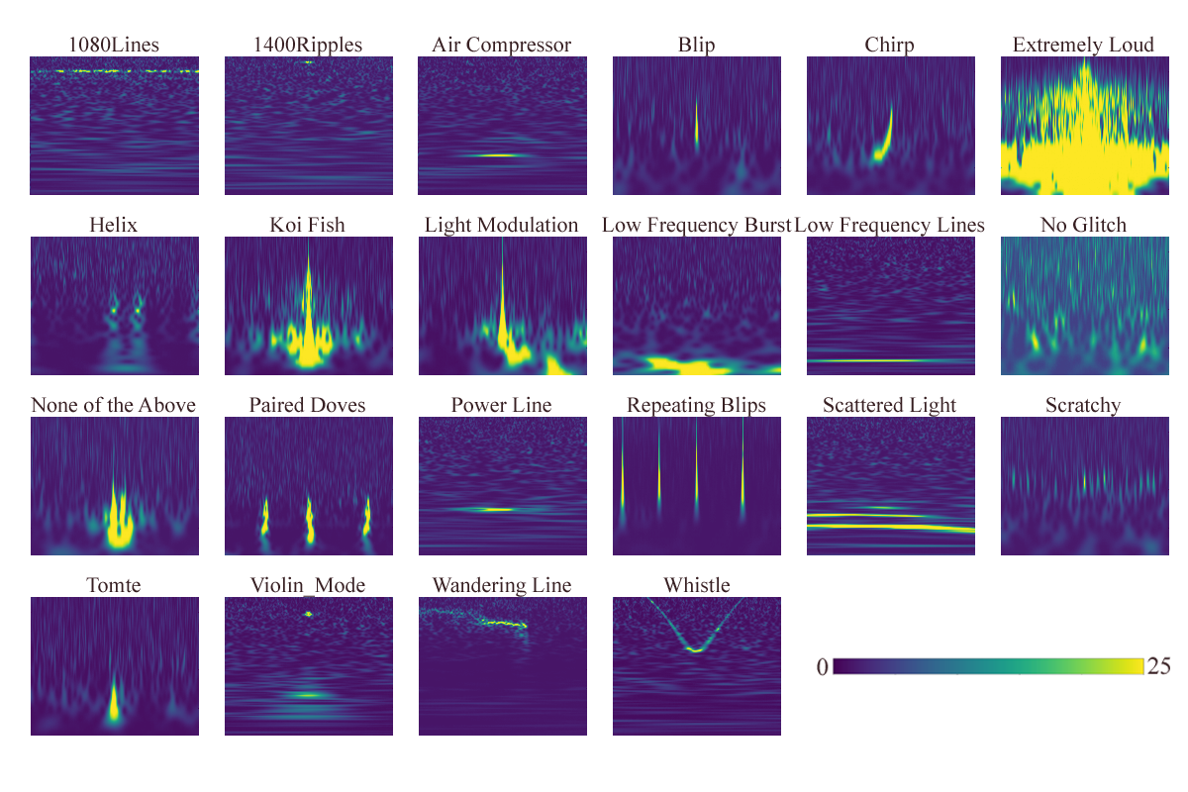
The dataset
Contains 21 sets of images for glitches and 1 set of images for background noise.
There are four versions for each image, the difference being the time window.
It is divided between three subsets:
  Train (6008 images)
  Validation (1288 images)
  Test (1287 images)

Slide 3
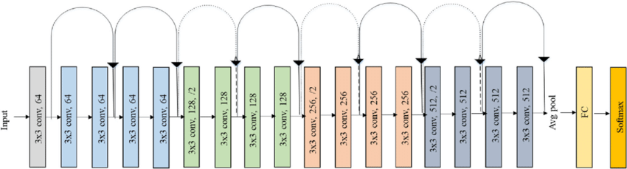
Resnet 18’s architecture
Image taken from: Ramzan, Farheen & Khan, Muhammad Usman & Rehmat, Asim & Iqbal, Sajid & Saba, Tanzila & Rehman, Amjad & Mehmood, Zahid. (2019). A Deep Learning Approach for Automated Diagnosis and Multi-Class Classification of Alzheimer’s Disease Stages Using Resting-State fMRI and Residual Neural Networks. Journal of Medical Systems. 44. 10.1007/s10916-019-1475-2.

Slide 4
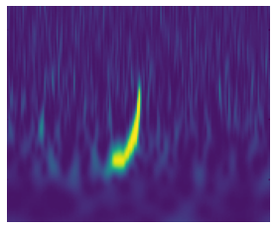
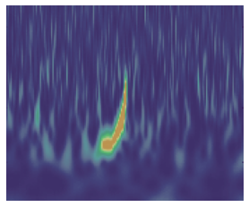
The supervised approach
Body
Head
(last layer)
Labeled dataset
Augmentation
Loss
Accuracy
F1-score
Confusion matrix
Resnet18

Slide 5
Self-supervised + transfer learning
Unlabeled dataset
Labels accordingly with the Augmentation
Body
Head
Loss
Accuracy
F1-score
Confusion matrix
Resnet18
Labeled dataset
Augmentation
Body
New Head
(fine-tunning)

Slide 6
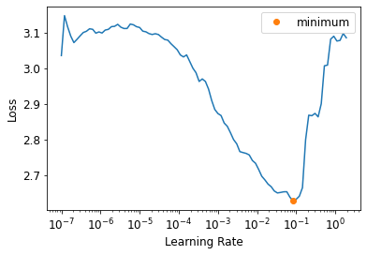
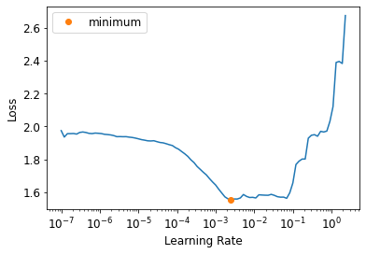
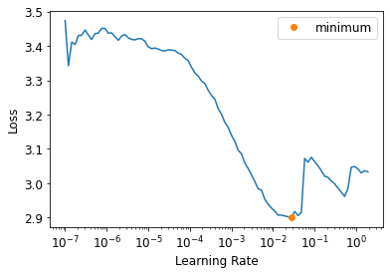
Finding the learning-rate
Supervised
Self-supervised
Self-supervised + transfer learning

Slide 7
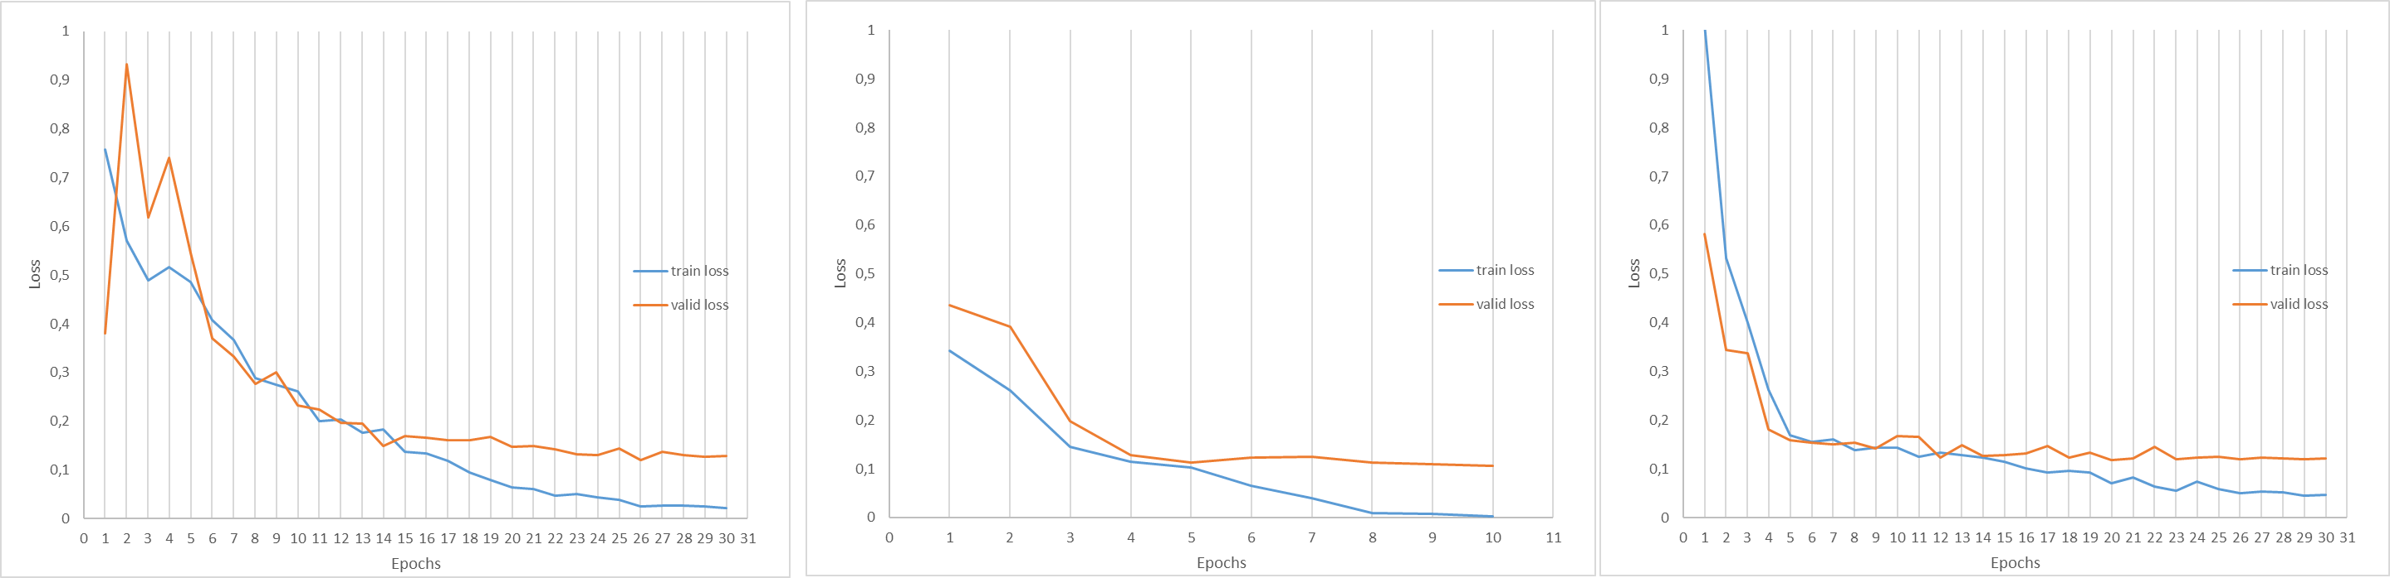
Train and valid loss across the epochs
Supervised
Self-supervised
Self-supervised + transfer learning

Slide 8
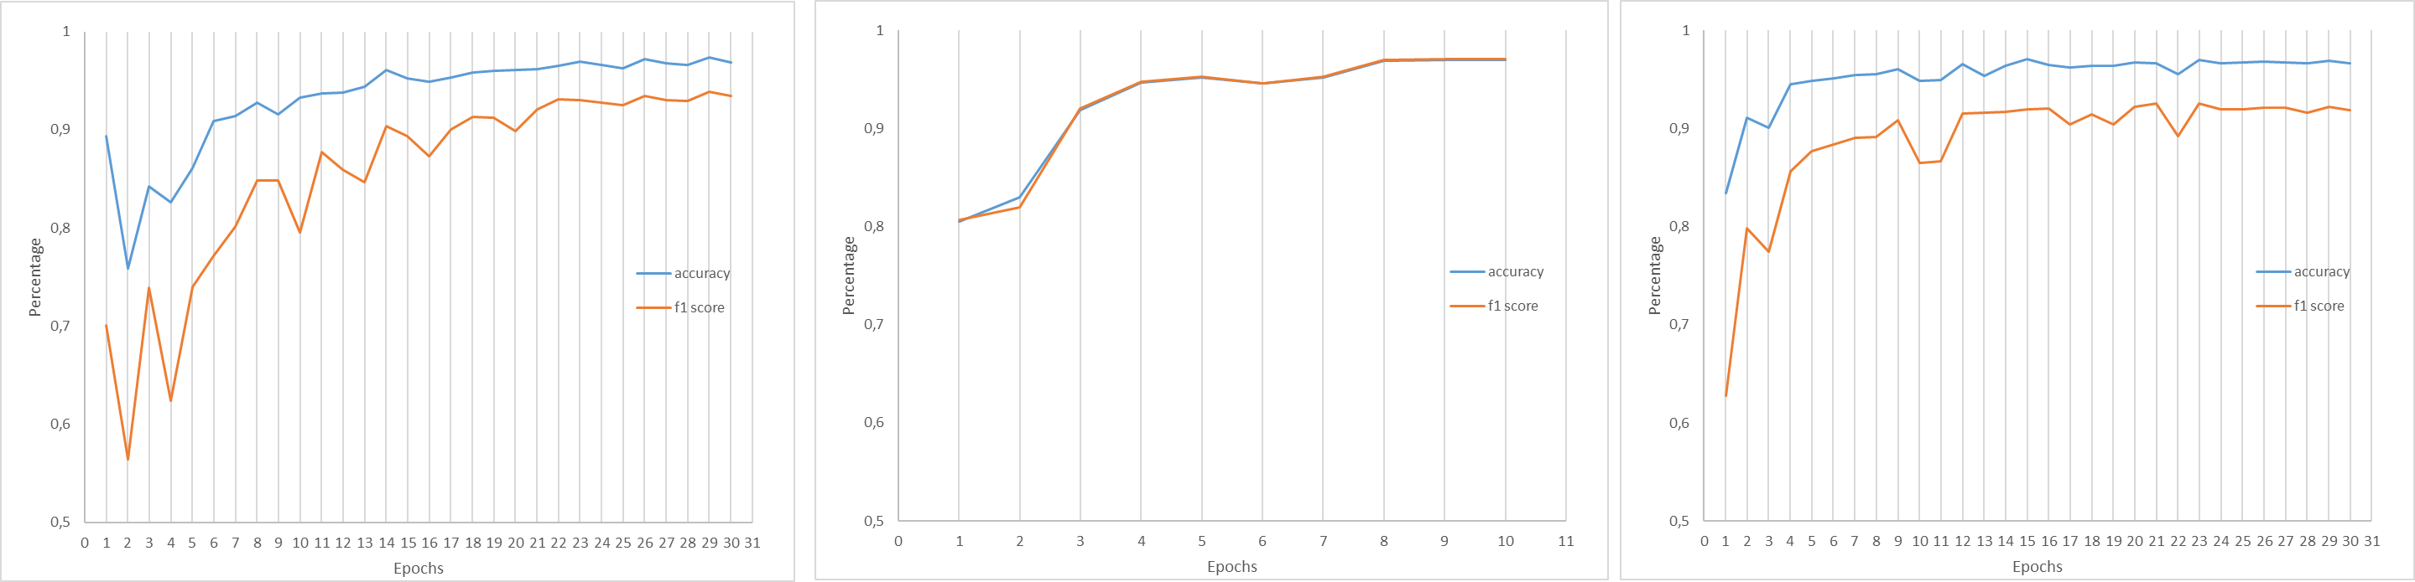
Accuracy and macro-averaged F1-score
Supervised
Self-supervised
Self-supervised + transfer learning

Slide 9
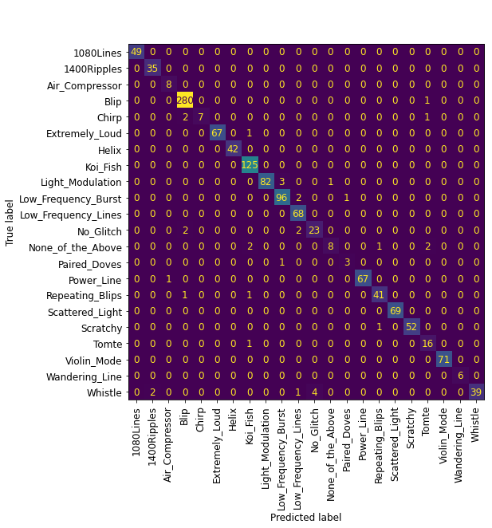
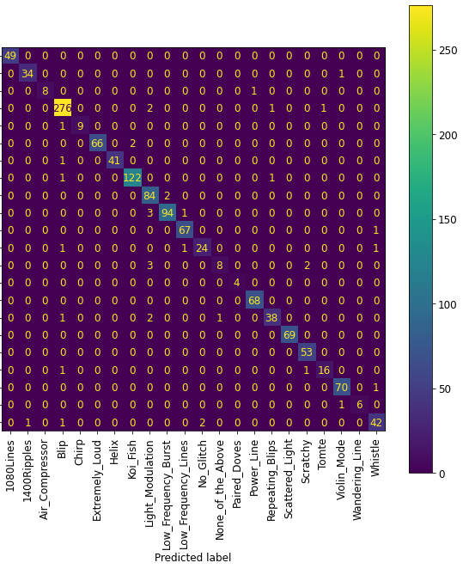
Confusion matrices: supervised
Validation dataset
Test dataset
Validation:
Accuracy: 97.36%
Macro-averaged F1-score: 93.88%
Test:
Accuracy: 96.97%
Macro-averaged F1-score: 95.19%

Slide 10
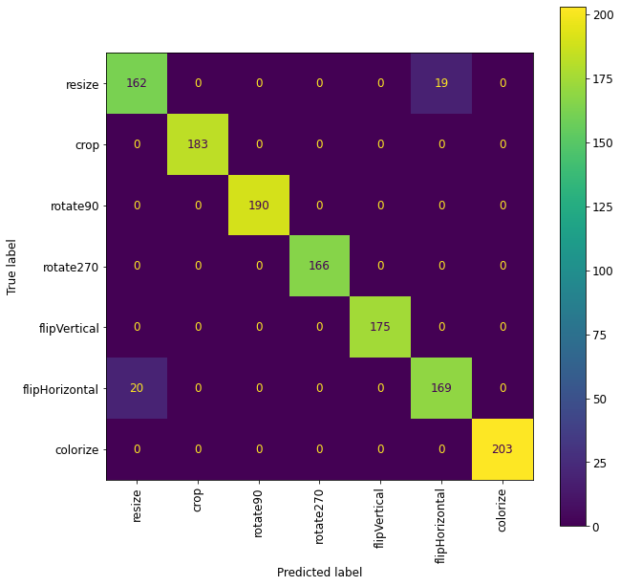
Confusion matrices: self-supervised
Test:
Accuracy: 96.97%
Macro-averaged F1-score: 96.99%
Test dataset

Slide 11


Confusion matrices: SSL+ transfer learning
Validation dataset
Test dataset
Validation:
Accuracy: 96.66%
Macro-averaged F1-score: 92.58%
Test:
Accuracy: 96.27%
Macro-averaged F1-score: 93.27%

Slide 12
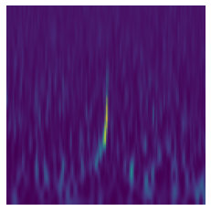
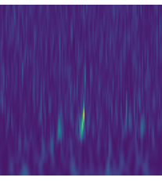
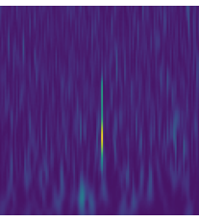
Can it detect as signals?
Signal
Chirp
Blip
Since chirps are supposed to emulate a signal, can it be detected by the neural network?

Slide 13
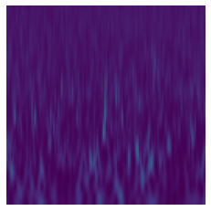
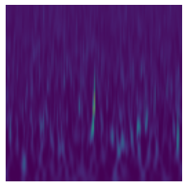
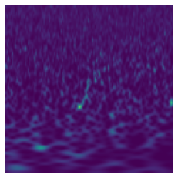
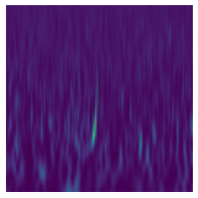
Can it detect as signals?
There are 11 images of events and 11 images of just background noise, and it didn't go so well…
It classified the events:
54.5% as Blips (6/11)
18.1% as Chirps (2/11)
Answer: Blip Blip Chirp Low_Frequency_Lines Chirp
Probability: 0.794 0.440 0.982 0.443 0.999

