Slide 1
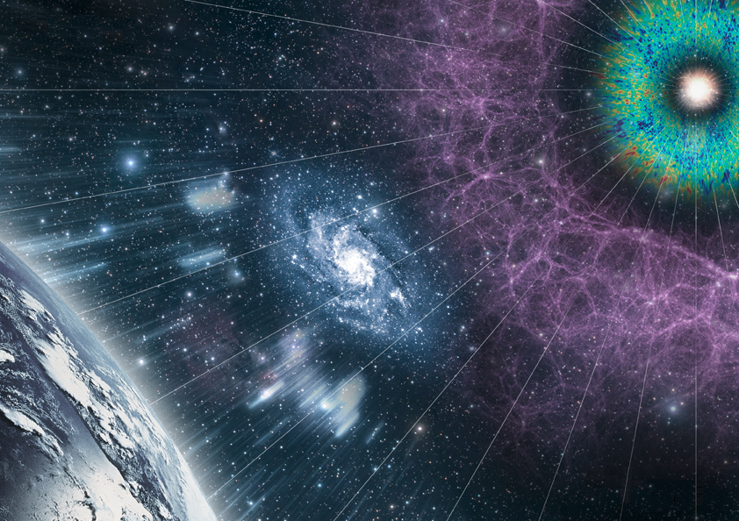
Searching for Primordial Black Holes
with
Gravitational Waves
Iberian GW Meeting, Braga, 8th June 2022
Juan García-Bellido
IFT-UAM/CSIC Madrid

Slide 2
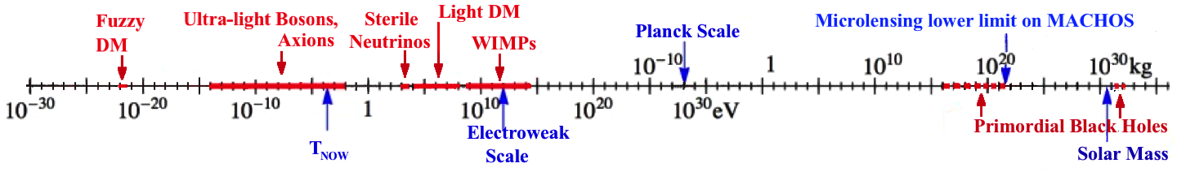
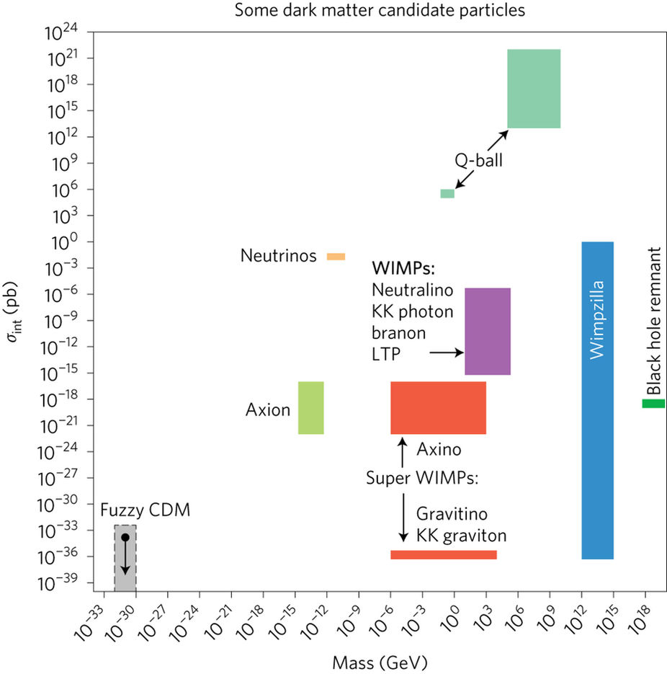
What is Dark Matter?
90 orders of magnitud in mass
80 orders
of magnitud
in strength

Slide 3

Inflation
JGB (2017)
Horizon crossing
1/(aH)
1/(aH)
comoving scale 1/k
CMB
LSS
PBH
-60
-50
-40
-30
-20
-10
PBH
BBN
rec
a₀
EW
QCD
eq
N=ln a/a_{end}
N=0
Inflation
Radiation
Matter

Slide 4
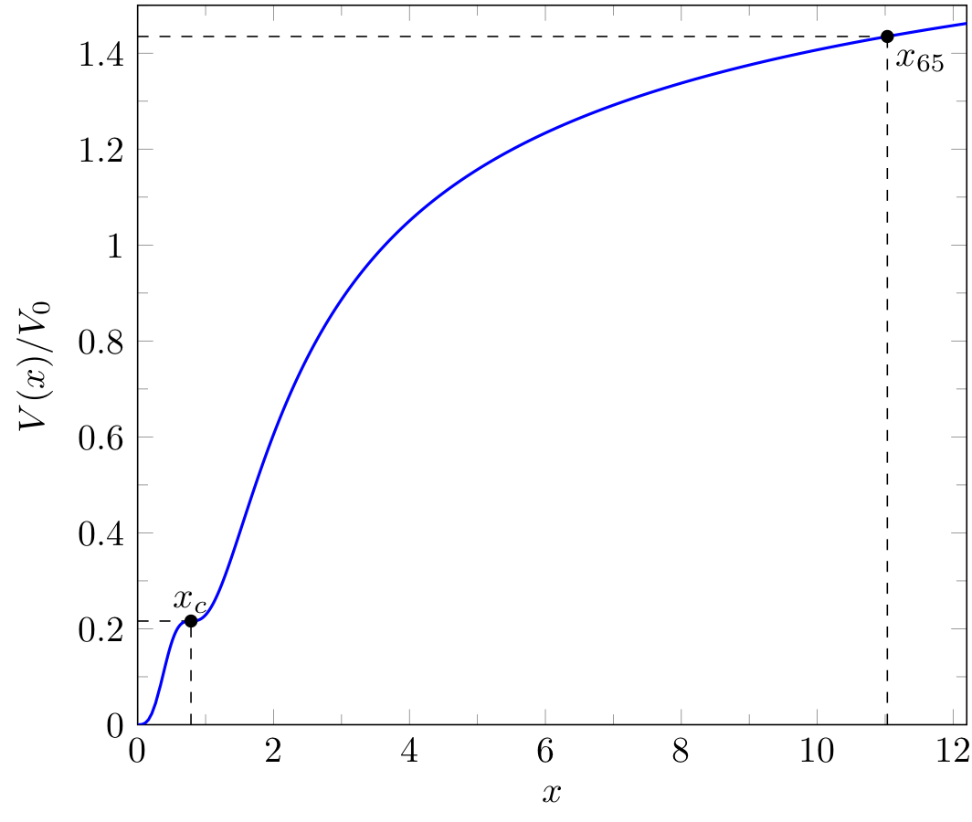
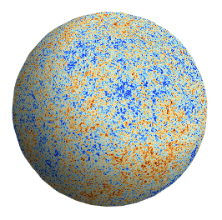
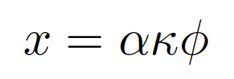
Ezquiaga, JGB, Ruiz Morales (2017)

Slide 5
Primordial Spectrum PBH
JGB, Ruiz Morales (2017)
CMB
Spectral
Distortions

Slide 6
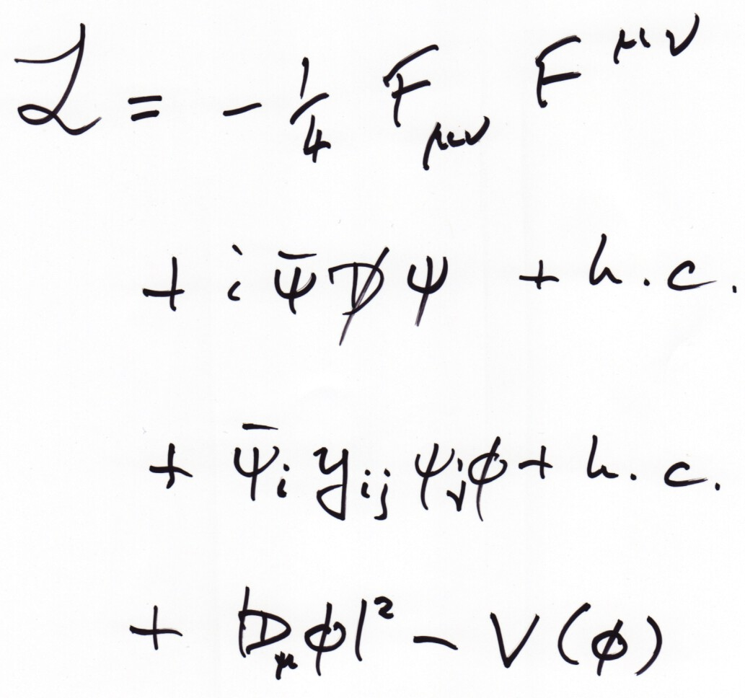
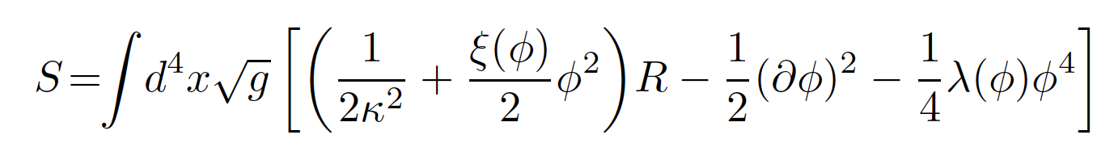
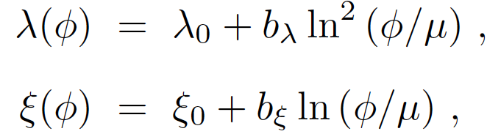
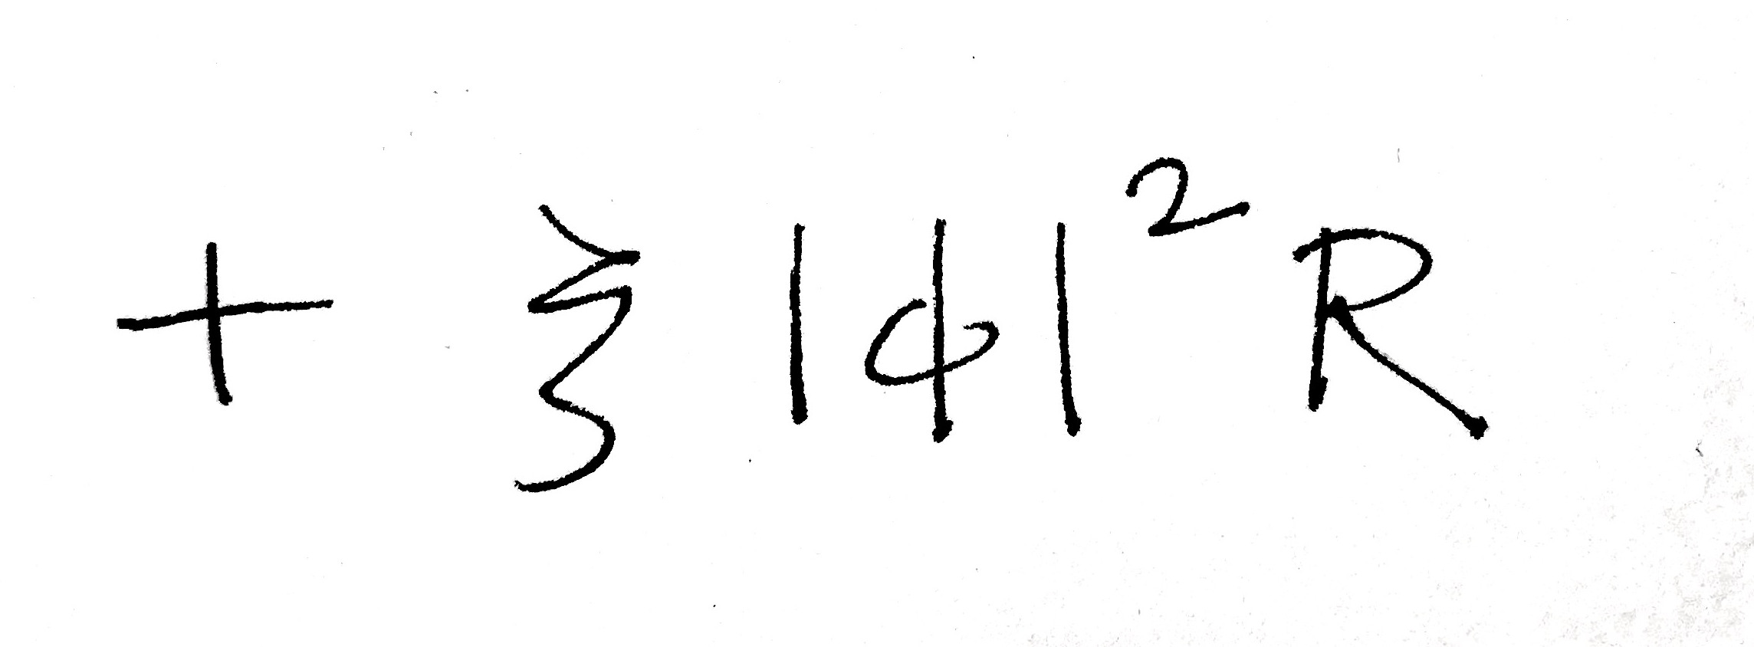
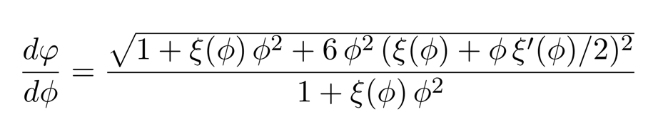
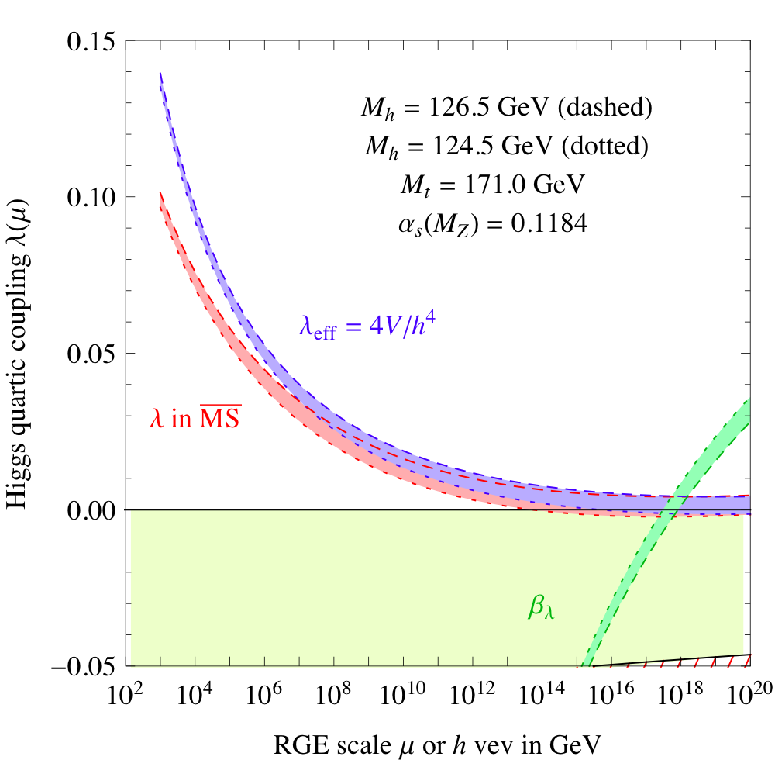
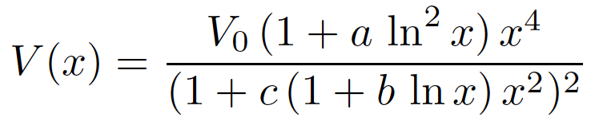

Critical Higgs Inflation
Standard Model Lagrangian
Ezquiaga, JGB, Ruiz Morales (2017)
Buttazzo et al (2012)

Slide 7
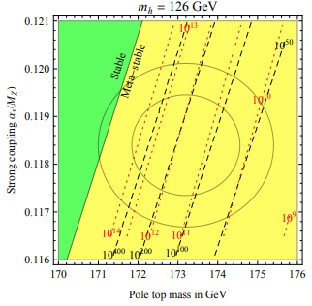
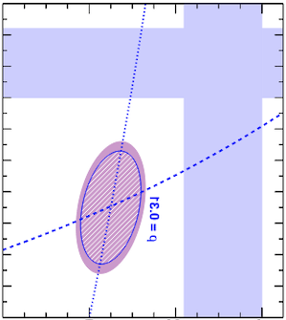


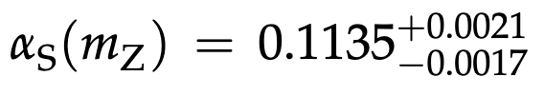



EW vacuum meta-stability
CMS Collab. (2020)
Buttazzo et al. (2012)
m_{h} = 125.5 GeV
Stable
Meta-stable

Slide 8
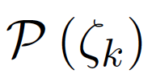
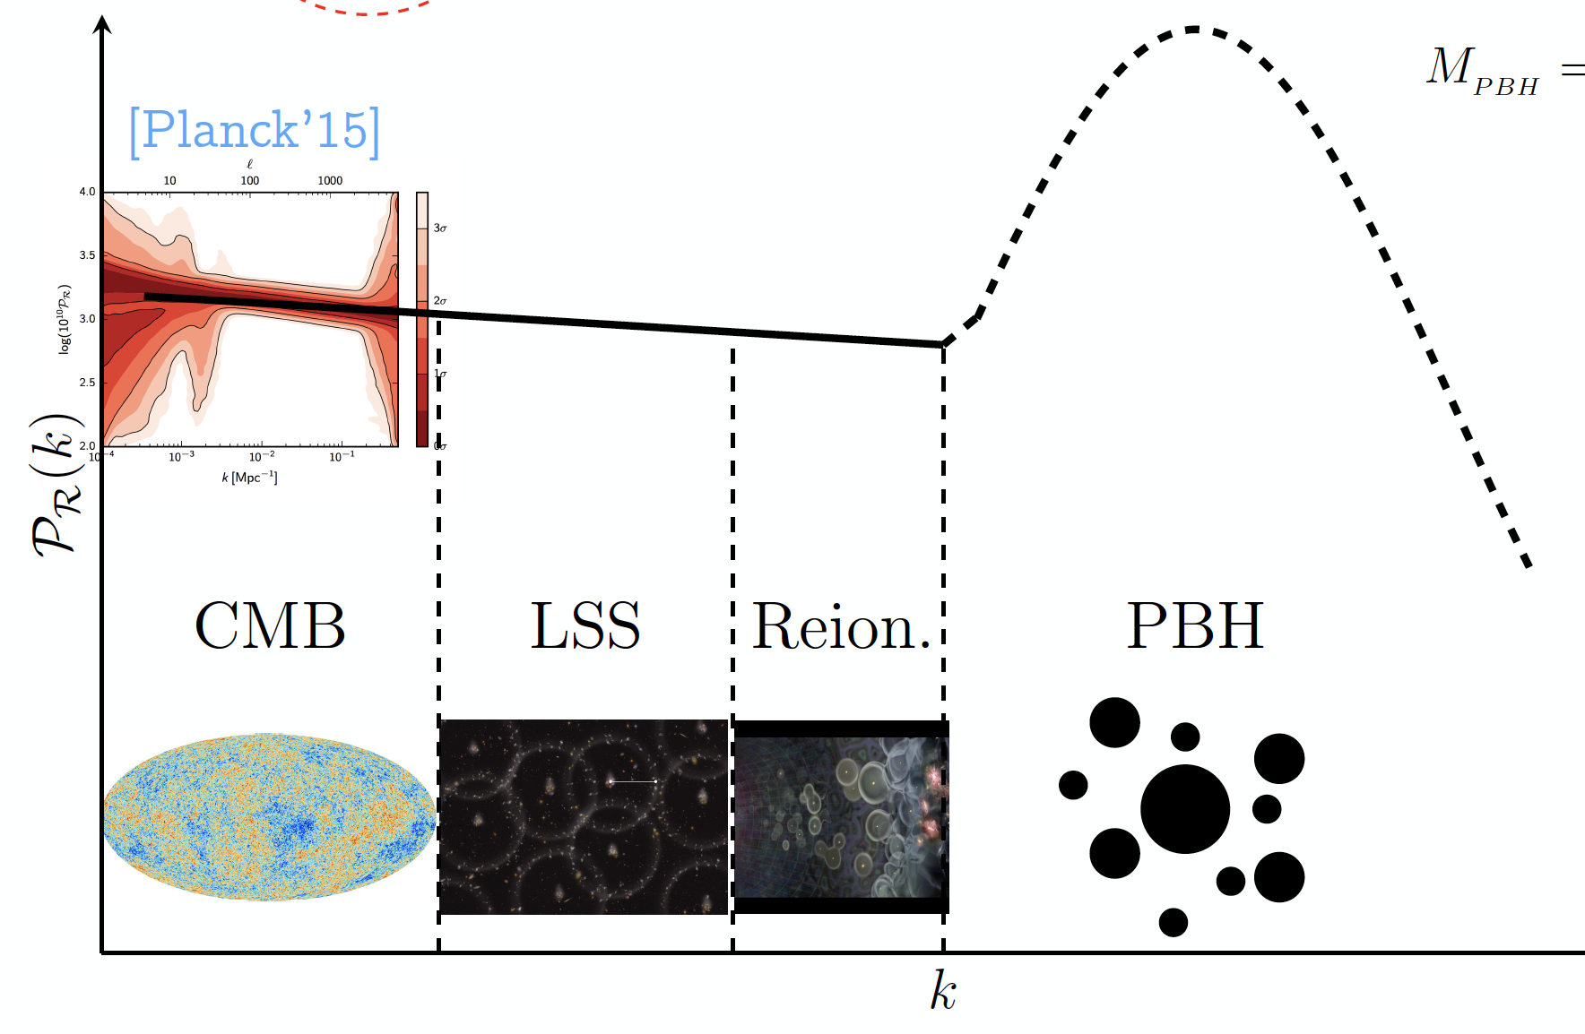



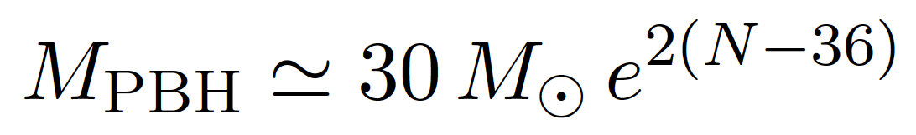
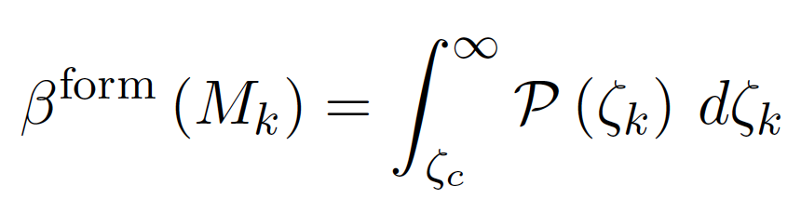
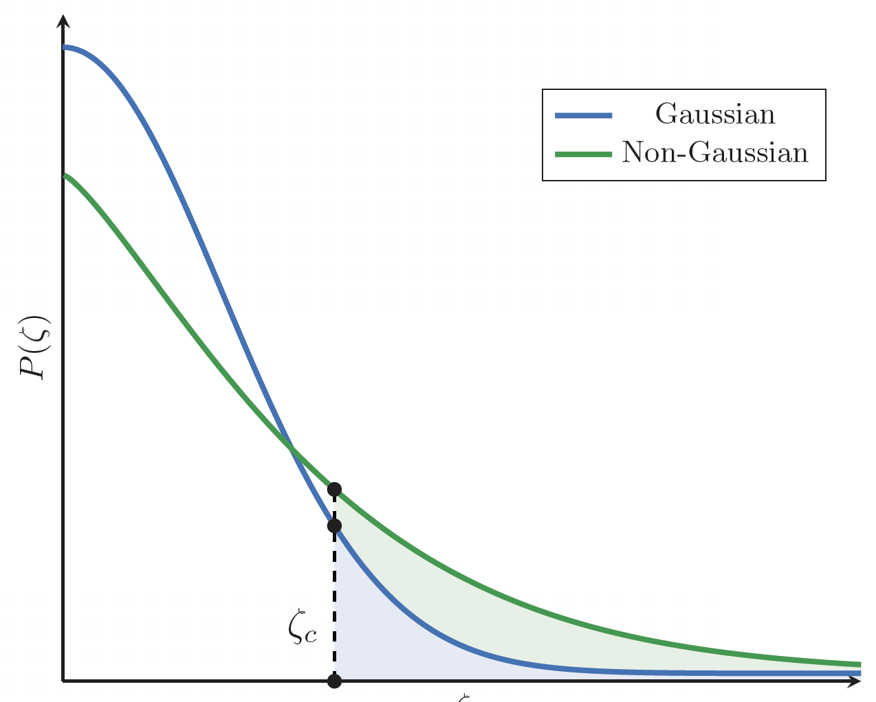
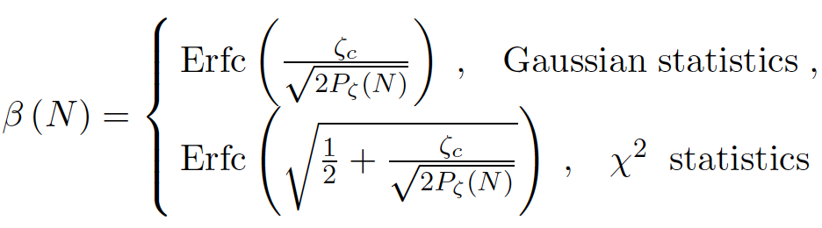
Gravitational Collapse of PBH
JGB (2017)

Slide 9

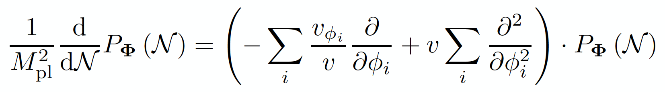
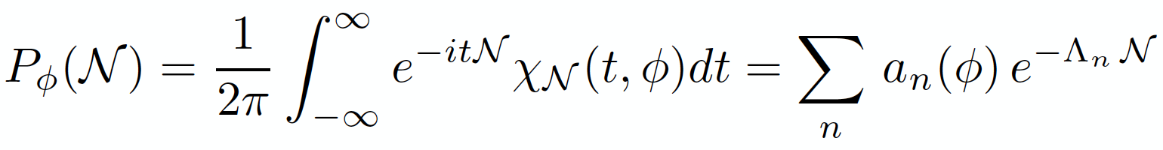
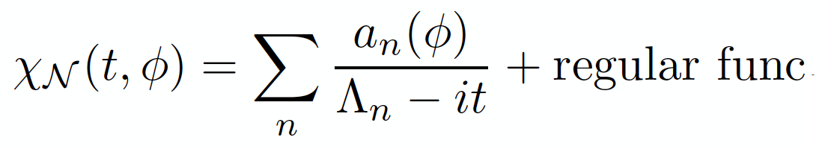
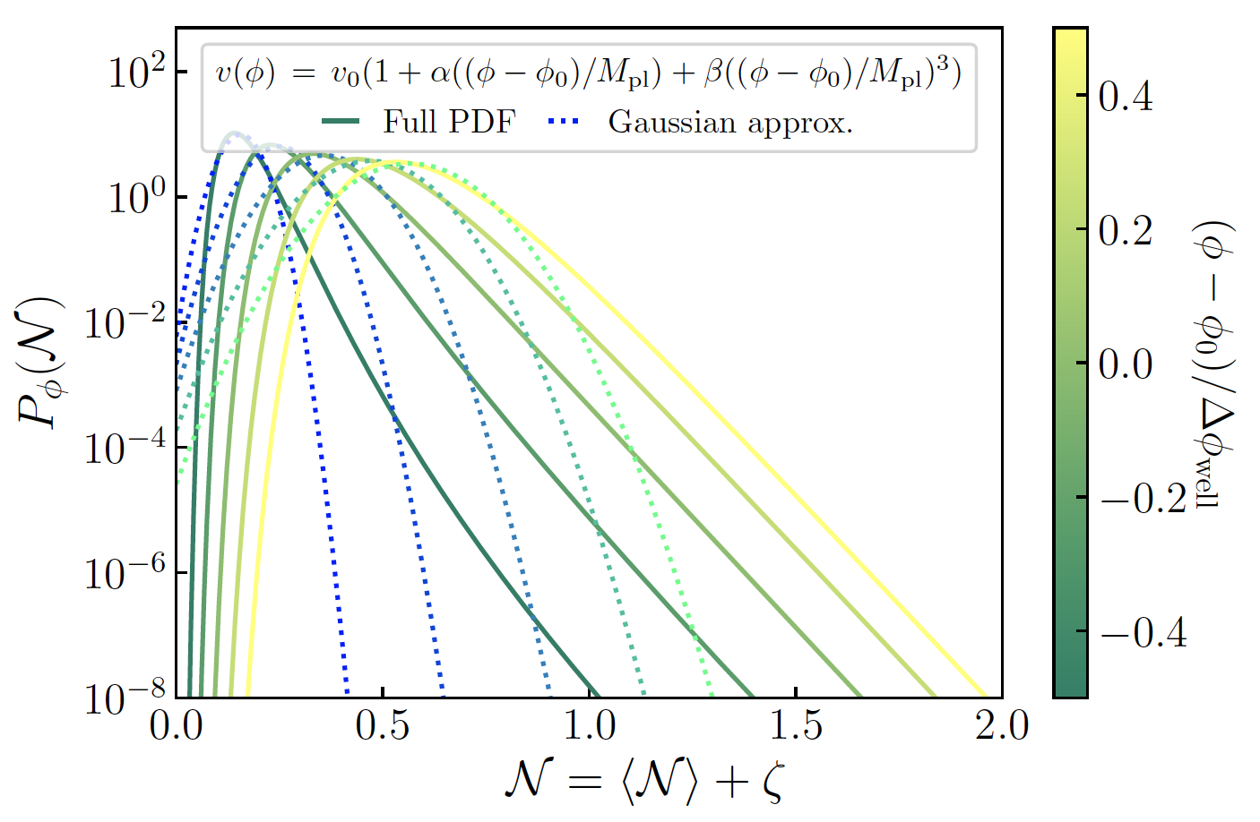
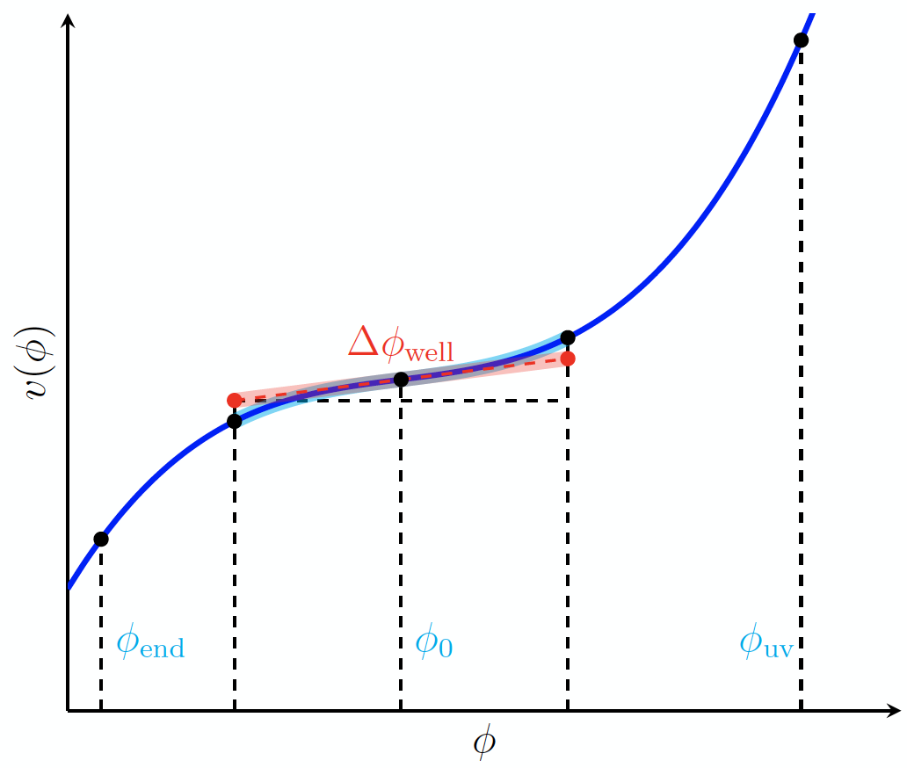
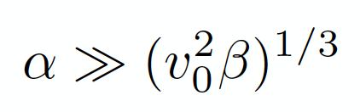
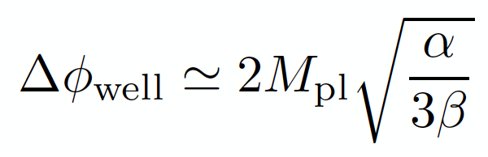
Coarse-grained curvature perturbation
Fokker-Planck
Diffusion Eq.
Determined by the poles of the characteristic function
Ezquiaga, JGB, Vennin (2019)

Slide 10
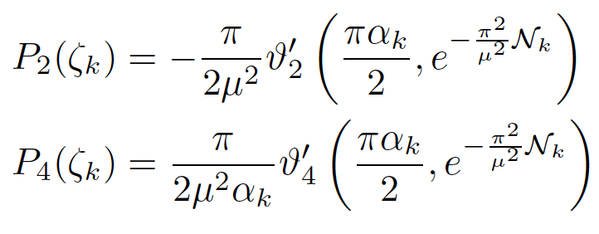
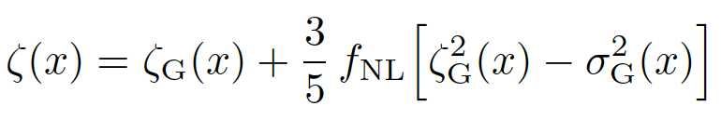
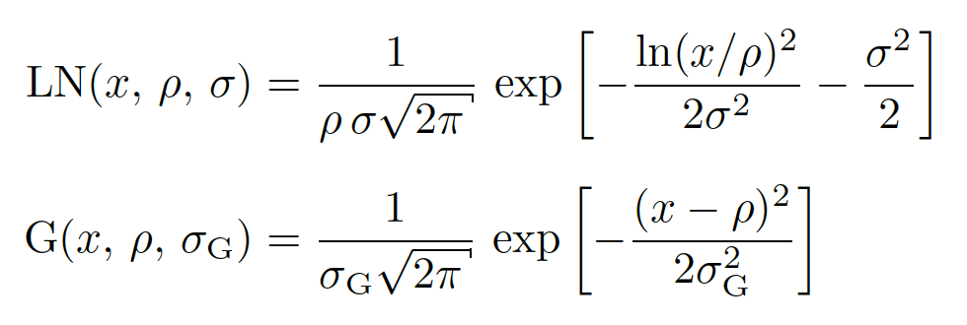
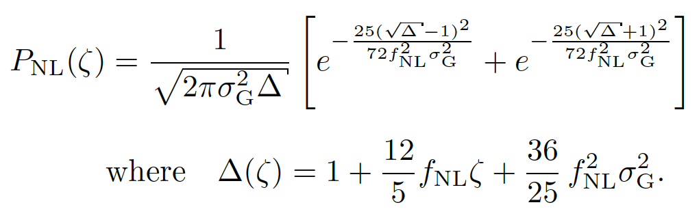
Quantum Diffusion @ CMB & LSS
Ezquiaga, JGB, Vennin (2022)

Slide 11


Spatial Distribution PBH
v
v
v
v
v
v
Monochromatic
Uniformly distributed
Broad range masses
PBH clusters
JGB (2017)

Slide 12

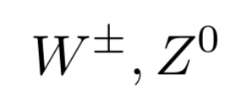






Thermal history of the universe
Carr, Clesse, JGB, Kühnel (2019)
PBH mass spectrum
m_{H}
m_{H}

Slide 13
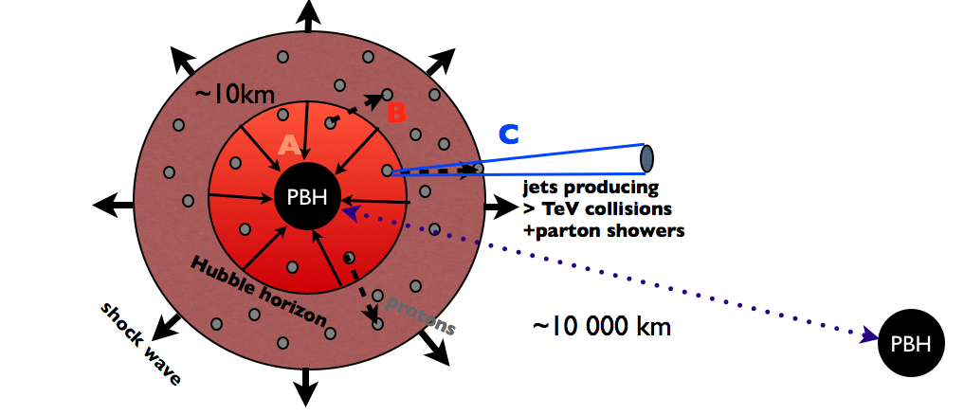
Electroweak baryogenesis @ QCD
“Primordial supernova”
JGB, Carr, Clesse (2019)
Sakharov conditions:
CP, C, B violation
Out of equilibrium

Slide 14
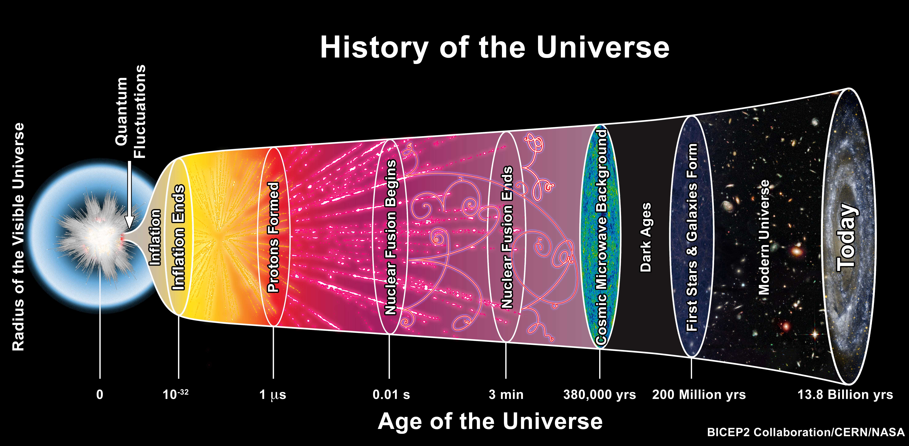
JGB
(2019)
PBH=DM
collapse
Baryogenesis
Nucleosynthesis
quark-hadron
transition
hot-spot
EWB
baryon
dilution
light
elements
200 MeV
100 MeV
10 MeV
1 MeV

Slide 15
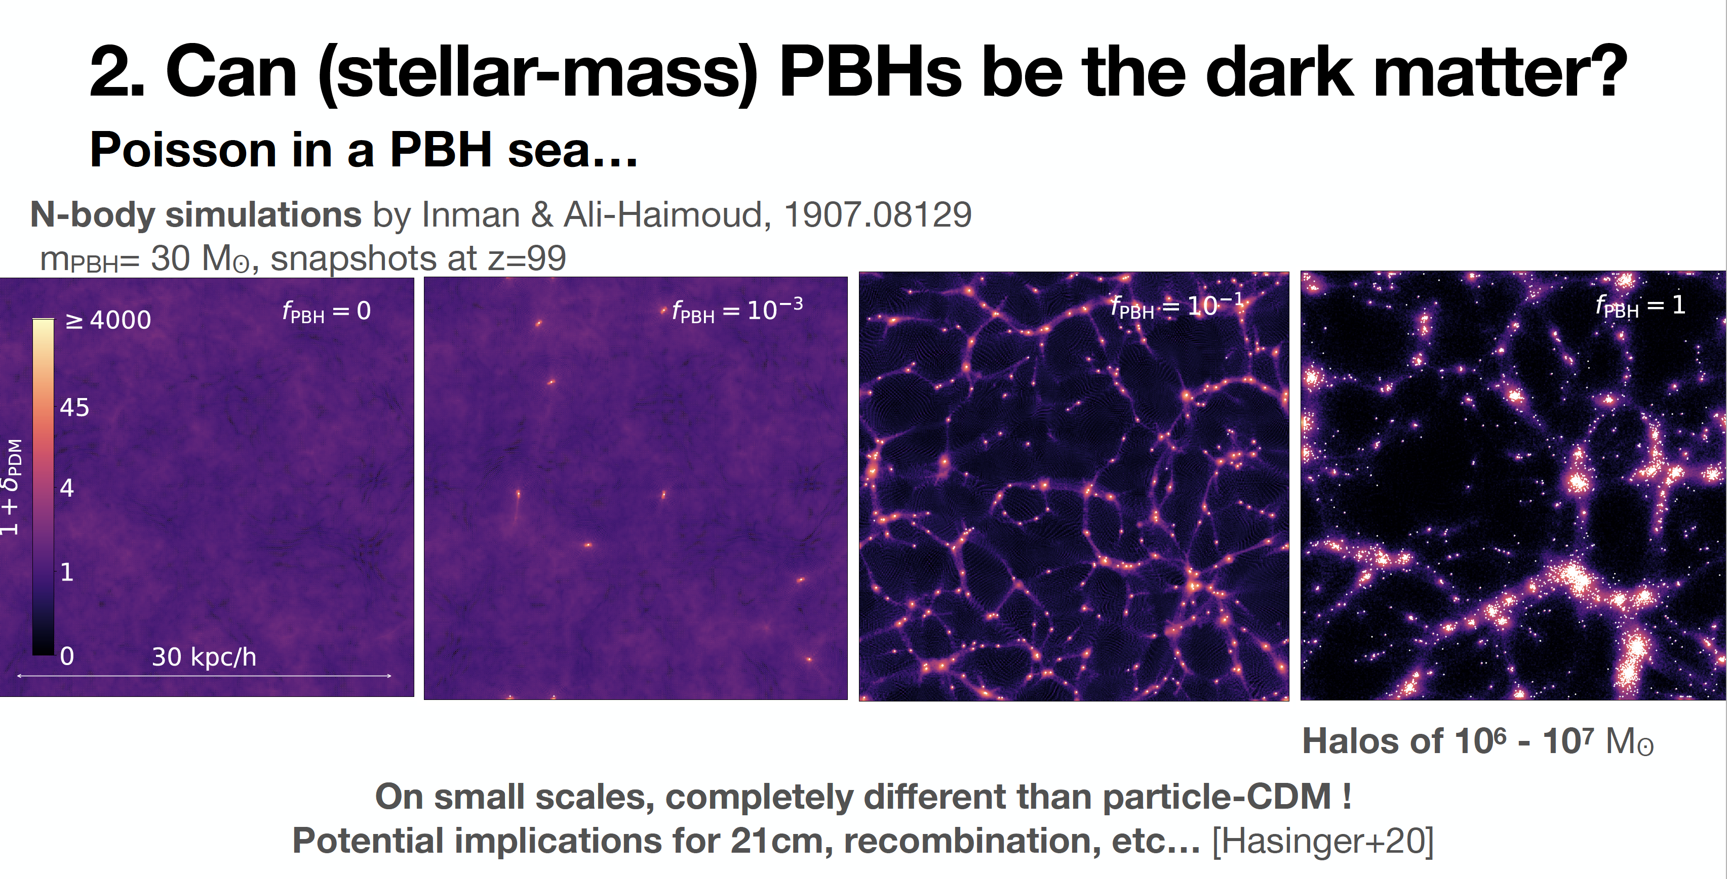
Clesse (2021)

Slide 16
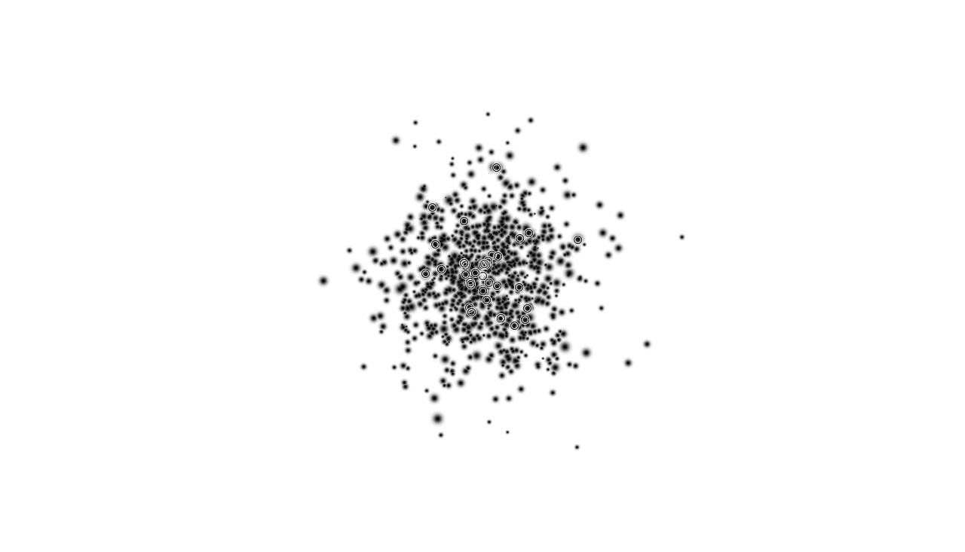
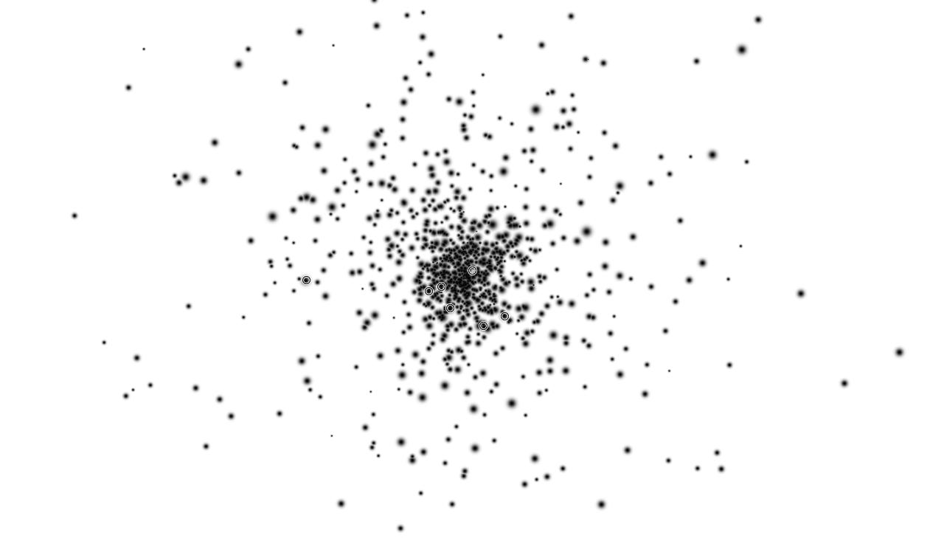
PBH clusters
Trashorras , JGB, Nesseris (2020)
v
v
v
v
v
v
v
v

Slide 17
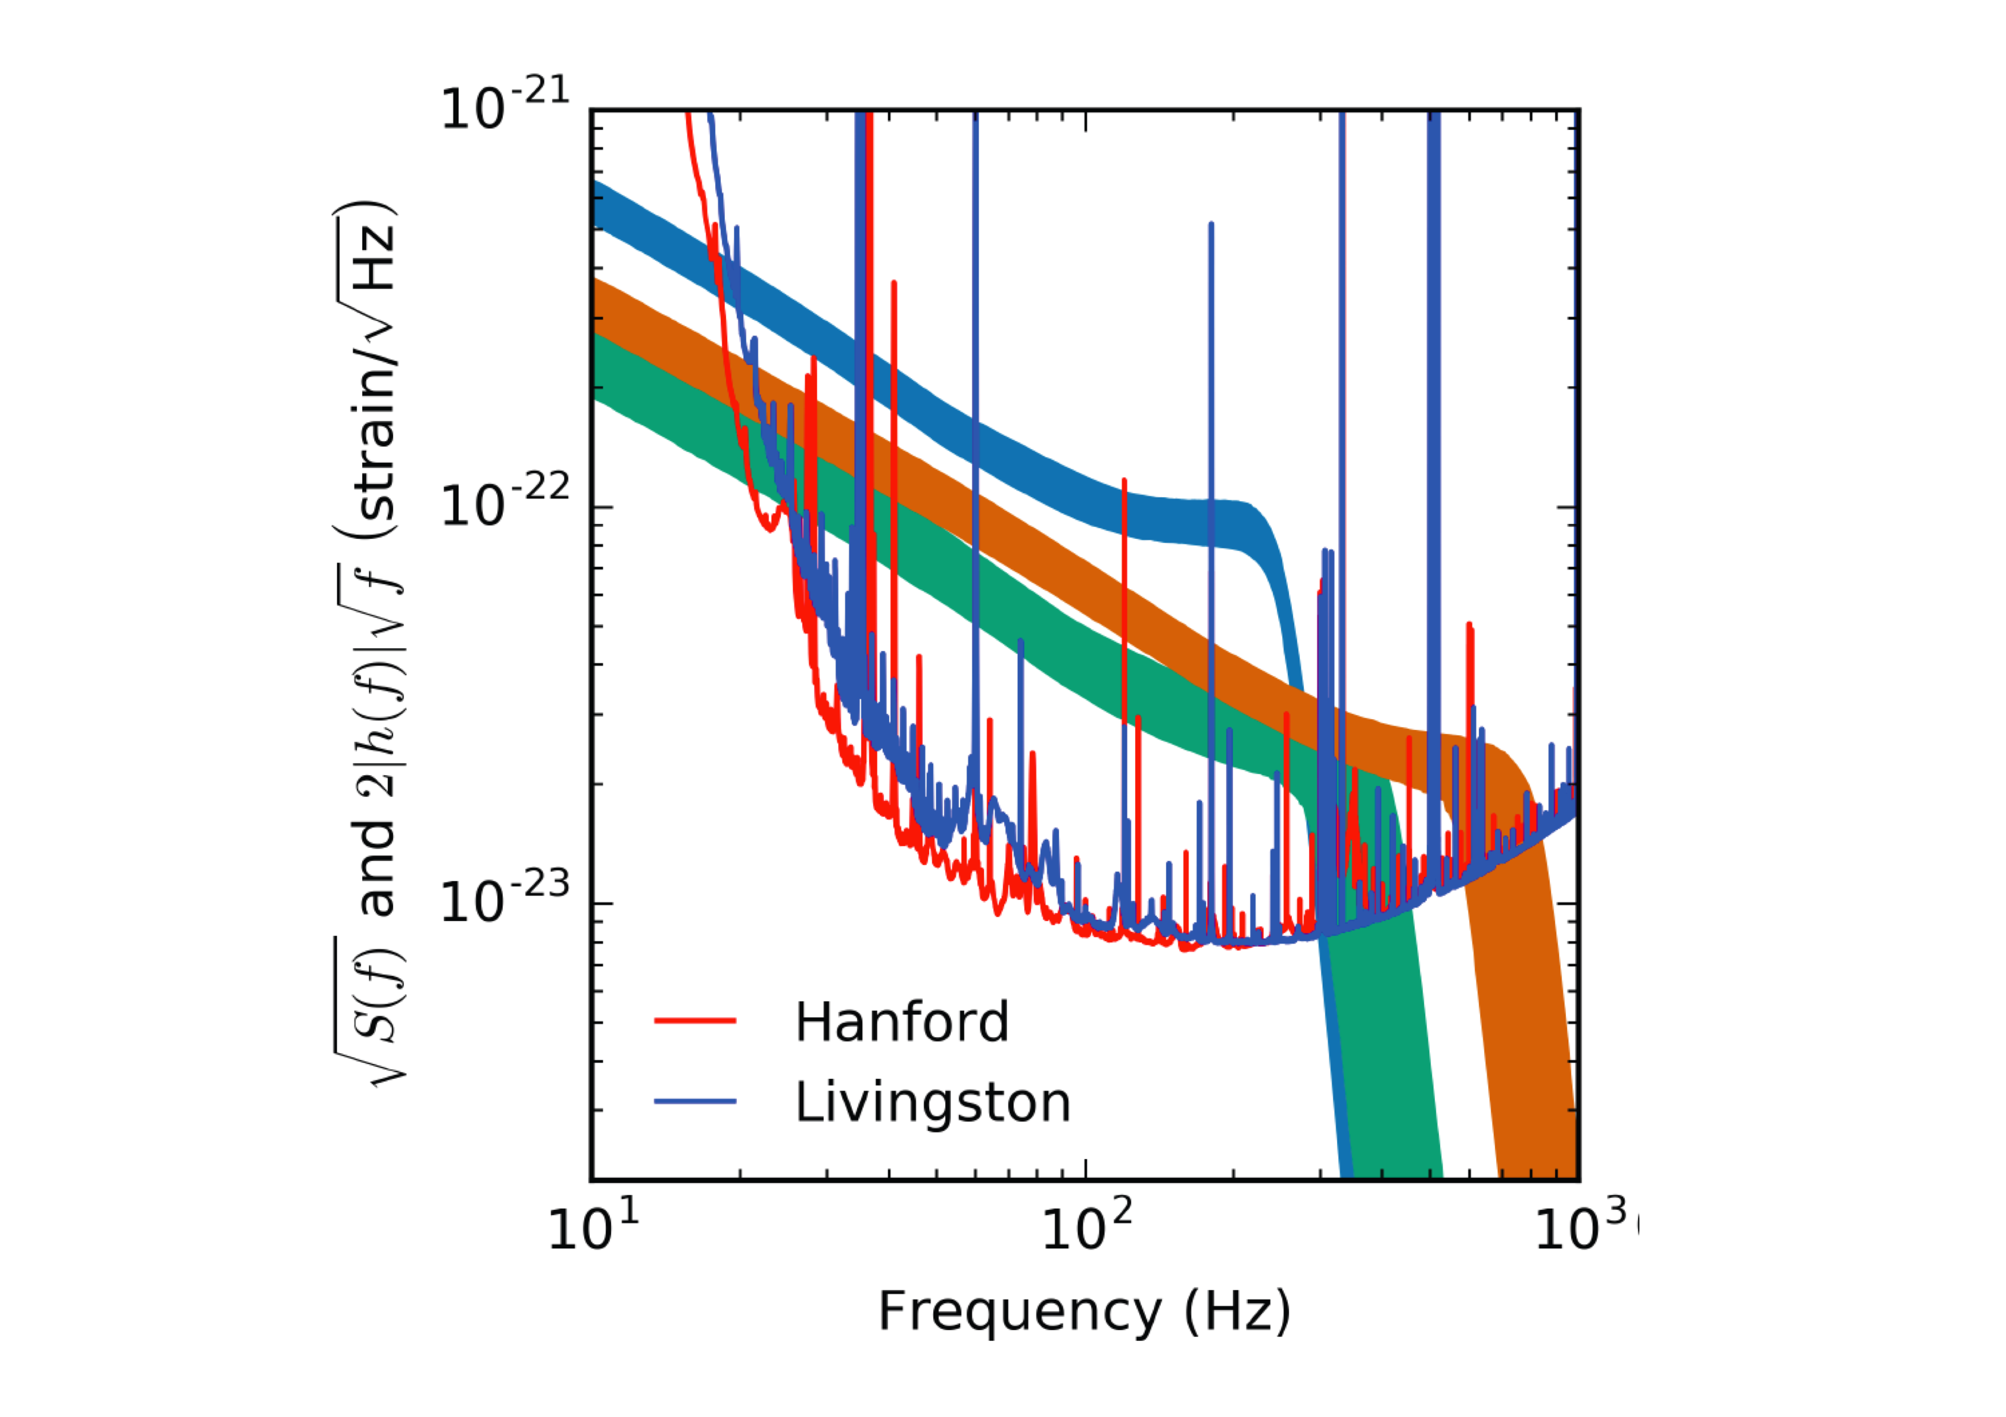
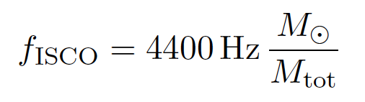
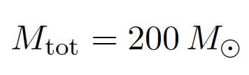
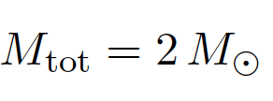
LVC BBH events

Slide 18
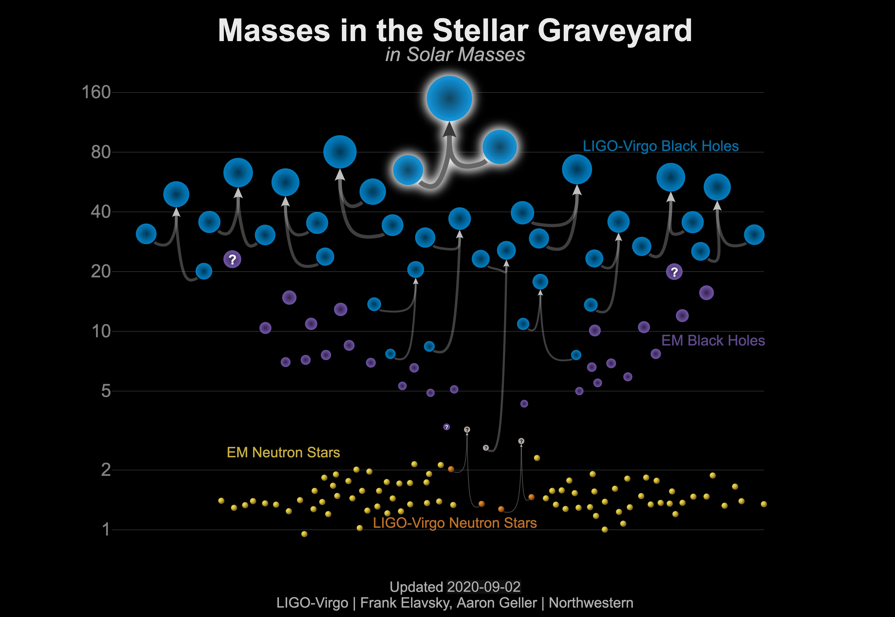
Black Holes and Neutron Stars
Astrophysical BH Mass Gap
Solar Mass
Astrophysical BH Mass Gap
M < Chandrasekhar mass

Slide 19
Black Holes and Neutron Stars
GW
Solar Mass
X-rays
Microlensing
GWTC-1
Radio

Slide 20
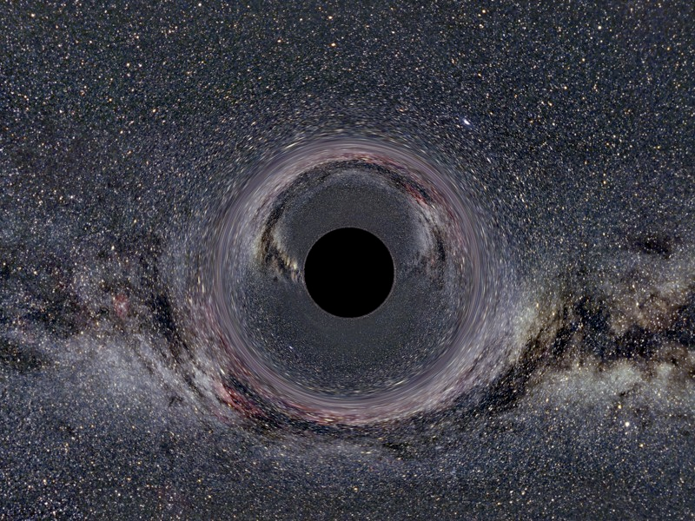
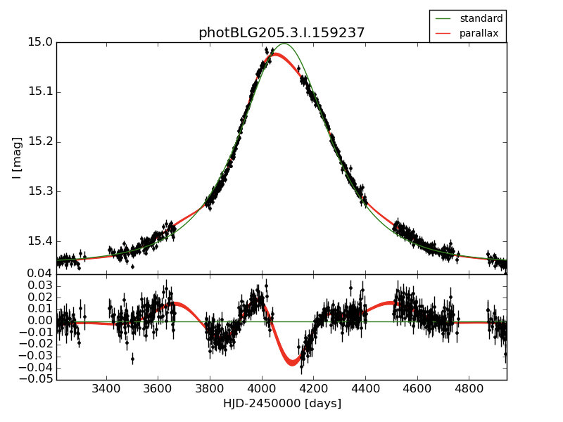
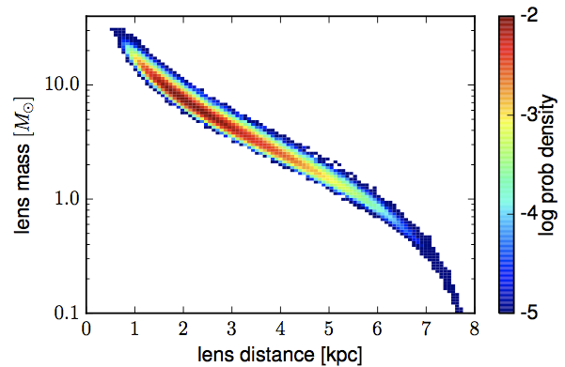
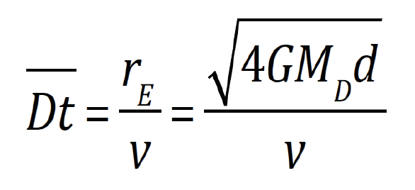
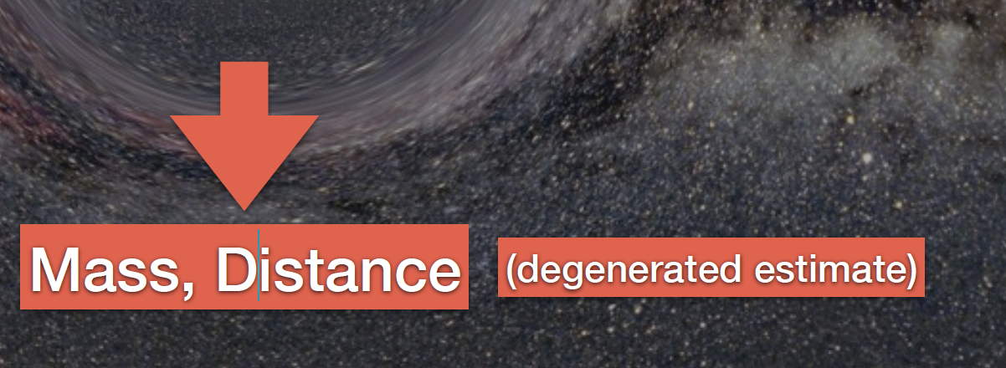
Wyrzykowski (2016)
OGLE3-UL-PAR-02 - candidate BH
M = 9.8 M⊙
⊙
2 Dt
1.8 kpc
OGLE photometry
from 2001-2008
and microlensing model

Slide 21
Primordial Black Holes & OGLE
Wyrzykowski & Mandel (2018)
JGB (2019)
Proton peak
Pion plateau

Slide 22
Model prediction: mass spectrum
JGB, Clesse (2020)

Slide 23
Rate of merger events
@ LIGO-Virgo
GWTC-2
Carr, Clesse, JGB, Kühnel (2019)

Slide 24
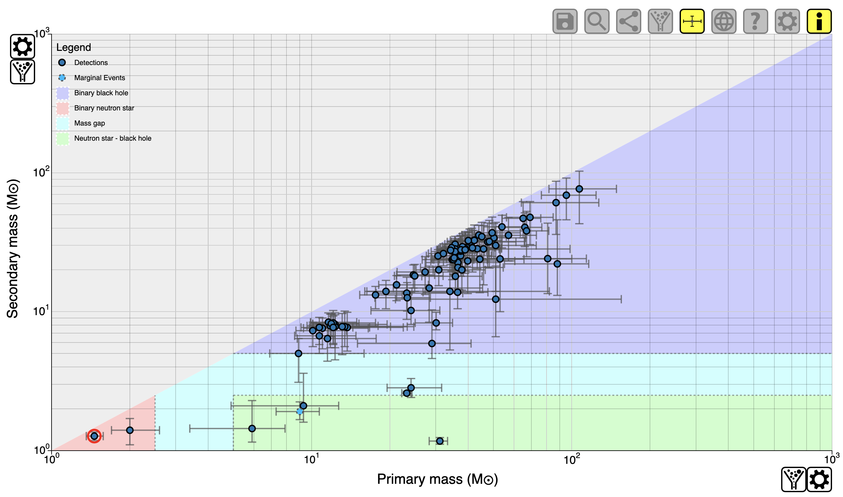
Primary and secondary masses
GWTC-3 (2021)

Slide 25



Effective & Final Spin
JGB (2019)

Slide 26




M-ratio, Effective & Final Spin: Priors
JGB, Nuño Siles, Ruiz Morales (2020)

Slide 27

Mass ratio and effective spin
GWTC-3 (2021)
s₁=s₂=0

Slide 28

Final spin and effective spin
GWTC-3 (2021)
s₁=s₂=0
q=1
q=0.11
s₁=s₂=0
q=0.07

Slide 29

Mass ratio and final spin
GWTC-3 (2021)
s₁=s₂=0

Slide 30

Final mass and final spin
GWTC-3 (2021)
s₁=s₂=0

Slide 31

Are LIGO/Virgo BH Primordial?
GWTC-3 (2021)
BH progenitors in the low mass gap
(2.5 to 5 M_{O})
- Mass uncertainties?
- BH vs Neutron Star?
- Mass gap hypothesis from XRB, no fundamental limitation?
- PBH: Transition form proton peak to pion bump

Slide 32

Are LIGO/Virgo BH Primordial?
GWTC-3 (2021)
BH progenitors in the PISN mass gap
(~60 to 130 M_{O})
- Mass uncertainties?
- Secondary mergers?
- Dense environments (AGN disks, GC)?
- Velocity kicks > v_{escape} are a problem!
- Why isn’t there a transition?
- PBH: pion bump naturally

Slide 33


Are LIGO/Virgo BH Primordial?
GWTC-3 (2021)
Asymmetric BH progenitors ( q < 0.25 )
- Comparable merger rates
- Spin primary component very low ( s < 0.07 )
- PBH: q<<1 appear naturally in dense clusters

Slide 34

Are LIGO/Virgo BH Primordial?
GWTC-3 (2021)
Well defined isolated population
(5 to 15 M_{O})
- Similar merger rates
- Aligned spins
- Very likely Stellar BH
- PBH: there is trough in TH model

Slide 35









Close Hyperbolic Encounters
Primordial Black Holes in dense clusters scatter off each other
JGB, Nesseris (2018)

Slide 36






Close Hyperbolic Encounters
Amplitude and Power emitted in GW
Time duration of Burst:
JGB, Nesseris (2018)

Slide 37






Close Hyperbolic Encounters
Power spectrum (frequency domain)
Quadrupole tensor

Slide 38





Close Hyperbolic Encounters
Power spectrum (frequency domain)
Total energy emitted:

Slide 39







Close Hyperbolic Encounters
Peak frequency:
GW memory effect (after scattering, s.t. remembers the event)
JGB, Nesseris (2018)

Slide 40


Close Hyperbolic Encounters
Detection at LIGO/Virgo/KAGRA and LISA
JGB, Nesseris (2018)

Slide 41






PBH spin-up by CHE
Jaraba, JGB (2021)

Slide 42

Close Hyperbolic Encounters
How do they look like? Simulated injections
Morras, JGB, Nesseris (2021)

Slide 43

Close Hyperbolic Encounters
How do they look like? Strain amplitude h(t)
Morras, JGB, Nesseris (2021)

Slide 44

Close Hyperbolic Encounters
How do they look like? Spectrogram f(t)
Morras, JGB, Nesseris (2021)

Slide 45

Close Hyperbolic Encounters
How do they look like? Can they be confused with glitches?
Morras, JGB, Nesseris (2021)

Slide 46






SGWB from BBH & CHE
SGWB form Black Hole Binaries
JGB, Jaraba, Kuroyanagi (2022)
Close Hyperbolic Encounters

Slide 47




SGWB: second order perturb.
JGB, Peloso, Unal (2018)
Bartolo et al. (2019)
Gaussian P(k)
Lognormal
Monochromatic

Slide 48


SGWB: Thermal History Model
Braglia, JGB, Kuroyanagi (2022)

Slide 49




SGWB: TH vs LN vs ABH
Braglia, JGB, Kuroyanagi (2022)

Slide 50

The future of GW (G3)

Slide 51

BBH sensitivity in future G3 GW

Slide 52
Conclusions
Quantum diffusion inevitably generates PBH
Thermal history predicts PBH have multimodal mass distribution ~ 1E-5, 1, 100, 1E5 Msun (1E-10 also?)
The predicted PBH spin and mass distribution
has been measured by LIGO/Virgo + OGLE
around 1-100 Msun (features: peak+plateau)
Other peaks could be explored with microlensing
PBH scenario can explain various cosmic conundra
Paradigm shift in Structure Formation of Universe
Very rich phenomenology: multiscale, multiepoch, multiprobe => Future G3 detectors (ET, LISA, GAIA)

Slide 53
Backup slides

Slide 54

PBH scenario (1996-2022)
From Quantum Fluctuations during inflation to PBH as all of DM
Quantum diffusion → NG tails → PBH inevitable @ small scales
Gravitational collapse during radiation era: Thermal History
Origin of matter (baryons) and DM at QCD transition:
Multimodal mass distribution PBH: 10⁻⁵, 1, 50, 10⁵ Msun
PNG → Clustered PBH: 10⁶ Msun evades all “monochromatic”
Seeds for Large Scale Structure: IMBH and SMBH
Resolve Small Scale Structure CDM crisis: UFDG, core-cusp…
Very rich phenomenology: wealth of observational signatures
Gravitational Lensing probes: strong, weak, micro, etc.
Gravitational Waves probe: mass, spin, merger rate, clustering
CMB spectral distortions: mass range, clustering prop. PBH
Galactic structures: UFDG, rot. curves, MBH(Mhalo), HVS-GAIA
Bright future: G3 GWO ET & LISA, LSST, Pixie, Theia,

Slide 55
PBH constraints
JGB & Clesse (2017)
OGLE
EROS
“monochromatic”

Slide 56
PBH constraints
JGB & Clesse (2017)
OGLE
EROS
window
“wide-mass”

Slide 57





PBH constraints
z=10⁴
JGB (2017)
z=10³
z=10
z=1
z=0
FIRAS
Planck
X-ray
CIB
Corr.
OGLE
SN-Ia
WB
Eri-II

Slide 58


PBH constraints
Clesse (2021)

Slide 59
Cosmic Conundra explained
Clesse, JGB (2017)
Carr, Clesse, JGB, Kühnel (2019)
Planetary-mass microlensing
Quasar microlensing
OGLE/GAIA microlensing Gal.Bulge
CIB/X-ray background
UFDG substructure large M/L
IMHB & SMBH seeds for LSS
Mass, spin & merger rate LVC BBH

Slide 60
Massive PBH = seeds of structure
Massive primordial black holes with
10⁻⁵ M< M_{PBH} <10⁶ M , which cluster and
merge and could resolve some of the most
acute problems of ΛCDM paradigm.
ΛCDM N-body simulations never reach the
10³ M particle resolution, so for them
PBH DM is as good as Particle DM.
PBH DM paradigm naturally incorporates
all properties of collisionless CDM scenario
on large scales but differs on small scales.

Slide 61

CIB x CXB fluctuations indicate high-z BH population
Significant cosmic background fluctuations have been found both in the NIR and in X-rays.
The strong CIB/CXB cross-correlation signal indicates a substantial contribution of Black Holes to the signal.
There is no correlation with fluctuations in the deepest HST images, therefore the signal likely comes from redshifts z>13.
Large angular scale also points to high-z origin.
Hasinger (2021)
Notes:
So my work is to investigate the origin of the CIB excess fluctuations by measuring its auto power with the new spitzer data in the COSMOS field,
As well as to improve the CIB CXB cross-correlation, especially at larger angular scales.

Slide 62





Fingerprint of the first Black Holes?
Hasinger (2021)
CIB x CXB Cross-Power
Chandra 0.5-2 keV
Raw Image
Chandra 0.5-2 keV
Background Image
Exposure
CIB
Spitzer 4.5 μ
Background image
CXB
Exposure
Cappelluti+13, Mitchell-Wynne+16, Yue+13, Pacucci+15, Helgason+14

Slide 63

Early Star Formation
Hasinger (2021)

Slide 64


PBH constraints
Hasinger (2021)

