Slide 1



Hierarchical approach to matched filtering using a reduced basis
12th Iberian Gravitational Waves Meeting
Rahul Dhurkunde, Henning Fehrmann and Alexander H. Nitz
Phys. Rev. D 105, 103001

Slide 2
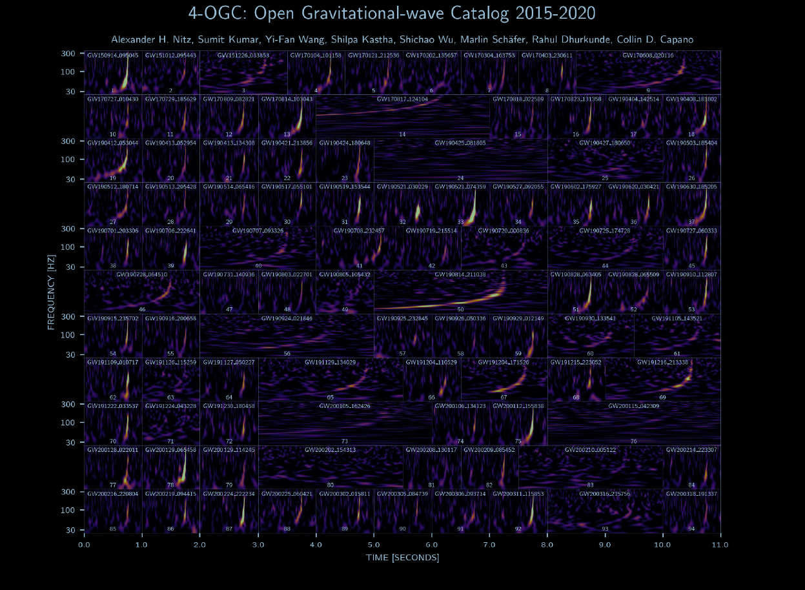

Slide 3
Modelled search
Data quality checks
Coincidence test
Ranking significance
Filtering data
Glitch vetoing

Slide 4
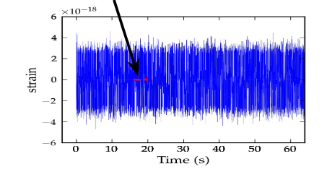
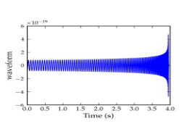
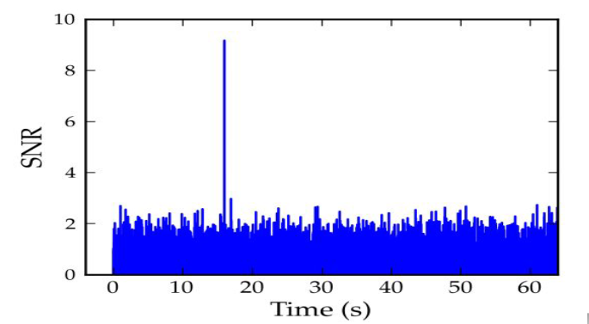



Matched filtering to extract the signal
Optimal detection statistic
Likelihood of data containing a signal
Signal embedded in strain data s(t)
Modeled waveform filters $h_{ζ}(t)$
. . . .
$$ρ\left(ζ\right)=\frac{\left(\tilde{s}|{\tilde{h}}_{ζ} \right)}{\sqrt{(h|h)}}$$
$$(a|b)=4\int_{−∞}^{∞}{\frac{{\tilde{a}(f)\tilde{b}}^{∗}\left(f\right)}{S_{n}}df}$$
Notes:
Very quickly how do we extract a GW signal? Once we can model the signals upto a high degree of accuracy then we can employ the MF technique.
We have a trigger which may or may not contain the signal. This uncertainity is because the MF assumes the detector noise to be stationary and Gaussian.

Slide 5
Search assumptions
Notes:
While performing MF we also make assumptions for the signal model in order to approximate the detection statistic

Slide 6
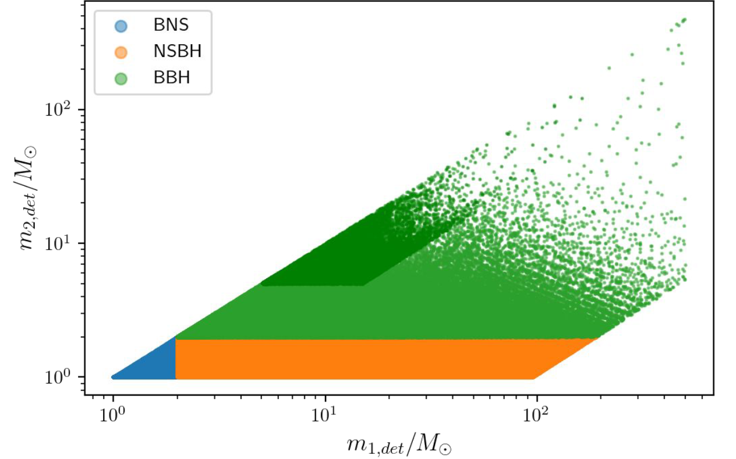





Approximating the search statistic
Aligned spins
Quasi circular orbits
Dominant mode of GW emission
15 parameters
(Likelihood maximization)
Masses $m_{1}$, $m_{2}$
Spins $S_{1z}$, $S_{2z}$
density
Extrinsic parameters $A , φ_{0}$
analytically
Signal arrival time $t_{c}$
FFTs
Aligned-spin template bank
$$∝$$
No. of templates
Signal duration
Computational costs
Notes:
The extrinsic parameter
In summary we should remember
For the current searches the computational costs do not pose any serious challenge. However, if we relax these assumptions or if we search with next gen detectors then these factors two quickly grow which may pose computational challenges

Slide 7
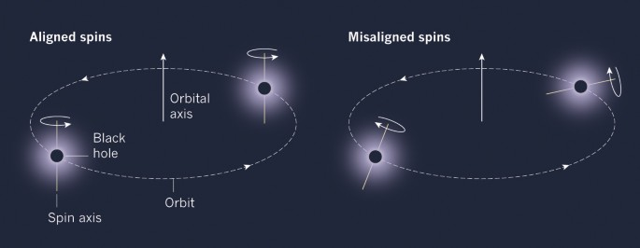
Current template banks are missing
1
Precessing systems
Eccentric binaries
~100x bigger template banks
Computationally limited
Huge astrophysical implications
Notes:
The reason for relaxing these assumptions would be to search for new sources
They provide a useful probe for how these binaries are formed and also provide insights

Slide 8
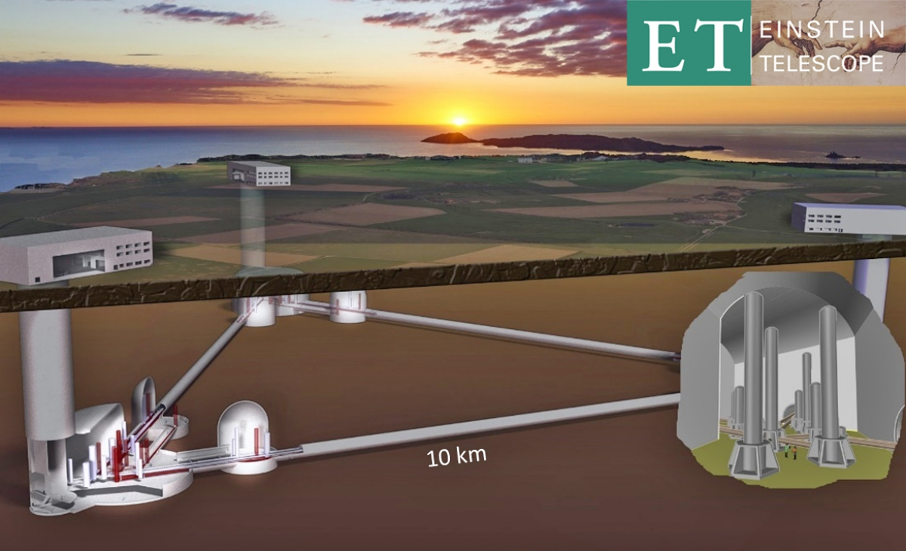

Third generation detectors
Better sensitivity at low frequencies
Longer templates
Larger costs
Notes:
Data analysis with next gen detectors can also be computationally challenging
Hence create an urgency to develop faster filtering algorithms

Slide 9
Improving the search performance
Notes:
Now I come back to my two highlighted keywords. In the past two types of approaches have been explored

Slide 10
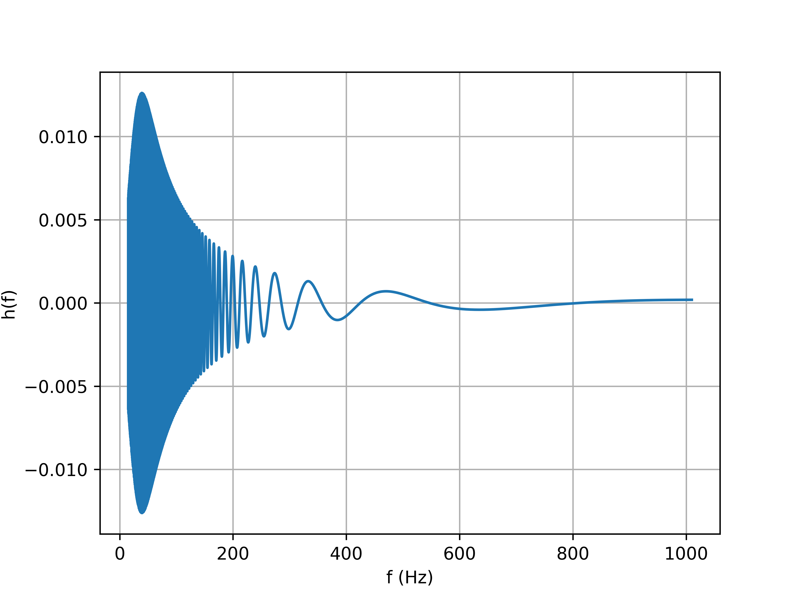
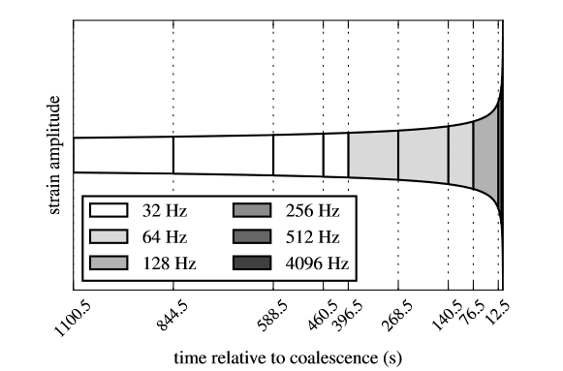

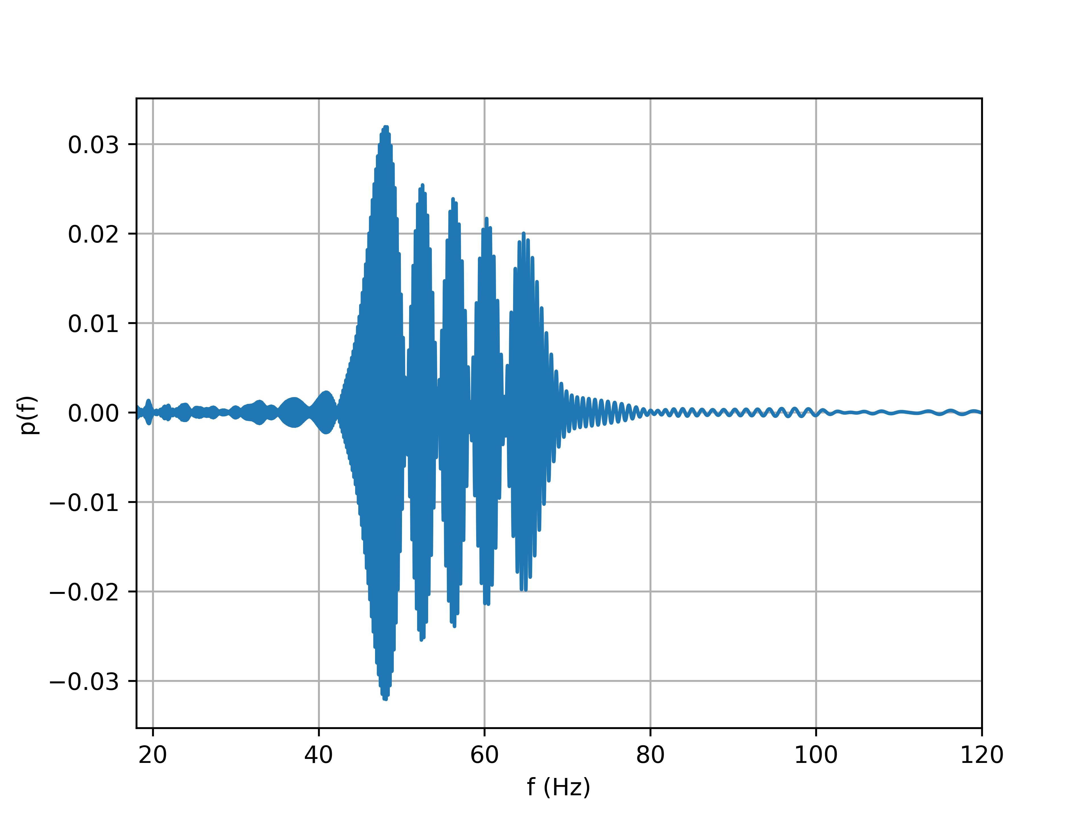
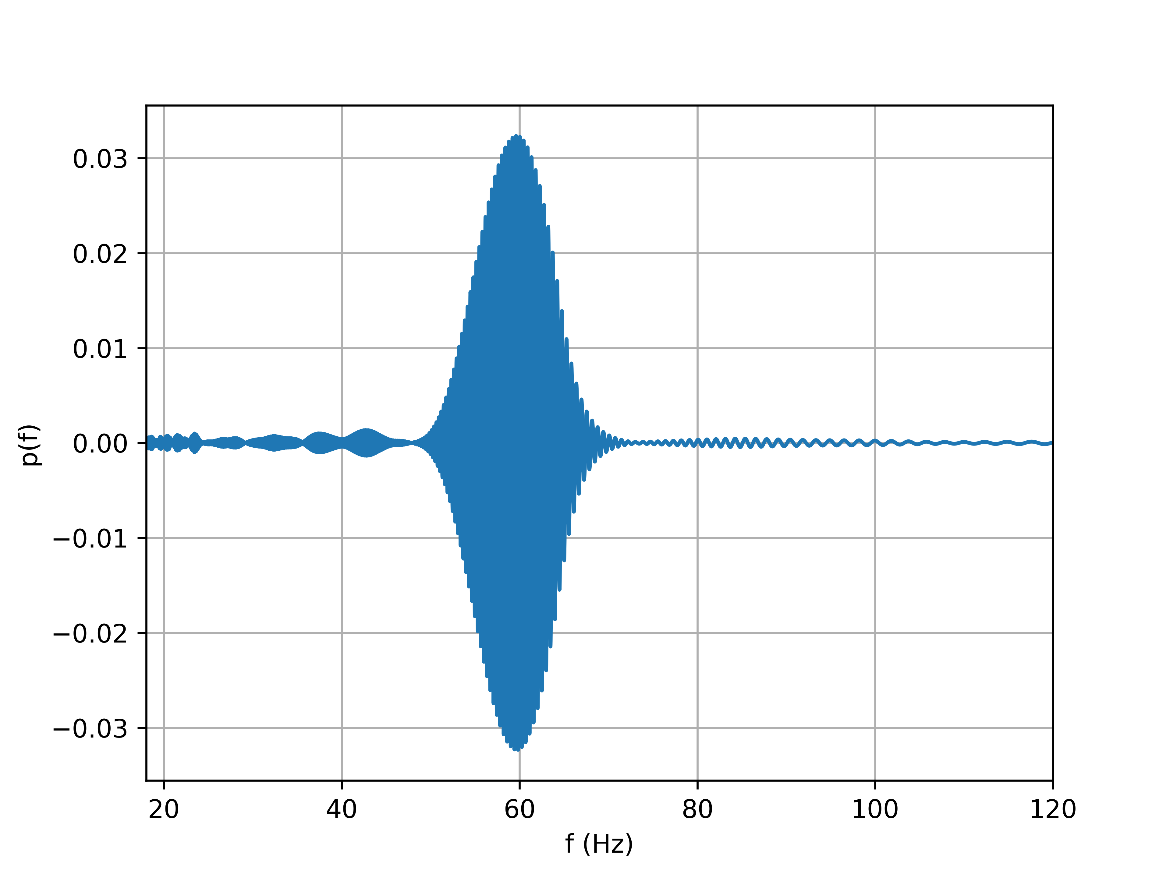
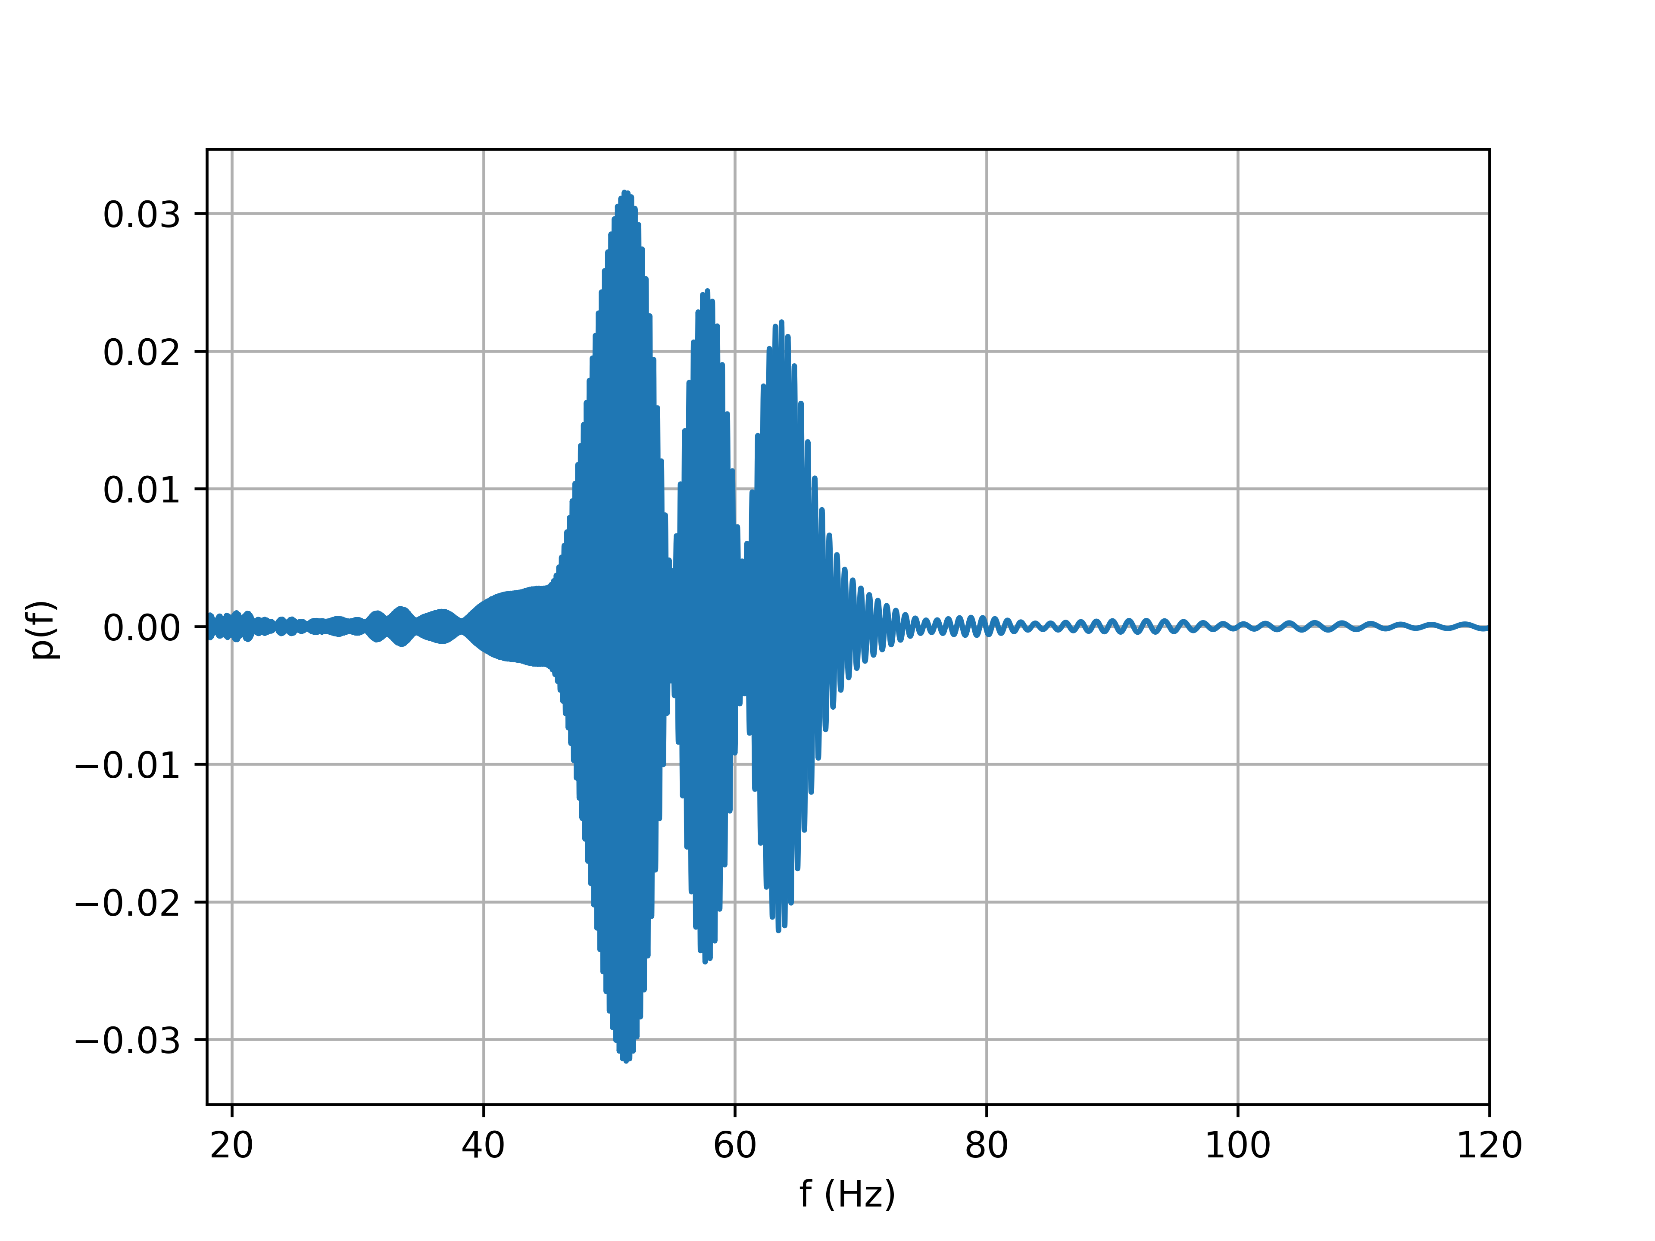
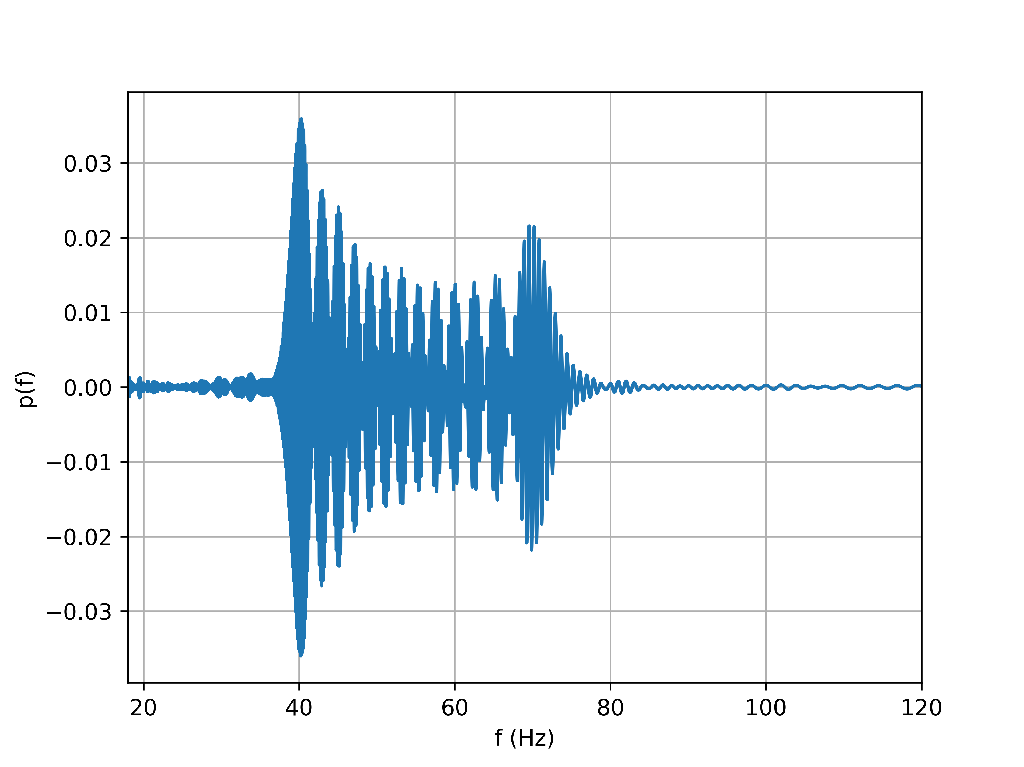

Multirate sampling with reduced basis
Templates
T
Nyquist’s criterion
$N= \frac{1}{(df dt)}$ number of samples
3
P < T
Basis
P
Greatly reduces subsequent computations
Used by GSTLaL, MBTA and SPIIR pipelines

Slide 11
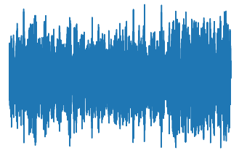
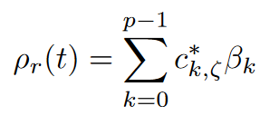
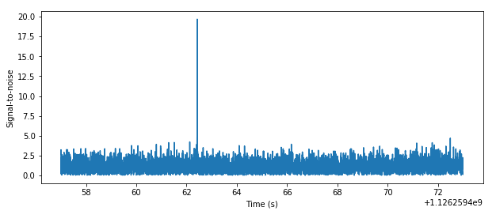






(Continued) Reduced basis matched filtering
$$β_{k}\left(t\right)=IFFT\left(\left\langle \tilde{s} | {\tilde{p}}_{k}\right\rangle \right)$$
Filter output from the basis
$$β_{0}$$
$$β_{1}$$
$$β_{2}$$
Reconstruction
$$β_{p−1}$$
Final output
Basis
$𝒪(NTlogN)$ < $𝒪(NpT)$
!! Expensive !!
Notes:
To explain it schematically,

Slide 12
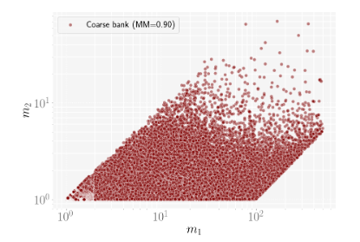
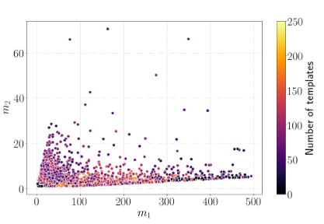
Hierarchical methods
Coarse bank
Two stage filtering using coarse and fine template banks
Only foreground triggers are followed from 1st stage to 2nd
Fine bank
This results in poor background estimation which can result in incorrect significance of an event
Computational gain at the expense of sensitivity
 | Phys. Rev. D 105, 064005
Notes:
From these two methods we learn that to develop faster algo, we need to ofc reduce the costs but maintaining the same sensitivity

Slide 13
Reduced basis hierarchical method

Slide 14
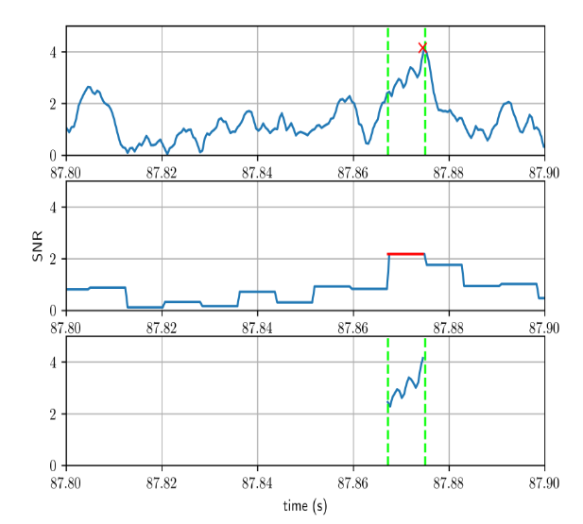
Reconstructing SNR series (hierarchically)
Fully sampled
SNR time-series
First stage
Average SNR
Down-sampling SNR series
Second stage
Recovered using basis
Notes:
We came up with a new hierarchical way of reconstructing the SNR

Slide 15

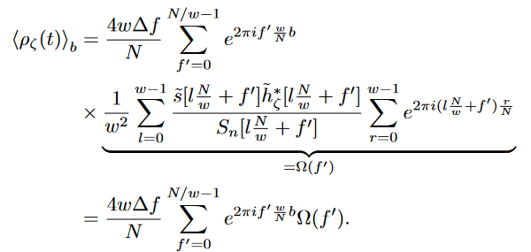



Estimating the average SNR
Averaging of SNR series in time-domain can be performed in the Fourier-domain
Bin containing $w$ samples
Thus, we need to perform IFFT of a frequency series of reduced length $N/w$ only
First stage costs are reduced by a factor of $w$
$$𝒪\left(\frac{N}{w}\log\left(\frac{N}{w}\right)\right)$$

Slide 16
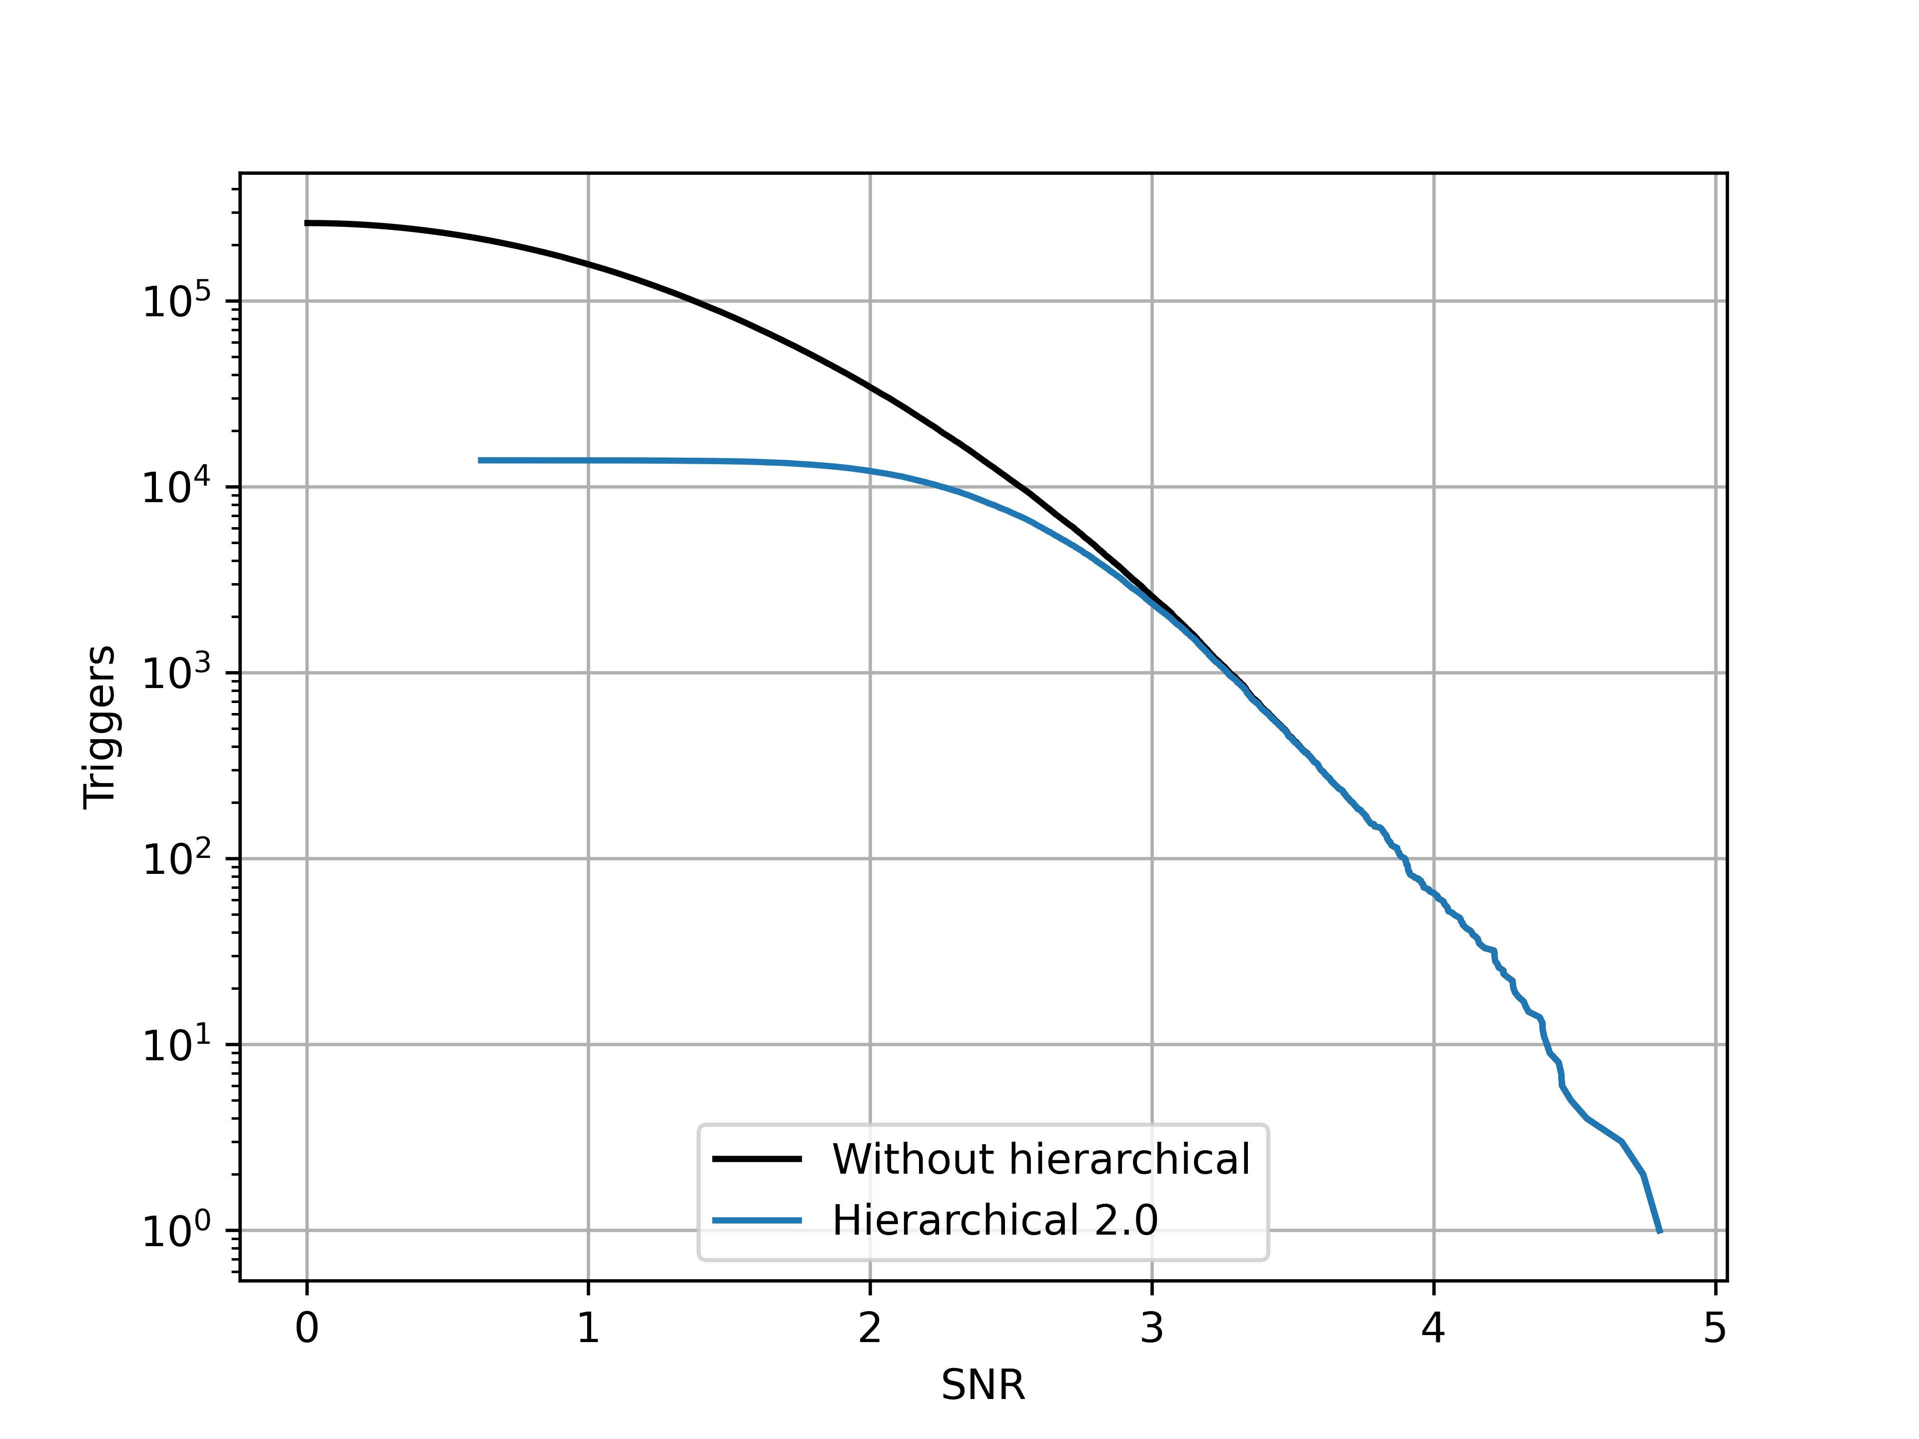


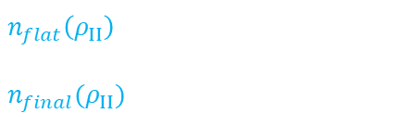
Triggering criteria
$$(w, ρ_{I})=(8, 2)$$
No. of triggers
$n_{flat}\left(ρ_{II}\right)$ flat scheme
$n_{final}(ρ_{II})$ hierarchical scheme
Two free parameters
$$w, ρ_{I}$$
No loss in sensitivity

Slide 17
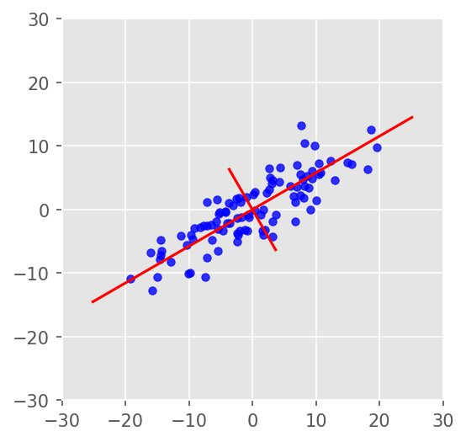

Second stage and cost estimation
Principal component analysis (PCA)
Follow up triggering bins
Reconstruct sample points using the basis
$$z_{flat}=NT(5 logN +6)$$
Baseline costs (FLOP)
$$z_{total}(w, ρ_{I})=NT\left(\frac{5}{w}log\left(\frac{N}{w}\right)+6+\frac{2}{w}\right)+4pwf\left(w,ρ_{I}\right)+Np\left(logN +6\right)$$
Hierarchical costs (FLOP)

Slide 18
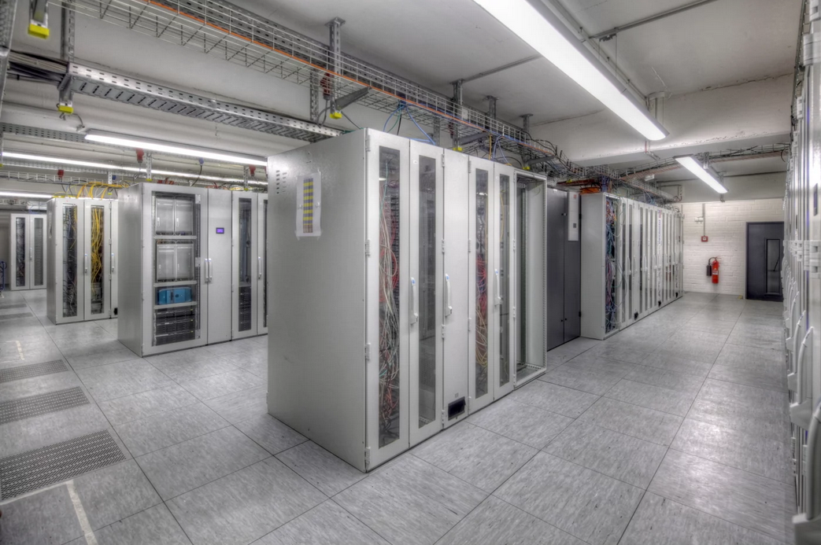
Implementation
Codebase in C language and operations on the GPU are performed using CUDA by Nvidia
Pre-compute the basis and store them on hard-drives
Data is divided into smaller segments of 128s and sampled at 2048 Hz
Highly parallelizable operations – Matrix multiplications, FFTs
Optimized libraries -- cuBLAS, cuFFT
ATLAS computing center at AEI
Nvidia Tesla V100 and RTX 2070

Slide 19
Results
Notes:
To showcase our results

Slide 20
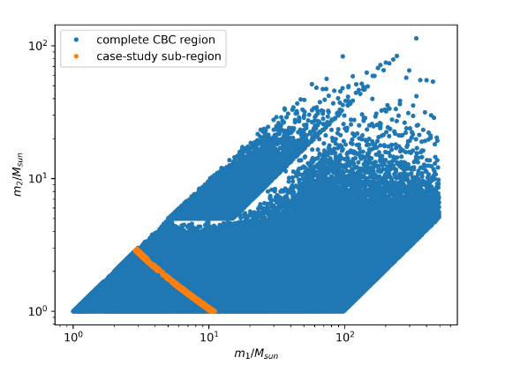
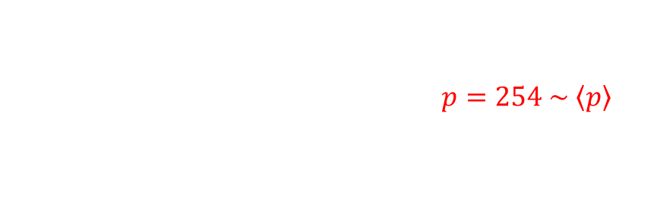

Case-study
Case-study performed on a sub-region
Conservative reduction in costs $p=254 \sim \left\langle p\right\rangle$
We target for SNR 5 and above
Primarily tested on simulated data containing only Gaussian noise
Also tested on a small population of BBH signals
Data generated using PyCBC
$$M ∈ \left[5.72, 12.05\right] \\ q ∈ [1.0, 11.05]$$
6250 templates

Slide 21
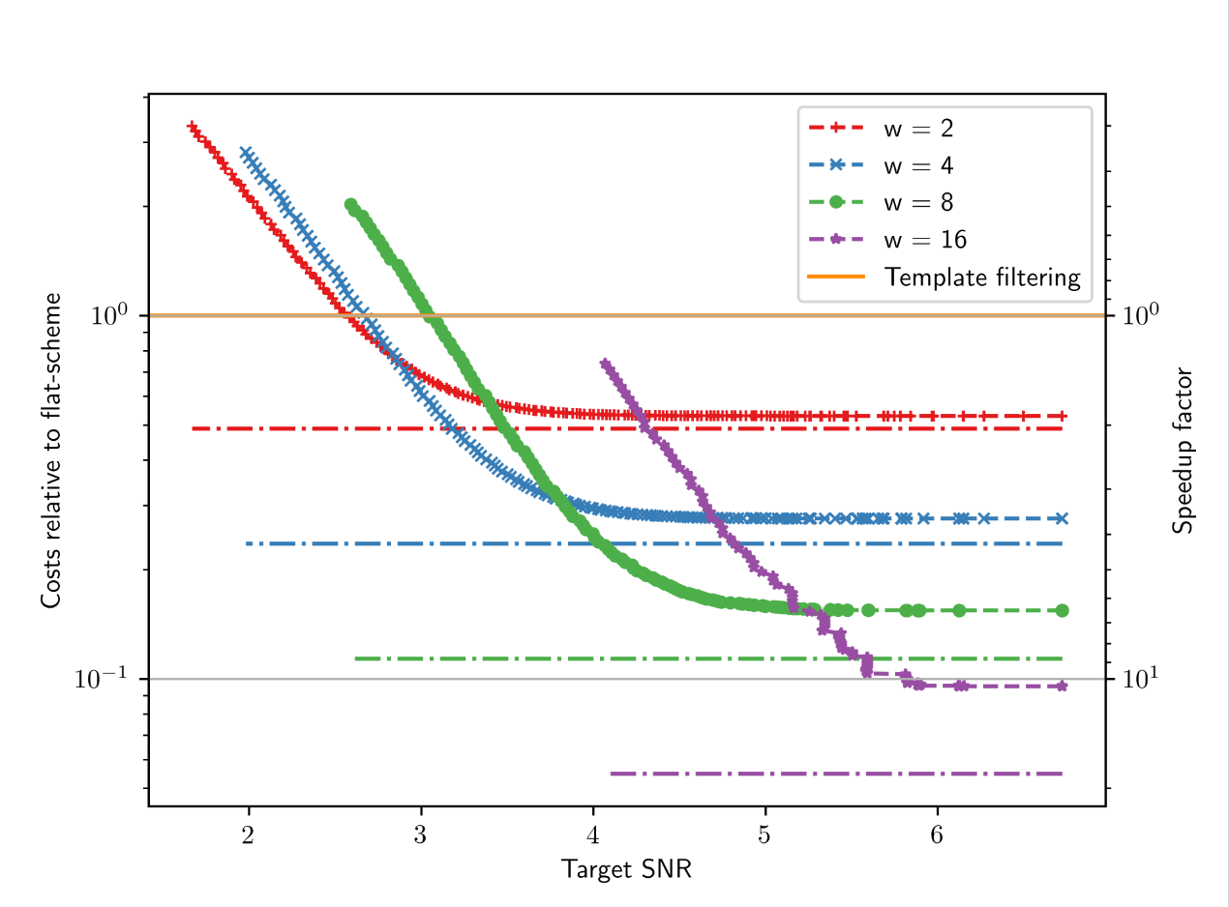
Total Costs
10x
5x
Improvement of
for SNR = 5
for SNR = 6

Slide 22
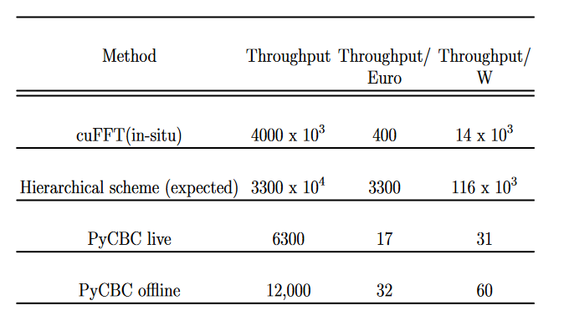
Observed performance
Improvement using GPUs
Evaluate performance using throughput of any method
Throughput = $\left(\frac{secs of data filtered}{time taken for filtering }\right)\left(No. of templates filtered\right)=NT/t$
in real-time
CPU implementation
Notes:
To measure the actual performance gain from our GPU implementation, we measure the throughput which tells us the number of templates

Slide 23
Conclusions and future prospects
Demonstrated our new hierarchical scheme using simulated data.
Achieved an improvement of 10x and 5x respectively for SNR = 6 and 5 respectively (without losing sensitivity)
Cost and energy efficient way of performing matched filtering using GPUs.
What’s next
Implement the scheme in PyCBC before O4.
Use it to perform precessing/eccentric or sub-solar searches

Slide 24
Thank you for your attention

Slide 25
References
https://www.nature.com/articles/548397a
https://towardsdatascience.com/visualizing-principal-component-analysis-with-matrix-transforms-d17dabc8230e
Kipp Cannon, et. al “TOWARD EARLY-WARNING DETECTION OF GRAVITATIONAL WAVES FROM COMPACT BINARY COALESCENCE,” The Astrophysical Journal 748, 136 (2012)

Slide 26
Backup slides

Slide 27
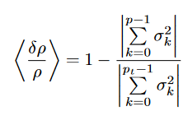
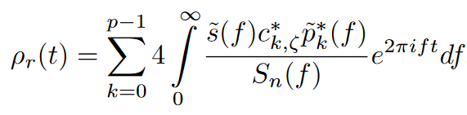


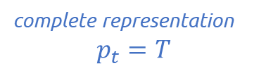
Reduced basis matched filtering
Consider $T$ templates ${\tilde{h}}_{ζ}$ and a basis ${\tilde{p}}_{k}$
Any template can be represented as a linear combination of the basis
complete representation
$$p_{t}=T$$
Truncating the basis for an approximate representation
$$p<T$$
Matched filter in terms of reduced basis

Slide 28


PCA (in a nutshell)
Obtain the basis
Perform principal component analysis (PCA)
How to perform PCA ?
2
Consider a set of $n$data points denoted as vectors $v$
Center the vectors and then normalize them $v_{s}=v−b$
Create a covariance matrix $C={{\hat{v}}_{s}}^{⊺}$ ${\hat{v}}_{s}$
Perform an EVD of $C$ to get the orthonormal basis vectors $p$
Decomposition coefficients $D=p{\hat{v}}_{s}$
Approximated vectors ${\hat{v}}_{s}^{approx}=D^{⊺}p$
$$b= 1/n\sum_{i=0}^{n−1}{v_{i}}$$

Slide 29
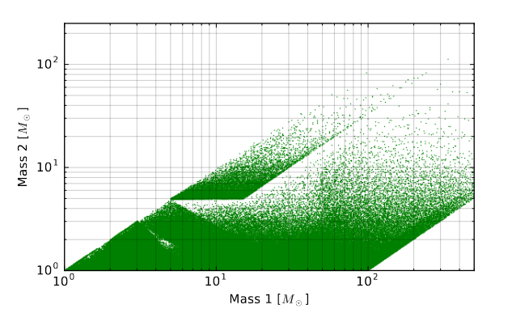
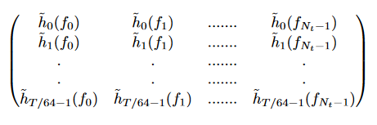
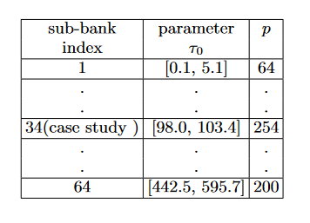

PCA on a template bank
Aligned spin
Sample waveforms using a non-uniform frequency list
(saves up lot of space and computation time)
Templates are whitened and normalized according to aLIGO ZDHP PSD.
Covariance matrix for each sub-bank $C^{m}= T^{m}× {(T^{m})}^{⊺}$
Diagonalisation using Lanczos algorithm
Obtain decomposition matrix $D^{m}$ and basis matrix $P^{m}$
~ 400,000 templates
MM = 0.97
6250 templates in each sub-bank

Slide 30


Hierarchical Matched filtering
Primary idea – Split the reconstruction stage
Compute forward FFT of $s(t)$ at a uniform sampling rate $1/dt$
Linearly interpolate $\tilde{p}\left(f\right)$ at the uniform frequencies
Filter data with every basis vector ${ \tilde{p}}_{k}$ to obtain $β_{k}$
Average $β_{k}$ in fixed bins of $w$samples to get $β_{k}^{avg}$
Perform first stage reconstruction to obtain averaged SNR time-series
Perform second stage reconstruction around the triggers from the first stage.
Methodology

Slide 31

Second stage filtering
Requires the basis vectors
Collect the first stage triggers using a threshold to then perform a finer reconstruction of the triggering bins
Partial reconstruction
Triggering criteria for the first stage ?
Two parameters -- $w and ρ_{I}$

Slide 32
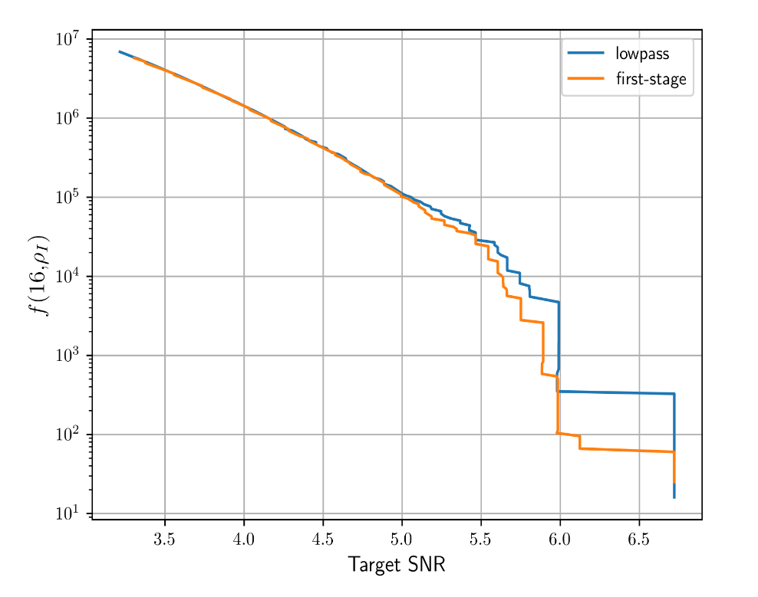
Low-pass filter as first stage

Slide 33






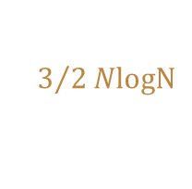
Cost Estimation
We compute the theoretical FLOP for filtering a data segment with $N$ samples
Consider 6 operations for multiplication and 2 operations for addition
For FFTs we consider a split-radix method
Baseline comparison – Template method
Forward real-to-half-complex FFT of data
Integrand for $T$ templates
Inverse complex-to-complex FFT to obtain the SNR time-series
$3/2NlogN$
$$6NT$$
$5NT logN$
Since $T≫1$
$$z_{basic}=NT(5 logN +6)$$

Slide 34


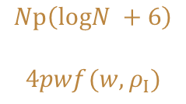
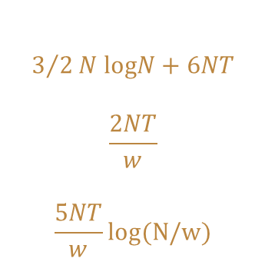
(Continued) Cost Estimation
Fast first stage
Second stage
Forward FFT and integrand computation
Binned averaging
IFFT to get averaged SNR time-series
$$3/2N logN+6NT$$
$$\frac{2NT}{w}$$
$$\frac{5NT}{w}log(N/w)$$
Assuming number of triggers $f(w, ρ_{I})$ do not vary with template
Compute the $β$’s
Second stage reconstruction
$$Np\left(logN +6\right)$$
$$4pwf(w,ρ_{I})$$
$$z_{total}=NT\left(\frac{5}{w}log\left(\frac{N}{w}\right)+6+\frac{2}{w}\right)+4pwf\left(w,ρ_{I}\right)+Np\left(logN +6\right)$$
Fine-tune the parameters to minimize the total costs

Slide 35
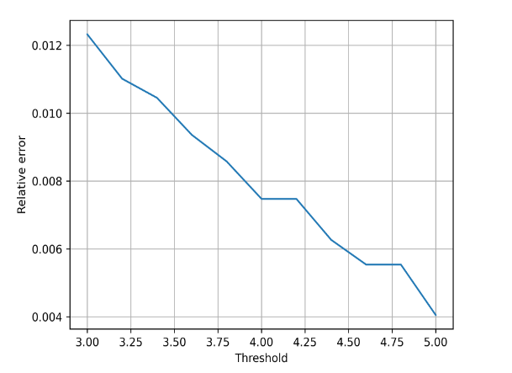
Accuracy of the SNR
Two primary contributions to the loss in SNR
Truncation of the number of eigenvalues
Interpolation of the basis/templates

Slide 36
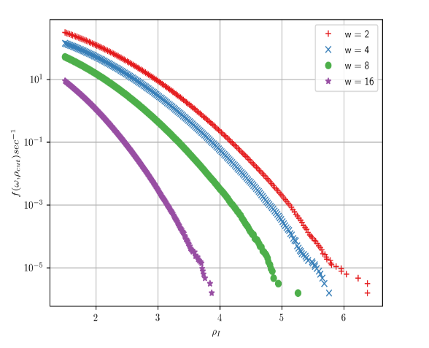
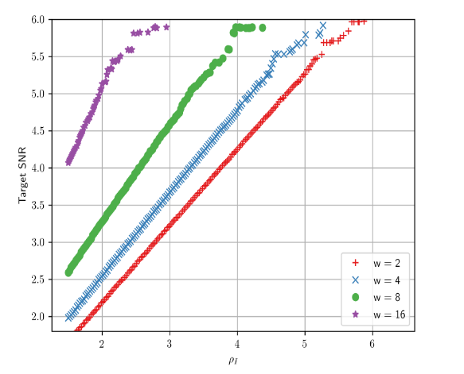

Comparing performance
Number of required operations
$$z_{total}=NT\left(\frac{5}{w}log\left(\frac{N}{w}\right)+6+\frac{2}{w}\right)+4pwf\left(w,ρ_{I}\right)+Np\left(logN +6\right)$$
First obtain the $f\left(w,ρ_{I}\right)$
Get the costs in terms of the target SNR

Slide 37
Implementation
Preparation stage
PCA
Matched filtering
Completely implemented on GPUs
Data is divided into smaller segments of 128s and sampled at 2048 Hz
FFTs are performed using cuFFT in parallel batches
First stage is implemented using basis with help of cuBLAS
Second stage is using customized kernel
Partially implemented on CPUs
Matrix multiplications – Covariance computation, Decomposition coefficients using cuBLAS
Diagonalization on CPUs using Lanczos algorithm
Results are compressed and stored on hard-drive

Slide 38



Fast First Stage Filtering using Templates
Average the matched filter before computing the IFFT
Consider a single bin $b$ of size $w$ samples and we compute the averaged SNR for that bin
$$t =wb+r$$
$$r ∈ [0,w−1]$$
Split the summation into a double sum

