Slide 1
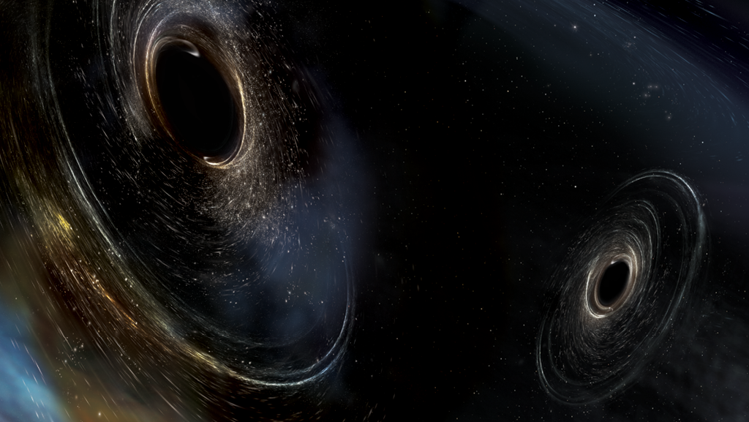


Fourier Analysis on two Black Holes Collision -Ligo Hanford
Group:
Britta Dorn
Marco Brito
Rafael Cerqueira
Physics Advanced Labs by Professor Onofre
1

Slide 2

Outline
Learn about:
  Fourier Analysis
  LIGO and Black Holes
Learn the Know-How:
  Data Treatment and Analysis
Conclusions

Slide 3
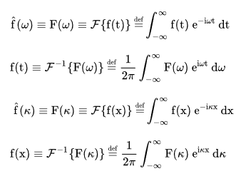
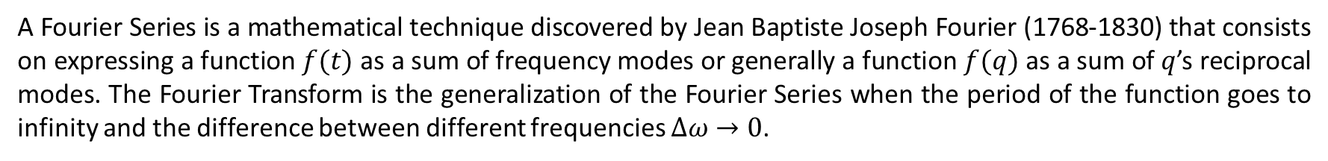

Fourier Transform
A Fourier Series is a mathematical technique discovered by Jean Baptiste Joseph Fourier (1768-1830) that consists on expressing a function $f(t)$ as a sum of frequency modes or generally a function $f(q)$ as a sum of $q$’s reciprocal modes. The Fourier Transform is the generalization of the Fourier Series when the period of the function goes to infinity and the difference between different frequencies $∆ω→0$.
Fourier Transform in Time Domain
W=2π*f (Angular Frequency)
Fourier Transform in Space Domain
Ϗ=$\frac{2π}{\text{λ}}$ (wave vector)
3

Slide 4
What is Fourier Analysis ?
With the Fourier transforms, one can do the so-called Fourier Analysis which is very important on data and signal analysis and is useful for:
Eliminating undesirable frequencies from a signal (i.e. white noise);
Imaging and sound filtering;
Simplifying physical problems that are easy to understand in reciprocal space;
Discover more about the hidden properties of signals.
4

Slide 5
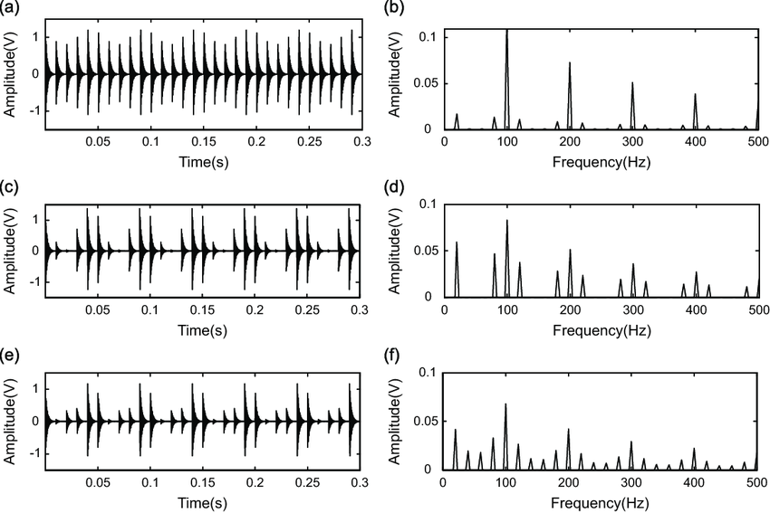
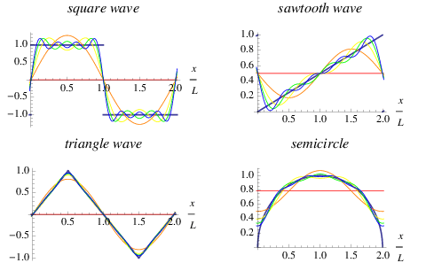
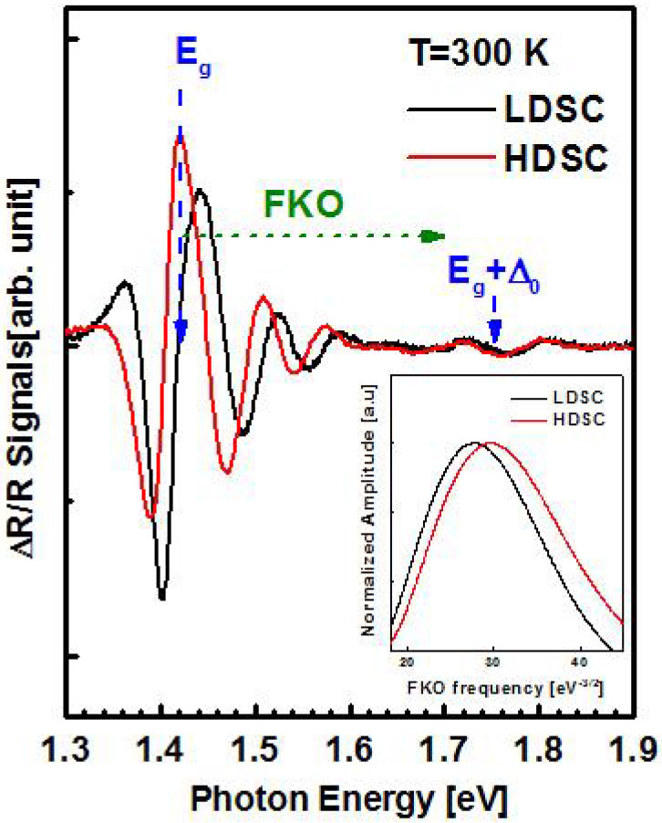
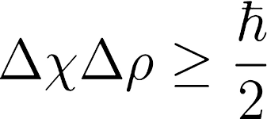
EXEMPLES OF FOURIER ANALYSIS
Signal Processing
Audio analysis and processing
New Physics !?
Quantum Physics
5

Slide 6
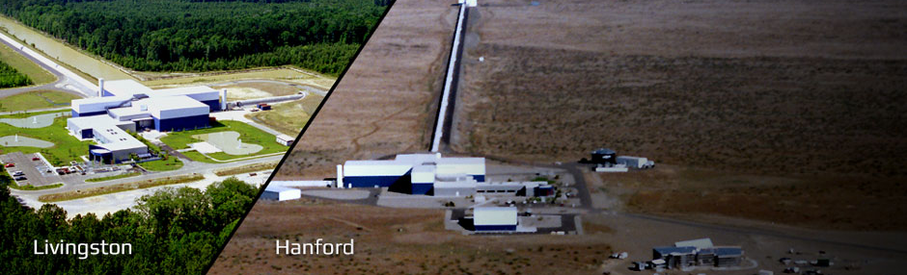
LIGO and Black Holes
Laser Interferometer Gravitational Wave Observatory, better known as LIGO, was founded in 1992 by Kip Thorne, Ronald Drever (Caltech) and Rainer Weiss (MIT).
As the name indicates, the LIGO´s main goal is detecting gravitational waves with the help of an interferometer.
For better data acquisition performance LIGO has two interferometers in USA (Hanford Site, Livingston) and in Europe in partnership with VIRGO Europe (Cascina, Italy);
In our work we analyze Hanford-LIGO data.
6

Slide 7
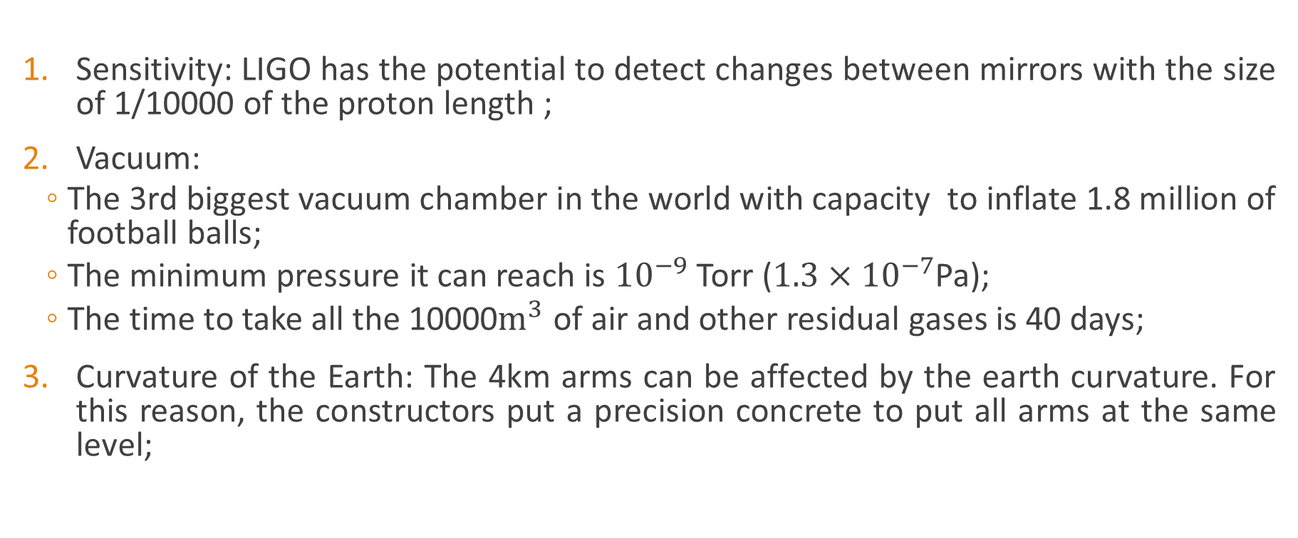
Facts about LIGO
Sensitivity: LIGO has the potential to detect changes between mirrors with the size of 1/10000 of the proton length ;
Vacuum:
  The 3rd biggest vacuum chamber in the world with capacity to inflate 1.8 million of football balls;
  The minimum pressure it can reach is ${10}^{−9}$ Torr ($1.3×{10}^{−7}$Pa);
  The time to take all the 10000$m^{3}$ of air and other residual gases is 40 days;
Curvature of the Earth: The 4km arms can be affected by the earth curvature. For this reason, the constructors put a precision concrete to put all arms at the same level;
7

Slide 8
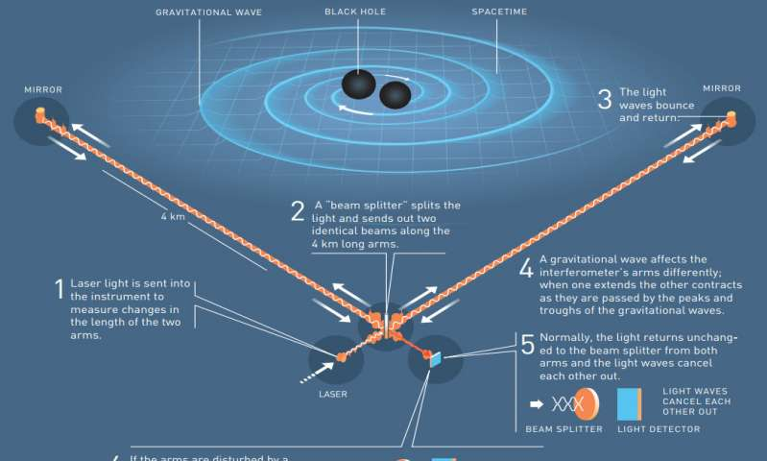
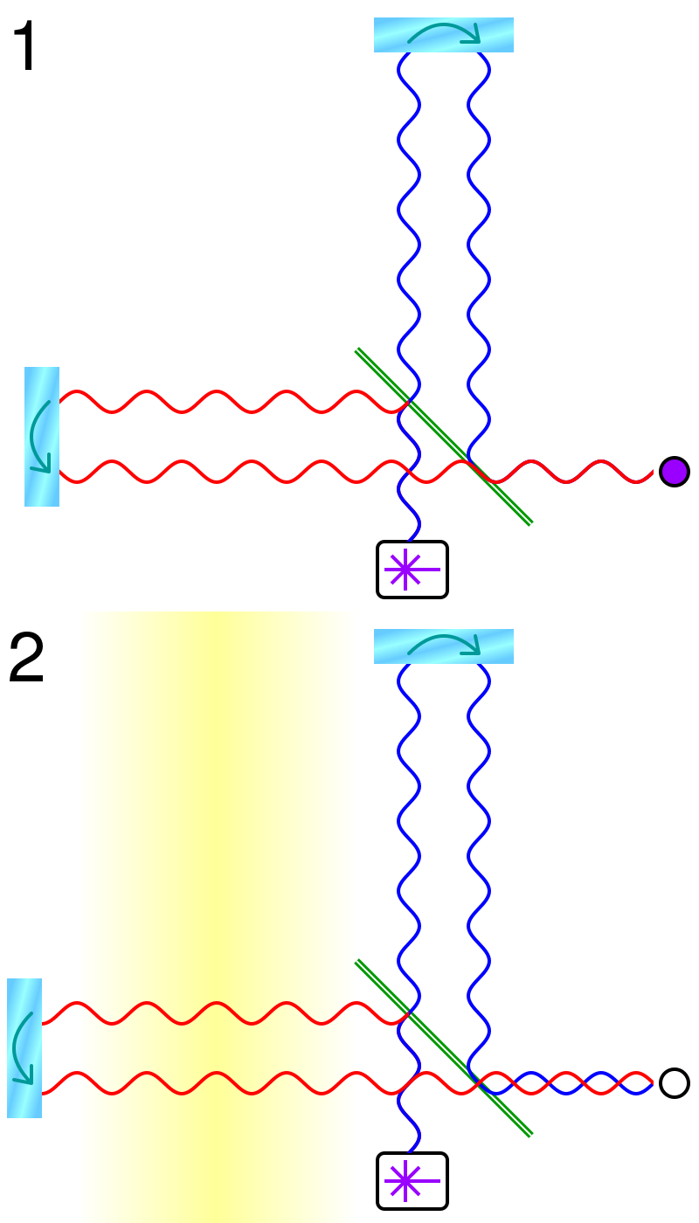
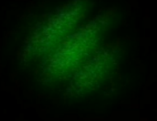
How LIGO works ?
LIGO is a very big Michelson Interferometer with 4Km arm length .
The moment when black holes collide, we have a constructive or a destructive interference that allow us to collect/study data.
8

Slide 9
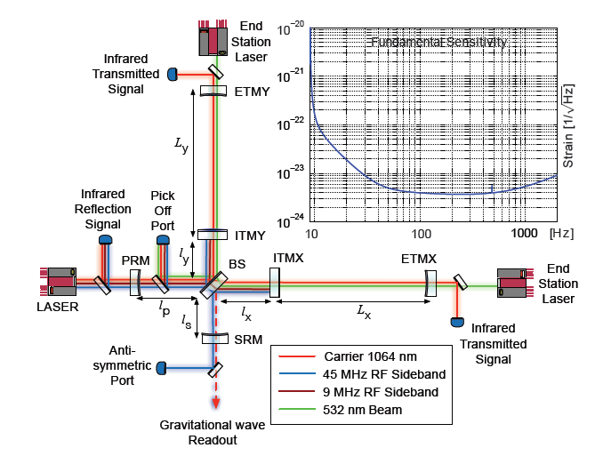
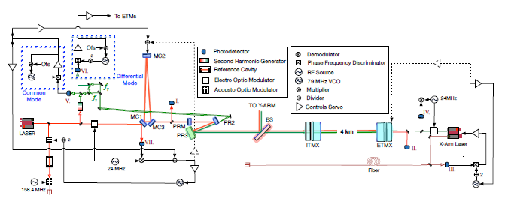
Instrumentation Map
9

Slide 10
Data treatment and analysis

Slide 11
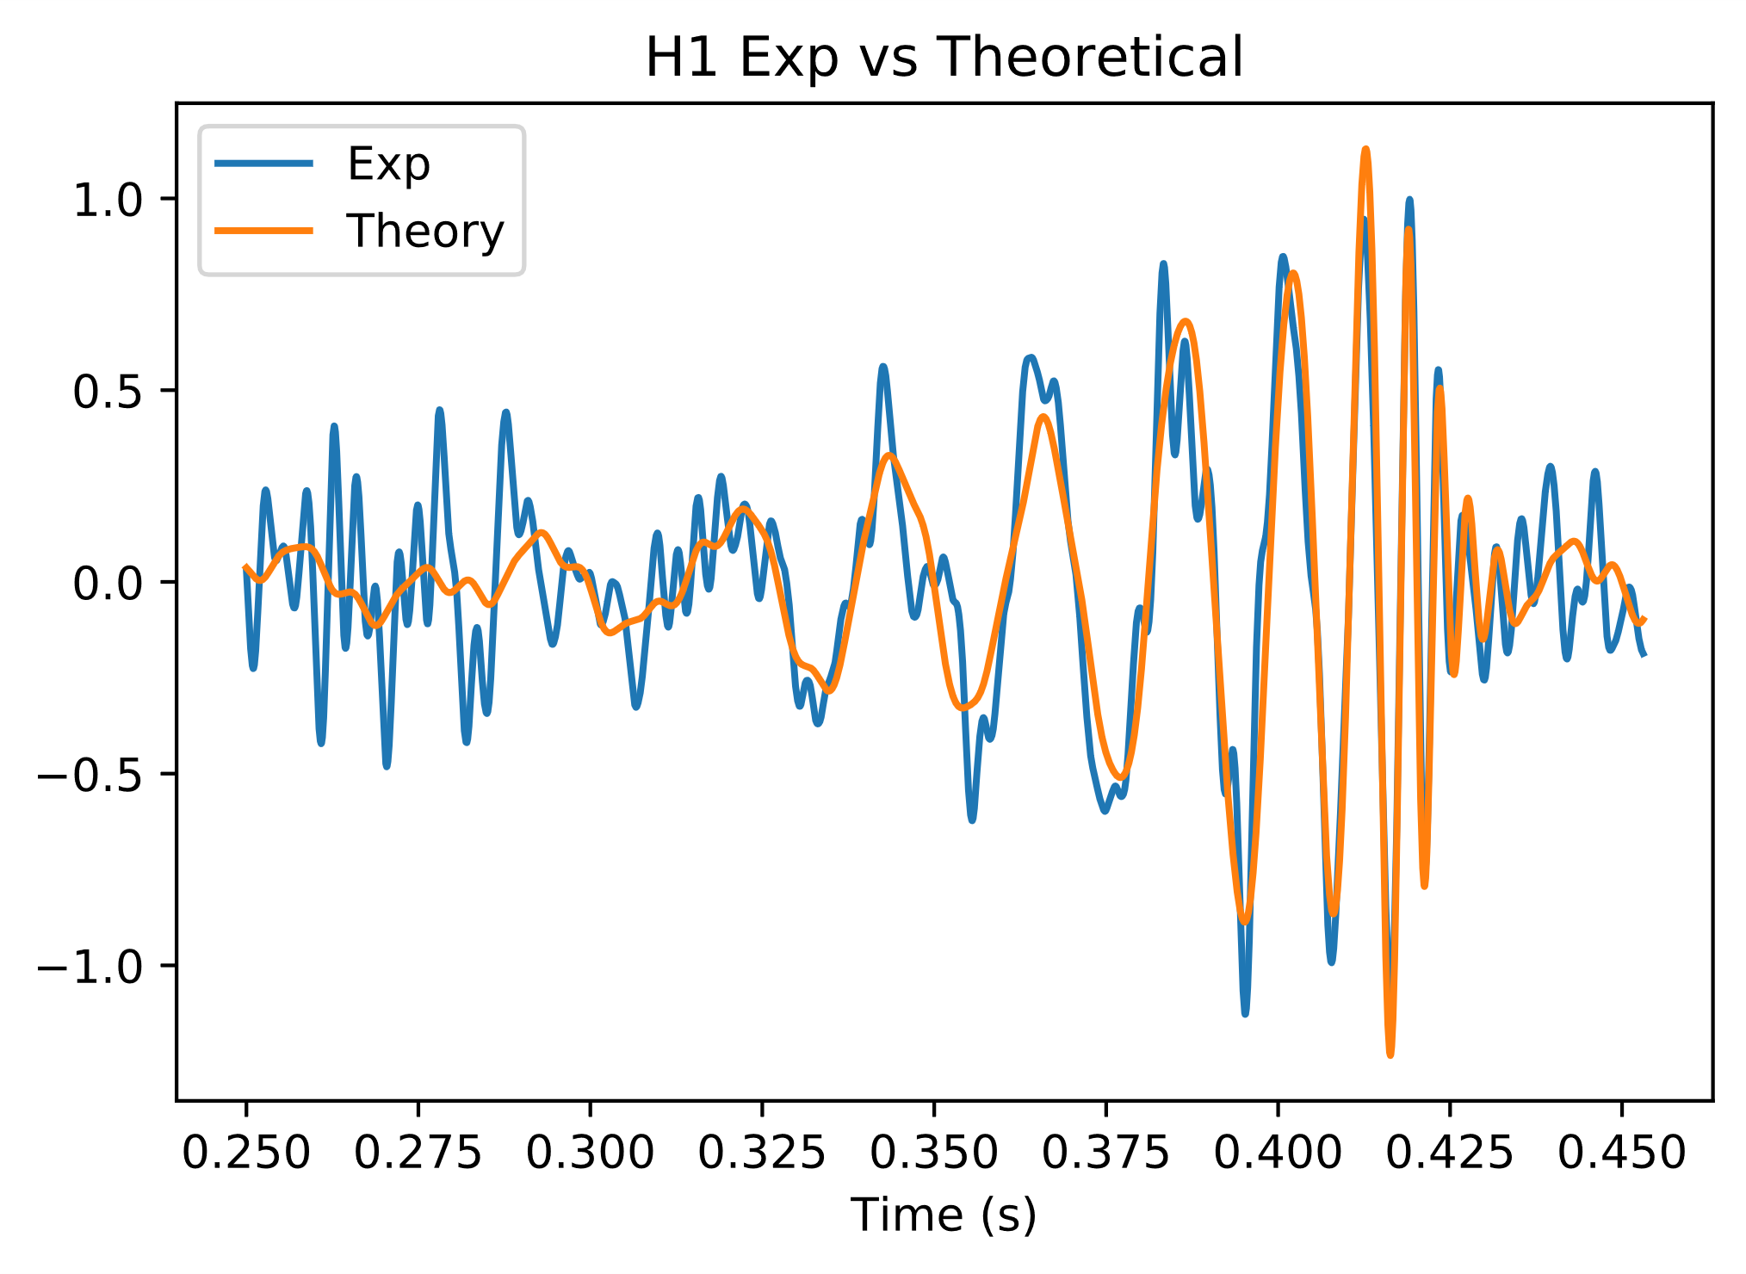
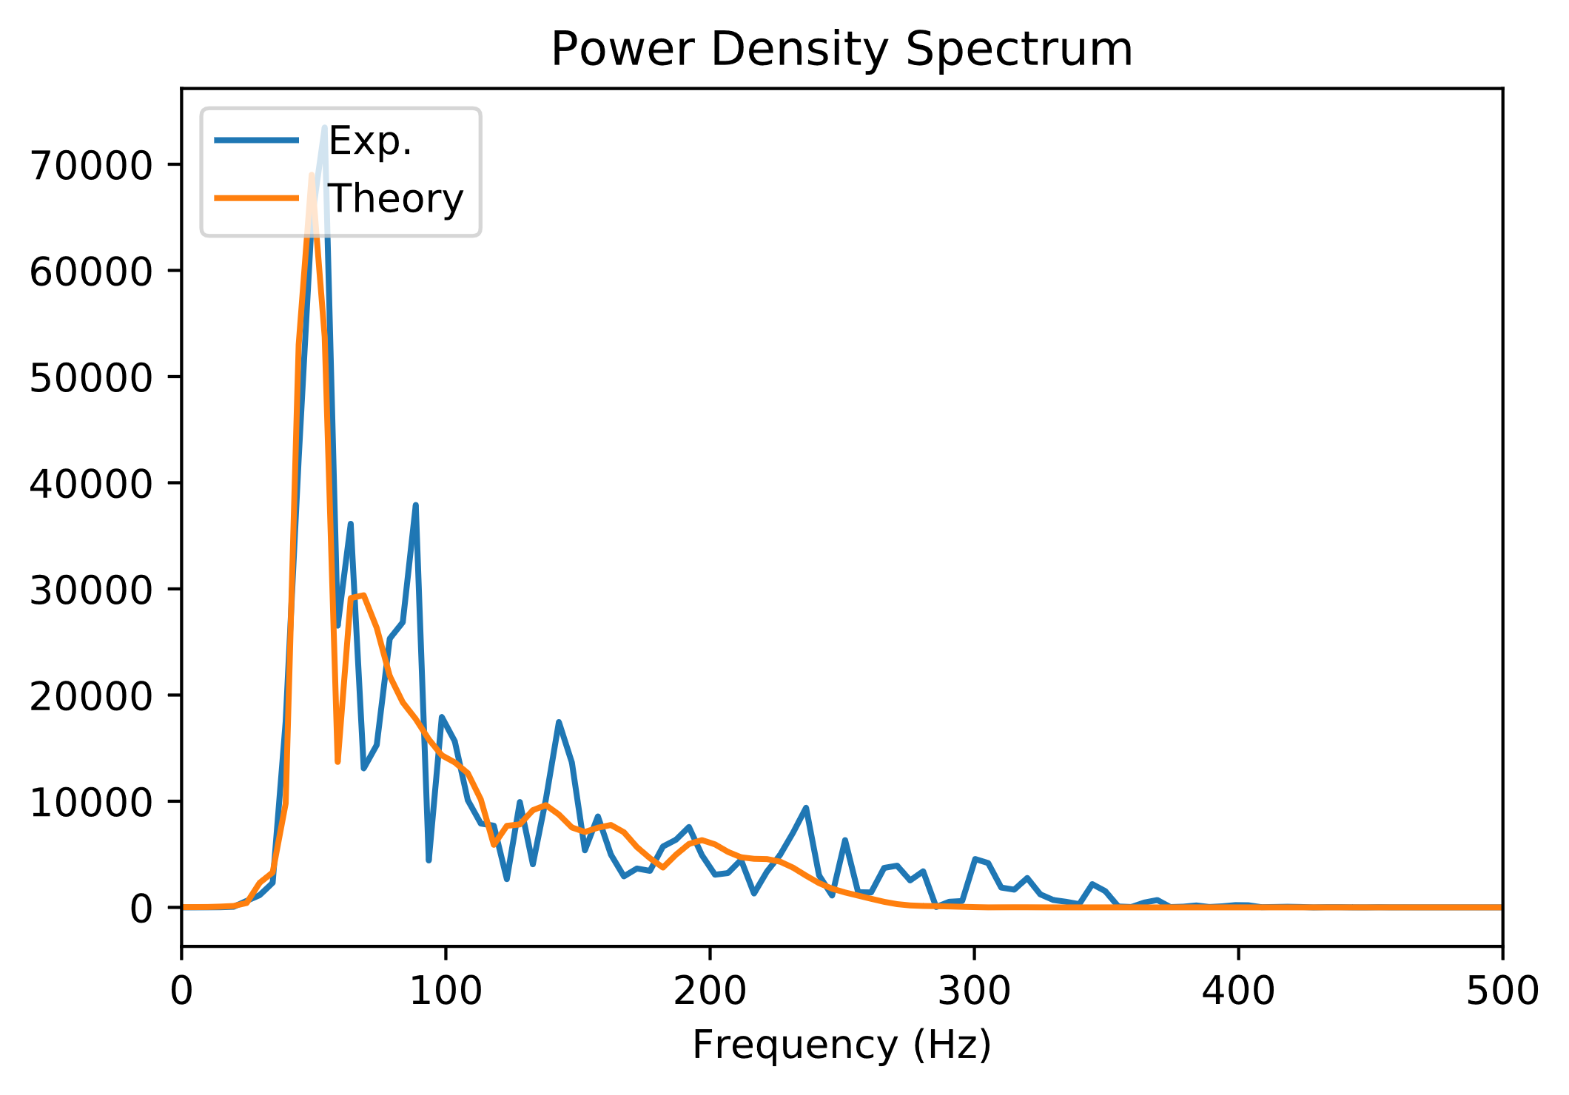
Non-Filtered Data
11

Slide 12
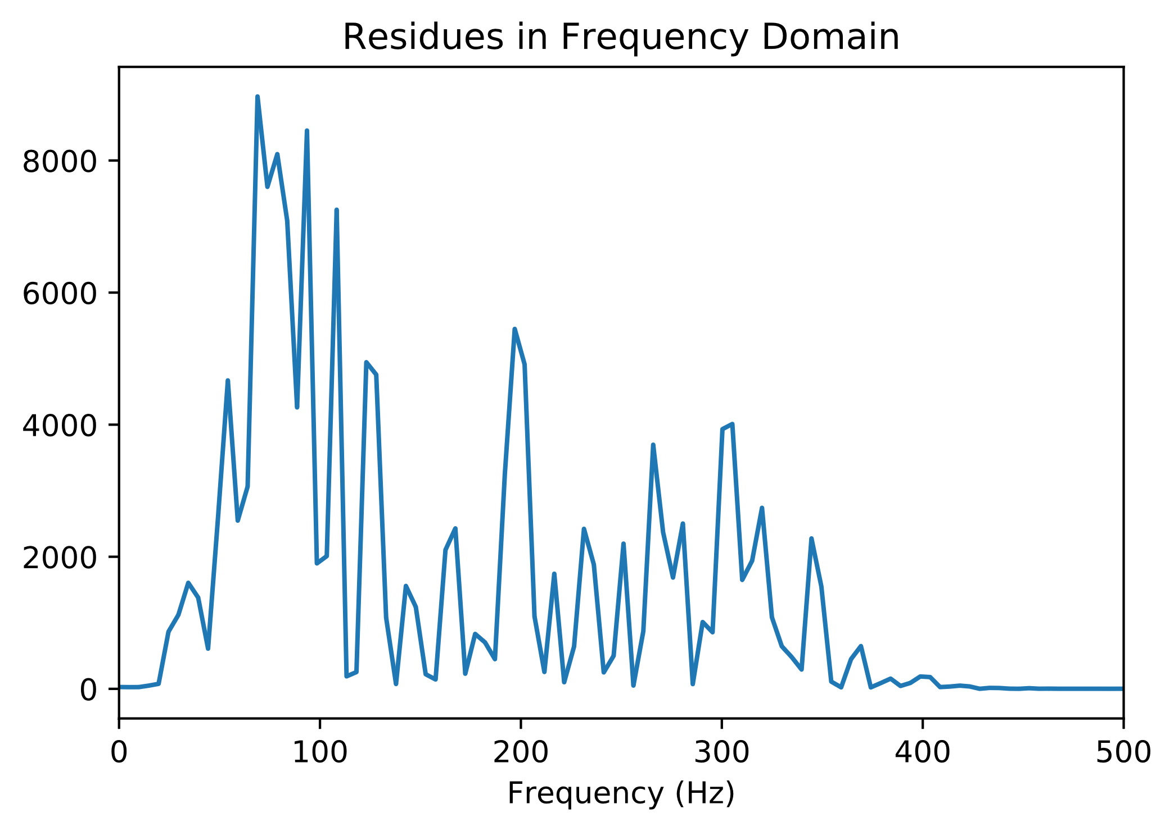
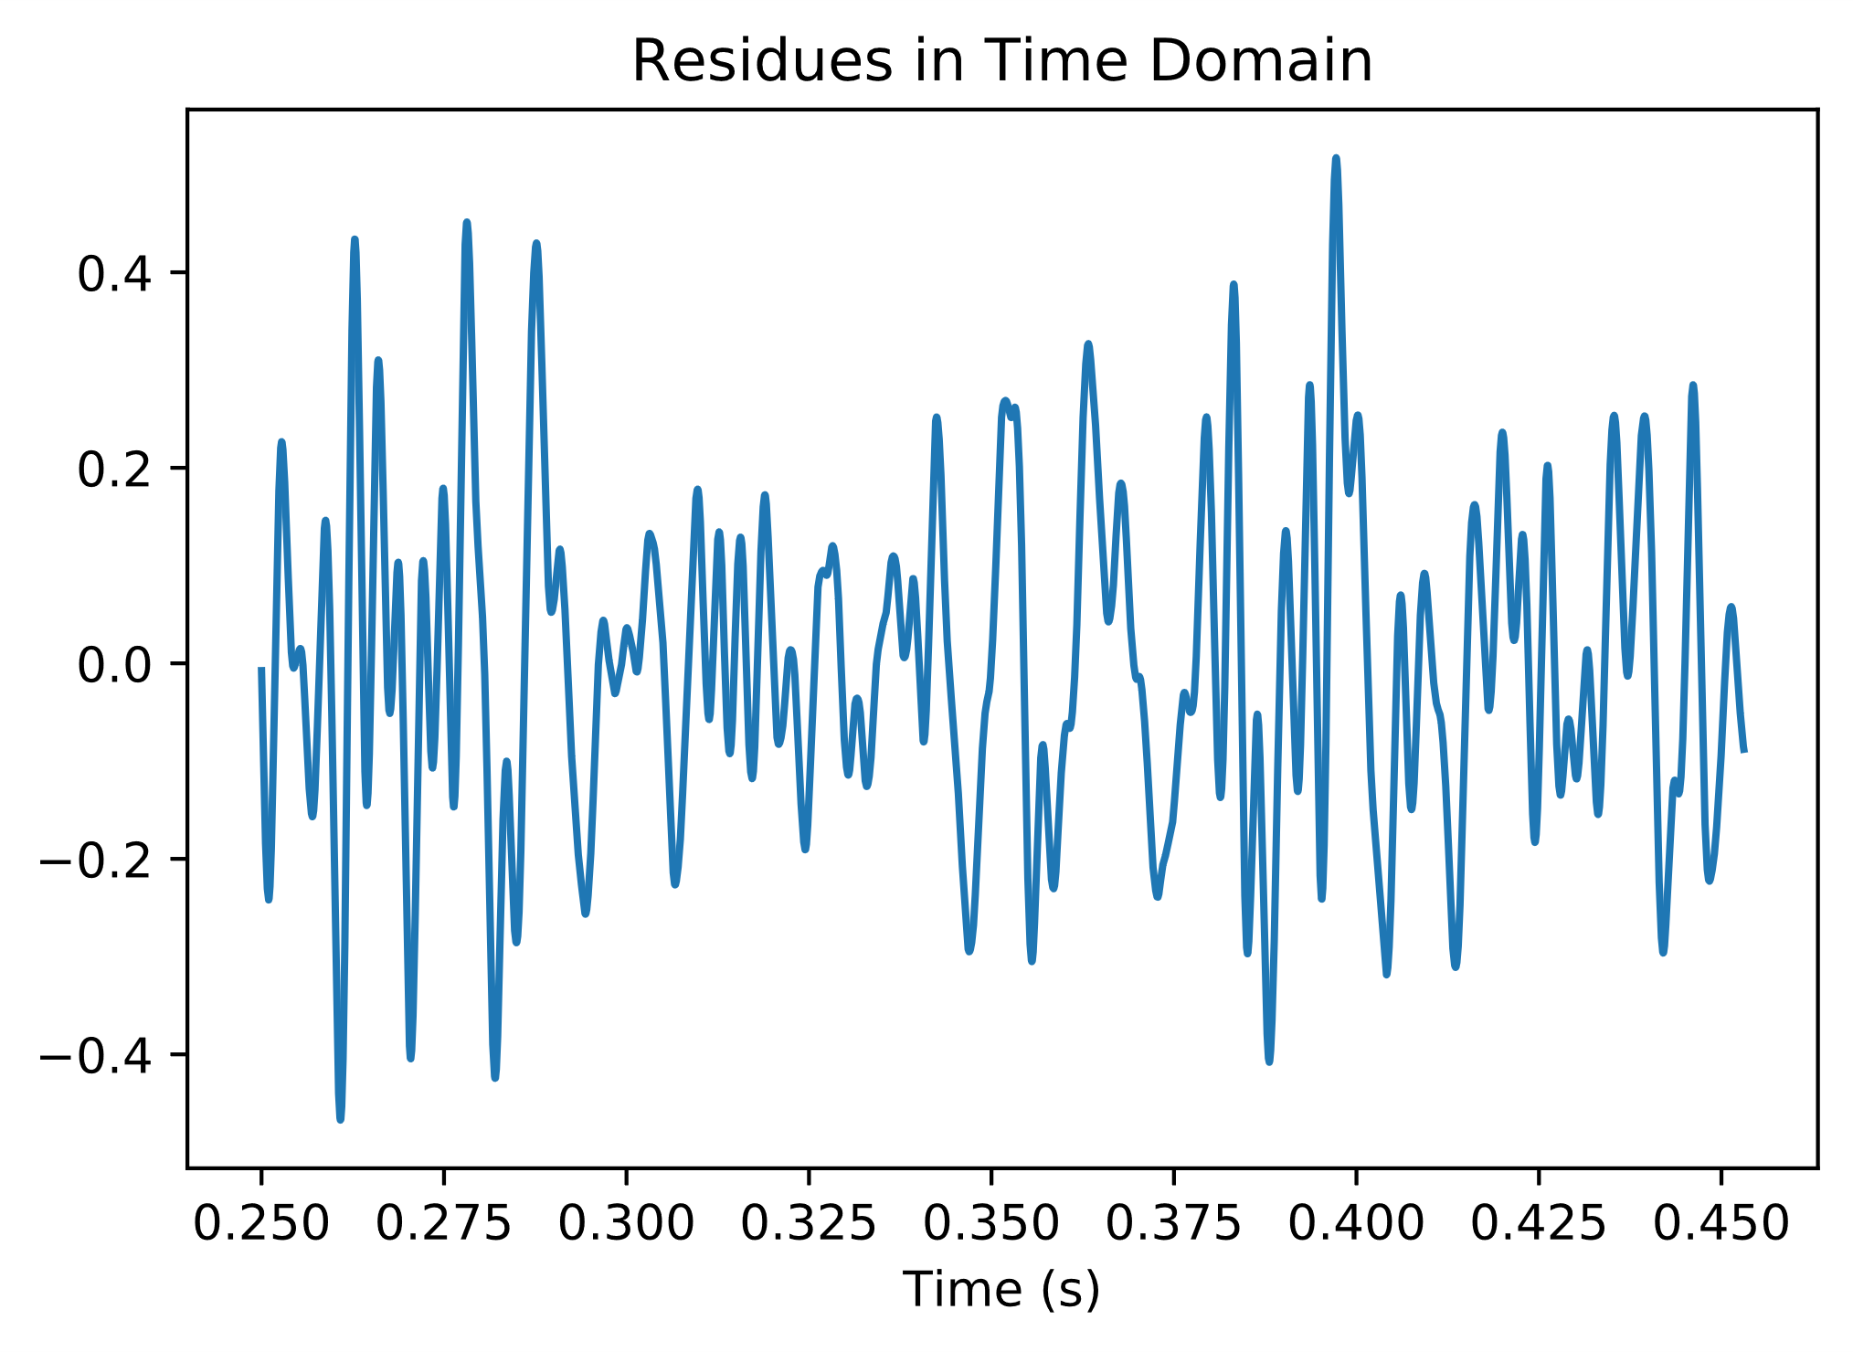
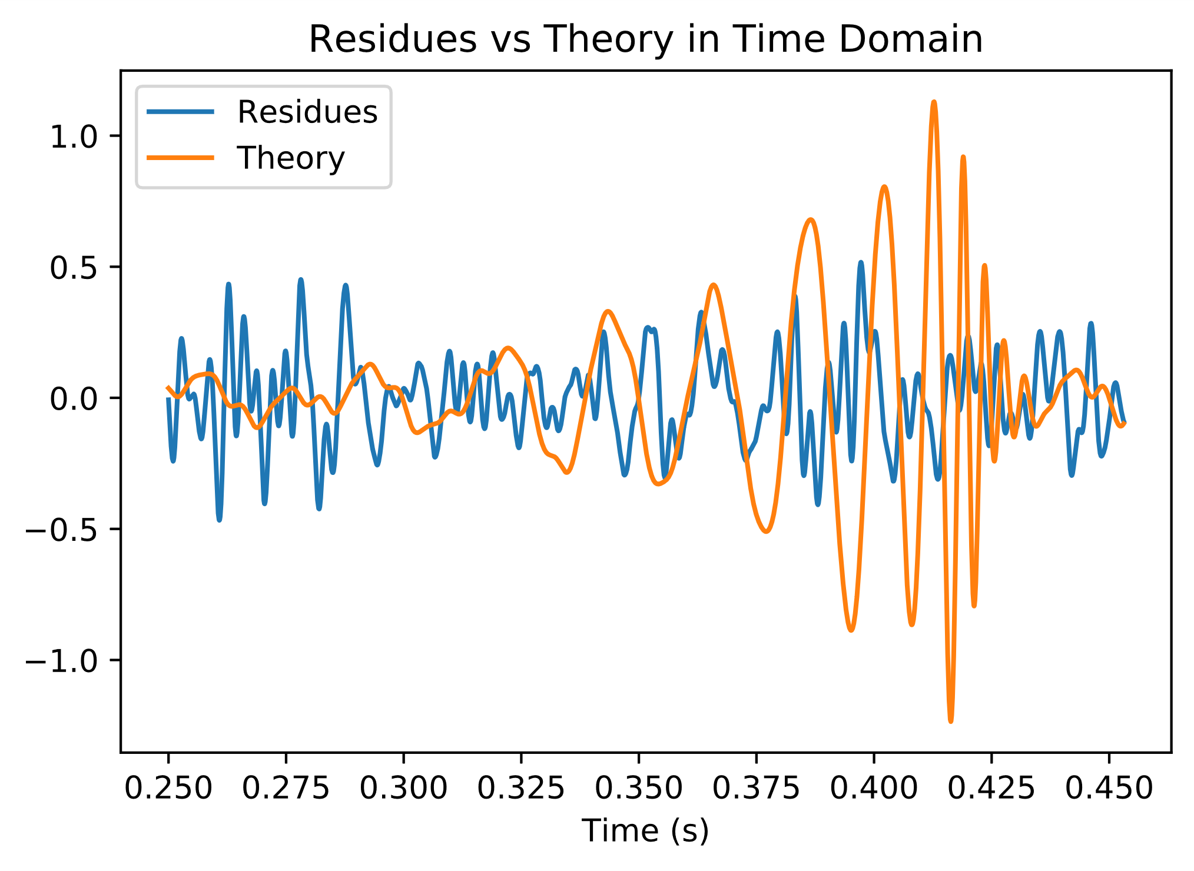
Residues
12

Slide 13
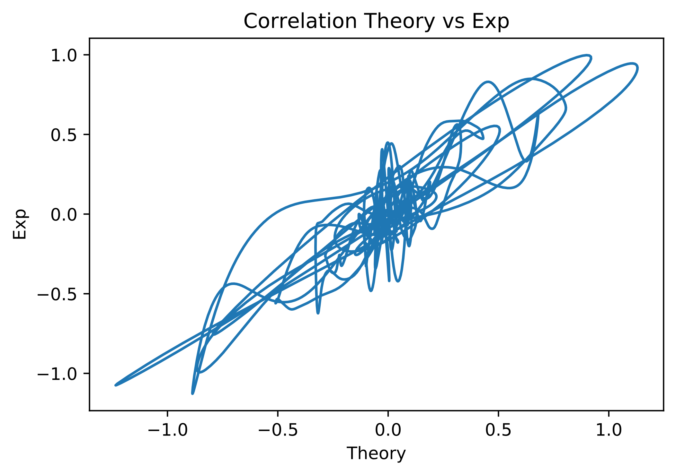
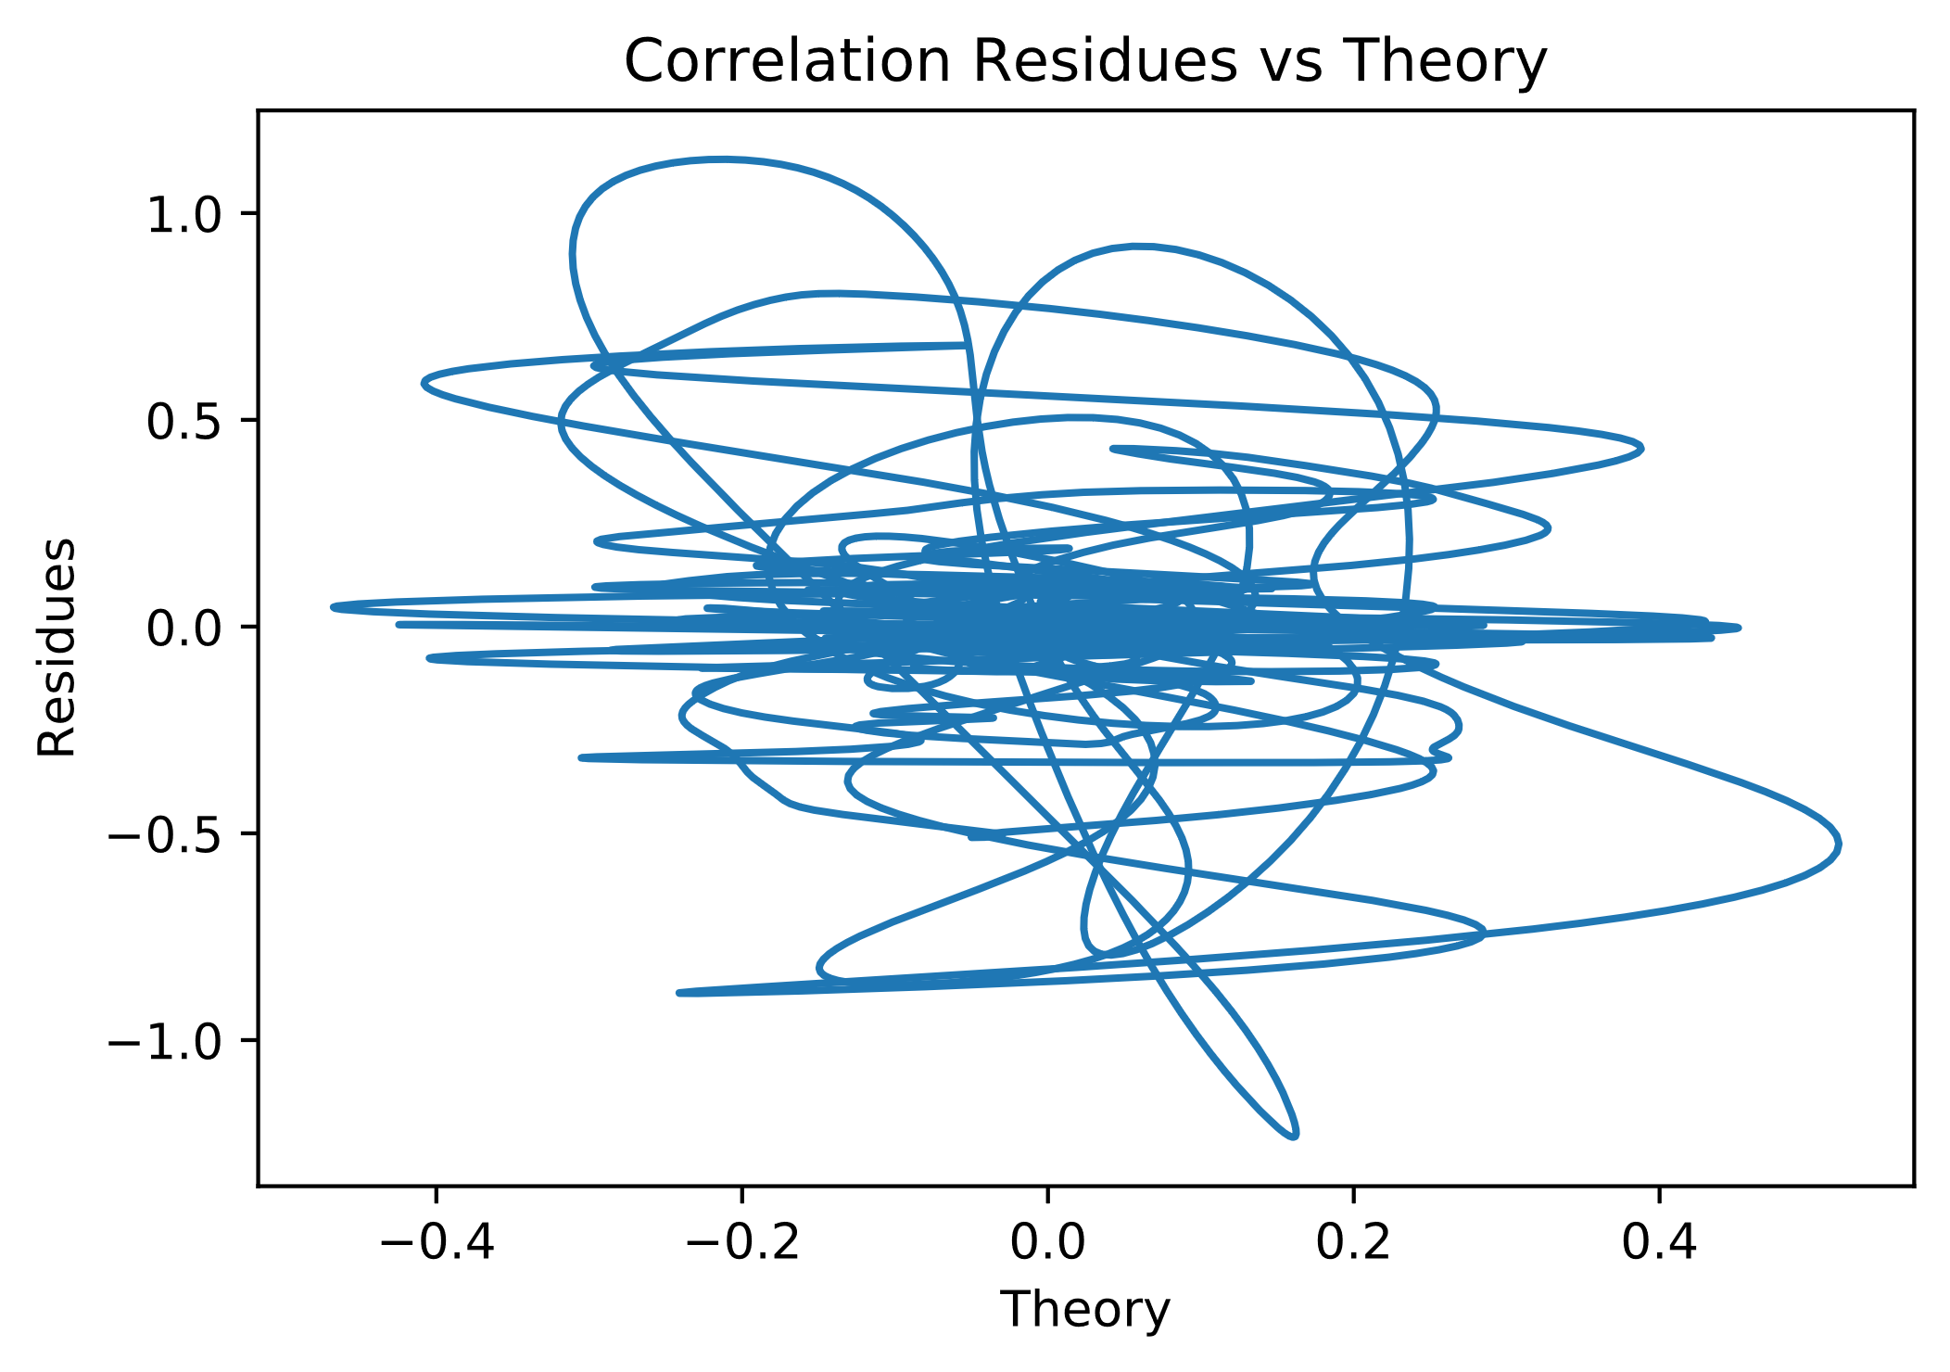
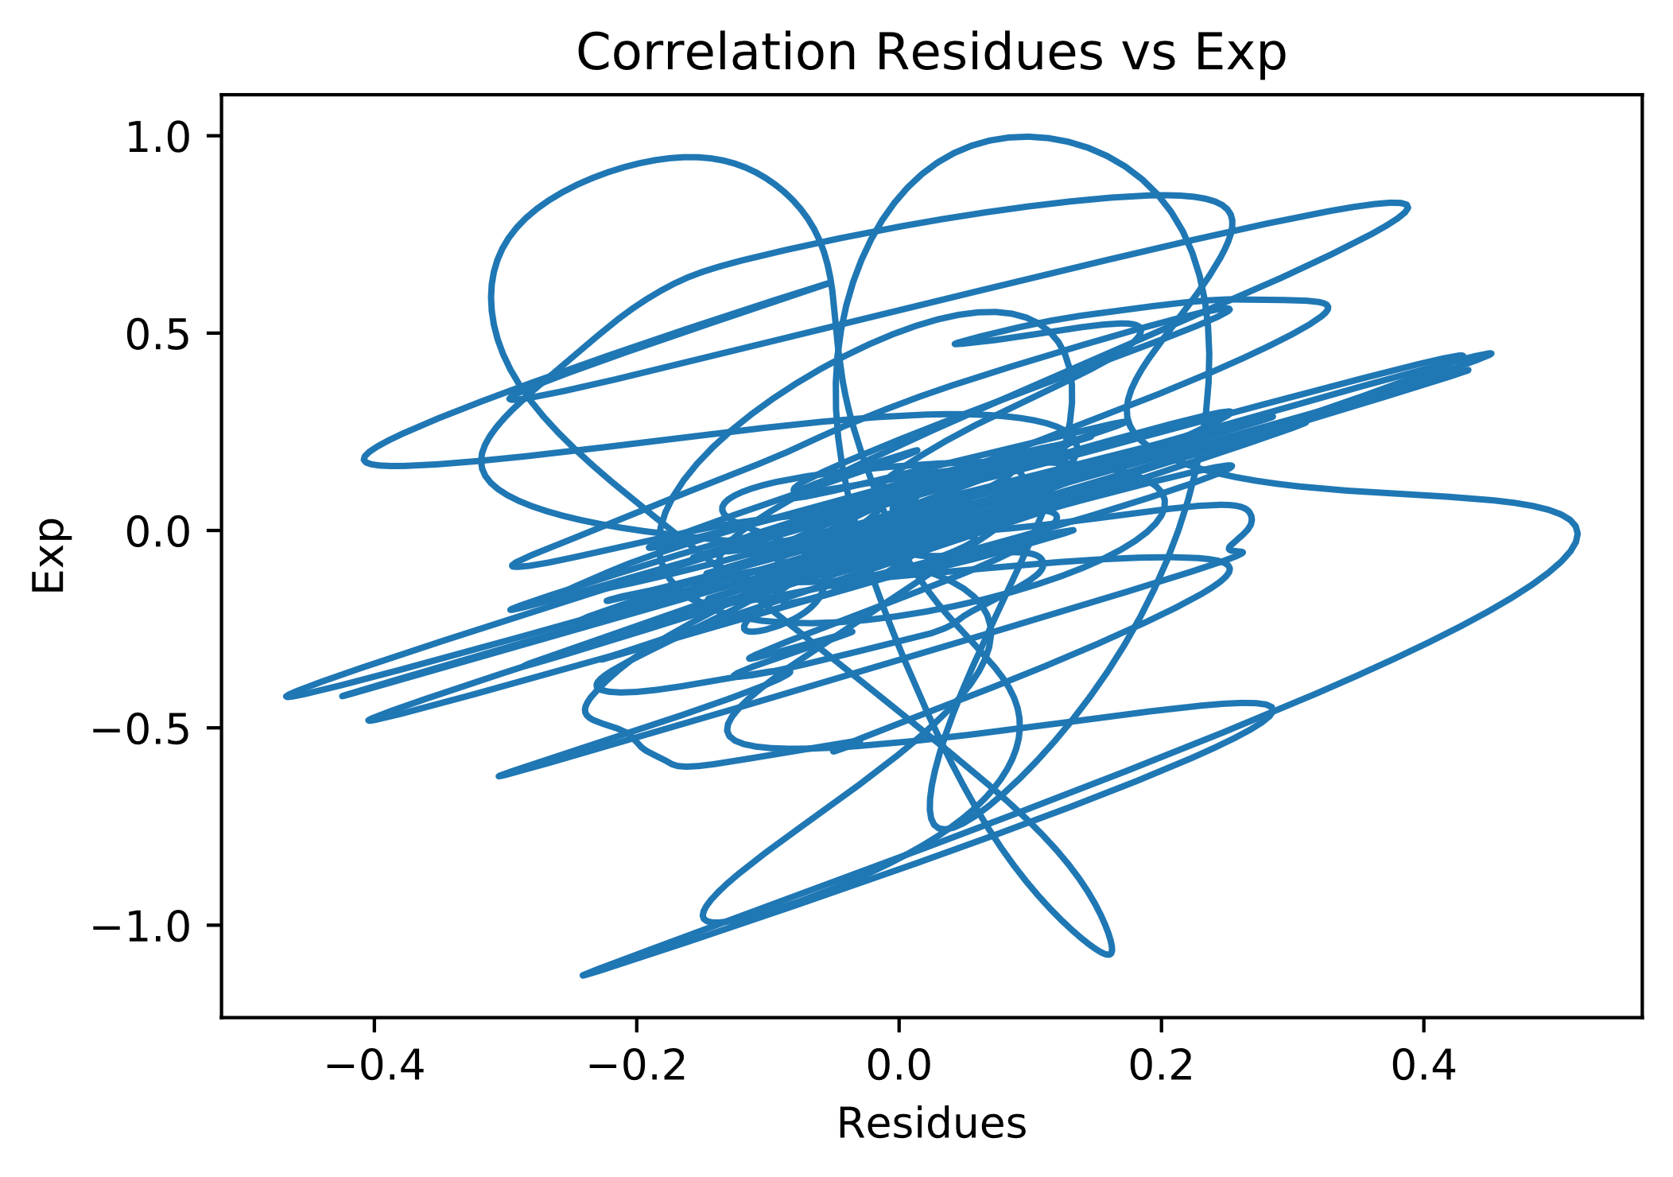
Residues Correlations
13

Slide 14
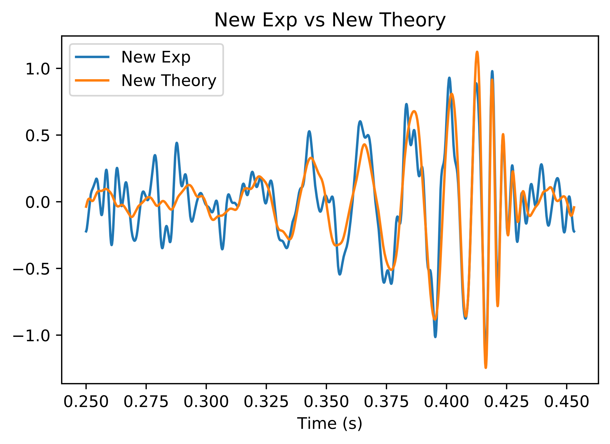
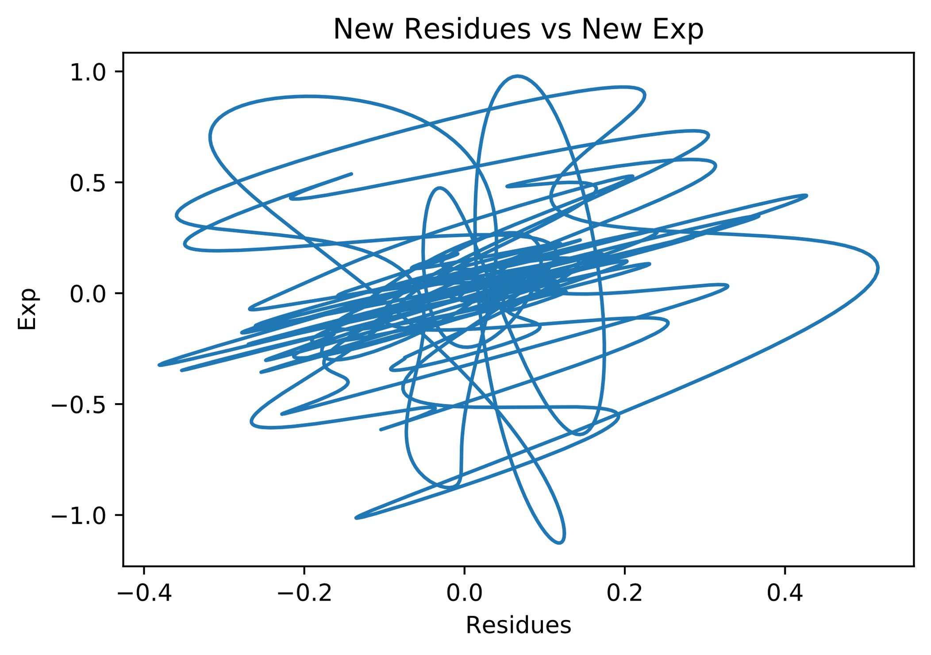
Filtered data – first try

Slide 15
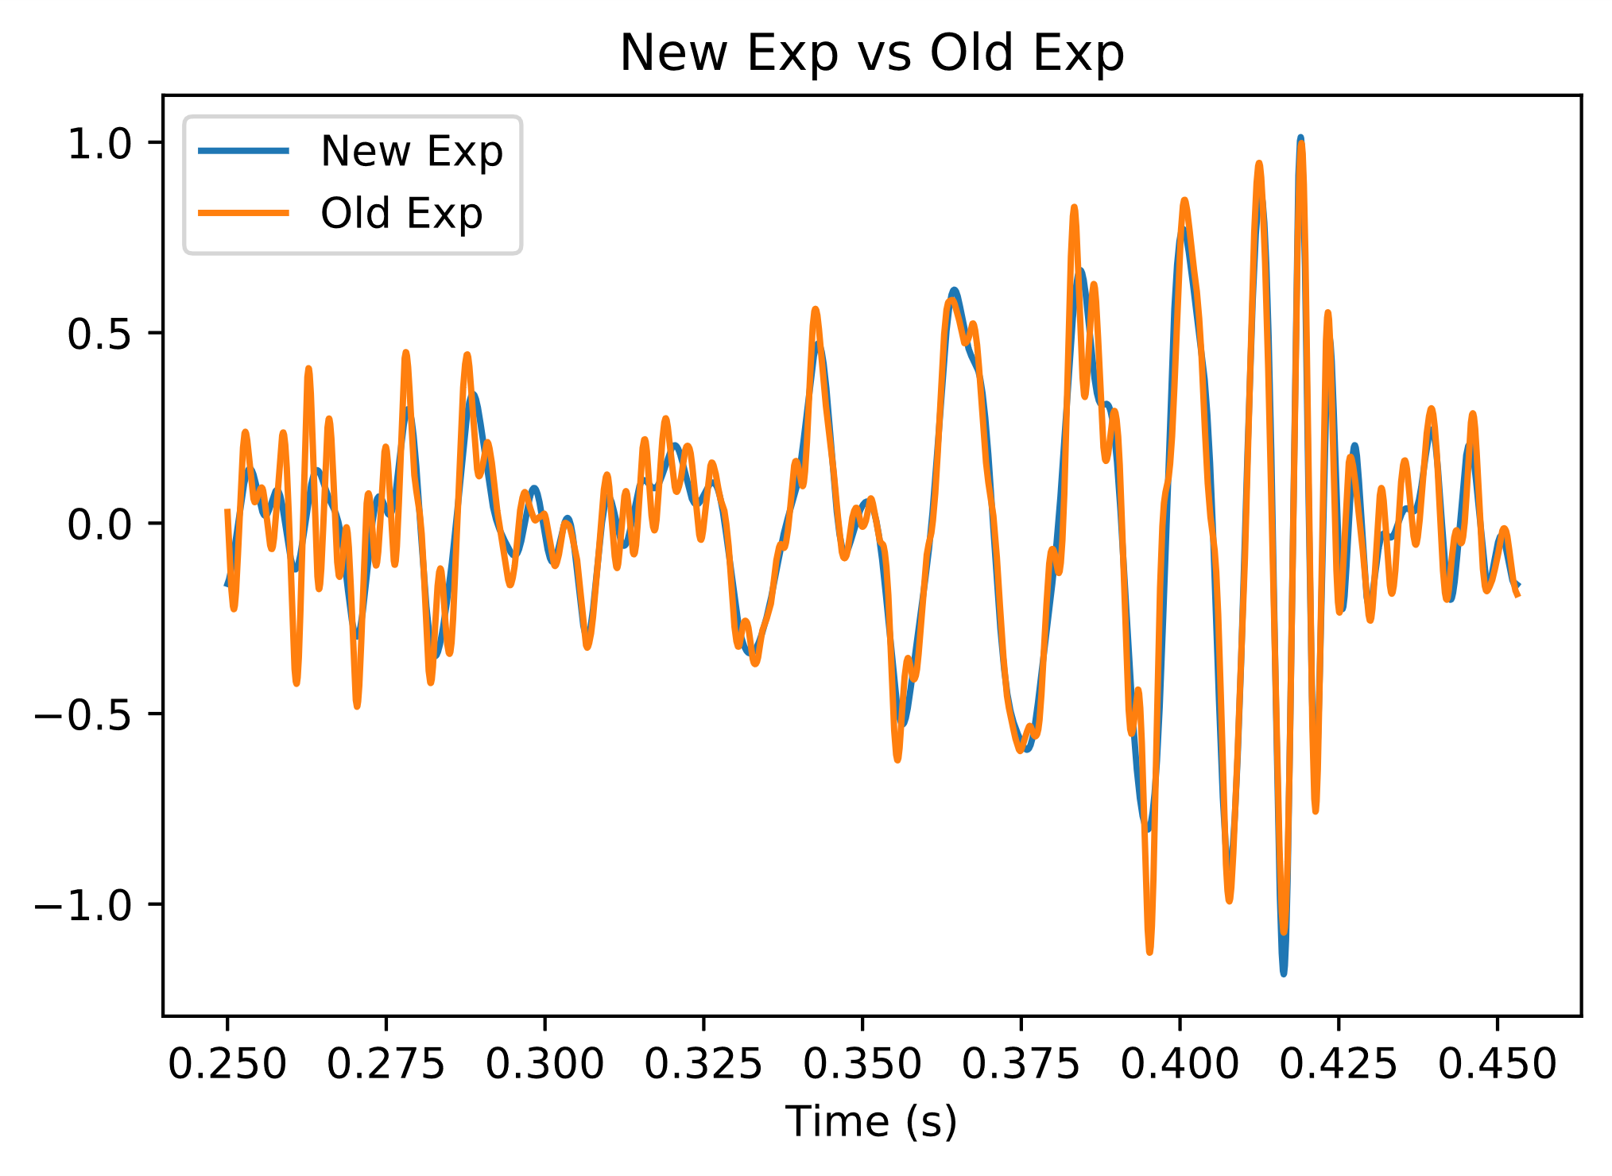
Filtered Data
15

Slide 16
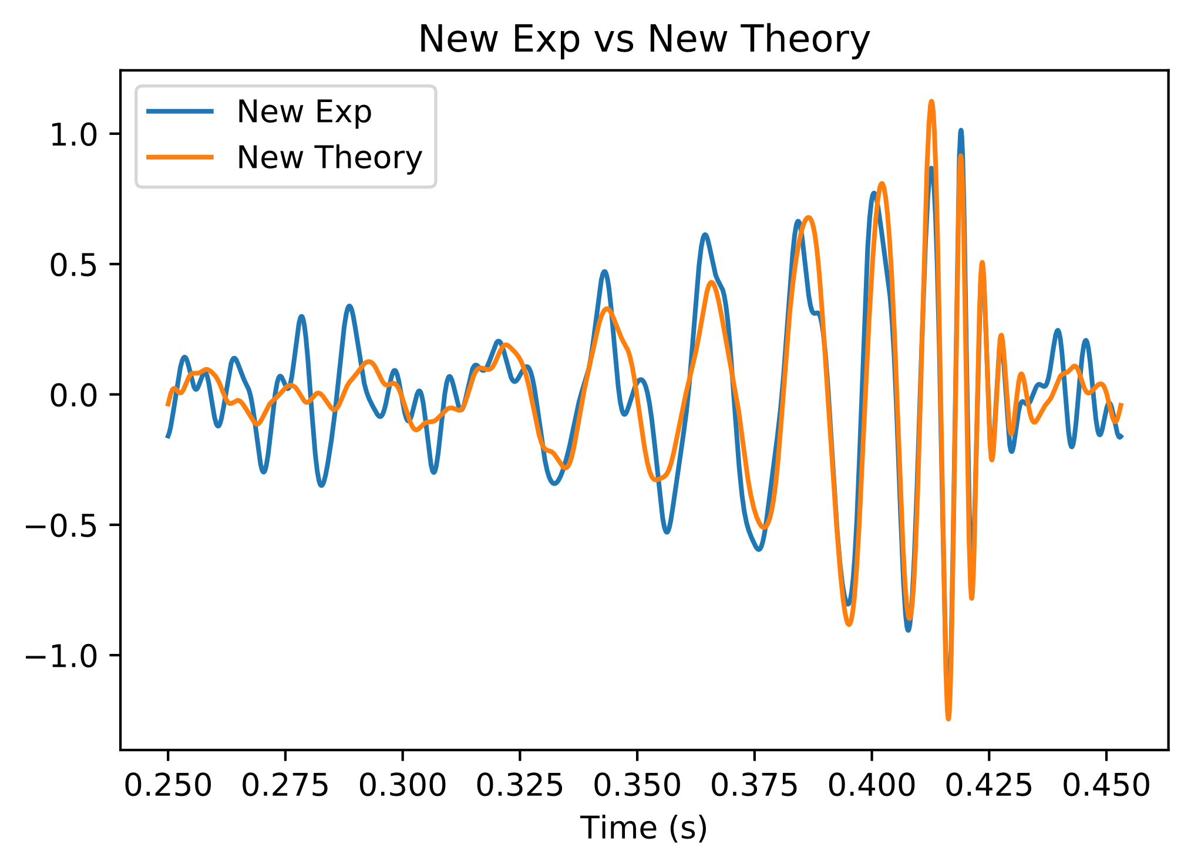
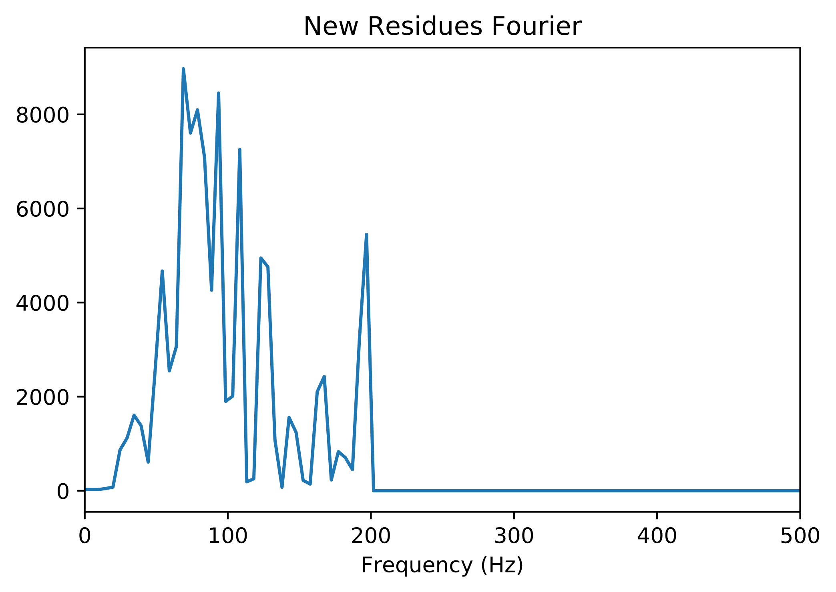
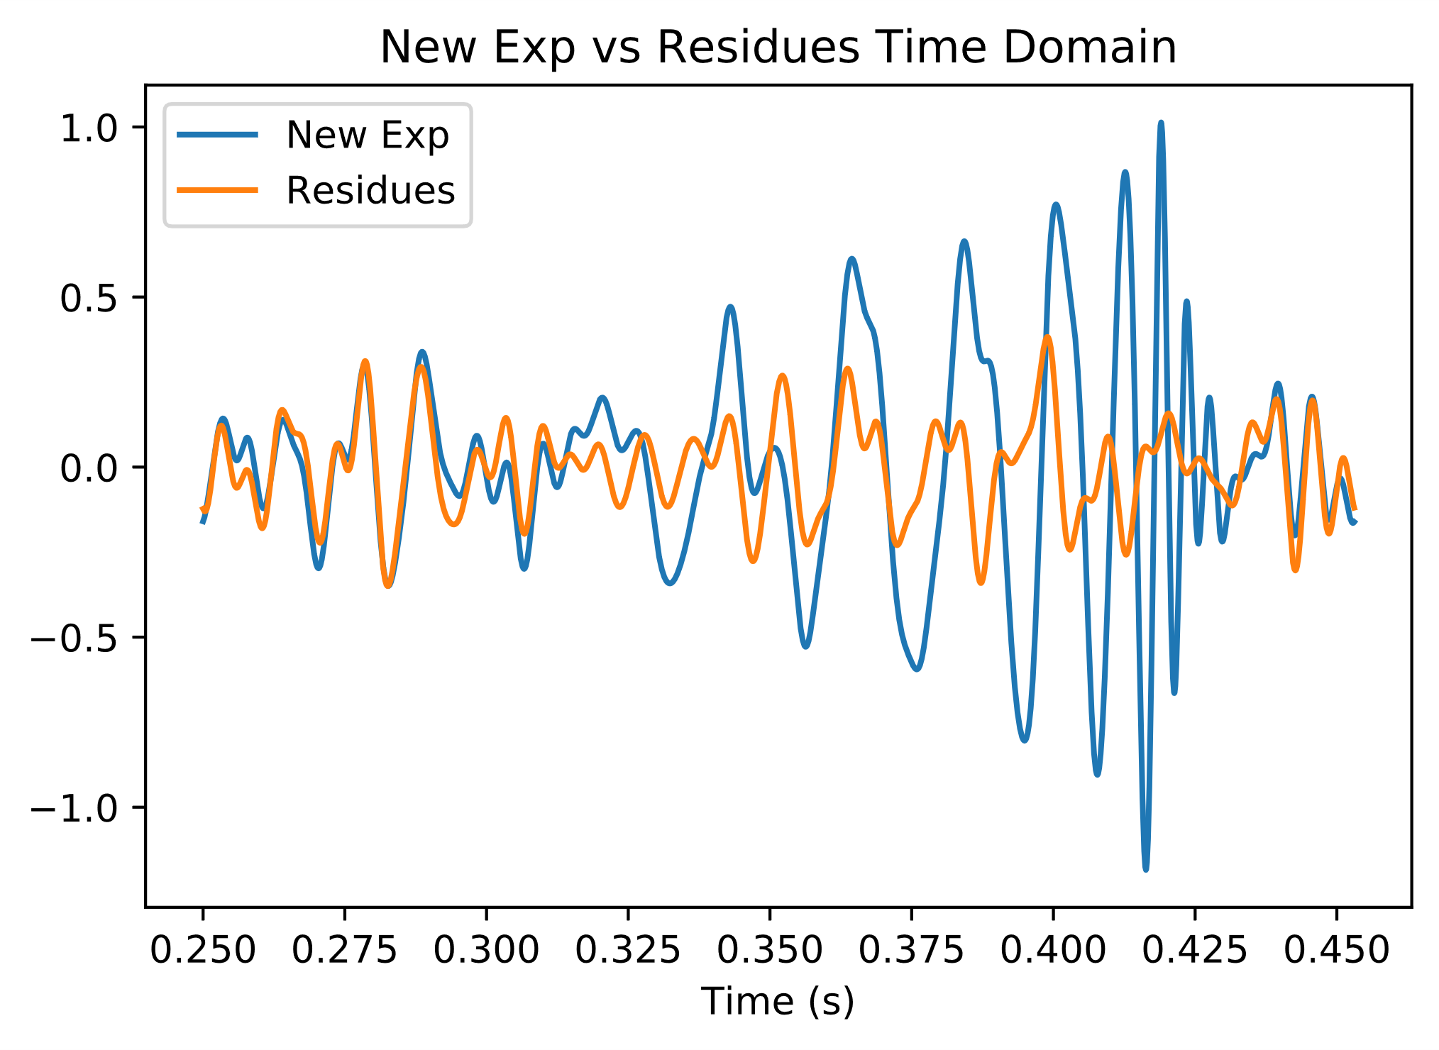
Filtered Data
16

Slide 17
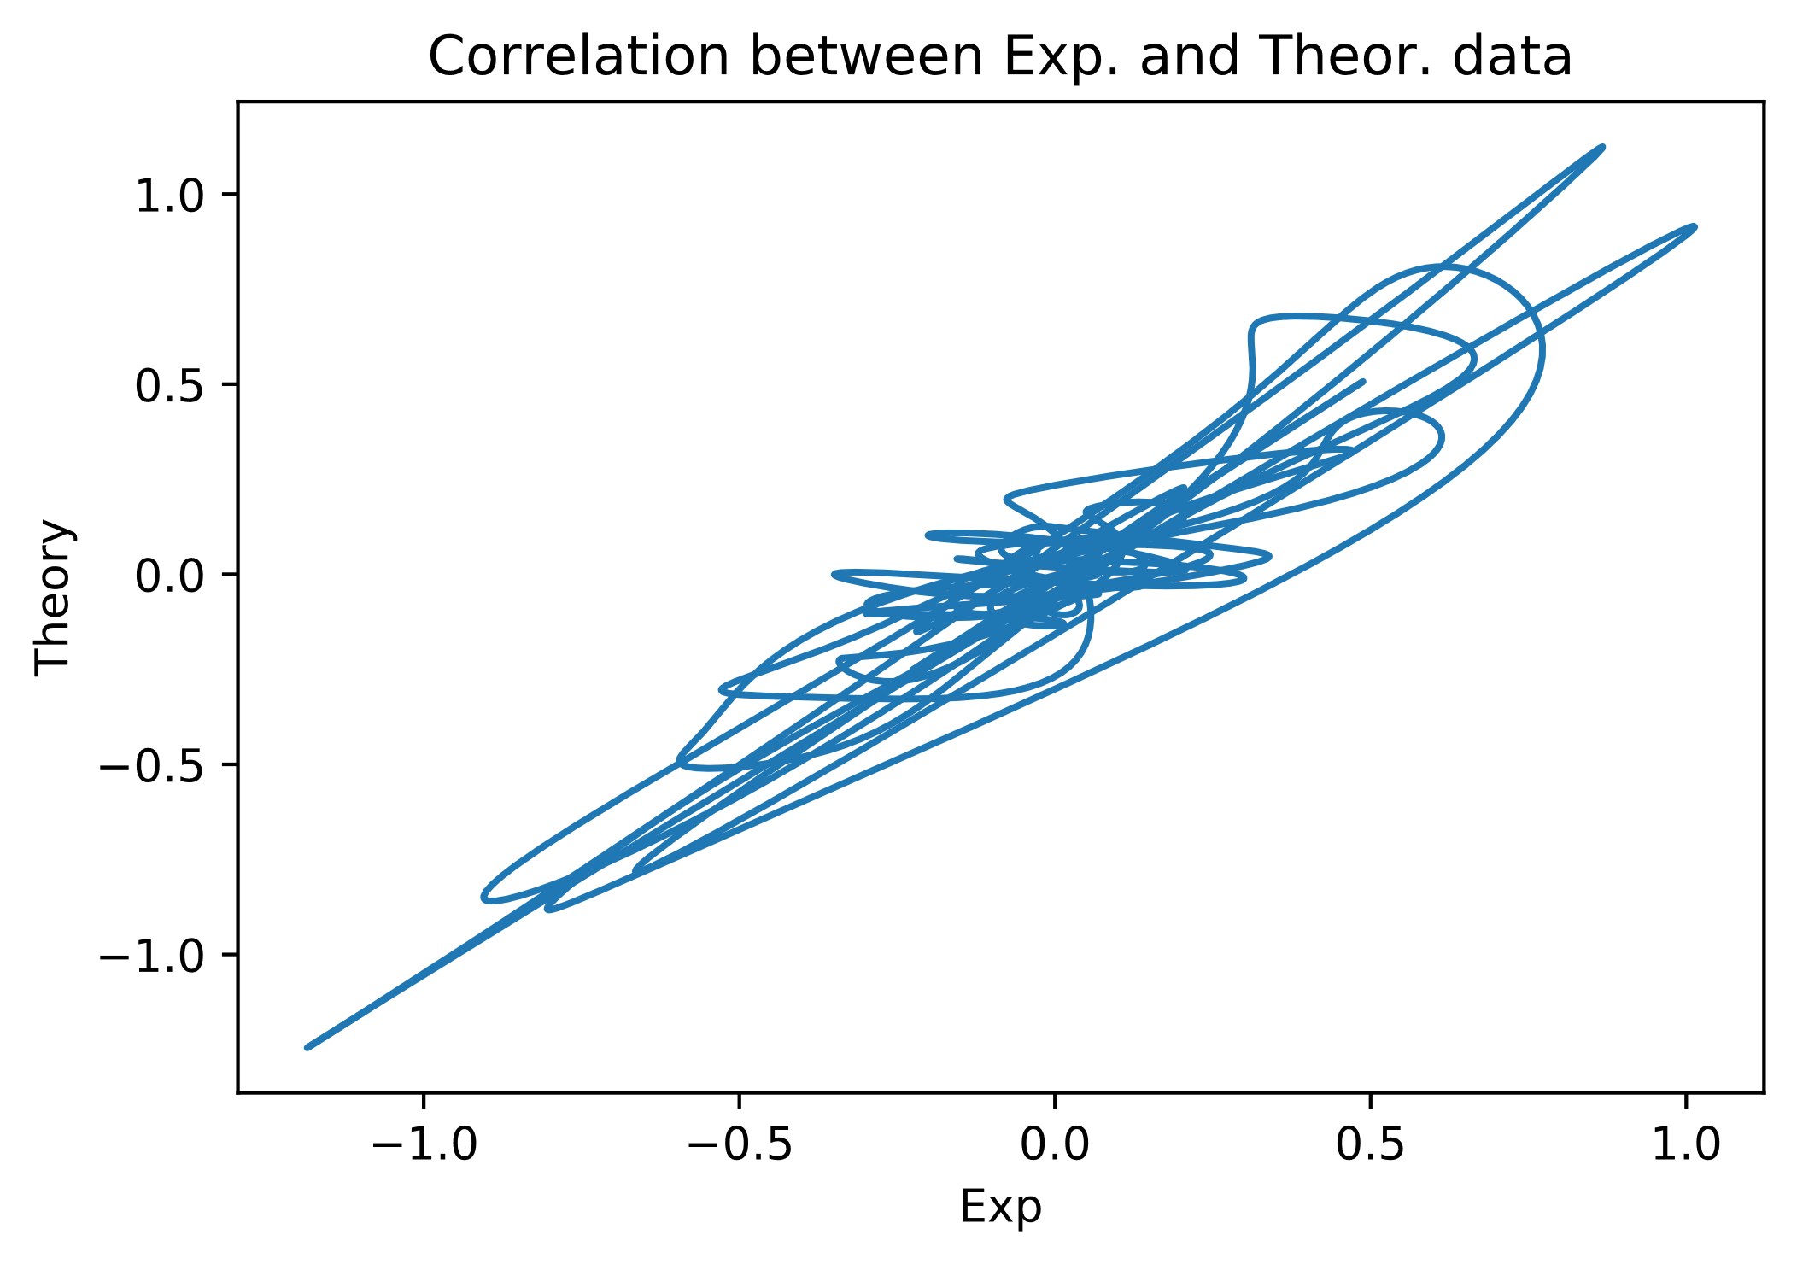
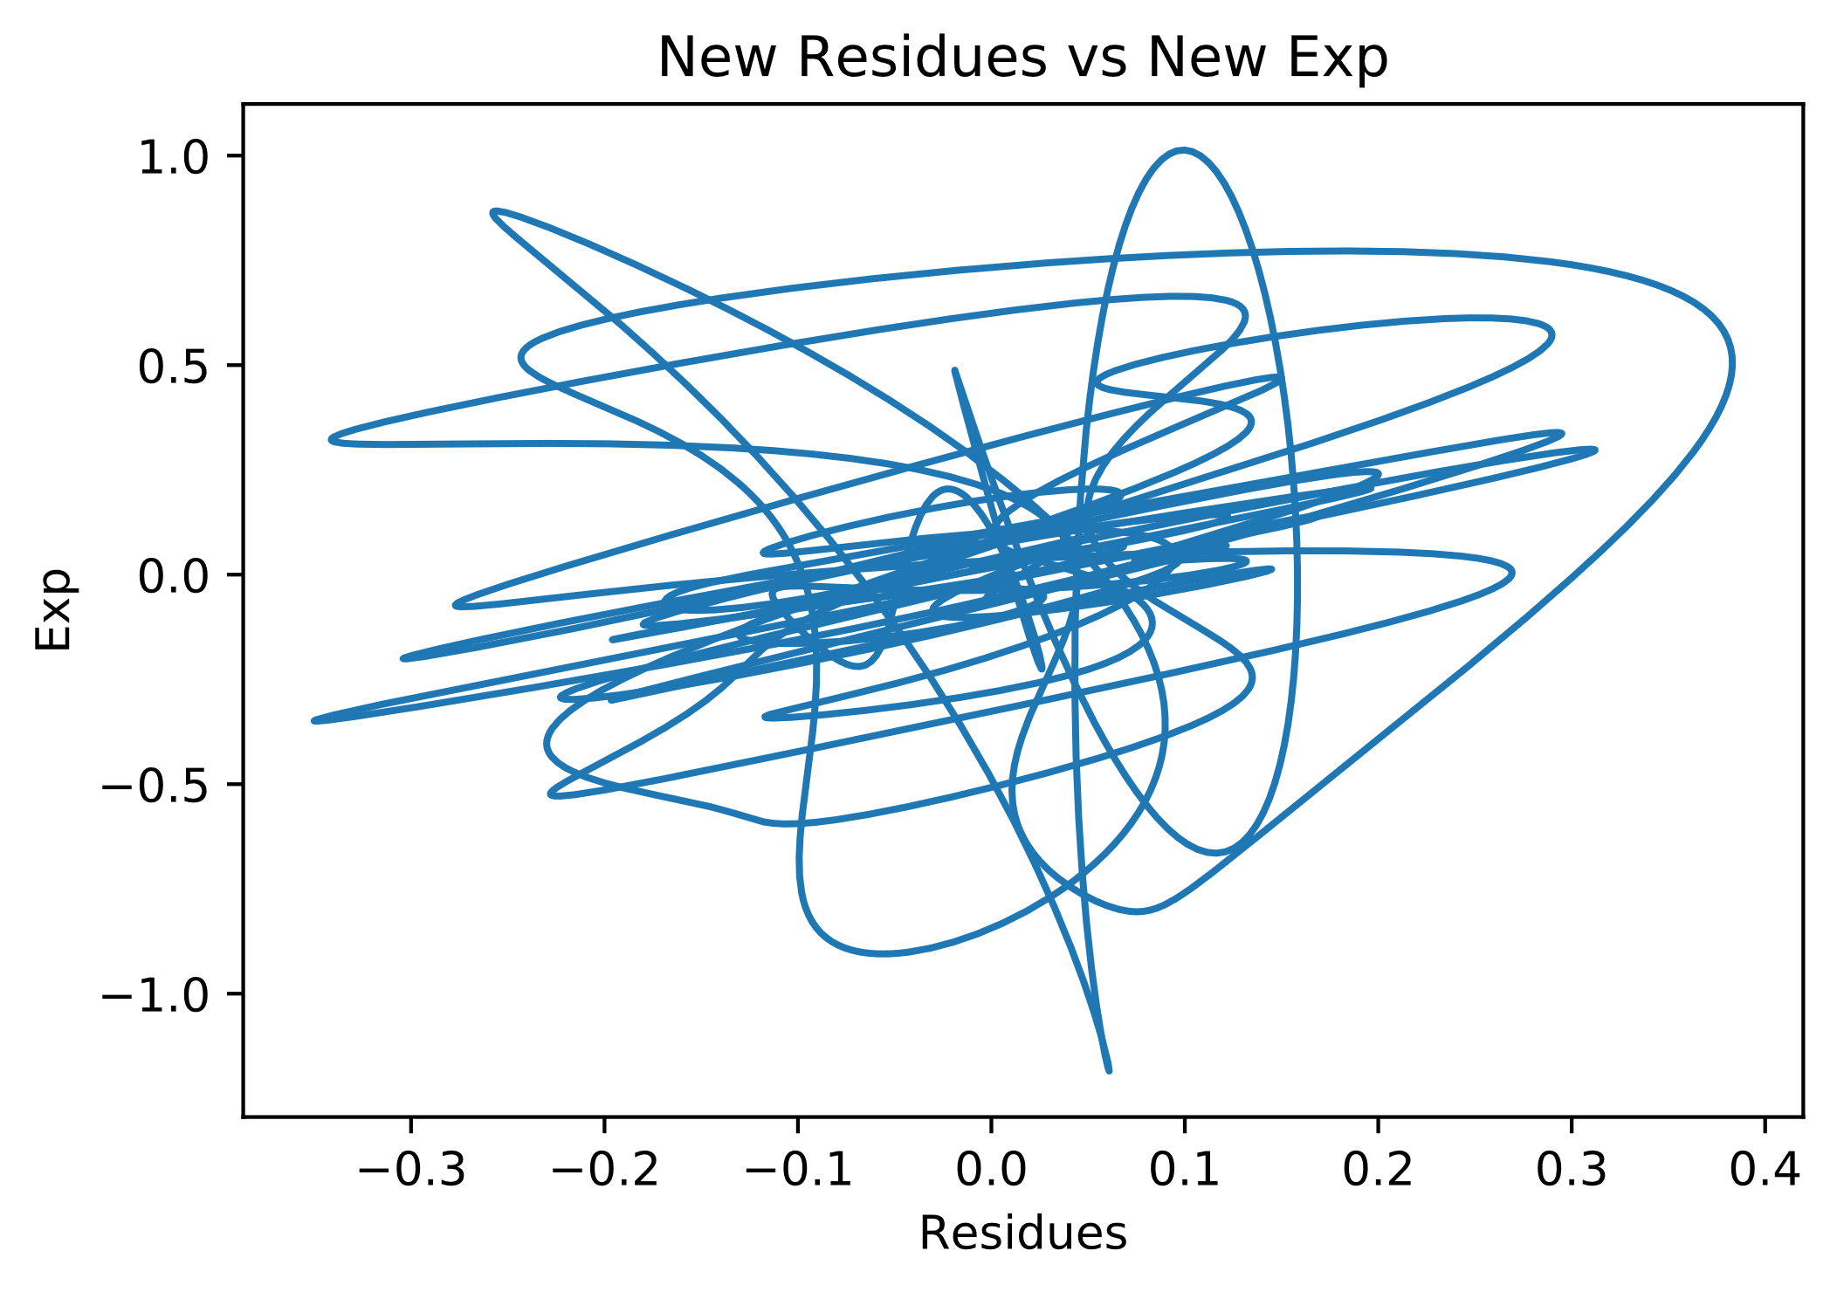
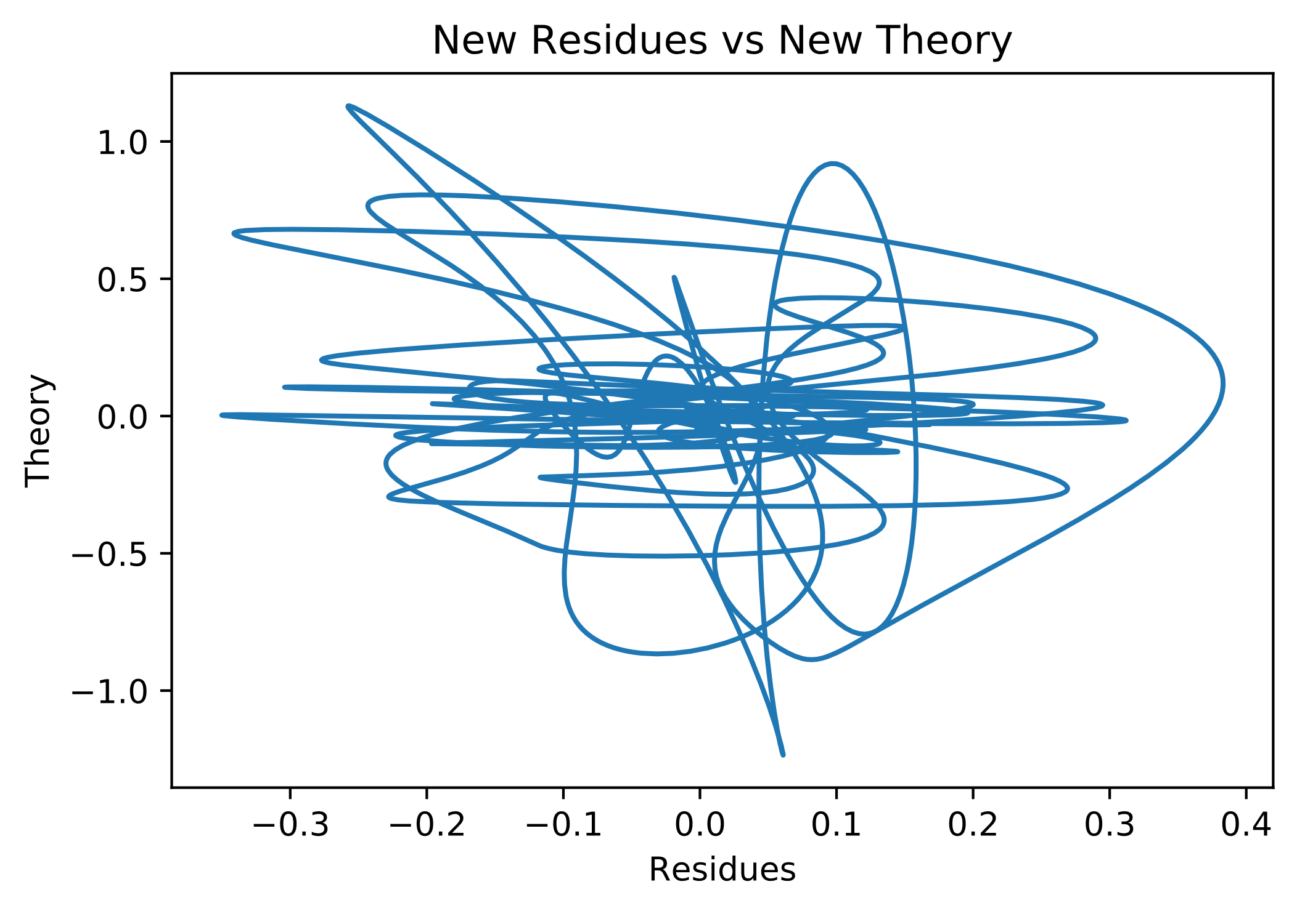
Residues
17

Slide 18
Correlations in Time Domain
New Correlations | Time Windows (s)
0.8565 | 0.250-0.275
0.9592 | 0.275-0.300
0.4822 | 0.300-0.326
0.4148 | 0.326-0.351
0.8021 | 0.351-0.376
-0.1021 | 0.376-0.402
-0.4011 | 0.402-0.427
0.8289 | 0.427-0.453
0.2492 | Total Correlation
Old Correlations | Time Windows (s)
0.9504 | 0.250-0.275
0.9687 | 0.275-0.300
0.6154 | 0.300-0.326
0.4572 | 0.326-0.351
0.7888 | 0.351-0.376
0.1094 | 0.376-0.402
-0.2907 | 0.402-0.427
0.8657 | 0.427-0.453
0.3545 | Total Correlation

Slide 19
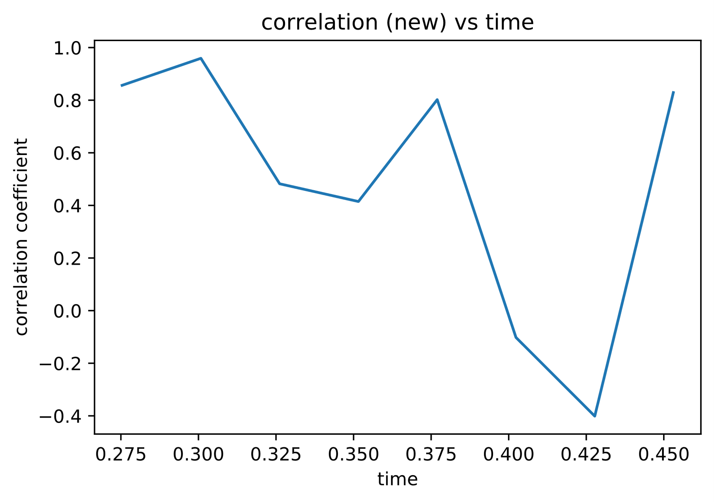
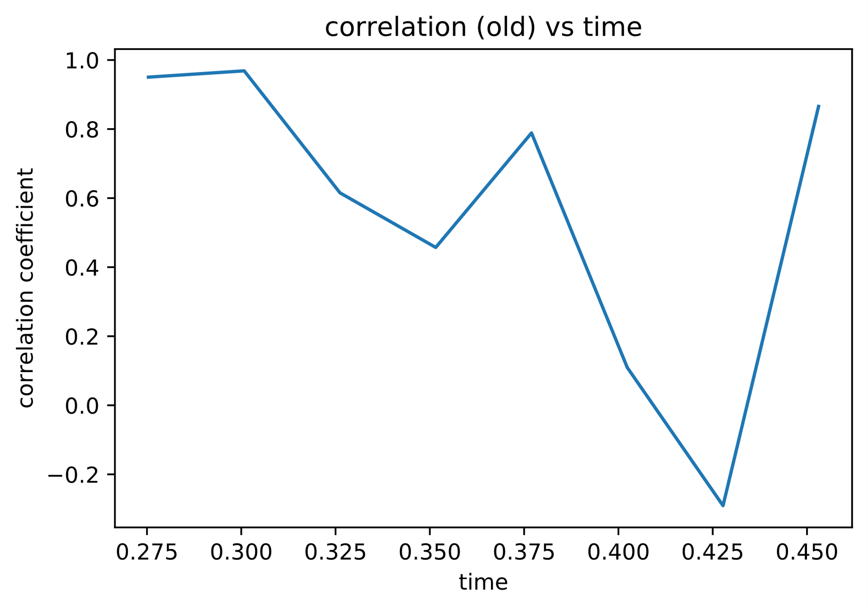
Correlations in Time Domain
19

Slide 20

Conclusions
Before filtering, the giant spikes of theoretical and experimental data already fit together very well (high signal part)
Deviation of theoretical and experimental data in the beginning and end is probably noise (more observable in low signal parts)
Residues are as expected not correlated with the theory (not predictable)
The filtered experimental data fits the theoretical data better (correlation between exp. vs theory is before 0.874; after 0.912)
20

Slide 21

Conclusions
The residue that stayed behind fluctuates randomly
Slight correlation between the residue and experimental signal
The correlation between residue and experimenal data is still very high in the beginning and end.
indication of unremoved noise
In the time window between, the residue and experimental data is nearly uncorrelated
theoretical model describes our data very well

