Slide 1
Measurement of top-quark pairs differential cross-sections at ATLAS
Michele Faucci Giannelli
On behalf of the ATLAS collaboration

Slide 2
Top differential cross-sections in ATLAS
ATLAS has performed many differential cross-sections measurement of top pair observables at 7, 8 and 13 TeV
  10 published papers and more ready to be submitted
Will focus on most recent publications at 13 TeV
  di-lepton channel (Eur. Phys. J. C77 (2017) 299)
  L+jet channel (boosted and resolved) (arXiv, submitted to JHEP)
  di-boosted hadronic channel (TOPQ-2016-09)
And 8 TeV
  Lepton differential measurements (ATLAS-CONF-2017-044)

Slide 3
Outline
Introduction
Topologies and reconstruction
Data-MC agreement
Results
Conclusions

Slide 4
Summary of cross-sections
Reco to parton unfolding
Theory
Partons
Full Phase space
Experiment
Reconstruction
Parton to particle (i.e. apply shower)
Particle
Fiducial Phase space
RIVET
Reco to particle unfolding
Focus on measurement close to experimental acceptance
Reduce dependency on theory
Migration matrix is more diagonal
Expected reduced systematic uncertainties from modelling
Theorist can compare new models
The results will be relevant for years

Slide 5
Two types of differential cross-sections
Data and MC can have a significant difference in the normalisation
  Absolute differential cross-sections takes into account the normalisation and give the actual cross-section
  Normalised differential cross-sections provide shape information with higher precision
    several uncertainties cancel when dividing for the total cross-section

Slide 6
Topologies and reconstruction
di-lepton channel: neutrino weighting (top variables)
l+jets resolved channel: pseudo-top
l+jets boosted channel: only 1 large-R jet
Hadronic di-boosted channel: 2 large-R jets
u/d/s/c
lepton
υ
W
b
Leptonic top:
lepton
E_{T}^{Miss}
Closest b-jet to lepton
t
W reconstruction:
select the two jets that best reconstruct the W mass
t
W
lepton
Select two highest p_{T} b-jets (70% WP)
u/d/s/c
b
u/d/s/c
u/d/s/c
Hadronic top:
two light jets
other b-jet
Top selection is identical at reconstruction and particle level

Slide 7


Data and MC samples used
$$\sqrt{\text{s}}\text{=}\text{8} \text{TeV}$$
$$\sqrt{\text{s}}\text{=13 }\text{TeV}$$
di-lepton
  2012 data (20.2 fb⁻¹)
MC predictions:
  PowHeg+Pythia6
  PowHeg+Pythia6 IFSR variations
  PowHeg+Pythia6 h_{damp}=∞
  PowHeg+Pythia8 h_{damp}=∞
  PowHeg+Herwig
  Alpgen+Herwig
  MC@NLO+Herwig
  MG5_aMC@NLO+Herwig++
di-lepton and l+jets
  2015 data (3.2 fb⁻¹)
di-boosted
  2015+2016 data (36.1 fb⁻¹)
MC predictions:
  PowHeg+Pythia6 (old nominal)
  PowHeg+Herwig++
  PowHeg+Pythia8 (new nominal)
  PowHeg+Pythia6/8 IFSR variations
  PowHeg+Herwig7
  MG5_aMC@NLO+Herwig++
  MG5_aMC@NLO+Pythia8
  Sherpa (2.2.1)

Slide 8
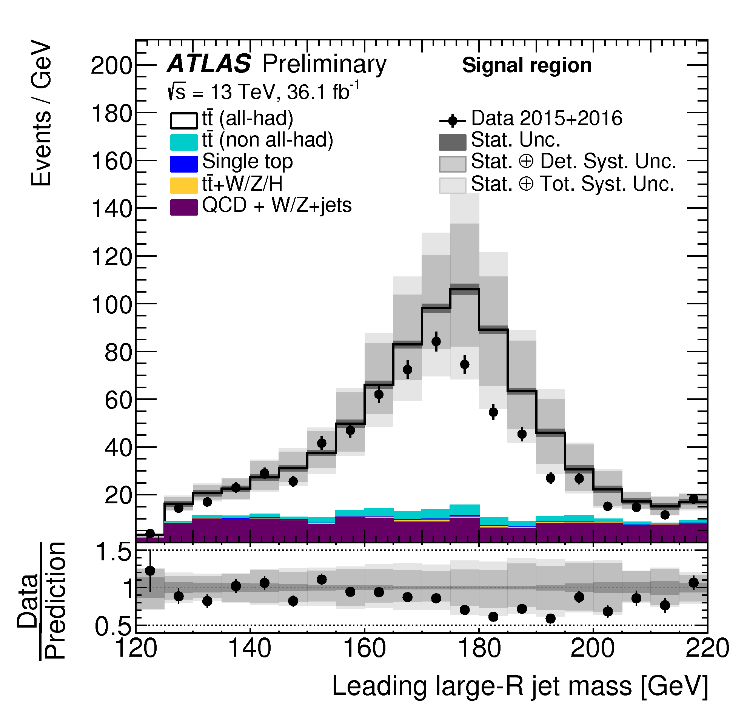
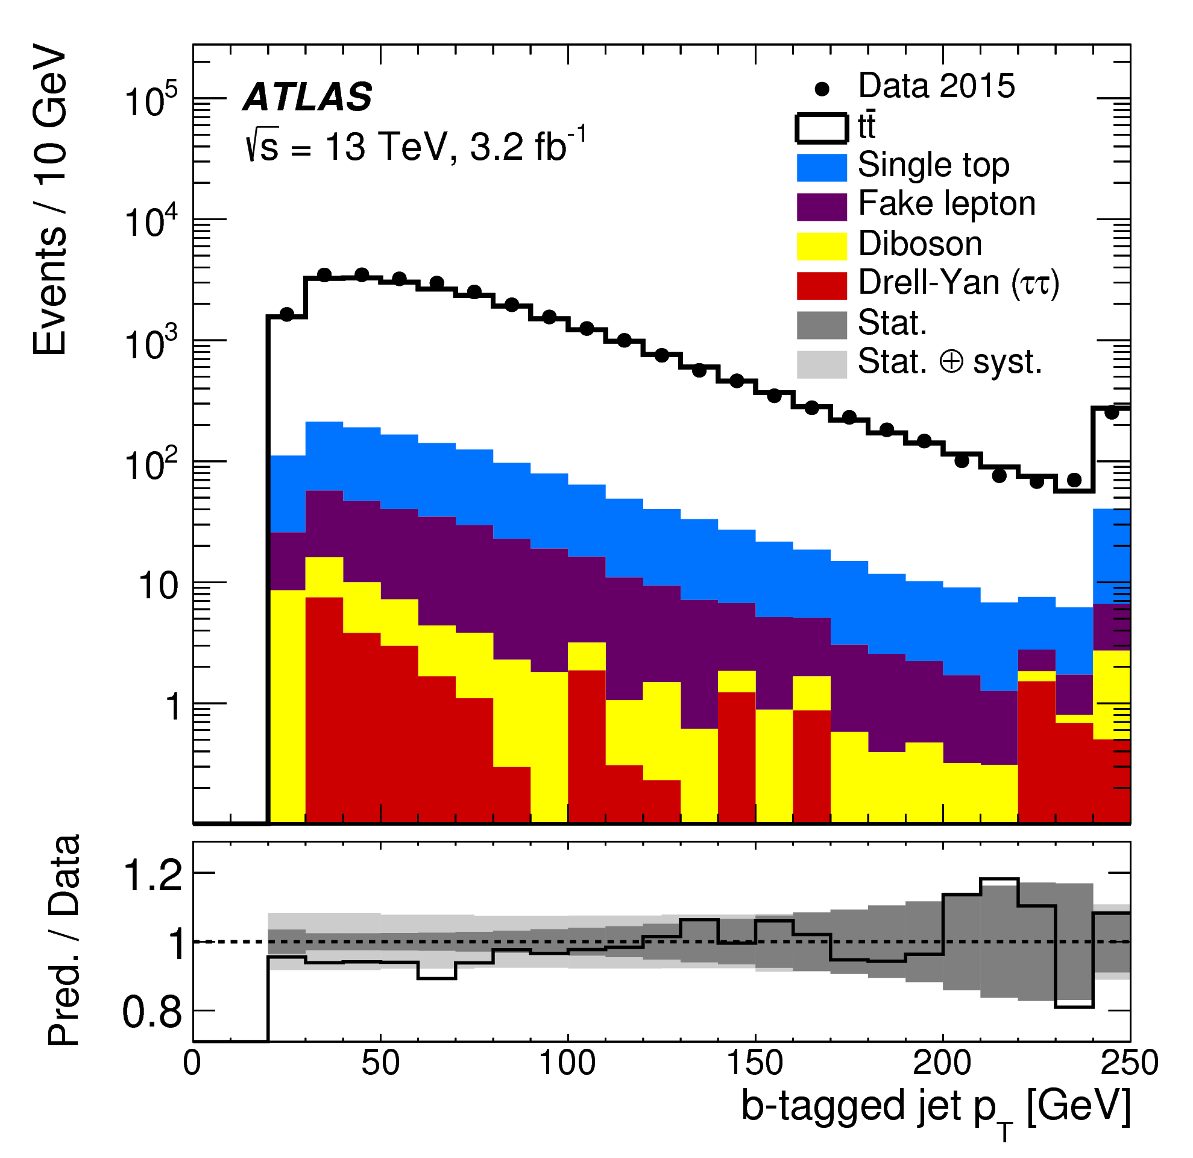
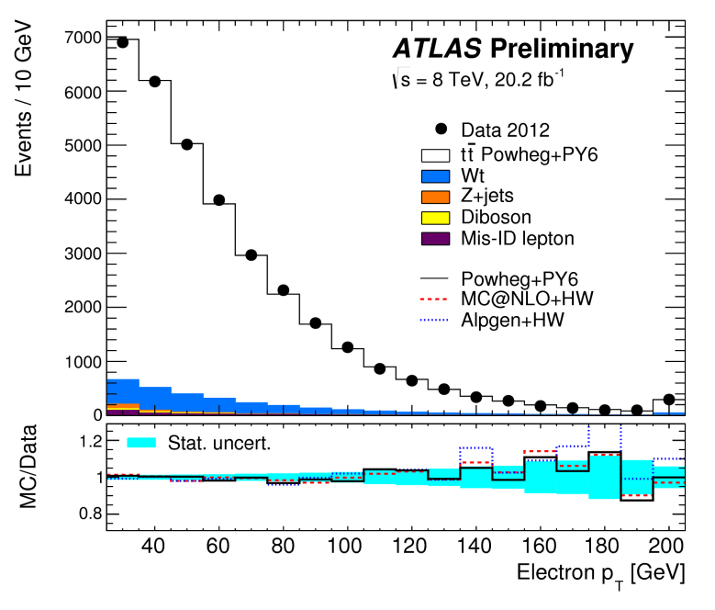
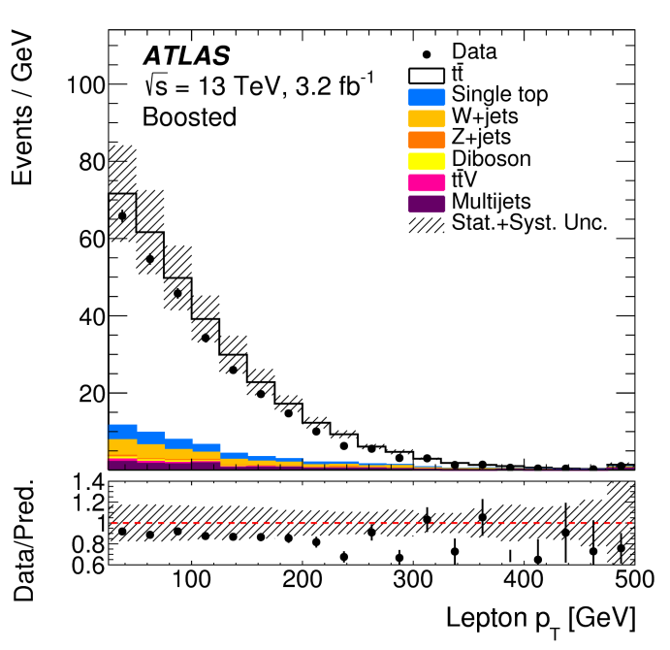
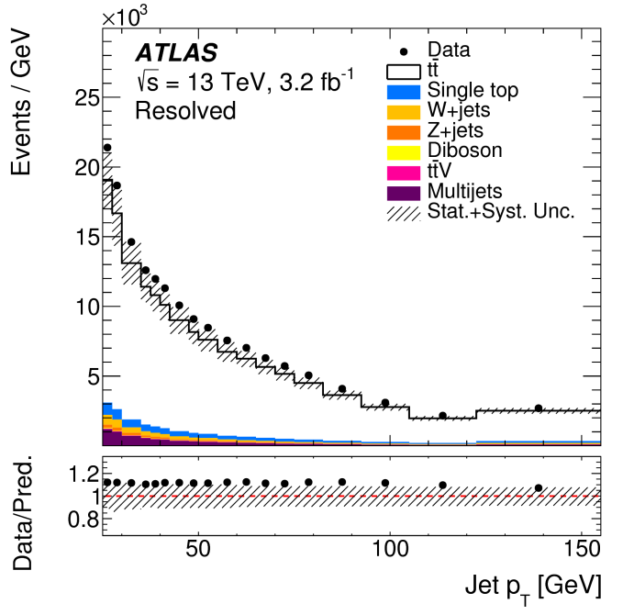
Data/MC agreement
di-lepton
di-boosted
di-lepton
l+jets
l+jets
The background is small in all channels

Slide 9
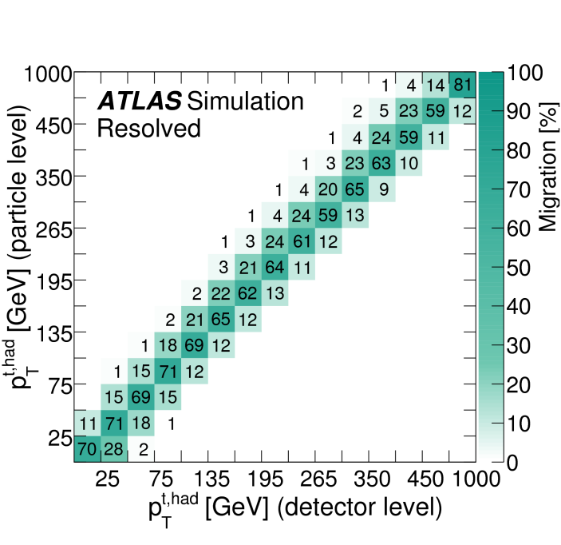
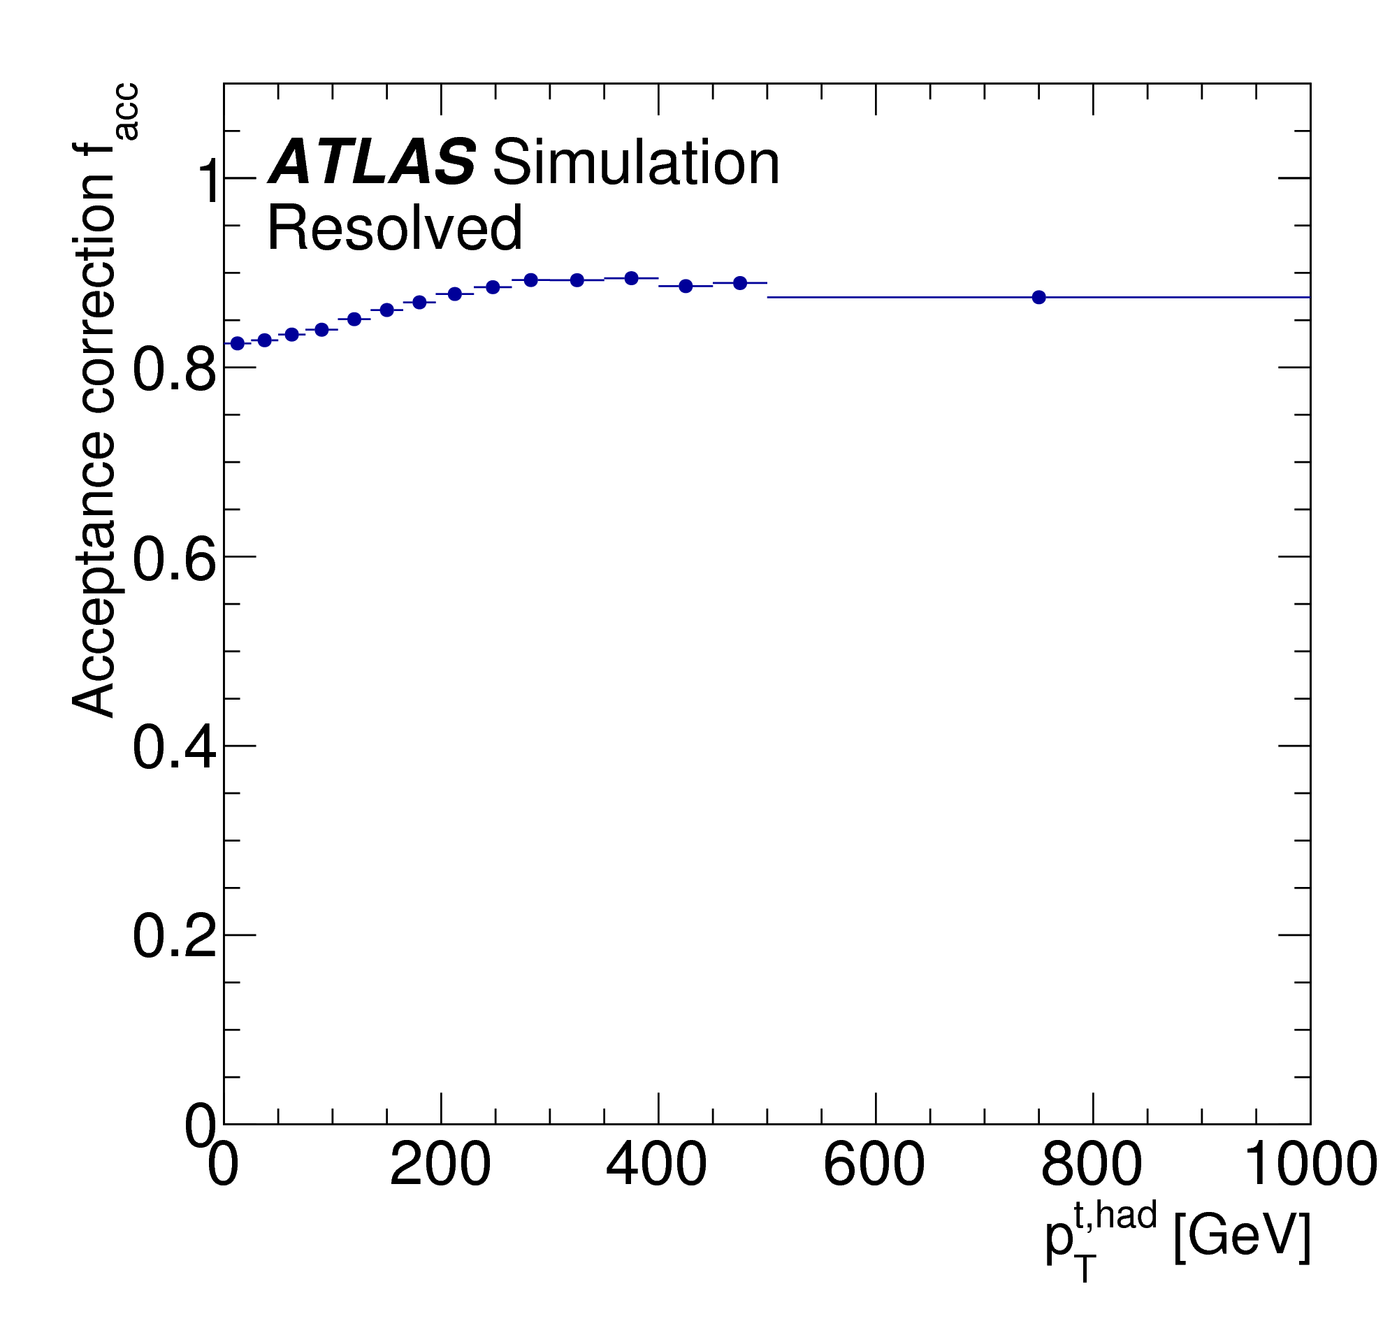
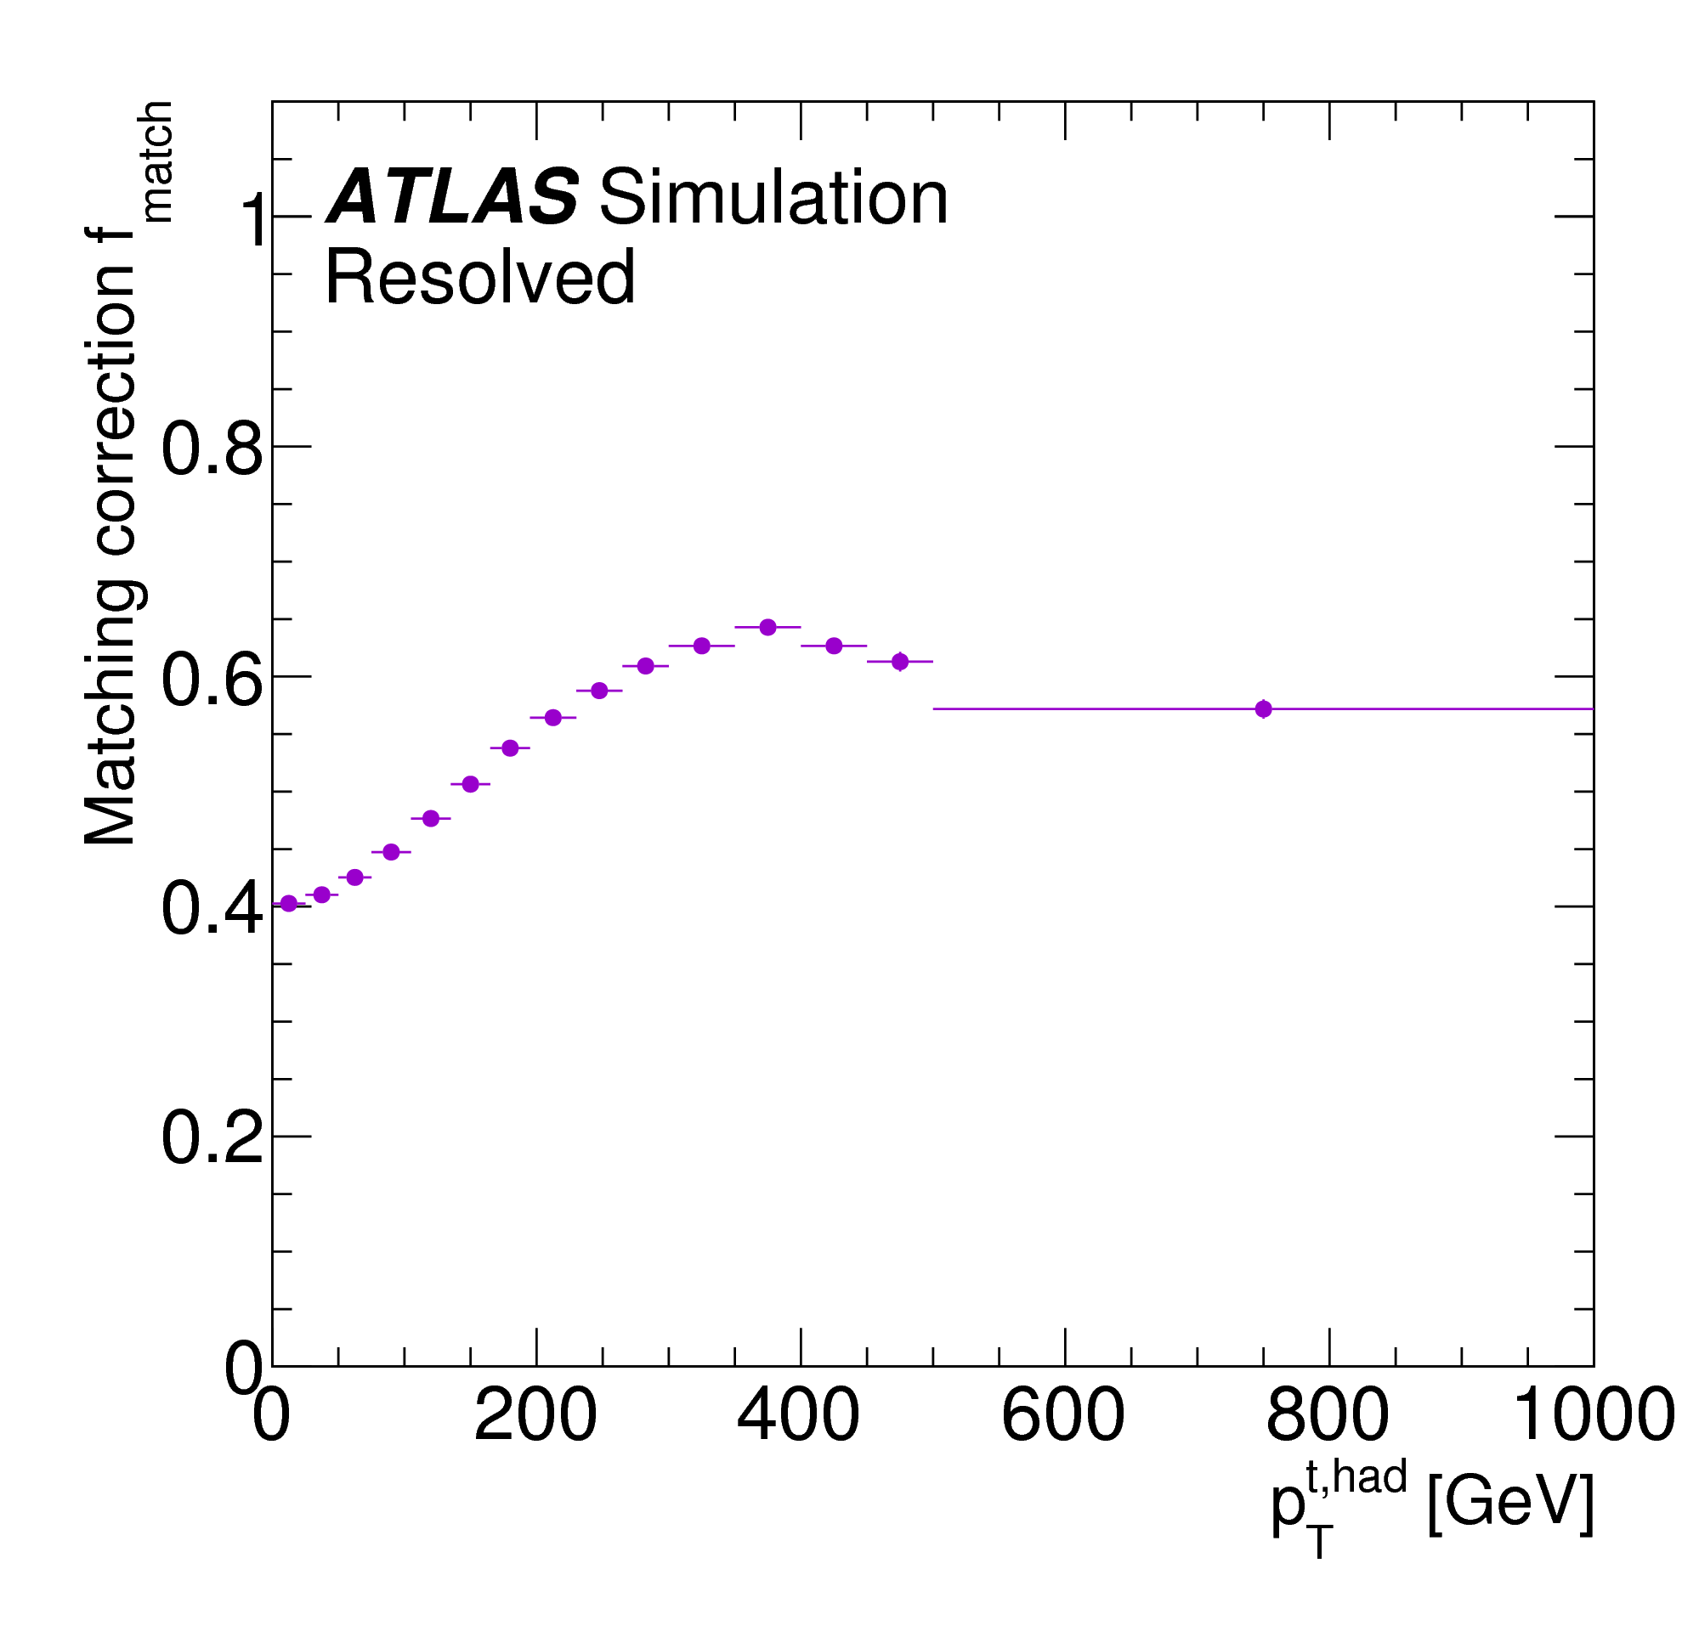
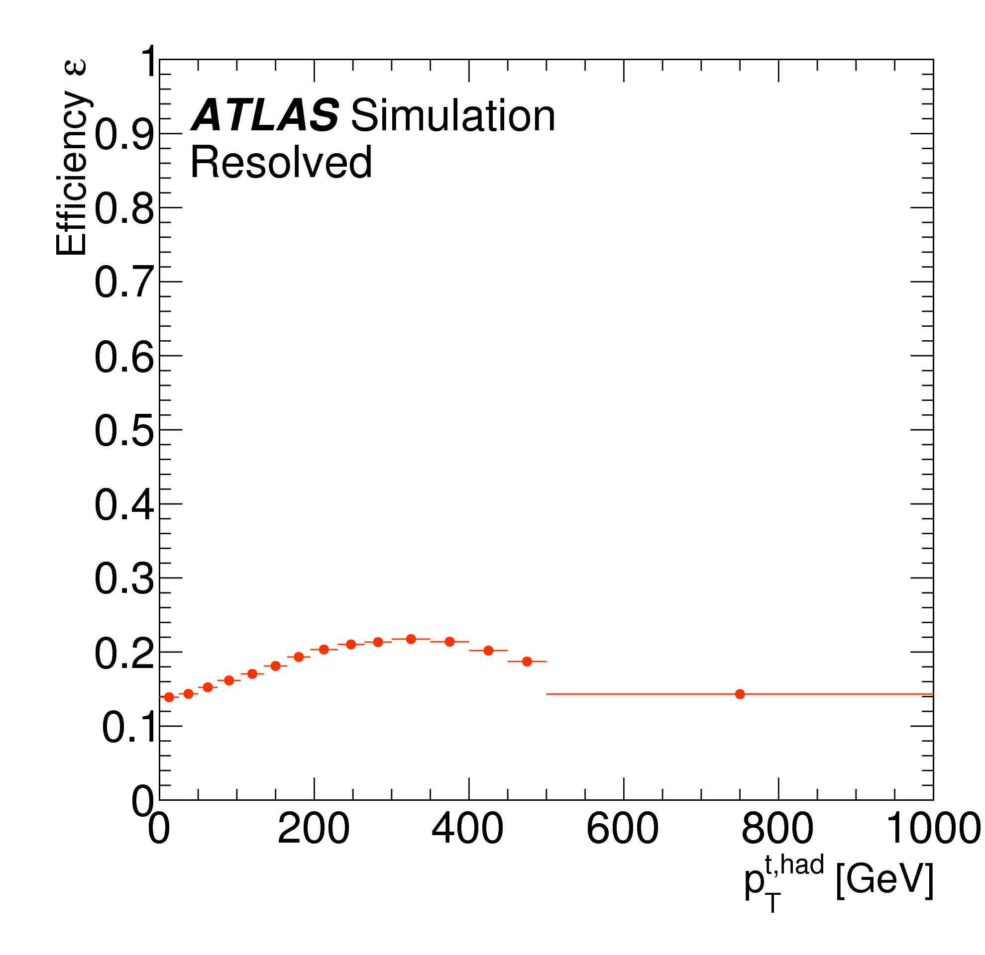
Unfolding
All 13 TeV analyses use Iterative Bayes
The matching between detector and particle level objects is only applied in the l+jet resolved channel.
This requirement produces more diagonal matrices that help the unfolding procedure

Slide 10
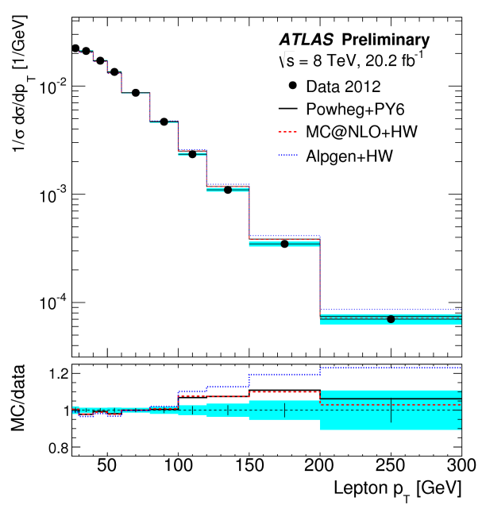
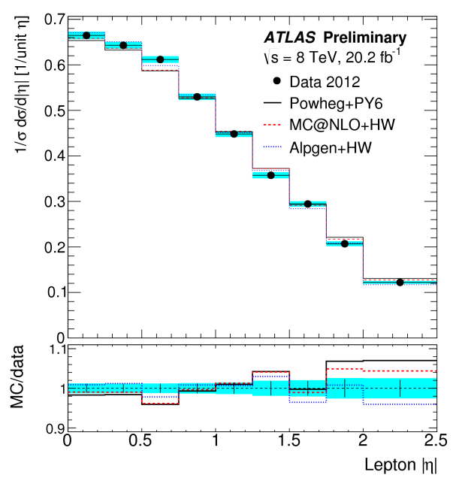
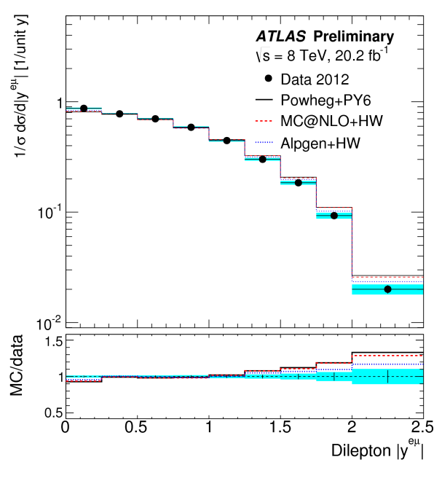
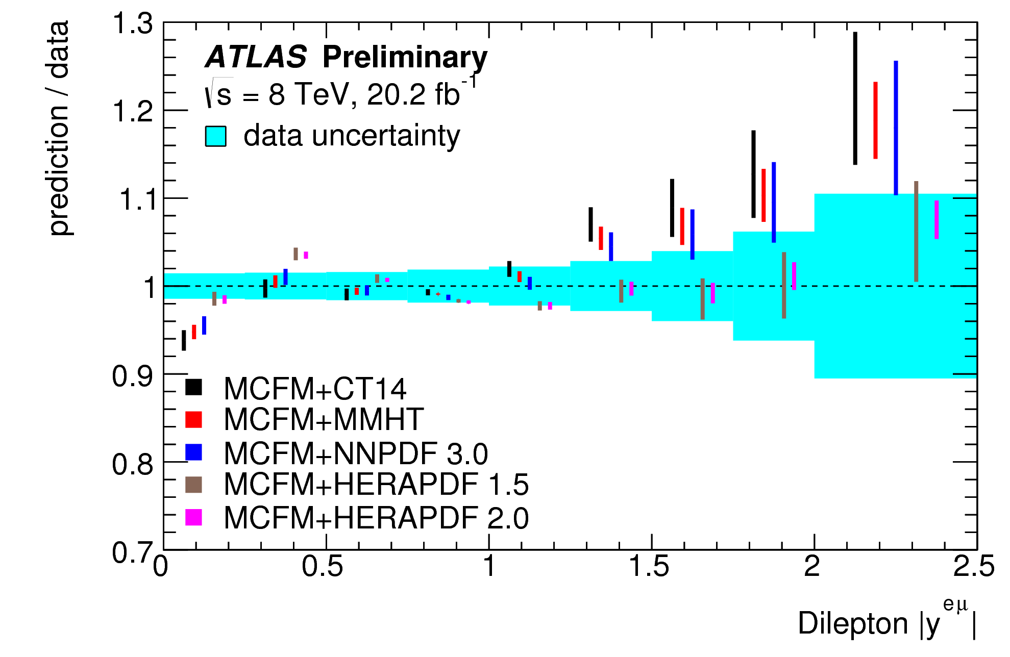
Results: leptons at 8 TeV
Bin-by-bin correction
Several variables are measured
Sensitive to PDF

Slide 11
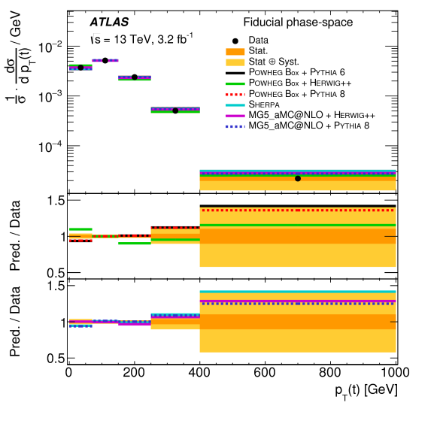
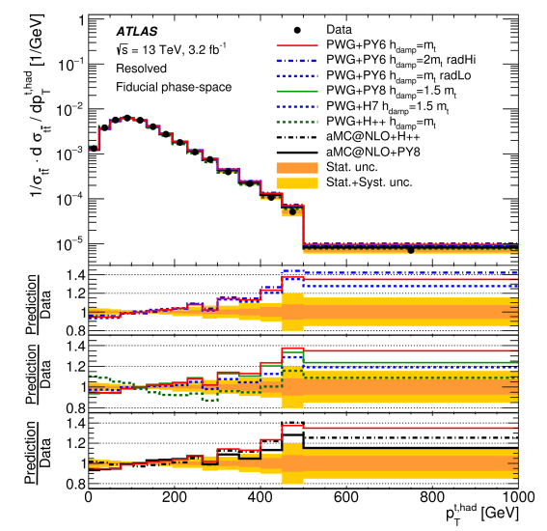
Result: top p_{T} resolved
di-lepton
l+jets
All MC predicts a higher cross-section at high p_{T} than what is observed in data

Slide 12
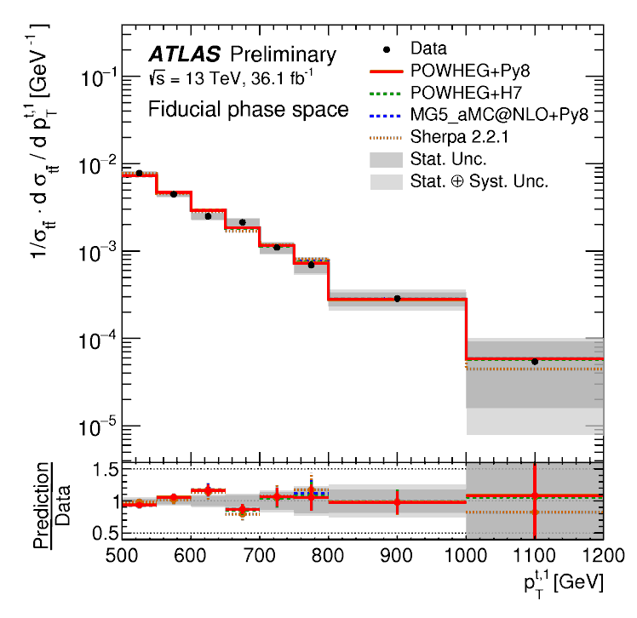
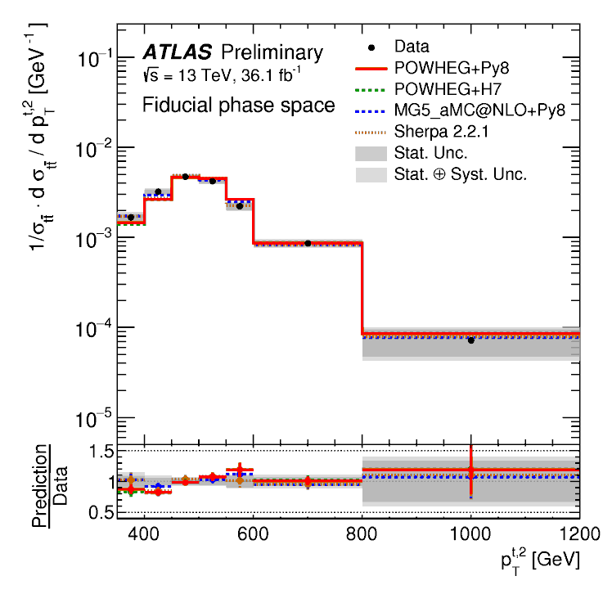
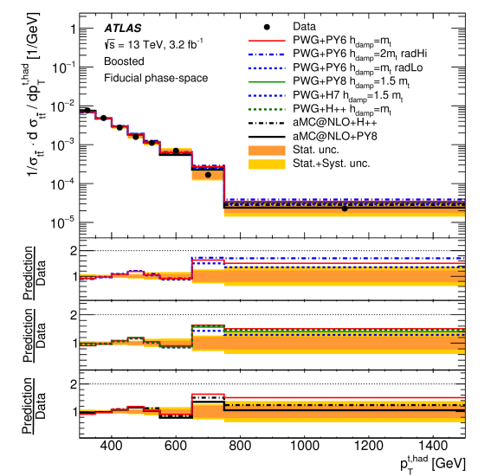
Result: top p_{T} boosted
Di-boosted
Leading top
Di-boosted
Sub-leading top
l+jets boosted
The agreement is different between leading and sub-leading tops
The sub-leading and in l+jets result are consistent with previous slide

Slide 13
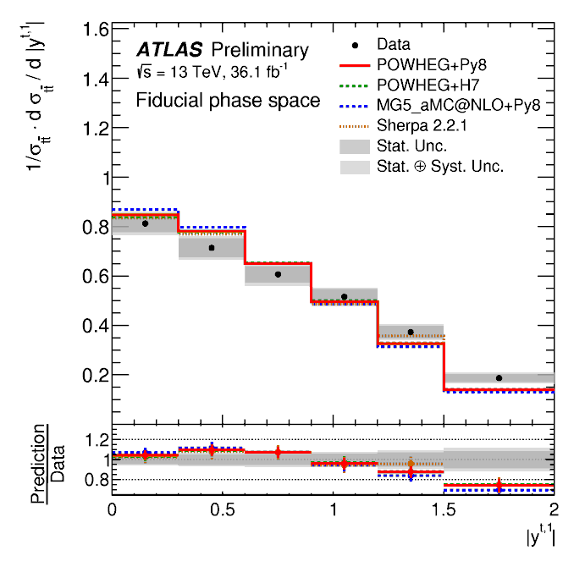
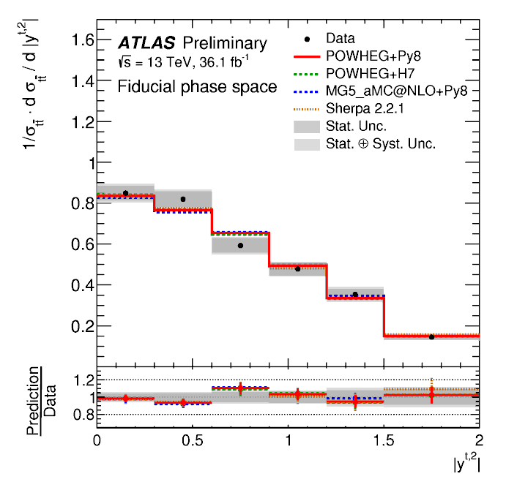
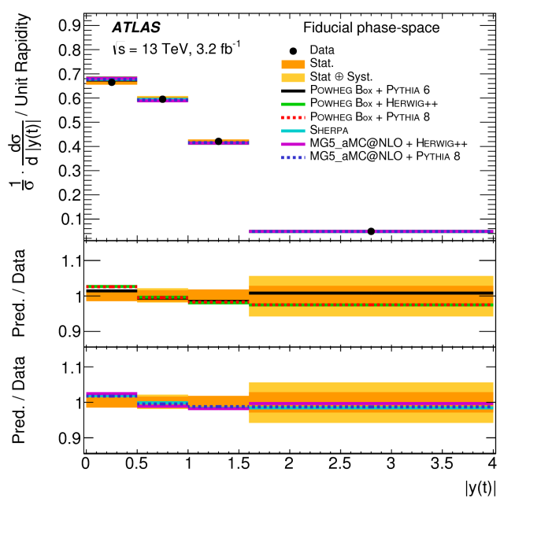
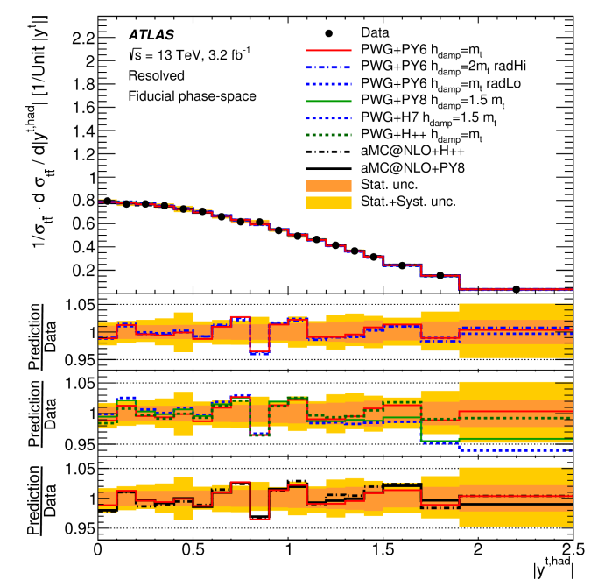
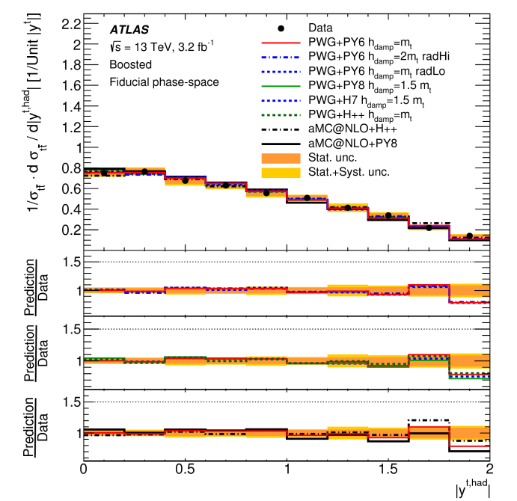
Top rapidity
Di-lepton
Di-boosted
Di-boosted
All predictions are compatible with data
l+jets
l+jets

Slide 14
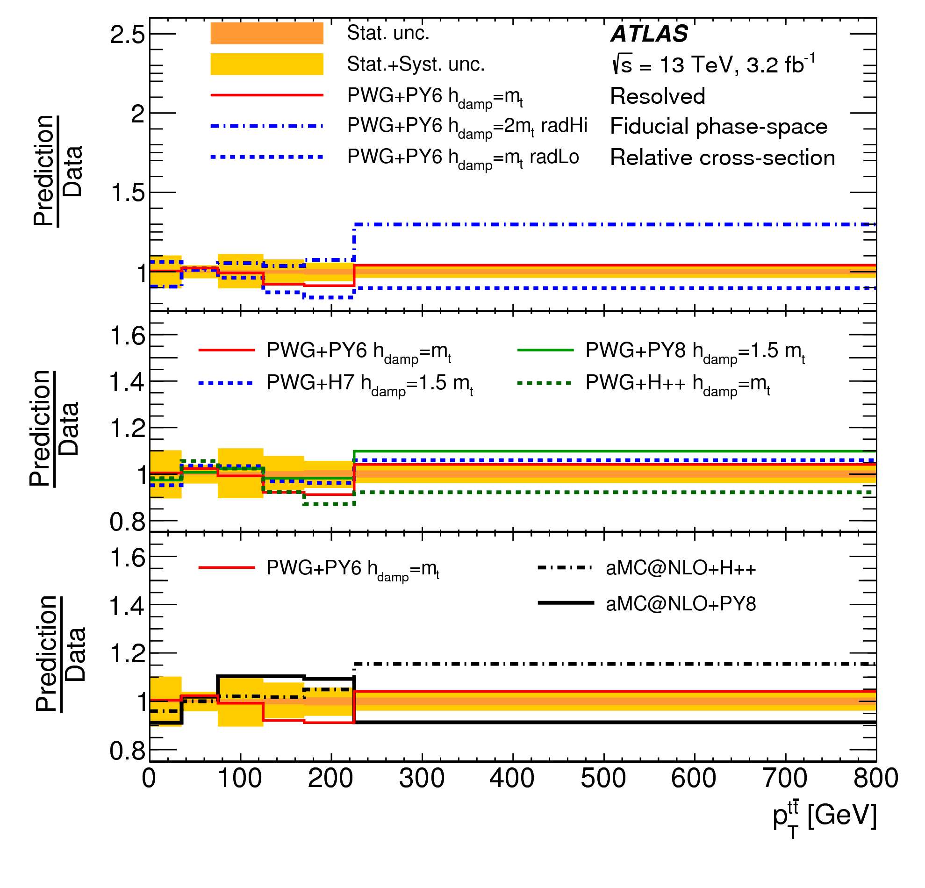
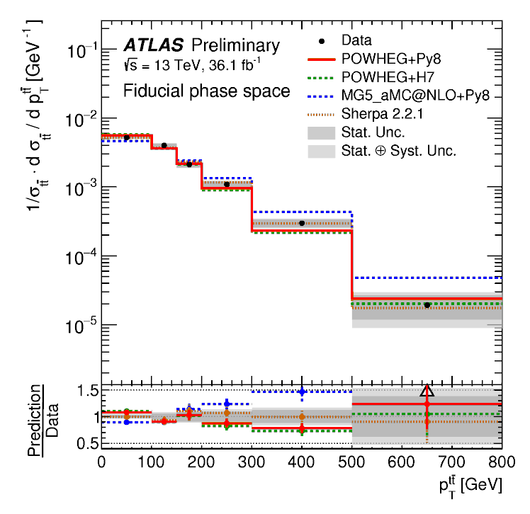
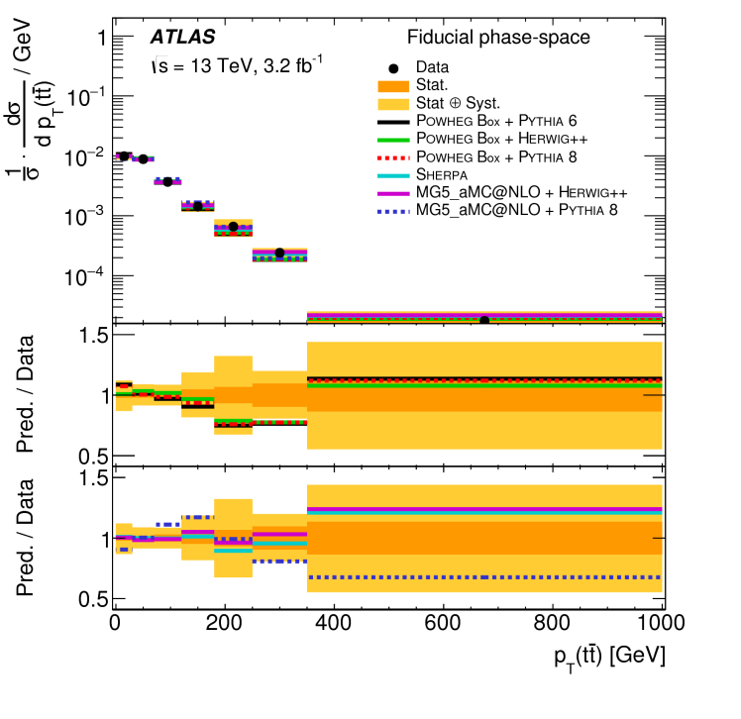
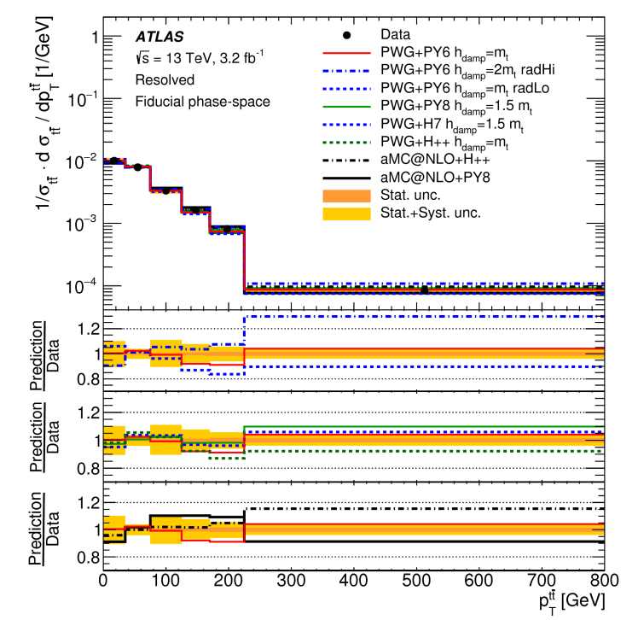
System p_{T}
di-boosted
di-lepton
l+jets
This variable is sensitive to additional radiation
Not all predictions can describe the high p_{T} region

Slide 15
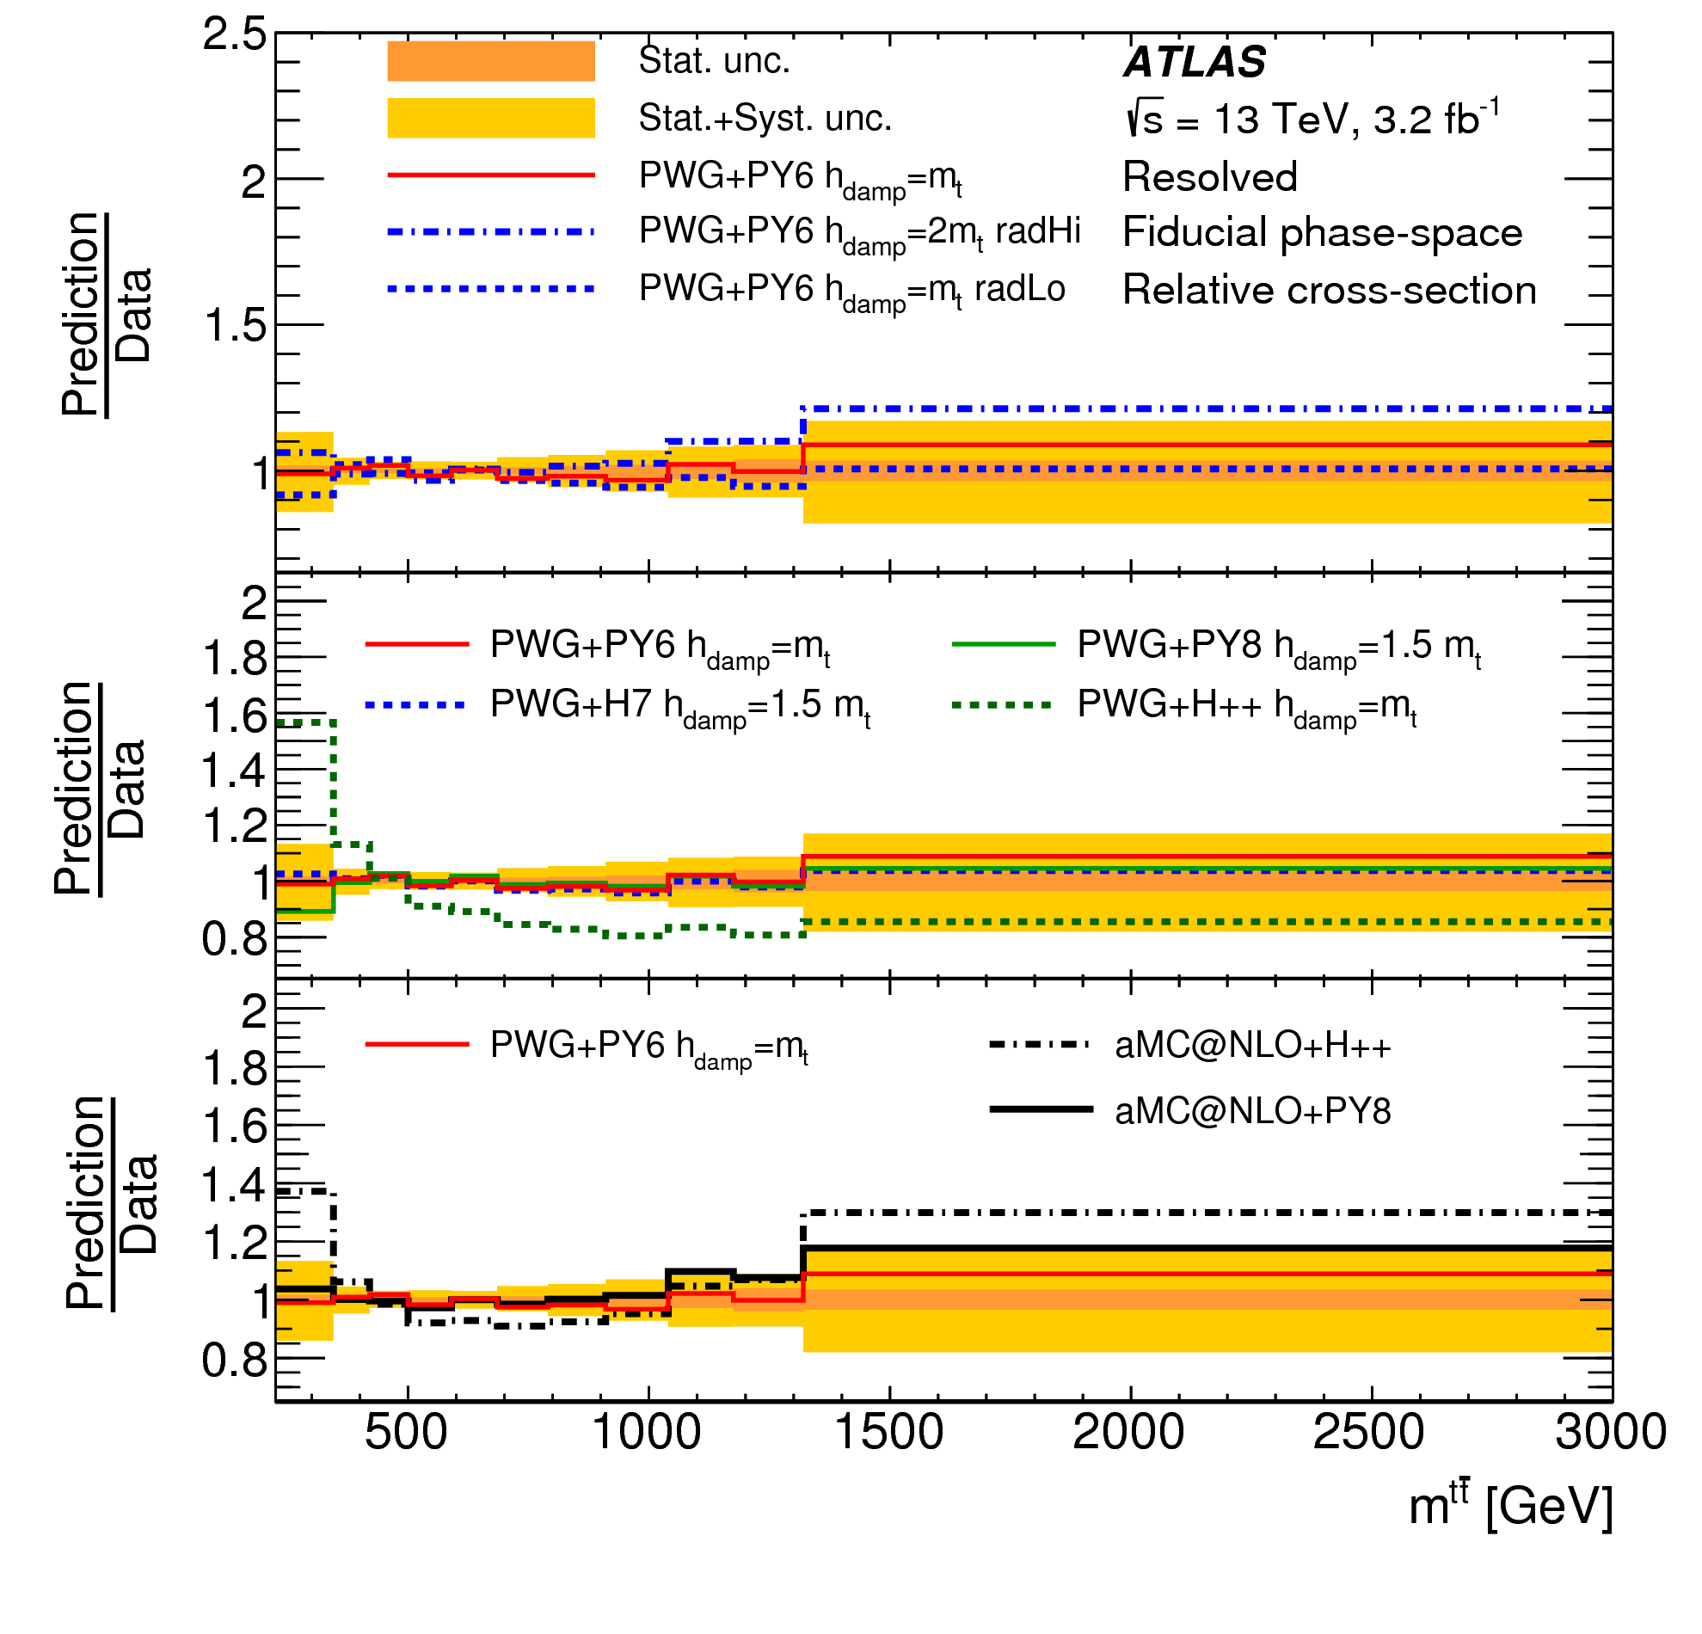
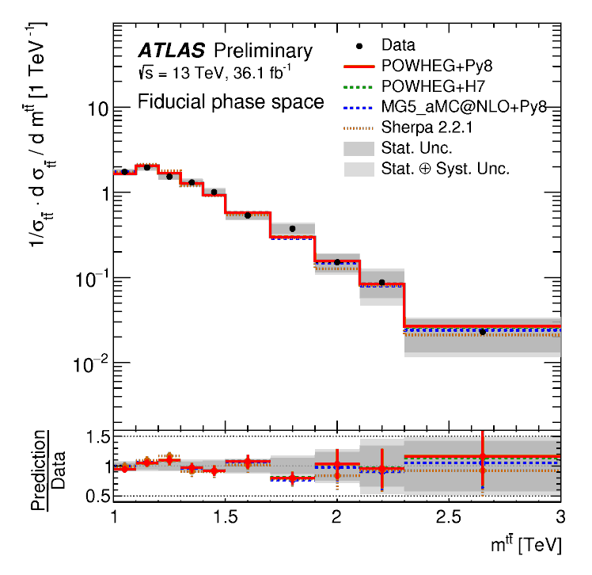
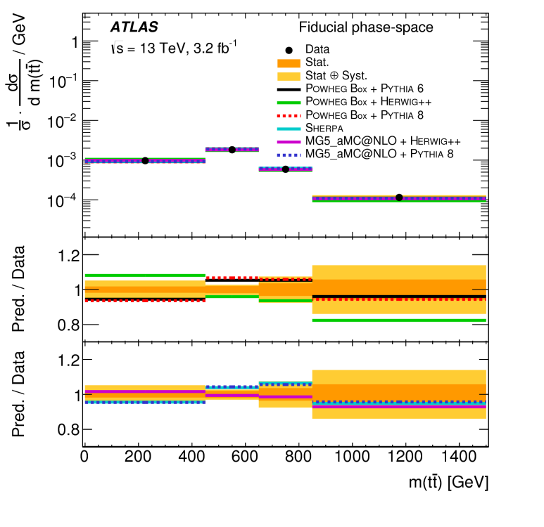
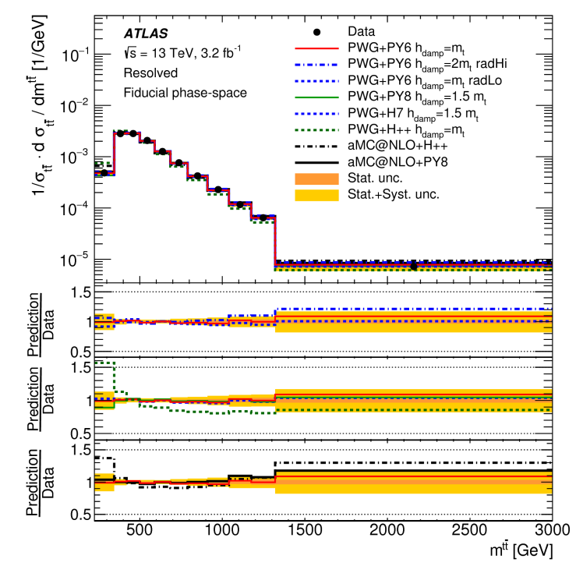
Mass
di-boosted
di-lepton
l+jets
Many predictions using Herwig++ are not compatible with data

Slide 16
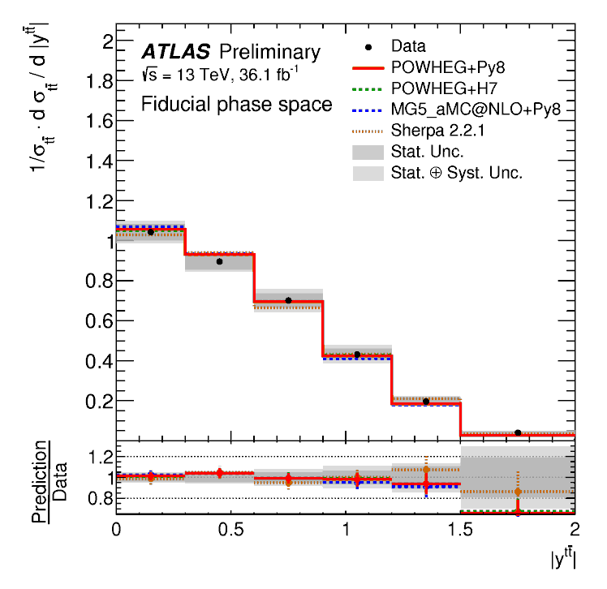
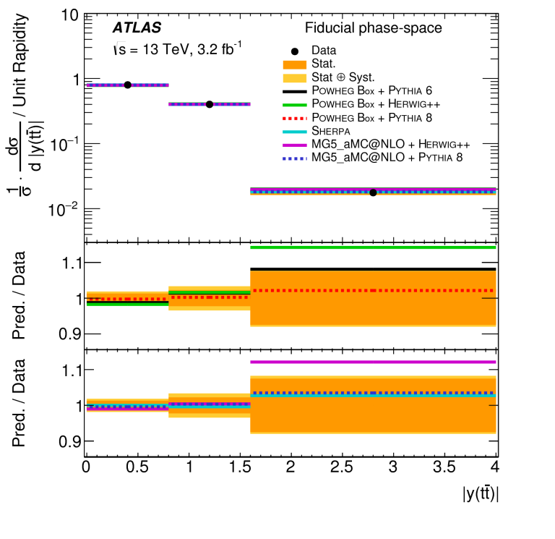
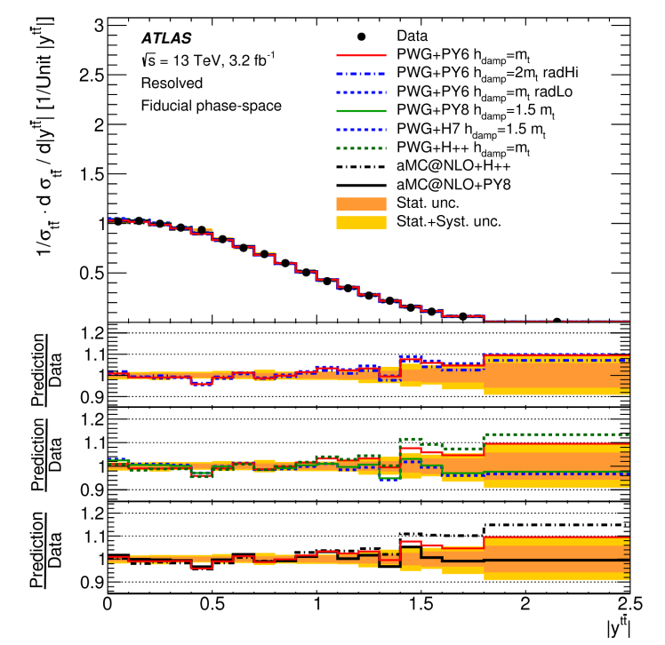
System rapidity
di-boosted
di-lepton
l+jets
All predictions are compatible with data

Slide 17
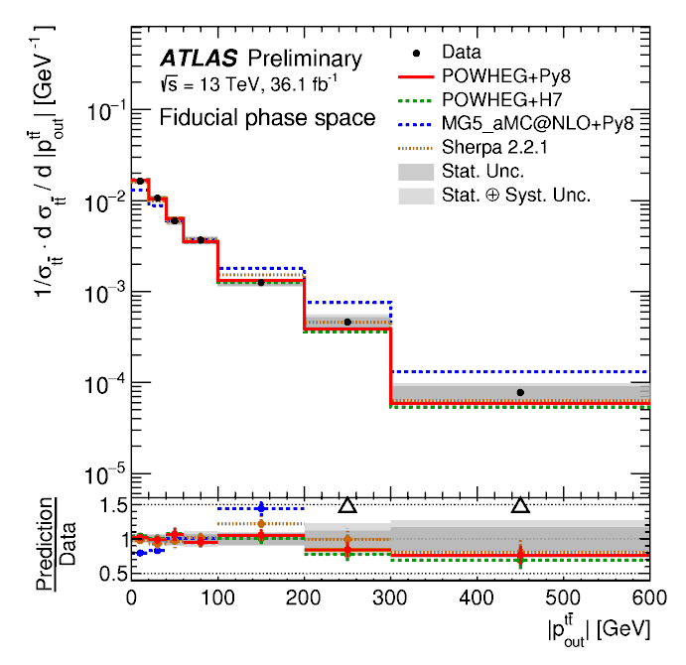
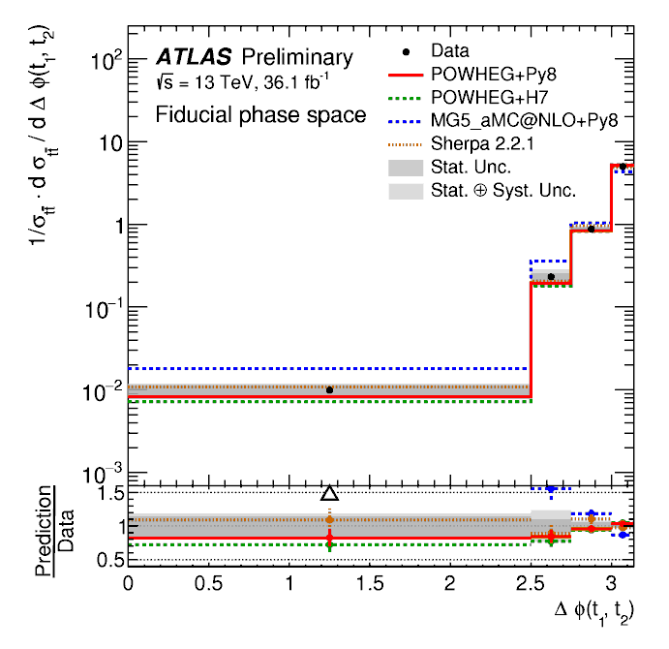
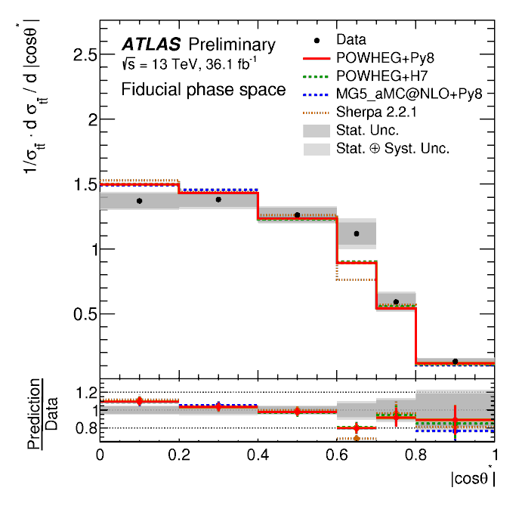
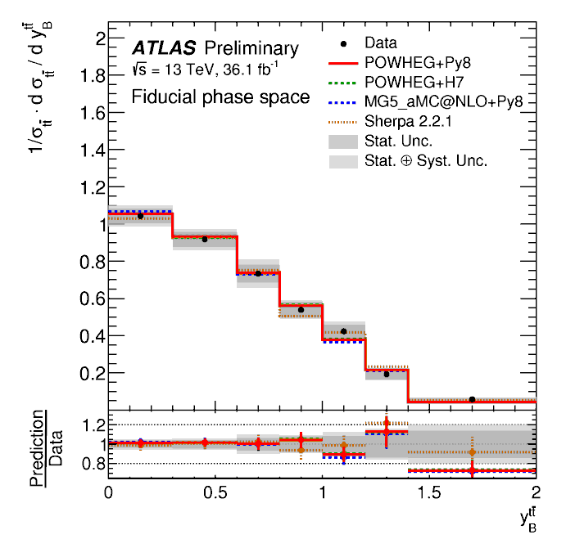
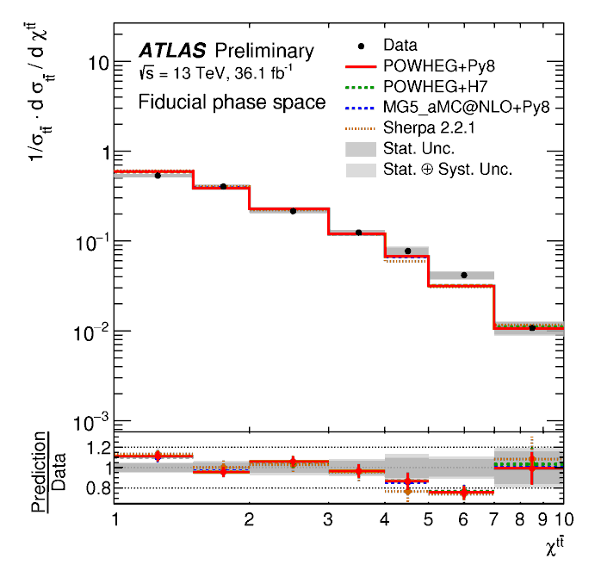

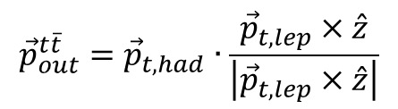
Other variables
di-boosted
Only MG5_aMC@NLO is not compatible with data
$${\vec{p}}_{out}^{t\overline{t}}={\vec{p}}_{t,had}∙\frac{{\vec{p}}_{t,lep}×\hat{z}}{\left|{\vec{p}}_{t,lep}×\hat{z}\right|}$$
$χ_{t\overline{t}}=exp\left[y_{t,had}−y_{t,lep}\right]$

Slide 18
Conclusion
Many results produced in the last year
  New channels and first look at 13 TeV data
Some tension is visible between data and predictions in different channels
  A slope is visible for the top p_{T}
  No MC can describe all variables perfectly
The new measurements can be used to improve the tuning of the next generation of MC
  A better agreement is seen for the MC predictions tuned with Run1 and 2015 data

Slide 19
Backup

Slide 20
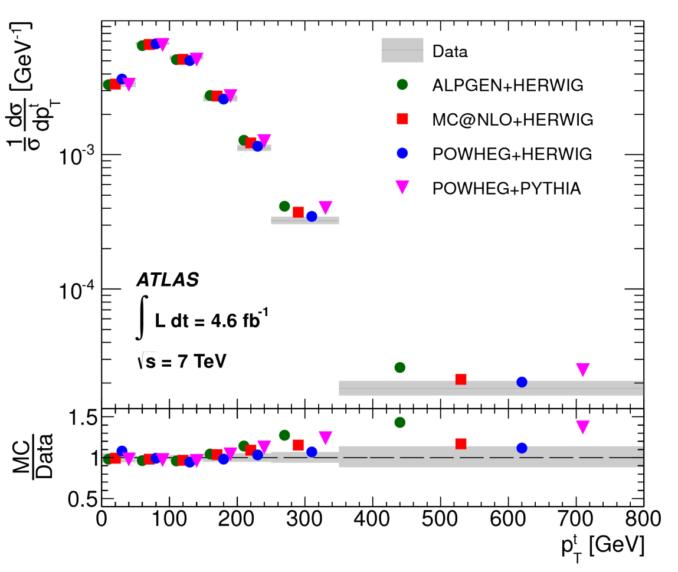
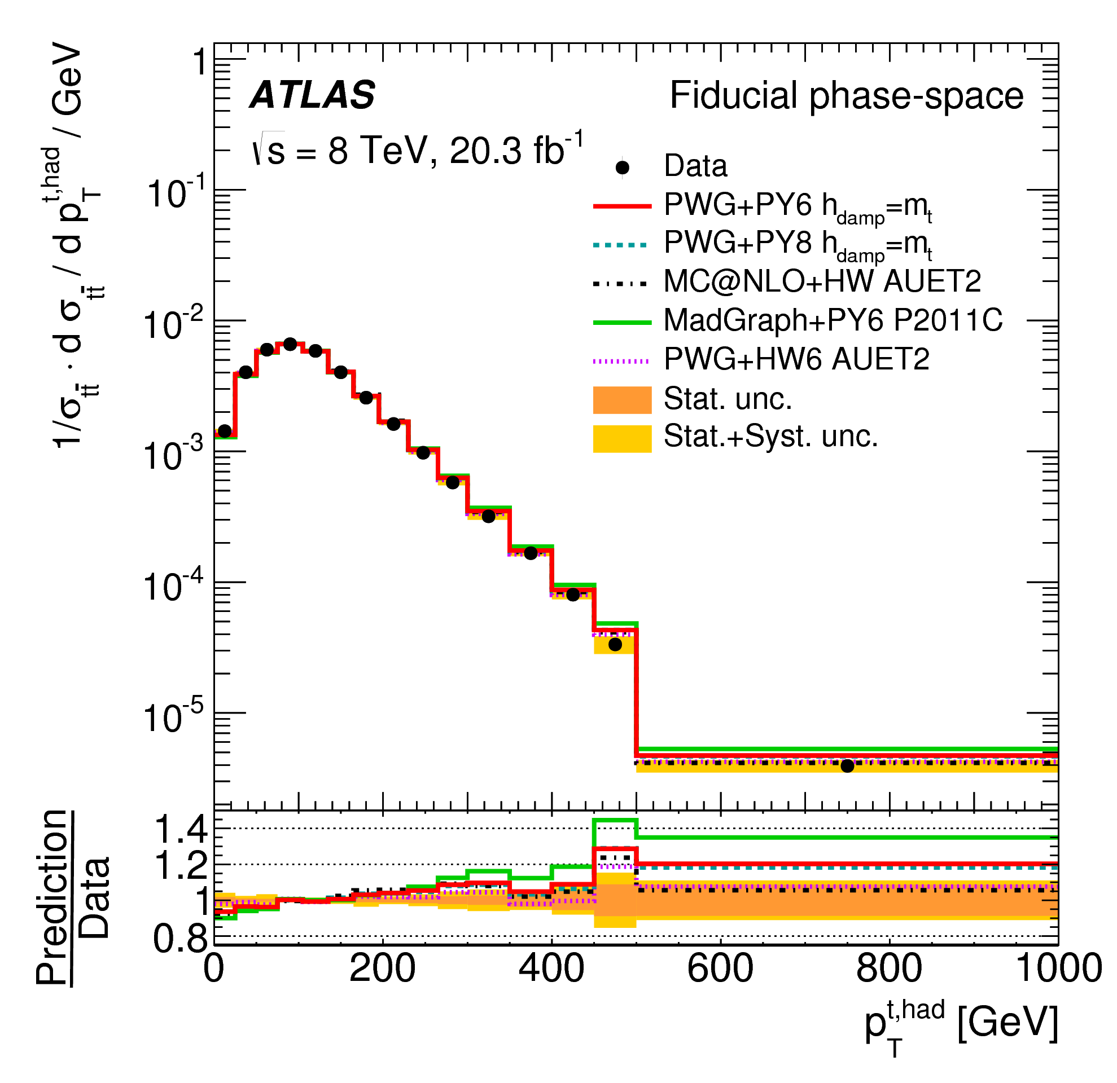
Top p_{T}: an history at particle

Slide 21
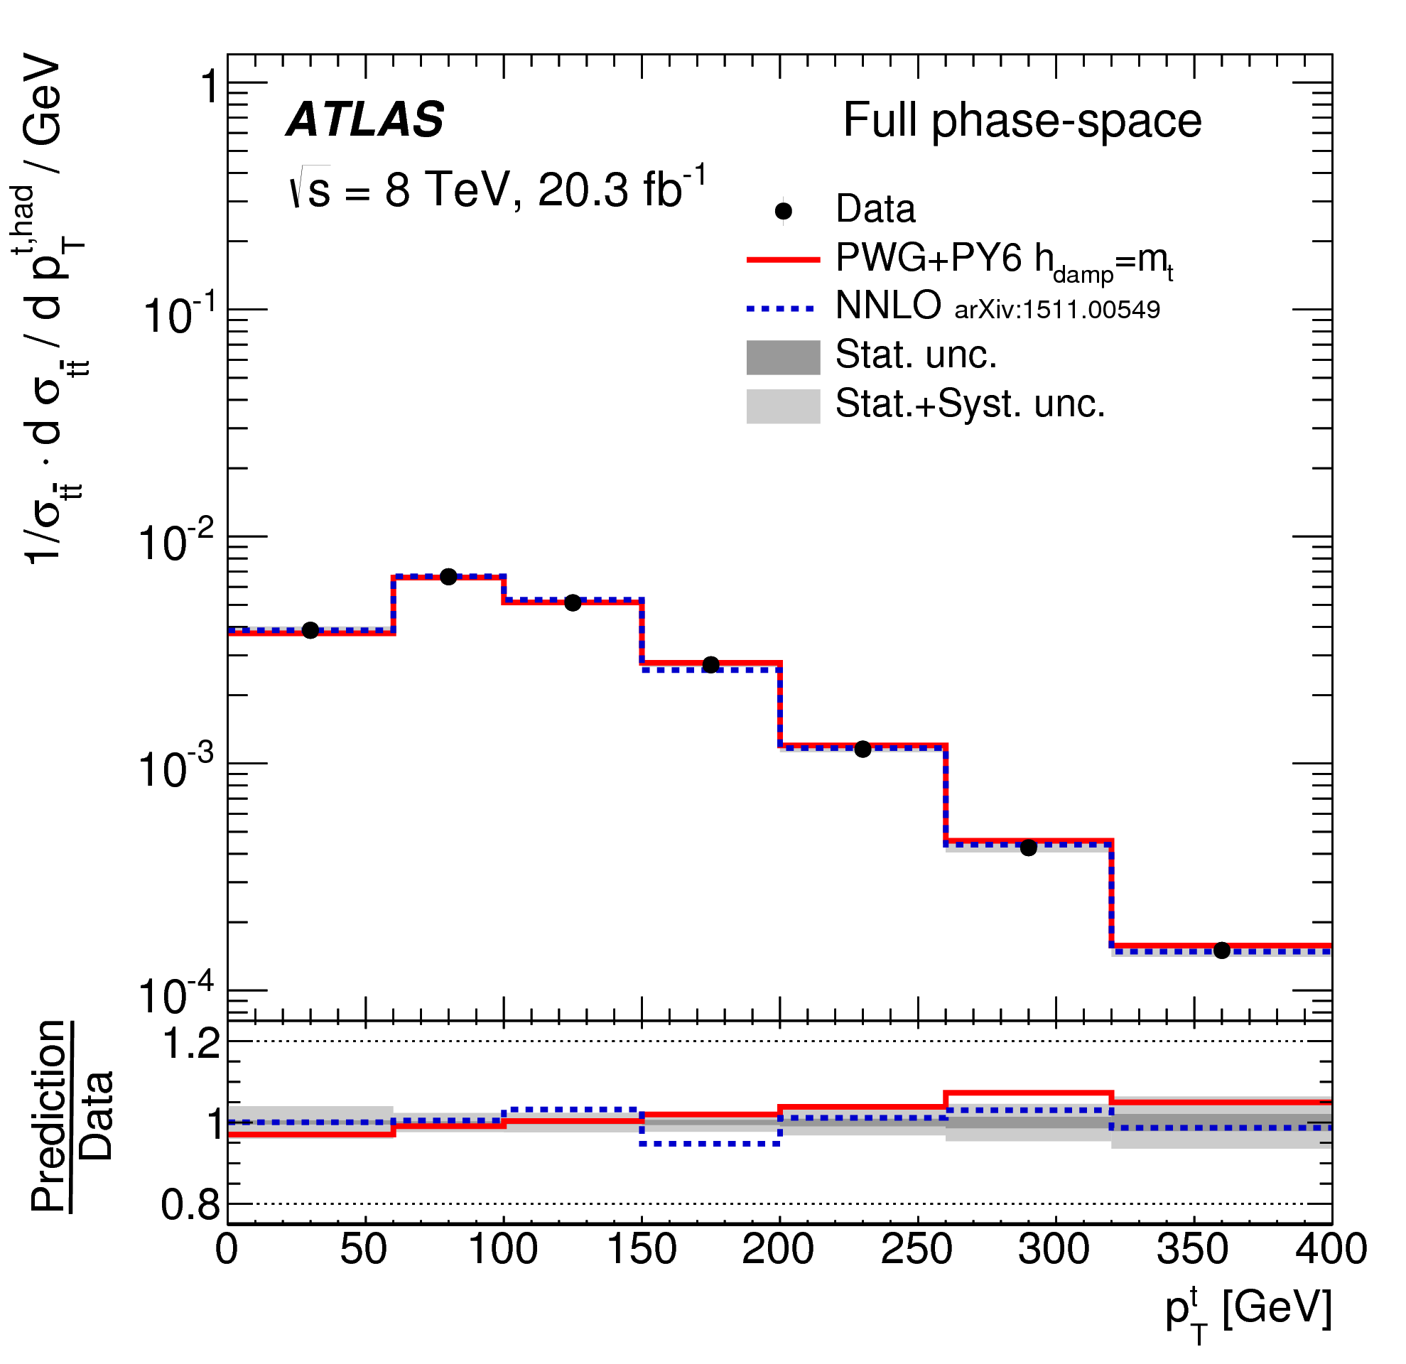
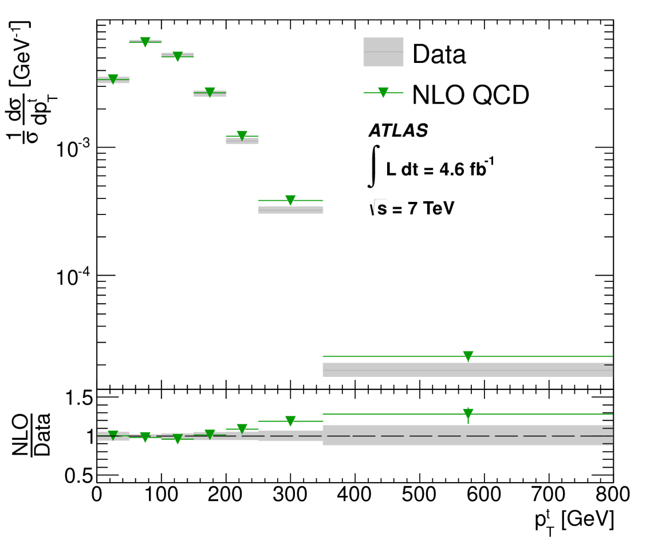
and parton level

Slide 22
Selections

Slide 23
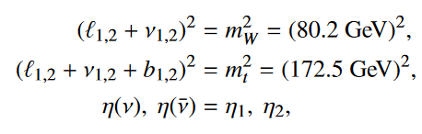
Di-lepton analysis: topology and selection
1 electron and 1 muon with opposite sign
Both leptons with p_{T} > 25 GeV
lepton
At least 2 jets with p_{T} > 25 GeV
υ
At least one b-jets (77% WP)
W
b
t
t
lepton
The reconstruction uses the neutrino weighting method
W
b
υ

Slide 24
Resolved l+jet analysis: topology and selection
Single lepton with p_{T} > 25 GeV
lepton
At least 4 jets with p_{T} > 25 GeV
υ
W
b
Leptonic Top:
lepton
E_{T}^{Miss}
Closest b-jet to lepton
t
W reconstruction:
two jets that best reconstruct W mass
t
Select two highest p_{T} b-jets (70% WP)
W
light quark
b
light quark
Hadronic Top:
two light jets
other b-jet
Top selection is identical at reconstruction and particle level

Slide 25
Boosted l+jets: topology and selection
Single lepton with p_{T} > 25 GeV
1 b-jet with p_{T} > 25 GeV (R=0.4)
lepton
E_{T}^{Miss} > 20 GeV
m_{T}(W) > 60 GeV
υ
W
ΔR(l, jet) < 1.5
t
ΔR(l, l-jet) < 1.5
b
t
W
ΔR(b-jet, l-jet) < 1.5
b
light quarks
Large jet R=1: p_{T}>300GeV, mass> 100 GeV

Slide 26
Di-boosted hadronic: topology and selection
2 Large-R jets:
J1 > 500 GeV
J2 > 300 GeV
light quarks
W
2 b-tag jets (>25 GeV, 70% WP)
They bust be inside the large-R jet cone
t
b
t
W
b
light quarks

Slide 27
Particle level objects
γ
Charged leptons not decaying from a hadrons are “dressed” with the energy from all photons within a R=0.1 cone around the lepton
l
ν
μ
π
K
Jets are clustered from stable MC particles using anti-k_{t} with R=0.4 (R=1 for boosted objects)
Neutrinos and muons from hadrons are included
E_{T}^{Miss} defined as sum of all other neutrinos
B tagging defined by matching a jet with a b quark with R<0.35
Overlap removal is not applied at particle level in 2015 only results

