Slide 1





Constraints of the EoS of strongly interacting matter and
on particle properties from relativistic heavy ion collisions
J. Aichelin, C. Hartnack
(Subatech, Nantes)
E. Bratkovskaya, T. Song
(GSI Helmholtzzentrum für Schwerionenforschung, Darmstadt)
IWARA, Antigua, Sept 5-9 2022
1

Slide 2
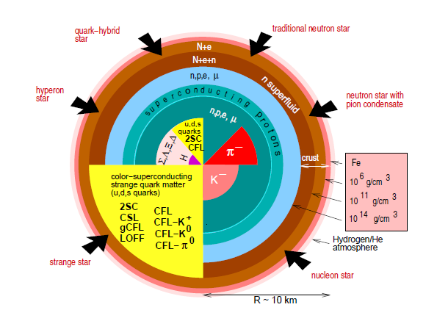
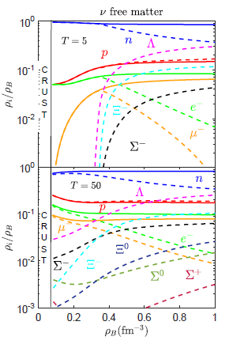
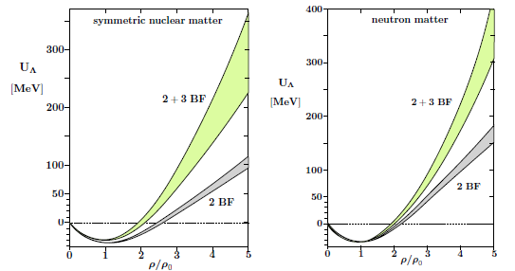
What we want to understand: neutron stars
Kochankovski et al. (Barcelona)
2206.11266 (SU(3) CPT)
full:no hyperons, dashed:hyperons
by courtesy
of F.Weber
2 and 3 body
Λ(Σ)NN
interaction
Gerstung et al. (Munich)
Eur.Phys.J.
A 56 (2020) 6, 175
ρ₀
3ρ₀
Multiplicity depends strongly
on the model (parameters)
… and on the order of the interaction

Slide 3
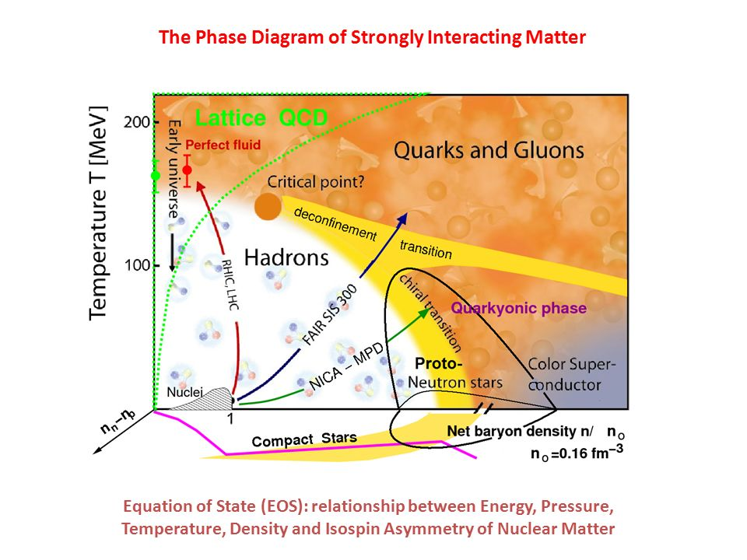
Study of neutron stars ↔ search for nucl. equation of state (EoS)
How much energy does it cost to heat or to compress matter ?
besides NS only heavy ion experiments
explore part of (T,μ(ρ)) region
but the EoS is not an observable
several strategies possible
Lattice QCD (but only at small μ)
effective theories (NS and HI)
Nambu Jona-Lasinio
dynamical quasi particle model
chiral perturbation theory
Collecting knowledge from experiment
Only point known
(extrapol. from cold nuclei )

Slide 4
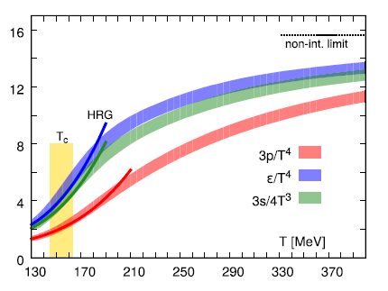
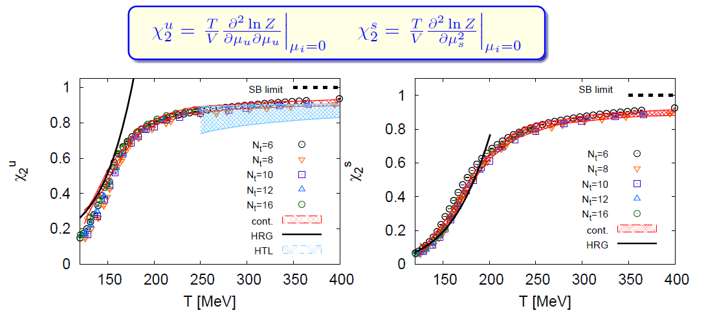
QCD Lattice calculation (limited to µ=0) and the hadrons resonance gas
Lattice calculations and hadron gas seem
to have a smooth transition

Slide 5
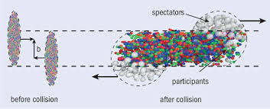
How to use heavy ion reactions to study the nuclear EOS?
_{Λ}H³
Λ
Strategy:
develop transport approaches
which simulate the transport of strongly interacting particles
(Quantum Molecular Dynamics, Boltzmann Ühling Uhlenbeck)
vary EoS in the simulation
identify observables which are sensitive to the EOS
compare experimental measurements with theory

Slide 6
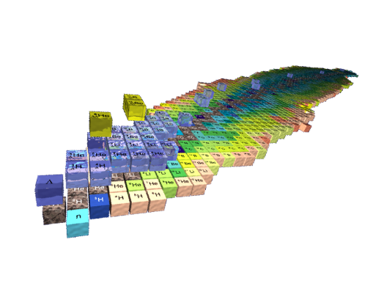
What can we study with transport approaches ?
_{Λ}H³
Λ
elementary strangeness production mechanism:
In HI collisions strangeness can be produced differently than in NN collisions
(three body reaction)
in medium properties of (strange) hadrons and Λ(K)N potential
(test of the theoretical predictions, -> neutron stars?)
the reaction dynamics
(midrapidity particles come exclusively from the participant zone -> elliptic flow)
transition to the quark gluon plasma and its properties
(different T_{c} for strange and nonstrange hadrons?)
Agreement between exp. results and all these theor. predictions assures validity of transport
6

Slide 7



Quantum Molecular Dynamics (QMD)
Time dependent Ritz variational principle (Koonin, TDHF)
Take trial wavefct with time dependent parameters and
solve
(1)
QMD trial wavefct for particle i with p_{oi} (t) and q_{oi} (t)
For N particles:
QMD
For the QMD trial wavefct eq. (1) yields
For Gaussian wavefct
eq. of motion very similar
to Hamilton’s eqs.
(but only for Gaussians !!)

Slide 8
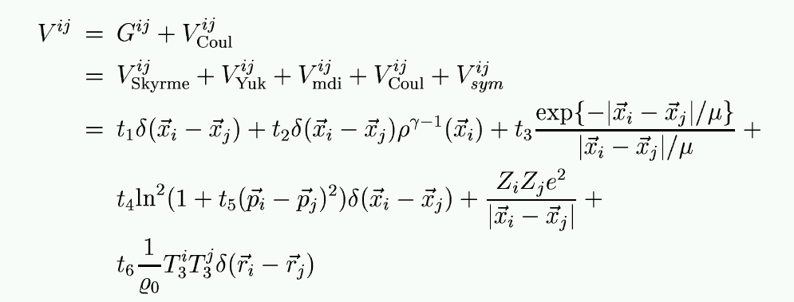
Quantum Molecular Dynamics (QMD) II
nucleon-nucleon density dependent two body potential:
t₁ -
t₃ depend on the EoS
t₄ contains the momentum dependence of the potential
In addition all necessary cross sections and decays:
like NN elastic, NN←→NΔ, Δ→Nπ

Slide 9
Strange hadrons as a tool to study the
nuclear reaction dynamics
and the nuclear equation of state
up to densities of 3ρ₀

Slide 10
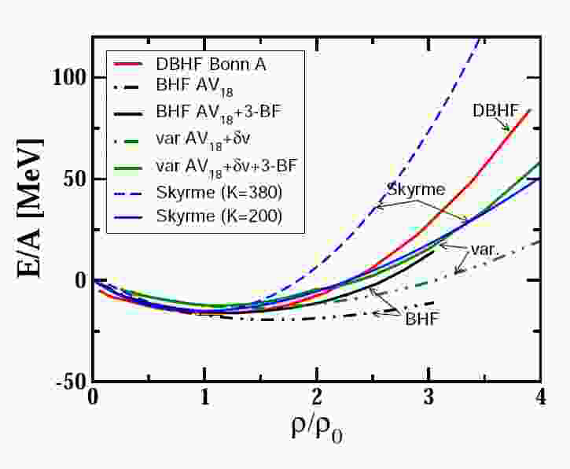
EoS from fundamental theories
theory based on fundamental interactions is limited to
low temperature and ρ < 1.5 - 2ρ₀ high temperatures and μ≈0
Brückner G –matrix lattice gauge calculations
(hole line expansion )
At low energies E/A(T,ρ) instead P(T,ρ(µ)) or ε(T,ρ(μ)
Lattice gauge calculations
μ = 0

Slide 11
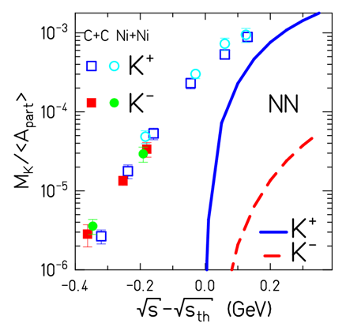
Strangeness and the nuclear equation of state
NN: Excitation function of K⁺ and K⁻
quite different
AA: Excitation function of K⁺ and K⁻
quite similar
Fermi motion cannot explain
very subthreshold production
Conclusion
AA: new mechanisms for
strangeness production
AA collisions:
experimental observation of K⁺,K⁻ production below the NN-threshold
(C. Hartnack et al., Phys. Rept. 510,119)

Slide 12
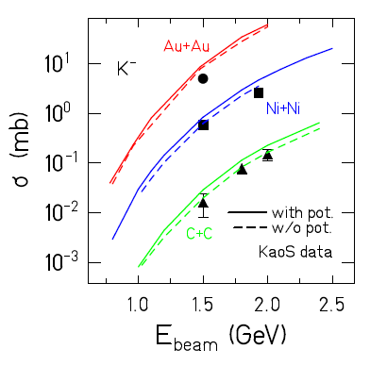
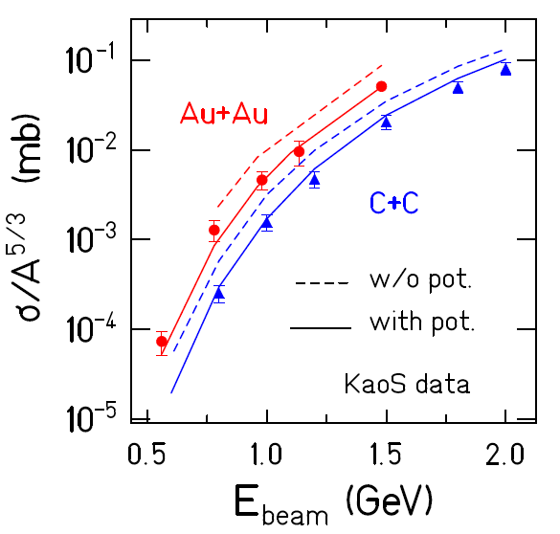

Near threshold strangeness production in AA
I. Strangeness production channels at low energies
baryon-baryon collisions:
Plots by C. Hartnack
meson-baryon collisions:
dominant channel for low energy K⁻ production!
meson-meson collisions:
K⁺
resonance decays:
K*→π+K,...,
φ$→K+\overline{K}$
II. Strangeness rescattering
= (quasi-)elastic scattering with baryons and mesons
III. K⁺ (K⁻)-Nucleus potential V(ρ)
12

Slide 13
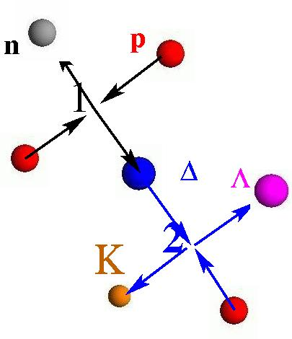
Origin of difference of pp and AA excitation functions
Dominant for K⁺ in AA: Two step process NN→NΔ NΔ→K⁺Λ N
lowers the effective threshold
enhances K⁺ below NN threshold
two step process more probable in central
collision
Theory and simulations:
soft EoS: system gets to higher densities
→ shorter mean free path for NΔ→K⁺Λ N
NΔ→ K⁺Λ N competes with Δ decay
→ for a soft EOS we expect more NΔ→K⁺Λ N
collisions
and hence more K⁺

Slide 14
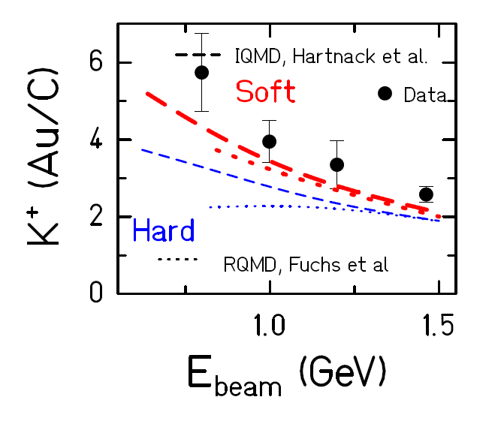
Strangeness production and the nuclear EoS
(Phys. Rept. 510,119)
Comparison with experiment
confirmes the EoS dependence of K⁺ yield
soft EoS: best agreement with data
Up to today the observable
which shows the strongest EoS dependence
Perspectives: FAIR and NICA (Russia) have higher beam energies
excitation functions of Ξ and Ω become available
sensitive probes for studying the reaction mechanism and EoS

Slide 15
The modification of strange hadrons
by the nuclear environment

Slide 16


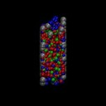
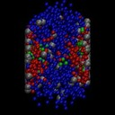
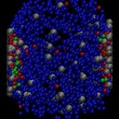
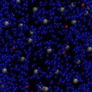

PHSD the transport approach to study off-shell dynamics
Parton-Hadron-String Dynamics (PHSD) is a non-equilibrium microscopic transport approach for the description of strongly-interacting hadronic and partonic matter created in heavy-ion collisions
Dynamics: based on the solution of generalized off-shell transport equations derived from Kadanoff-Baym many-body theory
Quark-Gluon Plasma: lQCD EoS
non-perturbative QCD - quasiaprticles
Dynamical
Hadronization
Hadronic interactions
➔final hadrons + leptons
Initial state: Au+Au
time
➔ PHSD provides a good description of ‘bulk’ hadronic observables as well as of dilepton spectra from SIS to LHC energies
PHSD: W. Cassing, E. Bratkovskaya, PRC 78 (2008) 034919; NPA831 (2009) 215; W. Cassing, EPJ ST 168 (2009) 3
16

Slide 17
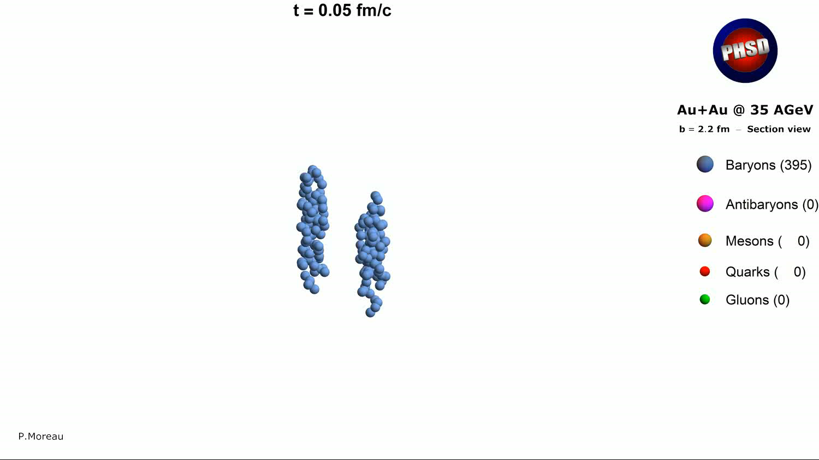

Slide 18
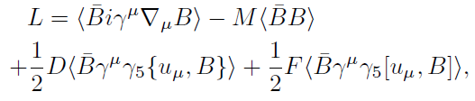
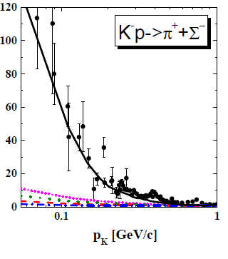
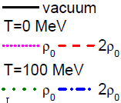
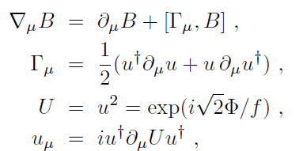
Hadrons in an hadronic environment – all but simple
Hadrons in an hadronic environment -> interaction among the hadrons
Chiral perturbation theory based on SU(3) baryon-meson chiral Lagrangian
(here including s- and p- waves) which is also used for NS studies
B = baryon field
M = meson field
Details: PRC103,044901

Slide 19
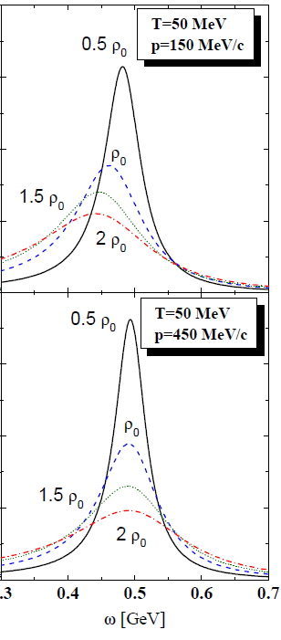
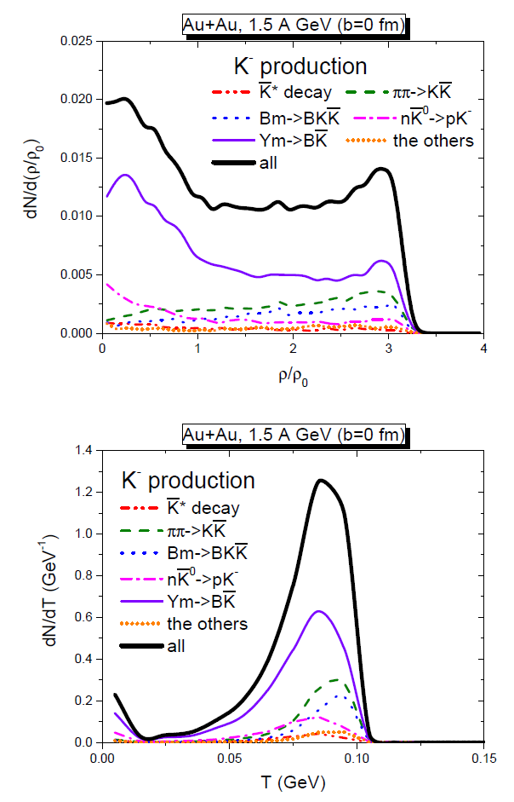
Spectral function and environment at creation
Spectral function
broader with
increasing density
mass shift for low
momentum hadrons
K⁻
Most K are produced
at high T and ρ
K⁻
→ Strong modification of
particles properties when
they are produced

Slide 20
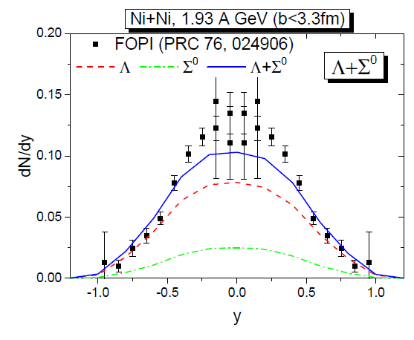
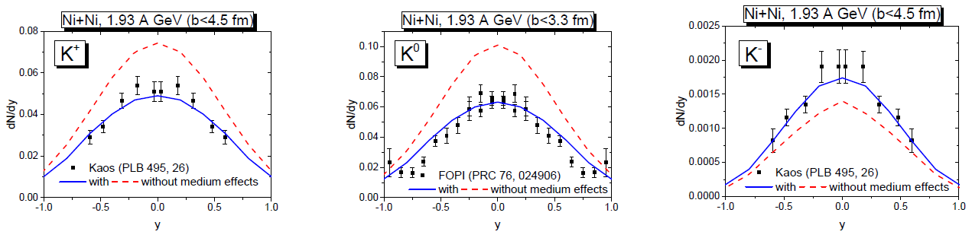
Consequences for the observables
The interaction of hadrons at their
creation point (and later) with the environment
changes multiplicity, rapidity distribution
and p_{T} spectra.

Slide 21
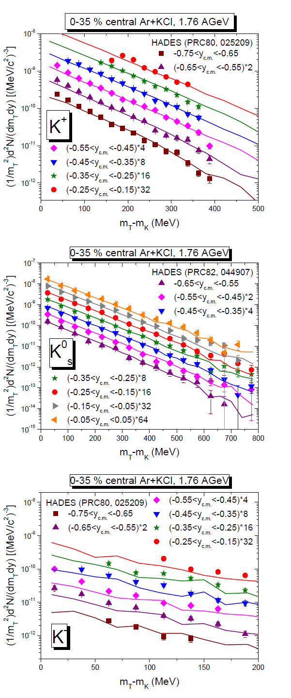
as well as the p_{T} spectra
Consequence: theoretical medium modification
of strange particle properties confirmed by
experiment.
They can be used to determine the EoS
dependence of particle properties
and reduce the present uncertainties in the
models of astrophysical and gravitational wave studies

Slide 22
Conclusions
The nuclear equation of state (EOS) of strongly interacting matter
is needed for several problems
the physics in the interior of neutron stars
to understand the transition between Quark Gluon Plasma and Hadrons
to interpret gravitational wave
Very complicated issue μ ≠ 0 problem for lattice
breakdown of the many body schema
Experimental results may help
K⁺ yield is sensitive to the nuclear EOS at ρ≈ 2-3 ρ₀
Strange particles properties and cross sections are
sensitive to T and ρ of the nuclear environment
change their spectral function and their masses
Future experiments at NICA and FAIR may allow for more information
and reduce the uncertainties for neutron star and gravitational wave studies

Slide 23
Thank you

