Slide 1

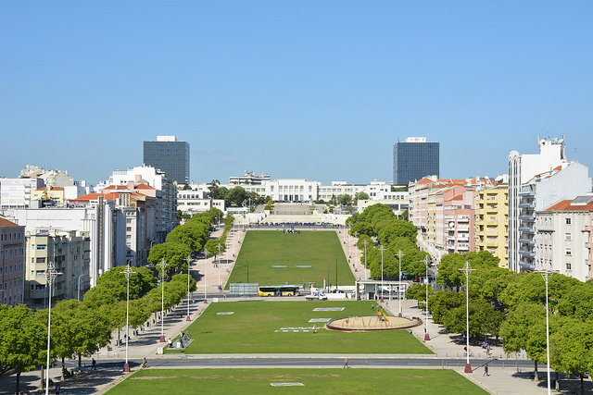



The Case for Extra Yukawas
January 17, Higgs ’n Flavour 2019 @ CFTP/IST, Lisbon
Thanks to Francisco and Bohdan and Nuno
+ others for various Intro

Slide 2

Curious
The Case for Extra Yukawas
˄
SM2
SM2 ≠ SM4
☺
/
2

Slide 3
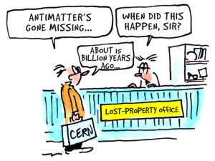
Motivation as Big as the Universe!
my 4G saga motivated by this
Kobayashi slides 2008
CP V
J₁₂₃ → J₂₃₄ : > 10¹⁵ Jump !
J seems short by at least 10^{‒10}
Jarlskog Invariant
51

Slide 4
The Case for Extra Yukawas
Intro: 2HDM-III
EWBG
III. Extra Yukawas
IV. Curious: Alignment
V. Conclusion: FPCP Bonanza & H ⁰, A ⁰, H ± in Our Time
Extra Yukawa Coupling Thoughts
O(1) Quartics: 1st Order PT
O(1) Im ρ_{tt}: Source of CPV
2nd Top Yukawa
an Experimental Question
O(1) Quartics Consistent !
Alignment: Replaces Glashow-Weinberg NFC

Slide 5
I. Intro: 2HDM-III
Extra Yukawa Coupling Thoughts

Slide 6
“Fundamental” Nature Needs Experimental Demonstration
from 2008 Nobel webpage

Slide 7
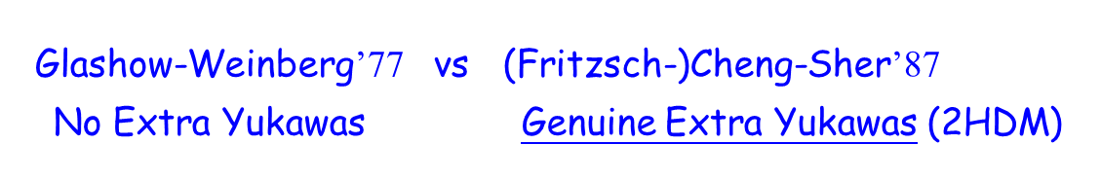

a second Higgs
let’s assume fundamental, then ...
Highly Plausible !
Known CPV in CKM ➔ Yukawa’s. Extra Yukawa’s ?
Jarlskog Invariant way too small for Universe !
Killed by Z₂ (Glashow-Weinberg 1977)
Natural Flavor Conservation
by Z₂
fermion mass-mixing
u-, d-type mass each
from separate doublet
→ Same Yuks. as SM
FCNC OK, if

Slide 8
My take (1991): t → ch
PLB’92
PSI-PR-91-34

Slide 9

2012⁺: One Higgs ➔ 2nd Higgs
Highly Plausible !
PLB’13
only scaffold
FCNH modulated by h‒H mixing
ρ_{cc} ρ_{ct}
ρ_{tc} ρ_{tt}
→ “Alignment” could overtake Glashow-Weinberg NFC
Extra Yukawas

Slide 10
2HDM (w/o Z₂): FCNH ρ_{ij}
→ Alignment can overtake Glashow-Weinberg NFC
General Yukawa interaction for up-type quarks
υ₁ = υ c_{β}
υ₂ = υ s_{β}
diagonal
FCNH (Flavor Changing Neutral H)
Neutral up-type Yukawa interaction
alignment
limit !
ρ_{i j}
→ diag. (SM-h)
ρ_{i j}
H
→ FCNH
ρ_{ij}
N.B. tanβ unphysical
[2HDM II notation]
ρ_{i j}
A

Slide 11
II. ElectroWeak BaryoGenesis
O(1) Quartics: 1st Order PT
O(1) Im ρ_{tt}: Source of CPV
2nd Top Yukawa

Slide 12
“Too Difficult.”
“I think ρ_{tt} would work.” ...
CMS 2015
disappeared since
Motivation:

Slide 13
~ O(1)
EWBG2: “λ_{i}”; Im ρ_{tt}
folklore
strongly 1st order EW phase transition (EWPT) Expanding Bubble of Broken Phase
Extra Higgs Thermal Loops
w/ O(1) Higgs Quartics
To avoid n_{B} washout:
Hubble const.
“λ_{i}”
2HDM OK
n_{B} changing rate (broken phase)
see e.g. Kanemura, Okada, Senaha, PLB’05
~ O(1)
vev @ T_{C}
fig. stolen from Jim Cline
(keep υ₁, υ₂)
Planck 2014
Baryon Asymm. of
Universe (BAU)
n_{B}/s
n_{B} changing rate (sym)
quark diffusion const
bubble wall
s
entropy density
bubble wall velocity
l.h. fermion density (l.h. top density)
K. Fuyuto, WSH, & E. Senaha, PLB’18 [1705.05034]
coord. oppo. bubble exp. dir.

Slide 14
CPV Top Interactions
Extra Yukawas
CPV source term
position in heat bath (Very Early Univ.)
# of color (quark based)
Function* of complex energies for i_{L}, j_{R}
physical variation ( )
* See e.g. Chiang, Fuyuto, Senaha, PLB’16
Baryon Asymm. of
Universe (BAU)
n_{B}/s
bubble wall
BAU ⇐ CPV Top Interactions
at Bubble Wall
skip
detail
(Transport)
left-handed Top density
K. Fuyuto, WSH, & E. Senaha, PLB’18 [1705.05034]
coord. oppo. bubble exp. dir.

Slide 15
CPV Top Interactions
Extra Yukawas
CPV source term
“Jarlskog”: both doublets participate
To understand the EWBG scatter plot to follow, suppose (H.K. Guo et al. 1609.09849)
then diag. by just
but not diag.
(Y₁)_{tc} ≠ 0, (Y₂)_{tc} ≠ 0, (Y₁)_{tt} = (Y₂)_{tt} ≠ 0 (3 params.)
all else vanish, and take t_{β} = 1 for convenience
solve
Im ρ_{tt}
CPV Source
still basically free param.
ρ_{tt} and ρ_{tc} least constrained
Altunkaynak, WSH, Kao, Kohda, McCoy PLB’15
K. Fuyuto, WSH, & E. Senaha, PLB’18 [1705.05034]

Slide 16
Bonus: Extra Yukawa Drive EWBG !
BaryoGenesis
Fuyuto, WSH, & Senaha, PLB’18
[1705.05034]
scan over
ρ_{tc}, ρ_{tt} satisfy
B_{d, s} mixing, b → sγ
for illustration (t_{β} = 1)
ρ_{tt}: Remarkably
Sufficient for BAU
Altunkaynak et al., 1506.00651
no obvious diff.
⇒ ρ_{tt} driven !
ρ_{tc} as backup
the charm of EWBG
small ρ_{tt}
sub-TeV
υ_{C}/T_{C} > O(1)

Slide 17
III. Extra Yukawas — an Experimental Question
• When h(125) was found lighter than top, there is no way to stop the experimentalist,
young or not so young (e.g. Daniel Fournier) from t → ch searching, because s/he can.
• If s/he was told that Glashow&Weinberg somehow forbade it since 1977, the response
would be ... What !? ... ... (pause) ... ‒ Splendid, so much the better, Can Not Lose !
• The bottom line: It is a PDG Entry. [my bottom line for 4G search at LHC]
Note: tch coupling is dimension-4, Not a Higher Dim. Operator.
It is in the form of a Yukawa coupling, but forbidden in SM.
It implies an Extra Scalar Doublet to have Extra Yukawa Couplings.
By generalization, it should be extended to Extra Yukawa Couplings
for i, j = 1‒3, and for F = u, d, ℓ.
Existence of Extra Yukawas is an Experimental Issue

Slide 18
IV. Curious: Alignment
O(1) Quartics Consistent !
Alignment: Replaces Glashow-Weinberg NFC

Slide 19
The Alignment Enigma: cos(β‒α) ≈ 0
BSM H Outlook Howie Haber @ Toyama, 3/2017
based on Bechtle et al., EPJC’17
< 0.05 (MSSM)
Alignment w/o decoupling seems not easy ...

Slide 20
Alignment: tanβ, m²₁₂ vs η₆, η₇; μ₂₂
2HDM-II vs 2HDM w/o Z₂
(tan β unphysical)
EWSB
assume CP-Inv.
minimization
[see Haber & O’Neil, PRD’06
“soft breaking” term absorbed
η₆ is unique mixing parameter

Slide 21
Alignment: tanβ, m²₁₂ vs η₆, η₇; μ₂₂
2HDM-II vs 2HDM w/o Z₂
(tan β unphysical)
EWSB
assume CP-Inv.
minimization
[see Haber & O’Neil, PRD’06
“soft breaking” term absorbed
η₆ is unique mixing parameter
cos(β‒α)
diag.
Near Alignment,
c_{γ} small
η₁υ² ‒ m_{h}² ~ sub-υ²
m_{H}² ‒ m_{h}² > several υ²

Slide 22
Alignment in G2HDM: No need for Small η₆ !
Large parameter space for η_{i}’s ~ O (1)
Near Alignment (c_{γ} small),
m_{H}² ‒ m_{h}² > several υ²
n.b. Not Required; η₆ ~ O (1) OK
Curiosity:
Single term (EWSB)
4 terms

Slide 23
Alignment can be Emergent in 2HDM w/o Z₂
in contrast with fine-tuning in 2HDM-II
Custodial SU(2) Illustration
EW Precision Constraint
η₅ < 3
m_{h}: level repulsion
η_{i}’s: Higgs
Self-Couplings
c_{γ} = ‒ 0.2
[‒ s_{γ} = 0.980]
c_{γ} = ‒ 0.1
[‒ s_{γ} = 0.995]
extreme
alignment
1/4
η₆ = O (1)
Quite Allowed !
O (1) Higgs (quartic) self-couplings → Near Alignment: c_{γ} Small

Slide 24
VI. Conclusion: FPCP Bonanza
& H ⁰, A ⁰, H ± in Our Time
• Higgs boson h ⁰ 125 GeV in mass discovered in 2012,
H ⁰, A ⁰, H ±
if remnant member of fundamental Higgs doublet → 2nd Doublet Reasonable
• Exquisite CKM “Flavor” picture (mass-mixing structure) at B Factories & LHCb
→ The Flavor physicists feel the Yukawa Dynamics in their bones!
• Happy marriage of Glashow-Weinberg NFC and SUSY for years: 2HDM-II
Alignment: h ⁰ resembles SM Higgs! → 2nd Doublet is Multi-TeV (decoupled) ?
and SUSY not seen ...
• Remove NFC, i.e. allow Flavor-Changing Neutral Higgs Couplings
→ Alignment can Emerge for O (1) Higgs Quartic Self-Couplings
WSH & M. Kikuchi, EPL’18
- H ⁰, A ⁰, H ± at Sub-TeV! ➔ Potential LHC Discovery
- Extra Yukawa’s: ρ_{ij} esp. ρ_{tt}, ρ_{tc} ➔ Impact Flav. Phys. & CP Violation
O (1)
no time to touch ...
Fuyuto, WSH, Seneha, PLB’18
- Bonus: account for Baryon Asymmetry of the Universe !?
triple-top !
Kohda, Modak, WSH, PLB’18
Verification: Extra Higgs Discovery @ LHC (e.g. cg → tH, tA)
Broad Future FPCP Program

Slide 25
Thank you !
SM2: SM with 2nd Higgs Doublet
No further assumptions,
except learn from Nature.
“FPCP” Review: Chang, Chen, WSH, PNPP’17
“HEP Window” Review: WSH, 1901.04033

Slide 26

CPV so far only observed in KM ...
Nontrivial CPV Phase
Nontrivial
All like-charge quark pairs nondegenerate,
Otherwise → Back to 2-gen. and CPV vanish.
Jarlskog’s Invariant for CPV
52

Slide 27
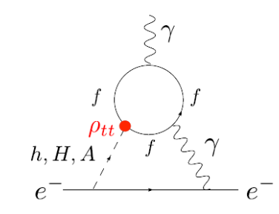
Much New FPCP Pheno
for illustration:
c_{γ} = 0.1
CMS 13 TeV (2016)
≲ 10^{‒8}
Belle II
vs < 0.46% (0.40%) ATLAS (CMS)
0.22% ATLAS 1707.01404
h → γγ width reduction
(ρ_{tt} compensate)
ACME projection
y_{e}=0
Barr-Zee
ACME, Science 2014
e-EDM (2-loop)
but: ,
|ρ_{ee}| ~ y_{e}
c_{γ} = 0.1
cancellations
when imaginary

Slide 28
Much New FPCP Pheno
most vanish with c_{γ} → 0
alignment protection
for illustration:
c_{γ} = 0.1
CMS 13 TeV (2016)
c_{γ} → 0
c_{γ} → 0
≲ 10^{‒8}
Belle II
vs < 0.46% (0.40%) ATLAS (CMS)
0.22% ATLAS 1707.01404
h → γγ width reduction
(ρ_{tt} compensate)
ACME projection
c_{γ} → 0
y_{e}=0
Barr-Zee
ACME, Science 2014
e-EDM (2-loop)
but: ,
|ρ_{ee}| ~ y_{e}
c_{γ} → 0
cancellations
when imaginary

Slide 29
What does not vanish with Alignment, c_{γ} → 0
circumvent alignment protection
for illustration:
c_{γ} = 0.1
CMS 13 TeV (2016)
c_{γ} → 0
c_{γ} → 0
≲ 10^{‒8}
Belle II
vs < 0.46% (0.40%) ATLAS (CMS)
0.22% ATLAS 1707.01404
O(1) ρ_{tt} & Complex
h → γγ width reduction
(ρ_{tt} compensate)
EWBG
h → γγ width reduction
Higgs @ LHC
O(1) Higgs Quartics
c_{γ} → 0
60%
Barr-Zee
e-EDM (2-loop)
but: ,
|ρ_{ee}| ~ y_{e}
c_{γ} → 0
the charm of EWBG
cancellations
when imaginary
probably hidden
in tt(bar)
param. space
much broader

Slide 30
ρ_{tt}
One-loop Protection
SM-like
still allowed
“wrong”
direction
ρ_{tt} c_{γ}
Purely Bosonic Loops (O (1) couplings)
New
Yukawa
ρ_{tt} > 0 and O (1) preferred: “Protects” Alignment
⇒ Original Motivation to Study Alignment in G2HDM
based on WSH & Kikuchi, 1704.03788 [PRD’17]

