Slide 1
25th iWoRiD Lisbon 2024
First characterisation of Trench Isolated LGADs fabricated at Micron Semiconductor Ltd
Neil Moffat^{b} , Fasih Zareef ª ,Dima Maneuski^{c}, Richard Bates^{c}, Agnieszka Oblakowska-Muchaª, Tomasz Szumlakª, Mark R. J. Williams^{d}, Mark Bullough^{e} , Oscar Augusto de Aguiar Francisco^{f}, Marco Gersabeck^{f} , Peter Lomax^{g}
ª AGH University of Krakow, Poland.
^{b} Centro Nacional de Microelectrónica (CNM), Barcelona, Spain.
^{c} University of Glasgow, Scotland.
^{d} The University of Edinburgh, Scotland.
^{e} Micron Semiconductor Ltd., Lancing, England.
^{f} University of Manchester, England.
^{g} Scottish Microelectronics Centre, Edinburgh, Scotland.
neil.moffat@imb-cnm.csic.es

Slide 2






Outline
Motivation
Segmentation Techniques
Fabrication
  TCAD simulations
  Run
  Electrical Measurements
TCT Measurements
  Gain
  Pixel Isolation
  Inter-pixel distance (IPD)
Discussion
Summary & Future Work

Slide 3
Motivation
    To develop a fast-timing silicon hybrid pixel detector (sub 100ps) , within the working group PixeLGAD, a UK based effort to develop LGAD technology.
    We must understand the LGAD technology, build simulation models and develop a fabrication process in collaboration with Micron Semiconductor.
    Detector should be for HEP experiments with modest radiation levels which require fast timing and good spatial resolution (i.e. LHCb VeloⅡ Upgrade).
    Detector applications include imaging “soft” or “tender” (< 5 keV) energy x-rays, with focus on the water window (~500 eV).
    The detectors will be applicable to and demonstrated on synchrotron beamlines and for electron microscopy.
    We do not target a given experiment but aim to push the small pixel LGAD technology and demonstrate this with start-of-the-art small pixel fast timing pixel chips.
    We want to create an imaging detector in collaboration with the Timepix4 readout ASIC.

Slide 4
Pixel Segmentation
p-stop
JTE
Pixel 1
Pixel 2
Standard LGADs:
  Segmentation → Junction Termination Extension (JTE), p-stop
  Large “no-gain region”
  IPD ~ 50 µm (G. Paternoster et. al., 2021)
  Low fill-factor (N.Moffat et al., 2021)
Gain Layer
No-gain region
Fig 1(a): Standard LGAD
Trench
Pixel 1
Pixel 2
Trench-Isolated LGADs:
  Segmentation → Trenches (SiO₂ filled)
  1 µm wide, and a few microns deep
  “no-gain region” is significantly reduced
  Fill-factor is increased
  Enhanced spatial resolution
Gain Layer
No-gain region
Fig 1(b): Trench-isolated LGAD
G. Paternoster, et. al., 2017

Slide 5
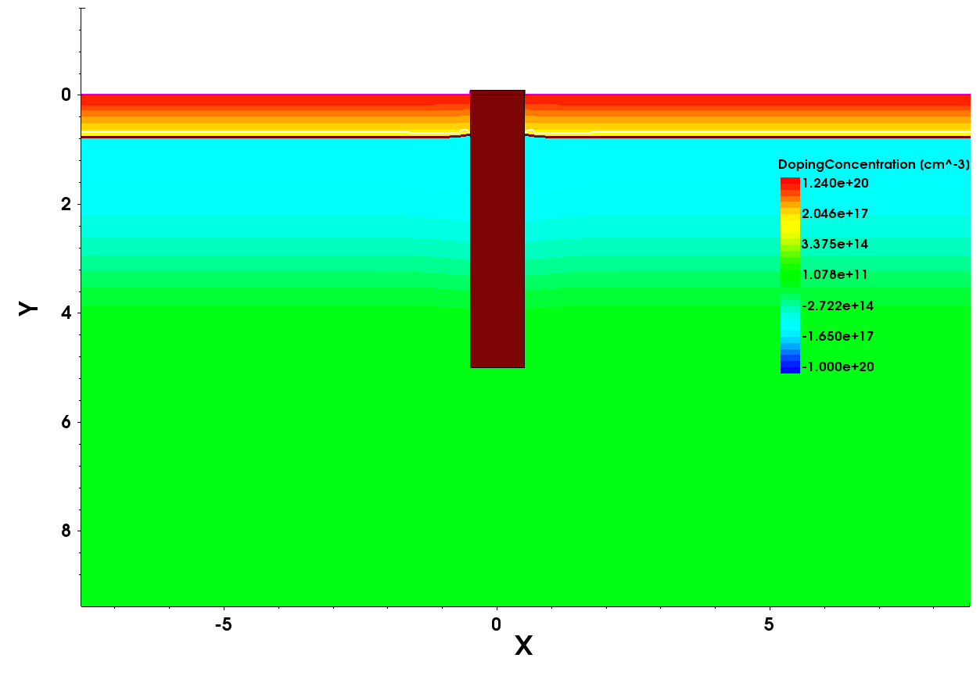
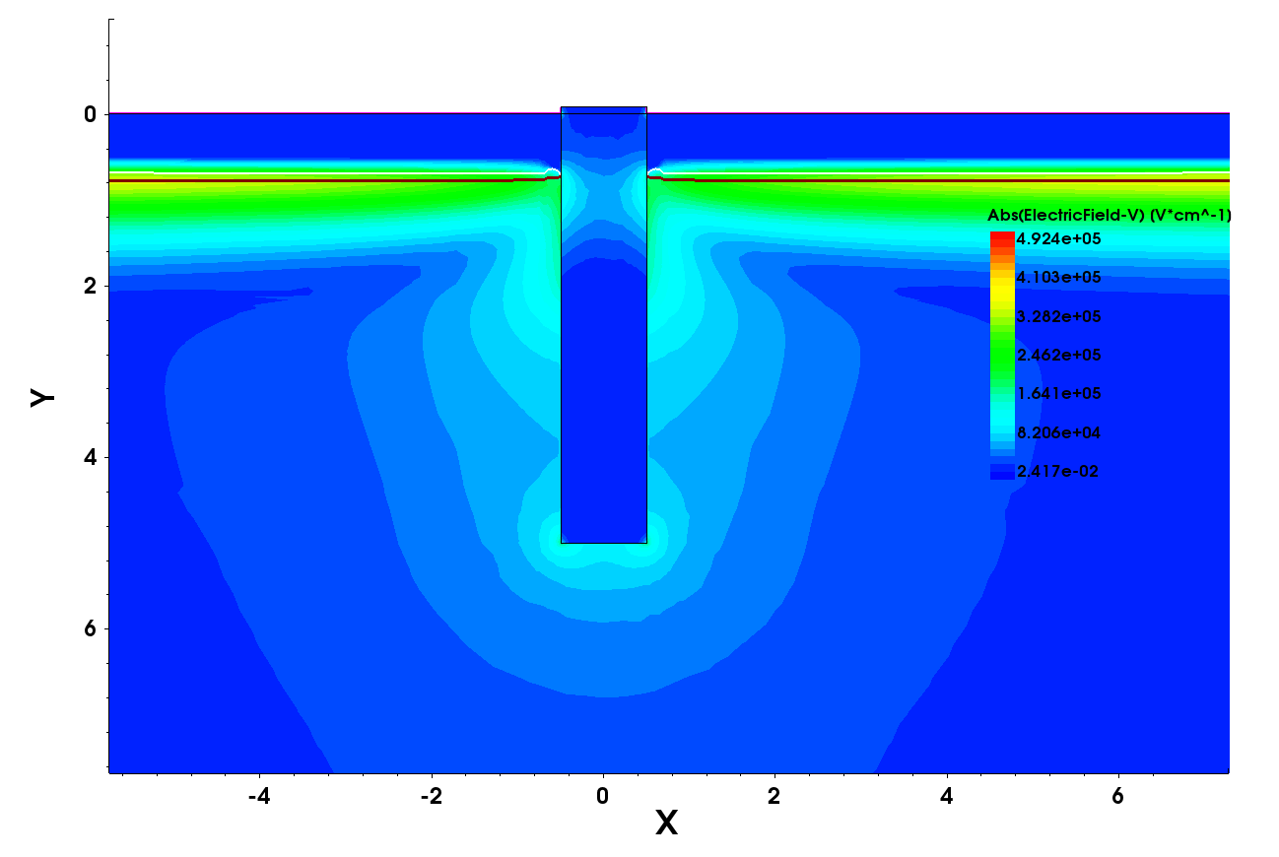
Simulations (I)
Sentaurus TCAD model used to create two adjacent pixels.
Trench used to isolate the pixels.
Trenched etched into silicon and filled with SiO2
No gap between trench and implantations
Doping Concentration
Electric field

Slide 6
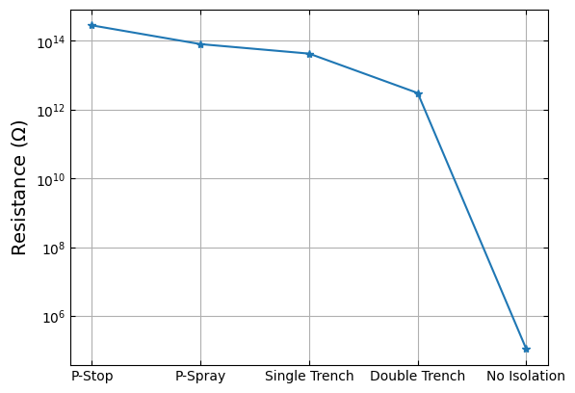
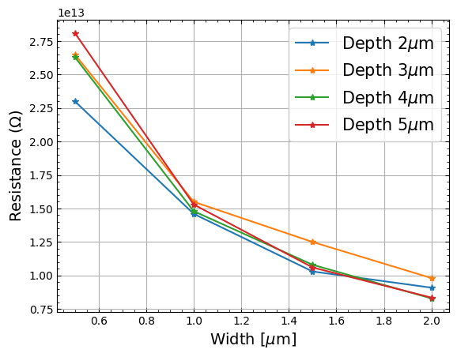
Simulations (II)
Isolation determined by the resistance between the adjacent pixels. Must be high resistance up to oxide charge saturation.
Isolation compared to standard isolation methods. i.e. p-spray and p stop.
Trench parameters optimised for highest isolation
Comparison of isolation methods between adjacent pixels: p-spray, p-stop, no-isolation, single-trench, double-trench

Slide 7
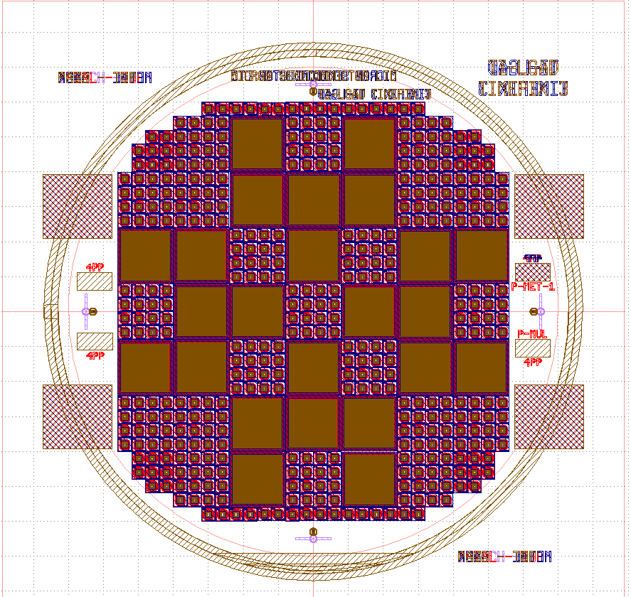
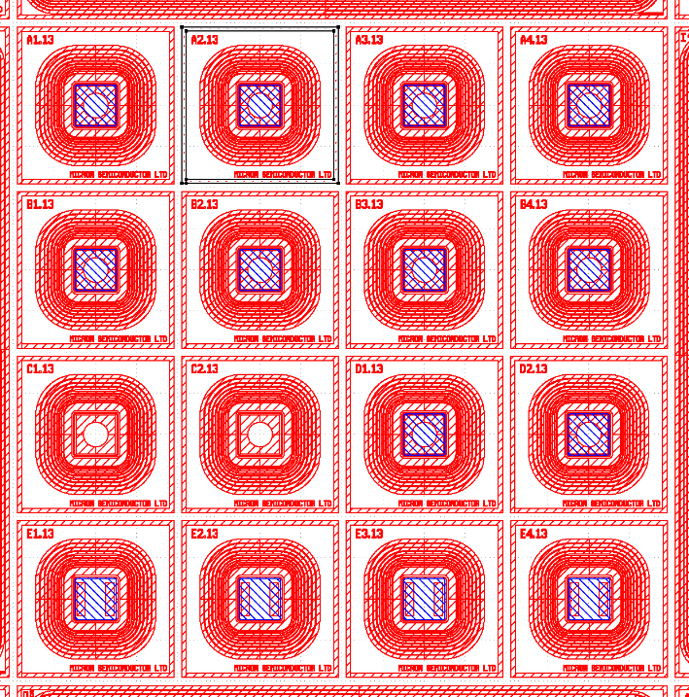
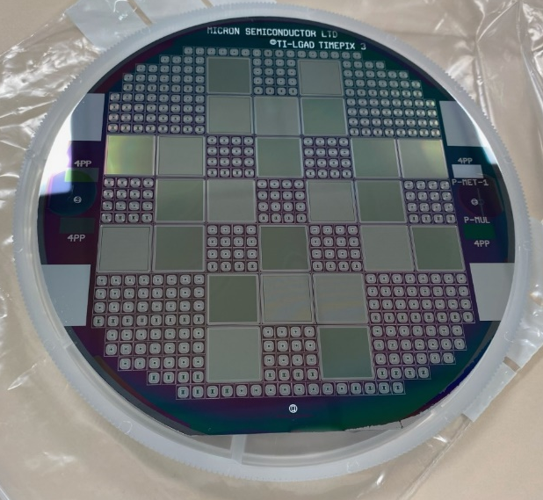
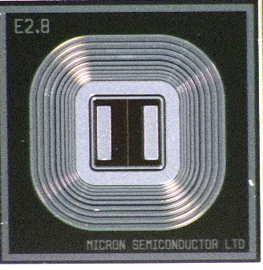
Production of TI-LGADs
Run-3455 produced by Micron Semiconductor Ltd:
  Wafer production based on increasing
  gain layer doping
  Active thickness = 250µm
  Pad area = 1x1 mm²
  Devices:
    A: 1x1 LGADs with JTE
    B: 1x1 LGADs with JTE + Trench
    C: 1x1 PIN (no gain)
    D: 1x1 LGADs with Trench
    E: 1x2 Pixels, isolated with Trench
  Medipix Arrays:
    55 µm pitch
    110 µm pitch

Slide 8
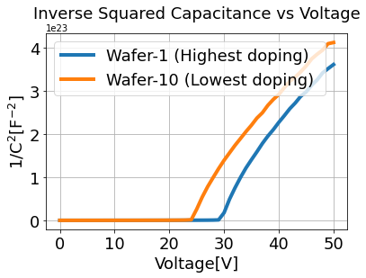
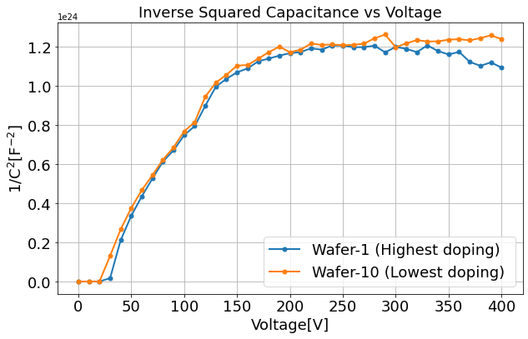
Electrical Measurements (I)
Capacitance-Voltage (CV):
  Gain layer depletion voltage, V_{GL}= 25-30 V
  Full depletion ~ 120V

Slide 9
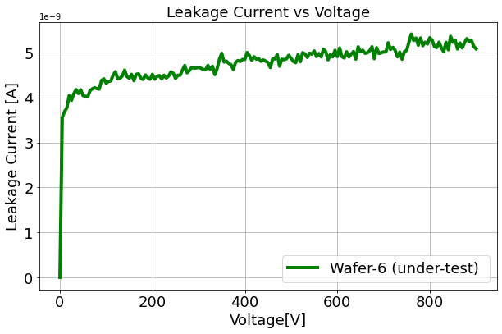
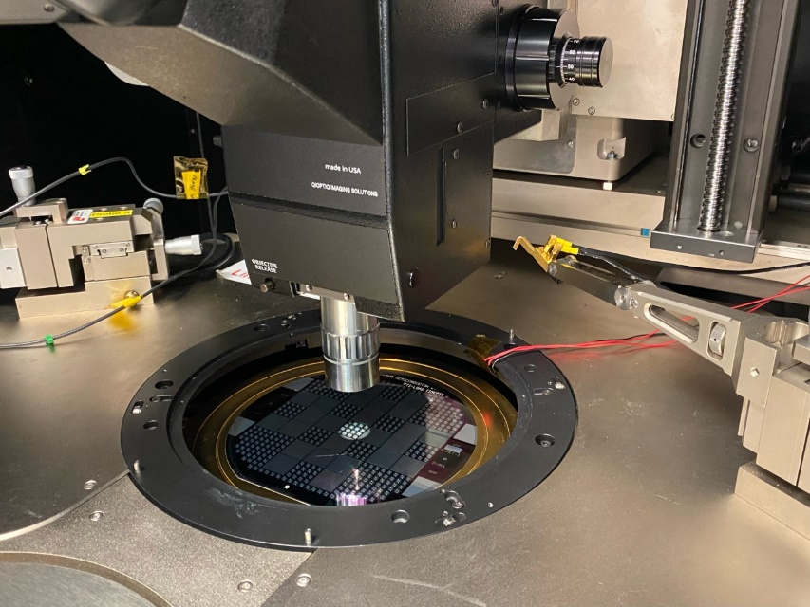
Electrical Measurements (II)
Capacitance-Voltage (CV):
  Gain layer depletion voltage, V_{GL}= 25-30 V
  Full depletion ~ 120V
Current-Voltage (IV):
  No sign of breakdown up to 1000V
  Leakage current is in nA’s
Devices are working!

Slide 10
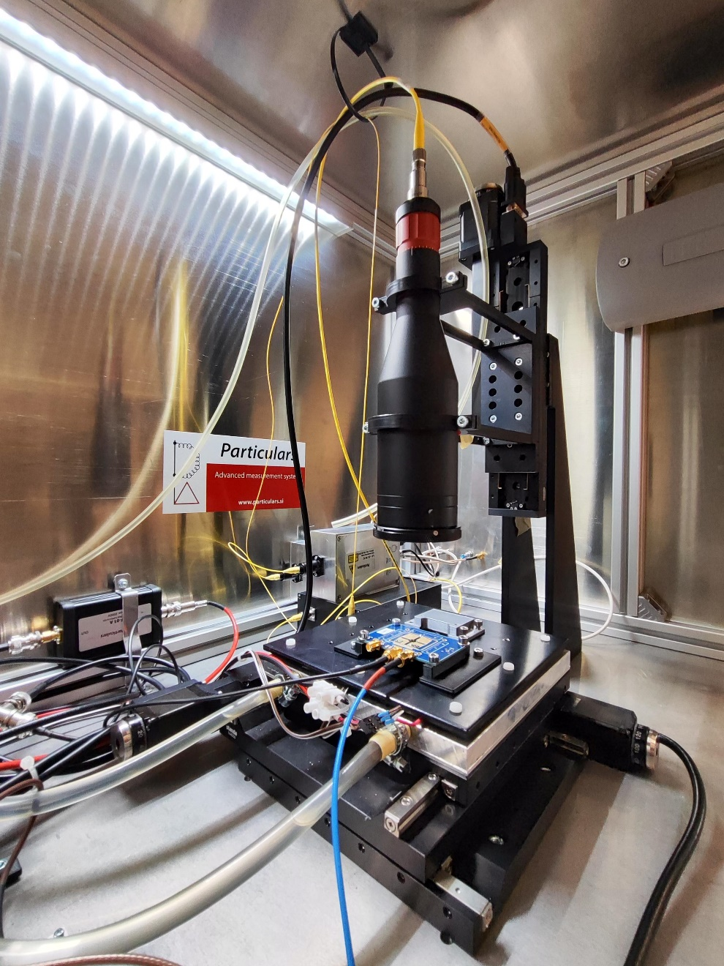
Transient Current Technique (TCT)
Particulars TCT Setup:
  IR pulsed laser (1064 nm) → 8-10 µm spot
  Broadband amplifier → 35 db
  Laser calibrated to minimum ionizing particles (MIPs)
  xy-stage with sub-µm precision
Focusing
Optics
Laser
DUT
x-y stage
03/07/2024
Fasih Zareef
AGH University of Krakow

Slide 11
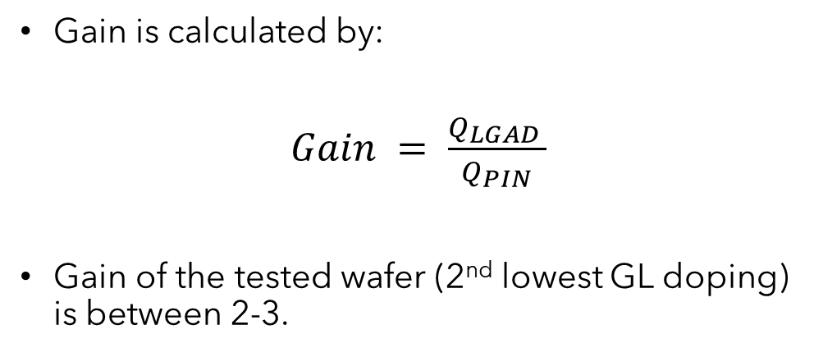
TCT: Gain Measurements
Fasih Zareef

Slide 12
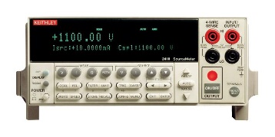
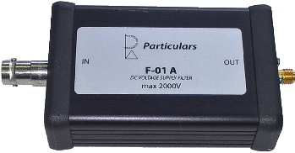
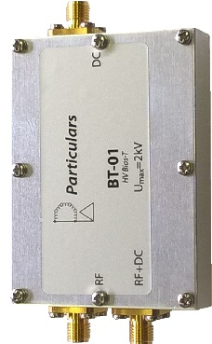
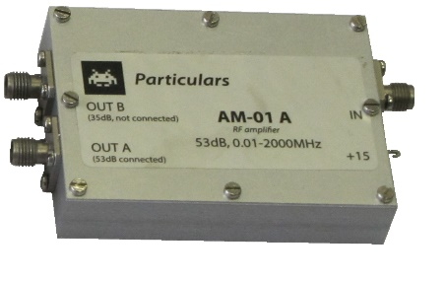
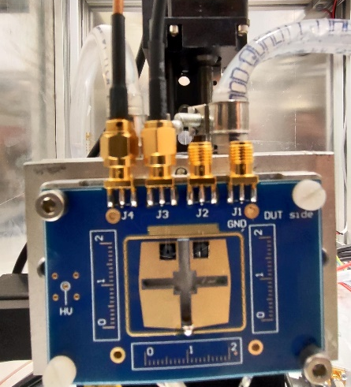
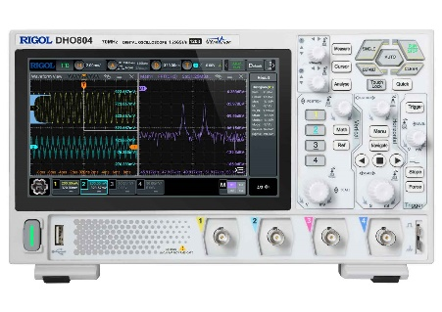
TCT: Pixel Isolation (I)
Bias Source
Bias Filter
Splitting the HV
  One pixel connected to the readout
  Other pixel is only connected to bias voltage
Bias-T
Amplifier
Oscilloscope
DUT/PCB
03/07/2024
Schematics of measurement setup for pixel isolation

Slide 13
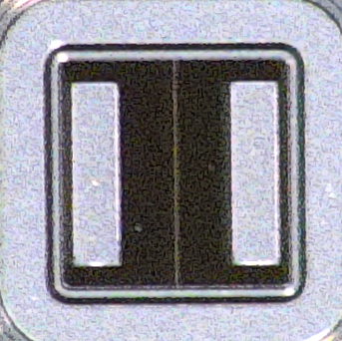
TCT: Pixel Isolation (II)
Bias Source
Bias Filter
Splitting the HV
  One pixel connected to the readout
  Other pixel is only connected to bias voltage
Bias-T
Pixel-1
Pixel-2
Amplifier
Connected to readout
Oscilloscope
DUT/PCB
03/07/2024
Schematics of measurement setup for pixel isolation

Slide 14
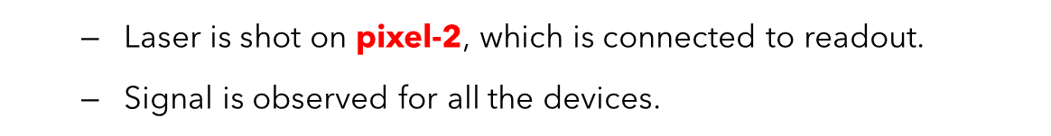
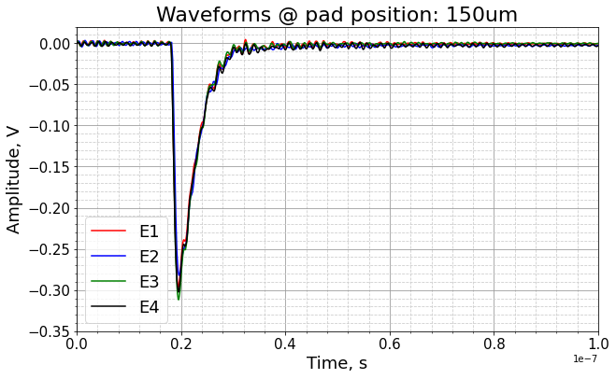
TCT: Pixel Isolation (III)
Pixel-1
Pixel-2
Connected to readout
03/07/2024

Slide 15
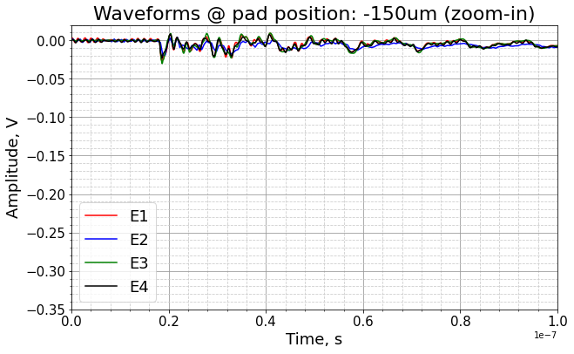
TCT: Pixel Isolation (IV)
  Laser is shot on pixel-1, which is not connected to readout.
  No Signal is observed for any device.
  Pixels are isolated! Trenches are working!
Pixel-1
Pixel-2
Connected to readout
03/07/2024

Slide 16
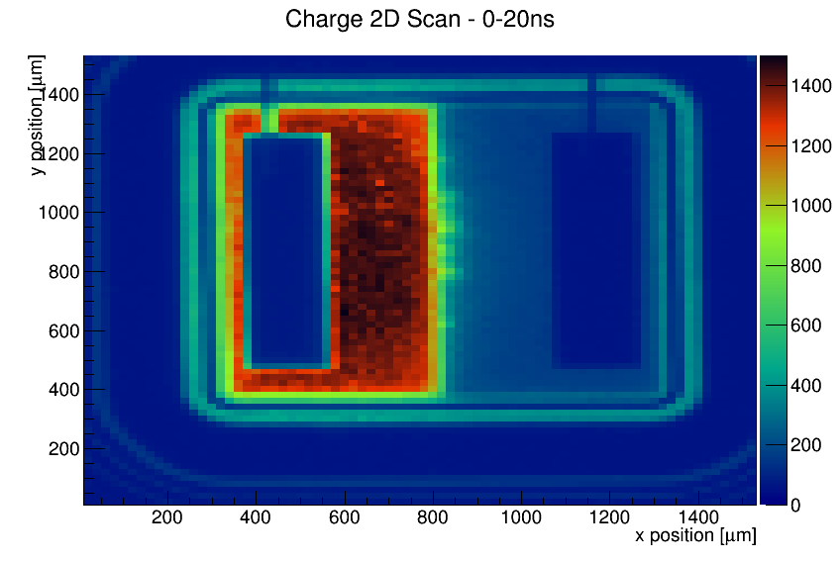
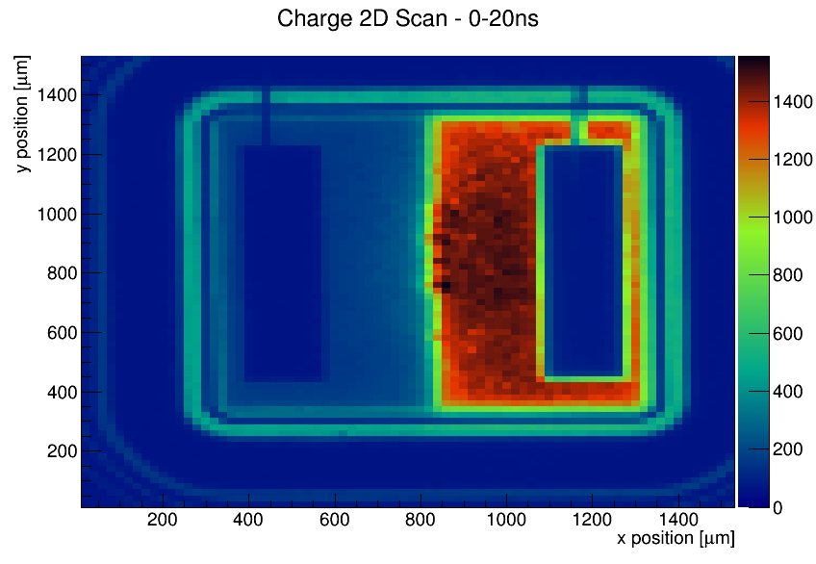
TCT: Pixel Isolation (2D Maps)
Pixel-1
Pixel-2
  One pixel connected to the readout
  Other pixel is only connected to bias voltage
  2-dimensional (x-y) scans also depicts isolation between the pixels
03/07/2024
Pixel-1 Connected to readout
Pixel-2 Connected to readout

Slide 17
TCT: Inter-Pixel Distance (I)
Laser
Pixel-2
Pixel-1
Q
IPD
Measuring the “no-gain region” also referred to as inter-pixel distance (IPD).
1-dimensional scans along the x-position, and plot charge vs position for both pixels.
Distance between the two pixels where normalized charge reaches 50% of its value.
Q = 50%
Siviero F., et al
x
σ = 8-10 µm
Fig: Schematics of IPD calculation
Pixel-1
Pixel-2
Fig: 1-dimensional scan in the x-direction

Slide 18
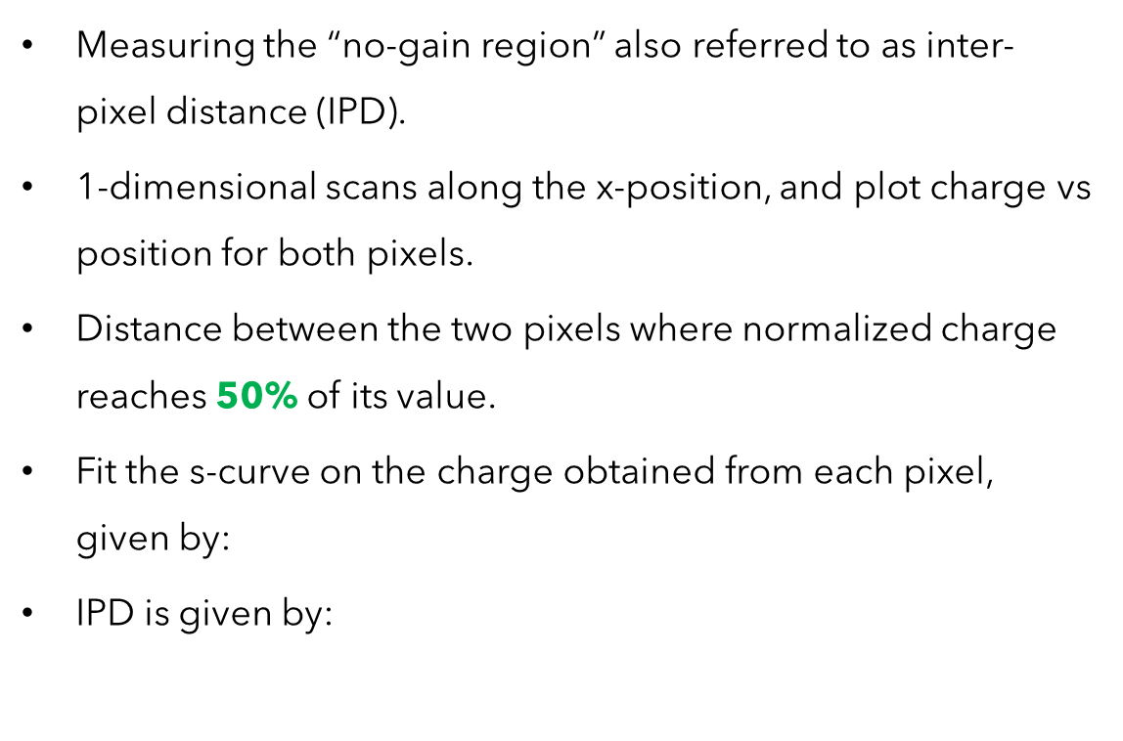
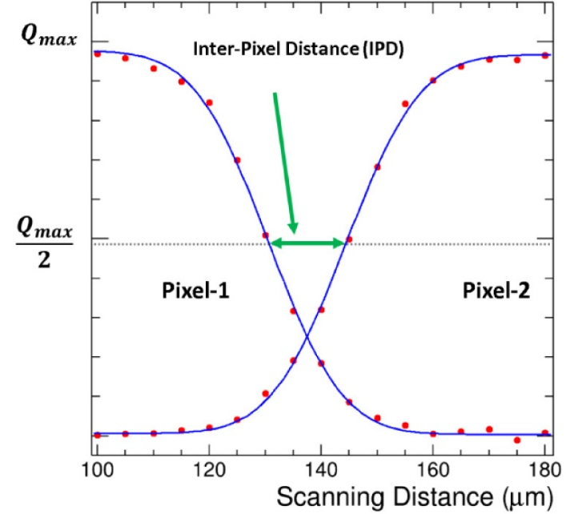


TCT: Inter-Pixel Distance (II)
Laser
Pixel-2
Pixel-1
Q
IPD
Q = 50%
Siviero F., et al
x
σ = 8-10 µm
Fig: Schematics of IPD calculation
A. Bisht, et. Al.

Slide 19
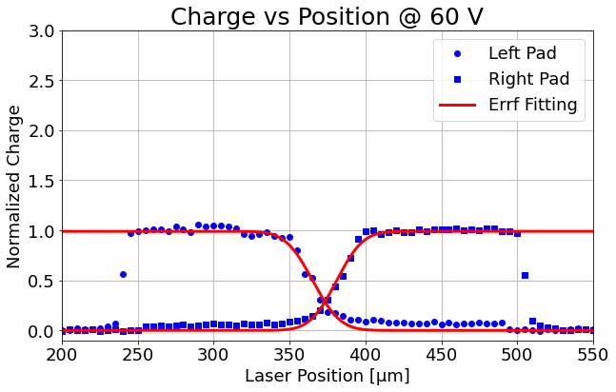

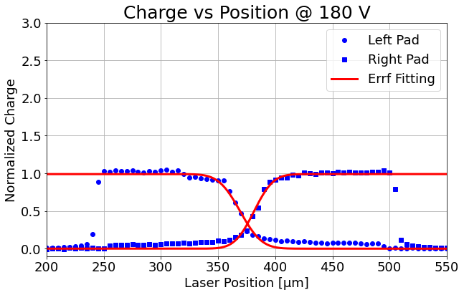

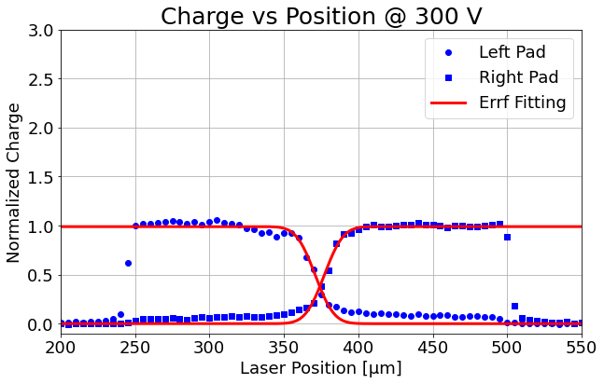
TCT: Inter-Pixel Distance (III)
IPD = 16.3 ± 1 µm
IPD = 14.2 ± 1 µm
IPD = 13.5±1 µm
IPD = 6.6 ± 1 µm
IPD = 6.8 ± 1 µm
These values correspond to the “Effective inter-pixel distance”

Slide 20
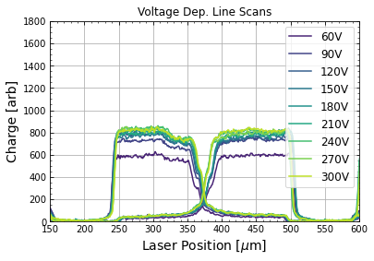
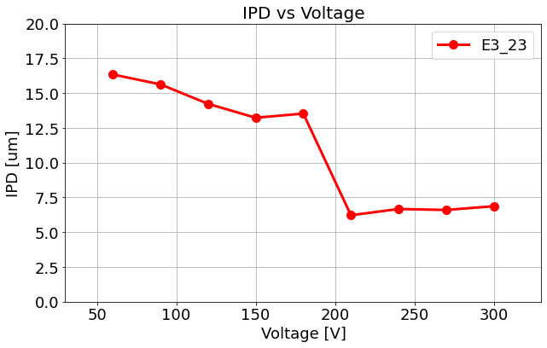
TCT: Inter-Pixel Distance (IV)
Interpixel distance decreases as voltage increases, as expected

Slide 21
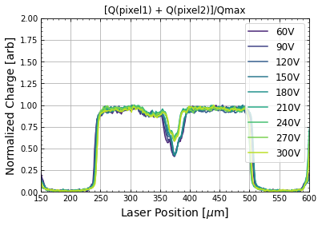
TCT: Inter-Pixel Distance (V)
Interpixel distance decreases as voltage increases, as expected
Fill factor is nearly 97%

Slide 22
Discussion: Isolation
There is still some charge collected from the pixel, when the laser is on adjacent pixel.
Most probably due to the cross-talk between the pixels.
Idea is to look inside the trenches
cross-talk

Slide 23
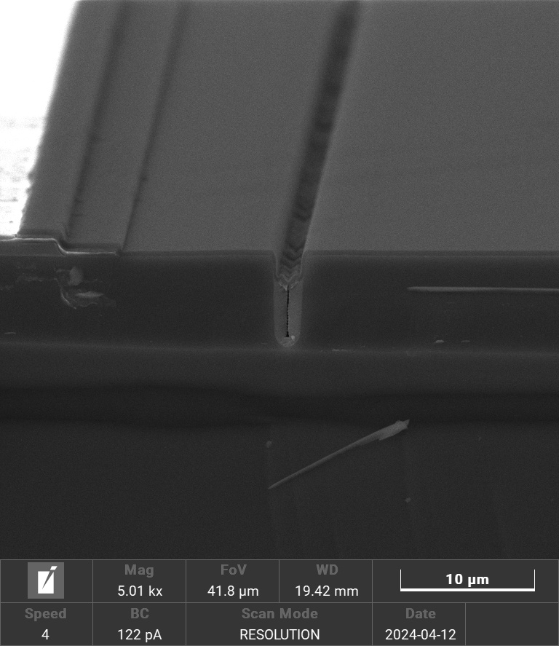
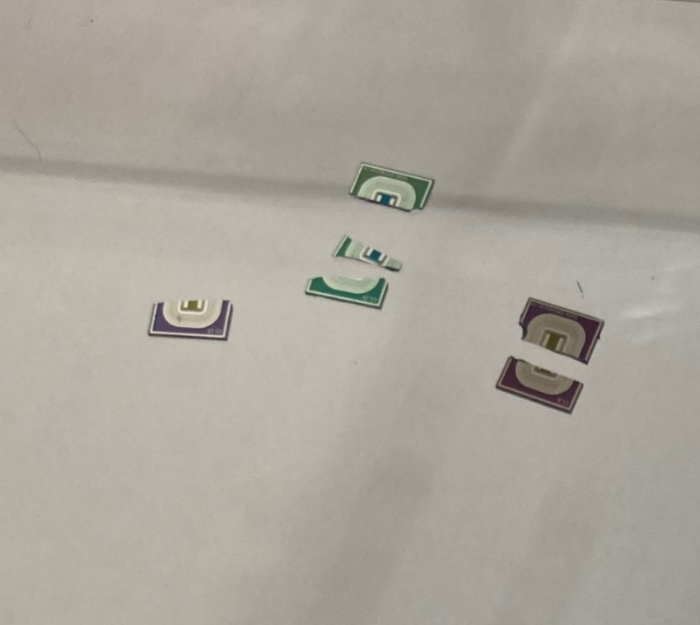
Discussion: SEM Images
A couple of devices from a different part of the wafer were cleaved to investigate the trenches.
E3.25
E1.13
E1.8

Slide 24
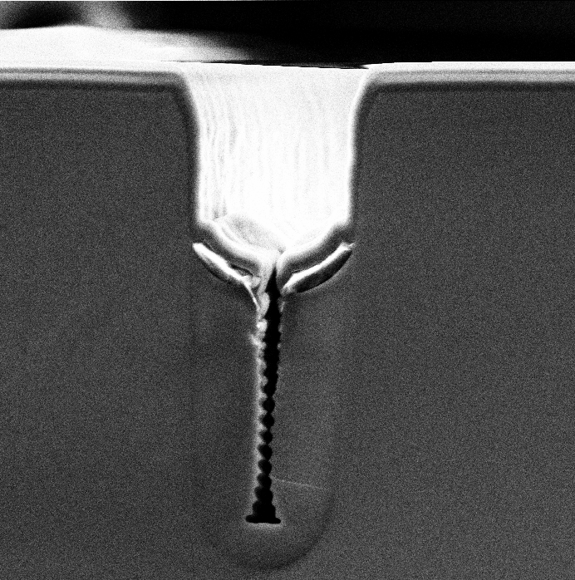
Discussion: SEM Images
Toast: to the Trench Isolated LGADs

Slide 25
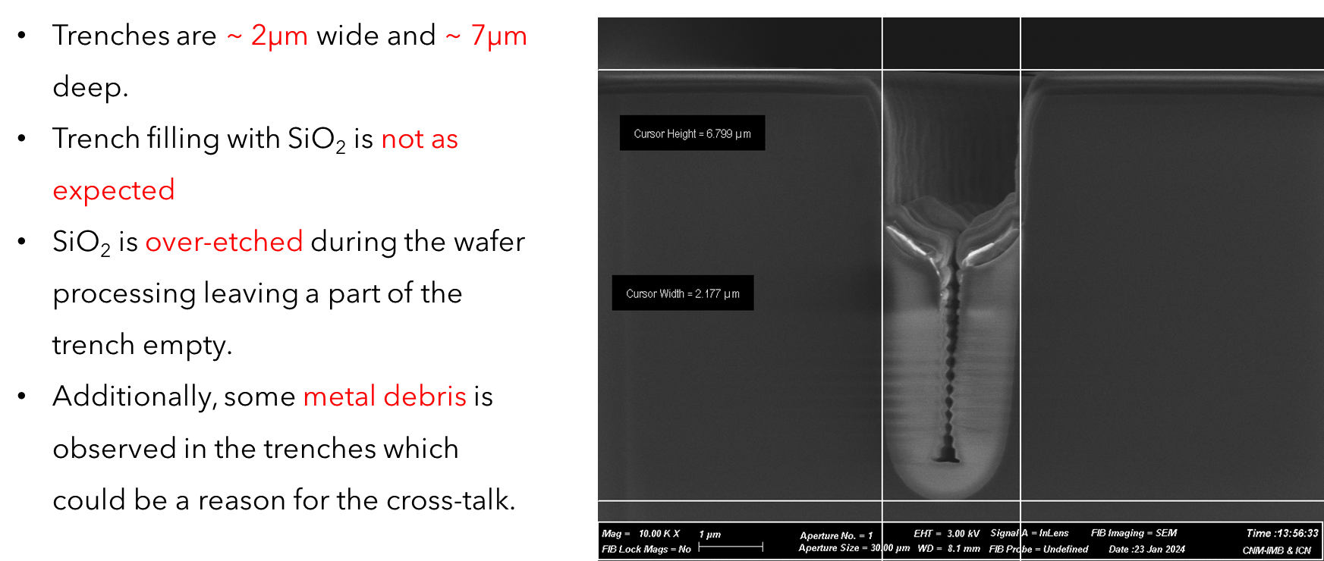
Discussion: SEM Images

Slide 26
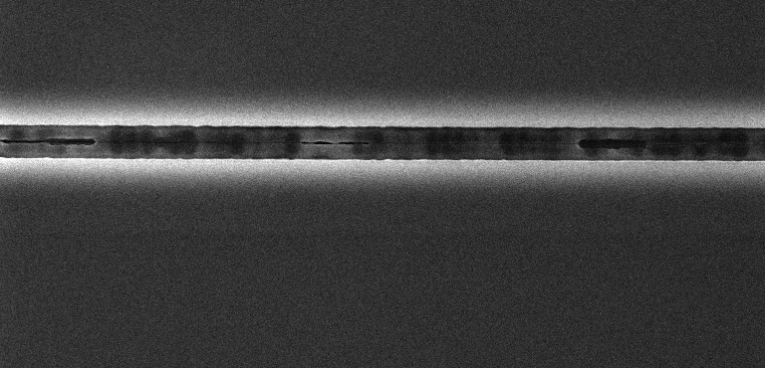
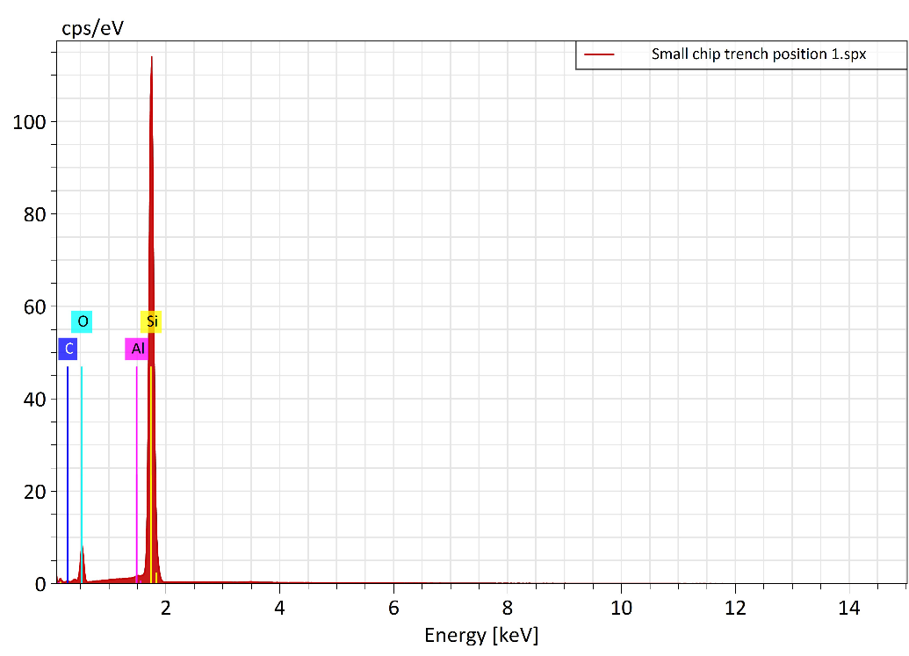
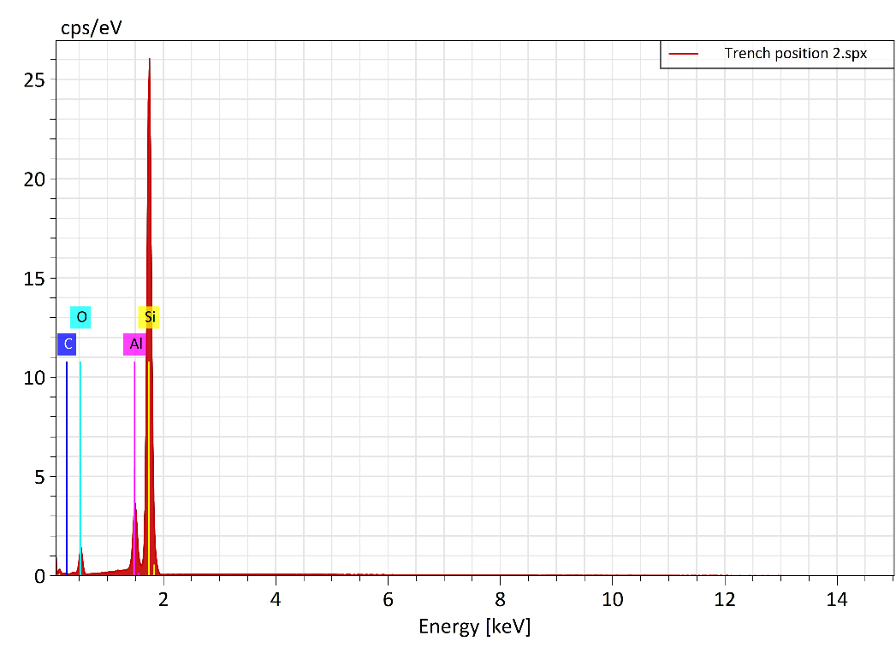
Discussion: Energy Dispersive X-Ray (EDX) Spectra
Confirmation of some metal debris in the trenches which could be a reason for the cross-talk.
Aluminium peak was observed at position 2 but not in position 1.
Position 1
Position 2
Position 1
Position 2
Measurements at
SMC, Edinburgh

Slide 27
Discussion: Next Production
Gap = Distance between trench and n-plus
n-plus
Gain layer
SiO₂
bulk
p-plus
Current Device Model
New Device Model
(uniform n+ implant)
(gap between trench and n-plus is introduced)
To avoid over-etching of SiO₂
Smooth trench filling

Slide 28
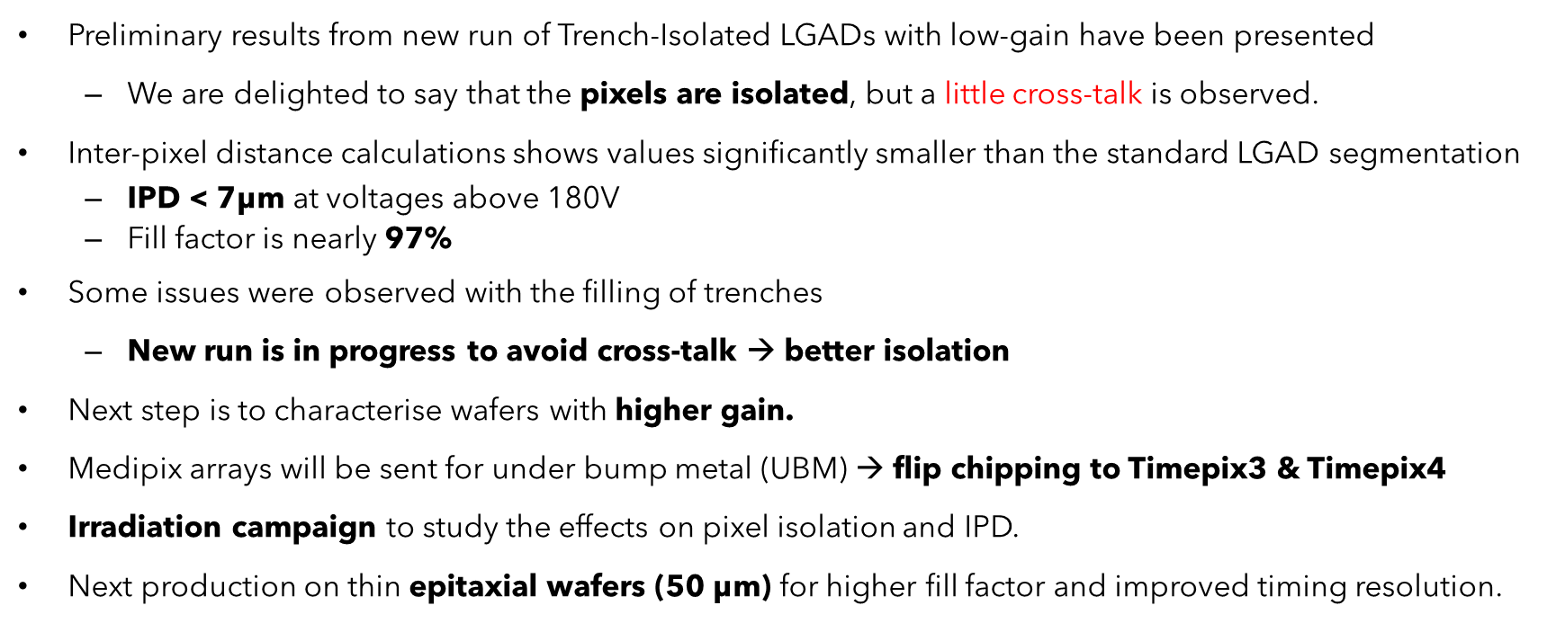
Summary and Future Work

Slide 29




Acknowledegments
This research has received funding from the European Union’s Horizon 2020 Research and Innovation programme under Grant Agreement No 101004761.
This research has received funding from the STFC Opportunities grant under agreement no. ST/T002751/1.
This research has received funding from the Royal Society
This research has received support from Polish National Science Center under the agreement no. NCN 2023/49/N/ST2/02314 and UMO-2018/31/B/ST2/03998.

