Slide 1
First applications of the JUNGFRAU detector with iLGAD technology
For Resonant Inelastic X-ray Scattering
R. Barten¹, F. Baruffaldi¹, A. Bergamaschi¹, B. Braham¹, M. Brückner¹, M. Carulla¹, R. Dinapoli¹,
N. Duarte², S. Ebner¹, K. Ferjaoui¹, E. Fröjdh¹, D. Greiffenberg¹, S. Hasanaj¹, J. Heymes¹,
V. Hinger^{1*}, L. Le Guyader³, T. King¹, P. Kozłowski¹, C. Lopez-Cuenca¹, D. Mezza¹, K. Moustakas¹, A. Mozzanica¹, E. Paris⁴, K. A. Paton¹, M. Ramilli², E. Razzoli⁴, C. Ruder¹, A. Scherz³, B. Schmitt¹, P. Sieberer¹, E. Skoropata⁴, D. Thattil¹, M. Turcato ², H. Ueda⁴, X. Xie¹, J. Zhang¹
¹ PSI Center for Photon Science Detector Group, ² European XFEL GmBH Detector Operations,
³ European XFEL GmBH Scientific Instrument SCS, ⁴ PSI Center for Photon Science SwissFEL Furka
* viktoria.hinger@psi.ch
25th iWoRiD, Lisbon, 04 July 2024

Slide 2

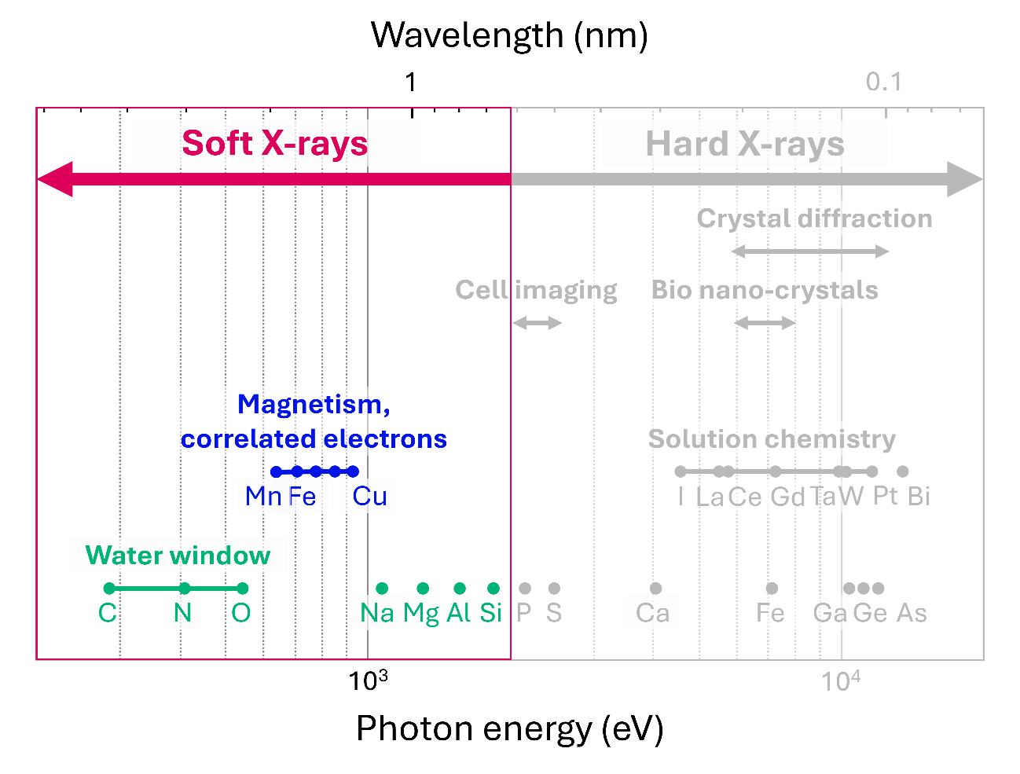

Why soft X-rays?
L-edges of 3d transition metals
  Mn, Fe, Cu …
  Quantum materials
  Spintronics
  Superconductors …
“Water window” and light elements
  C and O K-edges (282 – 543 eV), Na, Mg, …
  Biological samples
  Catalysis
  Photosynthetic water splitting …

Slide 3
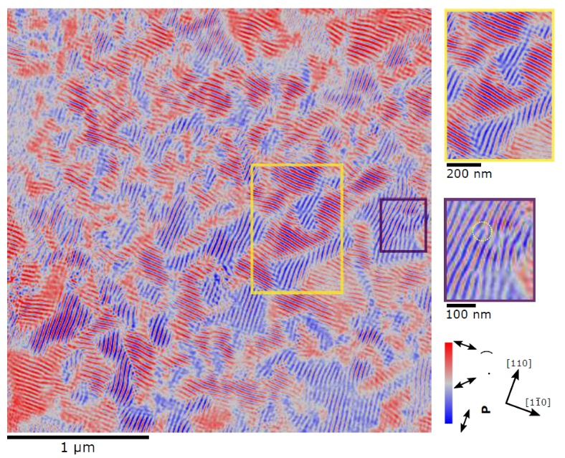
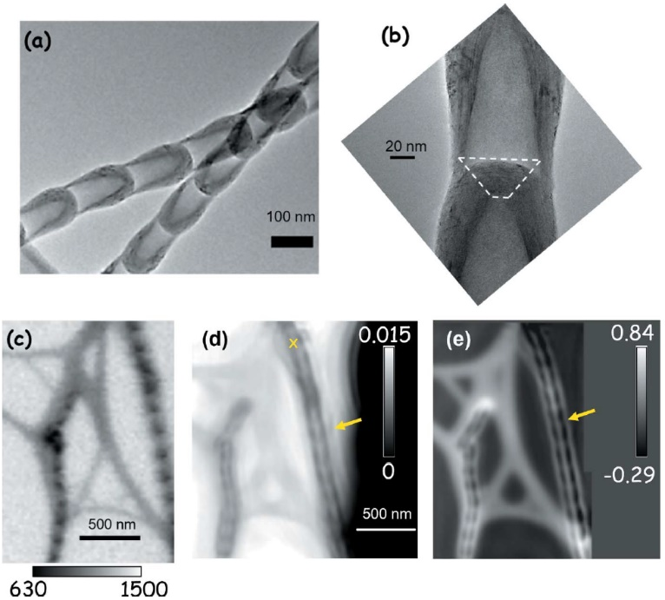
Why soft X-rays?
Magnetic contrast ptychography of BiFeO₃
EIGER with iLGAD sensor
(down to 700 eV)
L-edges of 3d transition metals
  Mn, Fe, Cu …
  Quantum materials
  Spintronics
  Superconductors …
T. A. Butcher et al 2024 Adv. Mater. 36, 2311157
“Water window” and light elements
  C and O K-edges (282 – 543 eV), Na, Mg, …
  Biological samples
  Catalysis
  Photosynthetic water splitting …
TEM
BN nanobamboo STXM & ptychography imaging
Backside illuminated scientific CMOS
STXM
Amplitude
Phase
J. Vijayakumar et al 2023
J. Synchrotron Rad. 30, 746-757

Slide 4
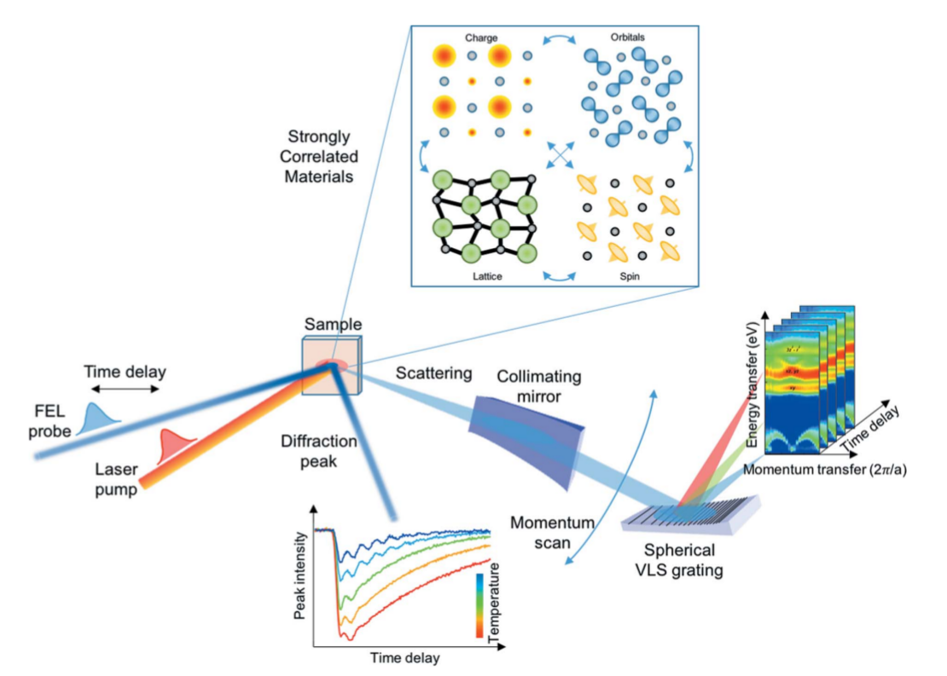
Resonant Inelastic X-ray Scattering (RIXS)
Scientific goal
Access very specific, complex electronic-structural information and dynamics
Charge, spin, orbital, and lattice excitations
Quantum materials: spintronics, superconductors
Method
Scan over electronic resonance
Measure transferred energy and momentum
Characteristics
Energy resolution ↔ spatial resolution
“Photon-hungry”
Single shot detection at high repetition rates
Multi-dimensional scans
R. Abela et al 2019 J. Synchrotron Rad. 26, 1073-1084
Notes:
Now, for this project, I want to target a specific spectroscopic technique, because
extremely powerful
Highly in-demand technique that pushes the boundaries of detector science and opens up paths for applications beyond
Science cases are for instance: correlated and quantum materials for possible spintronics applications and high-T superconductivity

Slide 5

Resonant Inelastic X-ray Scattering (RIXS)
Scientific goal
Access very specific, complex electronic-structural information and dynamics
Charge, spin, orbital, and lattice excitations
Quantum materials: spintronics, superconductors
Method
Scan over electronic resonance
Measure transferred energy and momentum
Characteristics
Energy resolution ↔ spatial resolution
“Photon-hungry”
Single shot detection at high repetition rates
Multi-dimensional scans
Challenges for Detectors
High signal-to-noise ratio (SNR) $→$ > 5 @ 200 eV
High spatial resolution $→$ 1-2 µm ideally
High image rate $→$ multi-kHz
Large area $→$ > 10 cm²
Hybrid pixel detectors
R. Abela et al 2019 J. Synchrotron Rad. 26, 1073-1084
Notes:
Now, for this project, I want to target a specific spectroscopic technique, because
extremely powerful
Highly in-demand technique that pushes the boundaries of detector science and opens up paths for applications beyond
Science cases are for instance: correlated and quantum materials for possible spintronics applications and high-T superconductivity

Slide 6
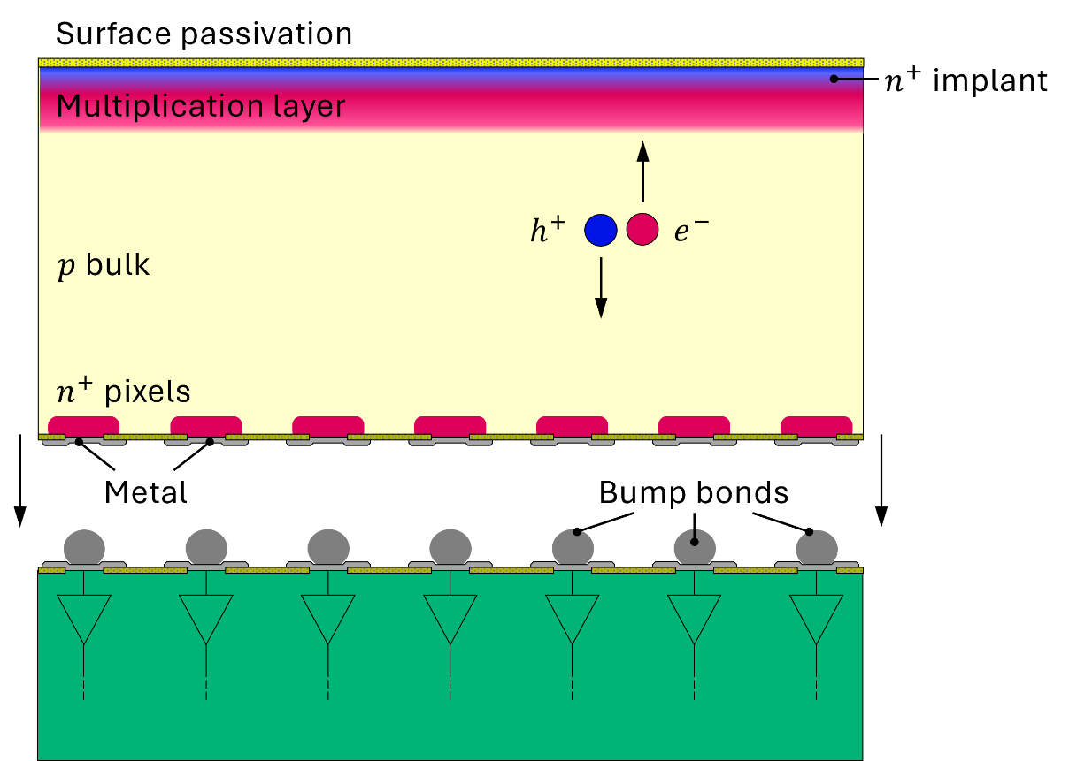

Challenges for hybrid pixel detectors
…if we want to apply them for RIXS
Detect soft X-rays with high SNR
iLGAD sensor with thin entrance window
+ low-noise readout chip
Achieve high spatial resolution
Charge sharing between neighbouring pixels
$→$position interpolation
Needs a charge integrating detector!
Native pixel resolution
Readout chip
Interpolated
Notes:
Now, for this project, I want to target a specific spectroscopic technique, because
extremely powerful
Highly in-demand technique that pushes the boundaries of detector science and opens up paths for applications beyond
Science cases are for instance: correlated and quantum materials for possible spintronics applications and high-T superconductivity

Slide 7
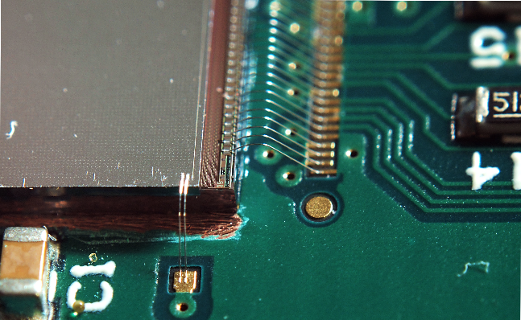
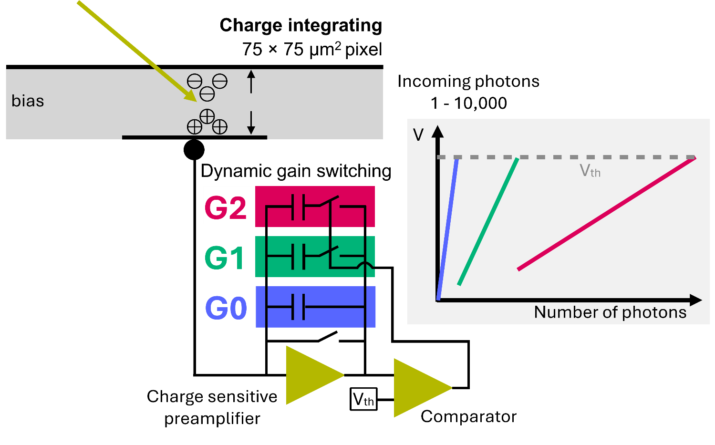
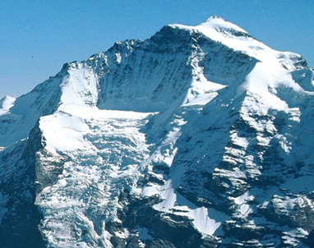
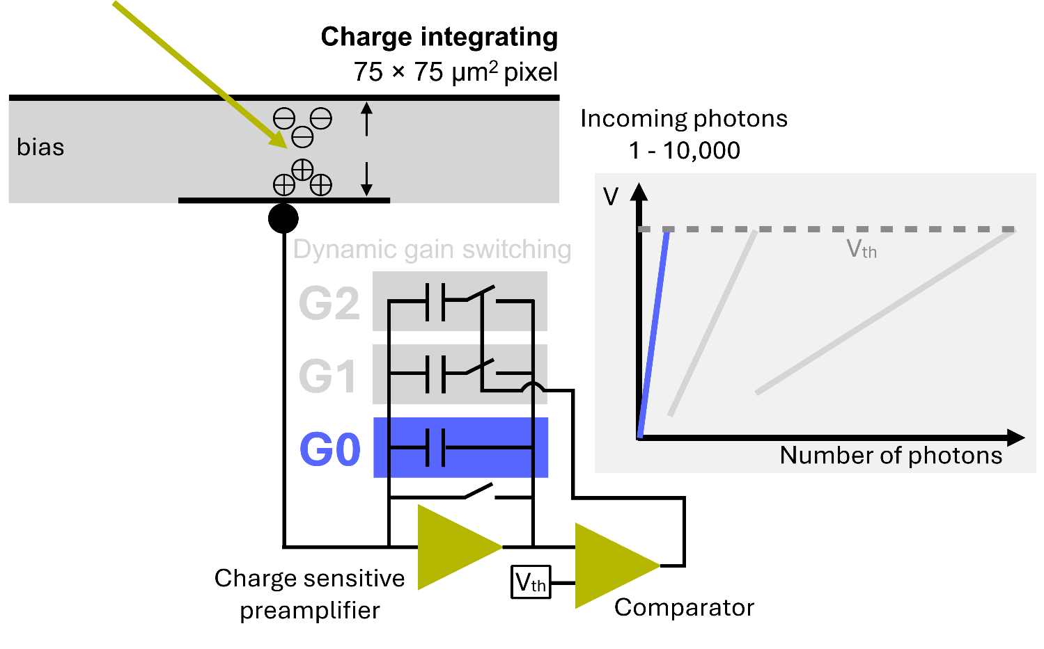
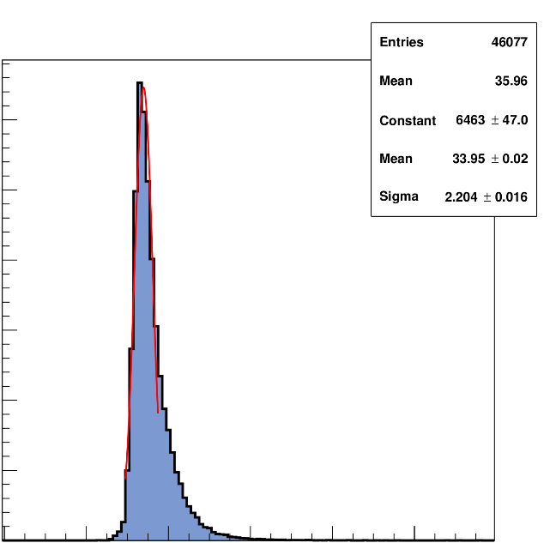
JUNGFRAU – low noise, high dynamic range
Jungfrau mountain
Wire bonded ASIC
Low-noise ASIC version JUNGFRAU 1.1
6000
34 e⁻ ENC r.m.s (52 e⁻ in JF1.0)
5000
max. 2.2 kHz frame rate
for continuos readout
max. 250 kHz burst mode
(16 images, only JF1.0)
4000
3000
2000
1000
SNR > 5 @ 800 eV
(detection limit for JUNGFRAU with standard sensors)
0
20
40
60
80
100
Noise (ENC r.m.s.)

Slide 8

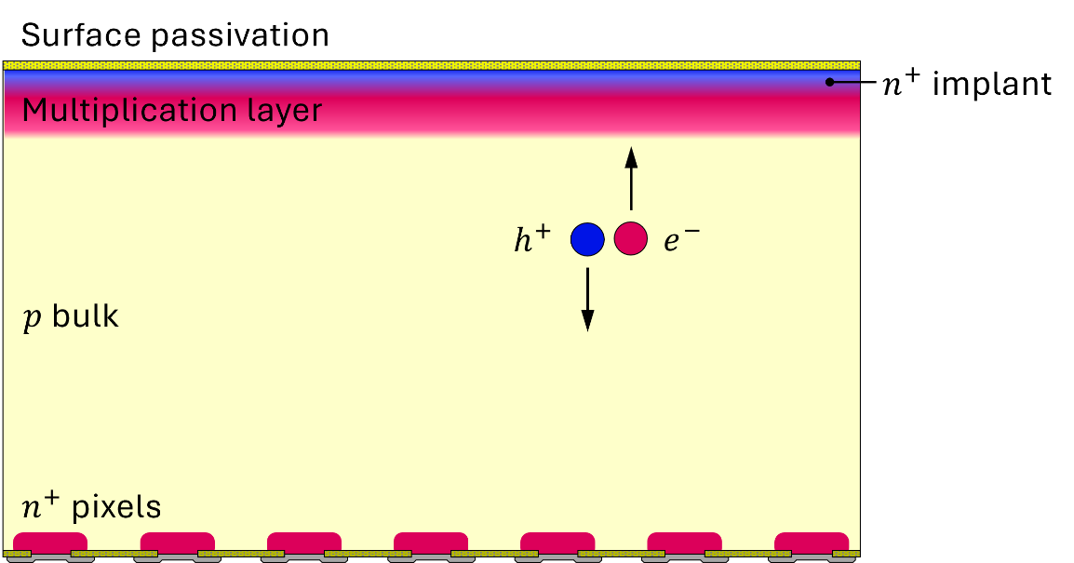
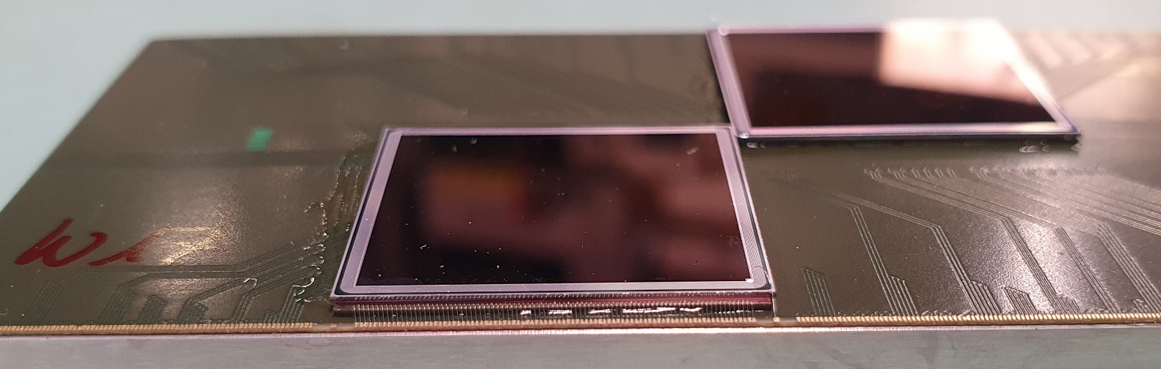
Start of the journey: The first JUNGFRAU-iLGAD prototype
(75 × 75 µm²)
JUNGFRAU 1.1
iLGAD sensor
V. Hinger et al 2024 Front. Phys. 12

Slide 9
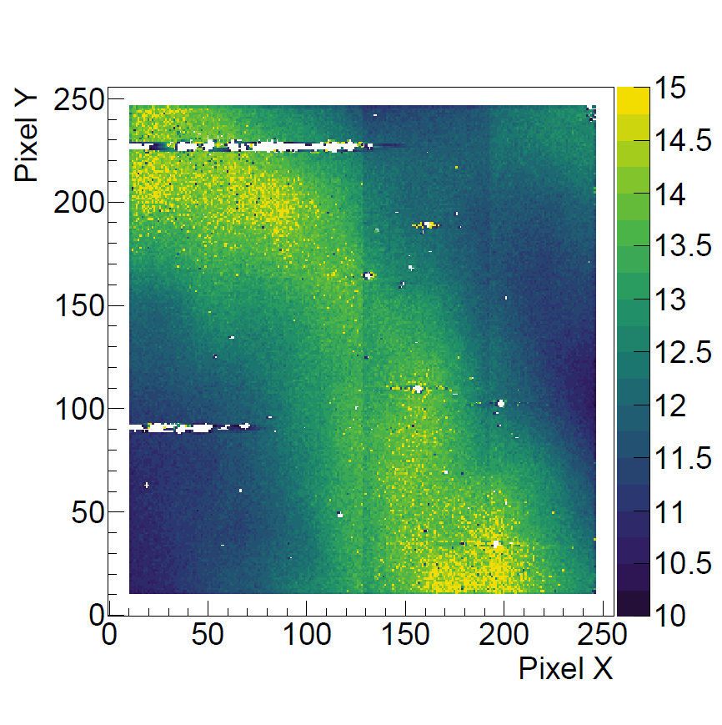
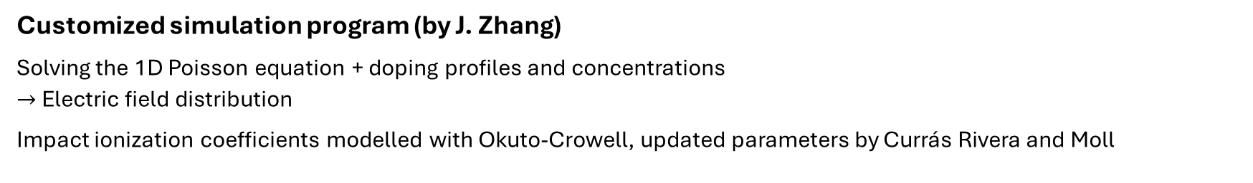
Multiplication factor is strongly influenced by temperature
iLGAD multiplication factor
Customized simulation program (by J. Zhang)
Solving the 1D Poisson equation + doping profiles and concentrations
$→$Electric field distribution
Impact ionization coefficients modelled with Okuto-Crowell, updated parameters by Currás Rivera and Moll
Simulated difference:
1.25% doping integrated dose
E. Currás Rivera and M. Moll 2023 IEEE Trans. Electron Devices 70, 2919–2926

Slide 10
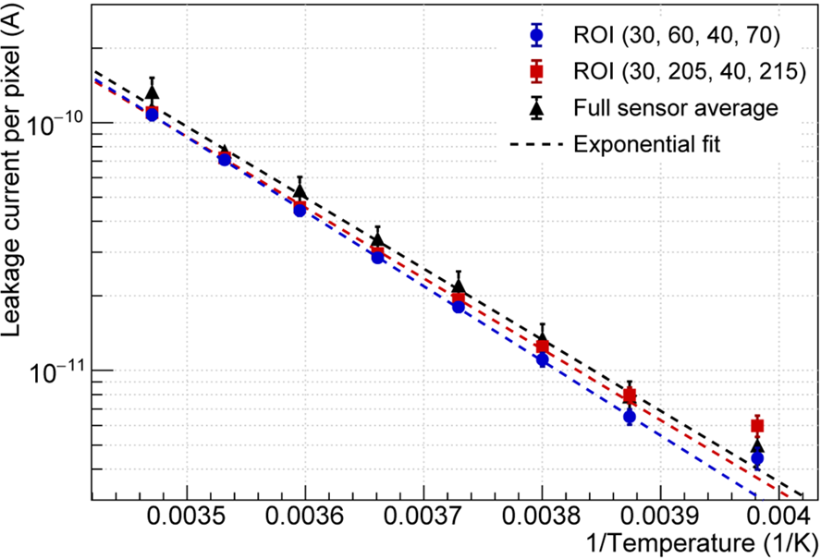
Cooling reduces the leakage current
iLGAD multiplication factor
15
10
5
0
-5
-10
-15
-22
(°C)
ROI (30, 205, 40, 215)
ROI (30, 60, 40, 70)
We benefit from increased gain and reduced shot noise!

Slide 11
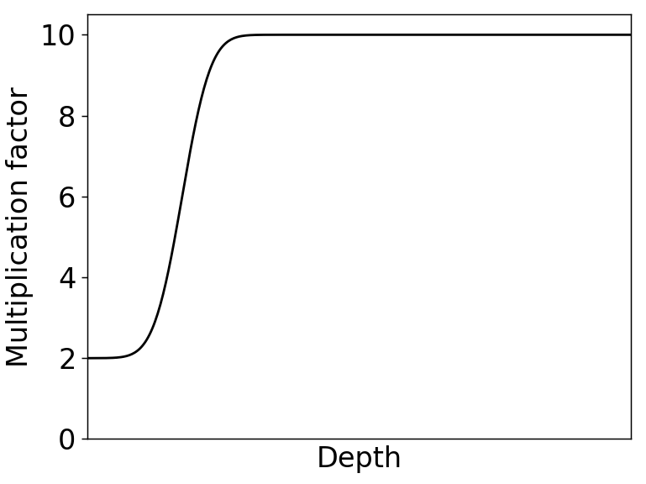
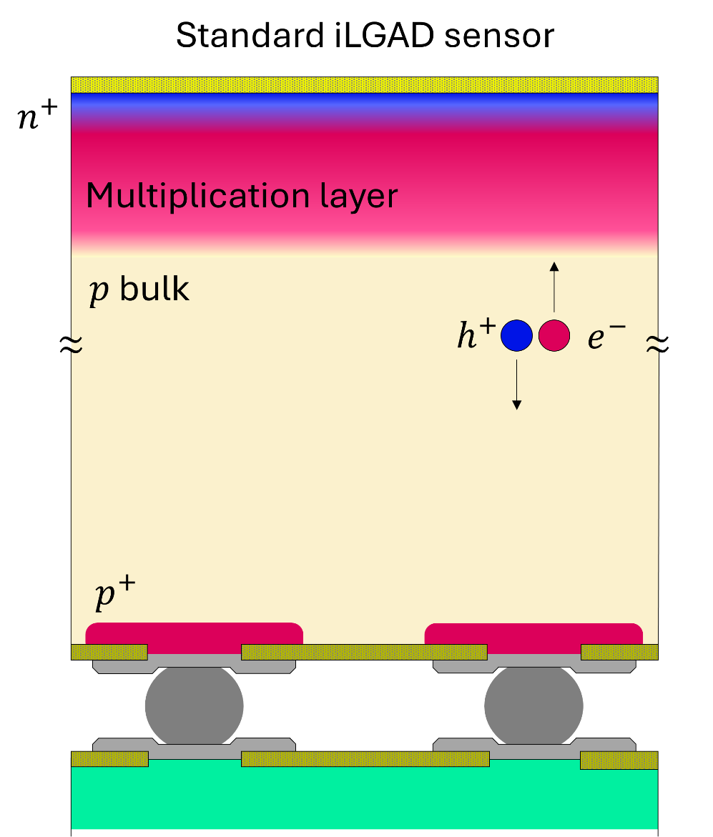
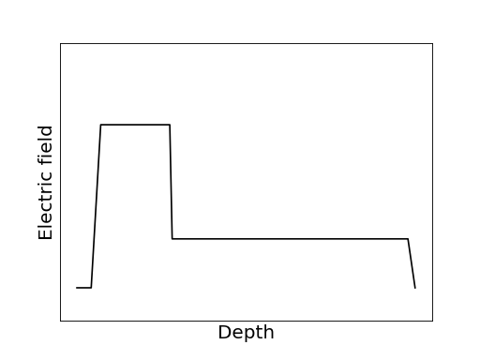
Multiplication factor depends on photon absorption depth
+
-
holes
+
-
+
-
-
+
-
+
-
+
-
+
-
-
+
-
electrons
Courtesy of M. Carulla
Standard gain layer design: M_{h}/M_{e} ~ 0.25

Slide 12
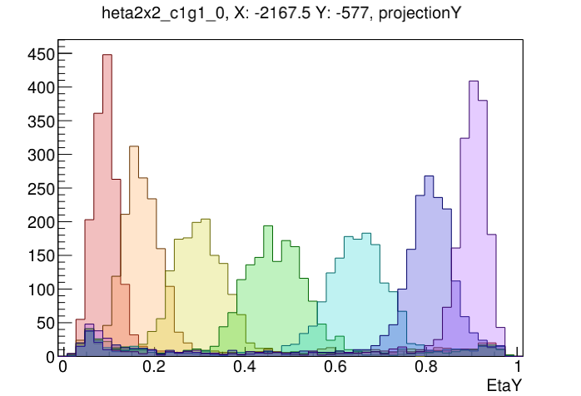
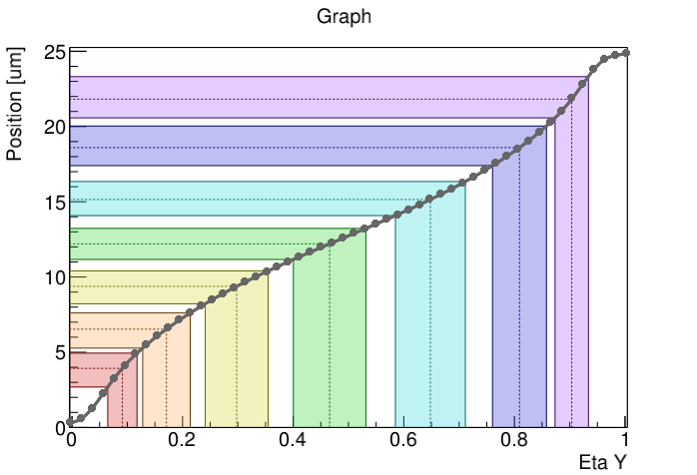

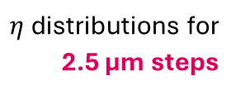
Next step: Spatial resolution
Pixel pitch must be comparable to spread of the charge cloud!
Sensor with rectangular pixels (“strixels”)
Validation with ~ 1µm beam scan
X-rays
75 µm
$η$distributions for 2.5 µm steps
1 keV
$$η=\frac{Q_{top}}{Q_{bottom}+Q_{top}}$$
75 µm
Interpolation direction
Estimated resolution
Bottom
Pixel gap
Top
Interpolation direction
∼ 2.7 µm
25 µm
∼ 2.6 µm
Implant
∼ 2.3 µm
∼ 2.1 µm
Metal
∼ 2.2 µm
∼ 2.3 µm
225 µm
∼ 2.3 µm

Slide 13
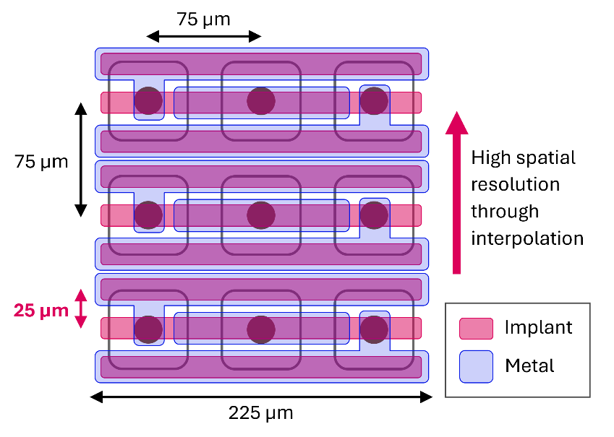
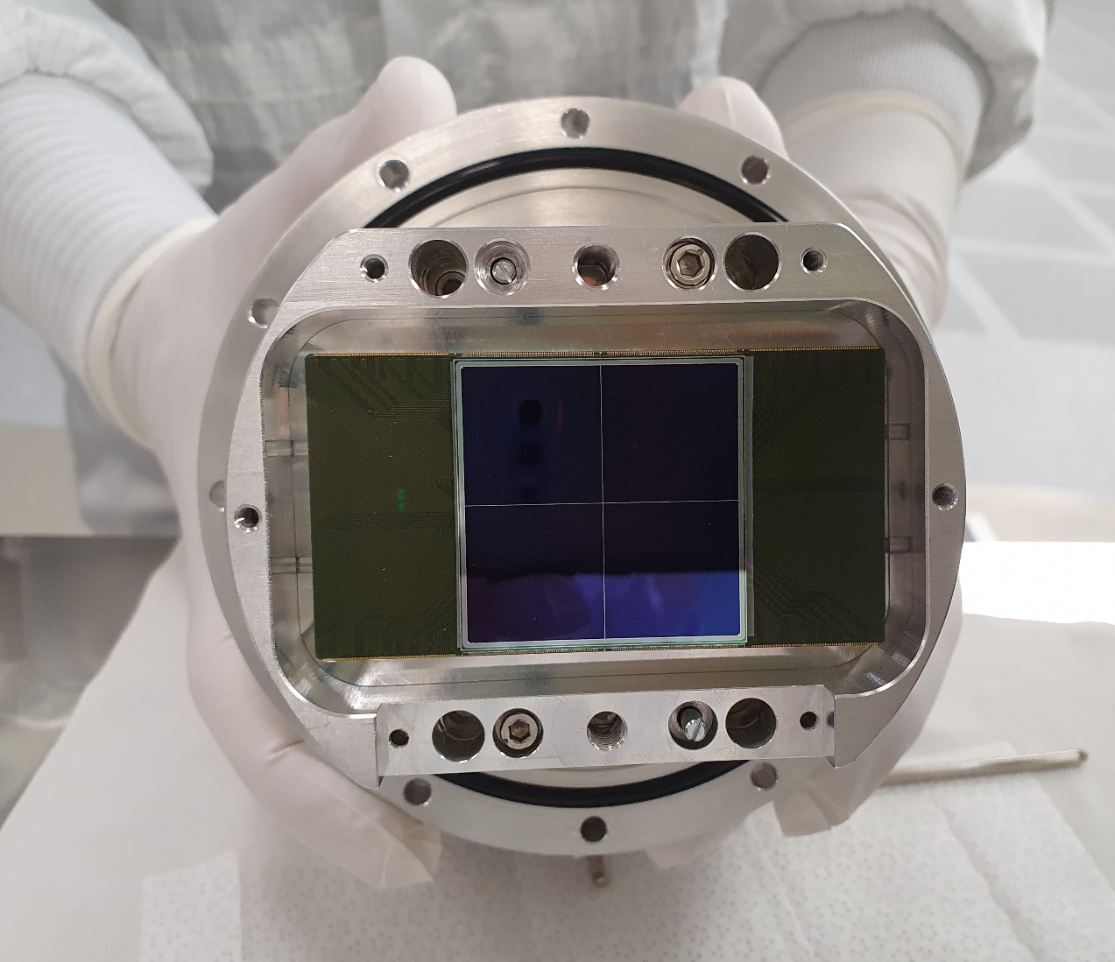
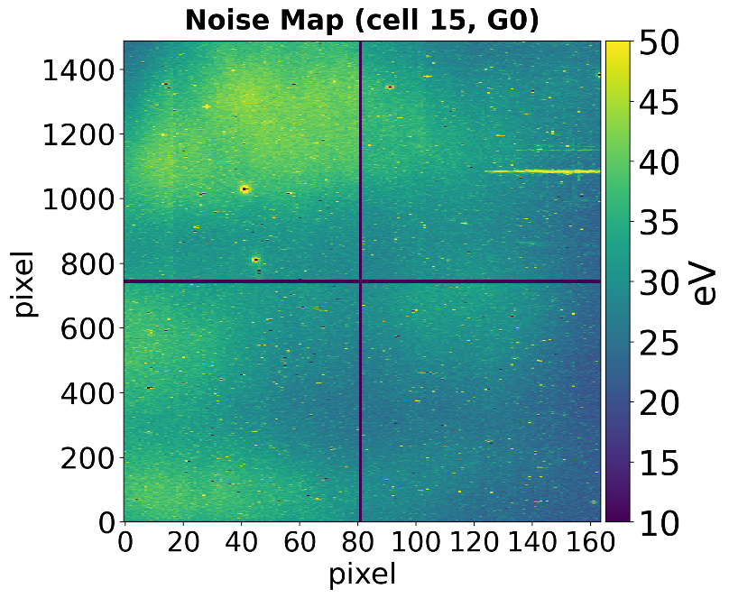
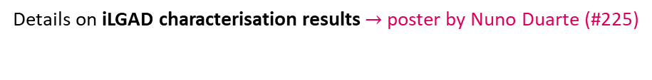
Next step: A JUNGFRAU detector with iLGAD strixels
4 cm
Effective noise (eV)
4 cm
- 20°C,
5 µs integration: ENC_{eff} ~ 9 e⁻ r.m.s.
Courtesy of
N. Duarte
Details on iLGAD characterisation results $→$ poster by Nuno Duarte (#225)

Slide 14

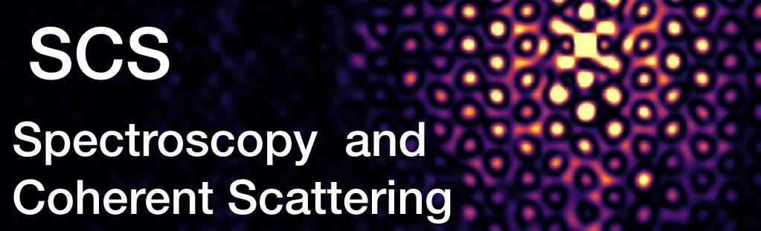
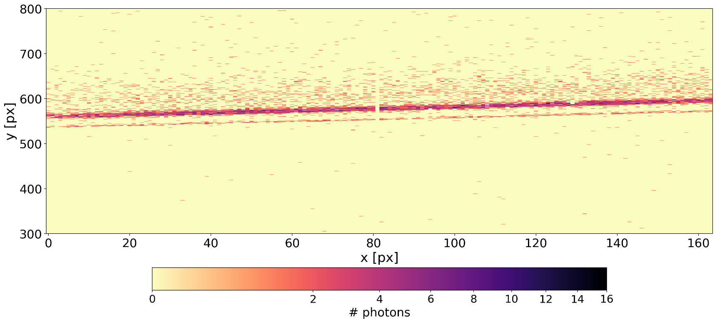
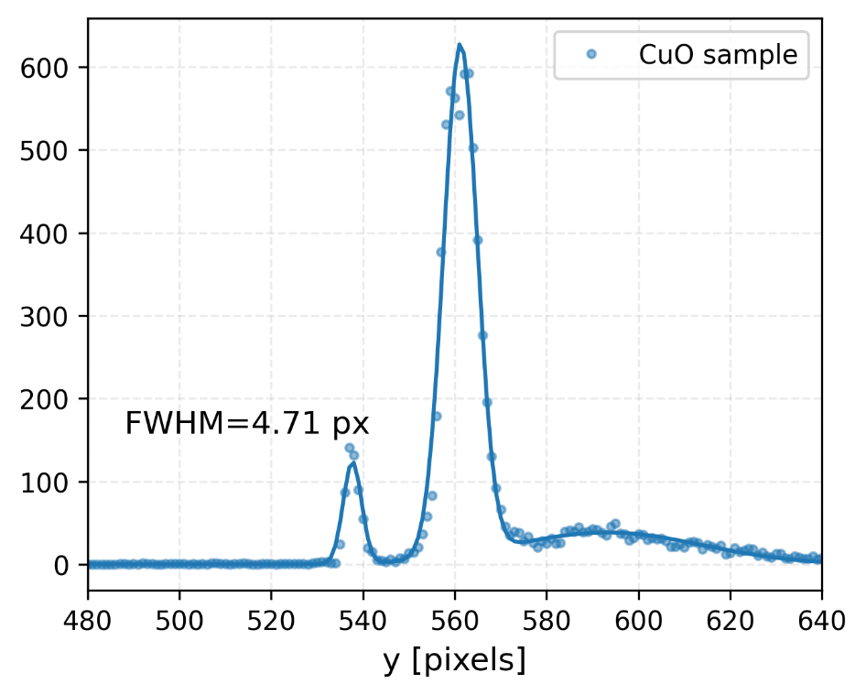
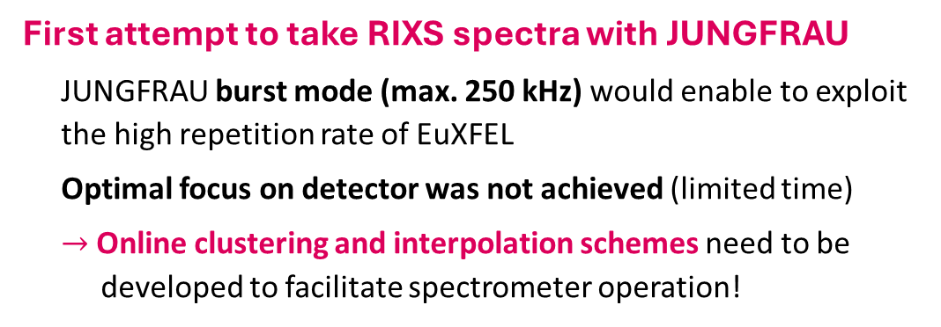
Test at European XFEL SCS hRIXS
First attempt to take RIXS spectra with JUNGFRAU
JUNGFRAU burst mode (max. 250 kHz) would enable to exploit the high repetition rate of EuXFEL
Optimal focus on detector was not achieved (limited time)
$→$Online clustering and interpolation schemes need to be
developed to facilitate spectrometer operation!
Only curvature correction, no interpolation
CuO elastic line (930 eV)
Courtesy of N. Duarte

Slide 15
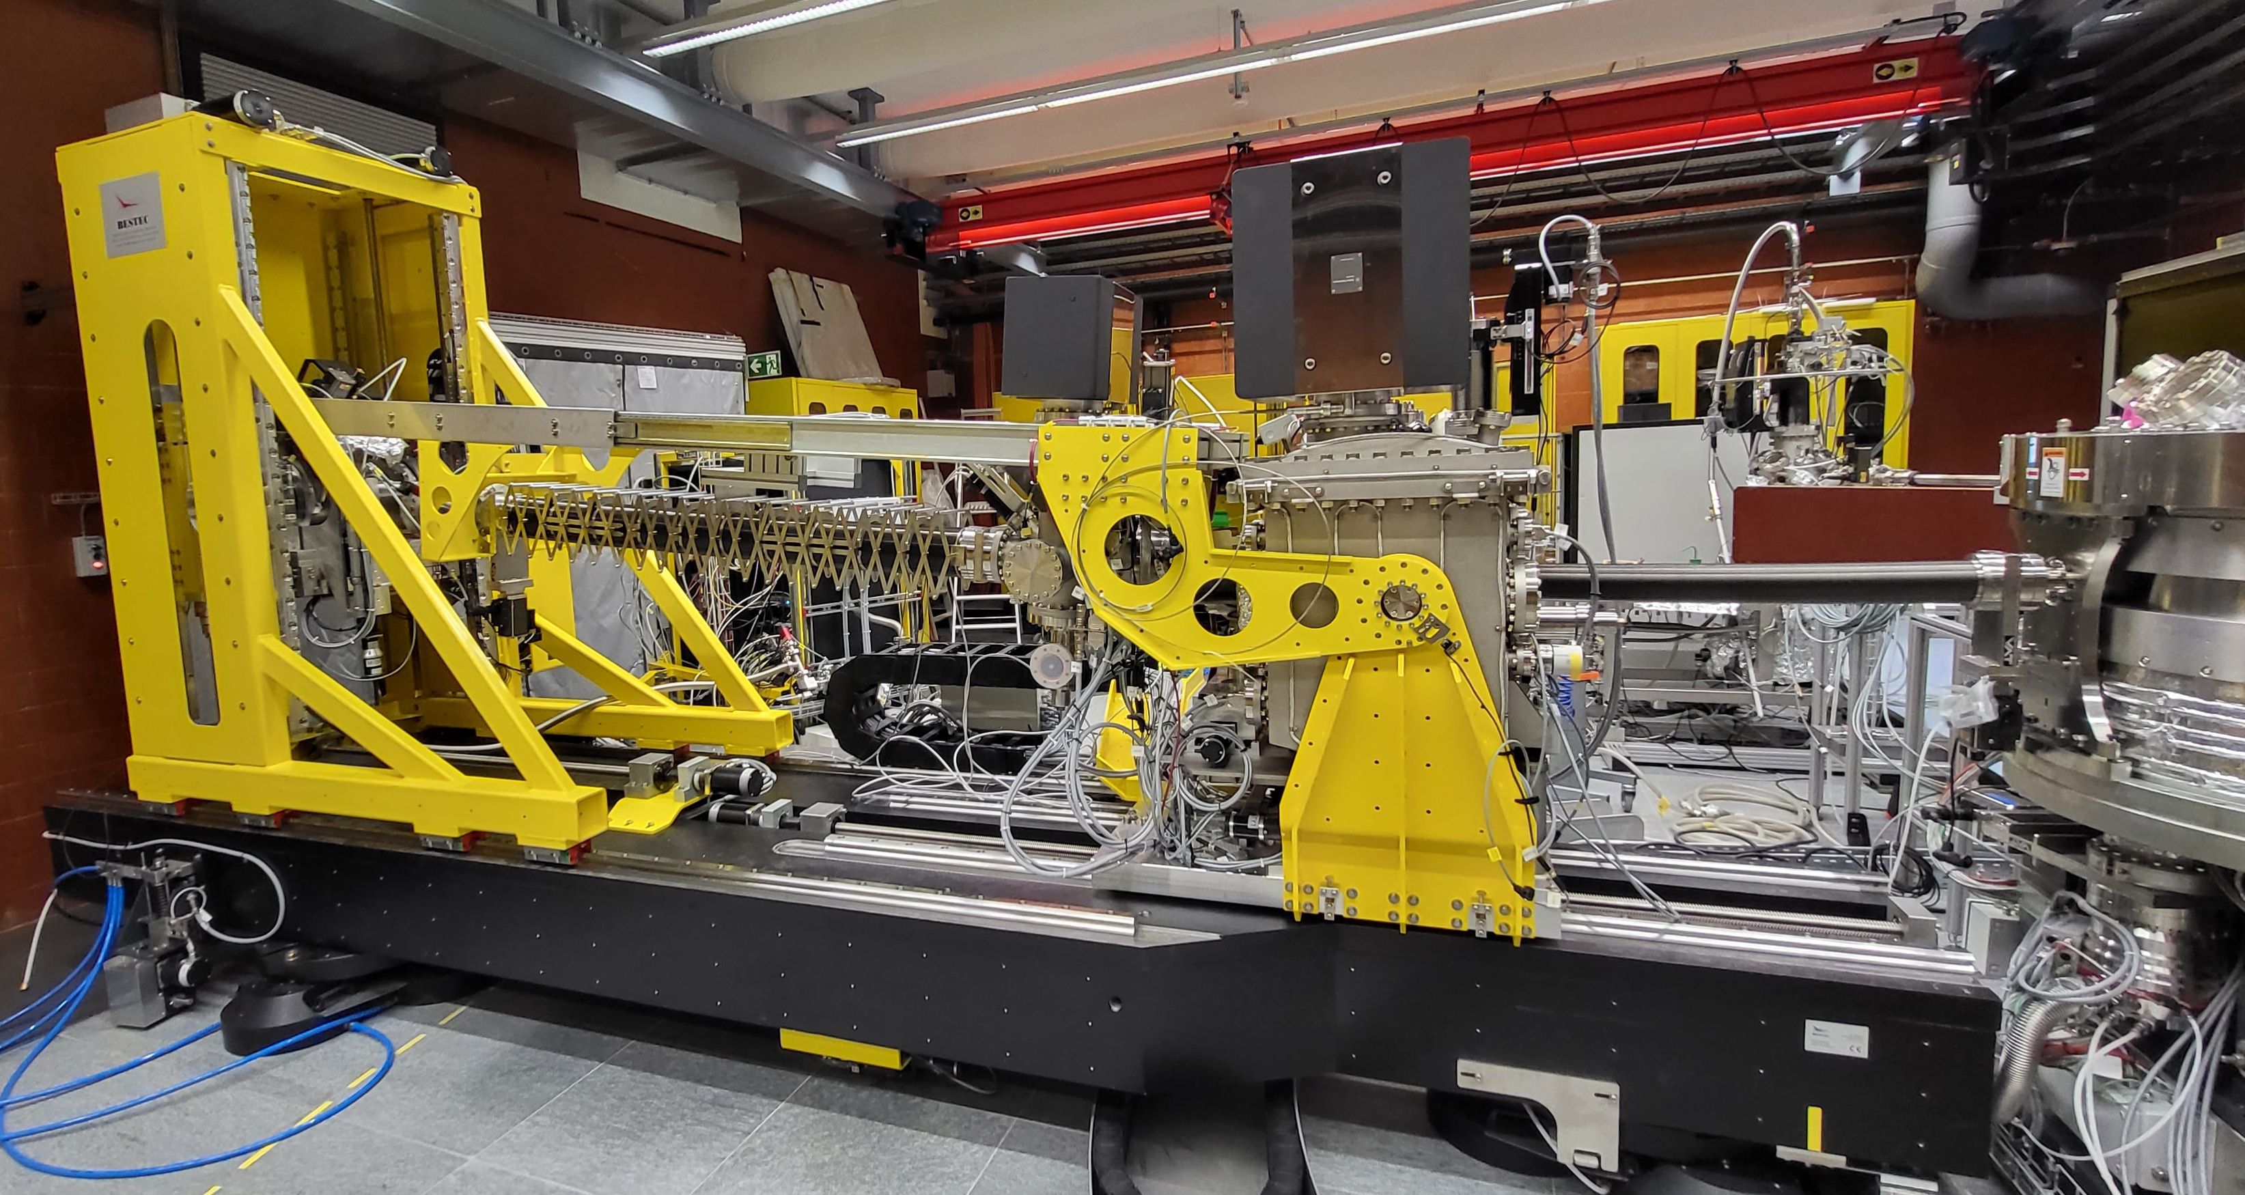


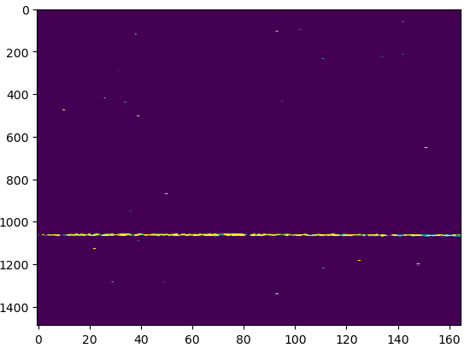
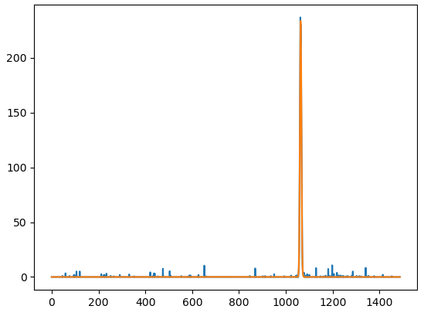
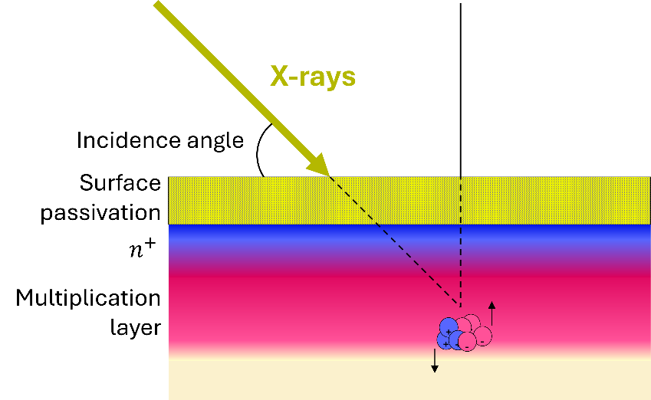
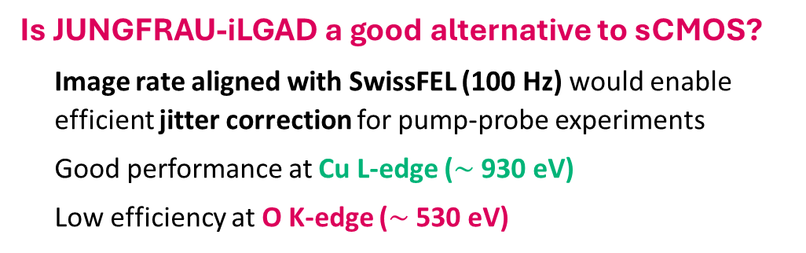
Test at SwissFEL Furka
Is JUNGFRAU-iLGAD a good alternative to sCMOS?
Image rate aligned with SwissFEL (100 Hz) would enable efficient jitter correction for pump-probe experiments
Good performance at Cu L-edge ($\sim$ 930 eV)
Low efficiency at O K-edge ($\sim$ 530 eV)
Preliminary
Only curvature correction, no interpolation
Elastic line (932 eV)
FWHM = 3.25 px

Slide 16
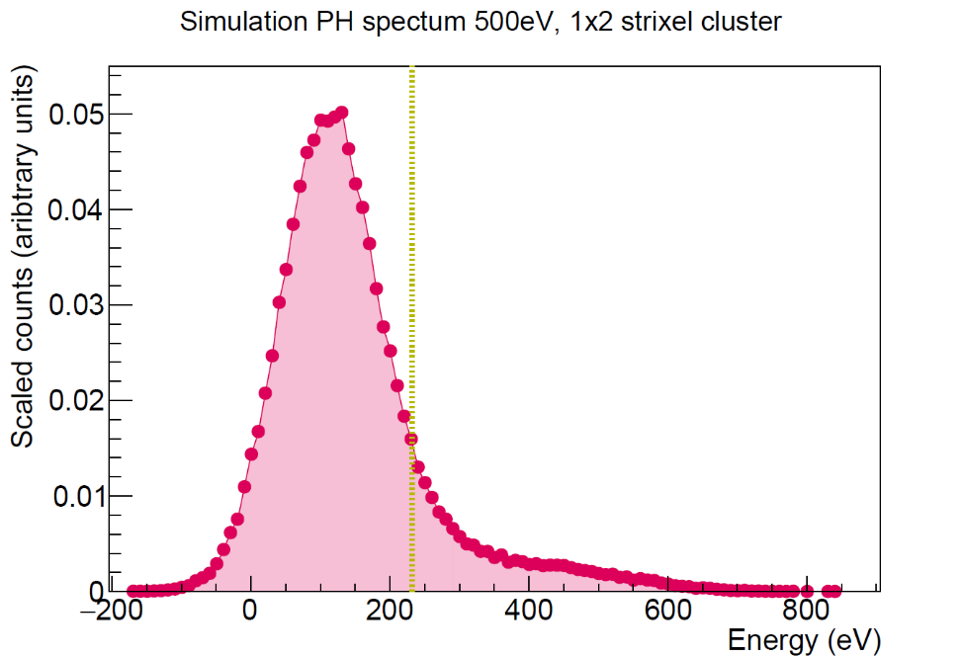
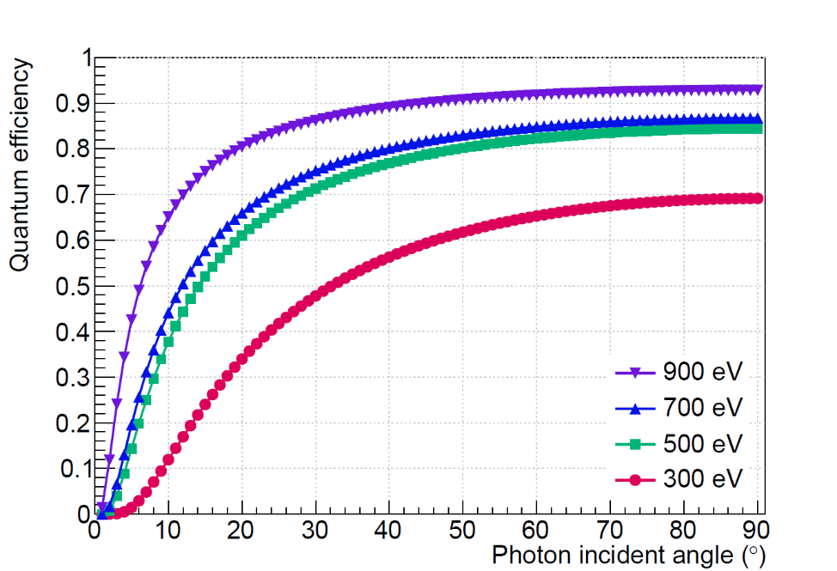

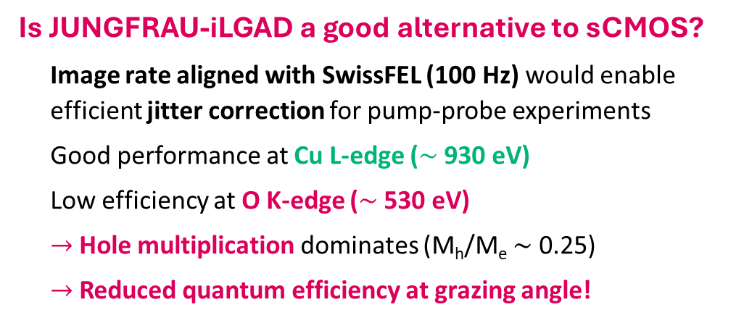
Test at SwissFEL Furka
Is JUNGFRAU-iLGAD a good alternative to sCMOS?
Image rate aligned with SwissFEL (100 Hz) would enable efficient jitter correction for pump-probe experiments
Good performance at Cu L-edge ($\sim$ 930 eV)
Low efficiency at O K-edge ($\sim$ 530 eV)
$→$Hole multiplication dominates (M_{h}/M_{e} $\sim$ 0.25)
$→$Reduced quantum efficiency at grazing angle!
Hole peak
5$σ$ effective noise
Not detected
Electron peak (500 eV)

Slide 17
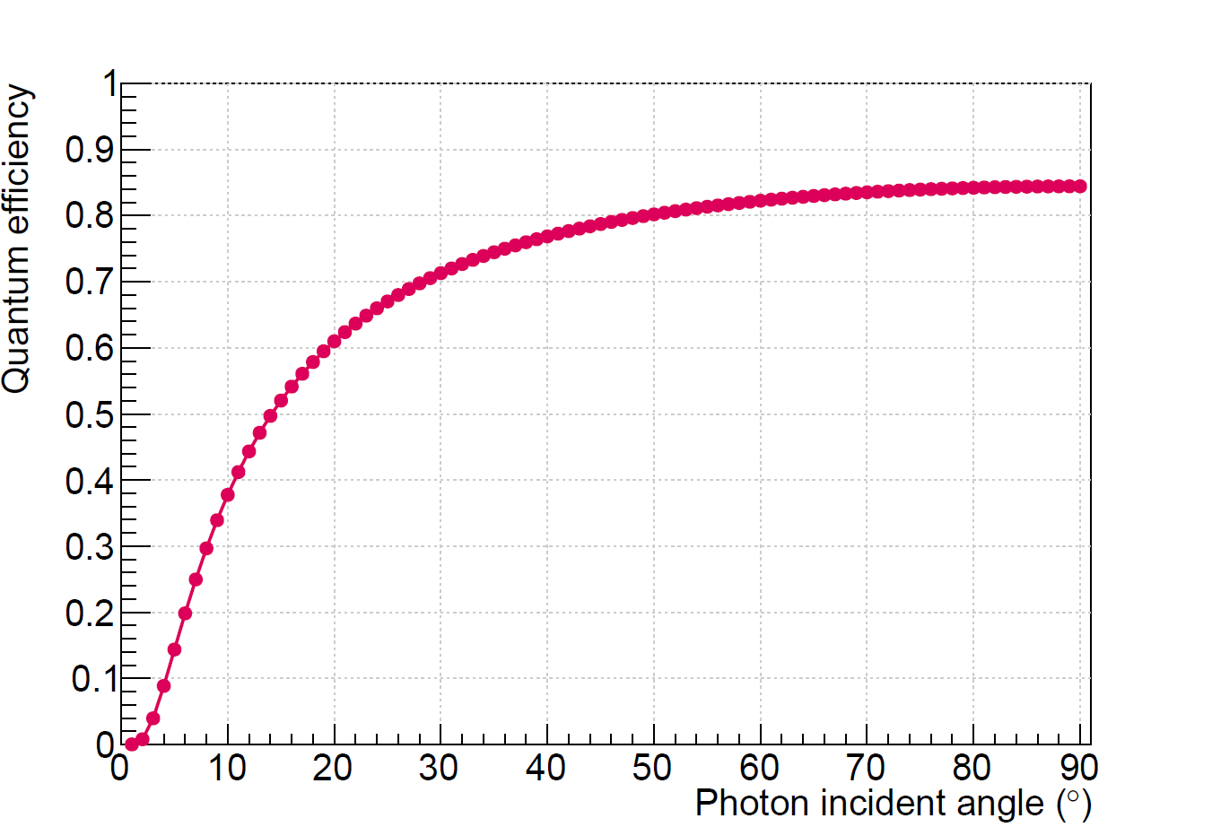
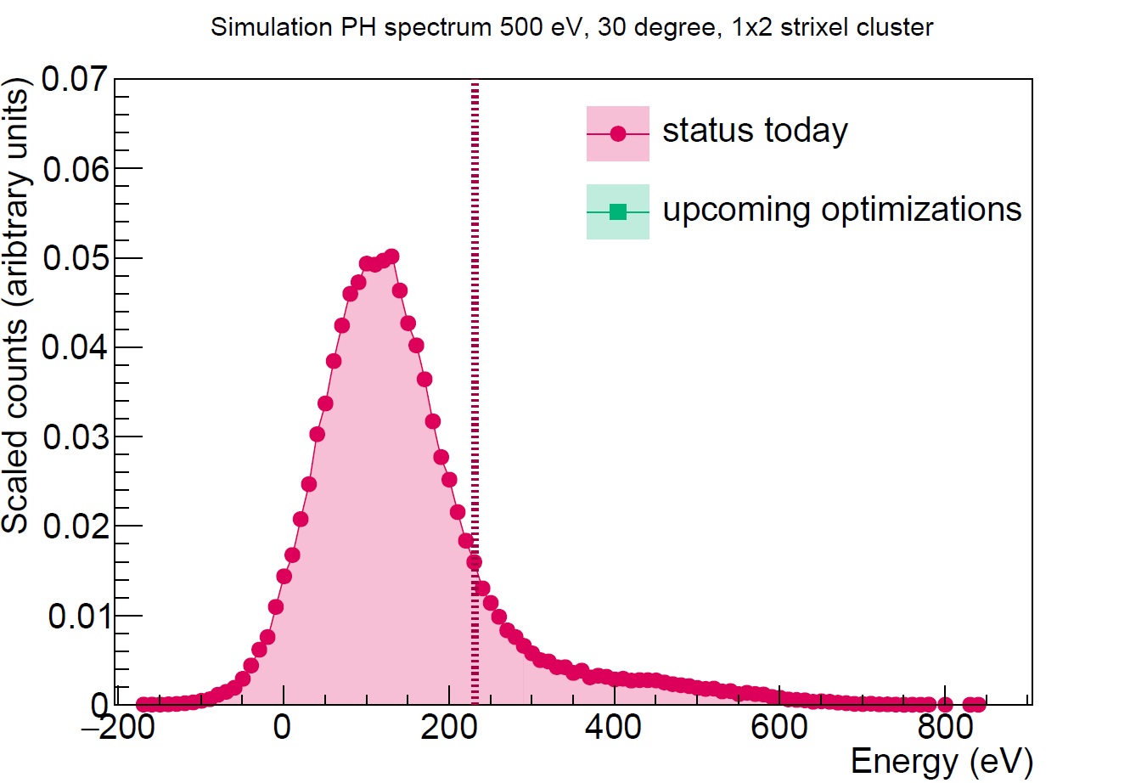
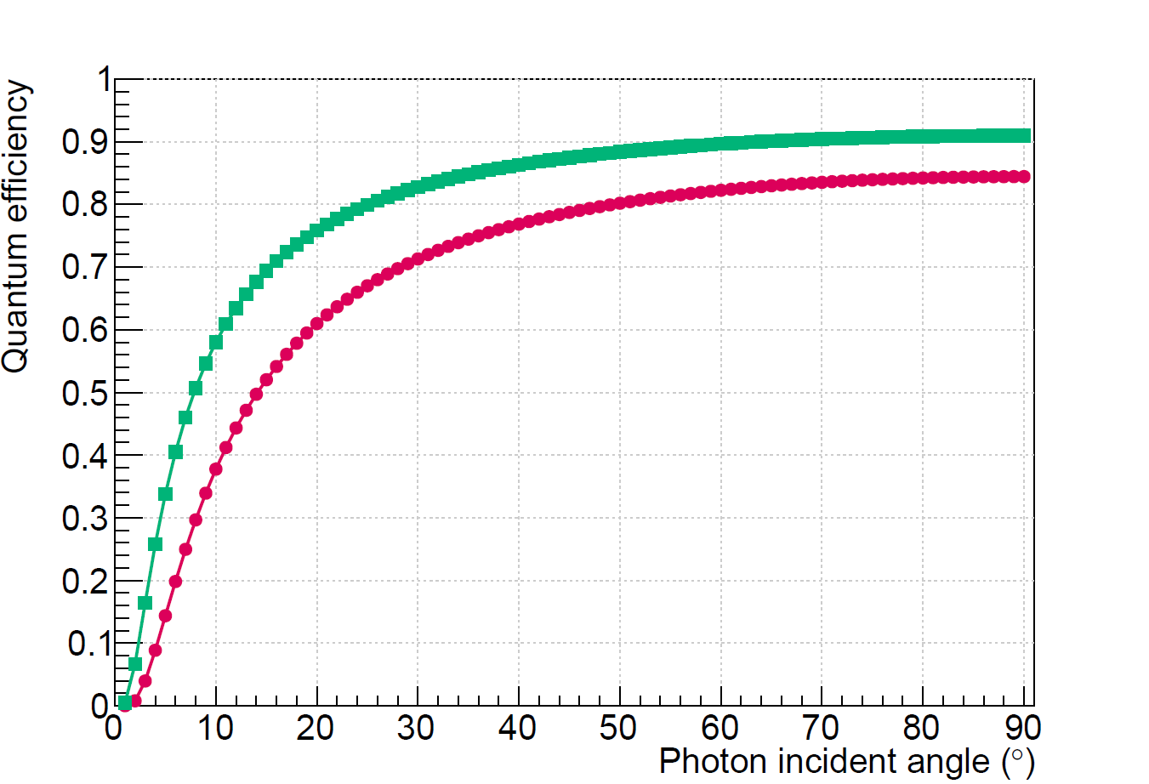
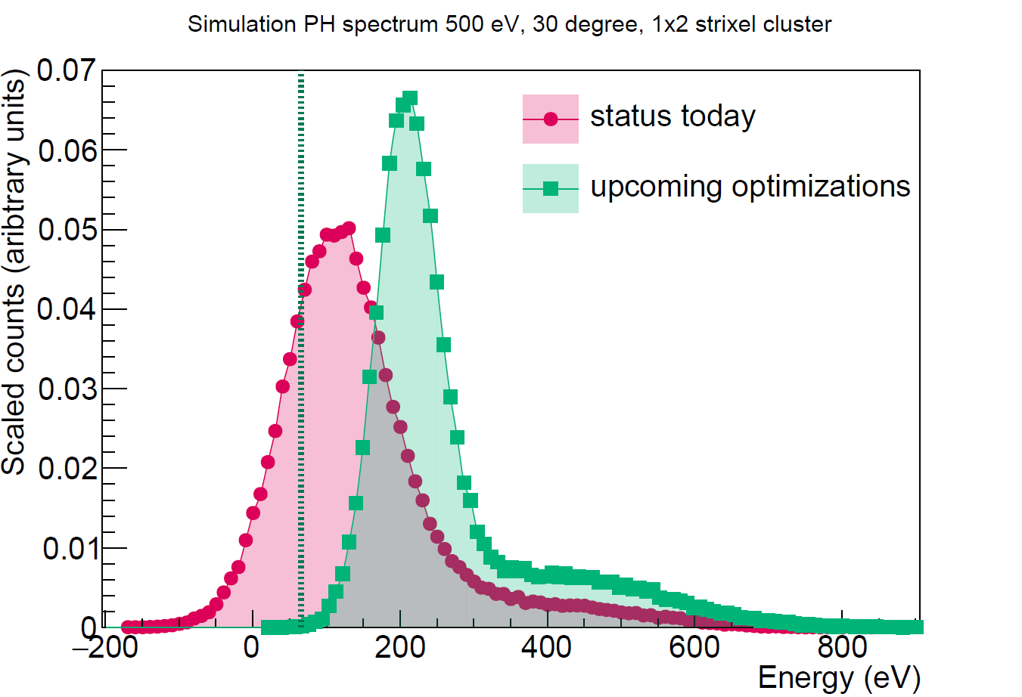
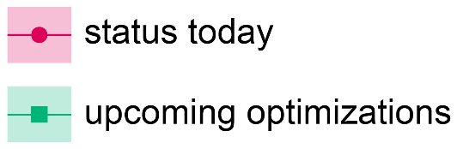
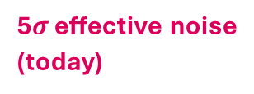
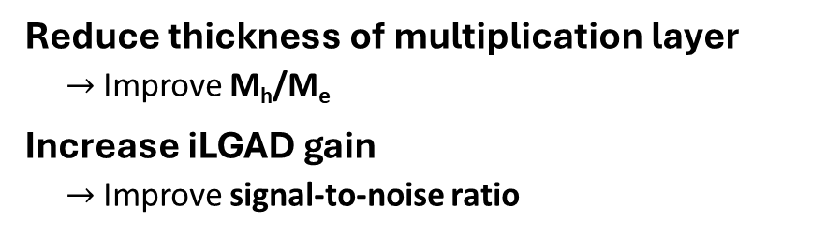
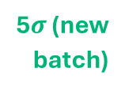
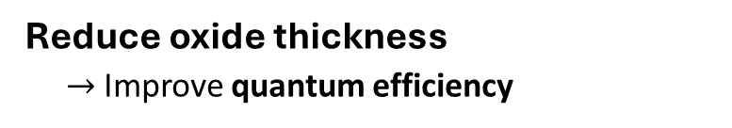
Optimizations are planned with upcoming iLGAD R&D batch
Combined detection efficiency (500 eV photons, 30° angle) $\sim$ 10% (today)
Combined detection efficiency (500 eV photons, 30° angle) $\sim$ 10% (today) $→$ > 80% (new iLGAD batch)
@ 500 eV
5$σ$ (new batch)
Hole peak
5$σ$ effective noise (today)
Hole peak
Electron peak (500 eV)
Reduce oxide thickness
$→$Improve quantum efficiency
Reduce thickness of multiplication layer
$→$Improve M_{h}/M_{e}
Increase iLGAD gain
$→$Improve signal-to-noise ratio

Slide 18
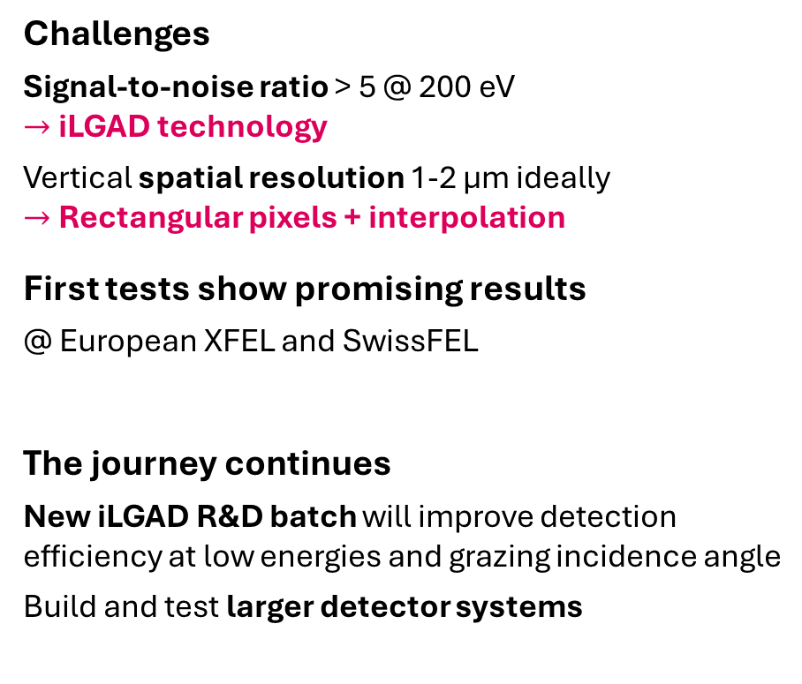
Summary & Outlook
Using JUNGFRAU for Resonant Inelastic X-ray Scattering (RIXS) at low photon energies
Challenges
Signal-to-noise ratio > 5 @ 200 eV
$→$ iLGAD technology
Vertical spatial resolution 1-2 µm ideally
$→$ Rectangular pixels + interpolation
First tests show promising results
@ European XFEL and SwissFEL
The journey continues
New iLGAD R&D batch will improve detection efficiency at low energies and grazing incidence angle
Build and test larger detector systems

Slide 19
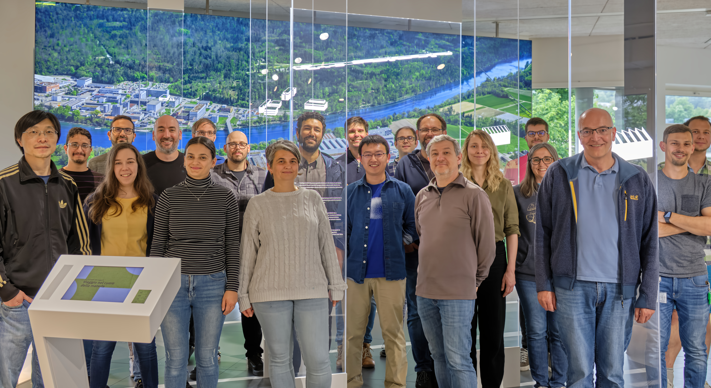
Acknowledgements
European XFEL
Nuno Duarte, Loïc Le Guyader, Marco Ramilli, Andreas Scherz, Monica Turcato
PSI Center for Photon Science Detector Group
Left to right: Jiaguo Zhang, Bechir Braham, Konstantinos Moustakas, Viktoria Hinger, Christian Ruder, Shqipe Hasanaj, Dominic Greiffenberg, Julian Heymes, Anna Bergamaschi, Khalil Ferajoui, Carlos Lopez-Cuenca, Xiangyu Xie, Pawel Kozłowski, Martin Brückner, Roberto Dinpoli, Kirsty A. Paton, Filippo Baruffaldi, Mar Carulla, Bernd Schmitt, Thomas King, Patrick Sieberer
Not on photo: Rebecca Barten, Simon Ebner, Erik Fröjdh, Davide Mezza, Aldo Mozzanica, Dhanya Thattil
SwissFEL Furka
Eugenio Paris, Elia Razzoli, Elisabeth Skoropata, Hiroki Ueda

