Slide 1
DynamiX
A prototype high-framerate, high-dynamic-range hard X-ray detector for 4th generation synchrotrons
Simon Knowles (STFC)
On behalf of the XIDyn Collaboration
iWoRiD 2024

Slide 2
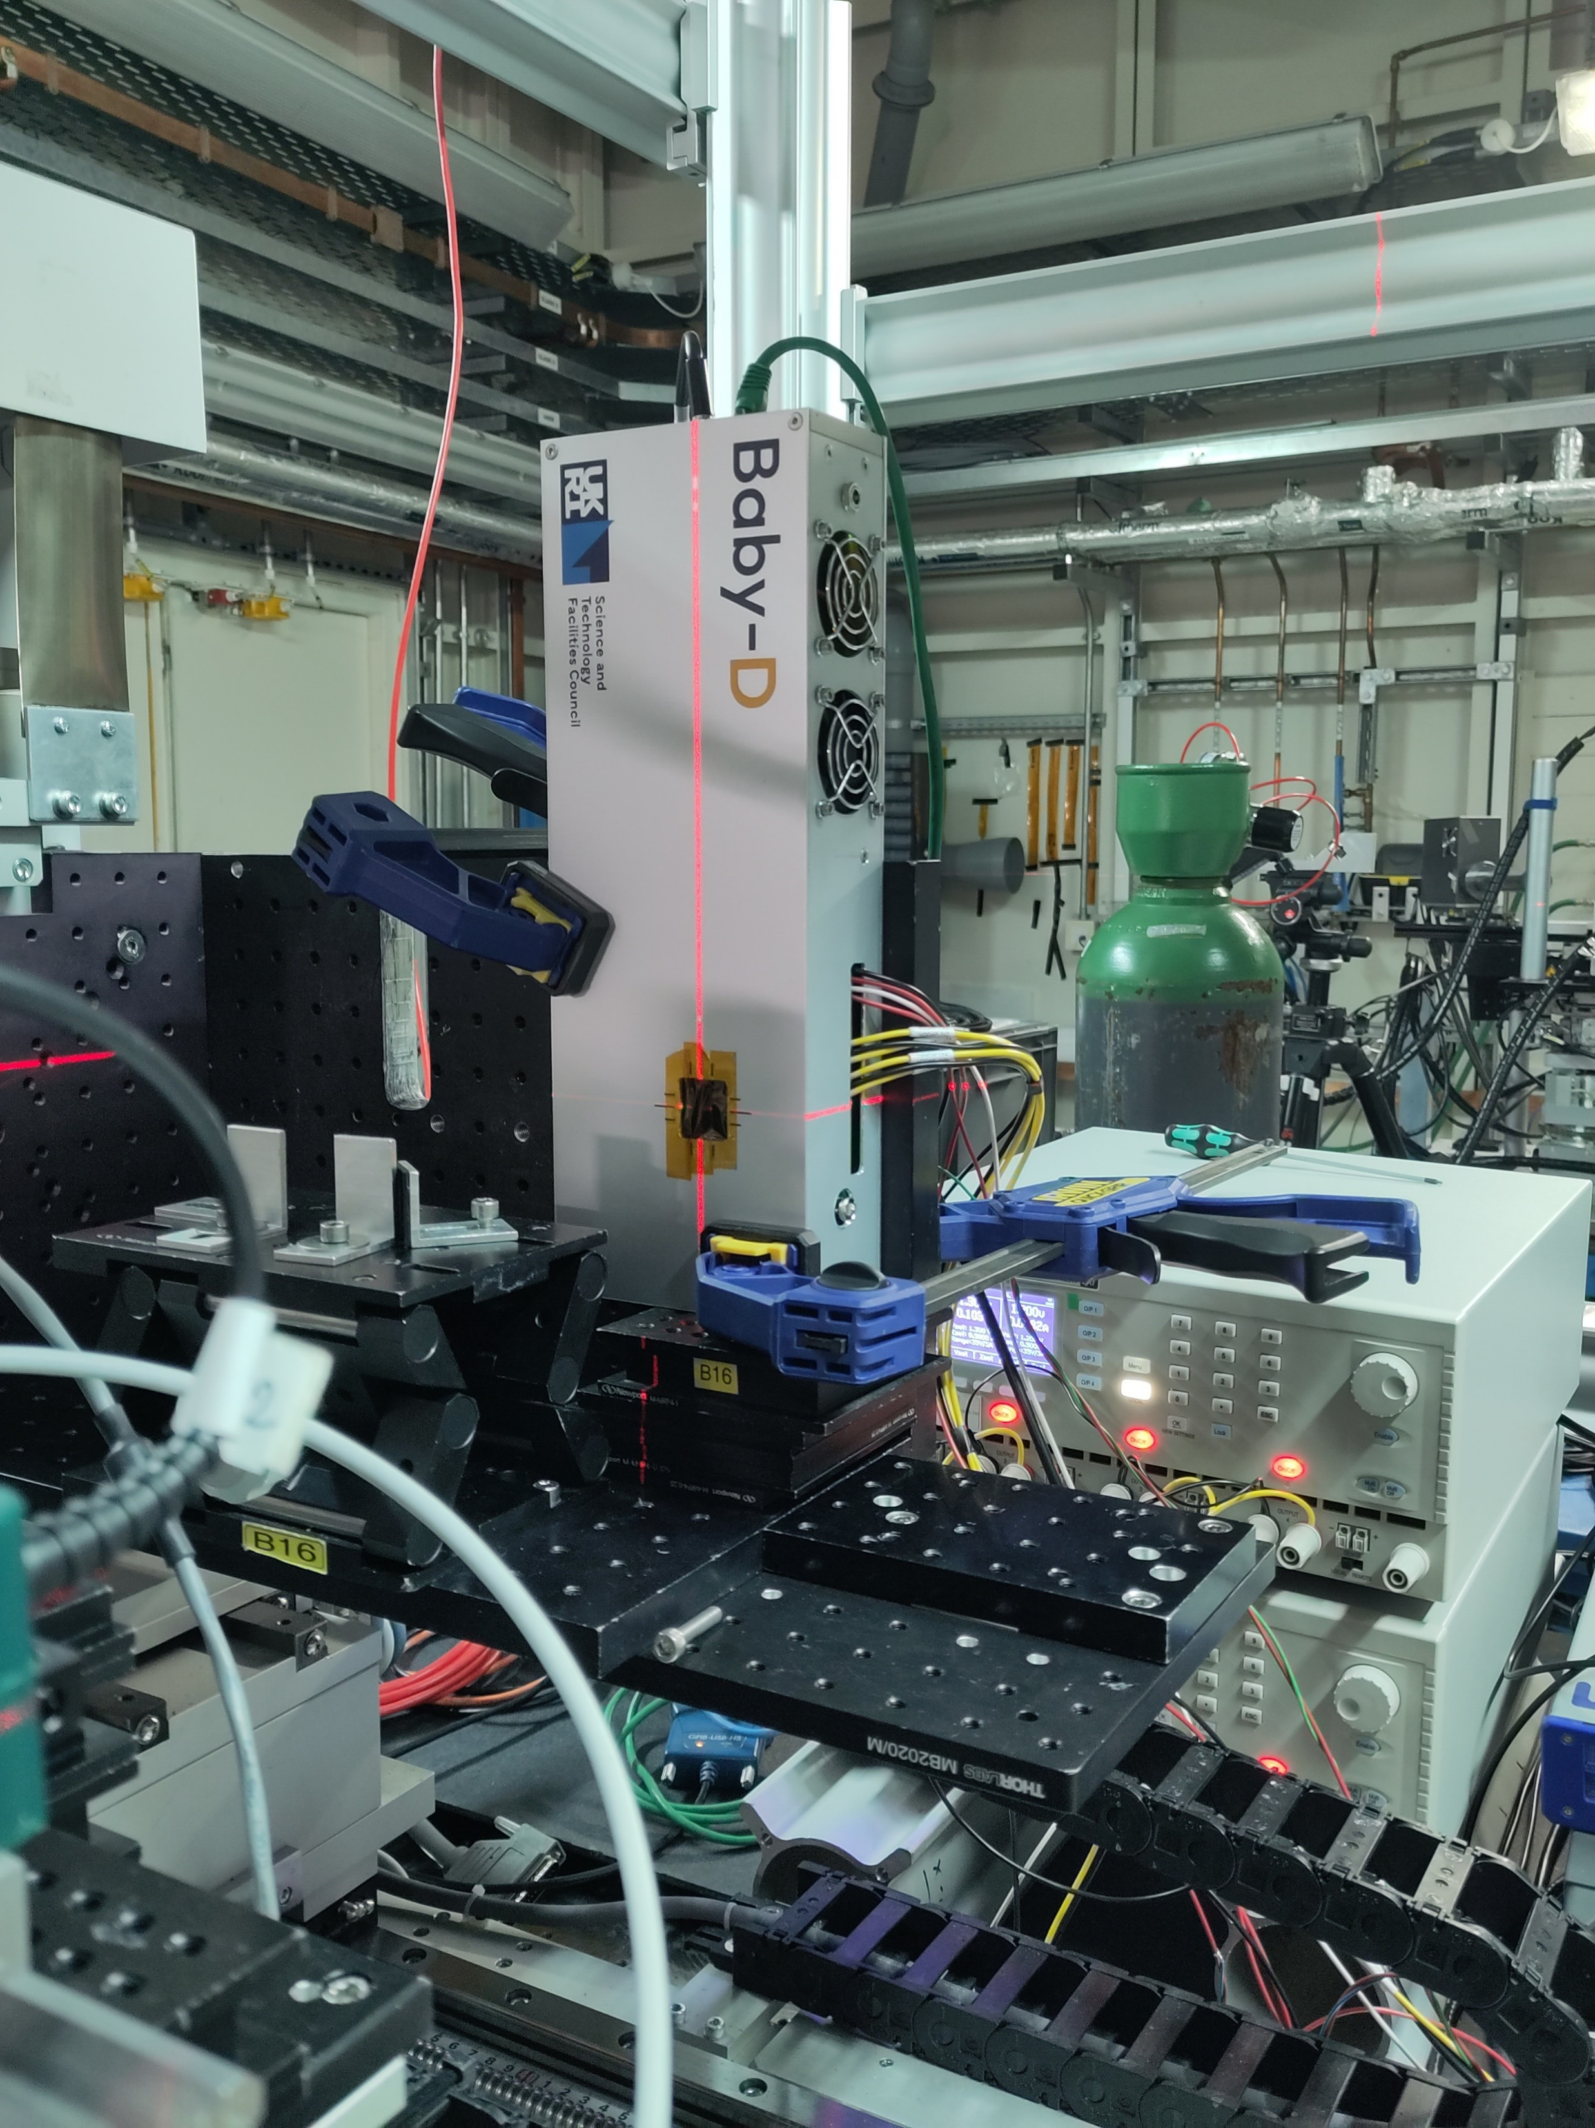
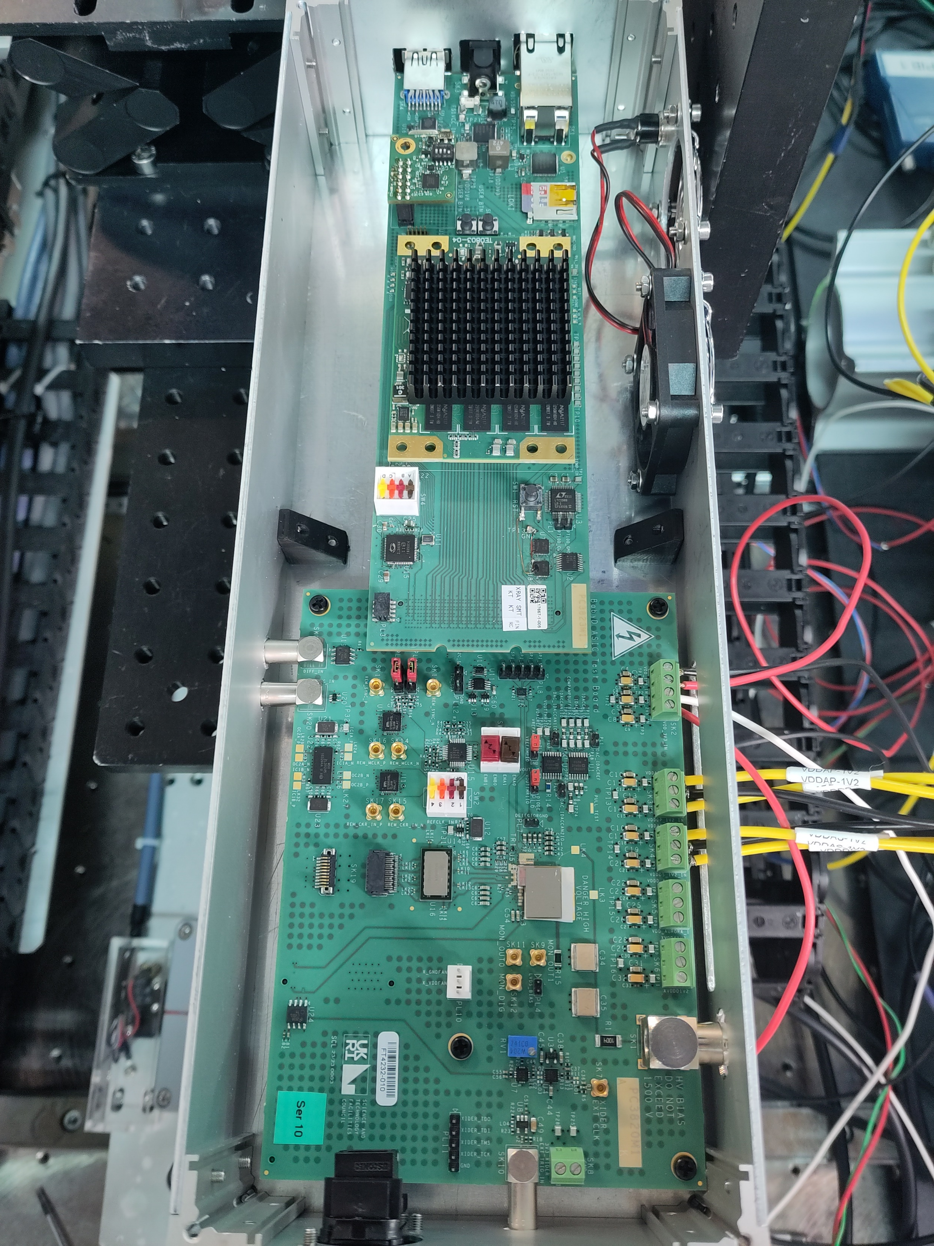
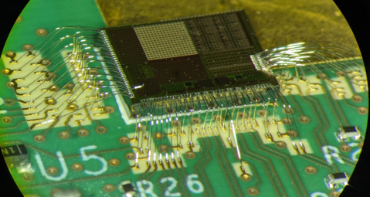
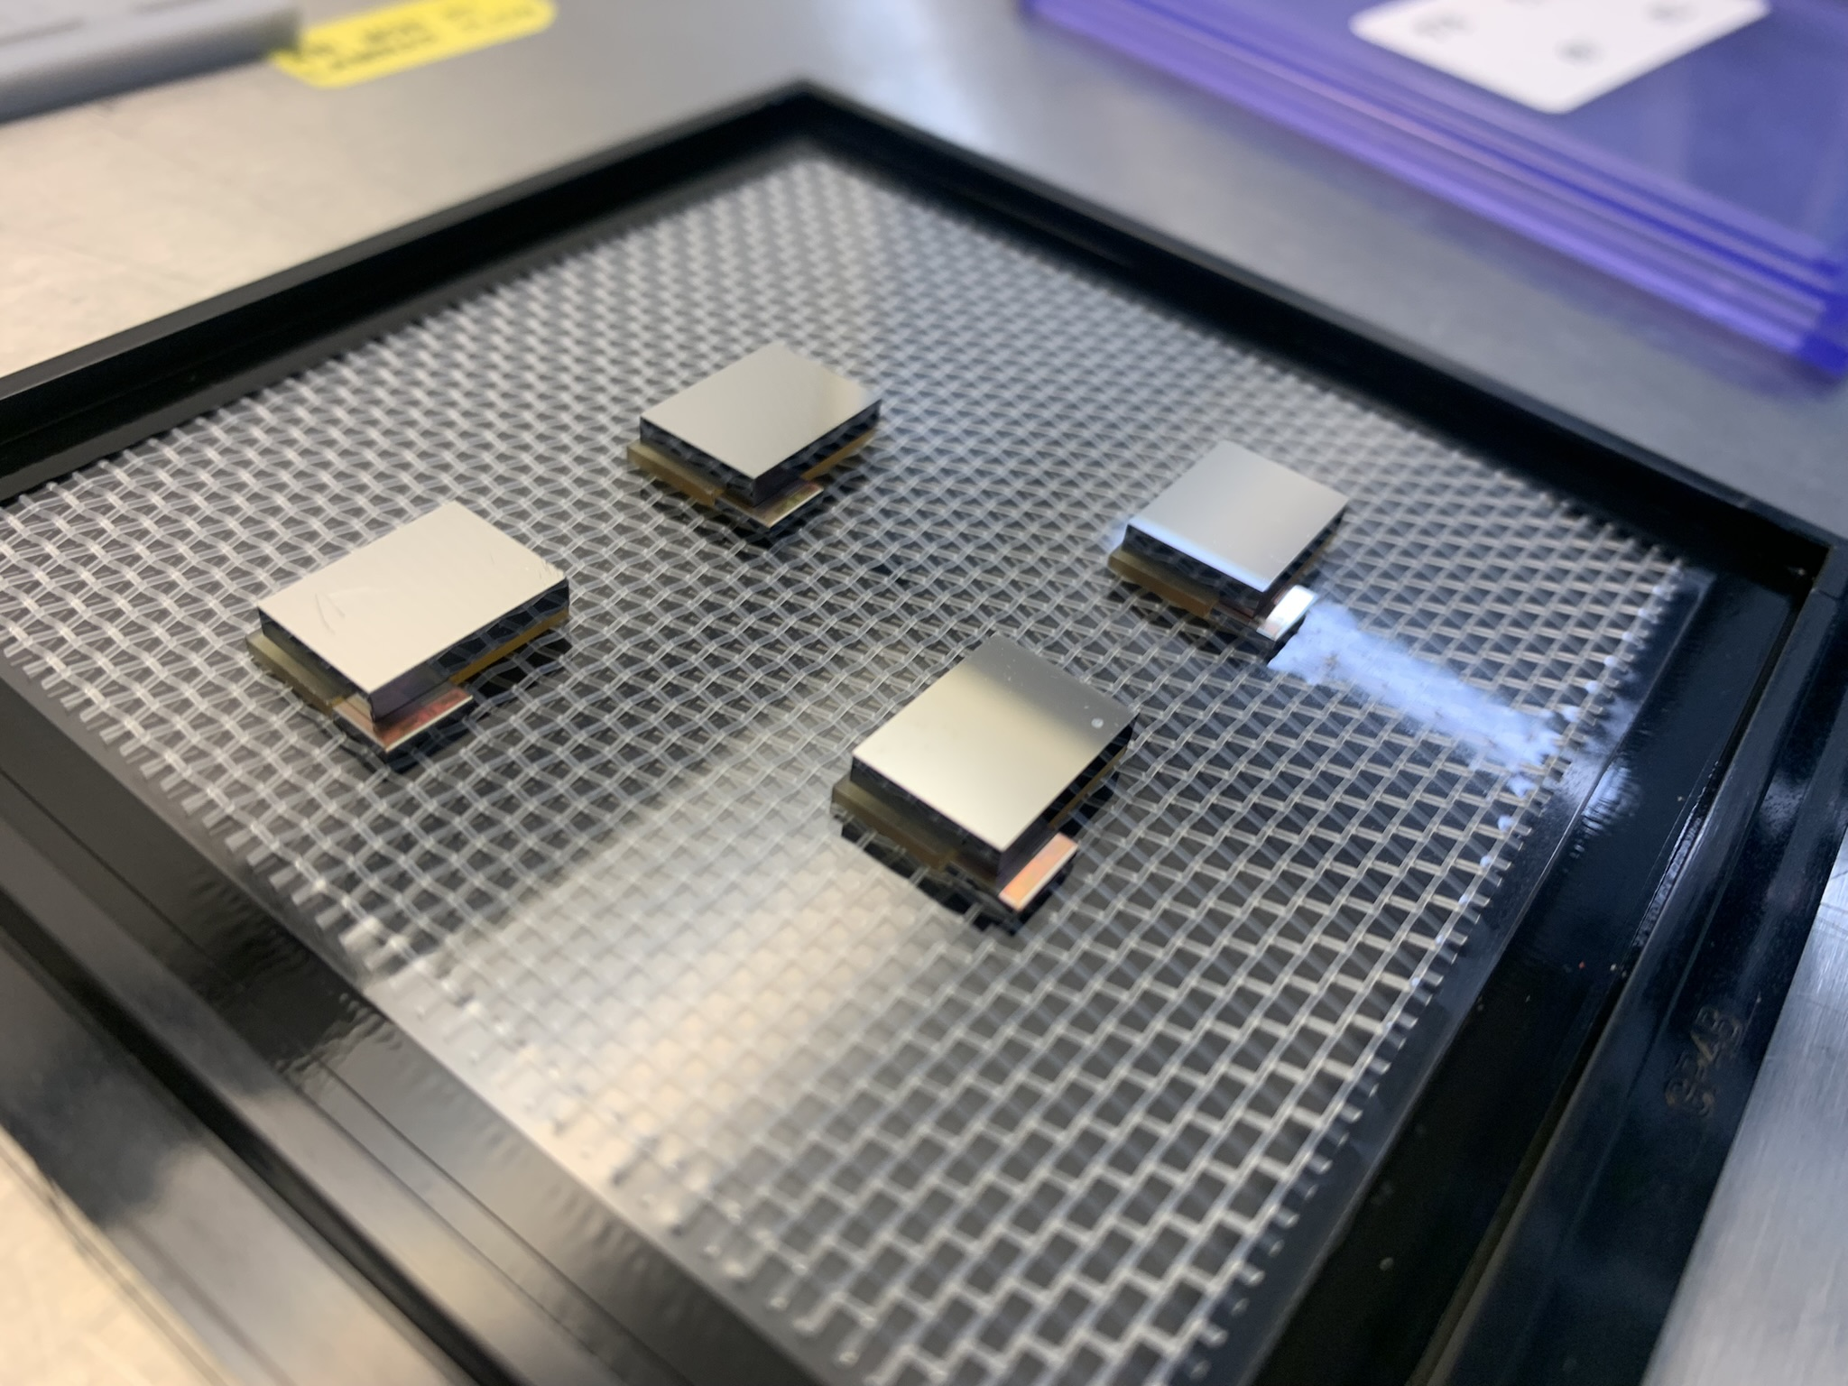
DynamiX Overview
Charge-integrating hybrid pixellated detector system prototype
Aims to meet challenges of beamline upgrades
  Higher fluxes → new ASIC architecture
  Higher energies → CZT sensor material
16 x 16 pixels on 110μm pitch
533kHz (adjustable) framerate to match Diamond orbit
Readout at 14.1Gbps
Aligning DynamiX at Diamond Light Source
DynamiX ASIC-CdZnTe hybrids
DynamiX after wire-bonding
Notes:
110um is not a small pitch!

Slide 3
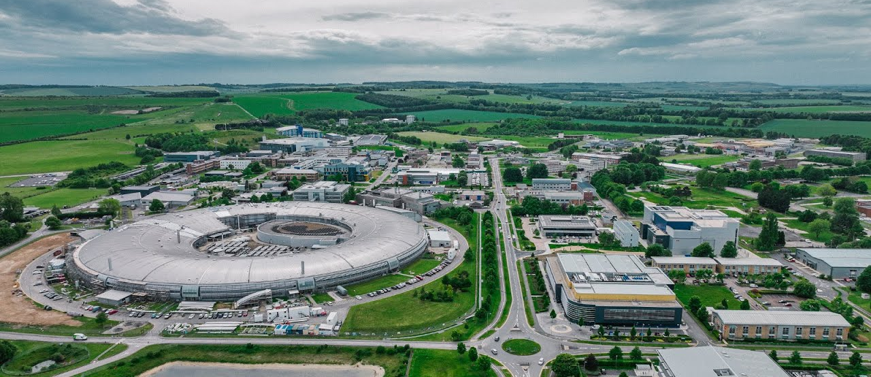

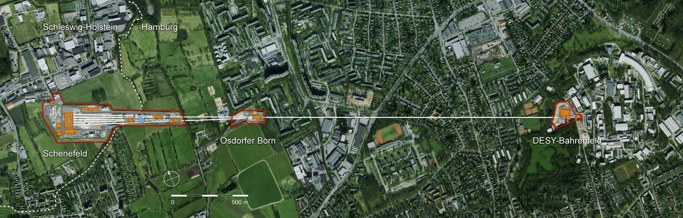
Content
Motivations
Chip architecture
Testing
Summary

Slide 4
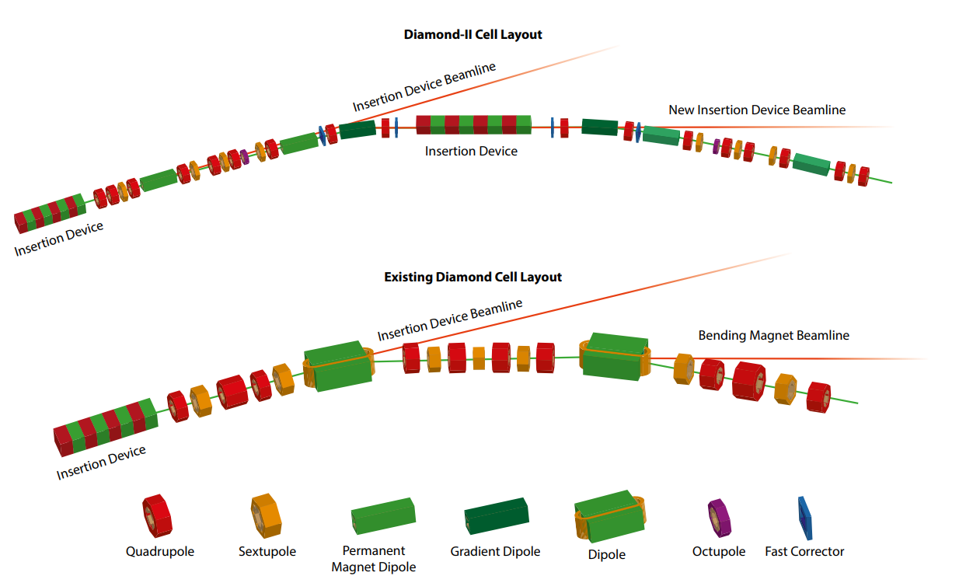

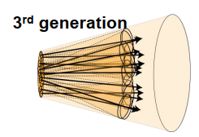
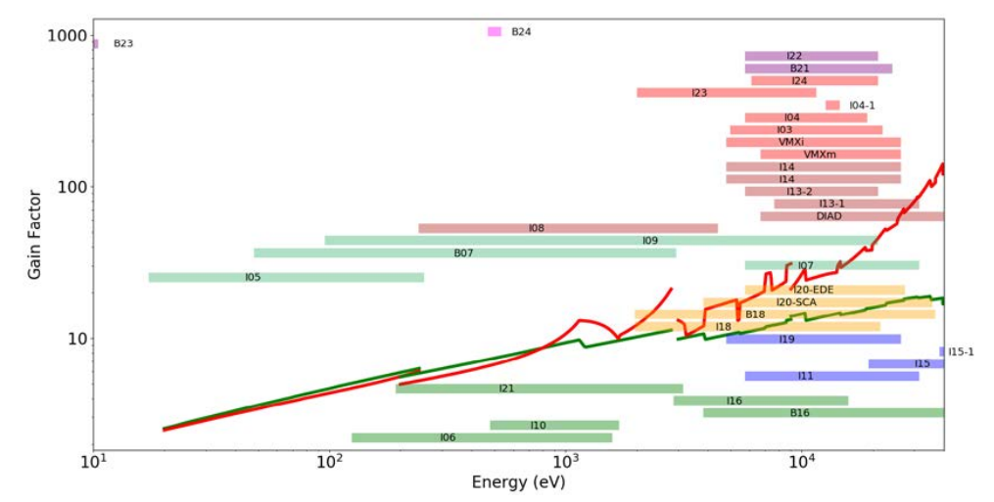
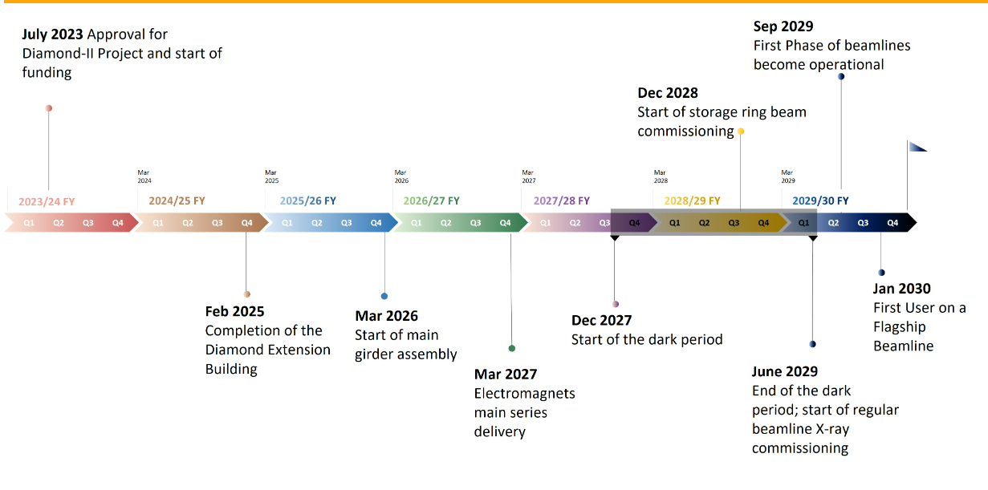
Motivation
Credit: https://www.diamond.ac.uk/Diamond-II.html
4th generation
Diamond II upgrade
Up to 10¹² ph/mm²/s
Many beamlines >20keV
~100kHz framerate
~100µm pixels
Mpixels for 2029
First light: 2029
Gain factor x100
Energy x100

Slide 5
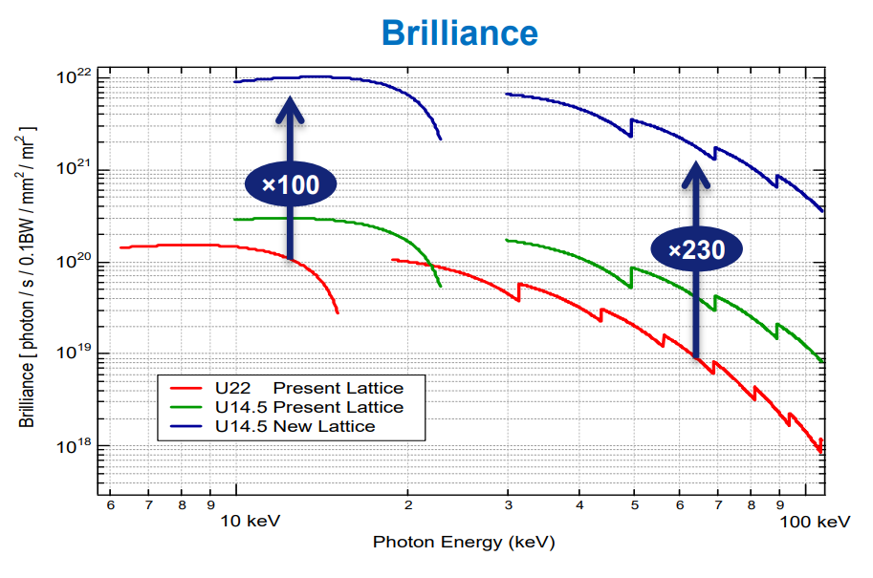
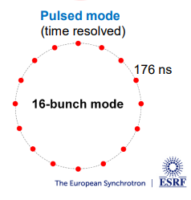
Motivation
ESRF-EBS
30-100keV
10¹¹ ph/mm²/s
10-100s kHz continuous framerate
Sufficient flux for time resolved with 16-bunch mode, 5.7 MHz burst – upcoming chip version

Slide 6
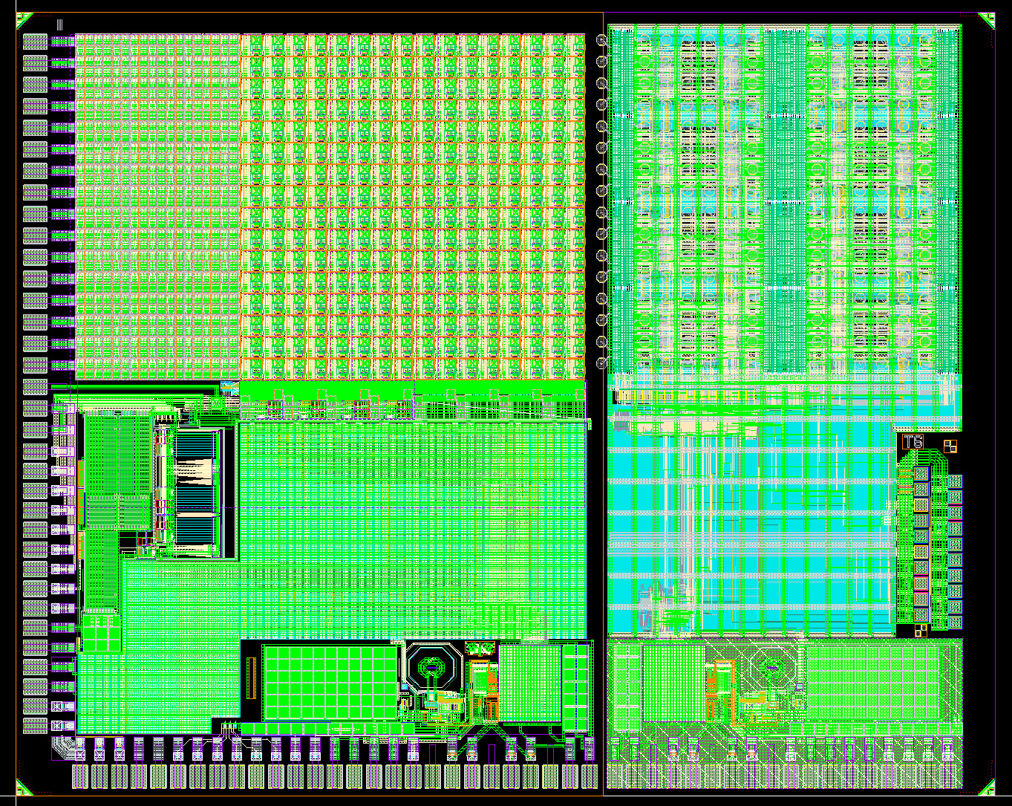
DynamiX Spec
DynamiX Chip
XIDer Chip
Parameter | DynamiX
Flux | >10⁹ ph/s/pixel
Pixel Size | 110 μm
Frame Rate | 533 kHz (Synchrotron determined)
Dynamic Range | >10¹¹ ph/mm²/s
Energy | 25keV typical
Noise Level | Single photon

Slide 7
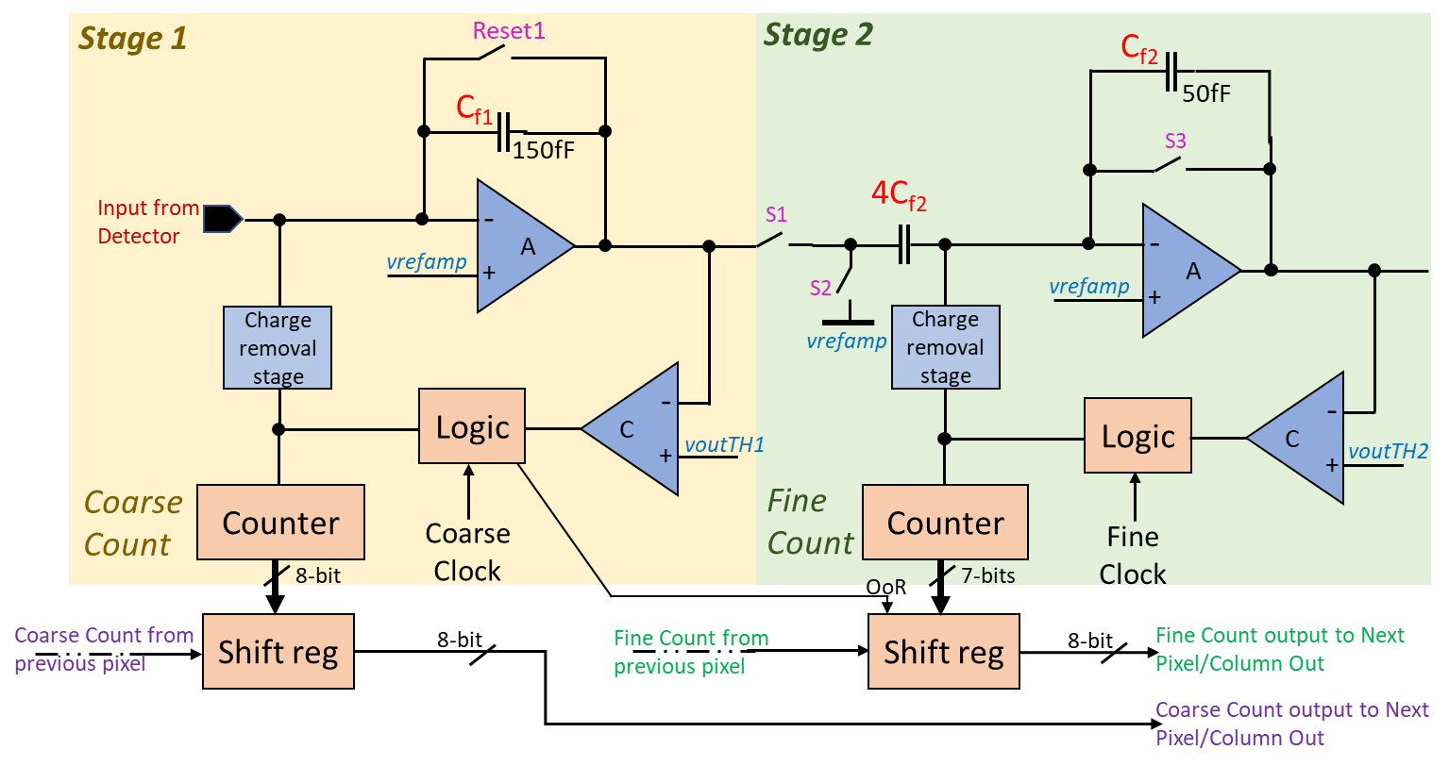
Chip Architecture
Incremental digital integration (per pixel):
2 stage charge cancellation circuit
Signal integrated in coarse stage cancelled and residual passed to fine stage
Coarse and Fine counters output
“Coarse stage”
“Fine stage”
Reference voltage
Reference voltage
Reference voltage
Coarse threshold
Fine threshold
Notes:
Start explanation with why we need charge subtraction then discuss how it works

Slide 8
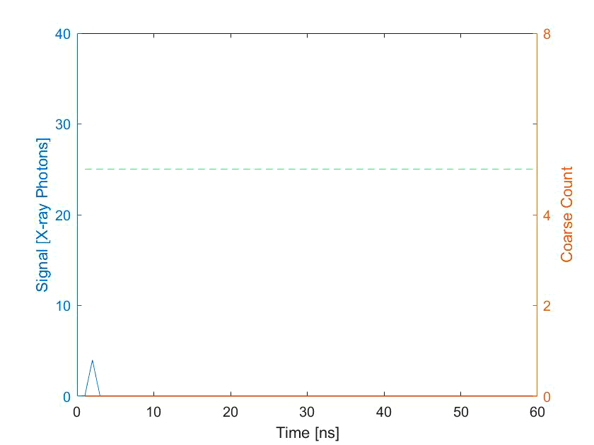
Coarse Stage (<6400 ph/pix/frame @ 30keV)
Reference voltage
Signal
Coarse threshold
Coarse threshold
Coarse counts

Slide 9
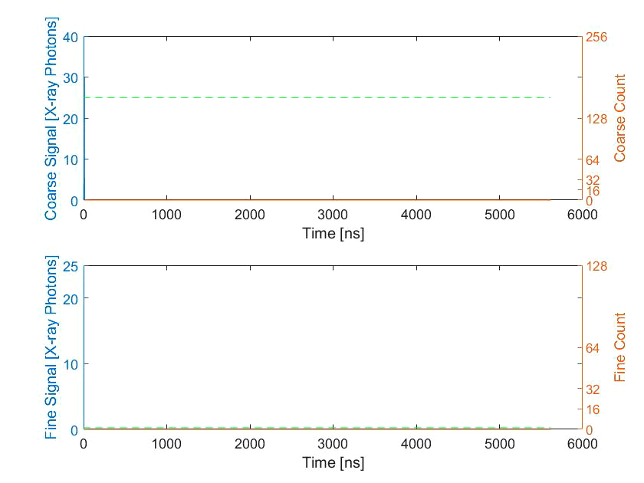
Transfer and Fine Stage (<25 ph/pix/frame @ 30keV)
NEW
FRAME
NEW
FRAME
“Coarse stage”
“Fine stage”
8bit Coarse
8bit Coarse
Reference voltage
Reference voltage
Reference voltage
Coarse threshold
Fine threshold
7bit Fine
7bit Fine
1 orbit of Diamond

Slide 10
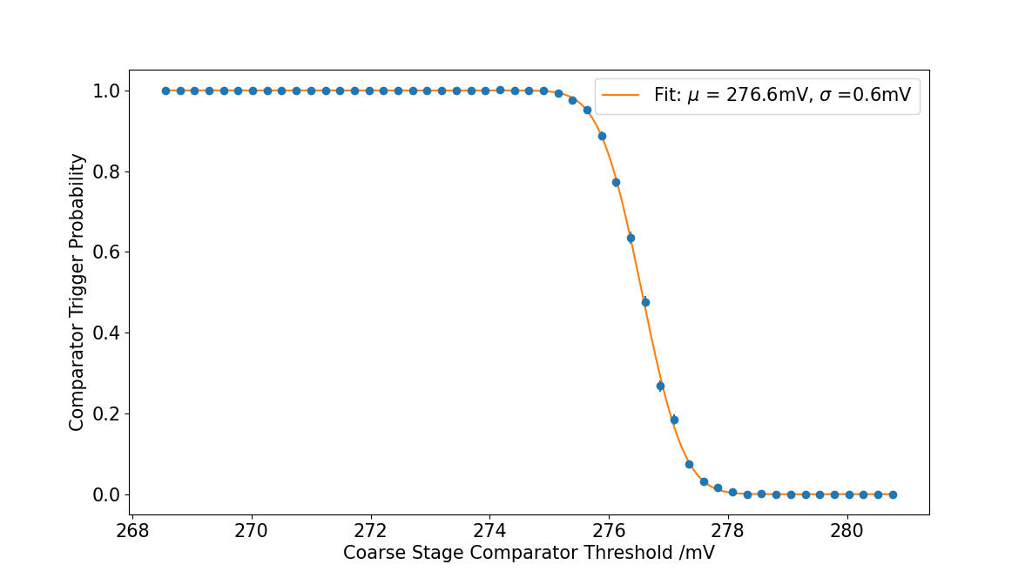
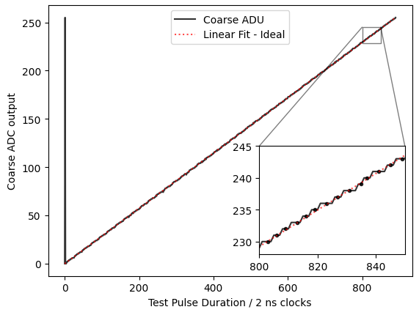
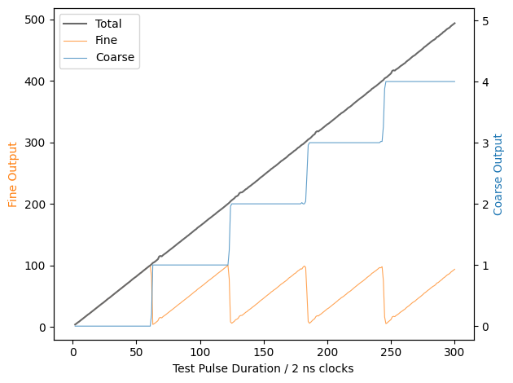
Pixel Test Results – Coarse Stage (inbuilt test pulse)
DNL 0.2 +/- 0.1
INL 0.7 +/- 0.3
Noise certainly below coarse threshold – does NOT trigger a count
Noise certainly above coarse threshold – triggers a count
Sweep coarse stage threshold → measure coarse output → repeat to obtain probability of triggering → determine dark noise
Injected test current (a.u.)
Injected test current (a.u.)
Vary input test current → measure coarse ADC output
Vary input test current → measure coarse and fine counts

Slide 11
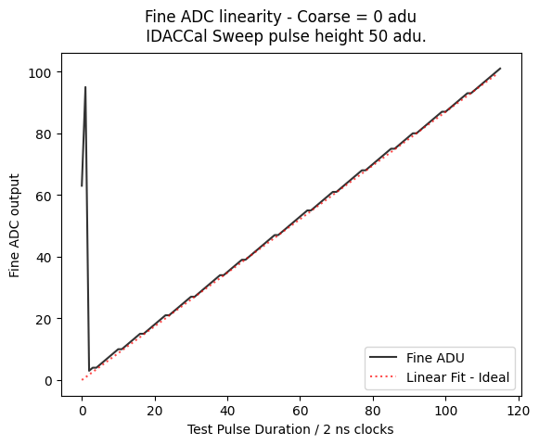
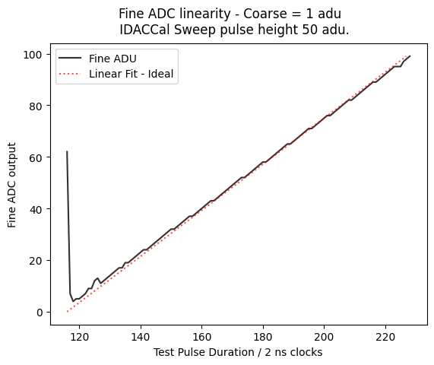
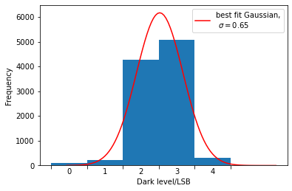
Pixel Test Results – Fine Stage
(inbuilt test pulse)
1 fine count = 0.25 of 30keV Photon
Fine stage ADC linearity
Coarse =0
Coarse =1
Dark level/ fine counts
Injected test current (a.u.)
No current injected → measure counts due to noise
Increase injected current → measure fine ADC output

Slide 12
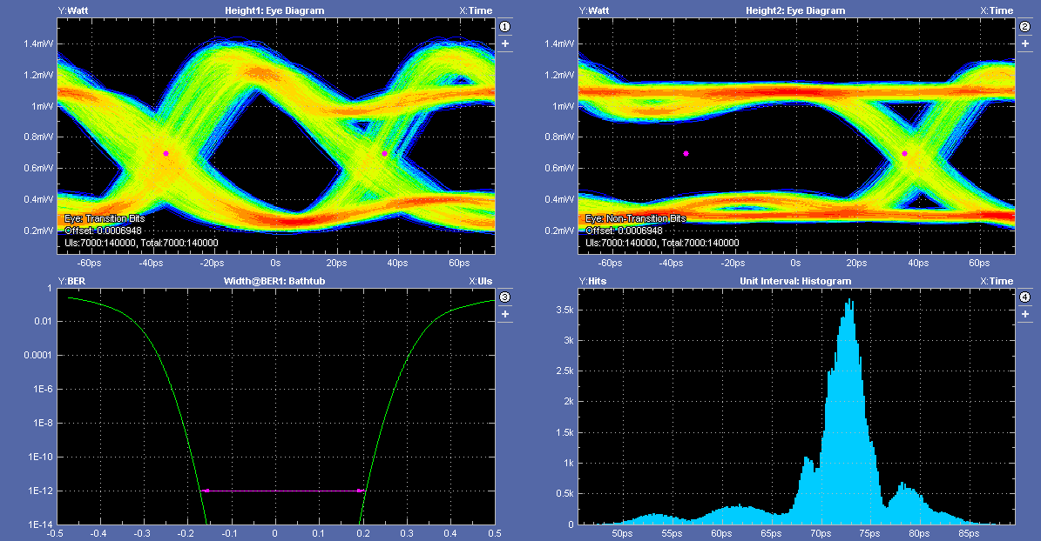
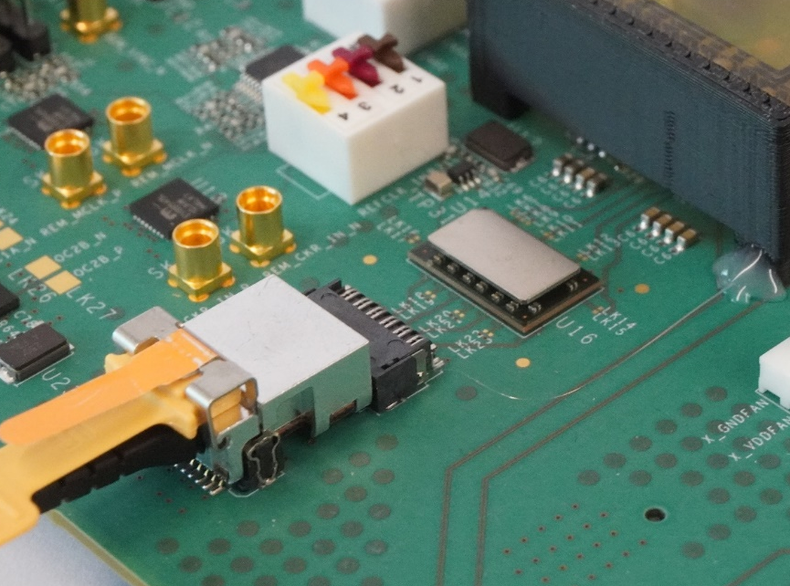
Serialiser Results
Aurora encoded 66b64b CML
14.1Gbps working
  Half speed contingency
Conversion to optical via Samtec Firefly close to ASIC
Receiver and frame build in FPGA with 100G UDP out
  Completed May 2024
Eye diagrams during serialiser testing
Samtec firefly next to ASIC (hidden under black cover)

Slide 13
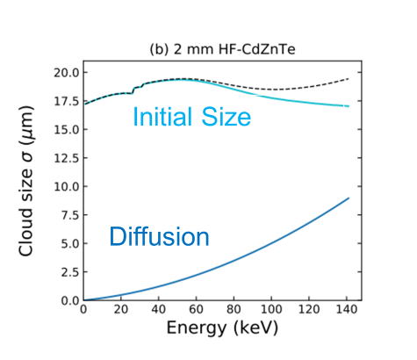
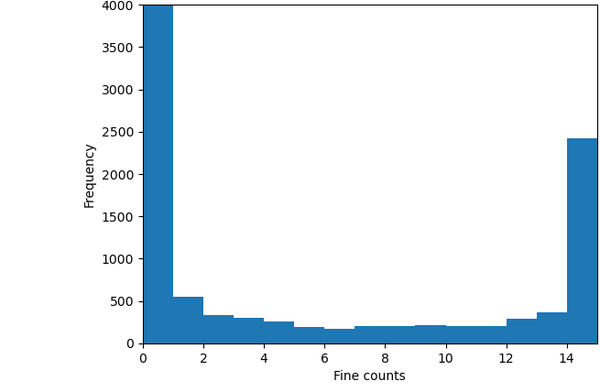
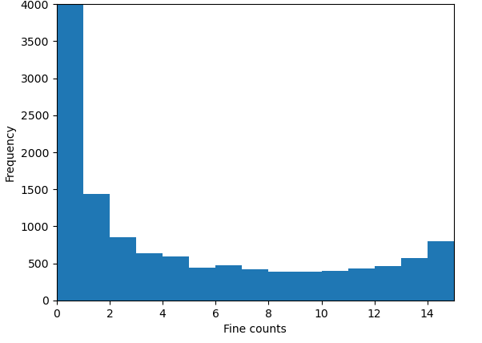
Charge-sharing simulations
Simulated charge cloud size in 2mm HF-CZT
Simulated DynamiX output, 10,000 photons, varying pitch
charge cloud size σ = 19μm (FWHM = 45μm)
>
>
Pixel pitch = 250μm
Pixel pitch = 110μm
(actual DynamiX pitch)
(https://doi.org/10.25392/leicester.data.23579085.v1)

Slide 14
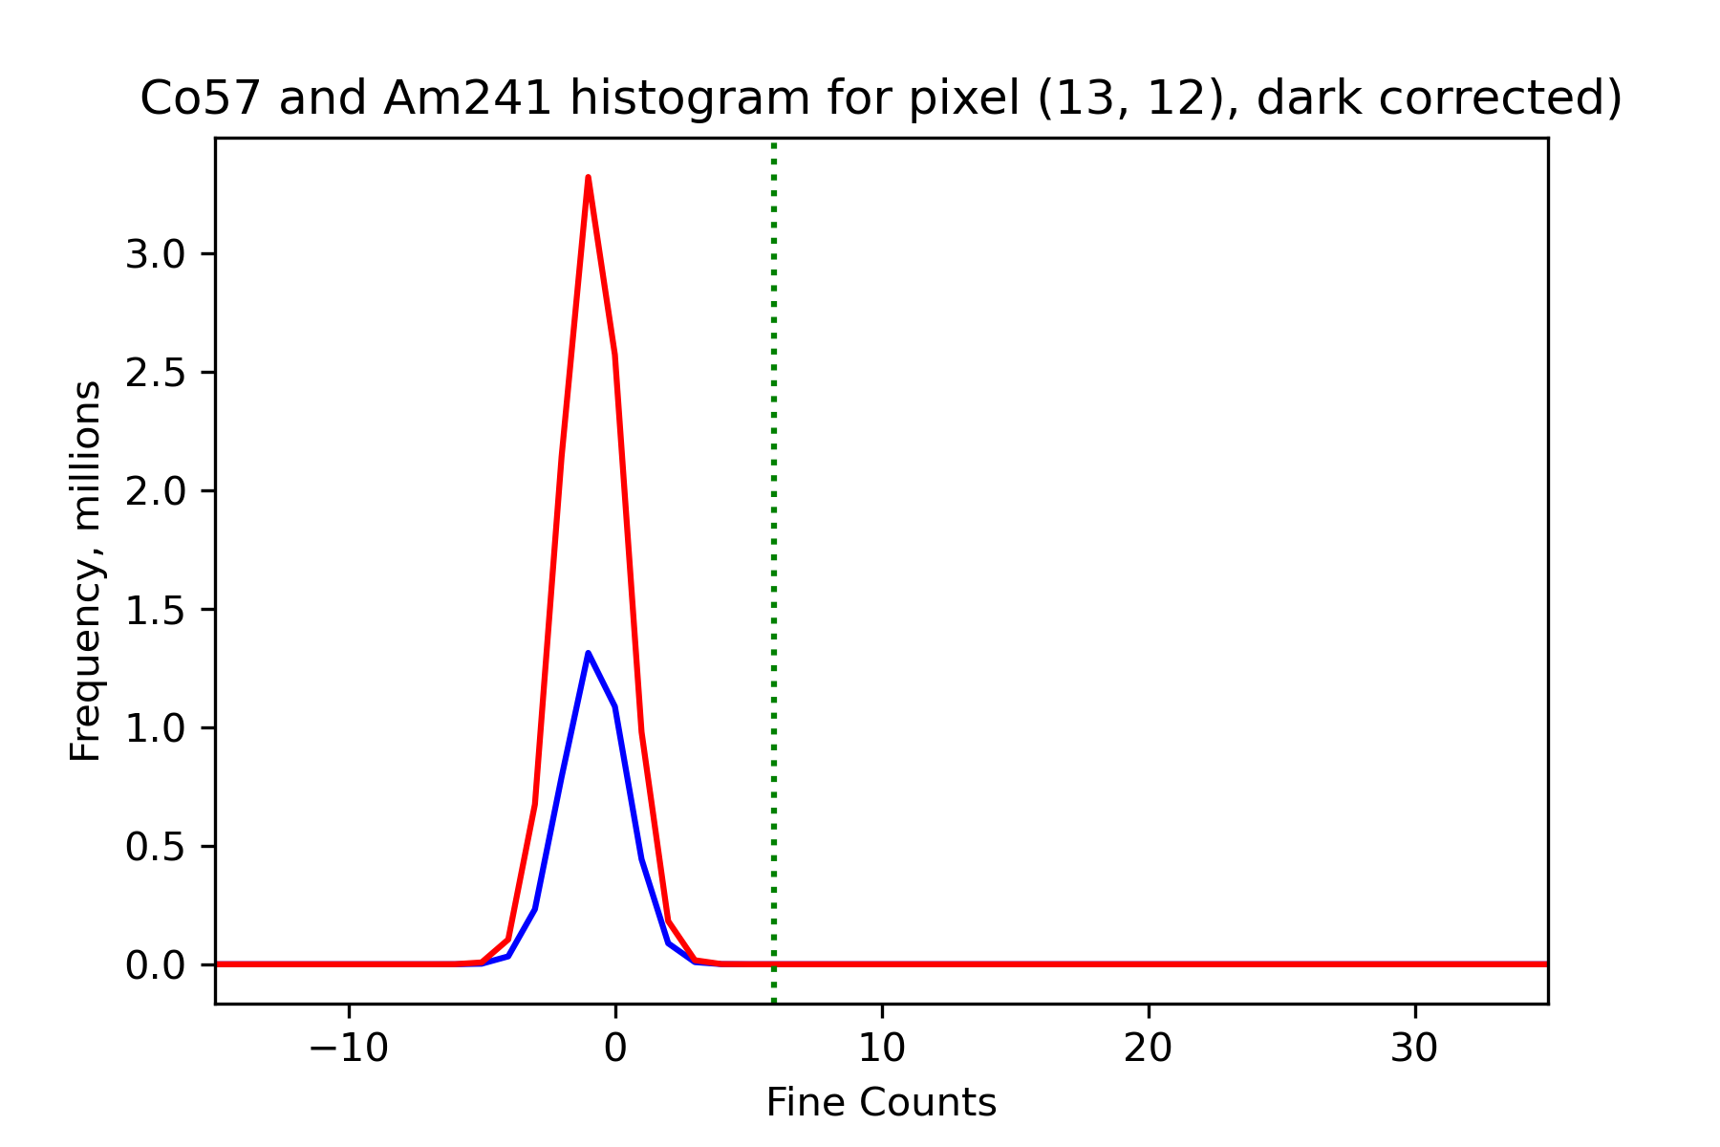
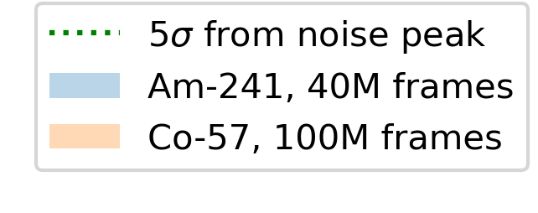
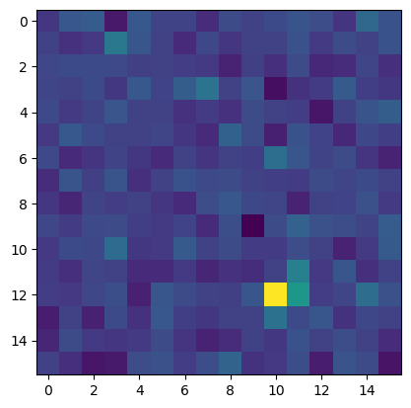
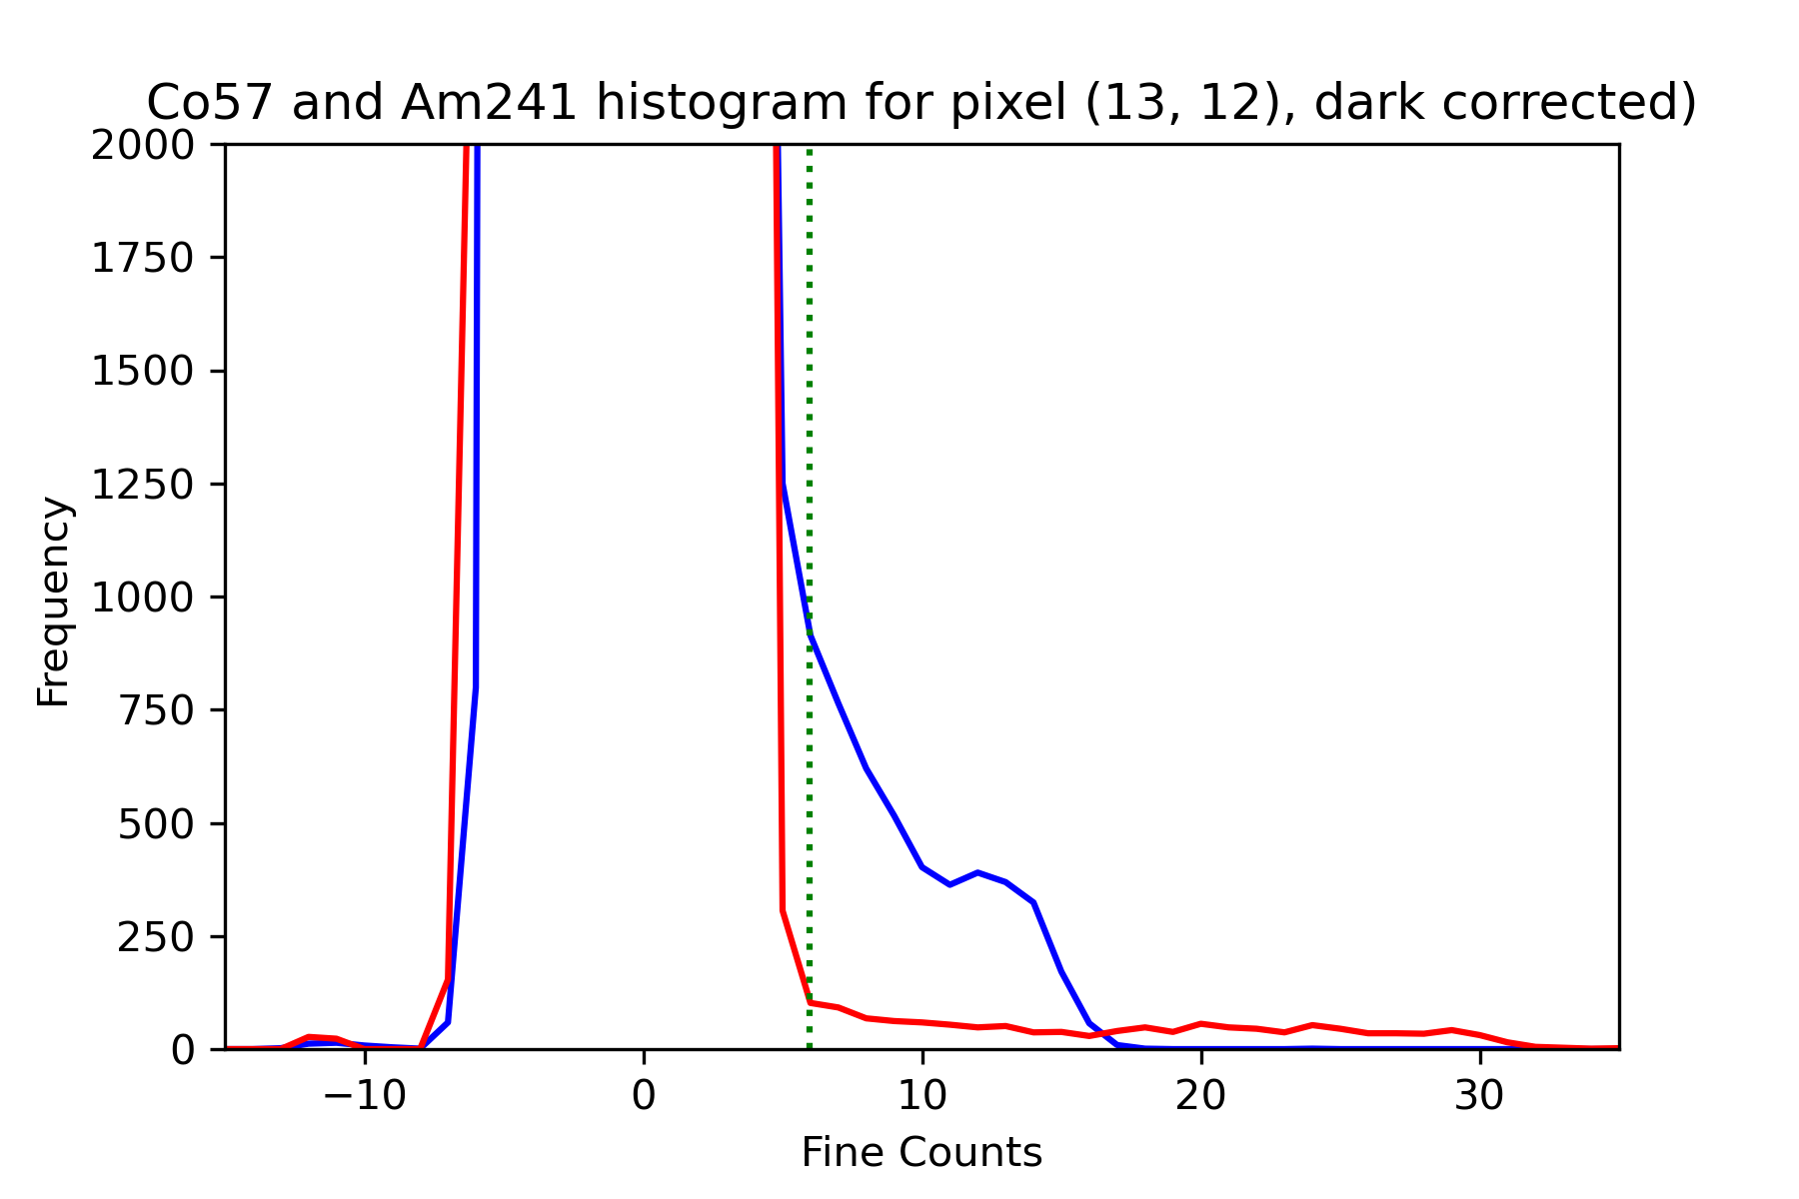
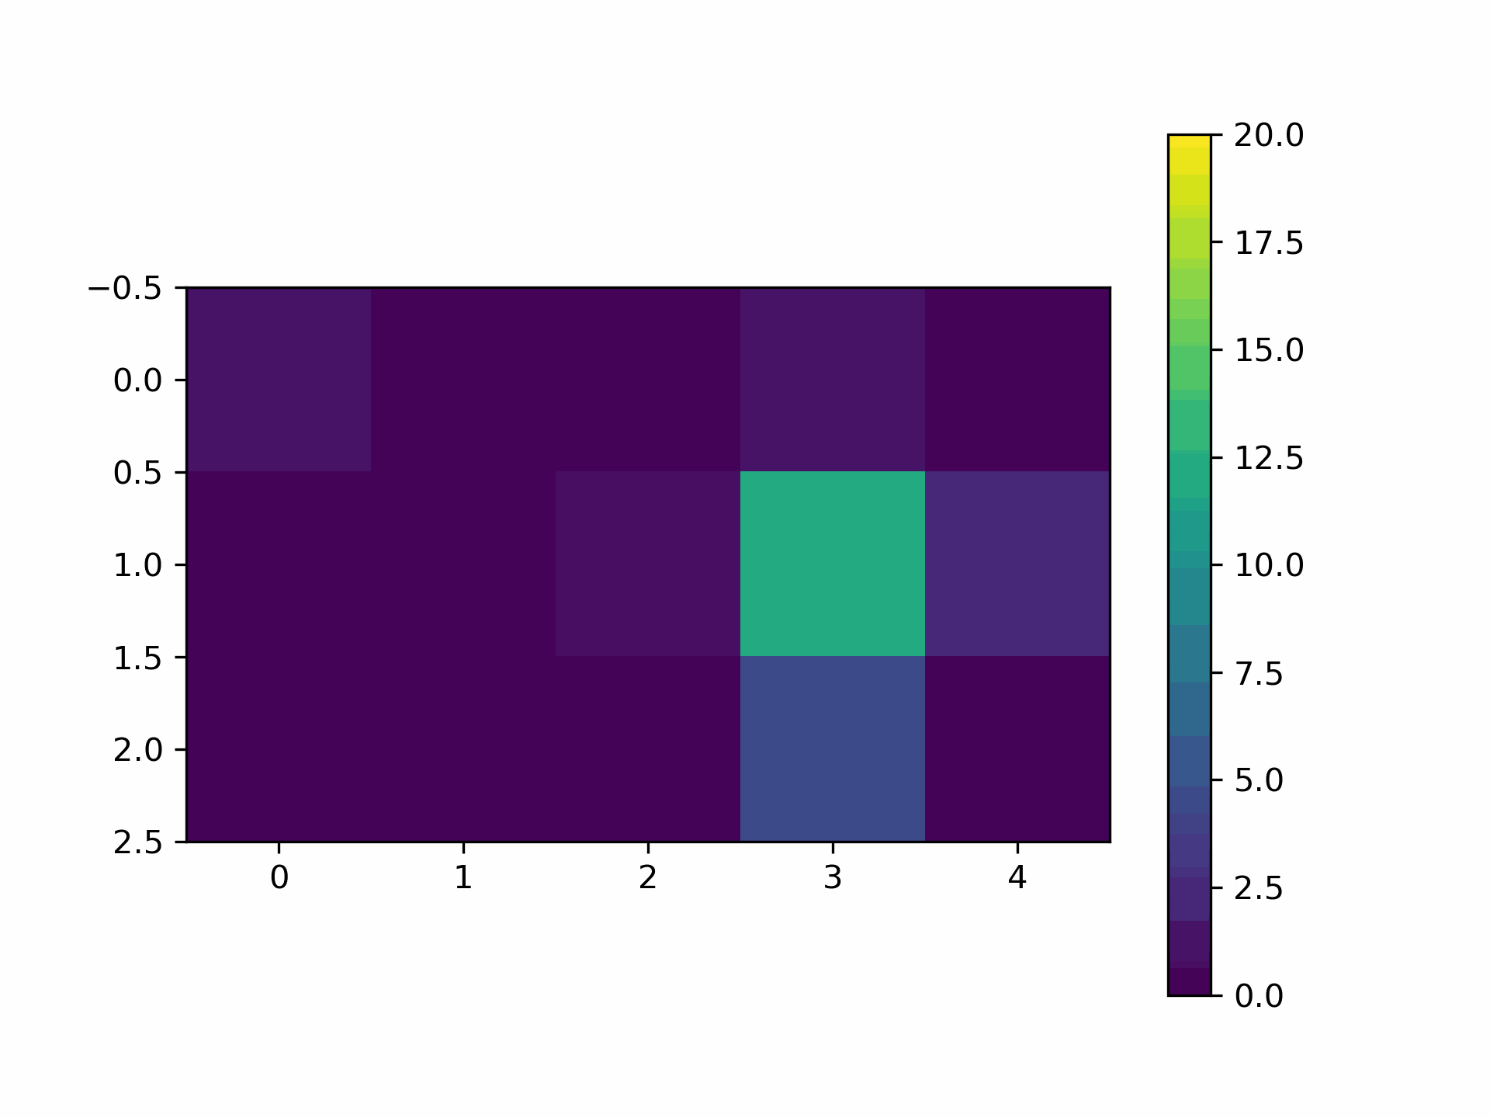
Sealed Source Tests
Single pixel pre-calibrated with test-pulse: 1 fine count = 4 keV eq.
Am-241 (60 keV peak) and Co-57 (122 keV peak)
Am-241: ~4,000 counts/pix
Co-57: ~1,000 counts/pix
Evidence of charge sharing for many events
Fine counts

Slide 15
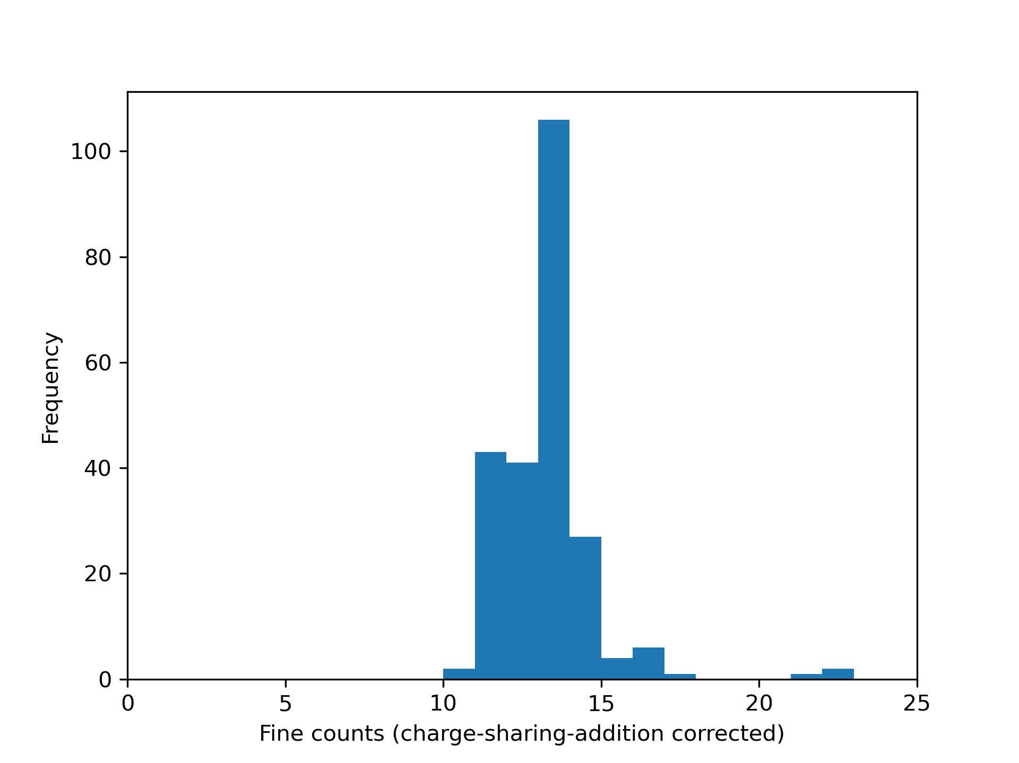
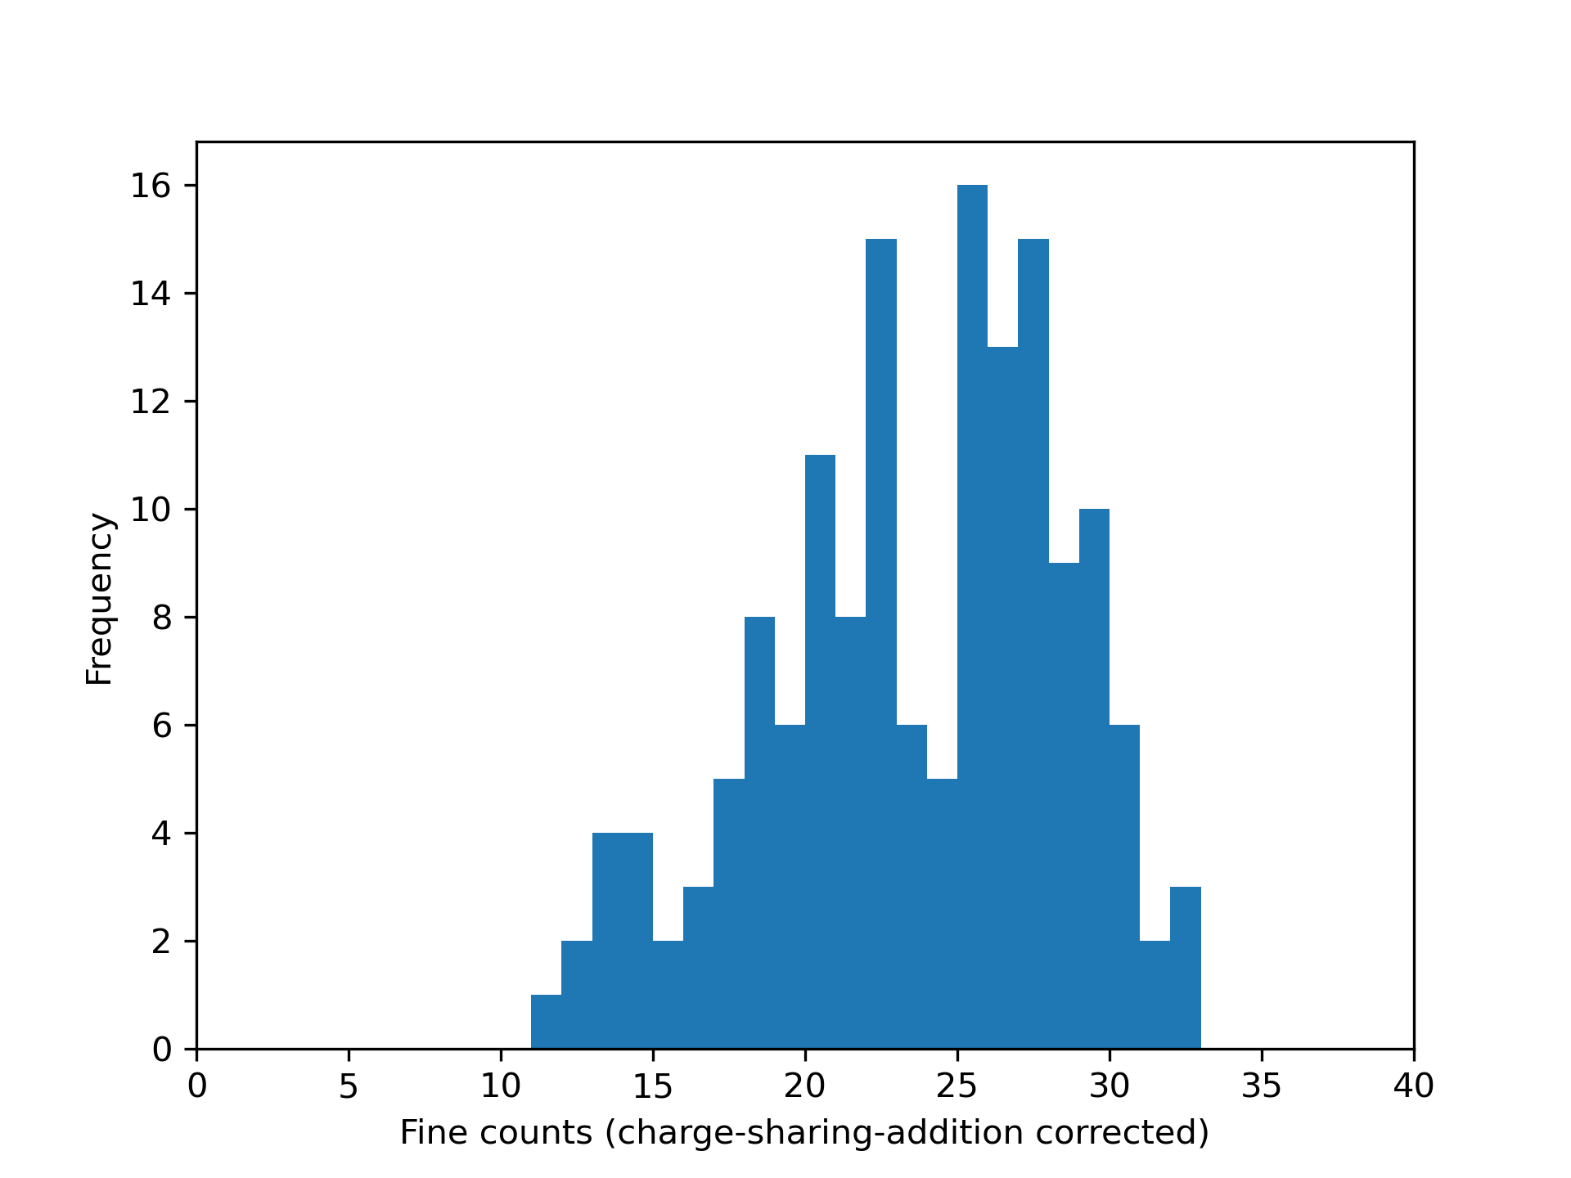
Sealed sources – basic charge sharing addition
Add all gain- & dark-corrected neighbouring pixel values if:
  they are >5σ above noise mean
  AND centre pixel is largest event
Both “corrected” peaks below expected value – likely 5σ too high and discarding real events
Am-241 charge sharing addition around pixel (13,13)
Co-57 charge sharing addition around pixel (13,13)

Slide 16
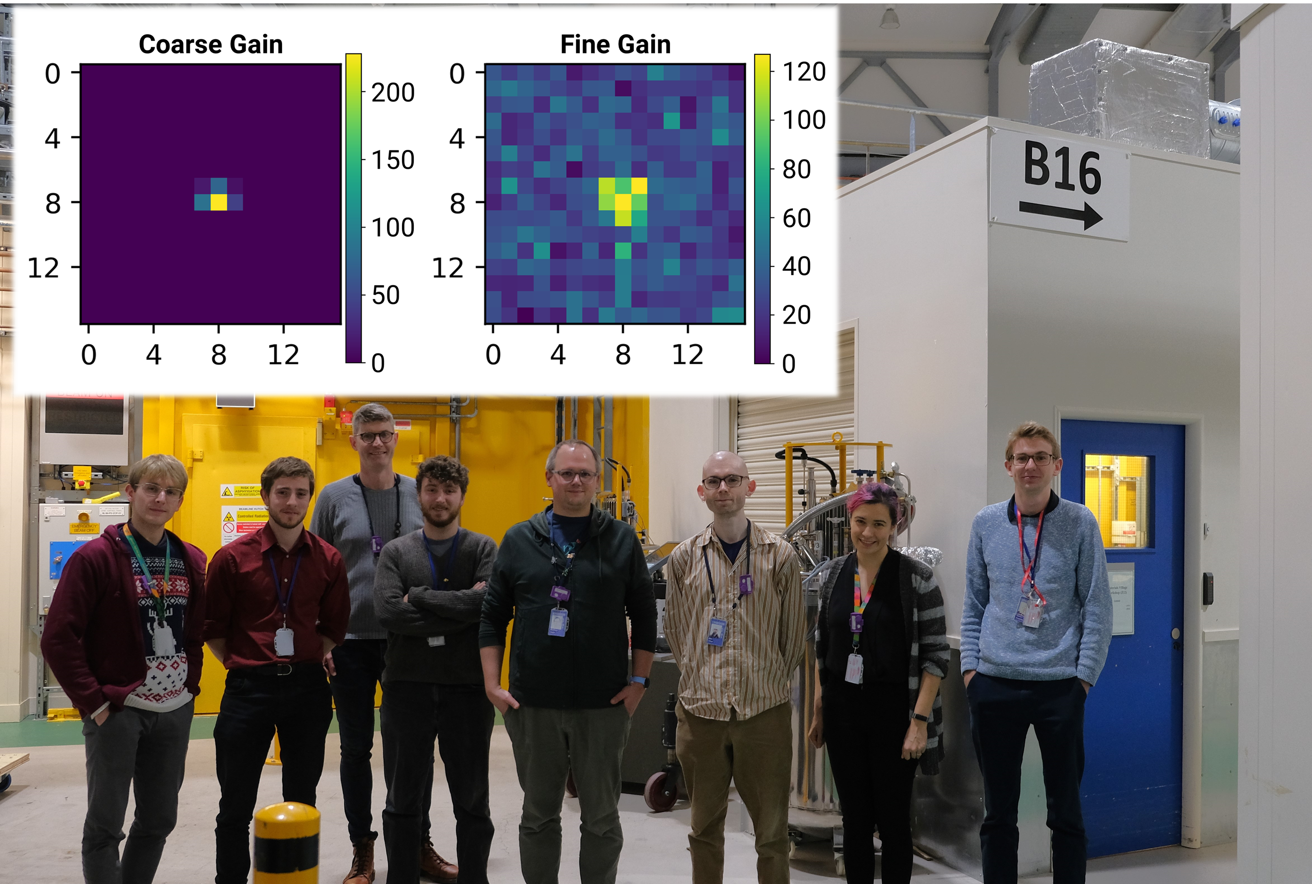
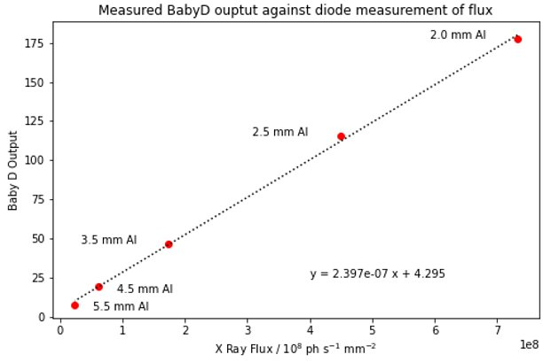
Diamond X-ray Test
Slitted beam – small area irradiation
Fine counts
Coarse counts
20keV mono-energy beam
Change filters and beam-size to change flux on the detector
Able to confirm linearity of output up to flux of <10⁹ ph/s/mm²
Combined Dynamix output (fine counts equivalent)

Slide 17
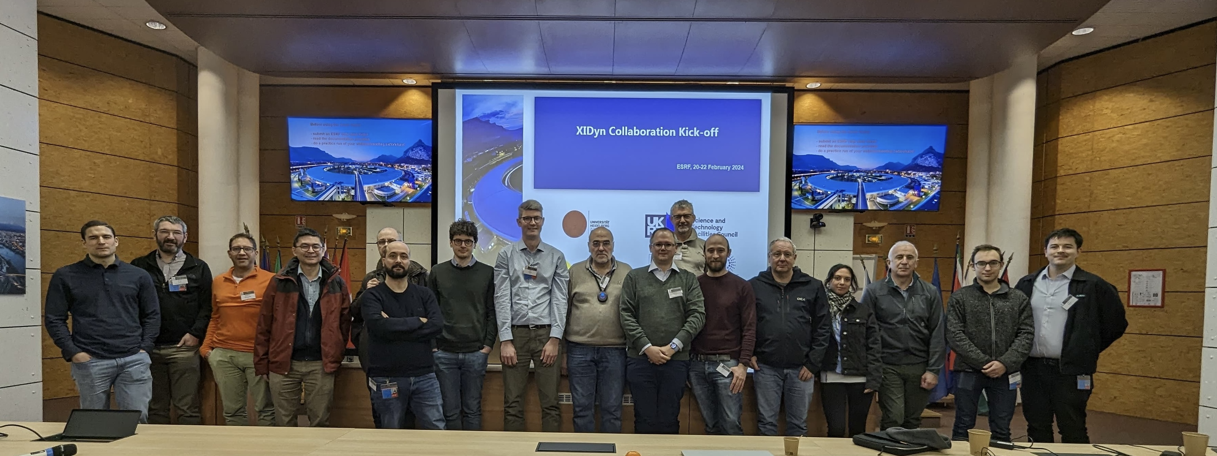
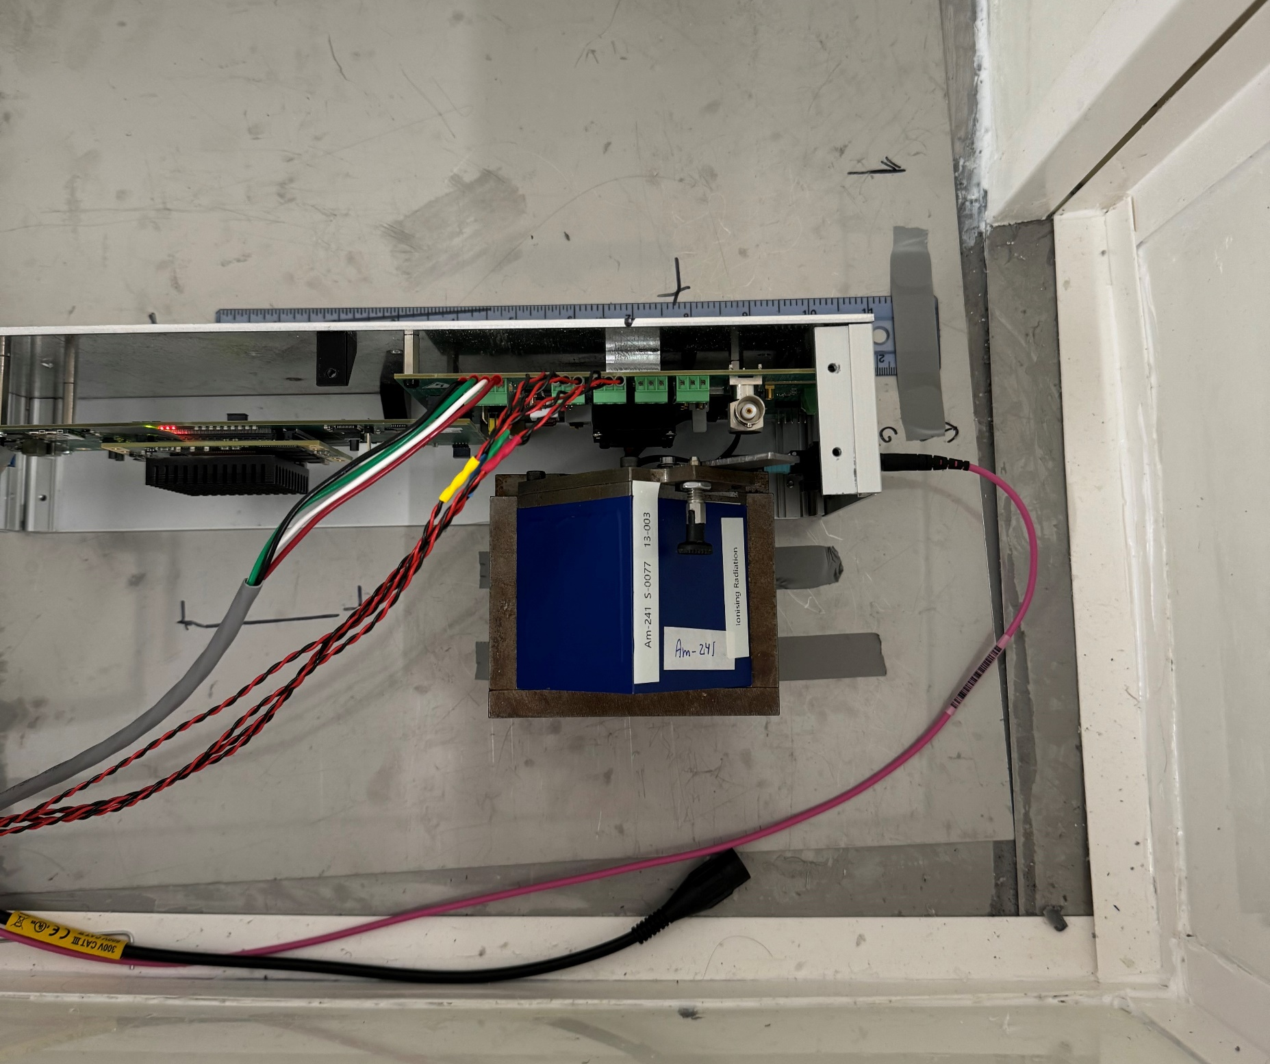
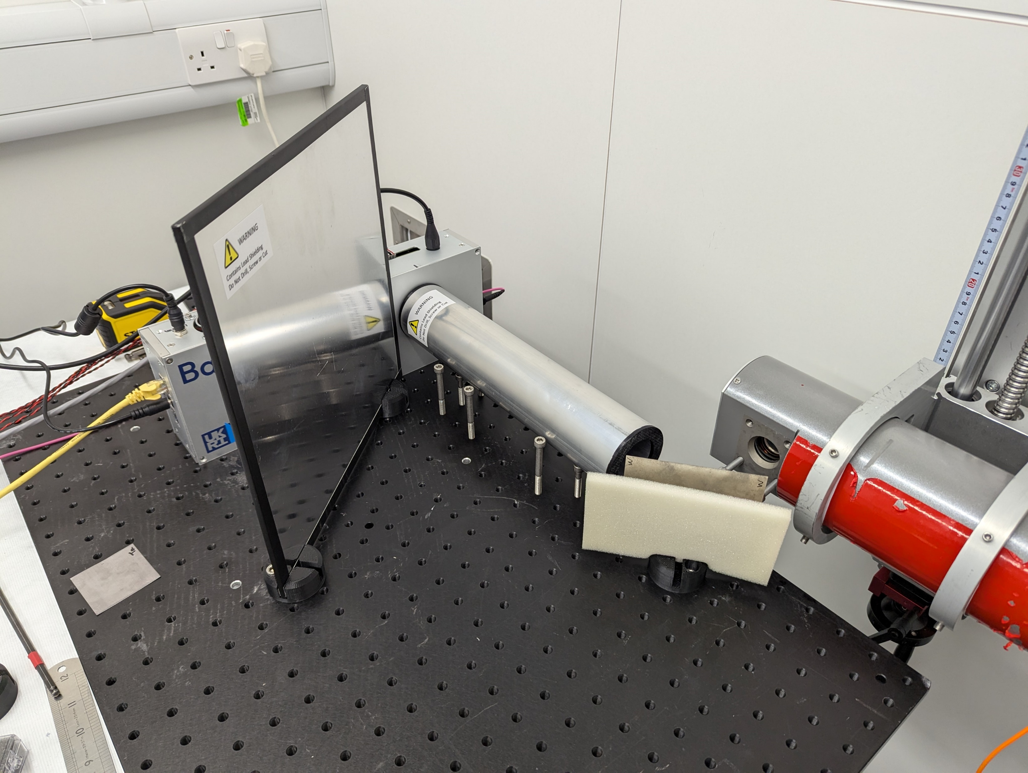
Summary
XIDyn Collaboration kick off, Feb 2024
Initial testing confirms architecture implementation works
Sealed sources useful for calibration but complicated by charge-sharing
Evidence of linearity with higher fluxes at beamlines
Upcoming beamtimes at Diamond & ESRF → opportunity for testing at higher fluxes and minimising charge-sharing
Single-pixel histograms for Am-241 & Co-57
Co-57 basic charge sharing addition around pixel (13,13)
Recent XRF testing with tungsten
Sealed sources testing

