Slide 1
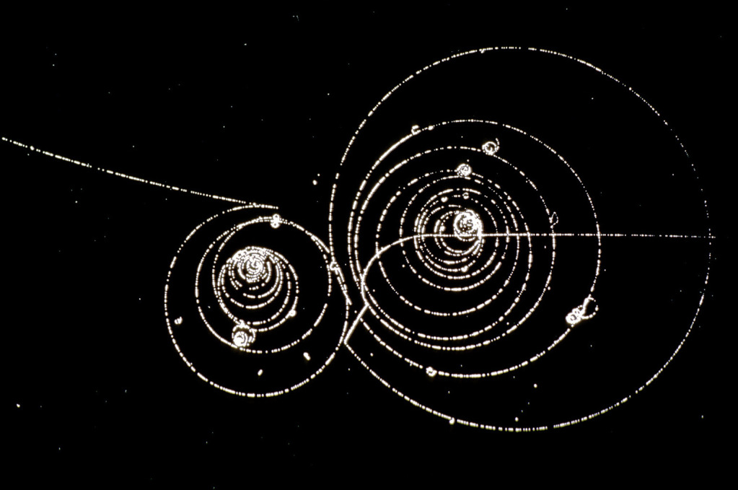
High Energy Physics
Lecture 1: Introduction
Ricardo Gonçalo
Universidade de Coimbra
Laboratório de Instrumentação e Física Experimental de Part.culas

Slide 2
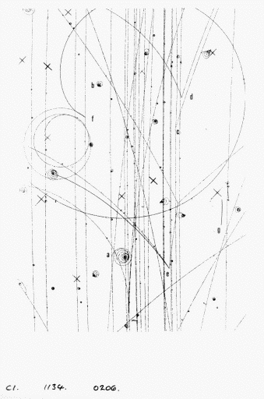
Welcome to High Energy Physics!
Introductions
Logistics
Course structure
Bibliography
Quick overview

Slide 3
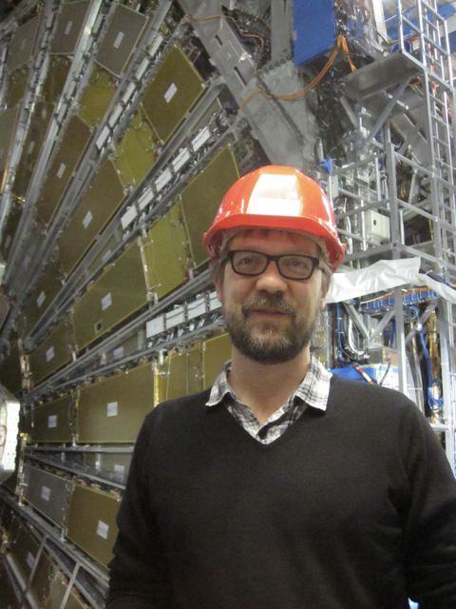
Introduction and Logistics
Ricardo Gonçalo
  Logistics:
  Email: jgoncalo@uc.pt
  Office: E.20
  Office hours: Tuesday 11am?
Research interests:
  Higgs boson properties
  Hadronic jet physics
  Trigger development
  Detector upgrade
  Data analysis
  etc

Slide 4
Overall learning objectives
Elementary particles, their spectrum and classification; fundamental interactions and corresponding gauge bosons
Klein-Gordon and Dirac equations and their free-particle solutions; zero mass and helicity limit; neutrinos and the V-A structure of weak interactions
Fermion and boson propagators; Yukawa potential of a bosonic field; propagators
Feynman diagrams; cross section calculation at 1st order for simple processes; higher order diagrams and renormalization
Proton form factor and structure functions; quarks and gluons; notions of quantum chromodynamics; strong coupling constant; quark confinement and asymptotic freedom
Neutrino physics; mixing and oscillation
P, C, and T symmetries; CP and T violation and the CPT theorem
Unified electroweak theory and the Standard Model; neutral and charged currents, W and Z bosons
The Higgs mechanism and electroweak symmetry breaking
High energy collider- and non-collider based experiments; important results
Limitations of the Standard Model and searches for new physics

Slide 5
Course structure
14 theory lectures:
  Mixture of slides and blackboard
  If time allows: a seminar (to be defined)
14 problem sessions:
  Sometimes will use for theory
Grading:
  Final test during 18th May problem session (50%)
  Problem sets to deliver individually (50%) in Inforestudante

Slide 6
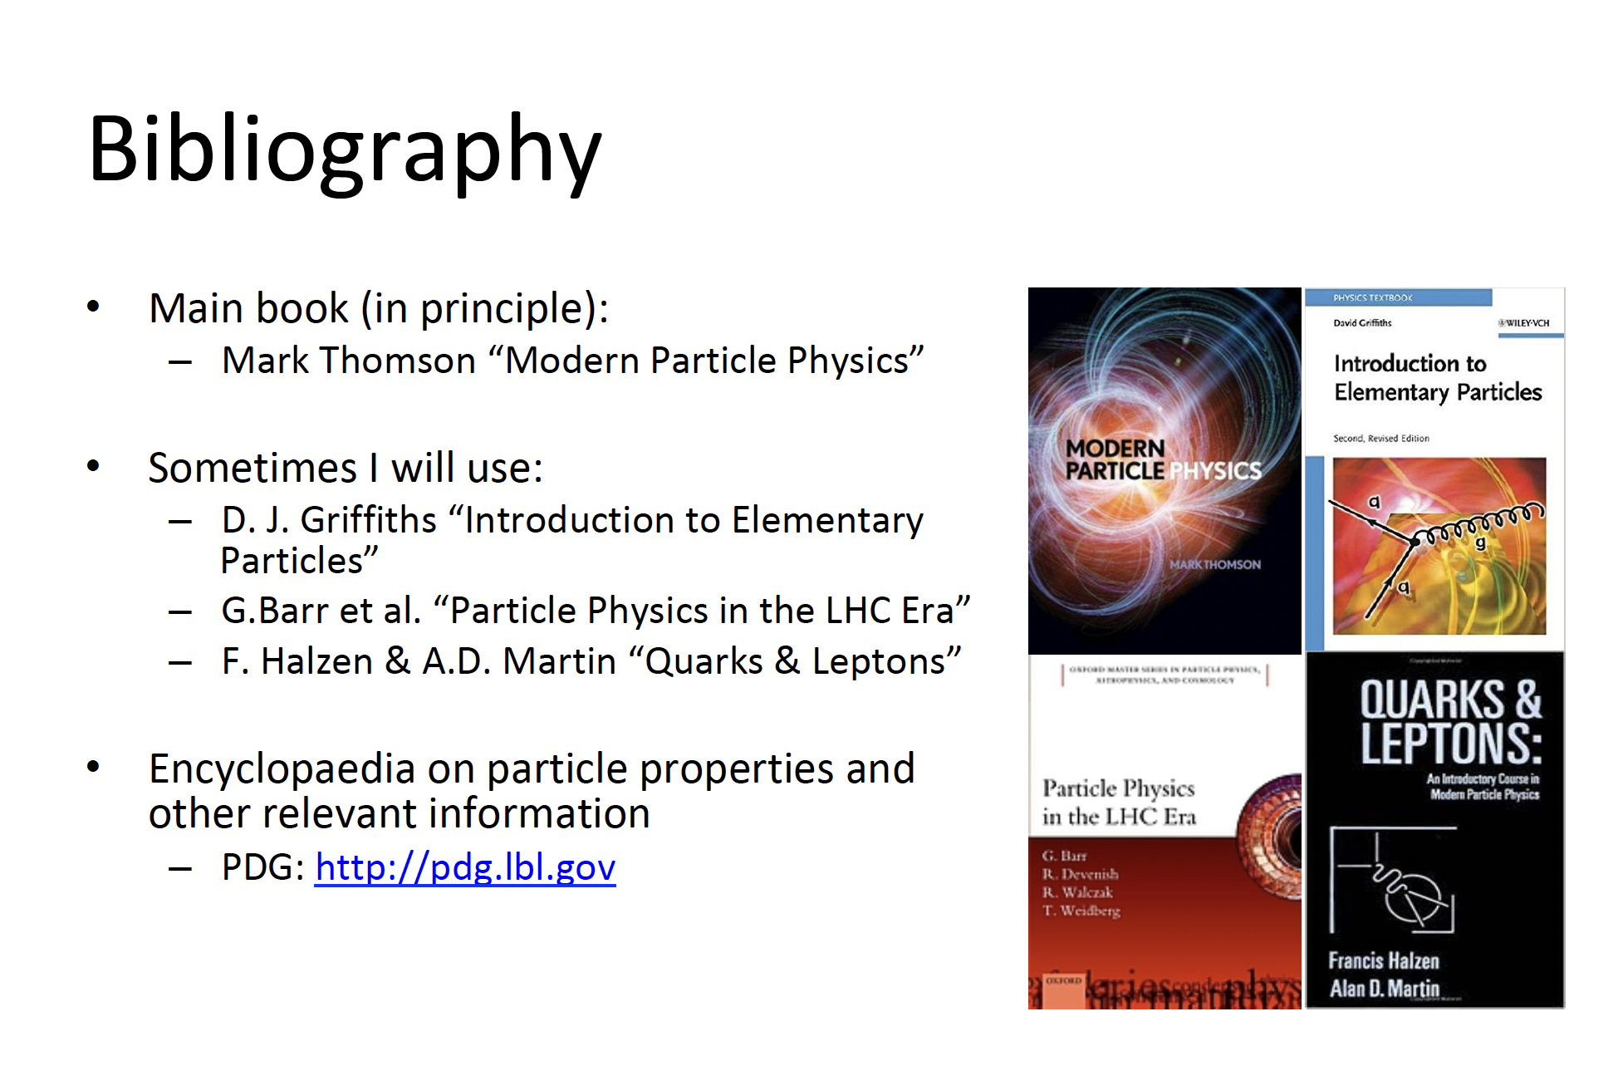

Slide 7

Particle Physics

Slide 8
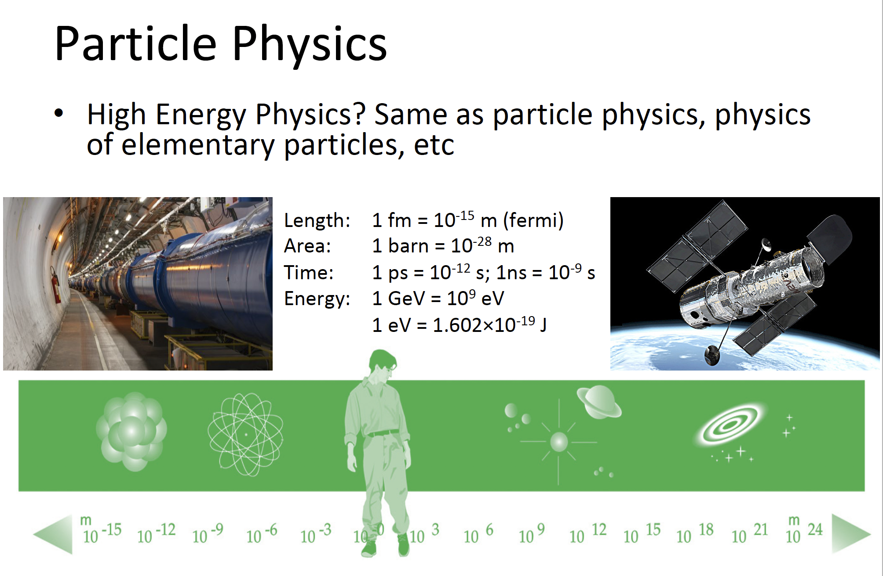
2
1pb=10⁻¹²b

Slide 9
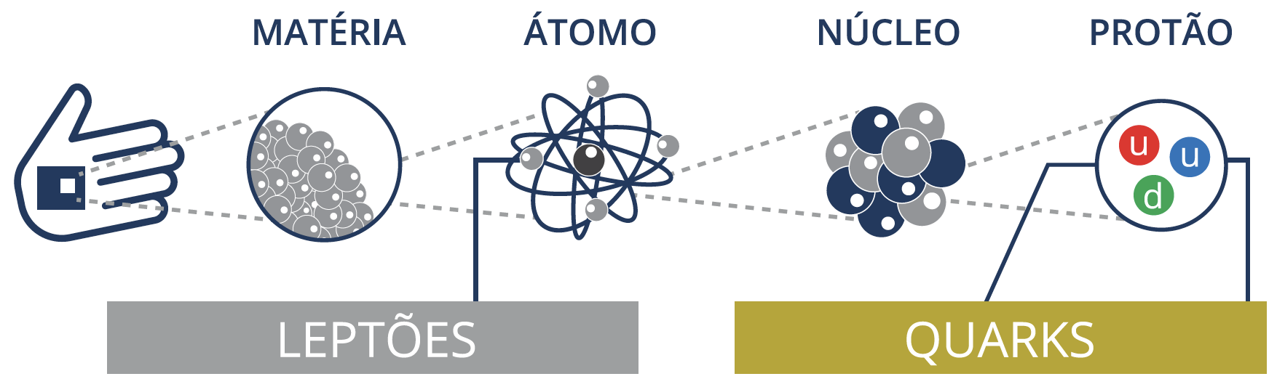



Plus antiparticles

Slide 10
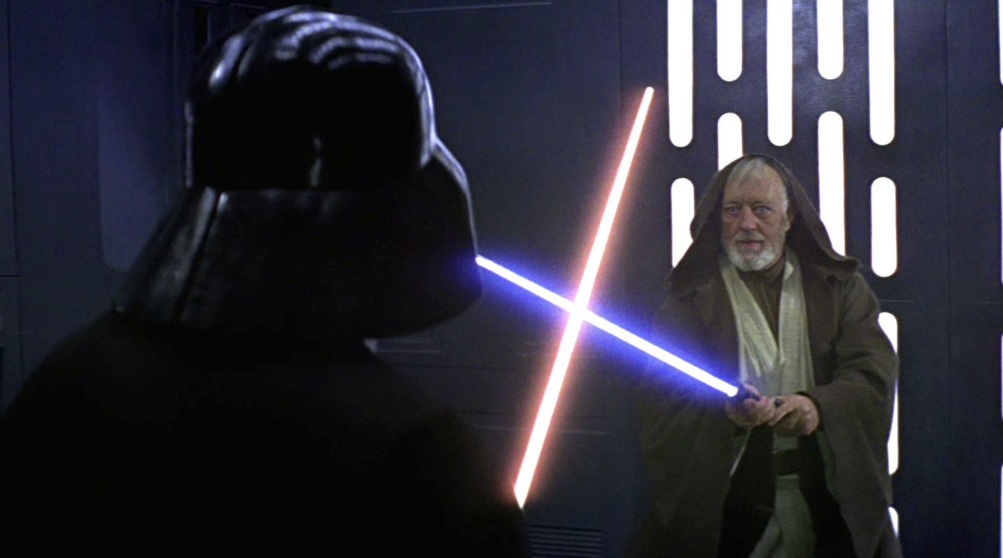
And the forces…

Slide 11
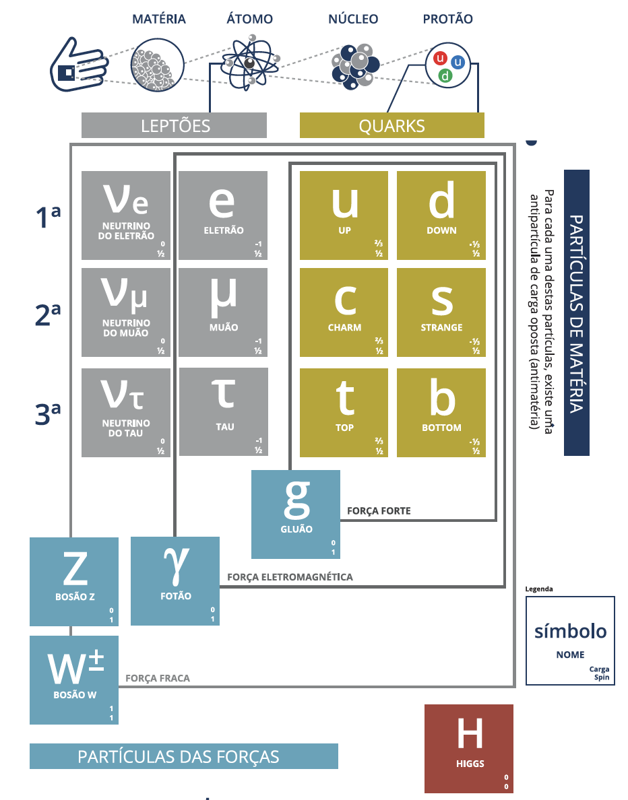
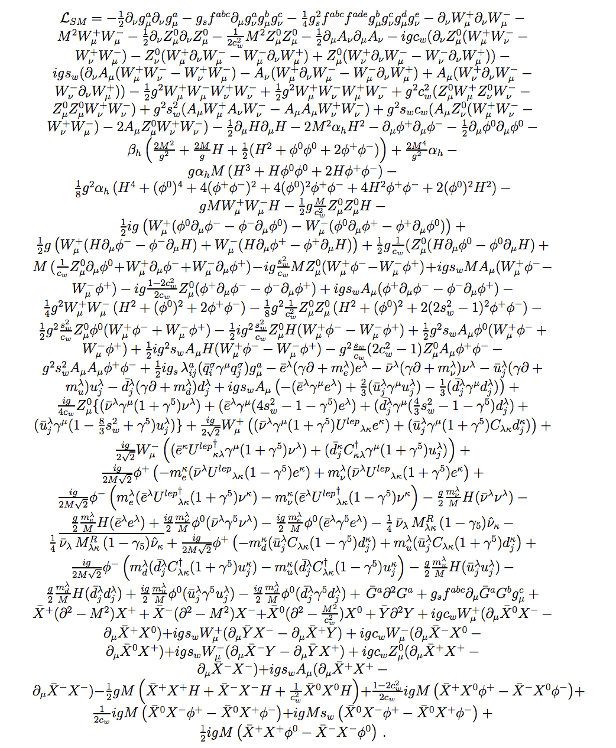
The Standard Model of Particle Physics

Slide 12
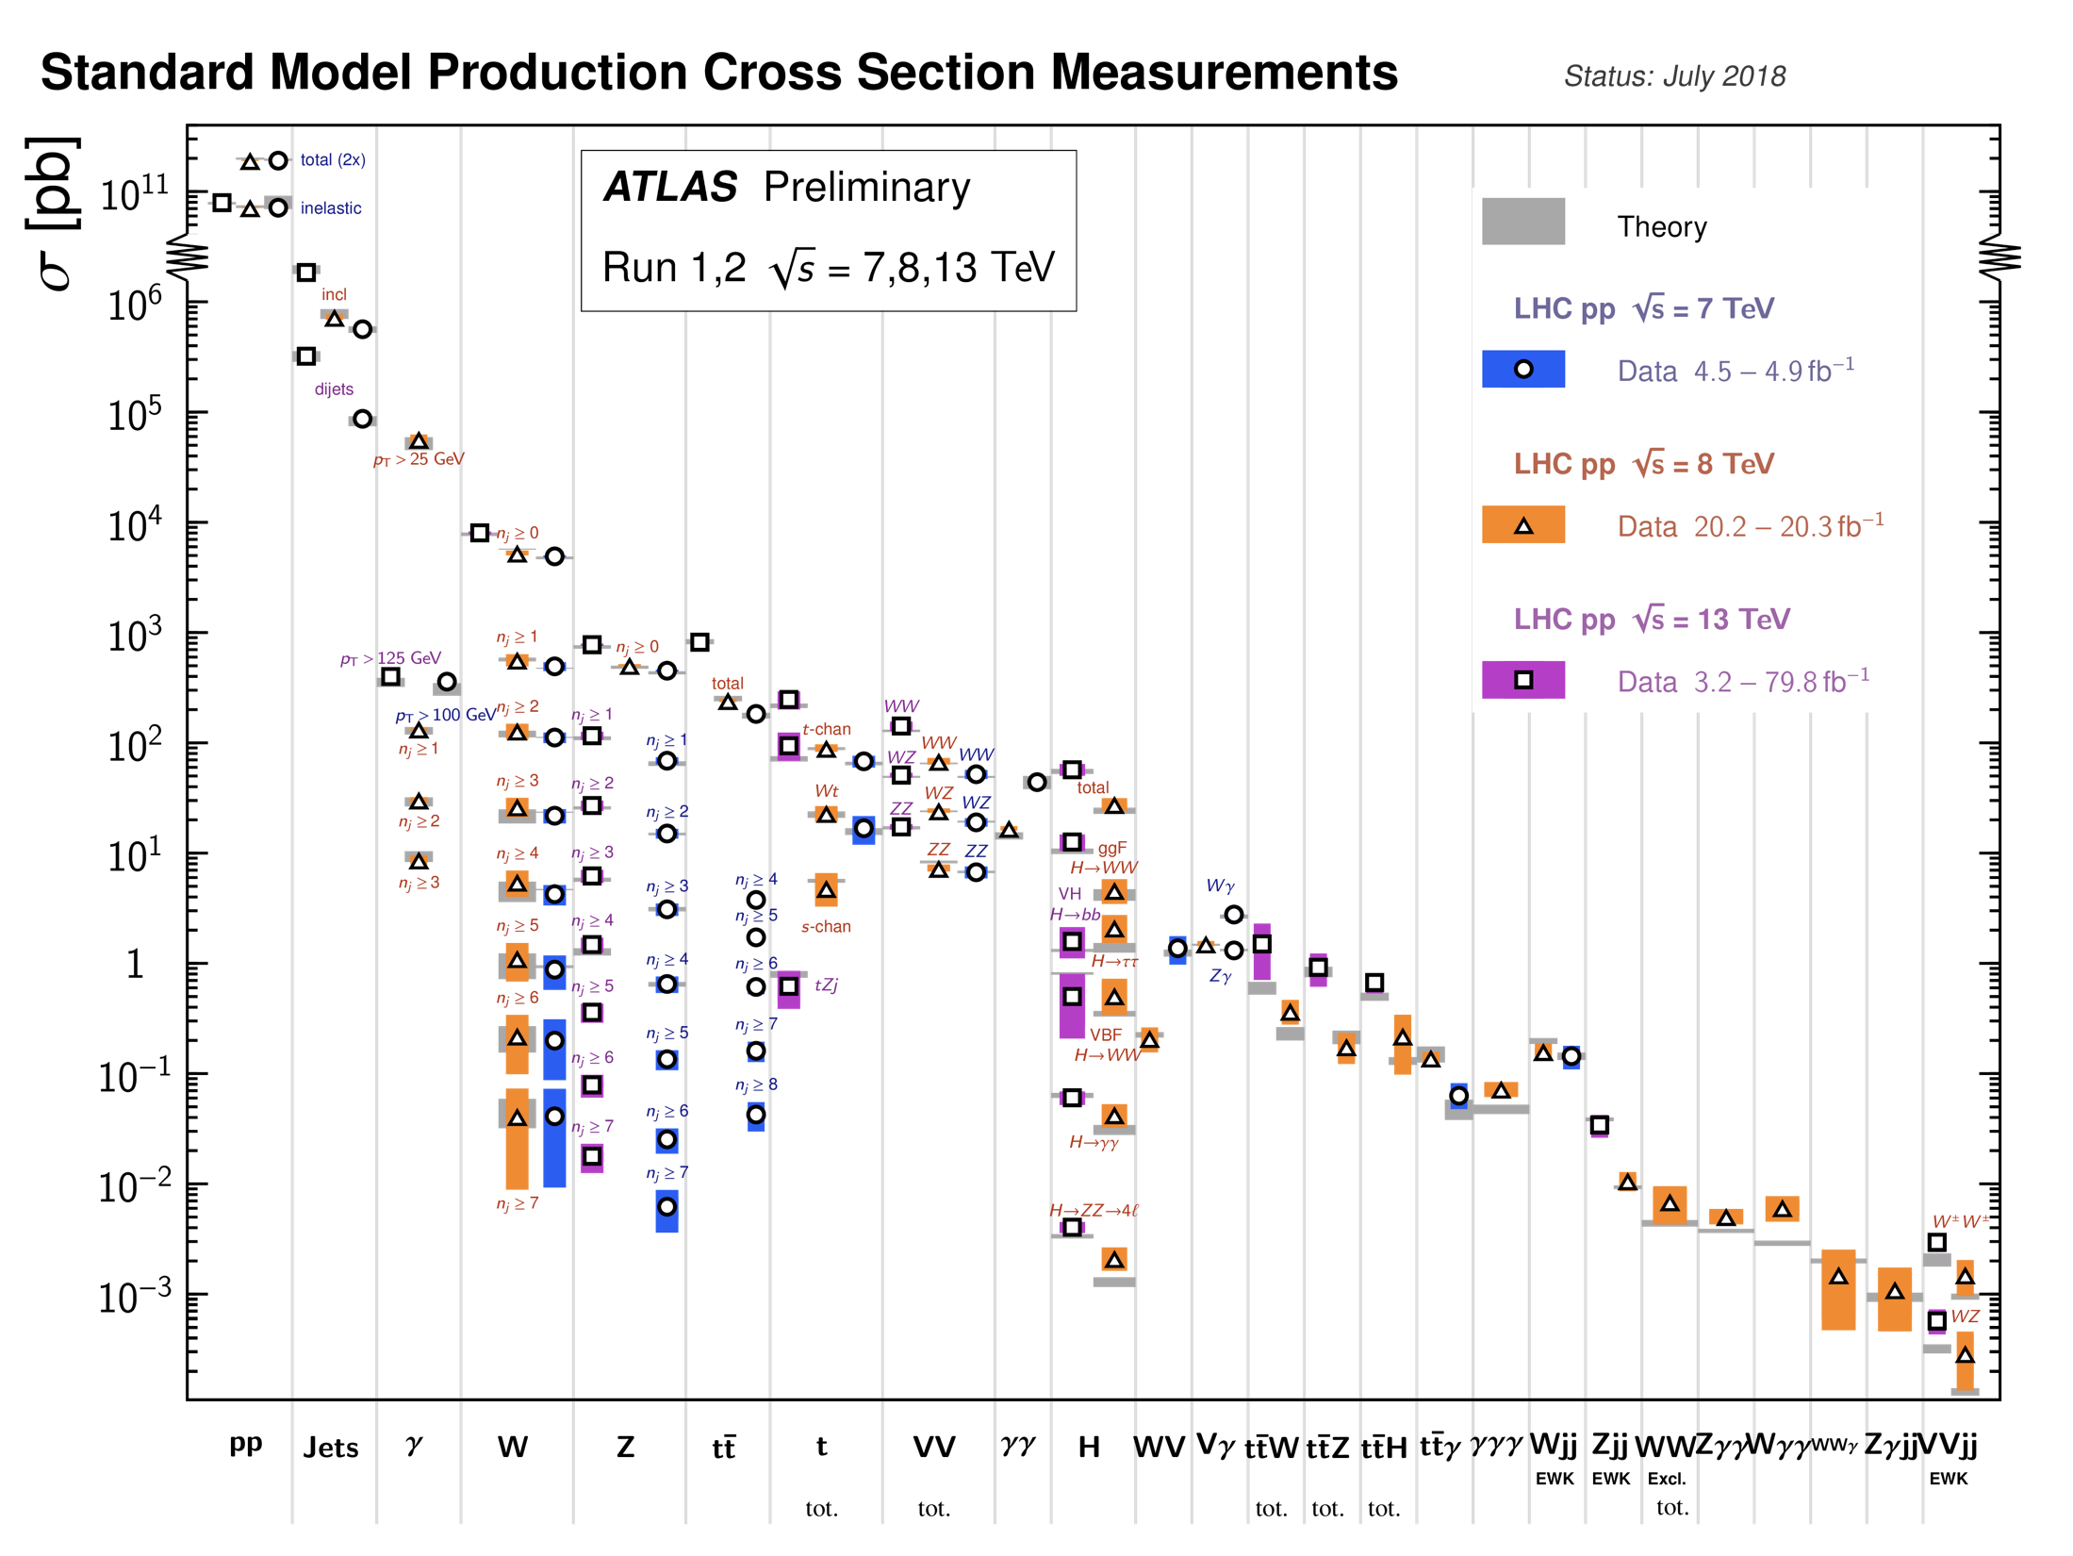

Slide 13
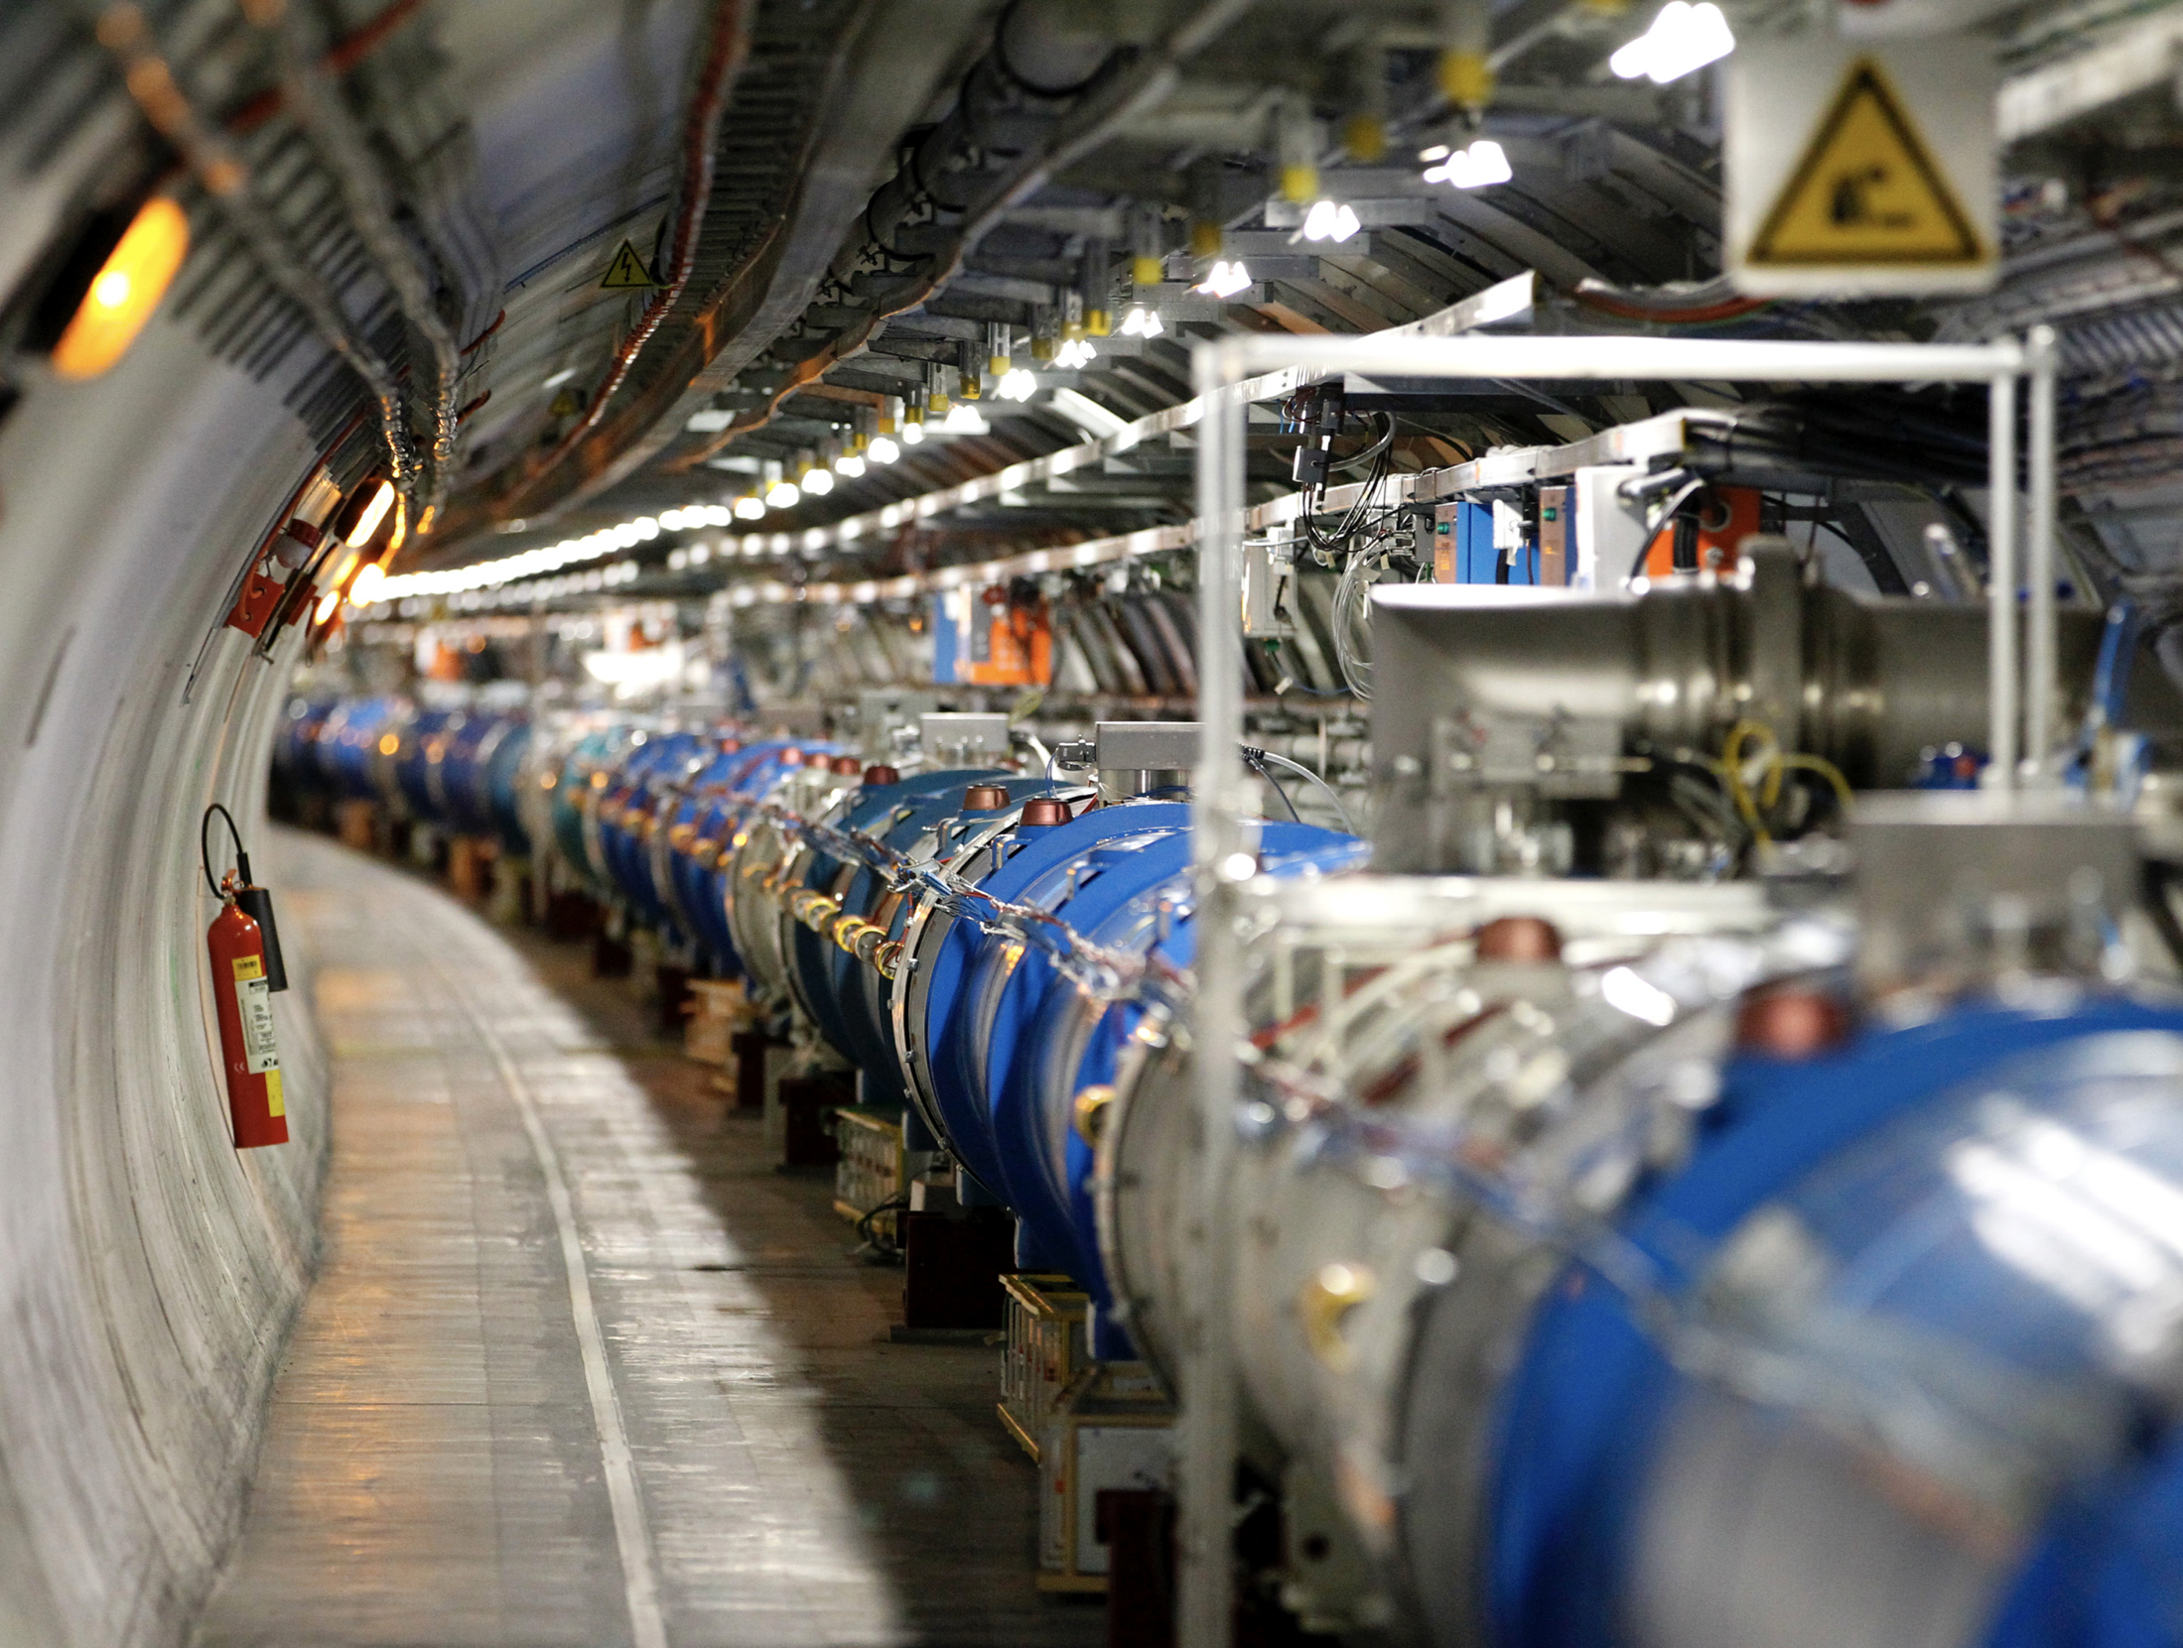

Slide 14
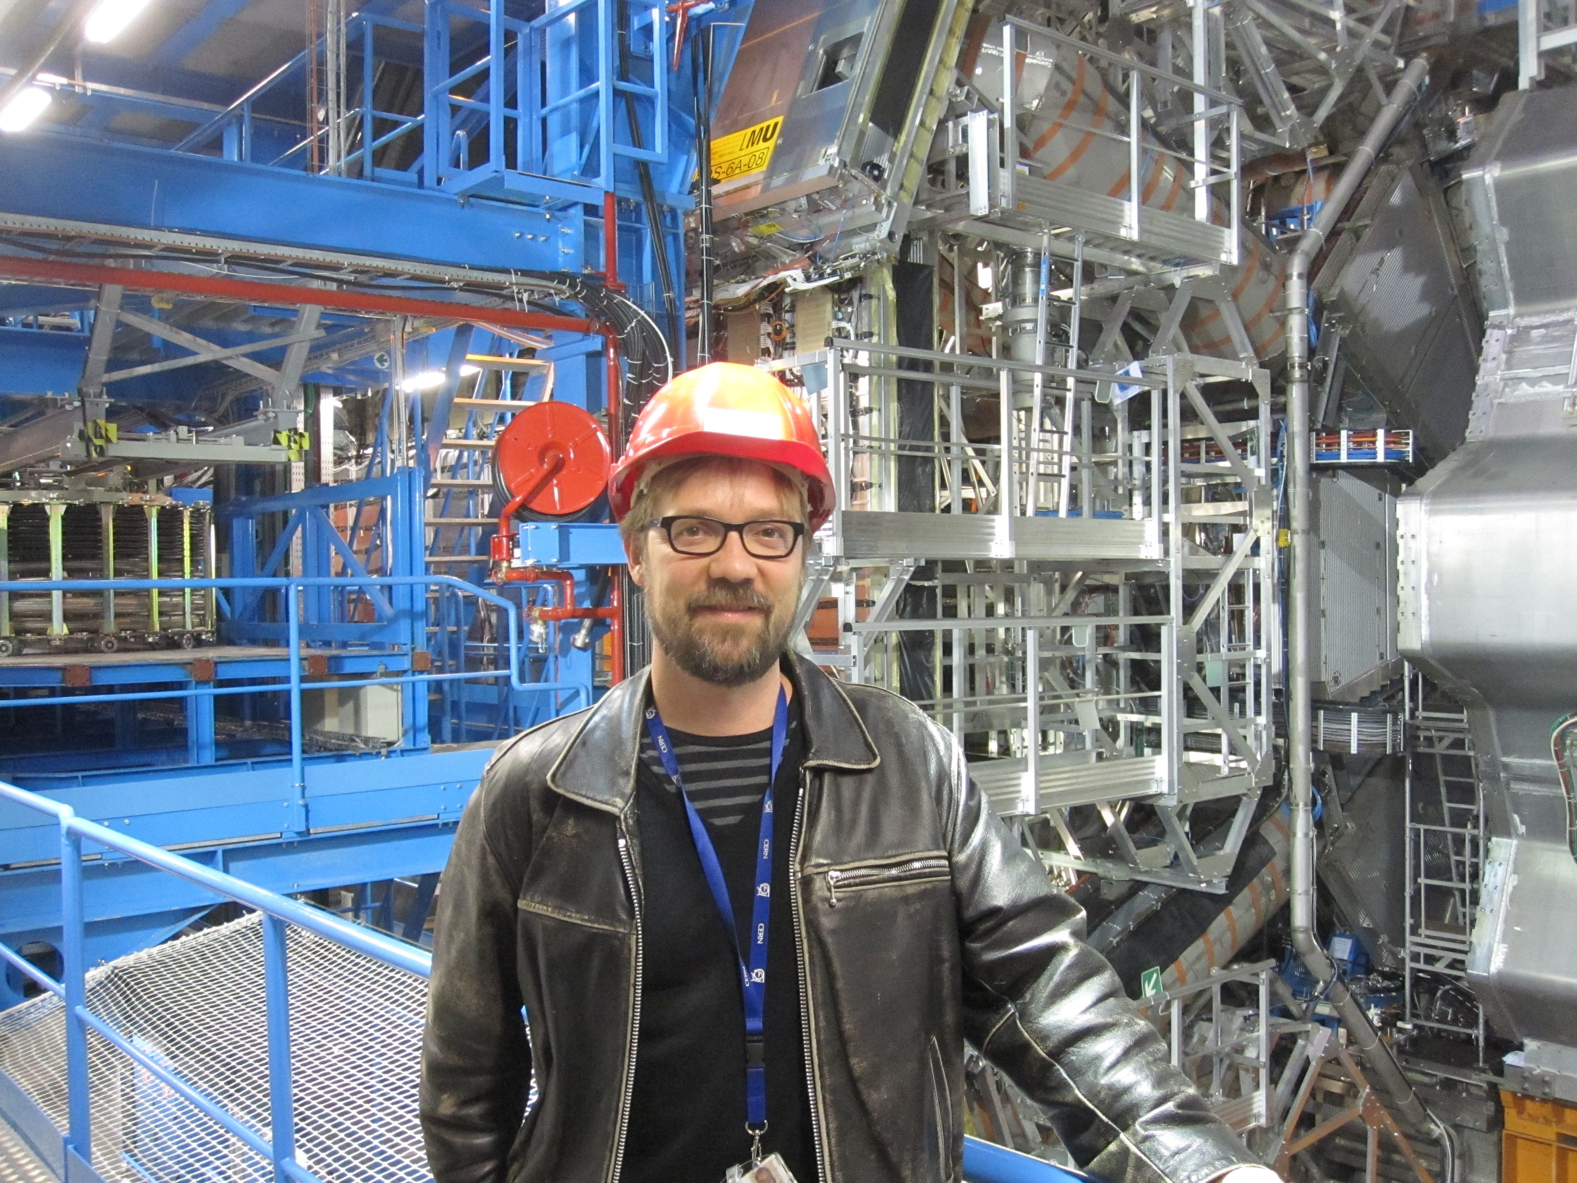


Slide 15
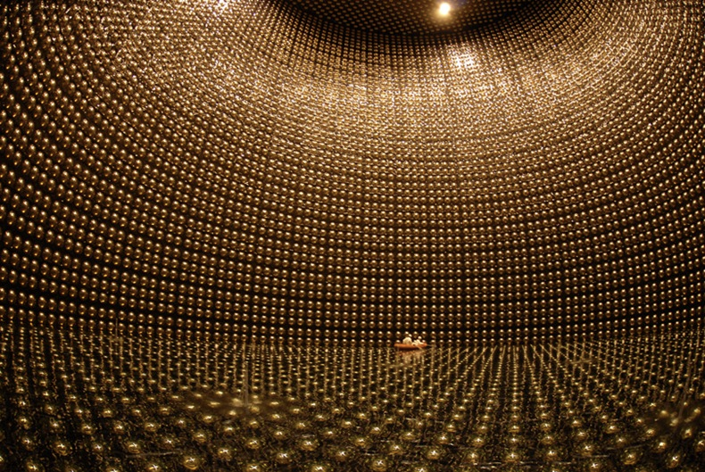

Slide 16
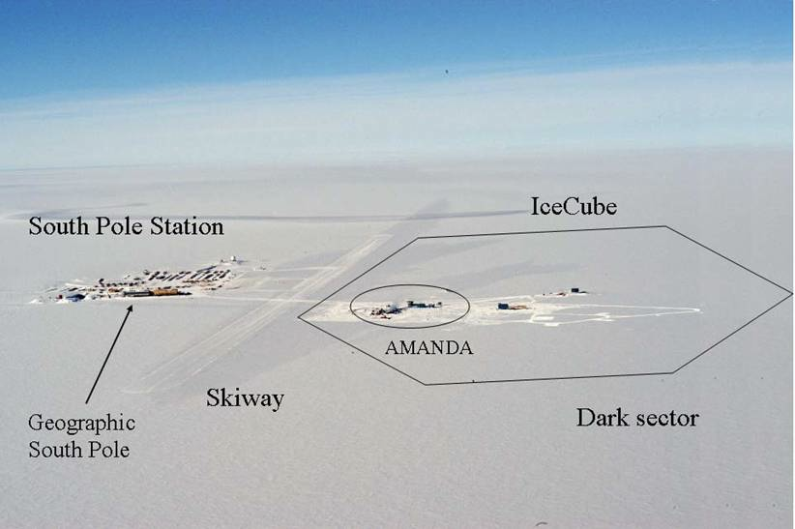

Slide 17


Slide 18

Back to school: Units

Slide 19
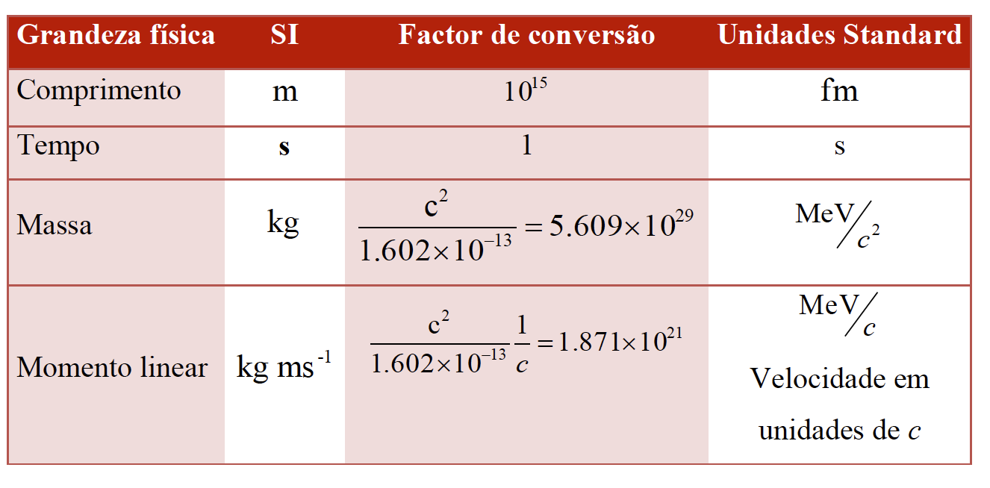
Standard Units

Slide 20
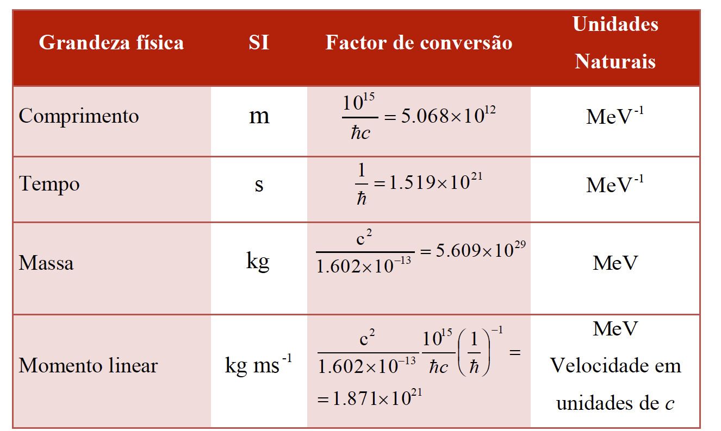

Natural Units: $ℏ=c=1$
Plus the electric charge: $α=\sqrt{4πε_{0}}\frac{e}{ℏc}=\frac{1}{137}$

Slide 21
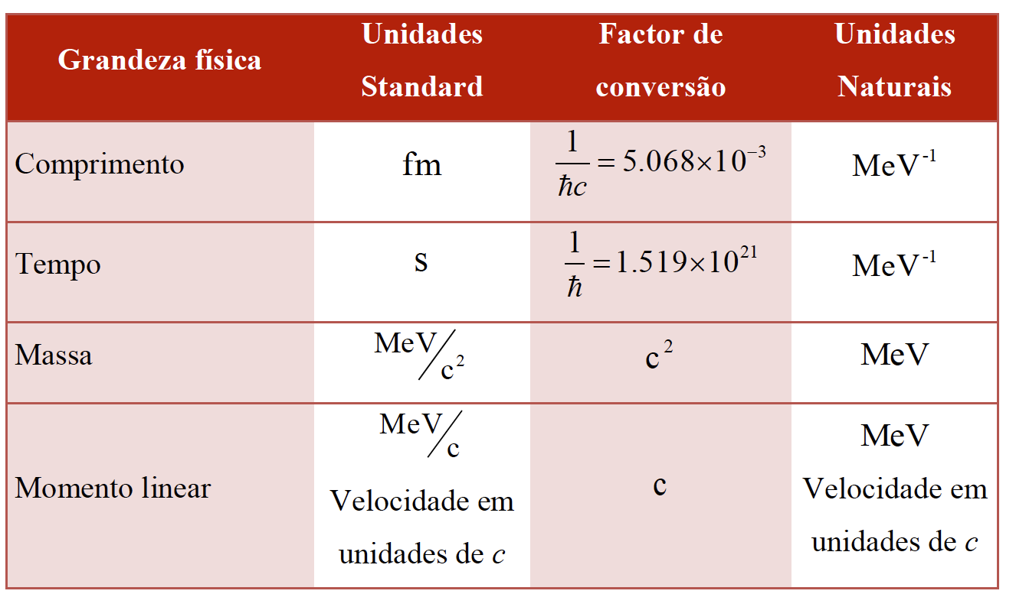
Standard vs Natural Units

Slide 22
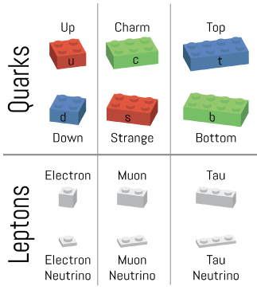
Particle Properties

Slide 23
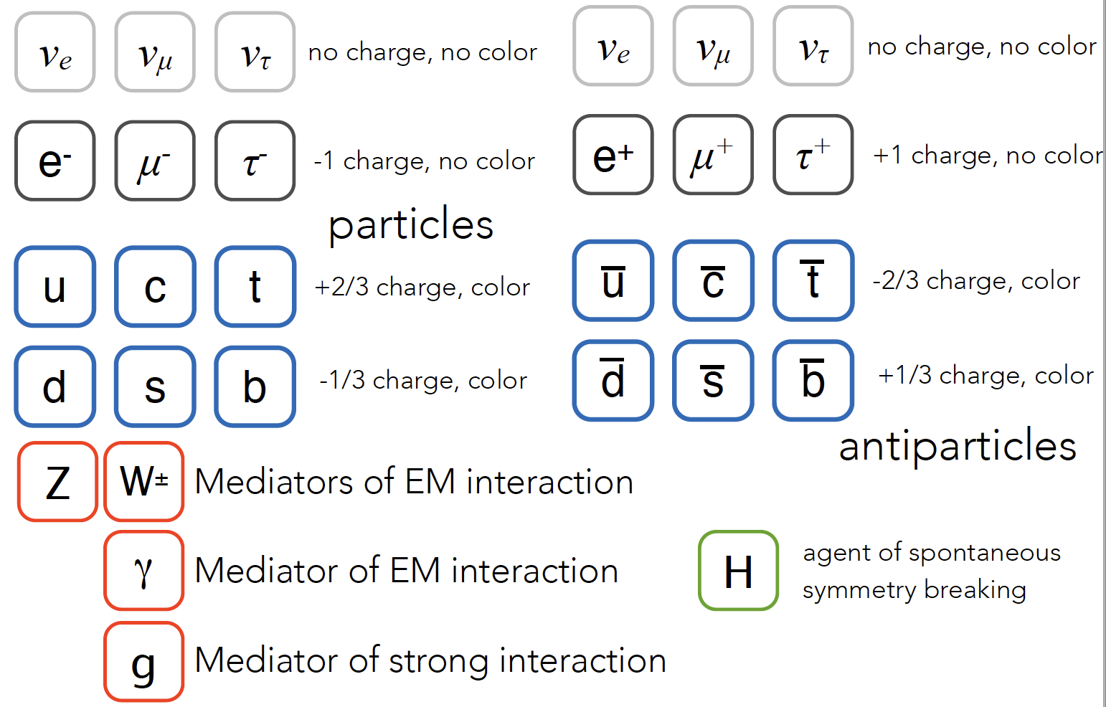
Quarks, Leptons, Gauge bosons

Slide 24
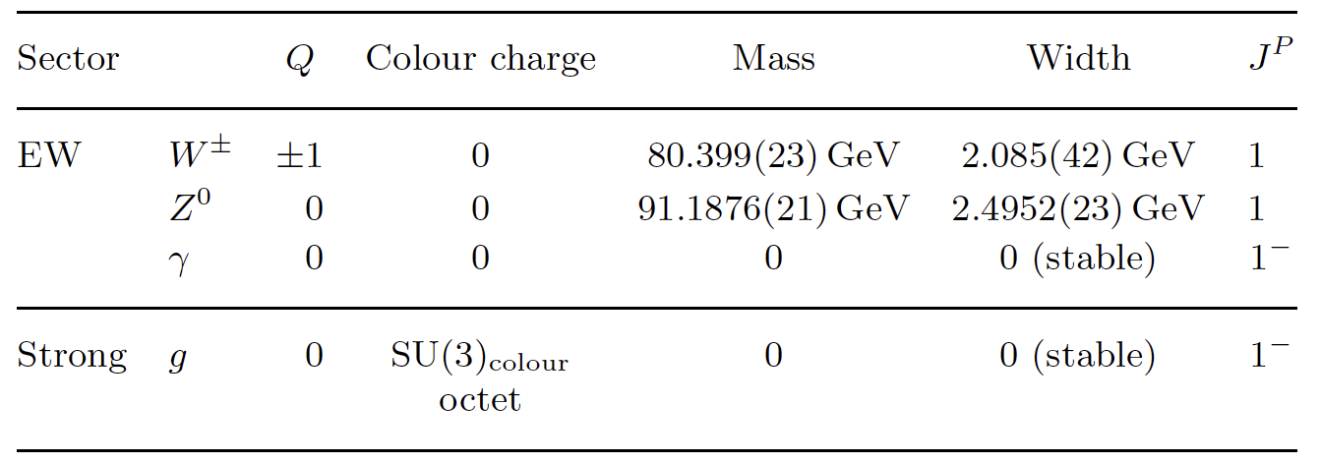
Gauge Bosons
Spin 1; different charges
Responsible for properties of interactions
Massive vs massless bosons

Slide 25
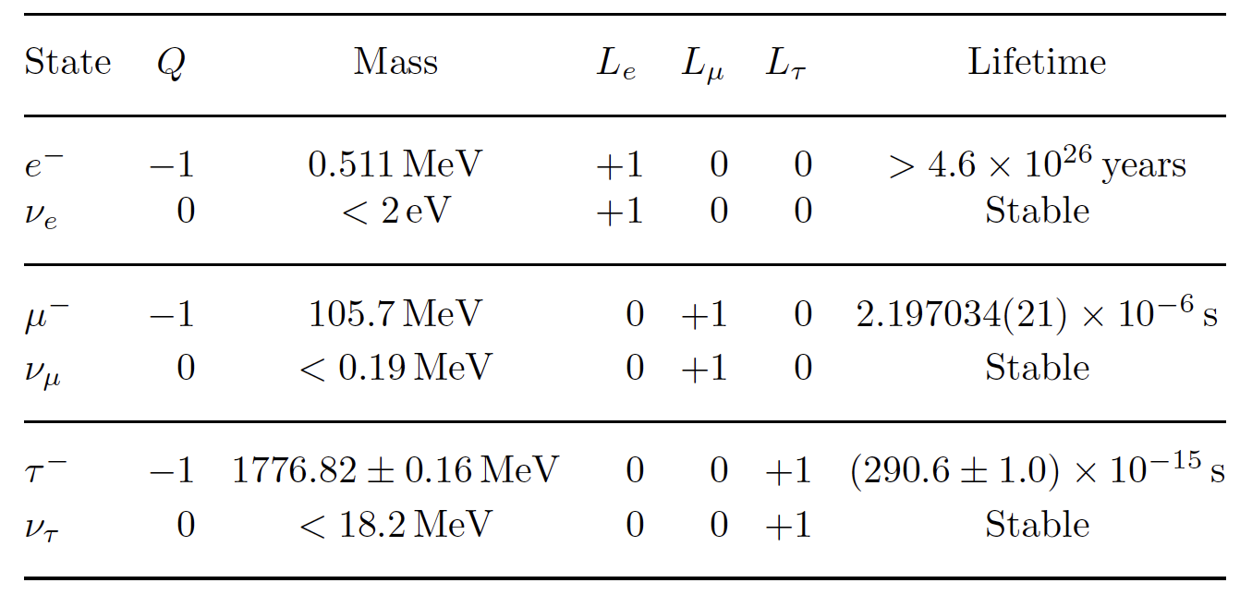
Leptons
Unit charge, spin 1/2
Feel electromagnetic and weak, but not strong force
Lepton number L_{e}, L_{μ}, L_{τ}
  Found to be conserved in all known interactions

Slide 26
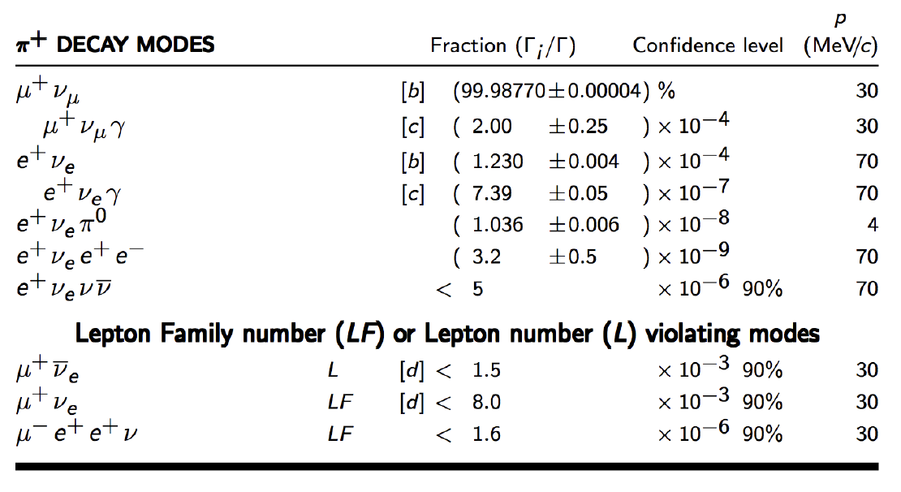
Particle Data Group: https://pdg.lbl.gov

Slide 27
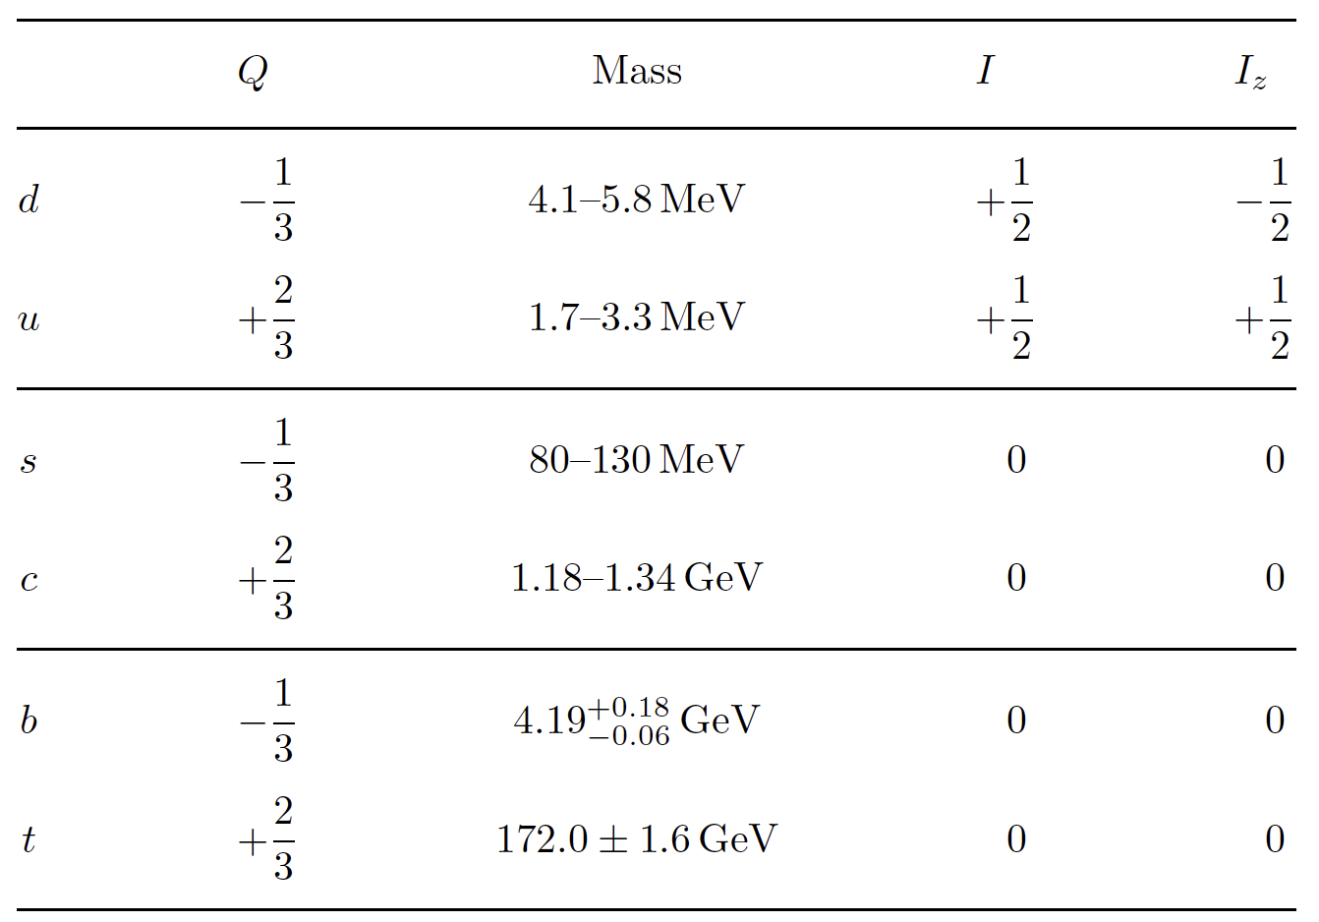
Quarks
Fractional electric charge, spin 1/2 (see later about Isospin)
Always confined in hadrons: mesons (qq); baryons (qqq)
Explain basic (static) structure of hadrons
Colour quantum number:
  3 values: Red, Green, or Blue
  Introduced to explain some
  baryon wavefunctions, for
  example of Δ++ (uuu)
  Only colour-neutral particles
  are stable
  Stable combinations are
  qqq and qq
  Gluons are bi-coloured:

Slide 28
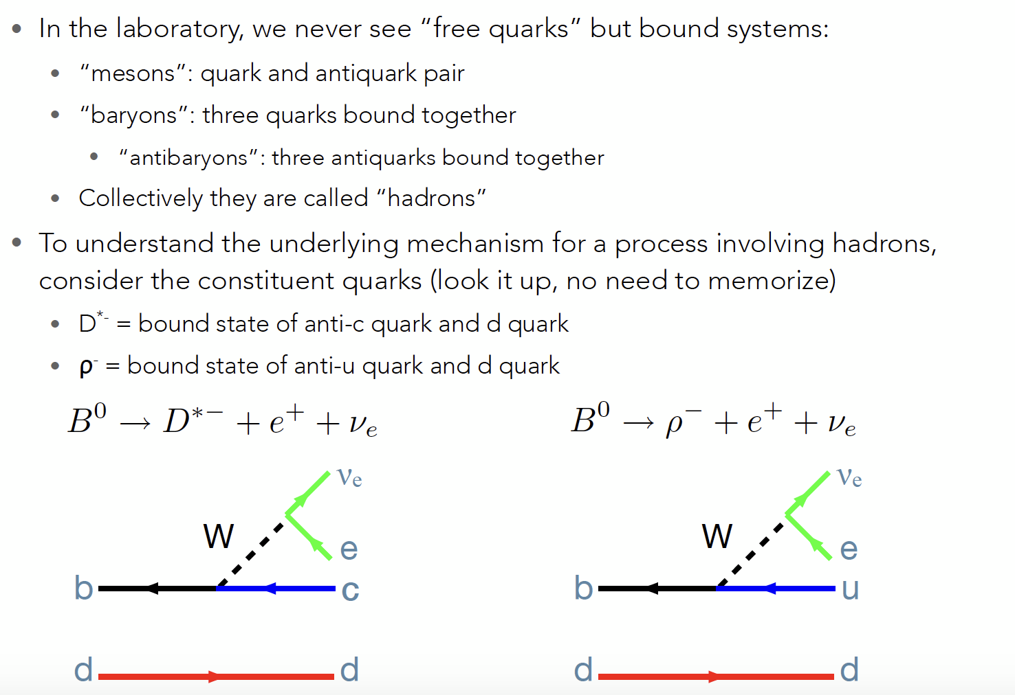

Slide 29
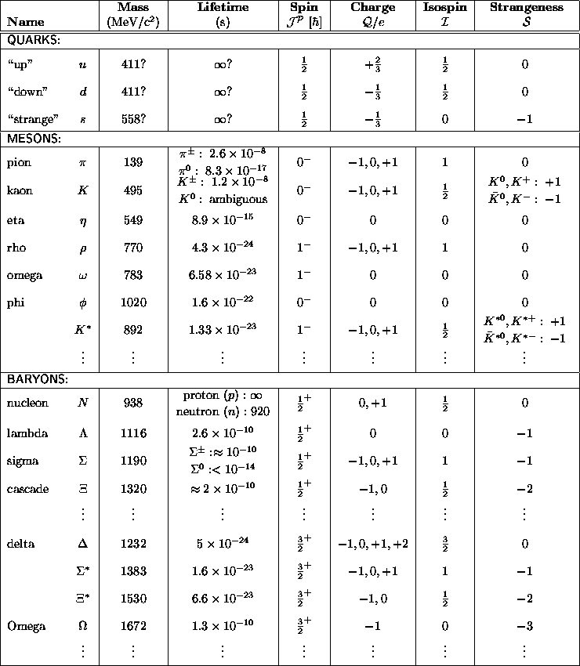

≈140 known mesons
≈65 baryons plus resonances
59 hadrons found at the LHC until 2021

Slide 30

Feynman Diagrams

Slide 31
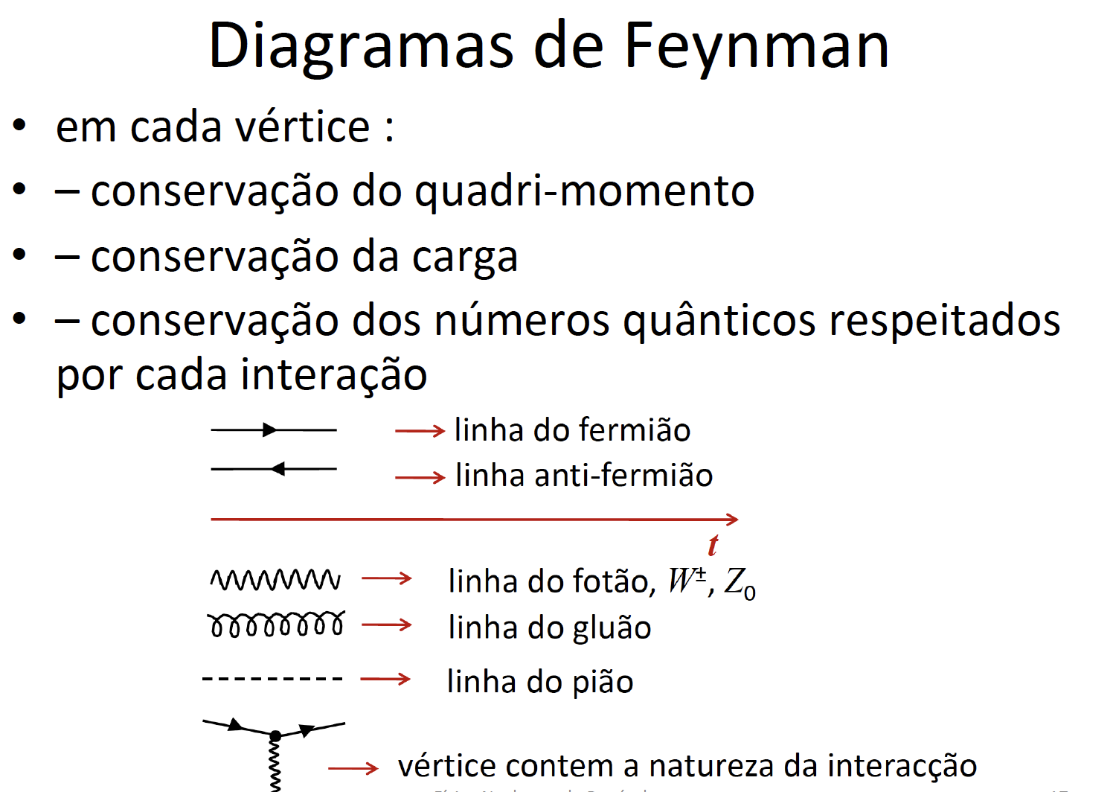
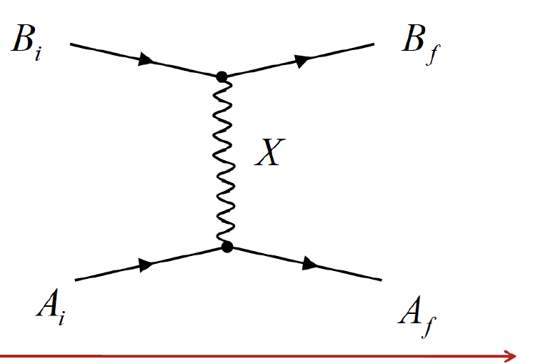
Intreractions
Interaction between two particles A and B interpreted as exchange of mediating particle X
Left hand side: initial state
Right hand side: final state
Middle: how transition happened
Time runs from left to right(*)
(*) But only in the sense that “before” is initial state and “after” is final state

Slide 32
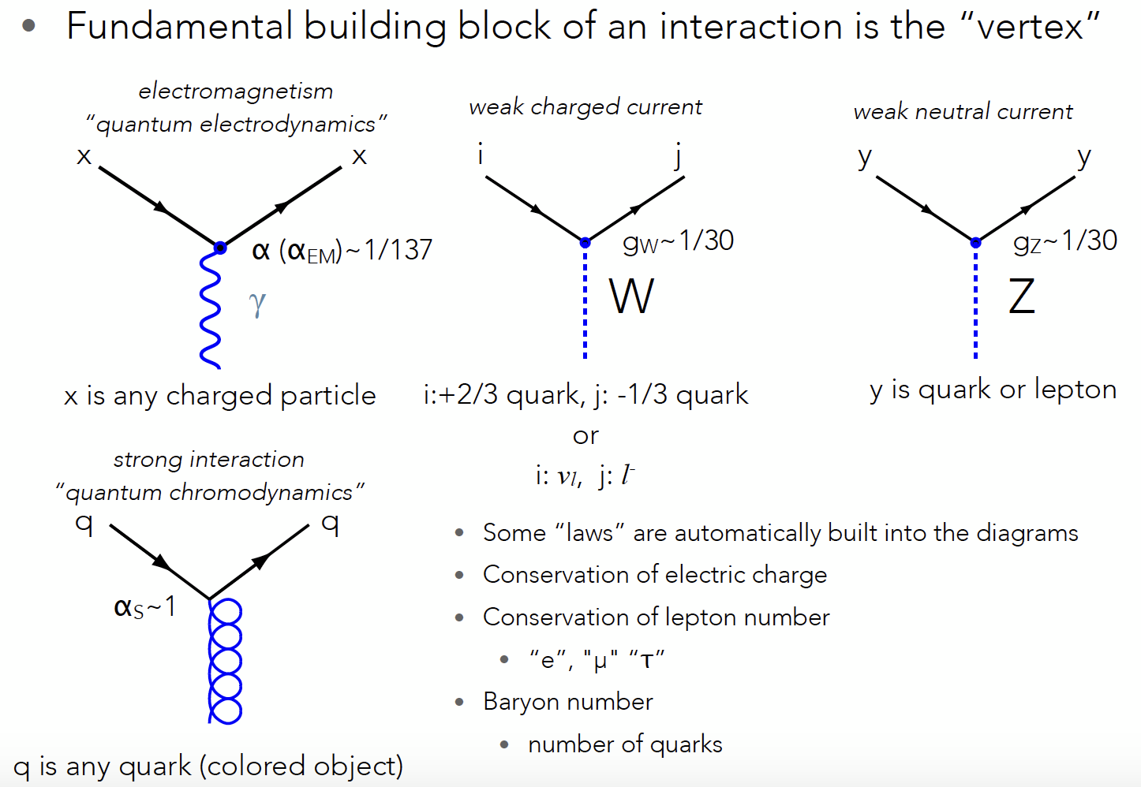

Slide 33
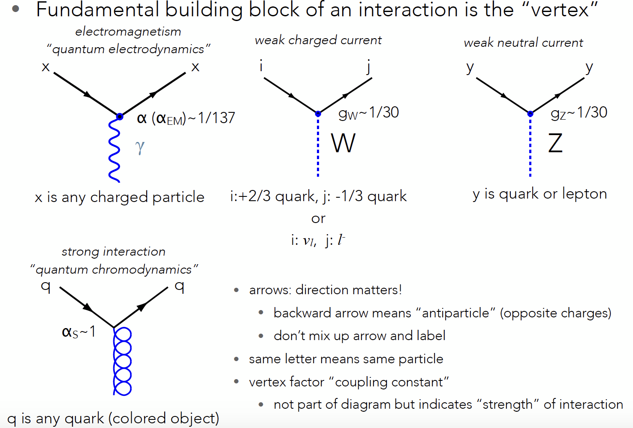

Slide 34
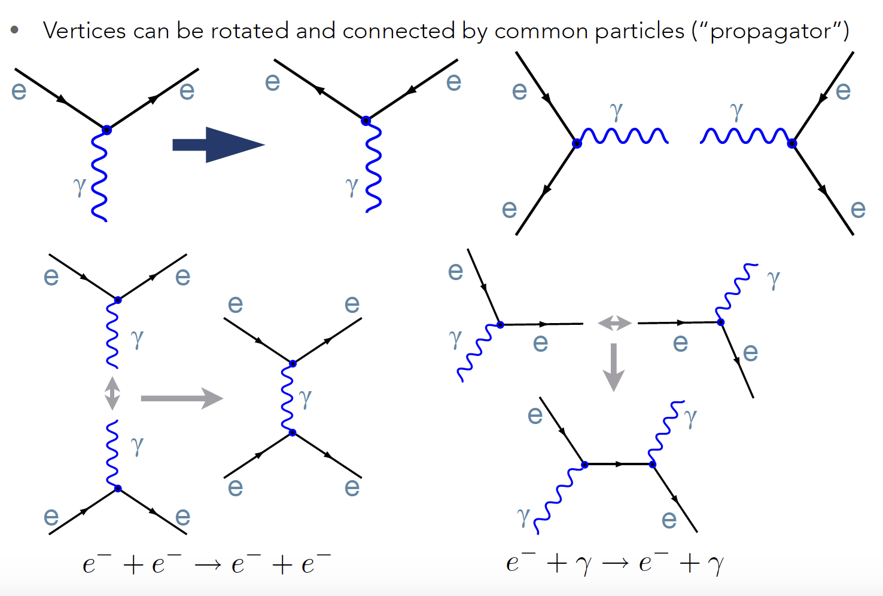

Slide 35
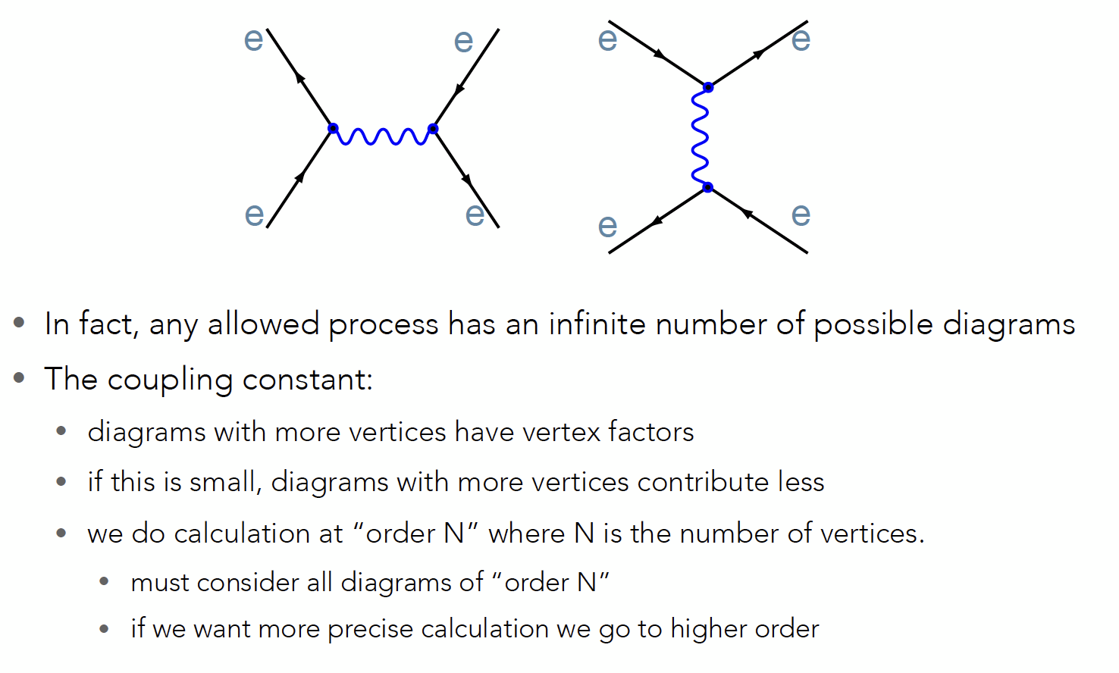

Slide 36
