Slide 1

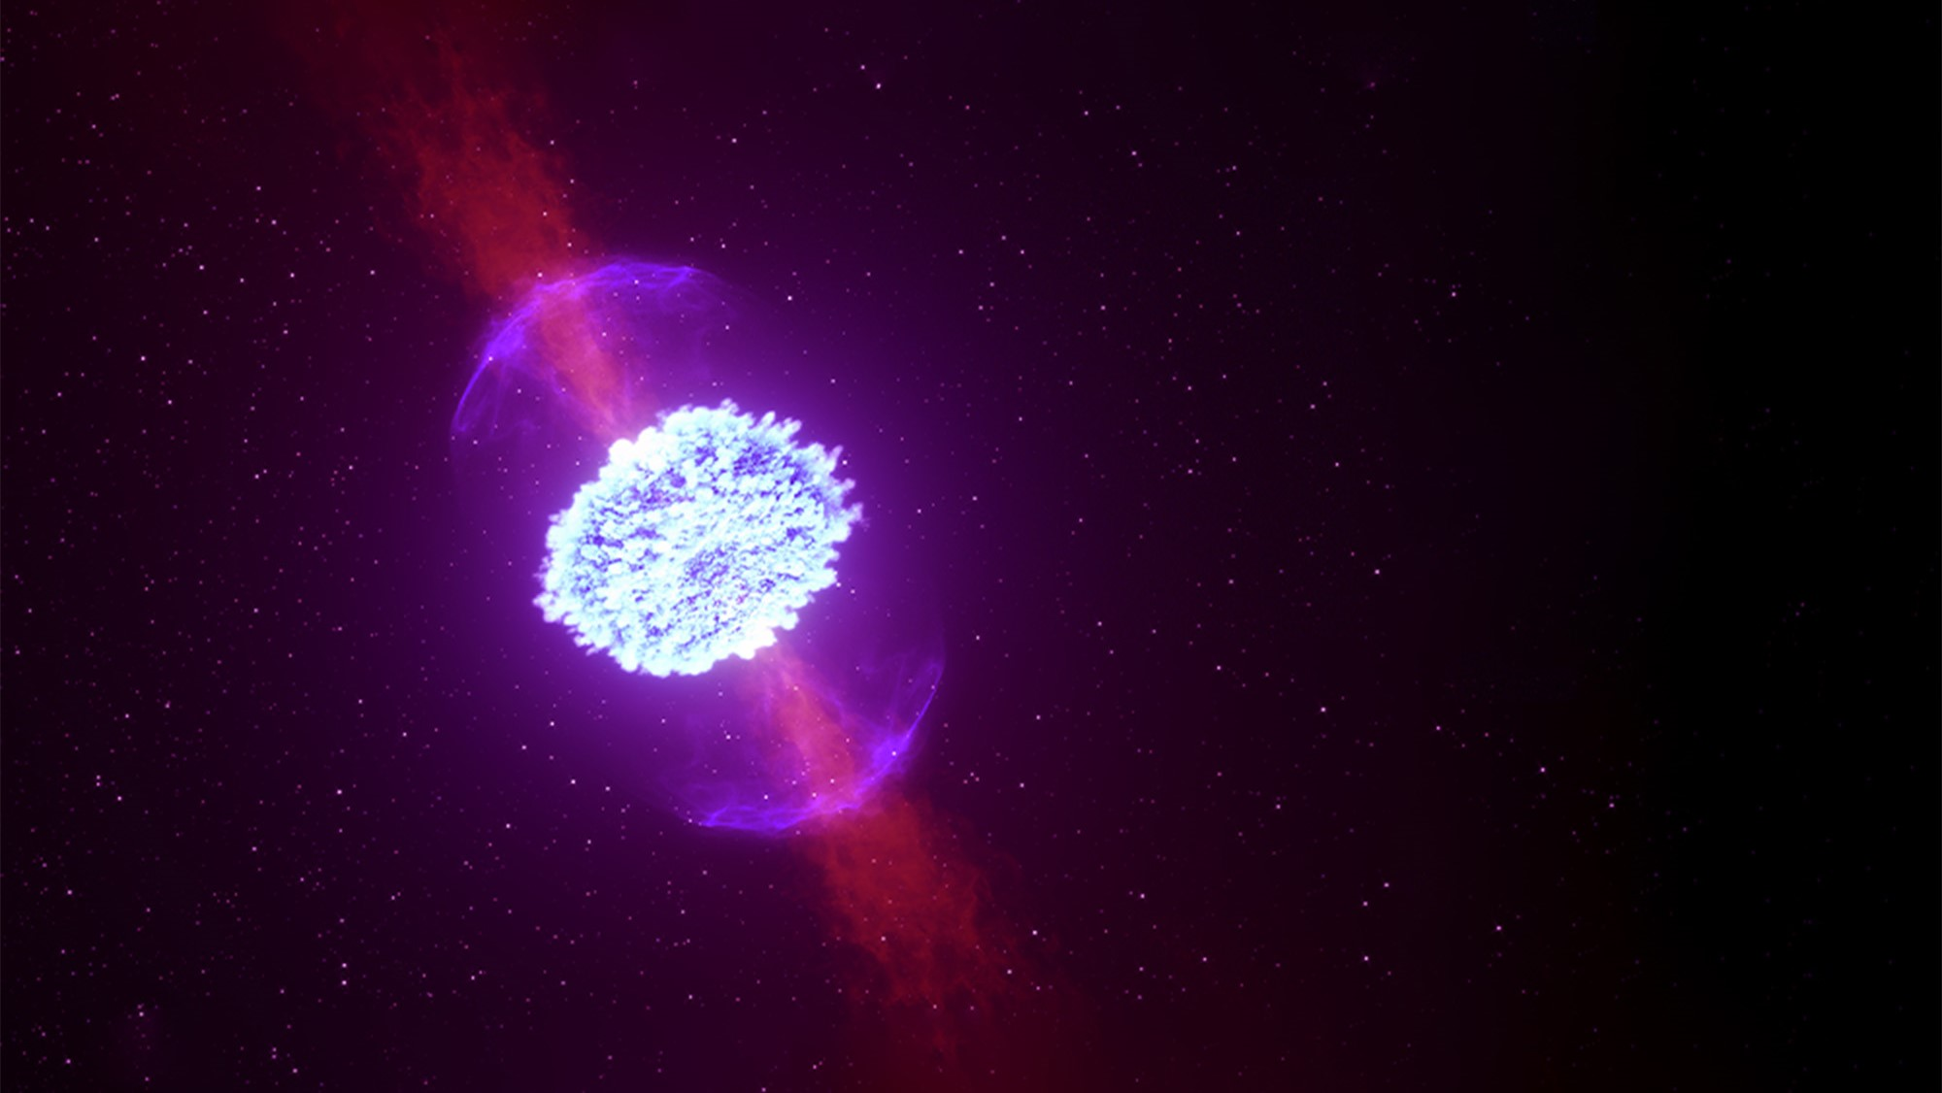


Improvement and benchmarking of atomic data for kilonova modeling
Luís Leitão
IBER2023

Slide 2
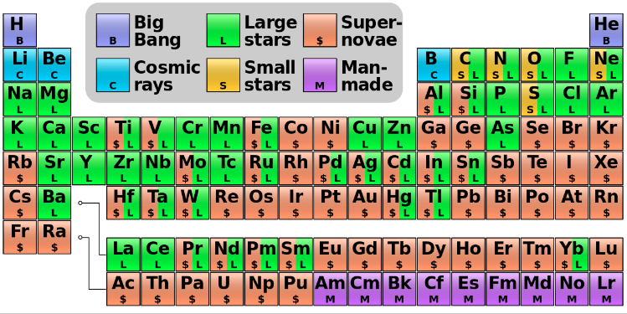
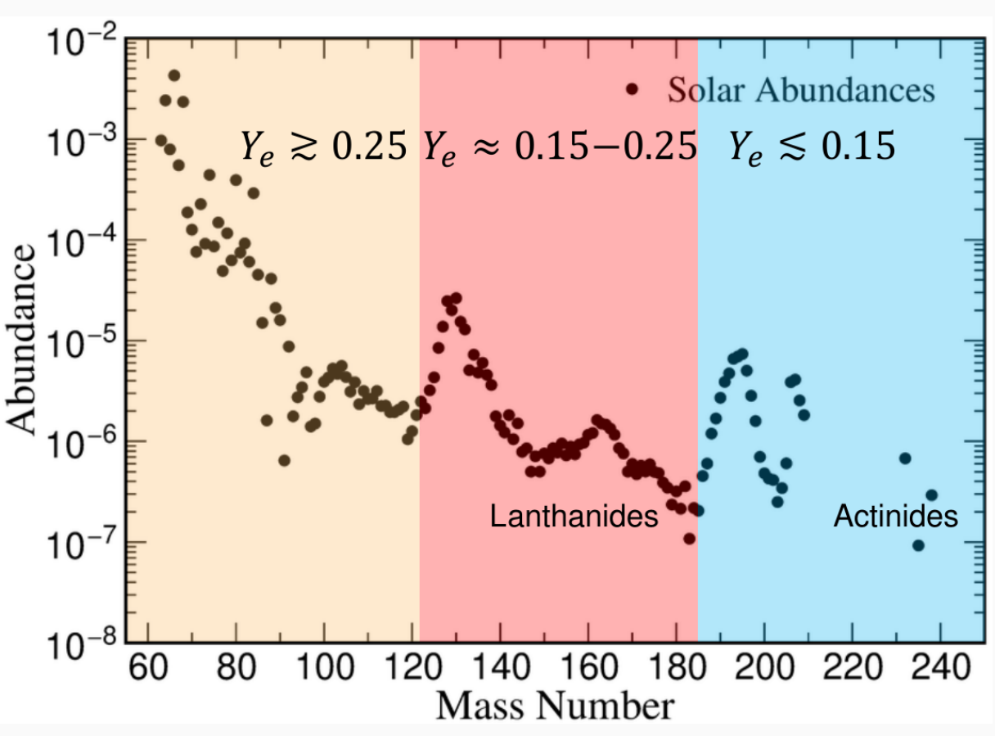
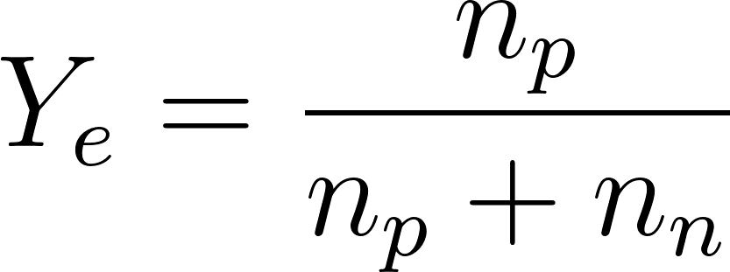
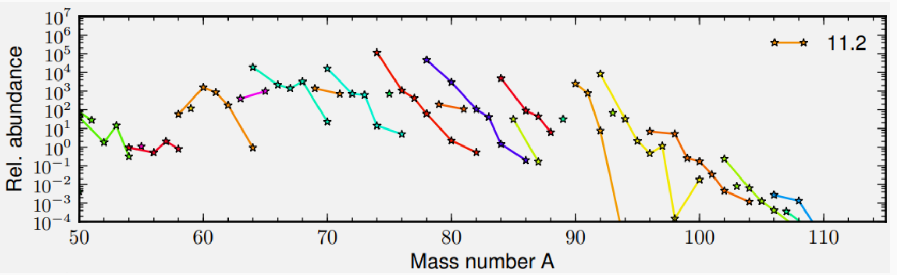
Motivation: Supernovae
Supernovae was thought to be the origin of the heavier elements;
Electron fraction above the necessary to produce lanthanides and actinides.
G. Martinez-Pínedo. et al, Supernova neutrinos and nucleosynthesis (2014)

Slide 3
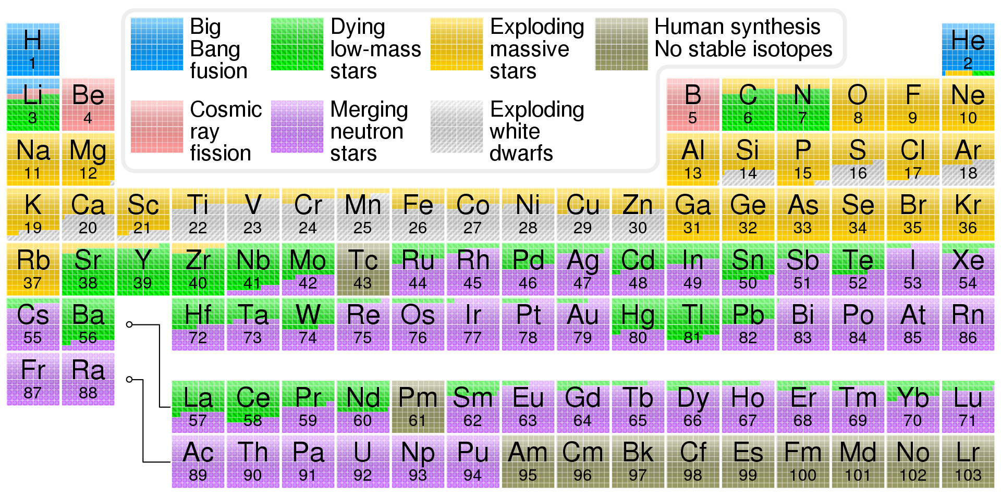
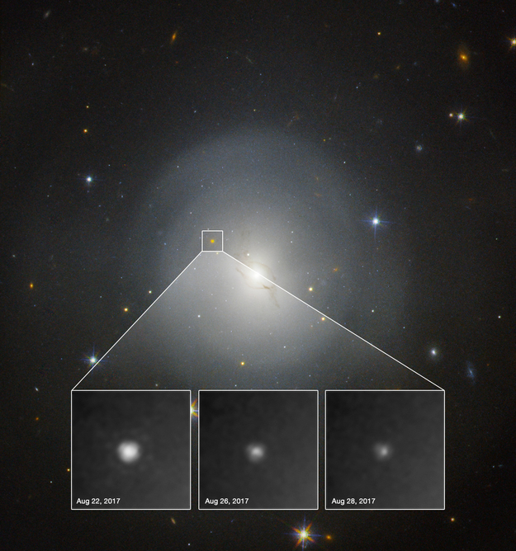
Motivation: Kilonovae
In 2017 was observed the first kilonova after the neutron star merger GW170817.
Initially there was almost no data for lanthanides and actinides:
  Extremely complex;
  No need in the atomic community until recently.

Slide 4
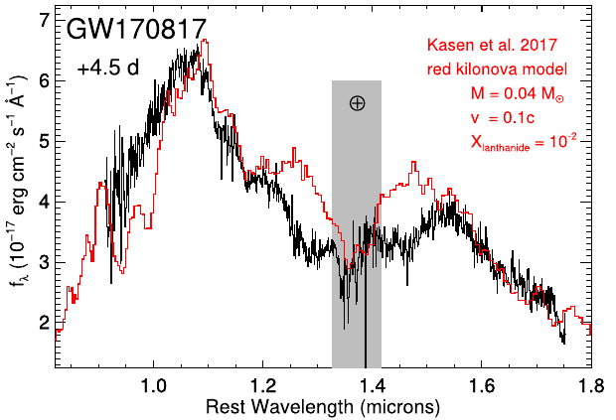
Motivation: Kilonovae
First simulations used iron-peak elements:
  Wrong conclusions because lanthanides and actinides have much higher number of levels/lines.
Encoding elemental abundances
Opacity

Slide 5
Method - FAC
For the atomic data calculations we make extensive use of the FAC software package:
Allows for a complete set of data for plasma modelling with speed and utility in mind
  Structure, radiative and collisional processes
Uses a Dirac-Fock-Slater Hamiltonian with a local central potential, computed for a fictitious mean configuration (FMC) with fractional occupation numbers
  Orthogonality is ensured automatically → Speed increase
  Potential not optimized for a single configuration → Accuracy issues
  Choice of FMC is mostly arbitrary and usually constructed by hand → Major source of uncertainty

Slide 6
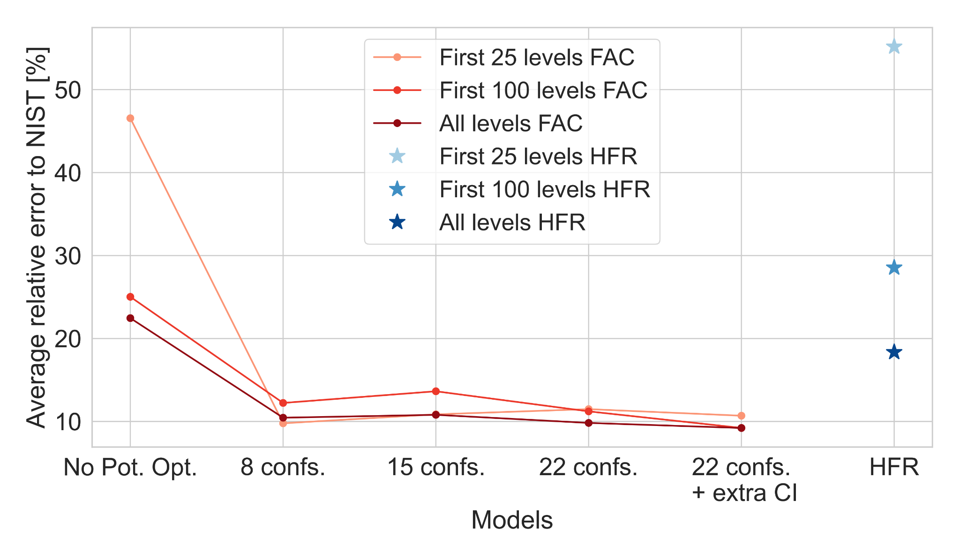
FAC - Potential Optimization
Average error of energy levels to NIST for Nd II
[A.Flörs+2023 (Submitted)]
FAC correction to local potential insufficient [Lu+21, McCann+21].
Potential optimization by changing mean configuration (weights) to minimize differences to experimental data.

Slide 7
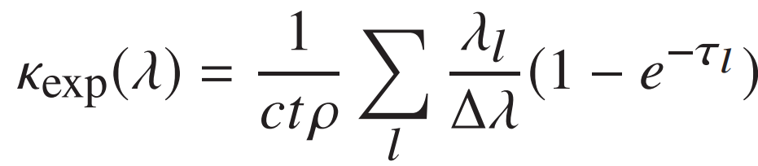
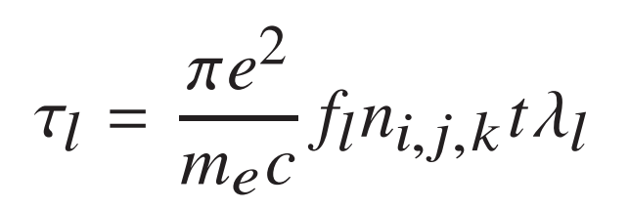
FAC - Potential Optimization (Opacities)
Expansion opacity formalism
Opacity ⇒ measure of impenetrability to radiation, given by the photons blocked because of atomic transitions.
Number density
Probability of photon absorption
Transition wavelength
Oscillator strength
Notes:
Legendar formula
Efeitos para os 2 graficos
CeII?

Slide 8
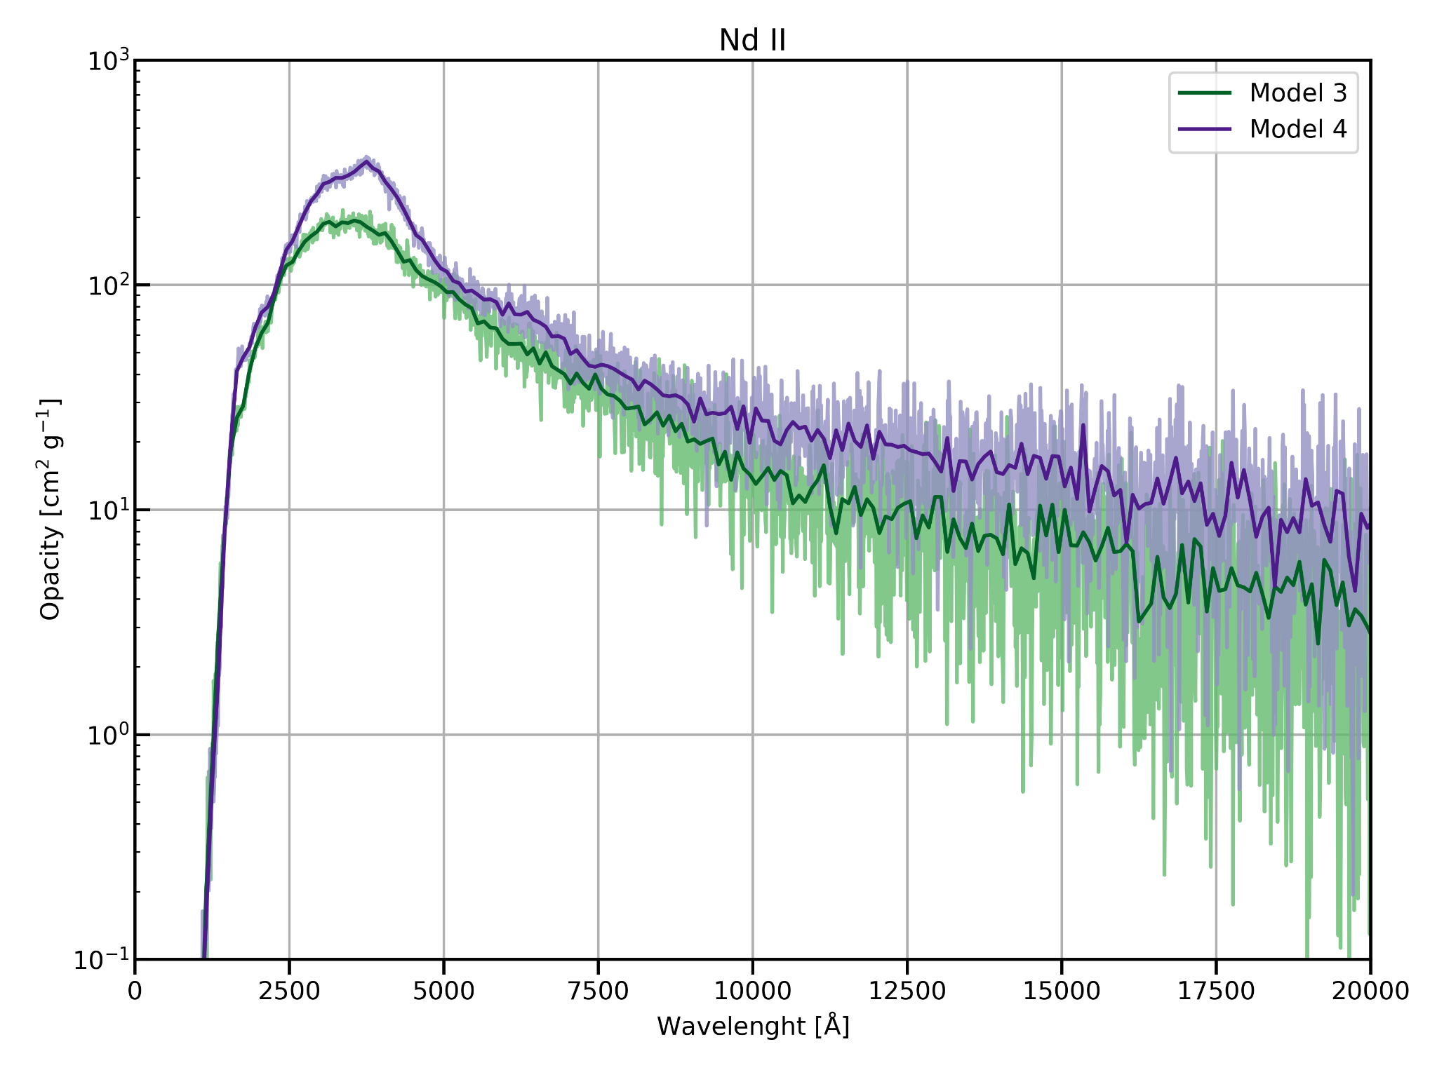
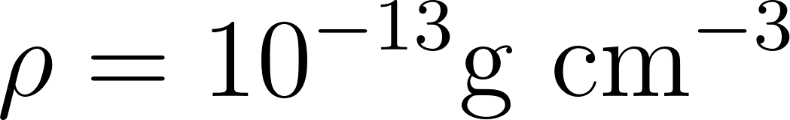

FAC - Potential Optimization (Opacities)
Expansion opacity formalism
Potential optimization impacts the full spectrum.
Notes:
Legendar formula
Efeitos para os 2 graficos
CeII?

Slide 9
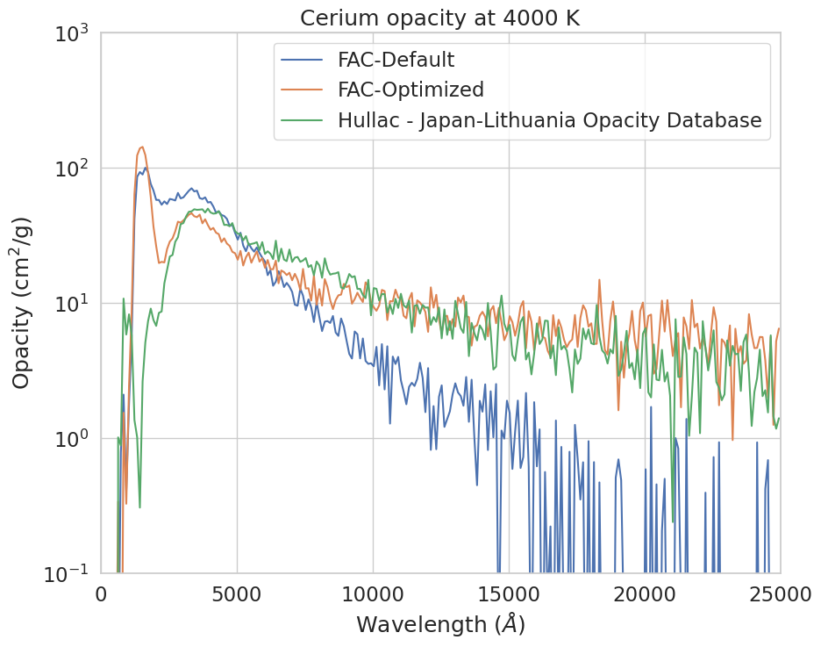
FAC - Potential Optimization (Opacities)
Expansion opacity formalism
Good general agreement with calculations with Hullac - differences at higher ionization stages.
Notes:
Legendar formula
Efeitos para os 2 graficos
CeII?

Slide 10
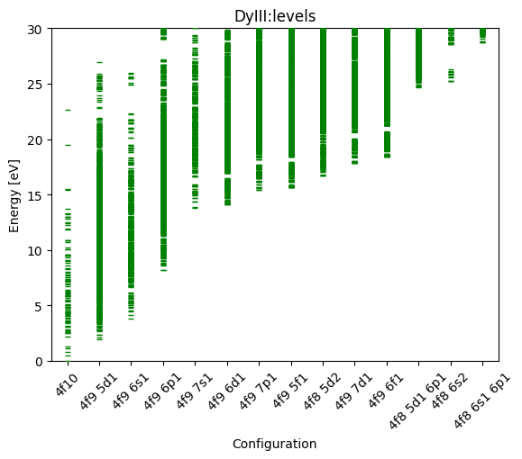
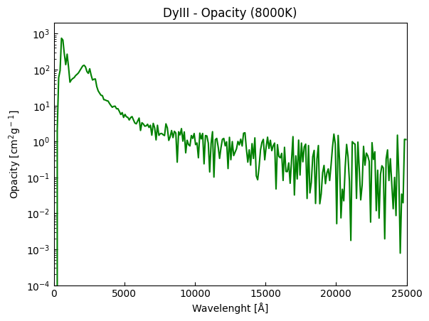
Results - Dy III

Slide 11
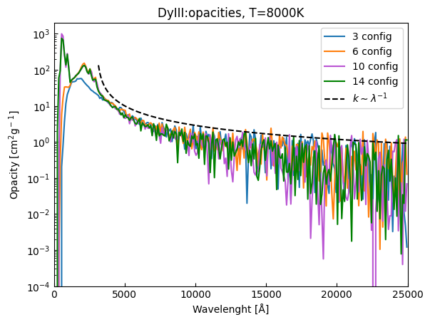
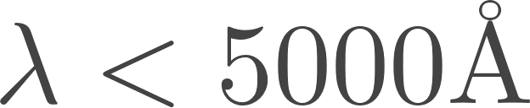
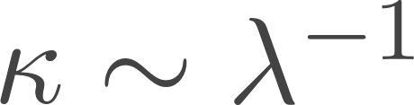
Convergence of Opacity for Dy III
Extended set of configurations to ensure convergence
  Higher impact at - transitions from highly excited levels to low energy levels
  High wavelength behaviour ruled by [R. F. SIlva+ 22, G.Leck 22]

Slide 12
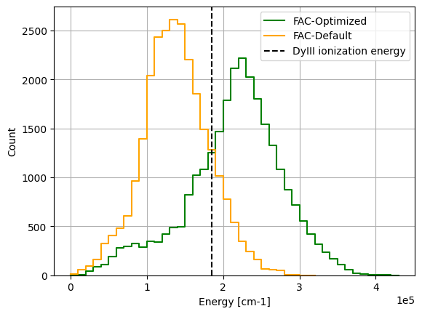
Results - Effects on level density
Contrary to calibration of individual levels, optimization of the central potential impacts the full spectrum;
Optimized levels typically closer to exponential behavior (up to ionization energy).

Slide 13
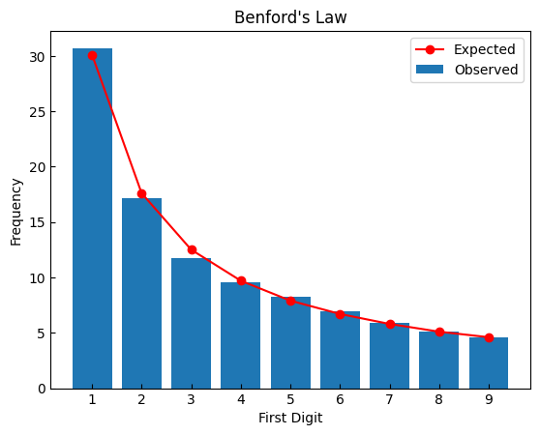
Statistical Test - CeII
Law of anomalous numbers - leading digits distribution for sets of numerical data;
Close match with Benford’s Law, suggesting that potential optimization procedure may not be giving biased results.

Slide 14
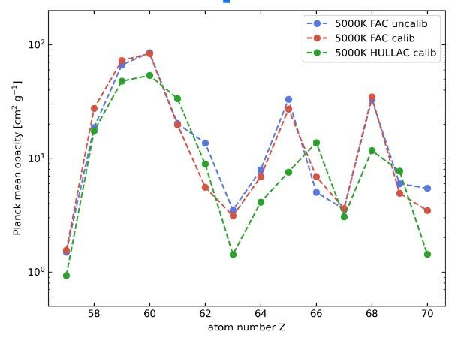
Results - Opacities
Calibration:
→ Find the lowest energy level for each set of values with the same parity and j;
→ Shift our data to that value.

Slide 15
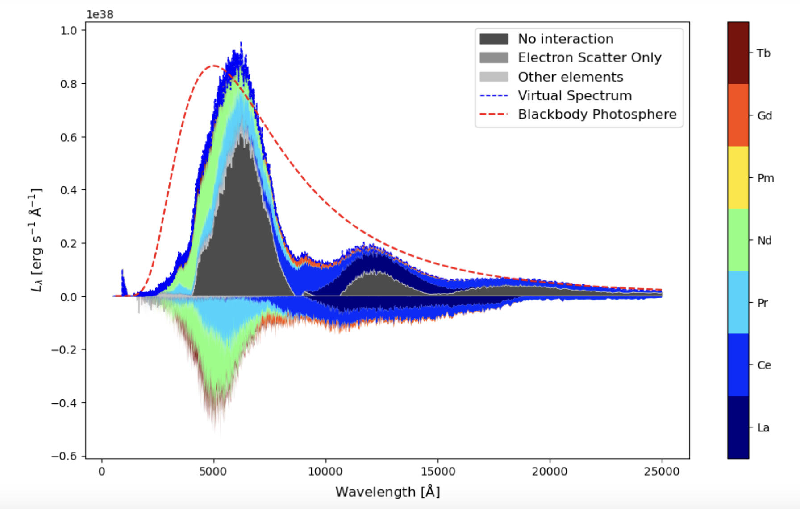
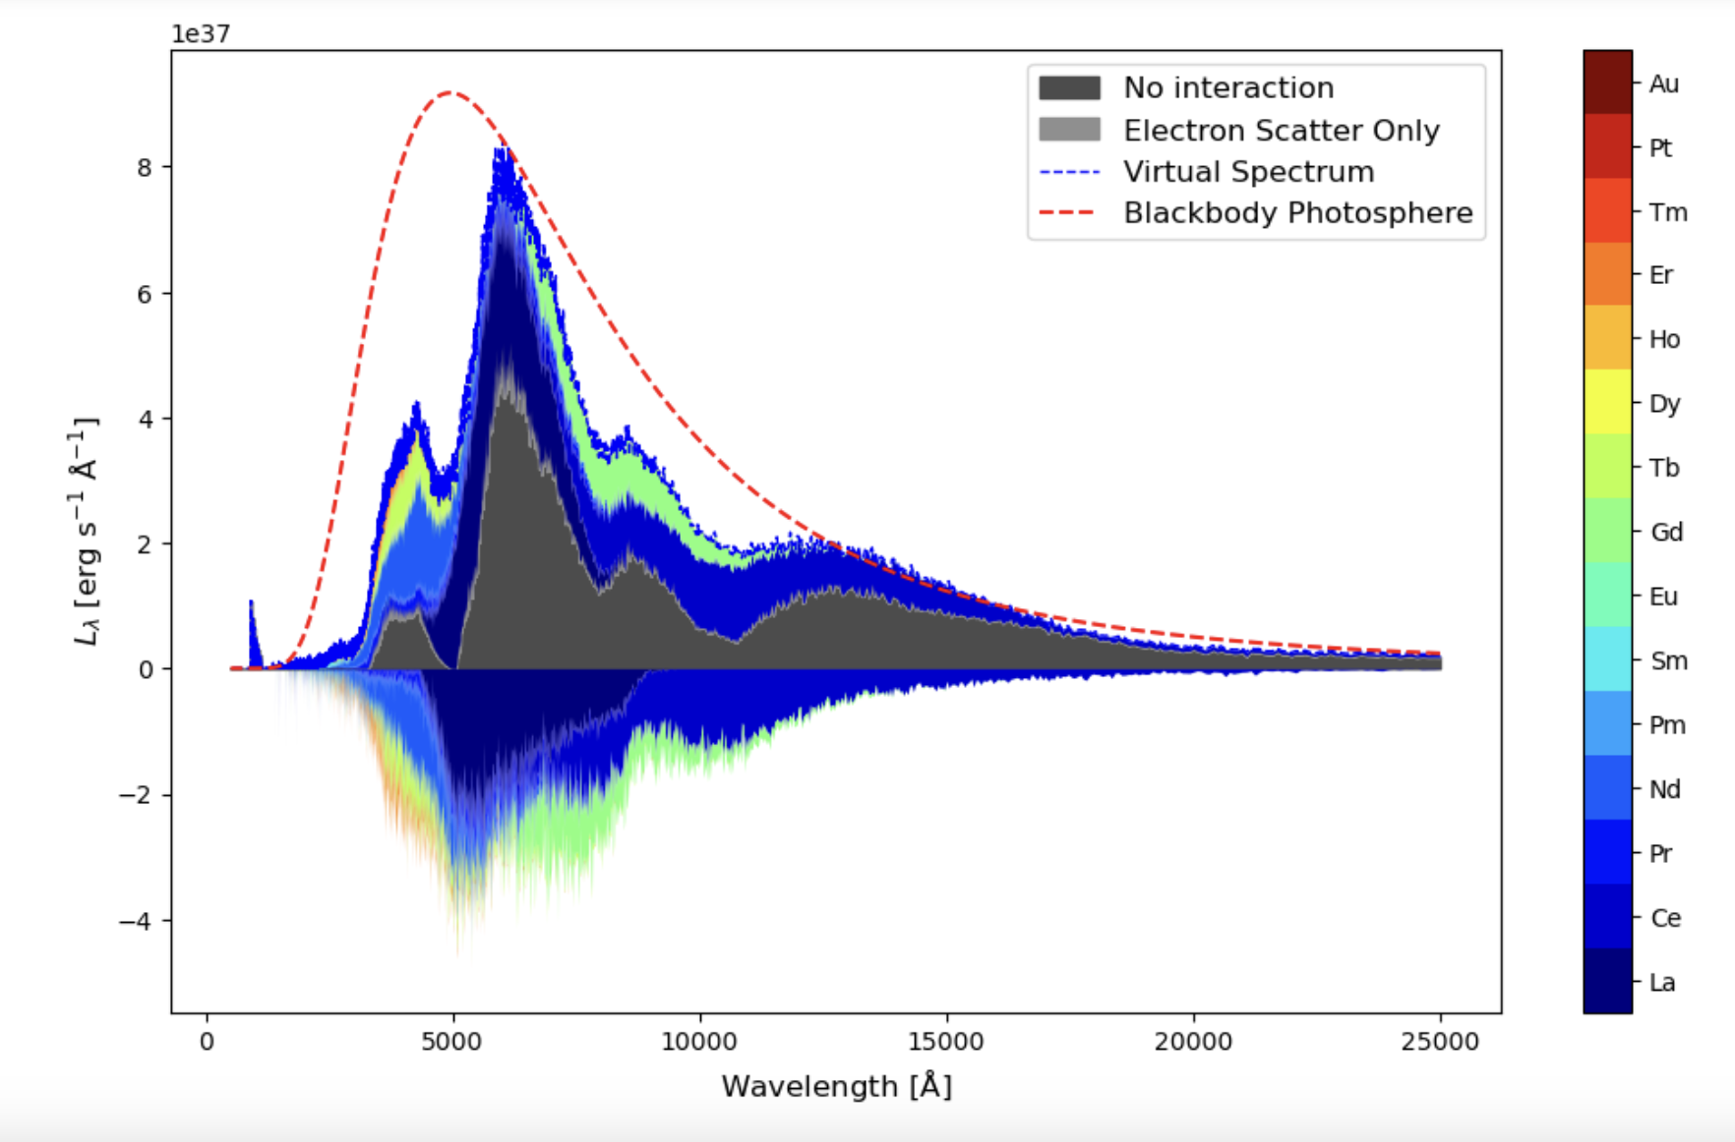
Results - Kilonova Flux
Preliminary study into the effects of lanthanides on kilonova flux
Too early to take conclusions about the abundance of this elements in the kilonova
FAC
calib
FAC
uncalib

Slide 16
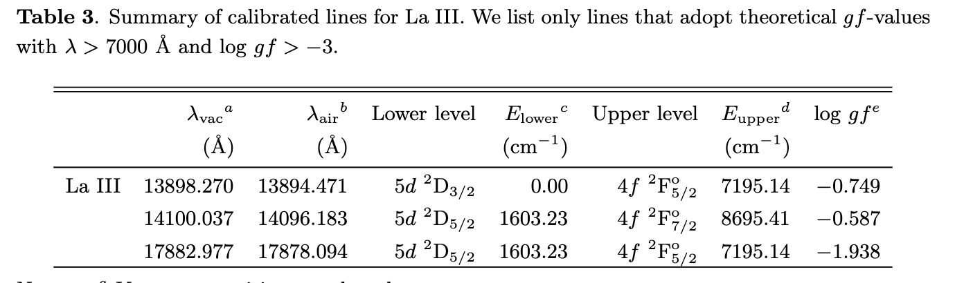
Results - Kilonova Flux
Preliminary study into the effects of lanthanides on kilonova flux
Too early to take conclusions about the abundance of this elements in the kilonova
FAC
calib
[Domoto+2022]
FAC
uncalib

Slide 17
Summary and future work
Our goal is to provide a complete set of atomic data to be used in the characterization of kilonova light curves and spectra
  Benchmarking of ab-initio for when no experimental data is available - MCDFGME, GRASP
  We will make our data publicly available after publication.
Optimisation of the mean local potential leads to very good agreement with NIST data and other structure codes (e.g. GRASP)
  Calibration still necessary
Radiative transfer calculations to test the impact of different atomic datasets

Slide 18









collaboration
Luis Leitão
Ricardo Ferreira da Silva
Jorge Miguel Sampaio
José Pires Marques
Pedro Amaro
Gabriel Martínez-Pinedo
Andreas Flörs
Gerrit Leck
Luke Shingles
Helena Carvajal
Patrick Palmeri
Pascal Quinet
Jérôme Deprince
Michel Godefroid
Stephane Goriely
Funded by:
2022.06730.PTDC

Slide 20
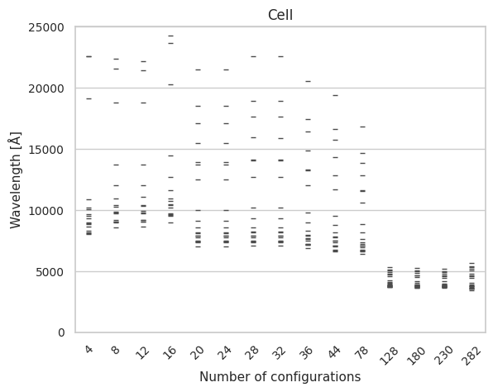
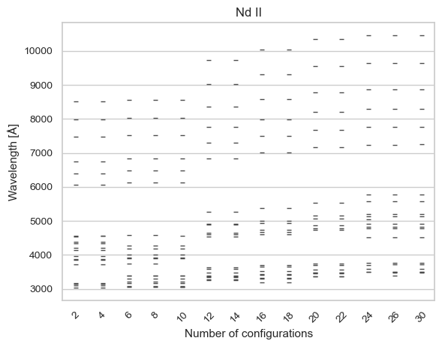
Lines Convergence
Line convergence is achievable for simple ions;
For complex ions (with more than 5 valence electrons) that may not be the case.

Slide 21
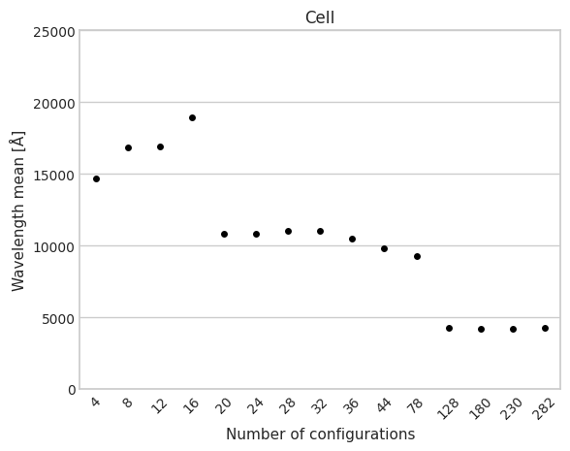
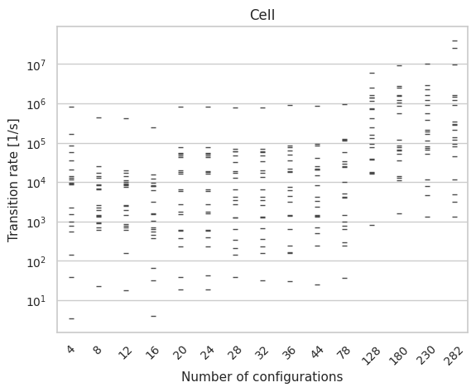
Convergence for CeII
20 selected transitions between 4f2 5d1 and 4f1 5d2.

