Slide 1

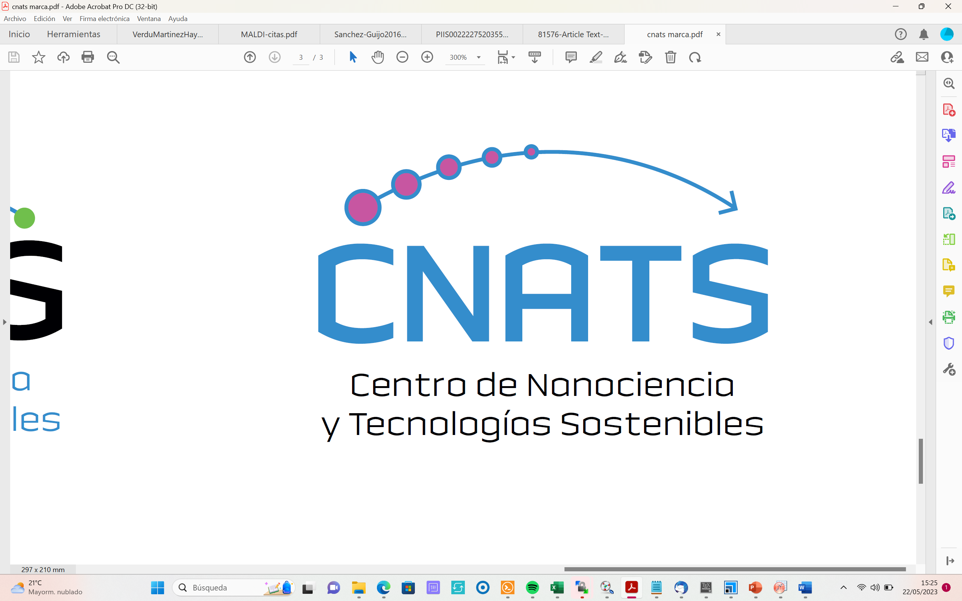
Proton diffusion in a benchmark
entangled hydrogen bonding network
Bruno Martínez-Haya
Center for Nanoscience and Sustainable Technologies (CNATS)
Department of Physical, Chemical and Natural Systems,
Universidad Pablo de Olavide, Seville, Spain
IBER-2023
Coimbra
september 6th, 2023

Slide 2


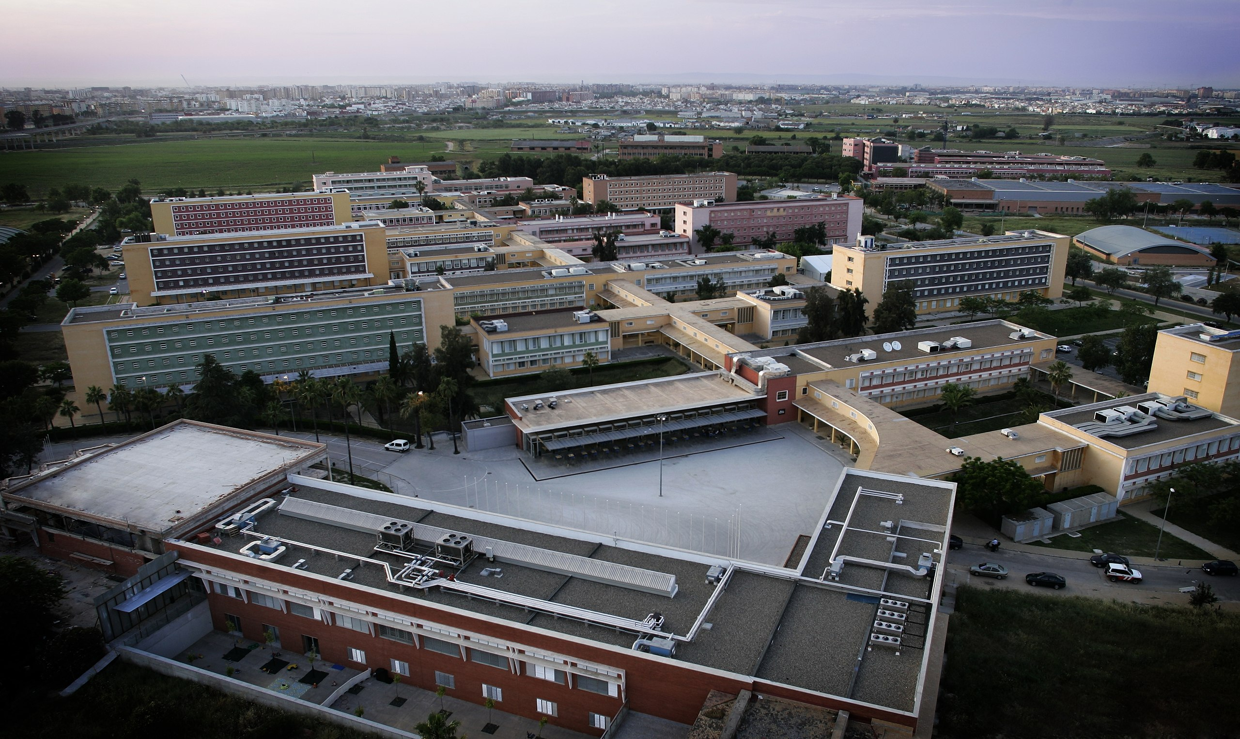

Slide 3
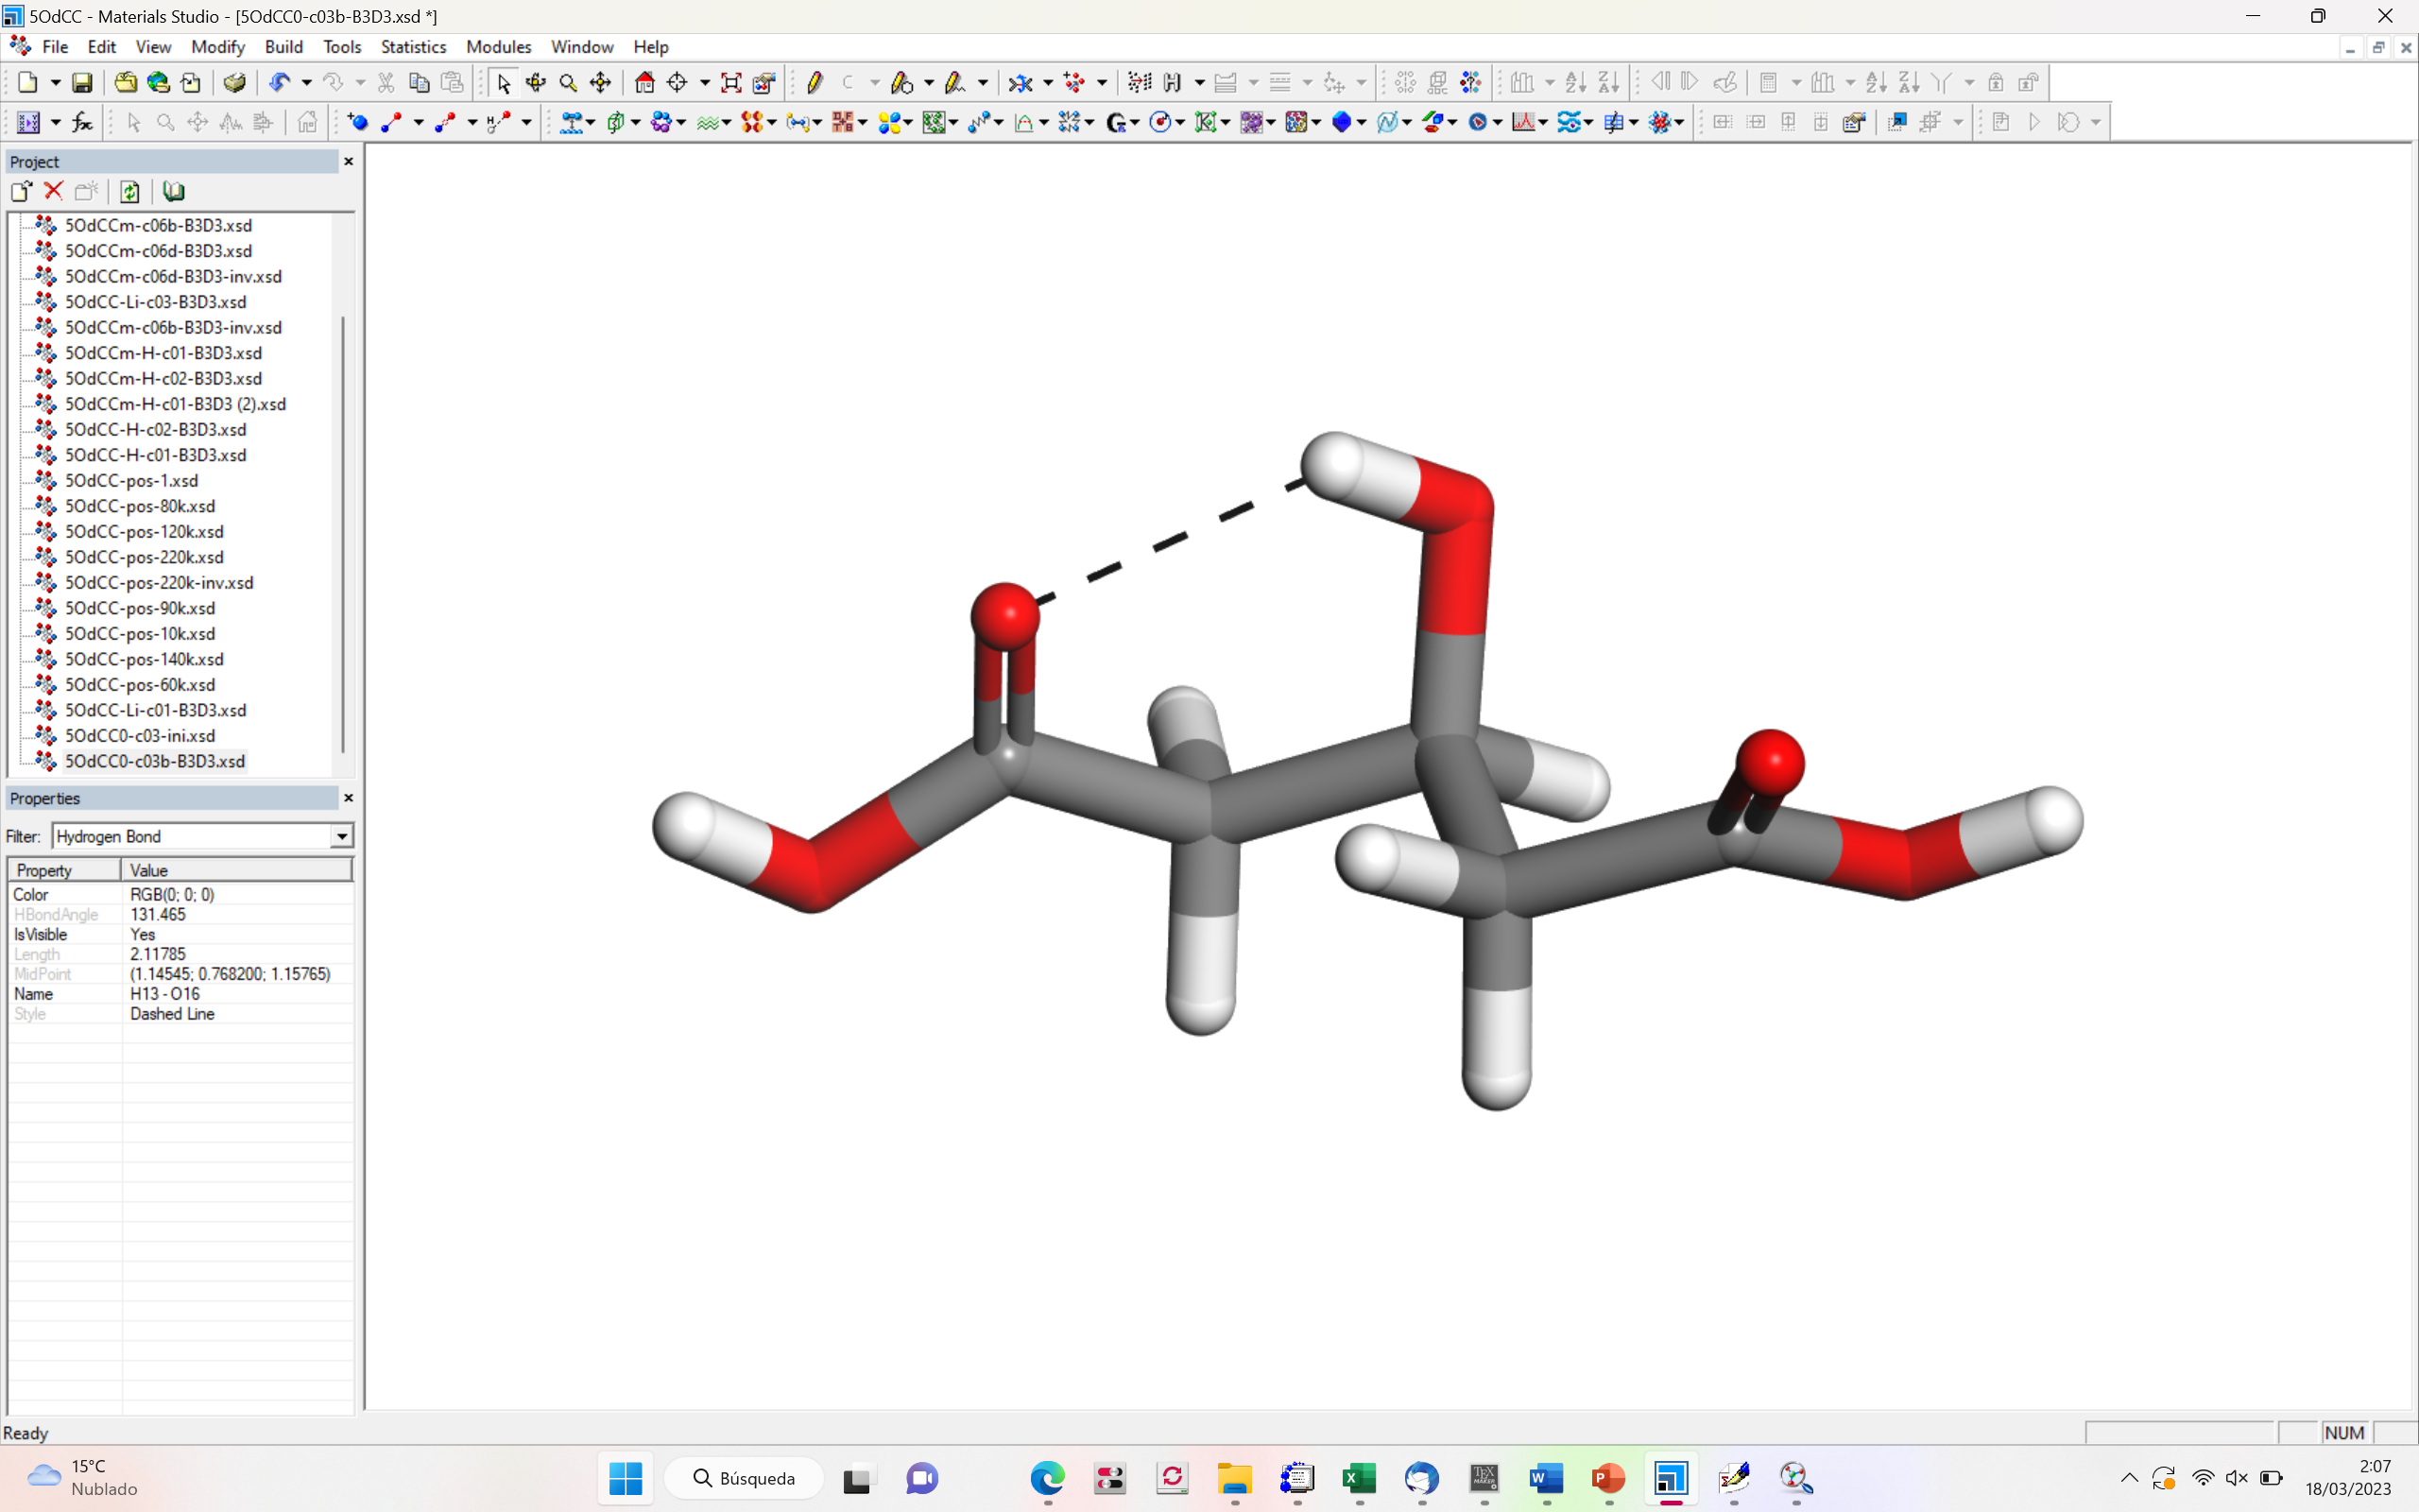
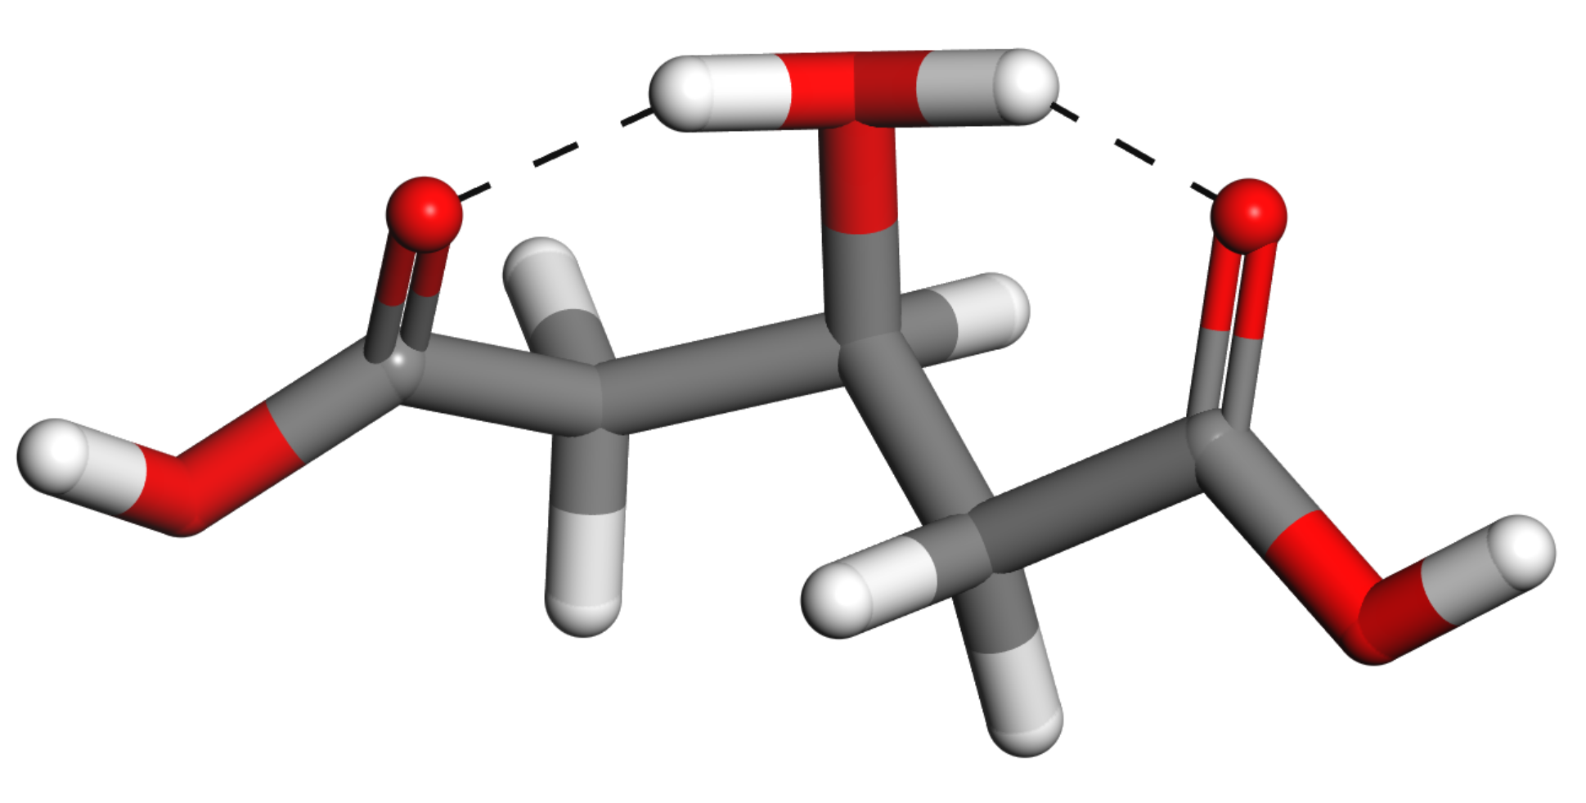
Entangled proton delocalization in
3-hydroxy glutaric acid
H⁺

Slide 4
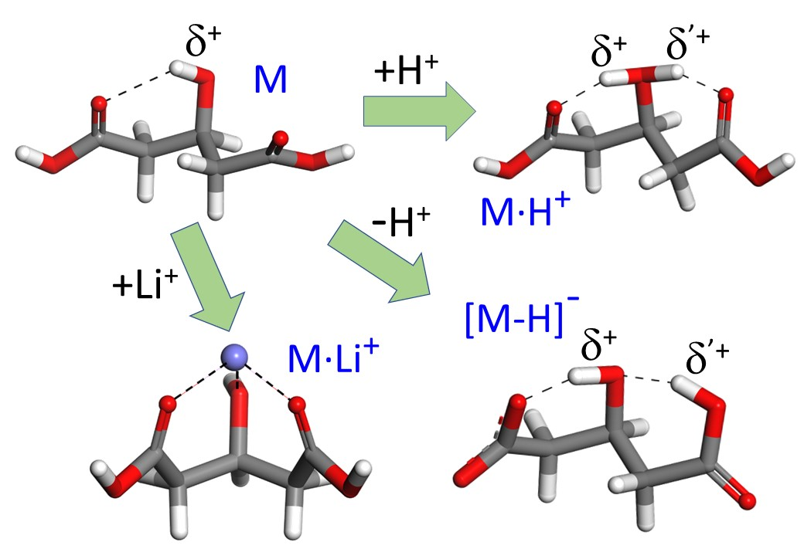
Entangled proton delocalization in
3-hydroxy glutaric acid

Slide 5
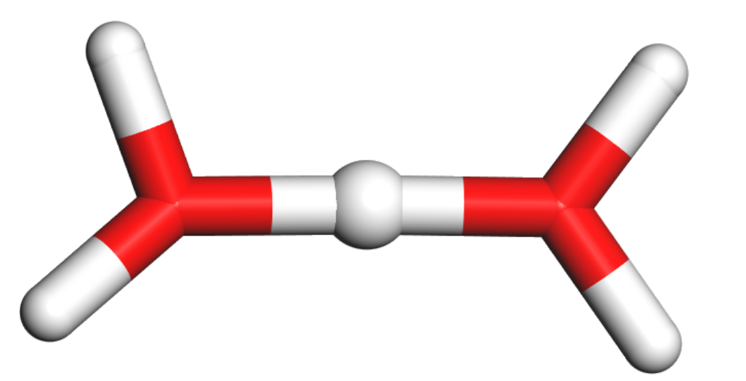
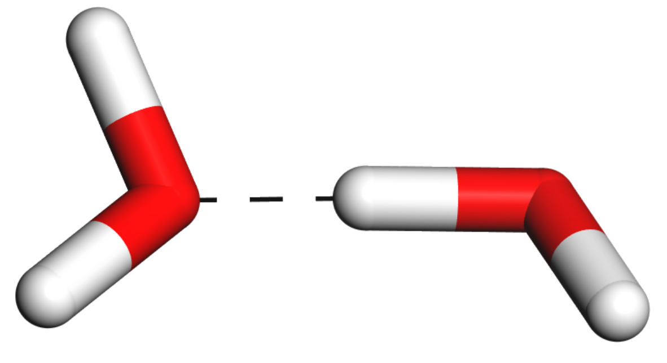
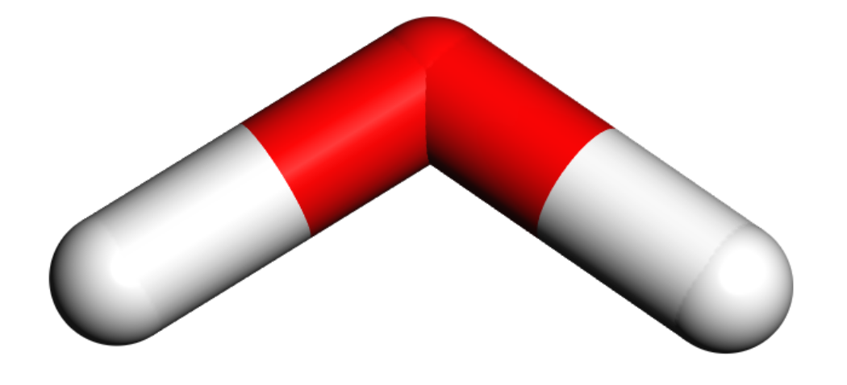
Vibrational signatures of proton bonding
(( ))
(( ))
(( ))
Loose proton-bond
O-H⁺···O
H-bond
O-H···O
free
O-H
2000 cm⁻¹ 3000 cm⁻¹ 4000 cm⁻¹
5 μm 4 μm 3 μm
Vibrational frequency

Slide 6
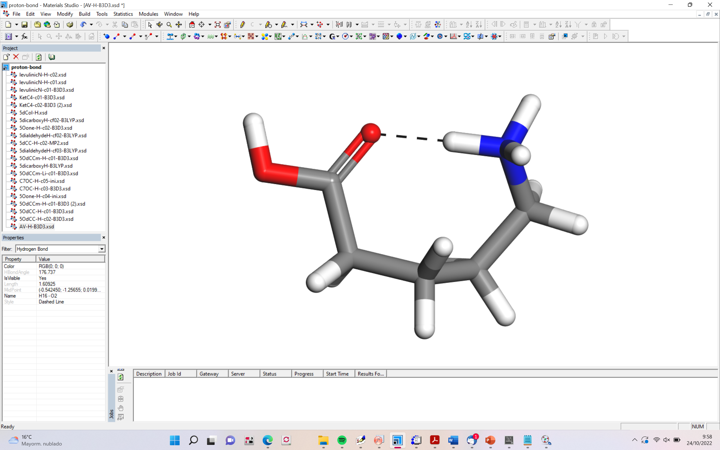
NH⁺
Spectral signatures
of aminovaleric acid
(( ))
OH
(( ))
(( ))
Proton-bond
N-H^{δ+}···O
free
N-H^{δ+}
free
O-H
ab initio
Molecular
Dynamics
x 0.2
wavenumbers (cm⁻¹)

Slide 7
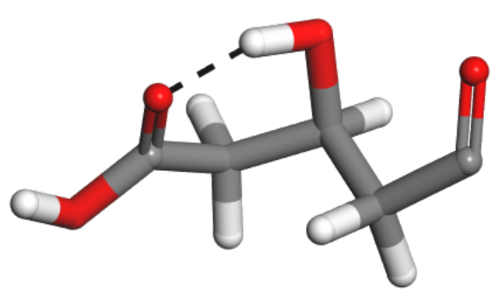
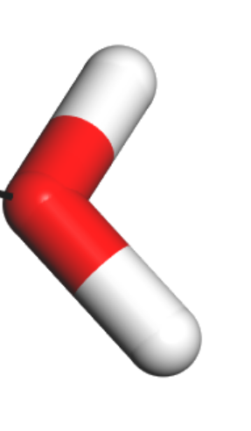
“conventional” spectroscopy, based on “what molecules do to light”
light detected
requires > 10⁸ cm⁻³
“action” spectroscopy, based on “what light does to molecules”
+
m/z 149
m/z 131
works with ~10³ cm⁻³
product ions detected

Slide 8
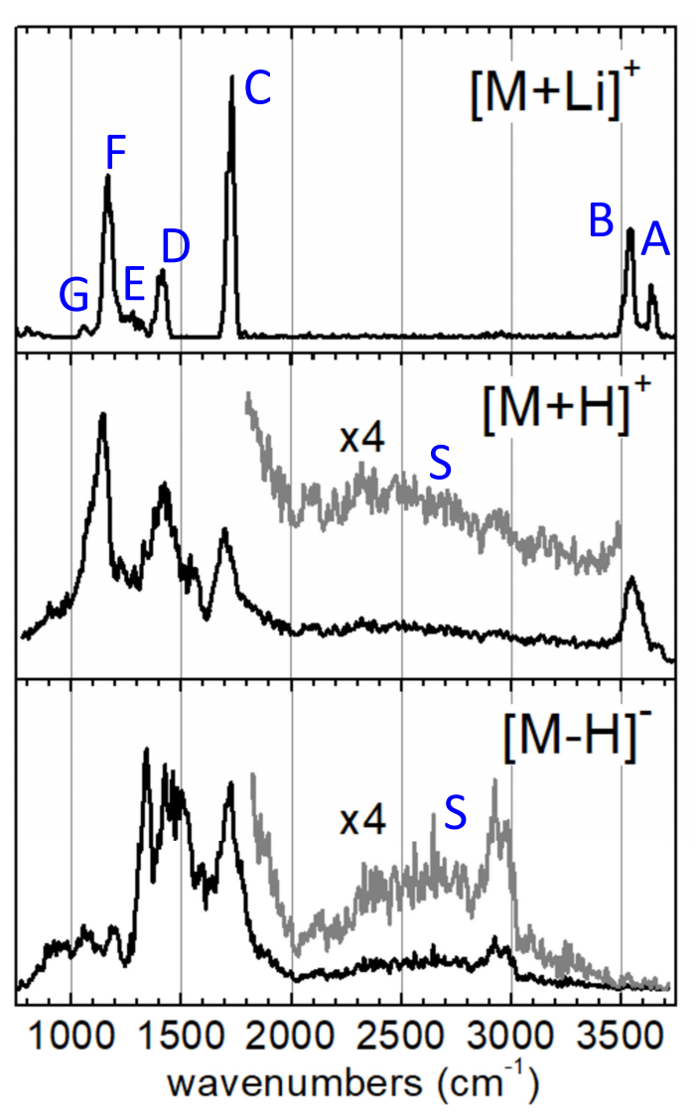
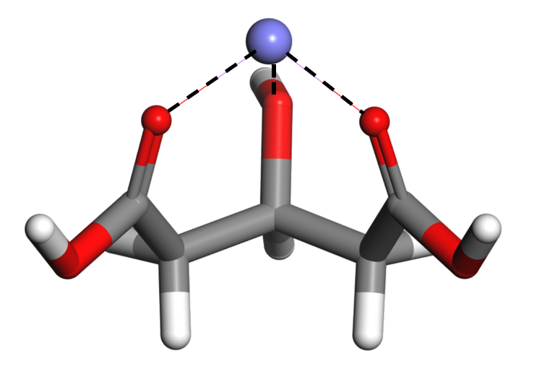

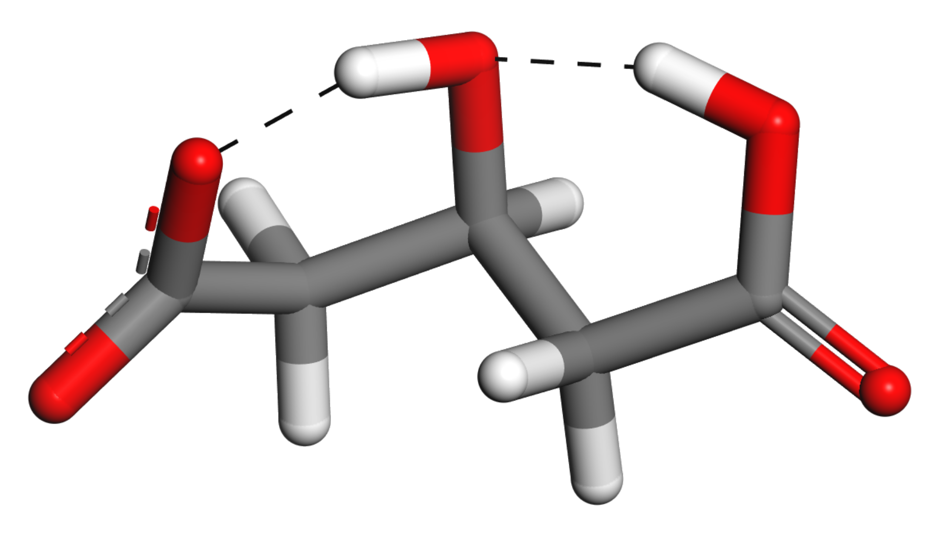
Li⁺
A: O-H stretching (hydroxy group)
B: O-H stretching (carboxylic group)
C: C=O stretching
D: CH₂ scissoring
E: C-C stretching, mixed with CH/CH₂ wagging
F: C-OH stretching and bending (carboxylic group)
G: C-O (hydroxy) and C-C stretching

Slide 10
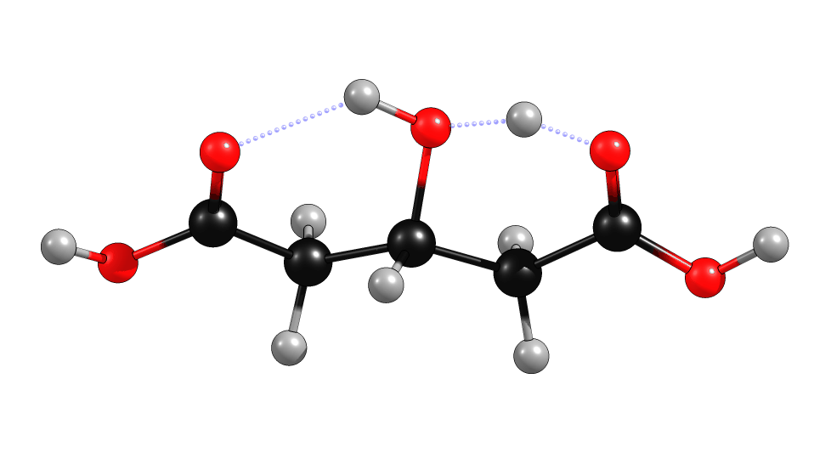
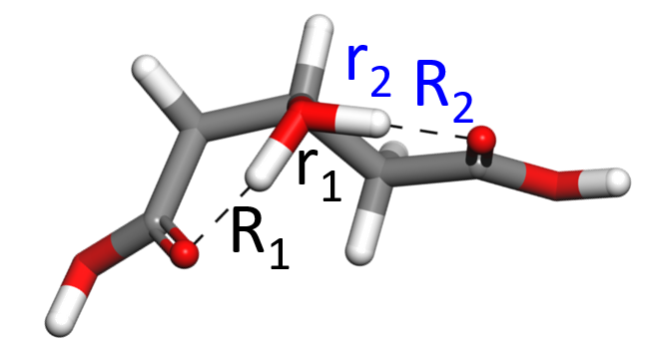
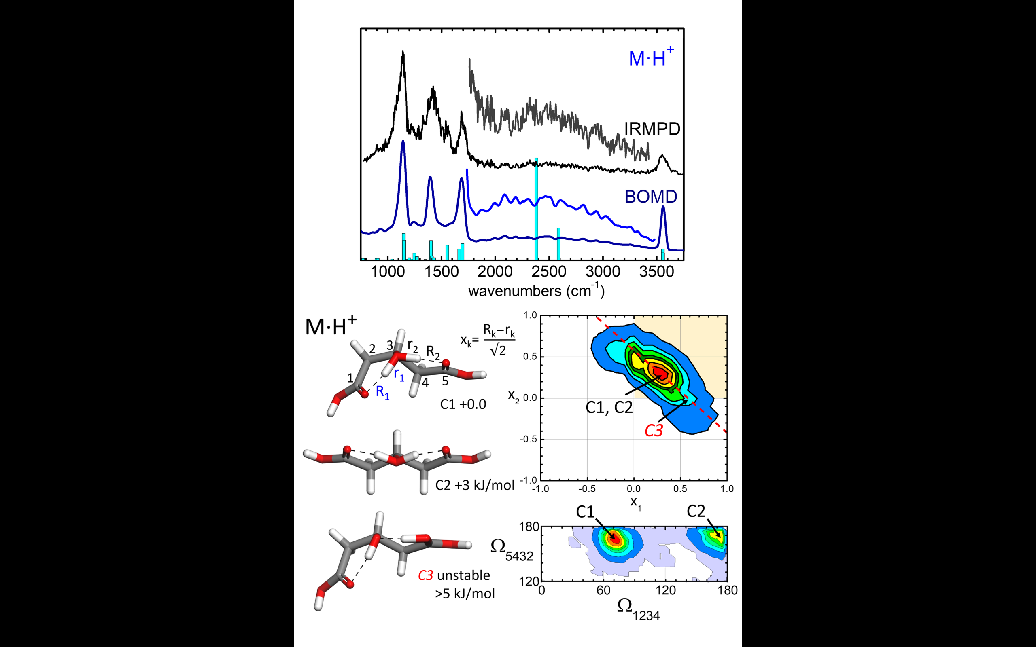
Motion I: proton difussion along H-bonds
C⁺
C⁺
₁
₃
(unstable)

Slide 11
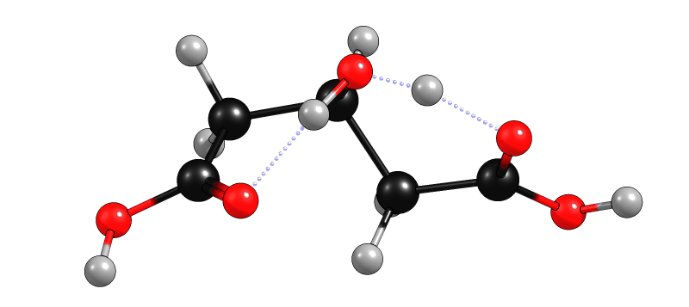
Motion II: backbone stretching/bending
C⁺
C⁺
₁
₂

Slide 12
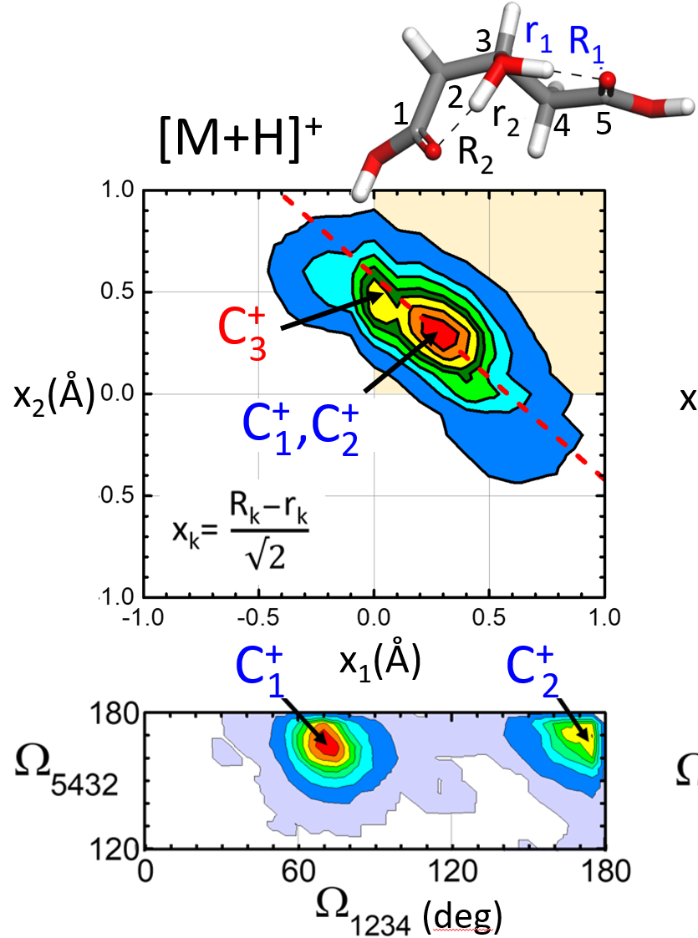
C⁺
₁
C⁺
₂
+3 kJ/mol
C⁺
₃
(unstable)

Slide 13
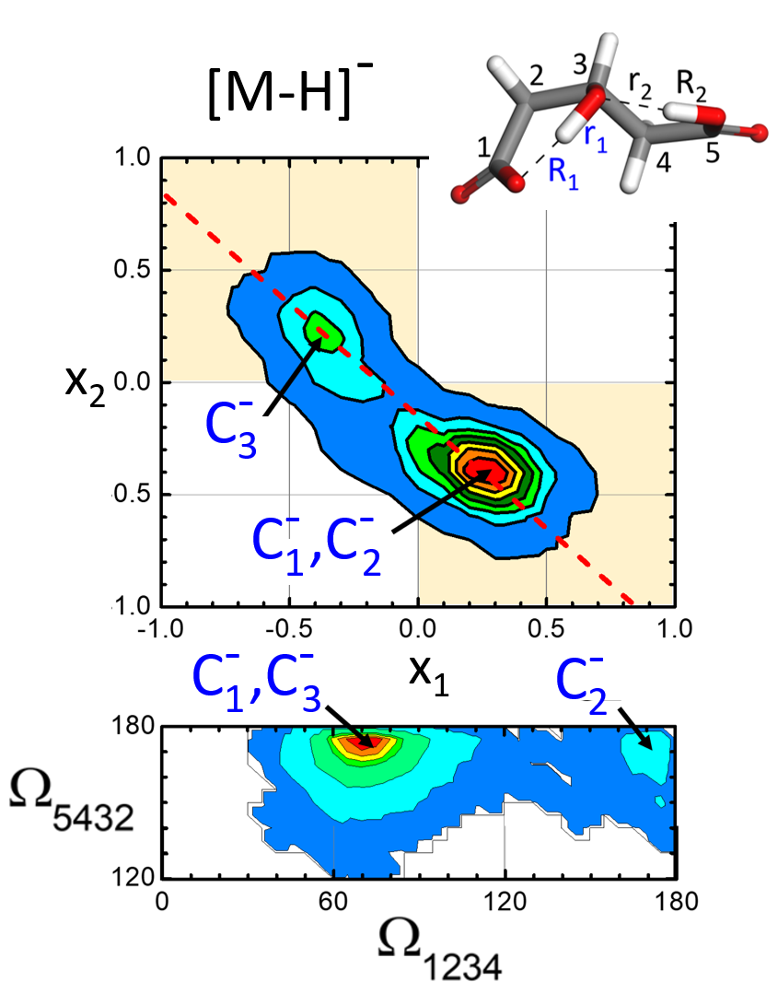
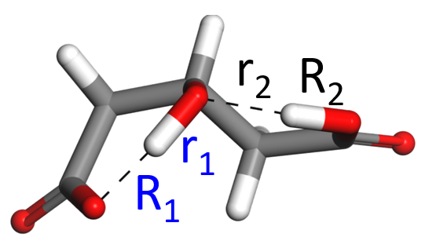
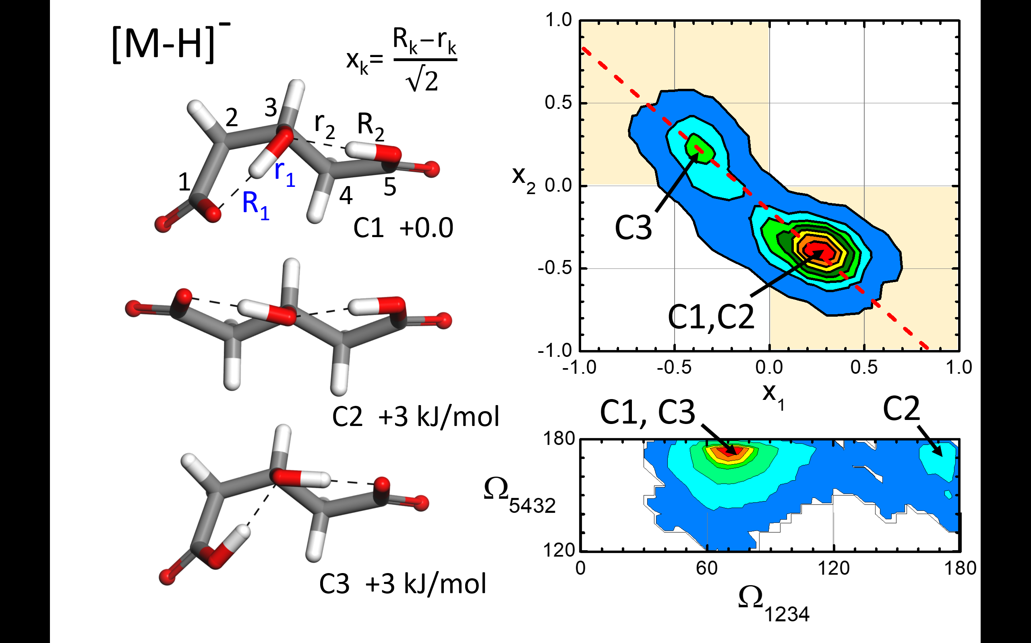
C⁻
₁
C⁻
₃
+3 kJ/mol
C⁻
₂
+3 kJ/mol

Slide 14
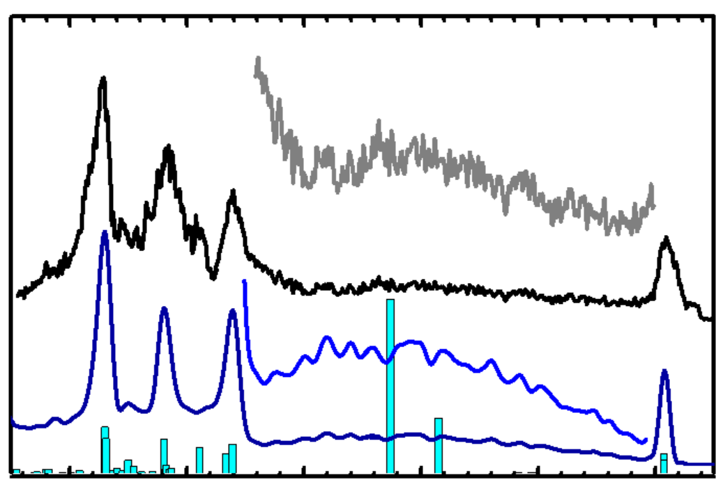
Comparison theory vs experiment
[M+H]⁺
x4
IRMPD
C⁺
x4
₁
BOMD

Slide 15
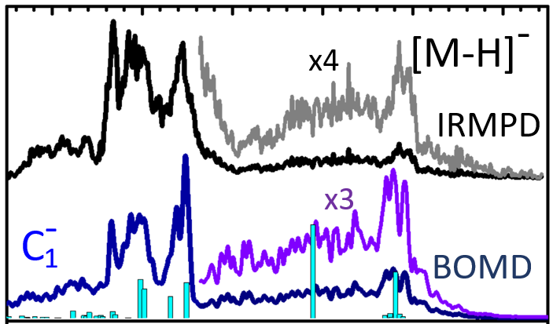

Comparison theory vs experiment

Slide 16
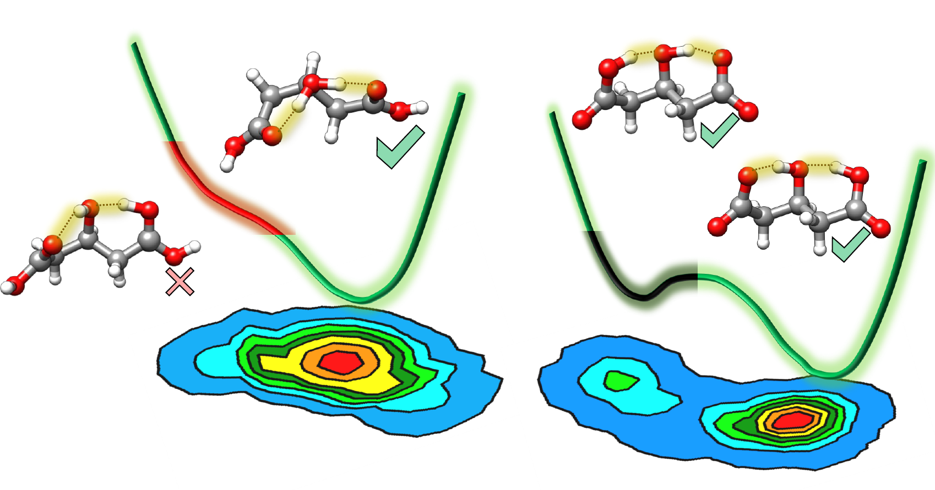
Conclusion: simple molecular ions provide
nice benchmarks to study entangled proton dynamics

Slide 17



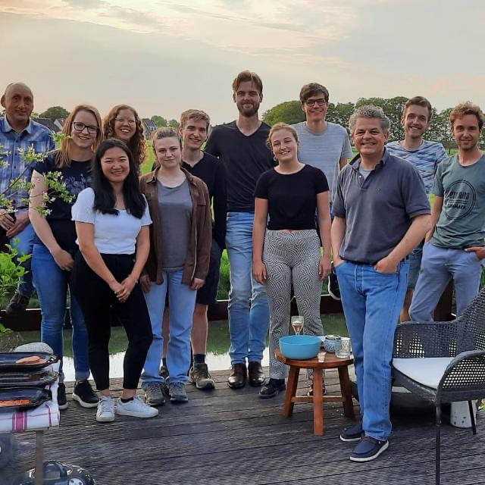
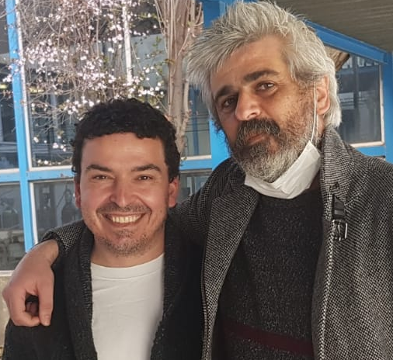



Giel Berden
Jonathan Martens
Francisco
Gámez
Juan Ramón
Avilés-Moreno
Jos Oomens
Molecular Structure and Dynamics research group

Slide 18
…and thank you for
your kind attention

Slide 20
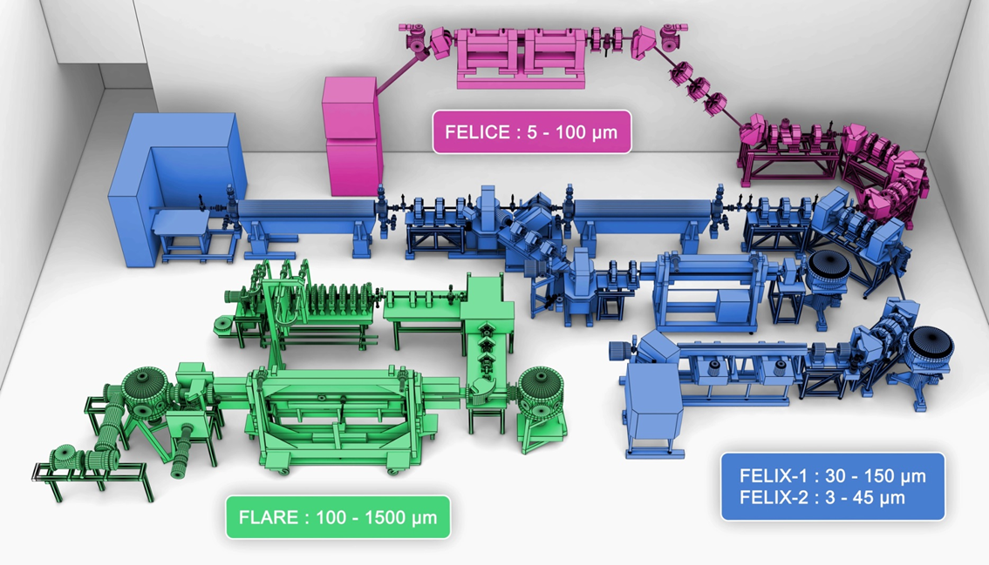
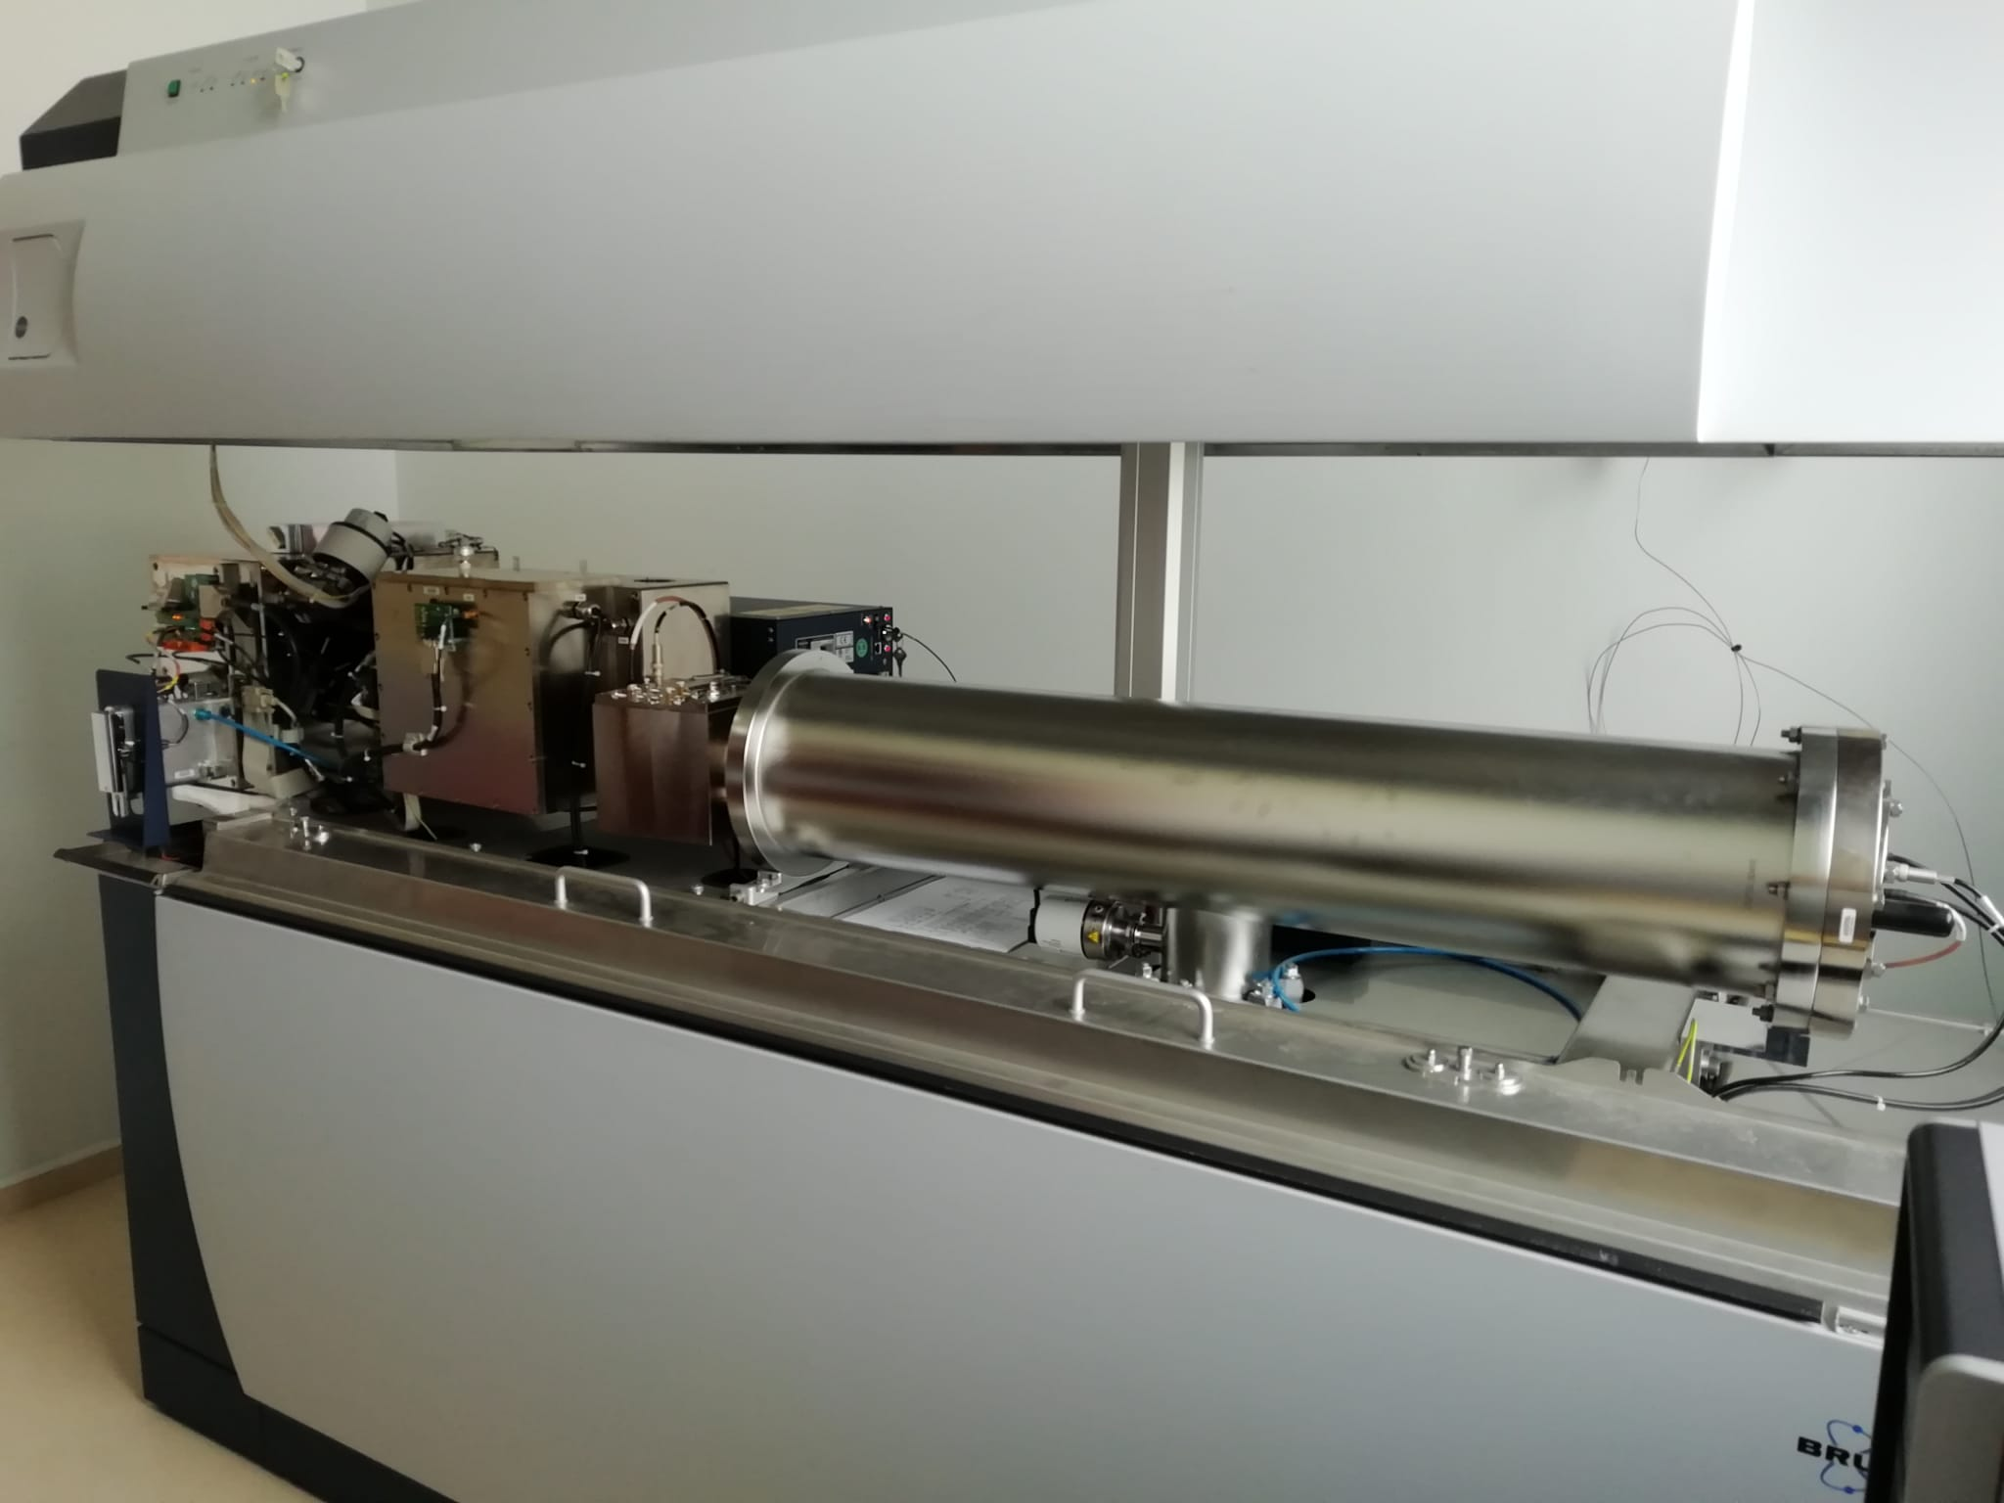
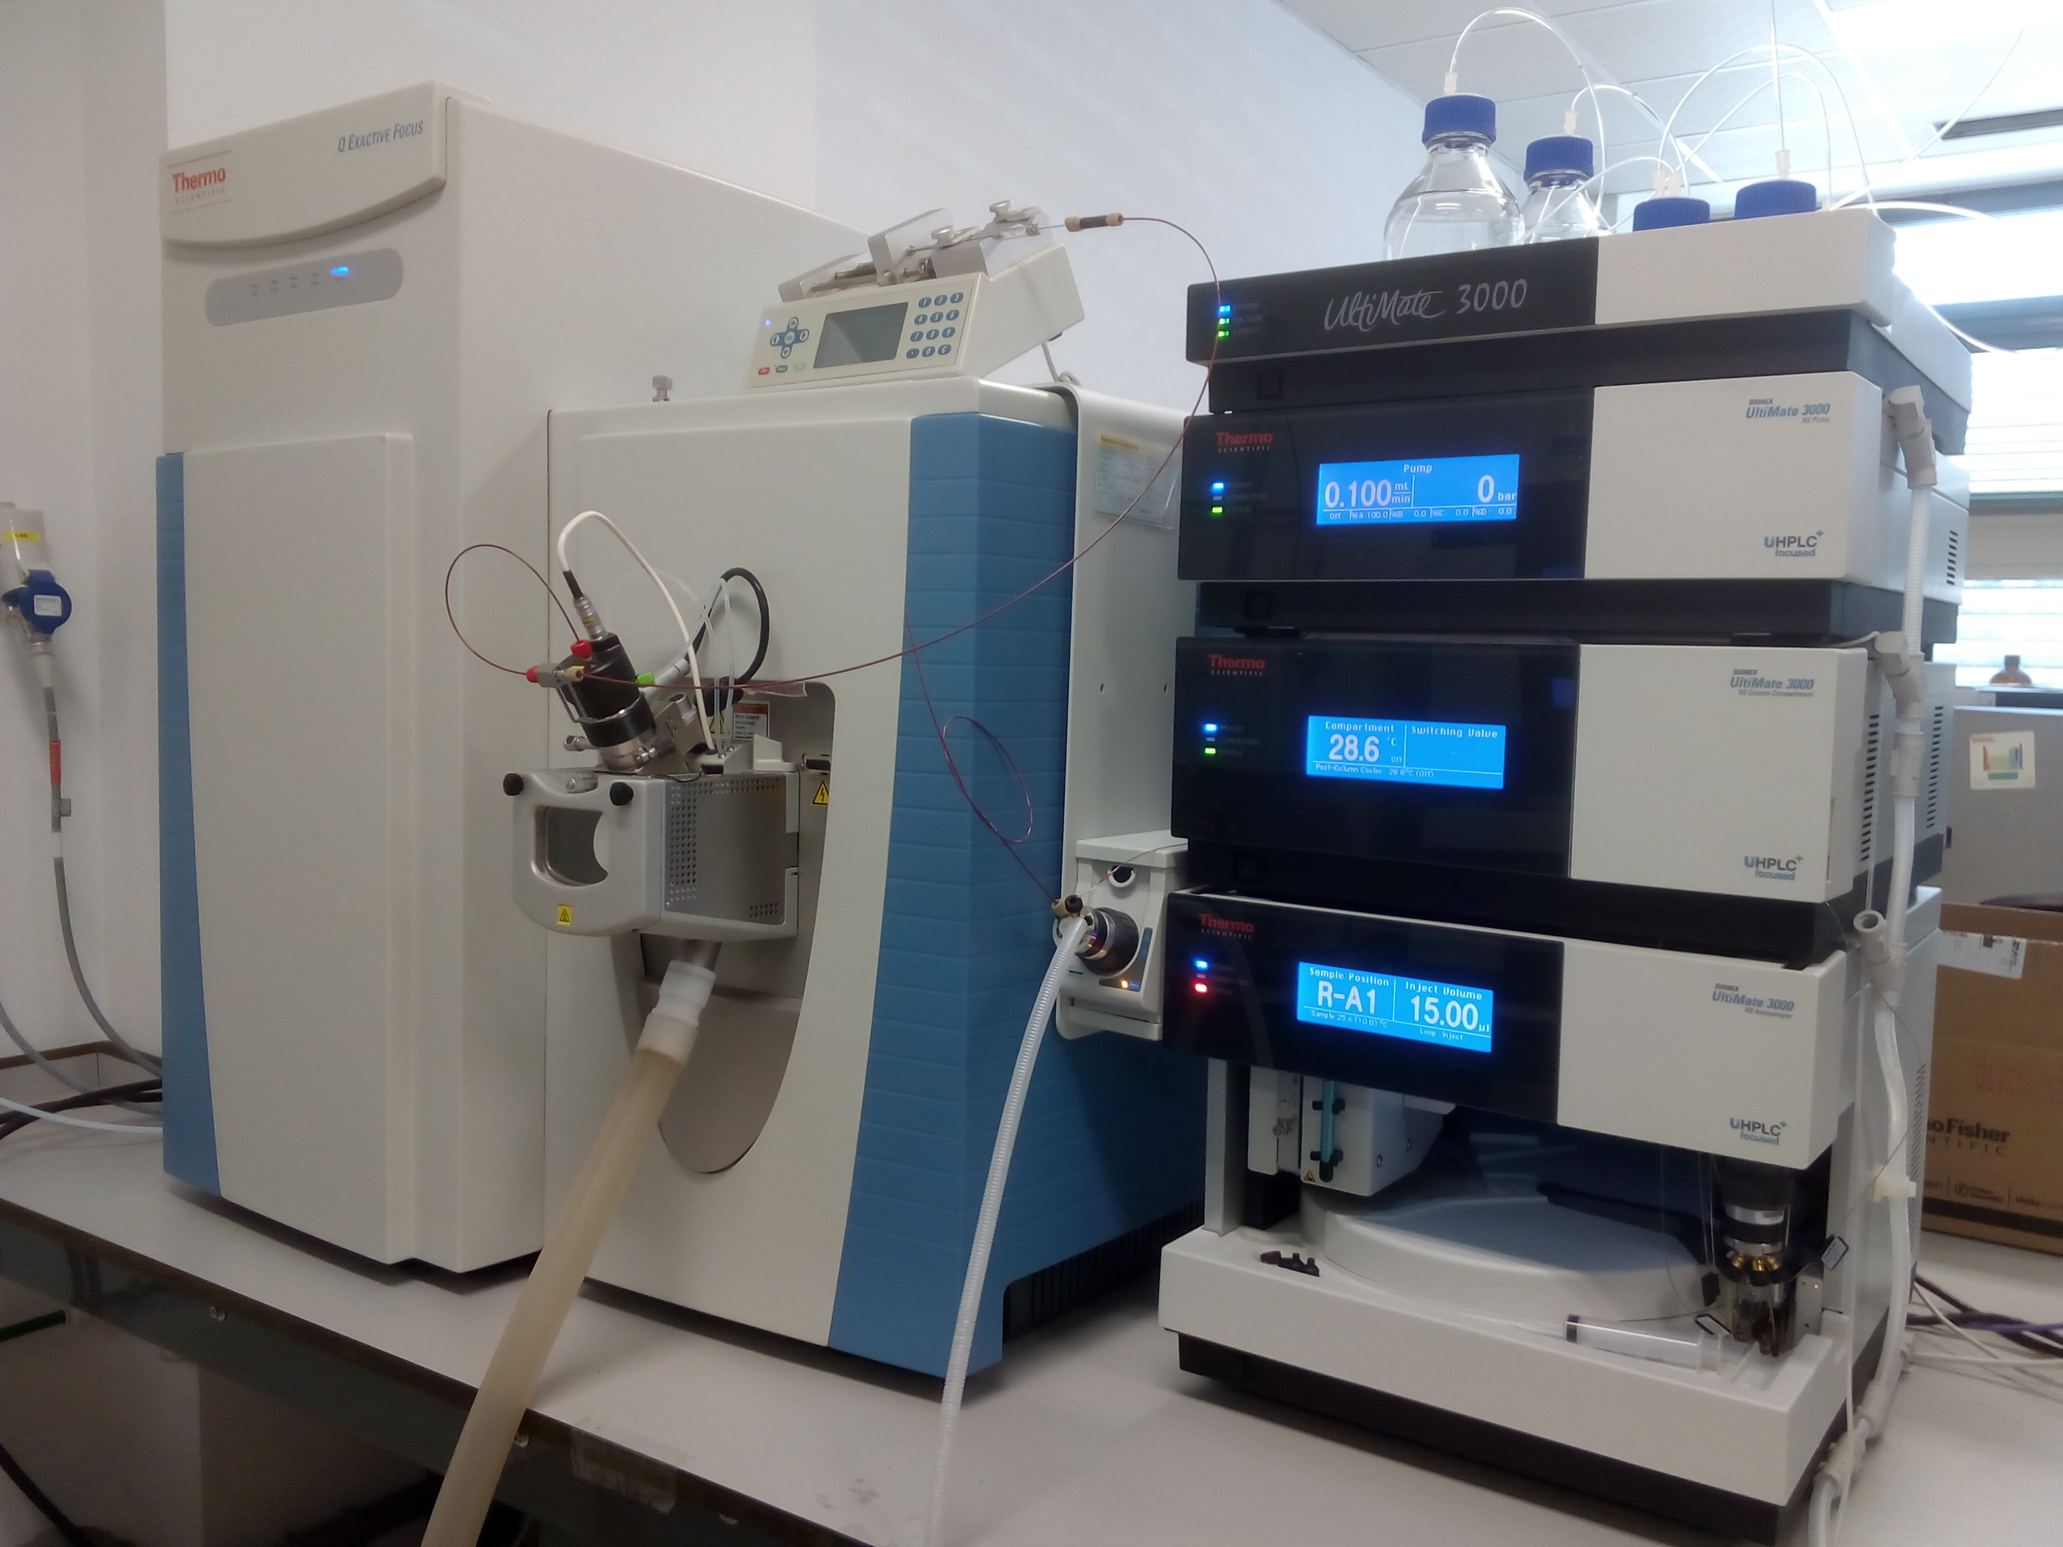
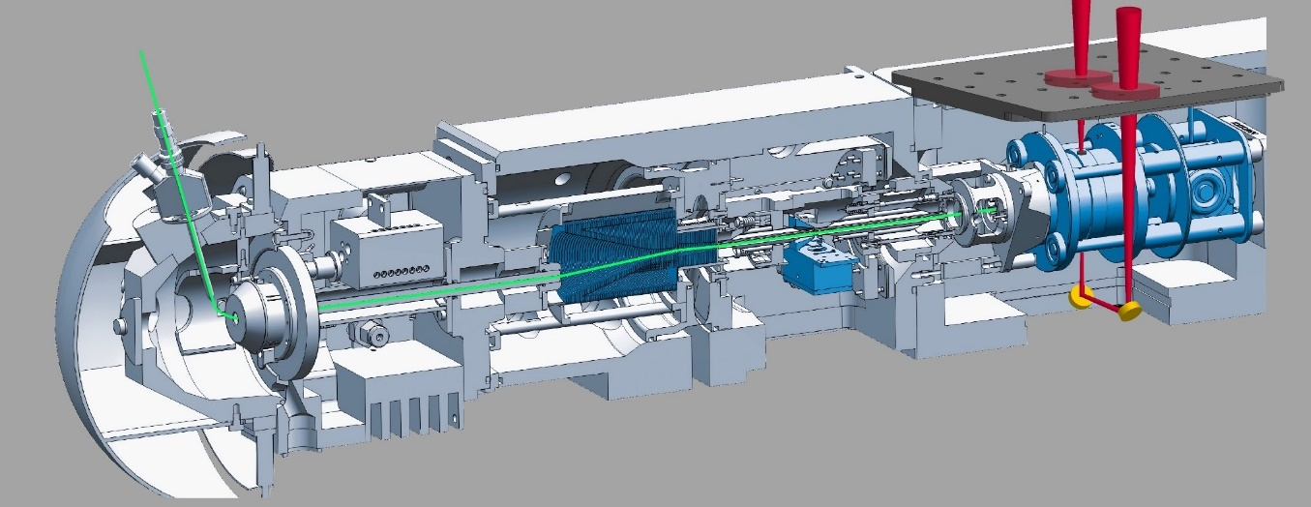
Biomolecular Mass Spectrometry Lab
Ion trapping experiments
- Complex formation with ESI, APCI, MALDI sources
- Relative stabilities, dissociation channels, etc
IRMPD spectroscopy of trapped ions
Computations:
- Born-Oppenheimer Molecular Dynamics (BOMD)
- DFT and MP2 “static” computations

Slide 21
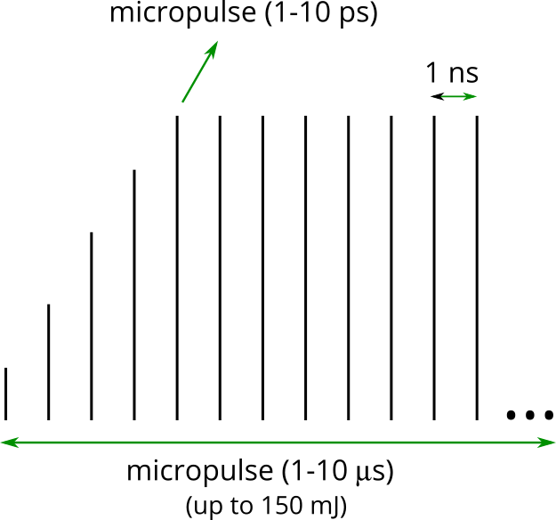
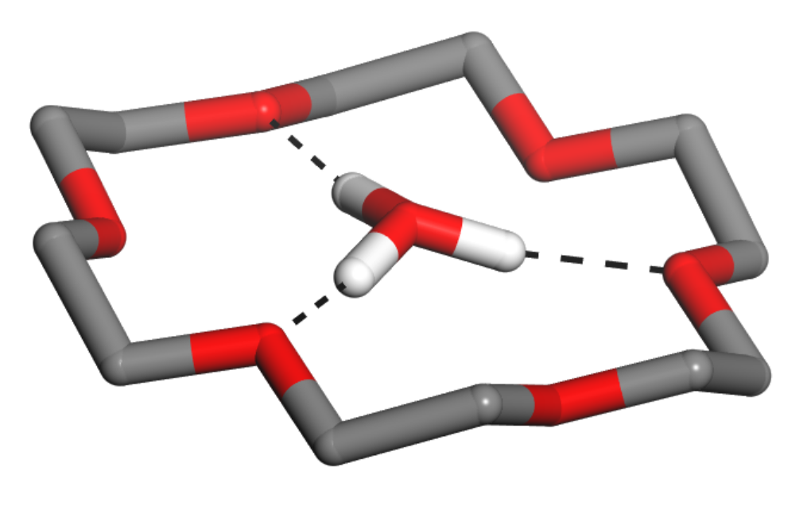
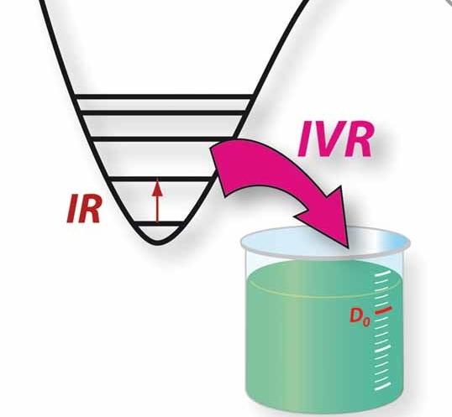
Resonant IR multiple-photon dissociation (IRMPD)
IR-FEL
typical FEL
pulse train
500-3800 cm⁻¹
M·H₃O⁺
m/z

Slide 22
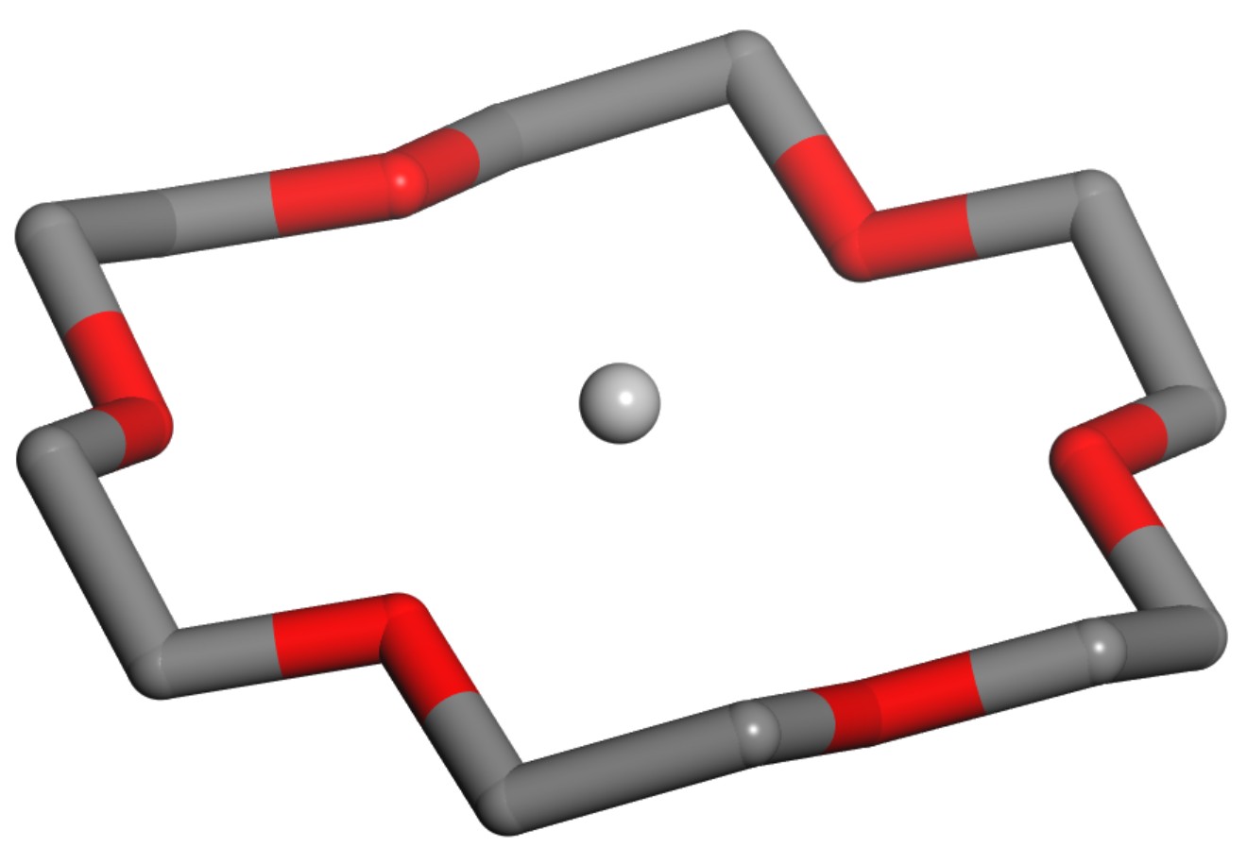
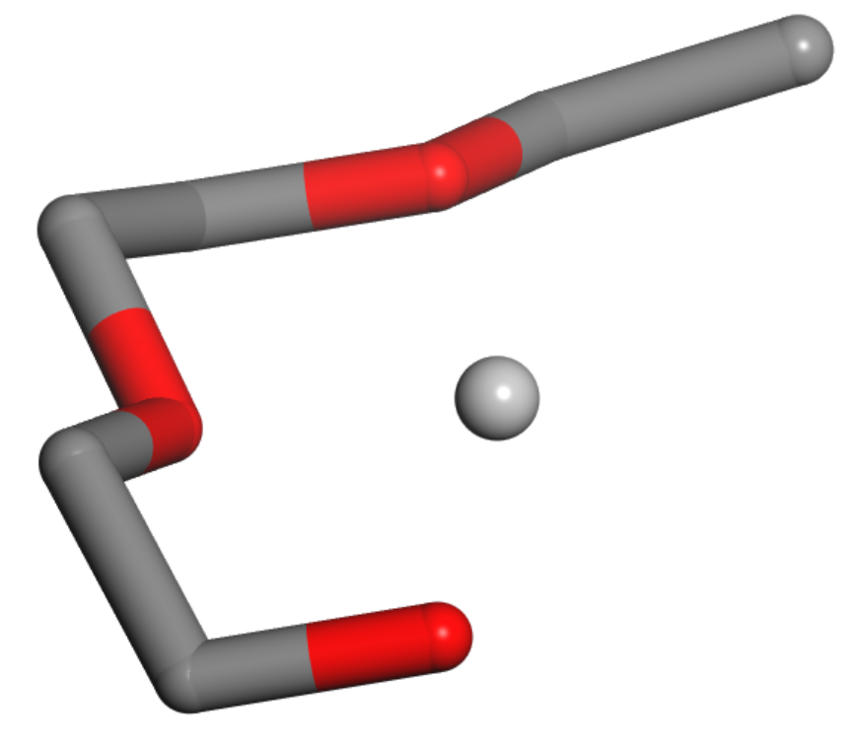
Resonant IR multiple-photon dissociation (IRMPD)
FELIX IR
+
H⁺
IRMPD
smaller
fragments
H⁺
IRMPD fragments
M·H₃O⁺
loss of
CH₂CH₂O units
M·H⁺
m/z

Slide 23
