Slide 1


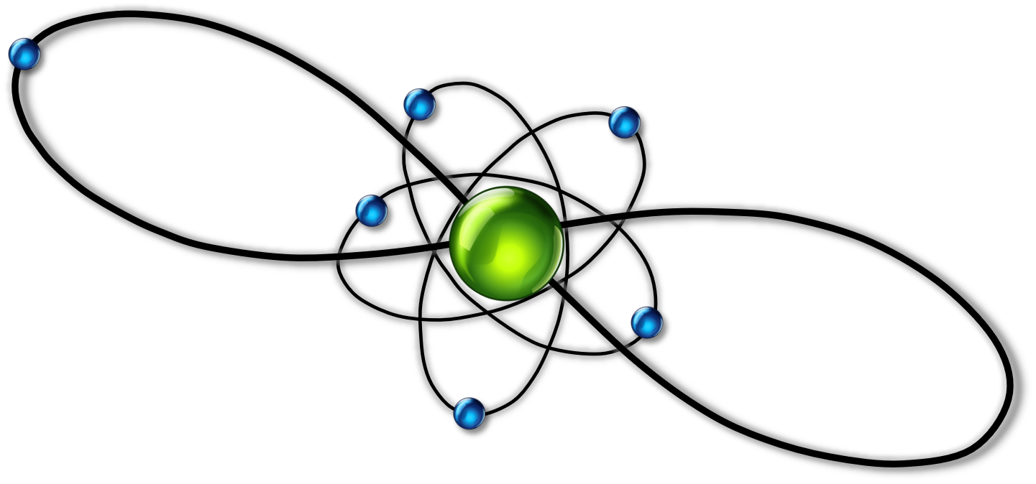
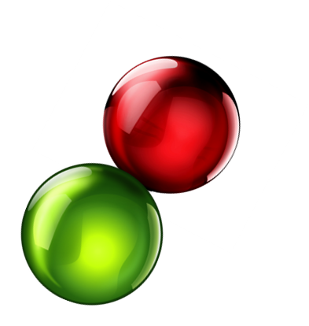

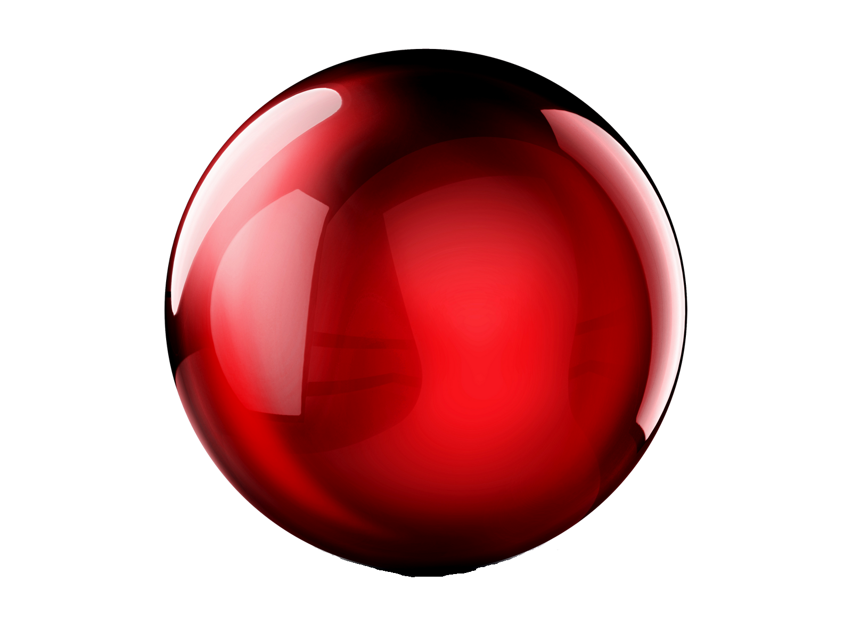
ULTRALONG-RANGE Cs-RbCs
RYDBERG MOLECULE:
NON-ADIABATICITY OF DIPOLE MOMENTS
PROGRAMA DE DOCTORADO EN FÍSICA Y MATEMÁTICAS
PROGRAMA DE DOCTORADO EN FÍSICA Y MATEMÁTICAS
PROGRAMA DE DOCTORADO EN FÍSICA Y MATEMÁTICAS
PROGRAMA DE DOCTORADO EN FÍSICA Y MATEMÁTICAS
DAVID MELLADO-ALCEDO
September 8th, 2023

Slide 2
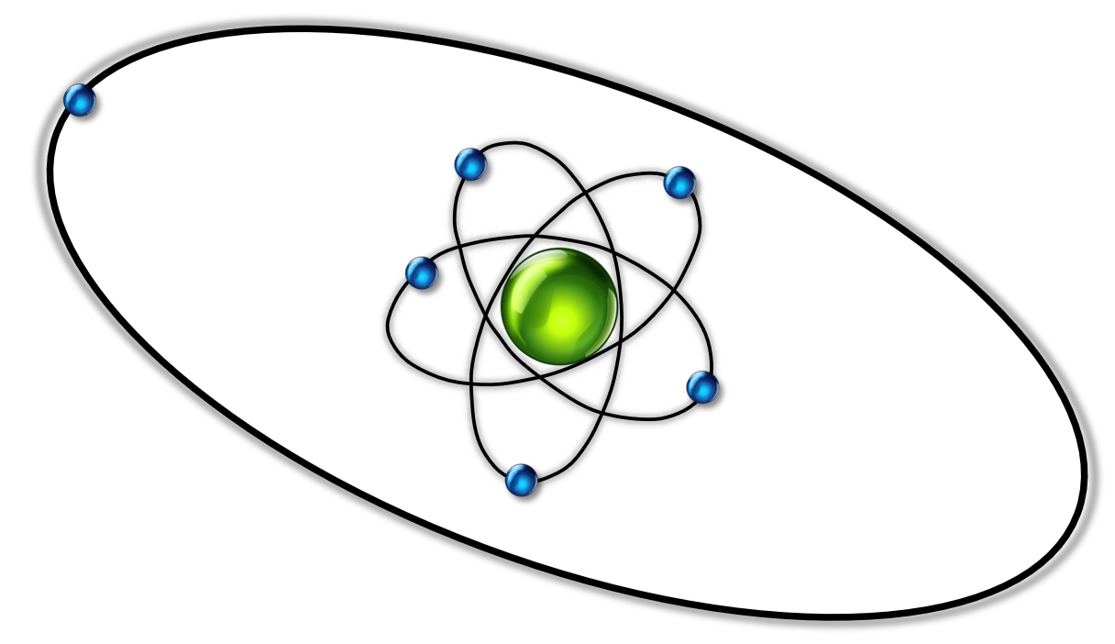
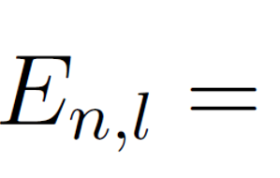
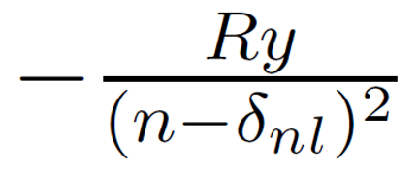
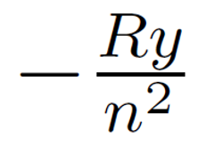
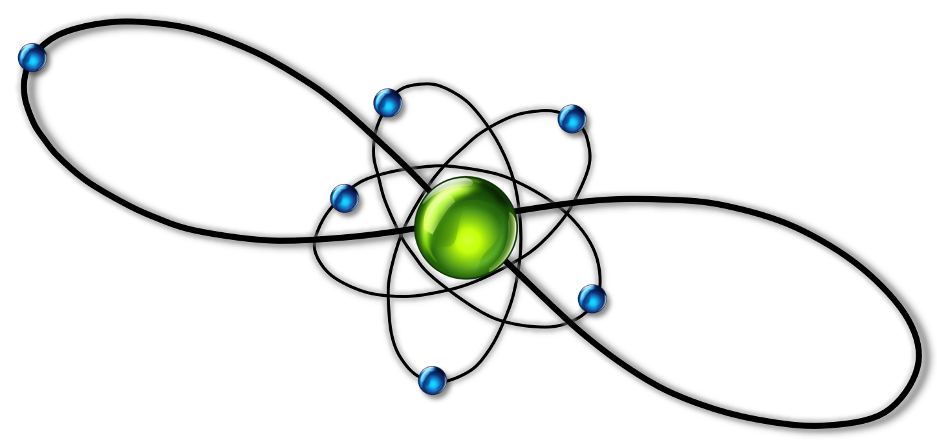
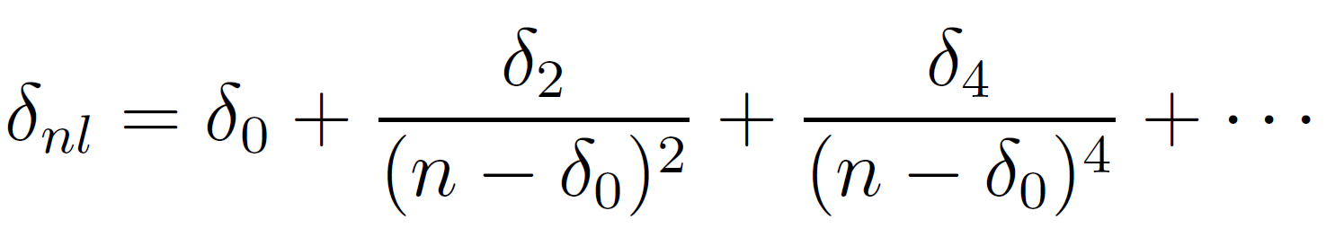
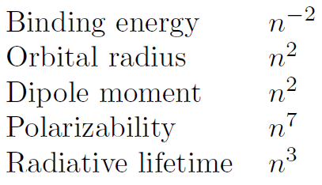
RYDBERG ATOM
Low angular momentum Rydberg states $l≤3$ High angular momentum Rydberg states $l≥4$
Rydberg-Ritz expression
Strong permanent electric dipole moment
Sensitivity to small external fields
Applications: ultracold chemistry or
quantum information processing

Slide 3
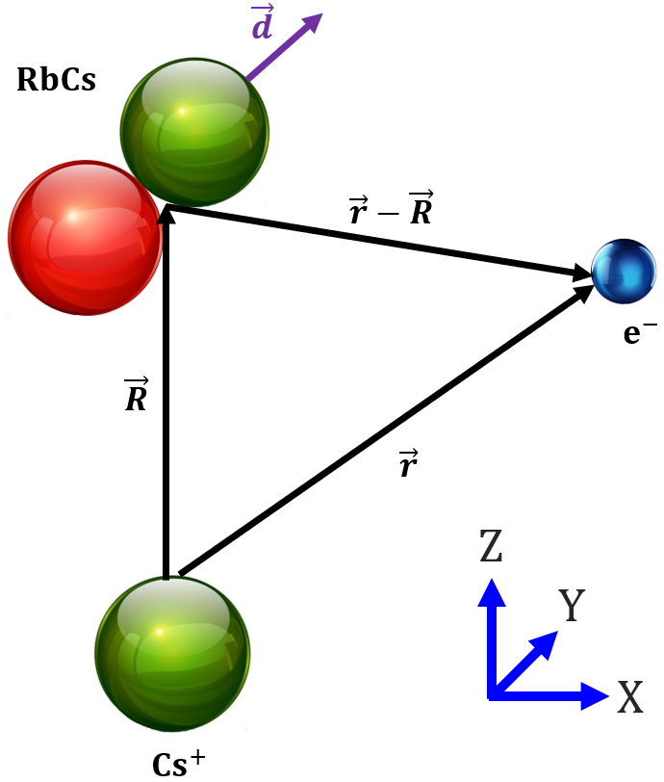
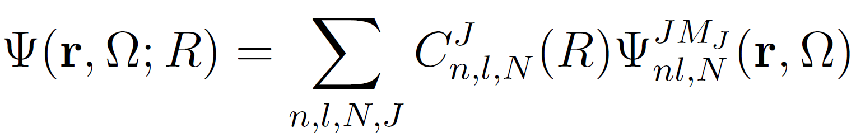
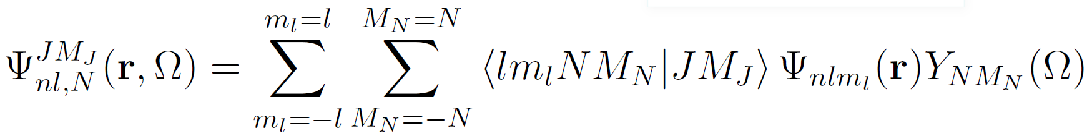





THE ADIABATIC HAMILTONIAN
Subcritical dipole moment: $d<1.639D$ (Fermi-Teller)
$H_{ad} =H_{A}+H_{rot}+H_{ryd}+H_{sw}$
$H_{A}=−\frac{ℏ^{2}}{2m_{e}}∇_{r}^{2}+V_{l}(r)$
$$H_{rot}=BN^{2}$$
$H_{ryd}=−d·\left(e\frac{R}{R^{3}}+e\frac{r−R}{{\left|r−R\right|}^{3}}\right)$ Charge-dipole interaction
$H_{sw}=2πa_{S}\left(k\right)δ\left(r−R\right)$ s-wave fermi pseudopotential
$$J=N+l$$
[$J_{Z},H]=0$
David Mellado-Alcedo
3 / 10

Slide 4
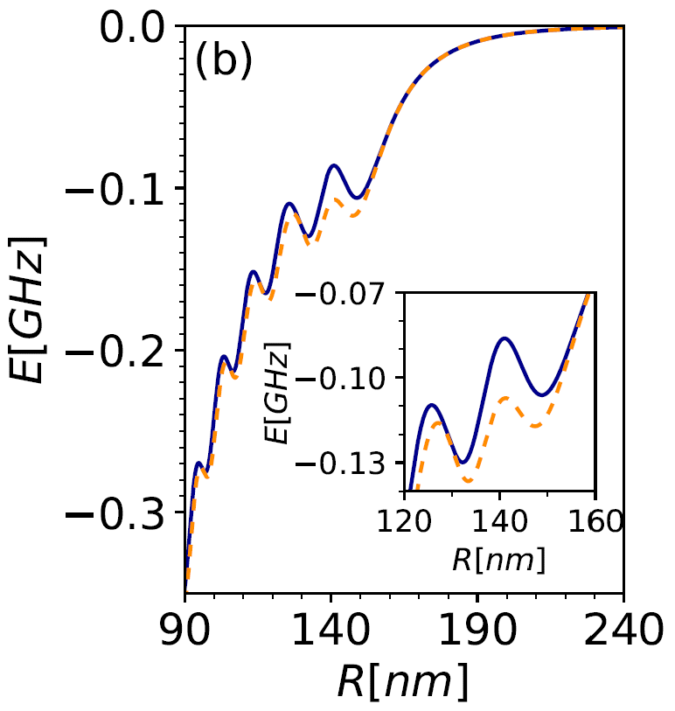

ZERO-RANGE ELECTRON-MOLECULE SCATTERING
Cs(40d)-RbCs(N=0)
$$H_{ryd}+H_{sw}$$
$$H_{ryd}$$

Slide 5
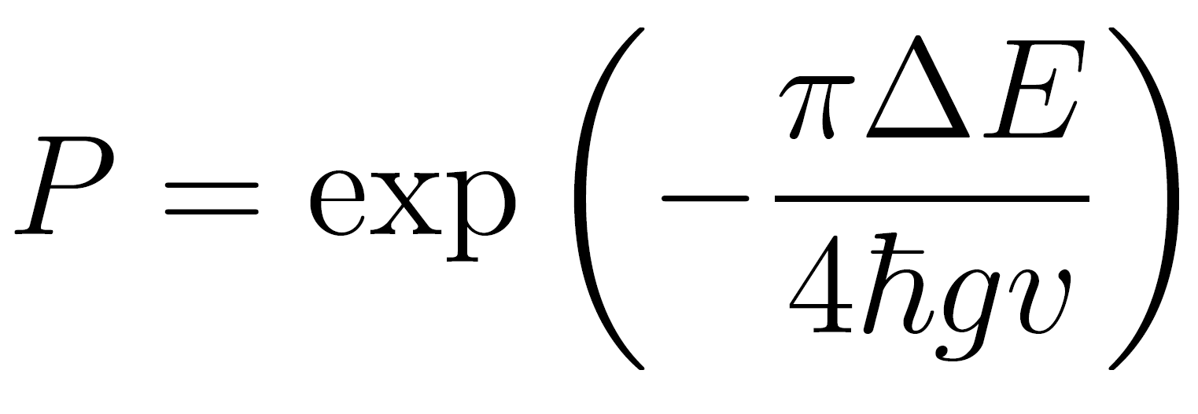
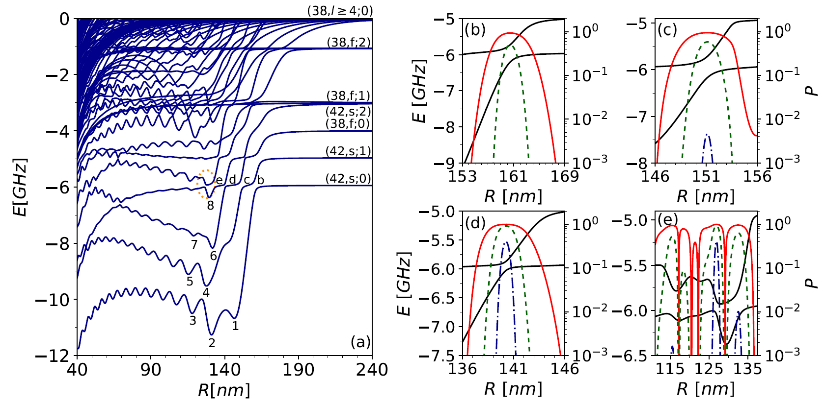



ELECTRONIC STRUCTURE OF Cs(38)-RbCs
Landau-Zener
$${10}^{2}cm/s$$
$${10}^{3}cm/s$$
$${10}^{4} cm/s$$

Slide 6



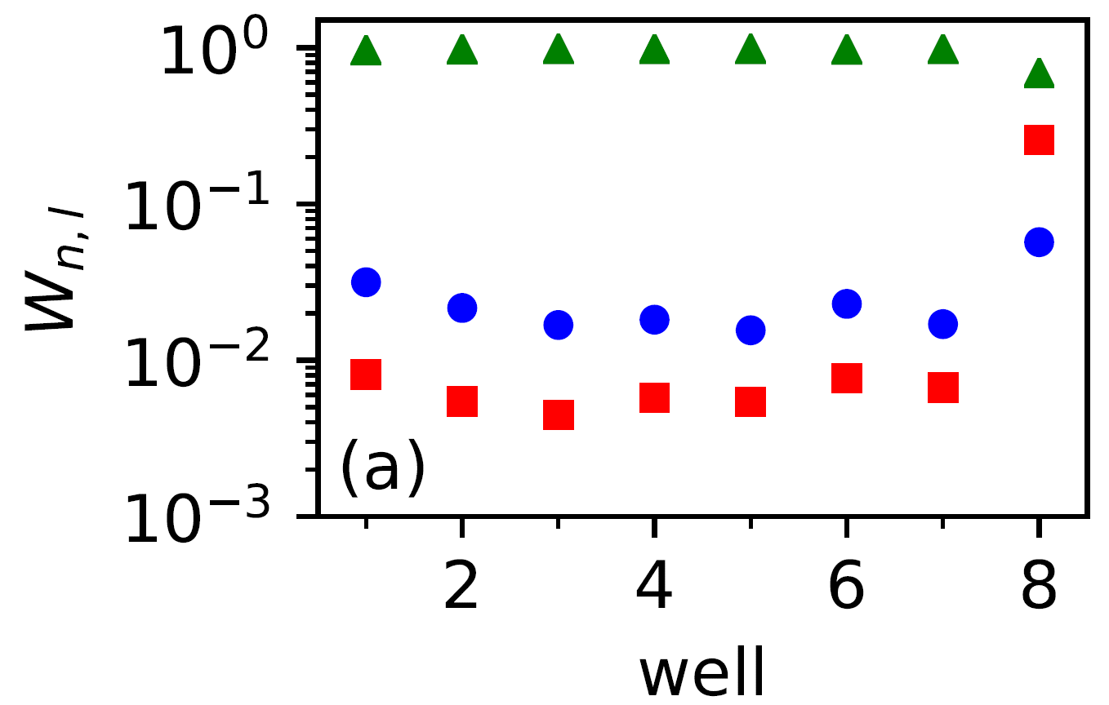
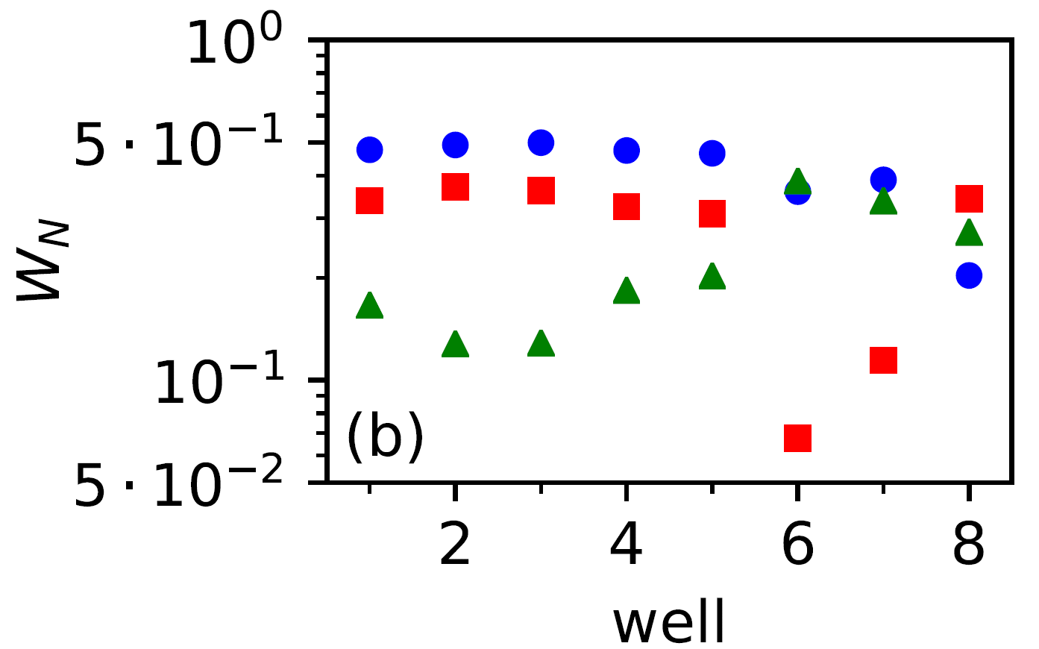
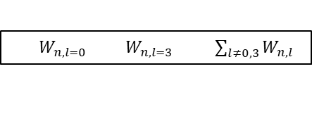

ELECTRONIC STRUCTURE OF Cs(38)-RbCs
$W_{n,l=0} W_{n,l=3} \sum_{l≠0,3}{W_{n,l}}$
$$W_{N=0} W_{N=1}{ W}_{N=2}$$

Slide 7
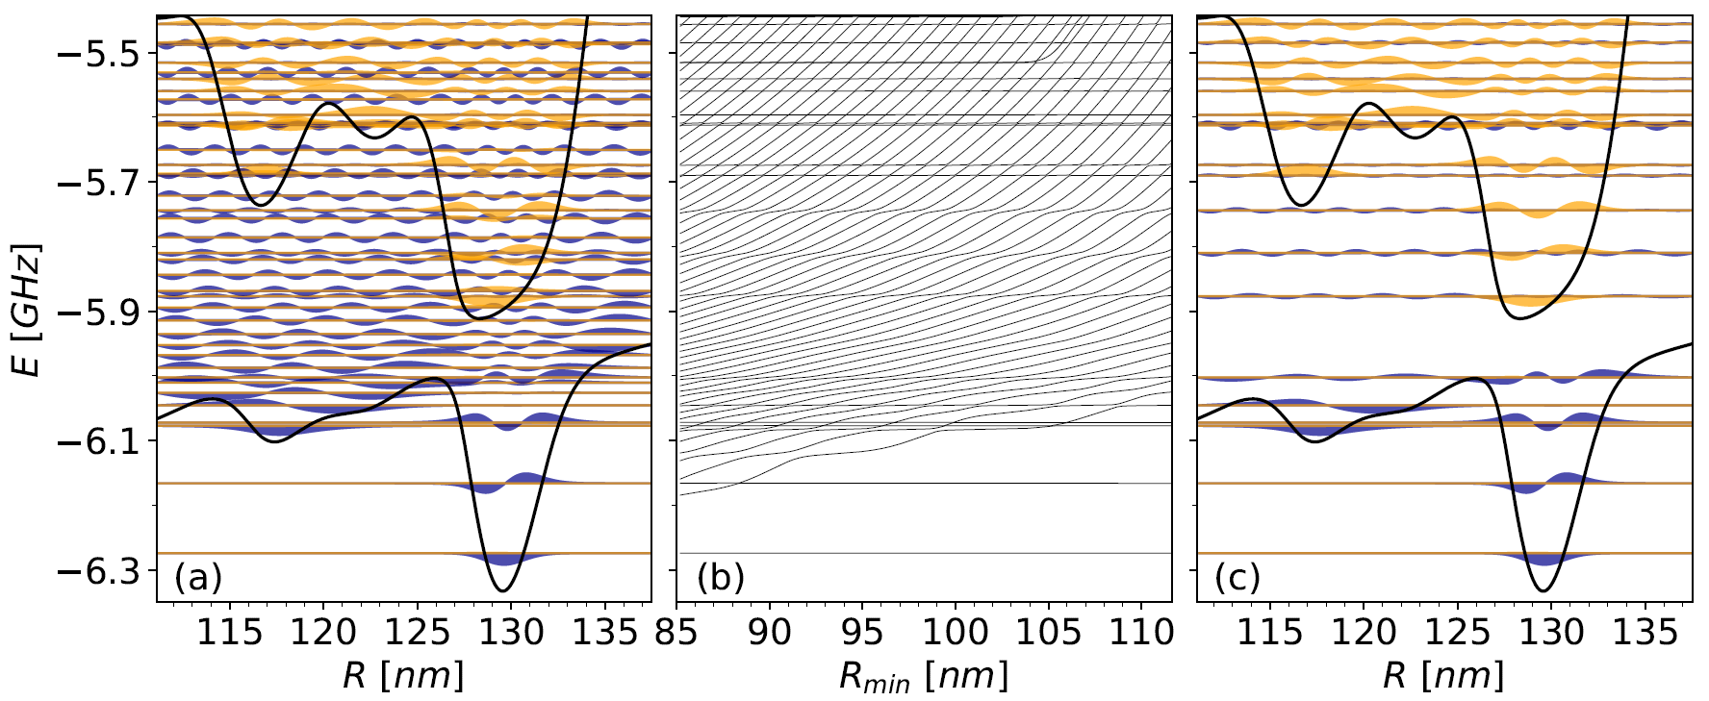
VIBRATIONAL STATES OF Cs(42s)-RbCs(N=0)
Stabilization method

Slide 8
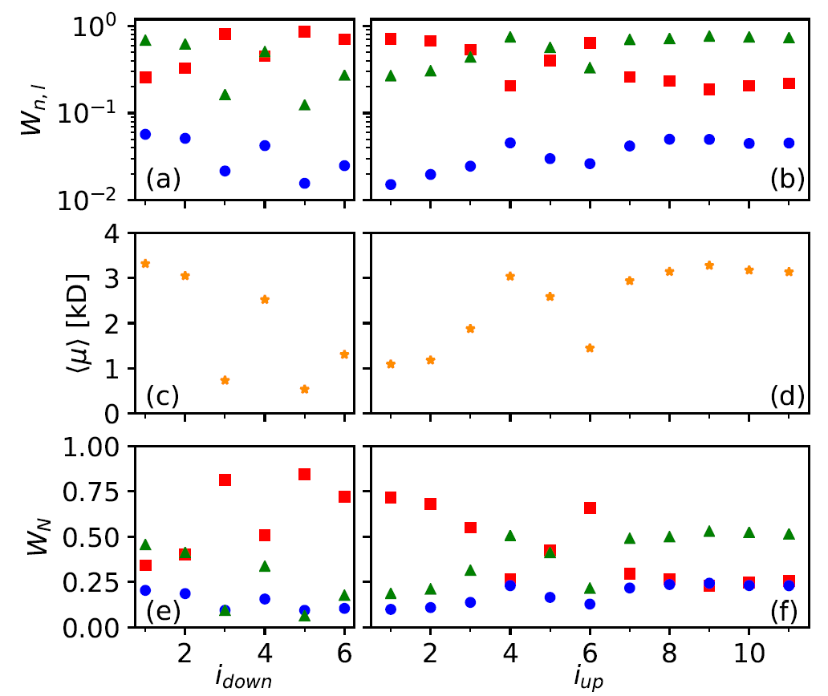
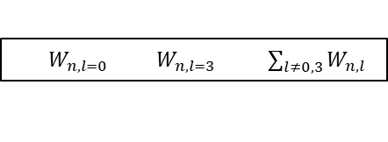
VIBRATIONAL STATES OF Cs(42s)-RbCs(N=0)
$W_{n,l=0} W_{n,l=3} \sum_{l≠0,3}{W_{n,l}}$

Slide 9
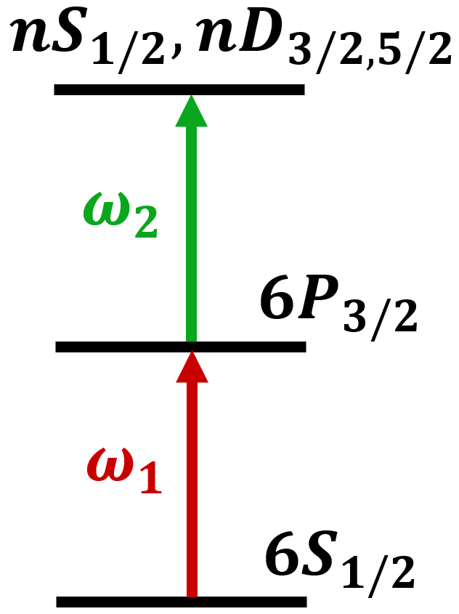
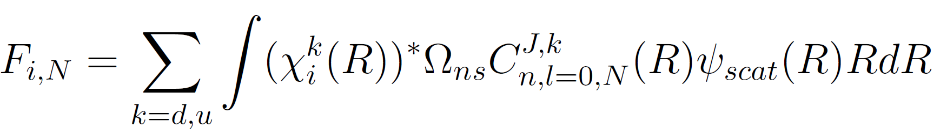
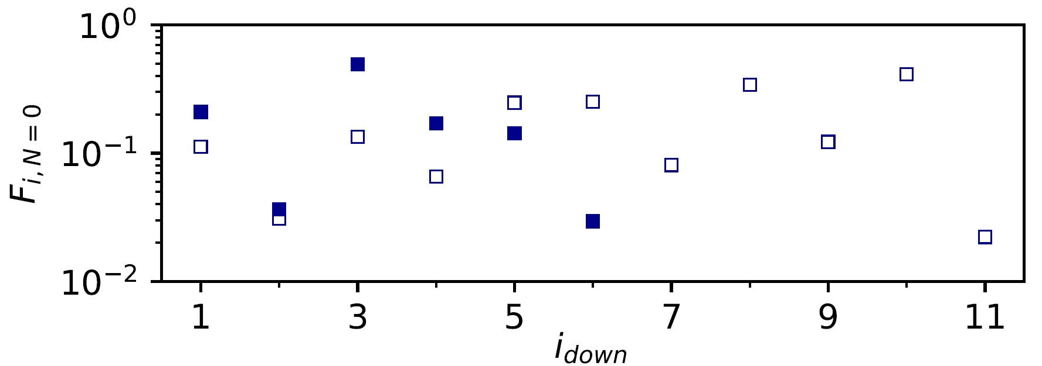

VIBRATIONAL STATES OF Cs(42s)-RbCs(N=0)
Cs
Franck-Condon factors
Cs
Cs
two-photon scheme
Notes:
Omega1=852nm / omega2 depends on n, for 69S1/2 omega2=510nm
https://opg.optica.org/directpdfaccess/ede054db-072c-410f-86264af781d307e7_466073/oe-29-26-43827.pdf?da=1&id=466073&seq=0&mobile=no

Slide 10
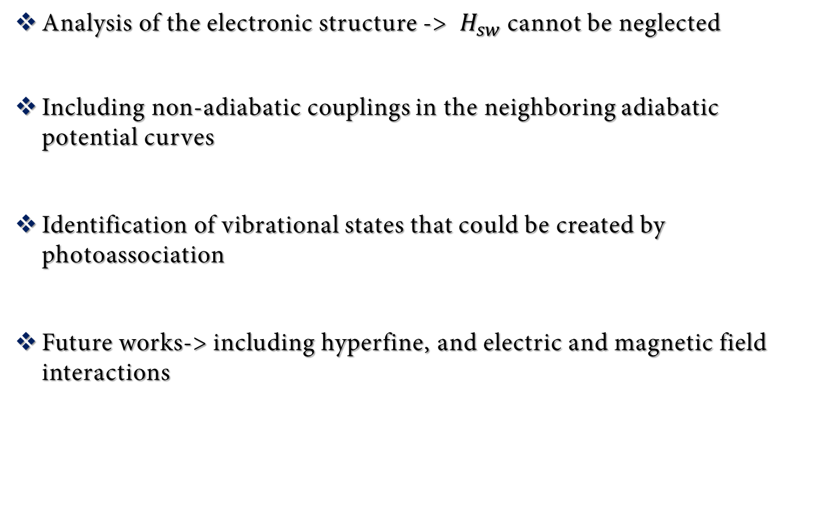
CONCLUSIONS AND OUTLOOK
Analysis of the electronic structure -> $H_{sw}$cannot be neglected
Including non-adiabatic couplings in the neighboring adiabatic potential curves
Identification of vibrational states that could be created by photoassociation
Future works-> including hyperfine, and electric and magnetic field interactions

Slide 11


Slide 12
ULTRALONG-RANGE Cs-RbCs
RYDBERG MOLECULE:
NON-ADIABATICITY OF DIPOLE MOMENTS
PROGRAMA DE DOCTORADO EN FÍSICA Y MATEMÁTICAS
PROGRAMA DE DOCTORADO EN FÍSICA Y MATEMÁTICAS
PROGRAMA DE DOCTORADO EN FÍSICA Y MATEMÁTICAS
PROGRAMA DE DOCTORADO EN FÍSICA Y MATEMÁTICAS
DAVID MELLADO-ALCEDO
September 8th, 2023

Slide 13
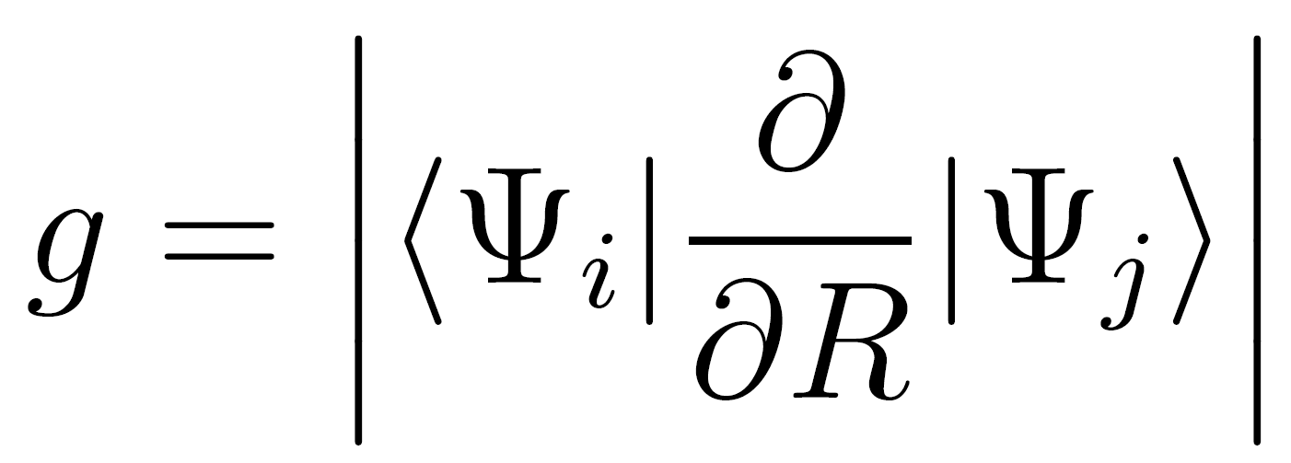
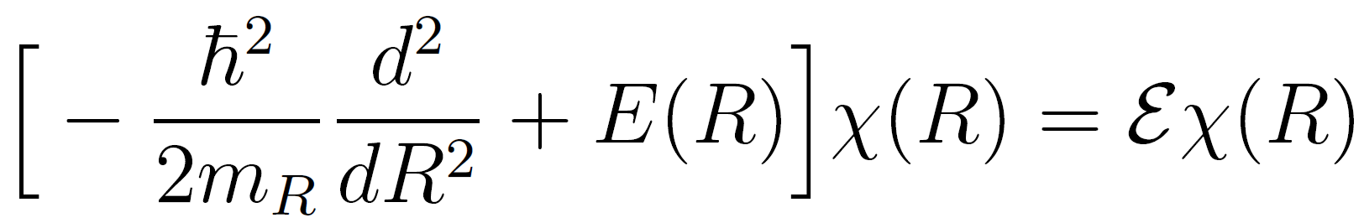
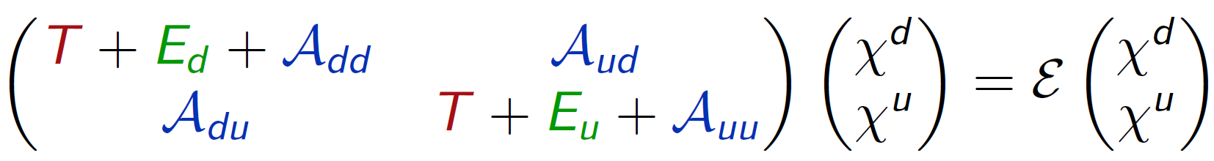
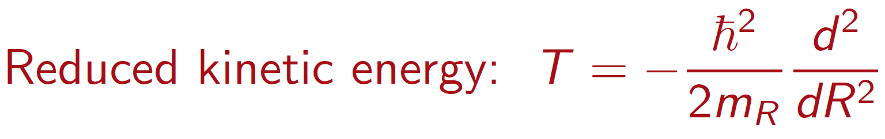

SUPPLEMENTARY MATERIAL
ROVIBRATIONAL HAMILTONIAN ($𝒥=0)$
Landau-Zener:
Decoupling:
Coupling:

Slide 14
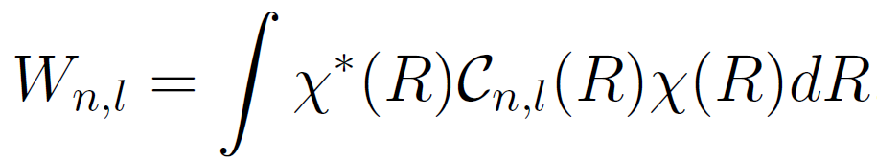
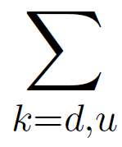
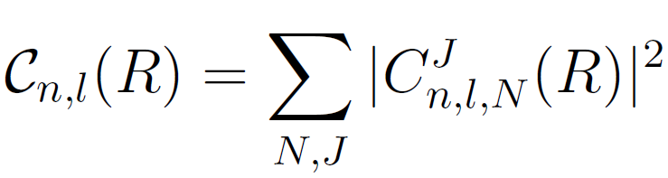
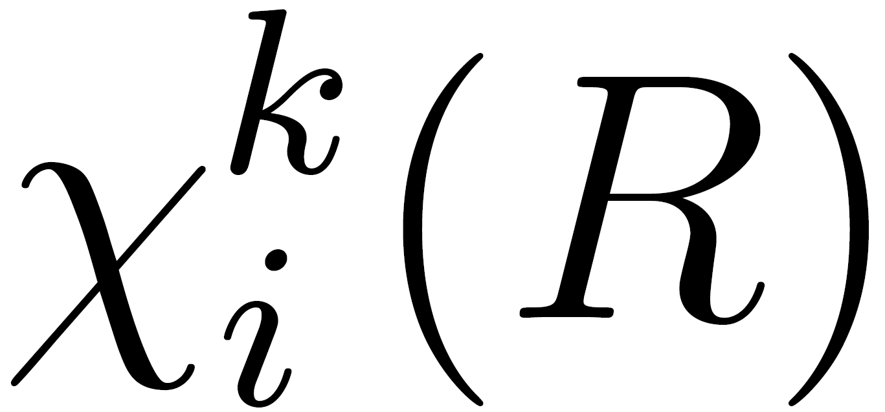

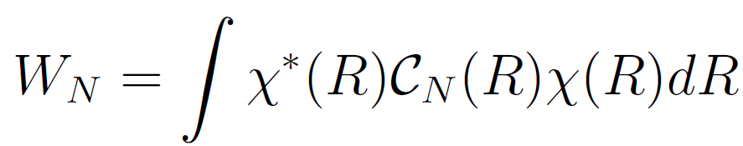
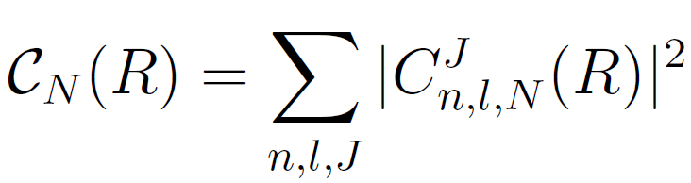
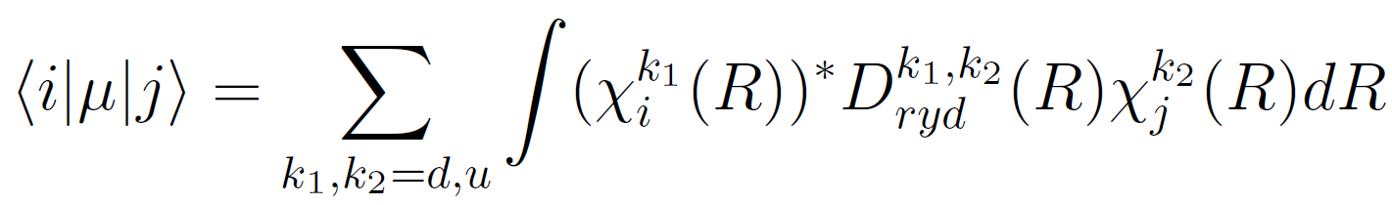
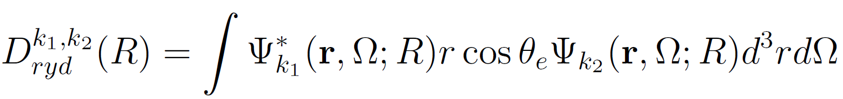
SUPPLEMENTARY MATERIAL
ROVIBRATIONAL HAMILTONIAN ($𝒥=0)$
Weights of the Rydberg atom partial waves:
Weights of the polar molecule partial waves:
Electric dipole moments:

