Slide 1
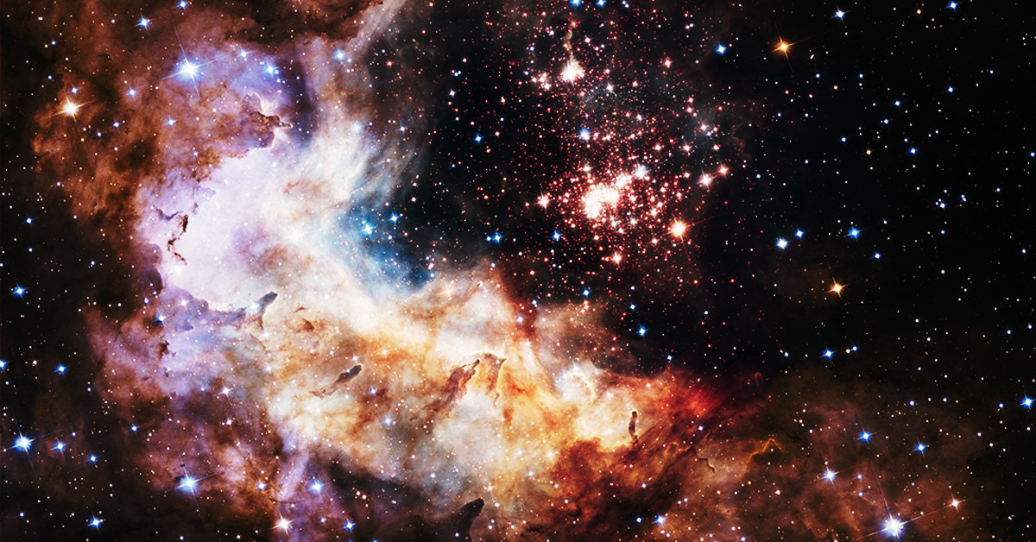


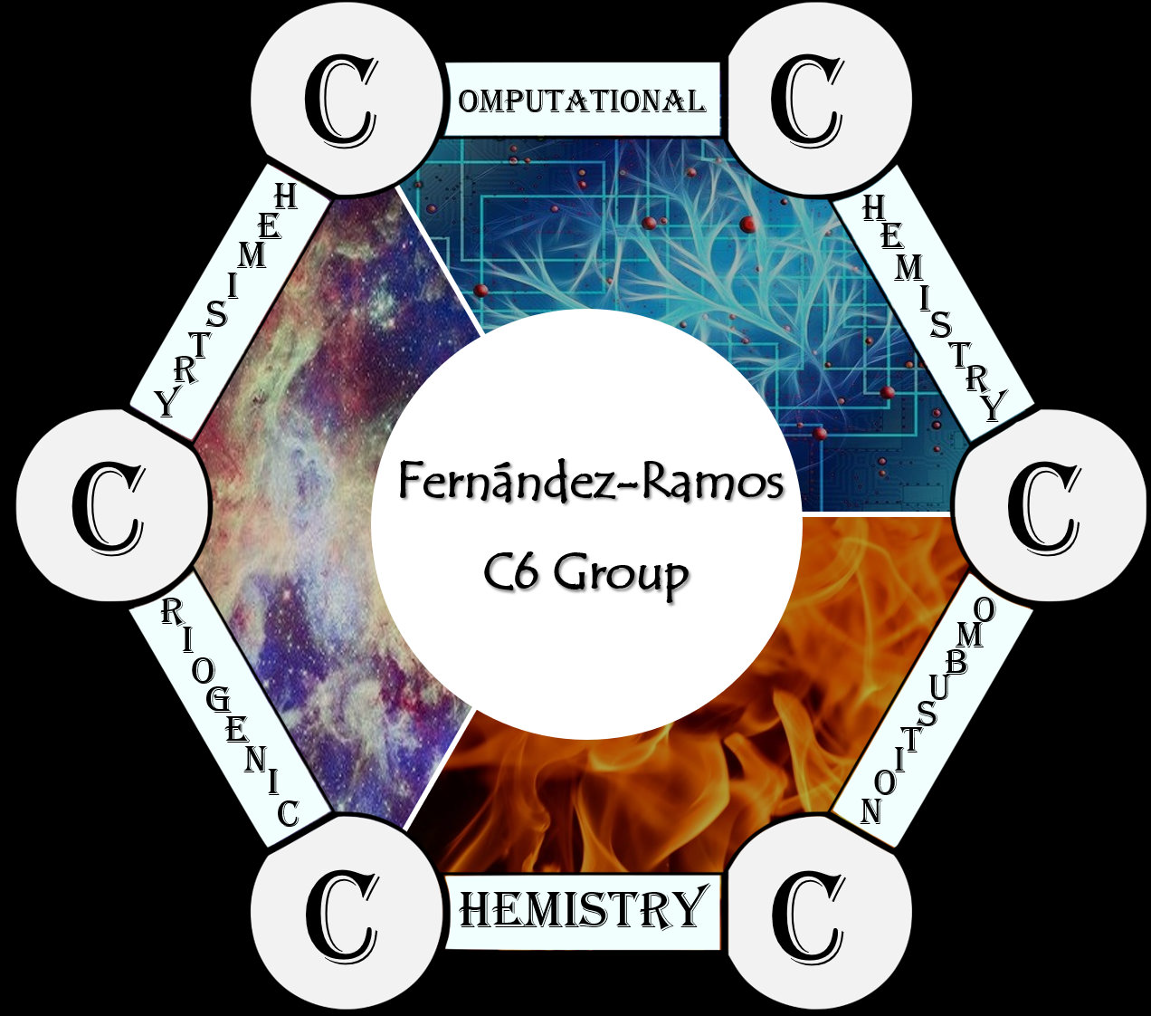
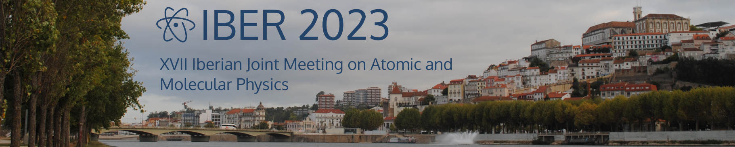
Understanding the formation of aromatic
compounds in the interestellar medium
Marta Castiñeira Reis
September 8th, 2023
Notes:
Good afternoom, thanks for the introduction.

Slide 2
Introduction
Benzene:
Industry: production of plastic, polymers, solvents…
Pharma:
Notes:
https://pubs.acs.org/doi/full/10.1021/acscatal.9b05200

Slide 3
Introduction
Benzene:
Synthesis:
Industry: production of plastic, polymers, solvents…
Syngas to methanol and methanol to aromatics ZSM-5 zeolites or metal catalysis.
Methane over Ni catalysts.
Pharma:
Science 2016, 351, 1065– 1068. Nature 2016, 538, 84– 87. Appl. Catal., A 2018, 557, 15– 24. Ind. Eng. Chem. Res. 2014, 53, 14932– 14940.
Chem. Commun. 2016, 52, 2011– 2014. J. Am. Chem. Soc. 1989, 111, 8749-8751.
Notes:
https://pubs.acs.org/doi/full/10.1021/acscatal.9b05200

Slide 4
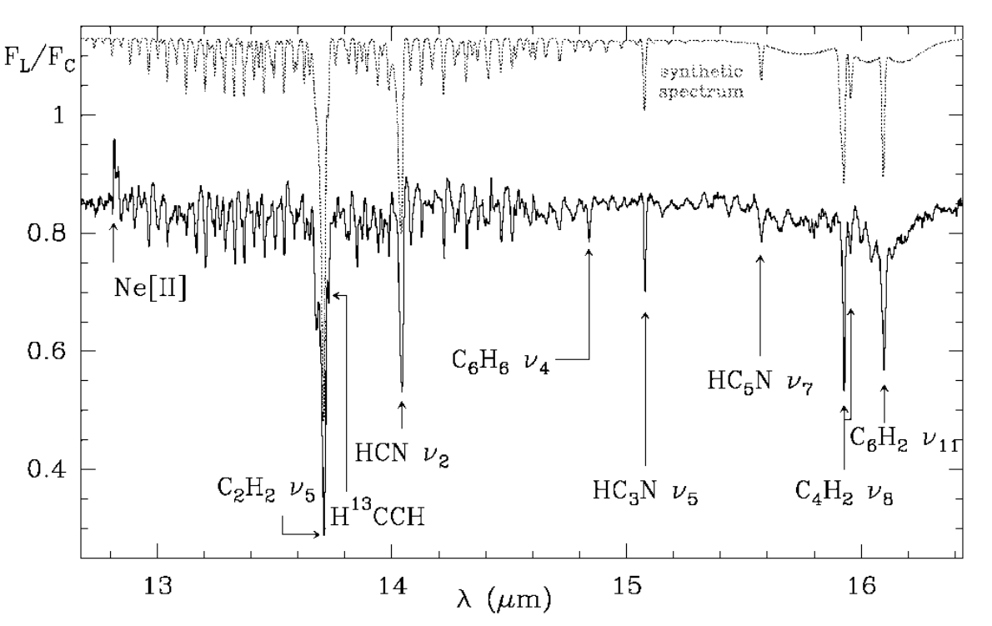
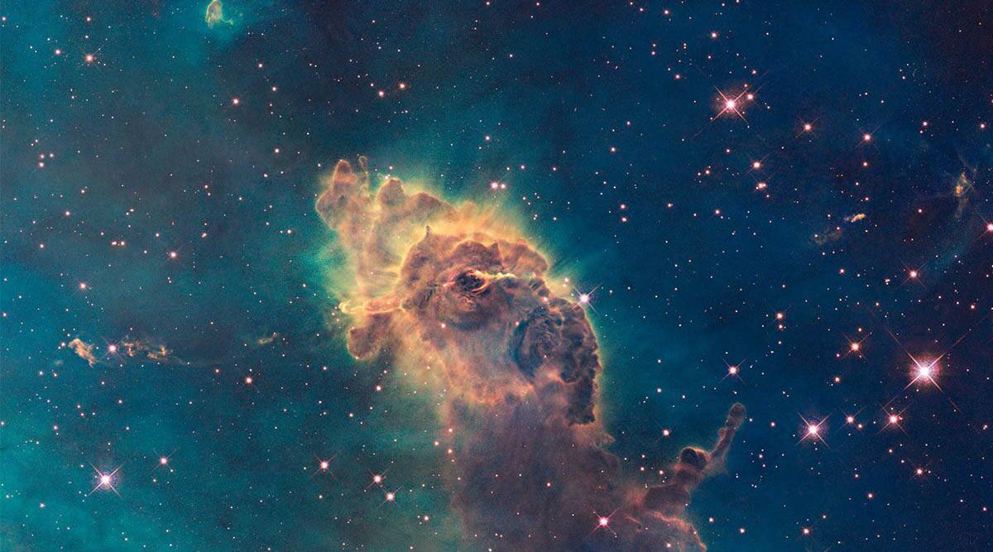
Introduction
Benzene:
Synthesis:
Industry: production of plastic, polymers, solvents…
Syngas to methanol and methanol to aromatics ZSM-5 zeolites or metal catalysis.
Methane over Ni catalysts.
Interstellar Medium (ISM):
2001, Cernicharo et. al CRL 618
2006, Bernard-Salas et. al SMP LMC 11
Low temperature (~10 K)
Low pressure
Astrophys. J. 2001, 546, L123-L126. Astrophys. J. 2006, 652, L29-L32.
Notes:
https://pubs.acs.org/doi/full/10.1021/acscatal.9b05200

Slide 5
Introduction
Benzene:
Synthesis:
Industry: production of plastic, polymers, solvents…
Syngas to methanol and methanol to aromatics ZSM-5 zeolites or metal catalysis.
Methane over Ni catalysts.
Interstellar Medium (ISM):
2001, Cernicharo et. al CRL 618
2006, Bernard-Salas et. al SMP LMC 11
How is it formed?
Low temperature (~10 K)
Low pressure
Astrophys. J. 2001, 546, L123-L126. Astrophys. J. 2006, 652, L29-L32.
Notes:
https://pubs.acs.org/doi/full/10.1021/acscatal.9b05200

Slide 6
ISM: reaction conditions
Low temperature (~10K)
Low pressure

Slide 7
ISM: reaction conditions
Low temperature (~10K)
Low pressure

Slide 8
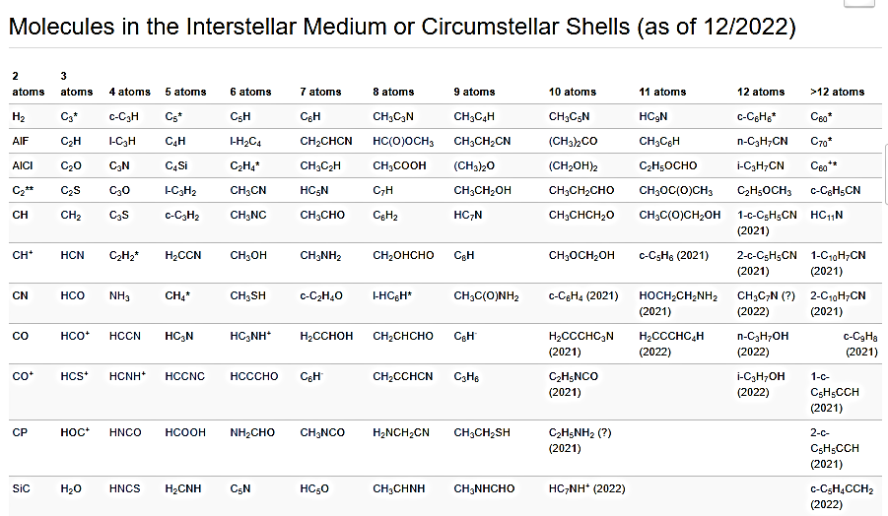
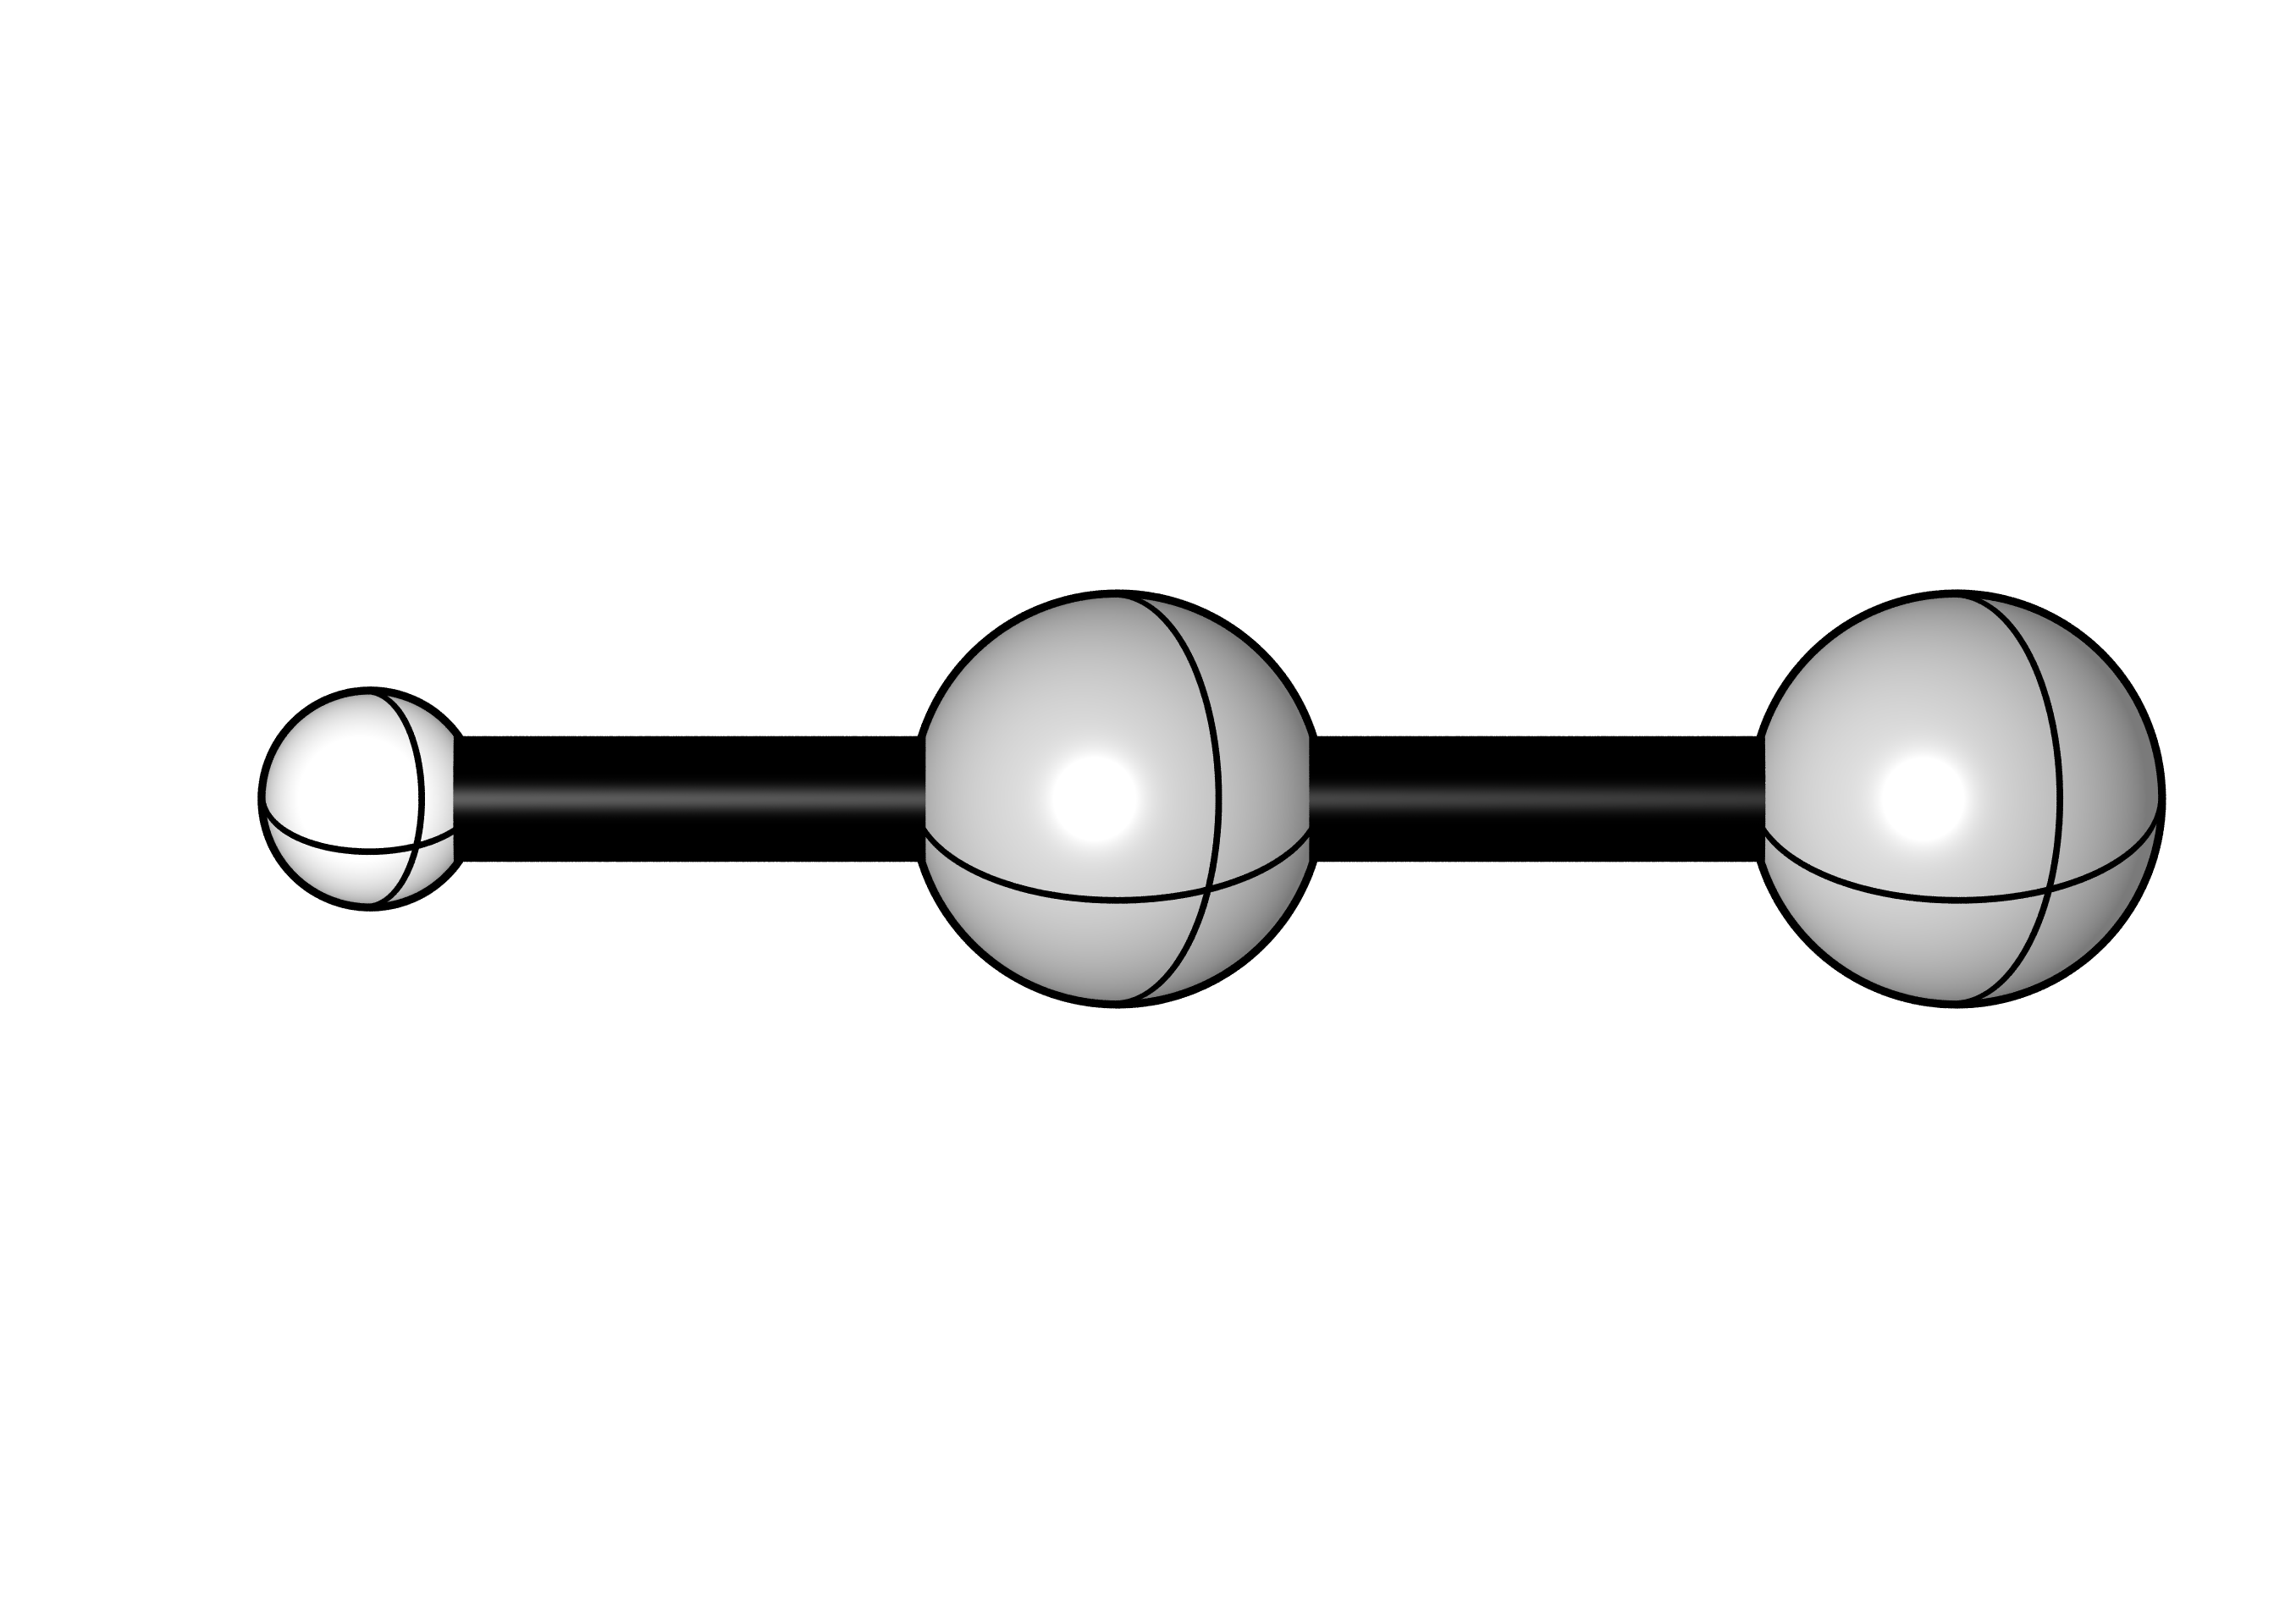
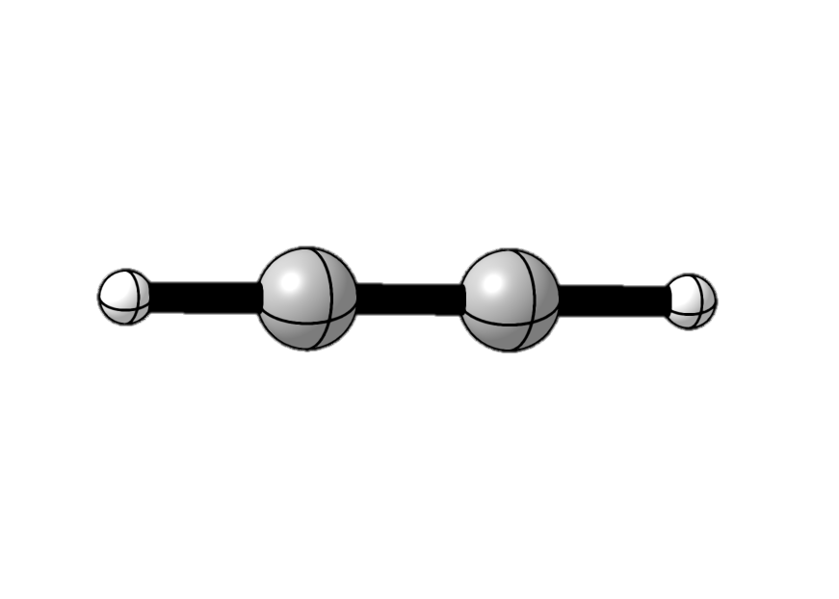
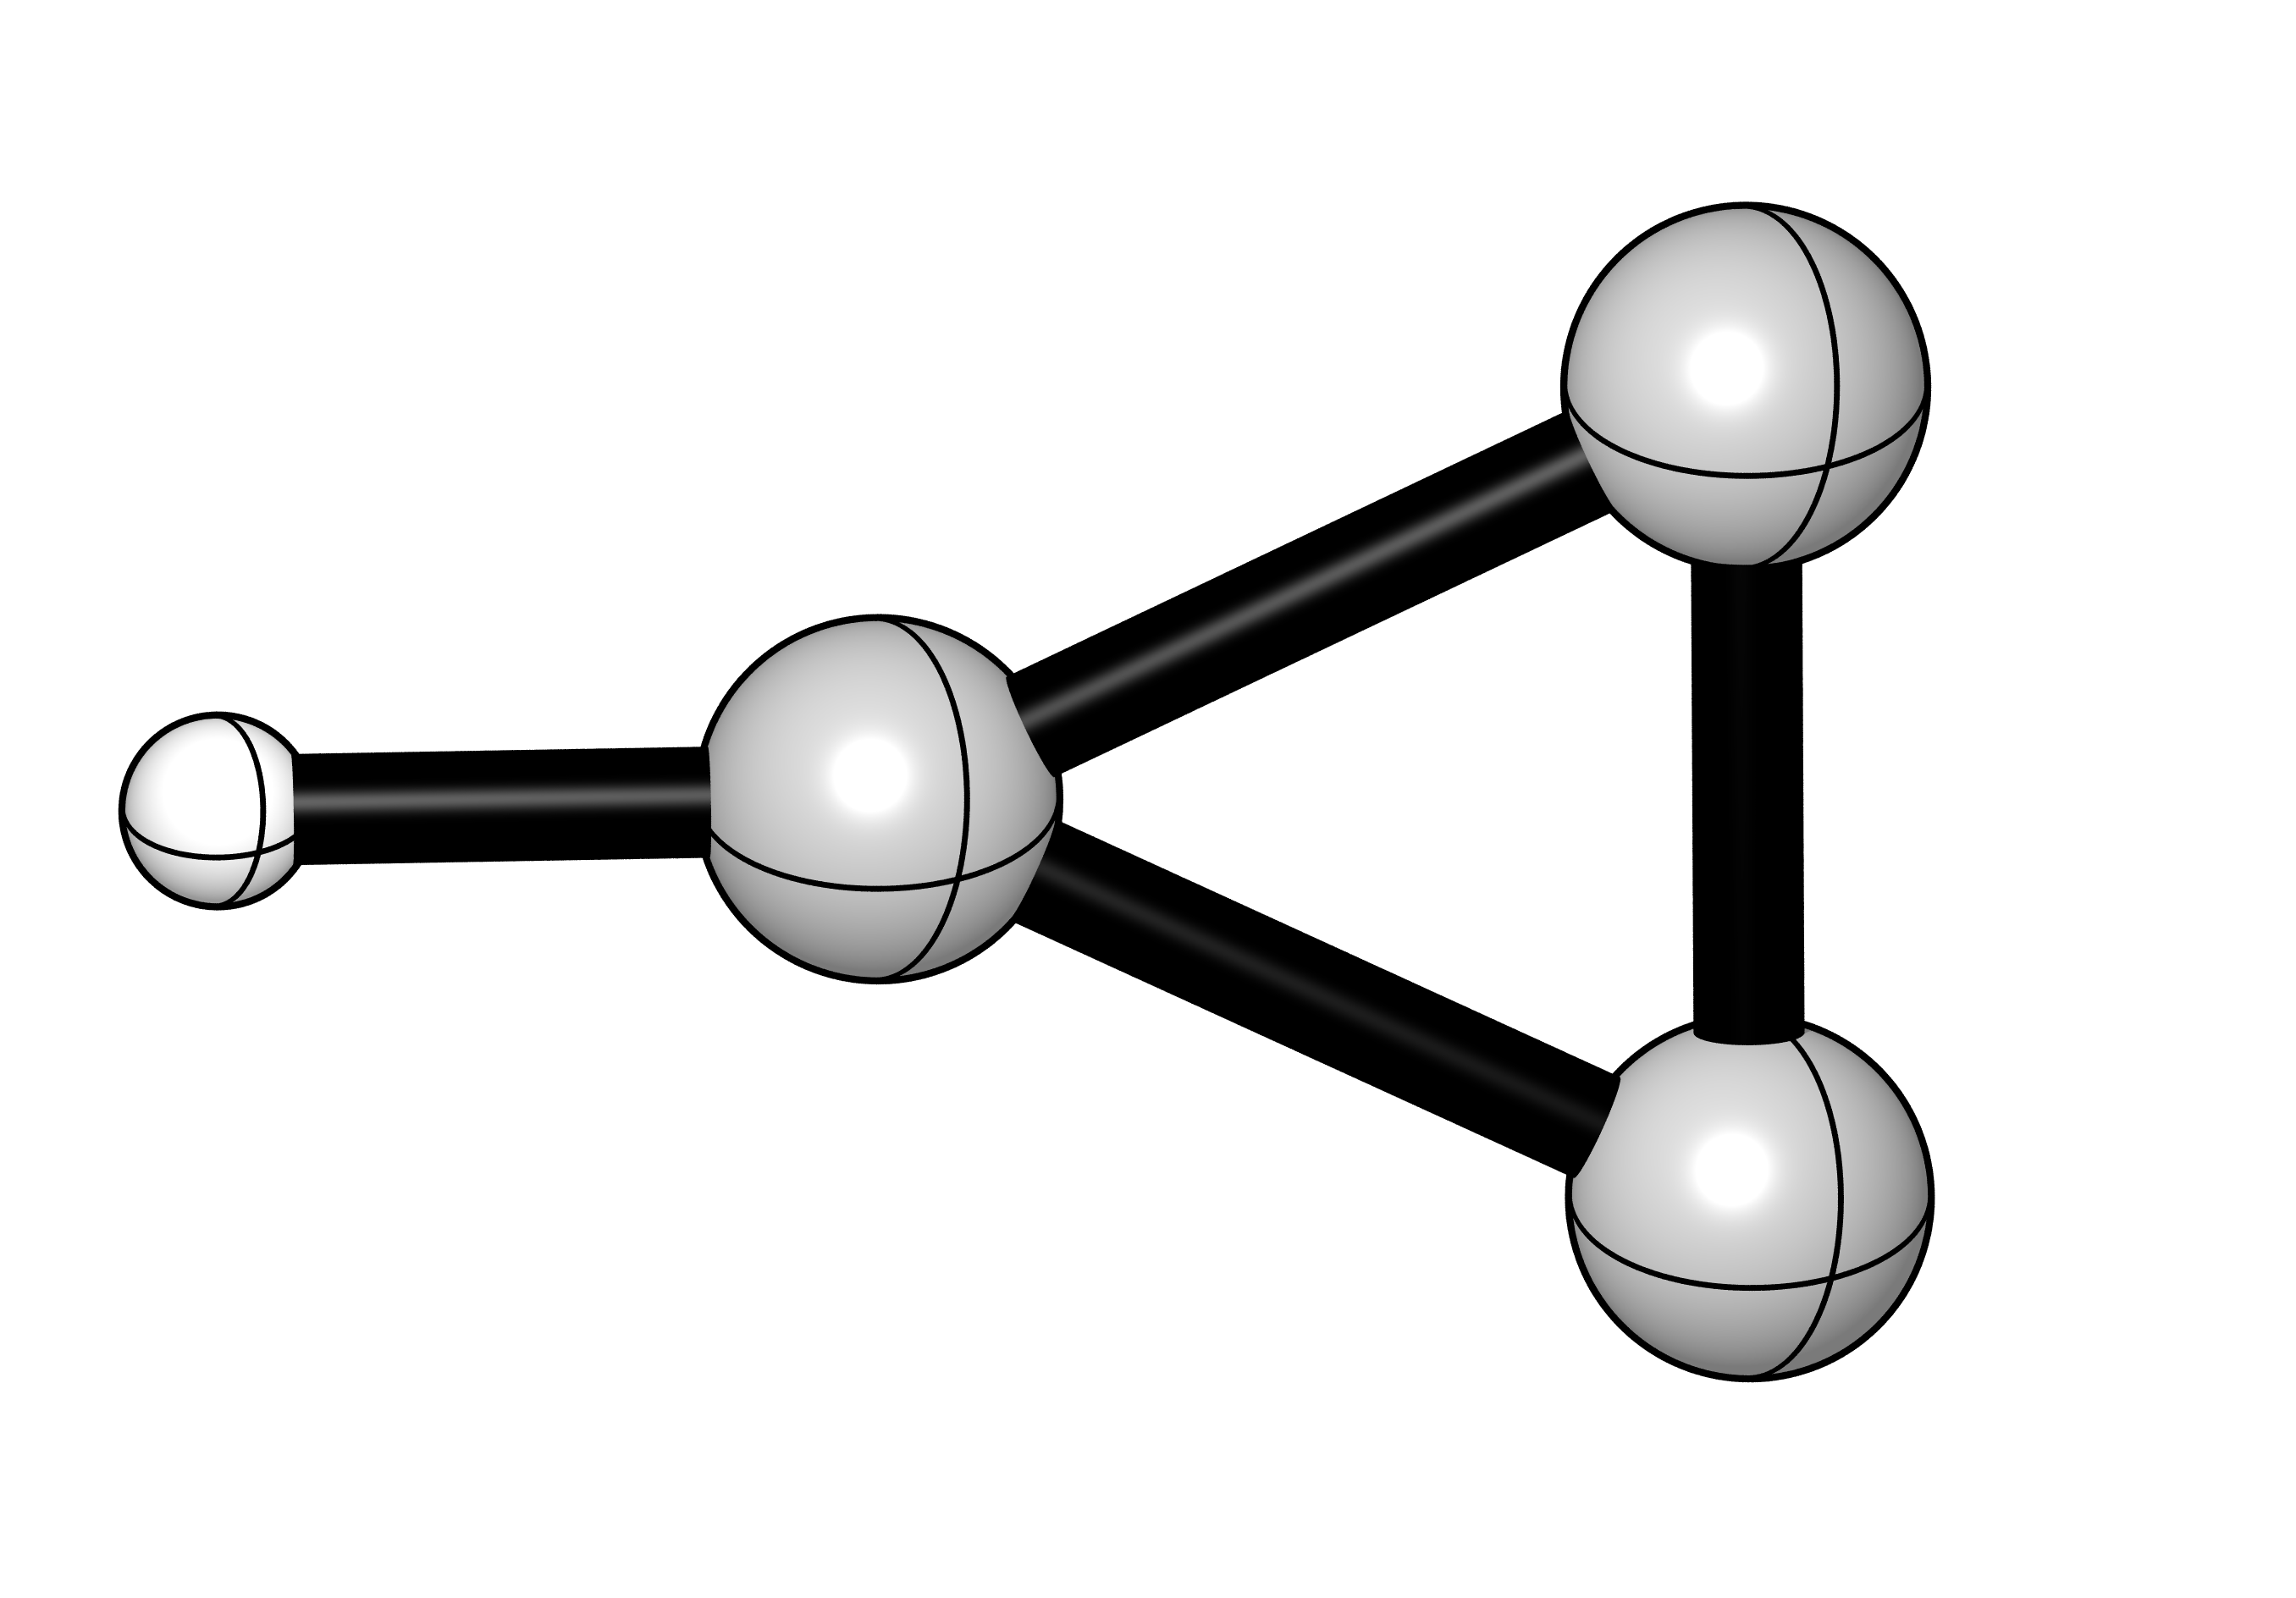
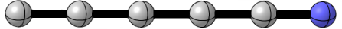
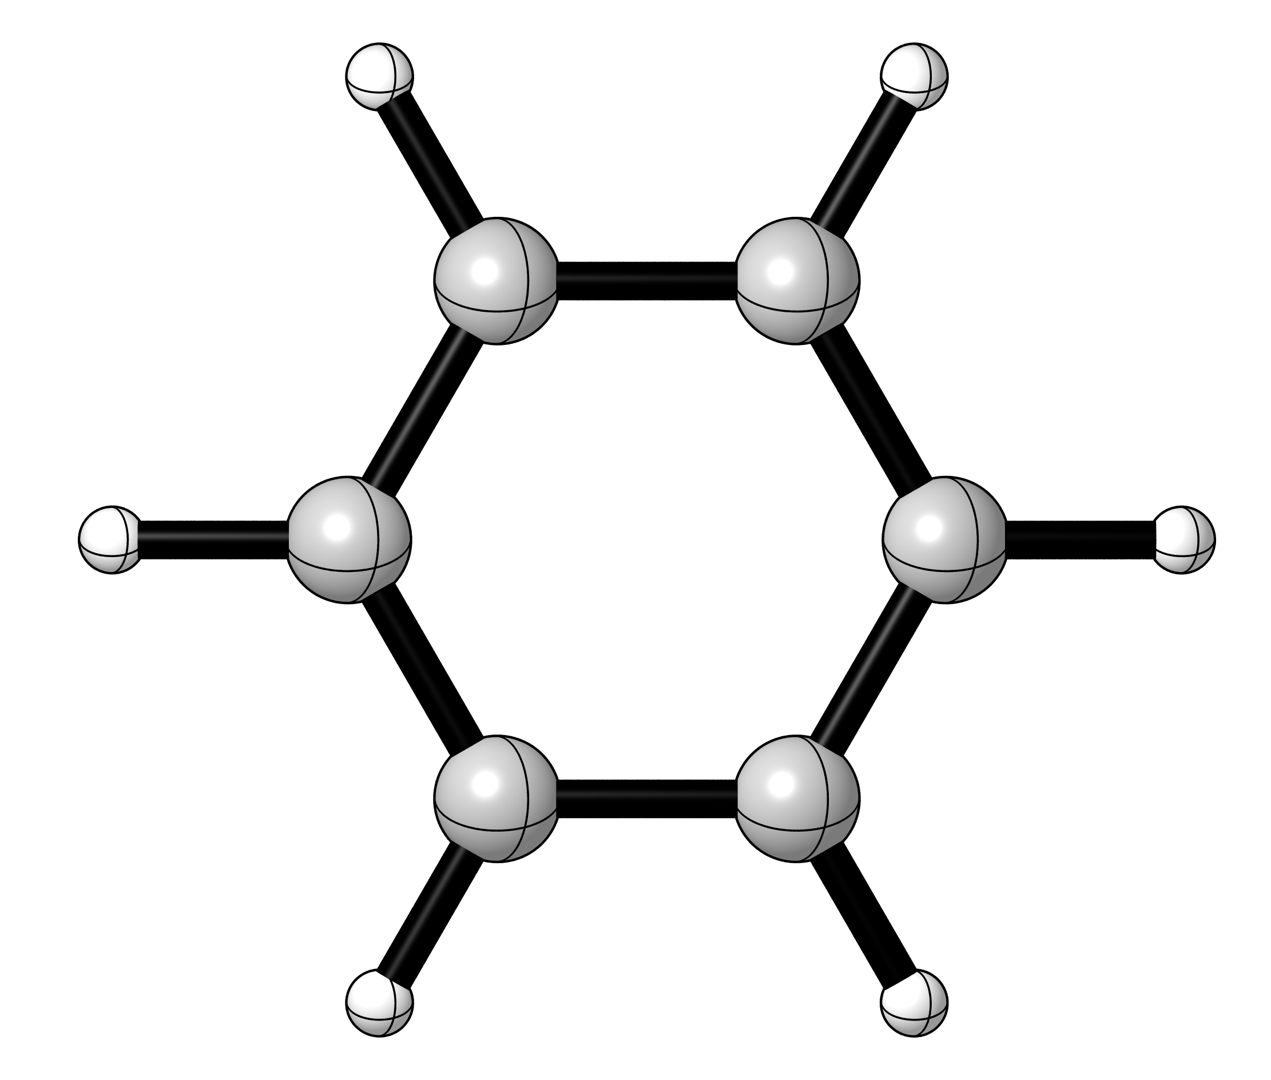
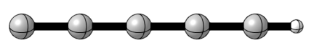
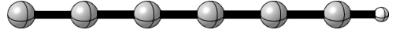
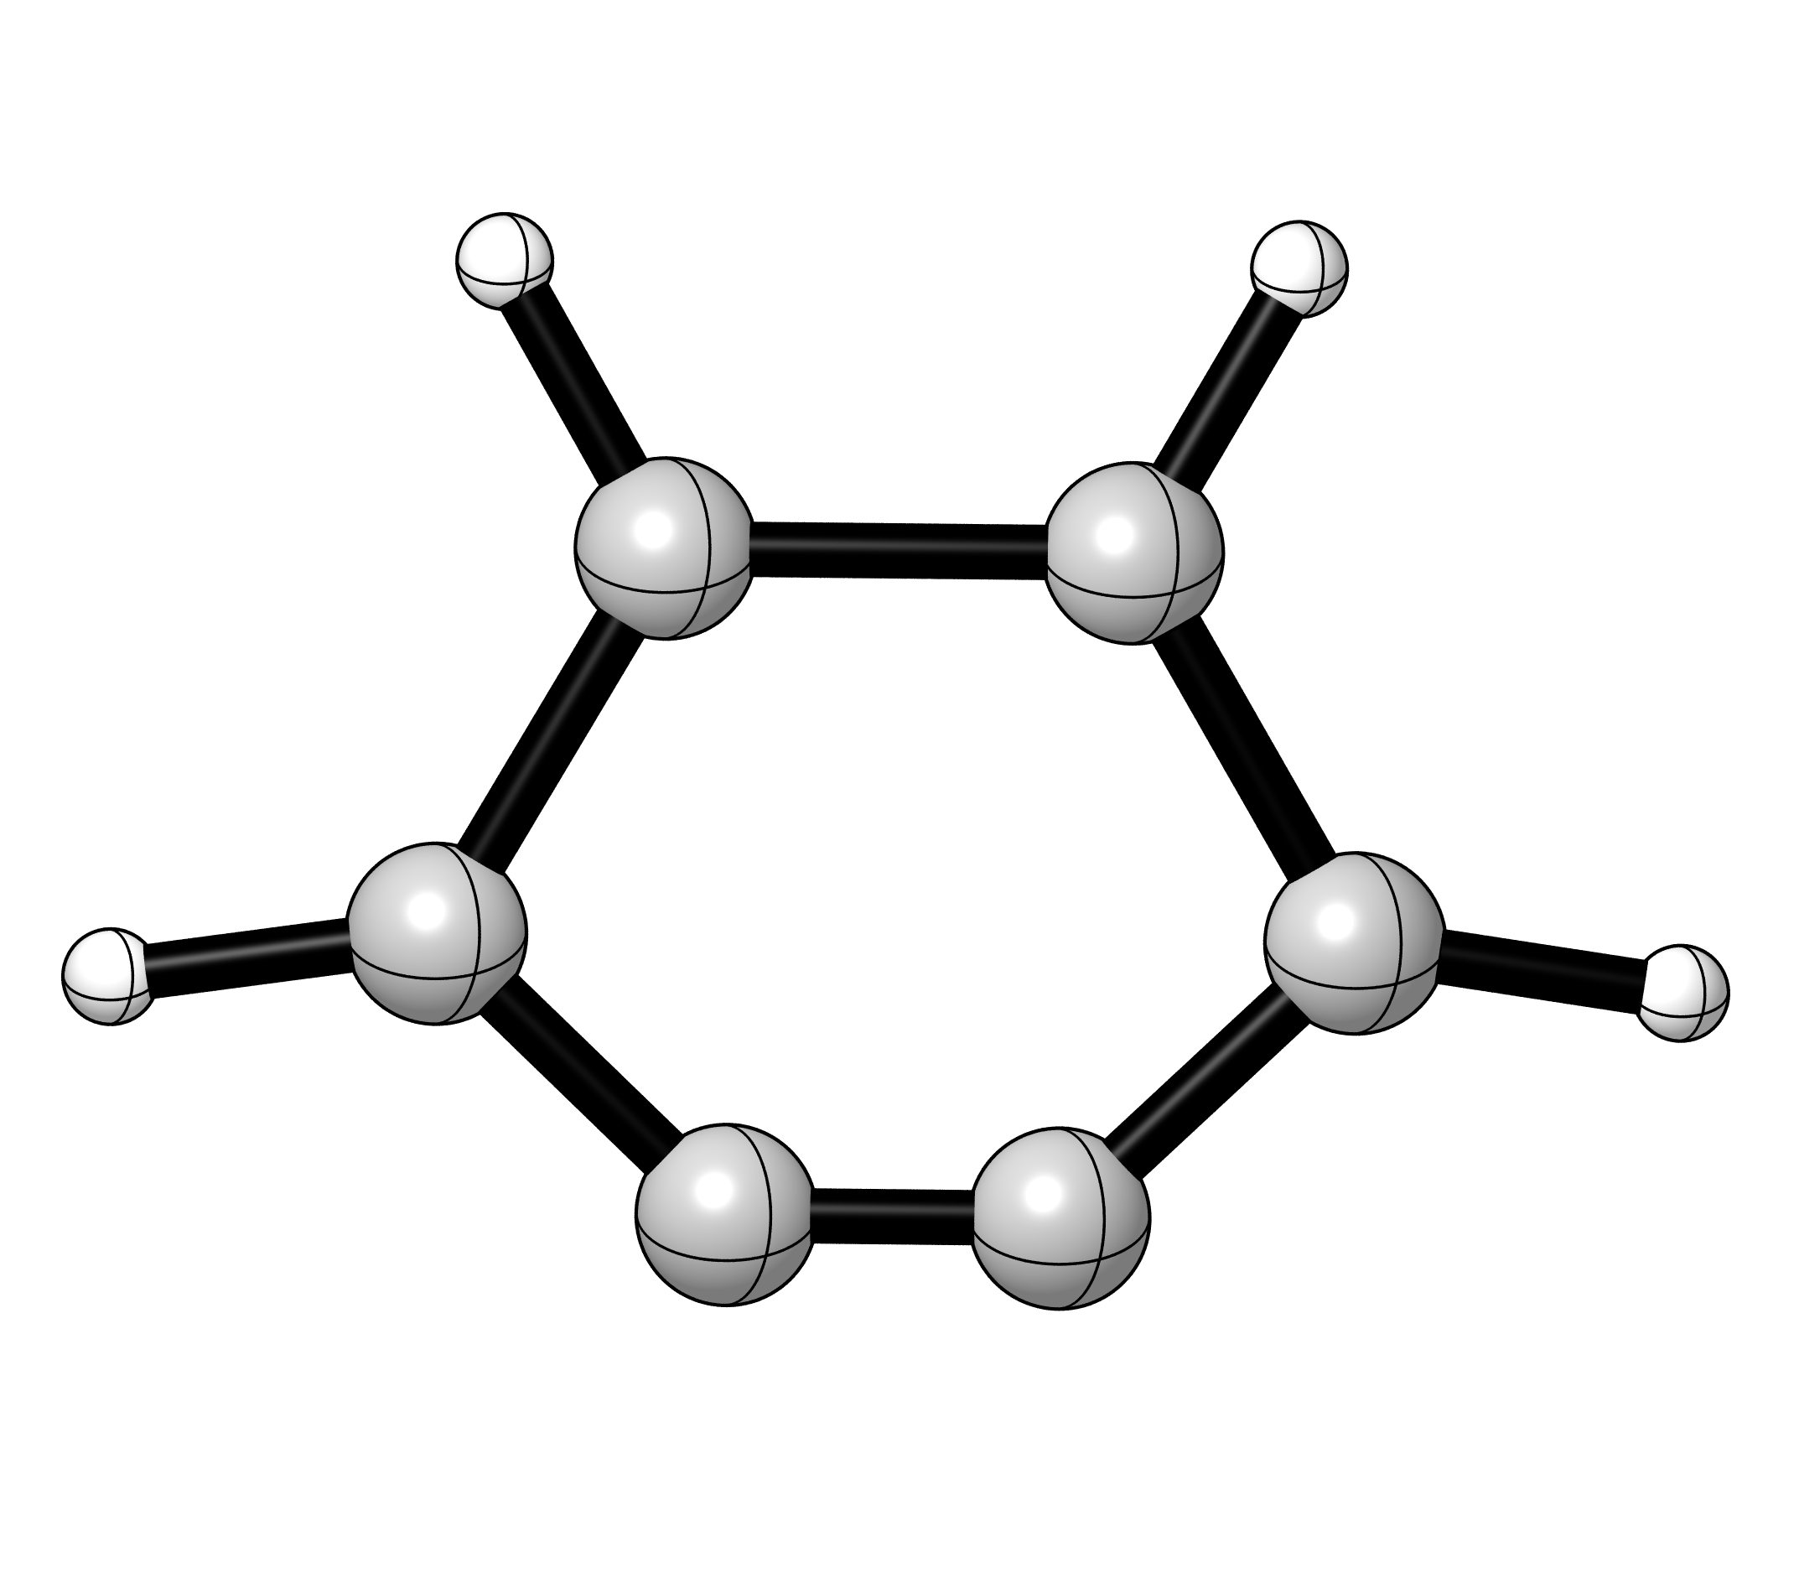
ISM: nature of the molecules
Low temperature (~10K)
Low pressure
Non-intuitive species
* indicates molecules that have been detected by their rotation-vibration spectrum,
** those detected by electronic spectroscopy only.

Slide 9
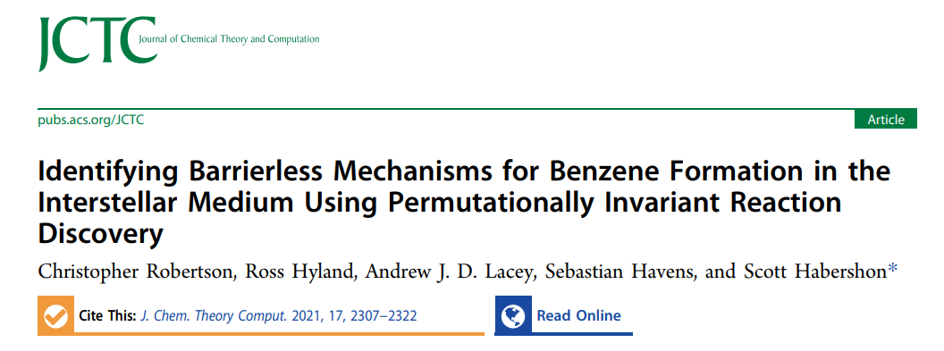
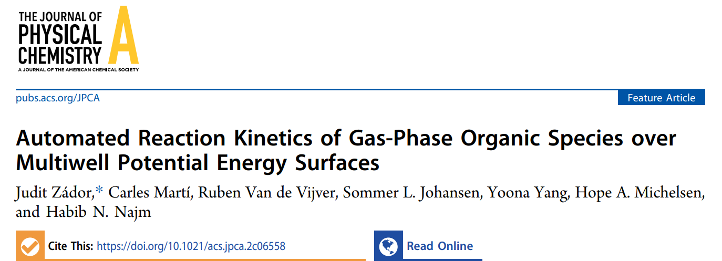
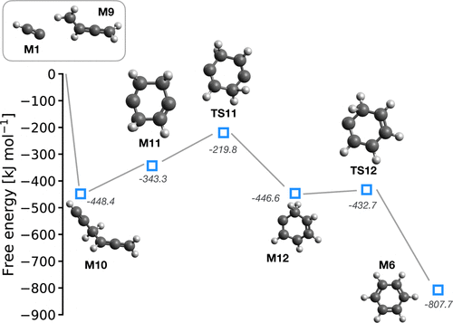
State of the art
Problems in the mechanistic search: human biasing
2021, Habershon and coworkers
2022, Zádor and coworkers
J. Chem. Theory Comput. 2021, 17, 2307-2322. J. Phys. Chem. A. 2023, DOI: 10,1021/cs.jpca.2c06558.

Slide 10

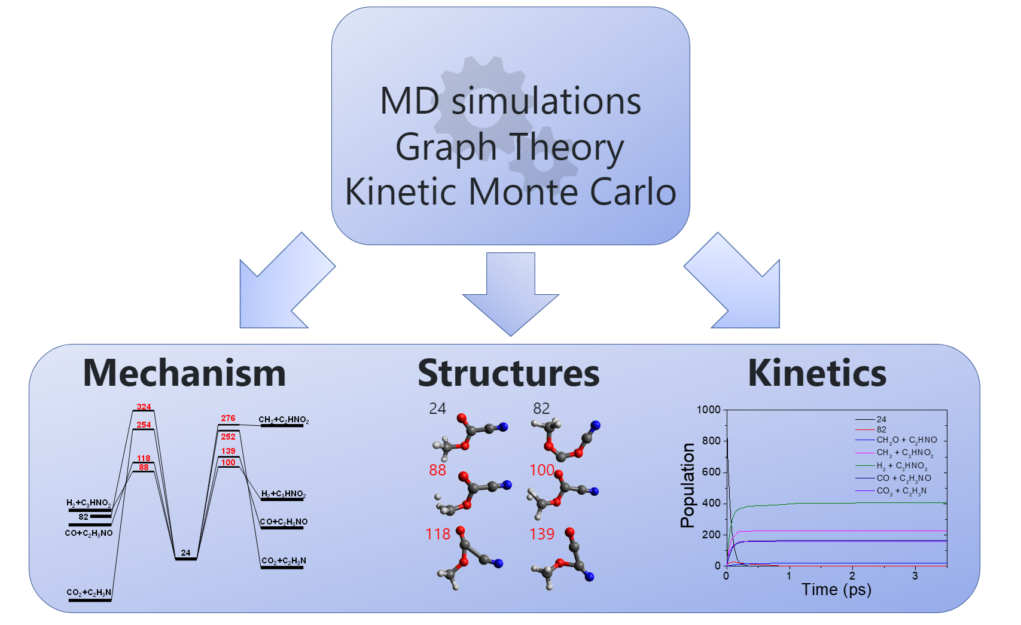
Goal
Break this human bias completely
Decomposition
Emilio Martinez Núñez
Phys. Chem. Chem. Phys. 2015, 17, 14912-14921. J. Comput. Chem. 2015, 36, 222-234. J. Comput. Chem. 2018, 39, 1922-1930. J. Comput. Chem. 2021, 42, 2036-2048.

Slide 11
Goal
Break this human bias completely
Decomposition
Emilio Martinez Núñez
Phys. Chem. Chem. Phys. 2015, 17, 14912-14921. J. Comput. Chem. 2015, 36, 222-234. J. Comput. Chem. 2018, 39, 1922-1930. J. Comput. Chem. 2021, 42, 2036-2048.

Slide 12
Goal
Break this human bias completely
Decomposition
Molecular Dynamic simulations run at a Low Level (MOPAC, PM7)
- Up to 4 sets of dynamics
Reaction network generation (Low Level)
Reoptimization of minima, TS and products at a High Level (G16 M08HX/6-31+G(d,p))
Reaction network generation (High Level)
Emilio Martinez Núñez
Phys. Chem. Chem. Phys. 2015, 17, 14912-14921. J. Comput. Chem. 2015, 36, 222-234. J. Comput. Chem. 2018, 39, 1922-1930. J. Comput. Chem. 2021, 42, 2036-2048.

Slide 13
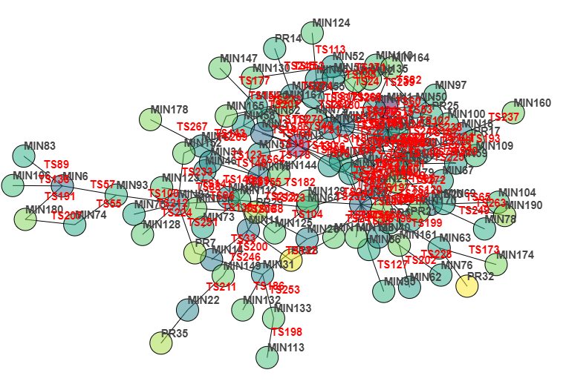
Results and discussion I : C₆H₆ (benzene)
Decomposition of benzene
benzene
intermediates
fragments

Slide 14
Results and discussion I : C₆H₆ (benzene)

Slide 15
Results and discussion I : C₆H₆ (benzene)
Molecules that have been detected in space.
Molecules whose structure is analogous to that of molecules detected in space but for H-loss or H-gain.
Not detected molecules.
(*) Those reactants that can be connected with benzene via a barrierless transformation.

Slide 16
Results and discussion I : C₆H₆ (benzene)
Molecules that have been detected in space.
Molecules whose structure is analogous to that of molecules detected in space but for H-loss or H-gain.
Not detected molecules.
(*) Those reactants that can be connected with benzene via a barrierless transformation.
Molecules that have been detected in space. Molecules whose structure is analogous to that of molecules detected in space but for H-loss or H-gain. Not detected molecules. We mark with a star those reactants that can be connected with benzene via a barrierless transformation.

Slide 17
Results and discussion I : C₆H₆ (benzene)
Molecules that have been detected in space.
Molecules whose structure is analogous to that of molecules detected in space but for H-loss or H-gain.
Not detected molecules.
(*) Those reactants that can be connected with benzene via a barrierless transformation.
Molecules that have been detected in space. Molecules whose structure is analogous to that of molecules detected in space but for H-loss or H-gain. Not detected molecules. We mark with a star those reactants that can be connected with benzene via a barrierless transformation.

Slide 18

Results and discussion I : C₆H₆ (benzene)
Molecules that have been detected in space. Molecules whose structure is analogous to that of molecules detected in space but for H-loss or H-gain. Not detected molecules. We mark with a star those reactants that can be connected with benzene via a barrierless transformation.

Slide 19
Results and discussion I : C₆H₆ (benzene)
Molecules that have been detected in space.
Molecules whose structure is analogous to that of molecules detected in space but for H-loss or H-gain.
Not detected molecules.
(*) Those reactants that can be connected with benzene via a barrierless transformation.
Molecules that have been detected in space. Molecules whose structure is analogous to that of molecules detected in space but for H-loss or H-gain. Not detected molecules. We mark with a star those reactants that can be connected with benzene via a barrierless transformation.

Slide 20
Results and discussion I : C₆H₆ (benzene)
Molecules that have been detected in space. Molecules whose structure is analogous to that of molecules detected in space but for H-loss or H-gain. Not detected molecules. We mark with a star those reactants that can be connected with benzene via a barrierless transformation.

Slide 21
Results and discussion I : C₆H₆ (benzene)
Potential benzene reactants
J. Chem. Theory Comput. 2021, 17, 2307-2322.
Proc. Natl. Acad. Sci. U.S.A. 2010, 108, 452−457.
Molecules that have been detected in space. Molecules whose structure is analogous to that of molecules detected in space but for H-loss or H-gain. Not detected molecules. We mark with a star those reactants that can be connected with benzene via a barrierless transformation.

Slide 22

Results and discussion I : C₆H₆ (benzene)
Potential benzene reactants
Molecules that have been detected in space. Molecules whose structure is analogous to that of molecules detected in space but for H-loss or H-gain. Not detected molecules. We mark with a star those reactants that can be connected with benzene via a barrierless transformation.

Slide 23
Results and discussion II : C₆H₅ (phenyl radical)
Molecules that have been detected in space. Molecules whose structure is analogous to that of molecules detected in space but for H-loss or H-gain. Not detected molecules. We mark with a star those reactants that can be connected with benzene via a barrierless transformation.

Slide 24
Results and discussion II : C₆H₅ (phenyl radical)
Molecules that have been detected in space. Molecules whose structure is analogous to that of molecules detected in space but for H-loss or H-gain. Not detected molecules. We mark with a star those reactants that can be connected with benzene via a barrierless transformation.

Slide 25
Results and discussion IV : C₆H₄ (benzyne)
Molecules that have been detected in space. Molecules whose structure is analogous to that of molecules detected in space but for H-loss or H-gain. Not detected molecules. We mark with a star those reactants that can be connected with benzene via a barrierless transformation.

Slide 26
Bird view
* Paths starting from unprecedent reagents
* Undetected intermediates
* Paths starting from previously reported reagents

Slide 27

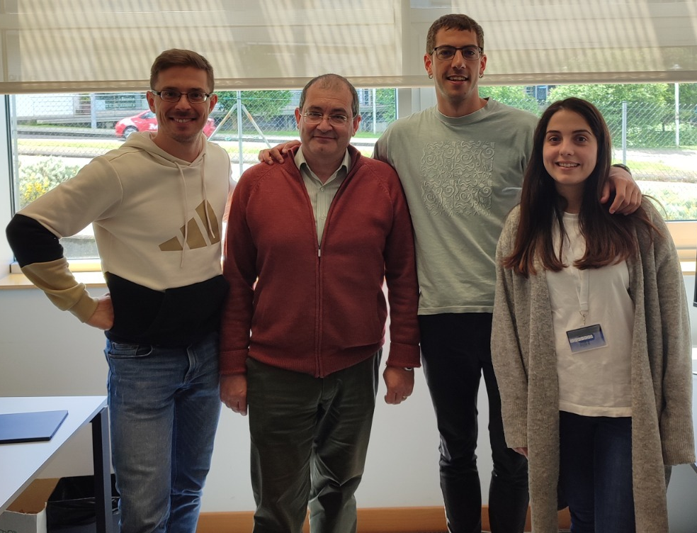
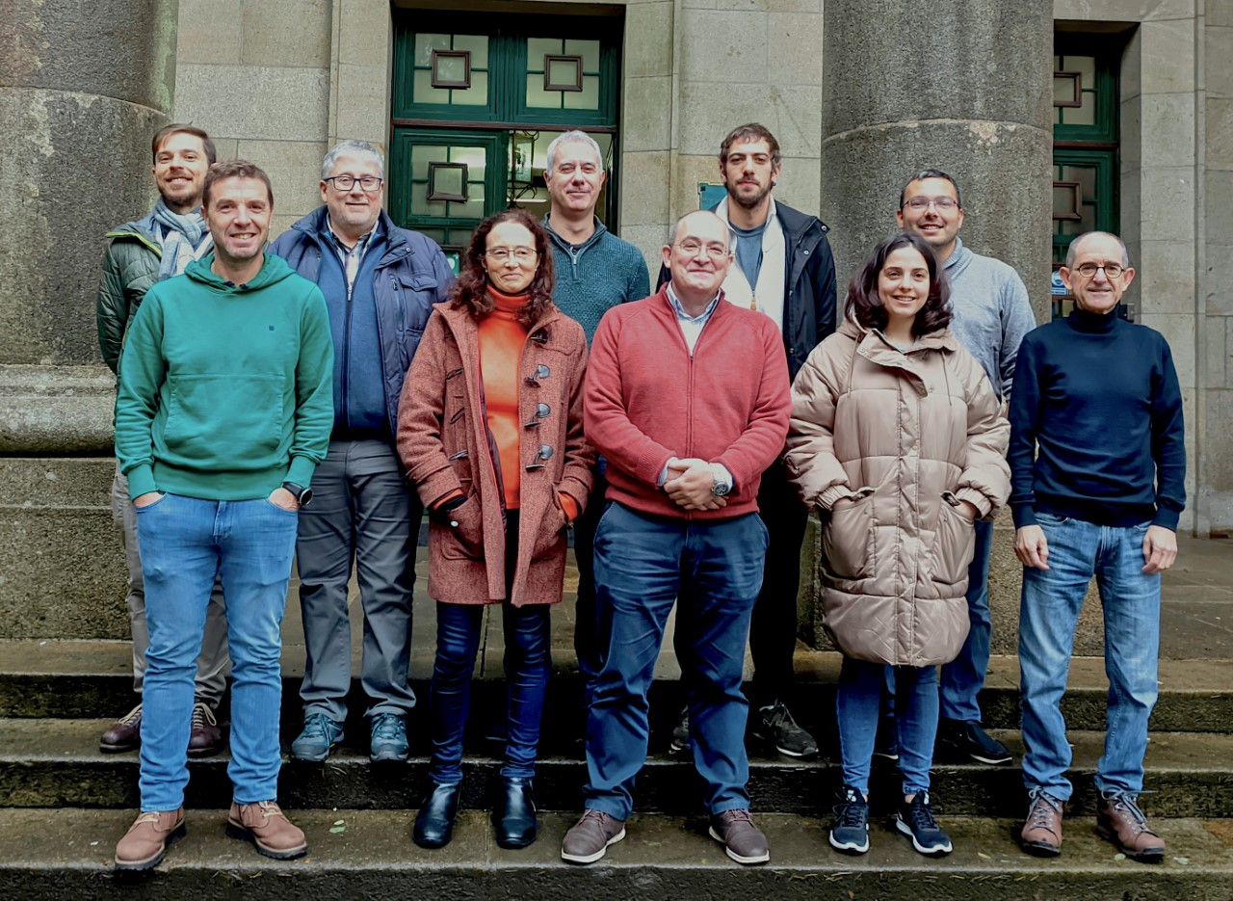



Acknowledgments
Thank you for your
kind attention!

Slide 28
Understanding the formation of aromatic
compounds in the interestellar medium
Marta Castiñeira Reis
September 8th, 2023
Notes:
Good afternoom, thanks for the introduction.

Slide 29
