Slide 1
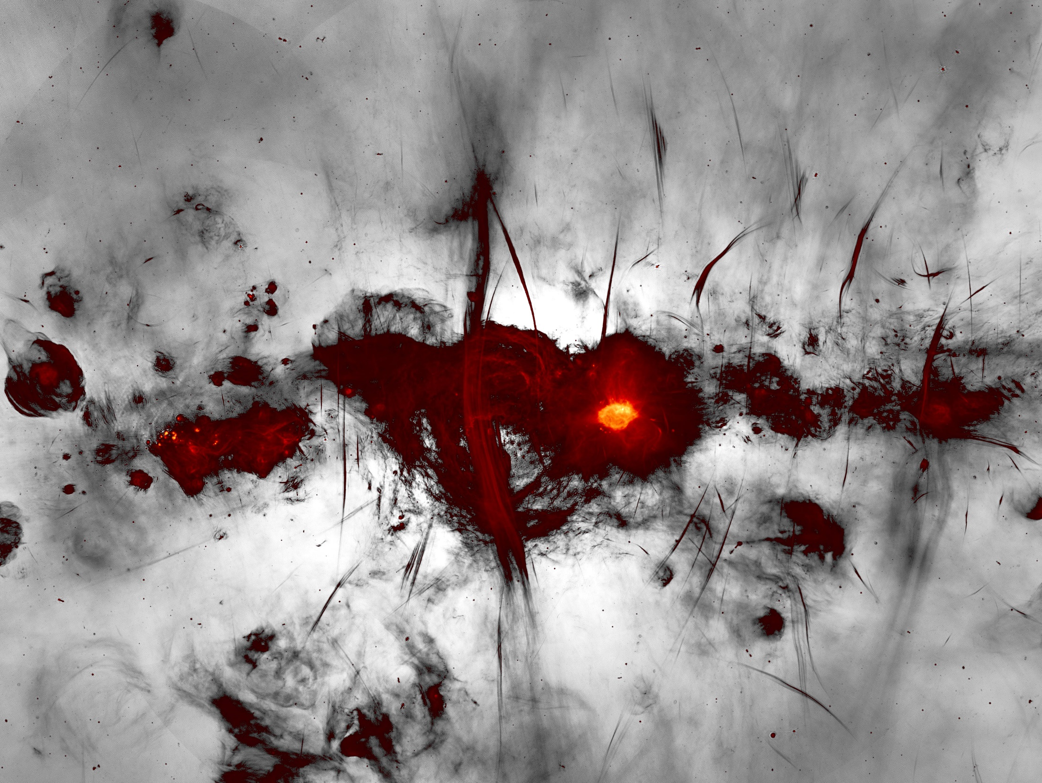







IBER, Coimbra, September 2023
“INTERSTELLAR DETECTION OF CARBONIC ACID (HOCOOH) AT LAST”
Miguel Sanz-Novo ^{1,2}
¹Centro de Astrobiología (CAB, INTA-CSIC), Torrejón de Ardoz, 28850 Madrid, Spain
² Computational Chemistry Group, Departamento de Química Física y Química Inorgánica, Universidad de Valladolid, E-47011 Valladolid, Spain
Image Credit: SARAO

Slide 2
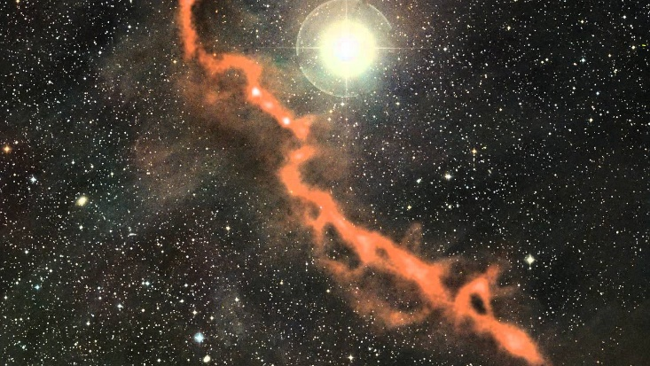
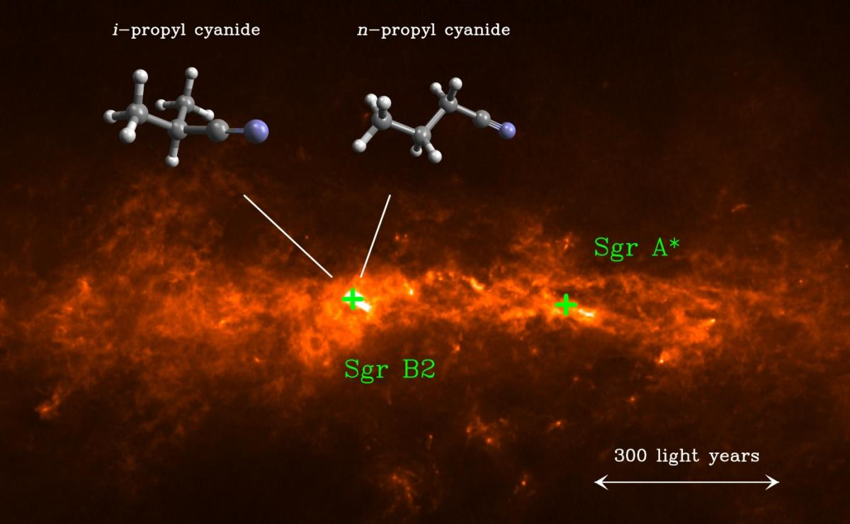
1. INTRODUCTION
2. METHODOLOGY
3. RESULTS AND DISCUSSION
4. CONCLUSIONS & PROSPECTS
1.1. Exploring complex chemistry in the ISM
Interstellar medium (ISM): diluted mix of ions, atoms, molecules, dust particles and electromagnetic fields between stars.
Taurus Molecular Cloud (TMC). Credit: ESO/APEX (MPIfR/ESO/OSO)
Sgr B2 Molecular Cloud. Credit: A. Belloche.

Slide 3
1. INTRODUCTION
2. METHODOLOGY
3. RESULTS AND DISCUSSION
4. CONCLUSIONS & PROSPECTS
1. INTRODUCTION
2. METHODOLOGY
3. RESULTS AND DISCUSSION
4. CONCLUSIONS & PROSPECTS
1.1. Exploring complex chemistry in the ISM
Interstellar medium (ISM): diluted mix of ions, atoms, molecules, dust particles and electromagnetic fields between stars.
Exploring complex chemistry:
How complex can molecules get in the ISM?
How do they form, grains, gas phase, which routes?
Where do they form – cold dark clouds or hot molecular cores?
Taurus Molecular Cloud (TMC). Credit: ESO/APEX (MPIfR/ESO/OSO)
Sgr B2 Molecular Cloud. Credit: A. Belloche.

Slide 4
1. INTRODUCTION
2. METHODOLOGY
3. RESULTS AND DISCUSSION
4. CONCLUSIONS & PROSPECTS
1. INTRODUCTION
2. METHODOLOGY
3. RESULTS AND DISCUSSION
4. CONCLUSIONS & PROSPECTS
1.1. Exploring complex chemistry in the ISM
Interstellar medium (ISM): diluted mix of ions, atoms, molecules, dust particles and electromagnetic fields between stars.
Exploring complex chemistry:
How complex can molecules get in the ISM?
How do they form, grains, gas phase, which routes?
Where do they form – cold dark clouds or hot molecular cores?
Taurus Molecular Cloud (TMC). Credit: ESO/APEX (MPIfR/ESO/OSO)
Sgr B2 Molecular Cloud. Credit: A. Belloche.

Slide 5
1. INTRODUCTION
2. METHODOLOGY
3. RESULTS AND DISCUSSION
4. CONCLUSIONS & PROSPECTS
1. INTRODUCTION
2. METHODOLOGY
3. RESULTS AND DISCUSSION
4. CONCLUSIONS & PROSPECTS
1.1. Exploring complex chemistry in the ISM
Interstellar medium (ISM): diluted mix of ions, atoms, molecules, dust particles and electromagnetic fields between stars.
Exploring complex chemistry:
How complex can molecules get in the ISM?
How do they form, grains, gas phase, which routes?
Where do they form – cold dark clouds or hot molecular cores?
Taurus Molecular Cloud (TMC). Credit: ESO/APEX (MPIfR/ESO/OSO)
Sgr B2 Molecular Cloud. Credit: A. Belloche.

Slide 6
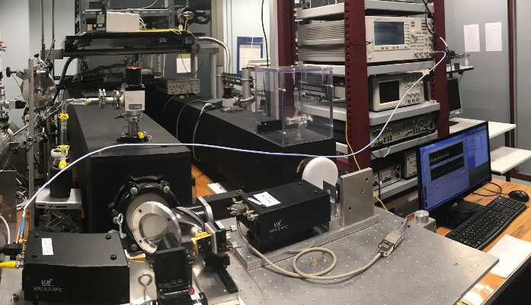
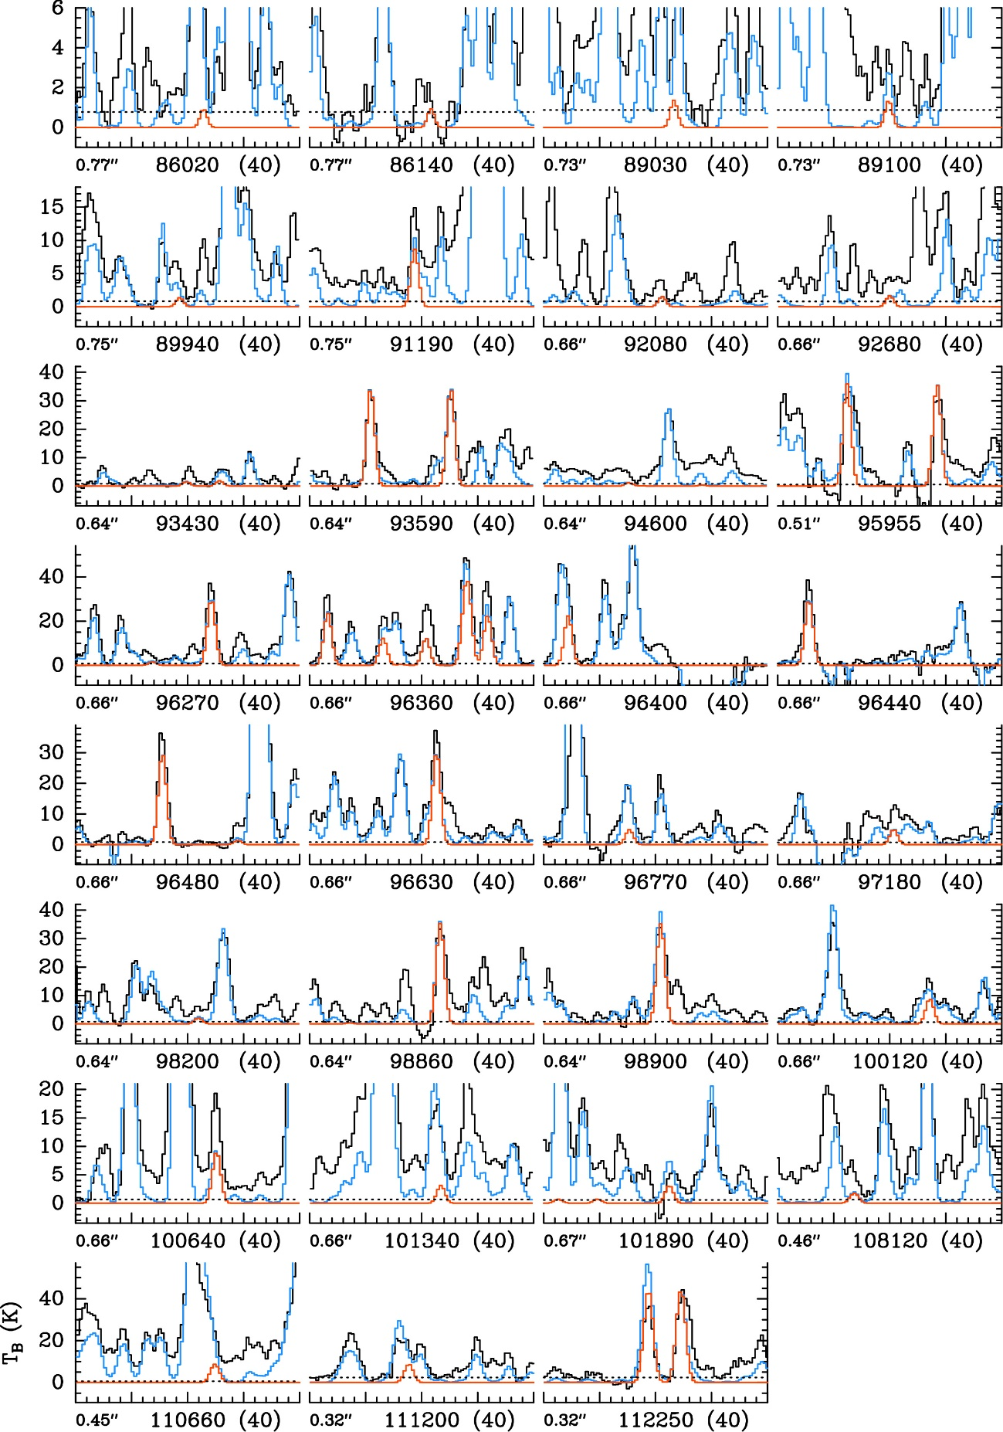
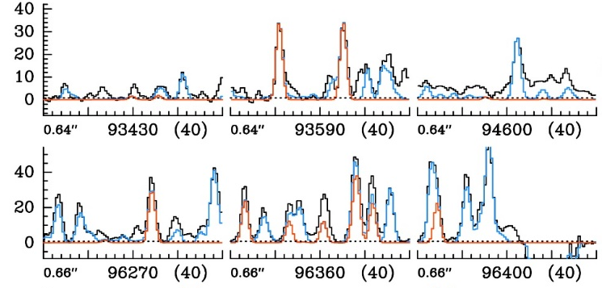
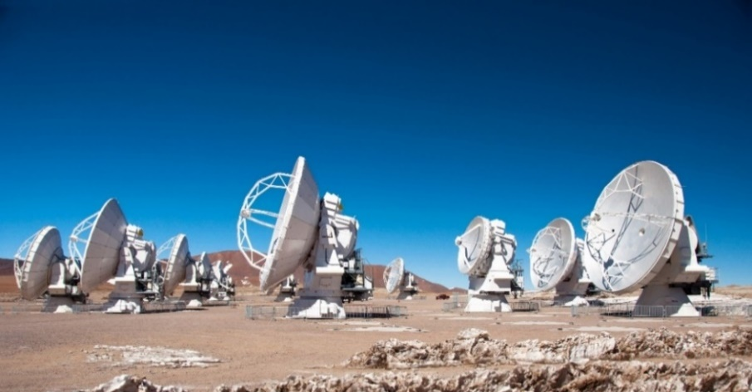
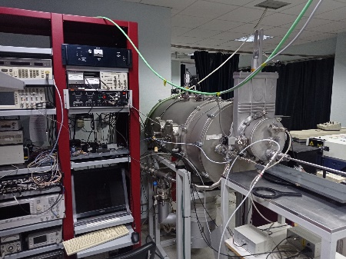

1. INTRODUCTION
2. METHODOLOGY
3. RESULTS AND DISCUSSION
4. CONCLUSIONS & PROSPECTS
1. INTRODUCTION
2. METHODOLOGY
3. RESULTS AND DISCUSSION
4. CONCLUSIONS & PROSPECTS
1.2. Synergy between radio astronomy and rotational spectroscopy
To answer this questions:
Symbiotic relationship between radio astronomy and laboratory experiments by means of rotational spectroscopy: need of accurate rotational data.
^{Sgr B2(N1S) (ALMA band 3)}
Acetaldehytde: LTE spectrum (lab data)
W. Garnier (ALMA)
Atacama Large Millimeter/Submillimeter Array - ALMA
McGuire, B. A. 2022, ApJS, 259, 30 (census)

Slide 7
1. INTRODUCTION
4. CONCLUSIONS & PROSPECTS
1. INTRODUCTION
2. METHODOLOGY
2. METHODOLOGY
3. RESULTS AND DISCUSSION
3. RESULTS AND DISCUSSION
4. CONCLUSIONS & PROSPECTS
1. INTRODUCTION
2. METHODOLOGY
3. RESULTS AND DISCUSSION
4. CONCLUSIONS & PROSPECTS
1.3. Systems under study and fundamental goals
Background: Significant experimental efforts have been made to study the so-called COMs.
Carboxylic acids (R-COOH) are some of the most widespread species in nature, being precursors of many biologically relevant molecules (i.e., amino acids).
The census of identified interstellar species has remained untouched for almost a quarter century
Need of new and dedicated observational effort
Zuckerman et al. 1971
Detection of formic acid (HCOOH; 50 yrs ago)
Mehringer et al. 1997
Acetic acid (CH₃COOH; 25 yrs ago)

Slide 8

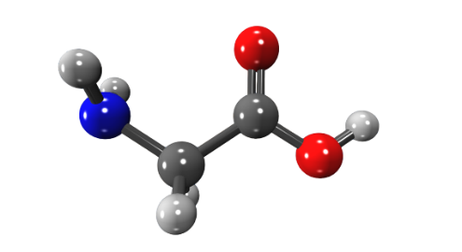
1. INTRODUCTION
4. CONCLUSIONS & PROSPECTS
1. INTRODUCTION
2. METHODOLOGY
2. METHODOLOGY
3. RESULTS AND DISCUSSION
3. RESULTS AND DISCUSSION
4. CONCLUSIONS & PROSPECTS
1. INTRODUCTION
2. METHODOLOGY
3. RESULTS AND DISCUSSION
4. CONCLUSIONS & PROSPECTS
1.3. Systems under study and fundamental goals
Final goal:
Holy Grail: precursors of life

Slide 9
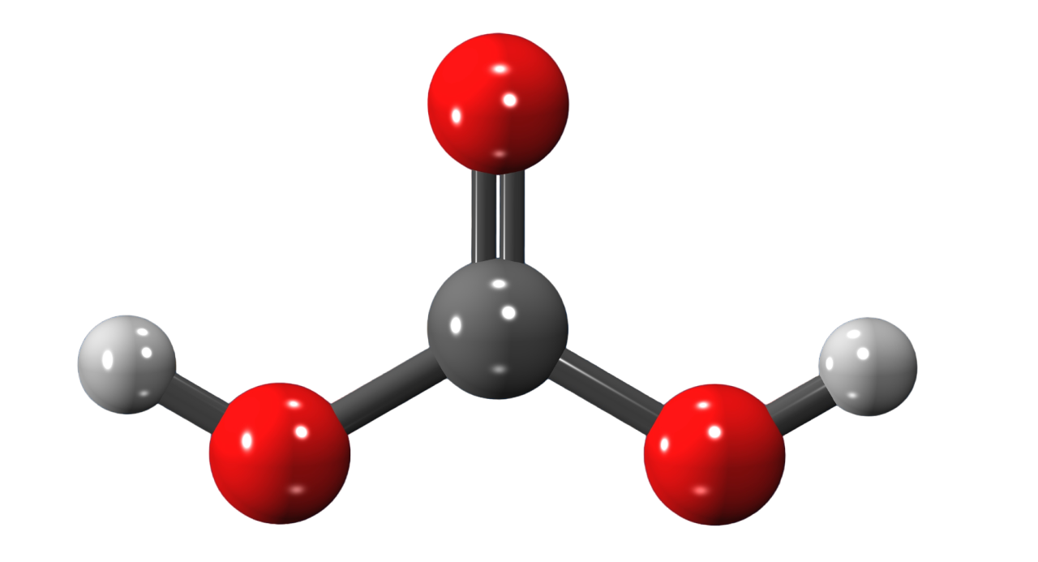
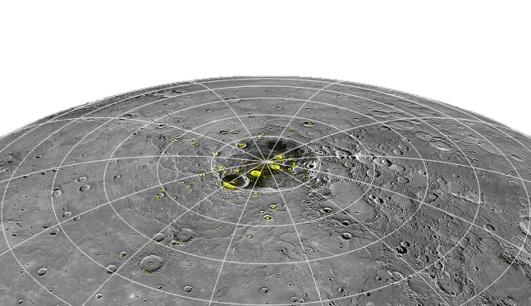
1. INTRODUCTION
4. CONCLUSIONS & PROSPECTS
1. INTRODUCTION
2. METHODOLOGY
2. METHODOLOGY
3. RESULTS AND DISCUSSION
3. RESULTS AND DISCUSSION
4. CONCLUSIONS & PROSPECTS
1. INTRODUCTION
2. METHODOLOGY
3. RESULTS AND DISCUSSION
4. CONCLUSIONS & PROSPECTS
1.4. Relevance of Carbonic acid.
Relevance of Carbonic acid (HOCOOH):
On earth:
Important role in various biological and geochemical processes
(Adamczyk et al. 2009; Loerting et al. 2000)
Implications in the global carbon cycle
(Jones et al. 2014; Wang et al. 2016)
Anthropogenic carbon and ocean pH
(Caldeira & Wickett 2003)
In space: Its presence has been suggested in different astronomical environments:
The Galilean icy moons
(Delitsky & Lane 1998; Jones et al. 2014; Bennett et al. 2014)
Mercury’s north polar region
(Delitsky et al. 2017)
The surface and/or atmosphere of Mars
(Strazzulla et al. 1996)
Icy mantles of dust grains (vast amounts of H₂O and CO₂)
(Moore et al. 2001; Zheng & Kaiser 2007; Oba et al. 2010; Ioppolo et al. 2021)
Cis-cis carbonic acid (HOCOOH)
Credit: NASA/Johns Hopkins University Applied Physics Laboratory

Slide 10
1. INTRODUCTION
4. CONCLUSIONS & PROSPECTS
1. INTRODUCTION
2. METHODOLOGY
2. METHODOLOGY
3. RESULTS AND DISCUSSION
3. RESULTS AND DISCUSSION
4. CONCLUSIONS & PROSPECTS
1. INTRODUCTION
2. METHODOLOGY
3. RESULTS AND DISCUSSION
4. CONCLUSIONS & PROSPECTS
1.4. Relevance of Carbonic acid.
Relevance of Carbonic acid (HOCOOH):
On earth:
Important role in various biological and geochemical processes
(Adamczyk et al. 2009; Loerting et al. 2000)
Implications in the global carbon cycle
(Jones et al. 2014; Wang et al. 2016)
Anthropogenic carbon and ocean pH
(Caldeira & Wickett 2003)
In space: Its presence has been suggested in different astronomical environments:
The Galilean icy moons
(Delitsky & Lane 1998; Jones et al. 2014; Bennett et al. 2014)
Mercury’s north polar region
(Delitsky et al. 2017)
The surface and/or atmosphere of Mars
(Strazzulla et al. 1996)
Icy mantles of dust grains (vast amounts of H₂O and CO₂)
(Moore et al. 2001; Zheng & Kaiser 2007; Oba et al. 2010; Ioppolo et al. 2021)
Despite being an auspicious interstellar candidate (-OH derivative of formic acid) HOCOOH still awaited detection in the ISM
Cis-cis carbonic acid (HOCOOH)
Credit: NASA/Johns Hopkins University Applied Physics Laboratory

Slide 11
1. INTRODUCTION
4. CONCLUSIONS & PROSPECTS
1. INTRODUCTION
2. METHODOLOGY
2. METHODOLOGY
3. RESULTS AND DISCUSSION
3. RESULTS AND DISCUSSION
4. CONCLUSIONS & PROSPECTS
1. INTRODUCTION
2. METHODOLOGY
3. RESULTS AND DISCUSSION
4. CONCLUSIONS & PROSPECTS
2.1. Rotational spectroscopy
2
30
300
500
1000
/ GHz
RF
FIR
MW
MMW
Sub-MMW
FIR
1 cm
1 mm
100 μm
FTMW techniques
(2 ─ 40 GHz)
Frequency modulation mmw and sub-mmw spectroscopy (50 ─ 1000 GHz)
First step: Rotational studies of COMs
Very robust technique for structural elucidation of molecules in the gas-phase that present a permanent dipole moment: accurate three-dimensional description.
Narrowband FTMW spectroscopy (pulsed discharge nozzle) + DR
Experimental work by Mori et al. JChPh, 139 (2009); JChPh, 134 (2011).

Slide 12



1. INTRODUCTION
4. CONCLUSIONS & PROSPECTS
1. INTRODUCTION
2. METHODOLOGY
2. METHODOLOGY
3. RESULTS AND DISCUSSION
3. RESULTS AND DISCUSSION
4. CONCLUSIONS & PROSPECTS
1. INTRODUCTION
2. METHODOLOGY
3. RESULTS AND DISCUSSION
4. CONCLUSIONS & PROSPECTS
2.1. Observational radioastronomy
Single dish astronomical observations:
Search toward the G+0.693-0.027 molecular cloud with IRAM 30m (3-mm) and Yebes 40m (7-mm) observations.
Observational Project lead by Víctor M. Rivilla (CAB, CSIC-INTA)
First identification in the ISM of a dozen of molecules:
ethanolamine (Rivilla, V. M. et al., 2021)
1,2-ethenediol (Rivilla, V. M. et al., 2022)
hydroxylamine (Rivilla, V. M., et al., 2020)
Sgr B2
Credit: SARAO

Slide 13
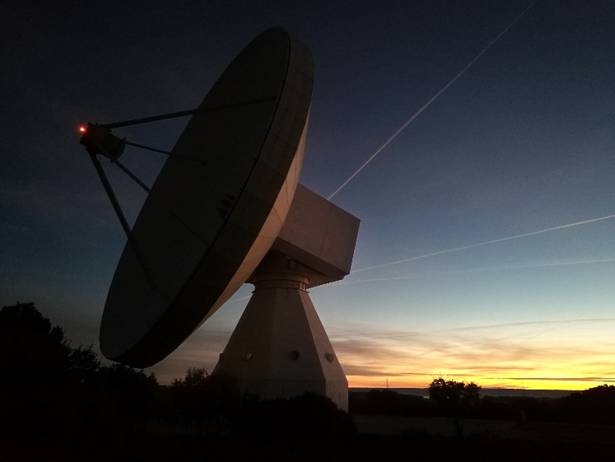
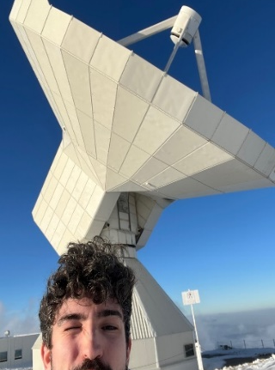

1. INTRODUCTION
4. CONCLUSIONS & PROSPECTS
1. INTRODUCTION
2. METHODOLOGY
2. METHODOLOGY
3. RESULTS AND DISCUSSION
3. RESULTS AND DISCUSSION
4. CONCLUSIONS & PROSPECTS
1. INTRODUCTION
2. METHODOLOGY
3. RESULTS AND DISCUSSION
4. CONCLUSIONS & PROSPECTS
2.1. Observational radioastronomy
NEW OBSERVING RUNS: Ultra-deep spectral survey of G+0.693
Yebes-40m sub-mK survey (new observations, March 2021 and March 2022):
Final noise levels between 0.25 − 0.9 mK across the whole Q-band
IRAM-30m (new observations, February 1−18 2023):
Final noise levels between 0.5 − 2.5 mK at 3 mm, and 1.0−1.6 mK at 2 mm.
NEW THRILLING SCIENCE!!!
Sanz-Novo, M. Rivilla, V. M., et al., ApJ, 954 3, 2023
Rivilla, V. M., Sanz-Novo, M. et al., ApJL, 953, L20, 2023
YEBES 40m (Guadalajara)
LINK TO THE PAPER
IRAM 30m (Granada)

Slide 14
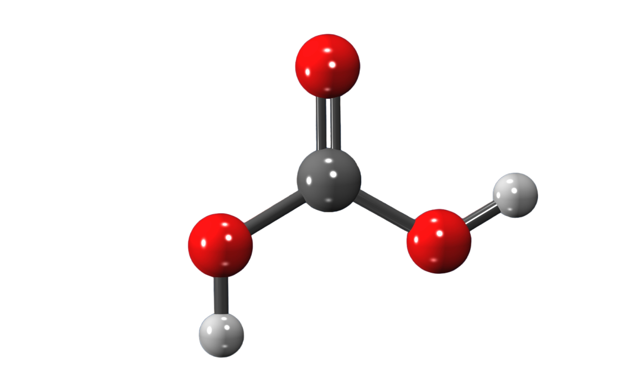
1. INTRODUCTION
4. CONCLUSIONS & PROSPECTS
1. INTRODUCTION
1. INTRODUCTION
2. METHODOLOGY
2. METHODOLOGY
2. METHODOLOGY
3. RESULTS AND DISCUSSION
3. RESULTS AND DISCUSSION
3. RESULTS AND DISCUSSION
4. CONCLUSIONS & PROSPECTS
4. CONCLUSIONS & PROSPECTS
1. INTRODUCTION
2. METHODOLOGY
3. RESULTS AND DISCUSSION
4. CONCLUSIONS & PROSPECTS
2.2 Computational methods
3.1. Rotational spectroscopy: generation of line catalogues and initial search
Scarce rotational spectroscopic data
Very unstable molecule (rapidly decomposes into CO₂ and H₂O under the presence of water).
Laboratory detection and conformational identification
Cavity-based FTMW (and DR) rotational study (Mori et al. 2009, 2011)
Our work approach
Two conformers well-characterized in the lab (up to 41 and 65 GHz, respectively).
The lower-energy conformer, cis-cis HOCOOH: extremely low dipole moment (fifteen times lower), which will hamper its detection.
Cis-cis Cis-trans
Preparation of line catalogues and implementation in MADCUBA
First inspection of the Q-band data (31-50 GHz) Detection of several lines
Exploration of the 3mm data Systematic frequency shifts at high frequencies.
New global fit including the newly measured astronomical lines

Slide 15
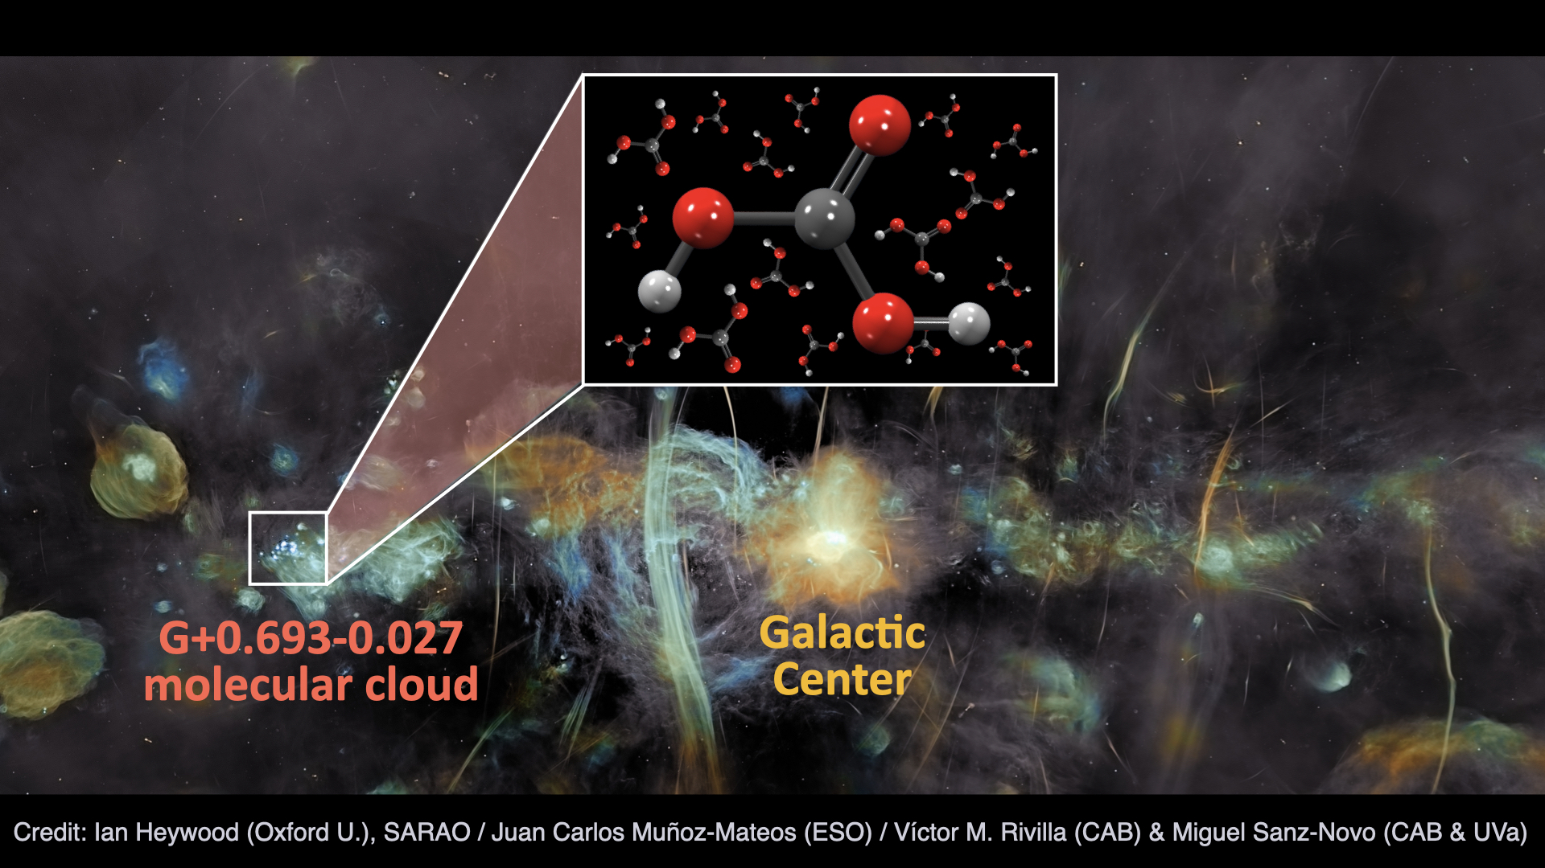
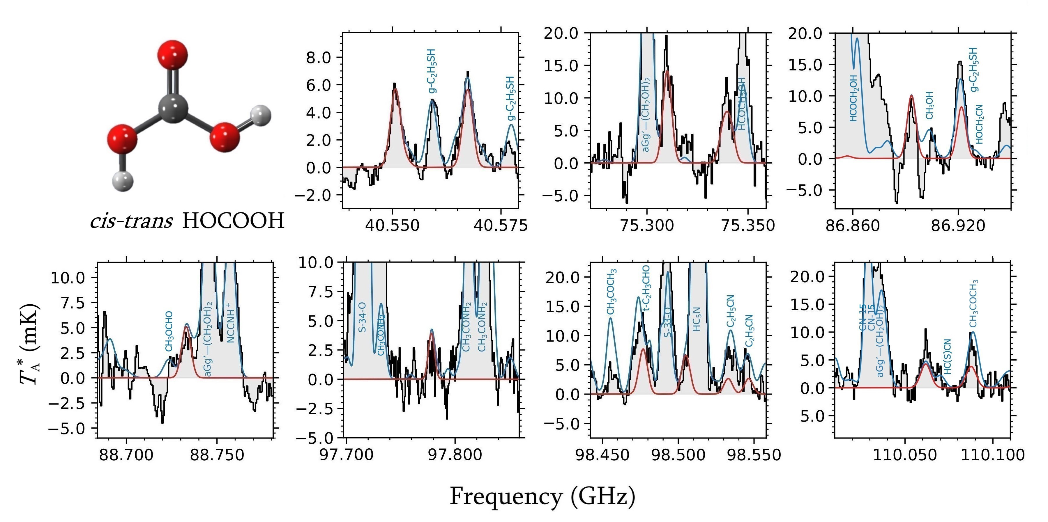
1. INTRODUCTION
4. CONCLUSIONS & PROSPECTS
1. INTRODUCTION
1. INTRODUCTION
2. METHODOLOGY
2. METHODOLOGY
2. METHODOLOGY
3. RESULTS AND DISCUSSION
3. RESULTS AND DISCUSSION
3. RESULTS AND DISCUSSION
4. CONCLUSIONS & PROSPECTS
4. CONCLUSIONS & PROSPECTS
1. INTRODUCTION
2. METHODOLOGY
3. RESULTS AND DISCUSSION
4. CONCLUSIONS & PROSPECTS
2.2 Computational methods
3.1. Rotational spectroscopy: generation of line catalogues and initial search
Initial search: cis-trans conformer of HOCOOH
al. 2009, 2011)
Our work approach
Preparation of line catalogues and implementation in MADCUBA
First inspection of the Q-band data (31-50 GHz) Detection of several lines
Exploration of the 3mm data (<120 GHz) Systematic frequency shifts.
New global fit including the newly measured astronomical lines

Slide 16
1. INTRODUCTION
4. CONCLUSIONS & PROSPECTS
1. INTRODUCTION
1. INTRODUCTION
2. METHODOLOGY
2. METHODOLOGY
2. METHODOLOGY
3. RESULTS AND DISCUSSION
3. RESULTS AND DISCUSSION
3. RESULTS AND DISCUSSION
4. CONCLUSIONS & PROSPECTS
4. CONCLUSIONS & PROSPECTS
1. INTRODUCTION
2. METHODOLOGY
3. RESULTS AND DISCUSSION
4. CONCLUSIONS & PROSPECTS
3.2. Astronomical search for HOCOOH
Search for cis-trans HOCOOH toward the G+0.693 molecular cloud
FIRST INTERSTELLAR MOLECULE WITH 3 OXYGEN ATOMS
Credit: Jay Young
Column density:
N = (6.4 ± 0.4)×10¹² cm⁻²
T_{ex} = 7.2 ± 0.6 K
LTE spectra overlayed with the observations
We detected several clear and unblended spectroscopic features with S/N ratio > 6 , highlighting four pairs of lines of cis-trans HOCOOH corresponding to different K_{a} = 0,1 and 2 progressions.

Slide 17
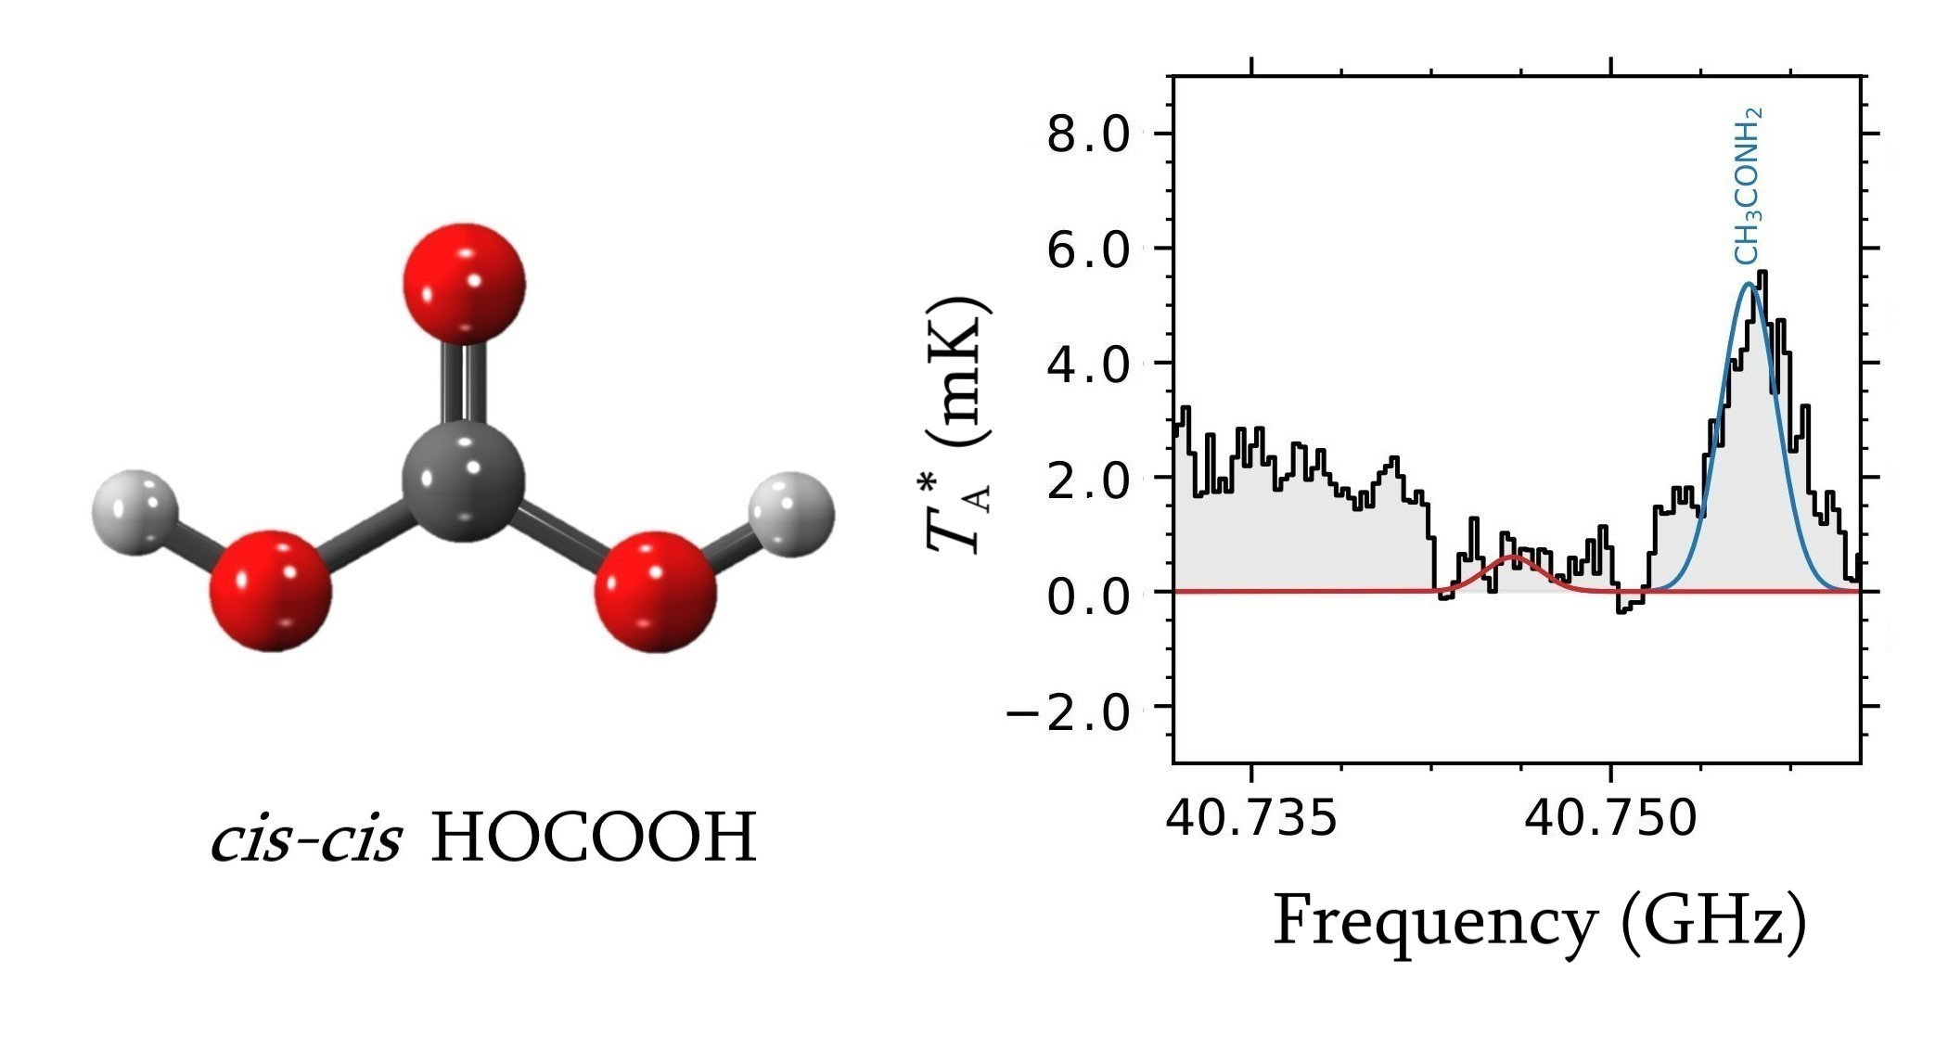
1. INTRODUCTION
4. CONCLUSIONS & PROSPECTS
1. INTRODUCTION
1. INTRODUCTION
2. METHODOLOGY
2. METHODOLOGY
2. METHODOLOGY
3. RESULTS AND DISCUSSION
3. RESULTS AND DISCUSSION
3. RESULTS AND DISCUSSION
4. CONCLUSIONS & PROSPECTS
4. CONCLUSIONS & PROSPECTS
1. INTRODUCTION
2. METHODOLOGY
3. RESULTS AND DISCUSSION
4. CONCLUSIONS & PROSPECTS
3.2. Astronomical search for HOCOOH
Search for cis-cis HOCOOH toward the G+0.693 molecular cloud
Nondetecton of the low-lying cis-cis conformer:
Upper limit of cis-trans HOCOOH:
N ≤ 1.6 × 10¹⁴ cm⁻²
Molecular abundance compared to H₂ of ≤ 1.2 x 10⁻⁹
Constrains on the abundance of cis-cis HOCOOH in the ISM
Its abundance is expected to be of the same order as that of trans-HCOOH.
Carbonic acid possibly emerges as an abundant O-bearing COM in the ISM although it went unnoticed so far.

Slide 18
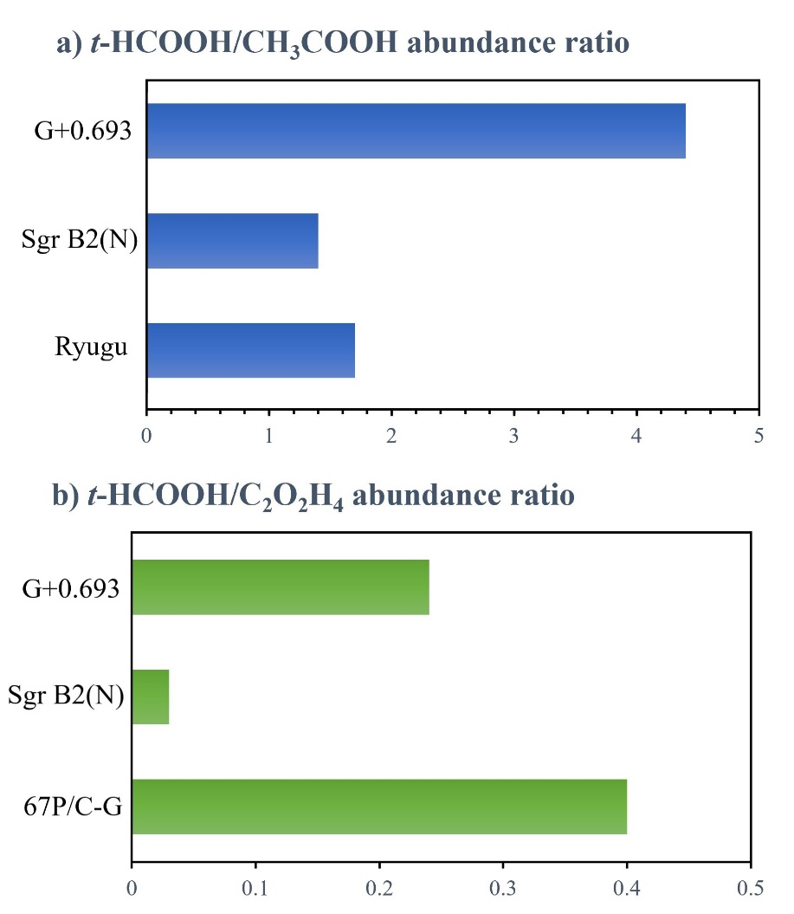
1. INTRODUCTION
4. CONCLUSIONS & PROSPECTS
1. INTRODUCTION
1. INTRODUCTION
2. METHODOLOGY
2. METHODOLOGY
2. METHODOLOGY
3. RESULTS AND DISCUSSION
3. RESULTS AND DISCUSSION
3. RESULTS AND DISCUSSION
4. CONCLUSIONS & PROSPECTS
4. CONCLUSIONS & PROSPECTS
1. INTRODUCTION
2. METHODOLOGY
3. RESULTS AND DISCUSSION
4. CONCLUSIONS & PROSPECTS
3.3. Discussion
Abundance of carboxylic acids in different astronomical environments:
Molecular cloud: G+0.693
(This work)
Star forming-regions: Sgr B2(N)
(Belloche et al. 2013)
Asteroids: Ryugu material
(Naraoka et al. 2023)
Comets: 67P/Churyumov-Gerasimenko
(Altwegg et al. 2016; Drozdovskaya 2019)
Relationship between their relative molecular abundances in the ISM and that found in minor bodies of the Solar System
Carboxylic acids seem to survive the star-formation process.
Chemical inheritance of inteterstellar carboxylic acids

Slide 19
1. INTRODUCTION
4. CONCLUSIONS & PROSPECTS
1. INTRODUCTION
1. INTRODUCTION
2. METHODOLOGY
2. METHODOLOGY
2. METHODOLOGY
3. RESULTS AND DISCUSSION
3. RESULTS AND DISCUSSION
3. RESULTS AND DISCUSSION
4. CONCLUSIONS & PROSPECTS
4. CONCLUSIONS & PROSPECTS
1. INTRODUCTION
2. METHODOLOGY
3. RESULTS AND DISCUSSION
4. CONCLUSIONS & PROSPECTS
3.3. Discussion
Formation pathways of HOCOOH: Plethora of experimental and theoretical studies
Surface of dust grains: OH radical addition to HOCO, which can be formed:
Through the reaction of CO and the radical species OH
(Lester et al. 2001; Noble et al. 2011; Nguyen et al. 2012; Ruaud et al. 2015; Tachikawa & Kawabata 2016; Ioppolo et al. 2021).
CO + OH → trans-HOCO (1)
CO + OH → cis-HOCO (2)
trans-HOCO + OH → HOCOOH (3)
cis-HOCO + OH → HOCOOH (4)
Through energetic processing of H2O/CO2 icy mixtures
(Zheng & Kaiser 2007)
H2O + e⁻ → H + OH + e ⁻ (5)
H + CO2 → cis-HOCO (6)

Slide 20
1. INTRODUCTION
4. CONCLUSIONS & PROSPECTS
1. INTRODUCTION
1. INTRODUCTION
2. METHODOLOGY
2. METHODOLOGY
2. METHODOLOGY
3. RESULTS AND DISCUSSION
3. RESULTS AND DISCUSSION
3. RESULTS AND DISCUSSION
4. CONCLUSIONS & PROSPECTS
4. CONCLUSIONS & PROSPECTS
1. INTRODUCTION
2. METHODOLOGY
3. RESULTS AND DISCUSSION
4. CONCLUSIONS & PROSPECTS
4. Conclusión & Prospects
TAKE-HOME MESSAGES:
Discovery of HOCOOH, the third insterstellar carboxylic acid and the first interstellar molecule with more than two oxygen atoms detected so far.
Relevant insight into the actual degree of chemical complexity of the ISM, significant implications to unravel the role of HOCOOH within interstellar C- and O- chemistry.
Overall good correlation between the relative molecular abundance of carboxylic acids in different astronomical environments.
We open the door to achieve indirect interstellar identifications of conformers that remained undetectable to radioastronomy.

Slide 21
1. INTRODUCTION
4. CONCLUSIONS & PROSPECTS
1. INTRODUCTION
1. INTRODUCTION
2. METHODOLOGY
2. METHODOLOGY
2. METHODOLOGY
3. RESULTS AND DISCUSSION
3. RESULTS AND DISCUSSION
3. RESULTS AND DISCUSSION
4. CONCLUSIONS & PROSPECTS
4. CONCLUSIONS & PROSPECTS
1. INTRODUCTION
2. METHODOLOGY
3. RESULTS AND DISCUSSION
4. CONCLUSIONS & PROSPECTS
4. Conclusión & Prospects
TAKE-HOME MESSAGES:
Discovery of HOCOOH, the third insterstellar carboxylic acid and the first interstellar molecule with more than two oxygen atoms detected so far.
Relevant insight into the actual degree of chemical complexity of the ISM, significant implications to unravel the role of HOCOOH within interstellar C- and O- chemistry.
Overall good correlation between the relative molecular abundance of carboxylic acids in different astronomical environments.
We open the door to achieve indirect interstellar identifications of conformers that remained undetectable to radioastronomy.

Slide 22
1. INTRODUCTION
4. CONCLUSIONS & PROSPECTS
1. INTRODUCTION
1. INTRODUCTION
2. METHODOLOGY
2. METHODOLOGY
2. METHODOLOGY
3. RESULTS AND DISCUSSION
3. RESULTS AND DISCUSSION
3. RESULTS AND DISCUSSION
4. CONCLUSIONS & PROSPECTS
4. CONCLUSIONS & PROSPECTS
1. INTRODUCTION
2. METHODOLOGY
3. RESULTS AND DISCUSSION
4. CONCLUSIONS & PROSPECTS
4. Conclusión & Prospects
TAKE-HOME MESSAGES:
Discovery of HOCOOH, the third insterstellar carboxylic acid and the first interstellar molecule with more than two oxygen atoms detected so far.
Relevant insight into the actual degree of chemical complexity of the ISM, significant implications to unravel the role of HOCOOH within interstellar C- and O- chemistry.
Overall good correlation between the relative molecular abundance of carboxylic acids in different astronomical environments.
We open the door to achieve indirect interstellar identifications of conformers that remained undetectable to radioastronomy.

Slide 23
1. INTRODUCTION
4. CONCLUSIONS & PROSPECTS
1. INTRODUCTION
1. INTRODUCTION
2. METHODOLOGY
2. METHODOLOGY
2. METHODOLOGY
3. RESULTS AND DISCUSSION
3. RESULTS AND DISCUSSION
3. RESULTS AND DISCUSSION
4. CONCLUSIONS & PROSPECTS
4. CONCLUSIONS & PROSPECTS
1. INTRODUCTION
2. METHODOLOGY
3. RESULTS AND DISCUSSION
4. CONCLUSIONS & PROSPECTS
4. Conclusión & Prospects
TAKE-HOME MESSAGES:
Discovery of HOCOOH, the third insterstellar carboxylic acid and the first interstellar molecule with more than two oxygen atoms detected so far.
Relevant insight into the actual degree of chemical complexity of the ISM, significant implications to unravel the role of HOCOOH within interstellar C- and O- chemistry.
Overall good correlation between the relative molecular abundance of carboxylic acids in different astronomical environments.
We open the door to achieve indirect interstellar identifications of conformers that remained undetectable to radioastronomy.

Slide 24
IBER, Coimbra, September 2023
“INTERSTELLAR DETECTION OF CARBONIC ACID (HOCOOH) AT LAST”
Acknowledgments
We are grateful to the IRAM 30 m and Yebes 40 m telescope staff for their help during the different observing runs.
M.S.N. is thankful for funding from the European Union—NextGenerationEU, Ministerio de Universidades and the University of Valladolid under a postdoctoral Margarita Salas Grant, and funding from the Spanish Ministry of Science and Innovation (PID2020- 117742GB-I00) and the GEFAM group.
The authors thank MCIN/AEI (PID2020- 117742GB-I00, RYC2020- 029387-I, PID2019-105552RB-C41, PID2019-107115GB-C21, PID2019- 106235GB-I00, PID2022-136814NB-I00) for financial support.
Image Credit: SARAO

Slide 25
IBER, Coimbra, September 2023
THANK YOU FOR YOUR ATTENTION!
LINK TO THE PAPER
Image Credit: SARAO

Slide 26
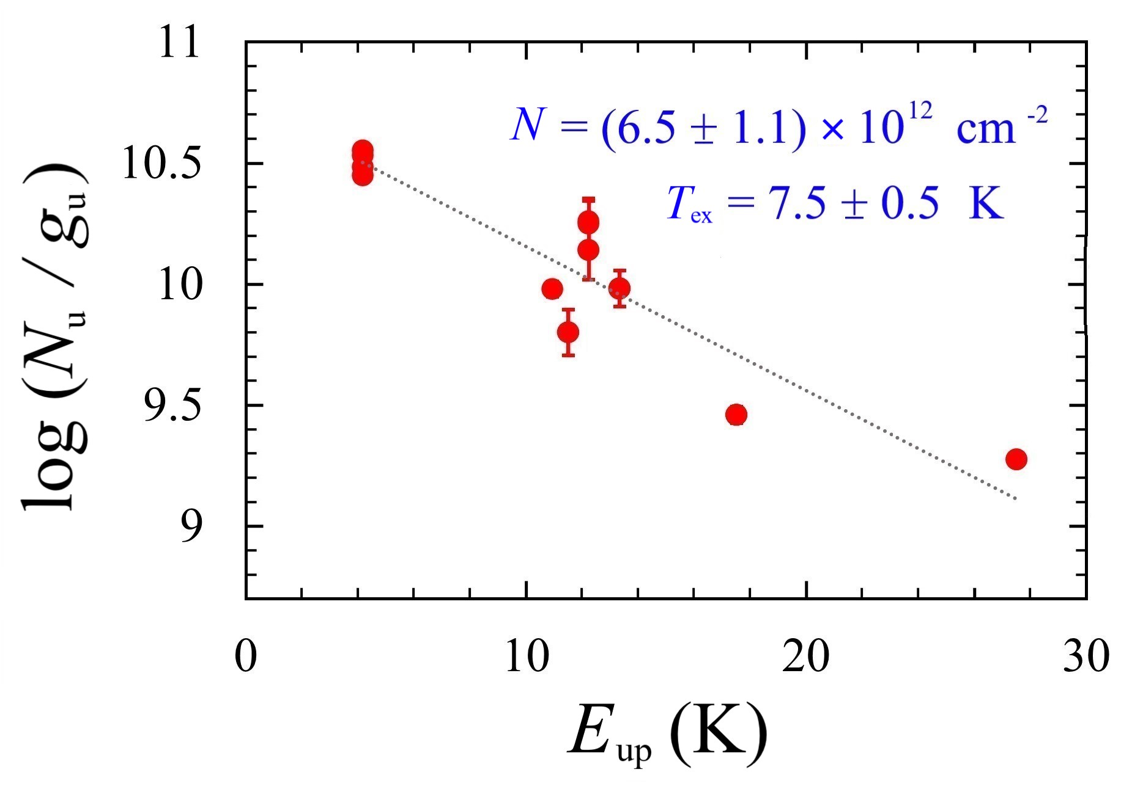
1. INTRODUCTION
4. CONCLUSIONS & PROSPECTS
1. INTRODUCTION
1. INTRODUCTION
2. METHODOLOGY
2. METHODOLOGY
2. METHODOLOGY
3. RESULTS AND DISCUSSION
3. RESULTS AND DISCUSSION
3. RESULTS AND DISCUSSION
4. CONCLUSIONS & PROSPECTS
4. CONCLUSIONS & PROSPECTS
1. INTRODUCTION
2. METHODOLOGY
3. RESULTS AND DISCUSSION
4. CONCLUSIONS & PROSPECTS
3.2. Astronomical search for HOCOOH
Search for cis-trans HOCOOH toward the G+0.693 molecular cloud
Autofit results of cis-trans HOCOOH:
N = (6.4 ± 0.4) ×10¹² cm⁻²
T_{ex} = 7.2 ± 0.6 K
Molecular abundance compared to H₂ of ∼ 4.7 x 10⁻¹¹
Consistent with the rotational diagram analysis
Rotational diagram of cis-trans HOCOOH
cis-trans HOCOOH is ∼31 and 7 times less abundant than trans HCOOH and CH₃COOH, respectively, toward G+0.693, but it is also ∼4 times more abundant than cis HCOOH.

Slide 27
1. INTRODUCTION
4. CONCLUSIONS & PROSPECTS
1. INTRODUCTION
1. INTRODUCTION
2. METHODOLOGY
2. METHODOLOGY
2. METHODOLOGY
3. RESULTS AND DISCUSSION
3. RESULTS AND DISCUSSION
3. RESULTS AND DISCUSSION
4. CONCLUSIONS & PROSPECTS
4. CONCLUSIONS & PROSPECTS
1. INTRODUCTION
2. METHODOLOGY
3. RESULTS AND DISCUSSION
4. CONCLUSIONS & PROSPECTS
3.3. Discussion
HOCOOH can also exhibit trans/cis rotational or conformational isomerism:
(Pettersson et al. 2002; Macôas et al. 2005; Tsuge & Khriachtchev 2015; García de la Concepción et al. 2022)
We obtain a cis-cis/cis-trans HOCOOH abundance ratio of ≤25, rationalized in terms of the different relative electronic energies:
Molecule | ΔE / kcal mol⁻¹ | Abundance ratio | Rerefence
HC(O)SH | 0.68 | ∼3.7 | (García de la Concepción et al. 2022)
HOCOOH | 1.71 | ≤25 | (Mori et al. 2009)
HCOOH | 4.04 | ∼ 117 | (García de la Concepción et al. 2022)
These isomerization processes are feasible under ISM conditions due to multi-dimensional ground-state quantum tunnelling effects.
(García de la Concepción et al. 2022)

