Slide 1


Atomic Calculations and Data Using the MultiConfiguration Dirac-Fock General Matrix Elements (MCDFGME) code
Daniel Pinheiro¹, Gonçalo Baptista¹, Jorge Machado¹, Mauro Guerra¹
¹Laboratory of Instrumentation, Biomedical Engineering and Radiation Physics (LIBPhys-UNL), Department of Physics, NOVA School of Science and Technology, NOVA University Lisbon, 2829-516 Caparica, Portugal.

Slide 2
Overview
Quick overview of the MCDF method
Code package available options
Calculation methods details and possible problems
How do we run a complete bound system calculation
Examples of recent atomic data
Conclusions

Slide 3
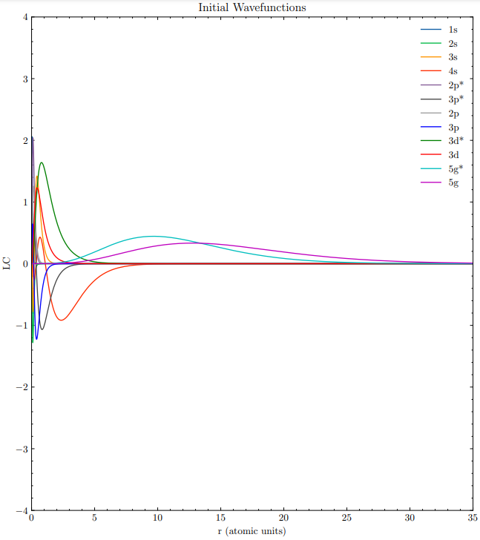
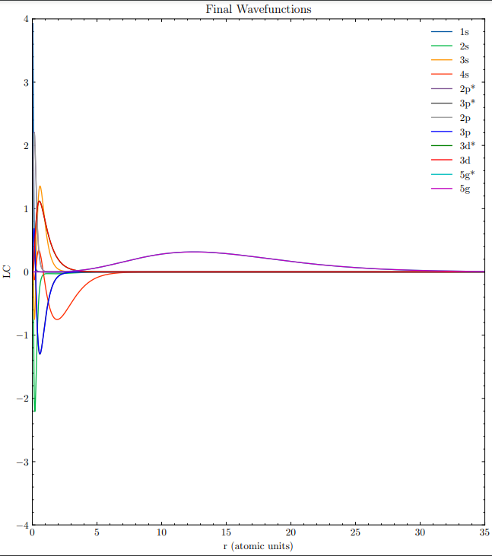
MCDF Method (step 1)
1-electron interactions
SCF
2-electron interactions
(QED)

Slide 4
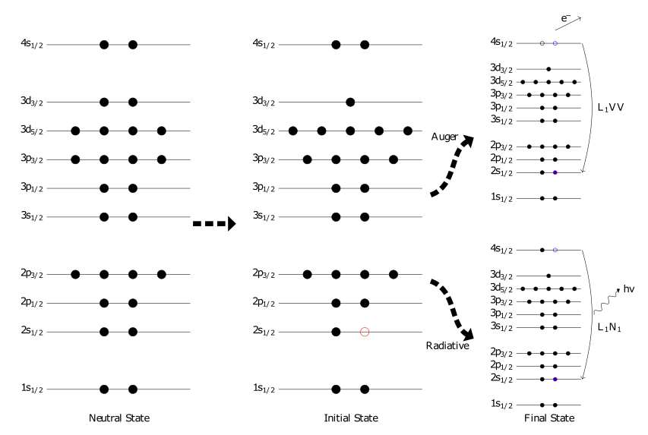
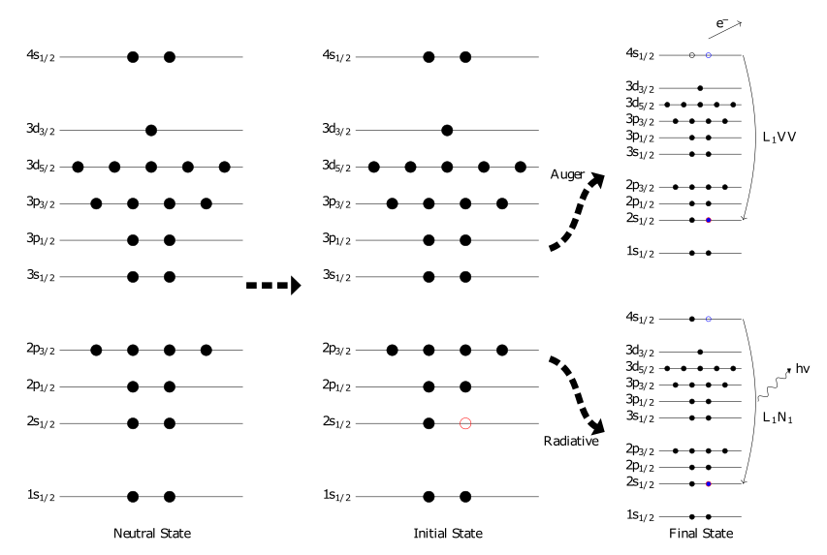
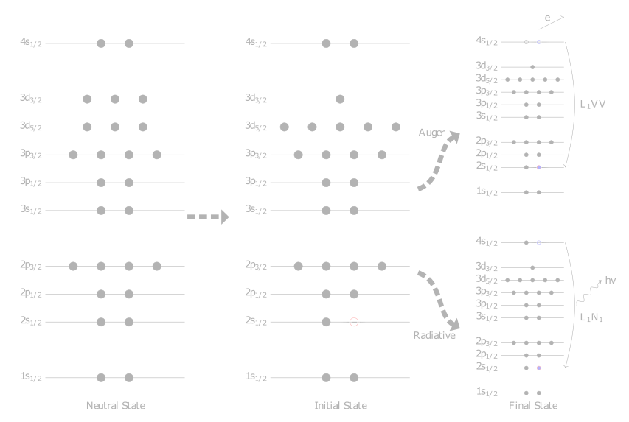
MCDF Method (step 2)
SC Diagonalization of the Hamiltonian

Slide 5
Available Calculation Options
total energy of a given state either at the single configuration or multiconfiguration level
radiative transition probabilities*
Auger transition probabilities
photoionization cross sections*
hyperfine structure constants
Landé factor
Born electron impact excitation cross section
Stark effect
parity non-conserving amplitude
magnetic part of the g−2 correction for antiprotons
scalar product of wave functions
Shiff moment
Overlaps of orbitals between a n-electron and a n-1-electron state for shake calculations
* With the option to use non orthonormalized orbitals between the two states
Besides electrons, option is given to add a single "exotic" particle (muon, antiproton, pion, kaon or sigma)

Slide 6
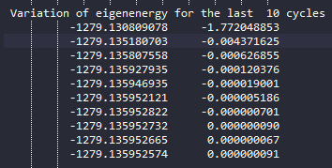
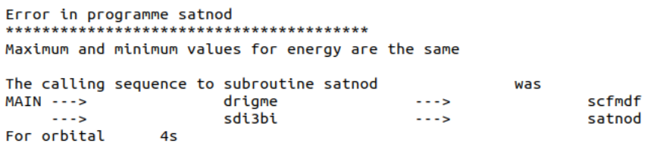
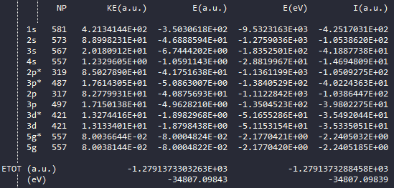

Calculation method details and possible problems
Failed 4s orbital calculation

Slide 7
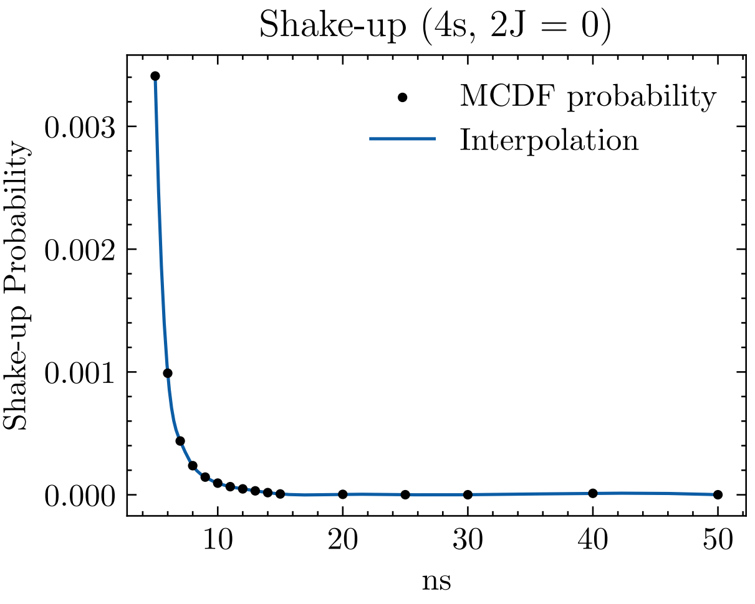
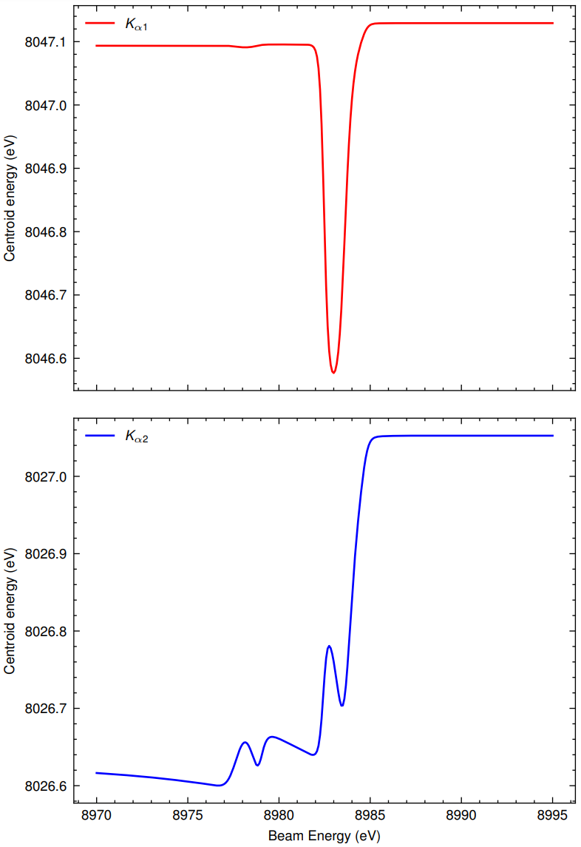
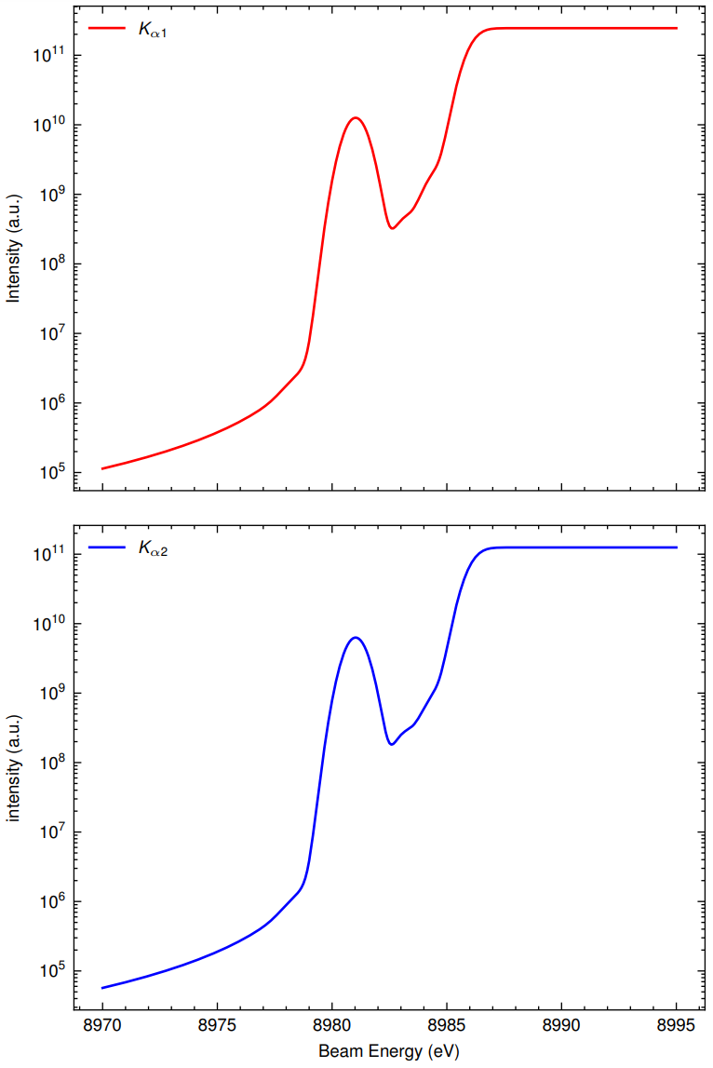
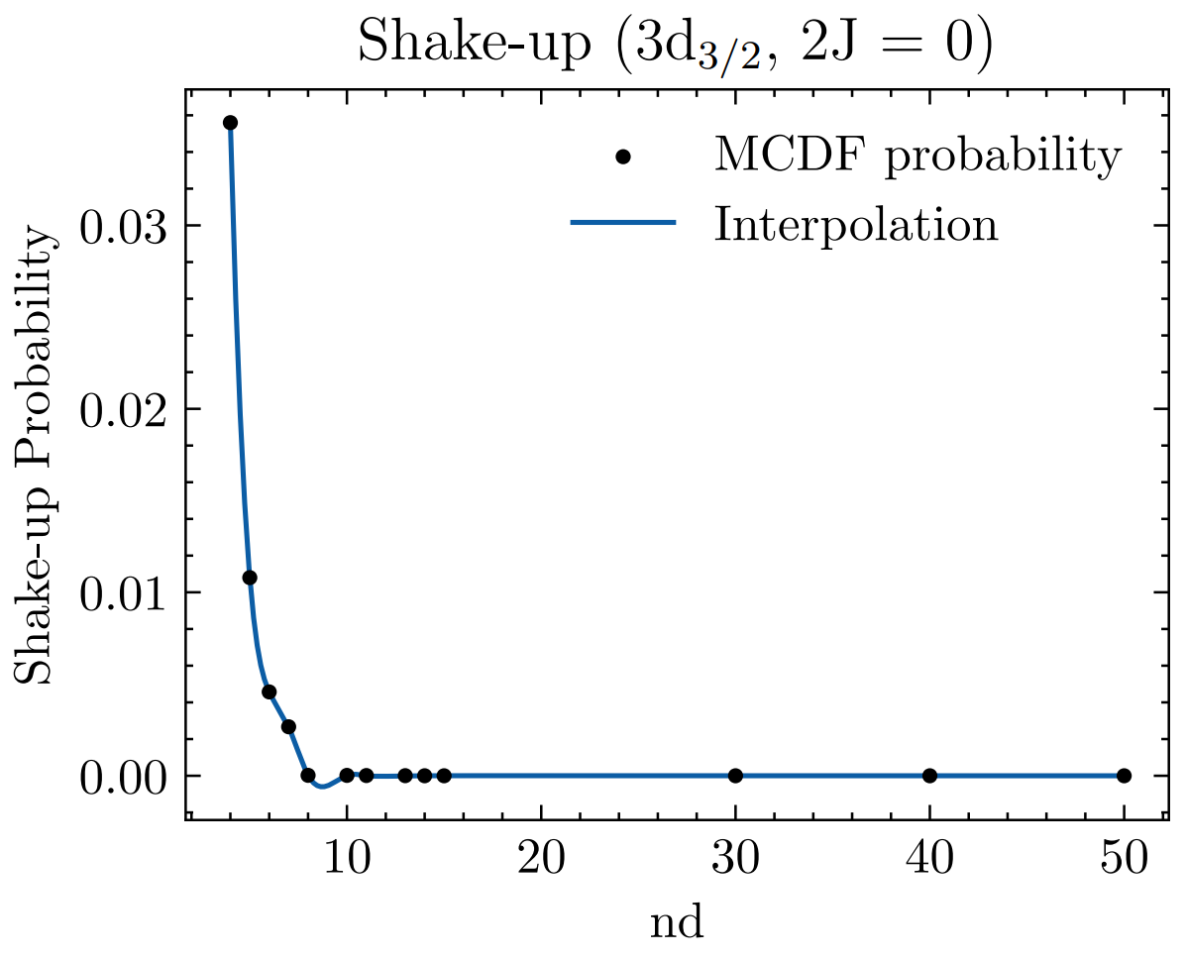
Calculation method details and possible problems

Slide 8
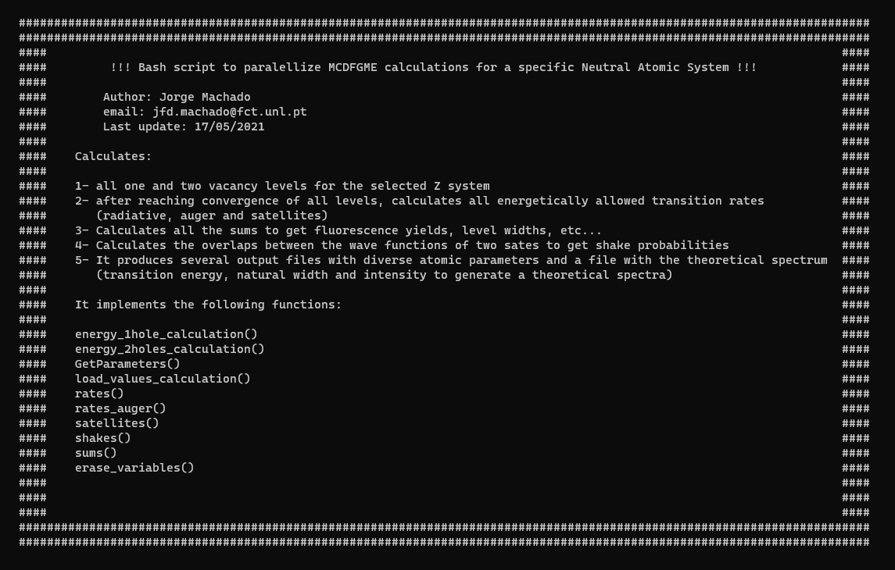
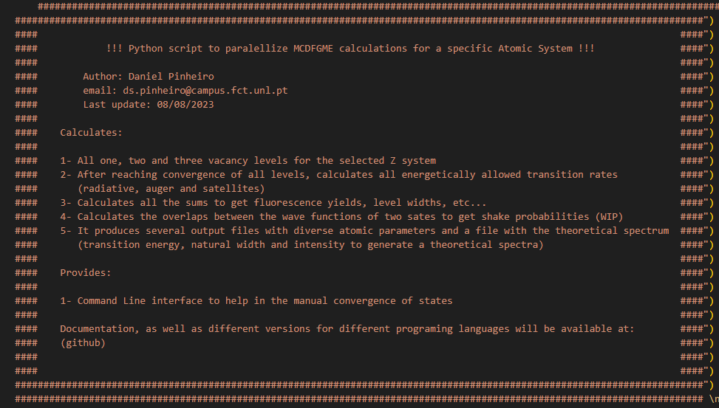
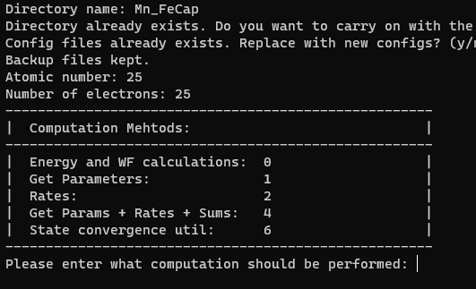
How do we run a complete bound system calculation
Bash script, GNU parallel.
Python script, GNU parallel.
3-hole transitions
Python script, MPI.
All these scripts execute about 6-12 calculations per second, mostly bound by the core count of our current cluster.

Slide 9
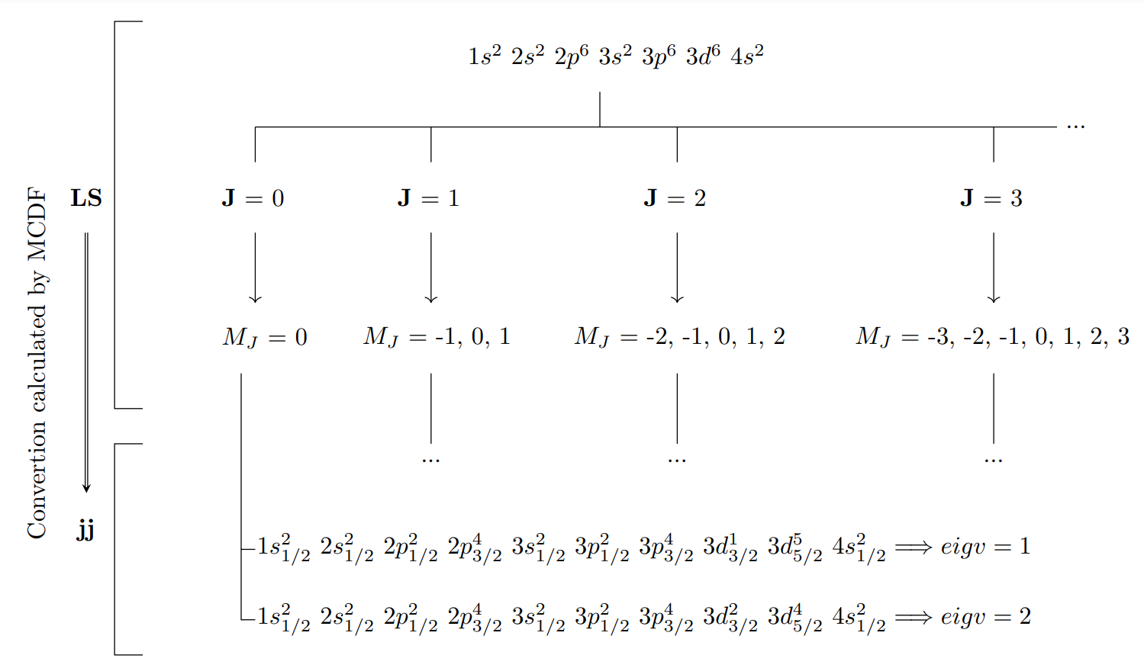
Fe transitions
Charge State | Radiative | Auger |  |  | Charge State | Radiative | Auger
+0 | 210276 | 951621 |  |  | +12 | 1081 | 1769
+1 | 726614 | 2759303 |  |  | +13 | 253 | 330
+2 | 171404 | 628699 |  |  | +14 | 10 | 20
+3 | 233586 | 755189 |  |  | +15 | 36 | 38
+4 | 161028 | 493451 |  |  | +16 | 6 | 10
+5 | 58653 | 168105 |  |  | +17 | 78 | 60
+6 | 9730 | 28583 |  |  | +18 | 210 | 160
+7 | 666 | 1780 |  |  | +19 | 300 | 150
+8 | 21 | 70 |  |  | +20 | 153 | 80
+9 | 351 | 650 |  |  | +21 | 36 | 12
+10 | 1224 | 2292 |  |  | +22 | 1 | 1
+11 | 1953 | 2963
Total |  |  | 6821008
Fe | 1-hole (LS) | 2-hole (LS)
Z=26 | 7 | 28
5 secs/transition
~394 days

Slide 10
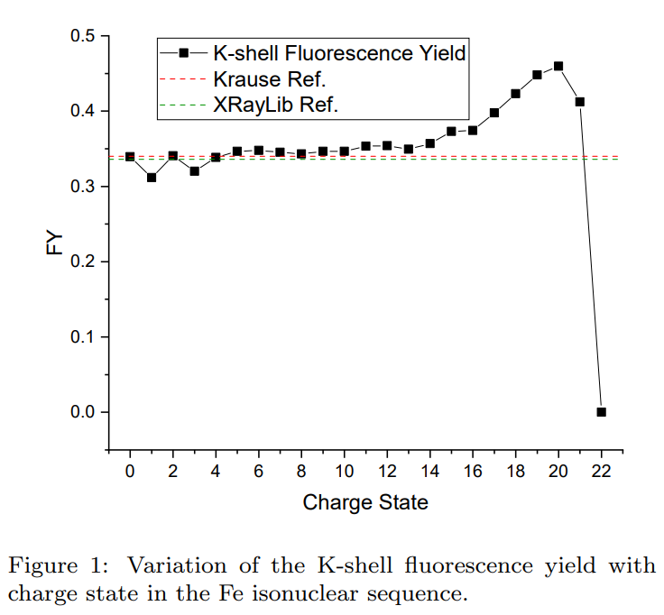
FY Evolution
Increase due to a higher number of available radiative channels, compared to radiationless channels.

Slide 11
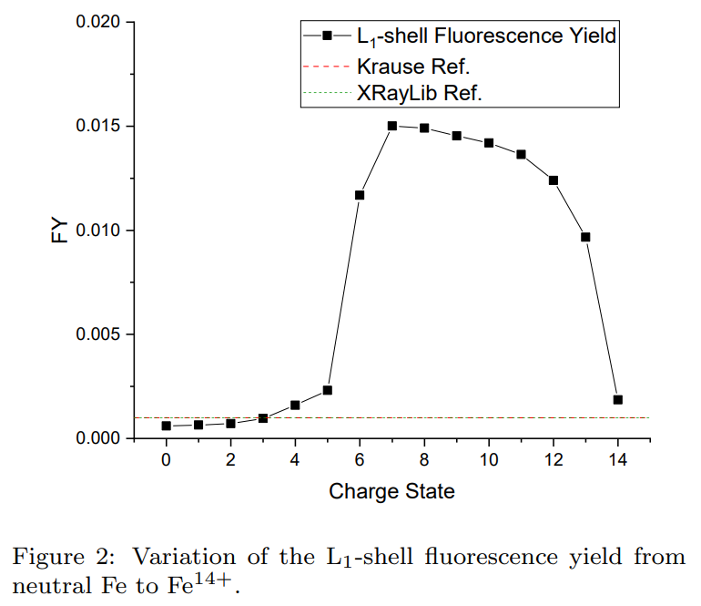
FY Evolution
Increase due to a higher partial widths of transitions, particularly for the L₁-M_{4,5}M_{4,5} Auger transition, which are 0.34eV and 0.05eV for Fe⁺⁵ and Fe⁺⁶, respectively.
Decrease due to the reduction of available radiative channels, particularly 2s → 3p transitions.

Slide 12
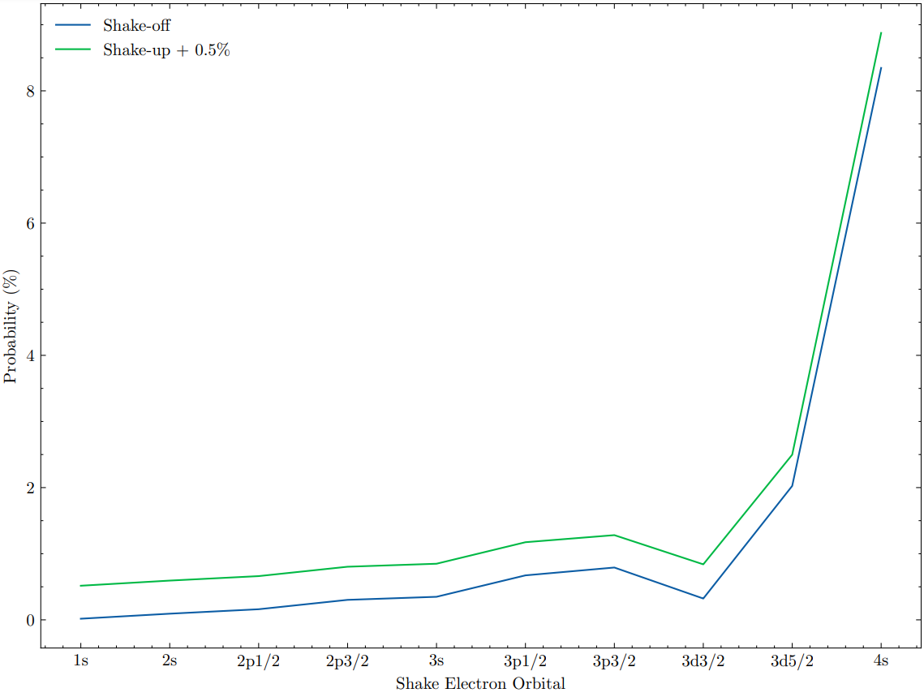
K-shell shake-off and shake-up probabilities for Cu
K-shell Cu Shake:
Shake-off = 13.080%
Shake-up = 13.091%
Total Shake = 26.171%

Slide 13
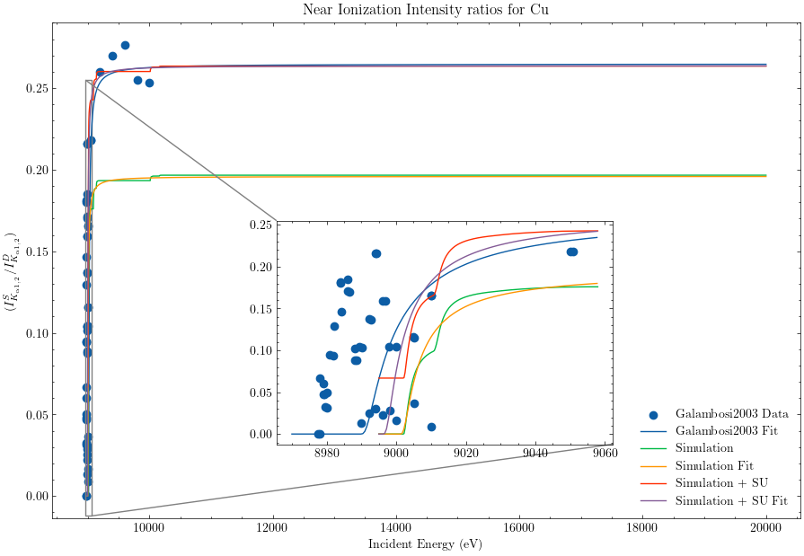
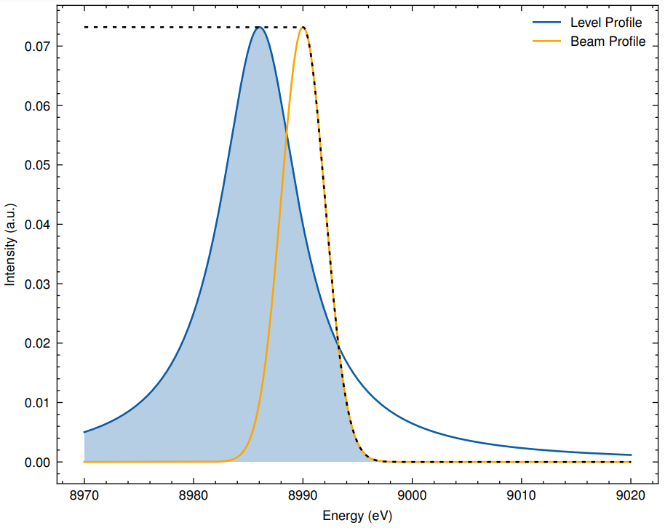
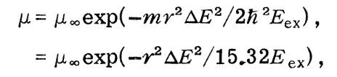
Near ionization Cu spectra
PRELIMINARY RESULTS
Darrah Thomas, T. (1984). Transition from Adiabatic to Sudden Excitation of Core Electrons. In PHYSICAL REVIEW LETTERS (Vol. 5, Issue 2).

Slide 14
Conclusions
Currently we have access to multiple programs that perform state-of-the-art atomic calculations (MCDFGME, grasp2k, FAC, etc)
Codes similar to MCDFGME oftentimes rely on fallible numeric methods that could result in wrong results and atomic data.
When using MCDFGME we need to perform a separate calculation for each atomic state.
We have developed various scripts to automate calculations and help manually reach convergence when required.
We have also showed you various examples of recent atomic data calculated in our group for Fe and Cu.

Slide 15
Thank you for your attention!

Slide 16
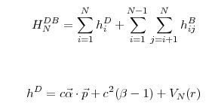

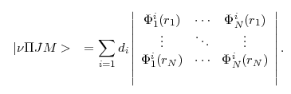
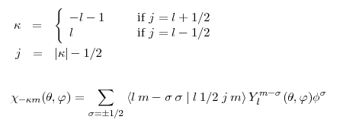




Equations
SC Step 1
SC Step 2

Slide 17
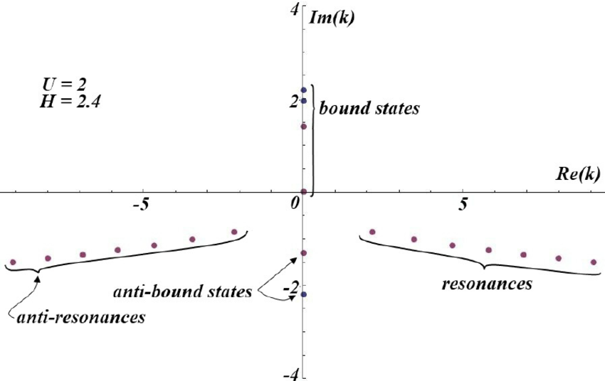
MCDF Method
The most common approximation is the “no pair” approximation, where we explicitly exclude the existence of electron-positron pairs. We do this by starting from the formal Hamiltonian of an N electron system:
H = H0[Ne-,0e+] + H1[(N + 1)e-,1e+] + H2[(N + 2)e-,2e+] + …,
Taking only the first term for our effective Hamiltonian.
The interactions considered are then the sum of one-electron and two-electron interactions, where both include and expansion in terms of the coupling constant (α).
When performing the sum for the whole series in powers of α for the one-electron interaction with the nuclear field, the Dirac one-electron operator enables us to consider the nuclear field as a classical external field.
The two-electron interaction must be deduced from QED, which is usually done in the bound state picture of the S-matrix, which after time integration, reduces to the generalized form of the Breit operator.

Slide 18
MCDF Method
We know that to accurately predict the electronic properties of atoms we need to introduce relativistic correction terms, especially for heavier atoms.
In 1951 Salpeter and Bethe published an equation for the fully relativistic interaction of two bound state particles, including QED corrections. This equation can also be extended to an N-electron system providing us with highly accurate results for any bound system. Additionally, in 1956 a reduction of the Dirac equation for an electron in external fields to small components was given by Sucher, which can be combined with the Salpeter and Bethe equation.
This is amazing but it has 2 main problems: as the relativistic quantum theory only conserved the total charge and not the number of particles, the Salpeter and Bethe equation must be written with an open-form integral kernel; as the theory requires a fully relativistic covariance the equation also must be expressed with more than 1 independent time variable.
This means we need some sort of approximation to calculate something out of these amazing theories.

Slide 19
Calculation methods details and possible problems
An iterative numerical method is used to obtain each of the optimized electron wavefunctions from first principles.
Due to the nature of this method convergence is not guaranteed and could produce wrong results.
Various quantities related with the calculation cycles, as well as with physical properties of each orbital, are available to evaluate the convergence of each calculation and prevent wrong results.
Wavefunctions can also be approximated by other functions during the iterative optimization process, of which splines produce the best results.
Even when arriving at a solution for the atomic structure, sometimes it will not be consistent with previously calculated states. Although oftentimes impossible, one must try to maintain consistency with the calculation parameters across all states.

Slide 20
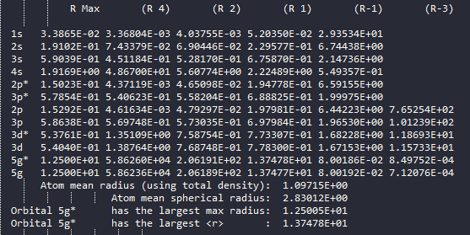
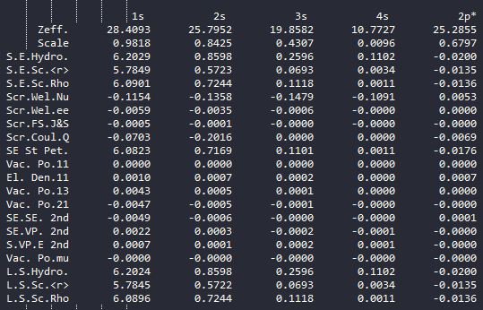


Slide 21
How do we run a complete bound system calculation
At the moment we use 3 different scripts to run the MCDFGME code in parallel. All these scripts work in a similar manner, using different tools / languages.
We have a bash script written by Prof. Jorge Machado using the GNU parallel tool that calculates all possible 1- and 2-hole transitions of an atomic system, followed by the synthetic spectra calculation.
The other 2 scripts were developed by myself and Gonçalo Baptista in python, using the same GNU parallel tool and MPI respectively. We chose python for easy code readability and future modification. These more recent scripts also calculate 3-hole transitions, as well as excitations.
All these scripts execute about 12 calculations per second, mostly bound by the core count of our current cluster.

Slide 22
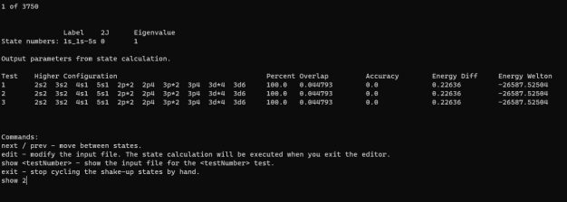
How do we run a complete bound system calculation
Convergence helper command line interface

Slide 23
Examples of Recent Atomic Data
Fe Fluorescence yield for the full isonuclear sequence
Shake-off and shake-up probabilities for Cu
Reproduction of the Thomas model for near ionization Cu spectra

Slide 24
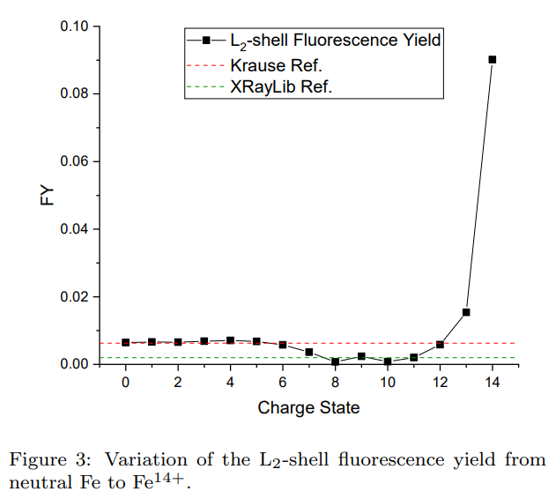
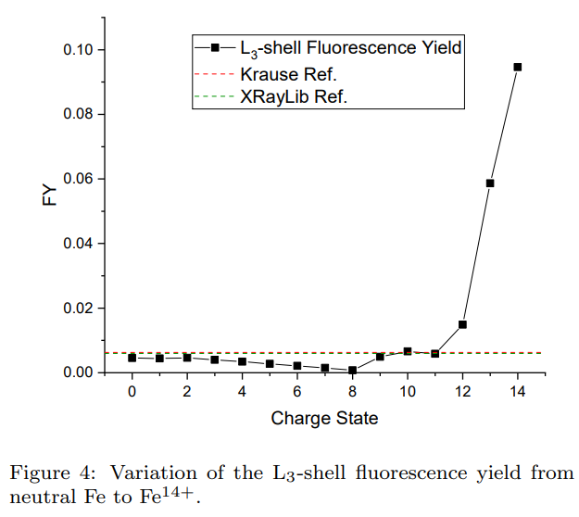
FY Evolution
Increase due to the reduction of available radiationless channels. (single electron in the 3p orbital)
Minimum due to the drop of both types of transitions, combined with the greater reduction of radiative yield, due to the filled 3p orbital.

Slide 25
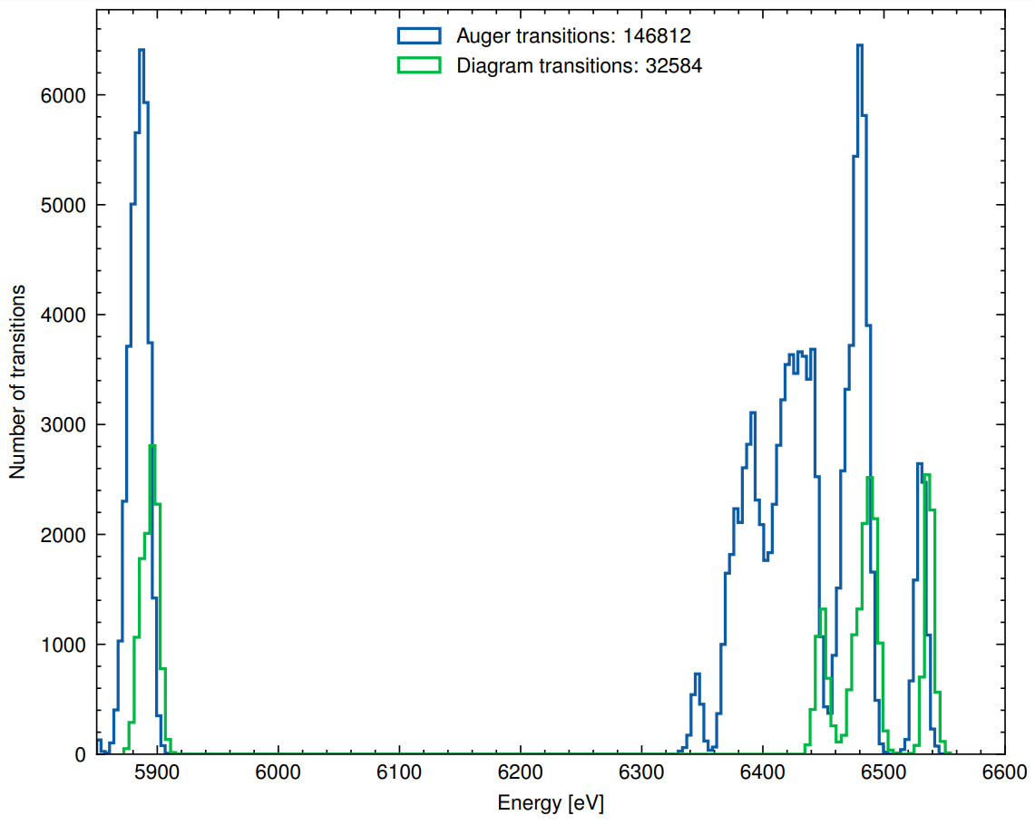
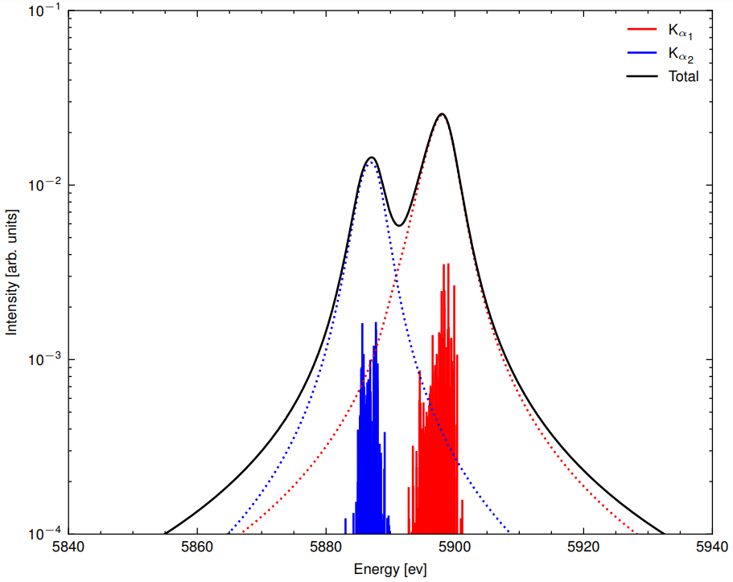
Mn Transitions (Electron Capture from Fe)

