Slide 1



Exploring Quantum Tunneling
In Organic Reactions
José P. L. Roque

Slide 2
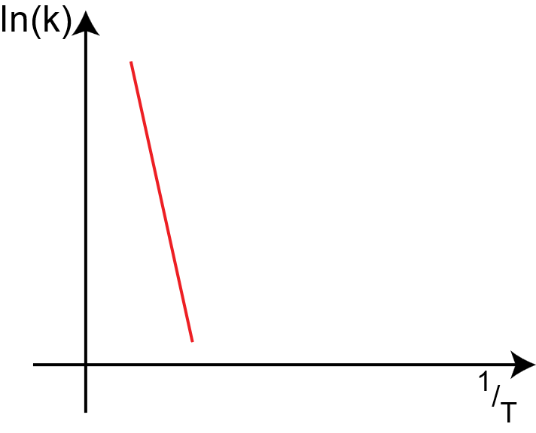
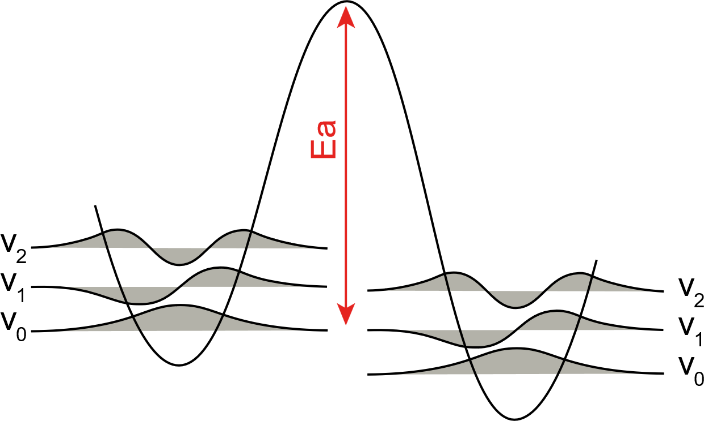

Over-the-barrier Reactivity
Double-well Potential
Arrhenius Plot
Arrhenius Equation
$$k=A{ .e}^{\frac{−Ea}{RT}}$$
$$\ln\left(k\right)=ln\left(A\right)− \frac{Ea}{R}\left(\frac{1}{T}\right)$$

Slide 3
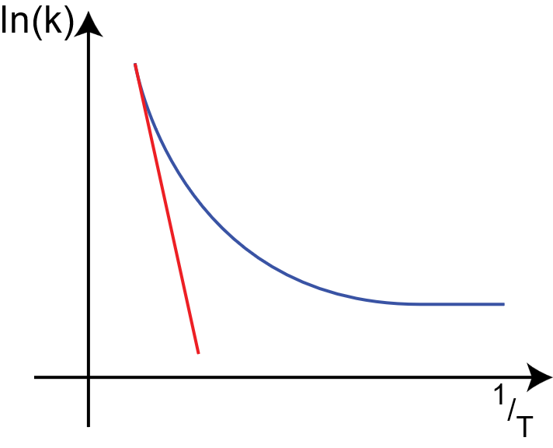
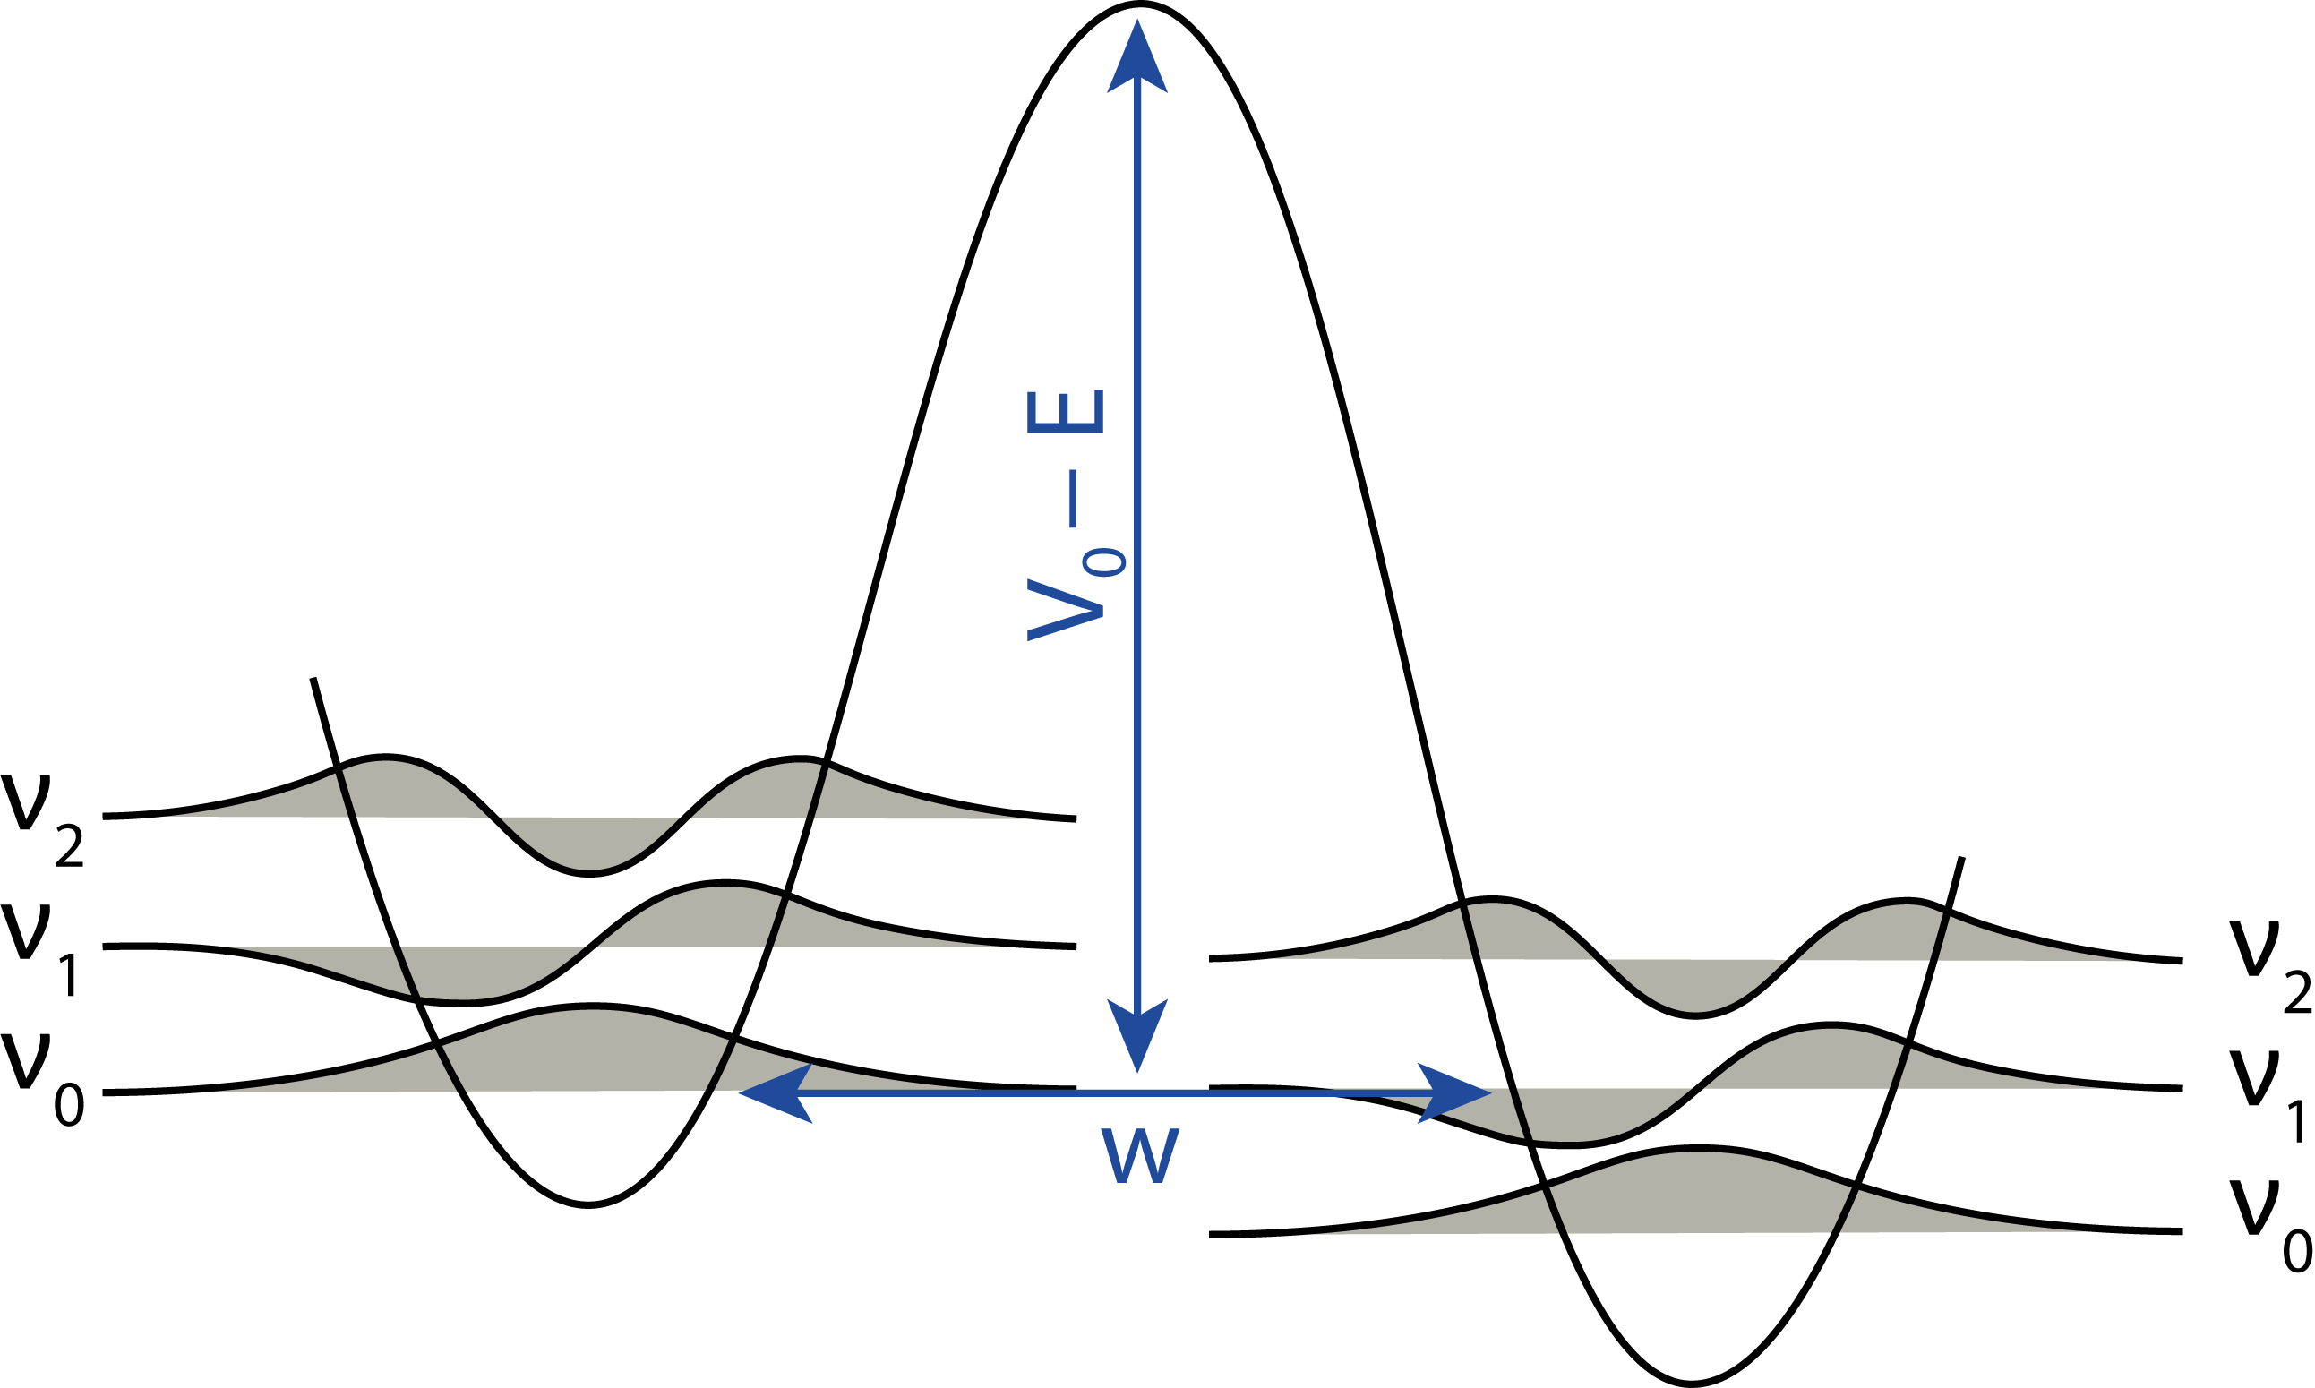


Quantum Tunneling: The phenomena
Double-well Potential
Arrhenius Plot
Tunneling Contribution
Arrhenius Equation
$$K= e\left(−π^{2}w\sqrt{\frac{2m}{h^{2}}\left(V_{0}−E\right)}\right).v$$
$$k=A{ .e}^{\frac{−Ea}{RT}}$$
$$\ln\left(k\right)=ln\left(A\right)− \frac{Ea}{R}\left(\frac{1}{T}\right)$$

Slide 4
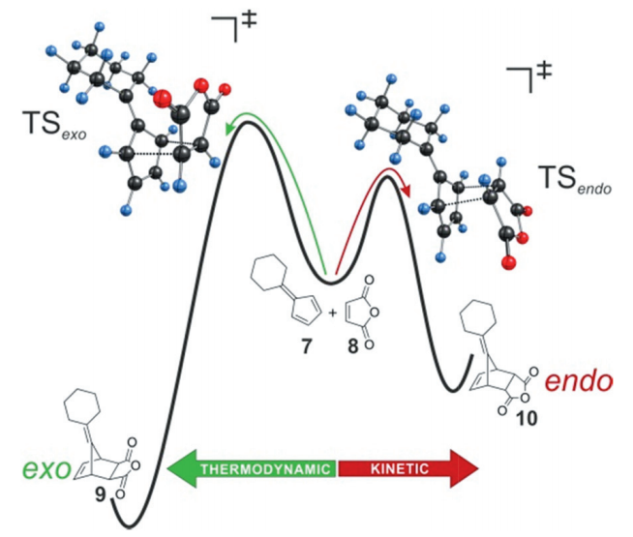
Selectivity in Chemistry: Classical Interpretation
Diels-Alder Reaction
Endo
Exo
Endo Preference until T ~ 25º C
Exo Preference from T > 25º C
Ley, D.; Gerbig, D.; Schreiner, P. R.; Org. Biomol. Chem. 2012, 10, 3781-3790.

Slide 5
Tunneling Control: The Game Changer
Decay of Methylhydroxycarbene
in Cryogenic Matrix
w = 3.07
w = 2.32
Reactive Coordinate [amu^{1/2}.bohr]
Schreiner, P. R.; Reisenauer, H. P.; Ley, D.; Gerbig, D.; Wu, C.; Allen, W. D.; Science, 2011, 332, 1300-1303.

Slide 6
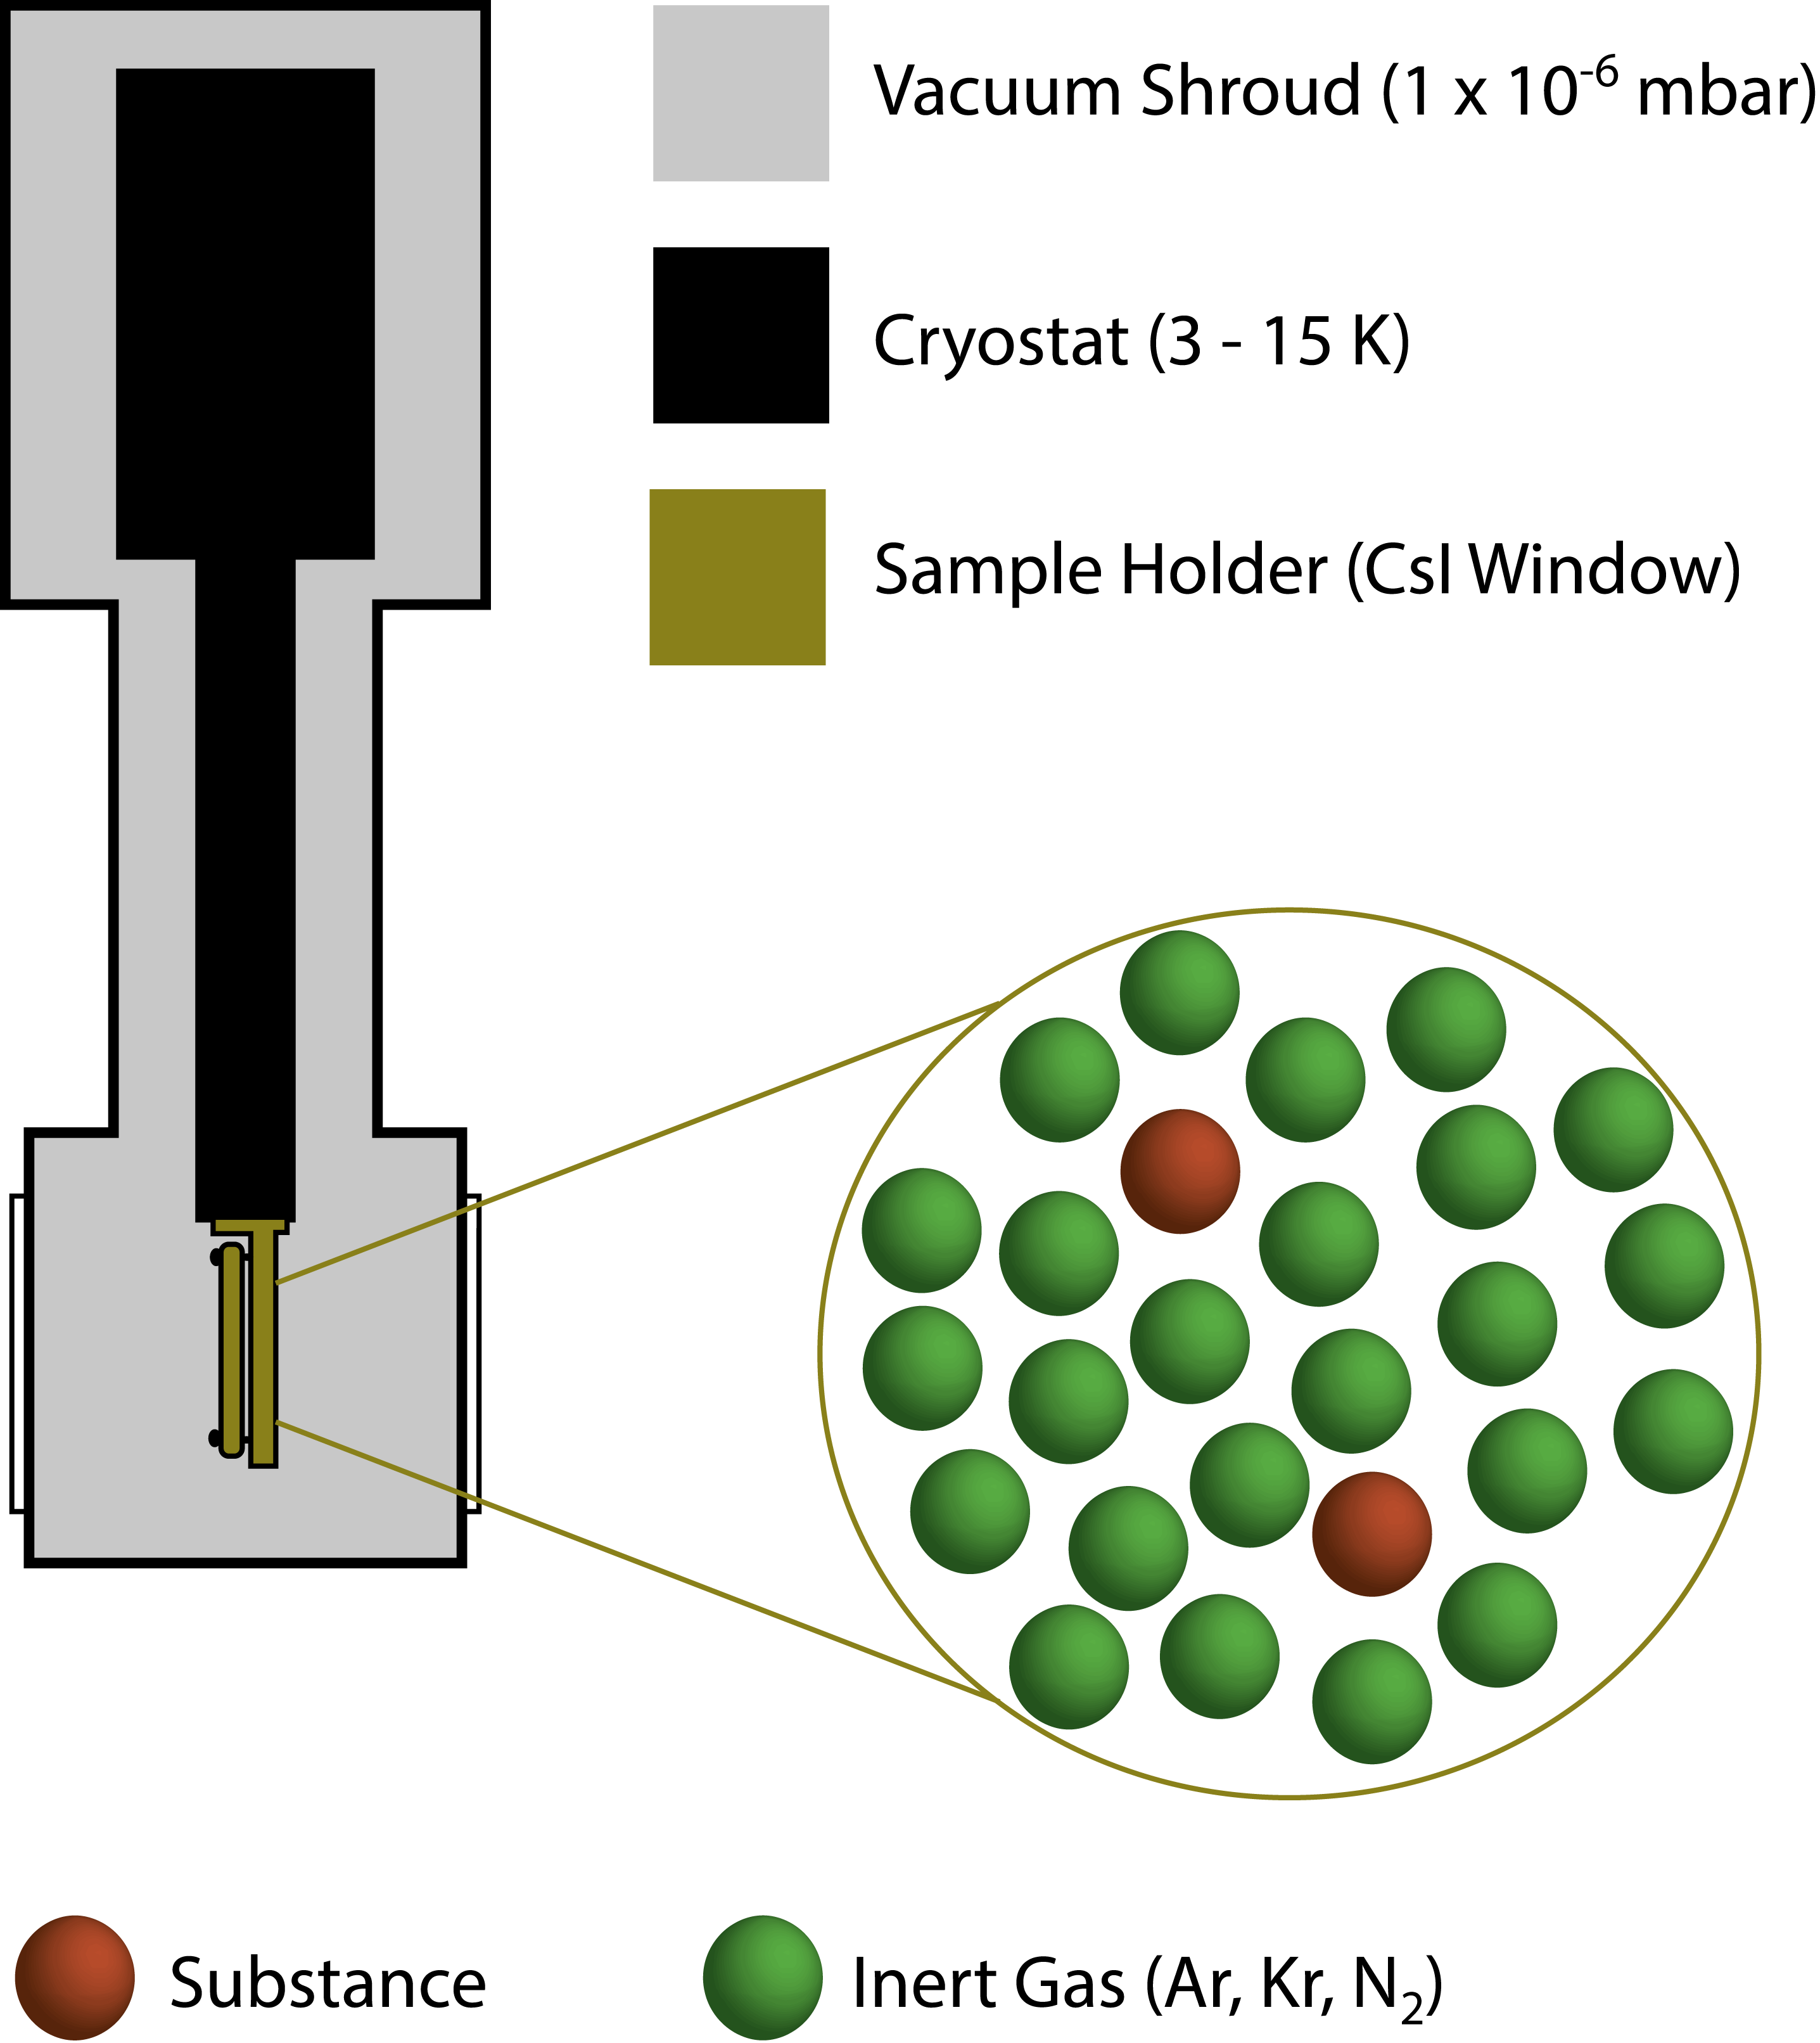
Matrix-Isolation and Phenylnitrenes

Slide 7
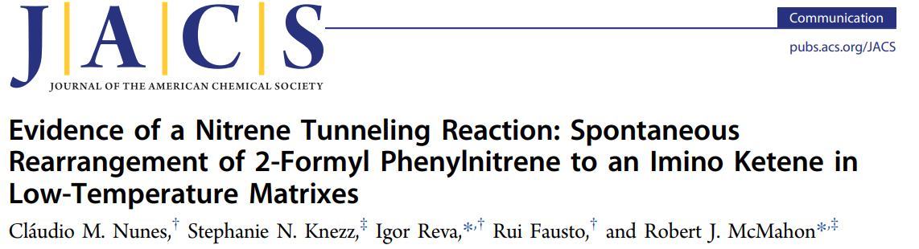
Tunneling in Nitrenes: The Proof of Concept
1
Direct Observation
Computed Barrier above 17 kcal mol⁻¹
2
Temperature Independency
Similar Kinetic profiles at 10 and 20 K
3
Large Kinetic Isotope Effect
No reaction for Deuterated isotopologue
Nunes, C. M.; Knezz, S.; Reva, I.; Fausto, R.; McMahon, R. J. J. Am. Chem. Soc. 2016, 138, 15287-15290.

Slide 8
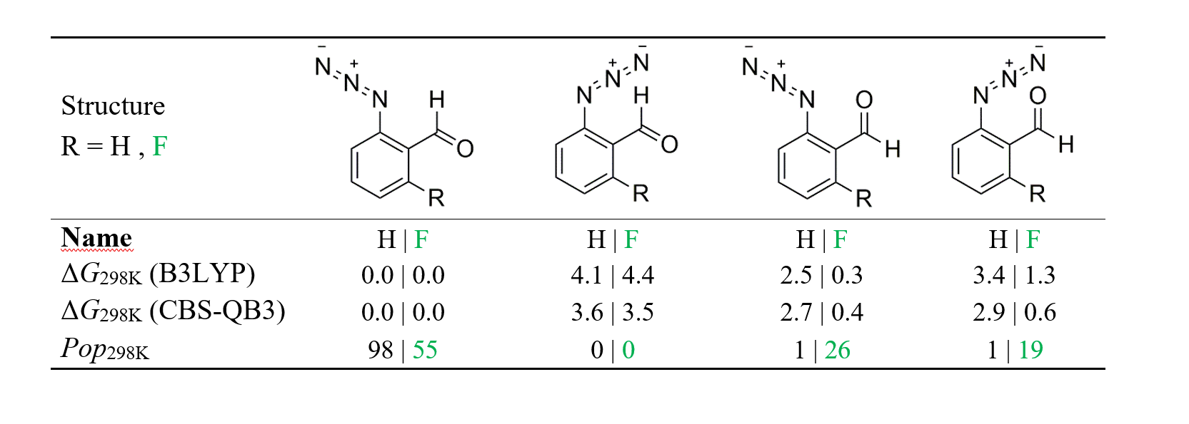
Tunneling Control in Nitrenes: The Strategy
anti-CHO
≈ 55%
syn-CHO
≈ 45%
Energies are given in kcal mol⁻¹ and Boltzmann populations in %.
Nunes, C. M.; Roque, J. P. L.; Doddipatla, S.; Wood, S. A.; McMahon, R. J.; Fausto, R. J. Am. Chem. Soc. 2022, 144, 20866-20874.

Slide 9
Tunneling Control in Nitrenes
Nunes, C. M.; Roque, J. P. L.; Doddipatla, S.; Wood, S. A.; McMahon, R. J.; Fausto, R. J. Am. Chem. Soc. 2022, 144, 20866-20874.

Slide 10
Tunneling Control in Nitrenes
Nunes, C. M.; Roque, J. P. L.; Doddipatla, S.; Wood, S. A.; McMahon, R. J.; Fausto, R. J. Am. Chem. Soc. 2022, 144, 20866-20874.

Slide 11
Switching on Tunneling Reactions: The Strategy
syn-OH
anti-OH
Structures 1′, 1 R = H, F
Name | as-1′ | as-1 | aa-1′ | aa-1 | sa-1′ | sa-1
ΔG_{298K} (CBS-QB3) | 0.0 | 0.0 | 15.5 | 4.5 | 12.8 | 2.6
Pop_{298K} | 99.2 | 66.1 | 0.2 | 10.7 | 0.6 | 23.1
Liebigs Ann. 1996, 2029–2037.
Liebigs Ann. 1996, 1971–1980.
H | F H | F H | F
Energies are given in kcal mol⁻¹ and Boltzmann populations in %.
Roque, J. P. L.; Nunes, C. M.; Viegas, L. P.; Pereira, N. A. M.; Pinho e Melo, T. M. V. D.; Schreiner, P. R.; Fausto, R. J. Am. Chem. Soc. 2021, 143, 8266-8271.

Slide 12
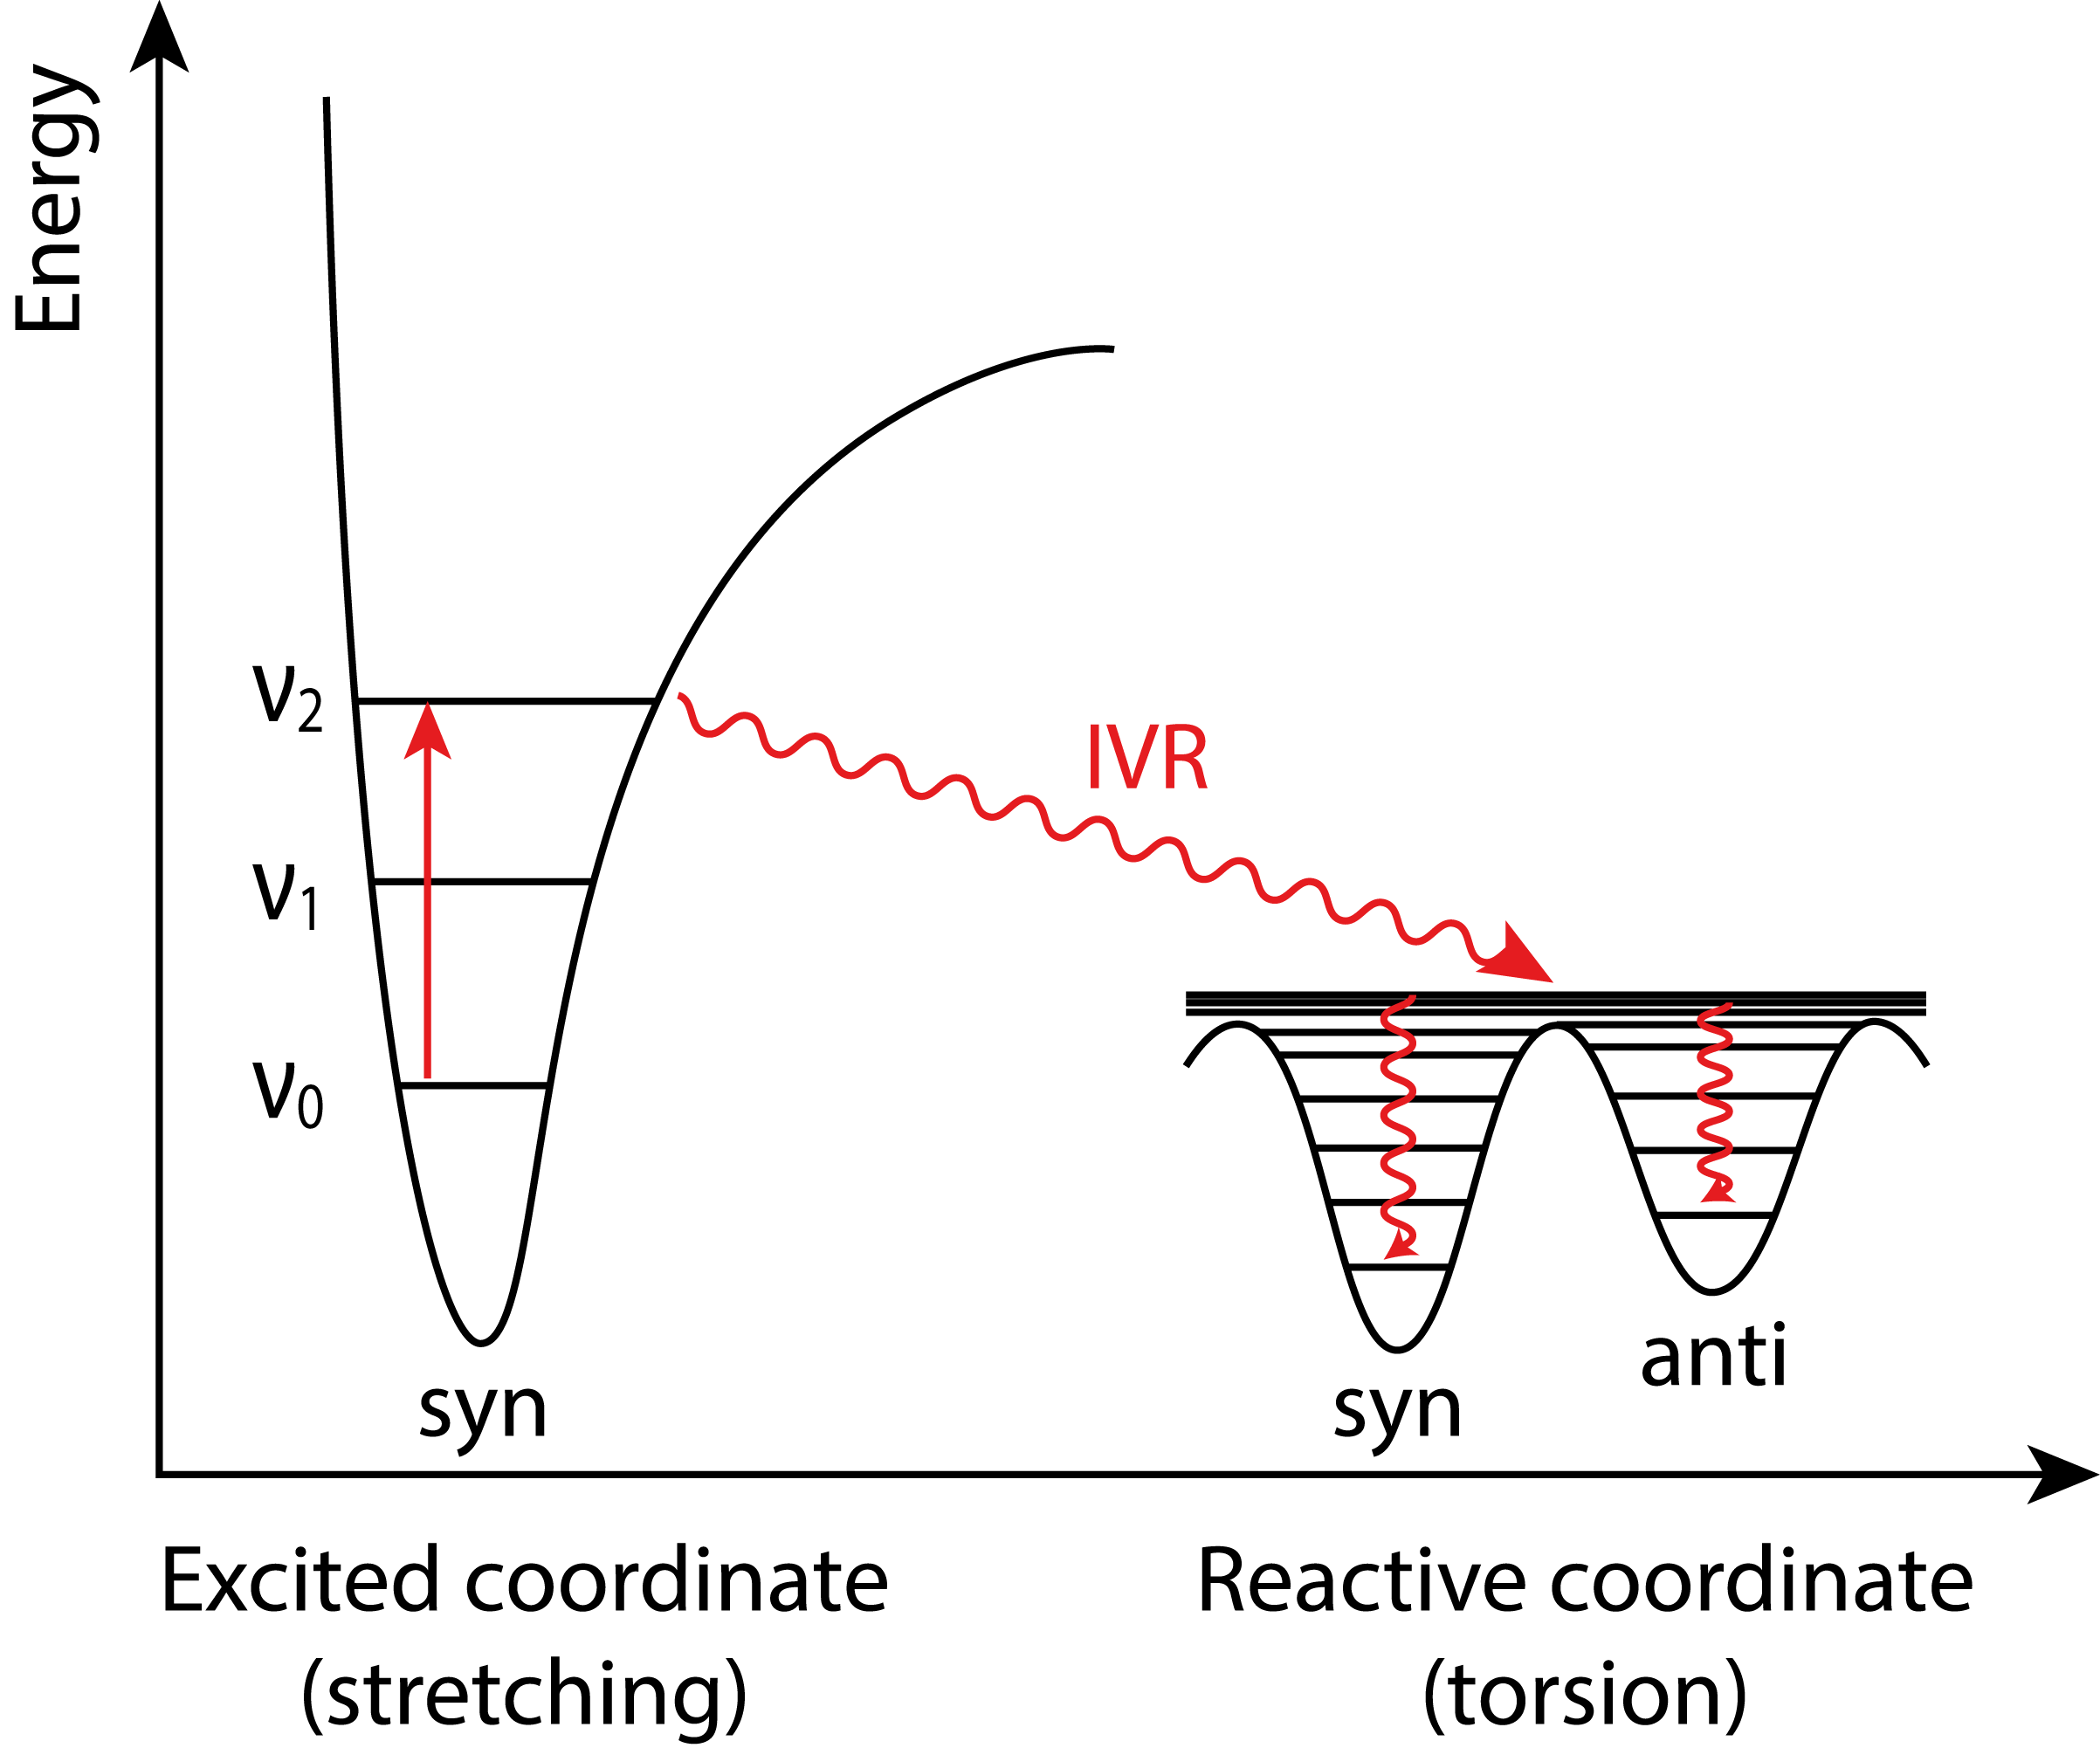


Vibrational Excitation: Mastering Conformations
ΔG$‡$ ≈ 50 kJ mol⁻¹
2ν(OH) ≈ 80 kJ mol⁻¹
J. Am. Chem. Soc. 1997, 119, 11715-11716.
J. Am. Chem. Soc. 2003, 125, 16188-16189.
ΔG$‡$ ≈ 25 kJ mol⁻¹
J. Phys. Chem. A. 2019, 123, 4396−4405
Chem. Phys. Lett. 2020, 747, 137069.

Slide 13

Switching on Tunneling Reactions
anti-³6
2ν(OH) = 6976 cm⁻¹
Roque, J. P. L.; Nunes, C. M.; Viegas, L. P.; Pereira, N. A. M.; Pinho e Melo, T. M. V. D.; Schreiner, P. R.; Fausto, R. J. Am. Chem. Soc. 2021, 143, 8266-8271.

Slide 14
Switching on Tunneling Reactions
Z-7 : Computed
a-³6 : Computed
a-³6
sa-5 | aa-5
as-5
s-³6
Z-7

Slide 15
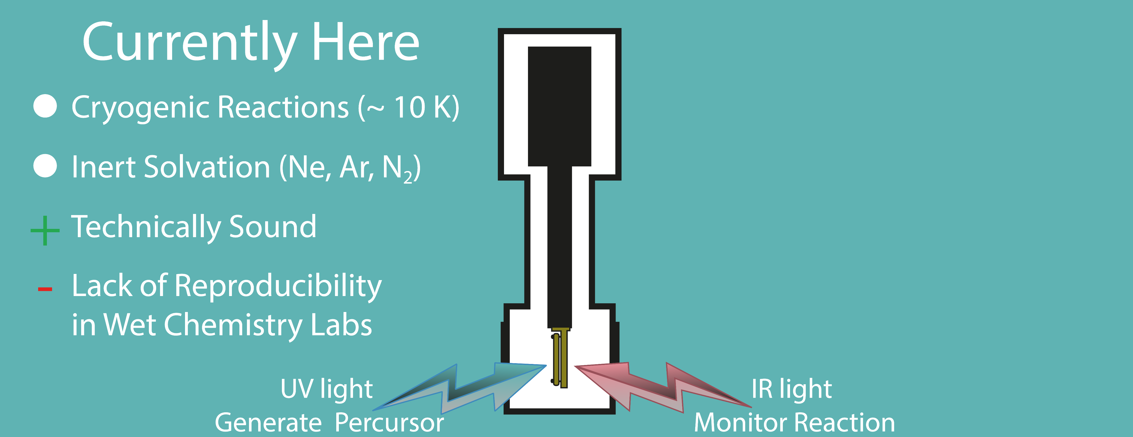
Conclusions and Outlook
Developments in Tunneling Reactivity
Limitations of TST
Role of Conformations

Slide 16
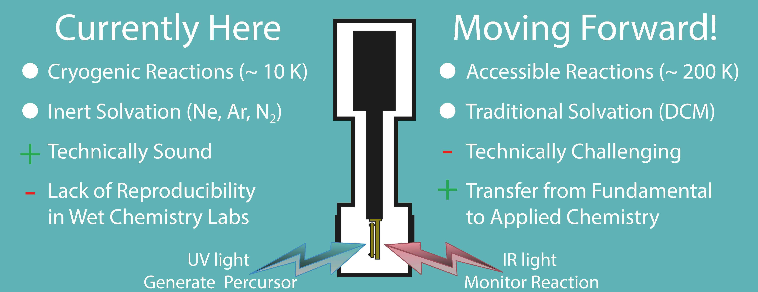
Conclusions and Outlook
Developments in Tunneling Reactivity
Design of Molecules and Synthesis Planning
Limitations of TST
Role of Conformations
Unleash Tunneling Control

Slide 17


Acknowledgments
Supervisors and Colleagues
Rui Fausto
Peter R. Schreiner
Cláudio Nunes
Igor Reva
Robert McMahon
Teresa M. V. D. Pinho e Melo
Srinivas Doddipatla
Nelson Pereira
Luís Viegas
Stephanie Knezz
Samuel Wood
PhD Grant (SFRH/BD/04467/2020)
This work was supported by Projects POCI-01-0145-FEDER-028973 and PTDC/QUI-QFI/1880/2020, funded by National Funds via the Portuguese Foundation for Science and Technology (FCT), the first being also funded by FEDER, via Portugal 2020 − POCI. The Coimbra Chemistry Centre is supported by FCT through projects UIDB/QUI/0313/2020 and UIDP/QUI/0313/2020, cofunded by COMPETE. J.P.L.R. acknowledges the Project POCI-01-0145-FEDER-028973 for a Researcher grant and FCT for a PhD (SFRH/BD/04467/2020) grant. C.M.N. acknowledges FCT for an Auxiliary Researcher grant. N.A.M.P acknowledges the Project POCI-01-0145-FEDER-028973 for a Junior Researcher grant.

Slide 18
Switching on Tunneling Reactions
sa-5 | aa-5
a-³6
Z-³7
s-³6
a-³6
Z-7
as-5
a-³6
Z-7

Slide 19
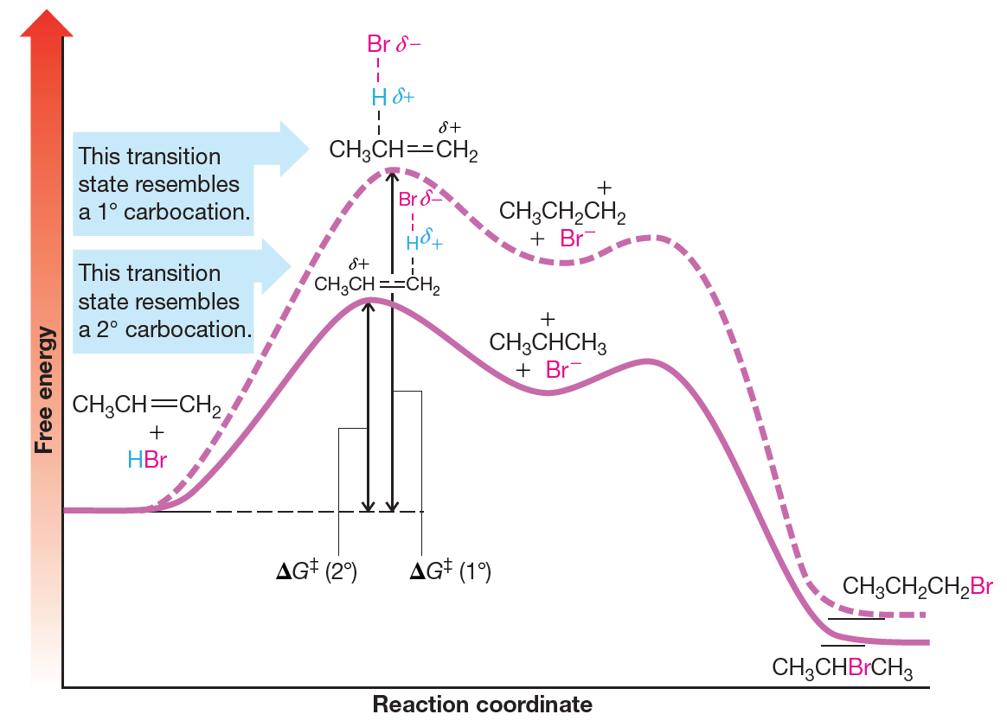
Selectivity in Chemistry: Classical Interpretation
Addition of Alkyl Halides to
Asymmetric Alkenes
T. W. G. Solomons, C. B. Fryhle, S. A. Snyder, Organic Chemistry, 12th Edn, John Wiley & Sons, 2016.

