Slide 1
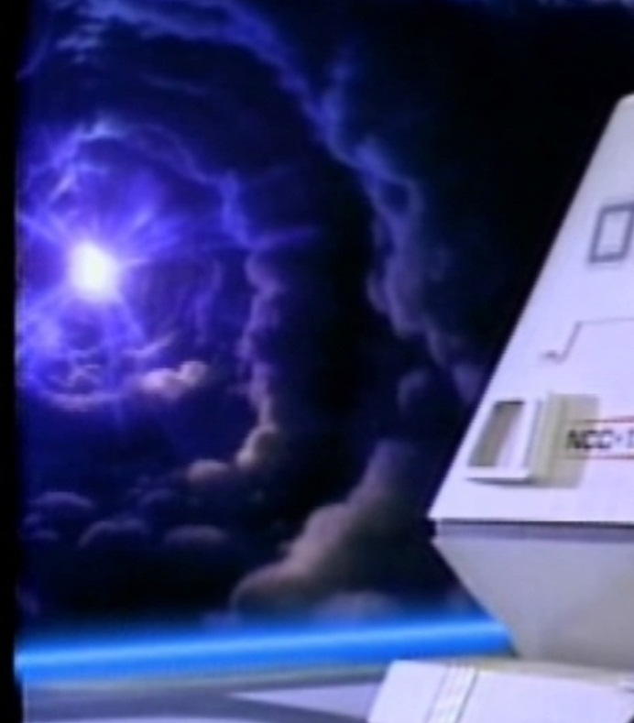
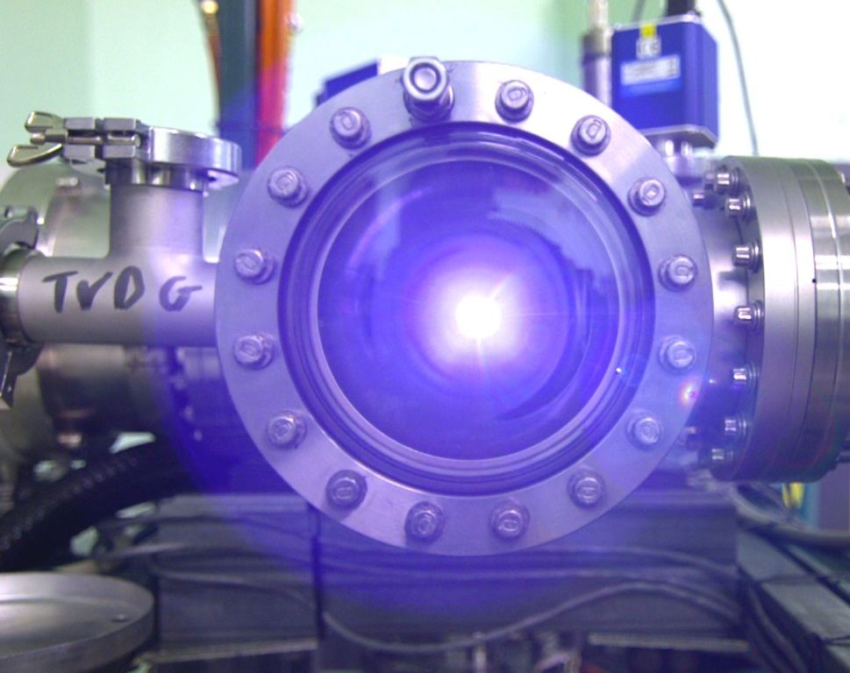











A Windowless Window to the Universe
Vacuum Separation by a Plasma Window for Nuclear Astrophysics Research
(and Various Applications)
Ophir Ruimi, Physics Ph.D. Student
HUJI Fundamental Interactions Group, Prof. Guy Ron
JGU Mainz & HIM, MAM Section, Prof. Dmitry Budker
IBER 2023 – University of Coimbra, September 6th, 2023

Slide 2
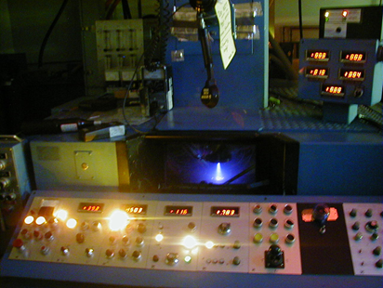
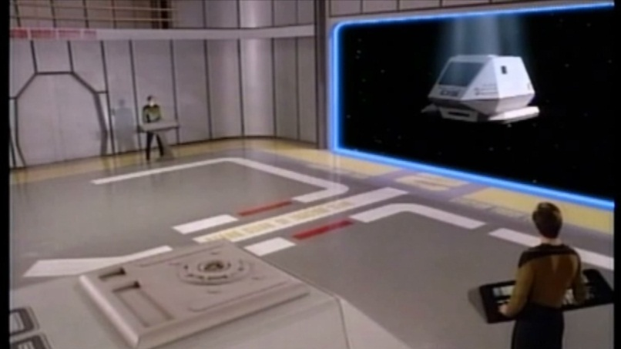
Talk Outline
What is a Plasma Window?
The Plasma Window is a novel apparatus that utilizes a stabilized plasma arc as an interface between vacuum and atmosphere or pressurized targets without solid material. It’s useful in non-vacuum electron-beam welding, as well as in some Physics experiments.
Why Plasma Windows
Operation principles, applications, Sci-Fi
Motivation: electron, ion and photon beam transmission from vacuum to atmosphere
Example: Stellar nucleosynthesis
Nuclear Astrophysics at SARAF: Liquid Lithium and enriched water targets
Results, conclusions and future work
Answer questions
Star Trek: The Next Generation (1987)

Slide 3
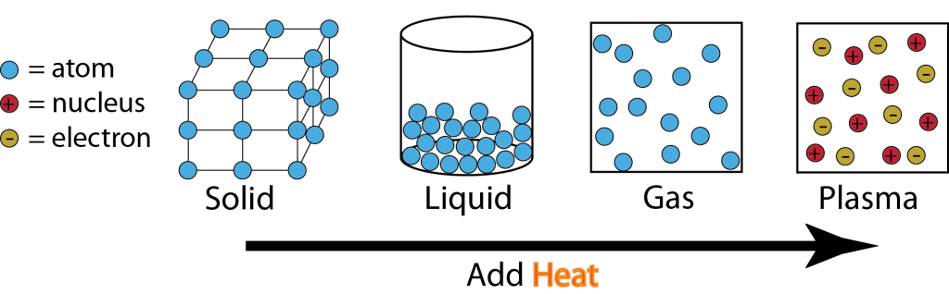
Plasma is ionized gas comprising of ions and electrons. Just like any other gas, plasma exerts pressure. Electric and magnetic fields exert forces on plasmas, which can confine plasmas in vacuum whose pressure can block, curb or confine other fluids. In a Plasma Window, electric and/or magnetic fields confine plasmas, whose pressure is large enough to balance atmospheric pressure (or even higher).
The states of matter and the idea behind a Plasma Window
A plasma is much less dense than a gas when both are at the same pressure.
Plasmas have a much larger resistance to flow (viscosity) than gases.
A plasma “plug” or “window” can slow down the flow of gases with
little effect of fast particles passing through it.

Slide 4
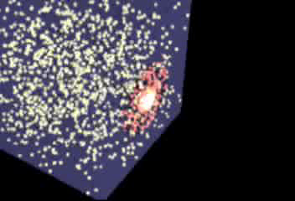
Simulation of a cube in empty space filled with air having a hole plugged by a Plasma Window; Courtesy of Jeffery Mitchell (BNL)

Slide 5

Operation Principles
Ideal Gas: p = nkT
Where p is the partial pressure, n is the density and T is the temperature of the gas or the plasma, k is the Boltzmann constant.
Viscosity: $Q= \frac{πd^{4}}{16ηl}p_{a}\left(p_{1} − p_{2}\right)$
Poiseuille equation for the gas flow rate Q, where d and ℓ are the tube radius and length, η is the gas viscosity, and p_{a} is the arithmetic mean of p₁ and p₂.
A critical assumption, gas is incompressible. Compressibility can be neglected if the Mack number M satisfies 0.5 M² << 1. Some of the assumptions are no longer valid once a discharge is initiated, since the flow becomes compressible and nonisothermal. Therefore, a thorough analysis of such a gas and plasma flow requires solution of Naviar-Stokes equation for the gas. For electrons and ions, the relevant transport equations are the continuity, momentum transfer and viscosity equations:
$\frac{D}{Dt}n_{e,i}+n_{e,i}∇⋅{\underline{V}}_{e,i}=0$
$m_{e,i}n_{e,i}\frac{D}{Dt}{\underline{V}}_{e,i}=−∇p_{e,i}−∇⋅{\underline{P}}_{e,i}+q_{e,i}n_{e,i}\left[\underline{E}+{\underline{V}}_{e,i}×\underline{B}\right]+{\underline{R}}_{e,i}$
$η_{i}=2×{10}^{5}μ^{1/2}\frac{k}{λ_{i}}{T_{i}}_{}^{5/2}$
$η_{e}=2.5×{10}^{7}\frac{k}{λ_{e}}{T_{e}}_{}^{5/2}$
$η_{gas}=aT^{x}$
Where m is the particle mass and q its charge. R is the species total momentum transfer, p its partial pressure and P is the stress tensor, $D/{Dt}=∂_{t}+∇⋅\underline{V}$; η is the viscosity, λ is the Coulomb logarithm. The Naviar-Stokes equation is basically the momentum equation without the electric and magnetic field terms. Note viscosity dependence on temperature x>1 for gases.

Slide 6

The Sky is not the Limit – When Sci-Fi Meets Reality:
Plasma Window Has Captured People’s Imagination
Featured in popular science magazines, newspapers, Michio Kaku‘s book Physics of the Impossible and in an accompanying syndicated article 10 Impossibilities Conquered by Science @#8 PW is listed under Creating force fields.
Star Trek Shuttle’s Bay Door
A Plasma Window at BNL
Star Trek: The Next Generation (1987)

Slide 7
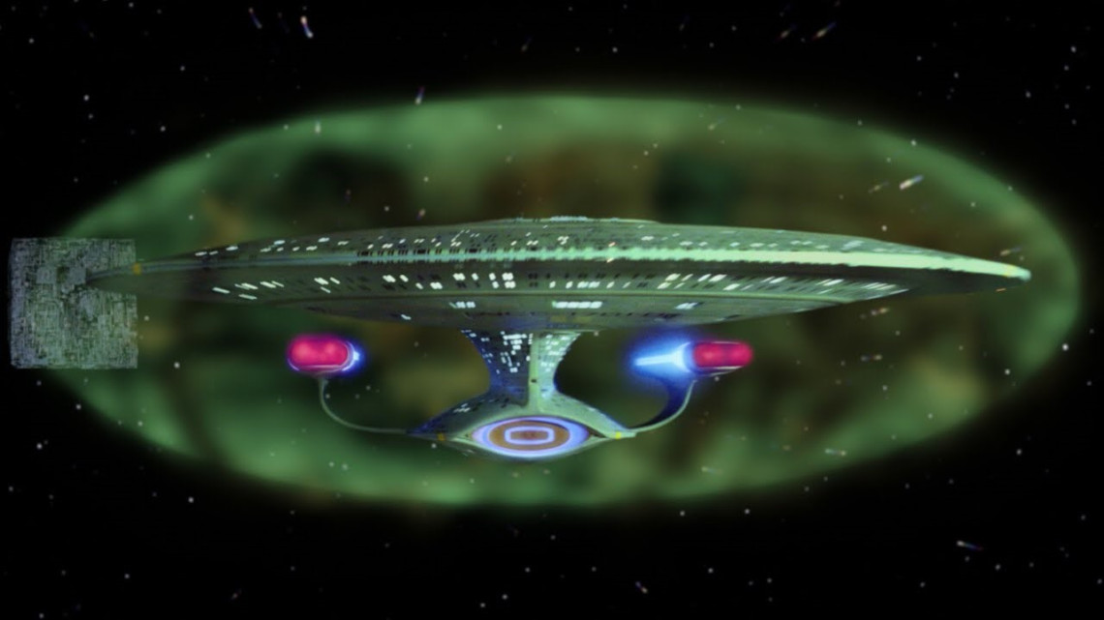
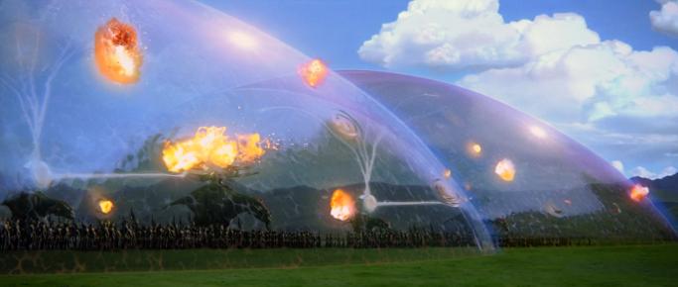
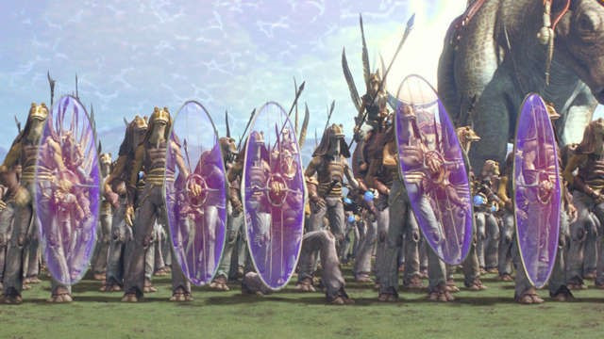
Force fields
Star Wars: A New Hope (Episode IV), George Lucas
1977
The shield around the USS Enterprise
Dome in the battle of Wakanda
Avengers: Infinity wars (2018)
The Gungan handheld shields

Slide 8
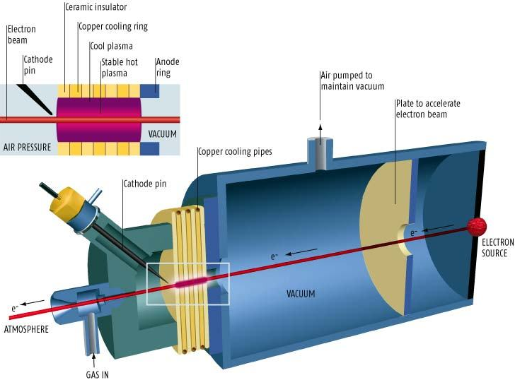
Down to Earth
Schematic diagram of a Plasma Window
The stabilized plug of plasma seals the vacuum chamber to air but allows particle beams to pass through

Slide 9
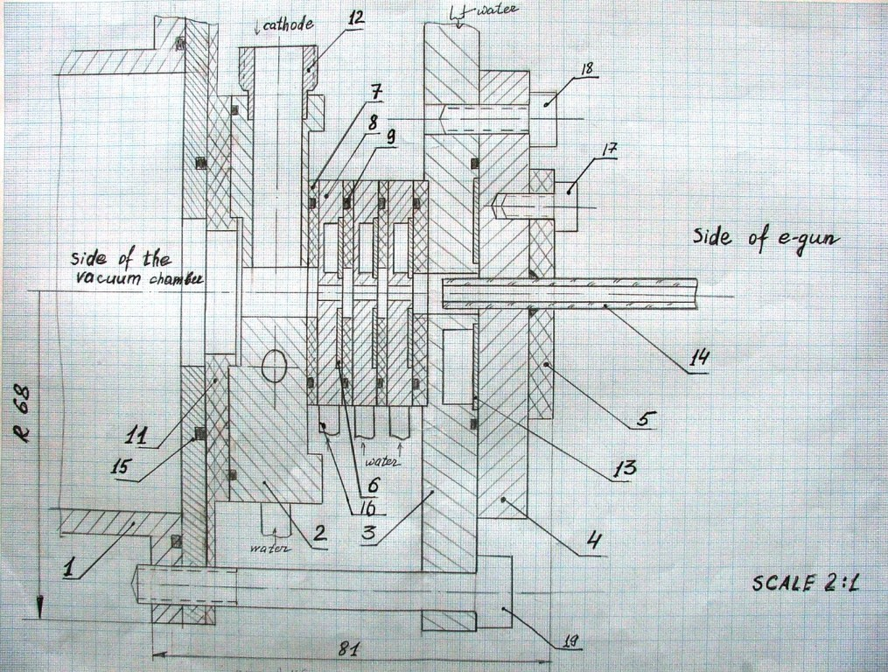
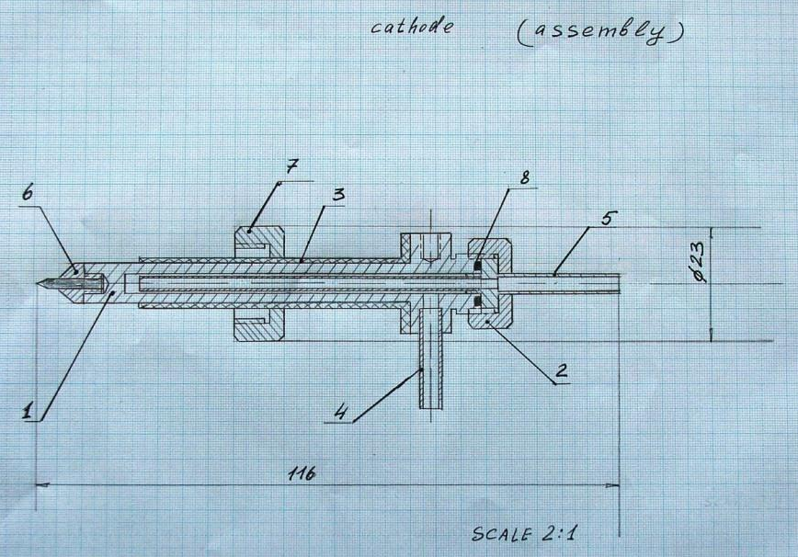
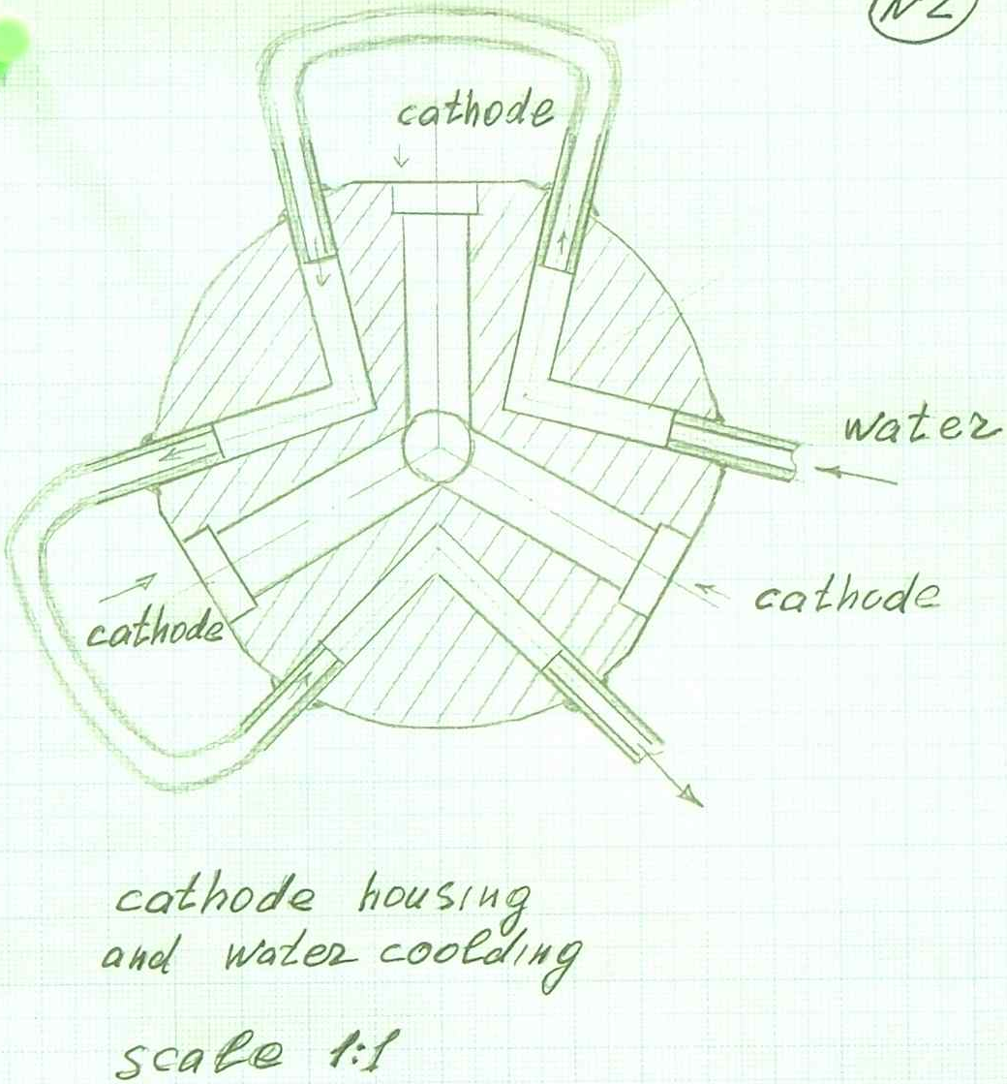
Producing a 3D CAD model from hand-written drawings

Slide 10
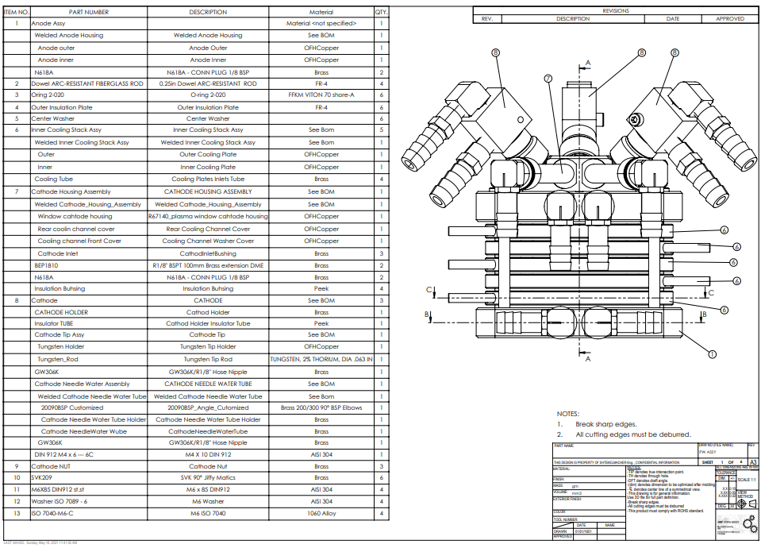
Producing a 3D CAD model from hand-written drawings

Slide 11
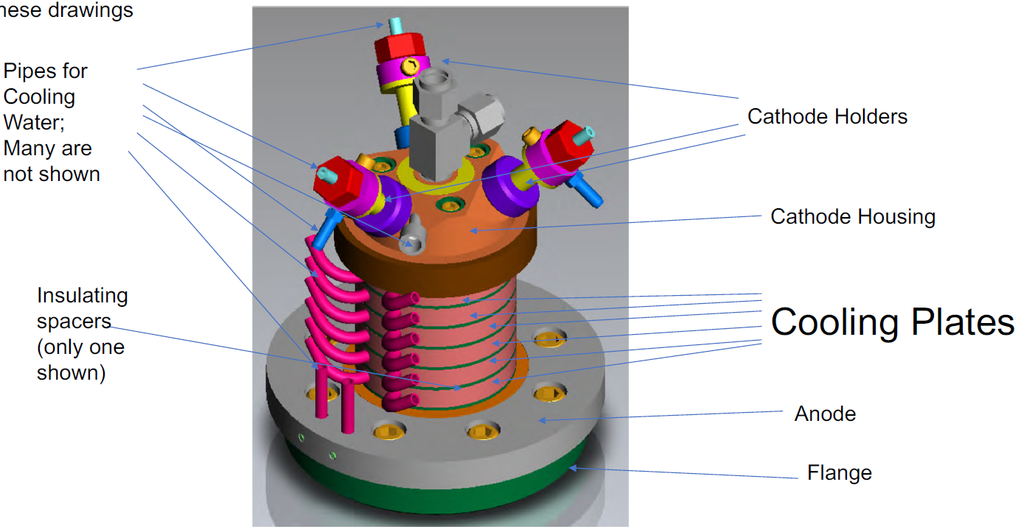
Plasma Window components’ terminology
(OFHC Cu)

Slide 12
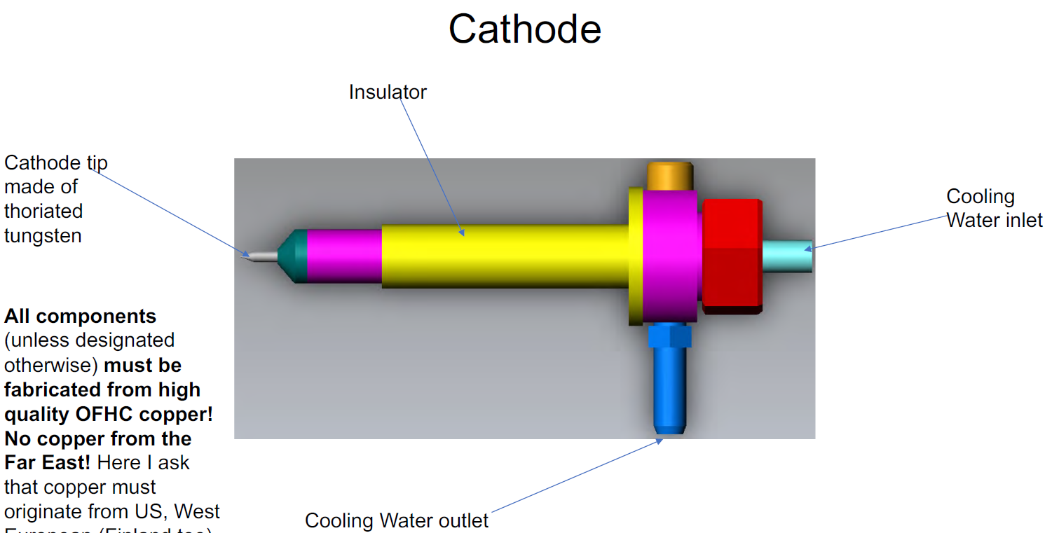
(2% Th)

Slide 13
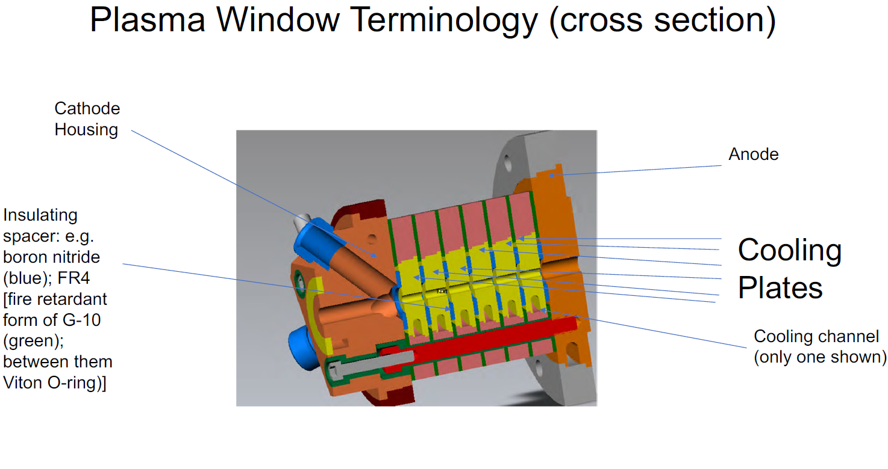
119.9 mm
9.5 mm, insulators: 1.4 mm
66.8 mm
(OFHC Cu)
Central aperture: 5 mm

Slide 14
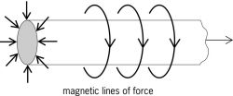
Plasma Lens
(Focuses charged particles similar to light focusing by an optical lens)
F_{r}
V_{z}
B_{θ}
Electron beam
exiting plasma
window
Electron beam
entering plasma
window
Current
$$\underline{F_{r}}=q\underline{V_{z}}×\underline{B_{θ}}$$

Slide 15
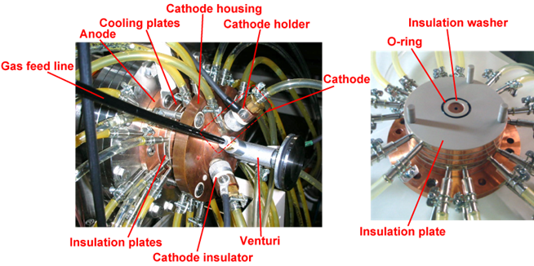
RIKEN (RIBF) Plasma Window
(Wako Center)
empty hole becomes window when filled with plasma

Slide 16
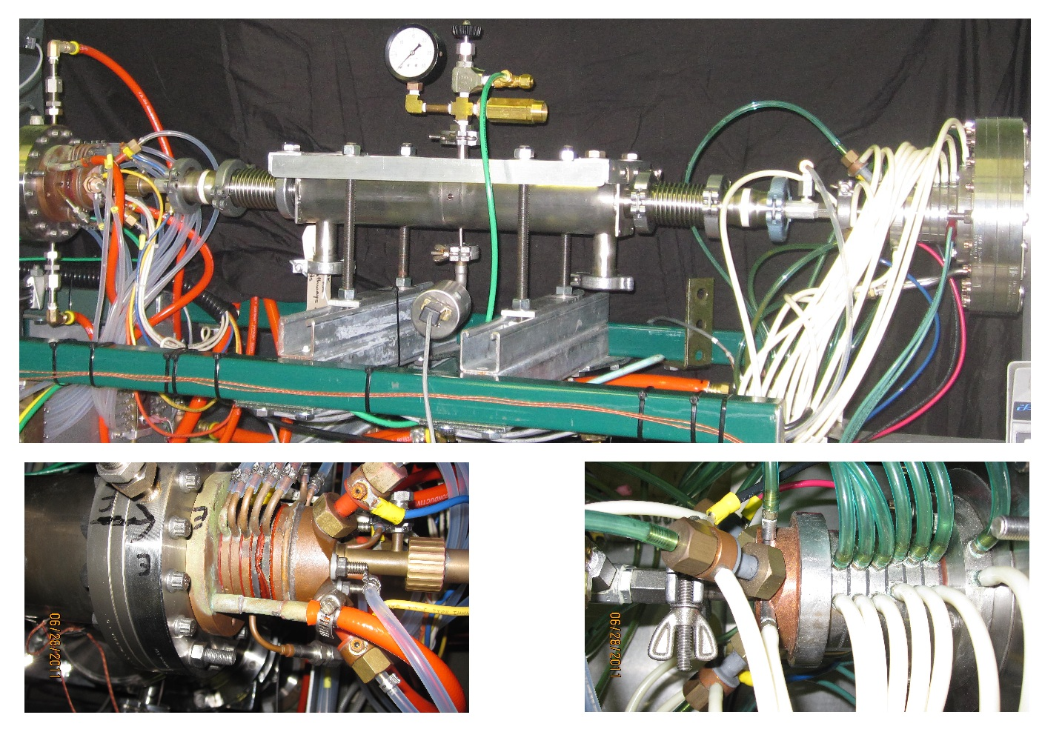
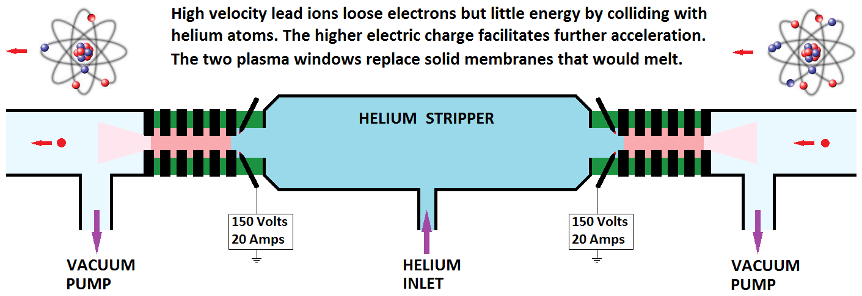

BNL Gas Stripper R&D for FRIB (MSU)
$${}_{}^{238}{U^{34+}}→{{}_{}^{238}U}^{71+}$$

Slide 17

Ady Hershcovitch
(BNL, SUNY)

Slide 18
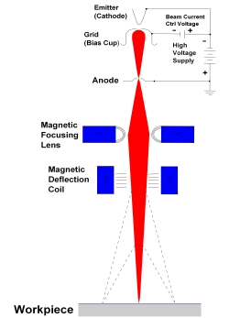
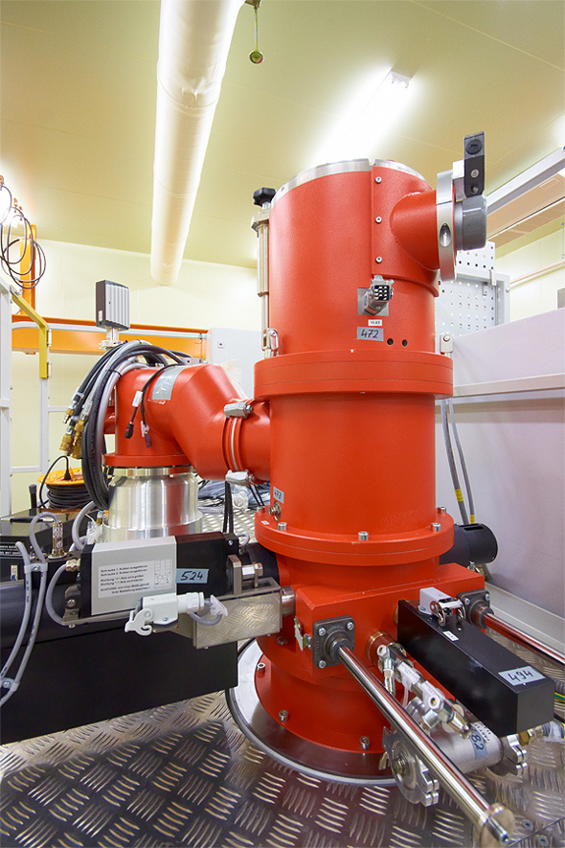
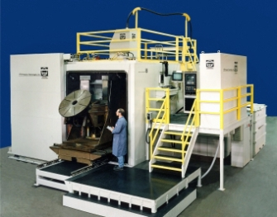
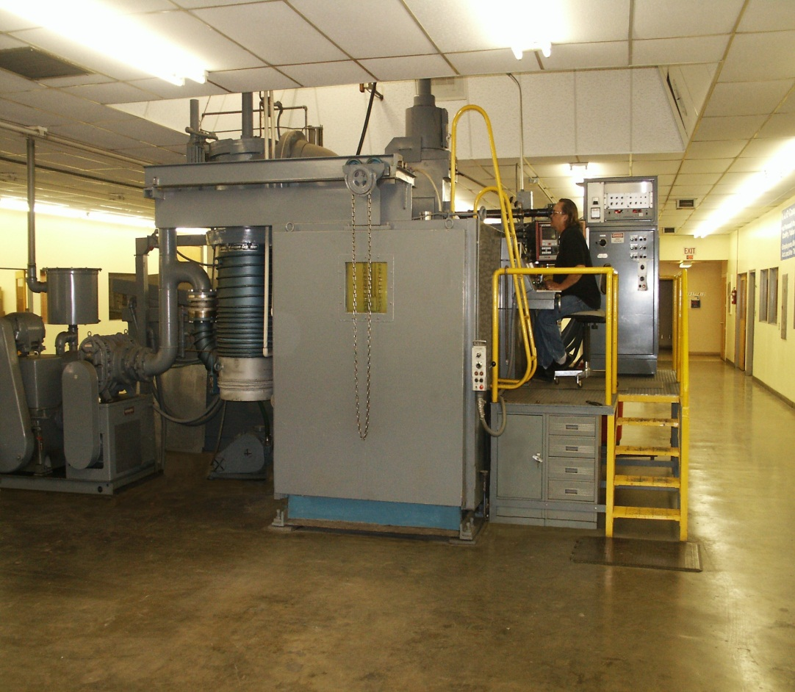
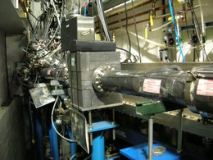
The challenge: Particle beams and electromagnetic radiation are usually generated in vacuum. For some applications it is desirable to bring beams in air or pass the beams through internal gas targets. Such applications include Nuclear Physics experiment, as well as electron beams for welding, X-ray, VUV, EUV for use in microscopy, lithography, etc.
Motivation
Electron-beam welding is the highest quality welding that can be performed. But, it’s done in vacuum, resulting in low production rates and limits on object size. Double hull ship can’t fit in a vacuum system. Past in-air EBW: lower quality.

Slide 19
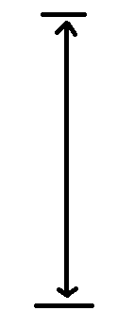
Motivation
Electron Beam Through Plasma Window
for the NRL
1 m
(East Granby, CT, USA)
Workpiece

Slide 20

Photons transmission via a Plasma Window
Thin solid windows are used for a whole spectra of high energy gammas; But, in some of these cases, these solid foils limit gamma outputs; i.e., machines are capable of generating higher intensities, the beam degrades, and the foil is damaged (two-fold problem).
Plasmas, including those in a PW, have a dual personality: electromagnetic radiation of frequency below the plasma frequency is severely attenuated, while the PW is completely transparent for electromagnetic radiation with frequency above the plasma frequency (unless there is a gas/plasma resonance).
The plasma frequency is the frequency at which electrons in a plasma oscillate: $ω_{p}^{cgs}={\left(\frac{4πn_{e}e^{2}}{m_{e}}\right)}^{1/2}$
A PW opened to atmosphere has a plasma density of about 1.5x10¹⁷ cm⁻³, for which the plasma frequency is $ω_{p}$ = 3.5x10¹² Hz; i.e., electromagnetic radiation with wavelength above 86000 nm are attenuated, while the PW is completely transparent for shorter wavelengths. There is no limit on radiation power that can pass through a PW. Furthermore, the bigger the radiation flux, the better
the PW works (creating more ionization).
Experimental data, e.g.: Light from a HeNe 632.8 nm laser and UV radiation from NSLS (BNL), as well as X- and gamma-
rays were passed through a PW open to atmosphere without any attenuation.
Cross sections for interaction of radiation from ultraviolet out into the hard x-ray regime, with individual particles is
usually minuscule, e.g., for Thompson scattering σ = 2/3 b (1 b = 10⁻²⁴ cm²), i.e. mfp $l$ ~ 10⁷ cm.
At resonance, however, some photo-absorption and -ionization cross sections can reach the 10⁻¹⁹–10⁻¹⁸ cm² level.
The typical target thickness of a PW$nl$ ~ 1.5x10¹⁷ cm⁻² is about four orders of magnitude lower than that of a
conventional 250 µm beryllium window with $nl$ ~ 2.5x10²¹ cm⁻². Electromagnetic radiation of an energy far
from the absorption resonances of the working gas should have negligible interaction with a PW due to
small target thickness coupled with low interaction cross sections.

Slide 21

Further applications: Commercial & Scientific
Several different types of accelerator systems can benefit from the utilization of the PW system.
Commercial Applications:
Non-vacuum electron beam welding: With PWs, higher production rates, no limit on the size of target objects, and high quality electron beams in atmosphere.
Non-vacuum material modifications by ion implantation, and dry etching, or micro-fabrication: Presently performed only in vacuum, since ion beams at energies used in these applications are completely attenuated by foils and by long differentially pumped sections.
Electron beam melting: for manufacturing alloys is performed at a pressure of about ${10}^{−2}$Torr. A major drawback of operating at this pressure range is the loss of elements with low vapor pressure. Consequently, it is desirable to raise the operating pressure to a higher level.
Electron beam generation of photo-neutrons for the production of medical isotopes (e.g., Tc-99): A 40 MeV electron beam strikes a W target. Resultant radiation can dislodge a neutron (via a giant resonance) to create a new element. With a plasma window, the target can be in the air, sufficiently cooled to absorb an intense electron beam to generate photo-neutrons.
Windowless gas targets for fast neutron radiography to detect nitrogen (weapons) and carbon (diamonds), as well as for other forms of neutron tomography and therapy (BNCT).
Windows for high power lasers (especially high-pressure gas lasers) and LBW.
Scientific Applications:
Windowless beamlines for transmission of synchrotron radiation: Plasma windows offer many advantages over presently used beryllium windows:
radiation passes through the window unaffected. A plasma window cannot be damaged by radiation. UV filter for rejection of ‘high-order’ light is of
significant benefit to experiments like threshold photoionization spectroscopy, where contamination even at the ${10}^{−4}$ harmonic content can obscure
the features of the spectrum of interest. X-ray microscopies, since it is free from the attenuation and spatial structure that attend the use of
conventional window materials (e.g. beryllium or SiN), i.e., no scratches.
Windowless gas targets for fast (fusion) neutron generation (neutron sources).
Radioactive waste transmutation (ATW): protons are accelerated to 2 GeV unto a heavy metal target in air. Resultant spallation neutrons
reduce radioactive waste. Presently, windows limit proton output.
APT – tritium production by accelerator: Solid windows limit beam and tritium output.
Spallation Neutron Source (SNS): To replace various solid windows with cooling problem.
Windows for high power x-ray source (DARHT).
Internal (gas or plasma) targets, strippers, lenses in storage rings: A plasma stripper/lens or an internal gas target
"sandwiched" between two PWs. Examples: BNCT based on recirculating proton beams and various internal targets
(including spin-polarized).
Fast acting valves in UHV beamlines. In case of vacuum breach, plasmas can be ignited faster than mechanical valves without damage to beamline (unlike, presently used, msec spring loaded shutters).

Slide 22
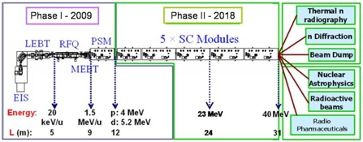
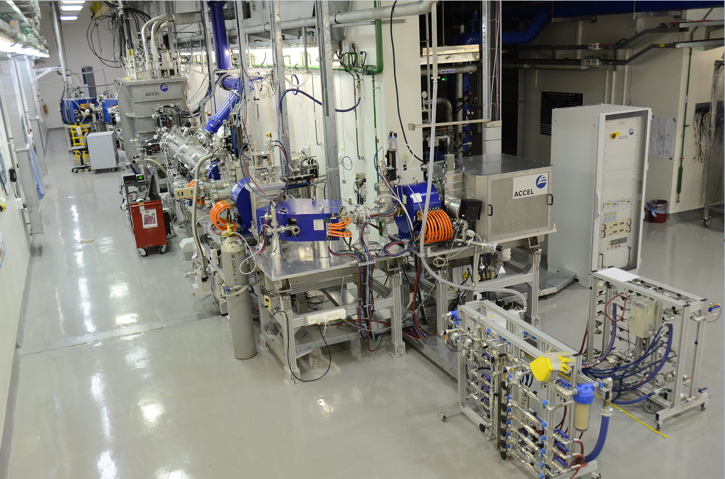
The Soreq Applied Research Accelerator Facility - SARAF
Motivation
A multi-user and versatile particle accelerator. It is based on a proton/deuteron RF superconducting linear accelerator, with variable energy (up to 40 MeV) and a continuous wave (CW) high ion current (0.04-5 mA), located at the Soreq Nuclear Research Center.
2024

Slide 23
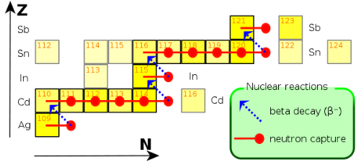
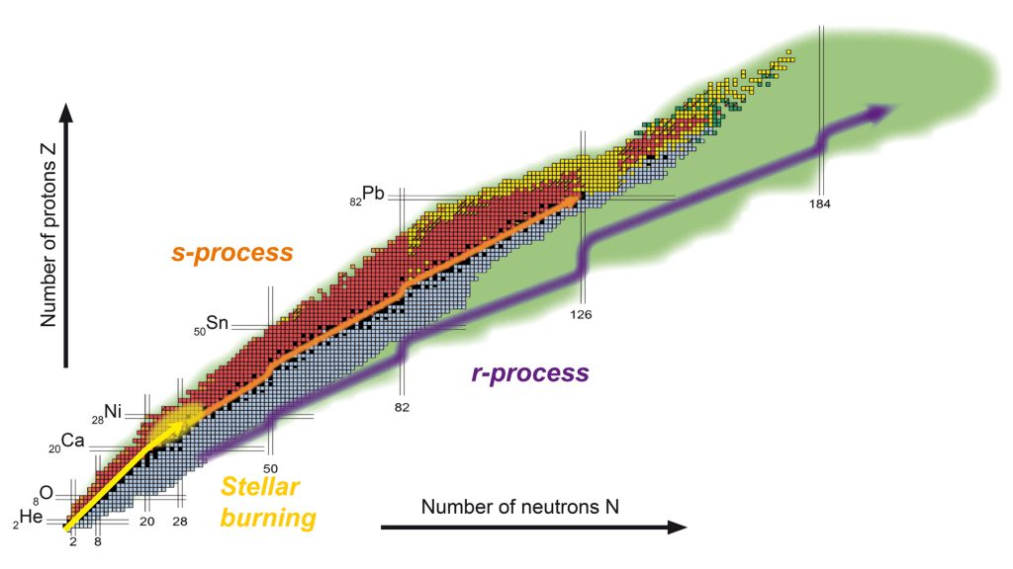



Motivation
Characterization of neutron-induced reaction rates on unstable isotopes is essential for understanding the nucleosynthesis occurring in astrophysical events involving massive stars (s-processes - e.g., the s-process acting in the range from Ag to Sb):
$$n → p + e^{−} +{\overline{ν}}_{e}$$
An enriched water ($H_{2}{}_{}^{18}O$) target is under consideration at SARAF, for using the (p,n) reaction at an accelerated proton energy of 2.6 MeV in order to produce a 5 keV Quasi-Maxwellian neutron spectrum. So far, this reaction has been operated on solid targets, with corresponding low proton current and neutron flux. We aim to make use of the very high current available at SARAF-II to produce orders of magnitude more neutrons, and thus require a high-density target that is able to withstand high currents, which leads us to select a liquid based target. The only relevant liquid is $H_{2}{}_{}^{18}O$.
$$MACS=〈σ〉=\frac{〈σv〉}{v_{T}}=\frac{2}{\sqrt{π}}\frac{\int_{0}^{∞}{e^{−E/kT}σ\left(E\right)EdE}}{\int_{0}^{∞}{e^{−E/kT}EdE}}$$
Image courtesy of EMMI, GSI/Different Arts.

Slide 24
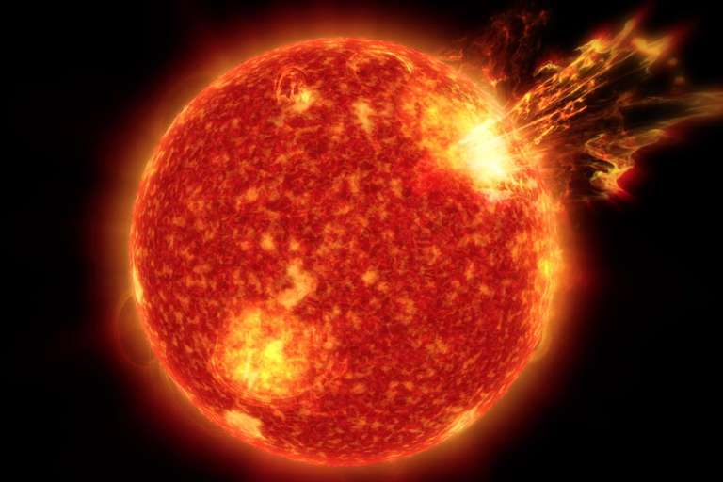
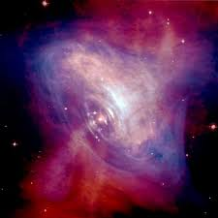
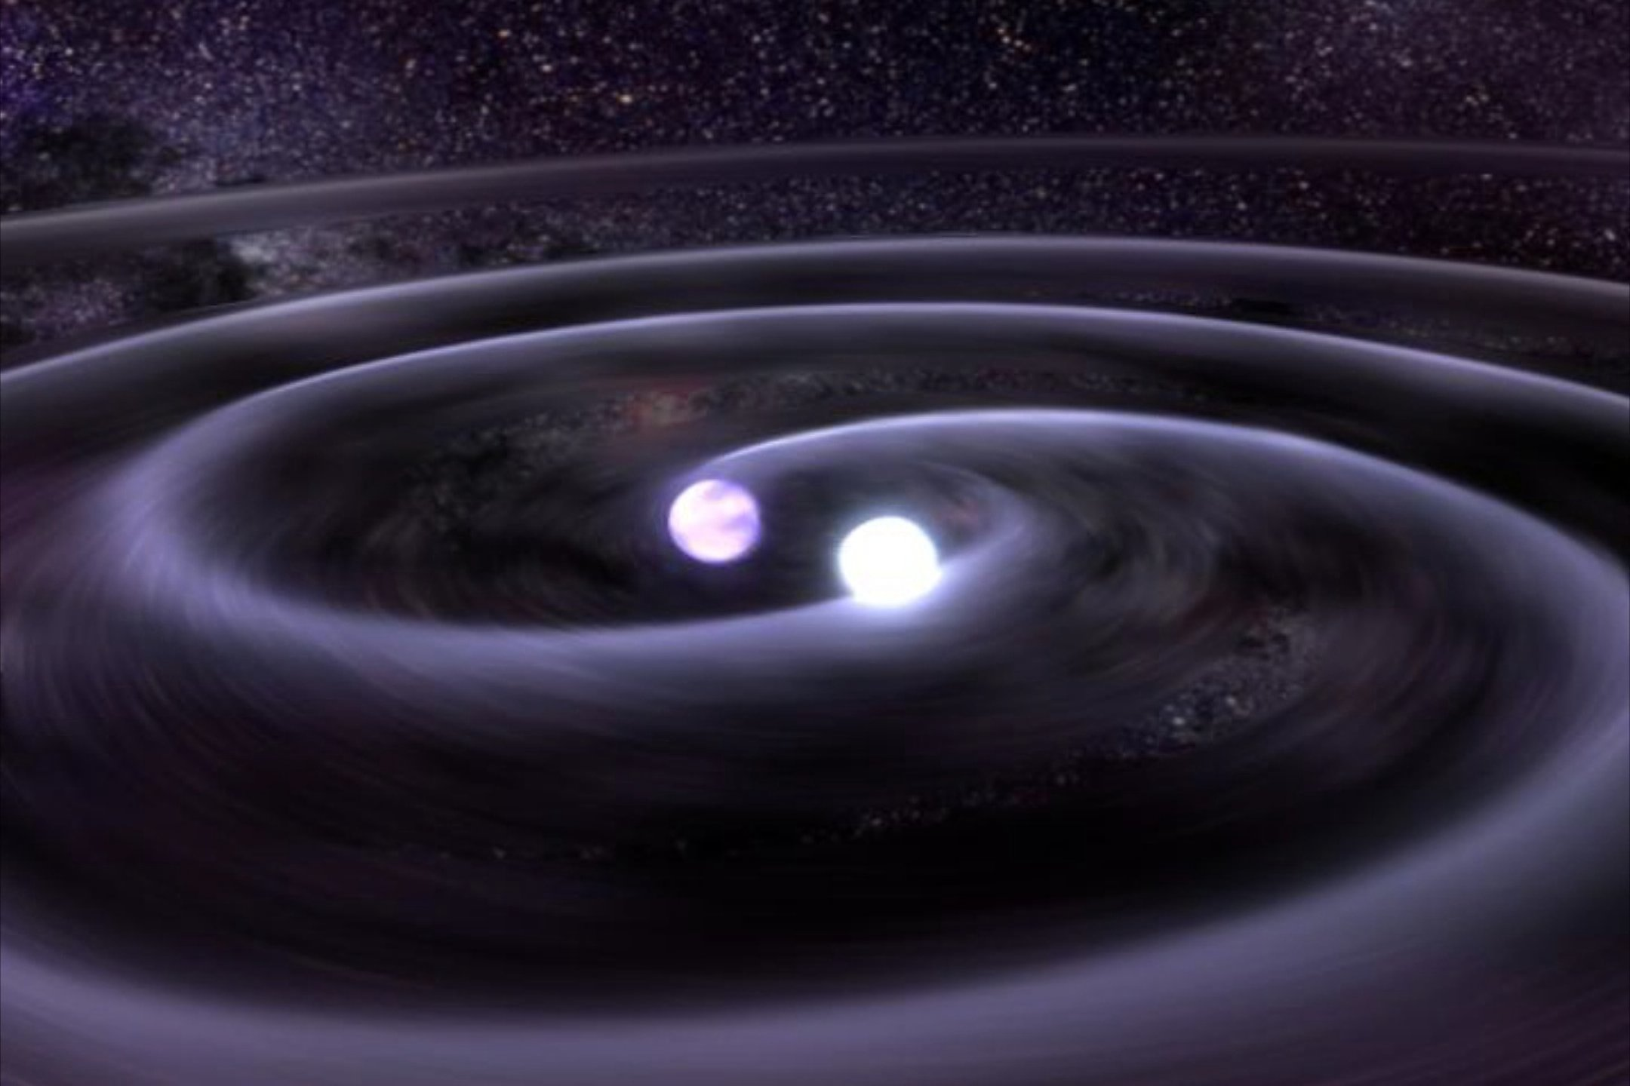
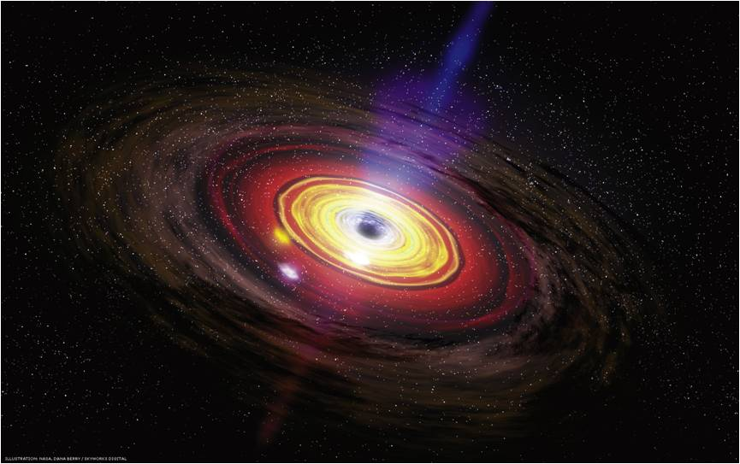
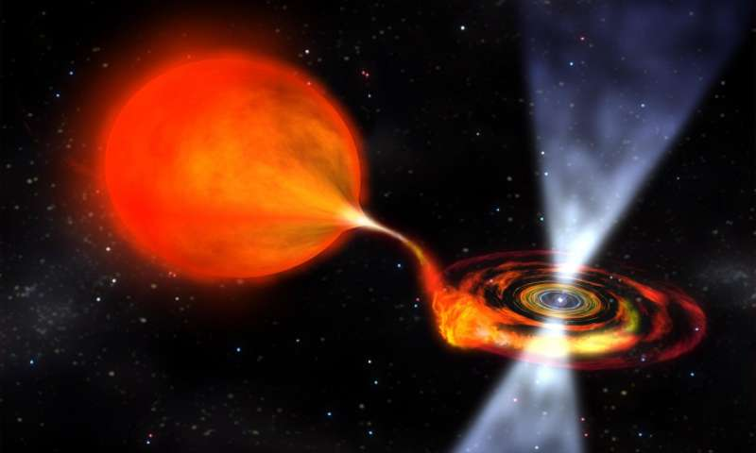
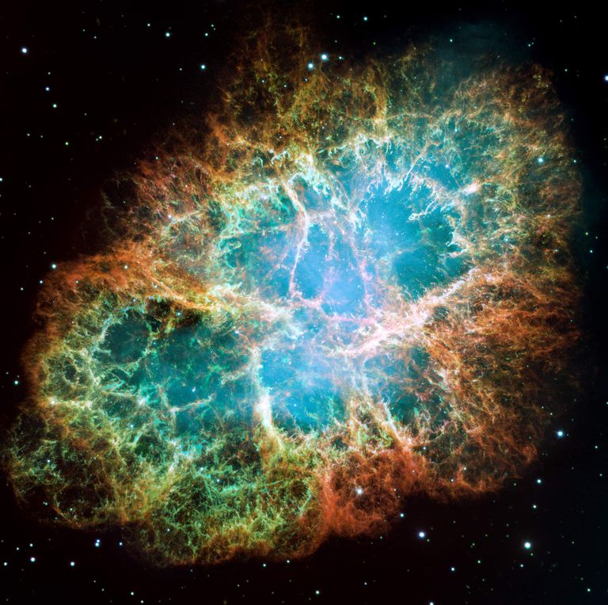
Motivation
Endgoal – The better understanding of processes occuring in:
Asymptotic giant branch stars
Pulsars, binary mergers
Active galactic nuclei
Supernova explosions
Data will be used in state-of-the-art nucleosynthesis codes simulating the interior of stars during different burning stages, in collaboration w/ Rene Reifarth’s gp. @GUF

Slide 25
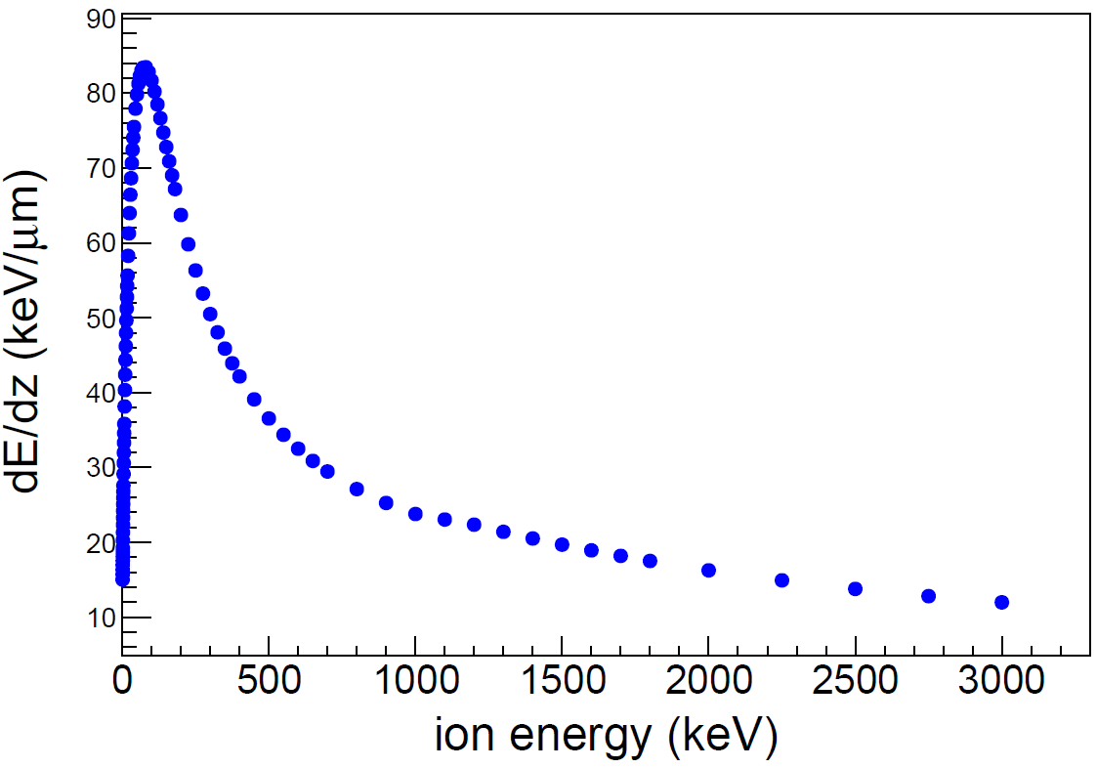
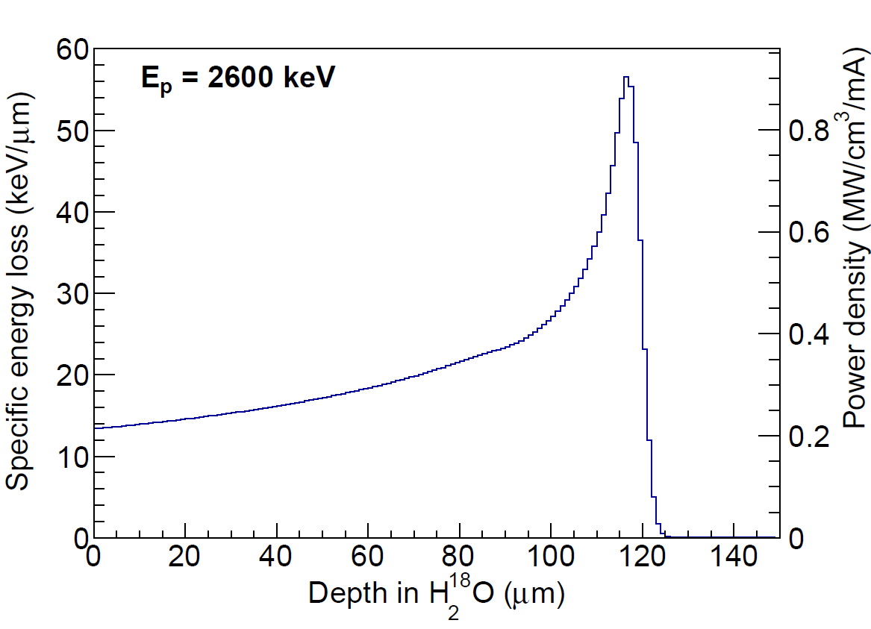
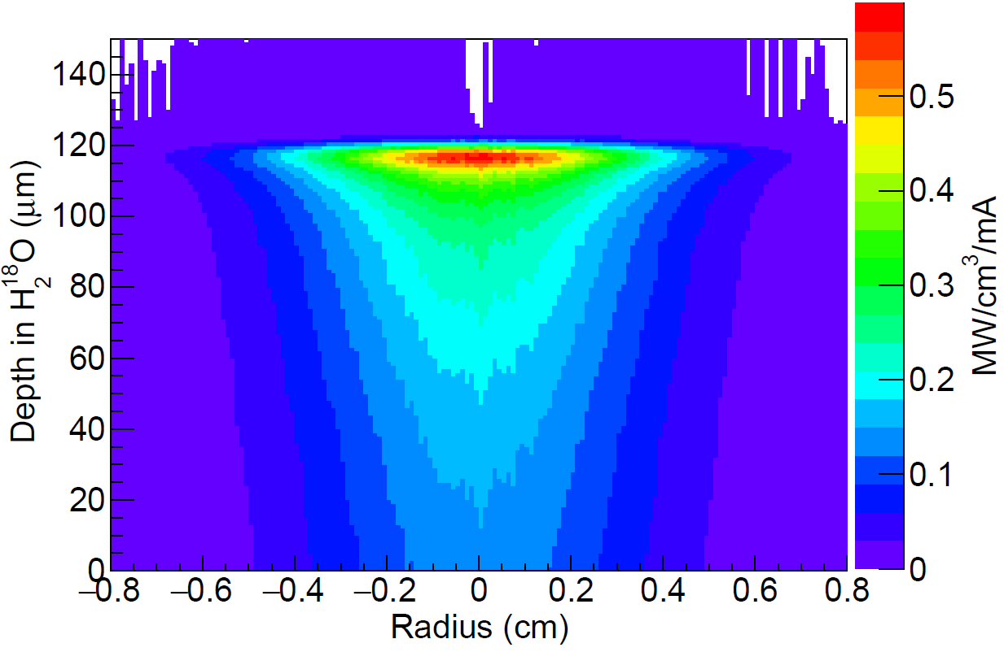
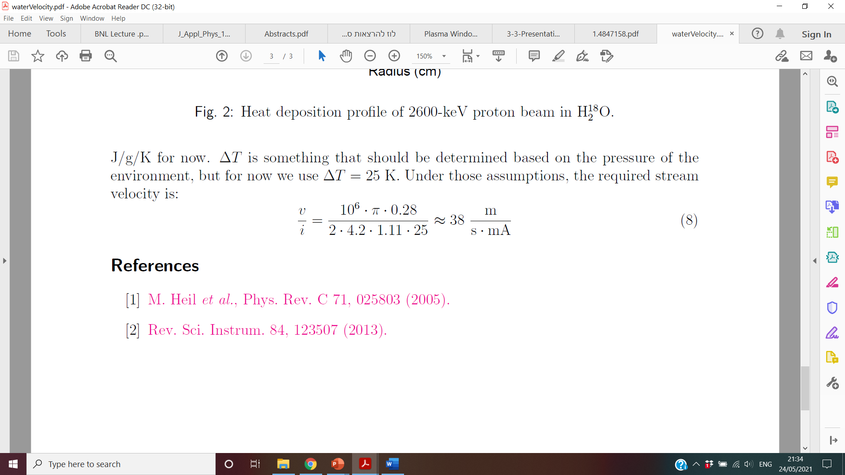

Simulation of $H$ energy and heat deposition in $H_{2}{}_{}^{18}O$ target – preliminary results
Energy loss and heat deposition probe of 2600-keV proton beam in $H_{2}{}_{}^{18}O$. The volume power density plotted is the power deposited within one radial standard deviation.
Energy loss rate vs. initial beam energy
Energy loss vs. depth in the target
Heat deposition
Conservation of the expensive $H_{2}{}_{}^{18}O$entails the use of a circulating target, containing a
reservoir, a heat exchanger and a cooling loop, which controls the liquid's temperature and
flow rate.
The high vapor pressure of $H_{2}{}_{}^{18}O$ is incompatible with accelerator vacuum.
We opt to solve this by using a Plasma Window.
Required stream velocity on impact:

Slide 26
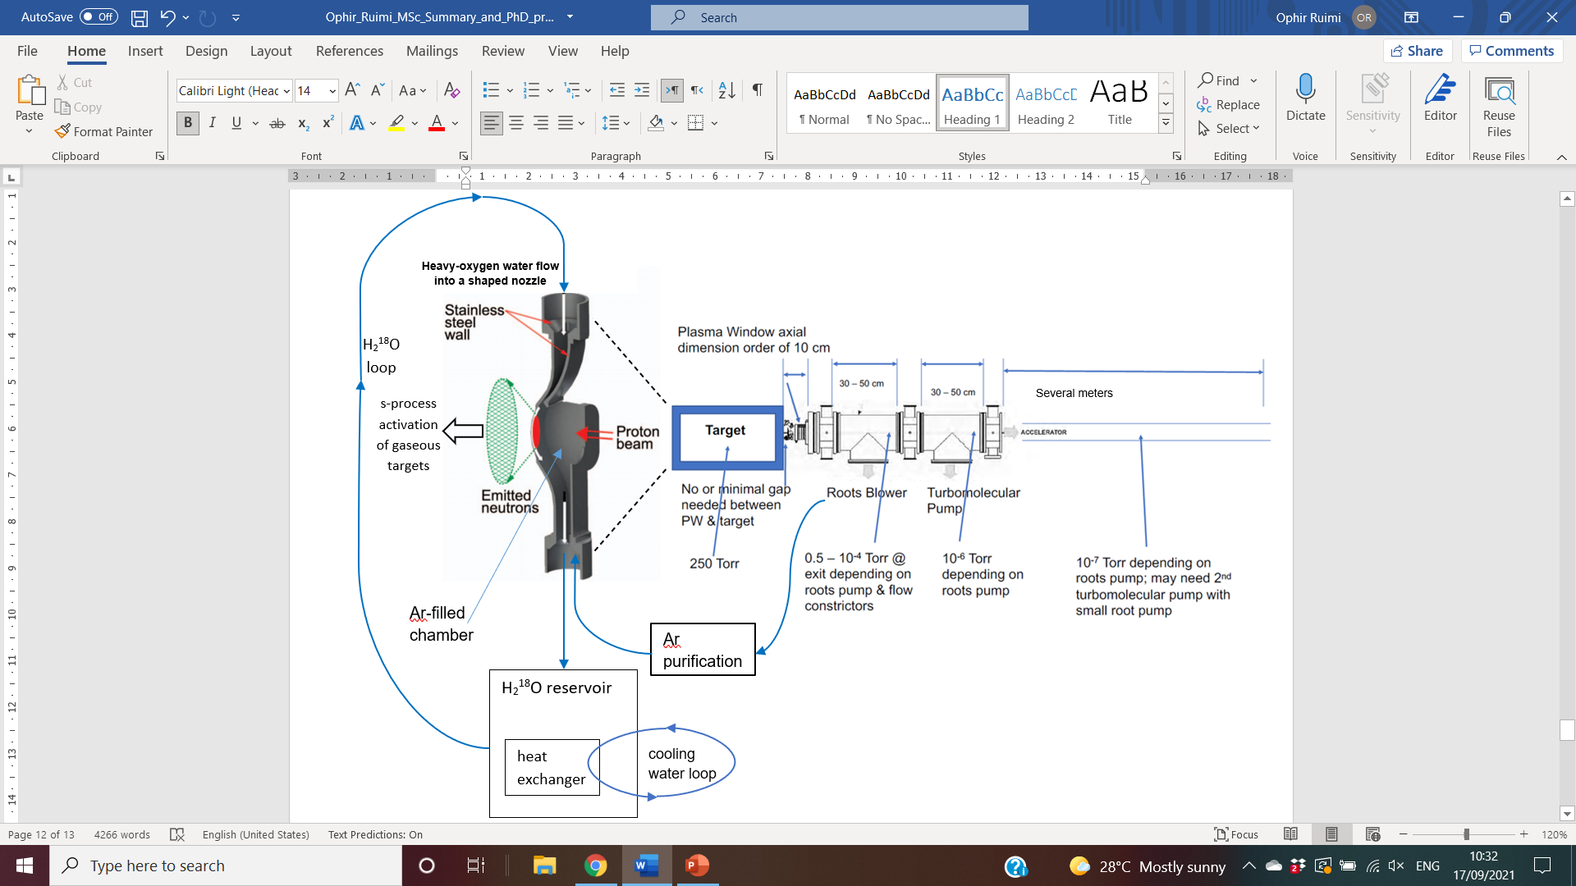
Experiment overview
s-process activation of gaseous targets: Kr, Xe, ⁹⁹Tc.
SARAF’s phase II is under construction, beamtime planned for mid-end 2024

Slide 27
Summary
Plasma is the fourth fundamental state of matter. It contains a significant portion of charged particles – ions and electrons. The presence of these charged particles is what primarily sets plasma apart from the other fundamental states of matter. It is the most abundant form of ordinary matter in the universe, being mostly associated with stars. Plasma can be artificially generated by heating a neutral gas or subjecting it to a strong electromagnetic field.
Plasma is much less dense and much more viscous than a gas when both are at the same pressure.
A Plasma Window (PW) is an apparatus that separates between vacuum and atmosphere without any solid walls, and can hinder the flow of gases with little effect of fast particles passing through it.
PWs have many applications in medicine (e.g. BNCT), industry (e.g. EBW, LBW) & science (e.g. in particle accelerators).
PWs are used for scientific research in the fields of experimental particle physics, nuclear astrophysics, plasma
chemistry, high-energy physics, accelerator physics and more.
PWs have been used for the transmission of electrons, protons, photons and heavy ions at various energies.
A particle beam passing via a PW can improve both the beam’s and the PW’s characteristics.
Photon transmission through a PW is possible above the plasma frequency, typically ~10 THz (or at a
wavelength below ~100 µm).
What seemed to be science fiction (“force fields”) 40 years ago is today’s reality.
PWs actively contribute to the noble cause of our better understanding of the universe we live in.

Slide 28
Questions?
Thank You for your attention

Slide 29

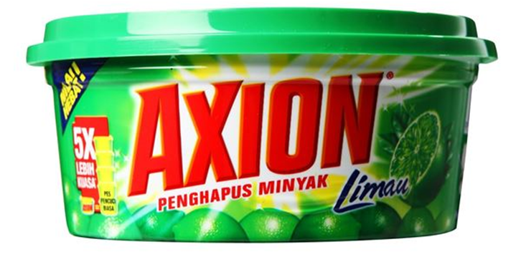
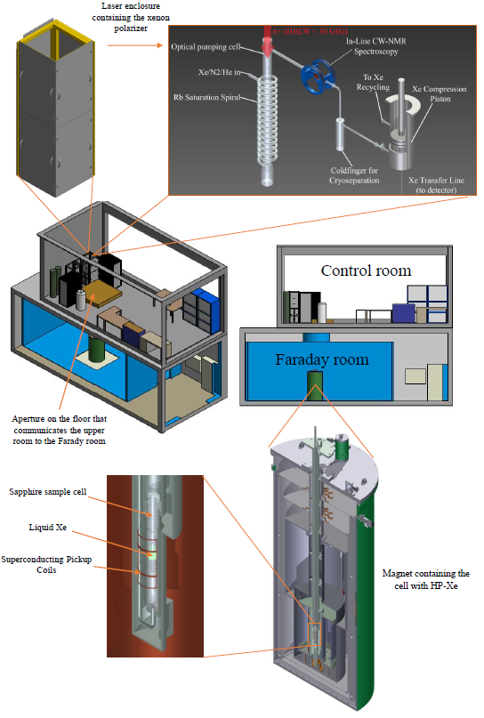
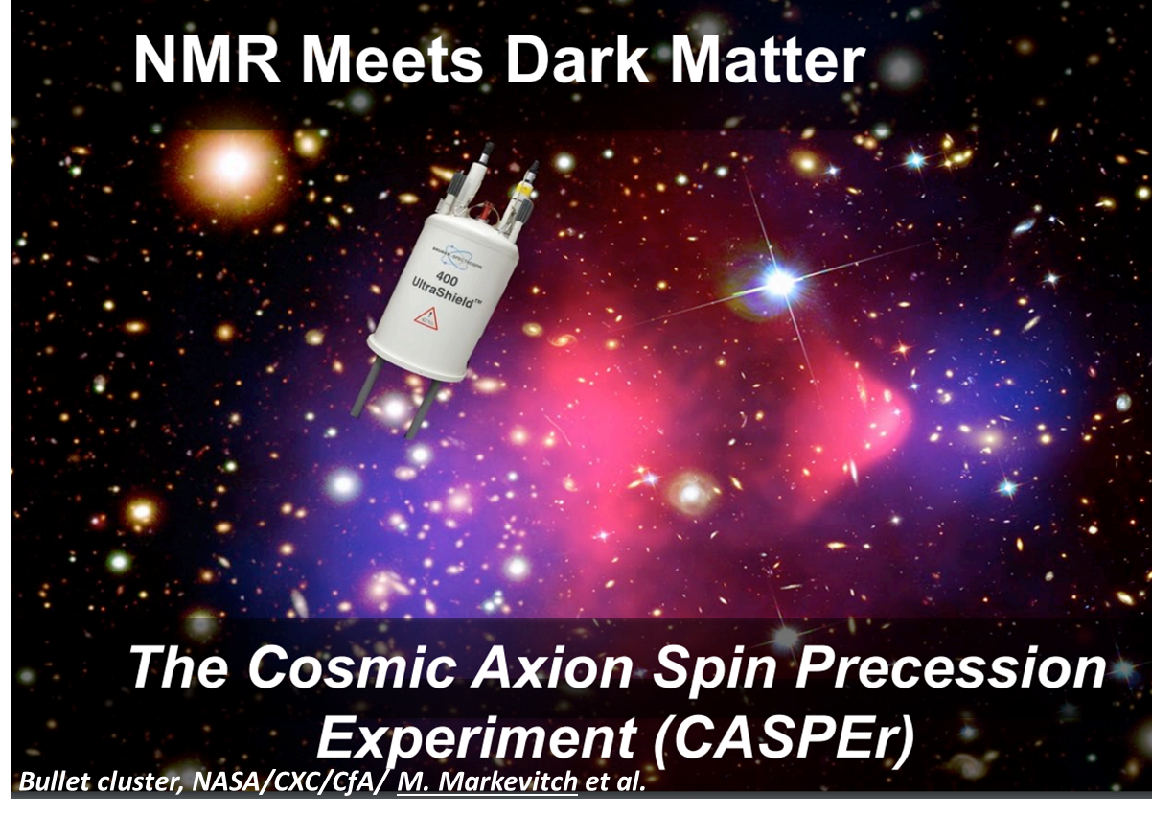
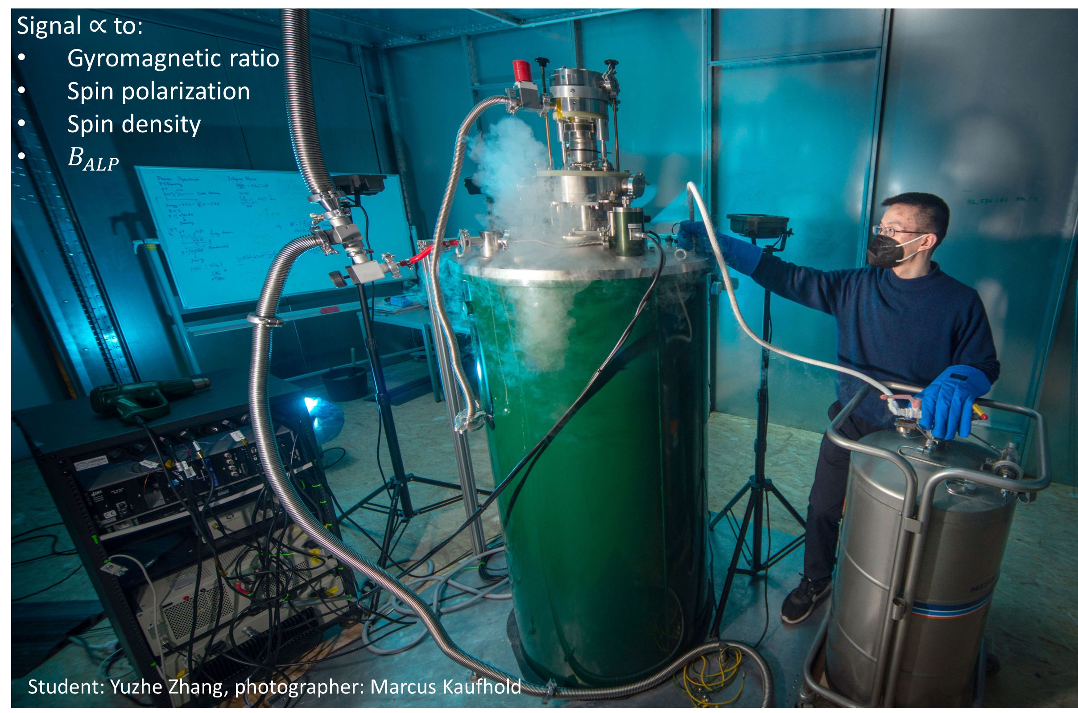
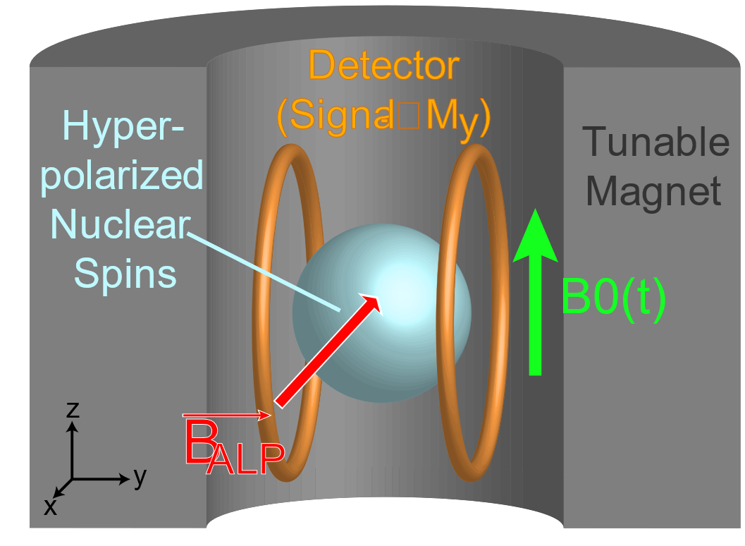
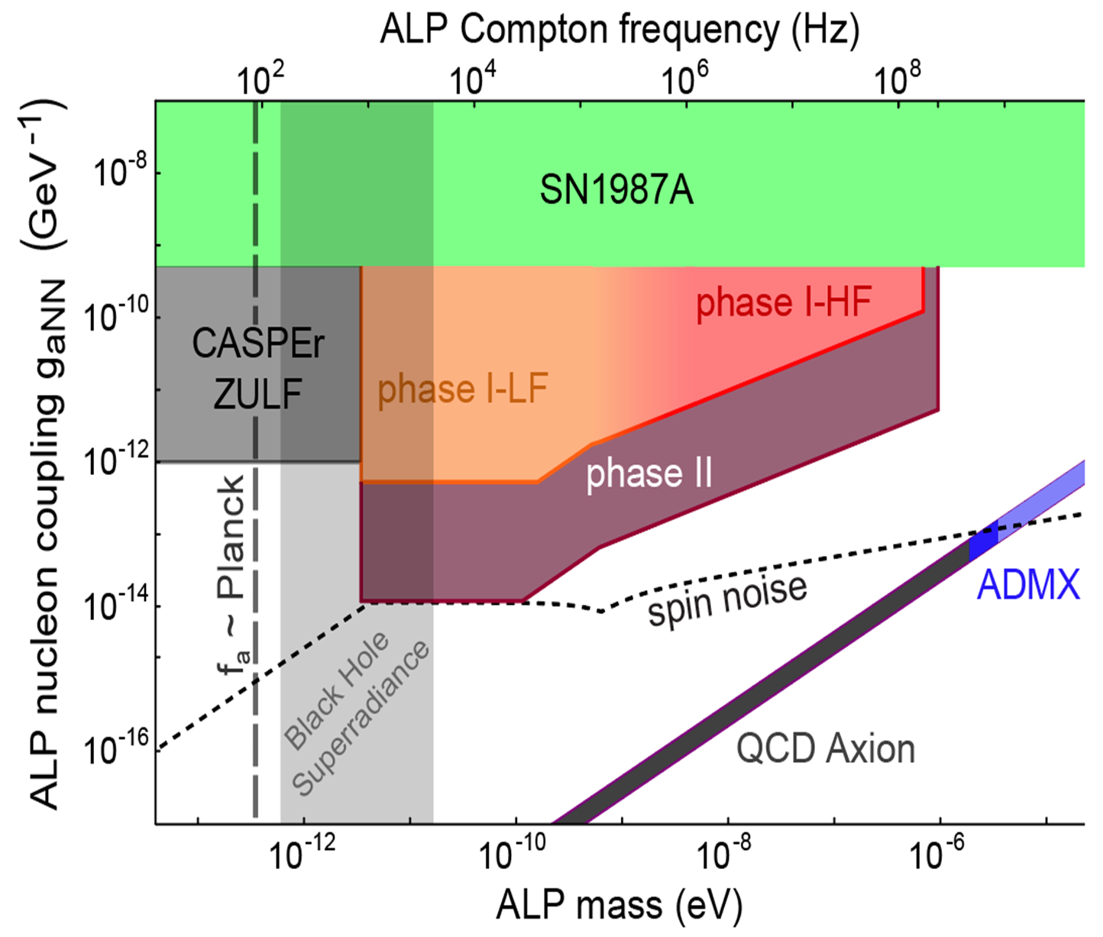



Magnetic Resonance Spectroscopy and Imaging
in the CASPEr Dark Matter Experiment
Poster #42/P12 – Ophir Ruimi (HUJI & JGU)
for the CASPEr collaboration
ophir.ruimi@mail.huji.ac.il
How to detect axions?
Hyperpolarization by SEOP
Xe transport and sample preparation
Achieved and projected results

