Slide 1


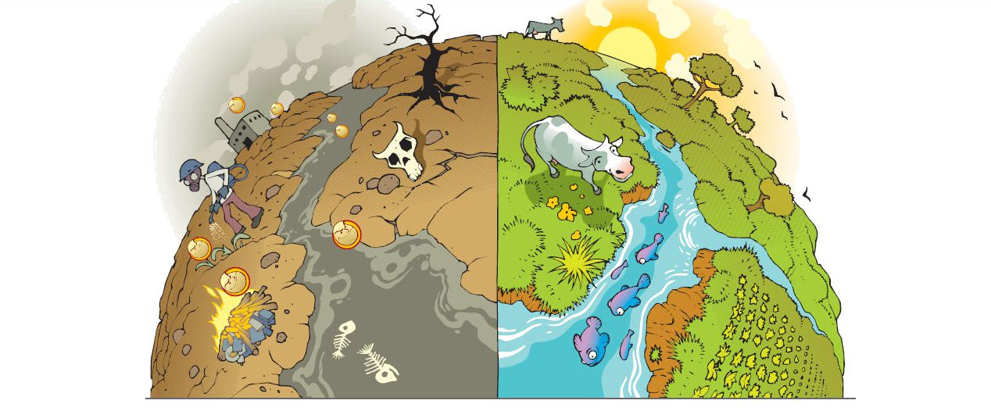
IBER 2023
Theoretical-computational comparative study of the persistent organic pollutants: adsorption, detection and permeability
Nicolás Ramos Berdullas
Dept of Physical Chemistry, Universidade de Vigo
Notes:
First of all, thank you chairman for your nice introduction and thanks to the organizers for inviting me and giving me this fantastic opportunity to present you our work. Again, thank you!
My presentation tackles the importance of a good description about non-covalent interactions, in the particular of persistant organic pollutants from a point of view of treatment, detection and action.

Slide 2





Introduction
Why do persistent organic pollutants matter?
Persistent organic pollutants (POPs) are hazardous chemicals that threaten human health and the planet’s ecosystems.
Remain intact for long periods of time
Accumulate and magnify in living organisms through the food chain
Are toxic to both humans and wildlife
Become widely distributed throughout the environment
Notes:
Why do persistent organic pollutants matter? Because they are dangerous chemicals that threaten human health and the planet’s ecosystems.
They present the following characteristics: they remain intact for long periods of time; they accumulate and magnify in living organisms through the food chain; they are toxic to both humans and wildlife; and they become widely distributed throughout the environment .

Slide 3
Introduction
Why do persistent organic pollutants matter?
Persistent organic pollutants (POPs) are hazardous chemicals that threaten human health and the planet’s ecosystems.
cancer risk
reproductive disorders
alteration of the immune system
neurobehavioral impairment
endocrine disruption
genotoxicity
increased birth defects.
long‐term exposure even to low levels of POPs
Notes:
In addition, scientific evidence shows that long‐term exposure even to low levels of POPs could cause important diseases and disorders

Slide 4


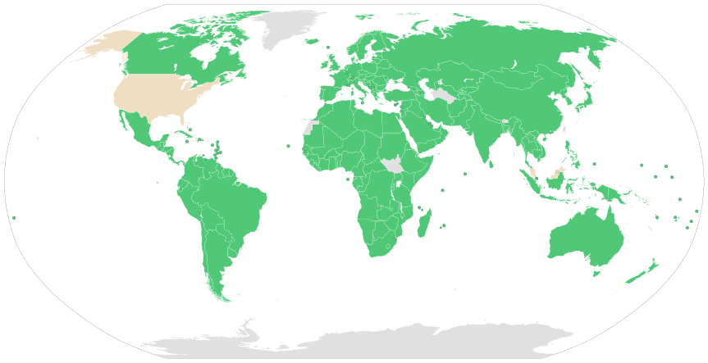
Introduction
Why do persistent organic pollutants matter?
A global treaty to protect human health and the environment from POPs
In 2004, the Stockholm Convention on persistent organic pollutants calls for reduction or elimination of releases of POPs globally.
To date, 185 countries have ratified the Convention
Notes:
For all these reasons, the United Nations with its Environment Programme prepared a global treaty to protect human health and the environment from POPs. This was ratified in 2004. The Stockholm Convention calls for reduction or elimination of releases of POPs globally. To date, 185 countries have ratified the Convention

Slide 5
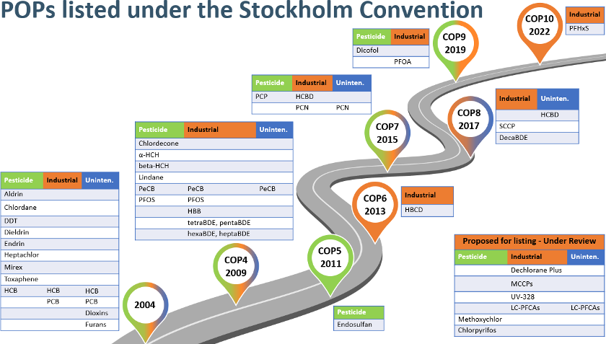
Introduction
Why do persistent organic pollutants matter?
New chemicals get added regularly. 34 POPs are listed under the Convention as 17 pesticides, 15 industrial chemicals, 7 unintentional by-products.
Notes:
As you can see, this agreement was updated and new chemicals get added regularly. So, nowadays 34 POPs are listed under the Convention
Among them, the Unintentional Persistent Organic Pollutants are really important due to address their reduction because…

Slide 6
Introduction
Why do persistent organic pollutants matter?
Unintentional Persistent Organic Pollutants (UPOPs) are not voluntarily produced or released into the environment but they derive from anthropogenic sources.
They are emitted during incomplete combustion process involving organic matter and chlorine or are created as by-products of manufacturing other chemicals.
Remarkable decline of unintentional POPs has been detected in all countries, which indicated that the effective implementation of the Stockholm Convention contributed to air quality control.
Notes:
They are not voluntarily produced or released into the environment but they derive from anthropogenic sources.
Usually, They are emitted during incomplete combustion processes involving organic matter and chlorine or are created as by-products of manufacturing other chemicals. Indeed, the UPOPs levels are directly related to air quality.

Slide 7
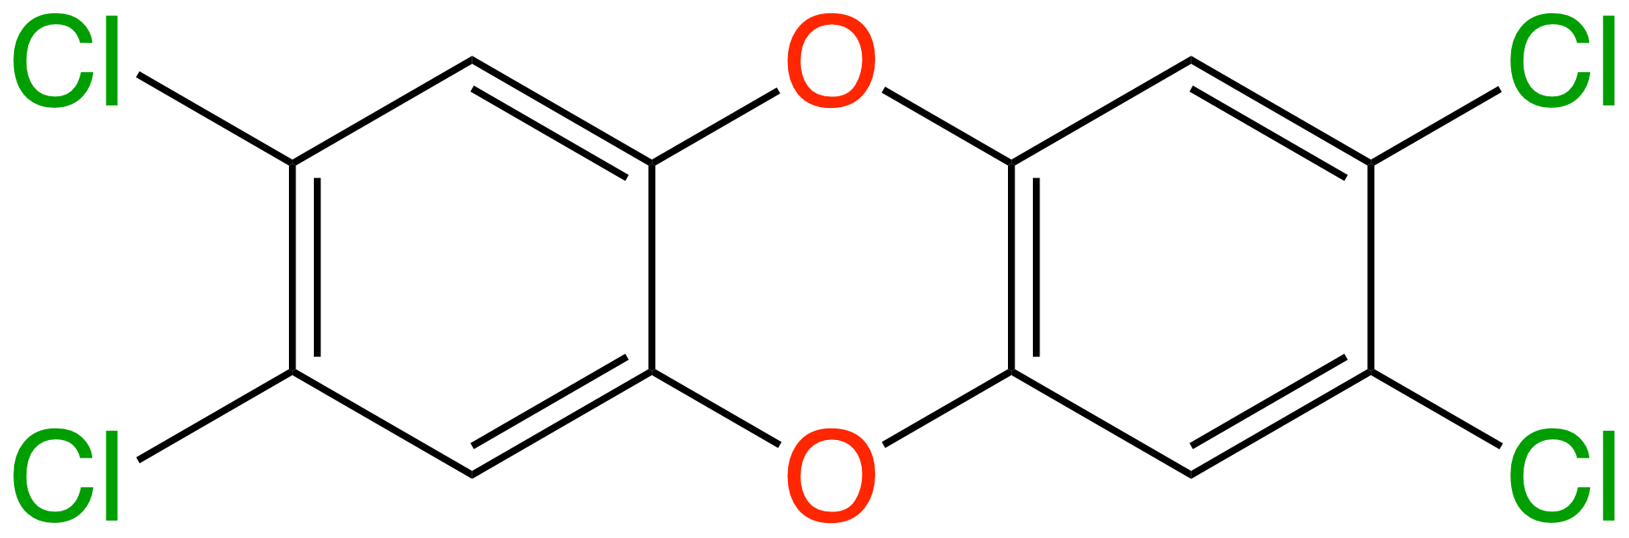
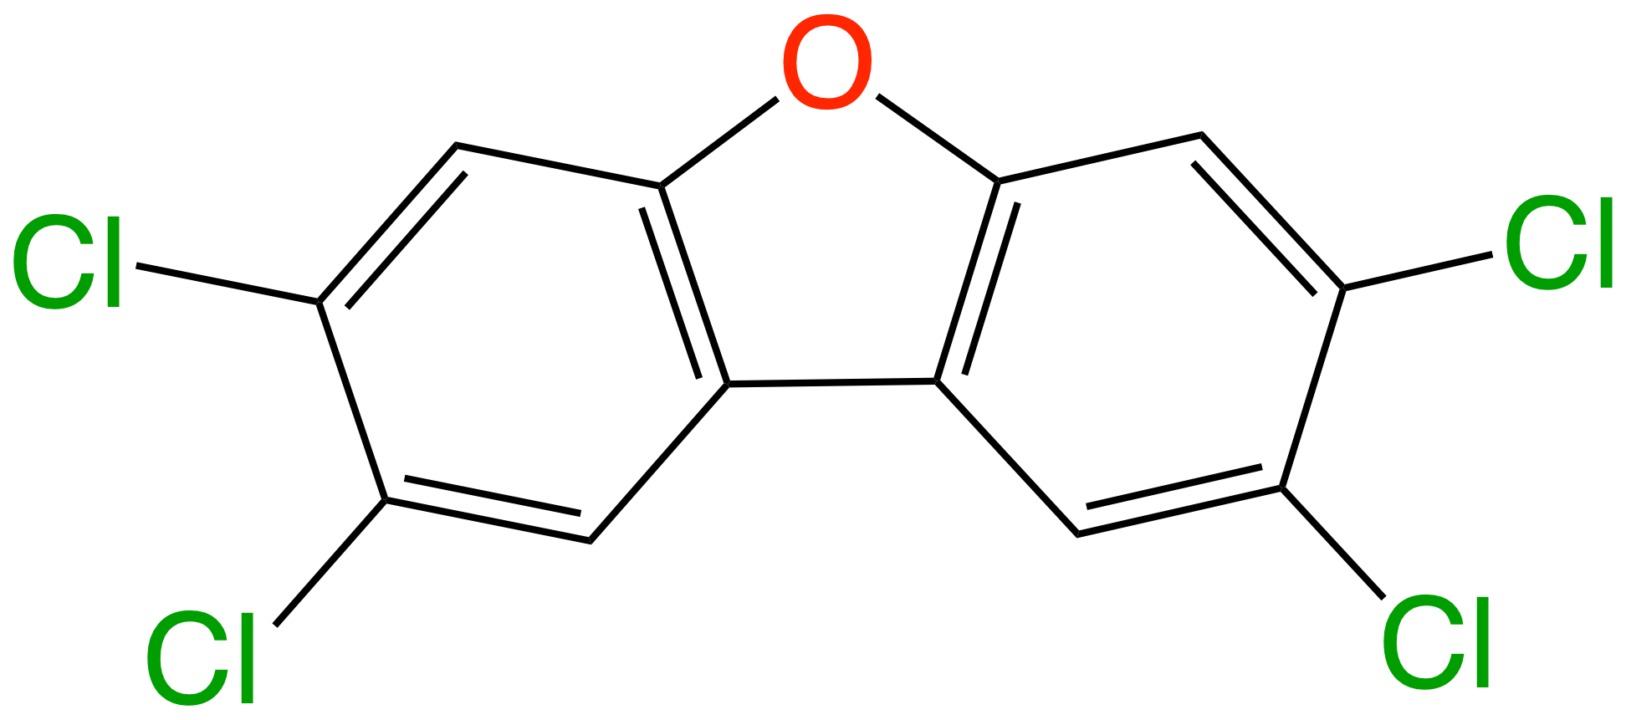
Introduction
Why do persistent organic pollutants matter?
Polychlorinated dibenzo-p-dioxins (PCDDs) and dibenzofurans (PCDFs) are the most known and the only listed as unintentional POPs.
75 PCDD and135 PCDF congeners
17 congeners substituted 2,3,7,8-positions (toxic!)
Measures from individual toxicity assays assign a single scaling factor known as the Toxic Equivalency Factor (TEF).
2,3,7,8-tetrachloro-p-dibenzodioxin
TCDD
TEF = 1.0
2,3,7,8-tetrachlorodibenzofuran
TCDF
TEF = 0.1
Notes:
From them, the Polychlorinated dibenzodioxins (PCDDs) and dibenzofurans (PCDFs) are the most known and the only listed as unintentional POPs in the initial treaty.
They are composed by a significant numbers of congeners, but only 17 of them are toxic.
Measures from individual toxicity assays assign a single scaling factor known as the Toxic Equivalency Factor (TEF). Thus, TCDD and TCDF are the best investigated UPOPs with the highest toxicity. That is why we will focus on them.

Slide 8
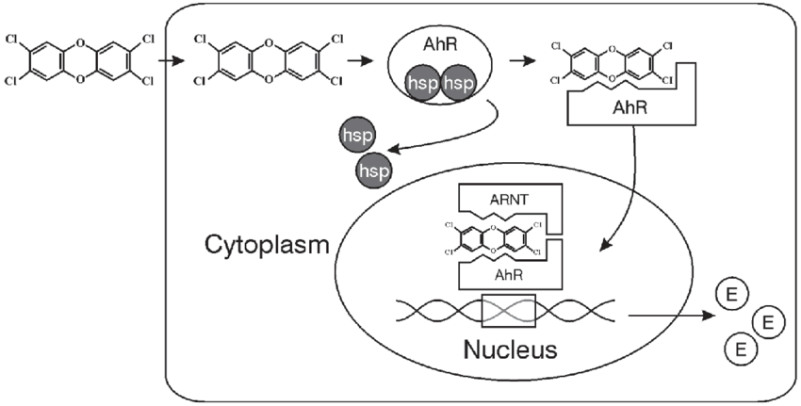
Introduction
Mode of Action: Inside the cell
The binding of "dioxin-like" chemicals to the AhR is considered the initial step in the toxic effects observed in mammals.
The translocation into the nucleus and the dimerization with the nuclear translocator is affected.
P. S. Ross and L. S. Birnbaum Human and Ecological Risk Assessment 2003, 9, 303
Notes:
The action mode of these pollutants is: at the beginning the diffusion through the membrane and once inside the cell, they bind to Aryl hydrocarbon receptor till causing changes in gene transcription.

Slide 9
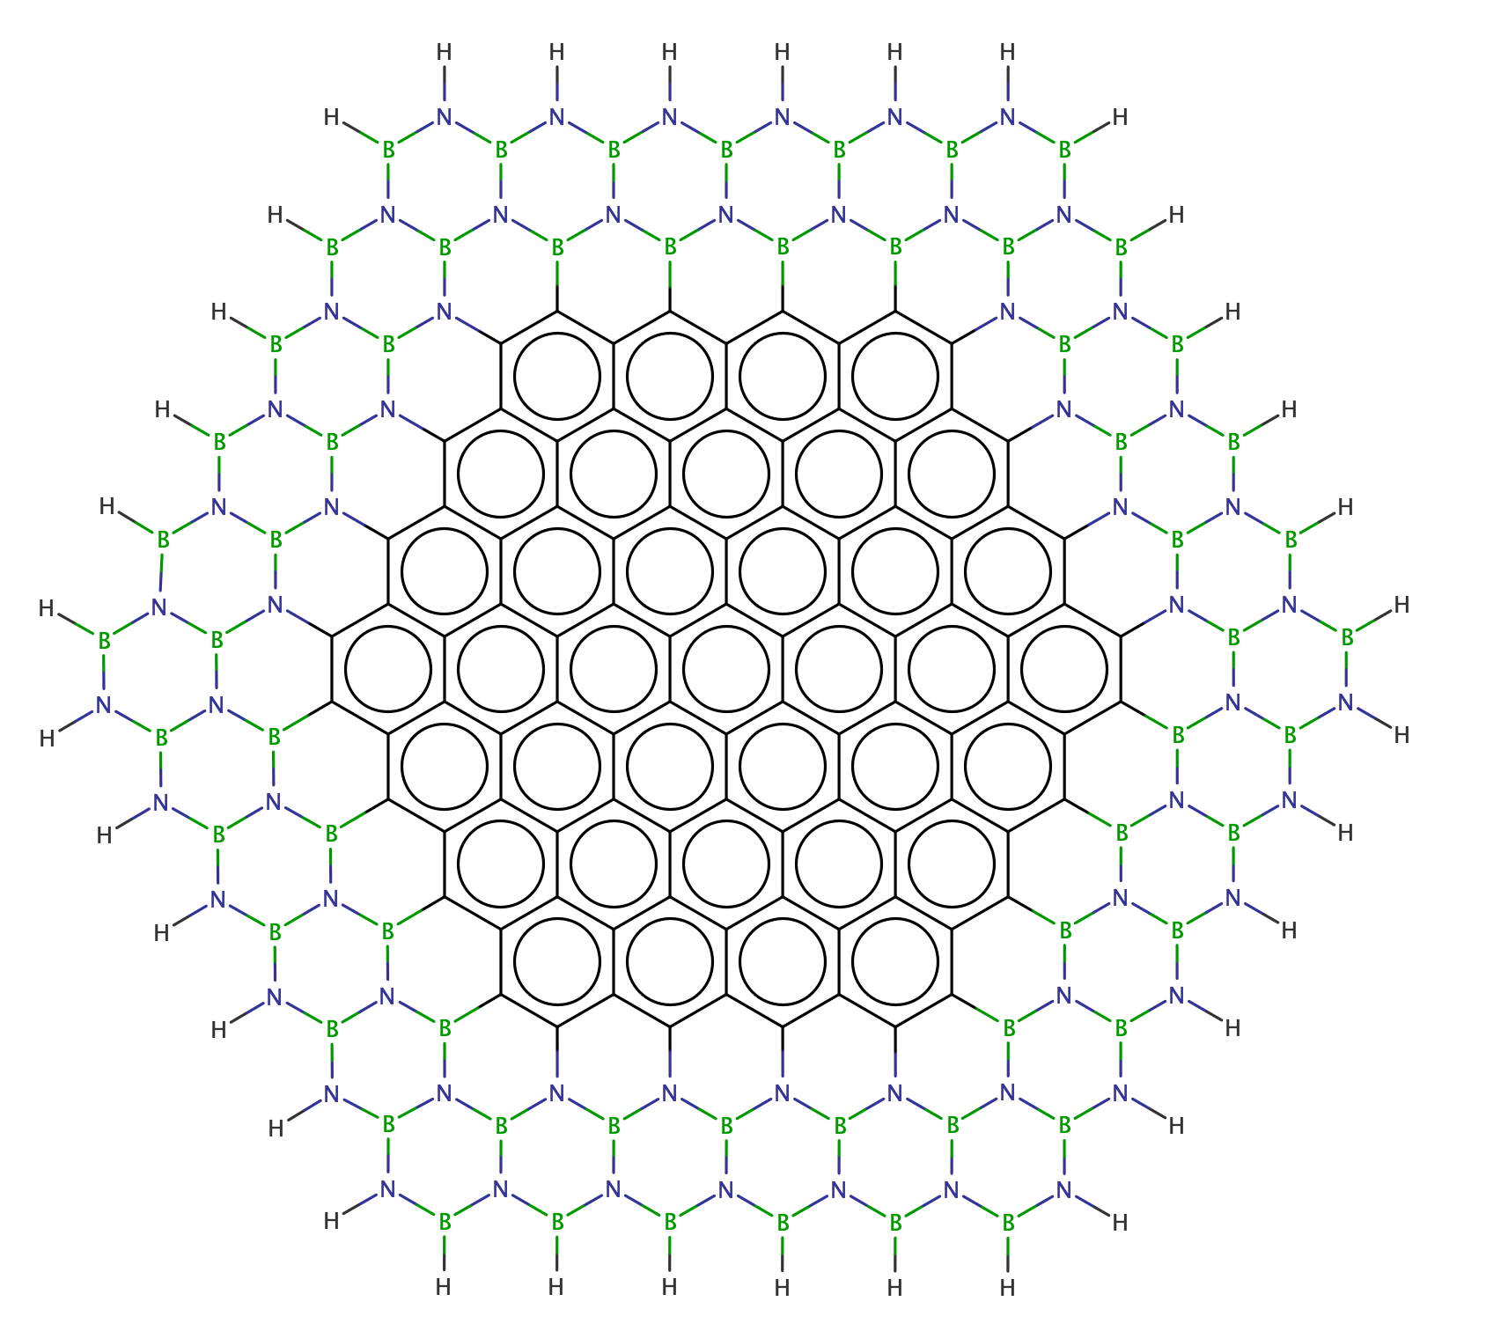
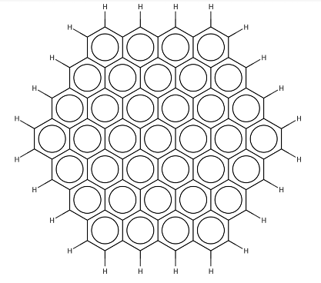
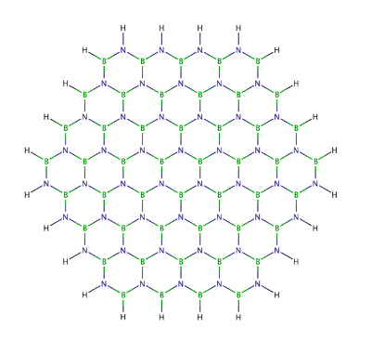
Introduction
State-of-the-Art on POPs
The reduction and/or detection of “dioxins” is a priority for preventing environmental contamination and to protect living organisms from their damages.
C96
BN96
h-BNC96
The development of new substrates as chemical sensors or filters for the treatment of polluting substances involves the analysis of the affinity and stability of the complexes formed between substrates and pollutants.
Notes:
From a theoretical point of view, the state of the art on POPs are mainly related to the reduction and/or detection of “dioxins”.
For that, the development of new substrates as chemical sensors or filters for the treatment of these substances involves the analysis of the affinity and stability of the complexes formed between pollutants and substrates. For example, using graphene or boron nitride surfaces, known as white graphene, or even hybrid materials based on boron, nitrogen and carbon, whose optical activity may be easily tuned for sensing.

Slide 10
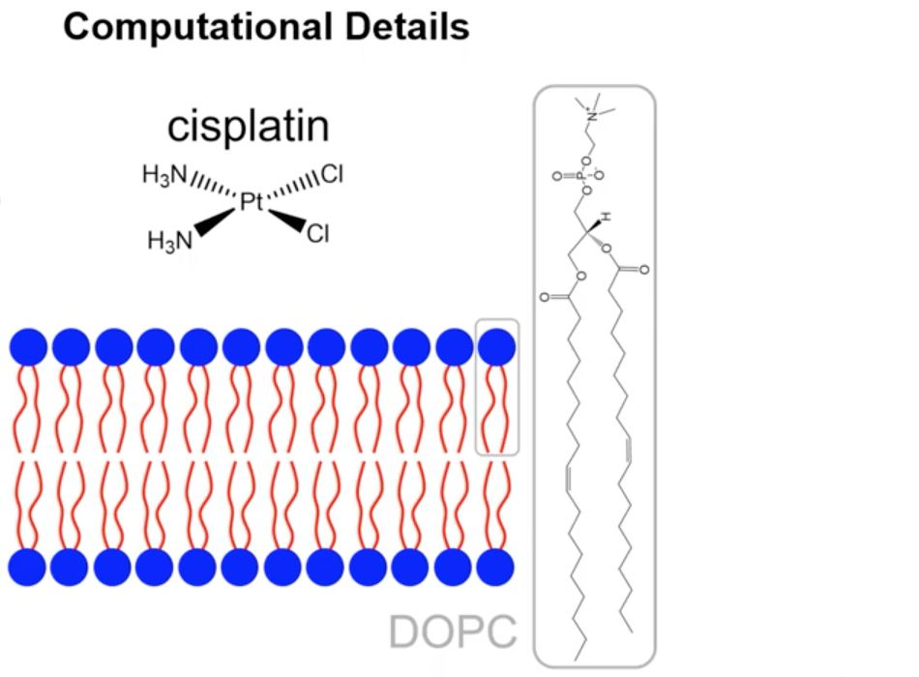
Introduction
State-of-the-Art on POPs
Absorption and diffusion of dioxins through the cell membrane are the first steps of its action mechanism within cells.
TCDD
TCDF
1,2-dioleoyl-sn-glycero-3-phos-phocholine
The analysis of the intermolecular interactions between substances and lipid bilayers tackles the existence of storage deposits in the membranes, which become an internal source of chronic exposure to these pollutants.
Notes:
On the other hand, spite of the action mode inside the cell is pretty experimentally well-known. The absorption and diffusion of dioxins through the cell membrane are really the first steps of its action mechanism within cells. So, the analysis of the intermolecular interactions between substances and lipid bilayers tackles the bioaccumulation in the membrane.

Slide 11
Introduction
Motivation
The characterization of pollutant-membrane or pollutant-substrates interactions are key to understand involved mechanims.
Non-covalent interaction such as dispersion (between instantaneous charges) and exchange/repulsion (due the to Pauli exclusion principle), are roughly represented in classical Force Fields.
A energy decomposition analysis (EDA) scheme was applied in combination with Quantum Mechanics/Molecular Mechanics (QM/MM) or QM calculations.
This theoretical research allows a complete vision of the problem; covering the action, detection and treatment of these substances.
Notes:
Thus, the motivation within these topics are:
The characterization of pollutant-membrane or pollutant-substrates interactions are key to understand involved mechanims.
For that, it is necessary to take into account that Non-covalent interaction such as dispersion and exchange/repulsion, are roughly represented in classical FFs.
So, for first time within this topic a energy decomposition analysis (EDA) scheme was applied in combination with QM/MM or QM calculations.
Finally, this theoretical research allows a complete vision of the problem; covering the action, detection and treatment of these substances.

Slide 12

Methodology
Interaction Energies: QM Case
Supermolecule Approach
$$E_{int}=E_{AB}\left(\text{AB}\right)−\left(E_{A}\left(\text{AB}\right)+E_{B}\left(\text{AB}\right)\right)$$
How to obtain the Energy contributions?
Density based Energy Decomposition analysis
Expression of the total energy:
M. Mandado and J. M. Hermida-Ramón J. Chem. Theory Comput. 2011, 7, 633.
Notes:
Now, I´m going to introduce briefly the EDA scheme in both cases. First, for QM case, the definition of the interaction energy using the supermolecule approach is going to be the difference of the energy of the complex minus the energies of each one of the monomers, considering the same basis set in the three calculations in order to correct the basis set superposition error.
However, what about the enegy contributions…we are going to use Density based Energy Decomposition analysis approaches developed by professor Mandado. The first thing is to consider the expression of the total energy. This is a functional of the one electron density and the two electron exchange correlation densities. This expression should be used to compute each one of these terms above.

Slide 13
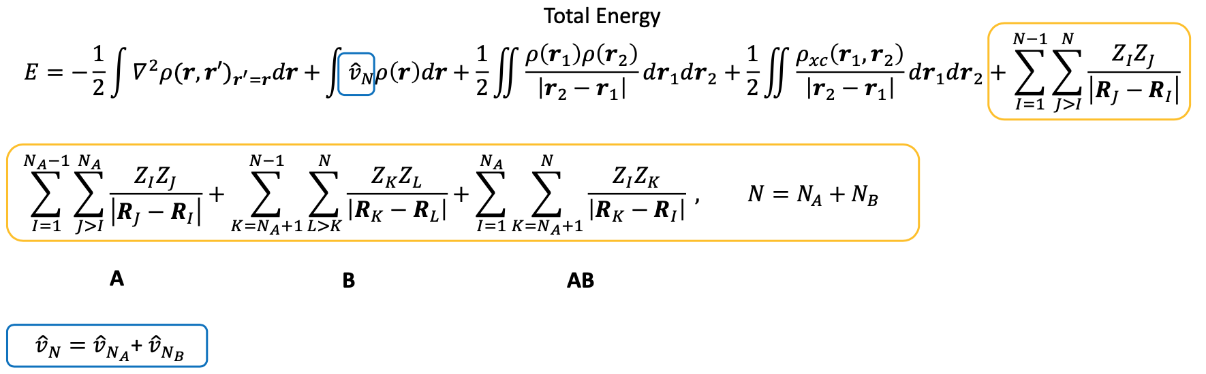
Methodology
EDA: QM Case
$$E_{AB}\left(\text{AB}\right)$$
Subdivide the nuclear terms as contribution of the monomers
M. Mandado and J. M. Hermida-Ramón J. Chem. Theory Comput. 2011, 7, 633.
Notes:
So we are going to manipulate this expression to obtain a proper energy decomposition, in particular, we are going to focus on the expression of the energy of the complex. We are going to do 2 things, the first one is gonna subdivide the nuclear terms as contribution of the monomers. Thus, these operators appear in the electron-nucleus attraction term and in the nucleus-nucleus repulsion.

Slide 14
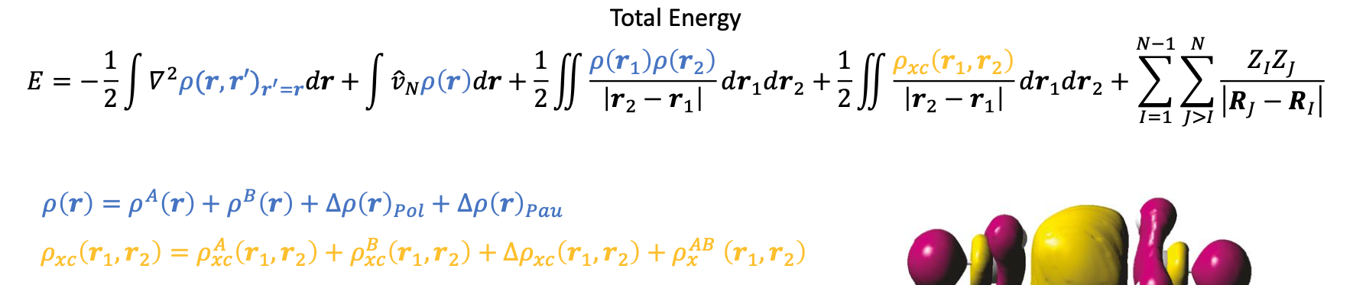
Methodology
EDA: QM Case
$$E_{AB}\left(\text{AB}\right)$$
Represent $ρ\left(\text{r} \right)$ and $ρ_{xc}\left({\text{r}}_{1}\text{,}{\text{r}}_{2} \right)$ as sums of unperturbed terms of each one of the monomers plus two perturbation terms from the interaction of the two monomers
M. Mandado and J. M. Hermida-Ramón J. Chem. Theory Comput. 2011, 7, 633.
Notes:
The second thing we´re gonna do is we are going to represent the one electron density and the two electron exchange correlation densities as sums of unperturbed terms of each one of the monomers plus two perturbation terms from the interaction of the two monomers

Slide 15
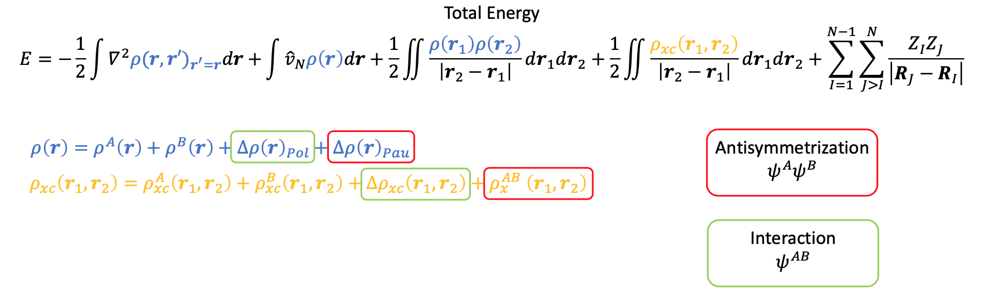
Methodology
EDA: QM Case
$$E_{AB}\left(\text{AB}\right)$$
Represent $ρ\left(\text{r} \right)$ and $ρ_{xc}\left({\text{r}}_{1}\text{,}{\text{r}}_{2} \right)$ as sums of unperturbed terms of each one of the monomers plus two perturbation terms from the interaction of the two monomers
These terms are going to account for the Exchange repulsion interactions between the two monomers
These terms are going to account for the polarization interactions between the two monomers
M. Mandado and J. M. Hermida-Ramón J. Chem. Theory Comput. 2011, 7, 633.
Notes:
Now, we take a look at these two perturbation term in both density expression. So the red term in both cases accounts for the anti-symmetrization of the two unperturbed wavefunctions of the two monomers. These terms are going to account for the Exchange repulsion interactions between the two monomers.
On the other hand, the green terms arise in the relaxation of the total wavefunction of the complex. These terms are going to account for the polarization interactions between the two monomers

Slide 16
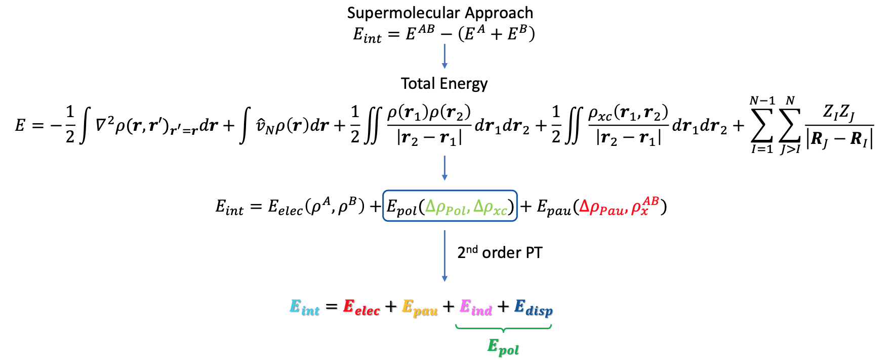
Methodology
EDA: QM Case
Supermolecule Approach
$$E_{int}=E_{AB}\left(\text{AB}\right)−\left(E_{A}\left(\text{AB}\right)+E_{B}\left(\text{AB}\right)\right)$$
$$E_{AB}\left(\text{AB}\right)$$
The development of new substrates as chemical sensors or filters for the treatment of polluting substances involves the analysis of the affinity and stability of the complexes formed between substrates and pollutants.
M. Mandado and J. M. Hermida-Ramón J. Chem. Theory Comput. 2011, 7, 633.
N. Ramos-Berdullas, I. Pérez-Juste, C. Van Alsenoy and M. Mandado Phys. Chem. Chem. Phys. 2015, 17, 575
Notes:
Now, if we´re putting all these things together including the energy expression for each one of these energy terms and considering the modifications in the complex energy, we obtain the following expression: We have an electrostatic term, a polarization term and an Pauli term.
However, it is possible to apply the 2nd order of perturbation theory which includes a correction inside the polarization deformation density obtaining the next energy decomposition with electrostatic, Pauli, inductive and dispersion energy terms. This expression is gonna be used on the study of affinity and stability between substrates-pollutants complexes.

Slide 17
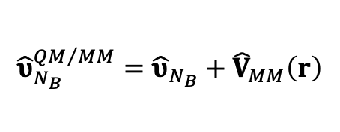
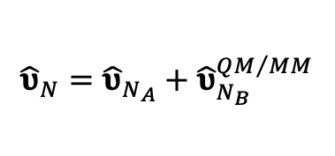

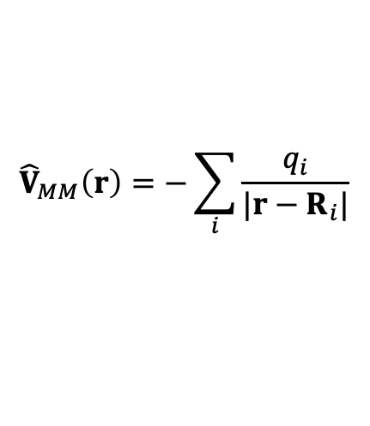
Methodology
EDA: QM/MM Case
Supermolecule Approach
$$E_{int}=E_{AB}\left(\text{AB}\right)−\left(E_{A}\left(\text{AB}\right)+E_{B}\left(\text{AB}\right)\right)$$
How to Include the MM Potential in the EDA Calculations?
MM point charges are included as nuclear terms in the energy
$${\hat{υ}}_{N}={\hat{υ}}_{N_{A}}+{\hat{υ}}_{N_{B}}$$
Nuclear potential operator
$${\hat{υ}}_{N}={\hat{υ}}_{N_{A}}+{\hat{υ}}_{N_{B}}^{QM/MM}$$
Fragment B includes the MM region
Electrostatic embedding
QM_{A}
$${\hat{υ}}_{N_{B}}^{QM/MM}={\hat{υ}}_{N_{B}}+{\hat{V}}_{MM}\left(r\right)$$
$${\hat{V}}_{MM}\left(r\right)=−\sum_{i}{\frac{q_{i}}{{|r−R}_{i}|}}$$
QM_{B}
MM_{B}
G. Cárdenas, Á. Pérez-Barcia, M. Mandado and J. J. Nogueira Phys. Chem. Chem. Phys. 2021, 23, 20533
Notes:
Now, how can we extend this EDA approach to the QM/MM framework. From the interaction energy expression we have to compute these three energy terms separately. Now, the complex no longer consists of just monomer A and monomer B because we have the molecular mechanics point charges. So, an electrostatic embedding QM/MM computation on the full complex is necessary. In addition, the real important thing here is to consistently assign these point charges to one of most present monomer in the system . In our case, we have assigned all point charges in the monomer associated with the lipid membrane whereas the other monomer is going to be the pollutants.
So, we are going to use the same expression as seen before except this time MM charges are included as nuclear terms in the energy expression.

Slide 18
Chemical sensors and filters
Adsorption complexes formed between TCDD and TCDF with finite models of graphene and white graphene formed by 96 atoms (No significant differences PCBs!).
EDA-QM scheme was applied on stacking and perpendicular complexes.
M062X hybrid functional includes most of dispersion energy implicitly, providing a more accurate description of the density polarization.
N. Ramos-Berdullas, I. Pérez-Juste, C. Van Alsenoy and M. Mandado Phys. Chem. Chem. Phys. 2015, 17, 575
R. Alvarado, N. Ramos-Berdullas and M. Mandado Int. J. Quantum Chemistry 2021, 121, e26591.
Notes:
So, we are going back to chemical sensor and filters study. The adsorption complexes formed between TCDD and TCDF with finite models of graphene and white graphene were explored as chemical filters. White graphene is used due to its pore size.
The choice of this size was based on a comparison using 96 atoms and periodic boundary conditions, showing no significant differences in adsorption complexes of graphene with other organic molecules. In order to analyze the affinity, EDA-QM scheme was applied on stacking and perpendicular complexes. The QM calculations was performed by this hybrid functional which includes most of dispersion energy implicitly, providing a more accurate description of the density polarization. We are gonna focused on stacking complexes due to larger stability.

Slide 19
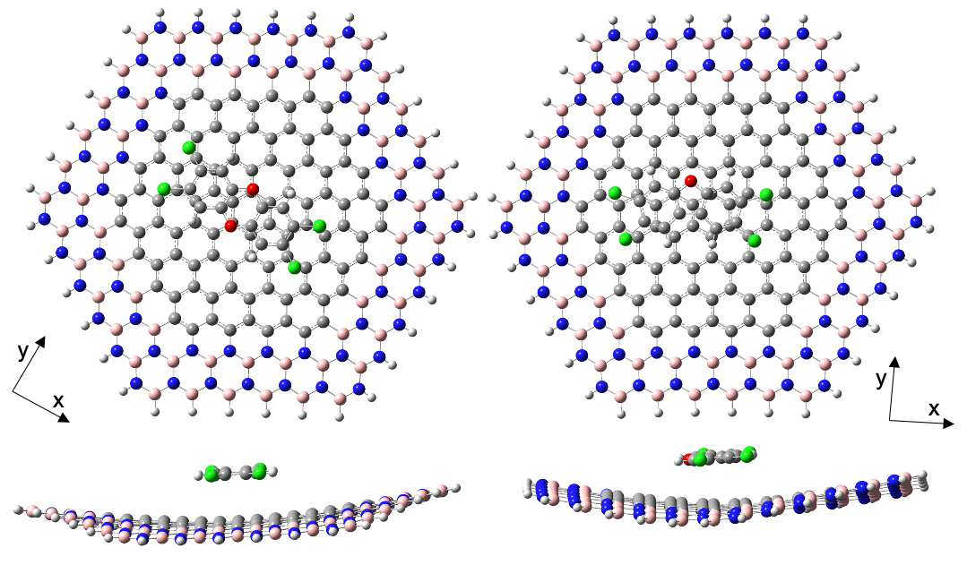
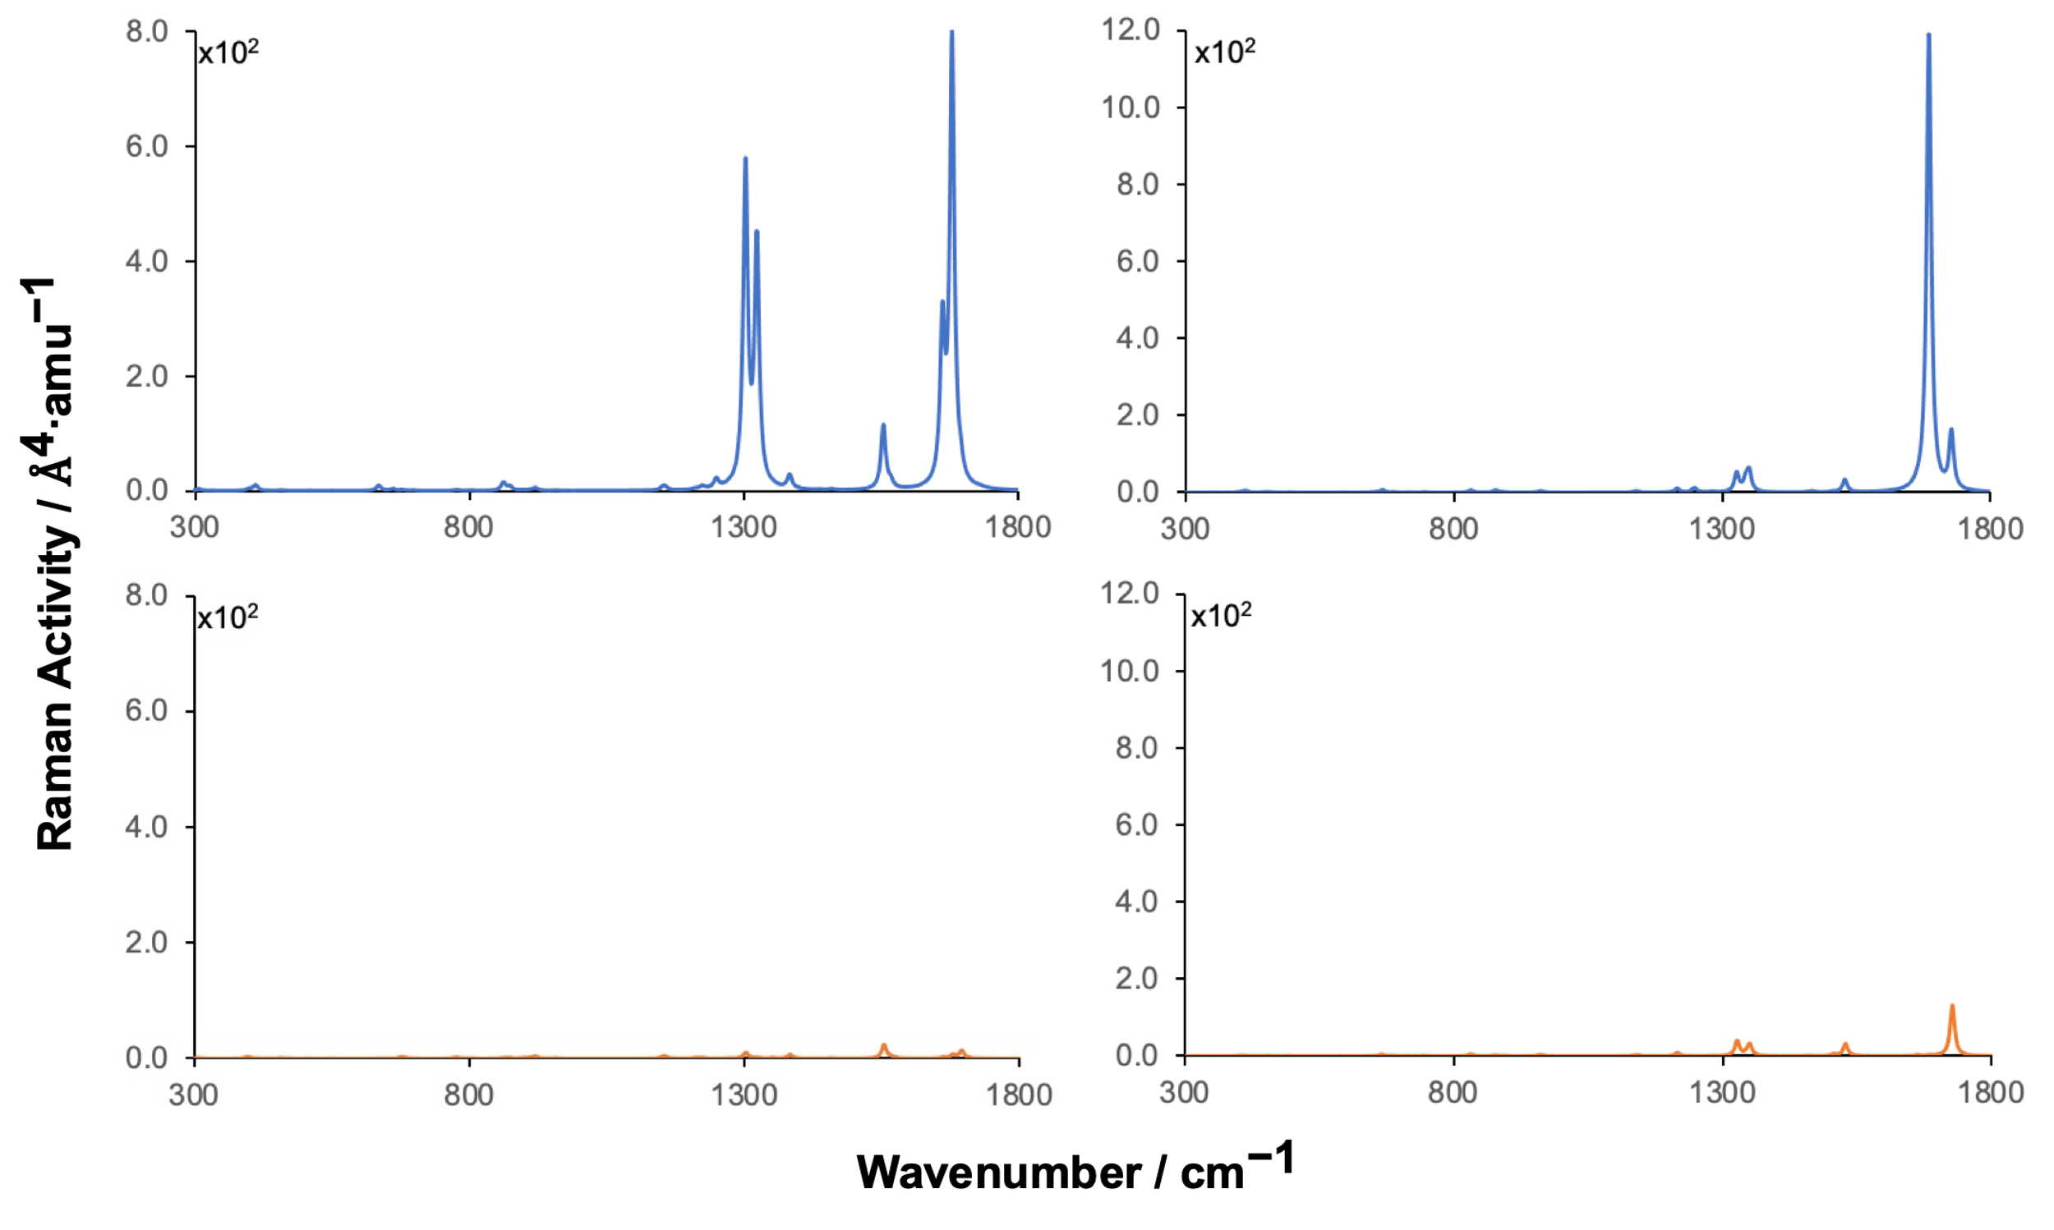
Chemical sensors and filters
Strong confinement of the electromagnetic response within the carbon domains
High modulation of the resonance wavelengths in the visible and/or UV region (SERS).
Time-dependent density functional theory (TDDFT) was used to characterize the electronic transitions with larger oscillator strengths in the complexes
Raman Activities were calculated using off- and on-resonance conditions with the couple perturbed density functional theory (CPDFT)
TCDD
TCDF
M. Mandado and N. Ramos-Berdullas Spectrochimica Acta Part A: Molecular and Biomolecular Spectroscopy 2022, 266, 120451.
R. Alvarado, N. Otero, M. Mandado and N. Ramos-Berdullas Chemosensors 2023, 11, 266.
Notes:
On the other hand, the use of hybrid surfaces with these compounds are really interesting since they present a strong confinement of the electromagnetic response within the carbon domains and a high modulation of the resonance wavelengths in the visible and/or UV region could extend its use as chemical sensor, in particular for the technique surface enhanced Raman Spectroscopy. Indeed, the Raman spectra simulated using off and on-resonance conditions for these complexes show a significant enhanced around 4 orders in some vibrational modes from pollutants, specially using laser excitation wavelengths.

Slide 20
Chemical sensors and filters
 | TCDD |  |  |  | TCDF
 | C96 | BN96 | BNC96 |  | C96 | BN96 | BNC96
Electrostatic | -21.3 | -22.8 | -21.1 |  | -19.6 | -18.8 | -19.0
Pauli | 52.5 | 55.4 | 51.2 |  | 48.7 | 47.6 | 46.9
Induction | -5.0 | -18.1 | -5.1 |  | -4.2 | -16.4 | -4.3
Dispersion | -59.5 | -45.0 | -59.7 |  | -56.2 | -39.2 | -55.9
Total | -33.4 | -30.6 | -34.7 |  | -31.4 | -26.9 | -32.3
The dispersion energy is the dominant contribution in all the complexes, but some important differences explain the trends observed in the total interaction energies.
The induction energy is significant in white graphene (BN96) due to the presence of polar B-N bonds.
External borazine rings have little influence on the interaction of the pollutants
R. Alvarado, N. Ramos-Berdullas and M. Mandado Int. J. Quantum Chemistry 2021, 121, e26591.
R. Alvarado, N. Otero, M. Mandado and N. Ramos-Berdullas Chemosensors 2023, 11, 266.
Notes:
Next, we are going to focus on the interaction energies and contributions from the complexes obtained with these surfaces. First of all, we can observe that the dispersion energy is the dominant contribution in all the complexes, but some important differences explain the trends observed in the total interaction energies.
On one hand, the induction energy is significant in white graphene (BN96) due to the presence of polar B-N bonds. However, it is not enough to reach the stability of the complexes with carbon atoms.
On the other hand, we can observe that the external borazine rings have little influence on the interaction of the pollutants with the internal carbon nanodisk. However, the slightly lower interaction energy of the complexes formed with hybrid with respect to graphene might be related to the bent structure adopted by the former.

Slide 21
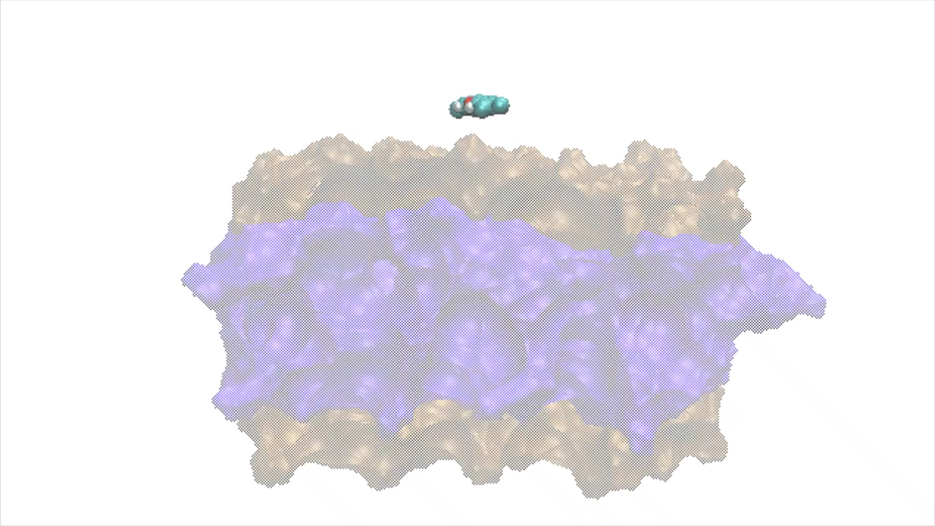
Permeation of POPs through Membranes
The lipid bilayer is formed by 64 molecules of DOPC per layer with 25 Å fo water thickness
Dioleoylphosphocholine (DOPC)
TCDD/TCDF are placed at 32 Å from CM of the membrane
Minimization, heating and producion by classical MD
The permeation processes of pollutants through the lipid bilayer were simulated by means of the umbrella sampling technique.
The reaction coordinate is divided into 65 windows separeted by 0.5 Å and CMD simulation of 20 ns was run within each window.
TCDD
TCDF
Is toxicity related to diffusion through the lipid bilayer?
R. Alvarado, G. Cárdenas, J. J. Nogueira, N. Ramos-Berdullas and M. Mandado Membranes 2023, 13, 28
Notes:
On the study of Permeation of POPs through Membranes. We have considered as membrane a lipid bilayer formed by 64 molecules of DOPC per layer. Then, the pollutants are placed at 32 Å from CM of the membrane and the equilibration was carried out.
The permeation processes of pollutants through the lipid bilayer were simulated by means of the umbrella sampling technique being the reaction coordinate the distance between the centers of mass of the pollutant and membrane along, which is divided into 65 windows and CMD simulation of 20 ns was run in each window.
This comparative study try to give an answer to next question Is toxicity related to diffusion through the lipid bilayer?

Slide 22
Permeation of POPs through Membranes
Free energy minimum in the middle of the bilayer (nonpolar region)
Dioleoylphosphocholine (DOPC)
Free energy maximum close to the polar heads
Free energy is slightly more favourable for TCDD than for TCDF
Pollutant/lipid interactions characterized by QM/MM and EDA
How many lipids in the QM region?
How many snapshots?
R. Alvarado, G. Cárdenas, J. J. Nogueira, N. Ramos-Berdullas and M. Mandado Membranes 2023, 13, 28
Notes:
The TCDD and TCDF energy profiles are very similar, where Free energy minimum in the middle of the bilayer (nonpolar region) and the maxima close to the polar heads. In addition, free energy is slightly more favourable for TCDD than for TCDF. For these interactions around the minima region, QM/MM-EDA scheme was applied in order to analyze.
However, in order to do that we need to know the region QM to take into account as well as the number of snapshots to take as a good sampling of these regions

Slide 23
Permeation of POPs through Membranes
Dioleoylphosphocholine (DOPC)
The optimal QM region must contain the pollutant and the minimum number of DOPC molecules
TCDD
Analysis of the convergence of the interaction energy and its components as the number of the DOPC molecules increases in the minimum region
Calculations performed with 7 lipid molecules and 100 snapshots
TCDF
R. Alvarado, G. Cárdenas, J. J. Nogueira, N. Ramos-Berdullas and M. Mandado Membranes 2023, 13, 28
G. Cárdenas, Á. Pérez-Barcia, M. Mandado and J. J. Nogueira Phys. Chem. Chem. Phys. 2021, 23, 20533
Notes:
The optimal QM region must contain the pollutant and the minimum number of DOPC molecules. So, it is necessary to analyze the convergence of the interaction energy and its contribution as the number of the DOPC molecules increases in the minimum region.
The convergence is reached with 7 lipids in both cases. Moreover, in a recent work on cisplatin permeation through the same lipid membrane was determined that 100 geometries as a good sampling.

Slide 24

Permeation of POPs through Membranes
$$E_{int}=E_{Pau}+E_{elec}+E_{ind}+E_{dis}$$
 | Elect | Pau | Ind | Disp | Total
TCDD | -19.6 | 49.7 | -6.5 | -41.1 | -17.5
TCDF | -19.3 | 52.1 | -6.4 | -43.0 | -16.5
The energy increase in the total interaction energy is significantly larger than that predicted by the CMD simulation. Good correspondence!
In both pollutants, dispersion is more than twice the electrostatic energy, whereas the induction energy has a marginal contribution.
The absorption and diffusion steps through the cell membrane do not explain the different toxicity measured for TCDD and TCDF.
Notes:
Next, the EDA results obtained under these conditions are displayed.
First, the energy increase in the interaction energy is significantly larger than that predicted by the CMD simulation. However, there exist a good correspondence in absolute and relative terms.
On the other hand, in both pollutants ,the dispersion is the dominant contribution and it is more than twice the electrostatic energy, whereas the induction energy has a marginal contribution.
As a general conclusion, the small differences found between the TCDD and TCDF in the permeation processes, both in the CMD simulations and the QM/MM-EDA calculations, points out that the adsorption and diffusion steps through the cell membrane do not explain the different toxicity measured for TCDD and TCDF.

Slide 25










Acknowledgements
Quantum Chemistry Group (University of Vigo)
Raúl
Alvarado
Marcos
Mandado
MoBioChem Group (Autonomus University of Madrid)
Gustavo Cárdenas
Juan José Nogueira
Notes:
Finally, I would like to thank the organizations and institutions that partially founded this research and I would also like to mention people that participate in this work, some of them in the audience. My colleagues from UVigo (Raul Alvarado and Marcos Mandado) and my colleagues from Mobiochem group from UAM (Gustavo Cárdenas and Juanjo Nogueira). Thank you very much for your kind attention.

Slide 26


Slide 27
Conclusions
Intermolecular interactions play an important role on the mode of action, detection and treatment of pollutants
EDA-QM scheme was applied on TCDD and TCDF with finite models of substrates
EDA-QM/MM schem was applied on TCDD and TCDF with lipid bilayer DOPC.
Boron nitride based materials are excellent alternatives to carbon-based adsorbents of dioxin-like pollutants
2D hybrid h-BNC structures could act as substrates for the Raman-enhancement of dioxins and dibenzofurans
The permeation and diffusion steps through the cell membrane do not explain the different toxicity measured for TCDD and TCDF.
Notes:
So, we have seen that…
Finally, we can conclude that…

Slide 28
Chemical sensors and filters
 | TCDD |  |  |  | TCDF
 | C96 | BN96 | BNC96 |  | C96 | BN96 | BNC96
Electrostatic | -21.3 | -22.8 | -21.1 |  | -19.6 | -18.8 | -19.0
Pauli | 52.5 | 55.4 | 51.2 |  | 48.7 | 47.6 | 46.9
Induction | -5.0 | -18.1 | -5.1 |  | -4.2 | -16.4 | -4.3
Dispersion | -59.5 | -45.0 | -59.7 |  | -56.2 | -39.2 | -55.9
Total | -33.4 | -30.6 | -34.7 |  | -31.4 | -26.9 | -32.3
R. Alvarado, N. Ramos-Berdullas and M. Mandado Int. J. Quantum Chemistry 2021, 121, e26591.
R. Alvarado, N. Otero, M. Mandado and N. Ramos-Berdullas Chemosensors 2023, 11, 266.

