Slide 1





GEOMAGNETICALLY INDUCED CURRENTS
IN POWER SYSTEMS
Rute Rodrigues Santos, M. Alexandra Pais, João Cardoso, Miguel Silva, Joana Alves Ribeiro, Fernando Pinheiro
Shield Wires effect on GICs in power network and design of an instrument to monitor GICs
Study funded by FCT under project MAG-GIC: PTDC/CTA -GEO/31744/2017

Slide 2
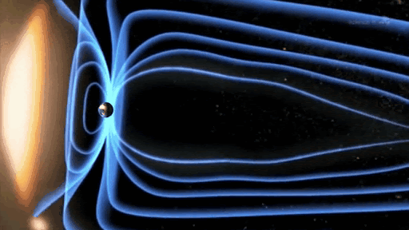
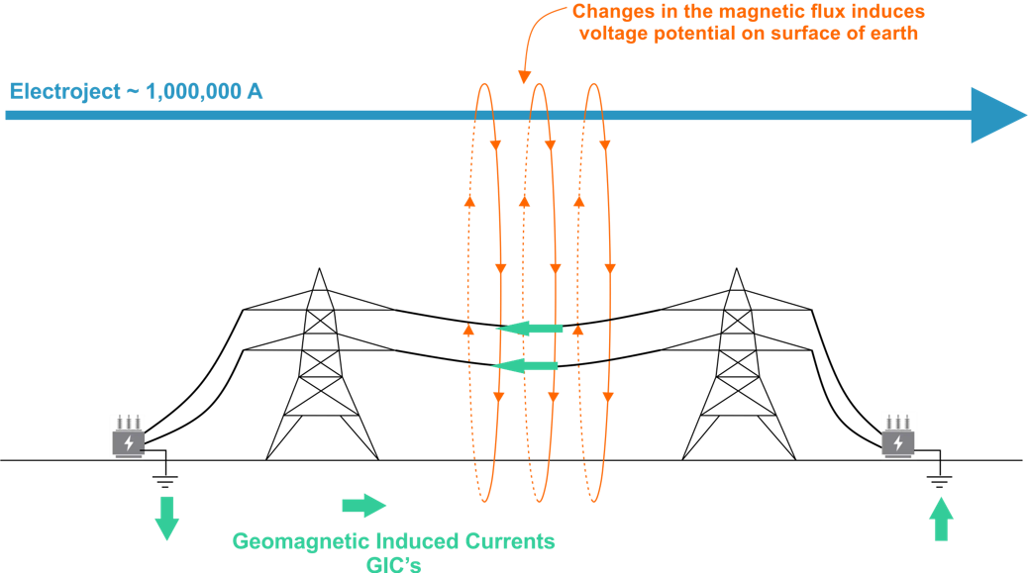
Geomagnetically Induced Currents in Power Systems
Credits to Joana Alves Ribeiro

Slide 3
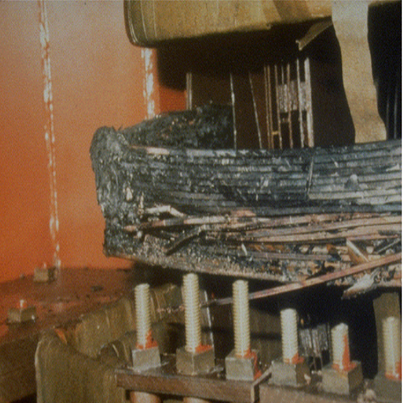
The importance of GICs mitigation
GIC – Sources Forecasting
GIC Modelling
To predict the flow of high GICs in the transmission network
GIC Measuring
To validate the models
GIC – Hazards Prevention
Numerous records of voltage sag, premature ageing of transformers and in some cases regional outages.
From Marusek, 2007

Slide 4
1.
GIC Modelling
The effect of the Shield Wires

Slide 5
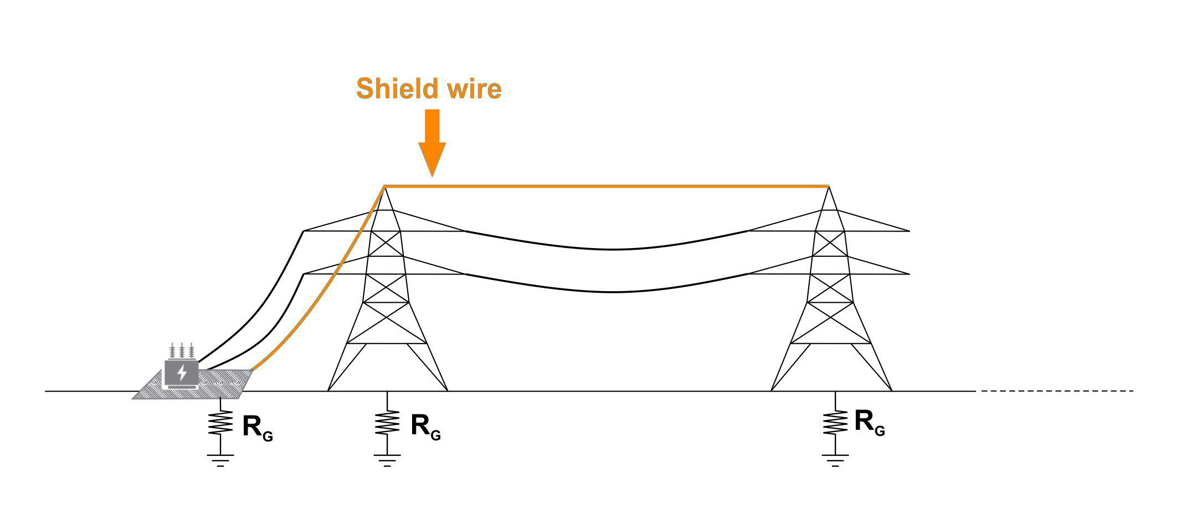
Shield Wires
Extra path for GICs
Protect the power transmission line from the effect of lightning

Slide 6
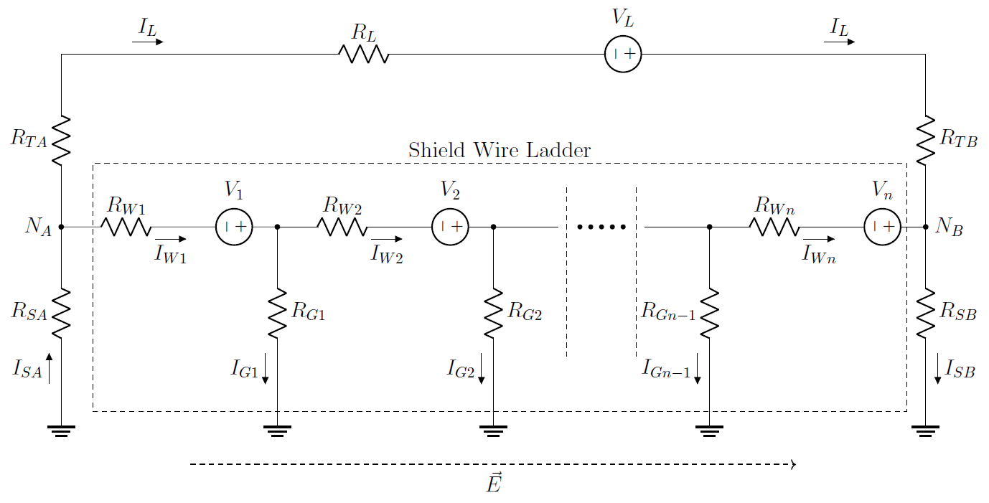
Model for analysing the effect of shield wire on GIC
power line resistance
induced emf along the power line
induced emf along each shield wire span
transformer wiring resistance
resistance of each shield wire span line
grounding resistance at each tower
substation grounding resistance

Slide 7

In Portuguese Network
In Portuguese Power Transmission Network, first initial tests on single lines gave errors of 5% for a short line, if shield wires were not considered.
When combining different lines, the effect may increase.
It is important to study this effect and understand if it is necessary to include shield wires in the GIC calculation models

Slide 8
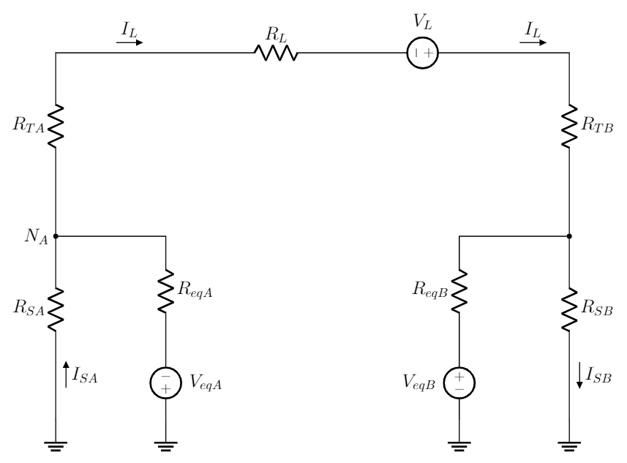
How can we simplify this study?
Getting a simpler circuit!
In which it would be sufficient to deal with a Thévenin equivalent circuit connected to each substation, as shown on the left

Slide 9
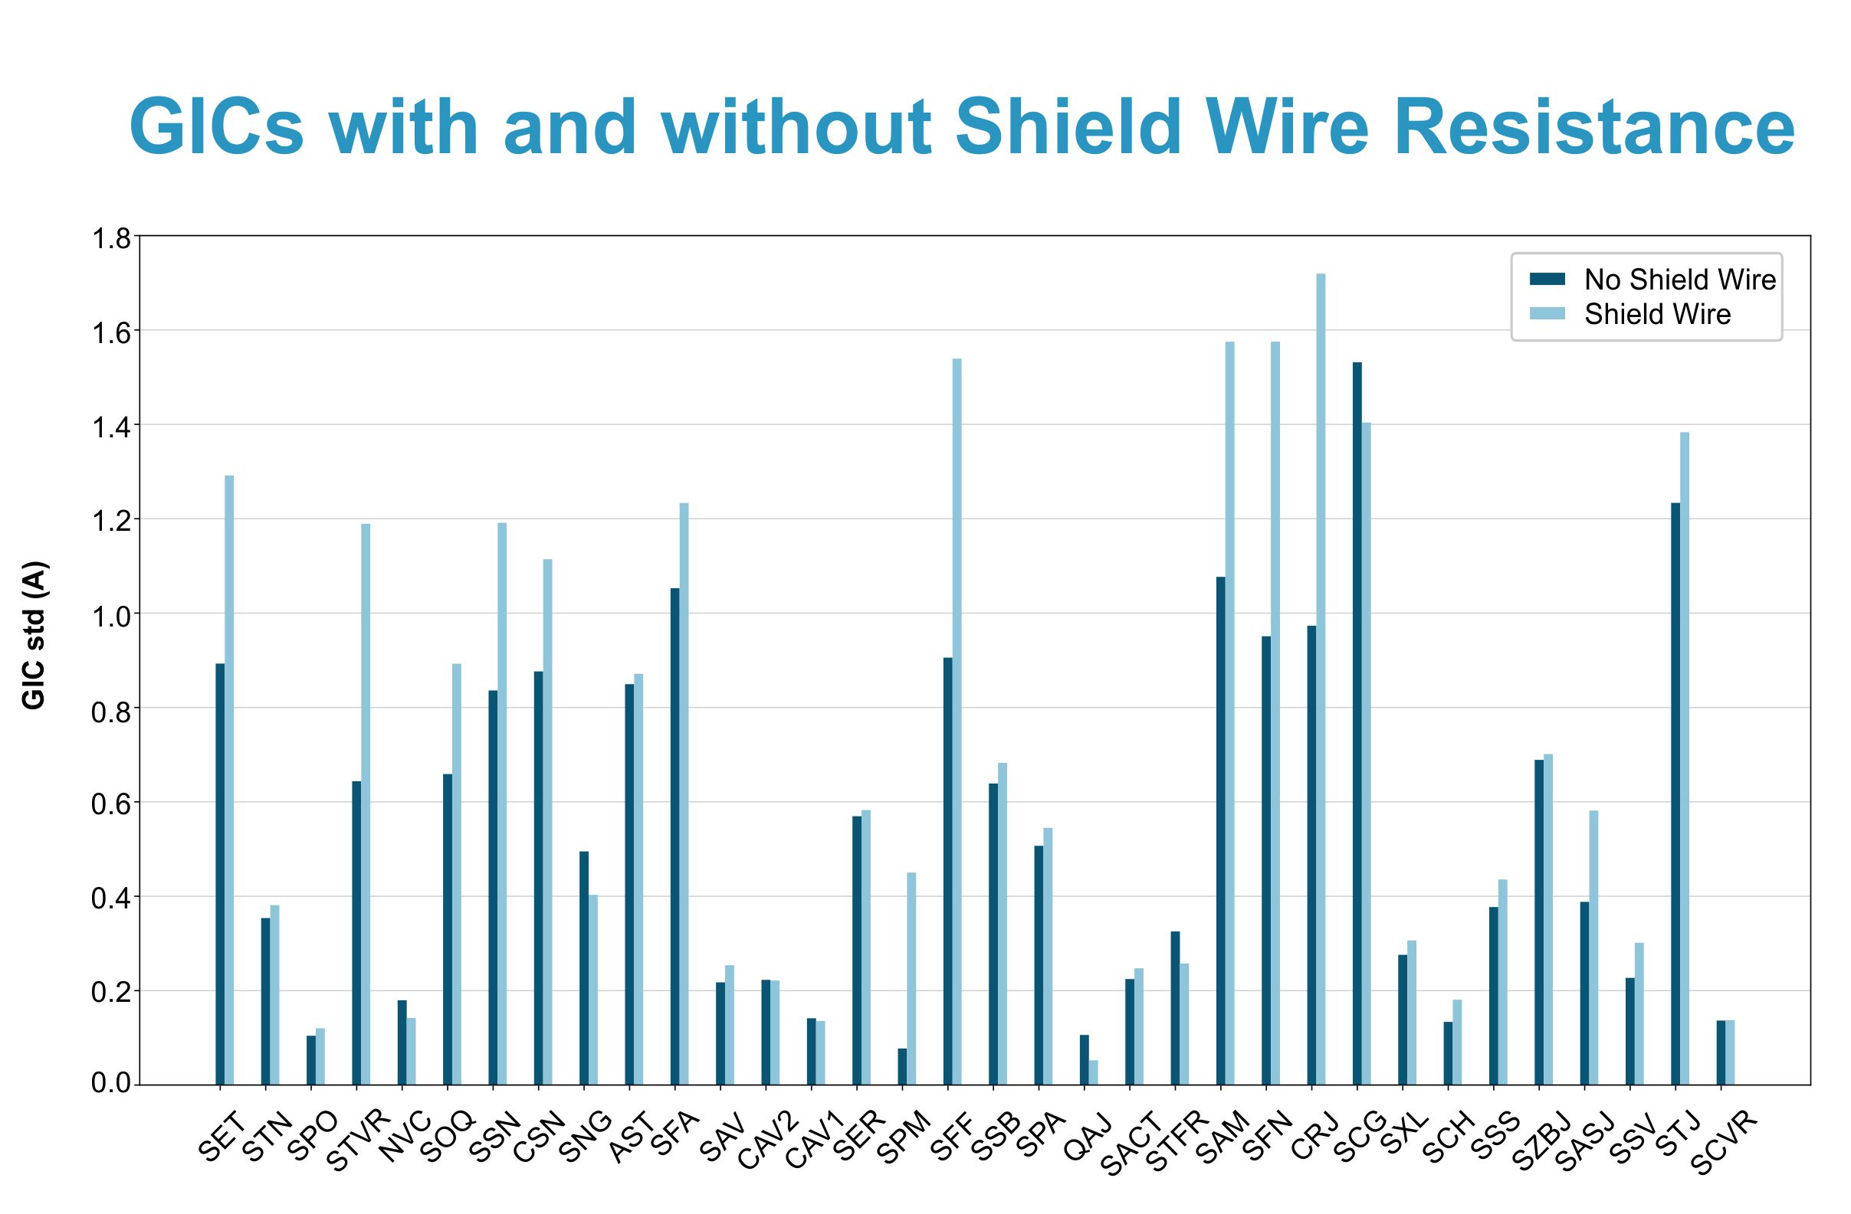
Results from a simulation in a complex power network.
Only the effect of the resistance of shield wires has been considered.
Credits to Joana Alves Ribeiro

Slide 10
2.
GIC Measuring
The design of an equipment to monitor GICs

Slide 11
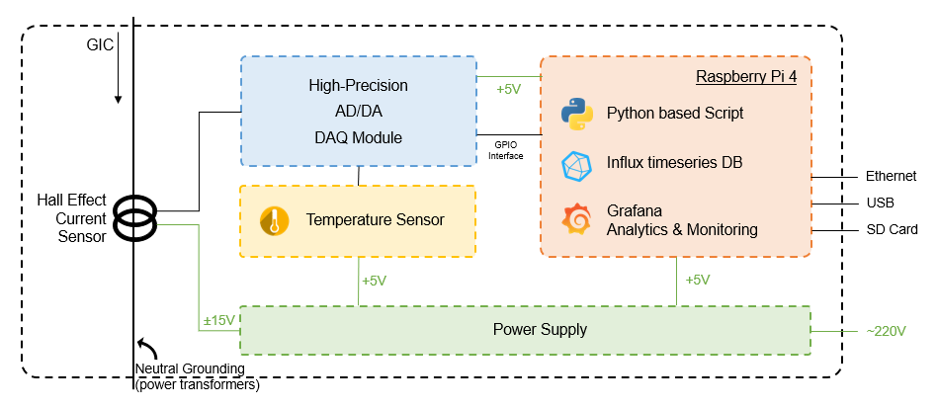
GIC Acquisition System

Slide 12
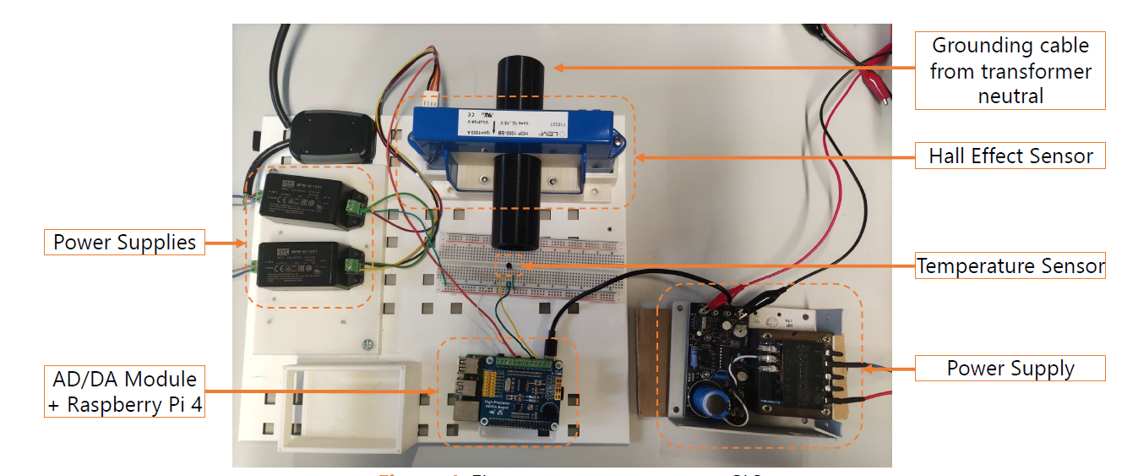
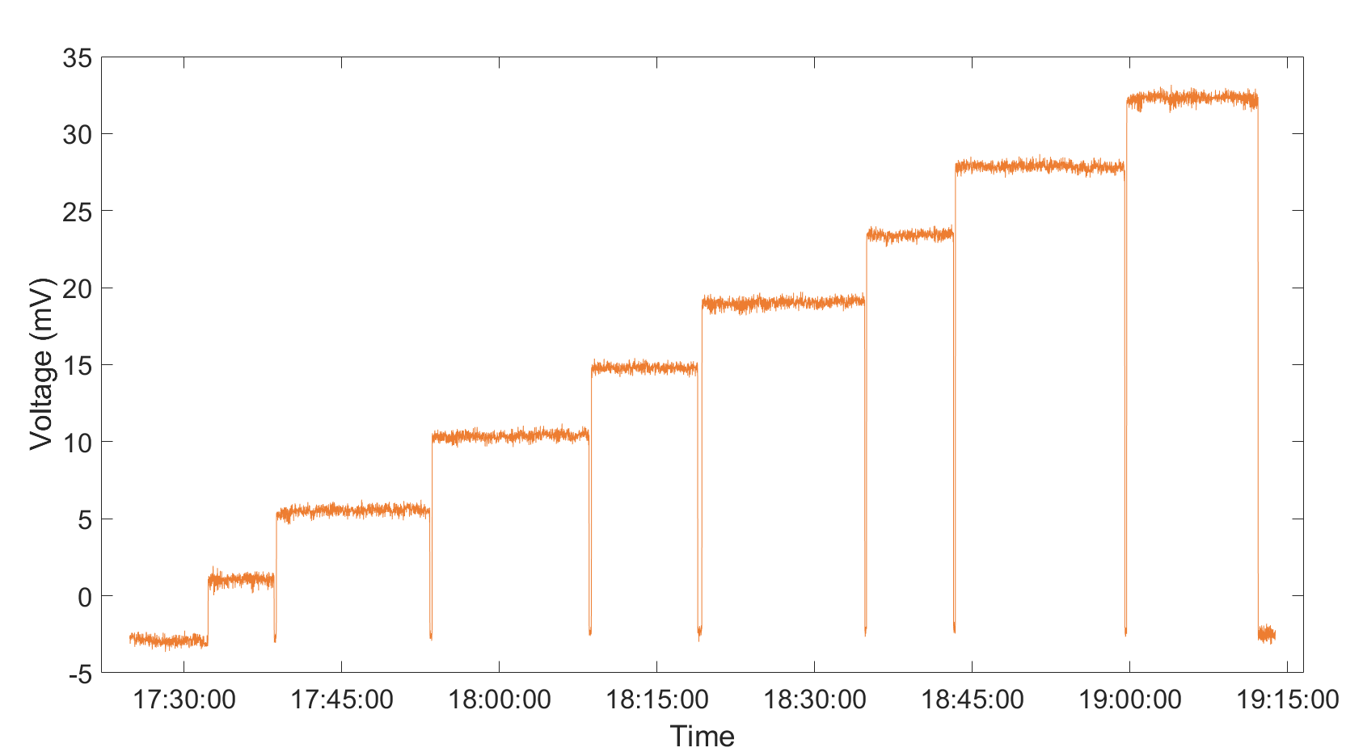
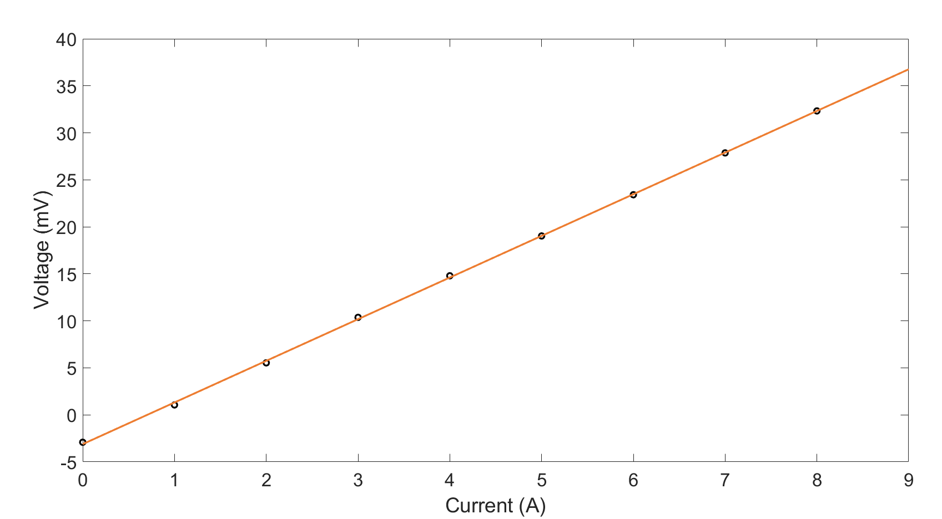
Instrument to monitor GICs
Voltage dependence on current intensity
Sensor calibration curve
The first prototype will be installed to measure the neutral point current on a transformer, at a substation belonging to the national transmission system operator (REN)

Slide 13
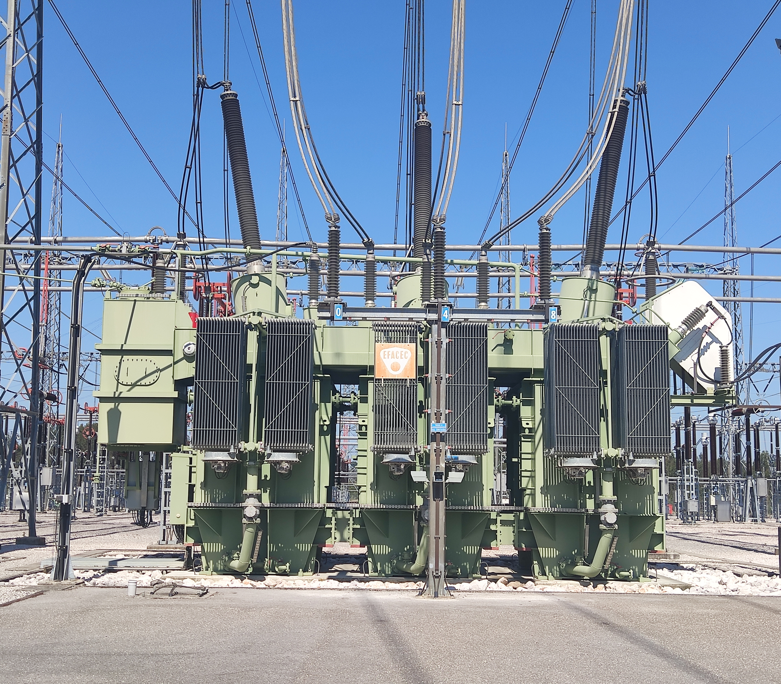
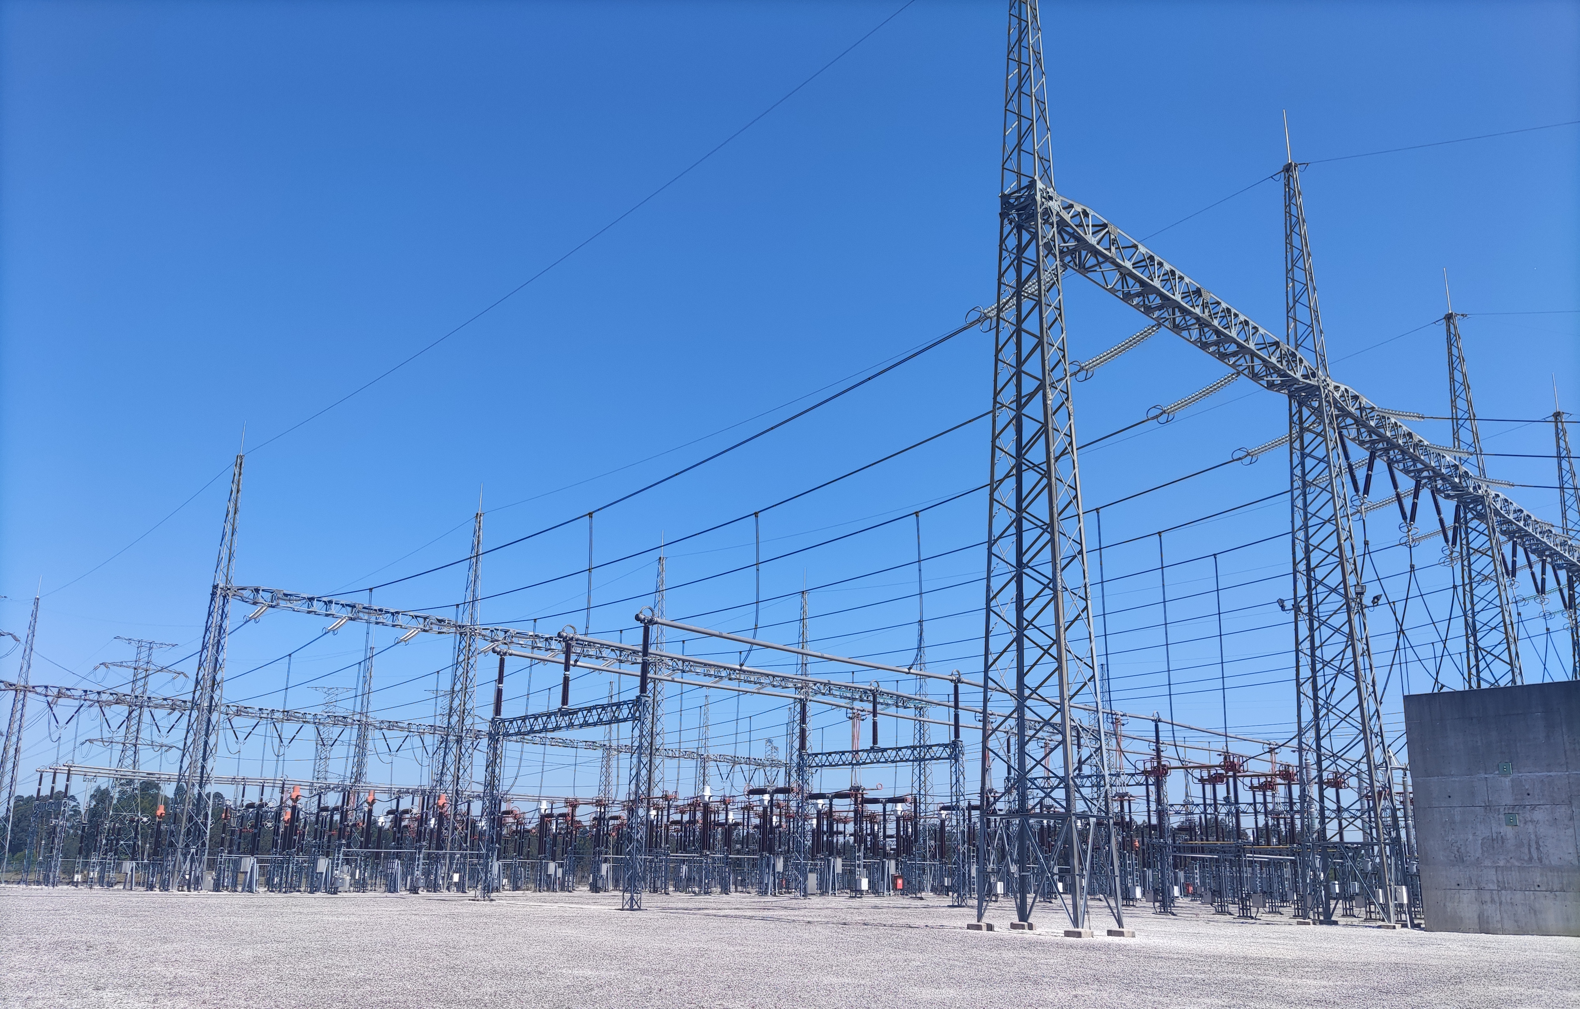
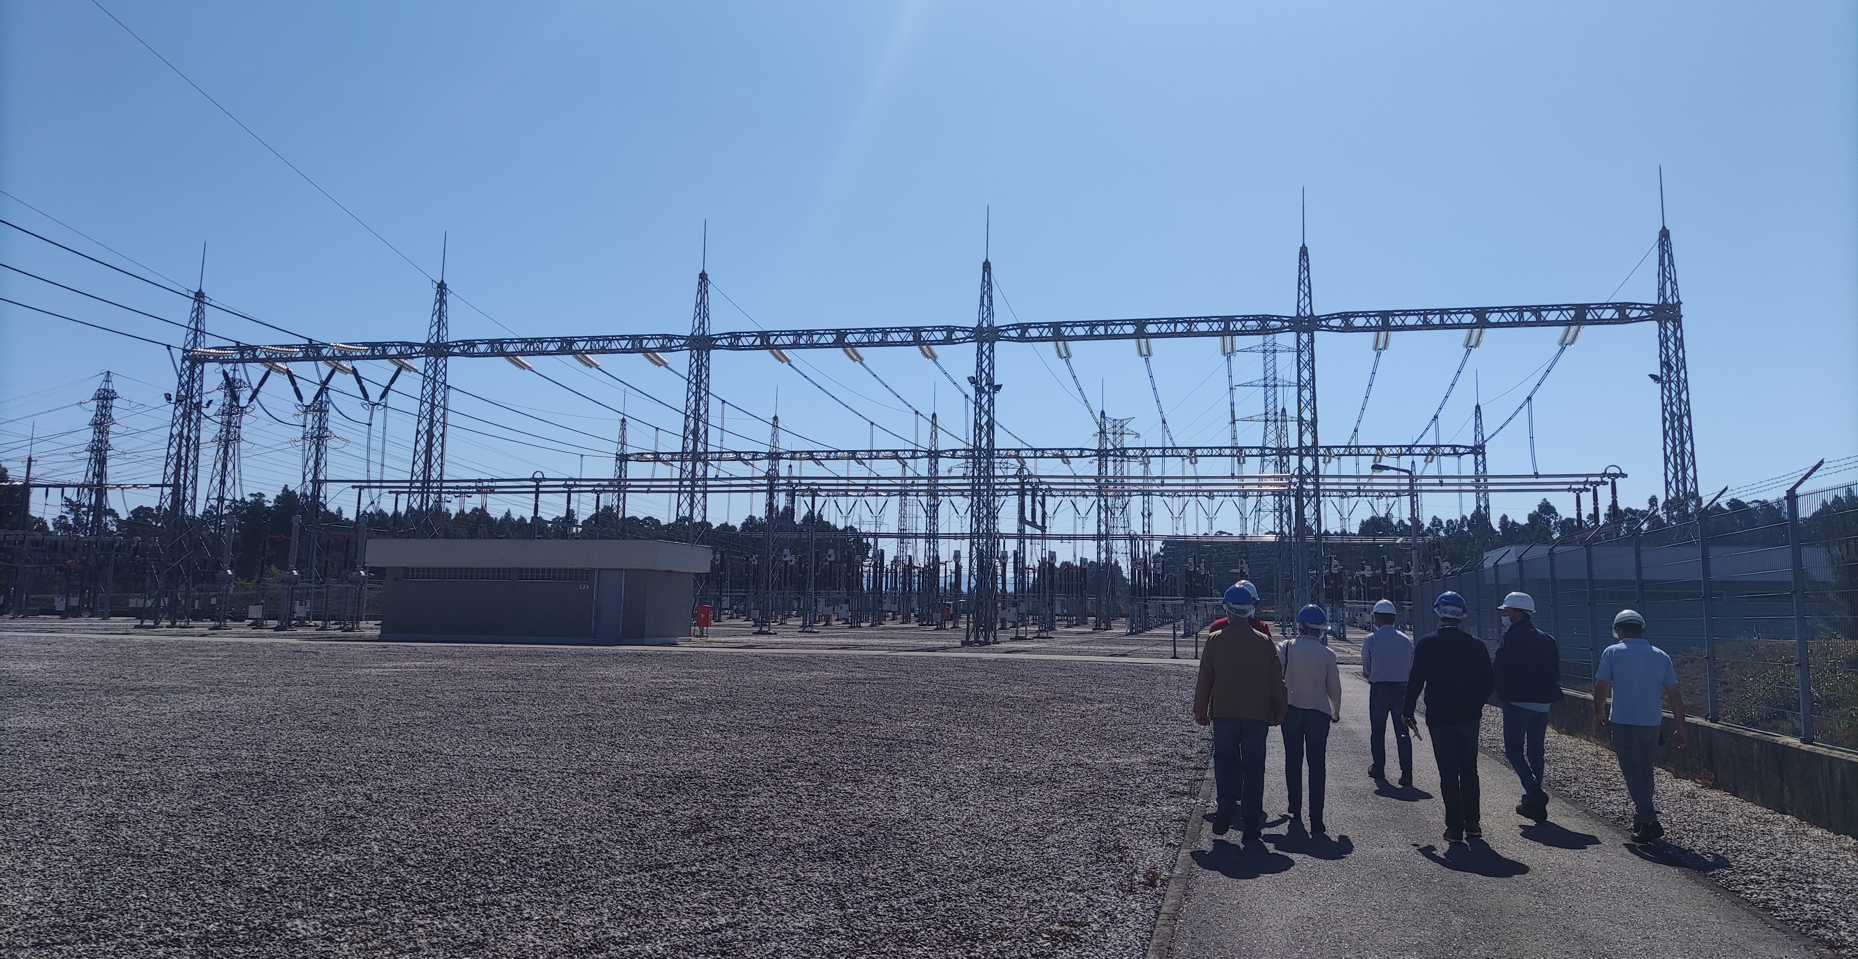
Substation Paraimo

Slide 14
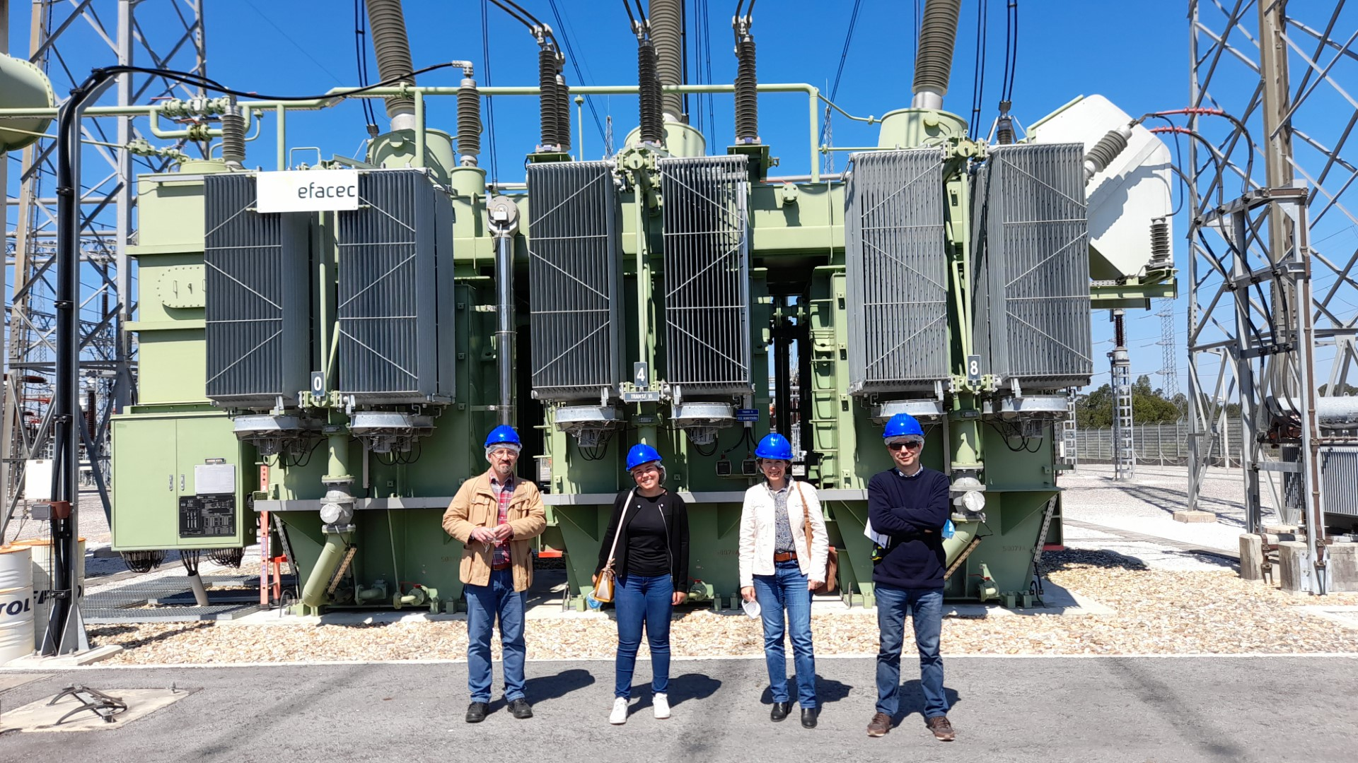
Thank you. Any questions? You can contact me: rute2rodrigues@gmail.com

