Slide 1
Measurering Light and Charge Yields in LKr
Why these measurements are important?
Both the light and charge signals provide valuable information needed for events reconstruction in TPC
The total deposited energy is shared to produce UV scintillation photons and electron-ion pairs – correlated signals
In LXe TPCs, e. g., in nEXO, the light and charge signals are added together to overcome fluctuations of the election-ion recombination to improve energy resolution
Early measurements using Bi-207 internal-conversion electrons by Kubota et al., “Dynamical behavior of free electrons in the recombination process in liquid argon, krypton, and xenon”, Phys. Rev. v. 20, 1979.
It is important to repeat these measurements with electron and also use alpha-particles
One possibility is to collaborate with Colombia University team (Prof. Elena Aprile)
Elena’s team took such measurements in LXe before and is very interested in taking similar measurements in LKr

Slide 2
Measurements in LXe done by Columbia group using electrons and alpha-particle
Apparatus used by Columbia team
E. Aprile et al., Phys. Rev. Lett. 97, 081302, 2006

Slide 3
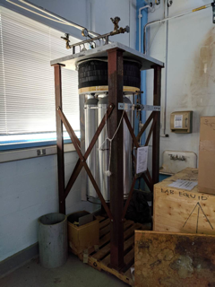
LKr at BNL
Kr storage at Physis

