Slide 1

Finite Feynman Integrals
David A. Kosower
Institut de Physique Théorique, CEA–Saclay
work with Giulio Gambuti, Pavel Novichkov, and Lorenzo Tancredi, [2311.16907]
and in progress with Leonardo de la Cruz and Pavel Novichkov [2409.nnnnn];
and Marc Canay;
and in progress with Yang Zhang, Zhihou Wu, and Rourou Ma
at INPP Demokritos-APCTP meeting and HOCTOOLS-II mini-workshop
Athens, Greece
October 1, 2024

Slide 2
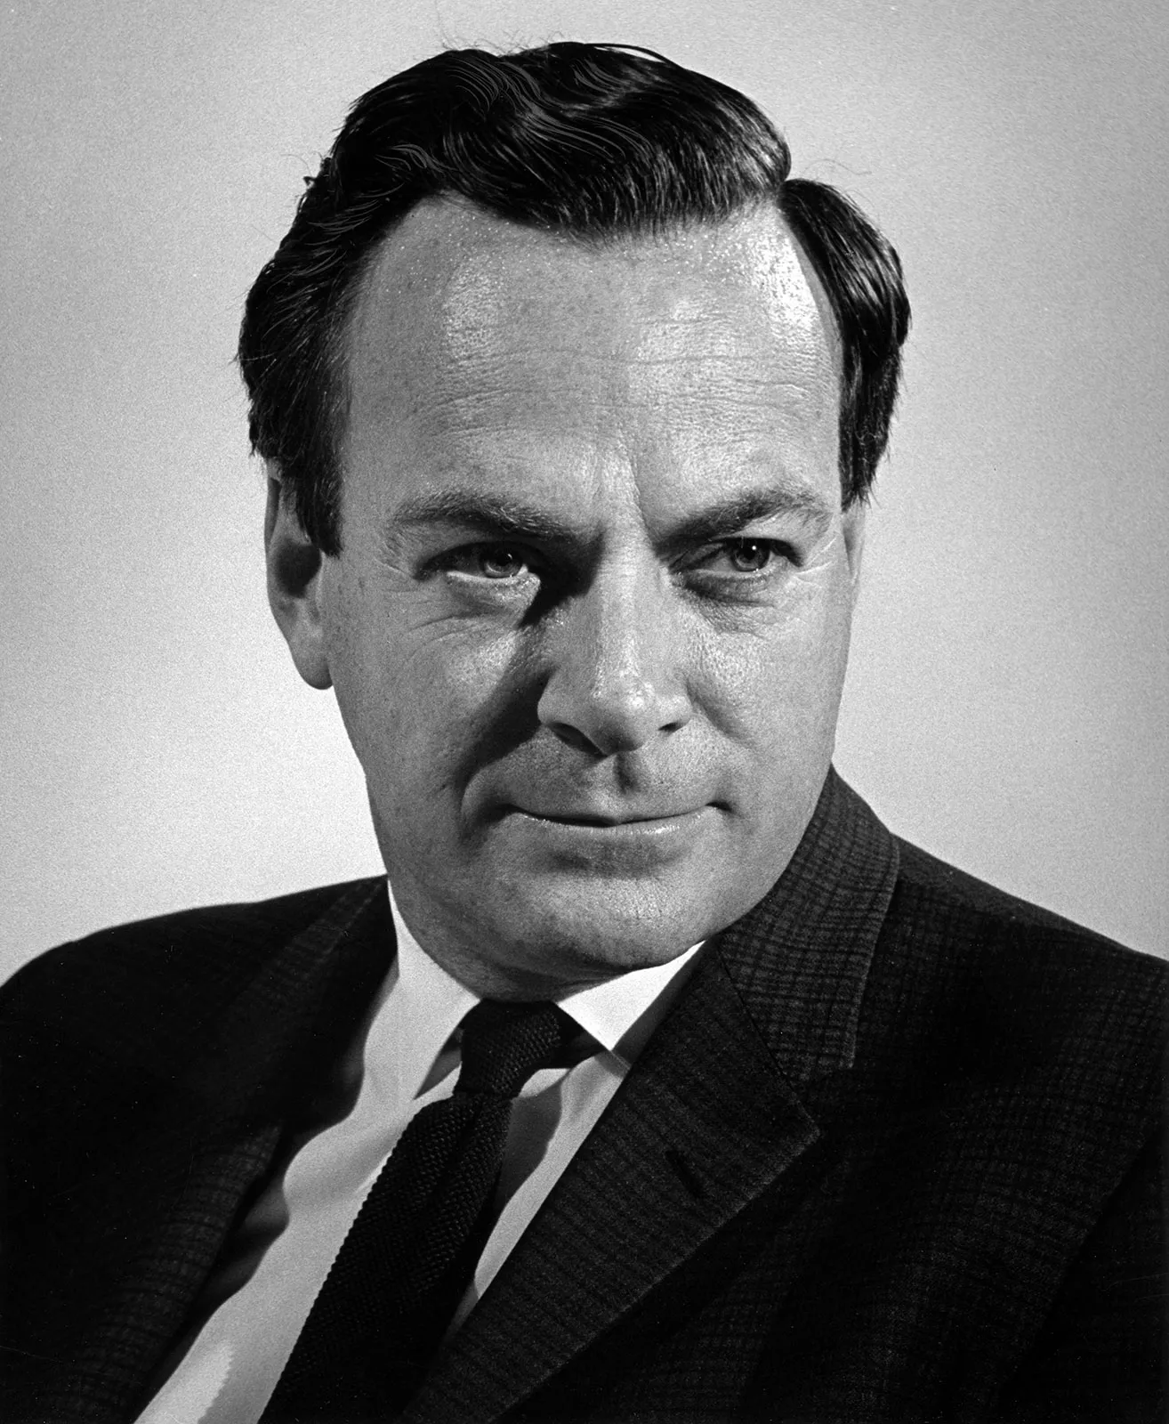
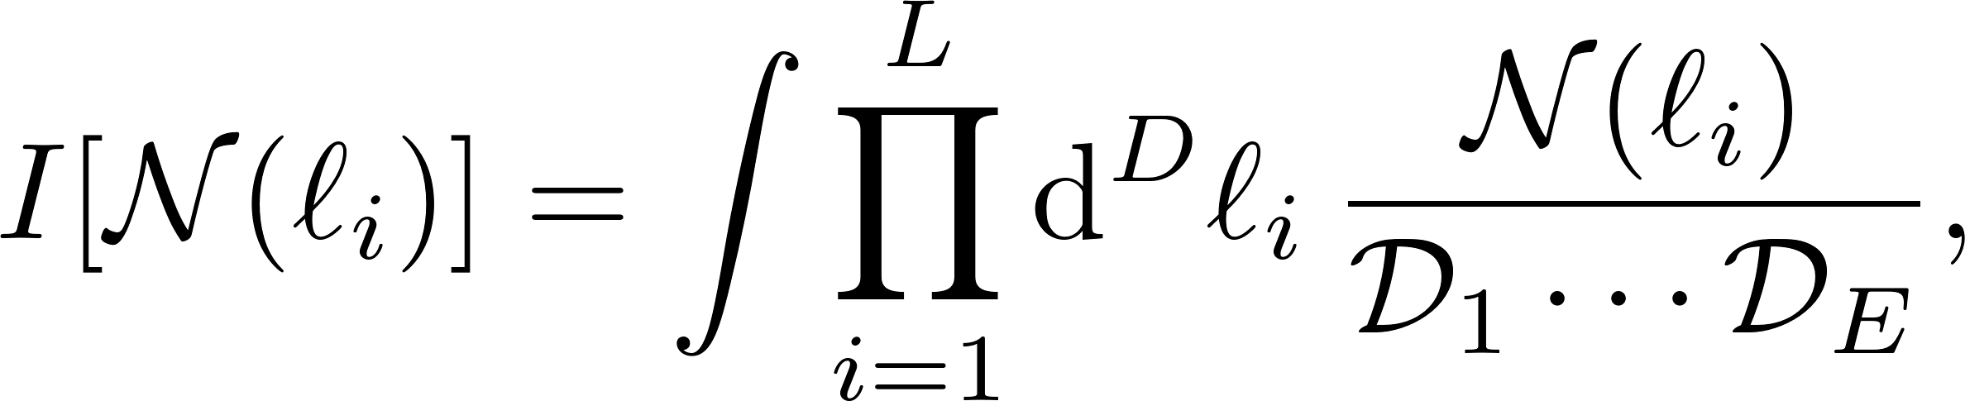
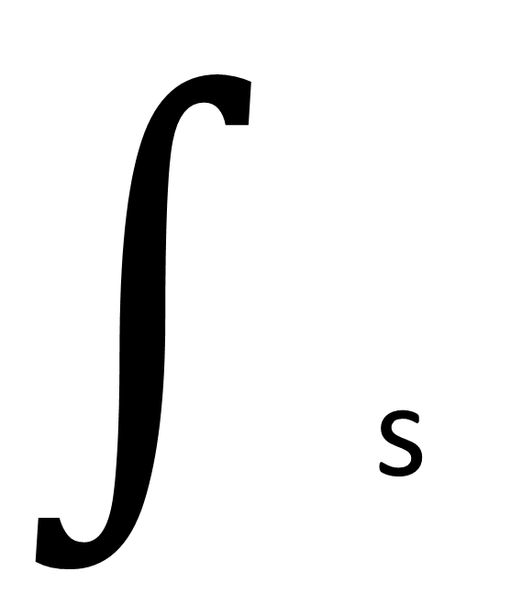
Feynman Integrals
Key ingredient for expressing loop amplitudes, form factors, …
Linear algebraic relations allow us to choose a basis of master integrals
Which ones?
$∫$s

Slide 3
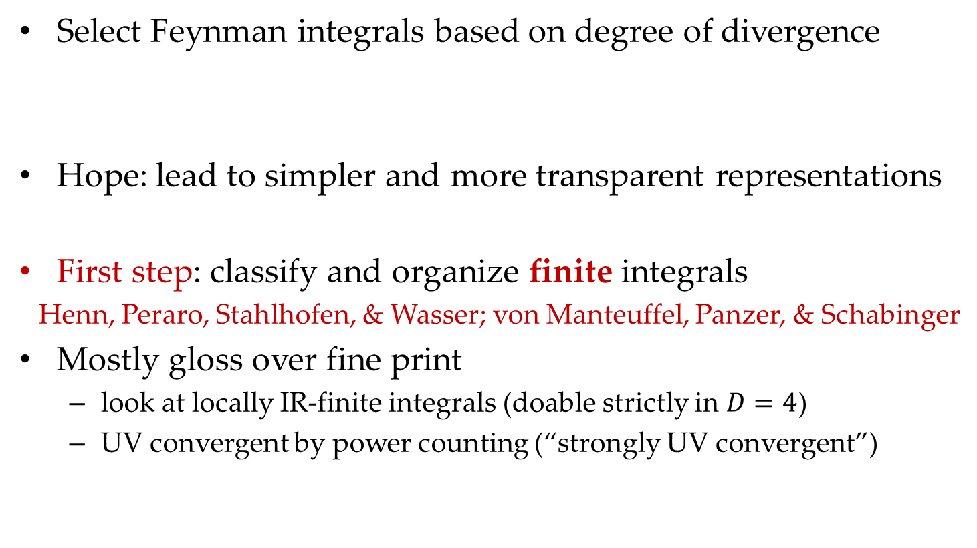
Goal
Select Feynman integrals based on degree of divergence
Hope: lead to simpler and more transparent representations
First step: classify and organize finite integrals
Henn, Peraro, Stahlhofen, & Wasser; von Manteuffel, Panzer, & Schabinger
Mostly gloss over fine print
  look at locally IR-finite integrals (doable strictly in $D=4$)
  UV convergent by power counting (“strongly UV convergent”)

Slide 4
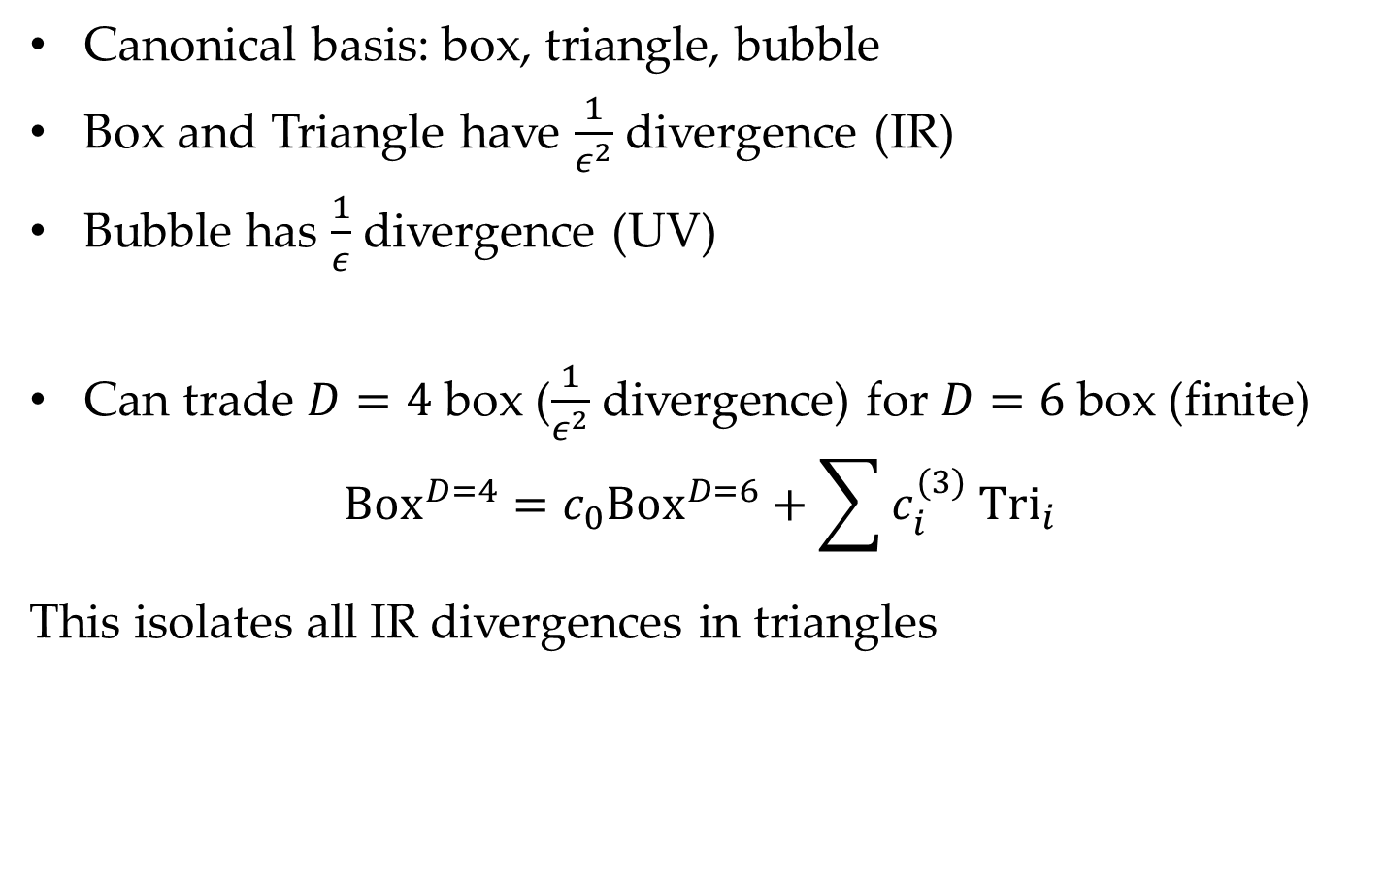
One-Loop Example
Canonical basis: box, triangle, bubble
Box and Triangle have $\frac{1}{ε^{2}}$ divergence (IR)
Bubble has $\frac{1}{ε}$ divergence (UV)
Can trade $D=4$ box ($\frac{1}{ε^{2}}$ divergence) for $D=6$ box (finite)
$${Box}^{D=4}=c_{0}Box^{D=6}+\sum{c_{i}^{(3)} {Tri}_{i}}$$
This isolates all IR divergences in triangles

Slide 5
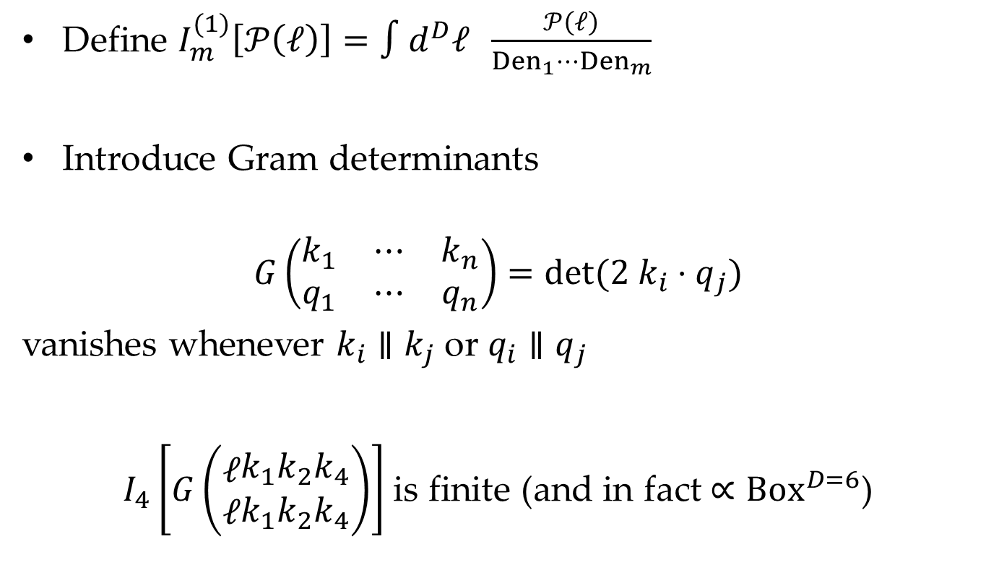
One-Loop Example
Define $I_{m}^{(1)}\left[𝒫\left(ℓ\right)\right]=∫d^{D}ℓ \frac{𝒫\left(ℓ\right)}{Den_{1}⋯Den_{m}}$
Introduce Gram determinants
$$G\left(\begin{matrix}k_{1} & ⋯ & k_{n} \\ q_{1} & ⋯ & q_{n}\end{matrix}\right)=det⁡(2 k_{i}⋅q_{j})$$
vanishes whenever $k_{i}∥k_{j}$ or $q_{i}∥q_{j}$
$I_{4}\left[G\left(\begin{matrix}ℓ \\ ℓ\end{matrix}\begin{matrix}k_{1} \\ k_{1}\end{matrix}\begin{matrix}k_{2} \\ k_{2}\end{matrix}\begin{matrix}k_{4} \\ k_{4}\end{matrix}\right)\right]$ is finite (and in fact $∝Box^{D=6}$)

Slide 6
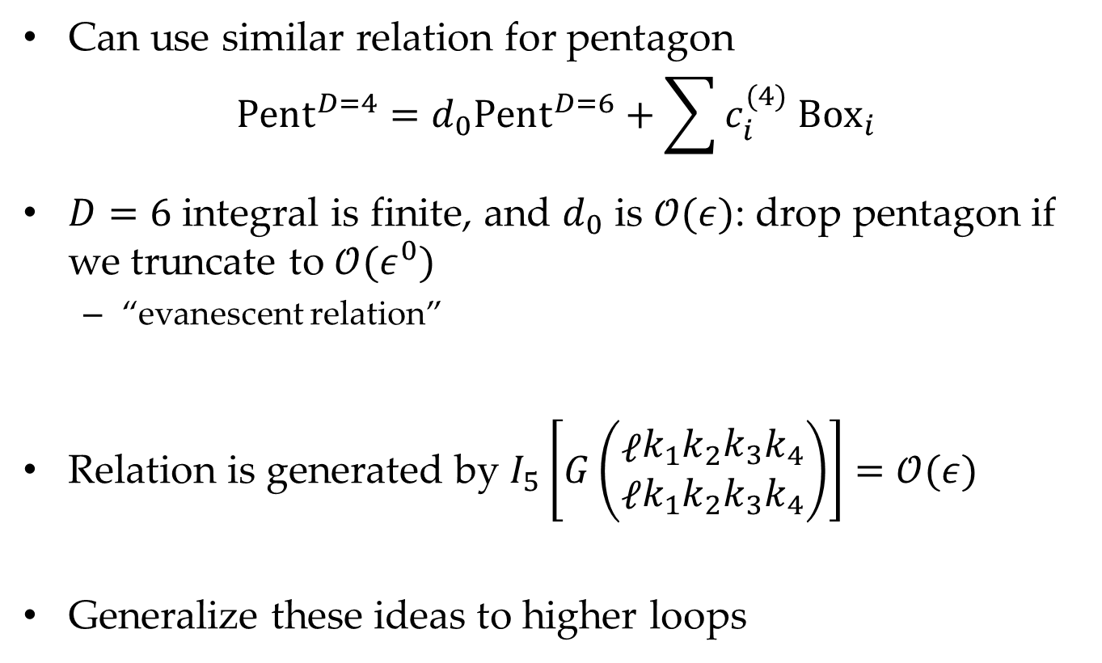
One-Loop Example
Can use similar relation for pentagon
$$Pent^{D=4}=d_{0}Pent^{D=6}+\sum{c_{i}^{(4)} {Box}_{i}}$$
$D=6$ integral is finite, and $d_{0}$ is $𝒪(ε)$: drop pentagon if we truncate to $𝒪(ε^{0})$
  “evanescent relation”
Relation is generated by $I_{5}\left[G\left(\begin{matrix}ℓ \\ ℓ\end{matrix}\begin{matrix}k_{1} \\ k_{1}\end{matrix}\begin{matrix}k_{2} \\ k_{2}\end{matrix}\begin{matrix}k_{3} \\ k_{3}\end{matrix}\begin{matrix}k_{4} \\ k_{4}\end{matrix}\right)\right]=𝒪(ε)$
Generalize these ideas to higher loops

Slide 7
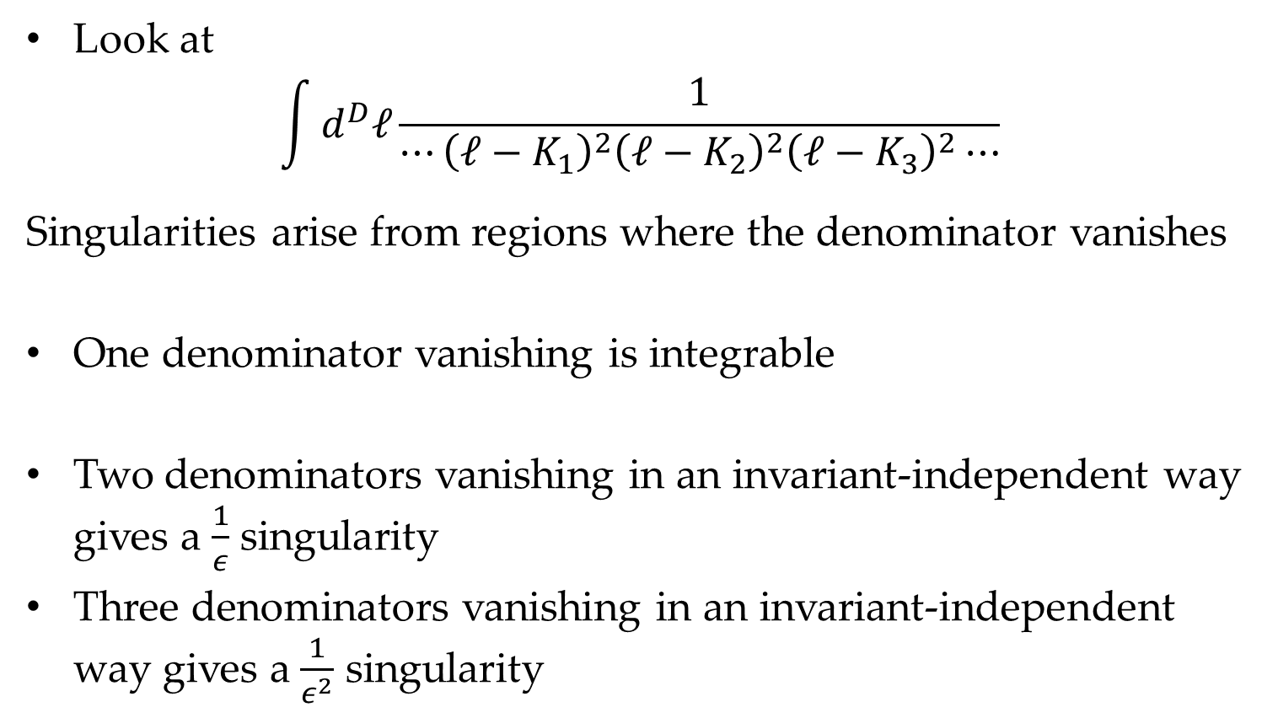
How Do IR Singularities Arise?
Look at
$$\int{d^{D}ℓ\frac{1}{⋯{\left(ℓ−K_{1}\right)}^{2}{\left(ℓ−K_{2}\right)}^{2}{\left(ℓ−K_{3}\right)}^{2}⋯}}$$
Singularities arise from regions where the denominator vanishes
One denominator vanishing is integrable
Two denominators vanishing in an invariant-independent way gives a $\frac{1}{ε}$ singularity
Three denominators vanishing in an invariant-independent way gives a $\frac{1}{ε^{2}}$ singularity

Slide 8
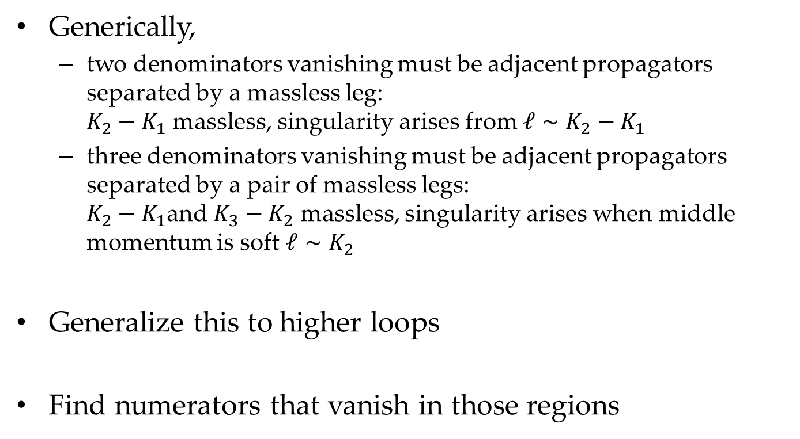
How Do IR Singularities Arise?
Generically,
  two denominators vanishing must be adjacent propagators separated by a massless leg:
  $K_{2}−K_{1}$ massless, singularity arises from $ℓ∼K_{2}−K_{1}$
  three denominators vanishing must be adjacent propagators separated by a pair of massless legs:
  $K_{2}−K_{1}$and $K_{3}−K_{2}$ massless, singularity arises when middle momentum is soft $ℓ∼K_{2}$
Generalize this to higher loops
Find numerators that vanish in those regions

Slide 9
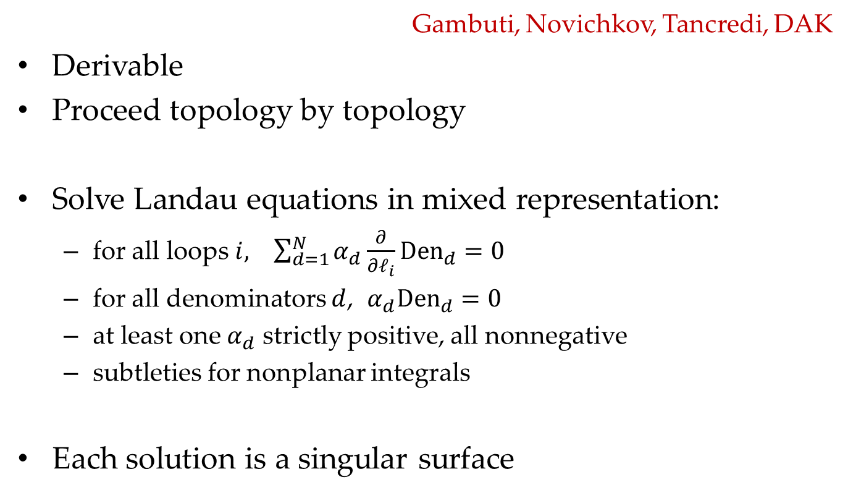
Analytic Strategy
Gambuti, Novichkov, Tancredi, DAK
Derivable
Proceed topology by topology
Solve Landau equations in mixed representation:
  for all loops$i, \sum_{d=1}^{N}{α_{d}\frac{∂}{∂ℓ_{i}}{Den}_{d}=0}$
  for all denominators $d$, $α_{d}{Den}_{d}=0$
  at least one $α_{d}$ strictly positive, all nonnegative
  subtleties for nonplanar integrals
Each solution is a singular surface

Slide 10
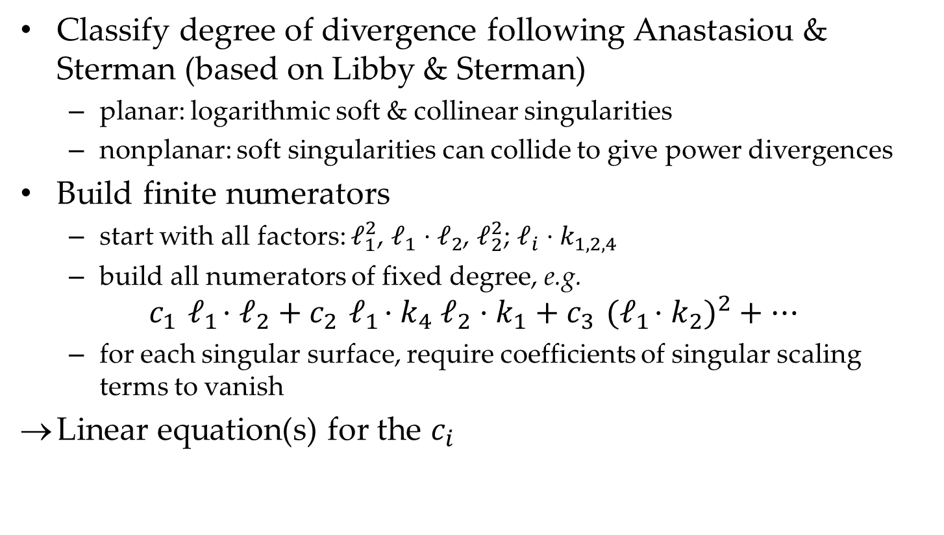
Analytic Strategy
Classify degree of divergence following Anastasiou & Sterman (based on Libby & Sterman)
  planar: logarithmic soft & collinear singularities
  nonplanar: soft singularities can collide to give power divergences
Build finite numerators
  start with all factors: $ℓ_{1}^{2}$, $ℓ_{1}⋅ℓ_{2}$, $ℓ_{2}^{2}$; $ℓ_{i}⋅k_{1,2,4}$
  build all numerators of fixed degree, e.g.
$$c_{1}{ ℓ}_{1}⋅ℓ_{2}+c_{2}{ ℓ}_{1}⋅k_{4} ℓ_{2}⋅k_{1}+c_{3}{ (ℓ}_{1}⋅k_{2})^{2}+⋯$$
  for each singular surface, require coefficients of singular scaling terms to vanish
Linear equation(s) for the $c_{i}$

Slide 11
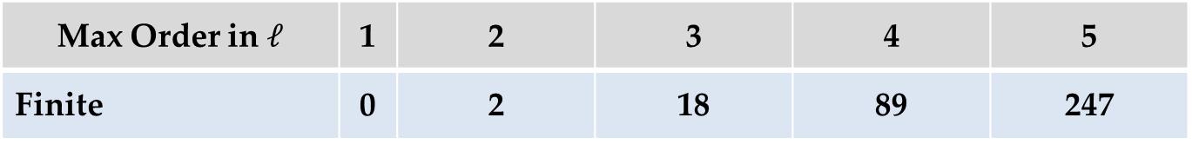
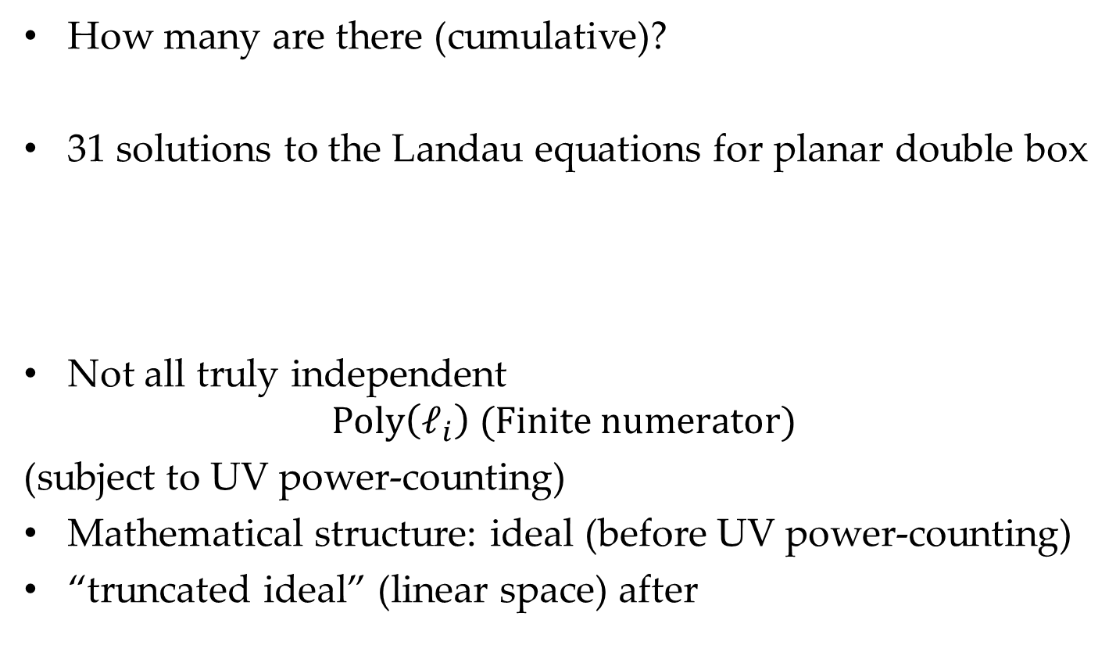
Independent Numerators
How many are there (cumulative)?
31 solutions to the Landau equations for planar double box
Not all truly independent
$$\text{Poly}\left(ℓ_{i}\right) (\text{Finite} \text{numerator})$$
(subject to UV power-counting)
Mathematical structure: ideal (before UV power-counting)
“truncated ideal” (linear space) after
Max Order in$ℓ$ | 1 | 2 | 3 | 4 | 5
Finite | 0 | 2 | 18 | 89 | 247

Slide 12

A Foreign-Language Lesson
Don’t learn animal behavior from DuoLingo

Slide 13
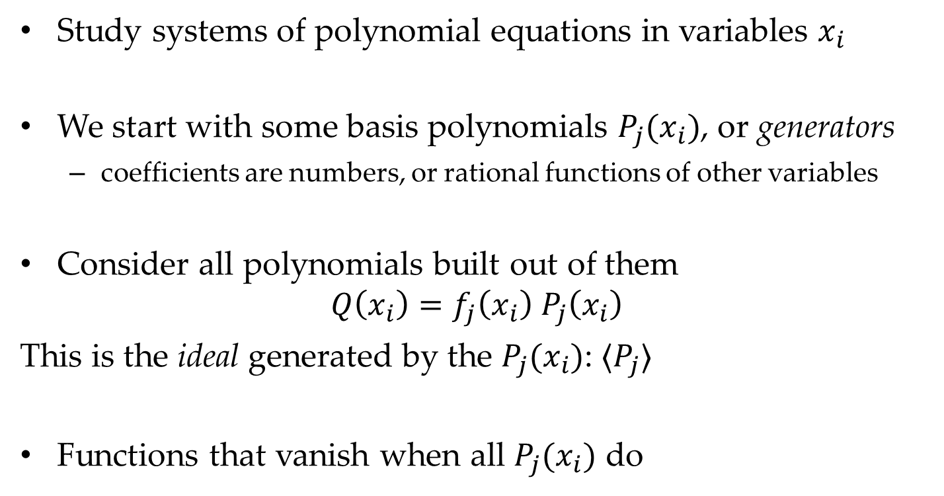
A Foreign-Language Lesson
Study systems of polynomial equations in variables $x_{i}$
We start with some basis polynomials $P_{j}(x_{i})$, or generators
  coefficients are numbers, or rational functions of other variables
Consider all polynomials built out of them
$$Q\left(x_{i}\right)=f_{j}\left(x_{i}\right) P_{j}\left(x_{i}\right)$$
This is the ideal generated by the $P_{j}(x_{i})$: $⟨P_{j}⟩$
Functions that vanish when all $P_{j}(x_{i})$ do

Slide 14
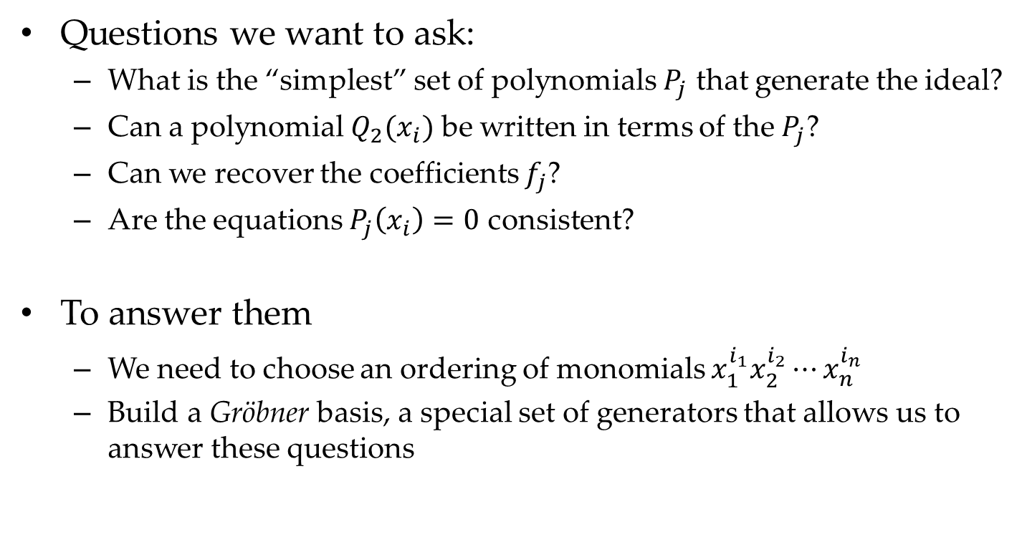
A Foreign-Language Lesson
Questions we want to ask:
  What is the “simplest” set of polynomials $P_{j}$ that generate the ideal?
  Can a polynomial $Q_{2}(x_{i})$ be written in terms of the $P_{j}$?
  Can we recover the coefficients $f_{j}$?
  Are the equations $P_{j}\left(x_{i}\right)=0$ consistent?
To answer them
  We need to choose an ordering of monomials $x_{1}^{i_{1}}x_{2}^{i_{2}}⋯x_{n}^{i_{n}}$
  Build a Gröbner basis, a special set of generators that allows us to answer these questions

Slide 15
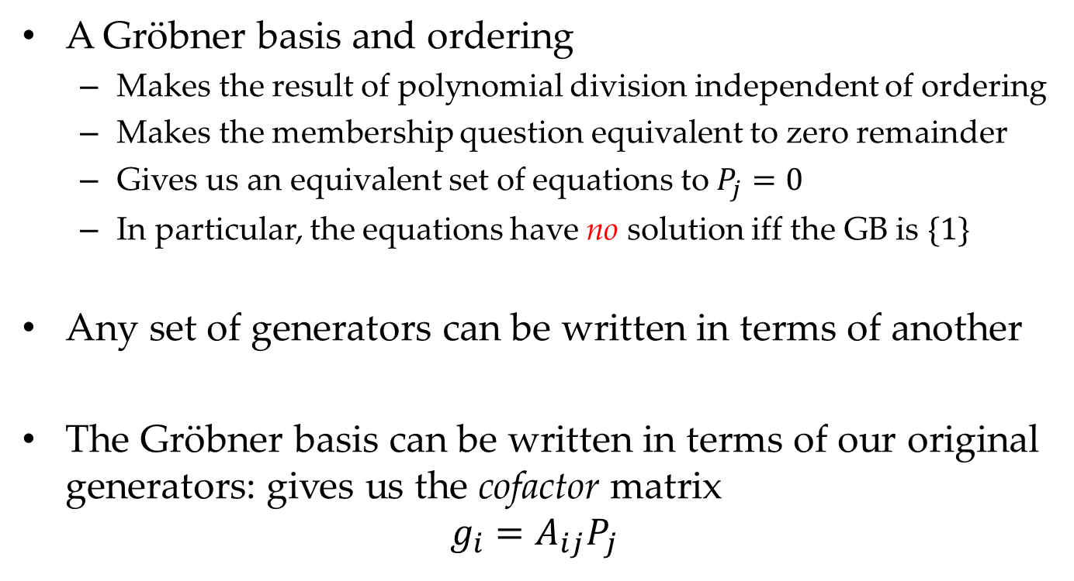
A Foreign-Language Lesson
A Gröbner basis and ordering
  Makes the result of polynomial division independent of ordering
  Makes the membership question equivalent to zero remainder
  Gives us an equivalent set of equations to $P_{j}=0$
  In particular, the equations have no solution iff the GB is $\{1\}$
Any set of generators can be written in terms of another
The Gröbner basis can be written in terms of our original generators: gives us the cofactor matrix
$$g_{i}=A_{ij}P_{j}$$

Slide 16
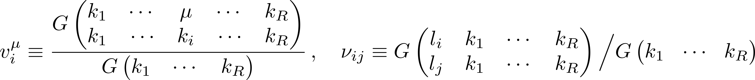
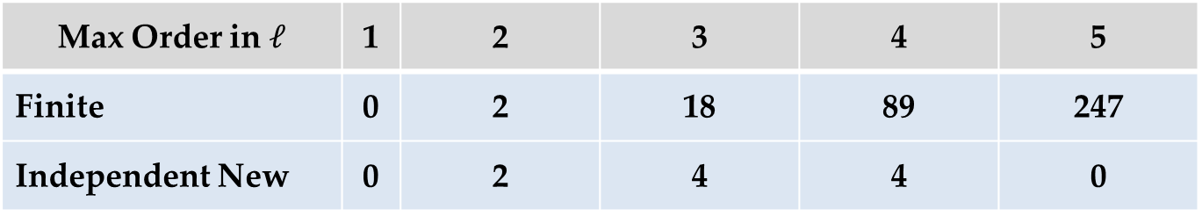
Independent Numerators
Appropriate technology: Gröbner bases
Compute Gröbner basis of order 2, retain independent remainders after dividing over the basis; iterate
Or, just compute overall Gröbner basis all at once
Define (van Neerven & Vermaseren)
to get nice forms for generators
Max Order in$ℓ$ | 1 | 2 | 3 | 4 | 5
Finite | 0 | 2 | 18 | 89 | 247
Independent New | 0 | 2 | 4 | 4 | 0

Slide 17
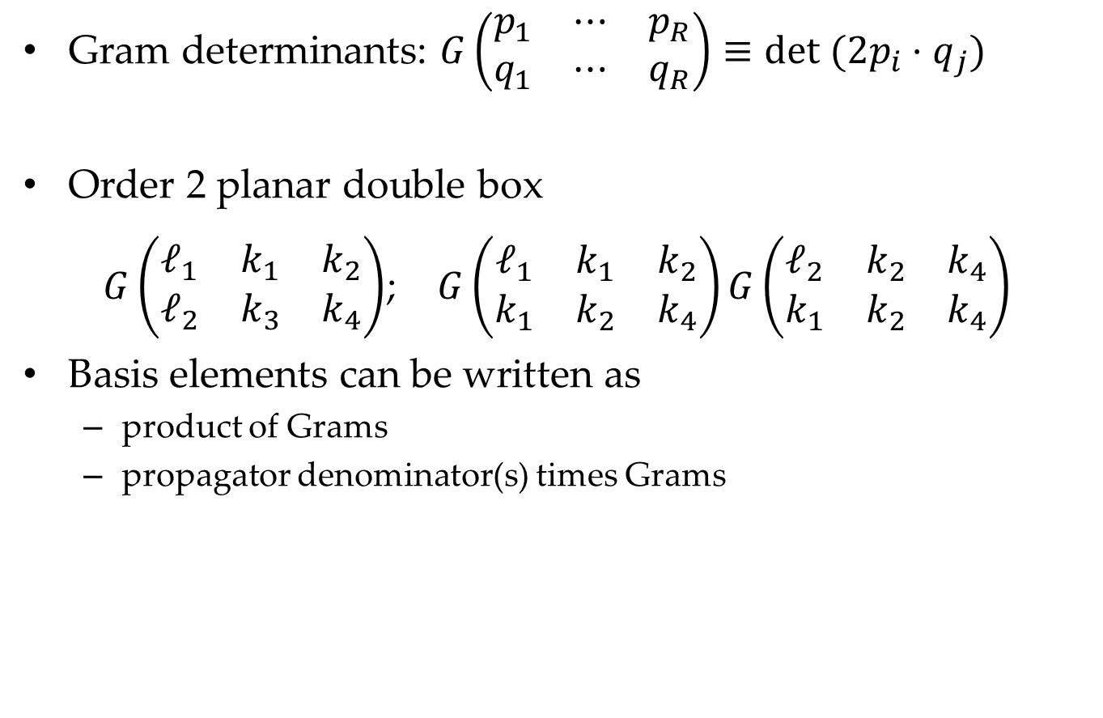
Nicer Packaging
Gram determinants: $G\left(\begin{matrix}p_{1} & ⋯ & p_{R} \\ q_{1} & ⋯ & q_{R}\end{matrix}\right)≡det (2p_{i}⋅q_{j})$
Order 2 planar double box
$G\left(\begin{matrix}ℓ_{1} & k_{1} & k_{2} \\ ℓ_{2} & k_{3} & k_{4}\end{matrix}\right)$; $G\left(\begin{matrix}ℓ_{1} & k_{1} & k_{2} \\ k_{1} & k_{2} & k_{4}\end{matrix}\right)G\left(\begin{matrix}ℓ_{2} & k_{2} & k_{4} \\ k_{1} & k_{2} & k_{4}\end{matrix}\right)$
Basis elements can be written as
  product of Grams
  propagator denominator(s) times Grams

Slide 18
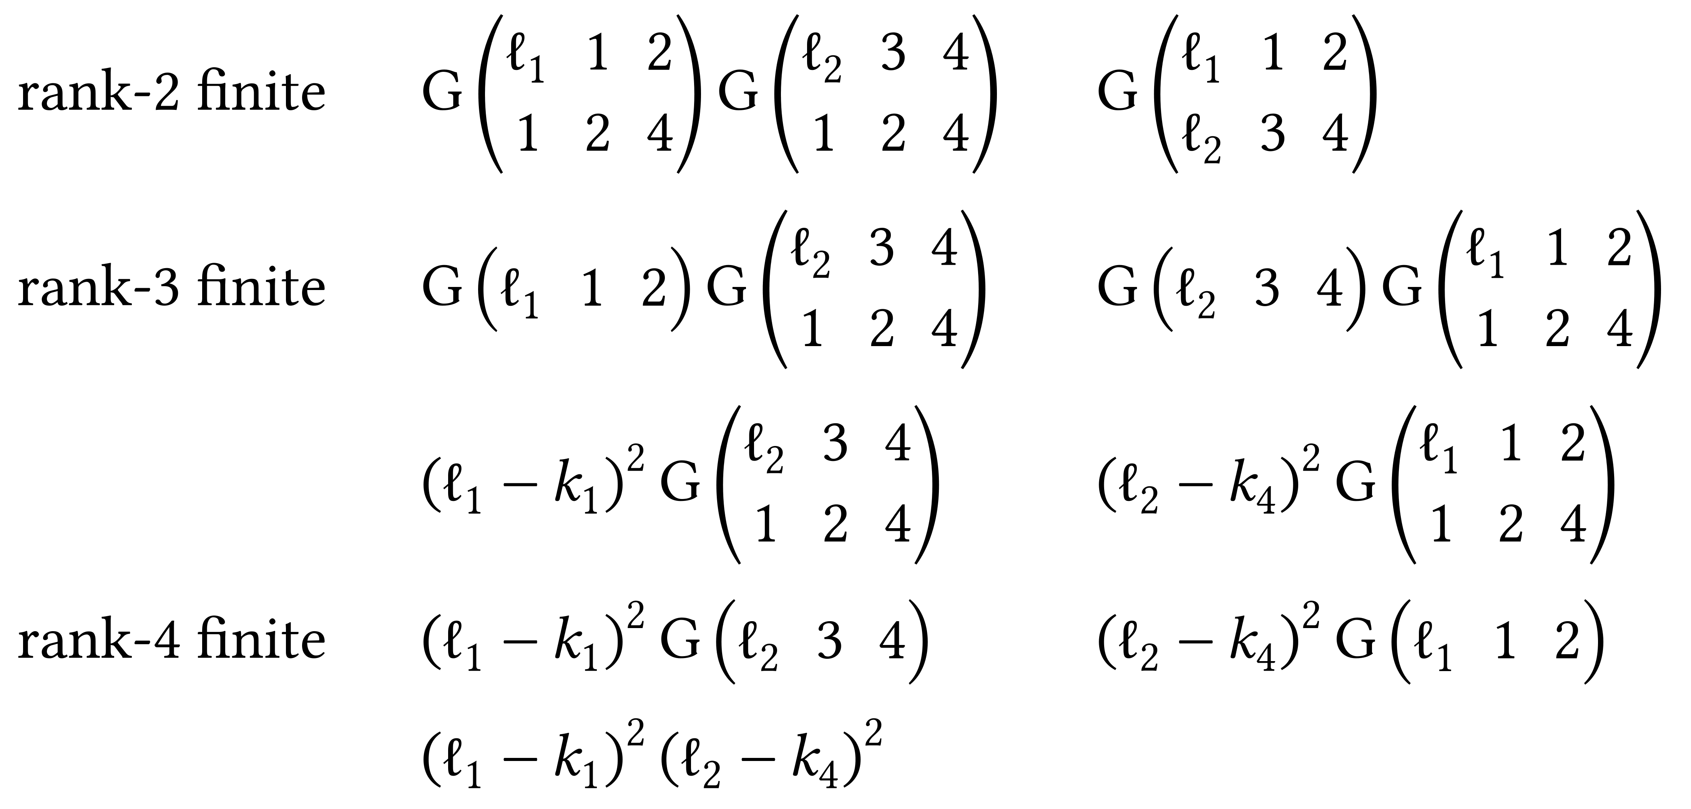

Planar Double Box
Basis of finite numerators
Evanescent basis (rank-4)
$$G(ℓ_{1},ℓ_{2},1,2,3)$$

Slide 19
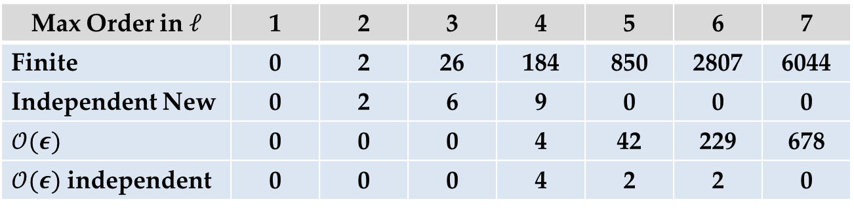

Three-Loop Ladder
Max Order in$ℓ$ | 1 | 2 | 3 | 4 | 5 | 6 | 7
Finite | 0 | 2 | 26 | 184 | 850 | 2807 | 6044
Independent New | 0 | 2 | 6 | 9 | 0 | 0 | 0
$𝒪(ε)$ | 0 | 0 | 0 | 4 | 42 | 229 | 678
$𝒪(ε)$ independent | 0 | 0 | 0 | 4 | 2 | 2 | 0
$𝒪(ε)$
  Finite
  Vanish when any loop momentum is four-dimensional
  Generalizes one-loop pentagon Gram

Slide 20
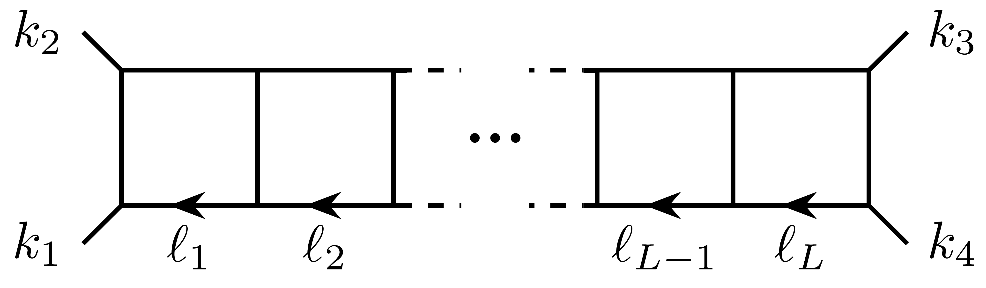

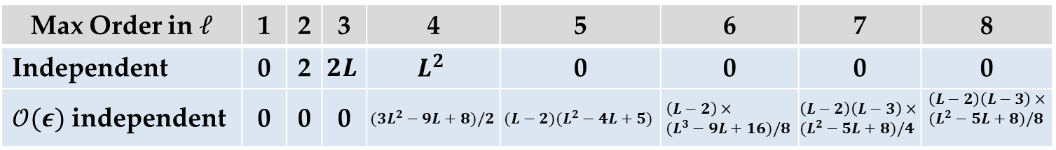
All-Loop Ladder Conjecture
Max Order in$ℓ$ | 1 | 2 | 3 | 4 | 5 | 6 | 7 | 8
Independent | 0 | 2 | $$2L$$ | $$L^{2}$$ | 0 | 0 | 0 | 0
$𝒪(ε)$ independent | 0 | 0 | 0 | $$(3L^{2}−9L+8)/2$$ | $$(L−2)(L^{2}−4L+5)$$ | $$\left(L−2\right)× \\ (L^{3}−9L+16)/8$$ | $$\left(L−2\right)\left(L−3\right)× \\ (L^{2}−5L+8)/4$$ | $$\left(L−2\right)\left(L−3\right)× \\ (L^{2}−5L+8)/8$$

Slide 21
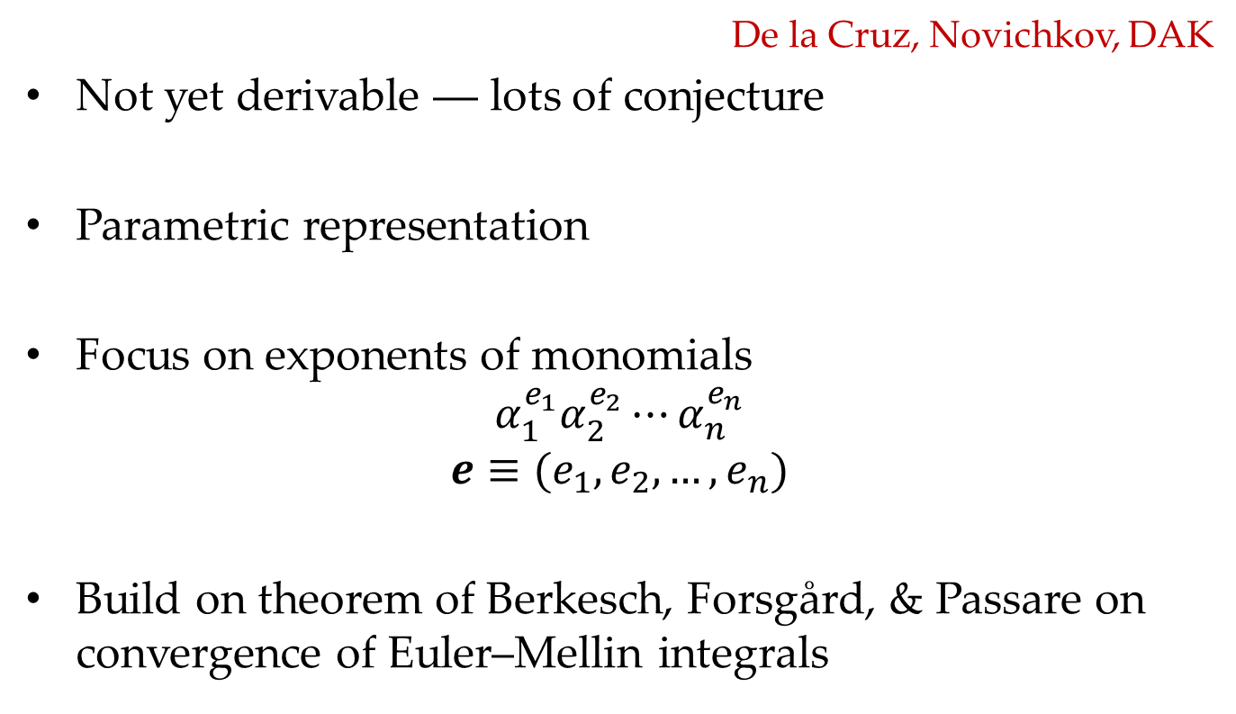
Geometric Strategy
De la Cruz, Novichkov, DAK
Not yet derivable ― lots of conjecture
Parametric representation
Focus on exponents of monomials
$$α_{1}^{e_{1}}α_{2}^{e_{2}}⋯α_{n}^{e_{n}}$$
$$e≡(e_{1},e_{2},…,e_{n})$$
Build on theorem of Berkesch, Forsgård, & Passare on convergence of Euler–Mellin integrals

Slide 22
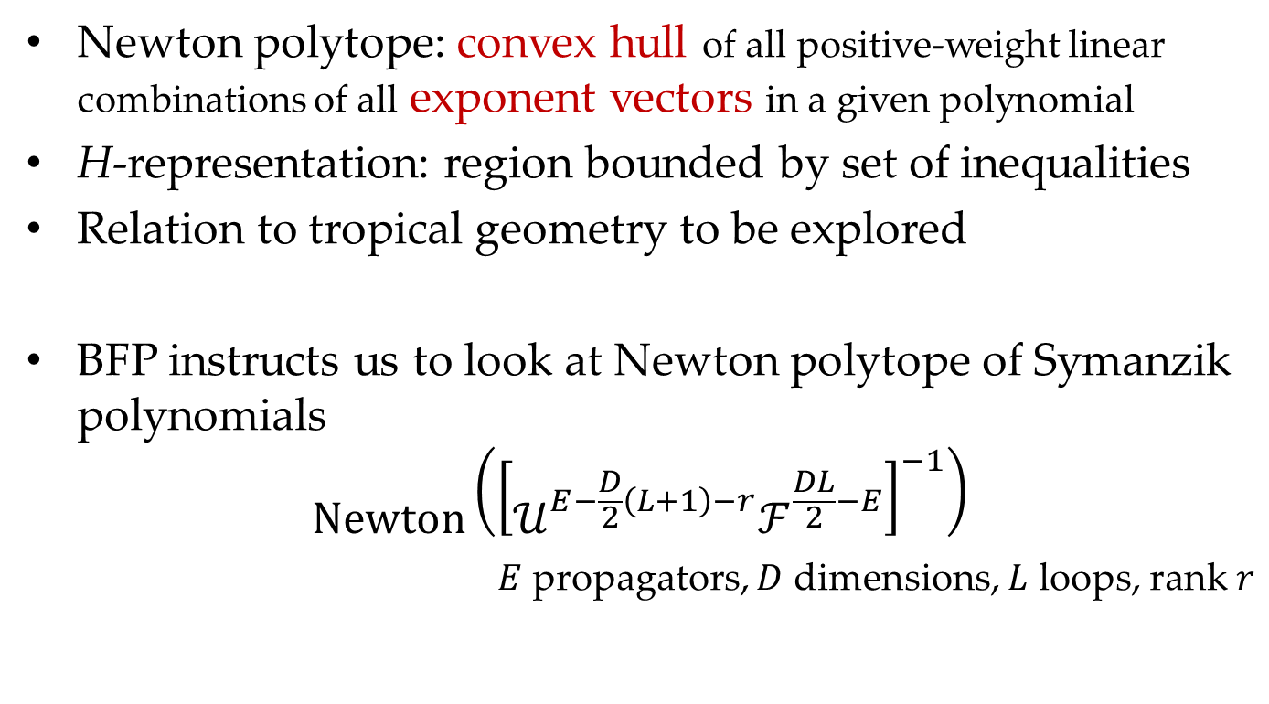
Geometric Strategy
Newton polytope: convex hull of all positive-weight linear combinations of all exponent vectors in a given polynomial
H-representation: region bounded by set of inequalities
Relation to tropical geometry to be explored
BFP instructs us to look at Newton polytope of Symanzik polynomials
$$Newton\left({\left[𝒰^{E−\frac{D}{2}\left(L+1\right)−r}ℱ^{\frac{DL}{2}−E}\right]}^{−1}\right)$$
$E$ propagators, $D$ dimensions, $L$ loops, rank $r$

Slide 23
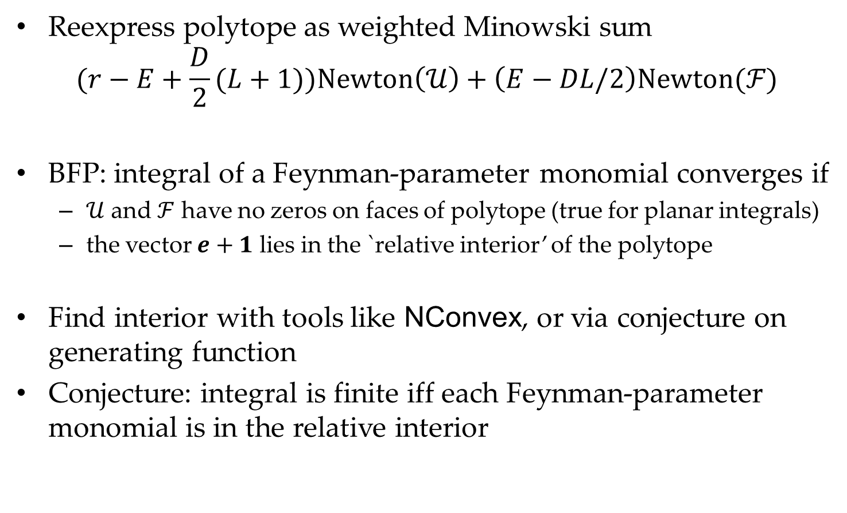
Geometric Strategy
Reexpress polytope as weighted Minowski sum
$$(r−E+\frac{D}{2}(L+1))Newton\left(𝒰\right)+\left(E−DL/2\right)Newton(ℱ)$$
BFP: integral of a Feynman-parameter monomial converges if
  $𝒰$ and $ℱ$ have no zeros on faces of polytope (true for planar integrals)
  the vector $e+1$ lies in the `relative interior’ of the polytope
Find interior with tools like NConvex, or via conjecture on generating function
Conjecture: integral is finite iff each Feynman-parameter monomial is in the relative interior

Slide 24
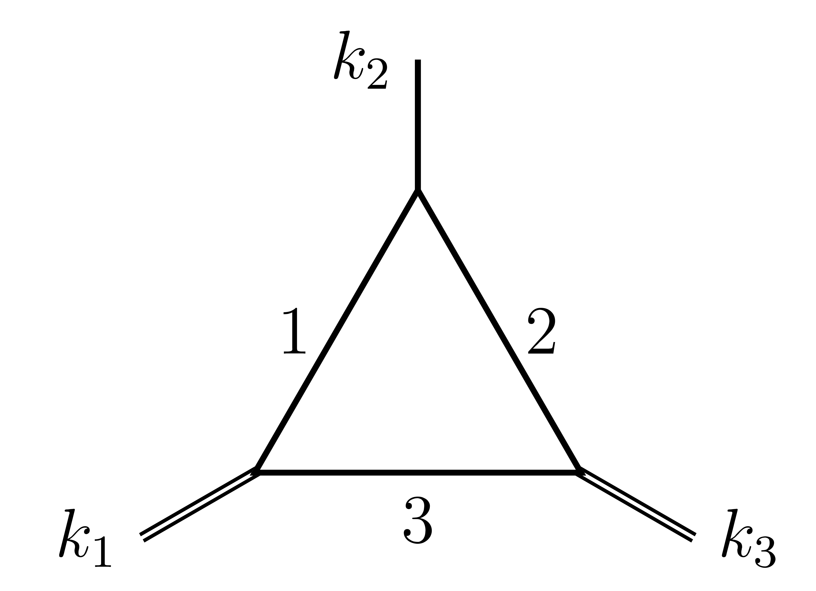
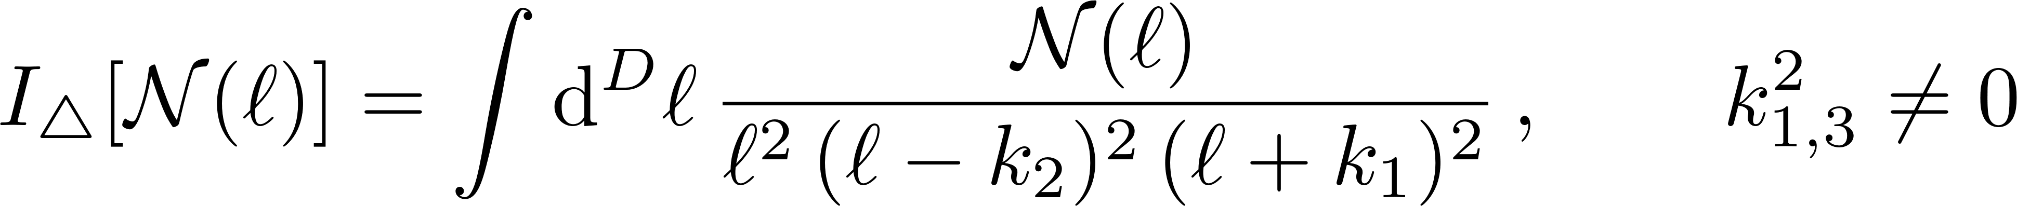

Geometric Strategy: Toy Example
Consider the two-mass triangle
In parametric form
$𝒰=α_{1}+α_{2}+α_{3}$, $ℱ=−(k_{1}^{2}α_{1}α_{3}+k_{3}^{2}α_{2}α_{3})$
Fix $α_{3}=1$

Slide 25
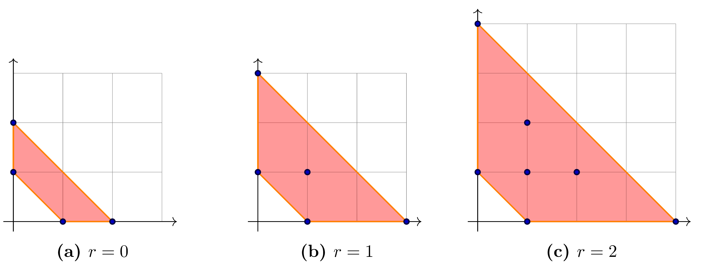

Feynman Polytope
All possible exponent vectors:
(0,0); (1,0); (0,1)
$$P_{3}=\left(r+D−3\right)Newt\left(𝒰\right)+\left(3−\frac{D}{2}\right)Newt(ℱ)$$
⇓ ⇓
divergent $ℓ⋅k_{2}$

Slide 26
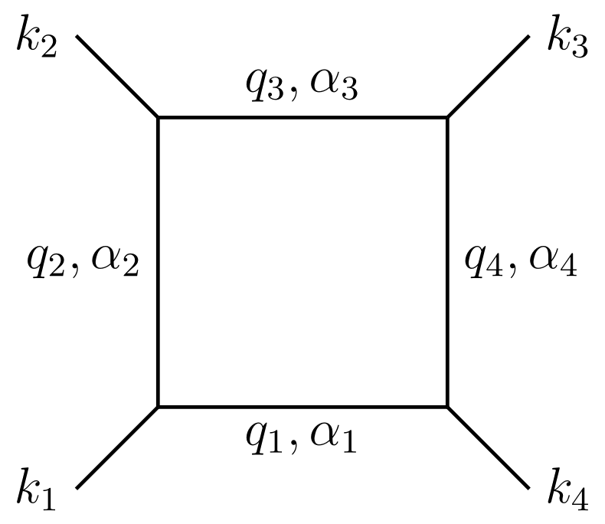
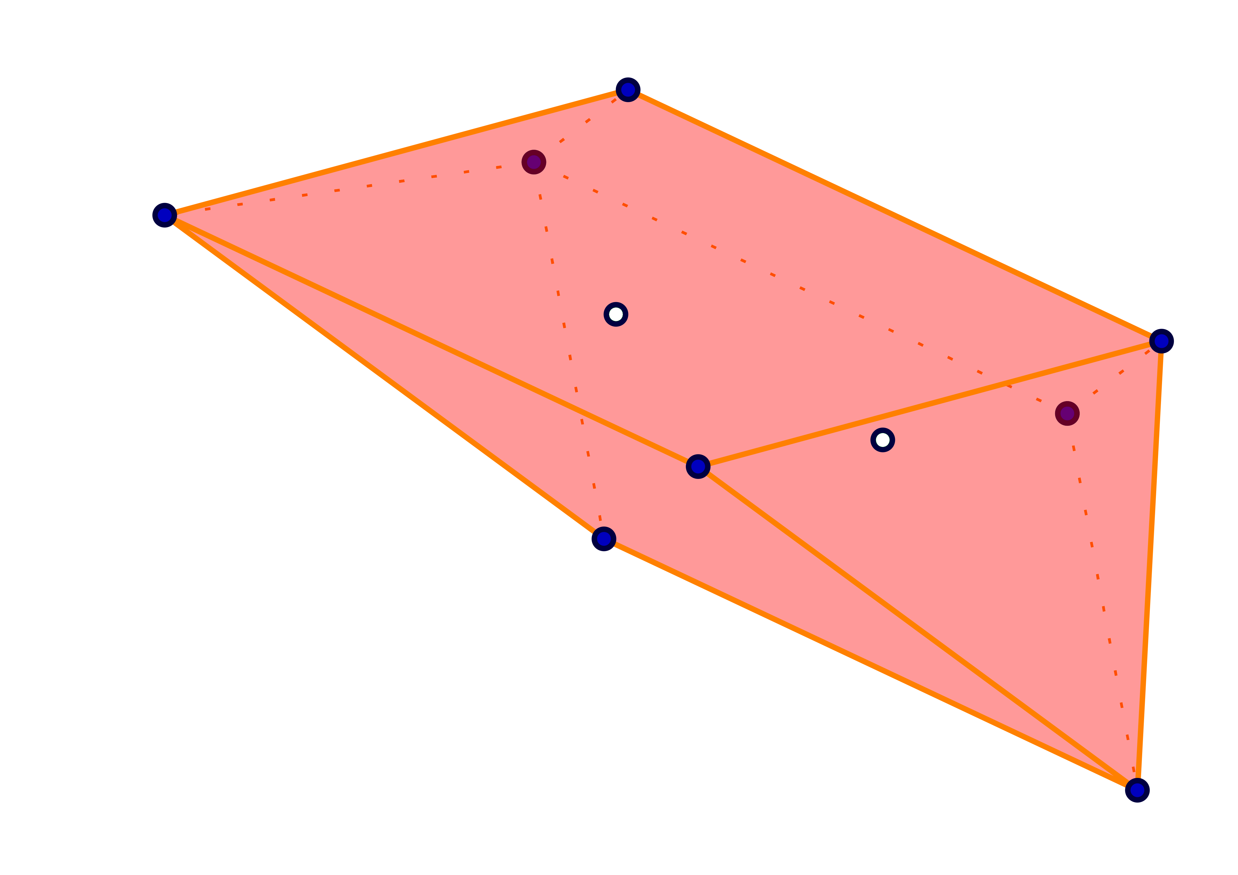
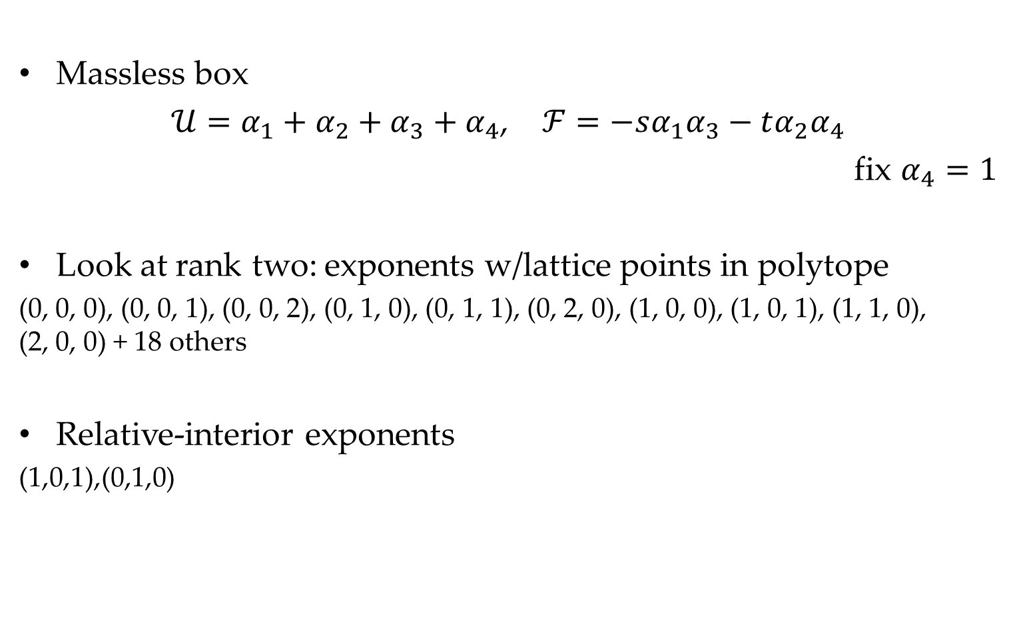
Geometric Strategy: Example
Massless box
$𝒰=α_{1}+α_{2}+α_{3}+α_{4}$, $ℱ=−sα_{1}α_{3}−tα_{2}α_{4}$
fix $α_{4}=1$
Look at rank two: exponents w/lattice points in polytope
(0, 0, 0), (0, 0, 1), (0, 0, 2), (0, 1, 0), (0, 1, 1), (0, 2, 0), (1, 0, 0), (1, 0, 1), (1, 1, 0),
(2, 0, 0) + 18 others
Relative-interior exponents
(1,0,1),(0,1,0)

Slide 27
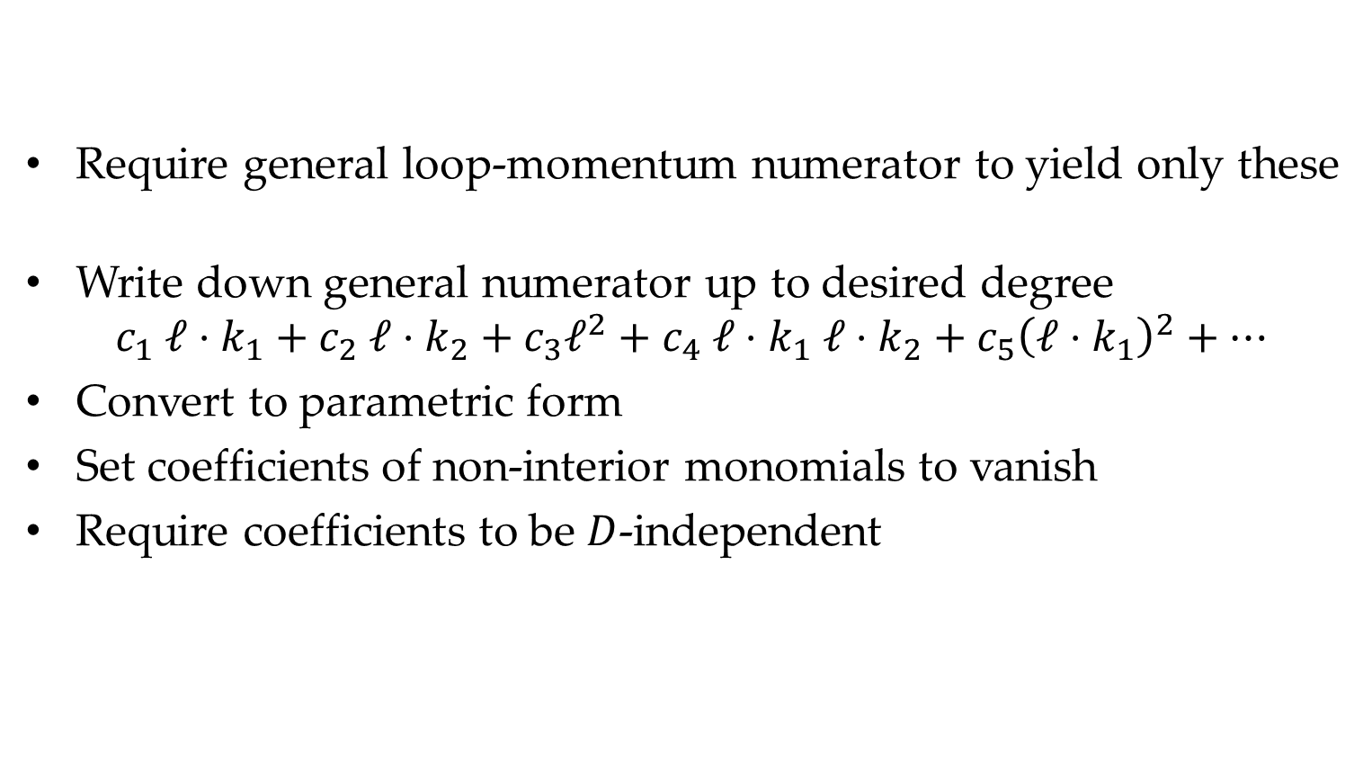
Geometric Strategy: Example
Require general loop-momentum numerator to yield only these
Write down general numerator up to desired degree
$$c_{1} ℓ⋅k_{1}+c_{2} ℓ⋅k_{2}+c_{3}ℓ^{2}+c_{4} ℓ⋅k_{1} ℓ⋅k_{2}+c_{5}{\left(ℓ⋅k_{1}\right)}^{2}+⋯$$
Convert to parametric form
Set coefficients of non-interior monomials to vanish
Require coefficients to be $D$-independent

Slide 28

Geometric Strategy: Example
$$N_{1}:(s+t)ℓ⋅k_{1}\text{+}tℓ⋅k_{2}\text{−}sℓ⋅k_{4}\text{−(}s+t\text{) }ℓ^{2}$$
$$N_{2}:\left(t^{2}−s^{2}\right){\left(ℓ⋅k_{1}\right)}^{2}+2t^{2}ℓ⋅k_{1} ℓ⋅k_{2}+t^{2}{\left(ℓ⋅k_{2}\right)}^{2}−2s^{2}ℓ⋅k_{1} ℓ⋅k_{4}−s^{2}{\left(ℓ⋅k_{4}\right)}^{2}+st^{2}ℓ^{2}$$
$$N_{3}:−\left(s+t\right){\left(ℓ⋅k_{1}\right)}^{2}−tℓ⋅k_{1} ℓ⋅k_{2}−\left(2s+t\right)ℓ⋅k_{1} ℓ⋅k_{4}+tℓ⋅k_{2} ℓ⋅k_{4}−s{\left(ℓ⋅k_{4}\right)}^{2}−\frac{1}{2}stℓ^{2}$$

Slide 29
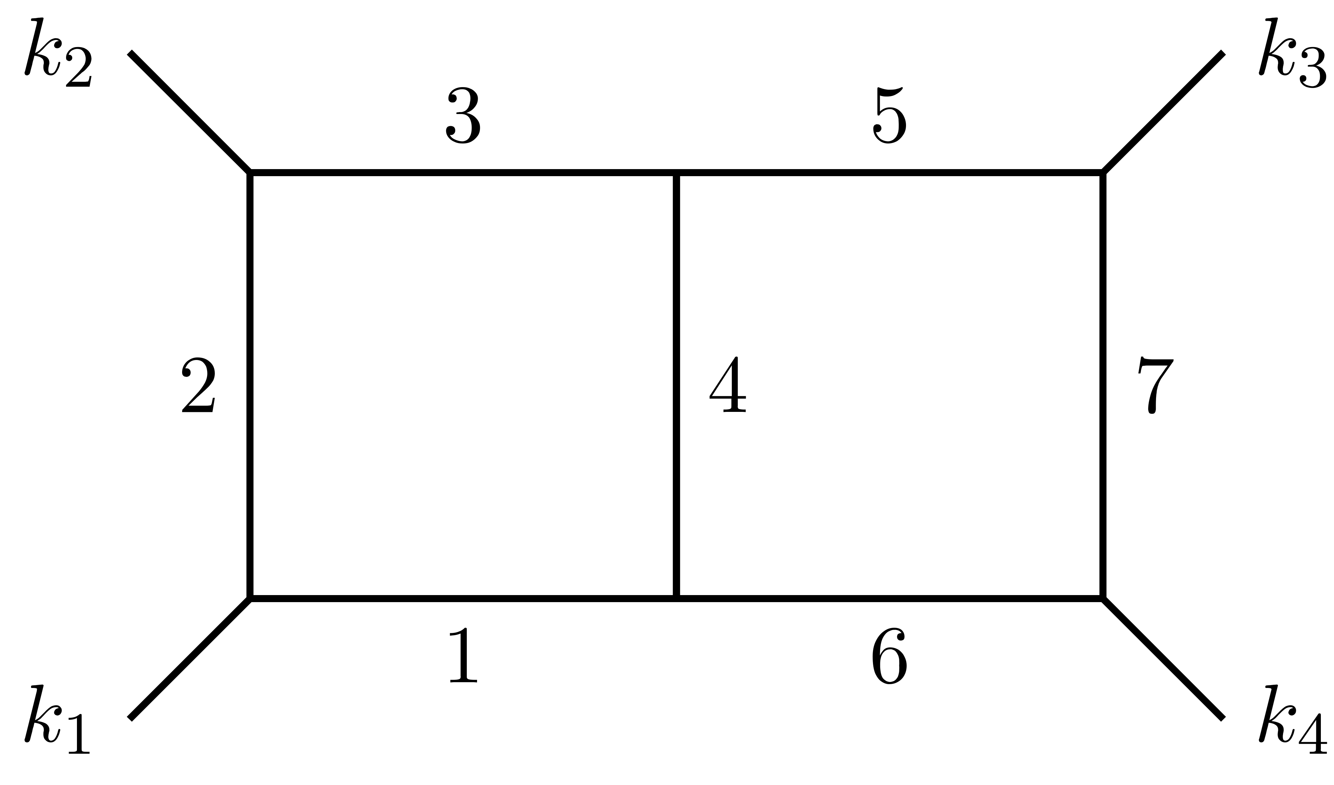
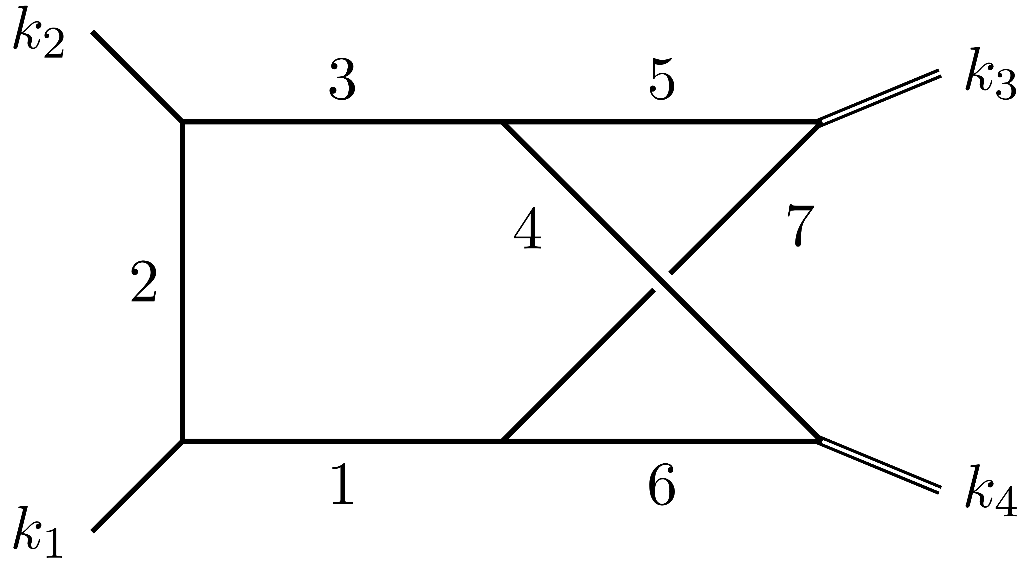
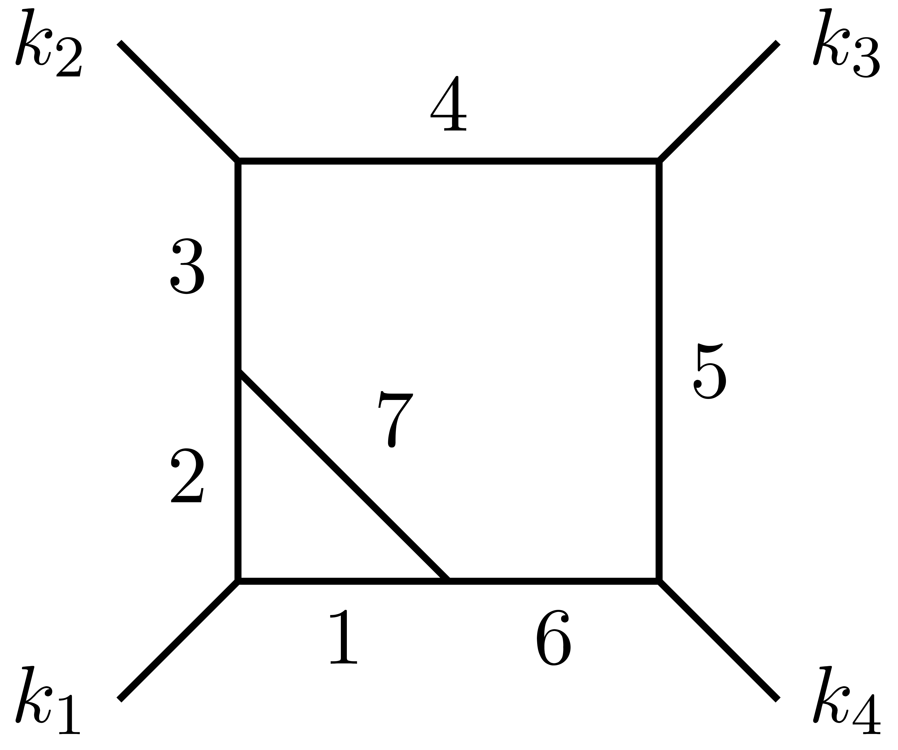
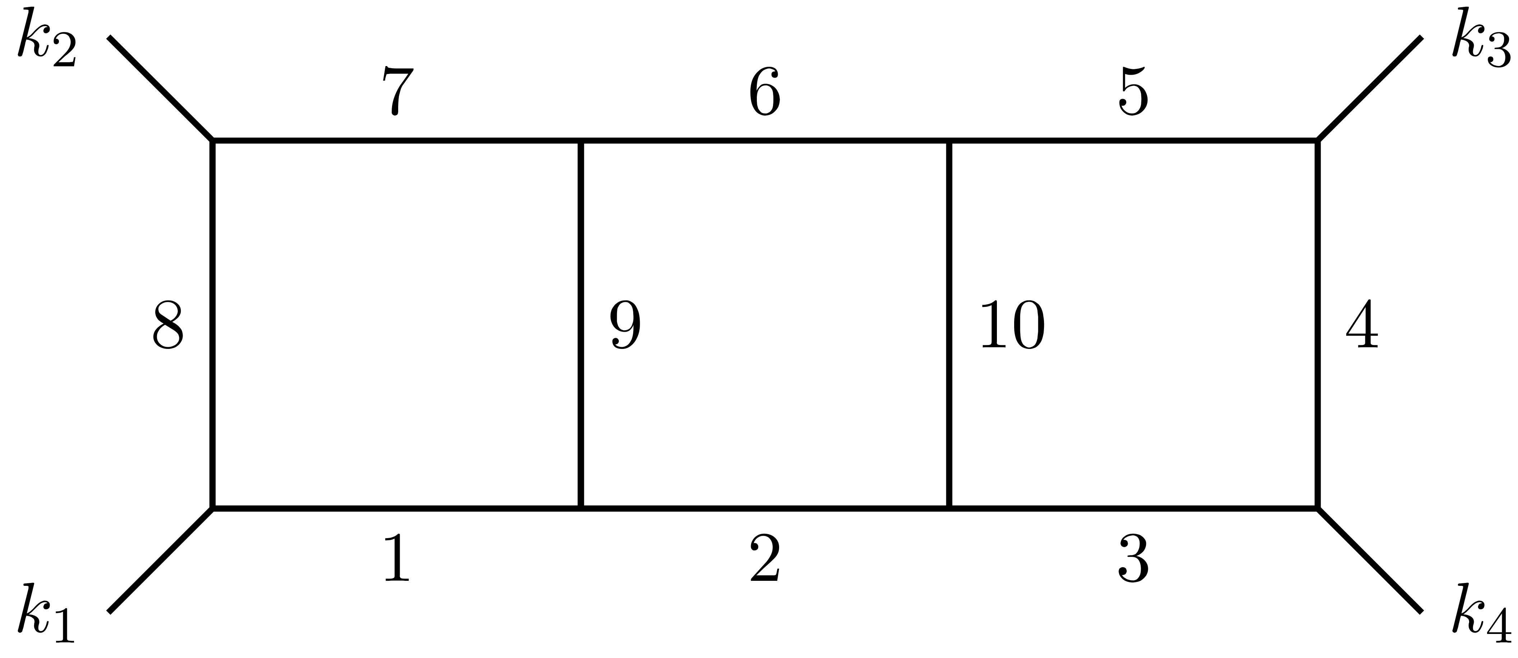
Other Integrals
Planar double box
Nonplanar double box
Beetle
Three-loop ladder

Slide 30
Comparison
Do the results of the two approaches agree?
Yes…
…but the comparison is subtle

Slide 31
Comparisons
Strongly UV convergent (by strict power counting)
vs [simply] weakly UV convergent (coefficient vanishes)
Nontrivial numerators can vanish in parameters
  Special total derivatives
General total derivatives caught in
  Not locally finite but still scooped up by polytopes
Compared
  Planar & nonplanar double box
  Beetle
  Three-loop ladder

Slide 32
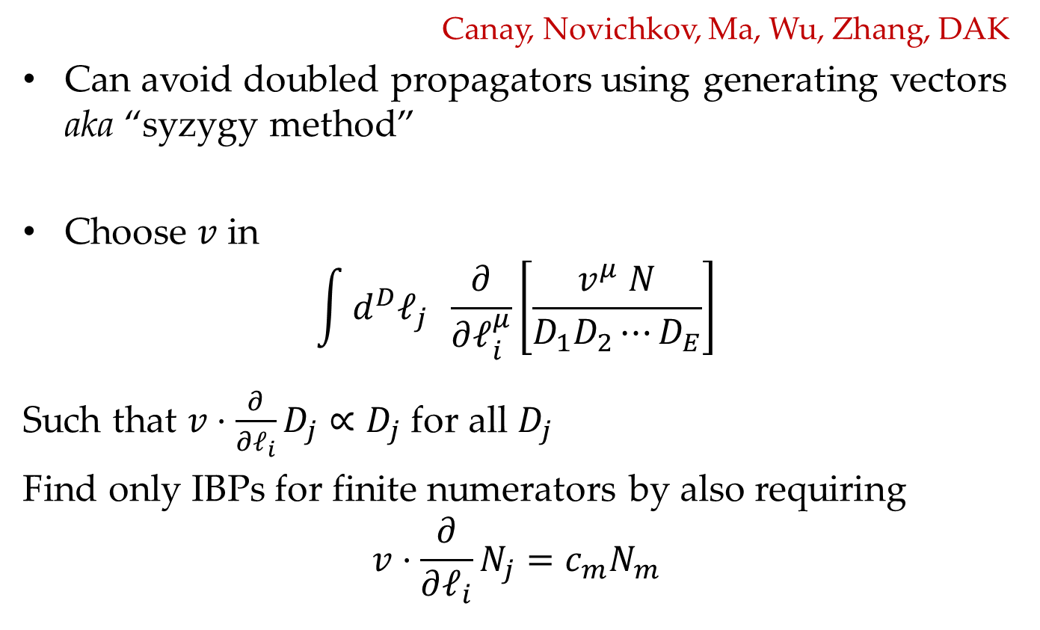
Integration by Parts
Canay, Novichkov, Ma, Wu, Zhang, DAK
Can avoid doubled propagators using generating vectors aka “syzygy method”
Choose $v$ in
$$\int{d^{D}ℓ_{j}} \frac{∂}{∂ℓ_{i}^{μ}}\left[\frac{v^{μ} N}{D_{1}D_{2}⋯D_{E}}\right]$$
Such that $v⋅\frac{∂}{∂ℓ_{i}}D_{j}∝D_{j}$ for all $D_{j}$
Find only IBPs for finite numerators by also requiring
$$v⋅\frac{∂}{∂ℓ_{i}}N_{j}=c_{m}N_{m}$$

Slide 33
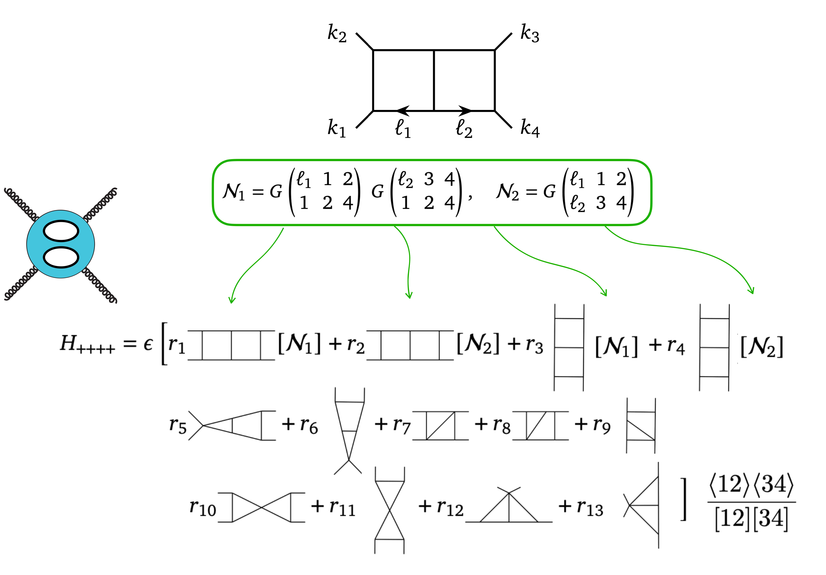

Use of New Integrals
Look at two-loop $A_{4}(++++)$
Coefficients simpler too

Slide 34
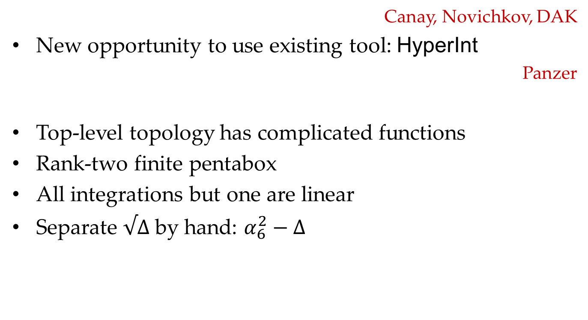
Integrating
Canay, Novichkov, DAK
New opportunity to use existing tool: HyperInt
Panzer
Top-level topology has complicated functions
Rank-two finite pentabox
All integrations but one are linear
Separate $√Δ$ by hand: $α_{6}^{2}−Δ$

Slide 35
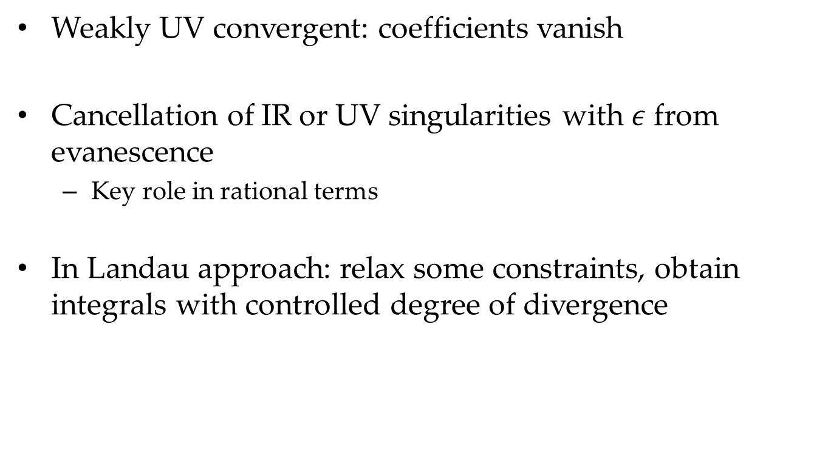
Beyond Scope
Weakly UV convergent: coefficients vanish
Cancellation of IR or UV singularities with $ε$ from evanescence
  Key role in rational terms
In Landau approach: relax some constraints, obtain integrals with controlled degree of divergence

Slide 36
Summary
With numerators
Feynman integrals settle
happily bounded
Finite integrals are a first step to exploring a new organization of scattering amplitudes
Two approaches
  Analytic approach: Landau equations + Anastasiou–Sterman scaling
  Geometric approach: Newton polytopes + BFP theorem
Applications
  Amplitude structure
  Integrating

