Slide 1
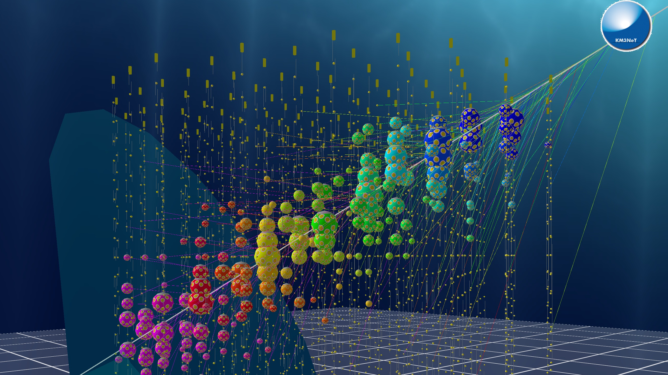

Astroparticle Physics at INPP
E. Tzamariudaki
ISAC 21/11/19

Slide 2
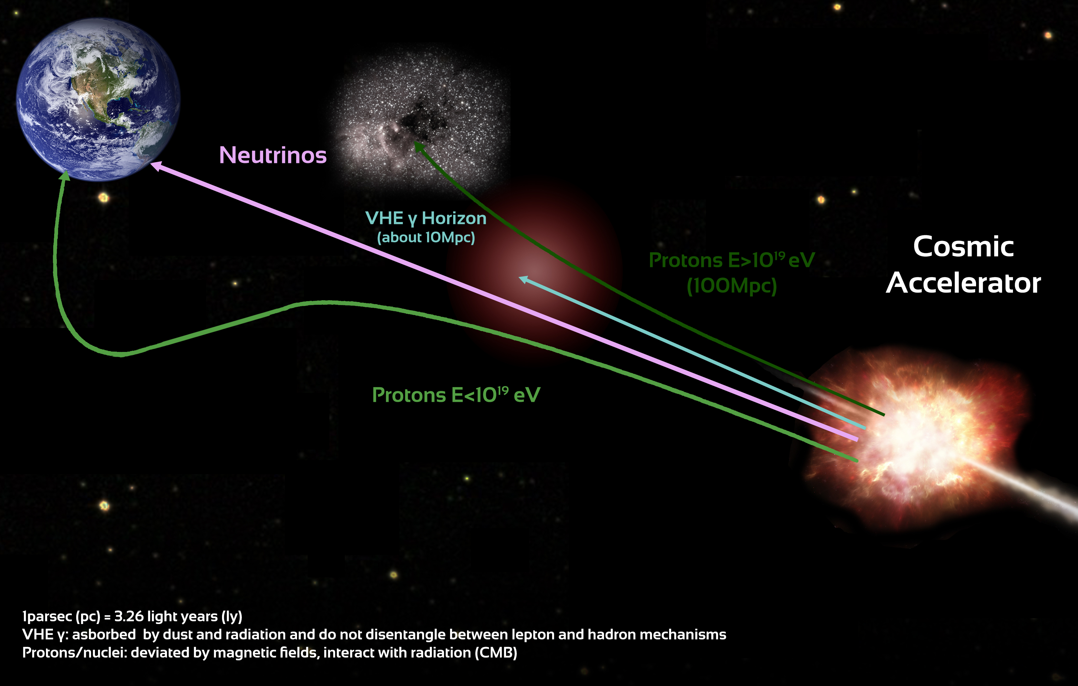
Science Objectives: Astroparticle
Explore the High Energy Universe
neutrinos: unique messengers
no interactions with ambient matter or radiation
no deflection by magnetic fields
information on the internal processes of the astrophysical sources inaccessible through photons or cosmic rays
KM3NeT-ARCA
neutrinos: probe of fundamental processes
origin of UHE cosmic rays
production mechanism of HE gamma-rays
(hadronic / leptonic)
dark matter
observe high energy (>TeV energy regime) neutrinos from astrophysical sources
measure the diffuse flux of astrophysical neutrinos

Slide 3
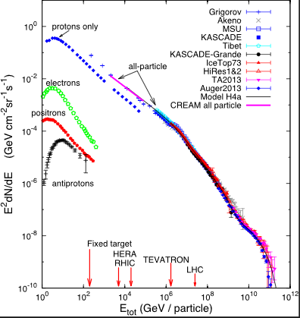
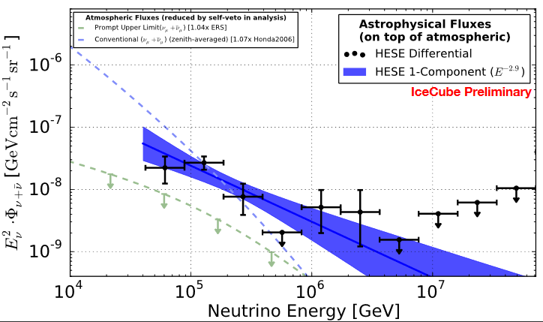
KM3NeT-ARCA: A Neutrino Telescope in the Mediterranean
Cosmic Rays
Astrophysical Neutrino Flux (IceCube)
from C. Kopper NOW 2018
acceleration sources remain mostly unknown
IceCube measures neutrinos up to ~10⁸GeV – origin of HE neutrinos not known

Slide 4
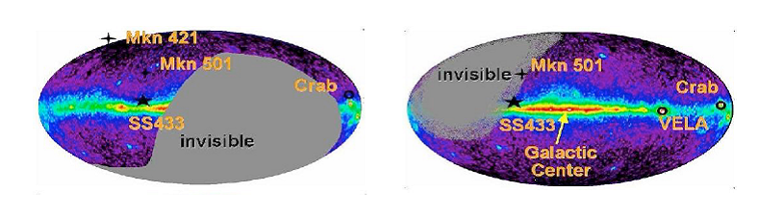
KM3NeT-ARCA: A Neutrino Telescope in the Mediterranean
Cosmic Rays
Astrophysical Neutrino Flux (IceCube)
KM3NeT-ARCA
Sky maps with unprecedented angular resolution
tracks @ 10 TeV : ~0.1°
cascades @ 10TeV : < 2°
from C. Kopper NOW 2018
High visibility (~70%) of the Galactic Centre
IceCube measures neutrinos up to ~10⁸GeV – origin of HE neutrinos not known
acceleration sources remain mostly unknown
Confirm measured astrophysical neutrino flux by IceCube
Multi-messenger astronomy

Slide 5
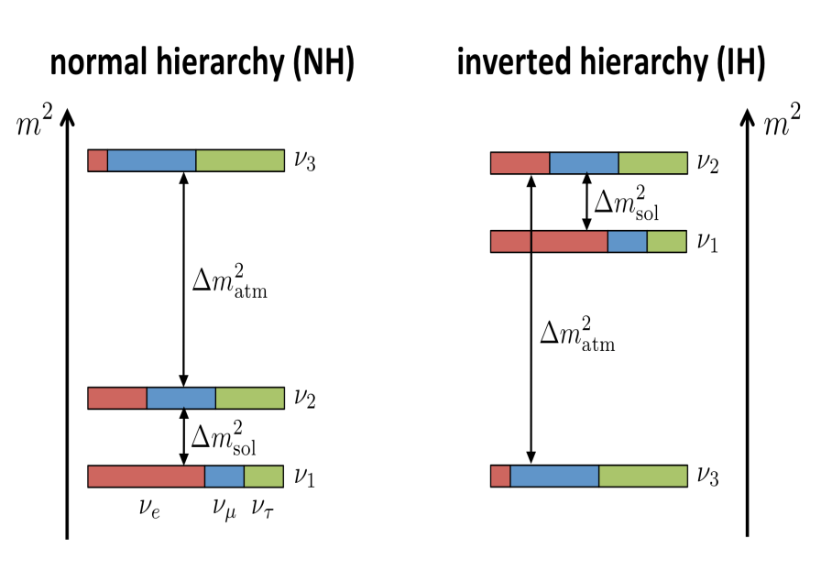
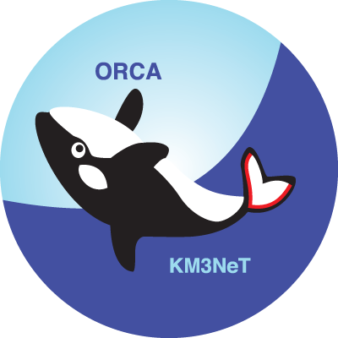
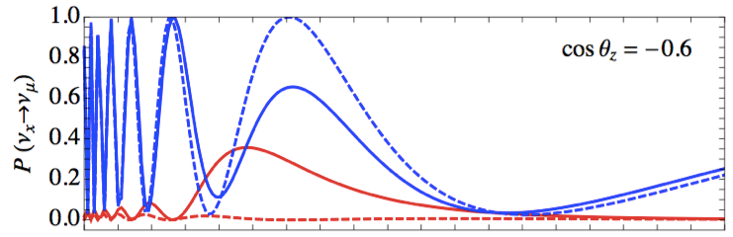
Science Objectives: Neutrino Physics
normal ordering (NO) inverted ordering (IO)
Atmospheric neutrinos:
"free beam" of known composition (ν_{e}, ν_{μ})
Oscillation pattern distorted by Earth matter effects
maximum difference for θ=130° (7645 km) and E_{ν} = 7 GeV
KM3NeT-ORCA: Oscillation Research with Cosmics in the Abyss
measuring the neutrino mass ordering (MC Simulation)
Measure θ and Ε_{ν} for upgoing atmospheric neutrinos (GeV scale)
1
IO
NO
P(νμ → νμ) for θ=130º
0.5
νμ
νe
Treatment of systematics is important
0
1
5
Eν [GeV]

Slide 6
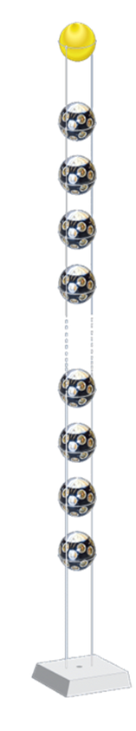
The KM3NeT Detectors
ARCA: Astroparticle Research with Cosmics in the Abyss
KM3NeT-It site; 3400 m; Capo Passero, Italy.
Astrophysical Neutrinos (TeV-PeV Energies).
2 blocks of 115 DUs each: Volume (0.5 * 2) km³ ≈ 1 Gton.
Each DU is about 700 m in height, with DOMs 36 m vertically spaced; The DU horizontal spacing is about 90 m.
Sparsely instrumented.
ORCA: Oscillations Research with Cosmics in the Abyss
KM3NeT-Fr site; 2475 m; Toulon, France.
Atmospheric neutrinos (GeV Energies).
1 block of 115 DUs : Volume ≈ 8 Mton.
Each DU is 200 m in height with DOMs vertically spaced 9 m. The DU horizontal spacing is about 20 m.
More densely instrumented.
Detection Unit (DU)

Slide 7
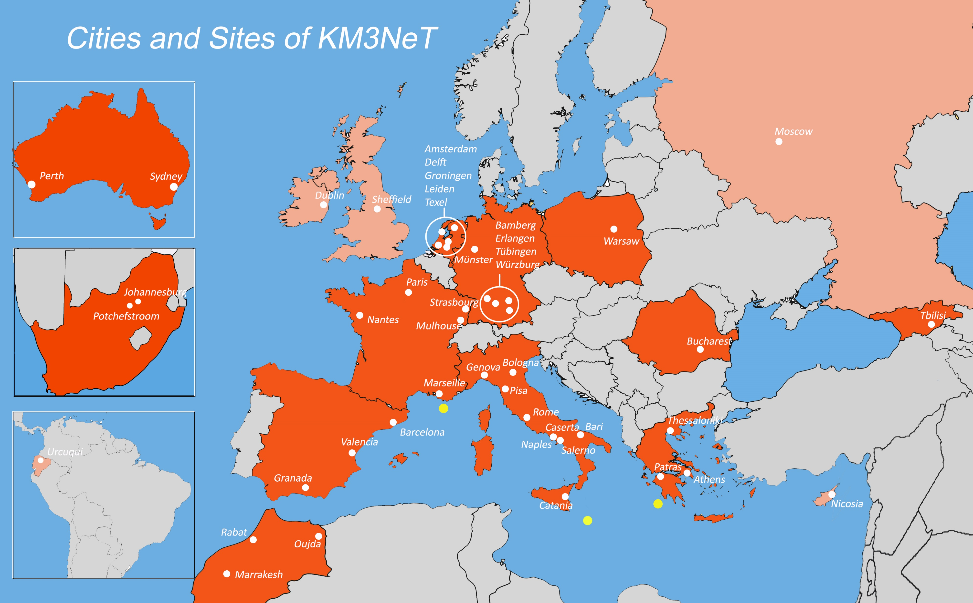
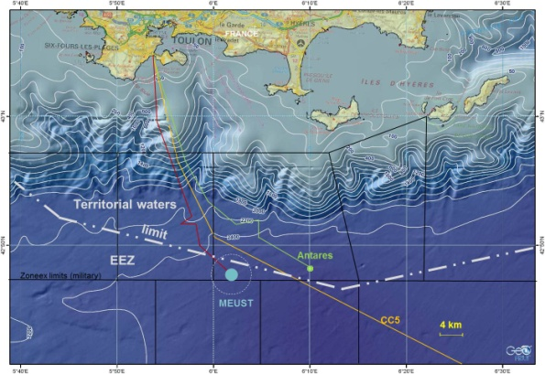
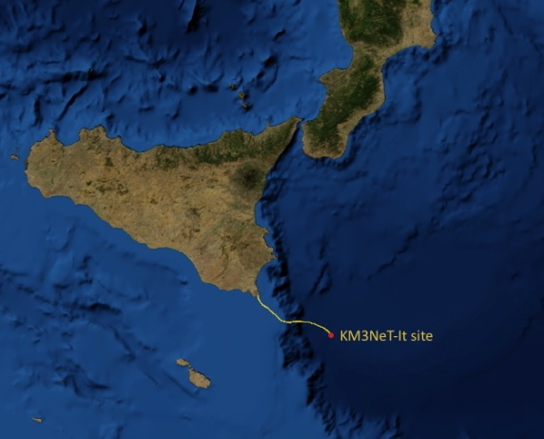
KM3NeT: A Distributed Research Infrastructure
> 50 Institutes from 17 countries in 4 continents
Oscillation Research
with Cosmics In the Abyss
Low-energy studies of atmospheric neutrinos
:
~2450 m
ORCA
Astroparticle Research
with Cosmics In the Abyss
High-energy neutrino astrophysics
Same collaboration, same technology
Distributed infrastructure
Pylos Gr-site for potential hosting of KM3NeT infrastructure

Slide 8
KM3NeT: Phased construction
Phase 1: 30 Detection Units (DUs) constructed by 2020; (6 for KM3NeT-Fr; 24 for KM3NeT-It).
Phase 2: secured funding for the construction of 89 DUs; additional funding requests in preparation or submitted for completing ORCA (1 block – 115 DUs) in Toulon (Fr), ARCA (2 blocks - 230 DUs) in Capo Passero (It).
Short term planning
ARCA: 12 operational DUs before summer 2021
ORCA: 6 operational DUs by the end of 2019; 7 additional DUs by the end of 2021

Slide 9
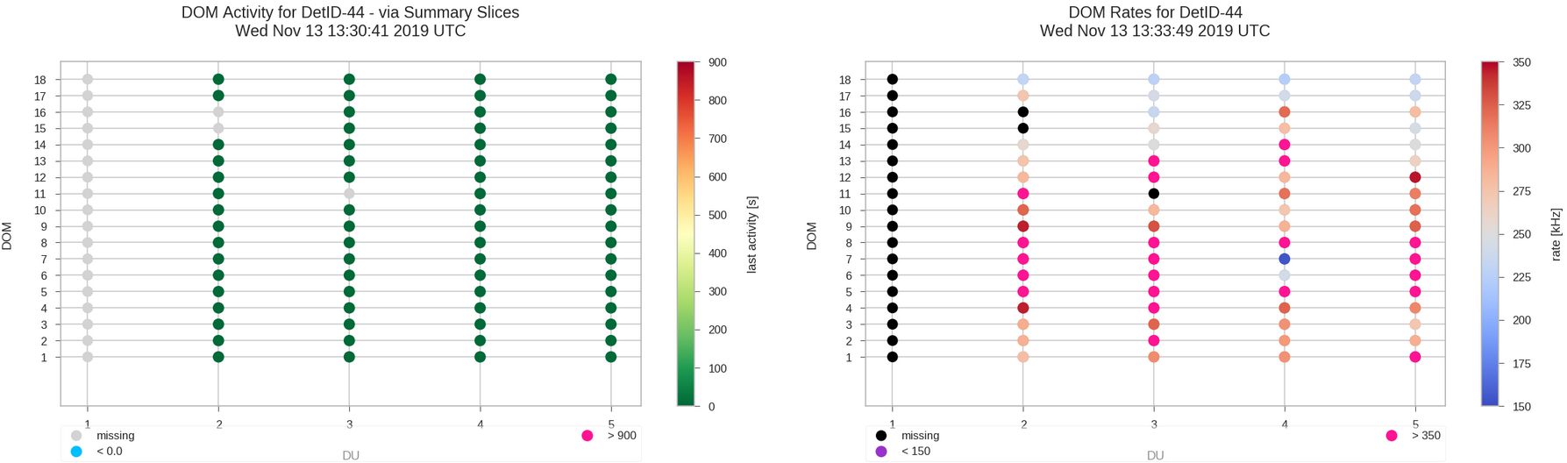
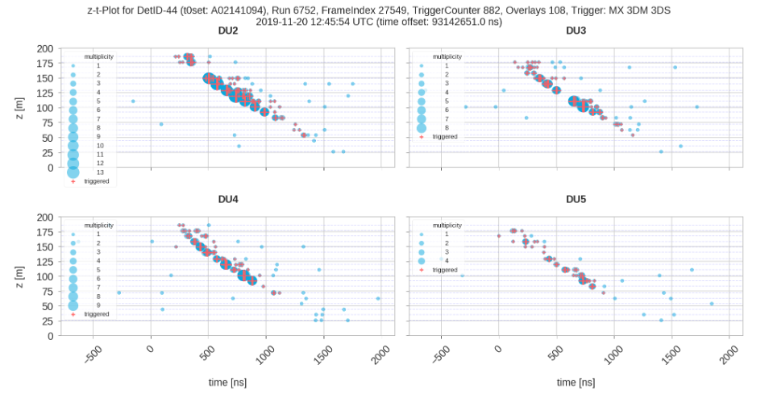
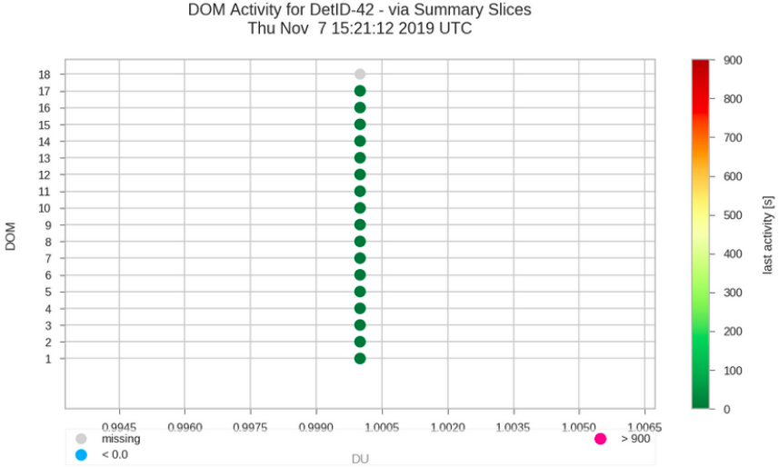
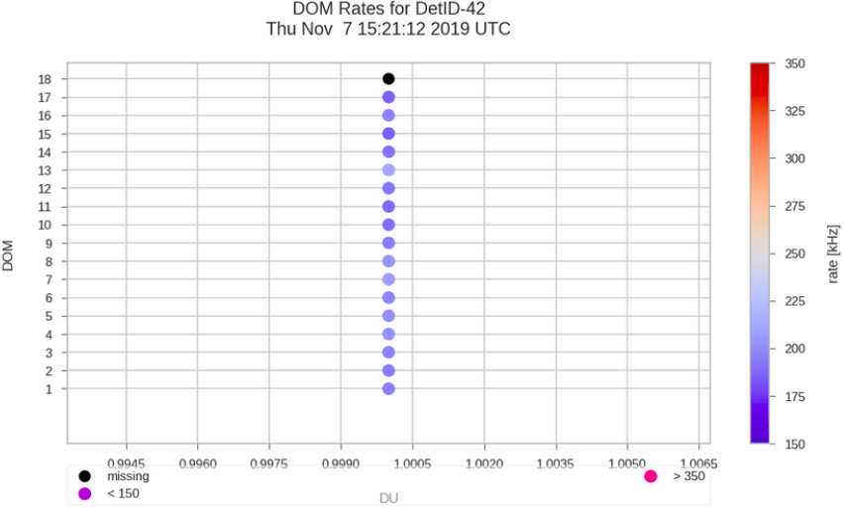
KM3NeT: Current Status
ORCA
Currently: 4 ORCA DUs and 1 ARCA DU deployed and taking data
2 more ORCA DUs fully assembled, tested, ready to be installed; sea operation scheduled before the end of 2019.
6 more ARCA DUs currently being assembled – to be deployed mid-2020.
ARCA
ARCA DU1 deployed December 2015

Slide 10
The Astroparticle Physics group in INPP
Currently active:
3 researchers (permanent stuff); expecting a new position (researcher);
technical and support personnel (4);
physicists under work contract (4);
Ph.D. students (4);
non-doctoral students (2)
financed through fixed-term projects and contracts -
“An important issue in view of the fact that many activities need a serious long term of (wo)manpower commitment”
as reported to the Scientific Advisory Board in 2015
Current funding:
3 year coordination and support Horizon 2020 INFRADEV project (2017-2019); INPP is involved in 7 out of 10 WPs, with coordination role in two WPs.
ORASY (until end of 2020).
HFRI scholarship supporting 1 Ph.D. student (who was also awarded an NSRF scholarship).
A number of proposals under evaluation.

Slide 11
Current Activities
KM3NeT
Governance and Management
Construction
QA/QC
Data Quality
Physics analyses and studies
    DOM integration
    High pressure testing of deep sea components - single point failure items
    Calibration of electronics and sensors
KM3NeT-INFRADEV
Assessment for making KM3NeT a research facility with zero-carbon footprint
Technology transfer
Construction Long Arm Marine Spectrophotometer (LAMS): an upgrade
Impact of KM3NeT-Gr on the environment
Equality, diversity and inclusion within KM3NeT
Outreach
Neutrino acoustic detection activities

Slide 12
Responsibilities of the APP group in KM3NeT
C. Markou: Chairman of the Institution Board (re-elected for a second 2-year term)
RRB member (KM3NeT Resources Review Board)
Publication committee member
E. Tzamariudaki: Management Team and Steering committee member
Publication committee member
Conference committee member
Equality, Diversity and Inclusion committee member
G. Androulakis: QA/QC manager of KM3NeT
Management Team and Steering committee member
C. Bagatelas: DOM integrator, responsible for the DOM lab.
KM3NeT-INFRADEV (HORIZON 2020) project
C. Markou coordinates the WP on making KM3NeT a research facility with zero-carbon footprint.
E. Tzamariudaki is coordinating the Innovation and Technology transfer WP.

Slide 13
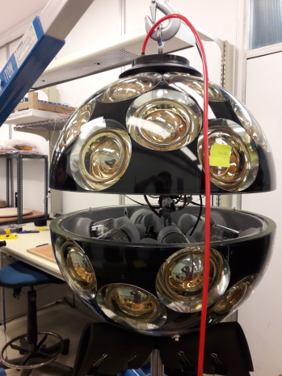
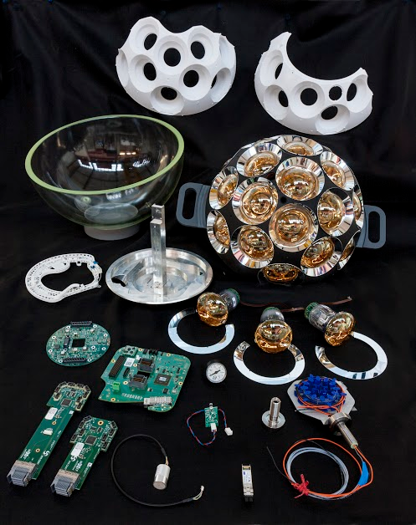
DOM Integration site at INPP (C. Bagatelas, V. Tsagli)
The Digital Optical Module (DOM)
Over 80 components to be integrated for each DOM (mechanics, electronics, sensors)

Slide 14
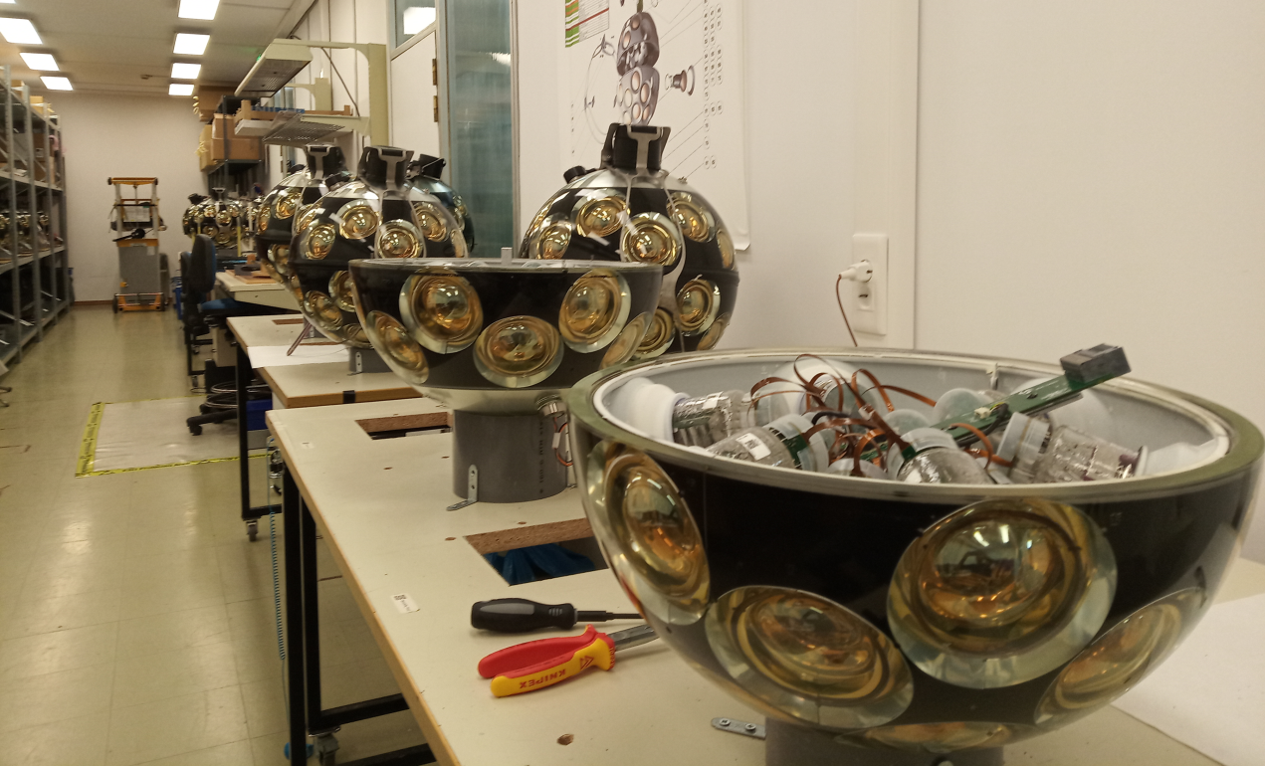
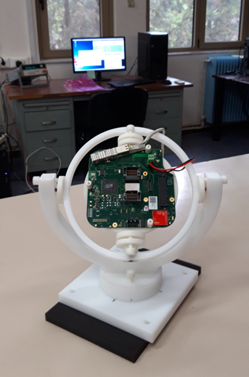
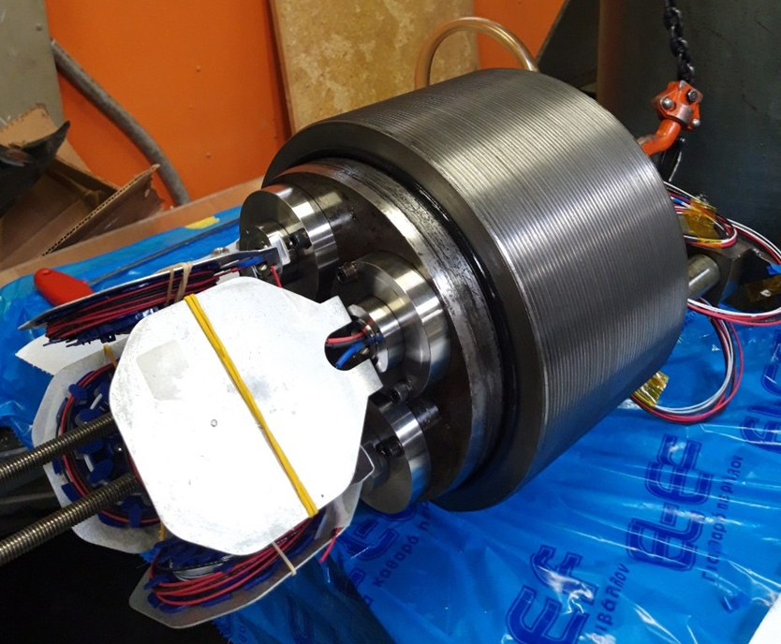
DOM Integration site at INPP (C. Bagatelas, V. Tsagli)
DOM integrators: C. Bagatelas , V. Tsagli
Technical support: A. Vougioukas
QA/QC: G. Androulakis
Upgrade of the DOM integration facility
DOM production rate: 10 DOMs/month.
36 DOMs sent to Genova in October to become ARCA-DU4 and ARCA-DU5.
Validation of new DOM components (2 prototype DOMs).
Test of DOM sensors (piezo tests).
Investigation and refurbishment of ORCA-DU1 DOMs.
Calibration and testing of DOM components: compass calibration
High pressure testing of deep sea components: penetrators

Slide 15
QA/QC in KM3NeT (G. Androulakis)
Scope: procurement, integration, testing, (de-)commissioning of the detector, embedded software, shipments and traceability of components, documentation..
Core of QA/QC:
  Non conformity Report (NCR) for reporting and treatment of non conformances.
  Design change request (DCR) for suggesting, validating, qualifying and implementing design changes.
  Shipment record sheet (SRS) for internal shipments of components.
Quality group: is one of the largest in terms of manpower (~19 people). It consists of the local quality supervisors (LQSs) and the quality manager (QM).
G. Androulakis is the KM3NeT QM as of Jan-2016; he has worked on:
  Reinforcement of QA/QC in accordance with the phase 2 mass production;
  establishing a quality culture throughout KM3NeT;
  integration of QA/QC with the central KM3NeT database;
  introducing a web based interface for QA/QC administration;
  establishing rules for documentation classification, release procedure and CIDL;
  establishing a risk based approach in the NCR treatment protocol;
  certifying all members of the QA/QC group as ISO 9001:2015 internal auditors;
  Reinforcing INPP’s involvement in the technical activities of KM3NeT.

Slide 16
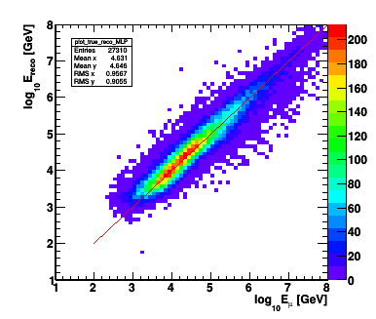
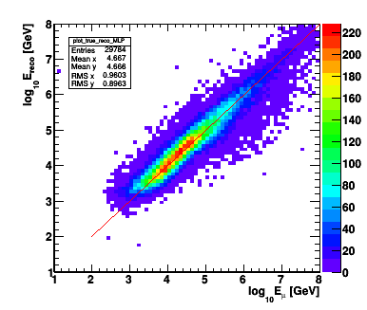
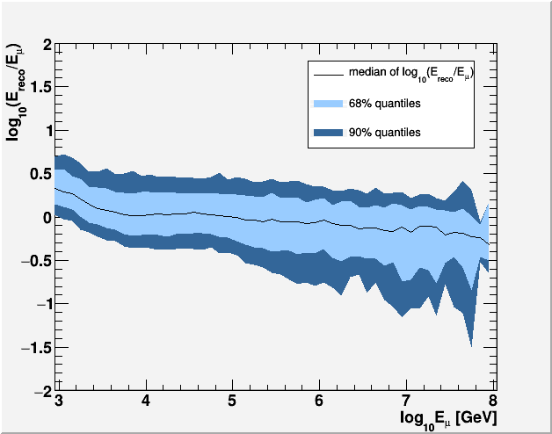
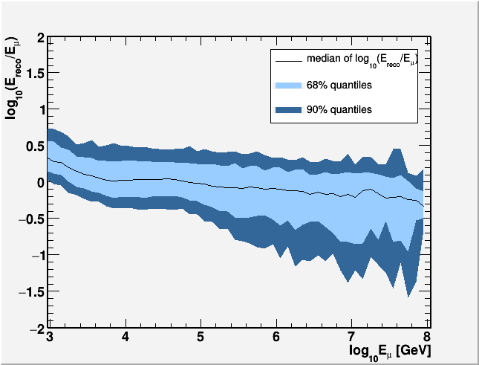
APP group: Physics Analyses and Studies
Muon Energy Reconstruction E. Drakopoulou PhD
muon energy estimation: critical for differentiating muons from neutrinos originating from astrophysical sources from muons and neutrinos generated in the atmosphere
events satisfying a containment selection
all reconstructed events
Internal note
KM3NeT official analysis/results
Published in :
“Letter of Intent for KM3NeT 2.0”, Published in J.Phys. G43 (2016) no.8, 084001
“Muon and neutrino energy reconstruction for KM3NeT”, Published in EPJ Web Conf. 121(2016) 05009
“Energy reconstruction of high energy muon and neutrino events in KM3NeT”, Published in EPJ Web Conf. 116(2016) 02001
“Muon track reconstruction and muon energy estimate in the KM3NeT/ARCA detector”, Published in PoS ICRC2015(2016) 1114
“Muon and Neutrino Energy Reconstruction for KM3NeT”, Published in PoS NEUTEL2015 (2015) 071
Energy Resolution: 0.27
Energy Resolution: 0.28

Slide 17
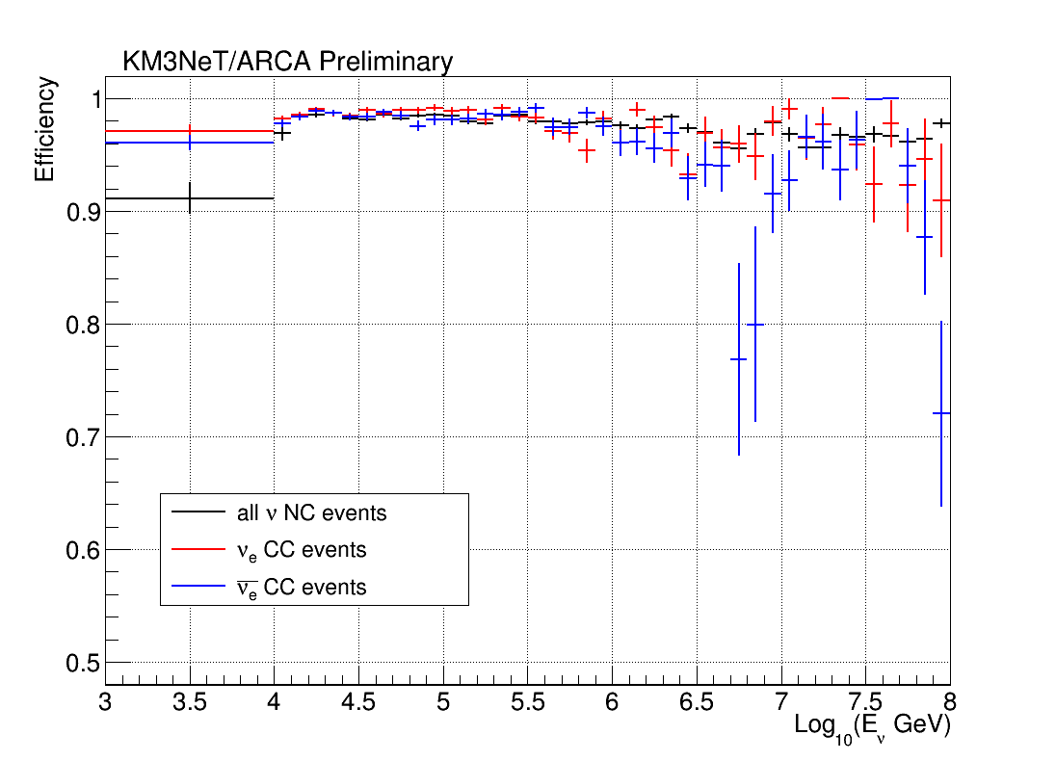
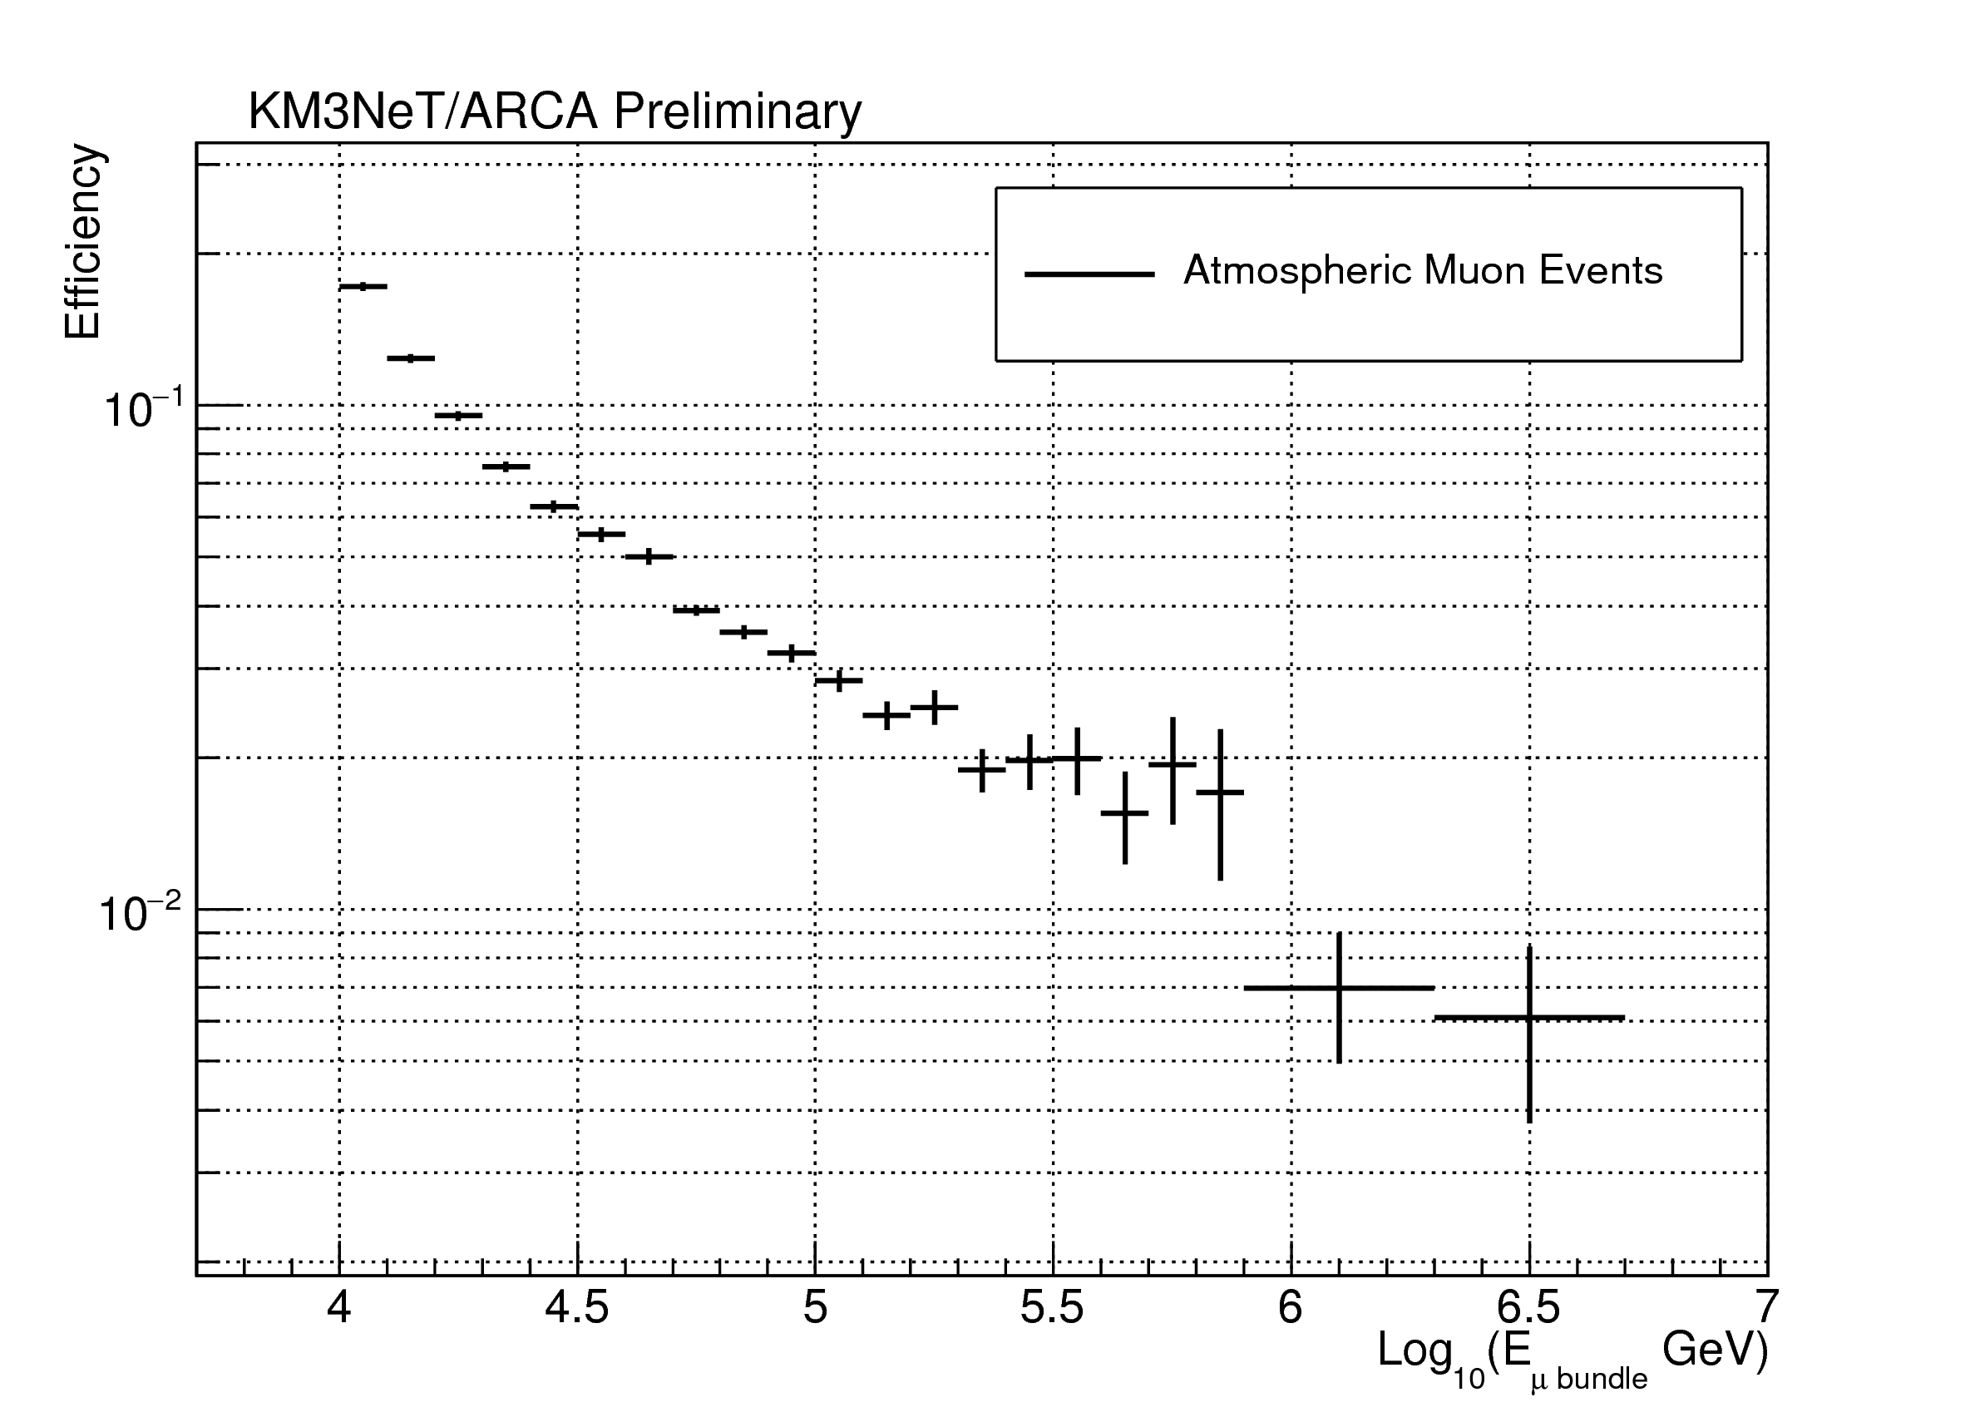
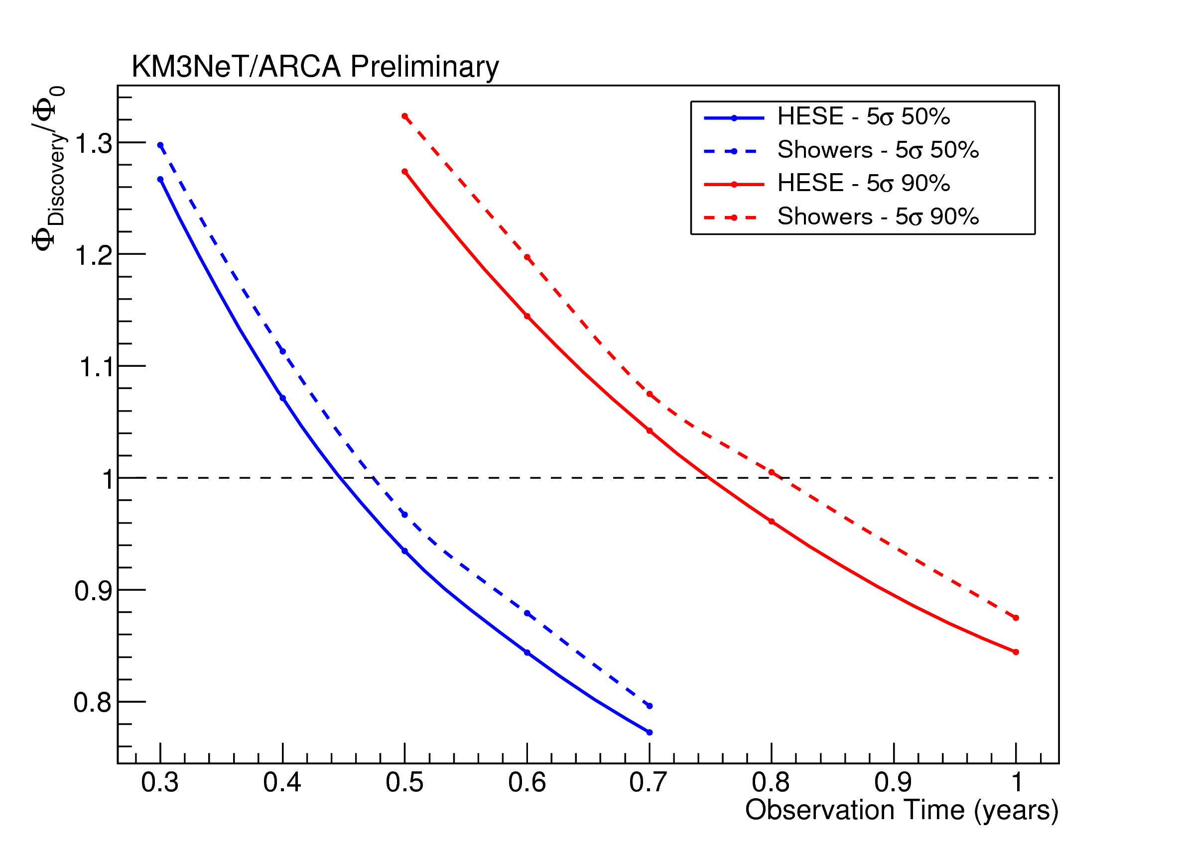
APP group: Physics Analyses and Studies
High Energy Starting Events (HESE) Analysis K. Pikounis PhD
maximise the discovery potential of KM3NeT/ARCA for a diffuse astrophysical neutrino flux
muons from high energy neutrino events interacting inside the detector volume and
contained showers (track / shower differentiation)
study of the self-veto effect
track / shower differentiation: Selection efficiency
Discovery potential for a diffuse flux of astrophysical neutrinos
Φ₀ =2.3·10⁻¹⁸·(E_{ν}/100TeV)^{-2.5} GeV s⁻¹ cm⁻² sr⁻¹
2 Internal notes ; KM3NeT official analysis/results
Presented/published in:
“Analysis of vertex-contained high energy neutrino events for the KM3NeT/ARCA detector”, Poster, Neutrino 2018 – International Conference on Neutrino Physics and Astrophysics, DOI: 10.5281/zenodo.1300717
“A HESE analysis with KM3NeT/ARCA Telescope”, K. Pikounis et al. for the KM3NeT Collaboration “VLVnT 2018 Very Large Volume Neutrino Telescope”, Published in EPJ Web Conf. 207 (2019) 02006

Slide 18
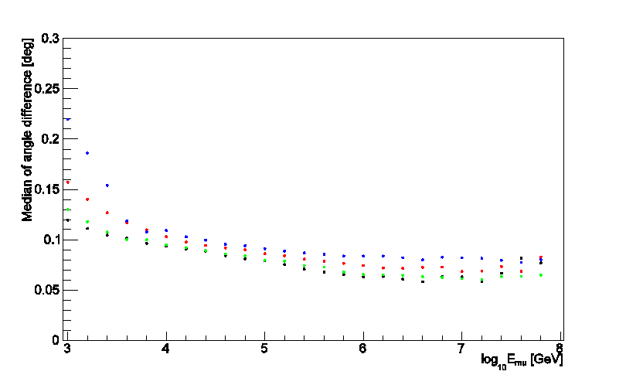
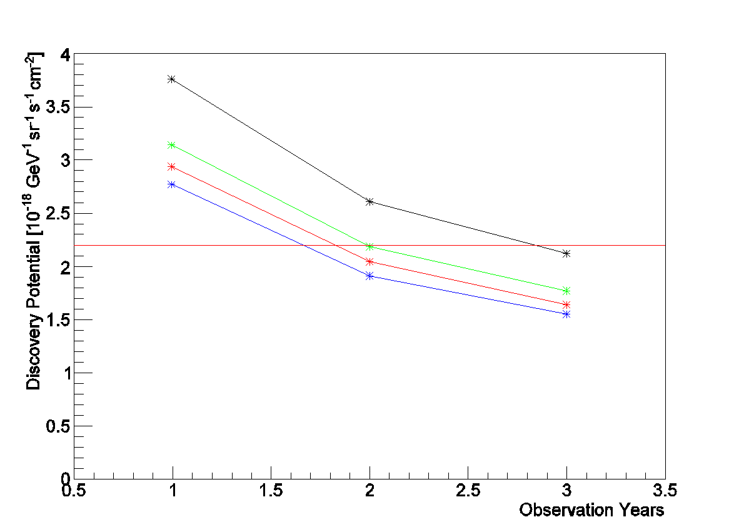
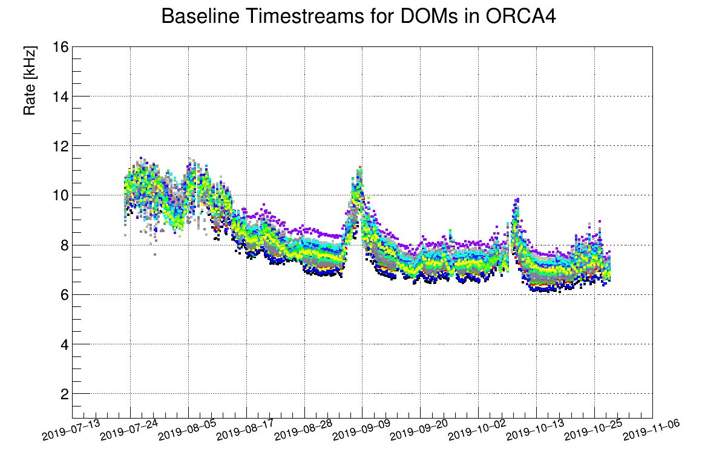
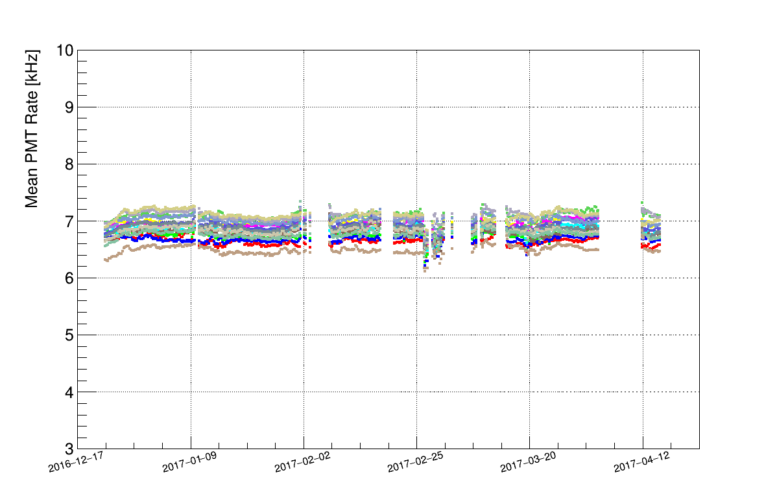
APP group: Physics Analyses and Studies
Studies of alternative detector configurations A. Sinopoulou MSc
Angular resolution
Discovery potential
effect of larger and sparser detector geometries on
Angular resolution
Energy resolution
Sensitivity & Discovery Potential
90m
120m
150m
180m
90m
120m
150m
180m
Internal note
Monitoring the performance of the first deployed Detection Units of the KM3NeT/ARCA and KM3NeT/ORCA Detectors
D. Stavropoulos MSc
evaluation of the impact of sedimentation & bioluminescence on the DOM efficiency
distribution of the mean PMT rates (dominated by K⁴⁰ decays and bioluminescence)
ORCA
ARCA

Slide 19
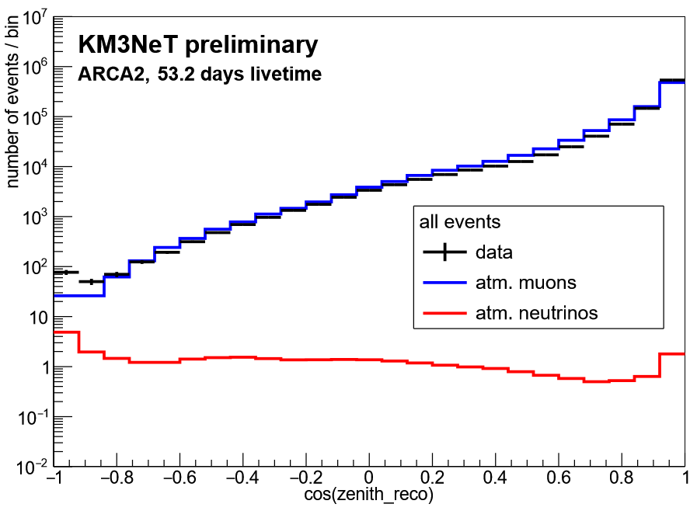
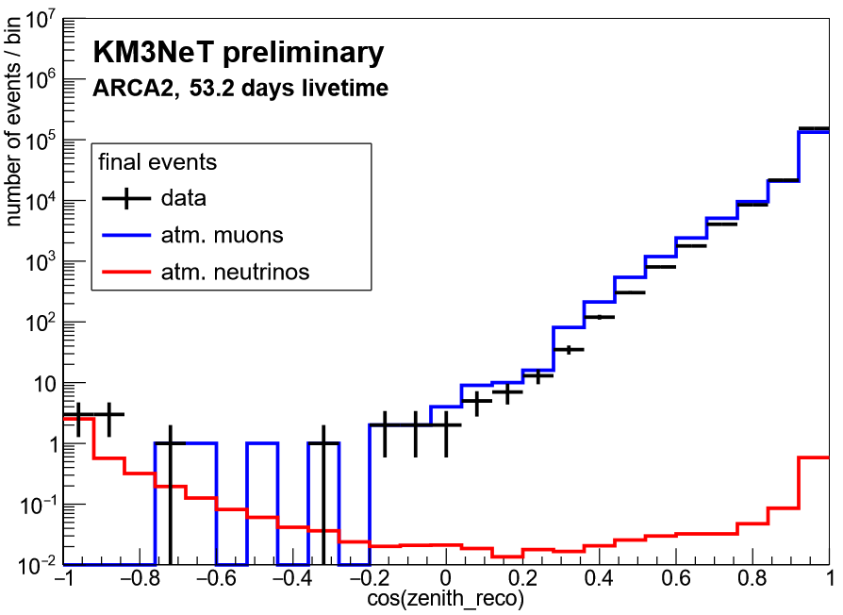
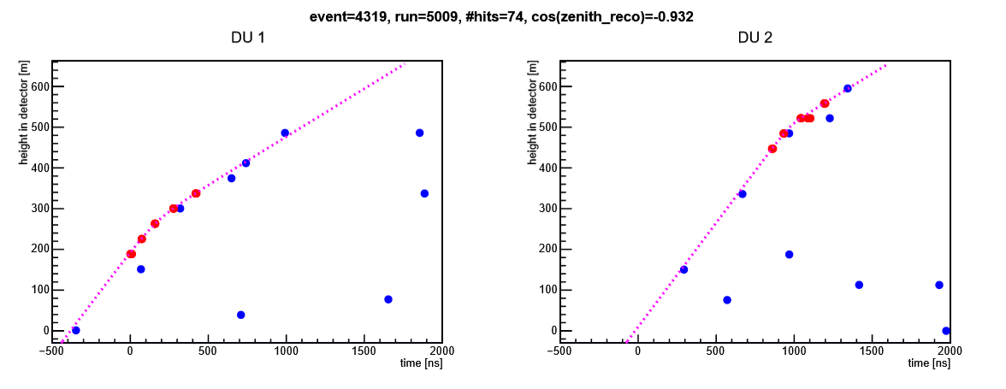
APP group: Physics Analyses and Studies
A. Sinopoulou PhD Thesis ongoing
Analysis of KM3NeT/ARCA data
data from the first 2 ARCA DUs
optimizing requirements for selecting well reconstructed events
atmospheric neutrino candidates from the first 2 KM3NeT/ARCA DUs
All reconstructed events
Selected events
Neutrino event candidate
KM3NeT official analysis/results
Analysis presented in the International Cosmic Ray Conference – ICRC 2019

Slide 20
APP group: KM3NeT-INFRADEV related activities
Making KM3NeT a research facility with zero-carbon footprint (WP10)
T. Georgitsioti
The objective of the work package 10 is to supply energy to the KM3NeT research infrastructures from renewable energy technologies (RET).
The aim was to present the techno-economic assessment of grid-connected photovoltaic (PV) and Wind energy technologies in the locations of Kalamata, Greece and Capo Passero, Italy.
Impact of KM3NeT-Gr on the environment (WP5): Environmental impact study, legal implications
G. Androulakis

Slide 21
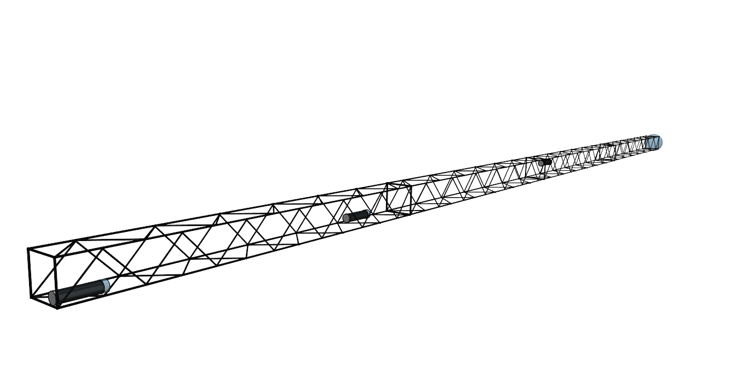
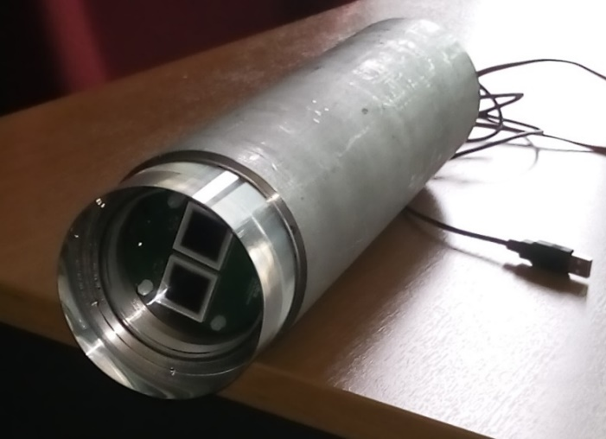
APP group: KM3NeT-INFRADEV related activities
Technology transfer and innovation (WP9)
Development/upgrade of water properties measurement device (LAMS)
S. Koutsoukos, G. Zarpapis, A. Vougioukas, K. Pikounis
LAMS system used to measure transmission length in deep sea during the sea campaigns in 2008 and 2009
a new version of the LAMS device is being constructed, keeping the same idea but simplifying the process by performing in a single deployment, simultaneous measurements at three different distances between emitter and receiver
Light source
10 m
16 m
Sensor module
20 m
Currently:
functional tests on the final boards.
Assemble all components into a complete system and run full functional test of the system.

Slide 22
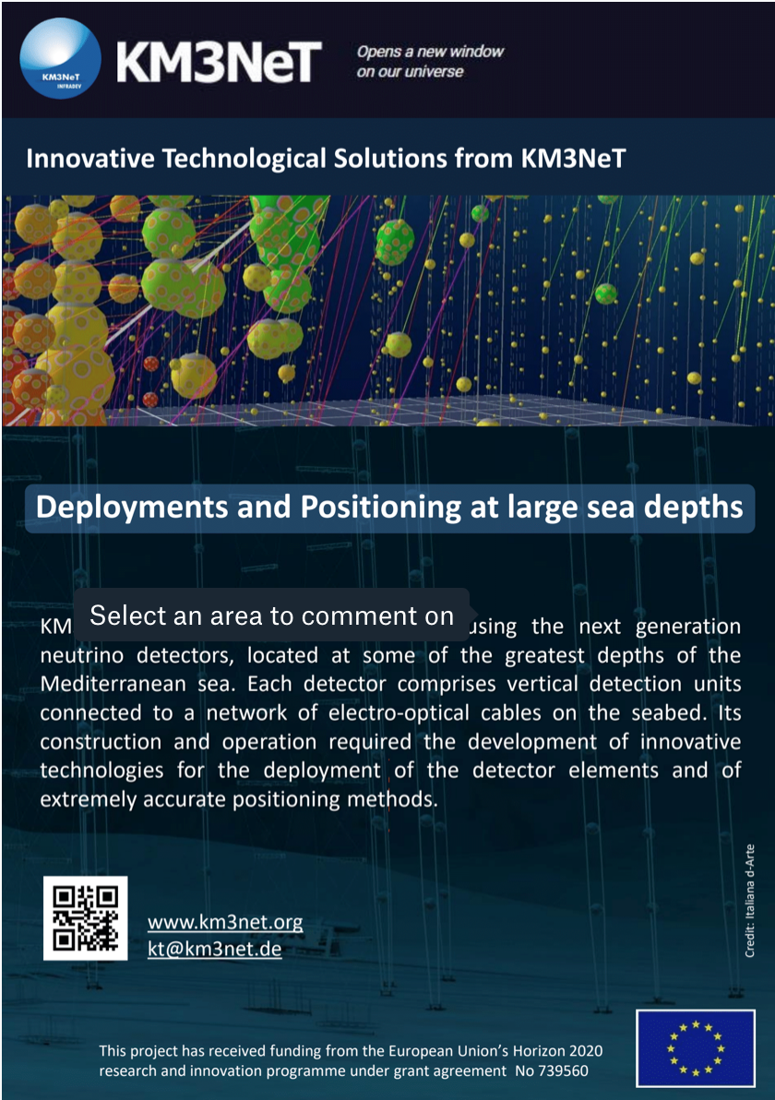
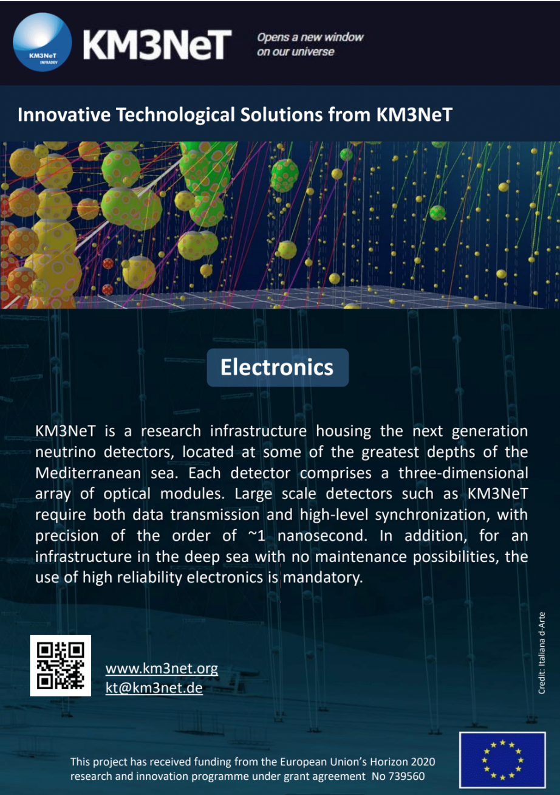

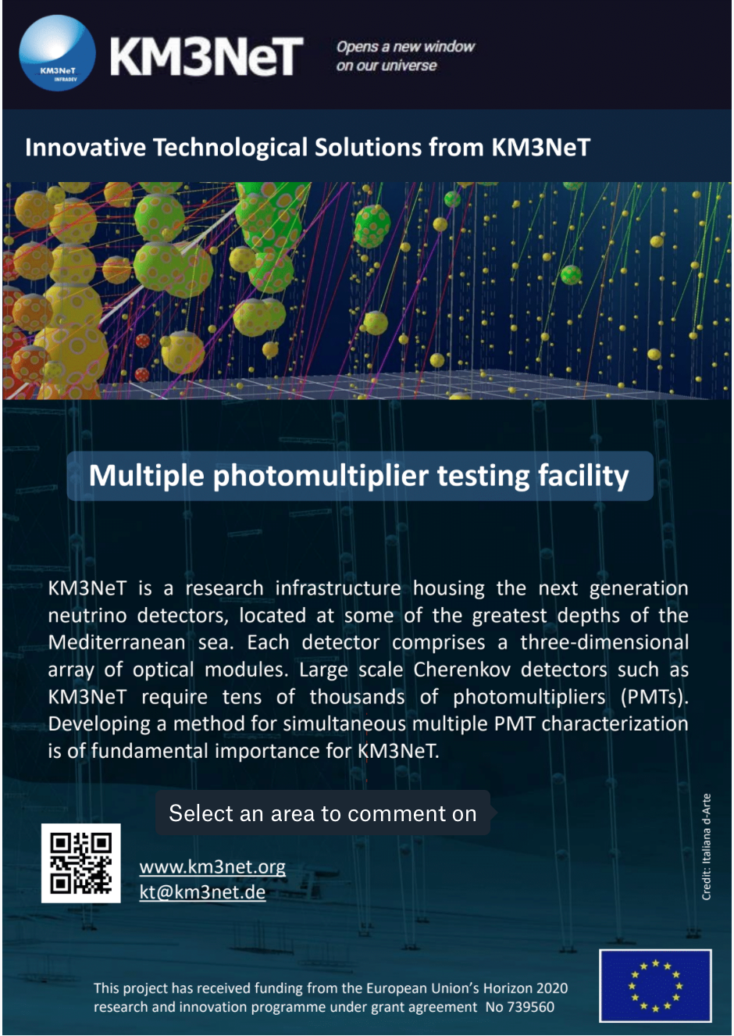
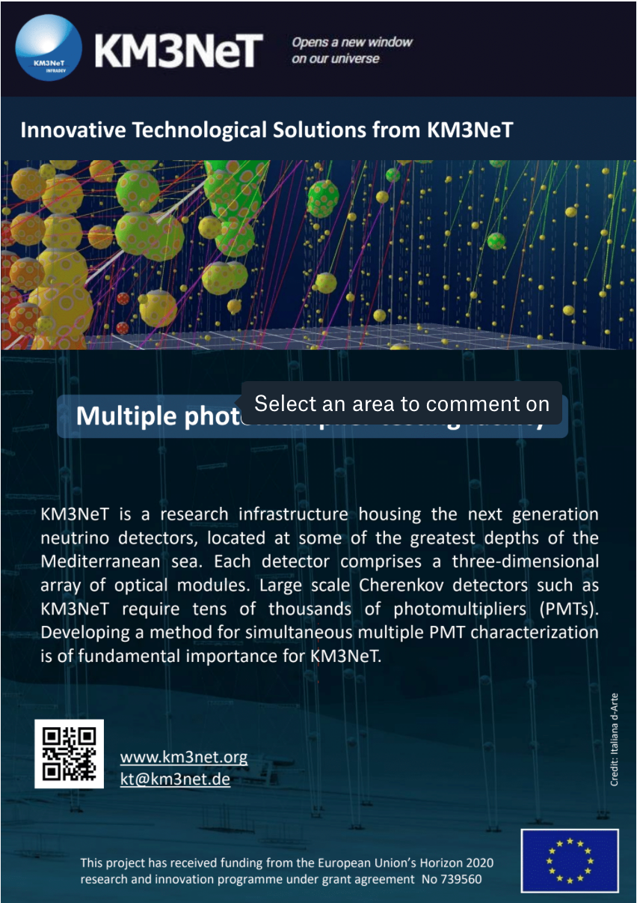
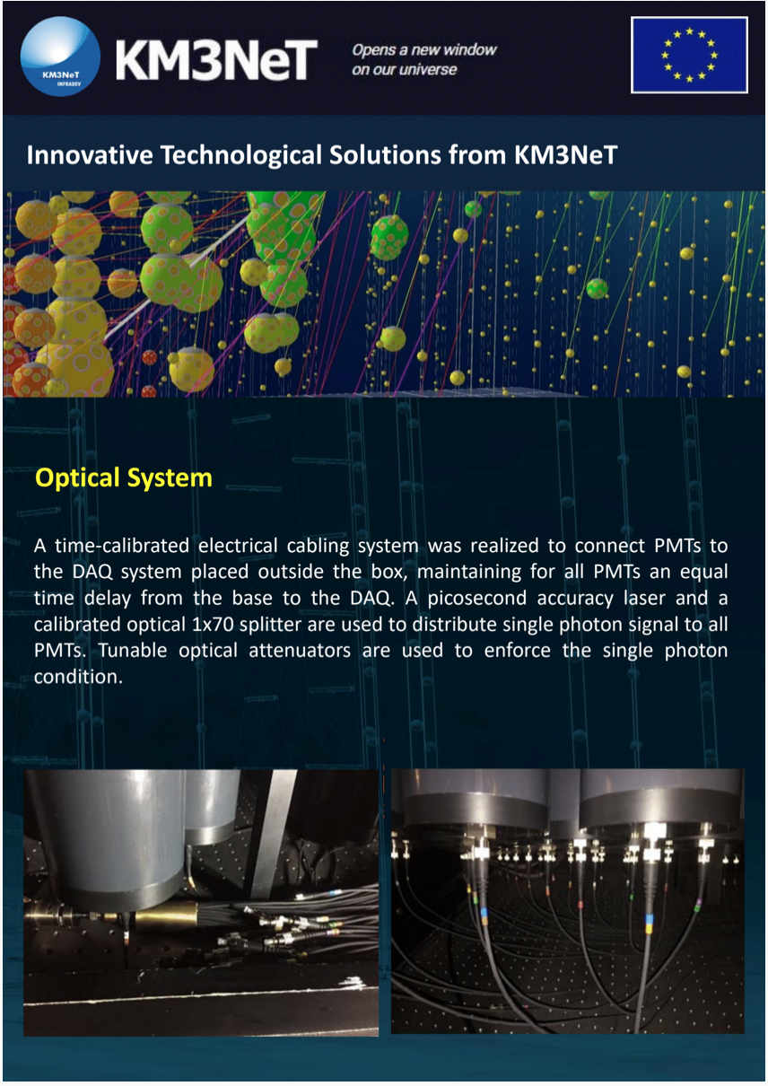
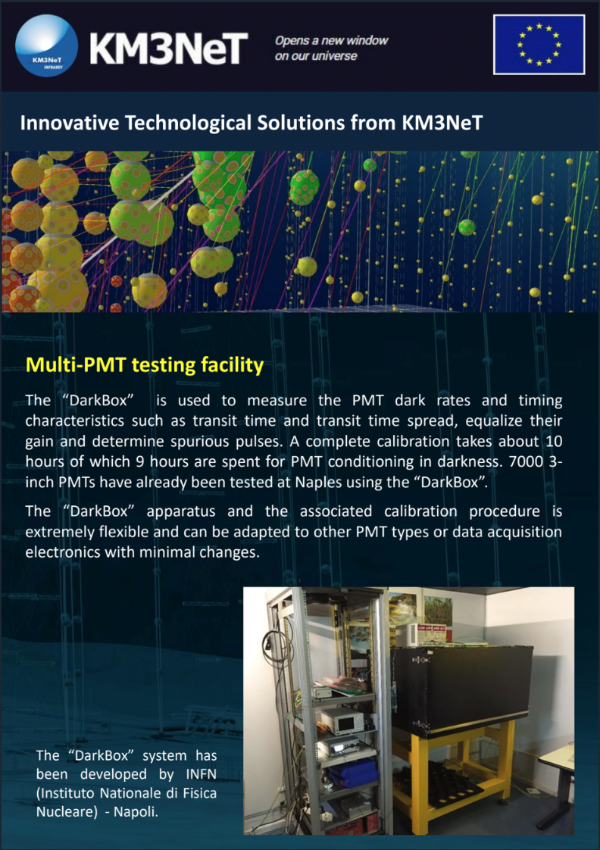
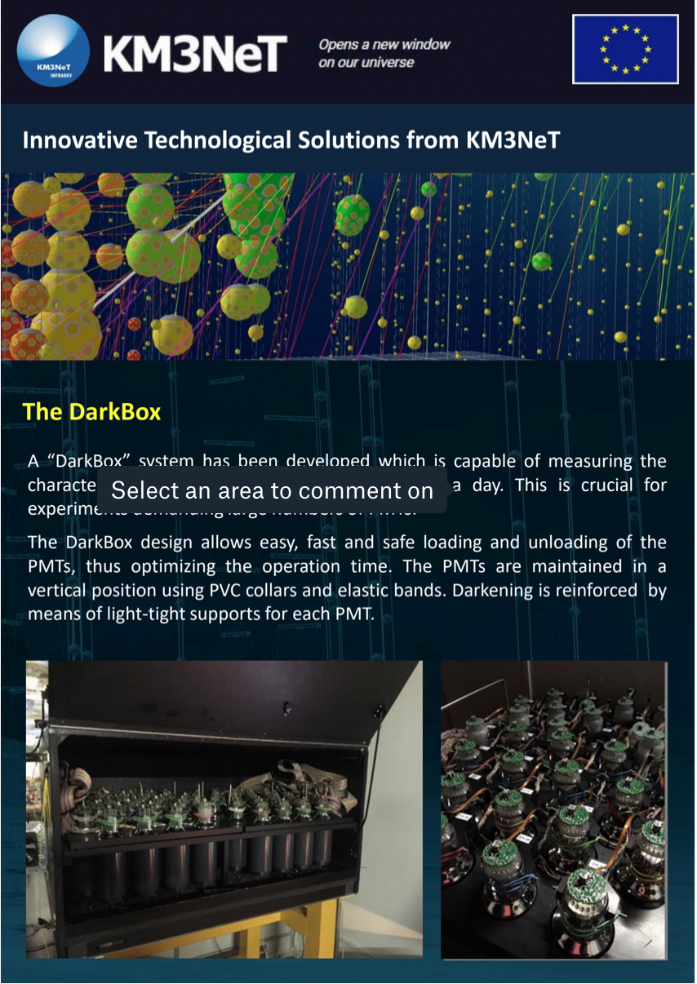
APP group: KM3NeT-INFRADEV related activities
Technology transfer and innovation (WP9)
continuous observation of technological advancement in the fields of interest of KM3NeT
presentation of technological solutions developed and adopted/modified by KM3NeT to the relevant industrial fora
exploitation of KM3NeT developed solutions for specific problems

Slide 23
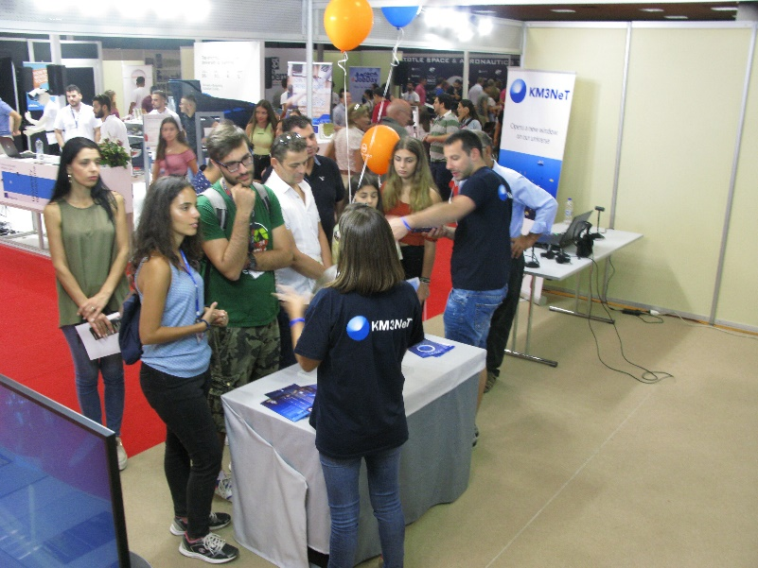
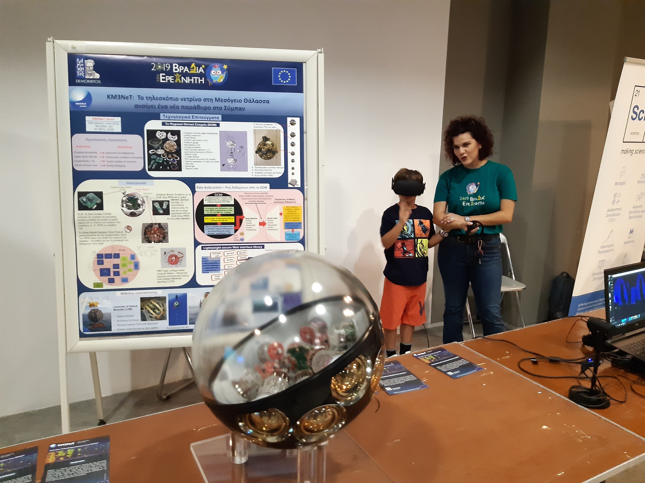
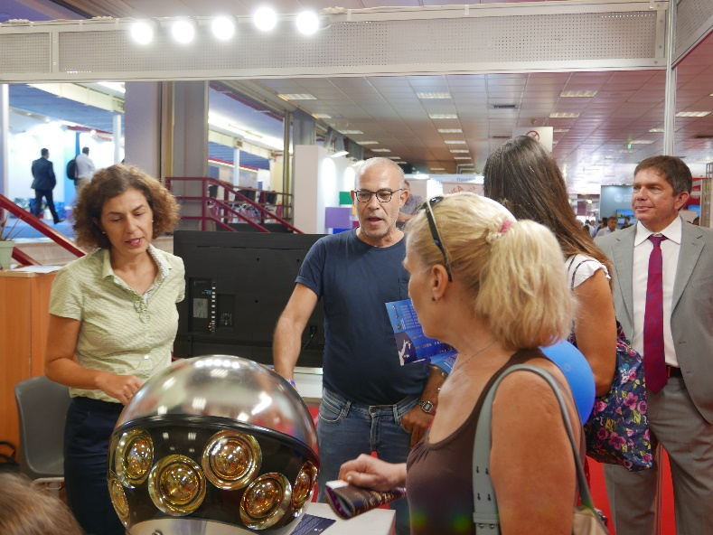
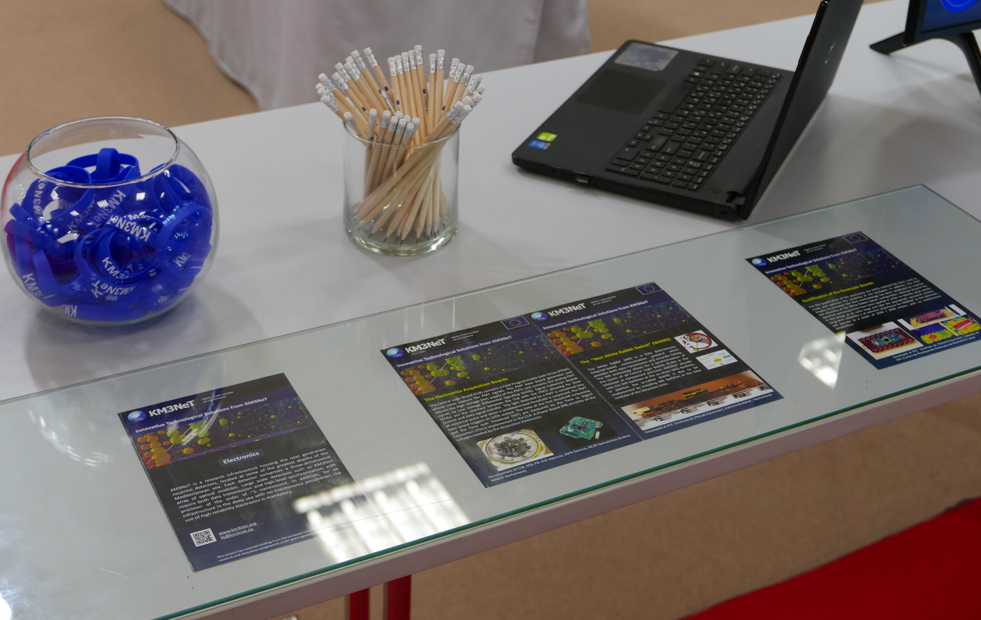
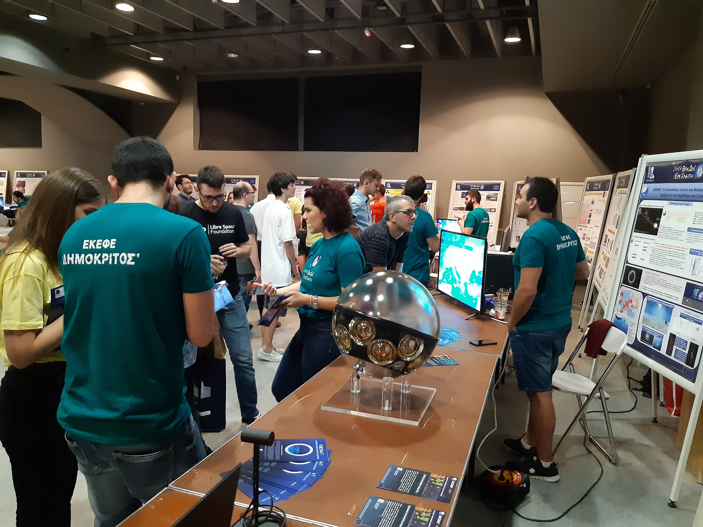
APP group: Outreach activities
Participation in technology exhibitions (WP9)
Participation in outreach events
Education & Training (virtual observatory) (WP4)
D. Stavropoulos

Slide 24
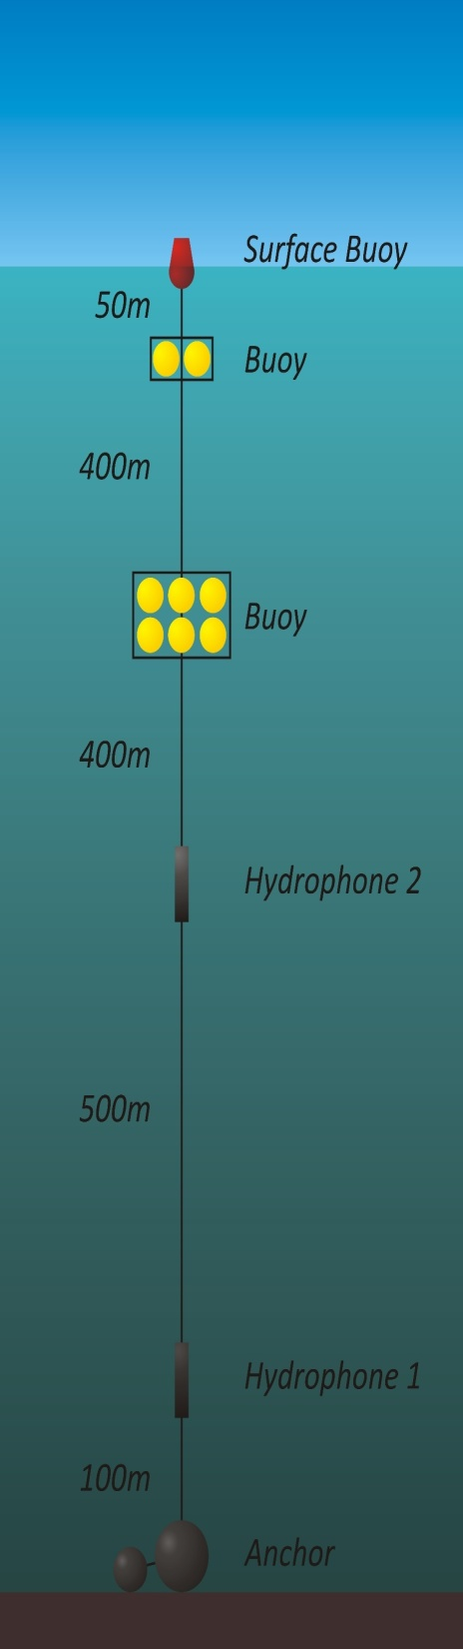



Acoustic detection of neutrinos
Study of the potential for acoustic detection of UHE neutrinos
2/2018: deployed 2 hydrophones at 1600 m depth to evaluate the acoustic load of the area.
1 month continuous recording
Data are used to tune algorithms and MC
Recorded sounds include ship traffic, environmental noises like rain, waves, wind, thunder, and marine life
Analysis of data collected by the 2 hydrophones deployed:
T. Chatzistavrou, V. Panagopoulos, G. Anastasiou
Investigation of the potential of using a wavelet transformation of the sound spectrum as a way to detect the expected signal from UHE neutrino interaction:
T. Chatzistavrou, V. Panagopoulos, G. Anagnostou
Acoustic signal analysis and classification : G. Anagnostou MSc
excellent accuracy on test samples:
> 95.0% for an amplitude of the neutrino induced acoustic pulse 2% of the maximum amplitude of the ambient noise

Slide 25

Activities in Kalamata
© 2018 XPRIZE Foundation competition for innovation in deep sea technology
Mapping of the ocean floor down to 4.000m with an accuracy better than 5m over an area of 500Km² with autonomous systems over 24h.
High-resolution seafloor maps have been delivered to INPP to provide additional information on the site characterization - extremely important for sound propagation measurements and studies.
detailed map
standard online map
The DAS experiment using the NESTOR and HCMR e-optical cables
Collaboration between Université Côte d’Azur, CNRS, Febus-optics, HCMR and the INPP aiming at the distributed sensing of earthquakes using two fiber optic seafloor cables, offshore Methoni.

Slide 26
APP group performance since the last ISAC
Publications & Talks:
22 publications including conference proceedings (12 from the APP group)
15 presentations in Conferences/Workshops
2 PhD, 3 MSc, 2 Diploma theses completed, 8 internships; 3 ongoing PhD
KM3NeT meetings / workshops held at INPP:
Software and Computing meeting, October 2016
KM3NeT Collaboration meeting, February 2017
Workshop on training of internal auditors for quality management systems, September 2017
KM3NeT Steering committee, November 2017
Scientific and Technical Advisory committee meeting, November 2017
Workshop on User ports related to the WP8 of the KM3NeT-INFRADEV project, December 2017
Workshop on Acoustic detection of high energy neutrinos, December 2017
KM3NeT Steering committee, May 2019

Slide 27
APP group: plans for the near and mid-term future
Continue work on the topics presented:
KM3NeT DOM integration (& calibration and testing of components)
QA/QC
physics analyses and studies
Intensify efforts towards acoustic neutrino detection
Funding is a major issue for continuing our current and planned activities
Continue to work within the KM3NeT Collaboration with the strategic goal of establishing an infrastructure for the detection of high energy and/or ultra-high energy neutrinos in the deep Ionian Sea.

