Slide 1


X-ray Spectrometry at INPP
Andreas Karydas
Head of the XRF laboratory
http://www.inp.demokritos.gr/xrf/
INPP, NCSR “Demokritos”
karydas@inp.demokritos.gr

Slide 2
X-ray Spectrometry group @ INPP
Andreas Karydas, Head of XRF-Lab, Director of Research
Collaborators:
Dr Vasiliki Kantarelou, up to April 2019, 6 MM contract over the last ~3 years
Dr Manos Manousakas, part time, employee of the ERL@ INRASTES
- in Cultural Heritage
Dr Maria Kaparou, part time on volunteer basis
Dr Georgios Mastrotheodoros, part time on volunteer basis
Nelly Kladouri, PhD candidate, Thesis partly implemented in the XRF-Lab

Slide 3
X-ray Spectrometry group @ INPP
Andreas Karydas, Director of Research (2014 -)
2003-2009: INPP, Associate (C’) & Senior (B’) researcher
2009-2015: XRF Group Leader, Nuclear Science & Instrumentation Laboratory@IAEA, Vienna
2015-2016: Senior Scientific Officer, Physics Section @IAEA, Vienna
2003- : Head of the XRF laboratory @INPP

Slide 4
Past activities – Accomplishments (2003-2009)
Research:
Development of prototype portable XRF spectrometers and of Cultural Heritage (CH) applications – Creation of a wide network of collaborators and end-users (2003-2006)
Development of analytical protocols for in-situ (museum collections) micro-XRF applications
Major contribution in the development of the Confocal Micro-PIXE technique, 3D-PIXE (2007)
Development of a unique accelerator based facility for producing intense monochromatic X-ray beams to study X-ray fundamental parameters and interactions achieving comparable results with synchrotron sources (2007-2009)
Development of an integrated external Ion Beam Analysis set-up for the combined and synergistic application of PIXE/RBS/PIGE techniques (2007-2009)
Funding:
From six (6) competitive research projects ~ 650 kE
From analytical services of the XRF laboratory (2003-) ~ 150 kΕ

Slide 5
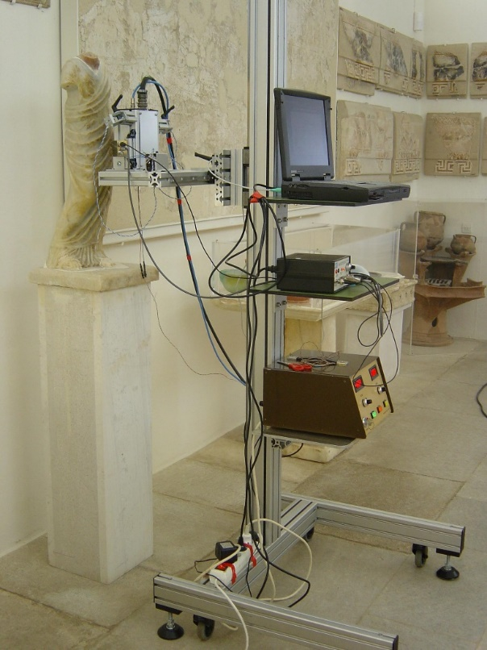
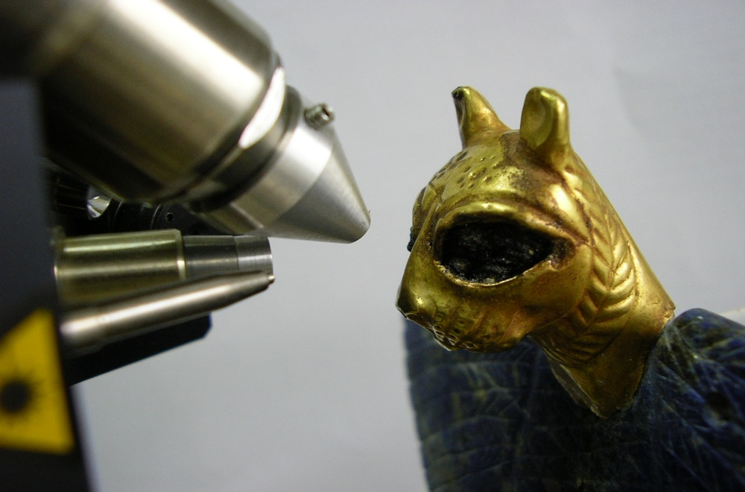
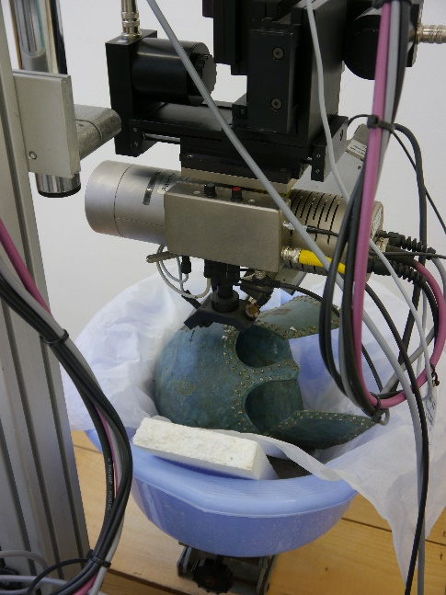
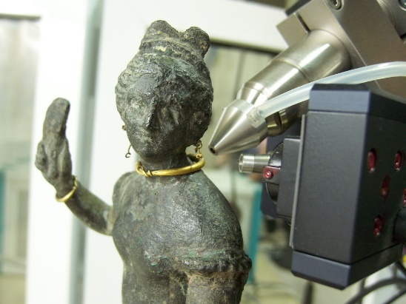
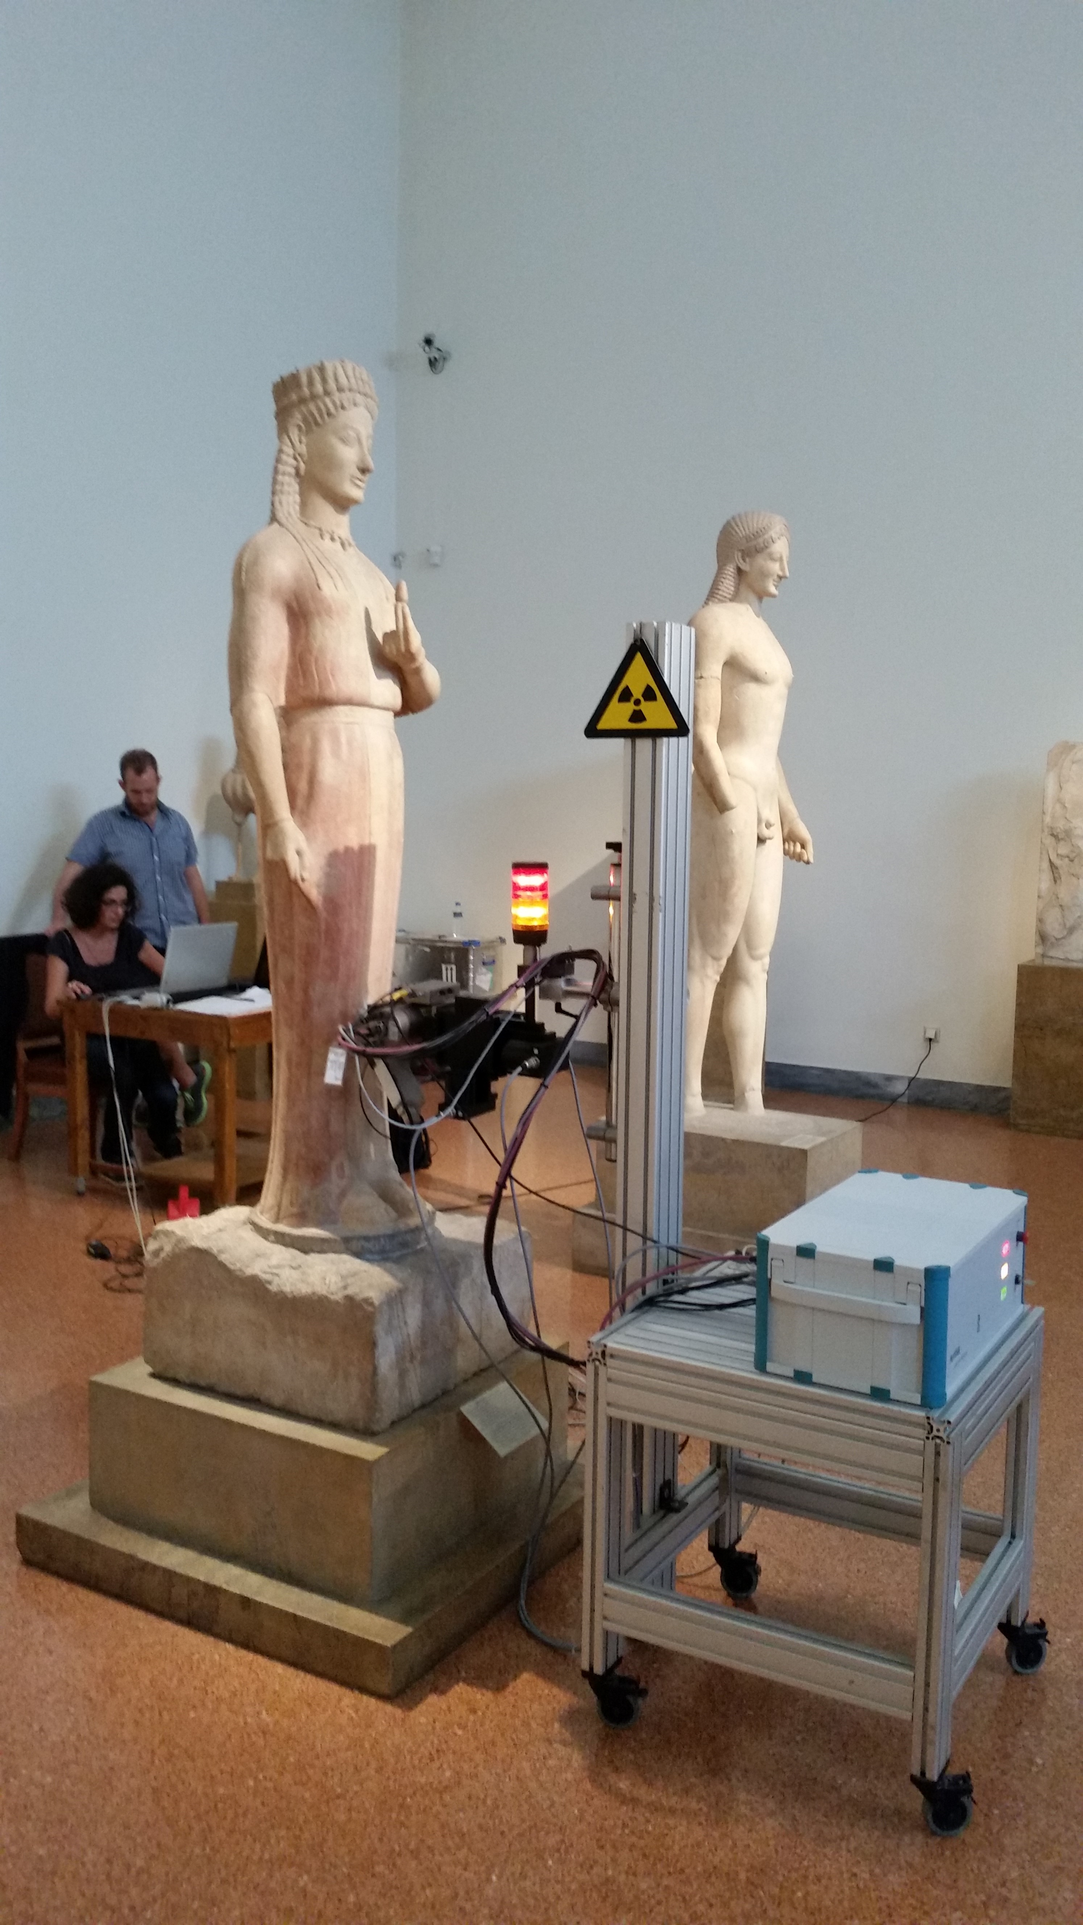
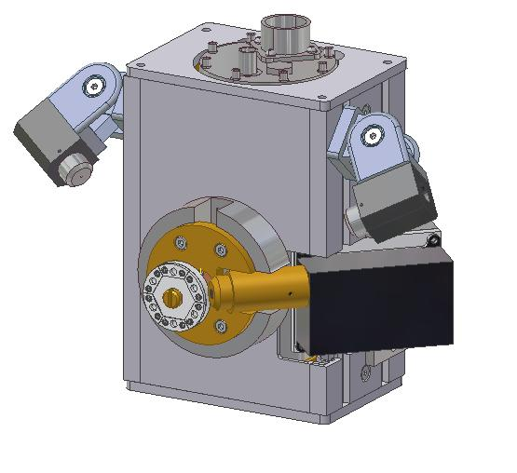
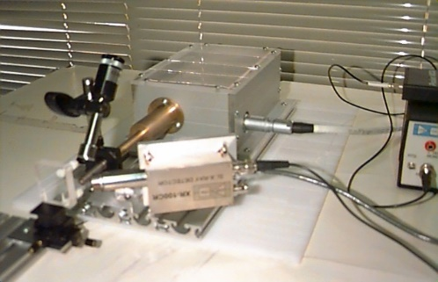
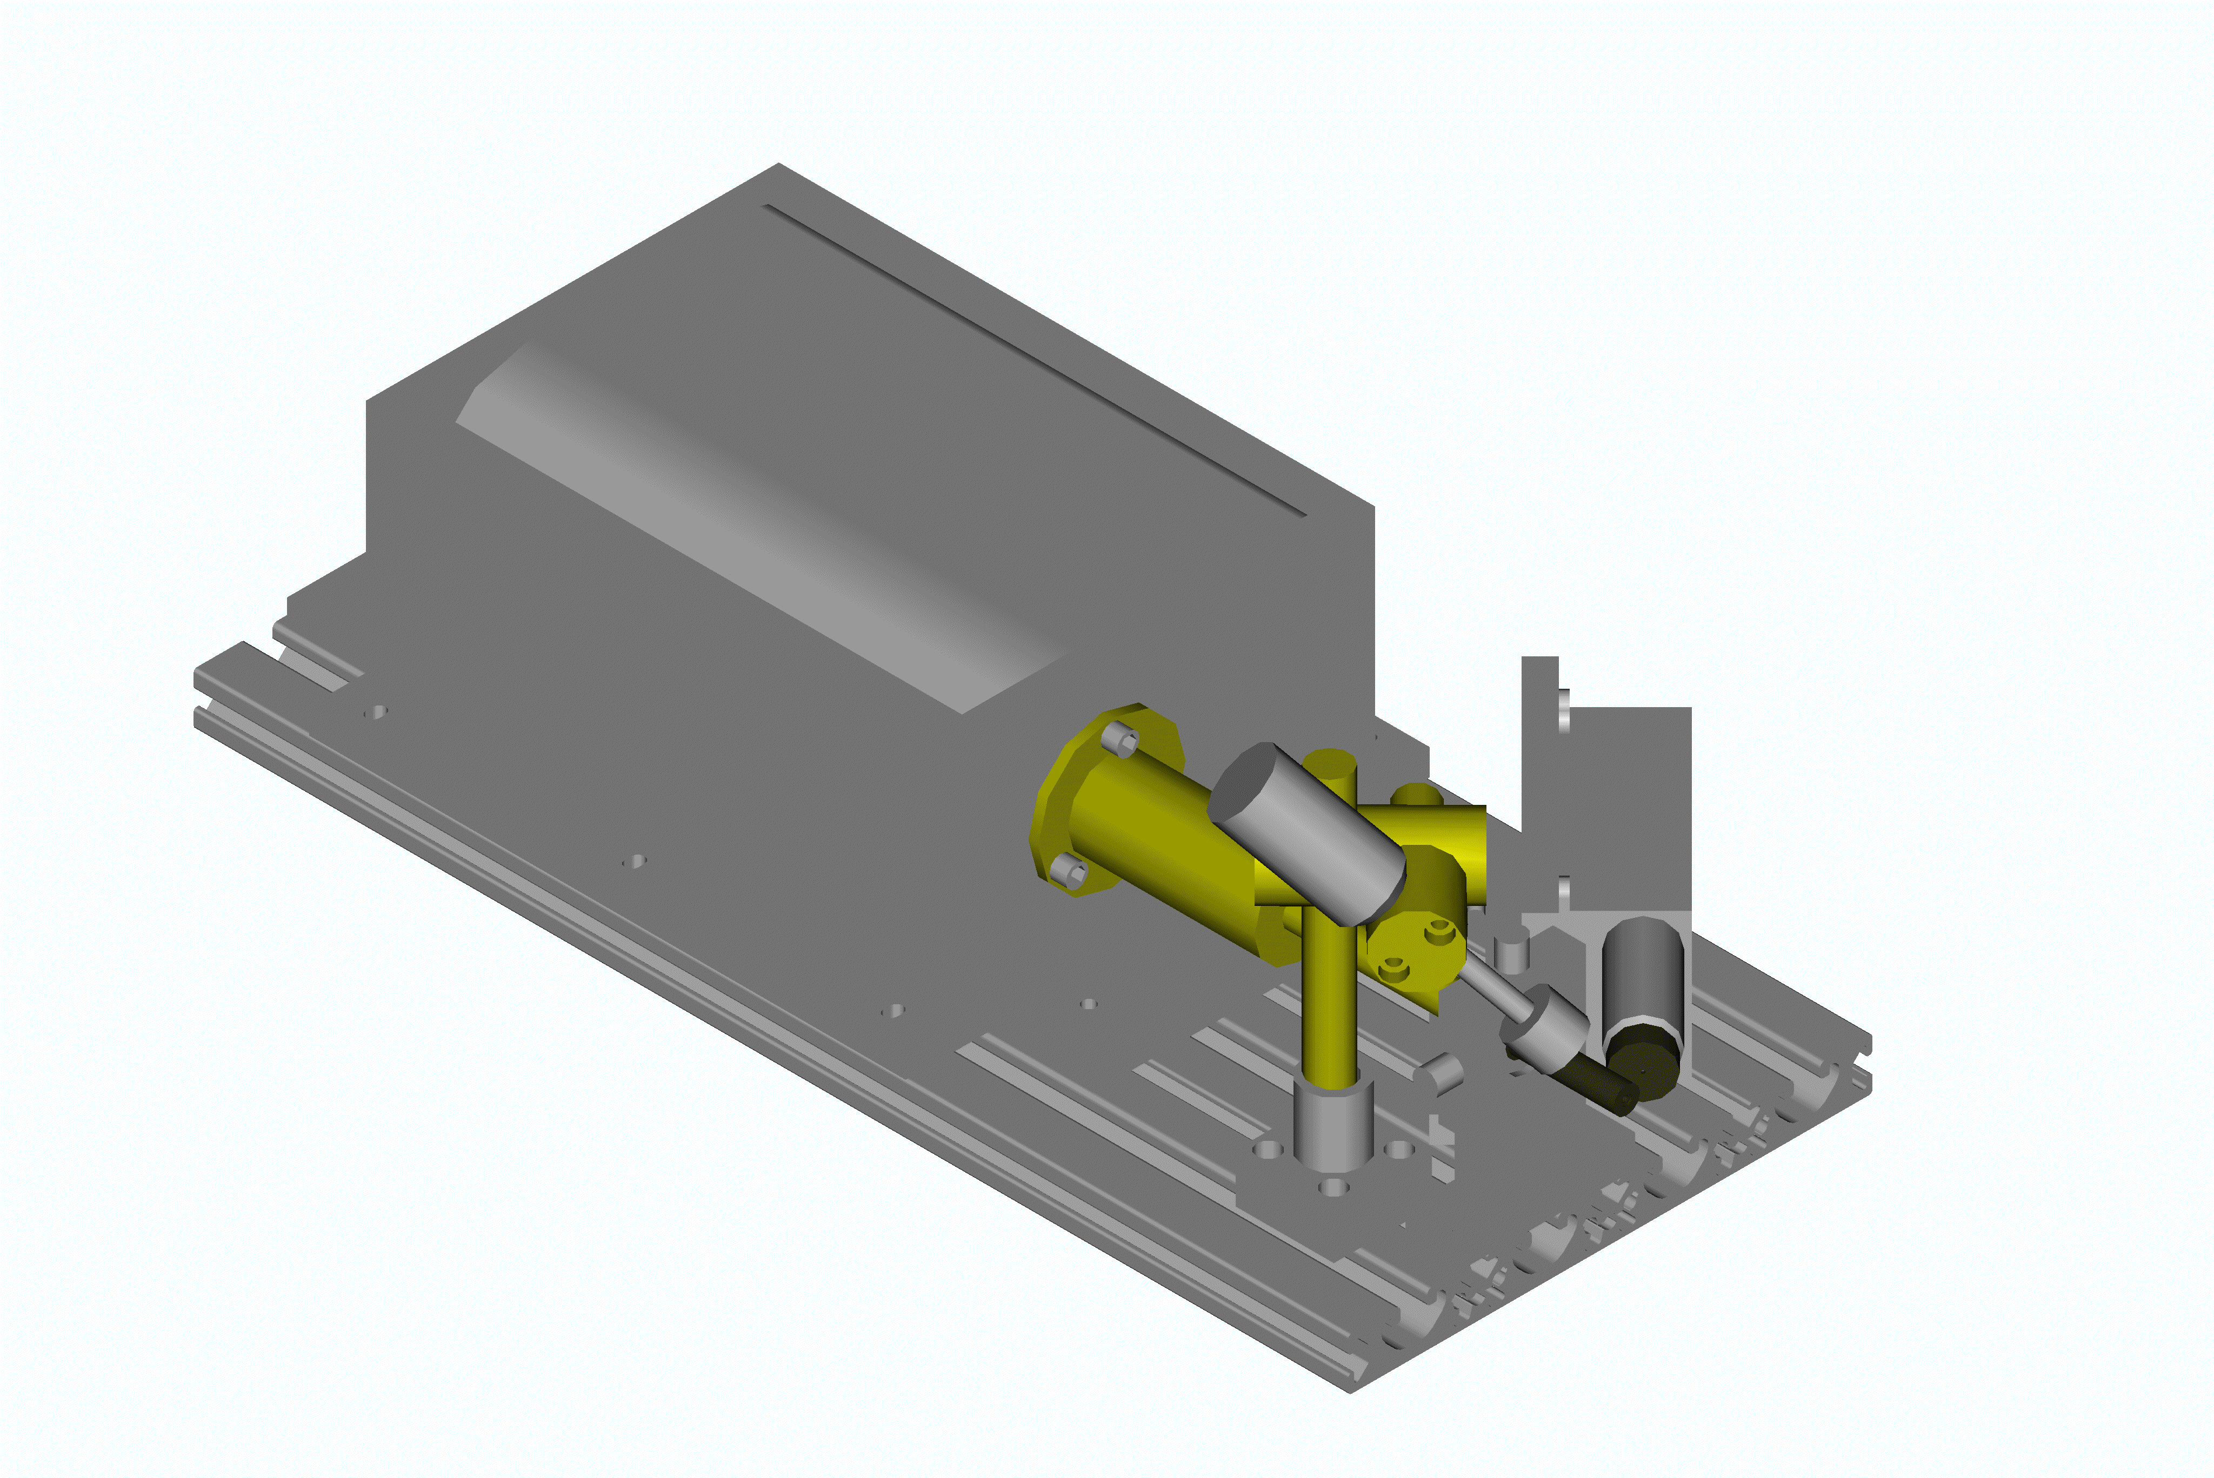
Infrastructure: Portable XRF spectrometers (μm-mm scale)
X-ray Detector
X-ray lens
Pointer
Headed Eagle lapis lazuli and gold
3000 B.C. Early Bronze Age
Archaeological Museum of Damascus October 2007
Museum of Delos,
2004
Customized design of the micro-XRF probe by IFG based on ARTAX model by Bruker-AXS

Slide 6
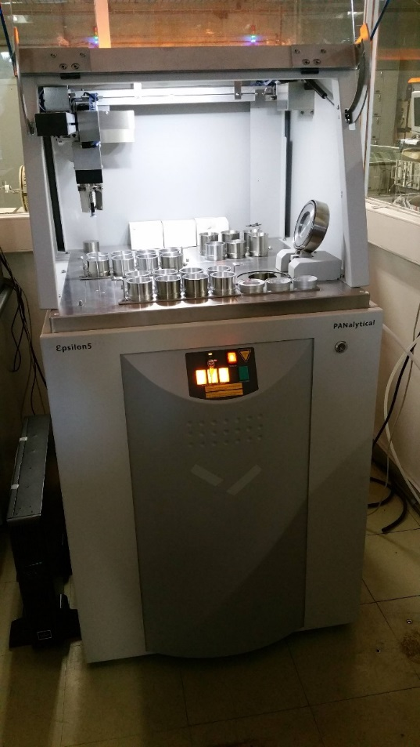
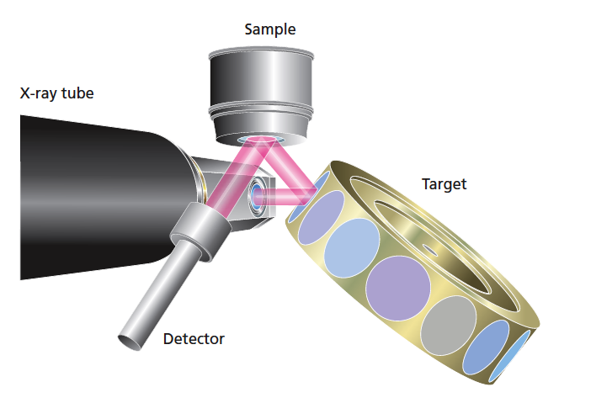
Infrastructure: High-Energy & Polarization XRF spectrometer
Property of Environmental Radioactivity Laboratory but operates at INPP and utilized in various projects
Measured elements in Air Particulate Matter (APM):
Na, Mg, Al, Si, S, Cl, K, Ca, Ti, V, Cr, Mn, Fe, Co, Ni, Cu, Zn, Ga, Ge, As, Br, Rb, Sr, Ag, Cd, Sn, Sb, Cs, Ba, Pt, Au, Hg and Pb
Routinely >20 elements are quantified

Slide 7
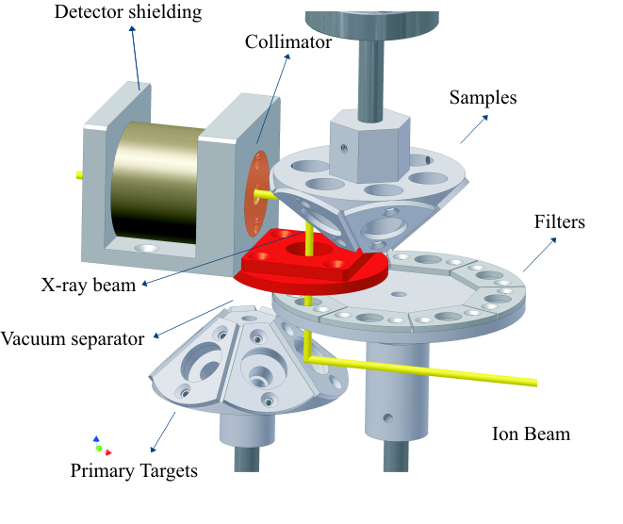
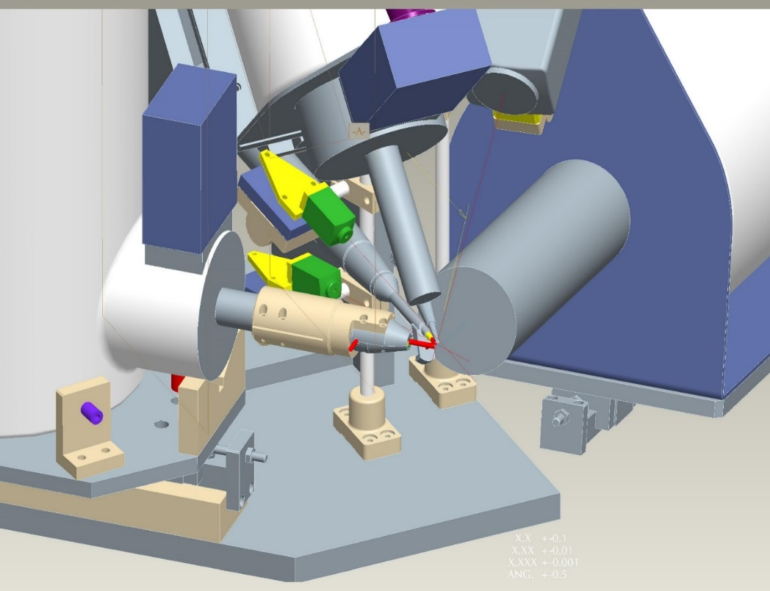
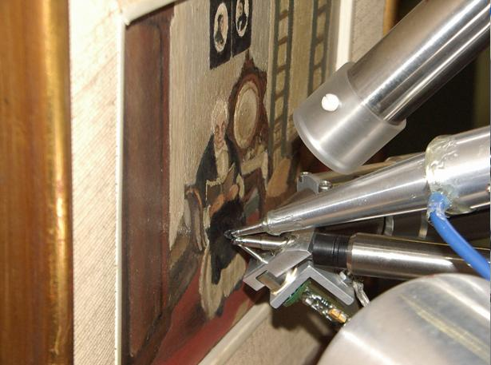
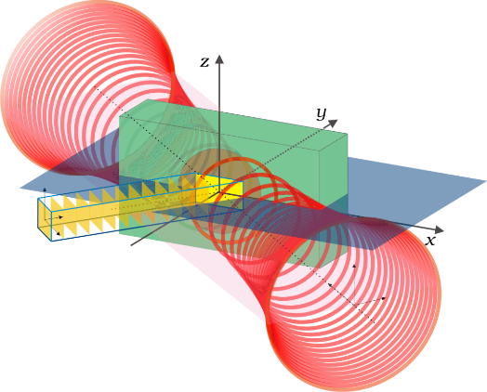
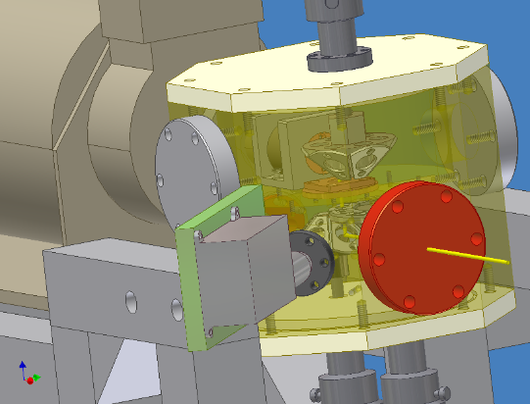
Infrastructure: Proton Induced monochromatic X-ray beams – External Ion Beam Analysis set-up
Sokaras et. al. NIM B 269 (2011) 519–527
High energy
Si(Li)
Camera
Lasers
HPGe
Low energy
Si(Li)
RBS conical chamber
Exit nozzle & Monitor detect.
Development of theoretical formulation for quantitative analysis using confocal Micro-PIXE
Karydas et al., JAAS, J. Anal. At. Spectrom 22 (2007) 1260
D. Sokaras, PhD thesis, 2010; Analytical Chemistry, 81(12), (2009) 4946; J. Anal. At. Spectrom., 24 (2009) 611
D. Sokaras, et al., Review of Scientific Instruments 83, 123102 (2012); Physical Review A 83 (2011) 052511;
A 81 (2010) 012703

Slide 8
  Research Activities
  2017-2019
Training: 2017-2019
5 MSc theses completed
1 Diploma work completed
Cultural
Heritage
X-ray
Fundamental
Parameters
Environmental
research
Cascade X-ray
Emission
PhD’s
2003
2010
2016
Spin-off
Basic Research in XRS
Elettra
X-ray Spectrometry Applications
XRF Laboratory
Elettra
AGLAE
KnowledgeTechnology
Transfer, Services
Resonant Raman
Scattering
Biomedicine
10 end-users
within 2019
Improvement/ Development
of quantification models/approaches
Development of XRF Spectrometers for tailored applications
Advanced Materials
Geochemistry

Slide 9
Scientific outcome: 2017-2019
12 Oral talks; 1 invited + 1 plenary invited
Total=30
Total=28

Slide 10
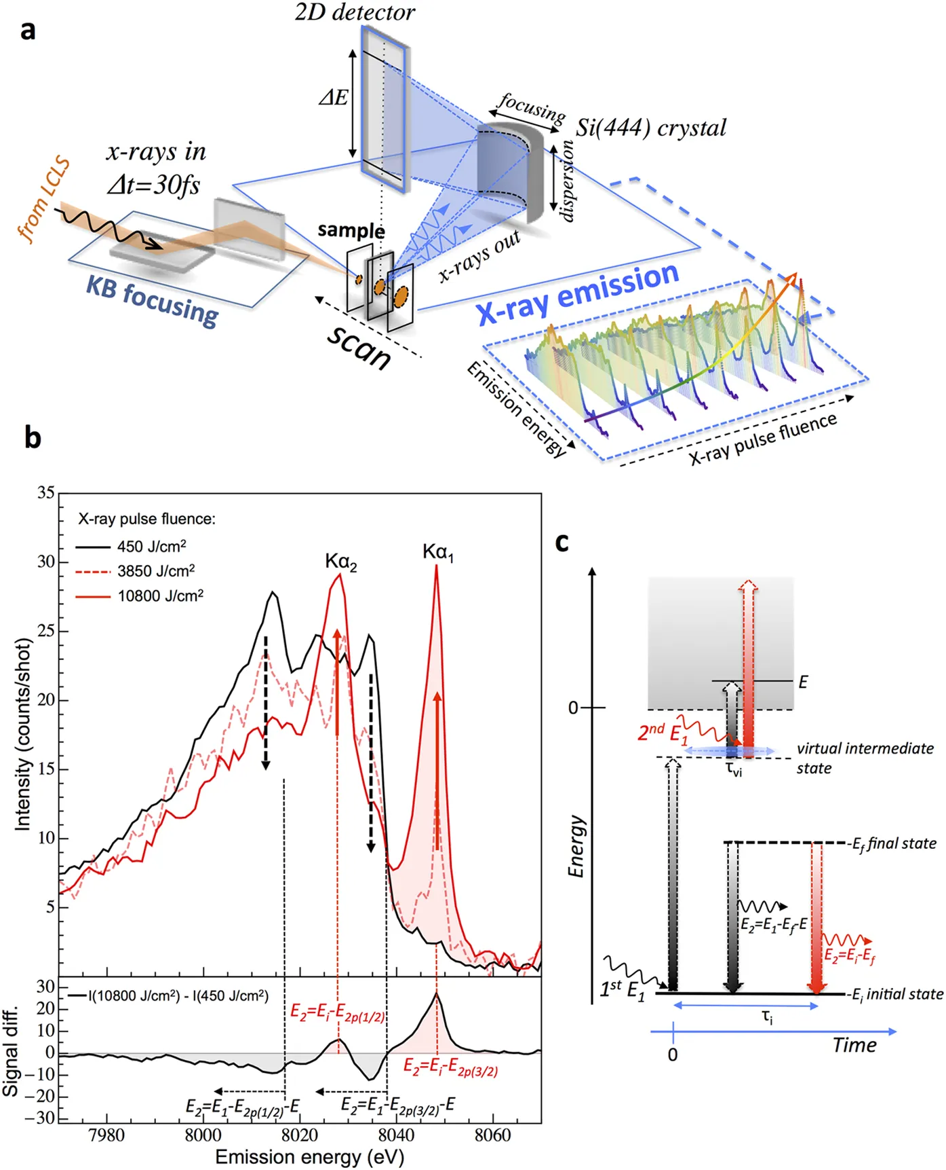
Motivation for basic research in X-ray spectrometry
E_{o} 12 eV below the
K-threshold of Cu
Experiment versus EPDL97 : MACs
Laboratoire National Henri
Becquerel (LNE‐LNHB), CEA‐Saclay
Ménesguen et al., X‐Ray Spectrometry,
2019;48:330
Black: RRS, one photon absorption
Red: Two photon absorption
Partial Photoionization on Mo
Nonlinear two-photon X-ray absorption spectroscopy in “Establishing nonlinearity thresholds with ultra intense
X-ray pulses”, Szlachetko et al., Scientific Reports, 2016
Honicke et al., PRL 113, 163001 (2014), BESSY II

Slide 11
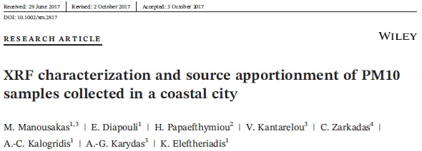
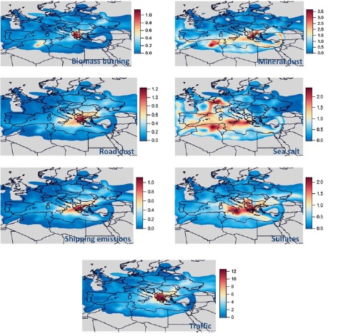
Air Pollution Studies: PM10 source profile in Patras
Concentration weight approach, CWT
X-ray Spectrometry 2018; 47:190-200
Collaboration with ERL at NCSR-D INRASTES
Yearlong measurement in Patras
West Peloponnese

Slide 12
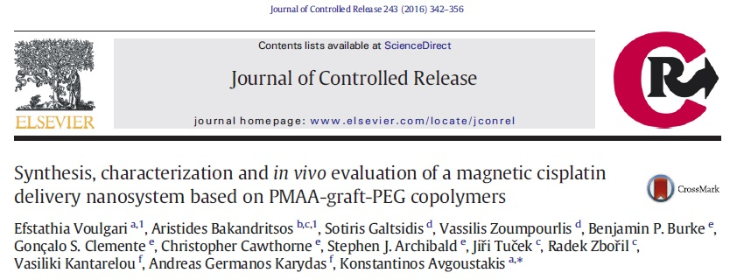
Biomedicine: XRF evaluation of nano-drug delivery
Collaboration University of Patras, Department of Pharmacy
Journal of Control Release 243 (2016) 342
Concentrations of cis-Pt in different mice tissues at the end of the study period (38th) day.
(FD) aqueous cis-Pt solution
(PD) cis-Pt-loaded Mag102-6 nano-assemblies
(PDMF) cis-Pt loaded Mag102-6 nano-assemblies in the presence of an external magnetic field in the tumor area
(*p < 0.05, **p < 0.01, ***p < 0.001)

Slide 13


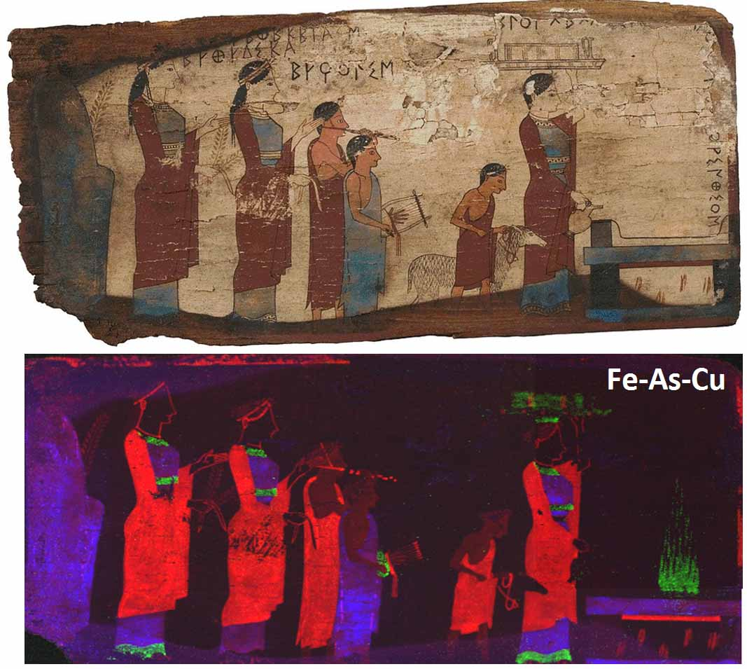
MA-XRF imaging: New analytical dimensions
Discovery of PGM inclusions in one Griffin Warrior ring
Myc-GoldPro
Archaic wooden panels of Pitsa, Earliest painting in Greece

Slide 14

Structure
The Managing Committee (MC) decided on the following Working Group (WG) structure for the Action:
WG1 - Instrumentation, modelling, data evaluation and software
WG2 - Metrology and standardization
WG3 - Sample preparation and analytical procedures
WG4 - Performance Assessment and Data Analysis
Thematic Sub Groups (SG) are also established:
SG Environment
SG Surfaces and Thin Films
SG Bio-medical Diagnostics
The Challenge (2019-2023)
The main aims and objectives of the Action is to coordinate the efforts made at national and transnational level to establish total reflection X-ray fluorescence (TXRF) as a reference technique for reliable elemental analysis of solid and liquid matrices, for the purposes of both fast screening and accurate quantitative determination. These objectives will be achieved via the development of a strong TXRF network, building capacity by training, connecting and involving stakeholders.

Slide 15
National & International collaborations (2019)
Collaborations with Greek Academic and Research Institutions
Institute of Historical Research, The National Hellenic Research Foundation, Athens (Dr Brecoulaki)
Institute of Electronic Structure and Laser, Foundation for Research and Technology-Hellas, Heraclion, Crete (Prof. Anglos)
Department of History, Archaeology and Cultural Resources Management, University of the Peloponnese (Prof. Zacharias)
Department of Physics, National Technical University of Athens (Prof. Kokkoris)
Aristotle University of Thessaloniki, School of Physics, Section of Solid State Physics, Thessaloniki (Prof. Katsikini)
Department of Materials Science & Engineering of the University of Ioannina, Ioannina (Prof. Anagnostopoulos)
Technical University of Crete, Chania, Crete (Prof. Kallithrakas)
Institute of Nuclear,Radiological Sciences and Technology, Energy and Safety, N.C.S.R. Demokritos, Greece (Dr Eleftheriades)
Institute of Nano Science and Nanotechnology, NCSR “Demokritos”, Greece (Dr Filippaki, Dr. Makarona)
University of Patras, Department of Pharmacy, (Prof. Avgoustakis)
University of West Attica, Department of Antiquities and Works of Art (Prof. Argyropoulos)
International Collaborators
Francesco Paolo Romano, Laboratori Nazionali del Sud, INFN, Italy
Sharon Stocker, Jack Davis, Department of Classical Archaeology, University of Cincinnati
Sanjiv Puri, Department of Basic and Applied Sciences, Punjabi University, Patiala, Punjab, India
Andrei Kochur, Rostov State University of Transport Communication, Russia
Eva Margui, Department of Chemistry, Faculty of Sciences, University of Girona, Spain
Mateusz Czyzycki and Pawel Wrobel, ANKA, Germany & AGH University of Science and Technology, Poland
Jorge Sanchez & Juan Jose Leani, National Scientific and Technical Research Council (CONICET), Argentina
Dimosthenis Sokaras, SLAC, USA, Ch. Zarkadas,
Nand-Nal Misra, Bhabha Atomic Research Centre, India

Slide 16
Concluding Remarks
The activity has no critical mass of personnel
Currently, there is no funding framework
Instrumentation is old (but not obsolete), generally is in very good operational state, but encounters high risk for failure and deviates from modern specifications
However the XRF Laboratory:
Holds unique infrastructure and expertise in Greece
Strong links/network with potential end-users and key national/international strategic partners (~20 Institutions/Universities)
Receives high appreciation in the community for the work done
Has generated excellent scientific production, undertaken broad activities but has prioritized key directions
Trained many young MSc students during the last few years who are attracted by the laboratory activities
If the need for personnel and financial support is not met, a critical domain of scientific activity for INPP is in jeopardy

Slide 17
Outlook – Future perspectives - Vision
Awaiting evaluation for 4 “Research + Innovation” projects + 1 “ELIDEK PostDoc” (passed in the 2nd phase) + 1 infrastructure EU project (H2020-INFRADEV-2019-3 “GEOANT-Labnet”)
Continuation of basic and applied research activities at Elettra Sinctrotrone Trieste
- Study of X-ray FPs of key elements: Ge, Sb, Re, Hf, Au; RRS studies on Ge, Au
- Four (4) beamtime experiments were already carried out within 2019. Data analysis has started
Continuation of “Myc-GoldPro” project in all “fronts”:
Beamtime @AGLAE (October 2019), many in-situ campaigns have scheduled, Big momentum!
Vision
The XRF Laboratory to be connected with the European Research Infrastructure Cultural Heritage (ERICH) as specialized XRF facility within the National Greek node (ERIHS.gr)
To lead in Greece the coordination & synergies for SR and IBA based applied research in thematic fields of interest, XRF-Lab will organize EXRS-2022 (>300 participants)
Further strengthening of the strategic partnership with LANDIS group at INFN-LNS, Italy to be equipped next year with state of the art X-ray instrumentation (3ME)
To take advantage of recent developments in XRS instrumentation to allow Synchrotron like research to be competitively performed at the INPP Laboratory scale, there is no such facility in Greece!

