Slide 1

CALIBRA
Cluster of Accelerator Laboratories for Ion-Beam Research and Applications
The CALIBRA Research Infrastructure
and the CALIBRA Project
Progress Report
Sotiris Harissopulos
2nd CALIBRA Meeting, 8 July 2019

Slide 2
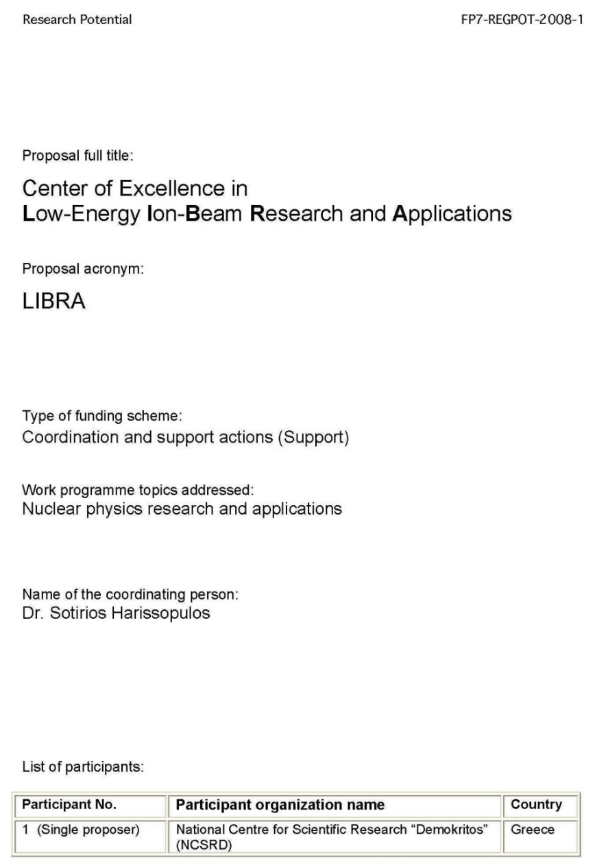

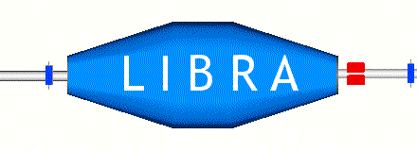
Ancestors of CALIBRA
Submitted in 2008 to EC FP7/REGPOT programme
Submitted in May 2010 to GSRT
within a call of the
National Strategic
Reference Framework
(ΕΣΠΑ/ESPA)
2007-2013
scored excellent: 14.5/15
rank 7 out of 451 proposals
Budget : 1.403.398
Call announced but not implemented …
Sotiris Harissopulos, 2nd CALIBRA Meeting, Athens, 8-9 July 2019

Slide 3
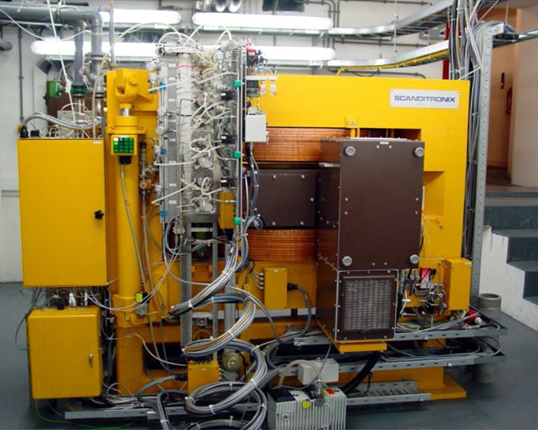
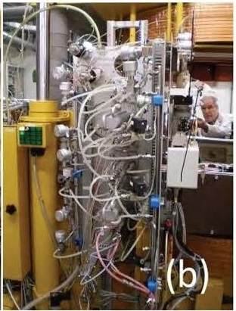
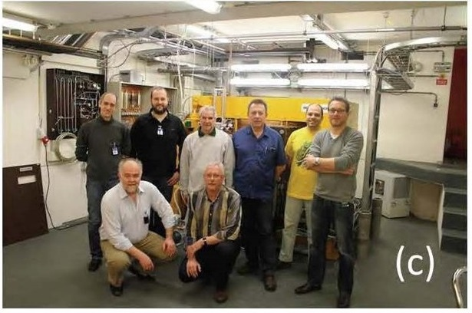

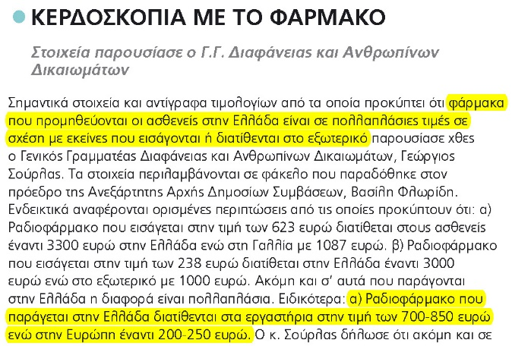
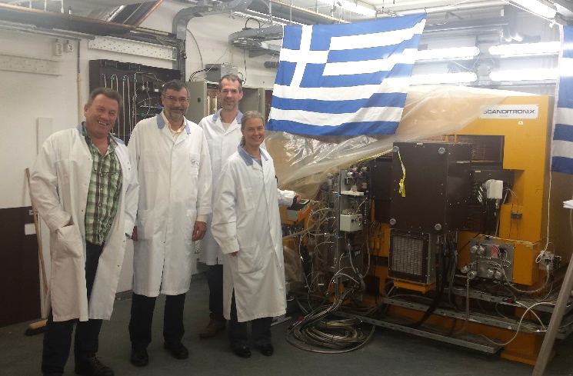
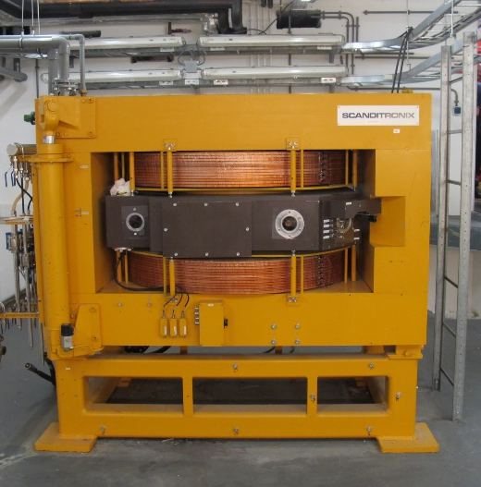
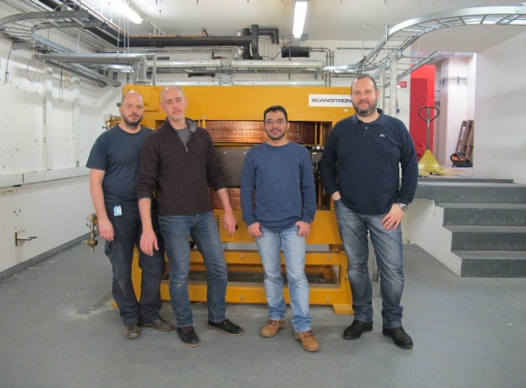
The 17 MeV Scanditronix Cyclotron donated by UMC Groningen
7/12/2012
MC-17F PET cyclotron
Target system
3/2012
10/2015
2/2016
2/2016
As of today no Cyclotron for R&D is installed in Greece …
Sotiris Harissopulos, 2nd CALIBRA Meeting, Athens, 8-9 July 2019

Slide 4
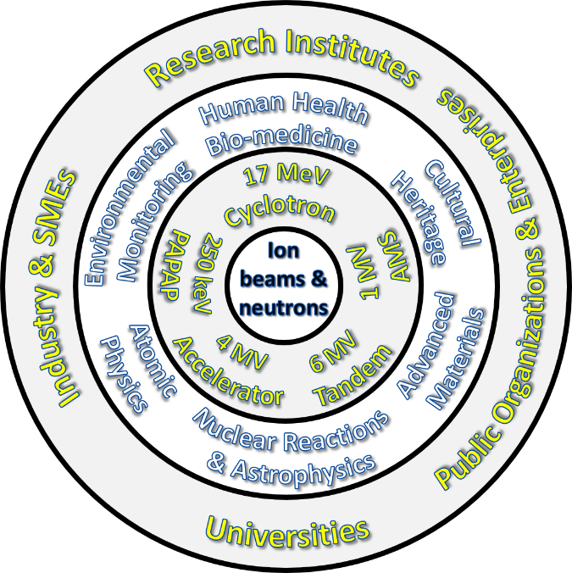
CALIBRA’s / NuSTAR’s concept and core idea
to deliver
ions
from the
lightest
(proton - p)
to the
heaviest
(Gold – Au)
from a
Cluster of
electrostatic
accelerators
and a cyclotron
to deliver
neutrons
with “fast”
energies
(1-30 MeV)
as secondary beams
from the accelerators
S. Harissopulos, AUTH, May 2, 2017

Slide 5

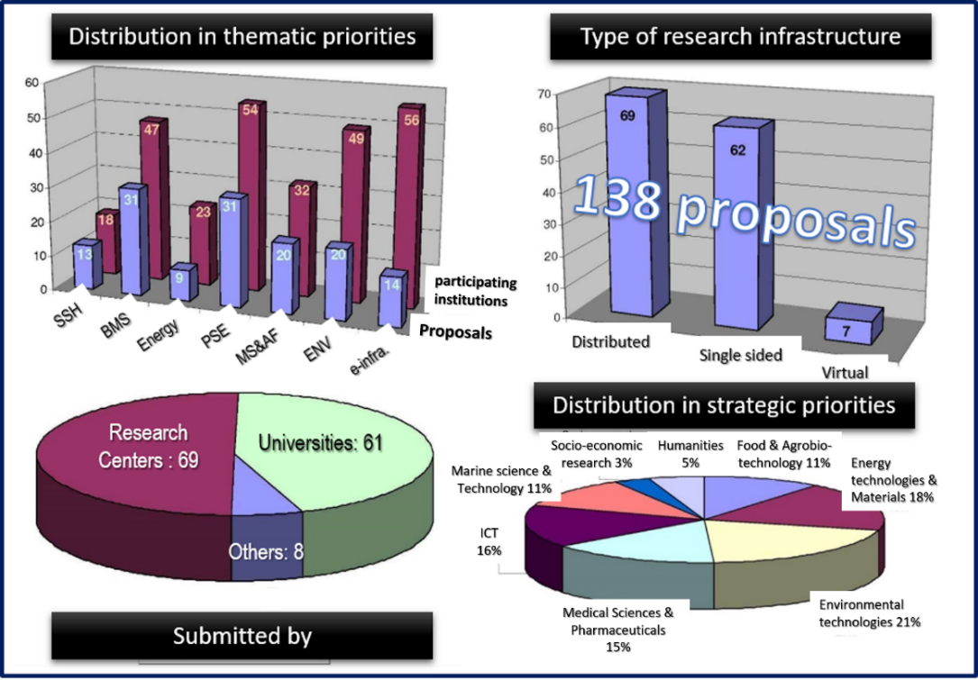
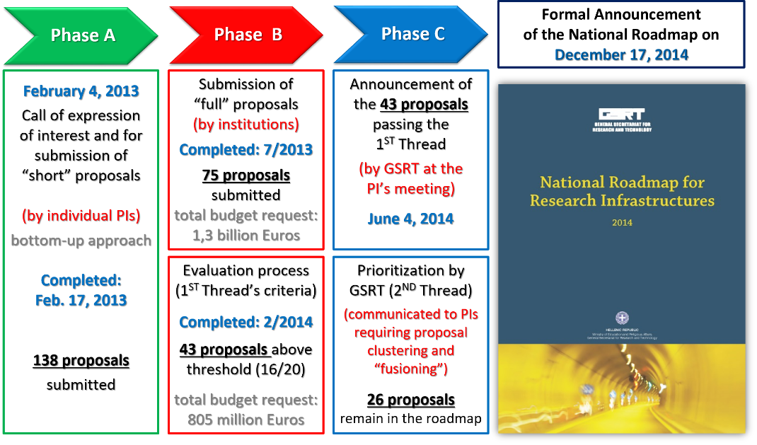
The National Roadmap for Research Infrastructures
Sotiris Harissopulos, 2nd CALIBRA Meeting, Athens, 8-9 July 2019

Slide 6
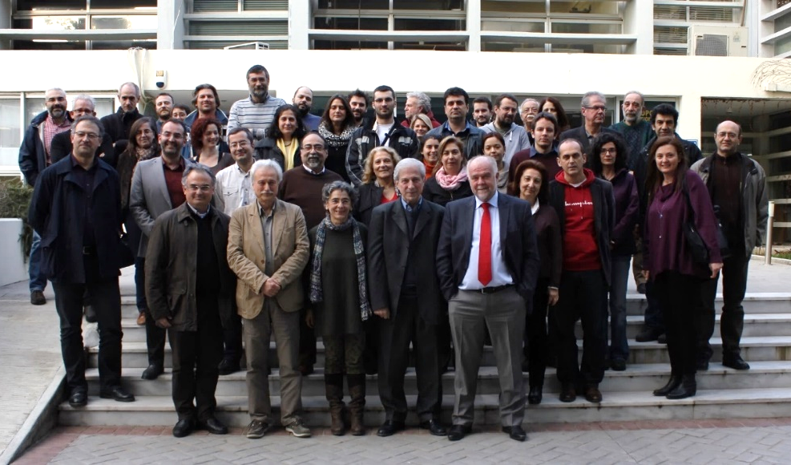
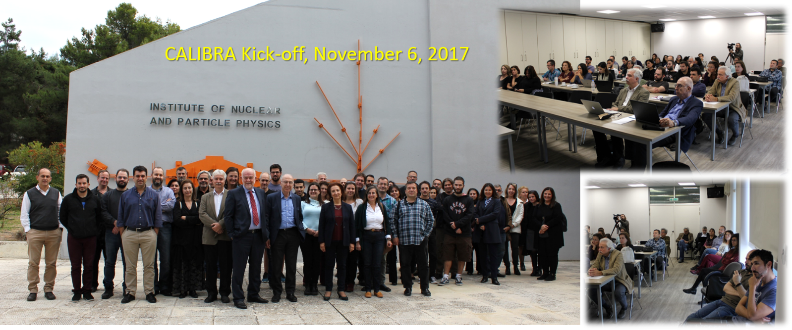
CALIBRA timelines
Feb. 2-3, 2015: NuSTAR’s (Pre)Kick-off
April 2016 : Communication with GSRT (5 M€ per project)
May 5, 2016 : Results of evaluation regarding RIS3 (invitation to submit technical proposal – 4 M€ max budget)
October 31, 2016 : Technical proposal submitted
July 25, 2017: Results of evaluation of technical proposal (budget approved = 3.359.203,25 M€)
July 31, 2017: Formal objection/appeal submitted
October 26, 2017: Result of the examination of the appeal received (partially accepted / Final Budget: 3.422.200 M€)
October 31, 2017: Ministerial decision received: CALIBRA’s formal inclusion in the NSRF 2014-2020
November 6, 2017:
Kick-off meeting
70 scientists from
15 Research Institutions
!!! Project start : July 2018 !!!
Sotiris Harissopulos, 2nd CALIBRA Meeting, Athens, 8-9 July 2019

Slide 7
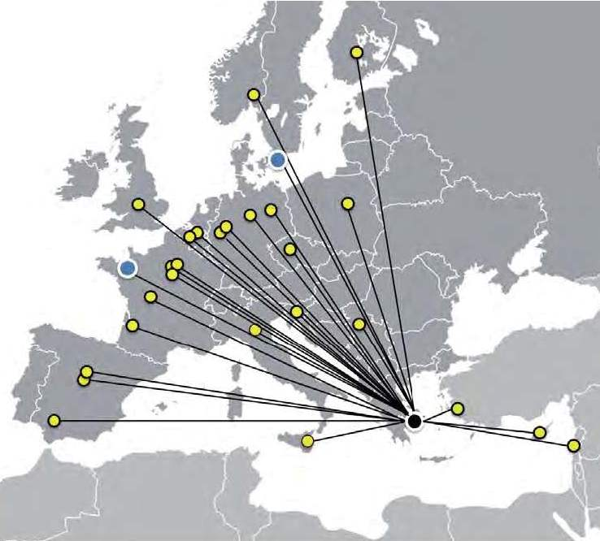




CALIBRA, the project
The CALIBRA project (MIS 5002799) is implemented under the Action “Reinforcement of the Research and Innovation Infrastructures” which is funded by the Operational Programme “Competitiveness, Entrepreneurship and Innovation” (NSRF 2014-2020) and co-financed by Greece and the European Union (European Regional Development Fund).
The project aims at gradually establishing the initially proposed full-scale CALIBRA Research Infrastructure, open to the national and the European scientific community to conduct research at excellence level, develop innovative applications of increased socioeconomic impact, provide highly-specialized services, unique at the country level, to the public and private sector.
Apart from fundamental research, CALIBRA strives for contribution to the goals of the National Strategy in Research and Technology regarding the country’s thematic priorities for smart specialization (RIS3), with emphasis in human health and radiopharmaceuticals, future energy sources, materials of technological interest, cultural heritage, environmental monitoring and the development of instrumentation and its testing under harsh irradiation environments.
Sotiris Harissopulos, 2nd CALIBRA Meeting, Athens, 8-9 July 2019

Slide 8
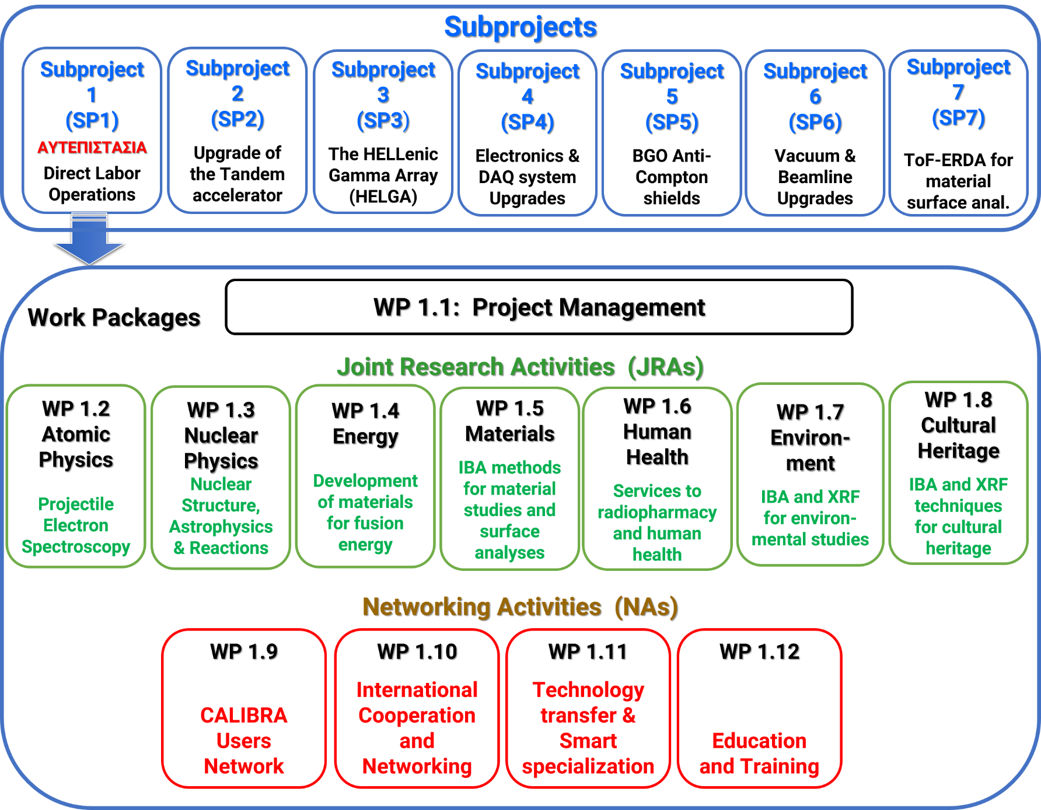
CALIBRA’s subprojects and work packages
Sotiris Harissopulos, 2nd CALIBRA Meeting, Athens, 8-9 July 2019

Slide 9
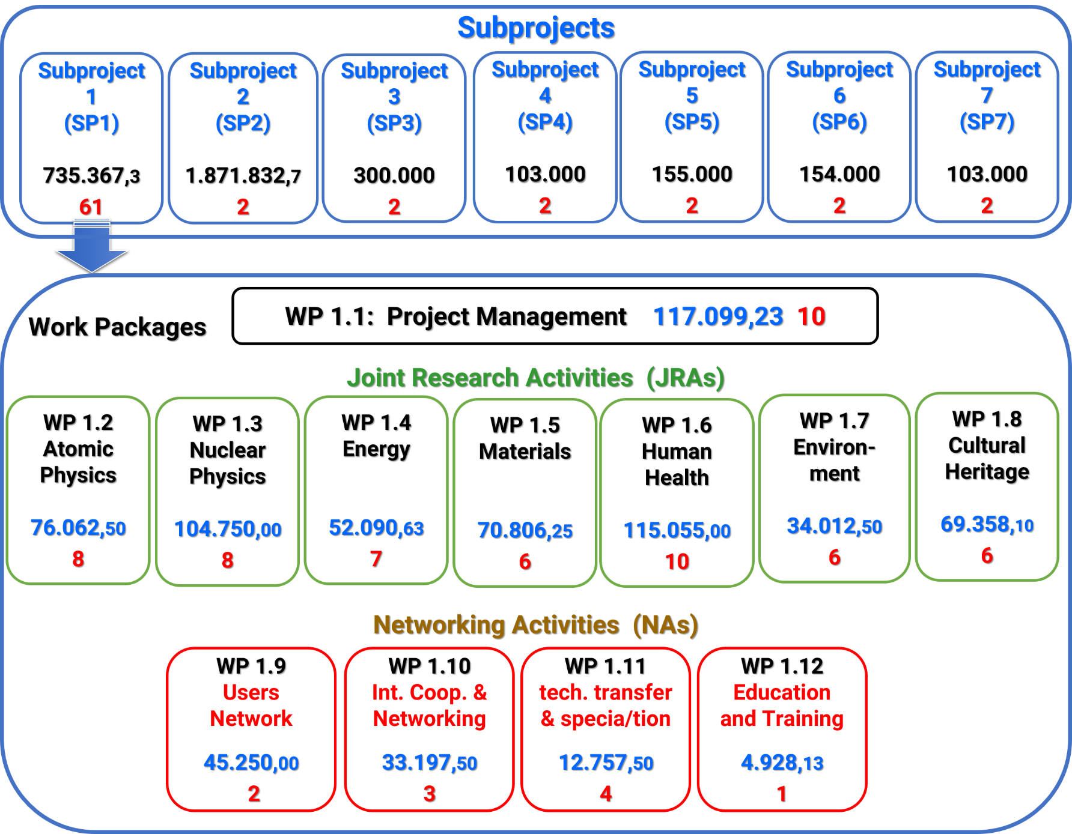
CALIBRA’s budget and number of deriverables per SP and WP
Sotiris Harissopulos, 2nd CALIBRA Meeting, Athens, 8-9 July 2019

Slide 10
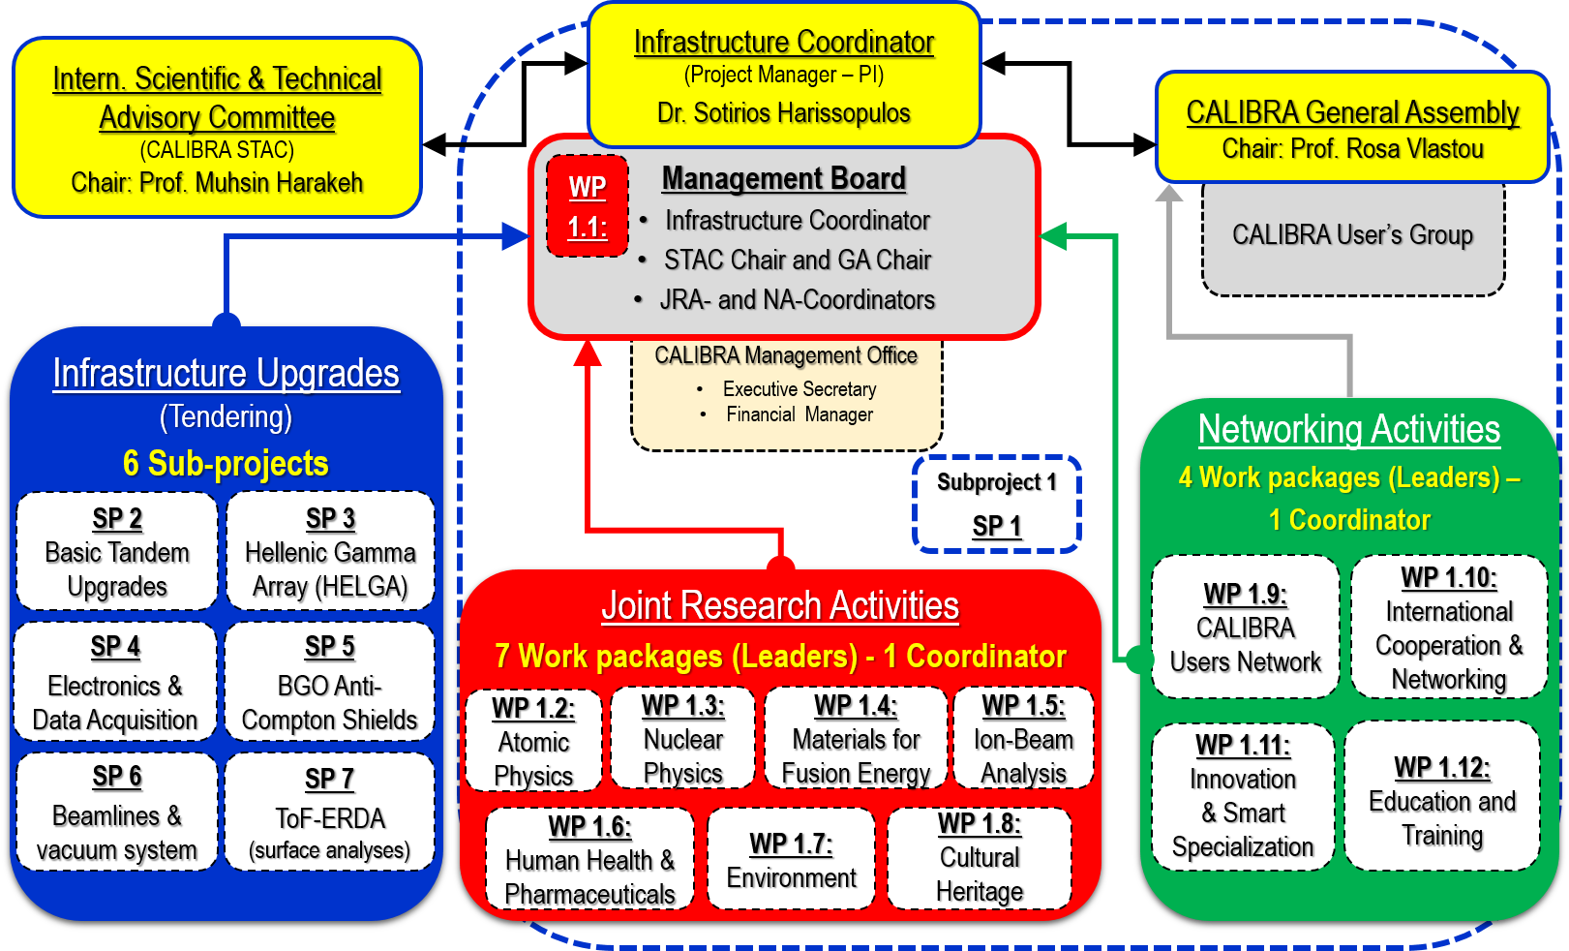
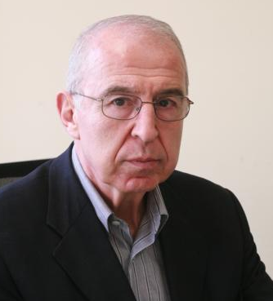
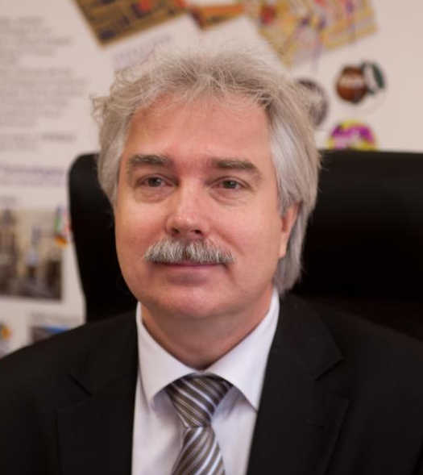
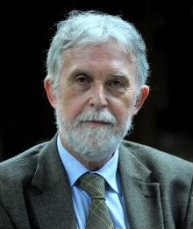
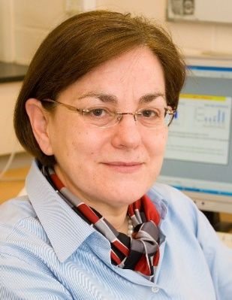

CALIBRA’s governance and structure
Prof. M. Harakeh
U. Groningen
Prof. M. Lewitowicz
GANIL/NuPECC
Prof. P.- A. Mando
U. Firenze
Prof. P. Batistoni
ENEA/Rome
Prof. R. Vlatou
NTU Athens
Sotiris Harissopulos, 2nd CALIBRA Meeting, Athens, 8-9 July 2019

Slide 11
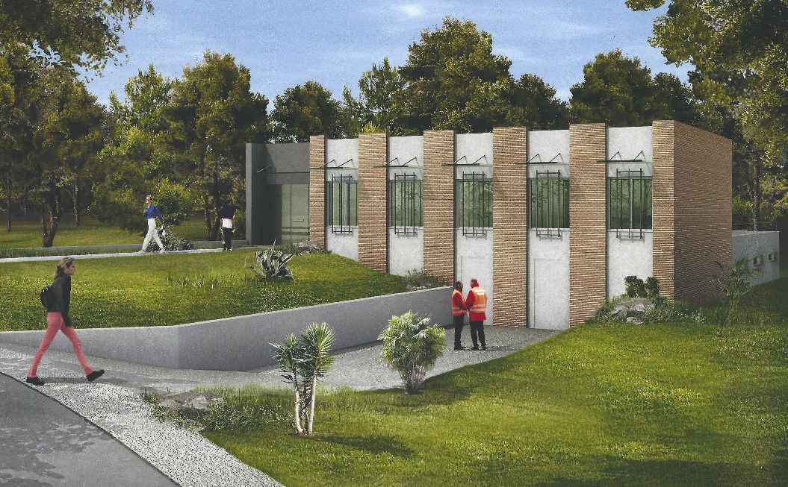
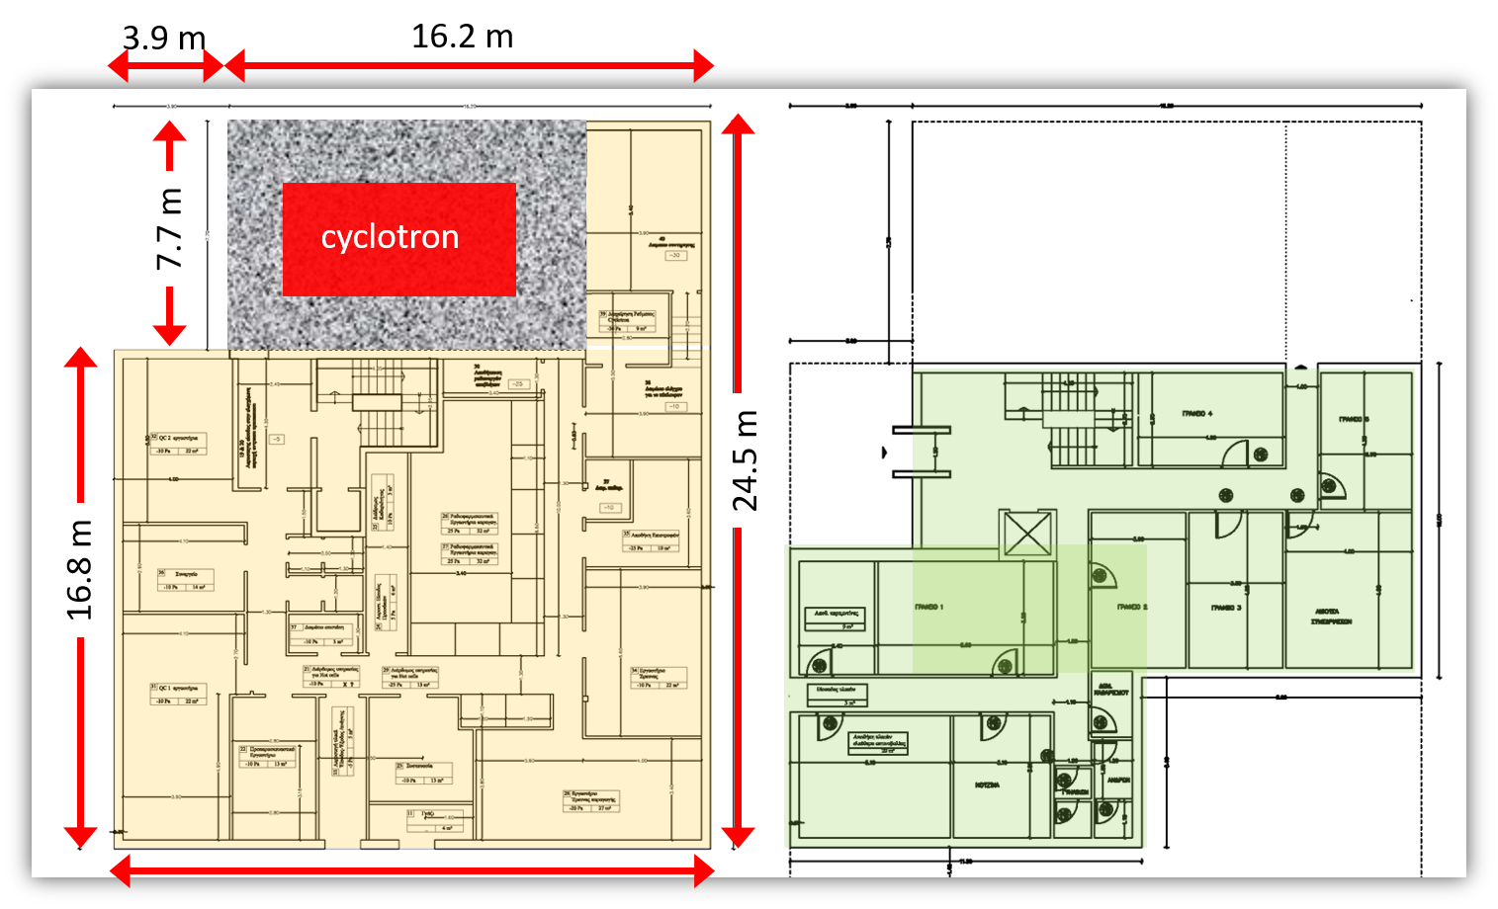
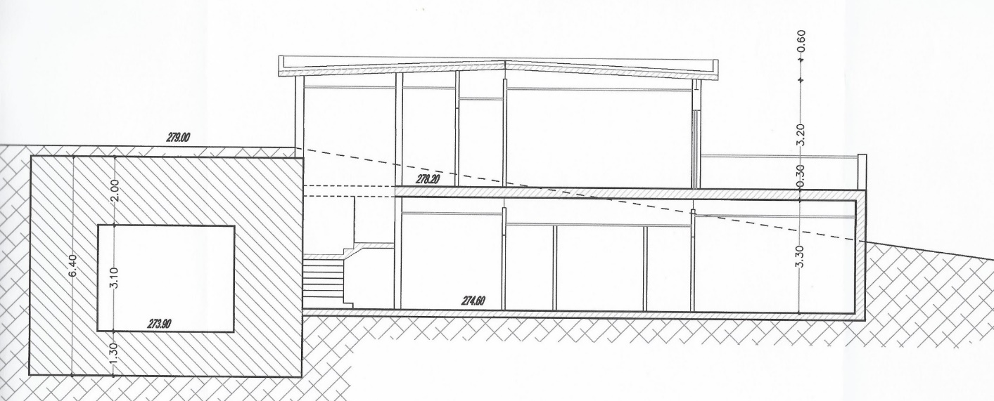
The draft technical design study for a cyclotron building at Demokritos
800 k€
Sotiris Harissopulos, 2nd CALIBRA Meeting, Athens, 8-9 July 2019

Slide 12
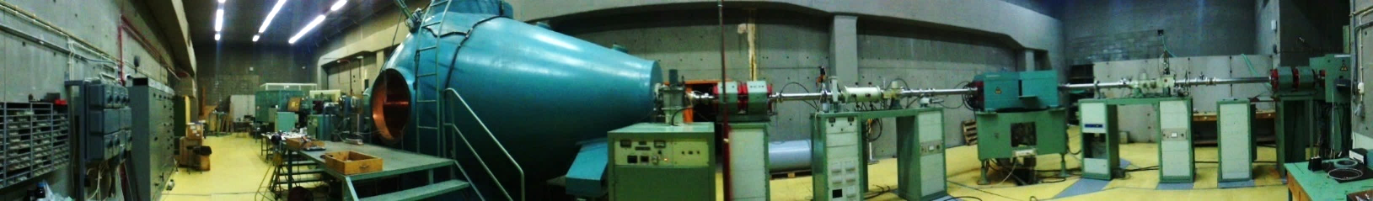
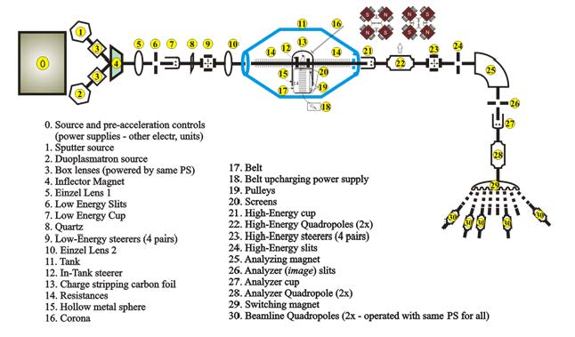
CALIBRA’s planned upgrades within Sub-Projects 2 and 6 (SP2, SP6)
5.5 MV Tandem Accelerator
Tandem hall
Sotiris Harissopulos, 2nd CALIBRA Meeting, Athens, 8-9 July 2019

Slide 13
CALIBRA’s planned upgrades within Sub-Project 2 (SP2)
5.5 MV Tandem Accelerator
Tandem hall
SP2 Upgrades (Tender in progress; 1.674 M€) expected to complete by end of 2020
1 | SNICS II Injection Beamline
2 | TORVIS Ion Source system
4 | Pelletron Charging System conversion
5 | Gas and foil strippers
6 | TPS6 voltage stabilizer system with GVM, corona probe and Controller
7 | AccelNET computer control system
8 | Beam Profile Monitor display system interfacing to AccelNET control system
9 | 5x Beam Profile Monitors (BPM80)
10 | New beam optics optimization
11 | Supervision of Installation and testing by technician at “Demokritos”
12 | Ocean freight and insurance
Sotiris Harissopulos, 2nd CALIBRA Meeting, Athens, 8-9 July 2019

Slide 14
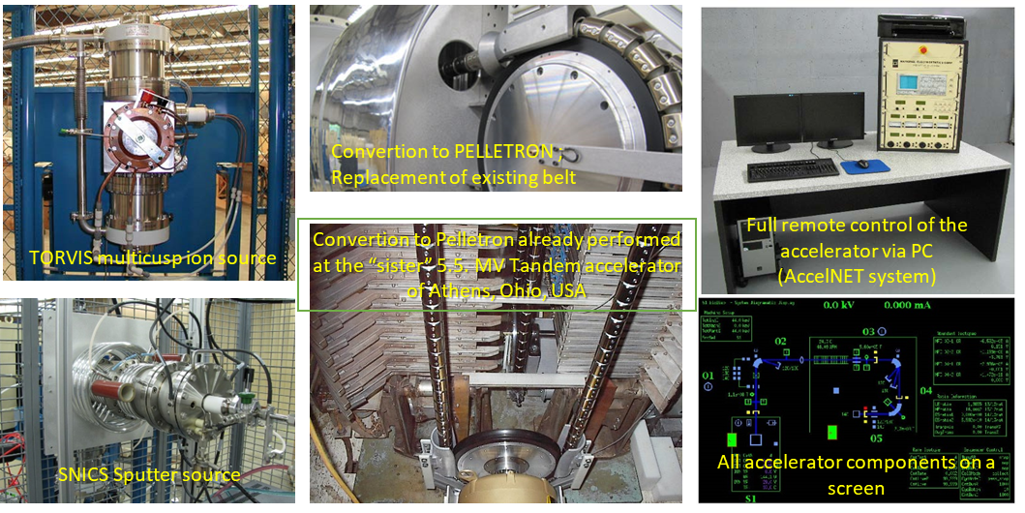
CALIBRA’s planned upgrades within Sub-Project 2 (SP2)
5.5 MV Tandem Accelerator
Tandem hall
Sotiris Harissopulos, 2nd CALIBRA Meeting, Athens, 8-9 July 2019

Slide 15
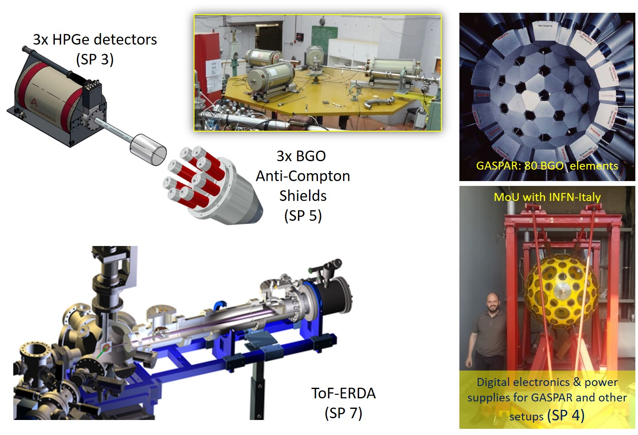
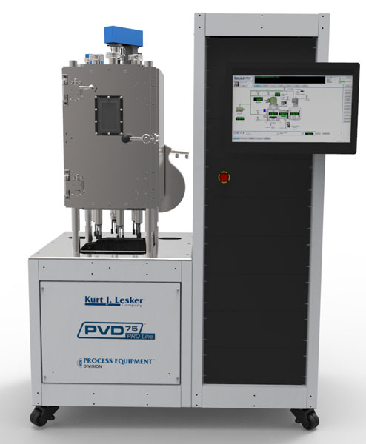
CALIBRA’s planned upgrades: SP3, SP4, SP5, SP7
HFRI proposal: 2nd Evaluation Phase
Sotiris Harissopulos, 2nd CALIBRA Meeting, Athens, 8-9 July 2019

Slide 16
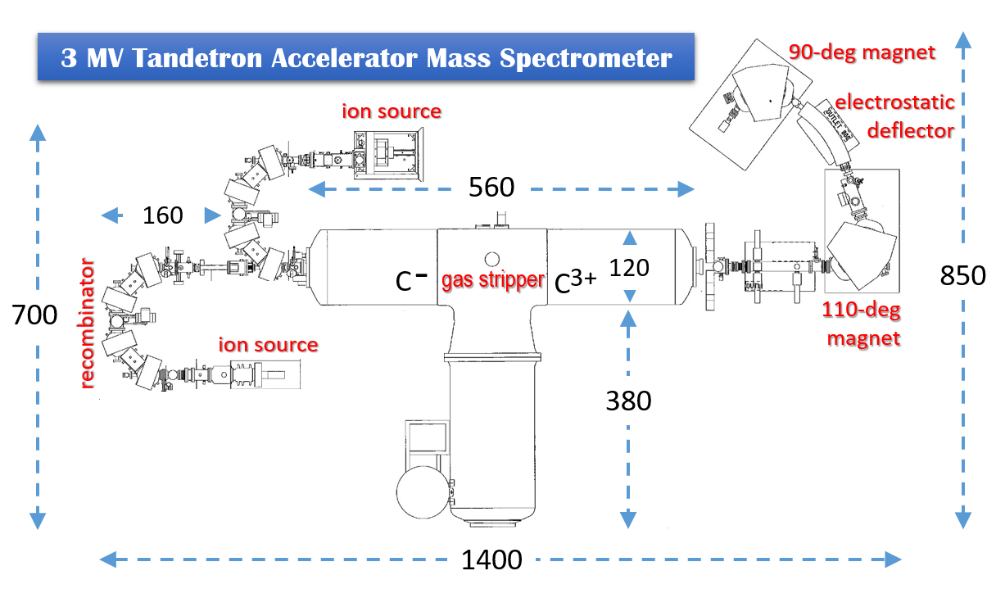
A very recent donation to CALIBRA: a 3 MV Tandetron AMS
Sotiris Harissopulos, 2nd CALIBRA Meeting, Athens, 8-9 July 2019

Slide 17
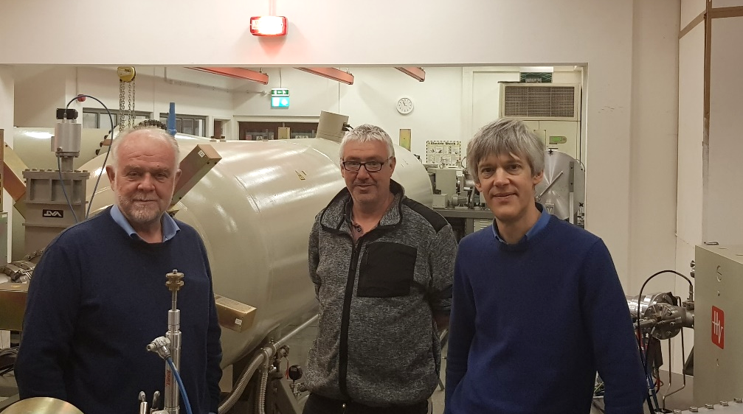
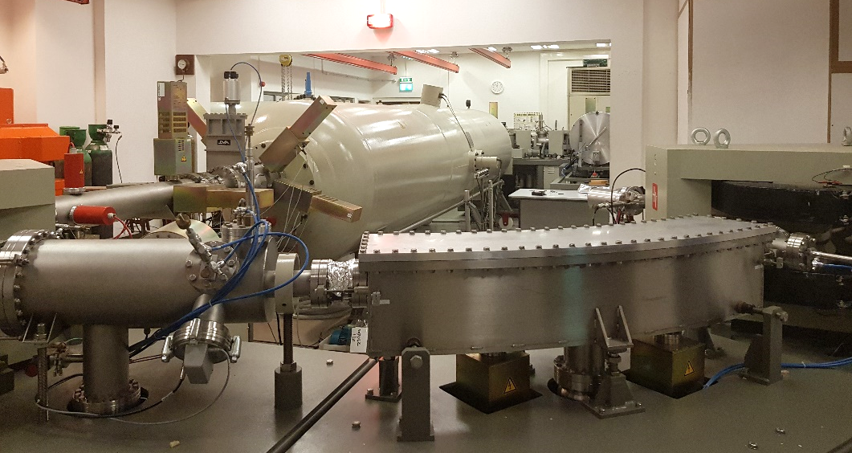
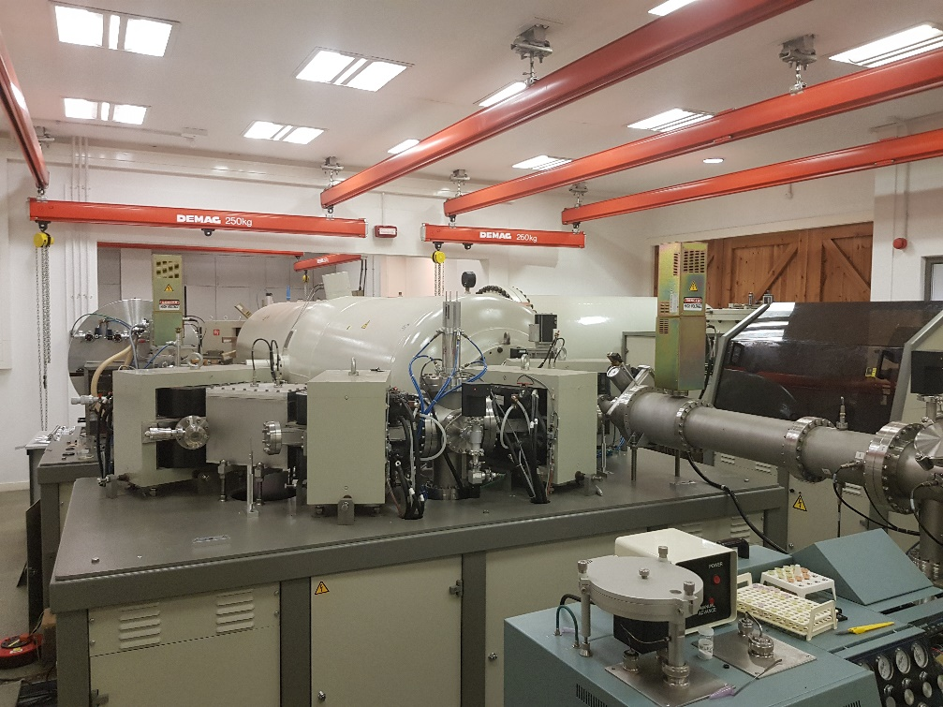
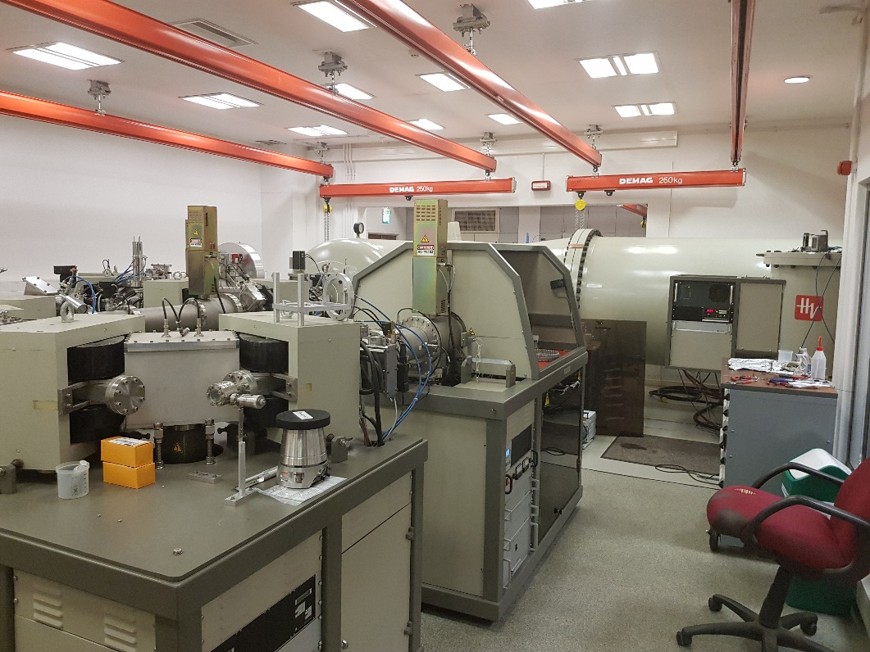
A very recent donation to CALIBRA: a 3 MV Tandetron AMS
Sotiris Harissopulos, 2nd CALIBRA Meeting, Athens, 8-9 July 2019

