Slide 1

CALIBRA
Cluster of Accelerator Laboratories for Ion-Beam Research and Applications
The CALIBRA Research Infrastructure
and the CALIBRA Project
Progress Report
Sotiris Harissopulos
2nd CALIBRA Meeting, 8 July 2019

Slide 2
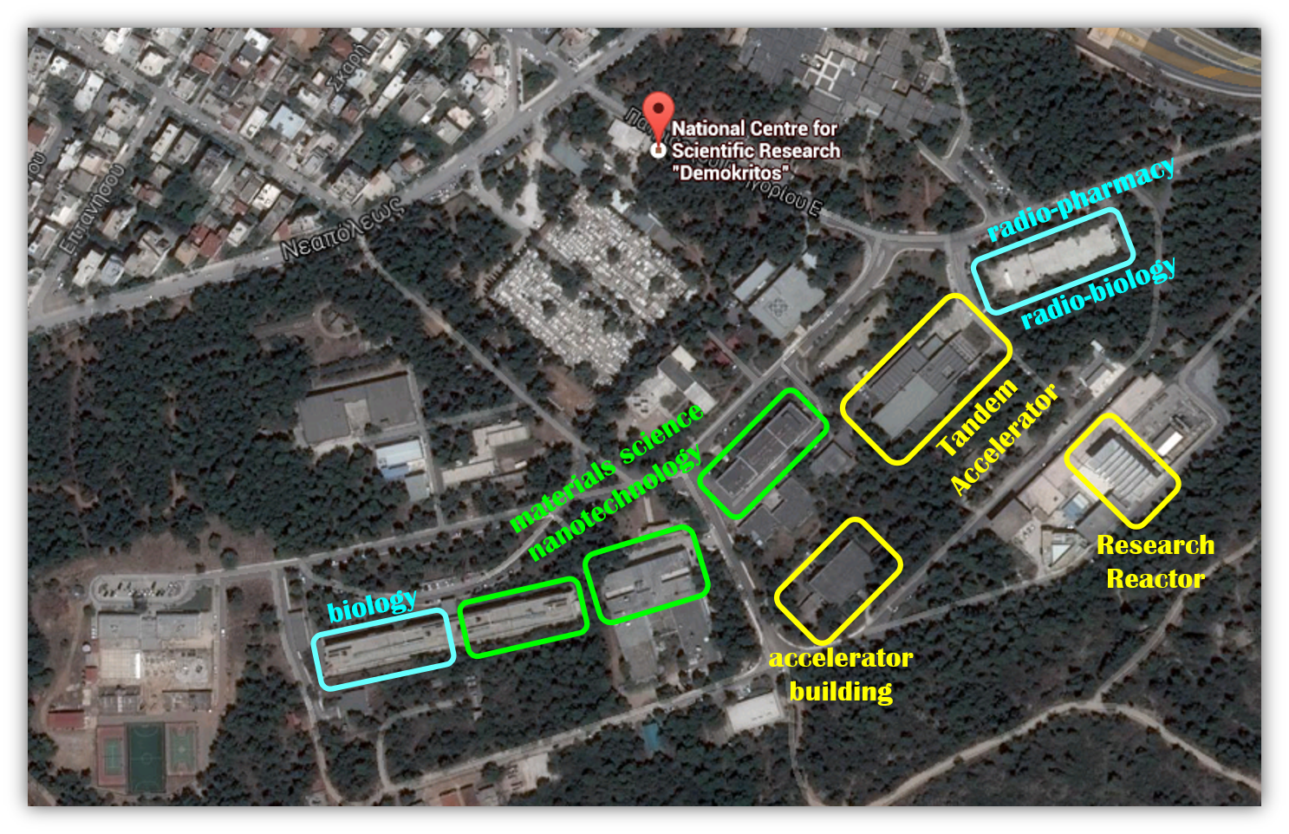
CALIBRA Research Infrastructure:
Part of a long-term vision for a state-of-the-art nuclear infrastructure with complementary analytical facilities within the fully multidisciplinary scientific environment of “Demokritos”
NuSTAR infrastructure
NuSTAR Infrastructure was already proposed in April 2013 …
Sotiris Harissopulos, 2nd CALIBRA Meeting, Athens, 8-9 July 2019

Slide 3
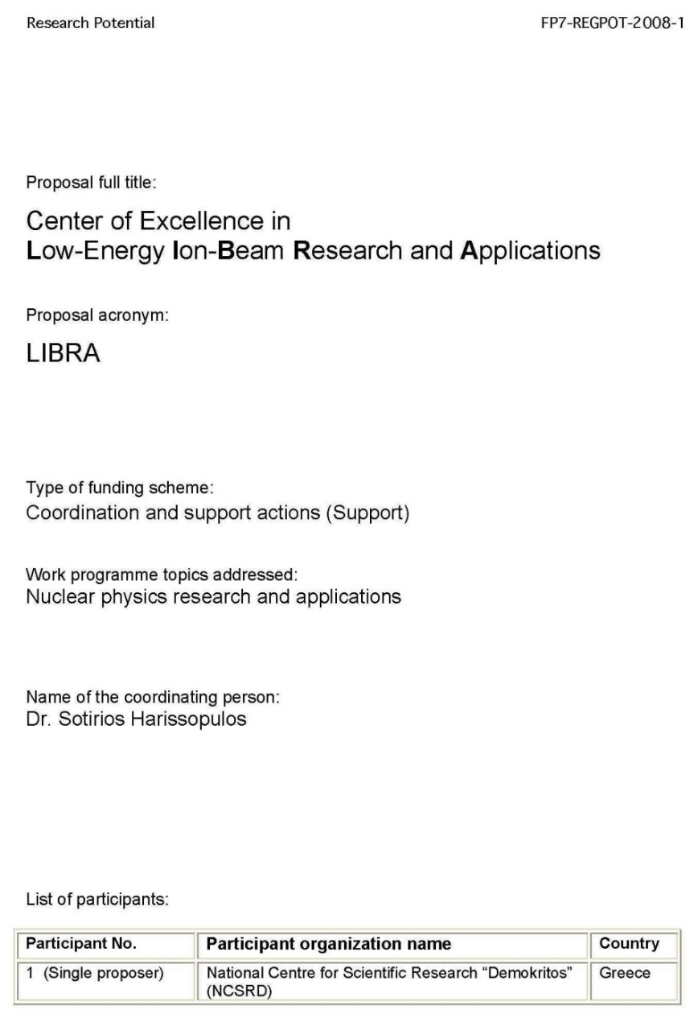

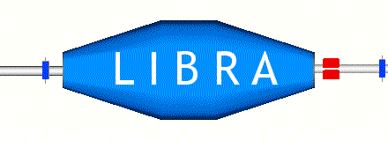
Ancestors of CALIBRA
Submitted in 2008 to EC FP7/REGPOT programme
Submitted in May 2010 to GSRT
within a call of the
National Strategic
Reference Framework
(ΕΣΠΑ/ESPA)
2007-2013
scored excellent: 14.5/15
rank 7 out of 451 proposals
Budget : 1.403.398
Call announced but not implemented …
Sotiris Harissopulos, 2nd CALIBRA Meeting, Athens, 8-9 July 2019

Slide 4
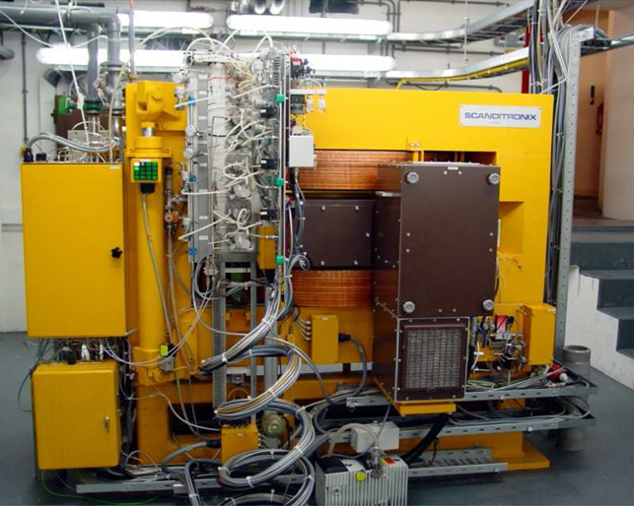
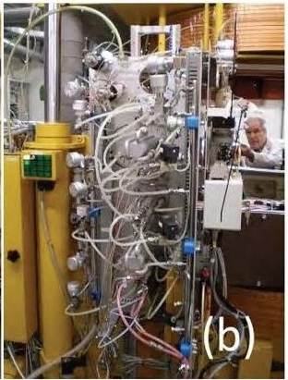
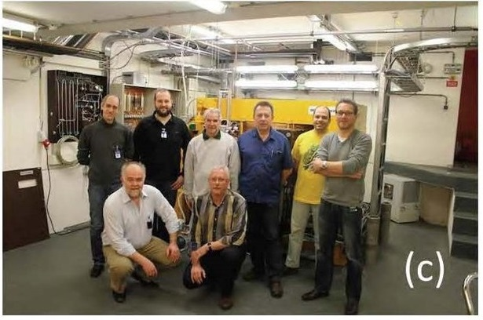

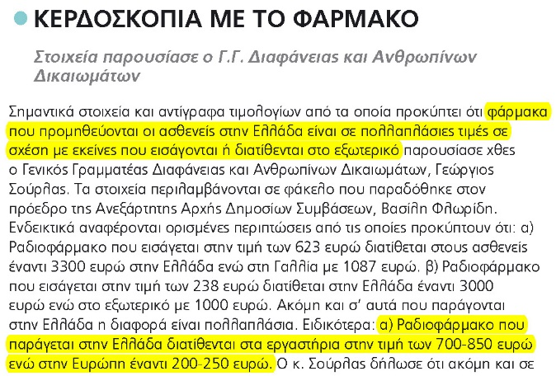
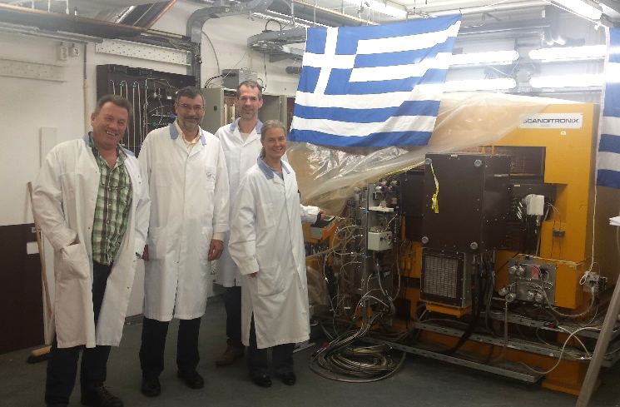
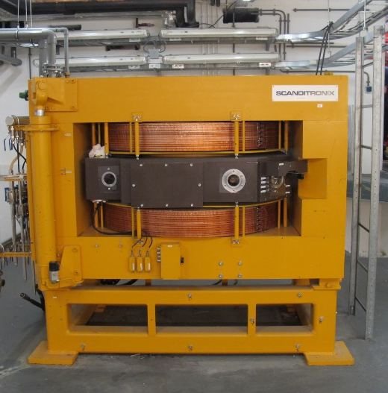
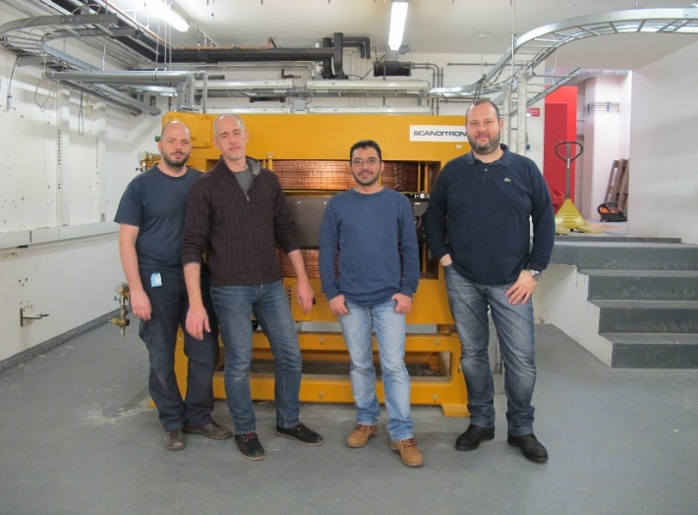
The 17 MeV Scanditronix Cyclotron donated by UMC Groningen
7/12/2012
MC-17F PET cyclotron
Target system
3/2012
10/2015
2/2016
2/2016
As of today no Cyclotron for R&D is installed in Greece …
Sotiris Harissopulos, 2nd CALIBRA Meeting, Athens, 8-9 July 2019

Slide 5
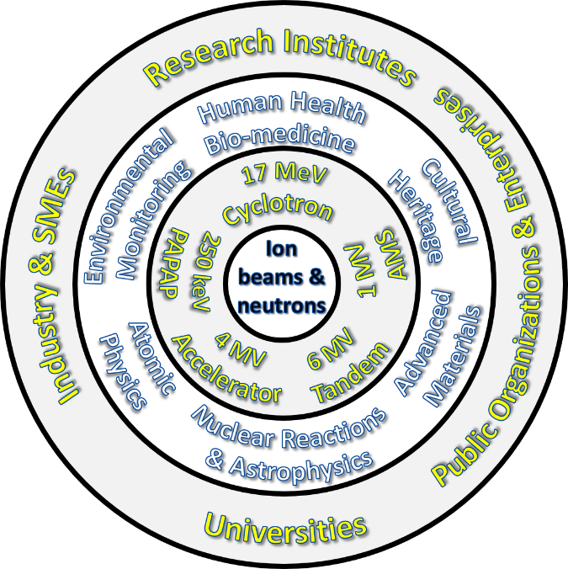
CALIBRA’s / NuSTAR’s concept and core idea
to deliver
ions
from the
lightest
(proton - p)
to the
heaviest
(Gold – Au)
from a
Cluster of
electrostatic
accelerators
and a cyclotron
to deliver
neutrons
with “fast”
energies
(1-30 MeV)
as secondary beams
from the accelerators
and thermal
energies
(eV - keV)
from a 5MW
research
reactor
S. Harissopulos, AUTH, May 2, 2017

Slide 6

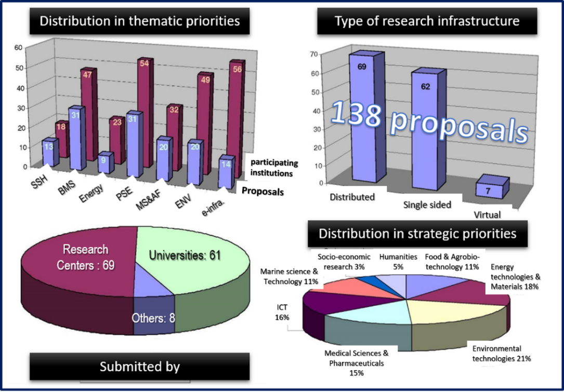
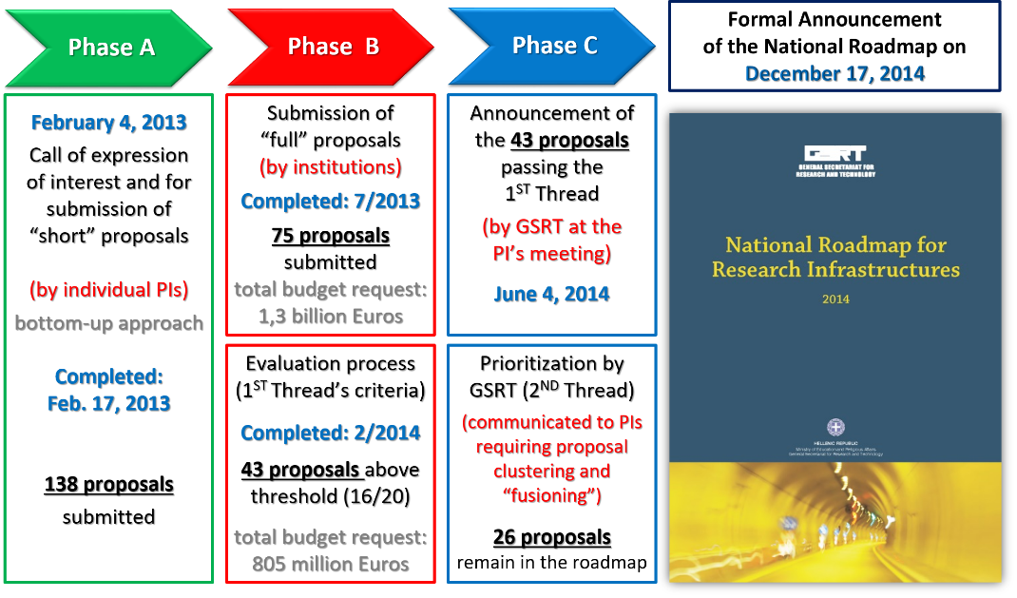
The National Roadmap for Research Infrastructures
Sotiris Harissopulos, 2nd CALIBRA Meeting, Athens, 8-9 July 2019

Slide 7
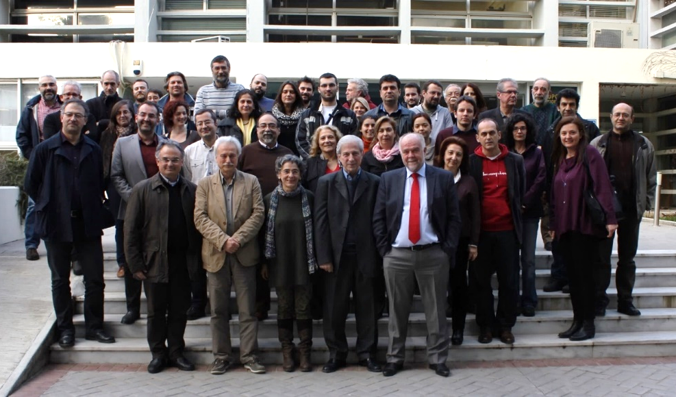
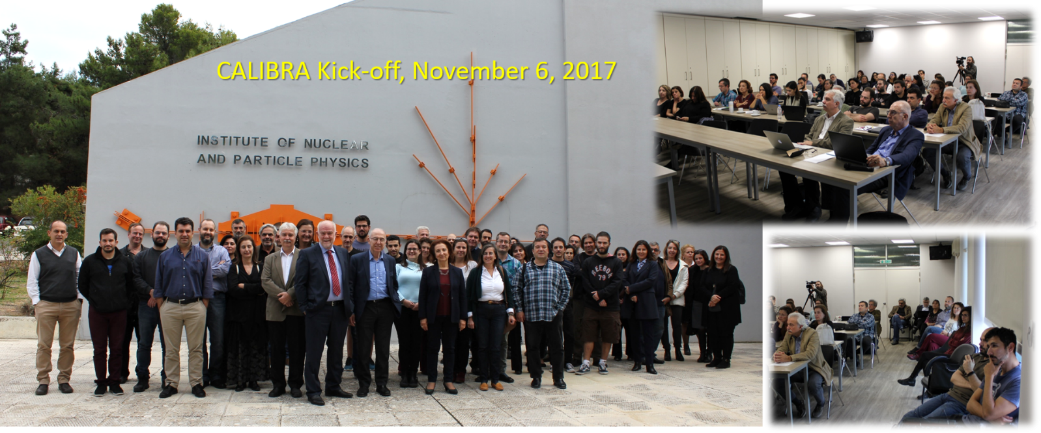
CALIBRA timelines
Feb. 2-3, 2015: NuSTAR’s (Pre)Kick-off
April 2016 : Communication with GSRT (5 M€ per project)
May 5, 2016 : Results of evaluation regarding RIS3 (invitation to submit technical proposal – 4 M€ max budget)
October 31, 2016 : Technical proposal submitted
July 25, 2017: Results of evaluation of technical proposal (budget approved = 3.359.203,25 M€)
July 31, 2017: Formal objection/appeal submitted
October 26, 2017: Result of the examination of the appeal received (partially accepted / Final Budget: 3.422.200 M€)
October 31, 2017: Ministerial decision received: CALIBRA’s formal inclusion in the NSRF 2014-2020
November 6, 2017:
Kick-off meeting
70 scientists from
15 Research Institutions
!!! Project start : July 2018 !!!
Sotiris Harissopulos, 2nd CALIBRA Meeting, Athens, 8-9 July 2019

Slide 8
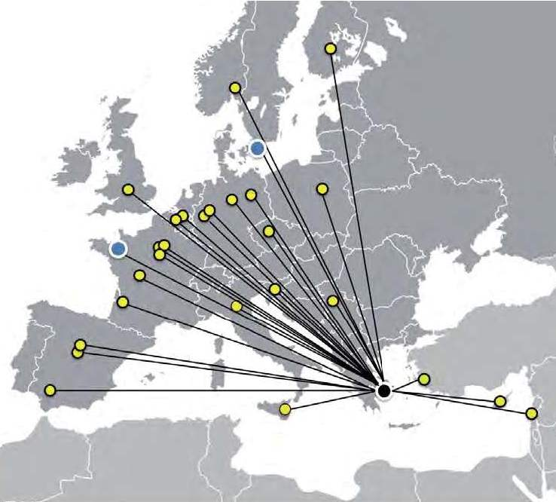




CALIBRA, the project
The CALIBRA project (MIS 5002799) is implemented under the Action “Reinforcement of the Research and Innovation Infrastructures” which is funded by the Operational Programme “Competitiveness, Entrepreneurship and Innovation” (NSRF 2014-2020) and co-financed by Greece and the European Union (European Regional Development Fund).
The project aims at gradually establishing the initially proposed full-scale CALIBRA Research Infrastructure, open to the national and the European scientific community to conduct research at excellence level, develop innovative applications of increased socioeconomic impact, provide highly-specialized services, unique at the country level, to the public and private sector.
Apart from fundamental research, CALIBRA strives for contribution to the goals of the National Strategy in Research and Technology regarding the country’s thematic priorities for smart specialization (RIS3), with emphasis in human health and radiopharmaceuticals, future energy sources, materials of technological interest, cultural heritage, environmental monitoring and the development of instrumentation and its testing under harsh irradiation environments.
Sotiris Harissopulos, 2nd CALIBRA Meeting, Athens, 8-9 July 2019

Slide 9
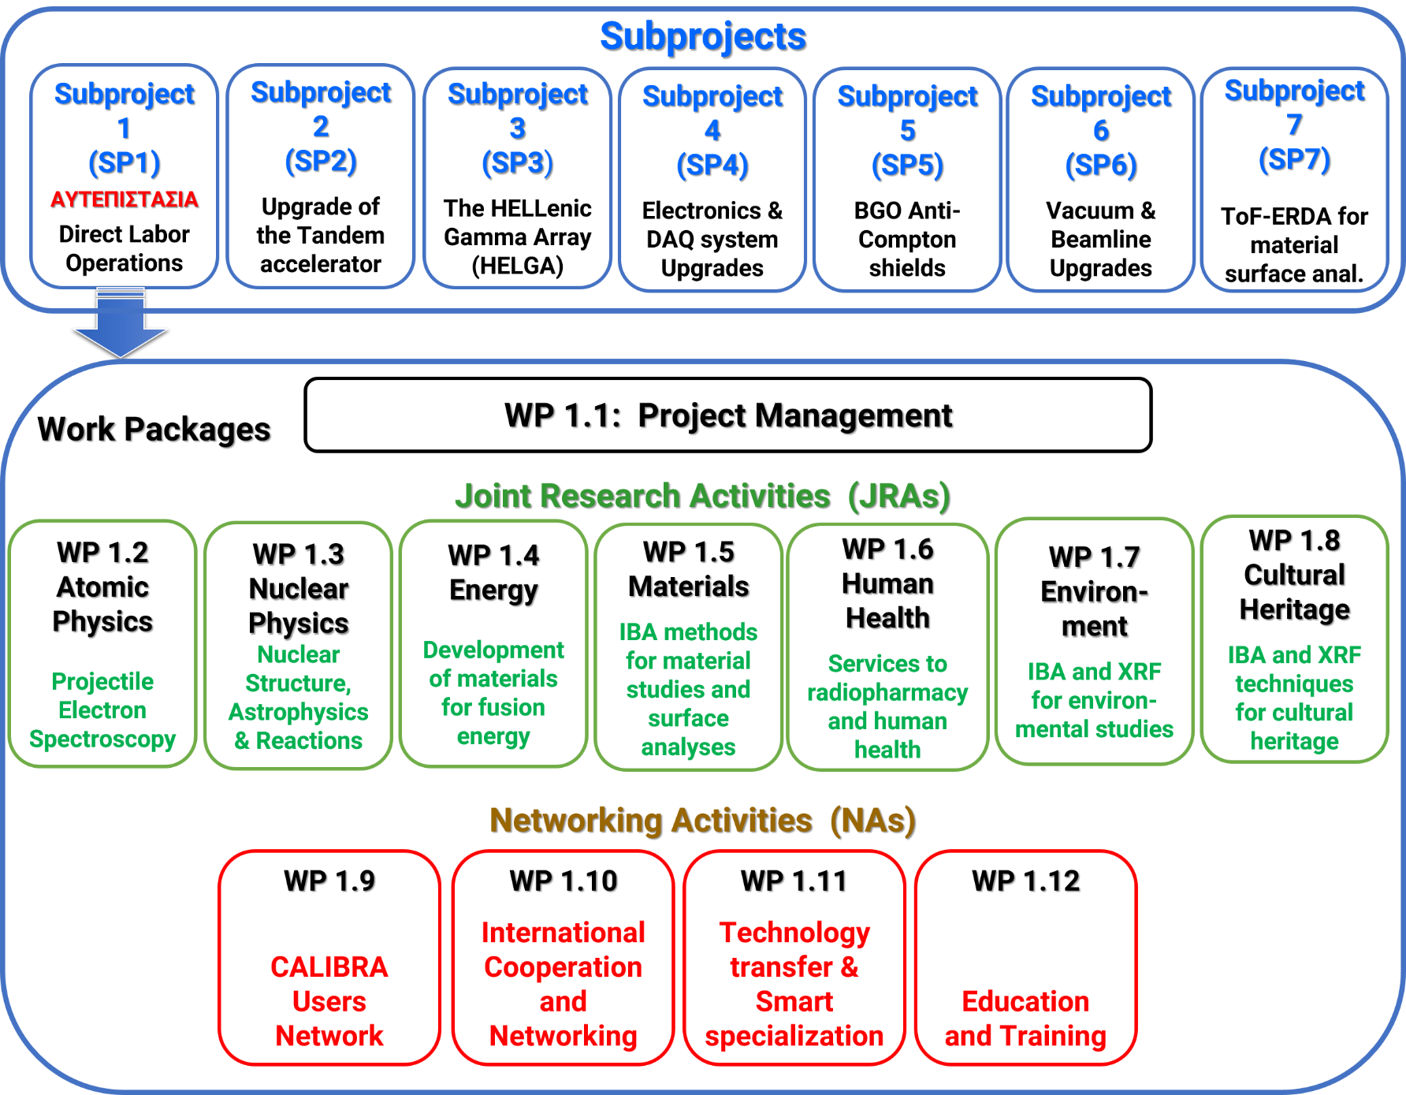
CALIBRA’s subprojects and work packages
Sotiris Harissopulos, 2nd CALIBRA Meeting, Athens, 8-9 July 2019

Slide 10
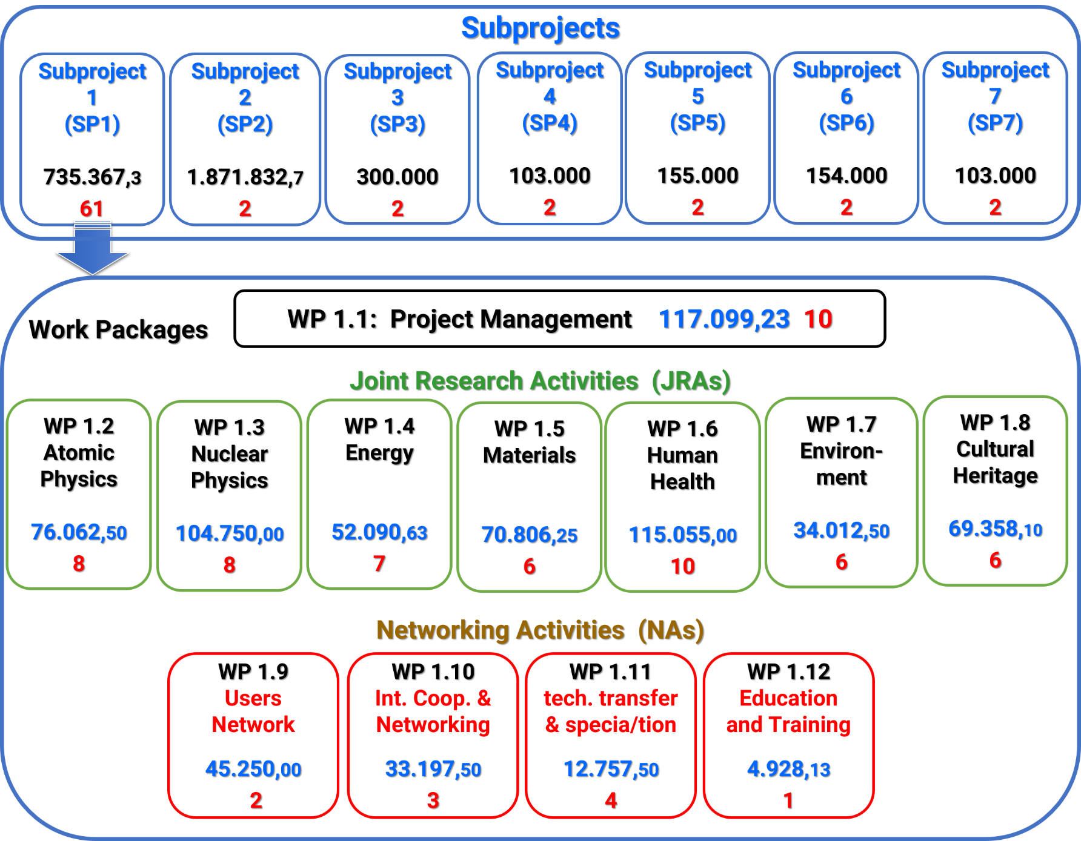
CALIBRA’s budget and number of deriverables per SP and WP
Sotiris Harissopulos, 2nd CALIBRA Meeting, Athens, 8-9 July 2019

Slide 11
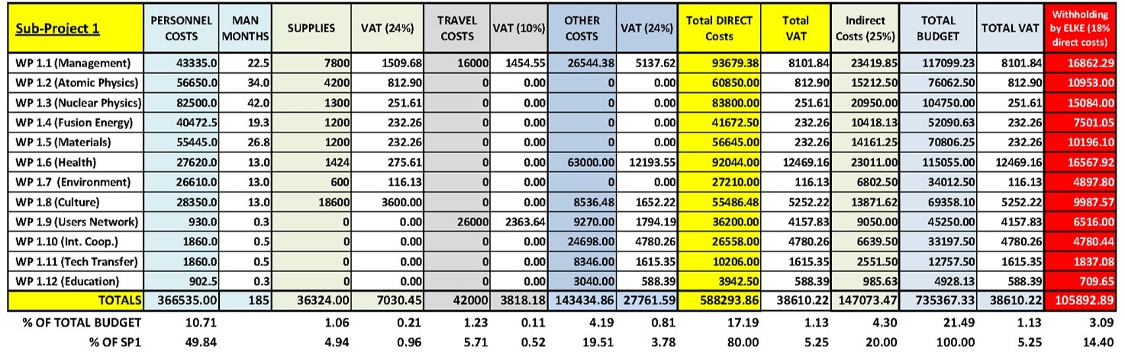
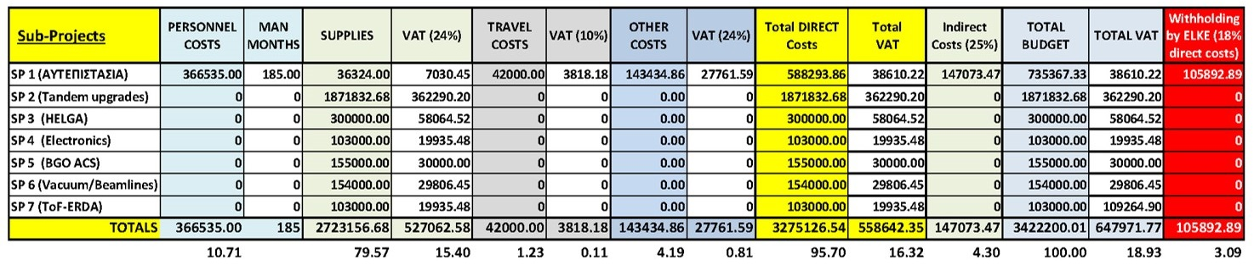
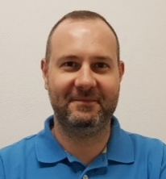
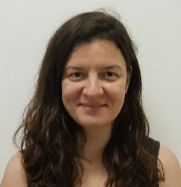
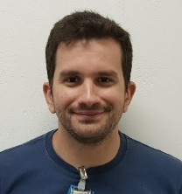
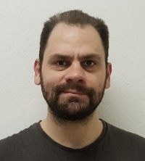
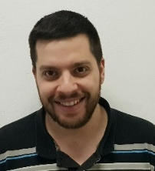
CALIBRA’s budget distribution per cost category
So far, five contracts with new scientific personnel signed; two more to sign by end of July 2017,
five more posts to be announced and filled in the coming three months
Sotiris Harissopulos, 2nd CALIBRA Meeting, Athens, 8-9 July 2019

Slide 12
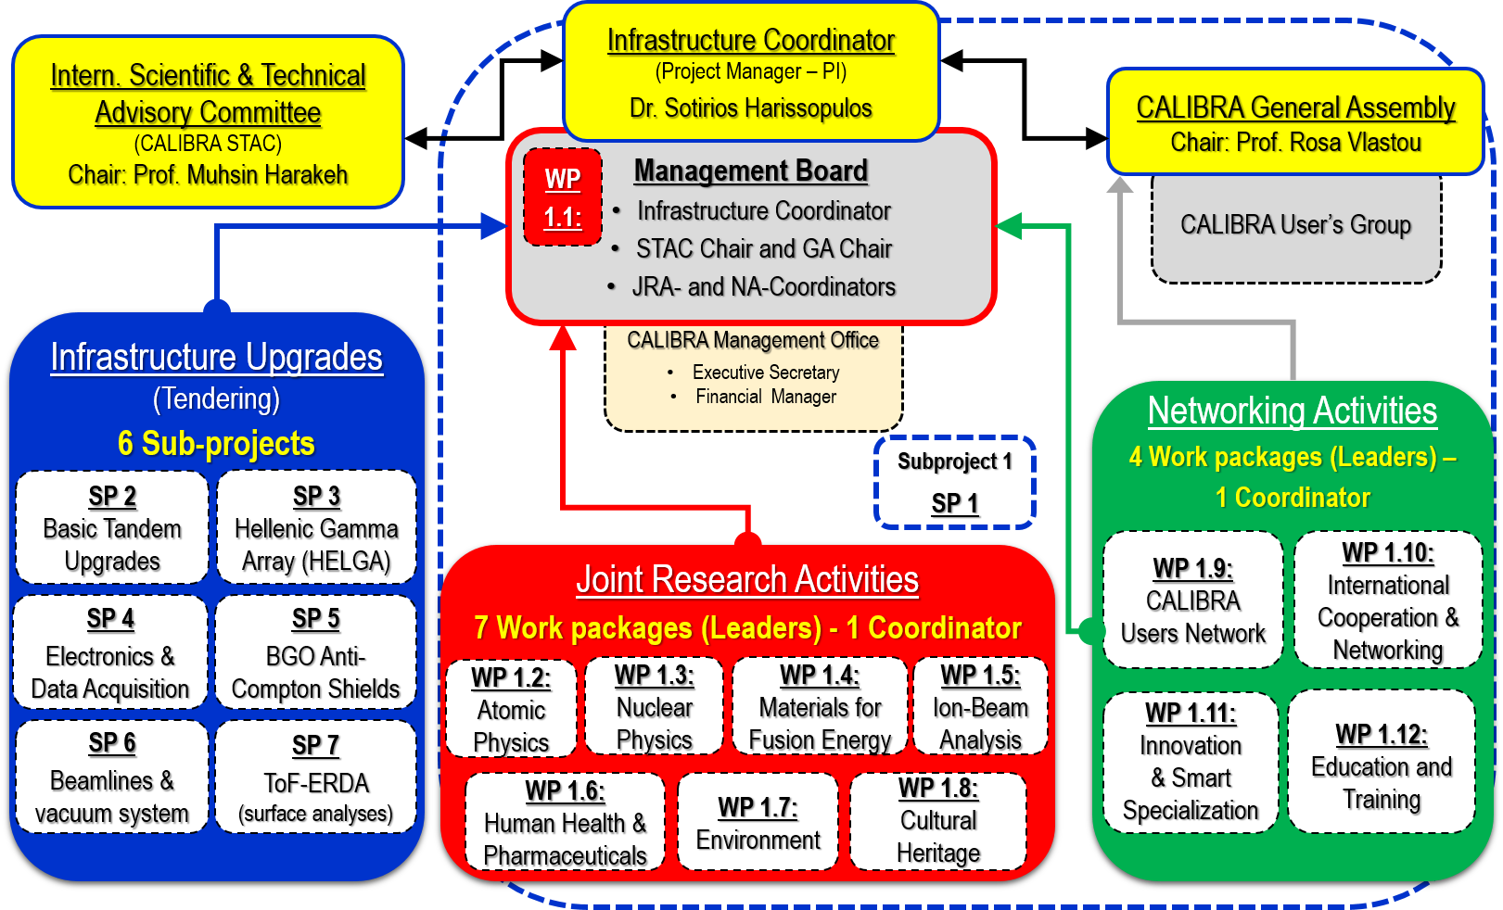
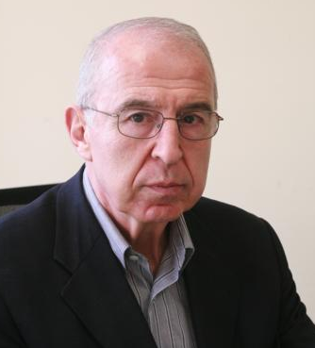
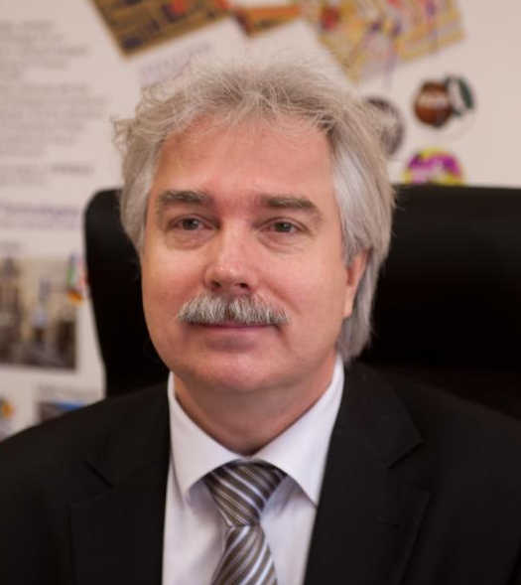
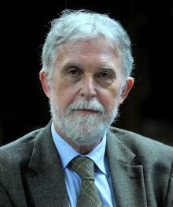
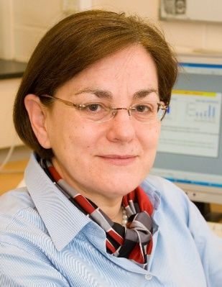
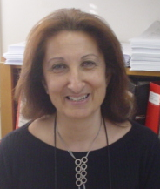
CALIBRA’s governance and structure
Prof. M. Harakeh
U. Groningen
Prof. M. Lewitowicz
GANIL/NuPECC
Prof. P.- A. Mando
U. Firenze
Prof. P. Batistoni
ENEA/Rome
Prof. R. Vlatou
NTU Athens
Sotiris Harissopulos, 2nd CALIBRA Meeting, Athens, 8-9 July 2019

Slide 13
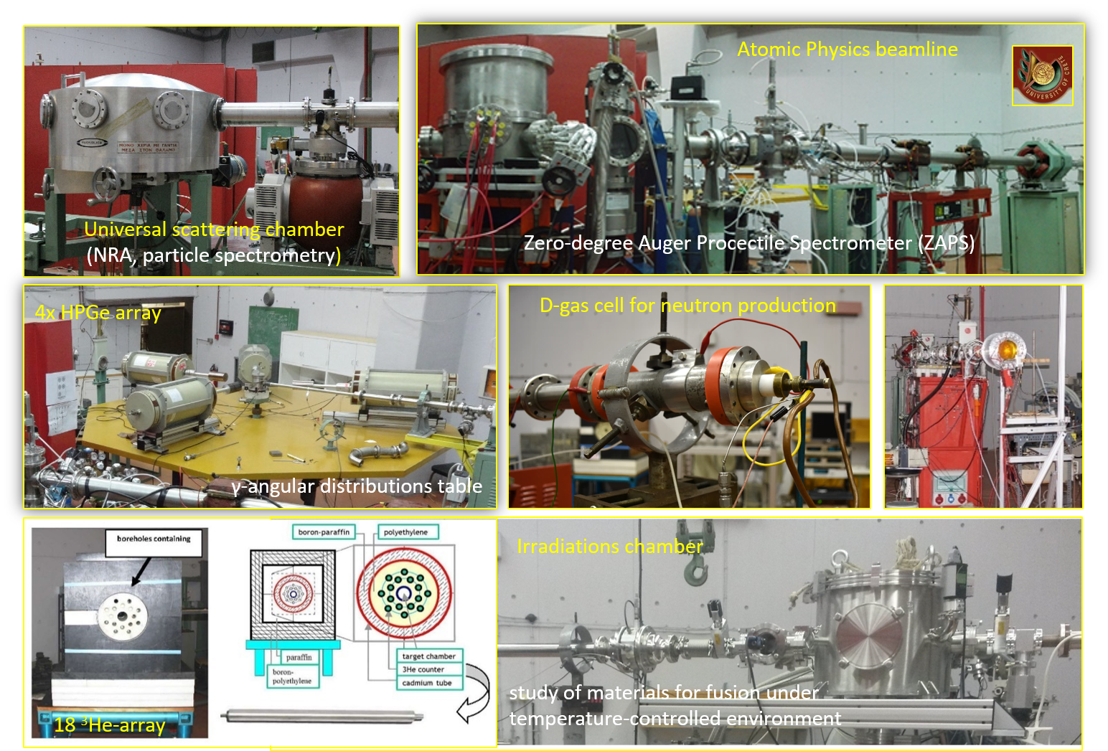
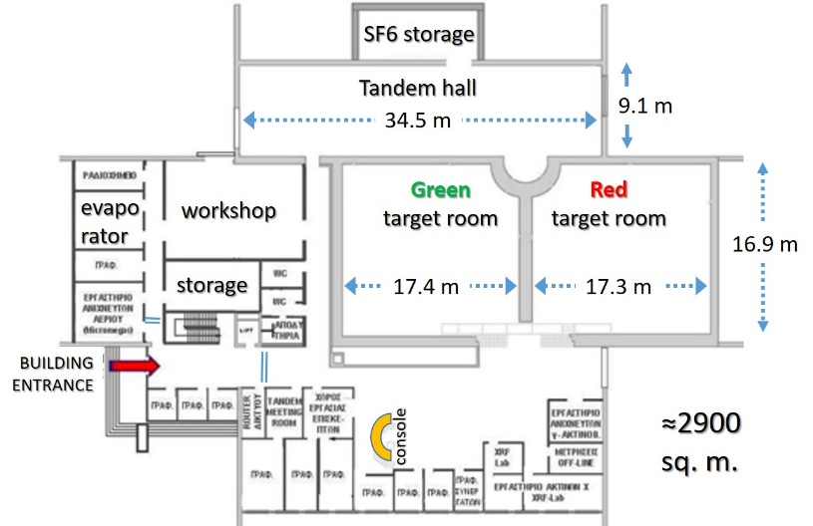
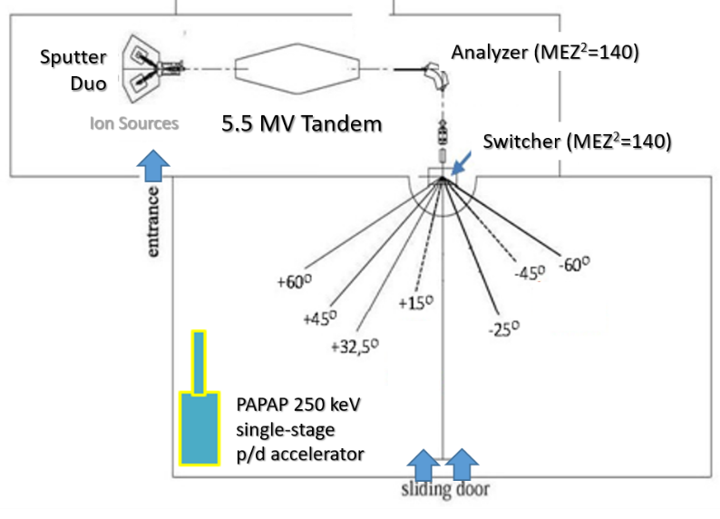
CALIBRA’s current infrastructure and planned upgrades
Tandem Lab at the ground floor
Green target
room
Tandem
Lab
layout
Red
target
room
Sotiris Harissopulos, 2nd CALIBRA Meeting, Athens, 8-9 July 2019

Slide 14
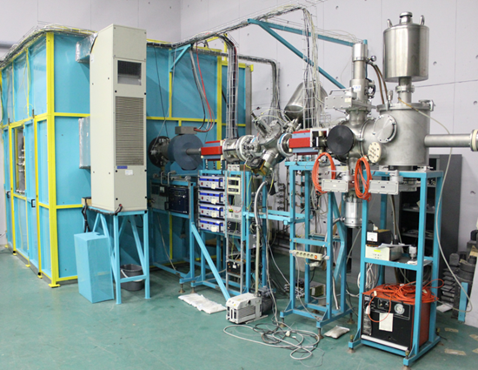
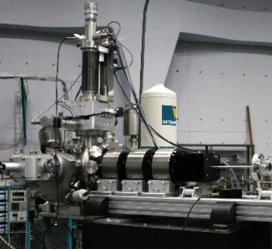
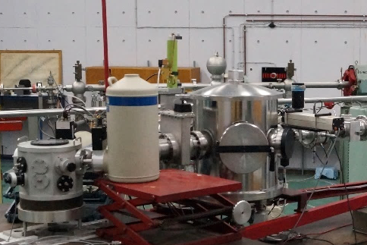
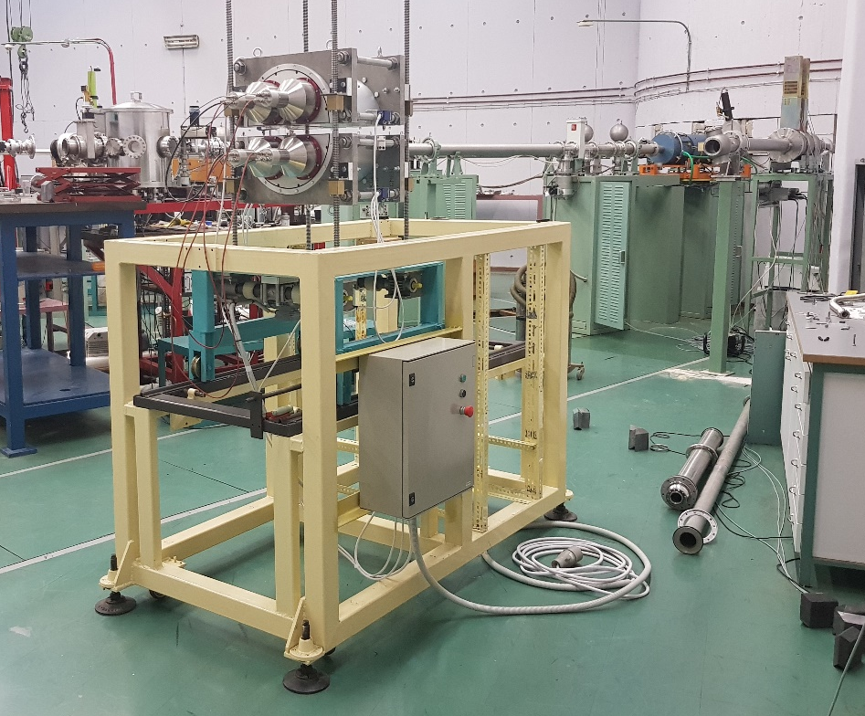
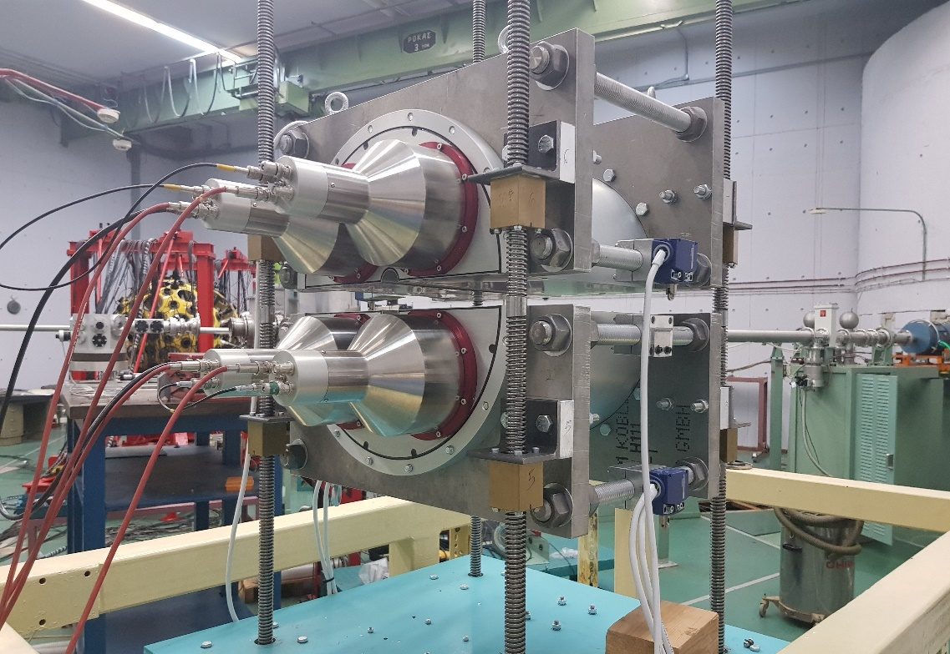
CALIBRA’s current infrastructure and planned upgrades
250 keV
PAPAP Accelerator
RBS & 4-axis
channeling chamber
Proton micro-beam
Sotiris Harissopulos, 2nd CALIBRA Meeting, Athens, 8-9 July 2019

Slide 15
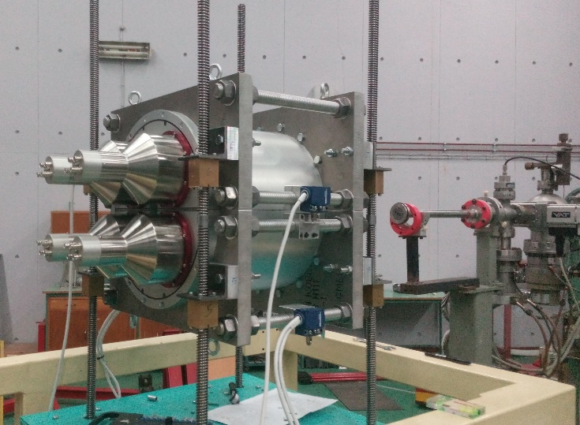
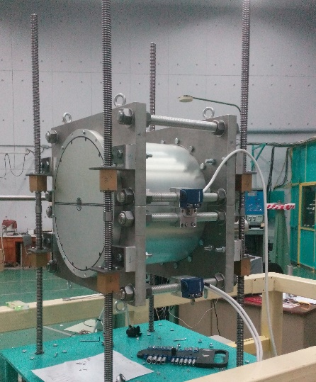
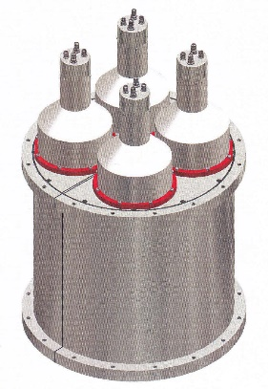
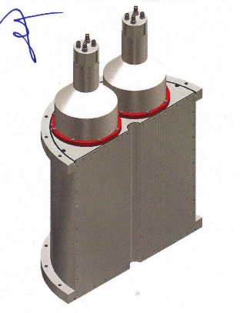
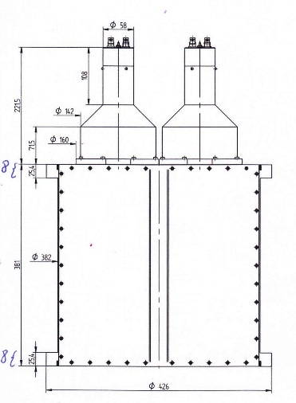
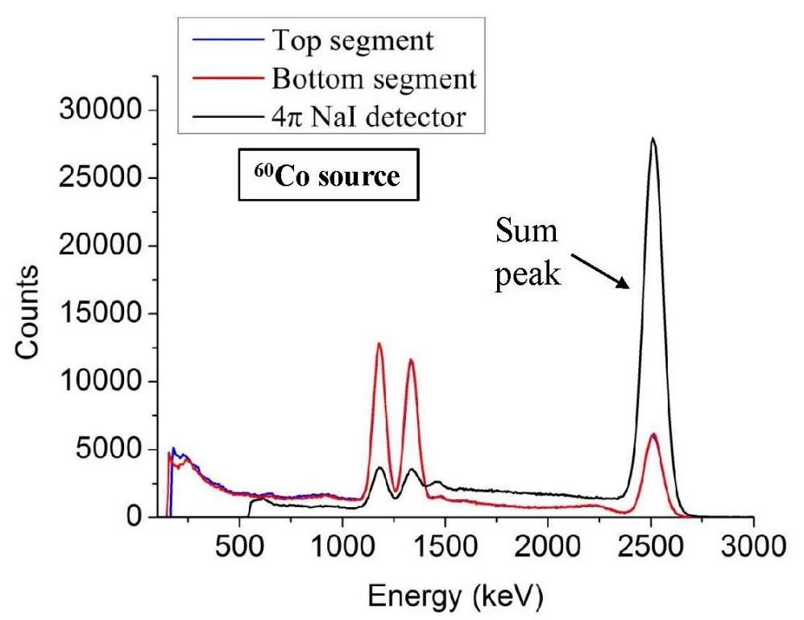
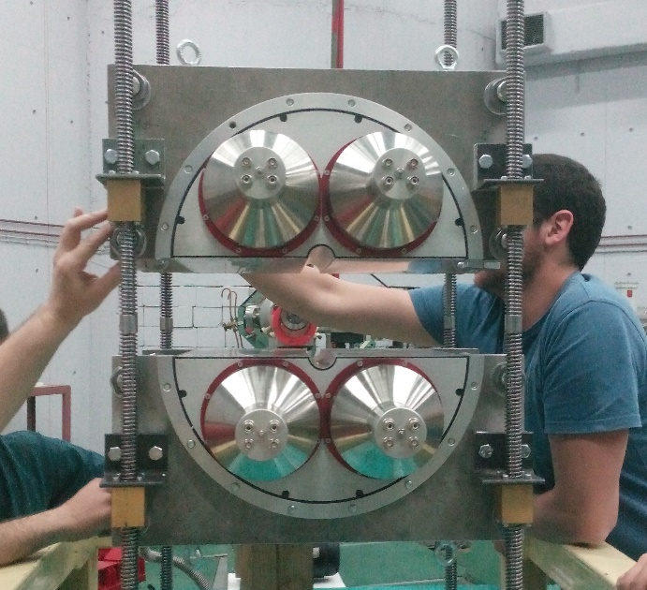
NeoPtolemos: A 14”x14” 4π γ-summing NaI(Tl) detector
beam
borehole
Ø 32 mm
efficiency ≈ 50%
(multiplicity = 2)
Sotiris Harissopulos, 2nd CALIBRA Meeting, Athens, 8-9 July 2019

Slide 16
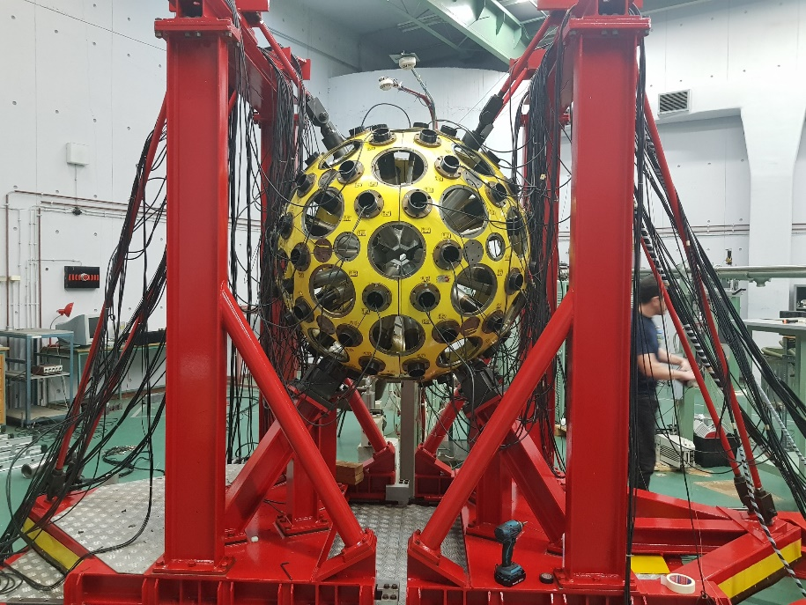
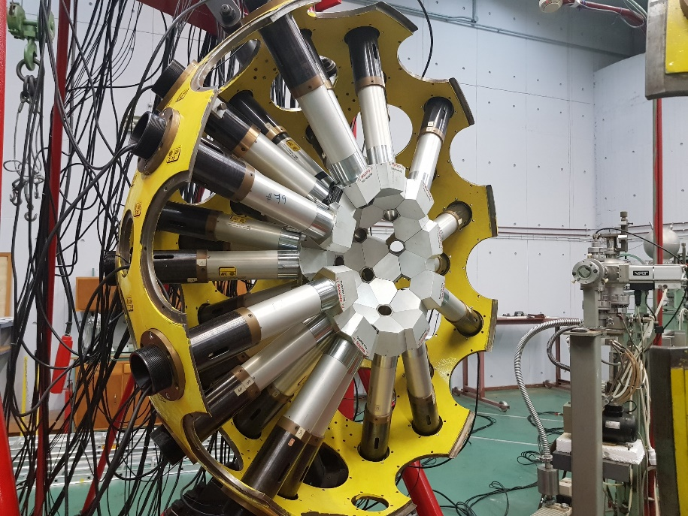
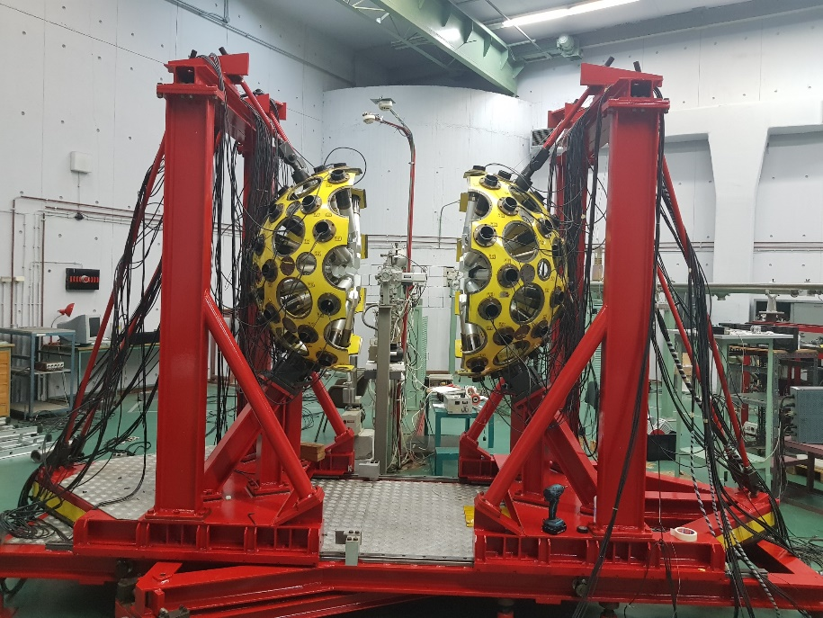
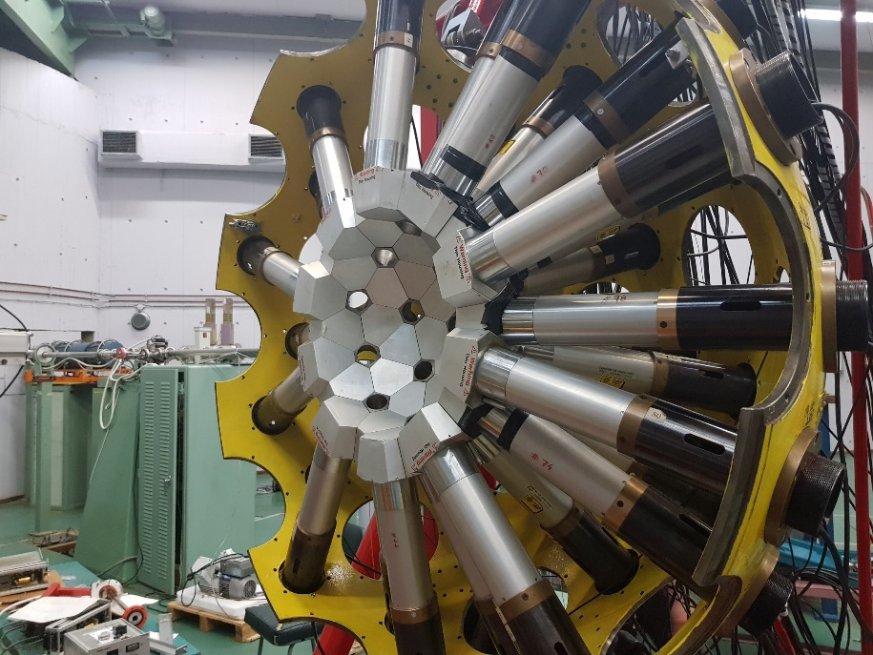
GASPAR: Gamma Spectrometer for Astrophysics and Reactions
Sotiris Harissopulos, 2nd CALIBRA Meeting, Athens, 8-9 July 2019

Slide 17



The draft technical design study for a cyclotron building at Demokritos
800 k€
Sotiris Harissopulos, 2nd CALIBRA Meeting, Athens, 8-9 July 2019

Slide 18


CALIBRA’s planned upgrades within Sub-Projects 2 and 6 (SP2, SP6)
5.5 MV Tandem Accelerator
Tandem hall
Sotiris Harissopulos, 2nd CALIBRA Meeting, Athens, 8-9 July 2019

Slide 19
CALIBRA’s planned upgrades within Sub-Project 2 (SP2)
5.5 MV Tandem Accelerator
Tandem hall
SP2 Upgrades (Tender in progress; 1.674 M€) expected to complete by end of 2020
1 | SNICS II Injection Beamline
2 | TORVIS Ion Source system
4 | Pelletron Charging System conversion
5 | Gas and foil strippers
6 | TPS6 voltage stabilizer system with GVM, corona probe and Controller
7 | AccelNET computer control system
8 | Beam Profile Monitor display system interfacing to AccelNET control system
9 | 5x Beam Profile Monitors (BPM80)
10 | New beam optics optimization
11 | Supervision of Installation and testing by technician at “Demokritos”
12 | Ocean freight and insurance
Sotiris Harissopulos, 2nd CALIBRA Meeting, Athens, 8-9 July 2019

Slide 20

CALIBRA’s planned upgrades within Sub-Project 2 (SP2)
5.5 MV Tandem Accelerator
Tandem hall
Sotiris Harissopulos, 2nd CALIBRA Meeting, Athens, 8-9 July 2019

Slide 21


CALIBRA’s planned upgrades: SP3, SP4, SP5, SP7
HFRI proposal: 2nd Evaluation Phase
Sotiris Harissopulos, 2nd CALIBRA Meeting, Athens, 8-9 July 2019

Slide 22

A very recent donation to CALIBRA: a 3 MV Tandetron AMS
Sotiris Harissopulos, 2nd CALIBRA Meeting, Athens, 8-9 July 2019

Slide 23




A very recent donation to CALIBRA: a 3 MV Tandetron AMS
Sotiris Harissopulos, 2nd CALIBRA Meeting, Athens, 8-9 July 2019

Slide 24
The 31 steps of a tendering procedure ….
Public-posting of the Decision for Budgetary Control of the Project, per expense category
Composition of the technical specifications by the Scientific Responsible
Fill in the Request for Supply (RfS) Form by the Institute Administration
Assignment of the RfS Form to the Procurement Dept., via “PAPYROS” (e-protocol platform)
Posting of the RfS Form at the National Electronic Public Procurement Platform (ΚΗΜΔΗΣ) by the Procurement Officer
If necessary: Update of the Project Application Form and approval by the Monitoring Committee. Estimated response time: 15 cd
In between:
Creation of electronic tenders at ΕΣΗΔΗΣ (Public Procurement platform)
maintained by the General Secretariat of Commerce
Preparation of the Tender Documents: Analytical terms and conditions,
Tender summary and the Decision for the Tender declaration.
Estimated time: 4-6 wd depending on workload
Uploading the Tender Documents at ΟΠΣ (e-monitoring information platform), maintained by the Monitoring Committee, for pre-approval.
Estimated response time: 15 cd
Comments by the Monitoring Committee regarding the Tender Documents
Uploading at ΟΠΣ the Revised Tender Documents. Estimated time: 1-2 wd
Approval of the Revised Tender Documents by the Monitoring Committee. Estimated time 7 wd
Assignment of the Decision for the Tender declaration at the President of Demokritos for signature. Posting at ΚΗΜΔΗΣ by the Procurement Officer.
Publication of the Tender Documents at Demokritos site, Press and at ΚΗΜΔΗΣ. If International Tender, it is published at the European Public Procurement platform (SIMAP) as well
While the tender is open for bids: public drawing amongst Demokritos researchers in order to create the Tender Evaluation Committee (3 members). Granting of electronic passwords to the members in order to handle ΕΣΗΔΗΣ for the electronic unsealing of proposals
Electronic unsealing and evaluation of the 1st phase – Participation Documents and Technical Proposals by the Tender Evaluation Committee at the date and time indicated in the Tender Documents
The results of the 1st phase are signed by the President of Demokritos and are publicly announced. Estimated time 2-5 wd.
Electronic notification of the results to the participating companies through the ΕΣΗΔΗΣ platform.
Waiting time for possible objections 10 cd
Electronic notification to the participating companies through the ΕΣΗΔΗΣ platform regarding the place and time of the unsealing of the 2nd phase – Financial offers. The place and time depend on the availability of the members of the Tender Evaluation Committee.
Electronic unsealing and evaluation of the 2nd phase – Financial Proposals by the Tender Evaluation Committee
The results of the 2nd phase are signed by the President of Demokritos and are publicly announced. Estimated time 2-5 wd.
Electronic notification of the results to the participating companies through the ΕΣΗΔΗΣ platform. Invitation to the pre-awarded tenderer to submit the award supporting documents
Waiting time for possible objections 10 cd
Electronic submission and checking of the award supporting documents by the tender evaluation committee
The results of the Tender are signed by the President of Demokritos and are NOT publicly announced.
Uploading of the documents of the Tendering procedure at ΟΠΣ along with the draft contract for pre-approval by the Monitoring Committee. Estimated time until the answer: 15 cd
Comments by the Monitoring Committee regarding the Draft Contract, if any. Uploading at ΟΠΣ the Revised Draft Contract. Estimated time: 1-2 wd
Approval of Contract Assignment by the Monitoring Committee. Estimated response time: 7wd
Public announcement of the tender results and electronic notification to tenderers, via ΕΣΗΔΗΣ.
Waiting time for possible objections: 10 cd
Contract Award.
at least 100 days are required
Sotiris Harissopulos, 2nd CALIBRA Meeting, Athens, 8-9 July 2019

Slide 25
Work Package 1.1 (WP 1.1)
Coordination - Management - Promotion of the CALIBRA Research Infrastructure
Delive rable | Title | project month
D1.1.1 | Report on the establishment of the International Scientific and Technical Advisory Committee (CALIBRA ISTAC) and the kick-off of the CALIBRA project | 3
D1.1.2 | Report on the establishment of CALIBRA’s website | 4
D1.1.3 | Action plan for outreach activities and communication days for the public | 9
D1.1.4 | Minutes of the International Scientific and Technical Advisory Committee meetings | annually
D1.1.5 | Report on the recruitment of new scientific and technical personnel | 12
D1.1.6 | Report on the dissemination of scientific results | 18 _and_ 36
D1.1.7 | Report on activities relevant to Smart Specialization | 36
http://www.inp.demokritos.gr/calibra/
http://project-calibra-gr.stackstaging.com/v1/
http://tandeminp-gr.stackstaging.com/
Sotiris Harissopulos, 2nd CALIBRA Meeting, Athens, 8-9 July 2019

Slide 26
Work Package 1.3 (WP 1.3)
Nuclear Structure, Astrophysics and Reactions – NuSTAR
Sotiris Harissopulos, 2nd CALIBRA Meeting, Athens, 8-9 July 2019

Slide 27
Work Package 1.9 (WP 1.9):
Network of CALIBRA Users
Work Package 1.10 (WP 1.10):
International Collaboration and Promotion of CALIBRA
Work Package 1.11 (WP 1.11):
Technology Transfer and Smart Specialization
Work Package 1.12 (WP 1.12):
InternationalTechnology Educational and Training Activities
Sotiris Harissopulos, 2nd CALIBRA Meeting, Athens, 8-9 July 2019

Slide 28
Sotiris Harissopulos, 2nd CALIBRA Meeting, Athens, 8-9 July 2019

