Slide 1

National Centre for Scientific Research “Demokritos”
Institute of Nuclear and Particle Physics
INPP ISAC meeting, 21-22/11/2019
Director’s report

Slide 2
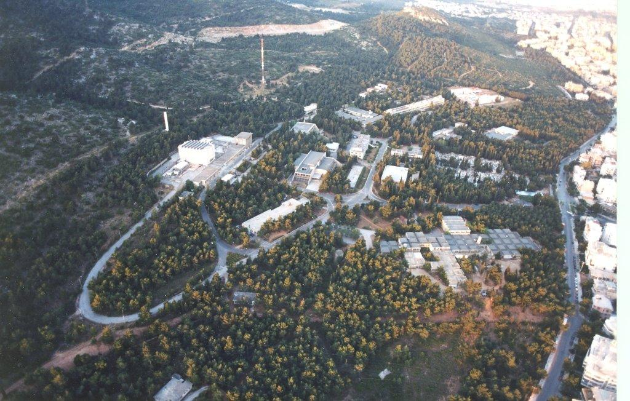
C. Markou, INPP ISAC meeting, 21-22/11/2019, Director’s report

Slide 3
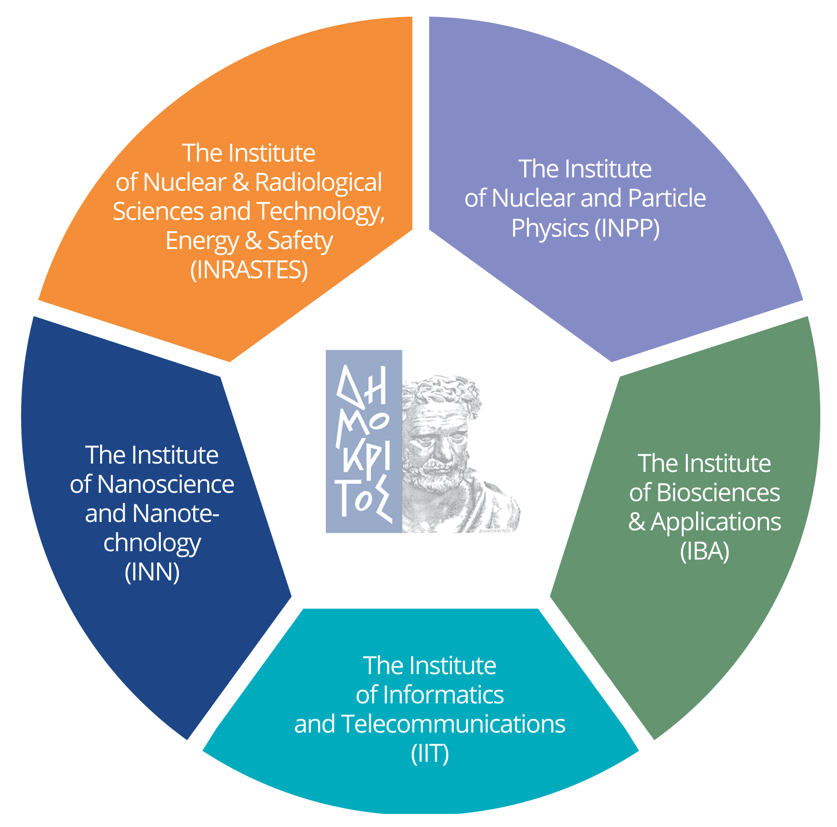

The Institutes
C. Markou, INPP ISAC meeting, 21-22/11/2019, Director’s report

Slide 4
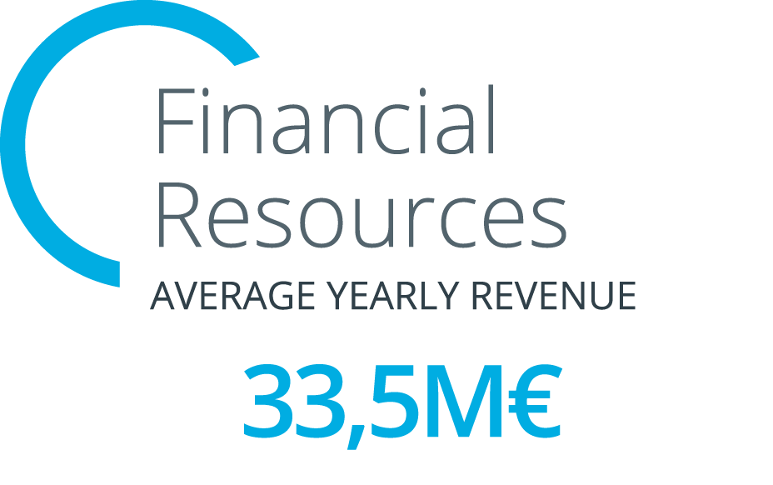
2018
37.1 mil. Euros
From GR state:
13 mil. Euros

Slide 5


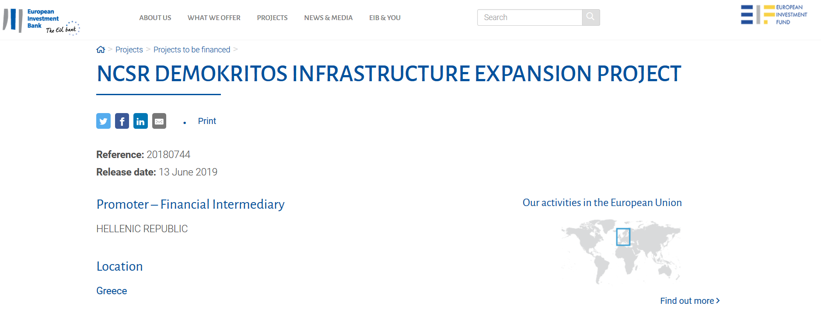
BUDGET: 50.3 million Euros

Slide 6
National Research Infrastructures
GSRT Administered Program for User- Accessible Research Facilities (ESFRI – related)

Slide 7
INNOVATION-EL
Nanotechnology, Advanced Materials and Micro/Nanoelectronics
OPENSCREEN-GR
Chemical Biology and Target-Based Screening for Health, Agriculture and the Environment
CALIBRA
Cluster of Accelerator Laboratories for Ion-beam Research & Applications
APOLLONIS Digital Arts, Humanities and Language Research
PROMETHEUS Integrated Energy Chain
INSPIRED Structural Biology
PANACEA Climate Change
ENIRRIST Shipping Transport and Logistics
deTAnet High-Energy Physics Detectors
BIOIMAGING Visualizing and Monitoring Fundamental Biological Processes

Slide 8
Organization chart
C. Markou, INPP ISAC meeting, 21-22/11/2019, Director’s report

Slide 9
Personnel
In 2019:
18 tenured / tenure-track researchers
9 administration / technicians / support personnel (permanent or indefinite duration contracts)
25 under fixed term contracts
2018: 1 tenure-track researcher (M. Axiotis, Nuclear Physics)
2019 : 1 tenure-track researcher (V. Kouskoura, Experimental HEP)
1 tenure track scientist (I. Kazas, electronics engineer, HEP)
Pending 1 researcher position in APP; 1 more researcher position in 2020.
C. Markou, INPP ISAC meeting, 21-22/11/2019, Director’s report

Slide 10
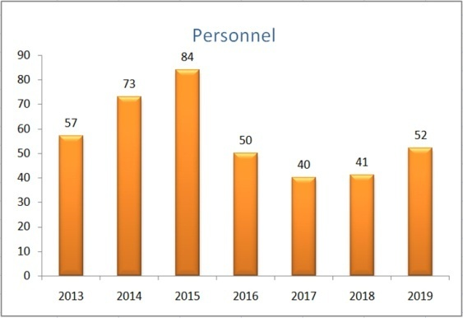
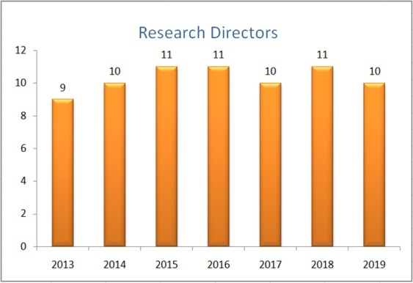
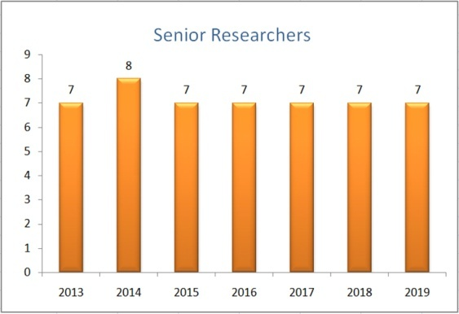
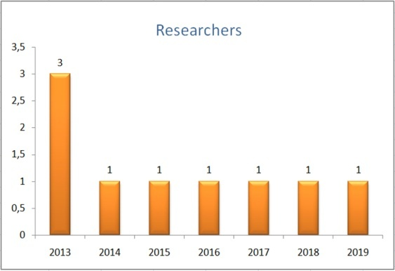
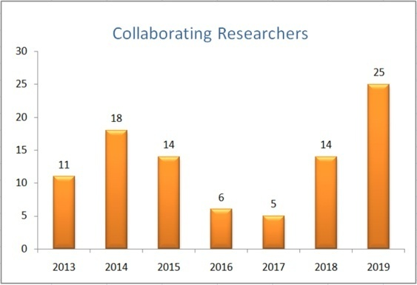
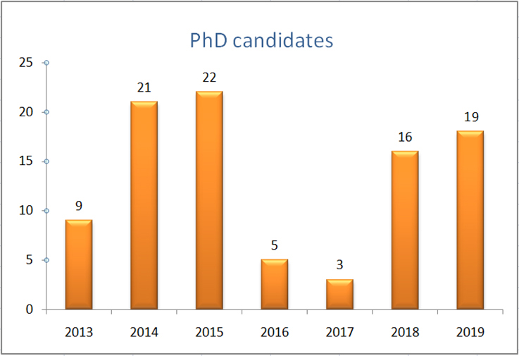
Evolution of personnel
C. Markou, INPP ISAC meeting, 21-22/11/2019, Director’s report

Slide 11
Active funded programs
Title | Principal Investigator | Starting date | Finishing date | Budget |  | Title | Principal Investigator | Starting date | Finishing date | Budget
Non destructive analyses with x-rays | Andreas Karydas | 1/4/1998 | 31/5/2022 | 50,000.00 € |  | Analytic applications using synchrotron techniques | Andreas Karydas | 10/3/2017 | 9/3/2020 | 15,000.00 €
Support for INPP | INPP Director | 28/7/1998 | 27/1/2022 | 25,000.00 € |  | Highly Miniaturized ASIC Radiation Detector | Dimitrios Loukas | 7/3/2017 | 25/5/2020 | 40,987.00 €
Detection devices systems | Dimitrios Loukas | 1/12/2002 | 31/12/2021 | 35.000,00 € |  | ESSnuSB (H2020) | George Fanourakis | 1/1/2018 | 31/12/2021 | 64,953.00 €
Techologies for education and development | Theodoros Geralis | 11/12/2002 | 21/12/2021 | 50.000,00 € |  | ORASY | INPP Director | 1/4/2018 | 31/12/2020 | 282,000.00 €
Particle Phenomenology | Kostas Papadopoulos | 1/3/2007 | 28/2/2022 | 90,000.00 € |  | CALIBRA | Sotirios Harissopulos | 1/1/2017 | 31/12/2021 | 3,422,000.00 €
Fusion – Radiation studies | Sotirios Harissopulos | 1/12/2008 | 31/12/2020 | 50,000.00 € |  | RENA II | George Fanourakis | 1/6/2018 | 31/2/2020 | 55,870.00 €
KM3NeT support activities | Christos Markou | 1/1/2013 | 31/12/2021 | 59,000.00 € |  | Holographic Applications of Quantum Entanglement (HAPPEN) | Georgios Pastras | 2/11/2018 | 1/11/2020 | 182.598,94 €
Irradiation studies | Anastasios Lagoyannis | 1/7/2013 | 5/7/2019 | 6.000,00 € |  | Development and Implementation of the MIXMAX Technology | George Savvidy | 1/2/2019 | 31/12/2019 | 31.000,00 €
LIBRA | Sotirios Harissopulos | 1/9/2014 | 31/8/2020 | 300,000. 00 € |  | Detector Development and Technologies for High Energy Physics (DeTANet) | Theodoros Geralis | 11/2/2019 | 10/2/2022 | 125.962,67 €
ENSAR 2 — H2020 | Sotirios Harissopulos | 1/3/2016 | 29/2/2020 | 60,000.00 € |  | GEANT4-Based particle simulation facility for future science mission support | Anastasios Lagoyannis | 1/4/2019 | 30/4/2022 | 120.935,00
ΚΜ3ΝΕΤ 2.0 | Christos Markou | 1/1/2017 | 31/12/2019 | 487,500.00 €
C. Markou, INPP ISAC meeting, 21-22/11/2019, Director’s report

Slide 12
Active funded programs
Title | Principal Investigator | Starting date | Finishing date | Budget |  | Title | Principal Investigator | Starting date | Finishing date | Budget
Non destructive analyses with x-rays | Andreas Karydas | 1/4/1998 | 31/5/2022 | 50,000.00 € |  | Analytic applications using synchrotron techniques | Andreas Karydas | 10/3/2017 | 9/3/2020 | 15,000.00 €
Support for INPP | INPP Director | 28/7/1998 | 27/1/2022 | 25,000.00 € |  | Highly Miniaturized ASIC Radiation Detector | Dimitrios Loukas | 7/3/2017 | 25/5/2020 | 40,987.00 €
Detection devices systems | Dimitrios Loukas | 1/12/2002 | 31/12/2021 | 35.000,00 € |  | ESSnuSB (H2020) | George Fanourakis | 1/1/2018 | 31/12/2021 | 64,953.00 €
Techologies for education and development | Theodoros Geralis | 11/12/2002 | 21/12/2021 | 50.000,00 € | 9 | ORASY | INPP Director | 1/4/2018 | 31/12/2020 | 282,000.00 €
Particle Phenomenology | Kostas Papadopoulos | 1/3/2007 | 28/2/2022 | 90,000.00 € | 7 | CALIBRA | Sotirios Harissopulos | 1/1/2017 | 31/12/2021 | 3,422,000.00 €
Fusion – Radiation studies | Sotirios Harissopulos | 1/12/2008 | 31/12/2020 | 50,000.00 € |  | RENA II | George Fanourakis | 1/6/2018 | 31/2/2020 | 55,870.00 €
KM3NeT support activities | Christos Markou | 1/1/2013 | 31/12/2021 | 59,000.00 € | 3 | Holographic Applications of Quantum Entanglement (HAPPEN) | Georgios Pastras | 2/11/2018 | 1/11/2020 | 182.598,94 €
Irradiation studies | Anastasios Lagoyannis | 1/7/2013 | 5/7/2019 | 6.000,00 € | 1 | Development and Implementation of the MIXMAX Technology | George Savvidy | 1/2/2019 | 31/12/2019 | 31.000,00 €
LIBRA | Sotirios Harissopulos | 1/9/2014 | 31/8/2020 | 300,000. 00 € |  | Detector Development and Technologies for High Energy Physics (DeTANet) | Theodoros Geralis | 11/2/2019 | 10/2/2022 | 125.962,67 €
ENSAR 2 — H2020 | Sotirios Harissopulos | 1/3/2016 | 29/2/2020 | 60,000.00 € | 2 | GEANT4-Based particle simulation facility for future science mission support | Anastasios Lagoyannis | 1/4/2019 | 30/4/2022 | 120.935,00
ΚΜ3ΝΕΤ 2.0 | Christos Markou | 1/1/2017 | 31/12/2019 | 487,500.00 € | 5
C. Markou, INPP ISAC meeting, 21-22/11/2019, Director’s report

Slide 13
Pending funding decisions – Funding opportunities
Long delays in the process of final decisions in National funding initiatives:
ELIDEK : ~2 years delay of the final decisions on large scale infrastructures.
3 calls are pending.
Other National calls : ~ more than 1.5 year delay.
H2020 and Horizon Europe do not target on basic science.
Research paradigm in Greece may change.
Nevertheless, several proposals in the pipeline for assessment.
C. Markou, INPP ISAC meeting, 21-22/11/2019, Director’s report

Slide 14
Our biggest asset is the young people who are willing to stay and work with us.
We hope to be able to keep them, and ISAC can be a significant enabler for this.
C. Markou, INPP ISAC meeting, 21-22/11/2019, Director’s report

