Slide 1

Nuclear Physics and Applications
presented by Dr. A. Lagoyannis
on behalf of the NPA Group

Slide 2

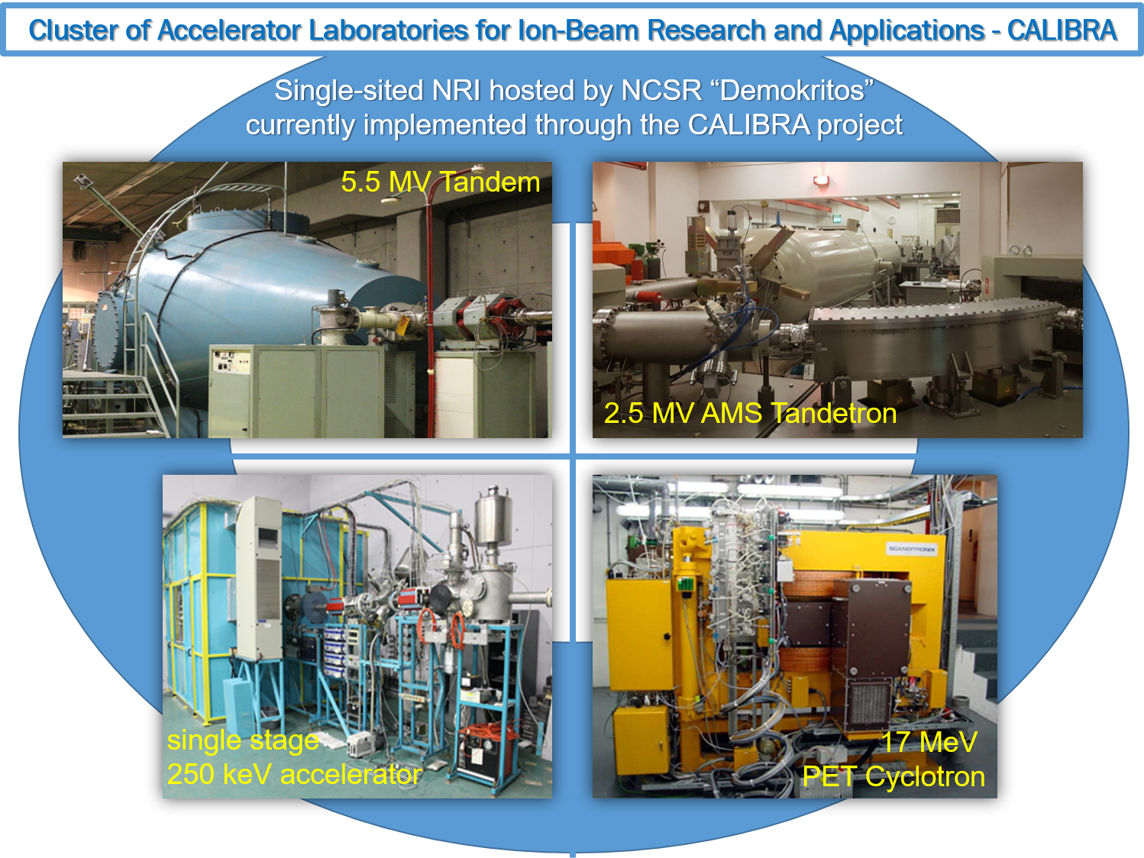

CALIBRA

Slide 3
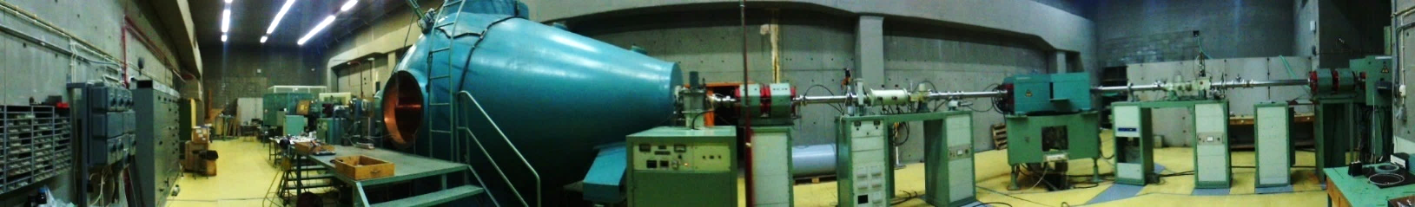
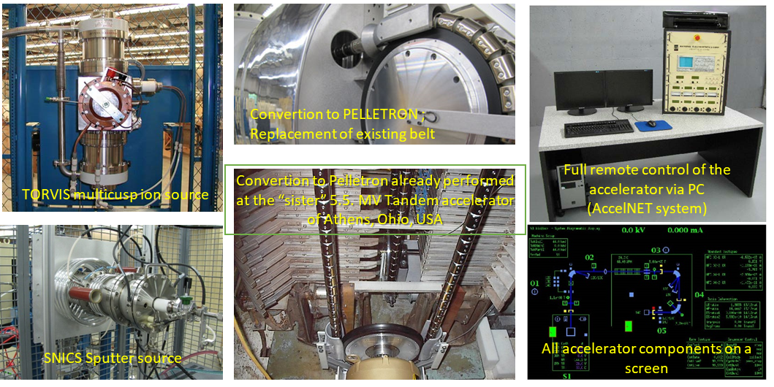
CALIBRA
5.5 MV Tandem Accelerator

Slide 4
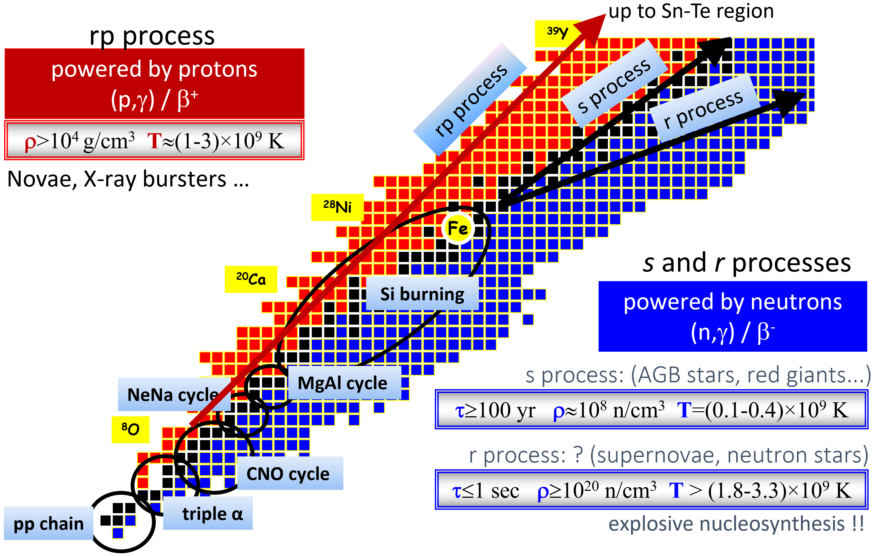
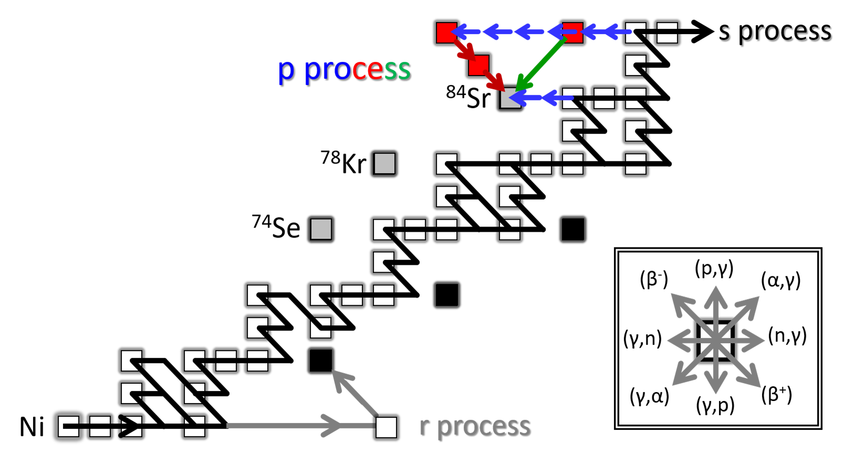
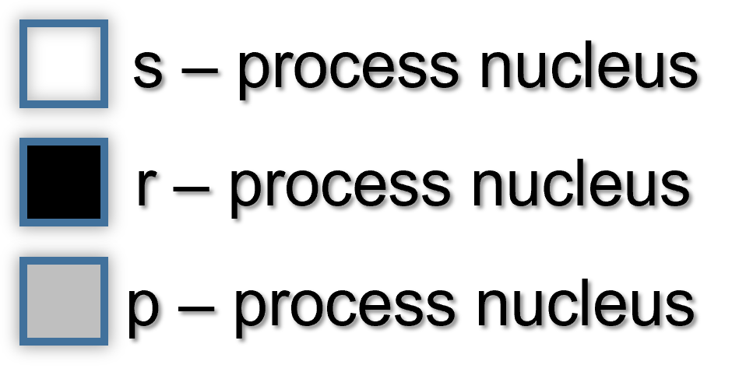
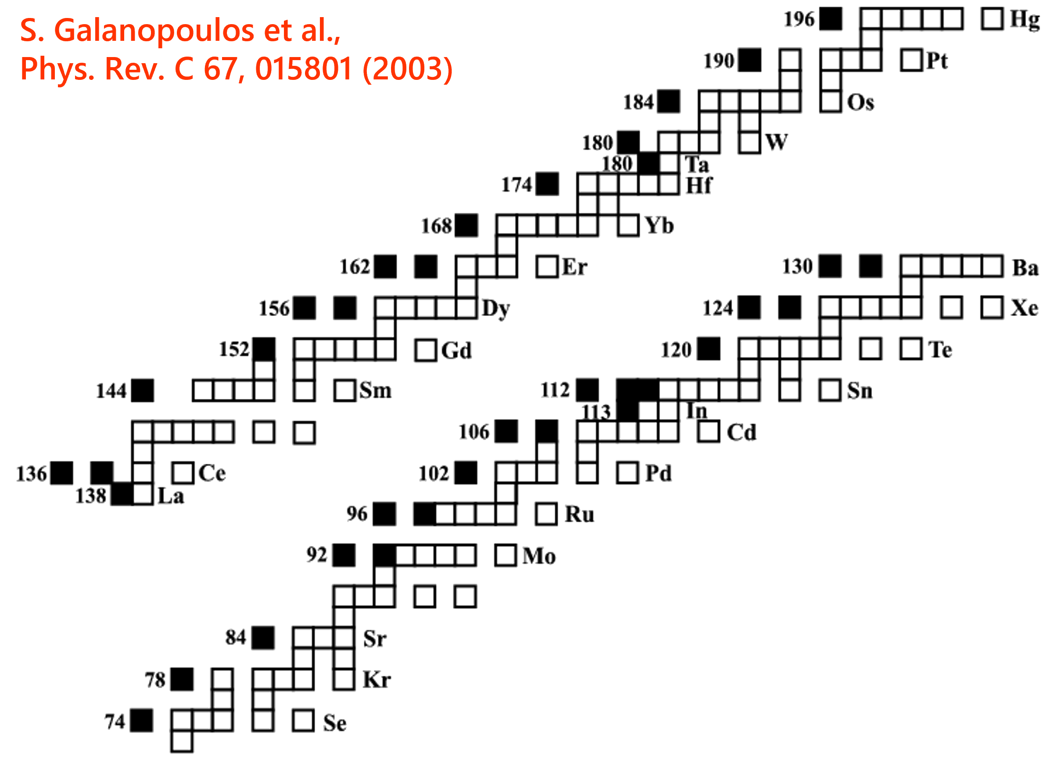
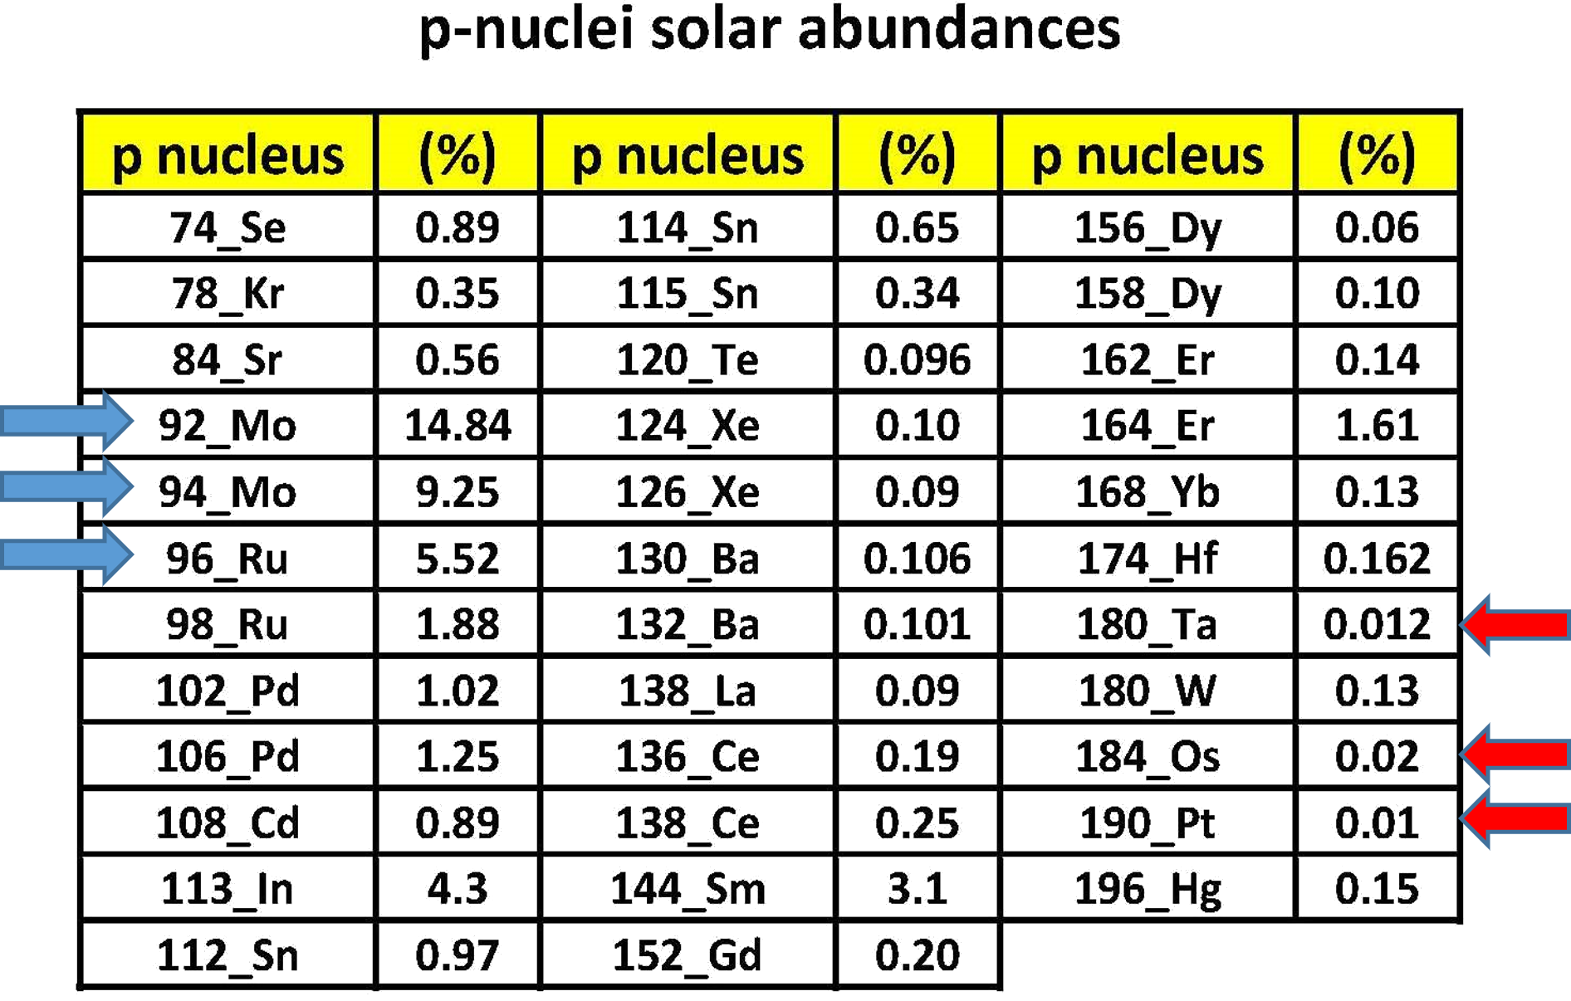
Nuclear Astrophysics (p process: the astrophysical point-of-view)
burning cycles and nucleosynthesis across the table of isotopes
p nuclei and their abundances are signatures of the creation of our solar system
p nuclei : 35 proton rich isotopes
Solar system p-nuclei abundances

Slide 5
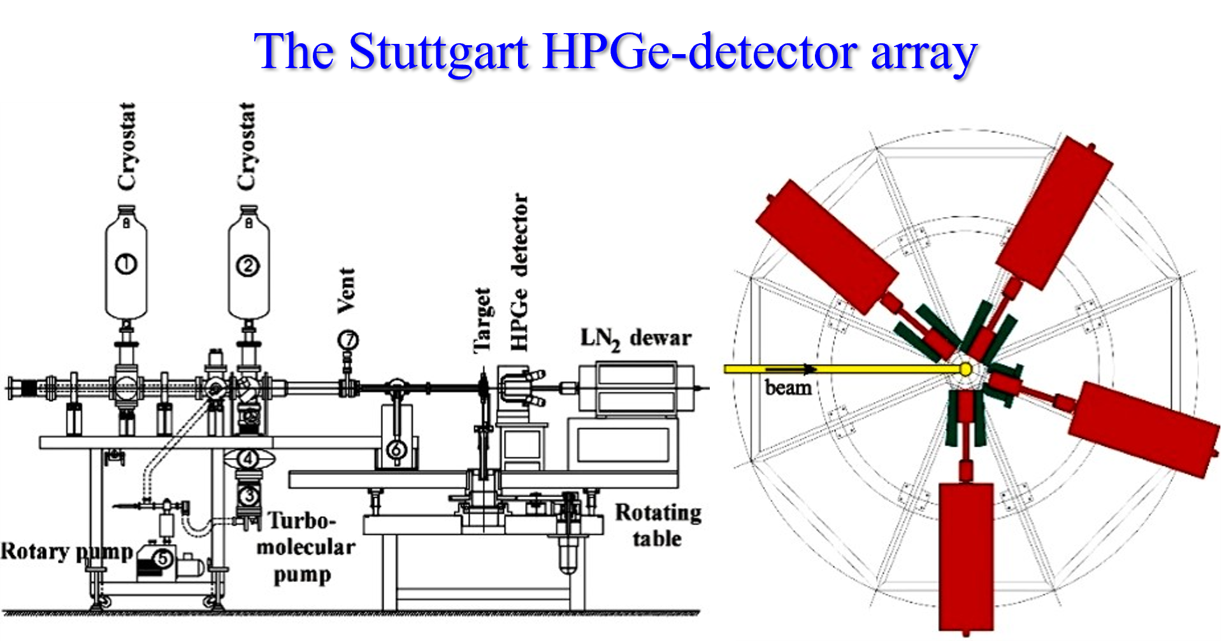
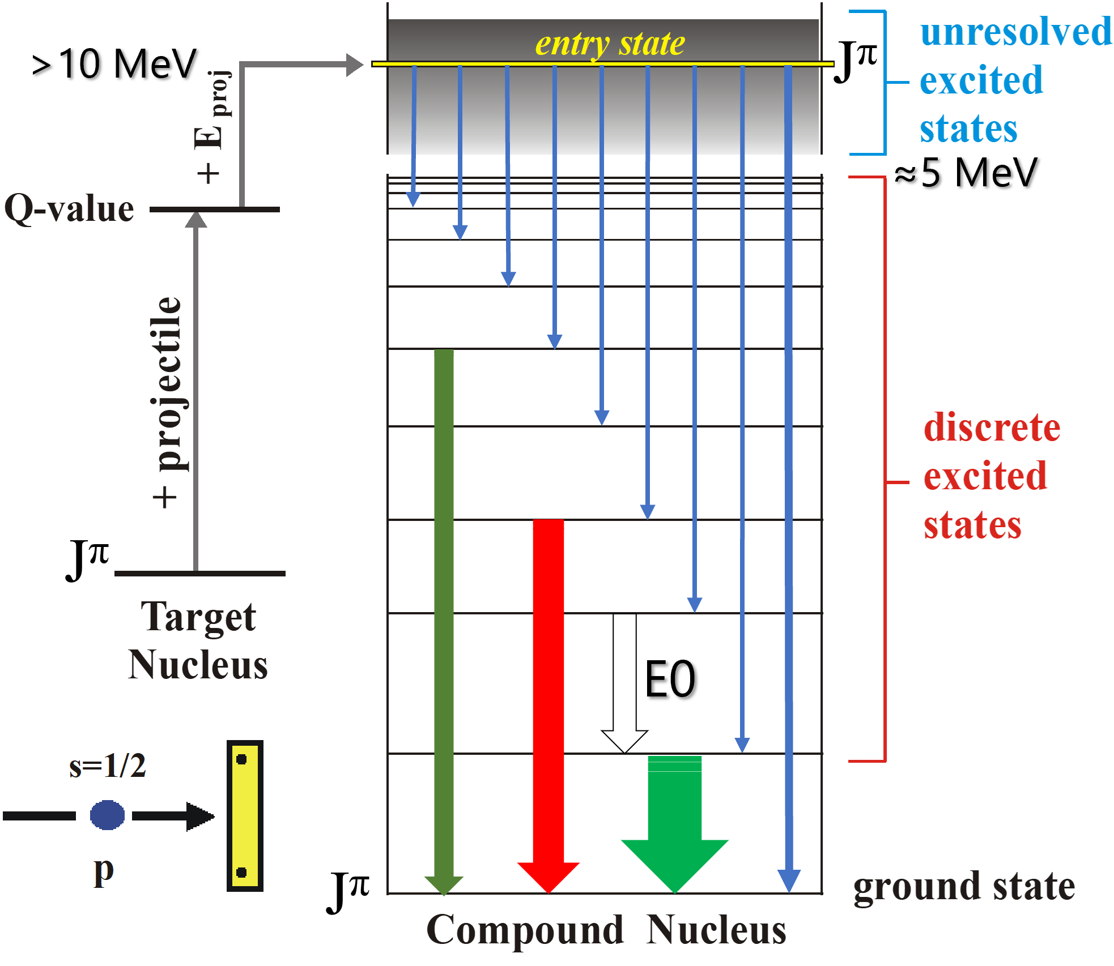
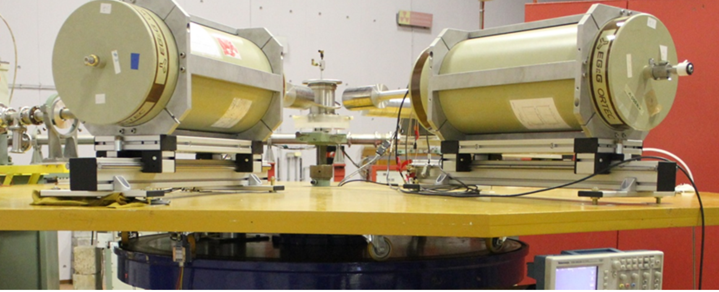
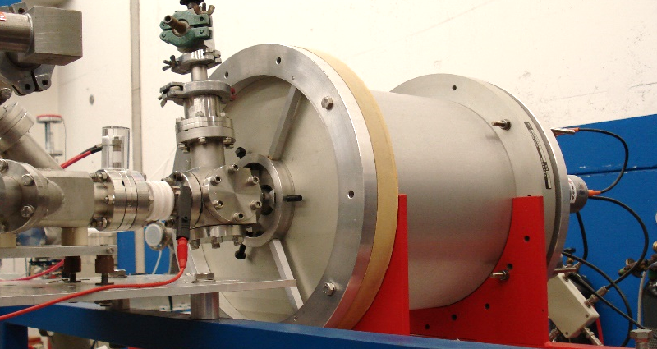
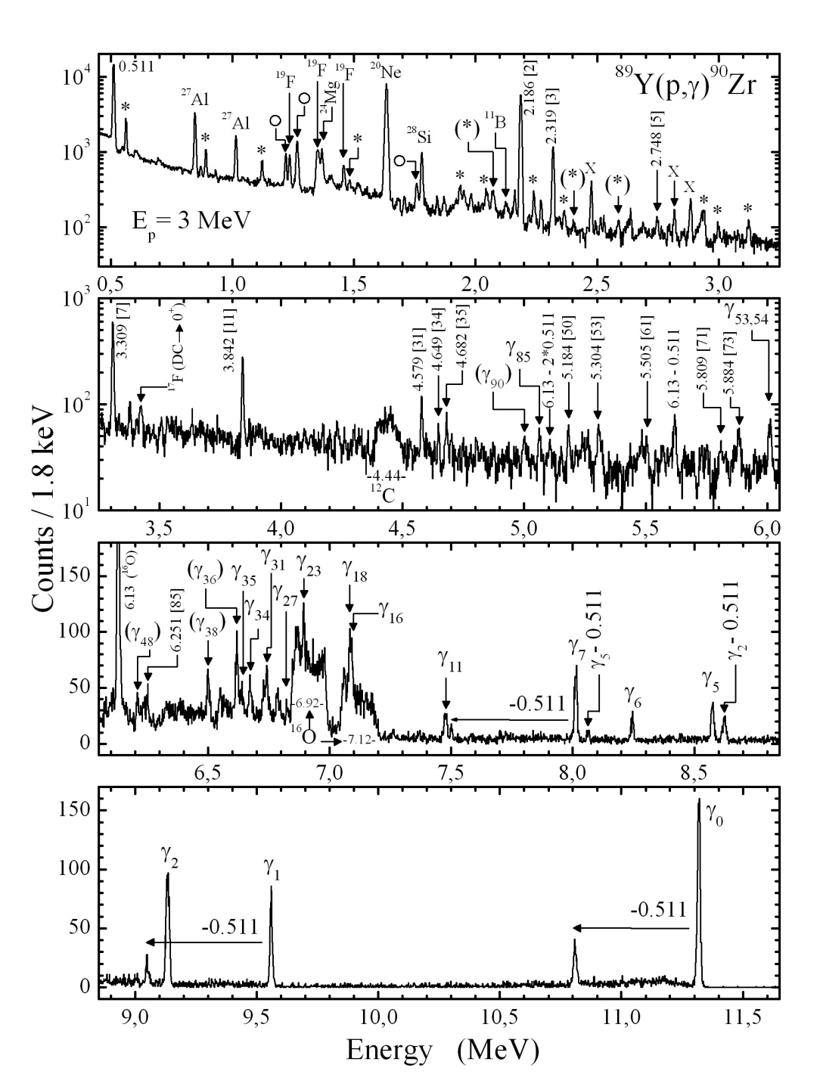
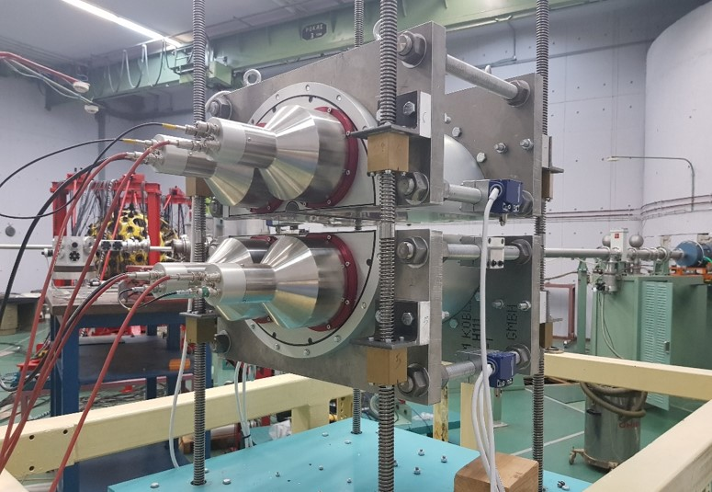
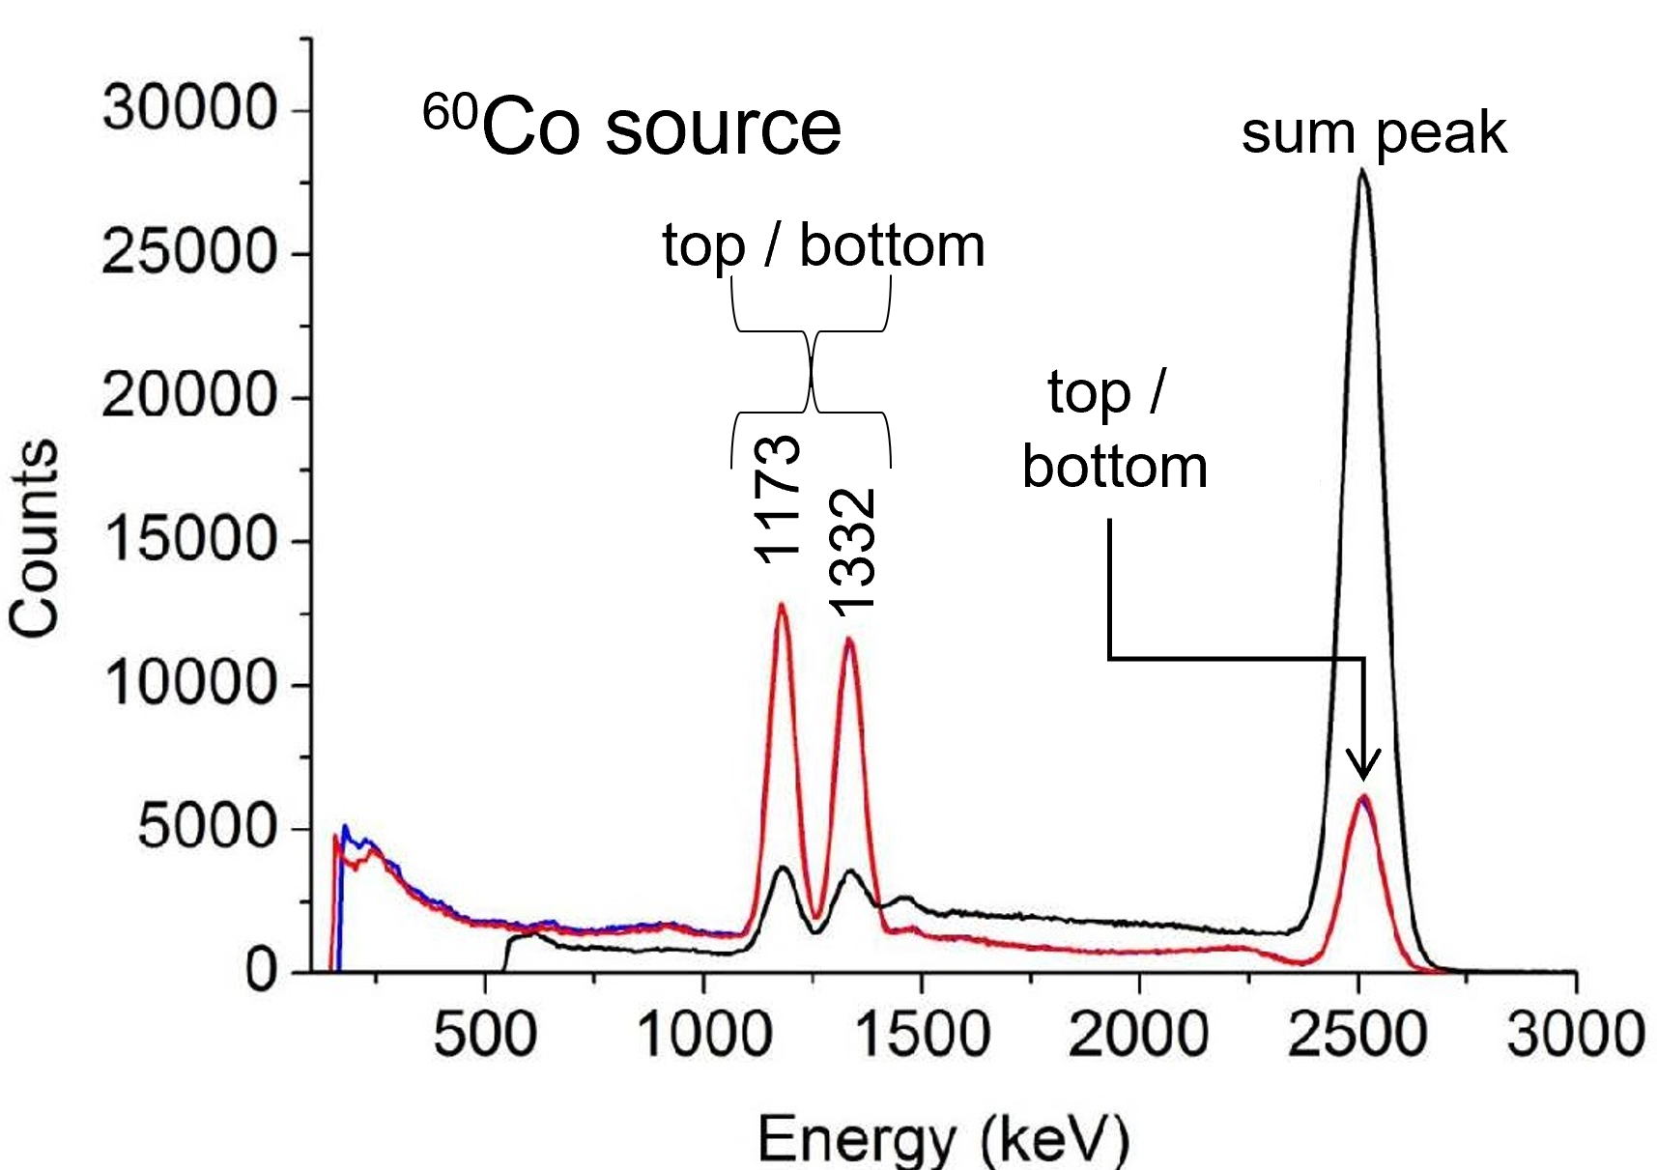
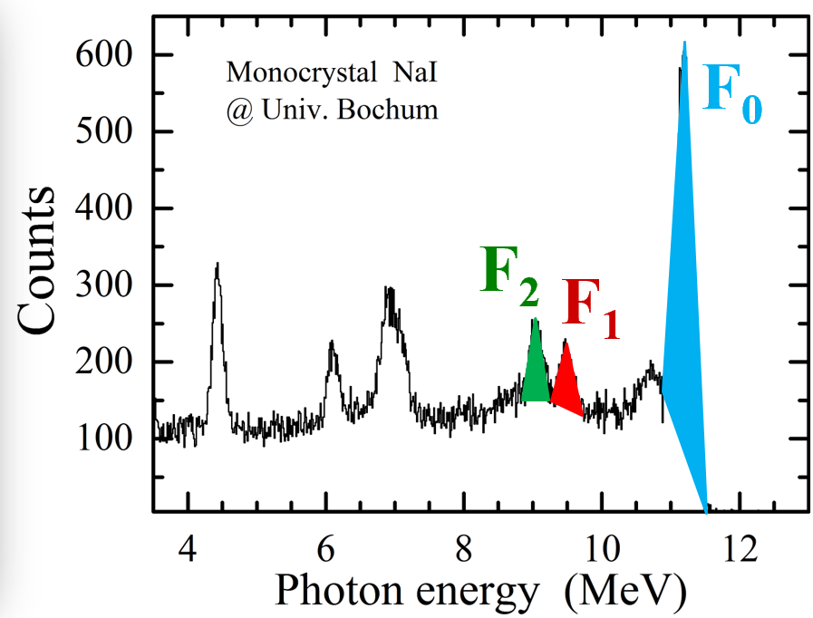
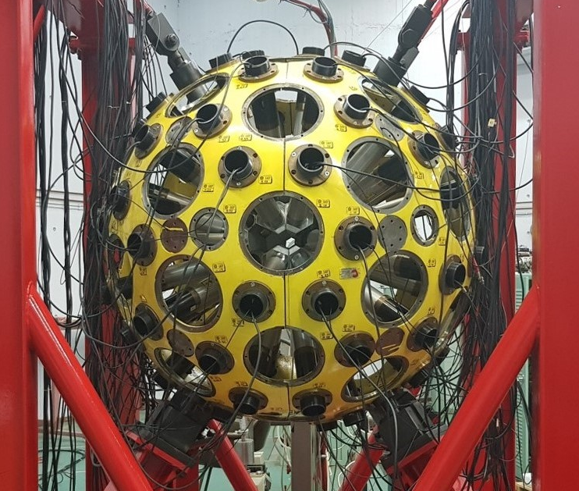
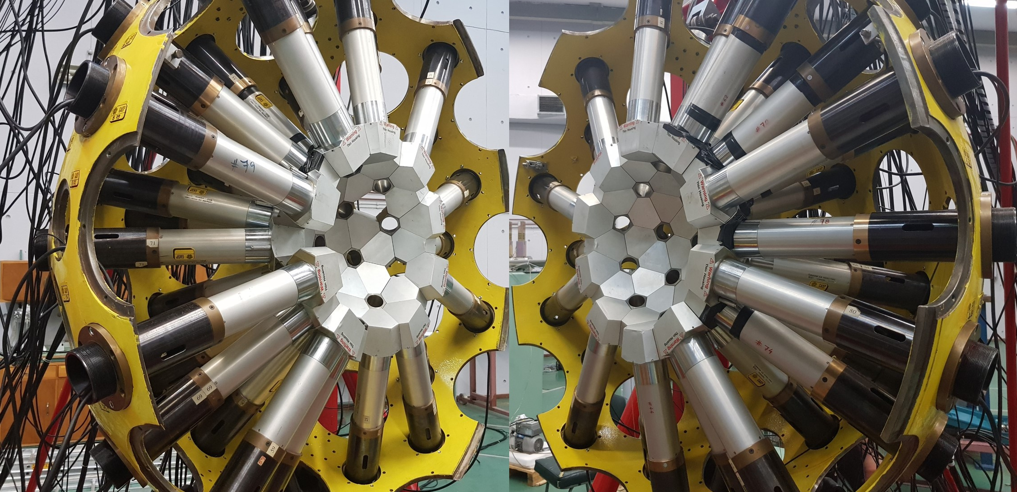
Nuclear Astrophysics (σ-measurements: our methods & tools: 1/2)
details in review paper by: Sotirios V Harissopulos, Eur. Phys. J. Plus 133, 332 (2018) https://doi.org/10.1140/epjp/i2018-12185-8
1) γ-angular distribution measurements
HPGe array now shared between Demokritos – U. Cologne – TU Darmstadt
CALIBRA: acquired 3x new HPGe (80%) with BGO Anti-Compton shields
2) 4π γ-summing technique
Developed by our Group: A. Spyrou et al., Phys. Rev. C 76, 015802 (2007); http://dx.doi.org/10.1103/PhysRevC.76.015802
12”x12” NaI Monocrystal
14”x14” 2-fold segmented NaI
Demokritos (LIBRA project)
RU Bochum
⁸⁹Y(p,γ)⁹⁰Zr
⁸⁹Y(p,γ)⁹⁰Zr
GASPAR Ball (80x BGO Crystals) loaned by INFN/LNL Italy

Slide 6
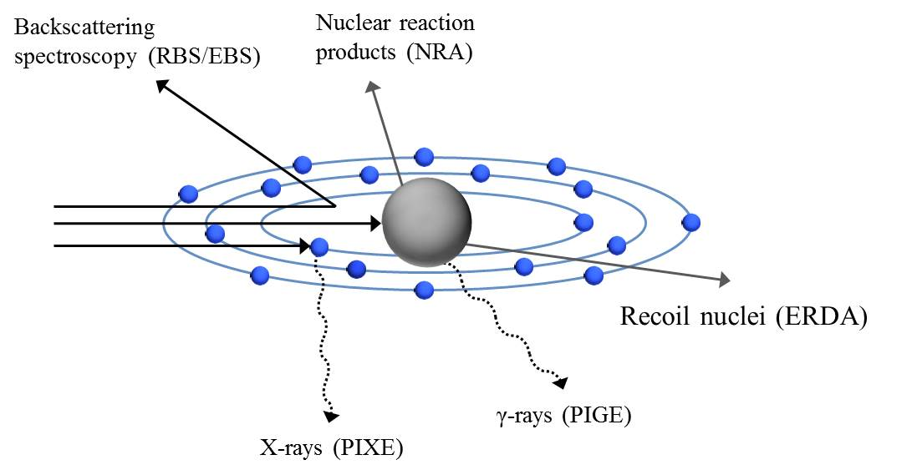
Ion Beam Analysis
Ion Beam Analysis (IBA) is based on the interaction of a high-energy charged particle with the electrons and the nuclei of the material atoms.
This interaction can lead to the emission of particles or radiation the energy of which is characteristic of the elements that constitute the sample material.
Method | Interaction | Ideal for
Backscattering Spectrometry (RBS/EBS) | Elastic scattering at backward angles | Depth profiling of heavy elements in light or medium-Z matrices
Elastic Recoil Detection Analysis (ERDA) | Elastic recoil at forward angles | Depth profiling of light elements
Nuclear Reaction Analysis (NRA) | Nuclear reaction between beam and target nuclei, producing a light charged particle | Depth profiling of light elements in high- or medium-Z matrices
Particle-Induced Gamma–ray Emission (PIGE) | Prompt γ-ray emission during ion beam irradiation | Bulk analysis of light elements from hydrogen to silicon
Particle-Induced X-ray Emission (PIXE) | Characteristic X-ray emission following ionization by the primary beam | Bulk analysis of elements with Z>11

Slide 7
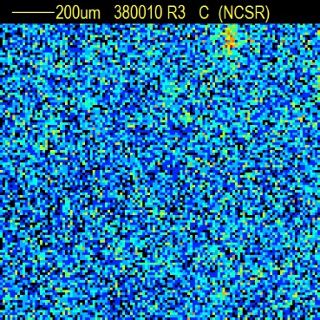
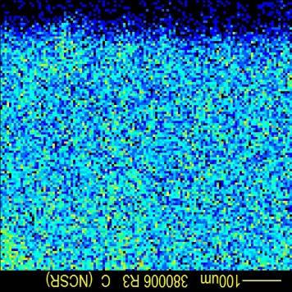
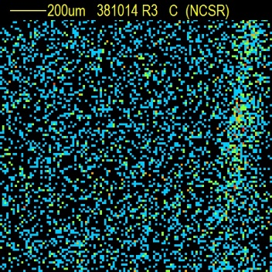
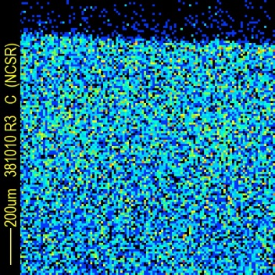
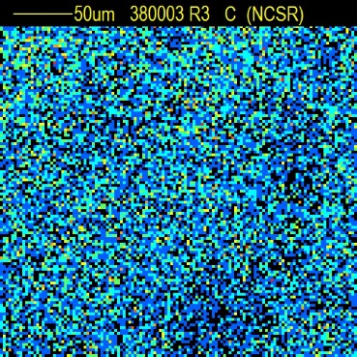
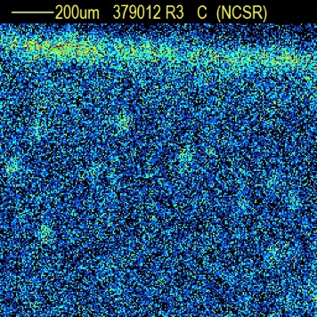
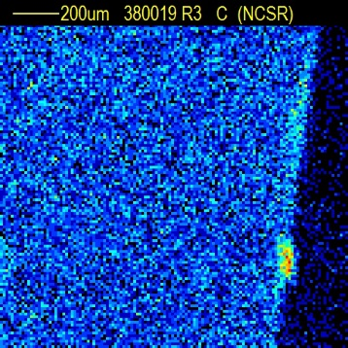
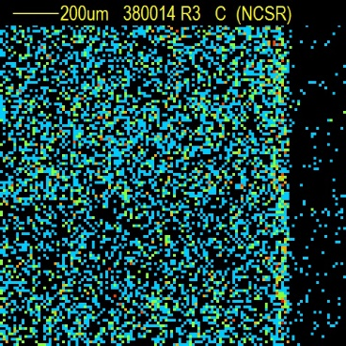
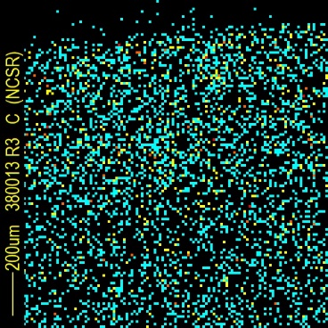
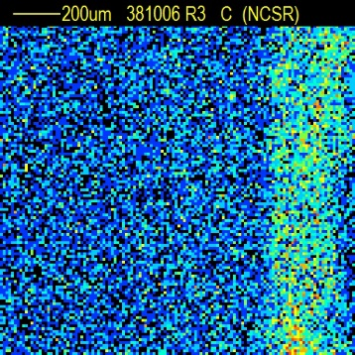
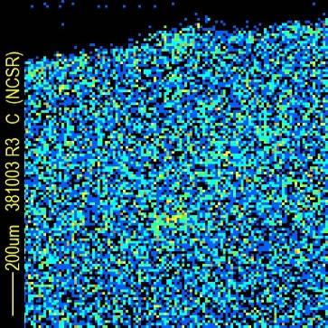
Ion Beam Analysis (JET results)
IWGL (27)
IWGL (174)
Surface
Castellation
Surface
Castellation
Ion beam analysis using ²H microbeam of 1.35 MeV and spot size 50×50 μm²
DP (80)
IWGL (191)
50 μm
OPL (120)
OPL (320)
In some surfaces & castellation sides carbon agglomerates of about 50-200 µm diameter are observed.
50 μm

Slide 8
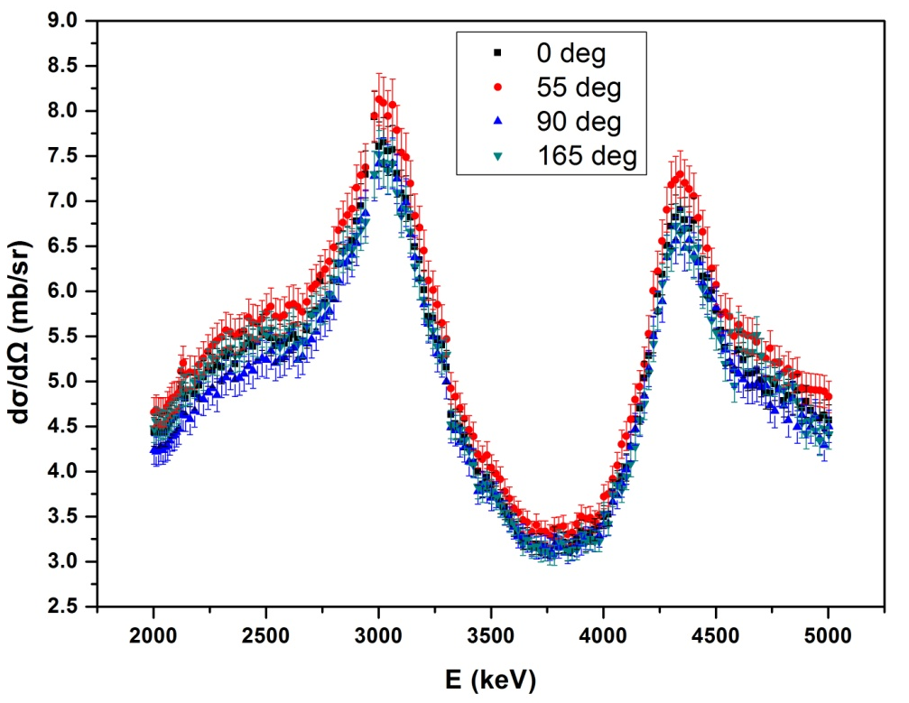
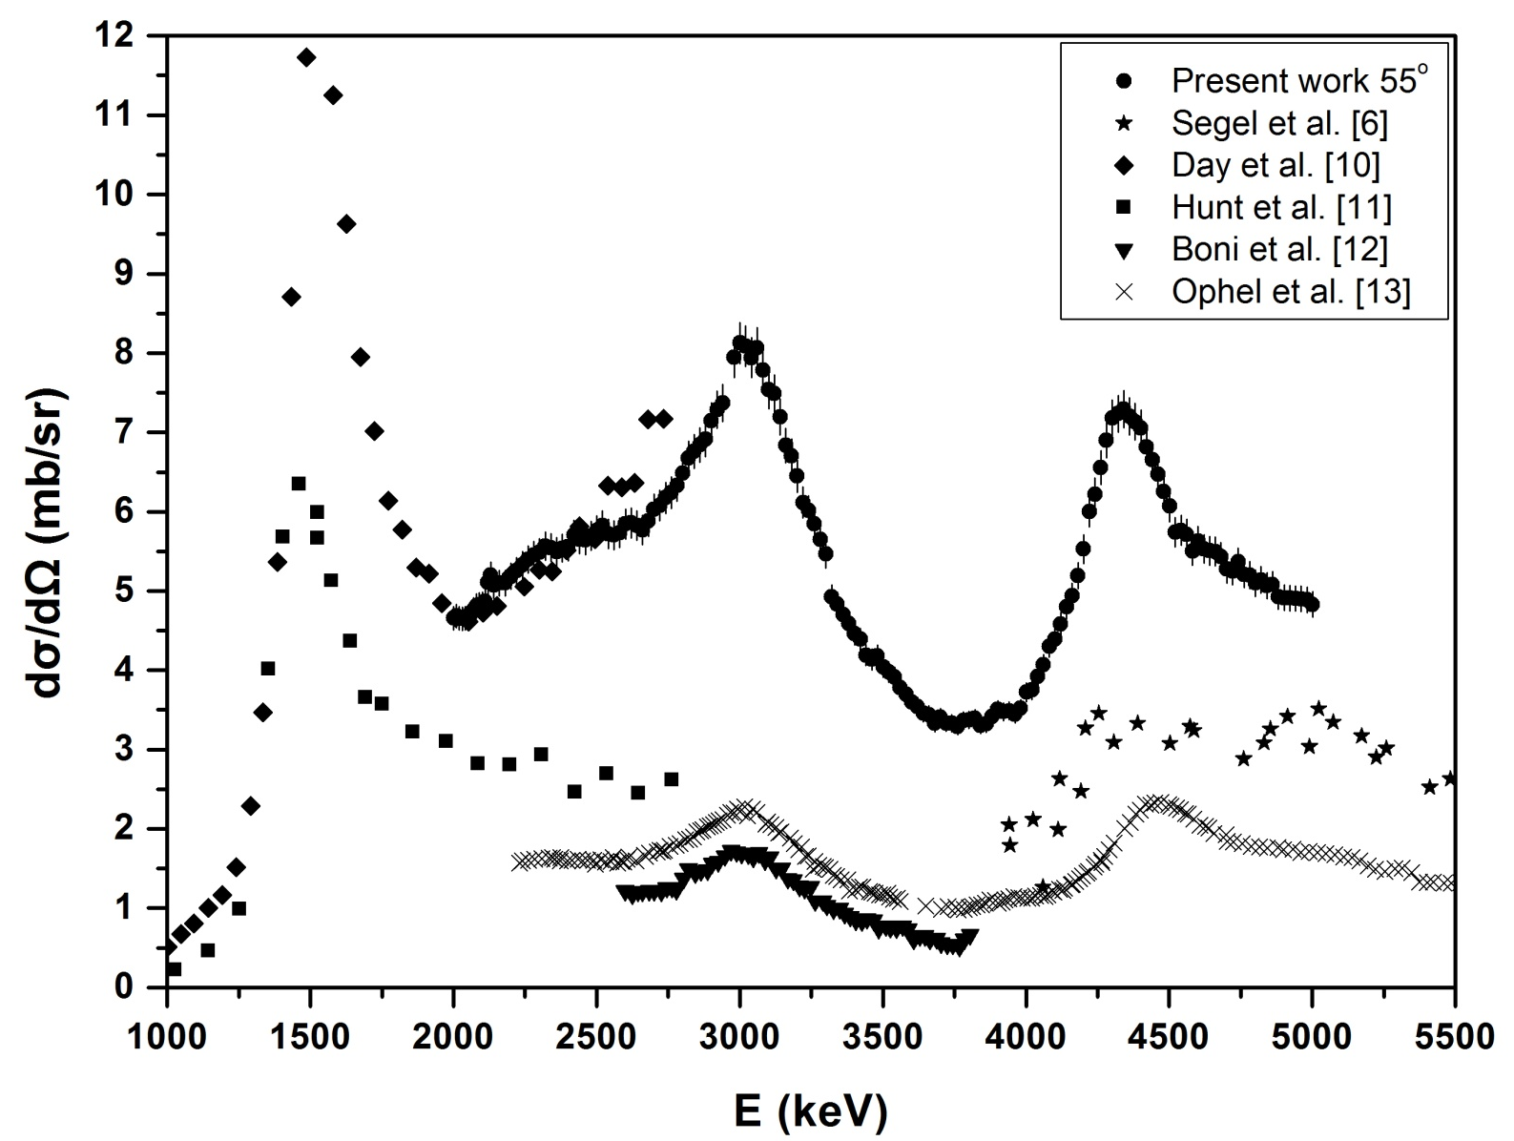
Ion Beam Analysis (PIGE dσ-Measurements)
WHY:
To pass from troublesome method using standars to a standardless one
HOW:
Measurement of Differential Cross Sections for light Elements
Development of a code for bulk analysis
¹⁰B(p,αγ)⁷Βe
Electronically controlled turntable
Initial angles: 0º – 55º – 90º ‐ 165º
4 HPGe detectors placed 30 cm from target
Air cooled target

