Slide 1


Some initial thoughts towards the design of the Low Energy neutrino Monitored Beam and LEnuSTORM Near Detector – Lemon-D
George Fanourakis, Spyros Tzamarias et al.

Slide 2

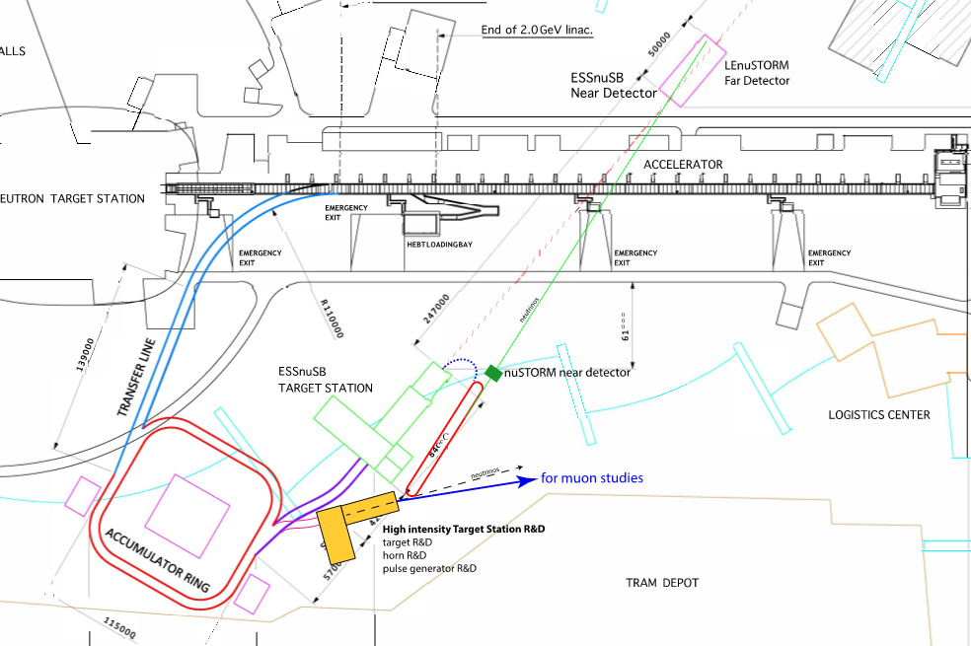
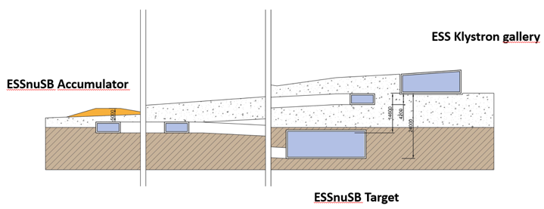
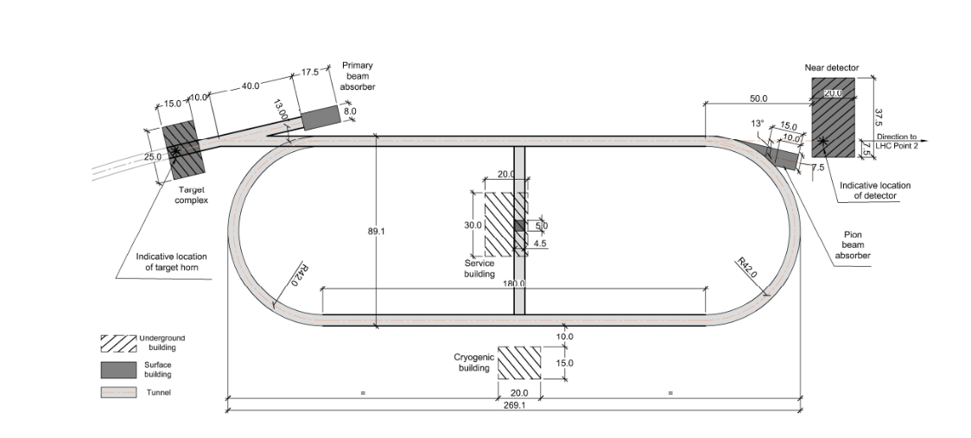
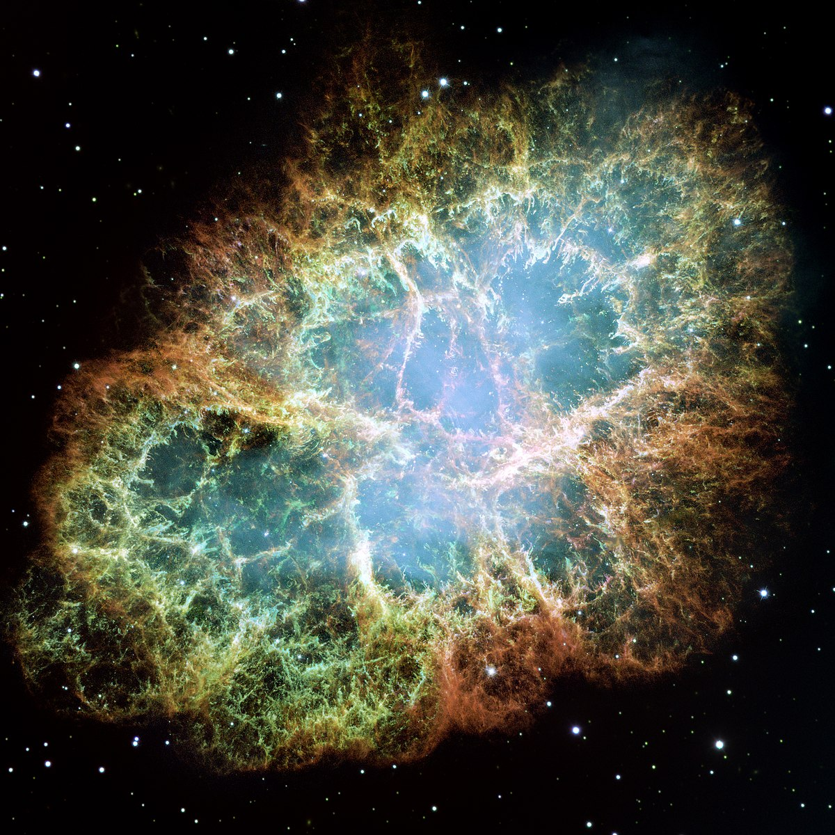
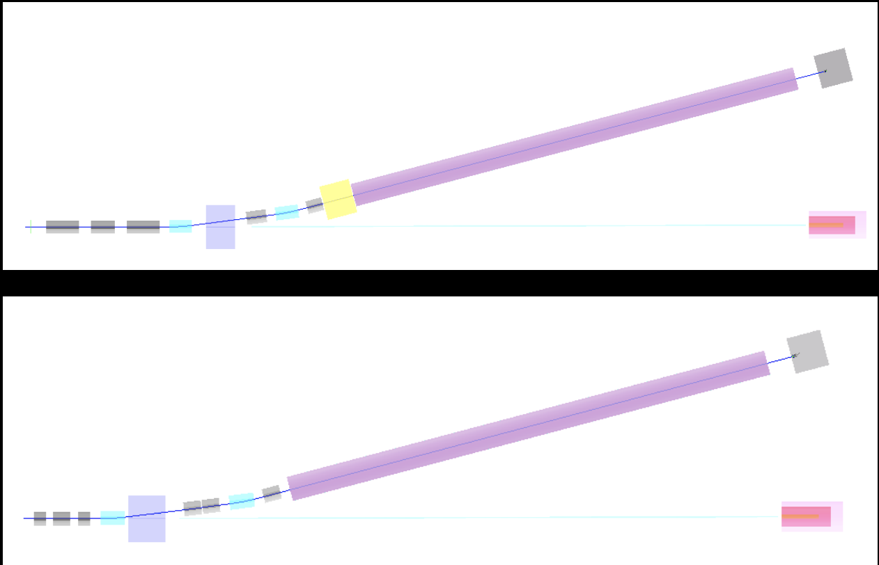
ESSnuSB+
Civil engineering
Gd doping
Mining
LEnuSTORM
New detector for LEnuSTORM
and monitored beam
Additional physics
R&D target station
(1.25 MW out of the 5MW).
Feeding LEnuSTORM and
monitored beam.
Monitored beam

Slide 3
Possible LEMON-D design features
production
Option 1: water target
  Interleaved with active detector elements (iron sheets + Picosec Micromegas detectors)
Option 2: Water Cherenkov detector doped with Gd. Instrumented with Picosec Micromegas detectors (to be investigated)
ν / ν-bar discrimination
μ+ and μ- tagging
e+ and e- tagging
Magnet ? Magnetized sheet ? Water Cherenkov ?
Good timing: the hadron dump of LEMNB beam will be instrumented and each muon detected will be synchronized with the detection of its neutrino partner from the π-decay.
Good energy and momentum resolution (how good to be determined). Magnet ? Magnetized sheet ? Range measurement ?
Cosmic ray protection/discrimination
detection

Slide 4
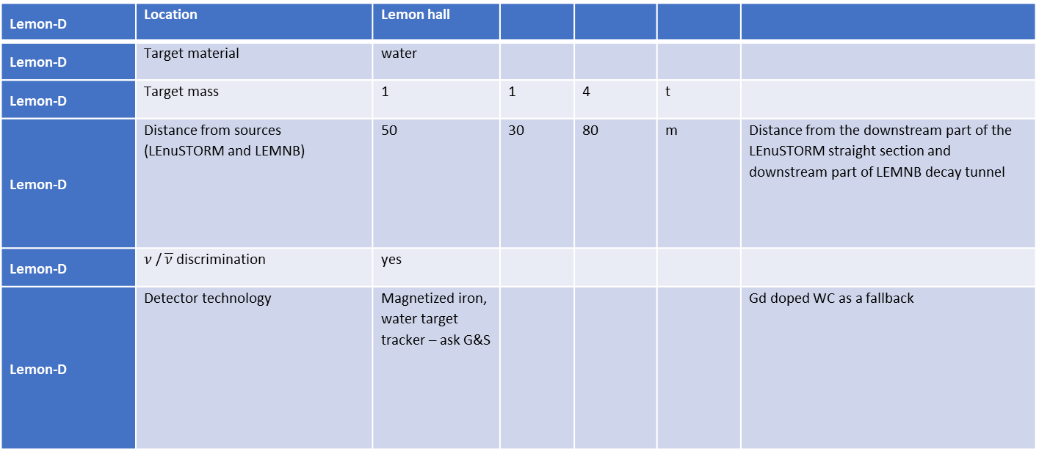
Initial LEMON-D parameters
Lemon-D | Location | Lemon hall
Lemon-D | Target material | water
Lemon-D | Target mass | 1 | 1 | 4 | t
Lemon-D | Distance from sources (LEnuSTORM and LEMNB) | 50 | 30 | 80 | m | Distance from the downstream part of the LEnuSTORM straight section and downstream part of LEMNB decay tunnel
Lemon-D | $ν$ / $\overline{ν}$ discrimination | yes
Lemon-D | Detector technology | Magnetized iron, water target tracker – ask G&S |  |  |  | Gd doped WC as a fallback

