Slide 1


Some initial thoughts towards the design of the Low Energy neutrino Monitored Beam and LEnuSTORM Near Detector – Lemon-D
George Fanourakis, Spyros Tzamarias et al.

Slide 2

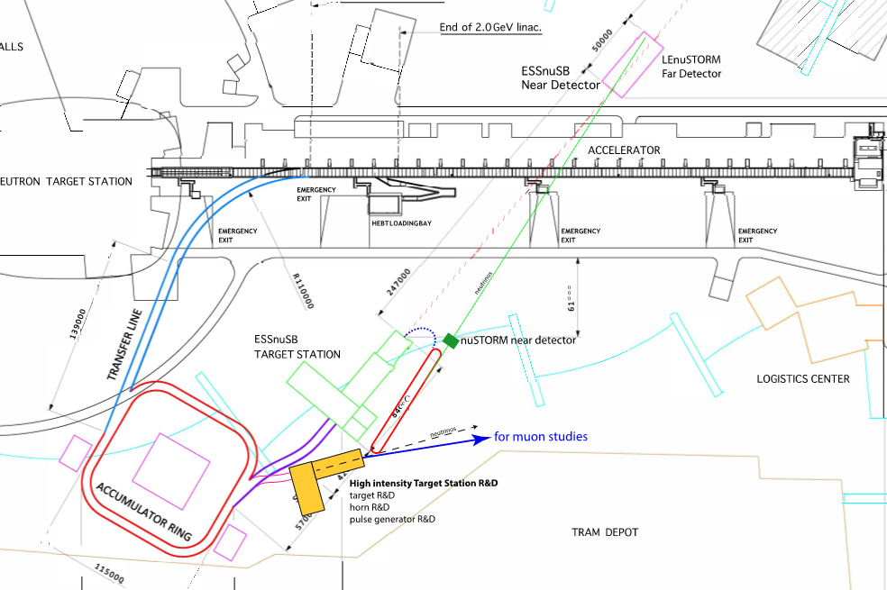
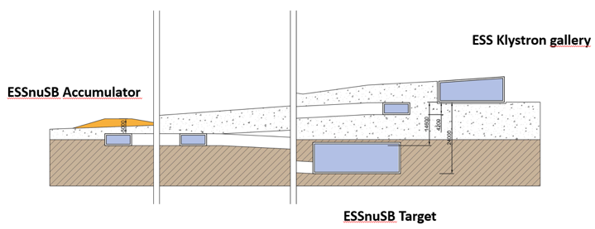
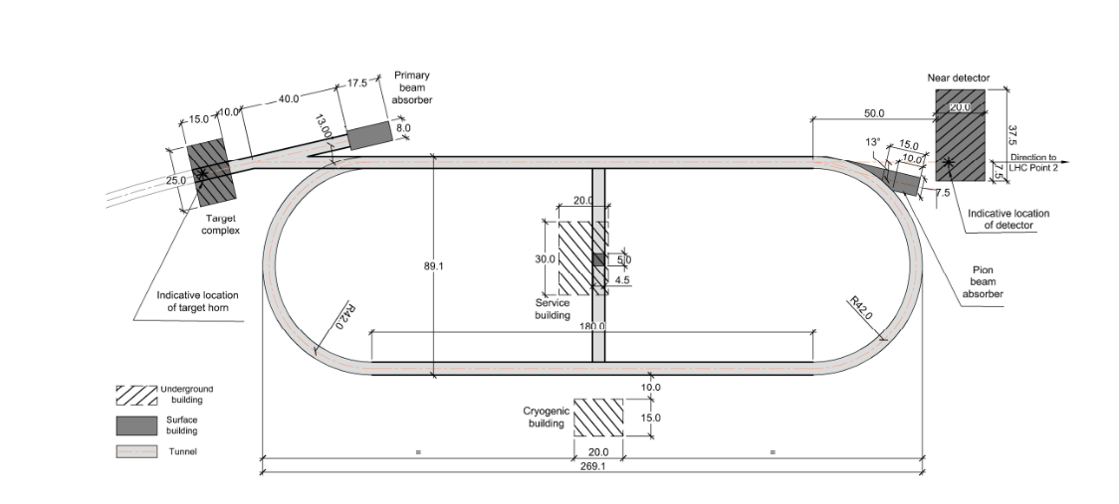
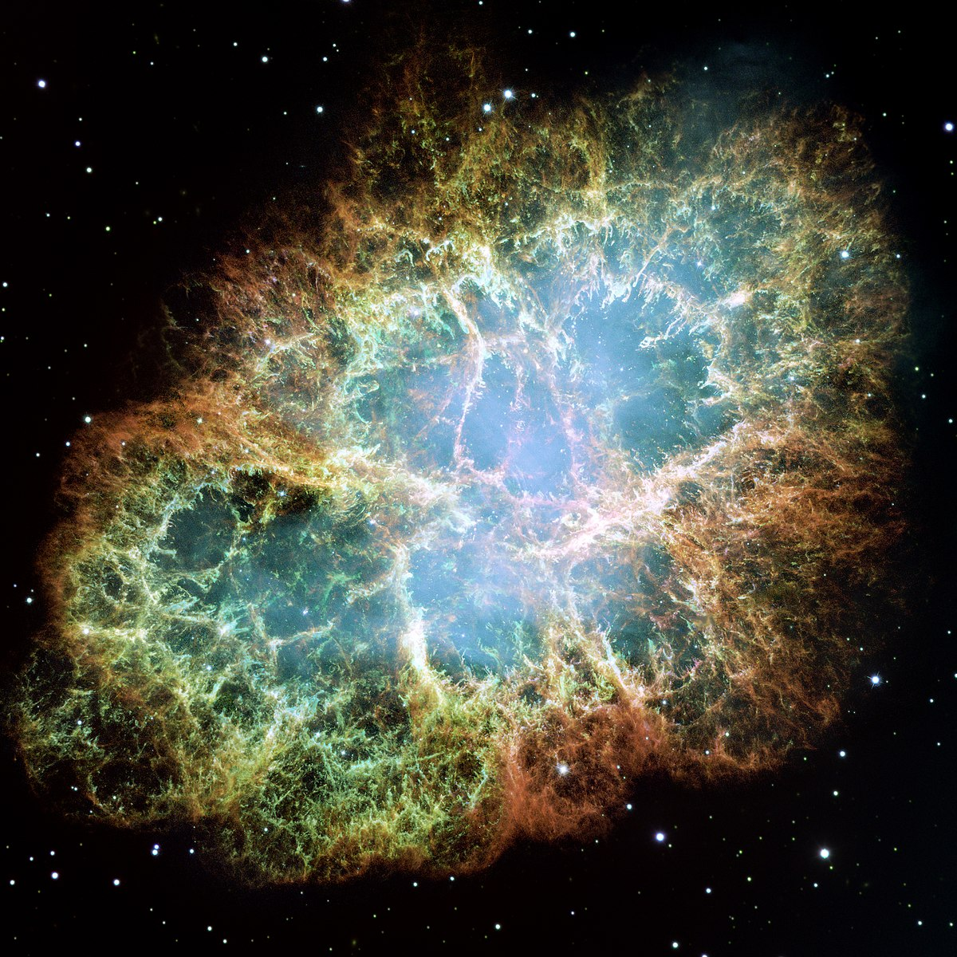
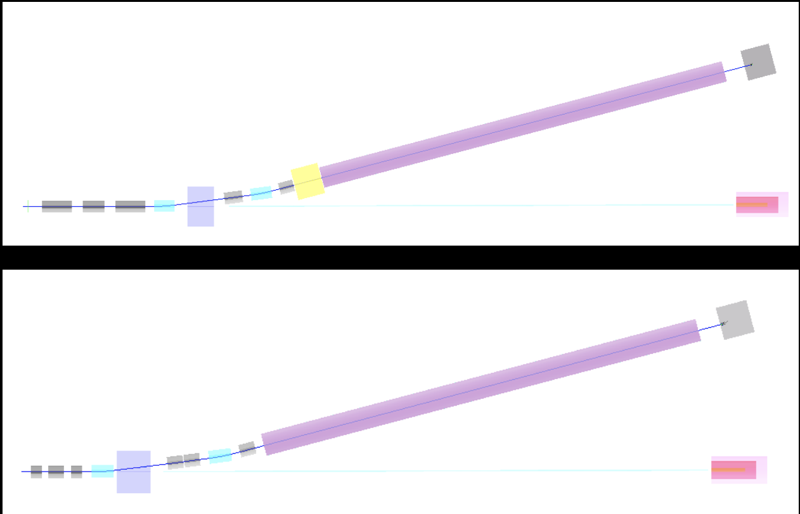
ESSnuSB+
Civil engineering
Gd doping
Mining
LEnuSTORM
New detector for LEnuSTORM
and monitored beam
Additional physics
R&D target station
(1.25 MW out of the 5MW).
Feeding LEnuSTORM and
monitored beam.
Monitored beam

Slide 3
LEnuSTORM physics potential
The Low Energy neutrinos from STORed Muons facility allows for several Physics studies at ESS
Low Energy nuSTORM
LEnuSTORM can produce intense, flavor pure neutrino beams (characterized by beam and ring instrumentation) of precisely known flux out of ~450MeV/c muons.
  Neutrino Interaction cross sections can be measured with excellent precision.
LEnuSTORM can be used to realize a Short Base Line (SBL) neutrino oscillation experiment, using a new magnetized iron Near detector and the ESSnuSB near detector as a Far detector.
  Use the “golden channel” in which a neutrino oscillation appearance signal is given by the observation of the “wrong sign” muon in the signal event. For example: with μ+ stored in LEnuSTORM (ν_{e} and anti-ν_{μ} production) the oscillation ν_{e}→ν_{μ} will produce a ν_{μ} CC interaction with a μ⁻ in the final state, which is the “wrong sign” with that expected by the CC interactions of the anti-ν_{μ} beam.
LEnuSTORM can be used to perform searches of sterile neutrinos with unmatched sensitivity: Looking for ν_{μ} appearance and anti-ν_{e} disappearance (in the case of μ+ stored muons).

Slide 4
LEMNB physics potential
The Low Energy Monitored Neutrino Beam at ESS
LEMNB can produce well defined neutrino tagged beams with a technique to be developed.
  Neutrino Interaction cross sections can be measured with excellent precision.
  Exploring sterile neutrino scenario as with the LEnuSTORM.
LEnuSTORM and LEMNB will share the same near detector.
LEMNB will be the first Instrument to be constructed and operational since it may have no need for an accumulator.

Slide 5
LEMON-D requirements
Lemon-D will detect neutrino interactions from LEnuSTORM and LENMB and will be located ~50 m away from their production points.
It will consist a short base line ν osc. experiment with ESSnuSB ND
water target
  Interleaved with active detector elements
ν / ν-bar discrimination
μ+ and μ- tagging
e+ and e- tagging
magnet
Good timing
Good energy and momentum resolution (how good to be determined)
Cosmic ray protection/discrimination

Slide 6
LEMON-D parameters
Input: neutrino energy and angle distributions vs distance from the sources
Distance from neutrino sources
Dimensions (to be determined based on containment issues, on the required precision for the x-section measurement but also in conjunction with the given dimensions of the Near detectors)
Target material and interleaved detector elements thickness
Magnet size and magnetic field required
What rate should the detector be able to withstand?
Cosmic rate veto counters (type, size)

Slide 7
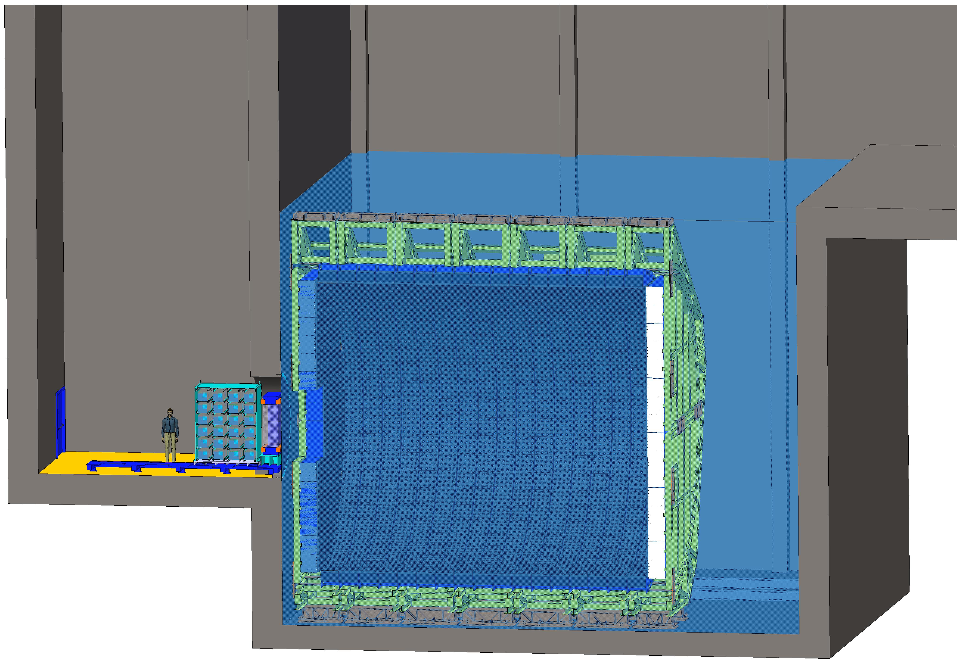
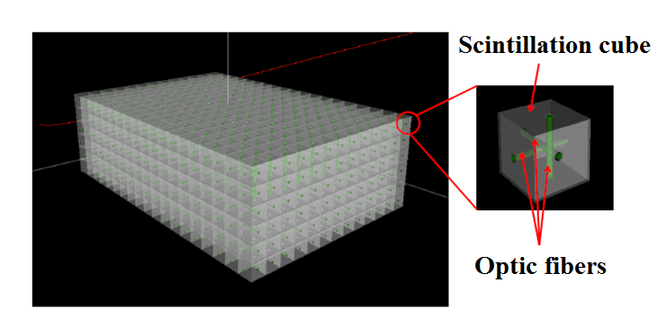
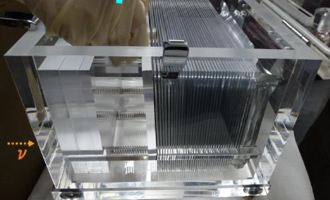
Near detectors (at 0.25 Km)
Monitor neutrino beam intensity and measure muon and electron neutrino and antineutrino cross sections
NINJA-like water-emulsion detector (1 t fiducial)
Super-FGD like detector
(1 t fiducial)
ν beam
Near Water Cherenkov detector (0.77 kt fiducial)

