Slide 1
Subjects for Master Theses
Dr. Aristotelis Kyriakis
Senior Researcher
INPP, NCSR DEMOKRITOS

Slide 2
Detector Instrumentation Lab
HL –HLC, CMS Tracker Upgrade
Candidate Profile:
1)Physicist/Engineer
2) Programming skills-> C++ /ROOT
Contact persons: loukas@inp.demokritos.gr, kyriakis@inp.demokritos.gr

Slide 3
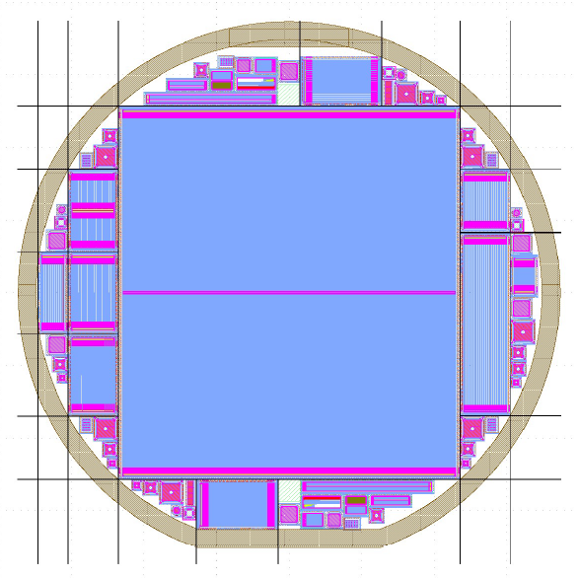
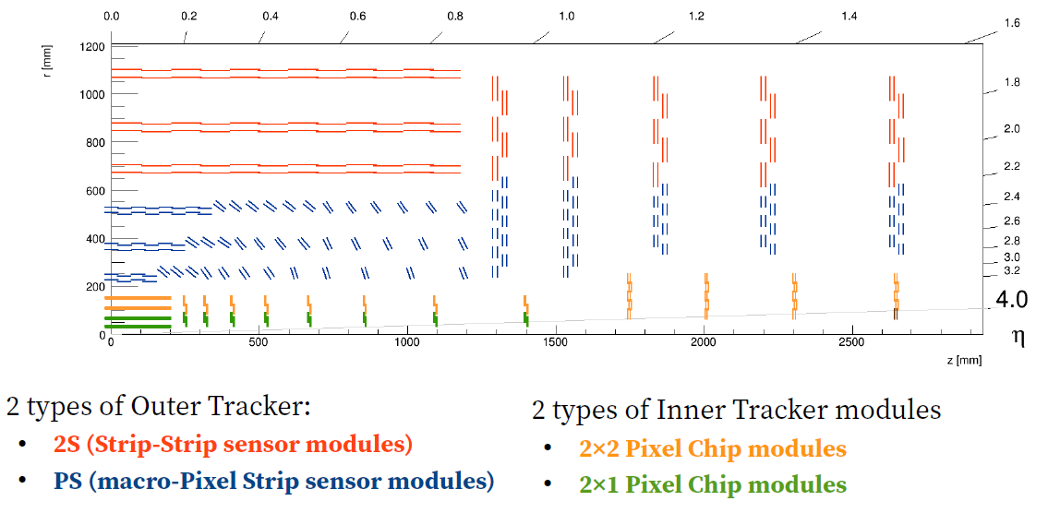
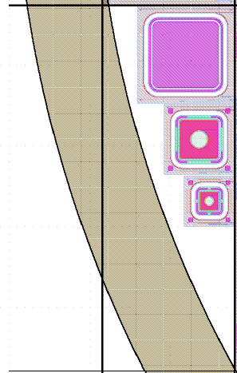
CMS Tracker Layout
2S Sensor
MOS
2S Sensor
Diode:2.5x2.5 mm²
Diode:1.25x1.25 mm²
HL-LHC : 6’’ wafer with 2S Sensors
FZ 240μm width p-type wafer

Slide 4
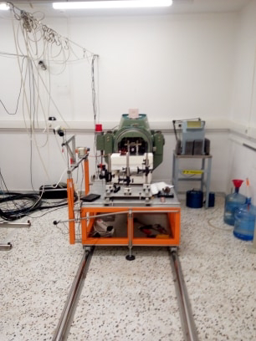
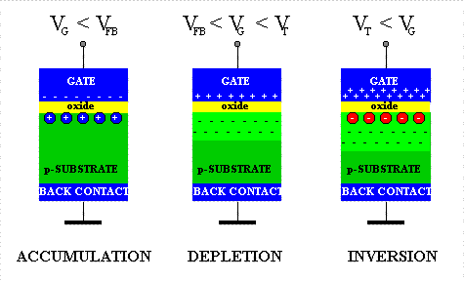
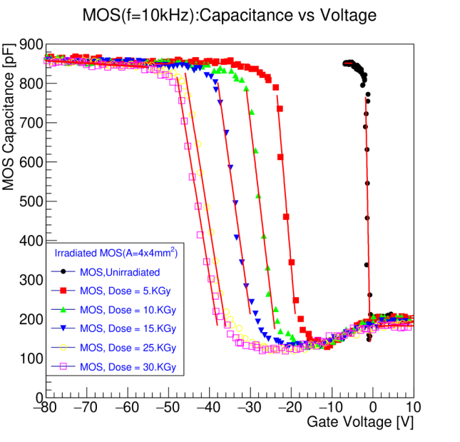
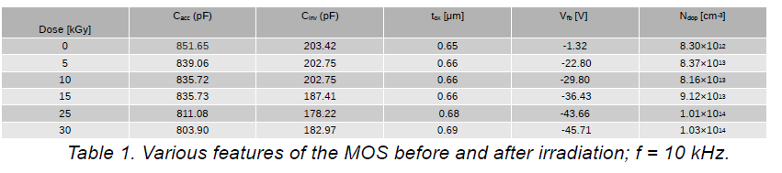
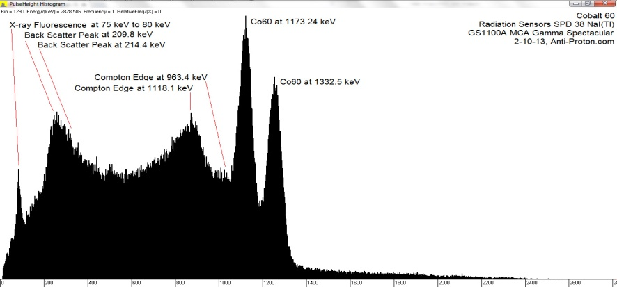
Sensor Irradiation, CV measurements
⁶⁰Co, 11TBq
Clear evidence of positive charge induced in the oxide of the MOS structures after exposure to gamma photons
Shift of the flatband voltage (V_{fb}) to higher absolute values and increase of the dopant concentration (N_{dop})
Oxide thickness remains not affected because it is a geometric characteristic of the device

Slide 5
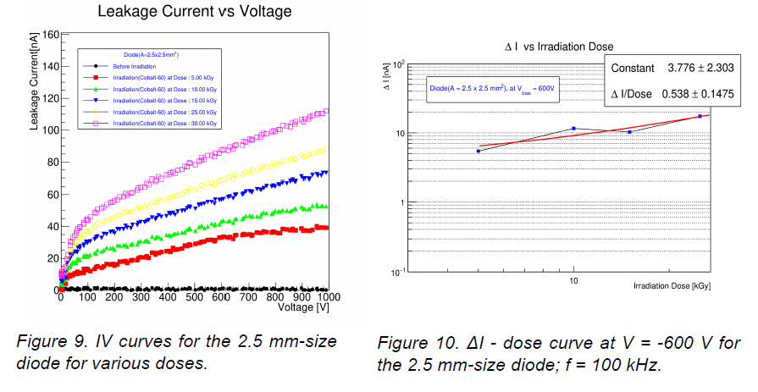
Sensor Irradiation, IV measurements

Slide 6
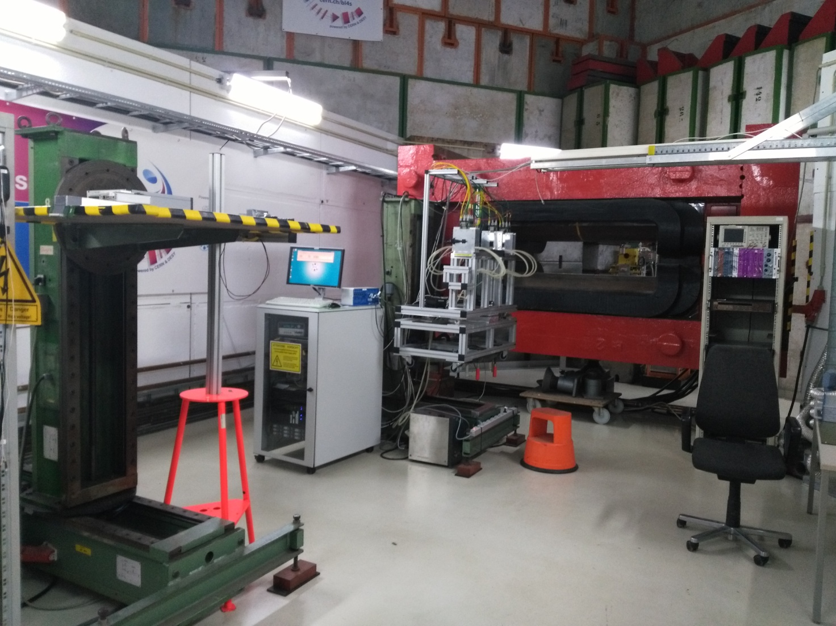
DESY - Test Beam Analysis (I)
1.5 T Dipole Magnet
Mimosa Telescope
MAPS pixel planes
1 x 2 cm² size
18.4μm pixel pitch

Slide 7
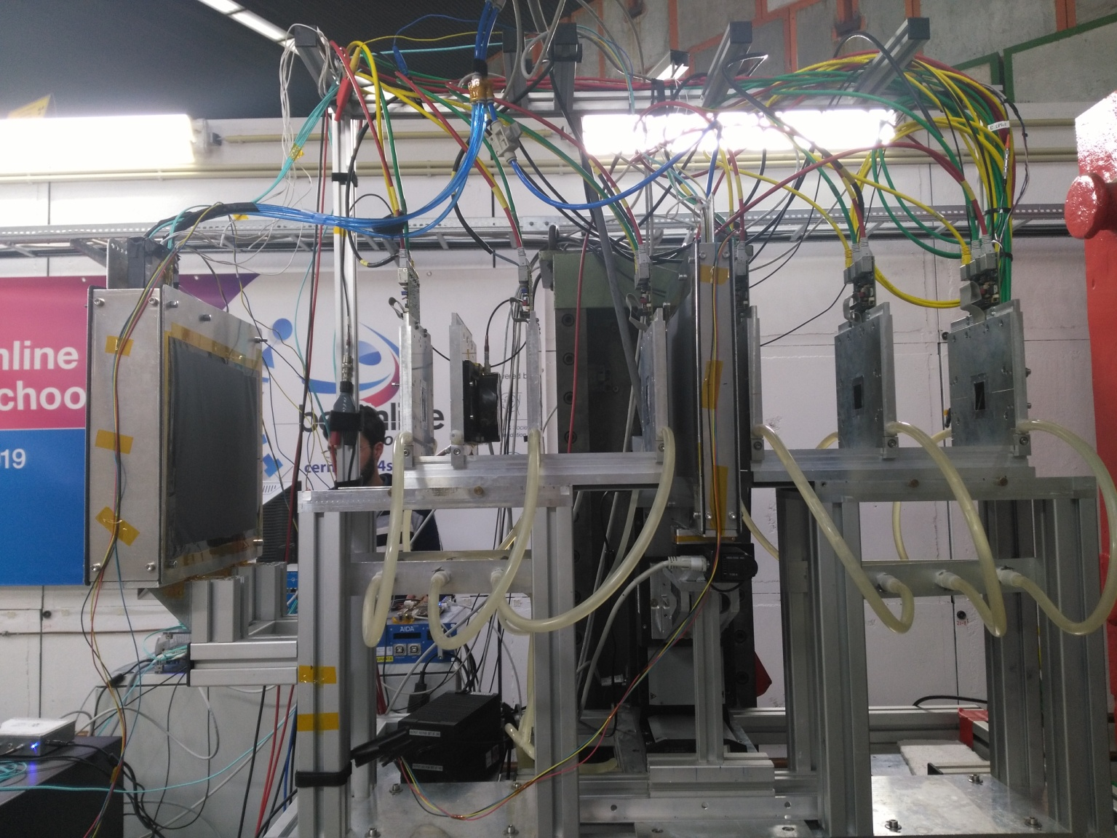
DESY - Test Beam Analysis (II)
DUT
AC-M1803
z_{TOP} = 365cm
z_{BOT} = 367cm
4GeV e⁻ Beam
M5
z = 707cm
M2
z = 152cm
M6
z = 859cm
FEI4
z = 782cm
M4
z = 556cm
M3
z = 305cm
M1
z = 0cm

Slide 8
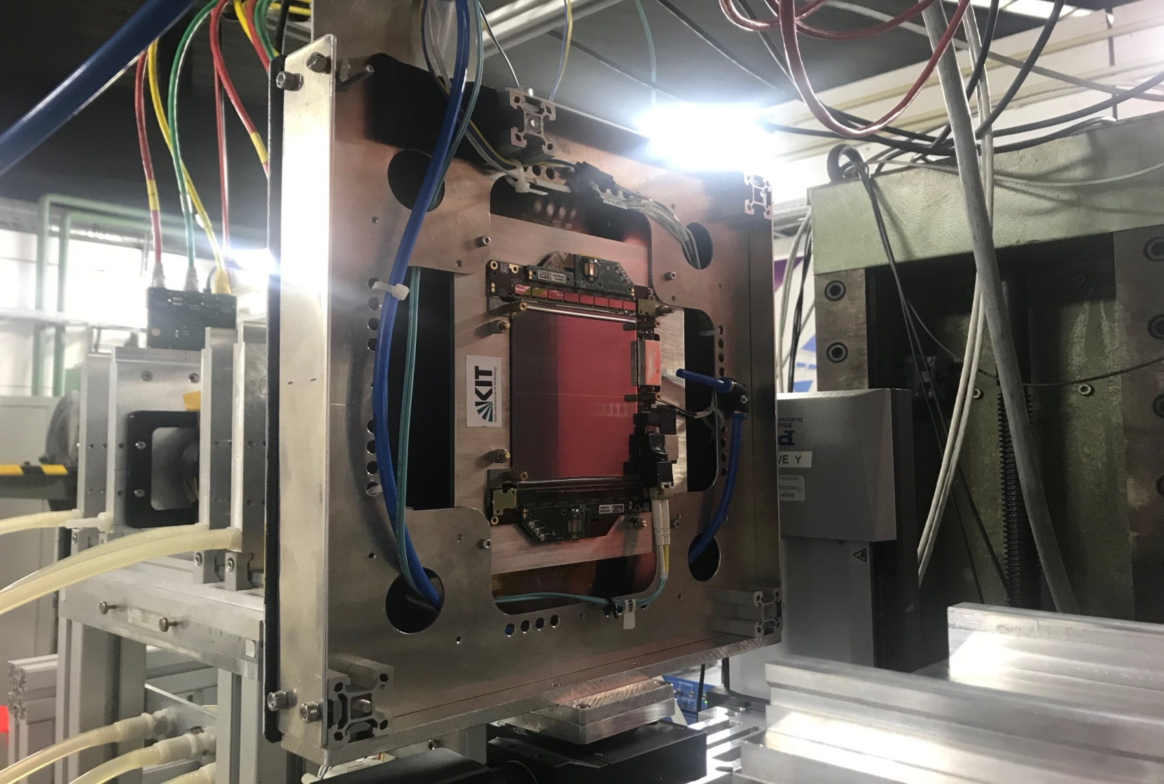
DESY - Test Beam Analysis (III)
CBC0
DC-DC
Right
Upstream
CBC0
CBC7
Left

Slide 9
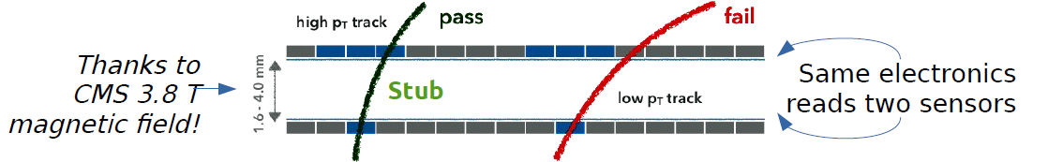
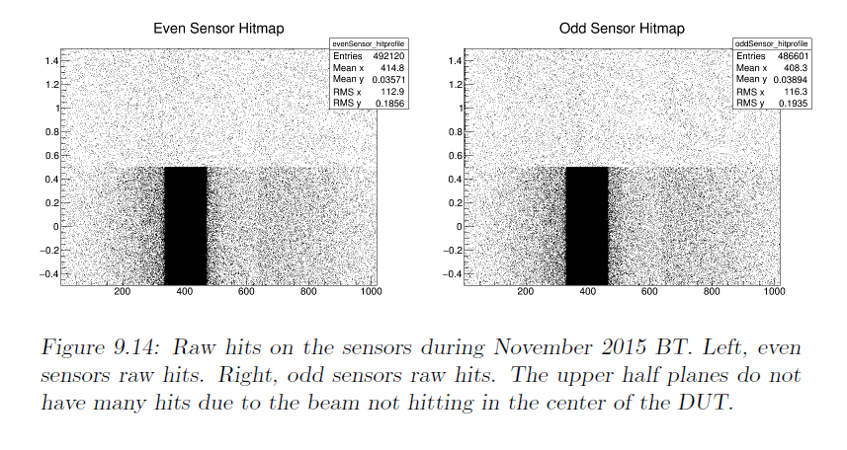
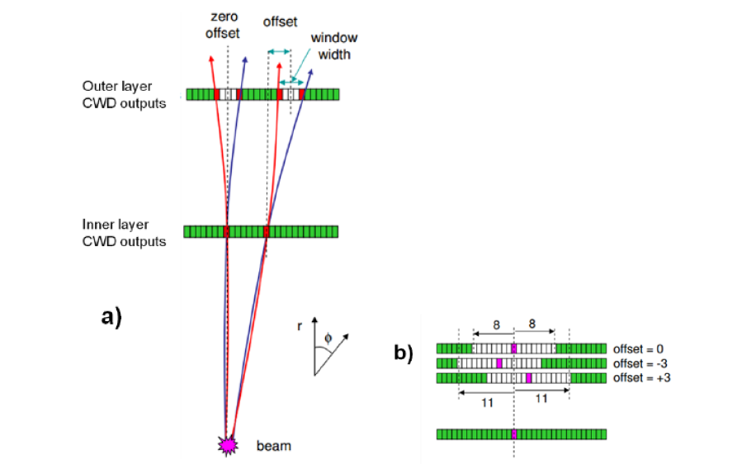
HL-LHC : CBC STUB logic

Slide 10
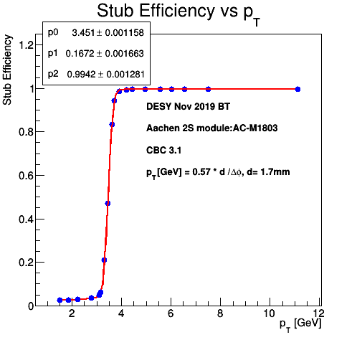
Stub logic in CBC chip

Slide 11
Radioactive Source Localization Lab
Contact person: kyriakis@inp.demokritos.gr

Slide 12
Radioactive Source Localization by a Network of CZT Sensors
Main task: Localization of light shielded and/or moving sources
Using Planar spectroscopic CZT sensor topology study the capability to localize Radioactive Sources in an open area
Candidate Profile:
1)Physicist/Engineer
2) Programming skills-> C++/ Java /ROOT

Slide 13
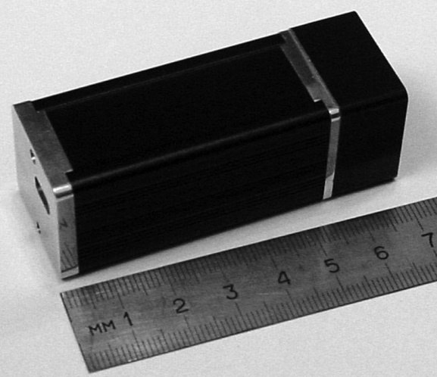
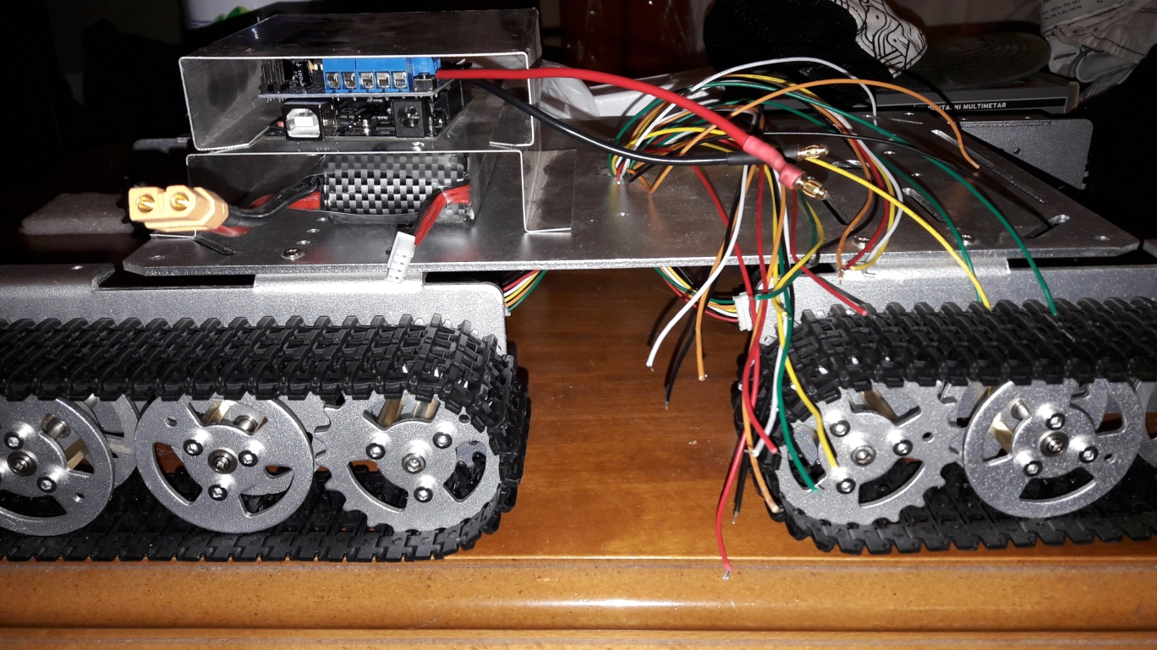
Radioactive Source Localization by an autonomous rover equipped with CZT Sensors
Main task: write a stand alone software in java to retrieve data from CZT sensor and analyze them
Candidate Profile:
1)Physicist/Engineer
2) Programming skills-> C++/ Java /python

Slide 14
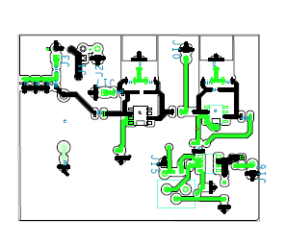
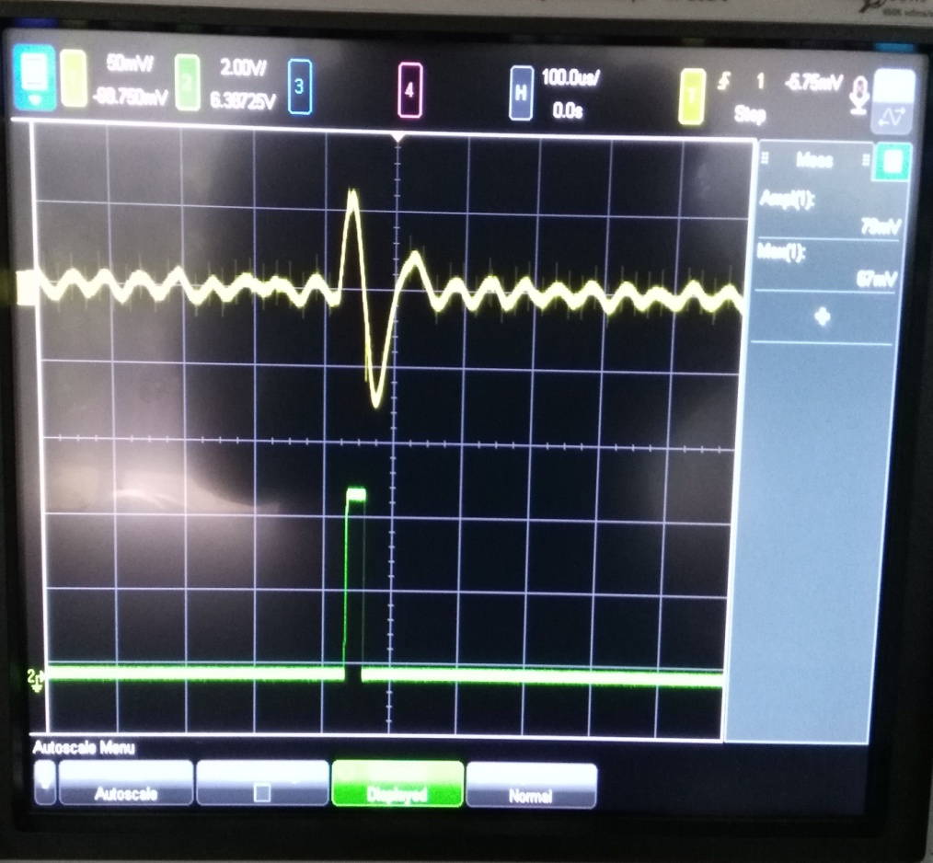
Low-Cost Radiation detectors
Main Task: Design Low noise board + evaluation software
Candidate Profile:
1)Physicist/Engineer
2) Programming skills-> Cadence/Orcad/Pspice simulation packages

