Slide 1

Simulation of neutrino events in a fine grained scintillator detector
Georgi Lyubenov Petkov
Sofia University “St. Kliment Ohridski”

Slide 2
Content
SuperFGD
Used platforms
Run simulations and results
Future work

Slide 3
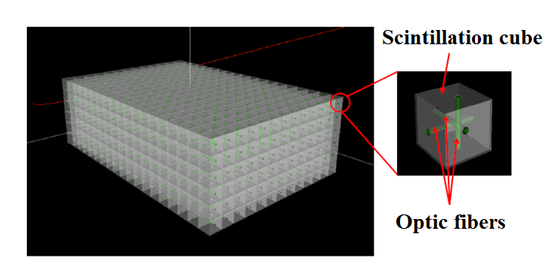
SuperFGD

Slide 4
Used platforms
GENIE – neutrino event generator
CERN ROOT – library for data analysis
Geant4 – platform for simulating interactions of charged particles with matter
Pythia6 – Monte Carlo generator
The software is build to run on OS Linux Mint 18.2 (or higher version)

Slide 5
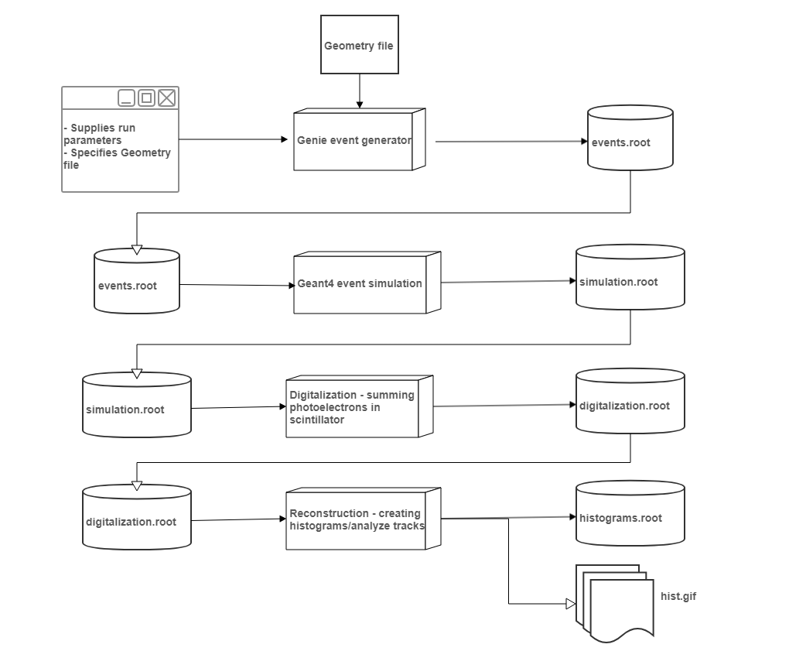

Slide 6
4 executables are build
nfevgen– used to generate the neutrino events and creates an events.root file
nfsim – reads the events from the events.root and uses Geant4 to simulate the neutrino events, creates the simulation.root file
nfdigit – reads the simulation.root file and digitizes the information according to the requirements, outputs digitalization.root file.
nfrecon – generates histograms (creates picture files for the moment) of the interaction.

Slide 7
EventGenerator
A class is implemented (NFFluxdriver) that inherits from GFluxI
A main file is created with the following flow:
Passed arguments are read – detector dimensions, neutrino energy etc.
Initialize cross section xml data
Initialize detector geometry
Initialize FluxDriver
Initialize Genie neutrino event generator and pass the fluxdriver
Initialize an Ntuple Writer to save GHEP records into a Ttree
Generates events and saves them into a file

Slide 8
Geant4 simulation
Specific classes are implemented for the simulation based on the detector parameters and materials – inherited classes include:
G4VPVParameterisation
G4VUserDetectorConstruction
G4VSensitiveDetector
G4UserEventAction
G4VUserPrimaryGeneratorAction
G4UserRunAction
G4RunManager
G4UserSteppingAction
G4VUserPhysicsList

Slide 9
Geant4 simulation flow
Reads cmd arguments
Construct the default run manager
Detector construction – detector is the same as in the Genie event generator
Physics list
Primary generator action
  Can be either the genie output file
  Primary particle generator – for test purposes
6. Initialize Stepping action
7. Initialize Event action
8. Initialize Run action
9. Initialize G4 kernel
10. Run the simulation

Slide 10
Digitalization step
From the run simulation in the G4VSensitiveDetector we extract the necessary data – energy deposited in each cube and convert into generated photons with a conversion formula. We do not use the Geant4 photon simulation since this will reduce the performance significantly.
The digitalizations sorts and sums the generated photons per cube and the output file basically is the information of only the number of generated optical photons per cube.

Slide 11
Reconstruction
The reconstruction for (the moment) reads the output file from the digitalization step and generates 3 views - one from X and Y, one from X and Z, and one from Y and Z axis; for each event.

Slide 12
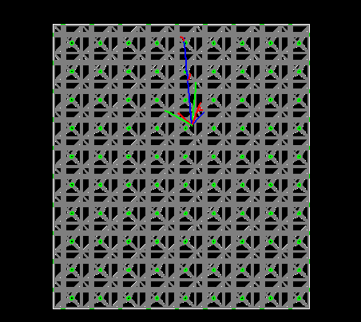
Simple simulation
Generated image in a scintillation detector using Geant4 [muon neutrino interaction with energy of 7.5GeV, view from X and Z axis, magnetic field is parallel to Y=0.5 T (into the screen), number of cubes per acis X=9, Y=1, Z=10]

Slide 13
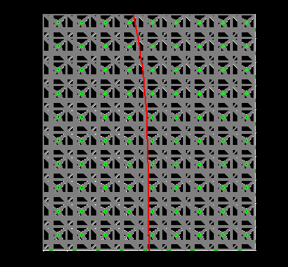
Simple simulation
Generated image of a muon with energy of 0.05GeV, view is from X and Z axis with an applied magnetic field in Y axis of 0.5 T, detector dimensions are 9 by 1 by 10 cubes

Slide 14
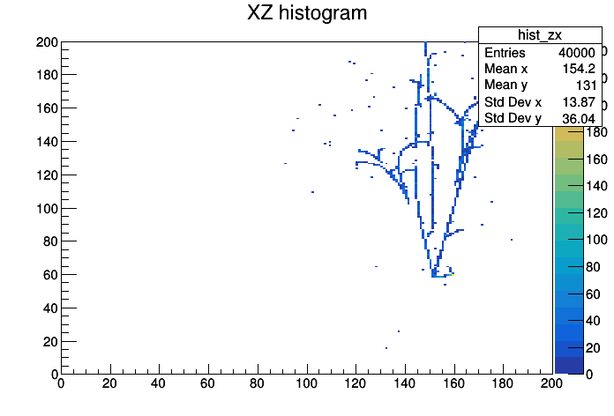
Simulation reconstruction
Reconstruction of a neutrino event with E=7.5 GeV and an applied magnetic field in the Y axis with 0.5 T in a granular detector with dimentions of 200x200x200 cubes [View is from the X and Z axis]

Slide 15
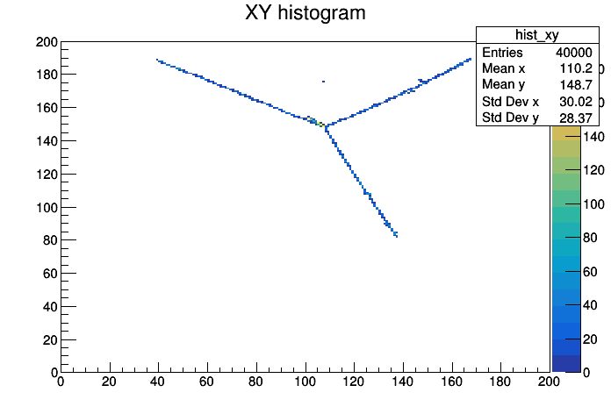
Simulation reconstruction
Reconstruction of another neutrino event with E=7.5 GeV and an applied magnetic field in the Y axis with 0.5 T in a granular detector with dimentions of 200x200x200 cubes [View is from the X and Y axis]

Slide 16
Future work
Simulation of the whole detector – scintillation and cerenkov detector
Adding the newest version of Geant4
4 executables can be run in parallel (multithreaded application can be made for faster data processing)
Reconstruction of the whole event based on the registered tracks

Slide 17
Questions?

Slide 18
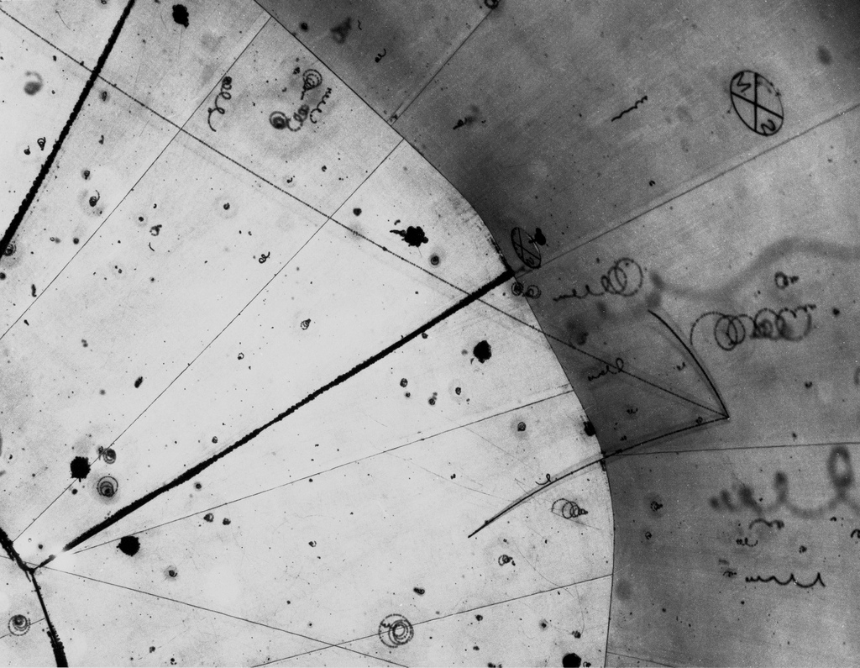
Thank you for your attention!

