Slide 1
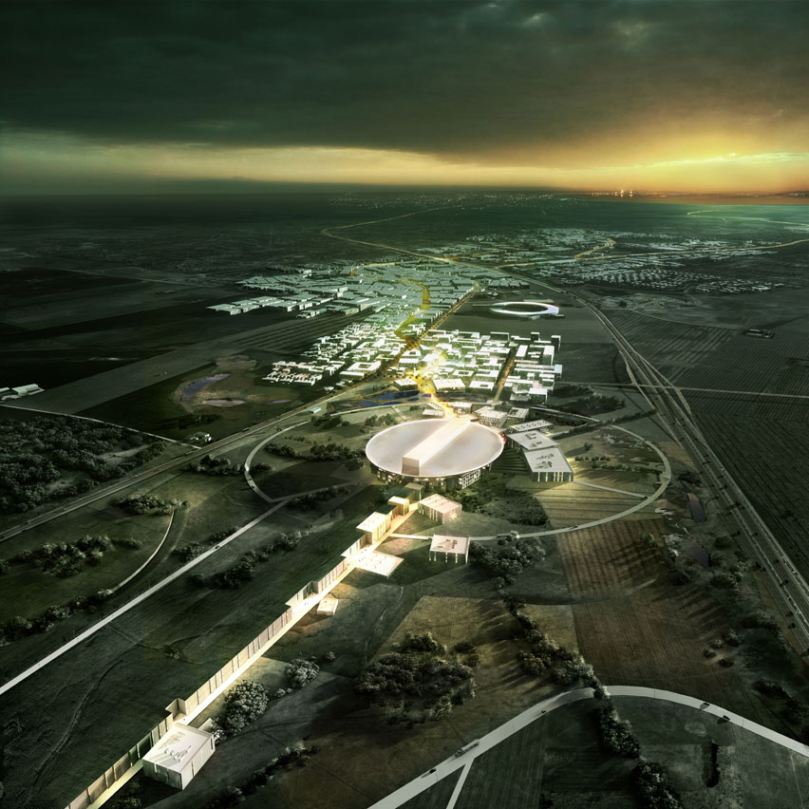
The ESS neutrino Super Beam (ESSνSB)
George Fanourakis
INPP – NCSR «Demokritos»
Work supported also by
Most slides provided by Marcos Dracos
CNRS Strasburg

Slide 2
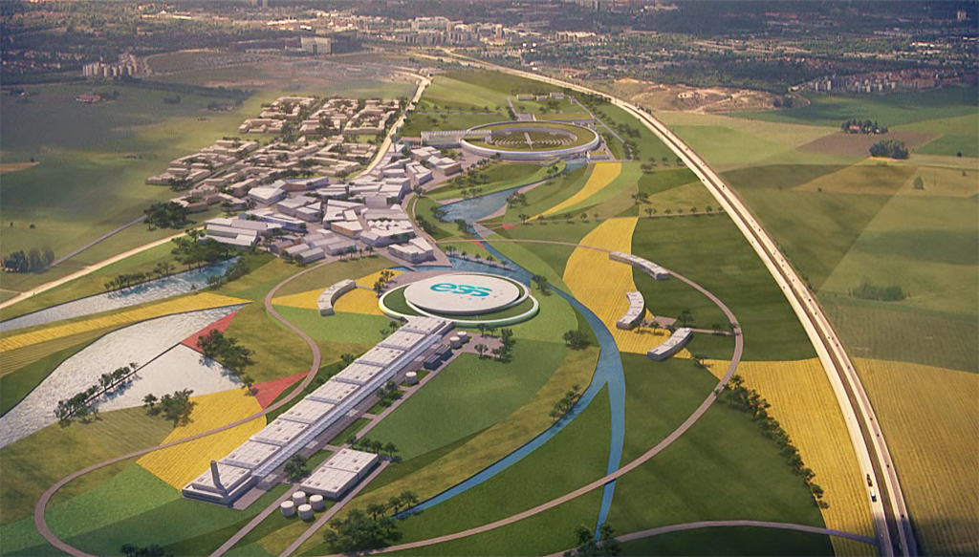
Overview
The European Spallation Source
The neutrino beam using the ESS facility
The needed ESS linac modifications
Physics performance
EU support and the Conceptual Design Study
INPP involvement

Slide 3




European Spallation Source
under construction since 2014
(~1.85 B€ facility)

Slide 4
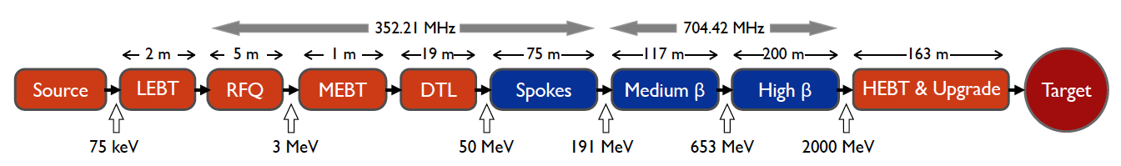
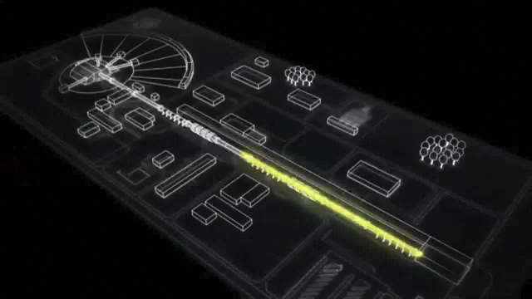
ESS proton linac
The ESS will be a copious source of spallation neutrons.
5 MW average beam power.
125 MW peak power.
14 Hz repetition rate (2.86 ms pulse duration, 10¹⁵ protons).
Duty cycle 4%.
2.0 GeV protons
  up to 3.5 GeV with linac upgrades
> 2.7x10²³ p.o.t/year.
Linac ready by 2023 (full power)

Slide 5
What kind of neutrino beam can we form using this linac?
by doubling the linac pulsing rate…
conventional neutrino (super) beam
decay tunnel
proton beam
hadrons
physics
p
⨂B
target
hadronic collector
(focusing)
Detector
production of a powerful neutrino beam
Modifications of the ESS linac required, without affecting the
neutron program of ESS: Cost ~ 250 MEuros

Slide 6
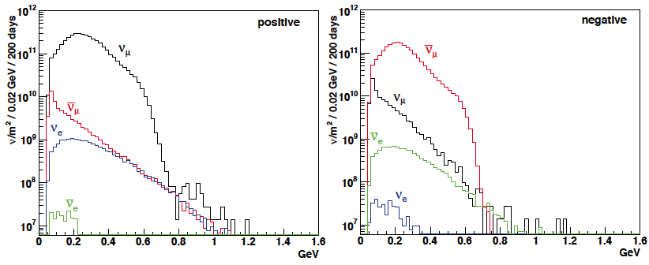
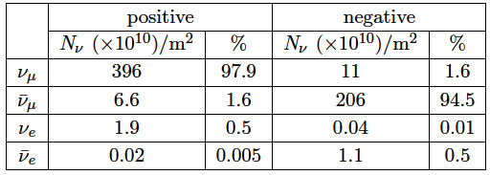
ESSνSB ν energy distribution
(without optimisation)
neutrinos
anti-neutrinos
almost pure ν_{μ} beam
small ν_{e} contamination which could be used to measure ν_{e} cross-sections in a near detector
at 100 km from the target and per year (200 days) in absence of oscillations.
Use the ν_{μ} → ν_{e} oscillation for CP violation (primary ν_{e} contamination small enough ≈ 0.5%)

Slide 7
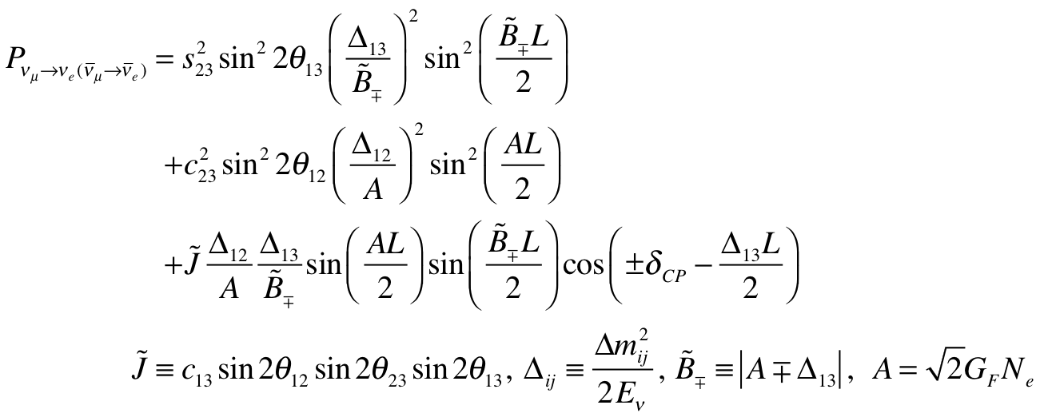
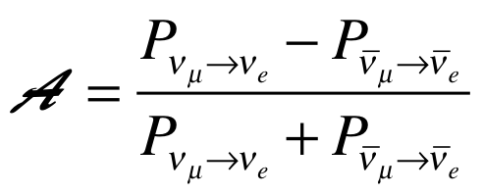
CP Violating Observables (ν_{μ}→ν_{e})
The primary aim of the ESSνSB initiative is to measure the parameters of the neutrino oscillation, in particular the leptonic CP-violating phase angle δ_{CP}.
atmospheric
Non-CP terms
solar
interference
CP violating
matter effect
⇒ accessibility to mass hierarchy
⇒ very long baseline
(small in our case)
≠0 ⇒ CP Violation
be careful, matter effects also create asymmetry

Slide 8
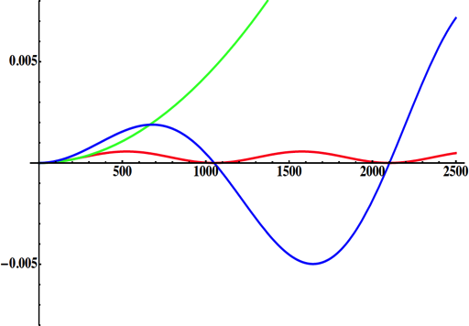
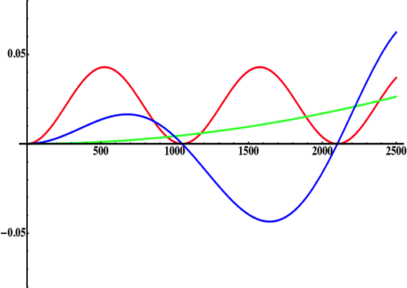
Neutrino Oscillations with "large" θ₁₃
solar
atmospheric
for "large" θ₁₃ 1st oscillation maximum is dominated by atmospheric term
for small θ₁₃ 1st oscillation maximum is better
atmospheric
solar
L/E
L/E
CP interference
(arXiv:1110.4583)
θ₁₃=1º
CP interference
θ₁₃=8.8º
2nd oscillation maximum
δ_{CP}=-90
δ_{CP}=0
δ_{CP}=+90
P(ν_{μ}→ν_{e})
1st oscillation max.: A=0.3sinδ_{CP}
2nd oscillation max.: A=0.75sinδ_{CP}
θ₁₃=8.8º
("large" θ₁₃)
(see arXiv:1310.5992 and arXiv:0710.0554)
L/E
more sensitivity at 2nd oscillation max.

Slide 9
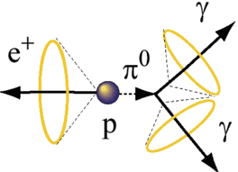
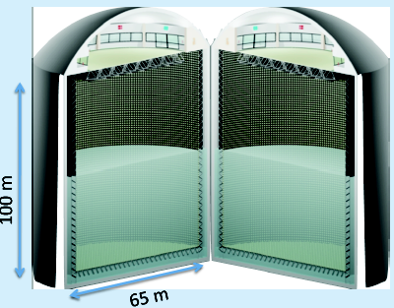
Can we go to the 2nd oscillation maximum using our proton beam?
Yes, if we place our far detector at around 500 km from the neutrino source.
MEMPHYS like Cherenkov detector
(MEgaton Mass PHYSics studied by LAGUNA)
(arXiv: hep-ex/0607026)
Neutrino Oscillations (Super Beam, Beta Beam)
Proton decay
Astroparticle physics
  Understand the gravitational collapse: galactic SN ν
    Supernovae "relics"
  Solar Neutrinos
  Atmospheric Neutrinos
500 kt fiducial volume (~20xSuperK)
Readout: ~240k 8” PMTs
30% optical coverage

Slide 10
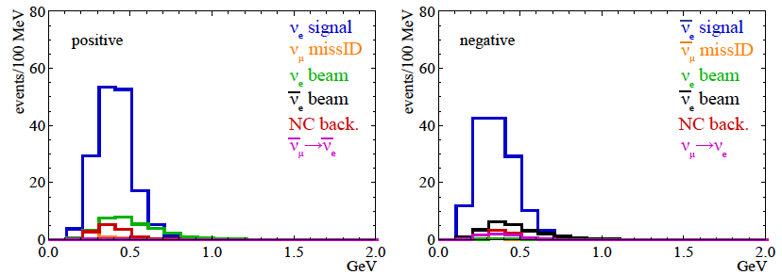
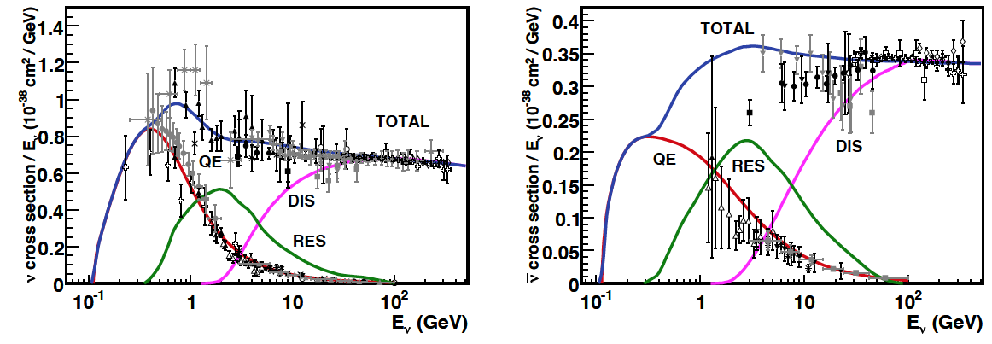
Neutrino spectra
540 km (2 GeV), 10 years, ~300 events
below ν_{τ} production, almost only QE events
neutrinos
anti-neutrinos
δ_{CP}=0
2 years
8 years
Notes:
Almost only (QE) quasi elastic events avoiding pi-zero production in the resonant regime. RES Resonant pion production.

Slide 11
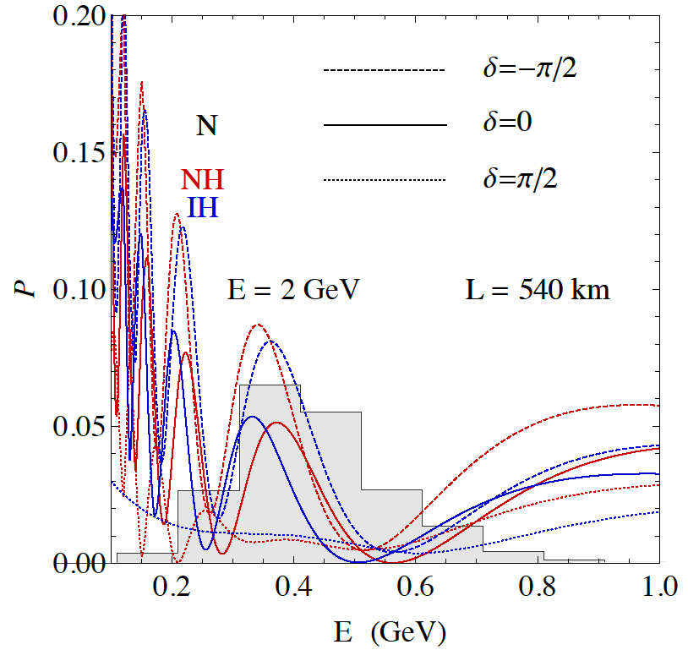
2nd Oscillation max. coverage
2nd oscillation max.
well covered by the ESS neutrino spectrum
1st oscillation max.

Slide 12
Physics Performance
little dependence on mass hierarchy (not so long baseline),
δ_{CP} coverage at 5 σ C.L. up to 60%,
δ_{CP} accuracy down to 6° at 0° and 180° (absence of CPV for these two values),
not yet optimized facility.
Even in this non-optimised case (E=2.5 GeV), ESSνSB would discover CP violation for at the level of 60% of the possible δ_{CP} values

Slide 13
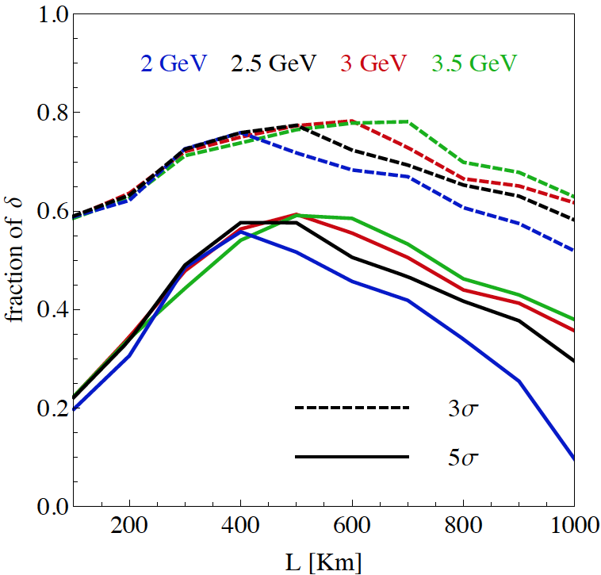
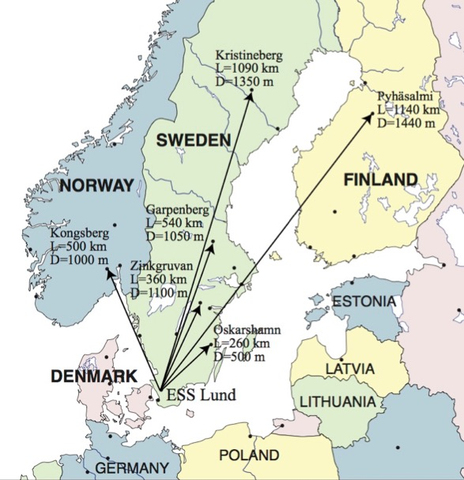
Which baseline?
CPV (Nucl. Phys. B 885 (2014) 127)
Garpenberg
Zinkgruvan
~60% δ_{CP} coverage at 5 σ C.L.
>75% δ_{CP} coverage at 3 σ C.L.
systematic errors: 5%/10% (signal/backg.)

Slide 14
Optimisations to be done
2.5 GeV
540 km
5%/10% syst.
optimizations are coming:
  with the present configuration: 5/5 yrs seems better than 2/8 yrs,
  horn shape,
  detector efficiency (cheaper PMTs with higher QE),
  near detector.

Slide 15
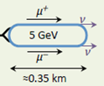
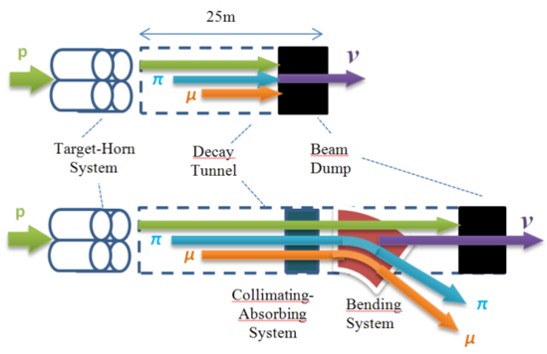
ESS neutrino and muon facility
2.7x10²³ p.o.t/year
Neutrons to ESS
ESS proton driver
Protons dump
ν_{μ} or ‾ν_{μ}
Long
Baseline
Detector
π decay
ESSnuSB
Test Facility
μ⁺ or μ⁻
ν_{μ} + ‾ν_{e}
Short
Baseline
Detector
Short
Baseline
Detector
Accumulator
Decay
channel or ring
nuSTORM
Front end
ν_{e} + ‾ν_{μ}
Muons of average energy ~0.5 GeV at the level of the beam dump
RLA
acceleration
Storage
ring
Cooling
Long
Baseline
Detector
Neutrino
Factory
RCS
acceleration
Collider
ring
Muon Collider
→ ←
μ⁺ μ⁻

Slide 16

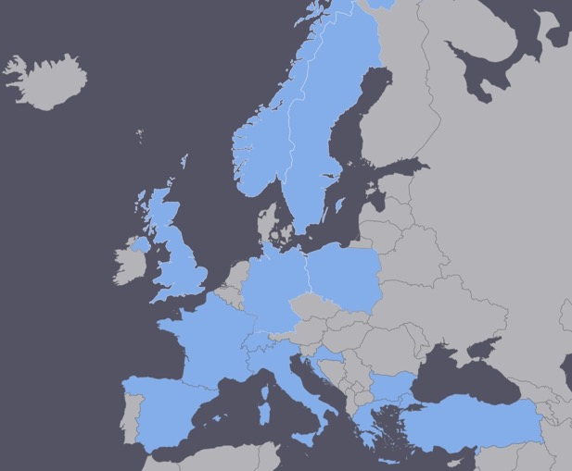
ESSνSB at the European level
COST application for networking has been succeeded: CA15139 (2016-2019)
  EuroNuNet : Combining forces for a novel European facility for neutrino-antineutrino symmetry violation discovery (http://www.cost.eu/COST_Actions/ca/CA15139)
  Major goals of EuroNuNet:
    to aggregate the community of neutrino physics in Europe to study the ESSνSB concept in a spirit of inclusiveness,
    to impact the priority list of High Energy Physics policy makers and of funding agencies to this new approach to the experimental discovery of leptonic CP violation.
  13 participating countries (network still growing).

Slide 17

ESSνSB at the European level
A H2020 EU Design Study has been submitted end of March (Call INFRADEV-01-2017)
Title of Proposal: Discovery and measurement of leptonic CP violation using an intensive neutrino Super Beam generated with the exceptionally powerful ESS linear accelerator
Duration: 4 years
Total cost: 4.7 M€
Requested budget: 3 M€
15 participating institutes from
11 European countries including CERN and ESS
6 Work Packages
Decision: end of August 2017
ESSνSB
BENE (2004-2008)
ISS (2005-2007)
EUROν (2008-2012)
LAGUNA (2008-2010)
LAGUNA-LBNO (2010-2014)
COST Action CA15139 (2015-2019)

Slide 18
Design Study ESSνSB
approved!

Slide 19
Design Study ESSνSB
(2018-2021)
very supportive letter from ESS director
Grant Agreement already signed,
Official start date 1st of January 2018.
ESSνSB has already started engaging postdocs.
partners: IHEP, BNL, SCK•CEN, SNS, PSI, RAL

Slide 20
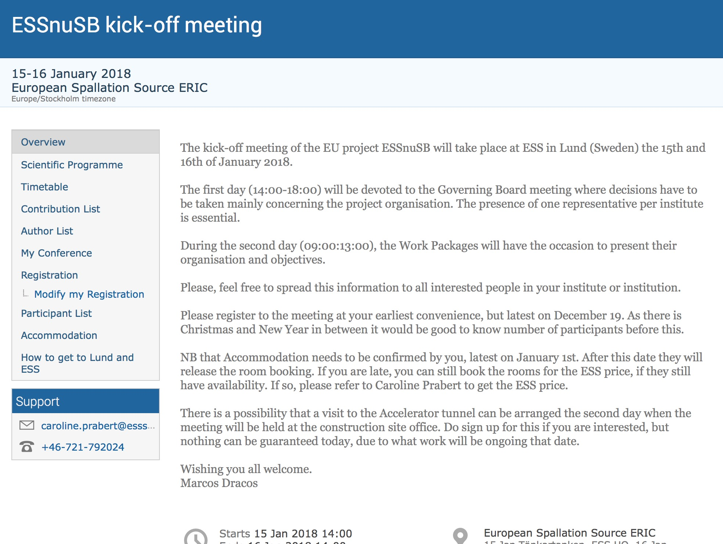
ESSνSB kick-off meeting in Lund

Slide 21
INPP involvement
Participants
George Fanourakis
Theodoros Geralis
George Stavropoulos
One year post-doc
INPP Budget: 64953

Slide 22
Conclusion
Significantly better CPV sensitivity at the 2nd oscillation maximum.
CPV: 5 σ could be reached over 60% of δ_{CP} range (ESSνSB) with large potentiality.
Large associated detectors have a rich astroparticle physics program.
The European Spallation Source Linac will be ready in less than 8 years (5 MW, 2 GeV proton beam by 2023), upgrade decisions by this moment.
COST network project CA15139 supports this project.
The EU-H2020 Design Study ESSνSB is approved and has started.
INPP plans to contribute to the ν Detectors optimization with respect to their physics potential and the Physics studies,

