Slide 1

Cooperation between
CERN and Greek Industries
2017

Slide 3
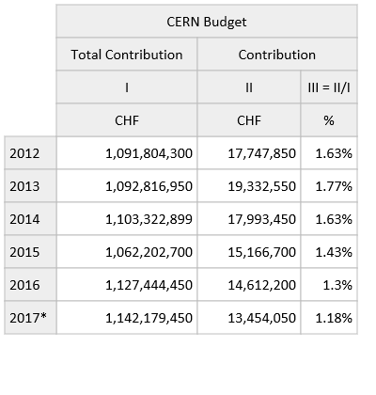
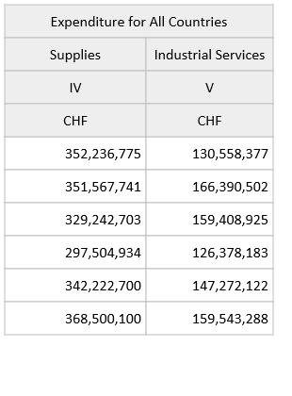
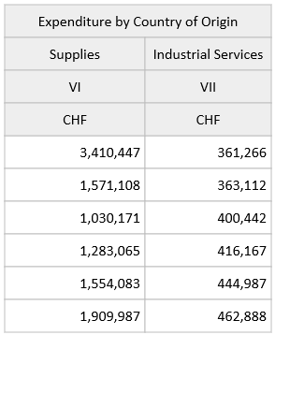

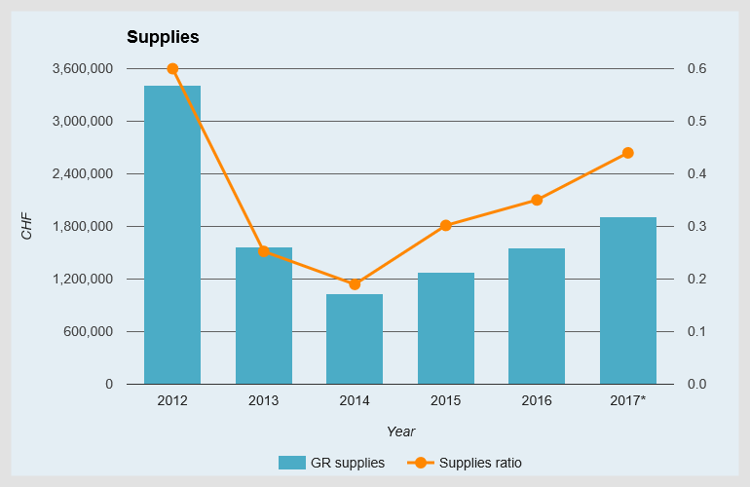
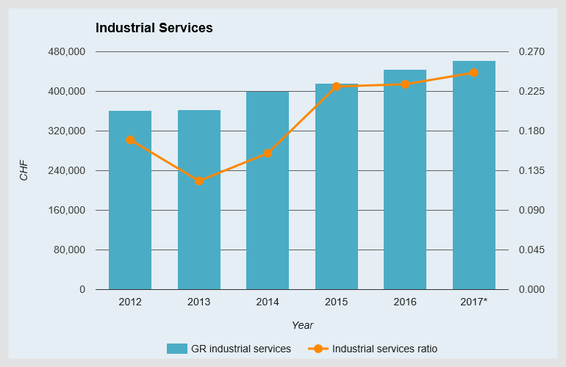
Industrial Returns (2012 to 2017)
* Provisional figures for the year

Slide 4
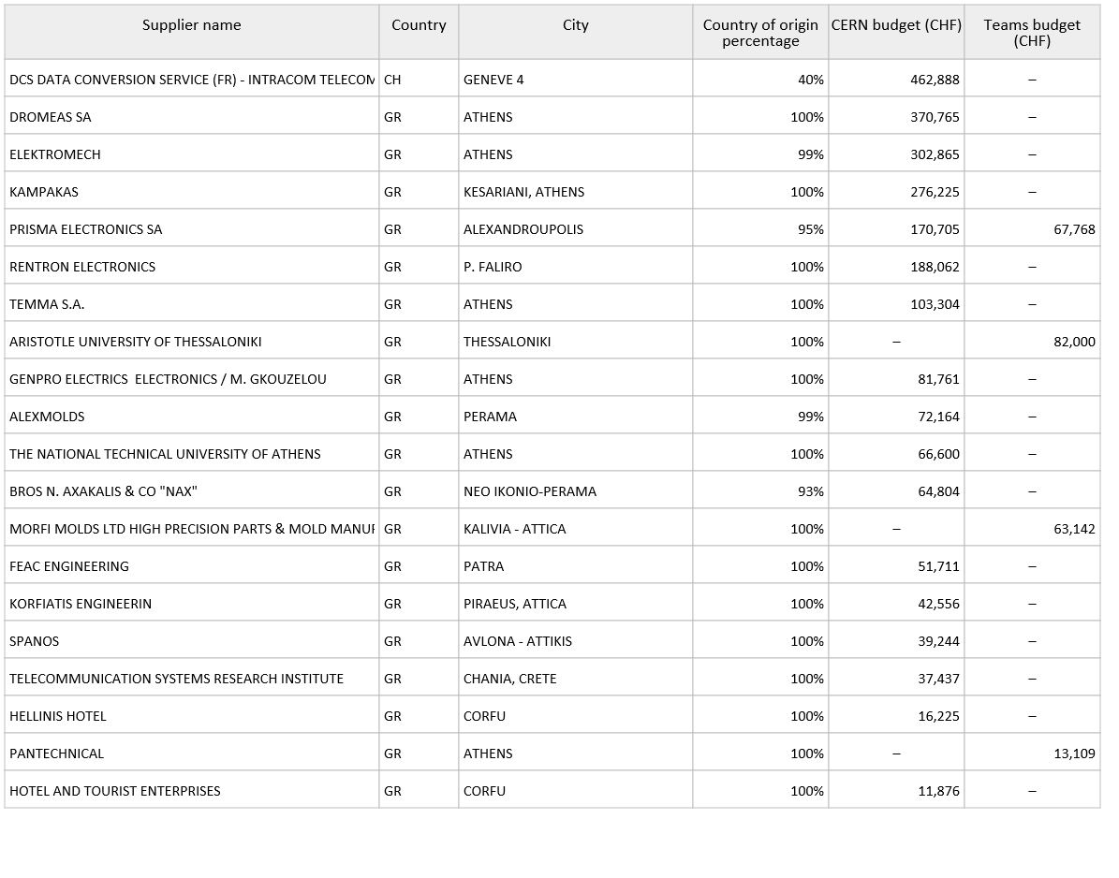
Suppliers with the highest turnover in 2017 (GR as the country of origin)

Slide 5
 | Supplies
 | Well balanced | Poorly balanced | Very poorly balanced
Austria |  | 0.57
Belgium |  | 0.50
Bulgaria | 1.87
Cyprus |  |  | 0.05
Czech Republic | 1.46
Denmark |  | 0.64
Finland |  | 0.60
France | 1.19
Germany |  | 0.78
Greece |  | 0.42
Hungary | 3.64
India |  |  | 0.17
Israel |  |  | 0.28
Italy | 1.33
Lithuania |  |  | 0.0
Netherlands |  | 0.86
Norway |  |  | 0.35
Pakistan |  | 0.88
Poland | 1.23
Portugal |  | 0.49
Romania |  | 0.66
Serbia |  | 0.86
Slovakia |  | 0.82
Slovenia |  |  | 0.11
Spain | 1.02
Sweden |  | 0.45
Switzerland | 4.40
Turkey |  | 0.51
Ukraine |  |  | 0.25
United Kingdom |  | 0.49
Industrial return,
Based on
2014-2017,
Supplies
Target = 1.0
8 states well balanced vs. 6 previous year
7 states very poorly balanced vs.
8 previous year.
(2 additional associate member states)

Slide 6
 | Services
 | Well balanced | Poorly balanced
Austria |  | 0.20
Belgium |  | 0.01
Bulgaria |  | 0
Cyprus |  | 0
Czech Republic |  | 0
Denmark | 3.03
Finland |  | 0
France | 2.85
Germany |  | 0.14
Greece |  | 0.23
Hungary |  | 0
India |  | 0
Israel |  | 0
Italy | 0.44
Lithuania |  | 0
Netherlands |  | 0.09
Norway |  | 0
Pakistan |  | 0
Poland |  | 0
Portugal |  | 0.06
Romania |  | 0
Serbia |  | 0
Slovakia |  | 0
Slovenia |  | 0
Spain | 1.15
Sweden |  | 0
Switzerland | 7.47
Turkey |  | 0
Ukraine |  | 0
United Kingdom | 0.48
Industrial return,
Based on
2014-2017,
Services
Target = 0.4

Slide 7
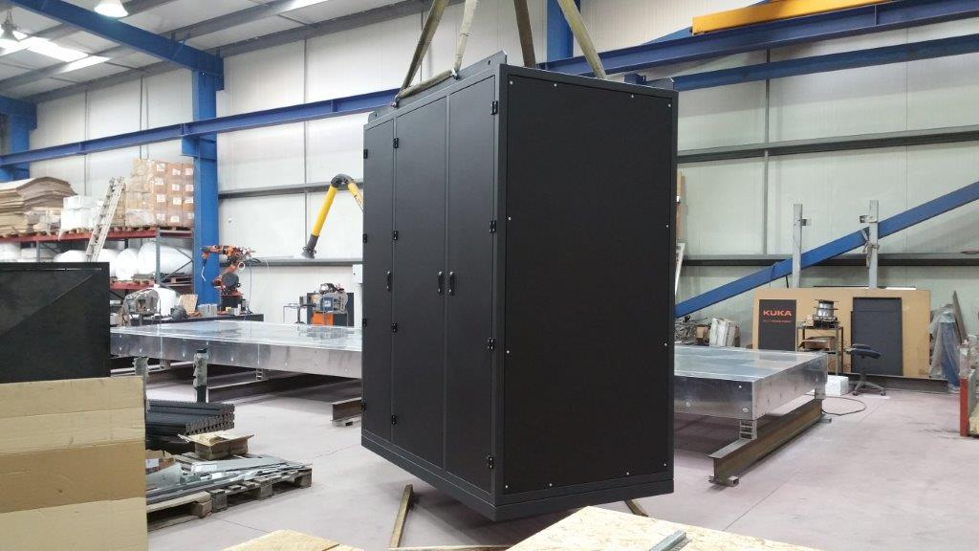

Slide 8
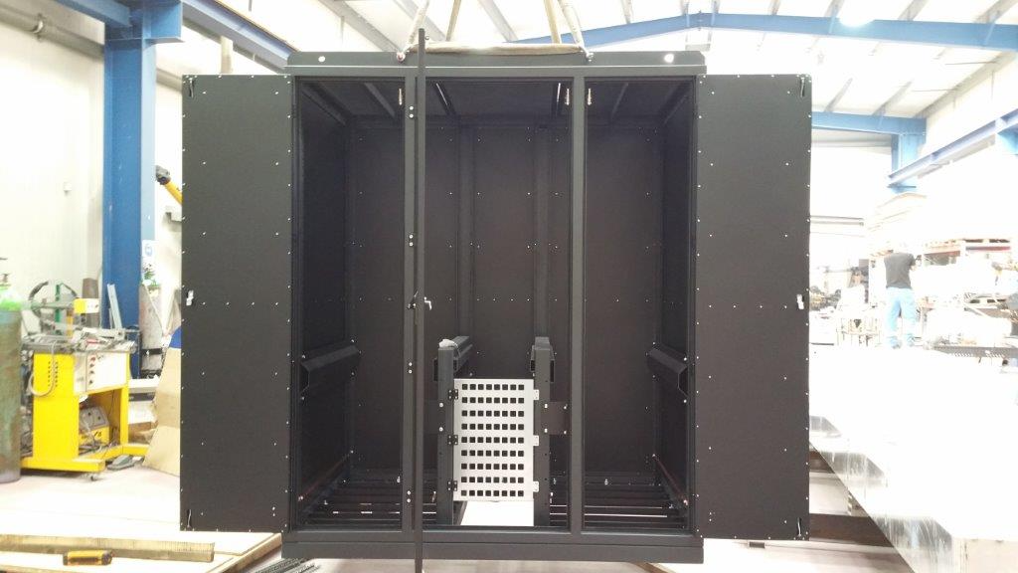

Slide 9
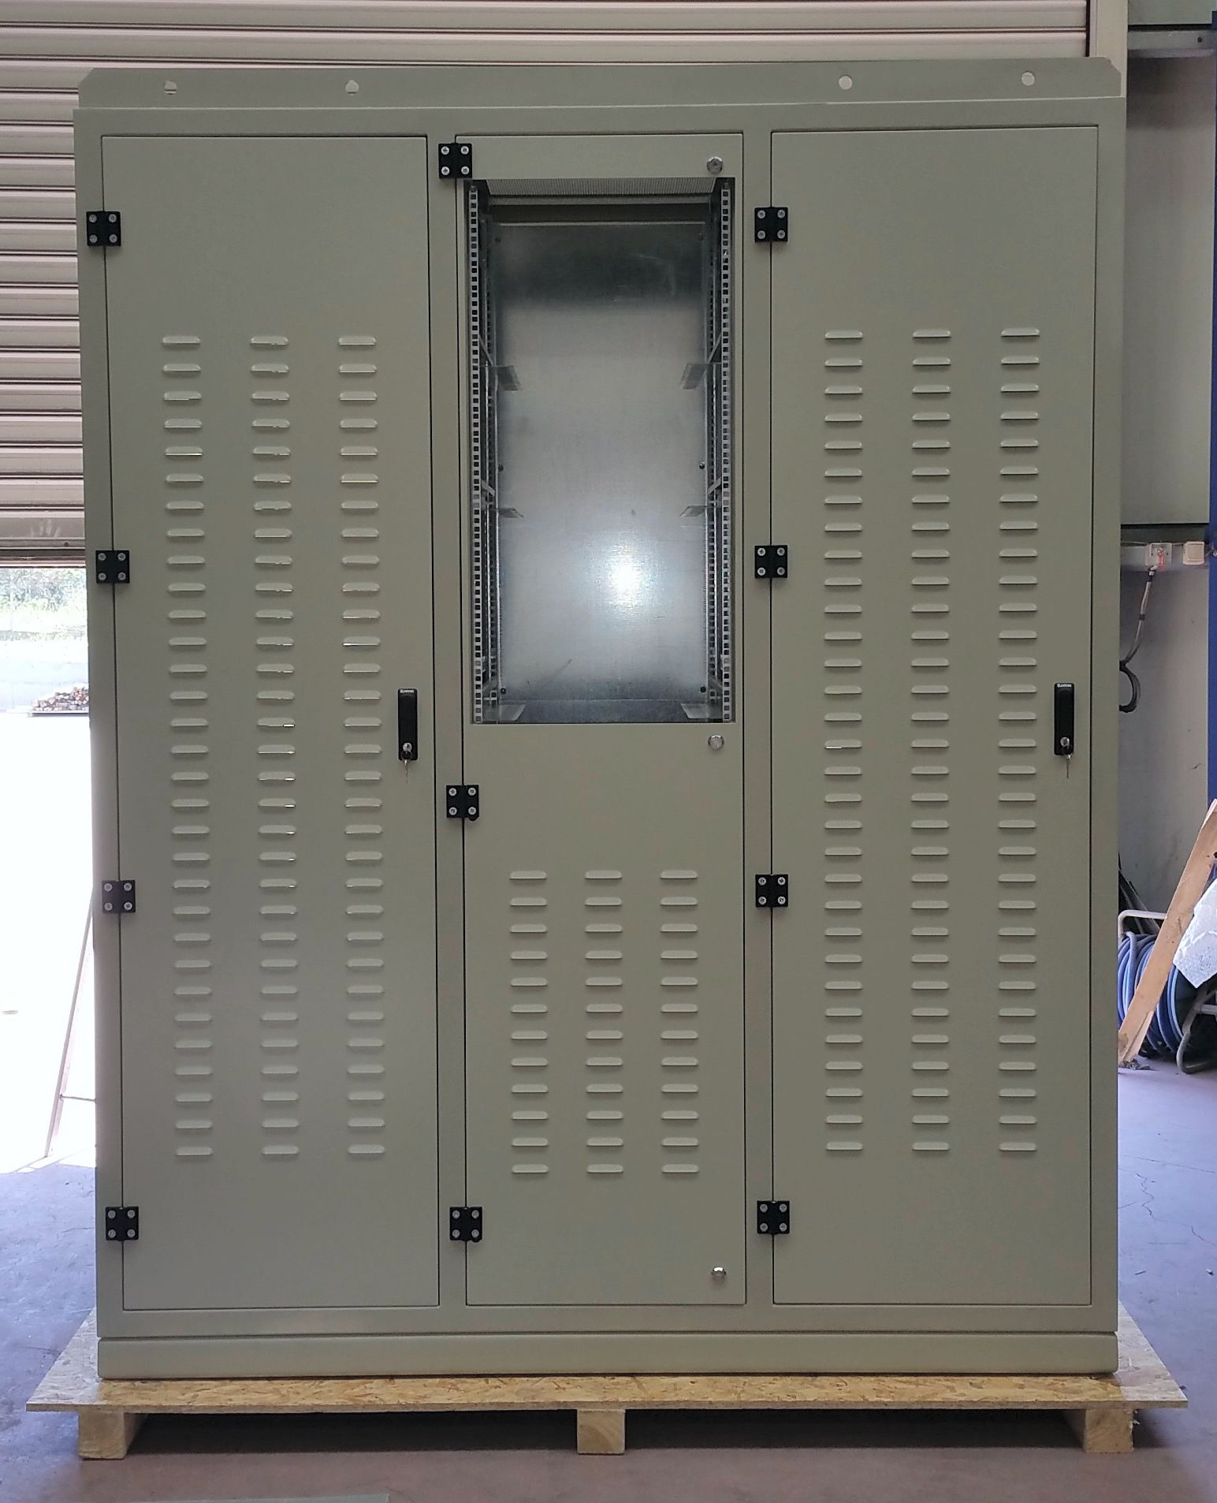

Slide 10
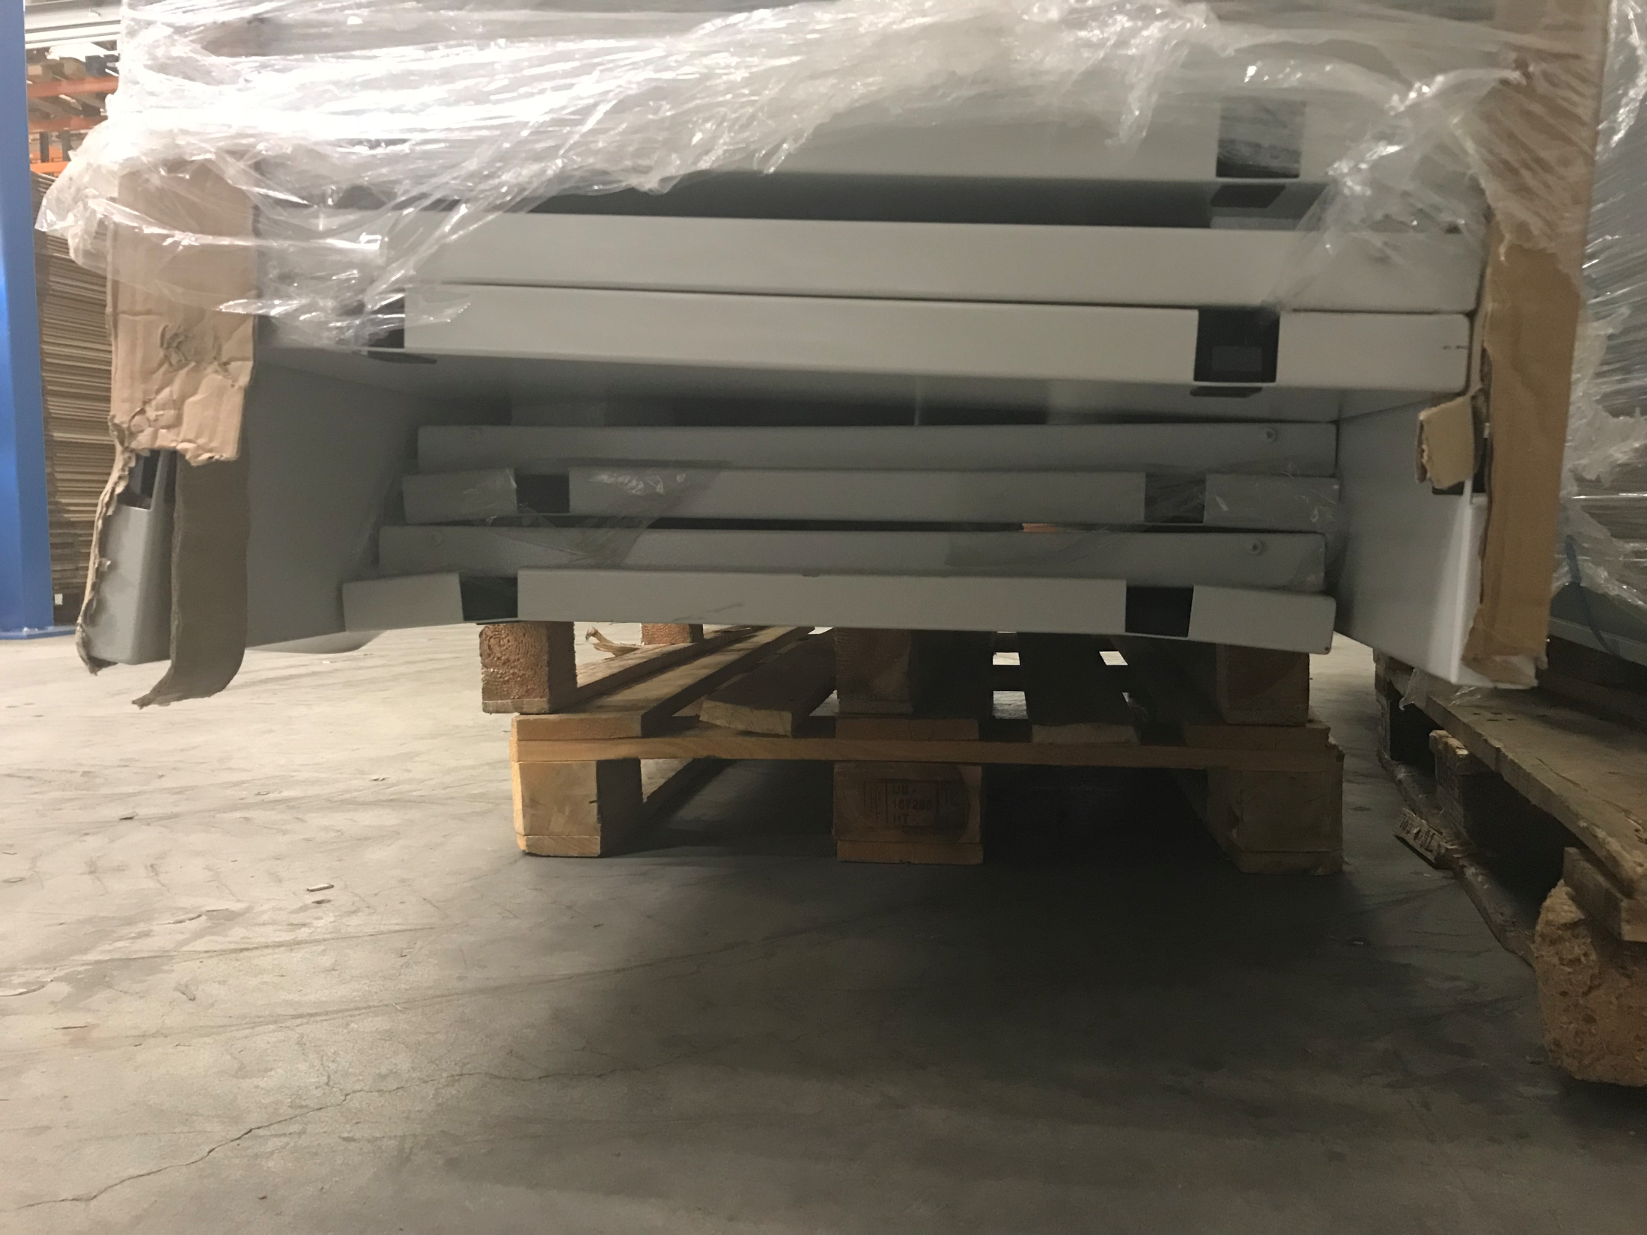

Slide 11
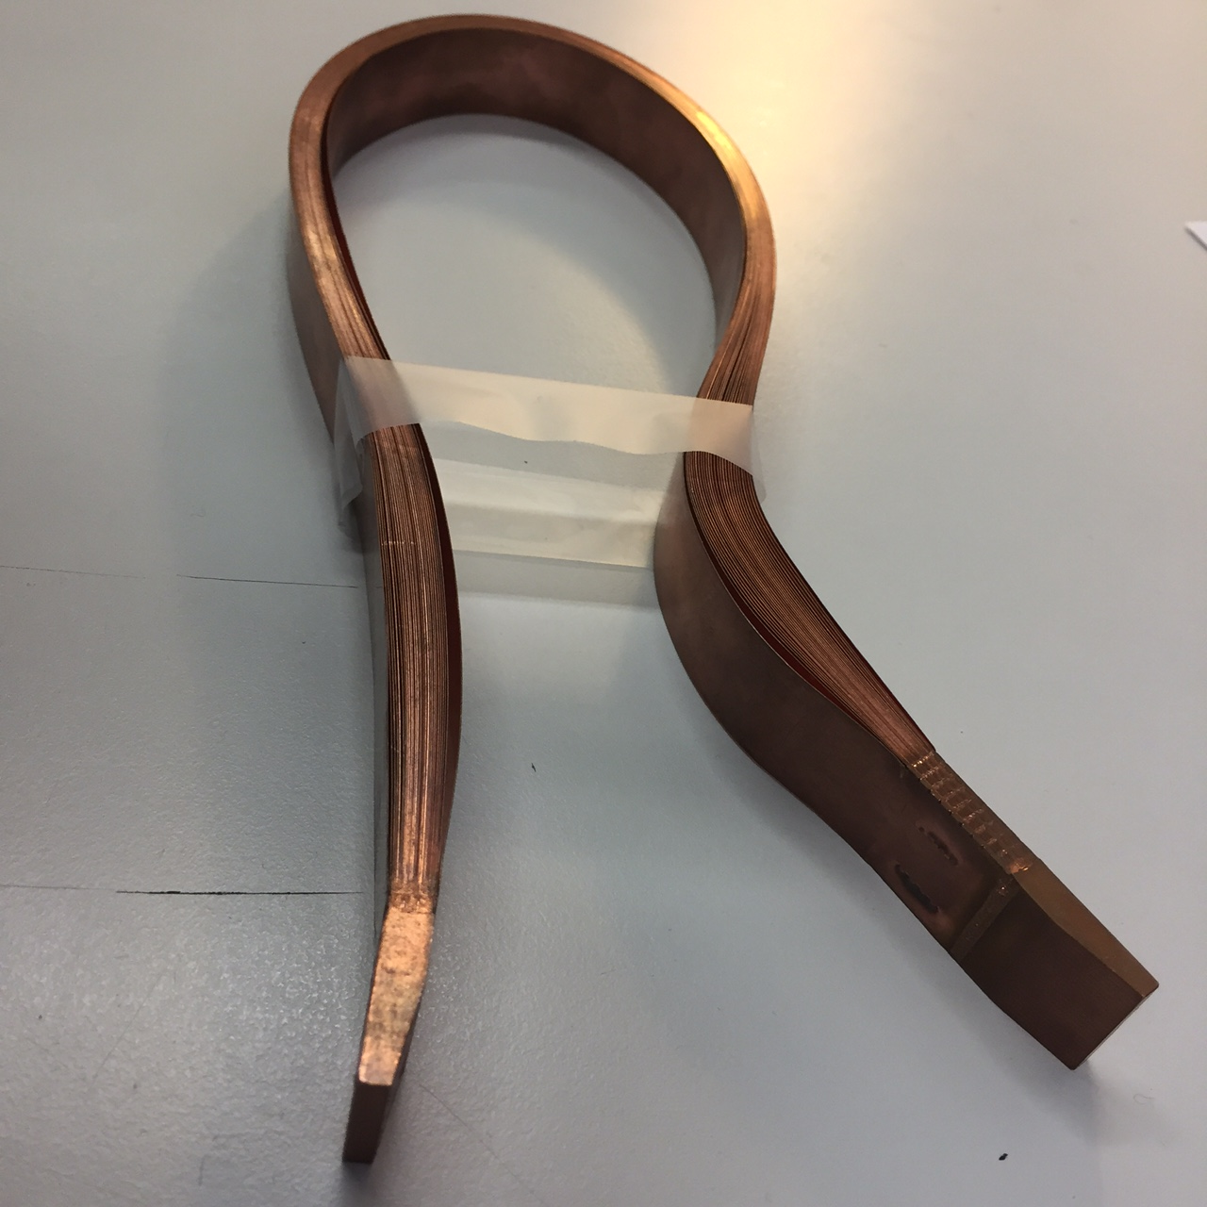

Slide 12
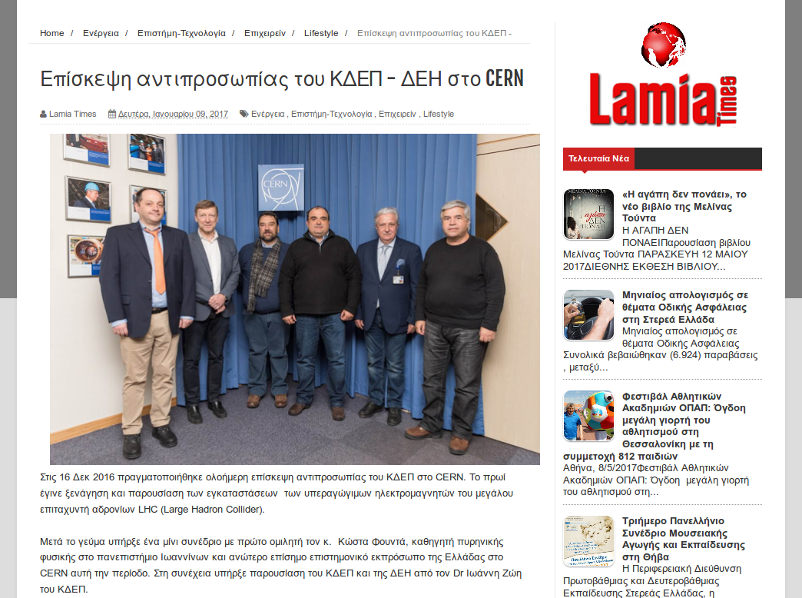

Slide 13
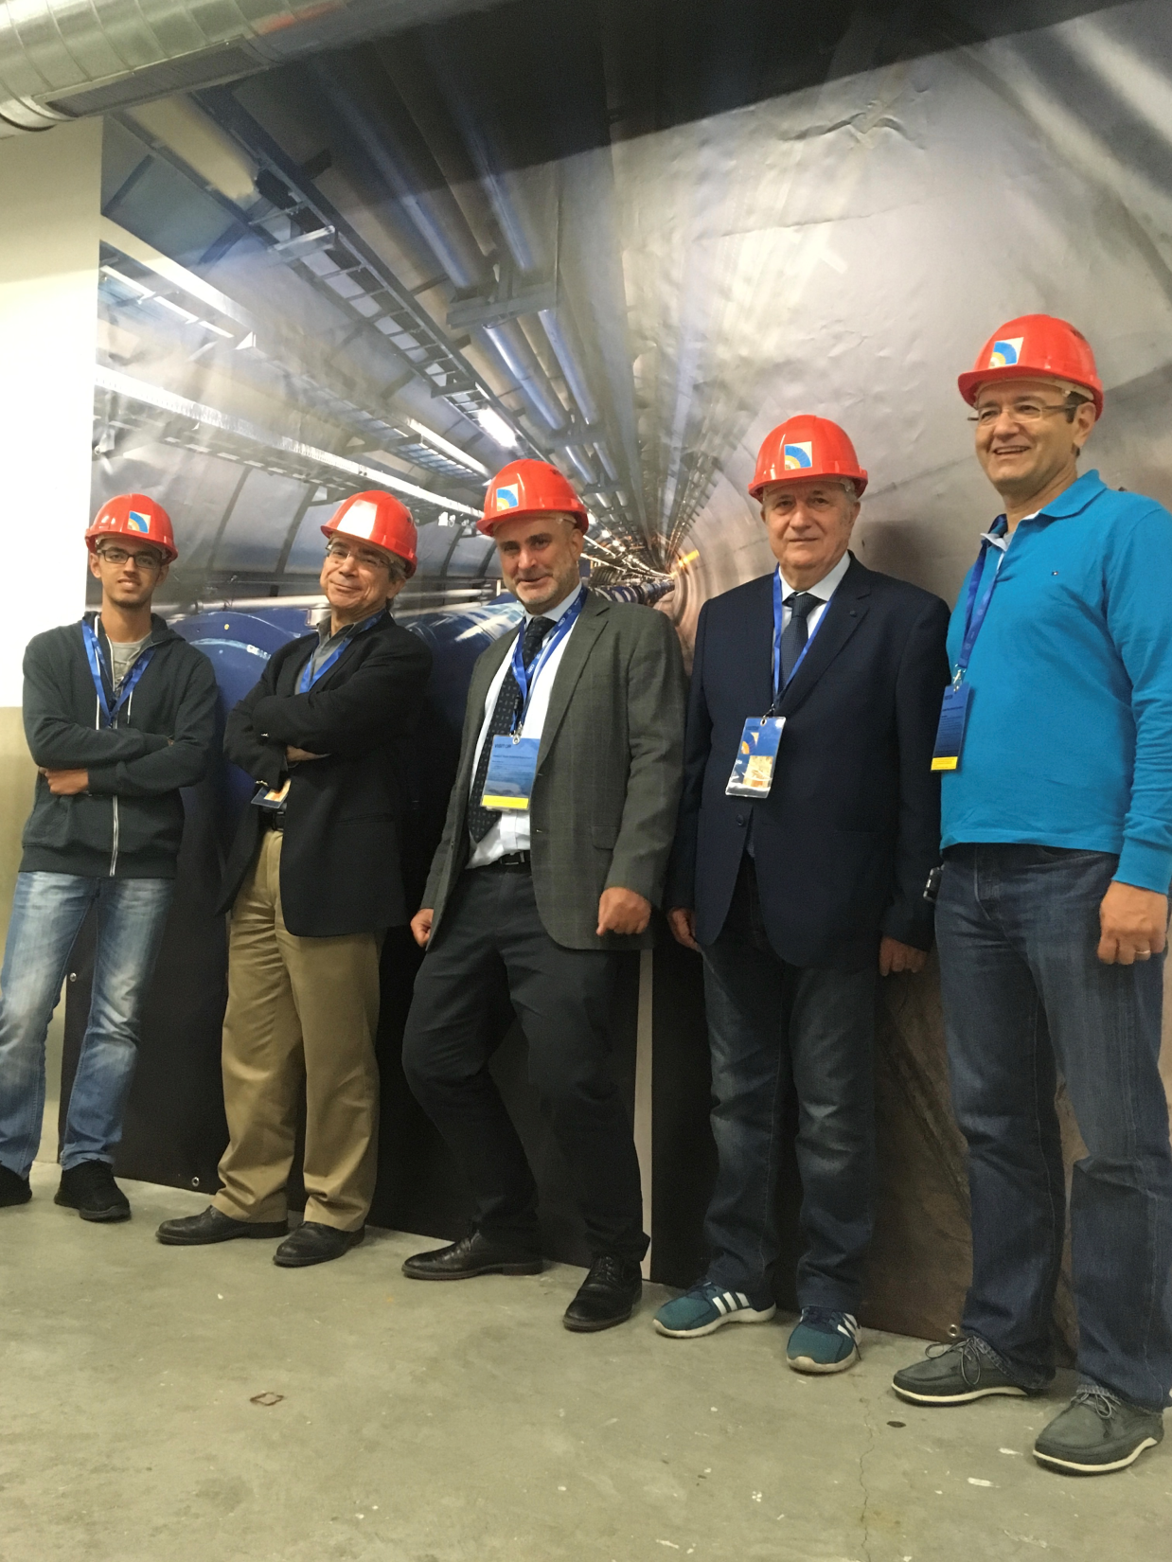

Slide 14
HEPTech Network
-Demokritos is one of the 22 nodes
Contribution to the various Editions of the Hellenic Forum

Slide 15
Around the members
➢ CERN
➢ DESY, Germany
➢ Sofia University, Bulgaria
In focus:
National Center for Scientific Research “Demokritos”, Greece
The interview:
Michele Barone, Technology transfer officer and Industry liaison officer for Greece at CERN
HEPTech upcoming events

Slide 16
LHC travelling roll-ups exhibition
Demokritos Main Library

Slide 17
Art@CMS is a collaboration between the CMS scientific community, art communities, and science education communities
The aim of the program is to reach out to as wide a range of people as possible in order to interest them in and inspire them to want to discover more about science, and in particular particle physics.
The program is comprised of 2 complementary modules, the Art@CMS exhibitions and the Science&Art@School

Slide 18
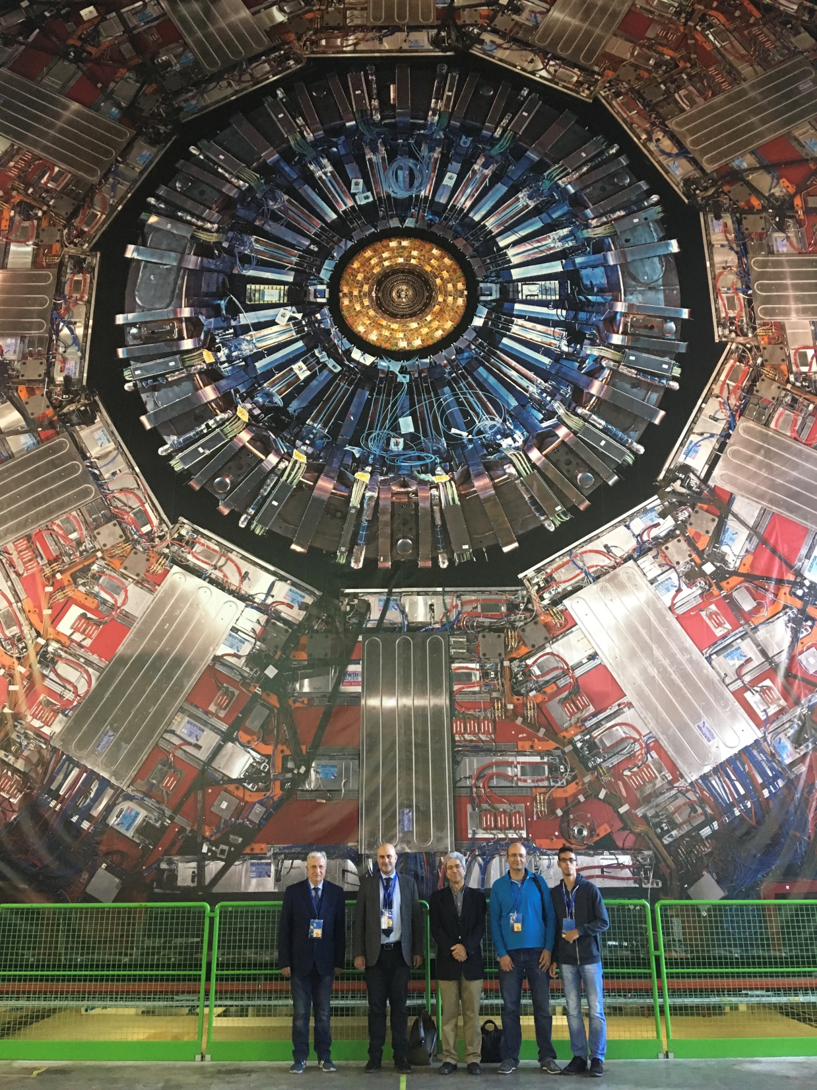

Slide 19

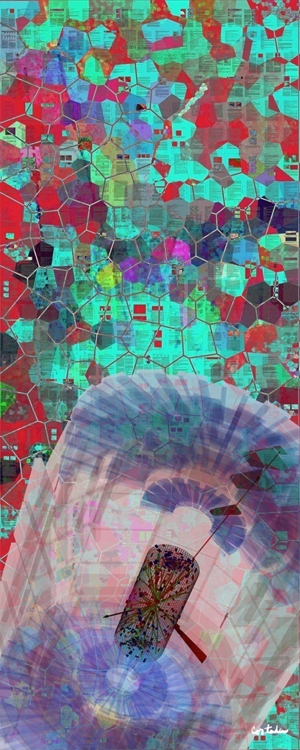
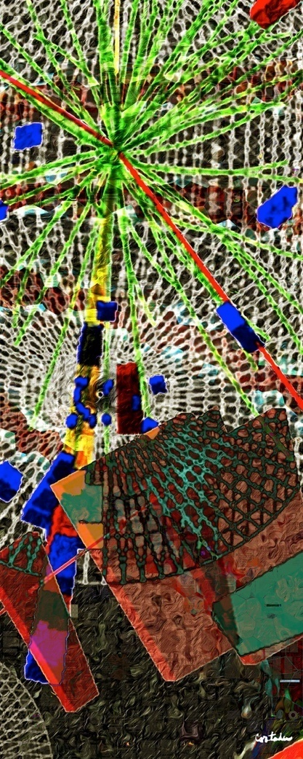
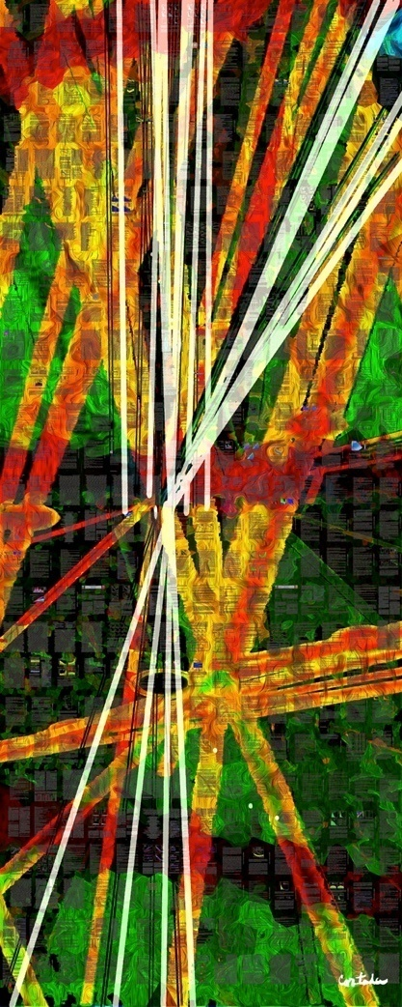
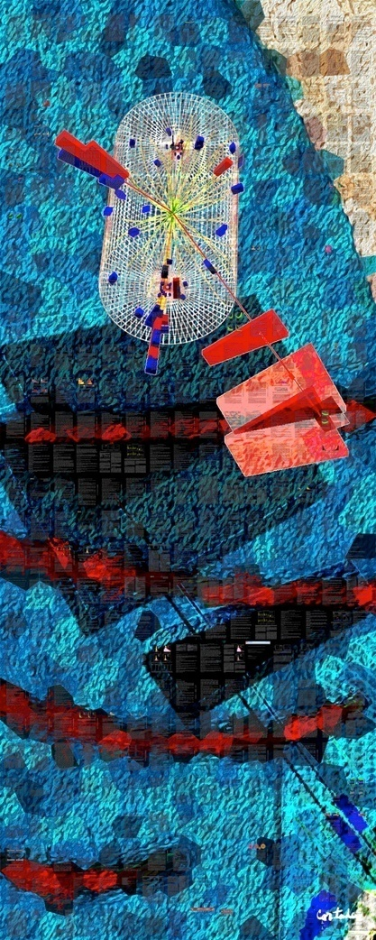
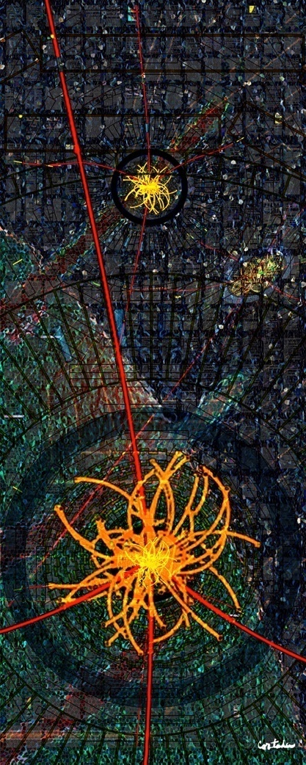
In Search of the Higgs Boson
Xavier Cortada (with the participation of physicist Pete Markowitz), digital art, 2013)
H→ WW
H→ γγ
H→ bb
H→ ττ
H→ ΖΖ

Slide 20
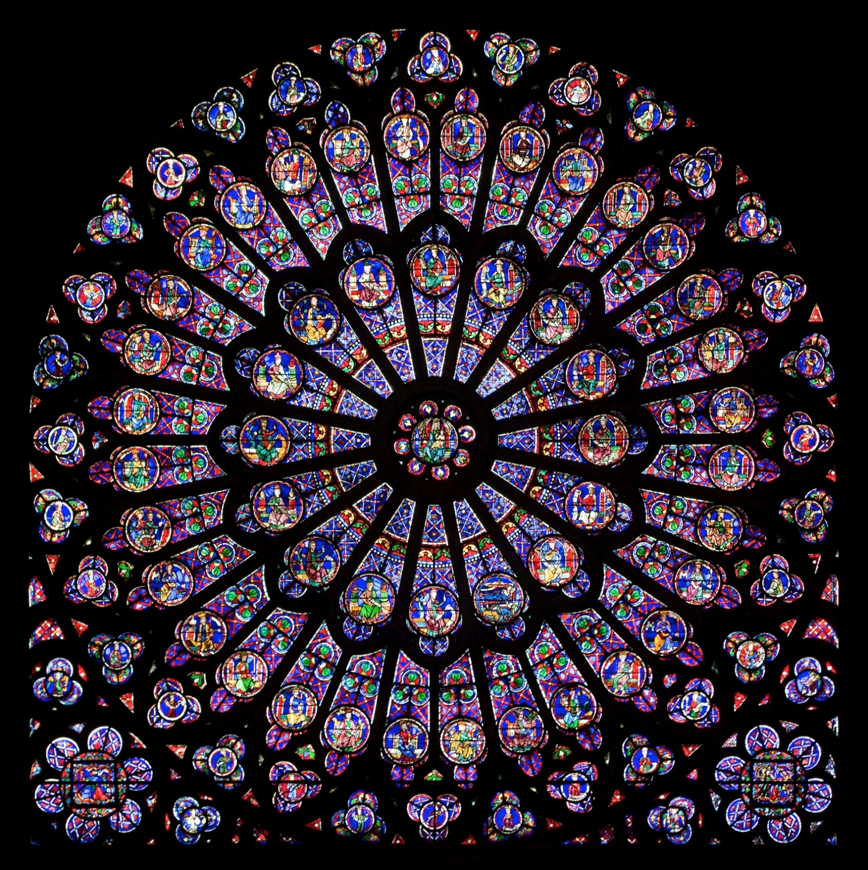

Slide 21
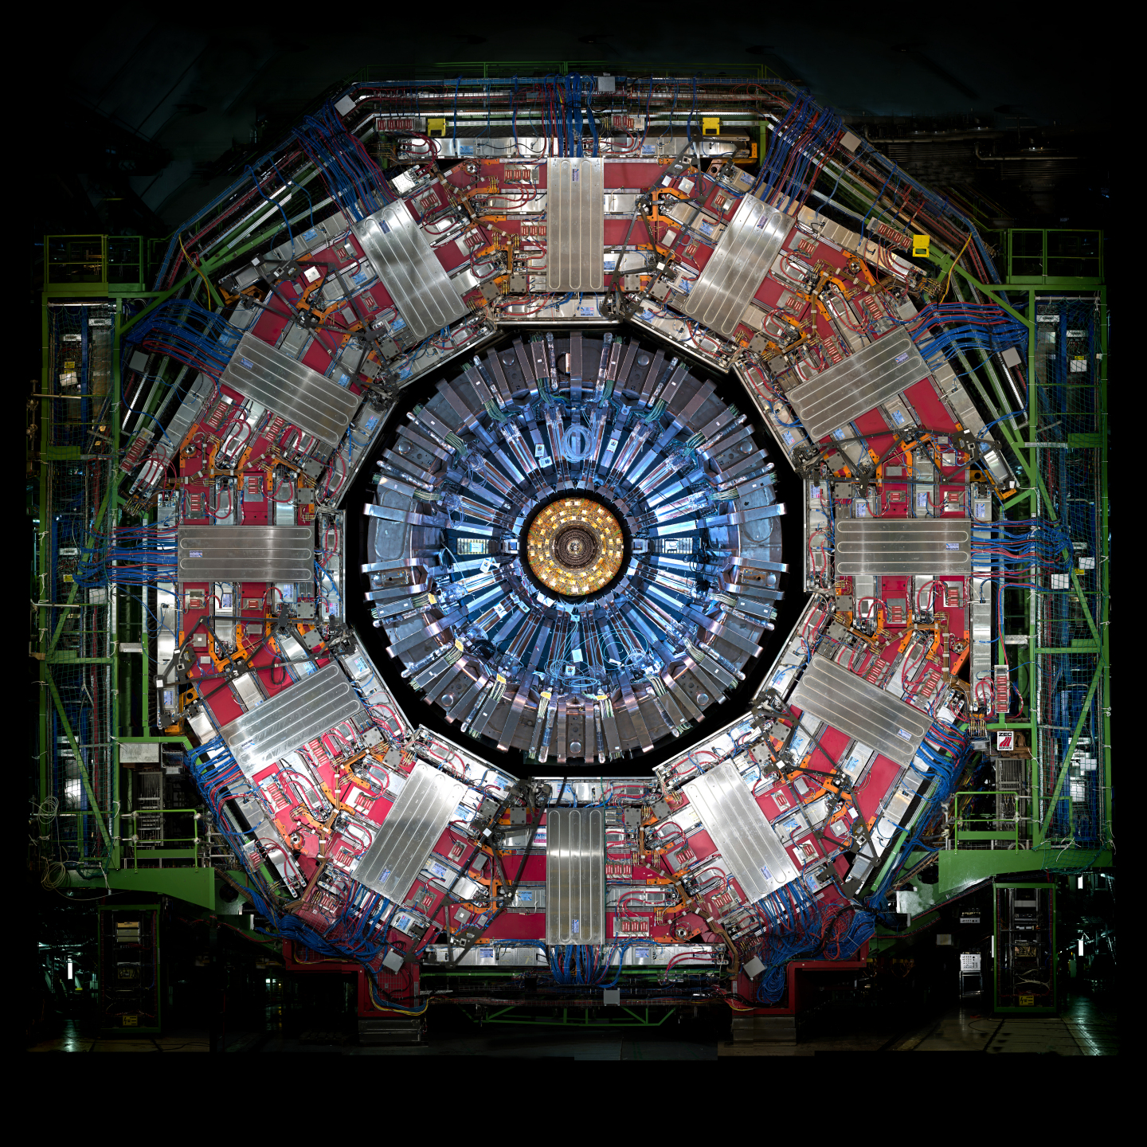

What is it ?
Fractal
O-ring
Window Rose
Catherine Wheel
Students have an open and creative mind

Slide 22
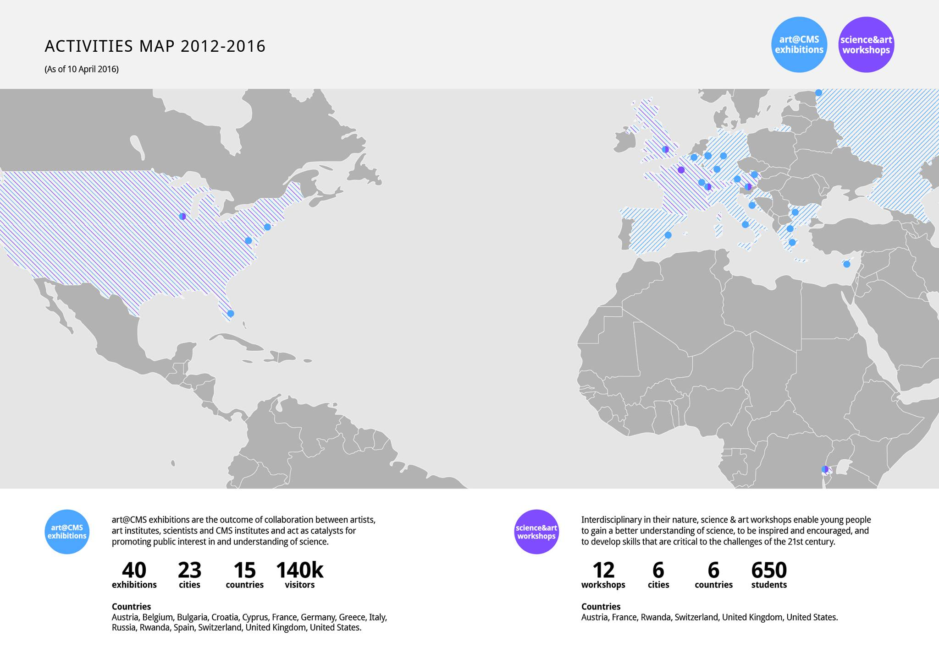
art@CMS
2014
B.A. International and European Economic Studies
Ph.D. Organisational Behaviour and
Human Resource Management
2016

Slide 23
Thank you!

Slide 24
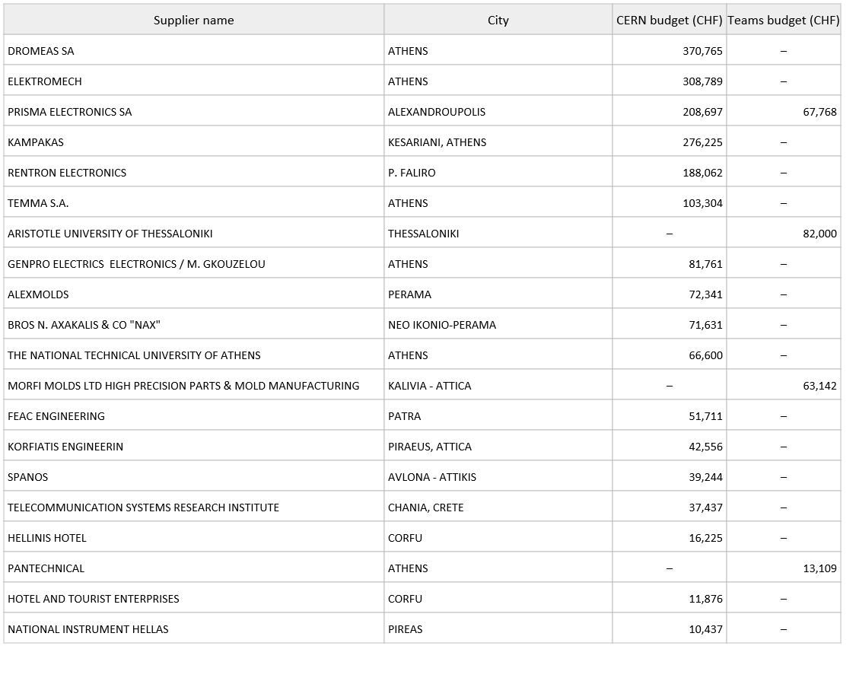
Suppliers with the highest turnover in 2017 (GR as the country of supplier)

Slide 25
