Slide 1
ISOLDE @ CERN
Anastasios Lagoyannis
Tandem Accelerator Laboratory
Institute of Nuclear and Particle Physics
N.C.S.R. “Demokritos”

Slide 2
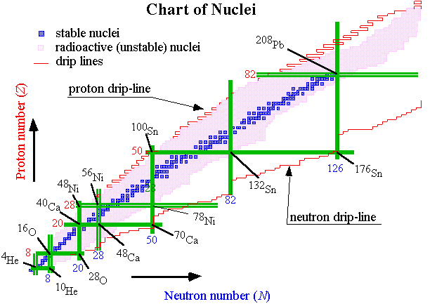
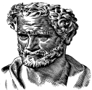
Why RIB’s ?
A. Lagoyannis
Institute of Nuclear and Particle Physics
NCSR “Demokritos”

Slide 3
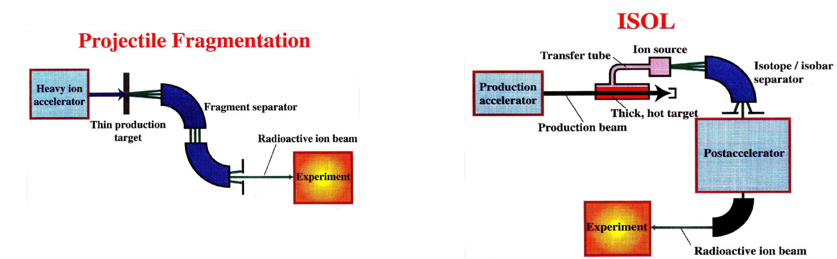

Production of RIB
Time limit ~1 μs
High luminosity
High energy beam >100 MeV/u
No chemistry
Time limit ~10-100 ms
High beam intensity close to stability
Better beam quality (purity, optics …)
Nuclei produced at rest
A. Lagoyannis
Institute of Nuclear and Particle Physics
NCSR “Demokritos”

Slide 4

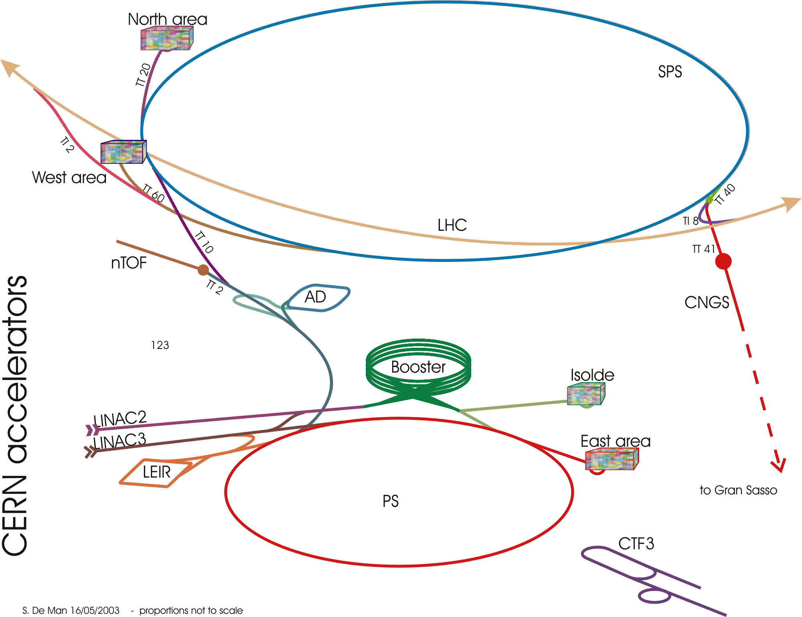


CERN
A. Lagoyannis
Institute of Nuclear and Particle Physics
NCSR “Demokritos”

Slide 5
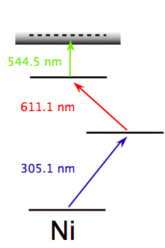
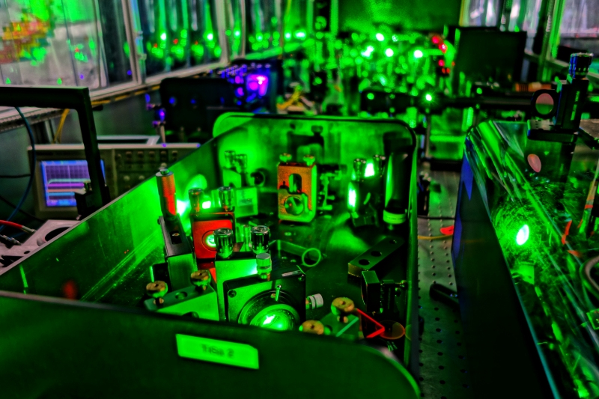
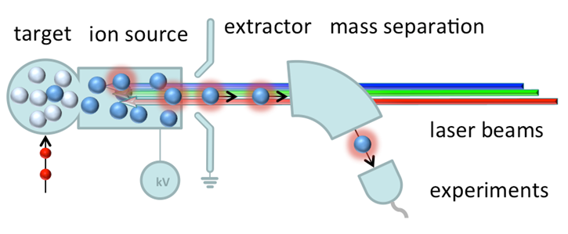
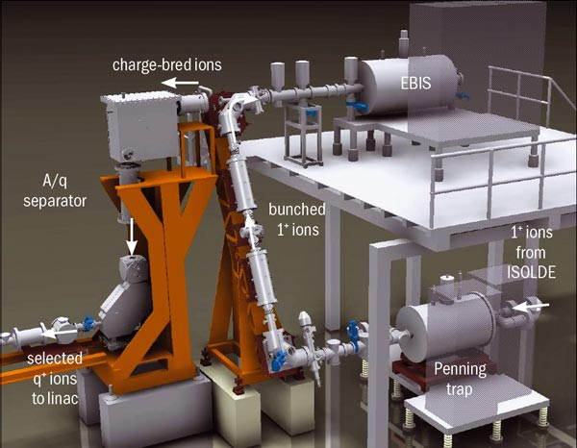
ISOLDE
Penning trap
Resonance Ionization
Laser Ion Source
Penning trap, slowing down ions,
accumulation and bunching
REXTRAP
REXEBIS
Electron Beam Ion Source
Charge breeding
Mass separator
A/q < 4.5
A. Lagoyannis
Institute of Nuclear and Particle Physics
NCSR “Demokritos”

Slide 6
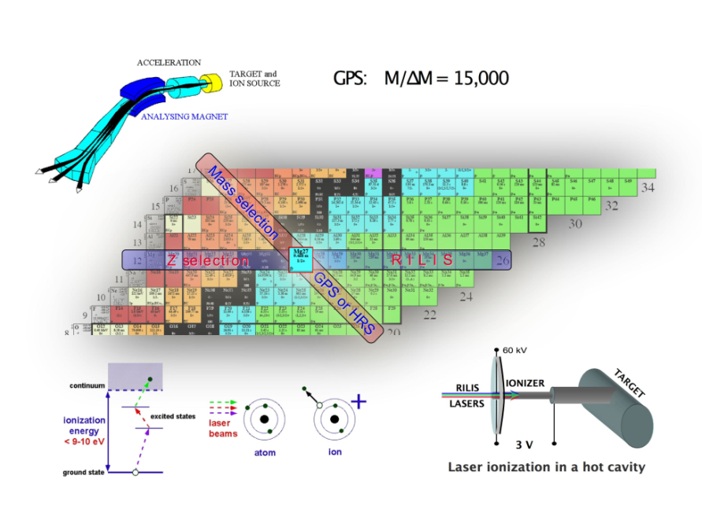
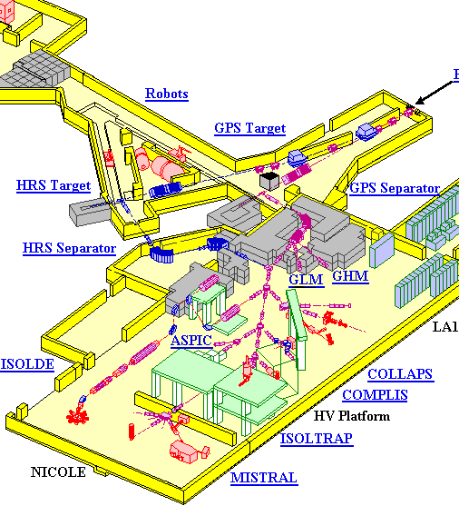
ISOLDE
1.4 GeV proton beam
RILIS
MNIBALL
A. Lagoyannis
Institute of Nuclear and Particle Physics
NCSR “Demokritos”

Slide 7
Yields
A. Lagoyannis
Institute of Nuclear and Particle Physics
NCSR “Demokritos”

Slide 8
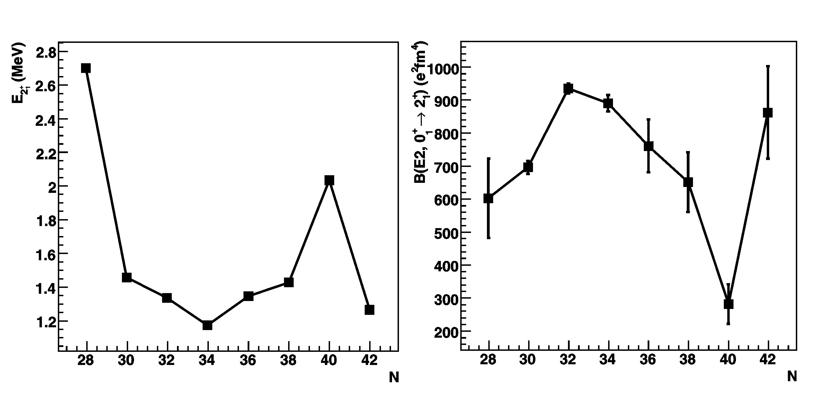

Physics case: ⁶⁸Ni
Is the nature of the N=40 subshell closure understood?
First excited state 0⁺ at higher energies
The 2⁺ state at larger excitation energy
Small B(E2, 0⁺ 2⁺)
No irregularity at the S_{2n} or at the binding energies
Fragile nature of the N=40 subshell closure
Other reasons for the small observed B(E2, 0⁺ 2⁺)
S. Rahaman et al., Eur. Phys. J. A 34, 5 (2007)
p_{1/2}
g_{9/2}
f_{5/2}
40
p_{3/2}
p_{1/2}
●●
28
f_{5/2}
●●●●●●
f_{7/2}
●●●●●●●●
p_{3/2}
●●●●
d_{3/2}
●●●●
π
ν
⁶⁸Ni
A. Lagoyannis
Institute of Nuclear and Particle Physics
NCSR “Demokritos”

Slide 9
Physics case: ⁶⁸Ni
Study of the single particle character of the neutron rich Ni isotopes
Physics case: ²H(⁶⁶NI,p)⁶⁷Ni ,Q = 3.583 MeV
⁶⁷Ni^{g} one hole state of the ⁶⁸Ni
g factor exp. value smaller by a factor of 2 than the expected for 1g_{9/2}
Unambiguous determination of the spin and parities of the
the first excited states - one more state ν_{3/2} not yet observed
Single particle character of the states of ⁶⁷Ni (relative SF’s)
A good starting point as to determine the single particle
character of the Ni isotopic chain – single particle systematics
p_{1/2}
g_{9/2}
f_{5/2}
40
p_{3/2}
p_{1/2}
●
28
f_{5/2}
●●●●●●
f_{7/2}
●●●●●●●●
p_{3/2}
●●●●
d_{3/2}
●●●●
π
ν
⁶⁷Ni
A. Lagoyannis
Institute of Nuclear and Particle Physics
NCSR “Demokritos”

Slide 10
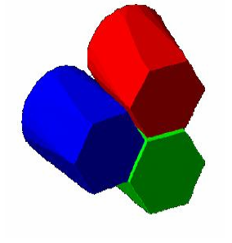
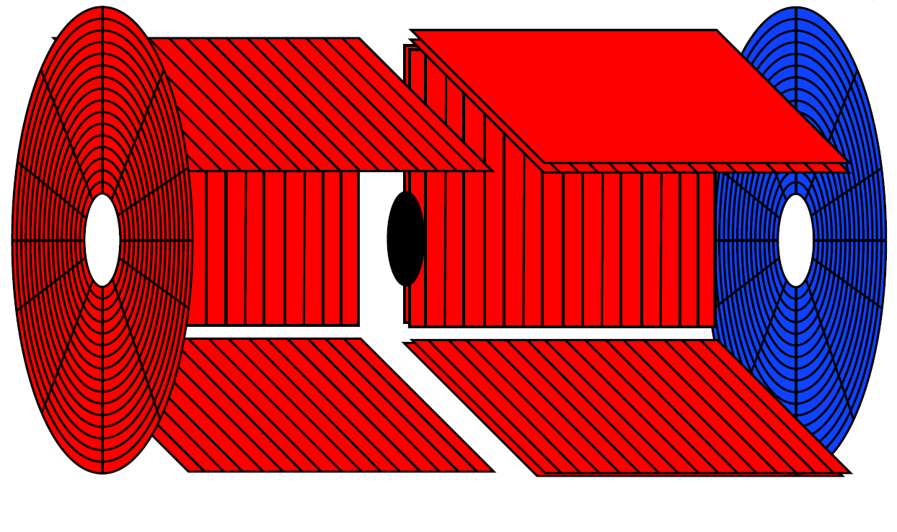
Experimental Setup
“Thick” CD₂ target measurement (1mgr/cm²)
Spectroscopic information for the
excited states up to 3 MeV.
Coincidences with γ
“Thin” CD₂ target measurement (100 μgr/cm²)
Spectroscopic information for the ground
and the second excited state.
Singles: only backward angles
A. Lagoyannis
Institute of Nuclear and Particle Physics
NCSR “Demokritos”

Slide 11
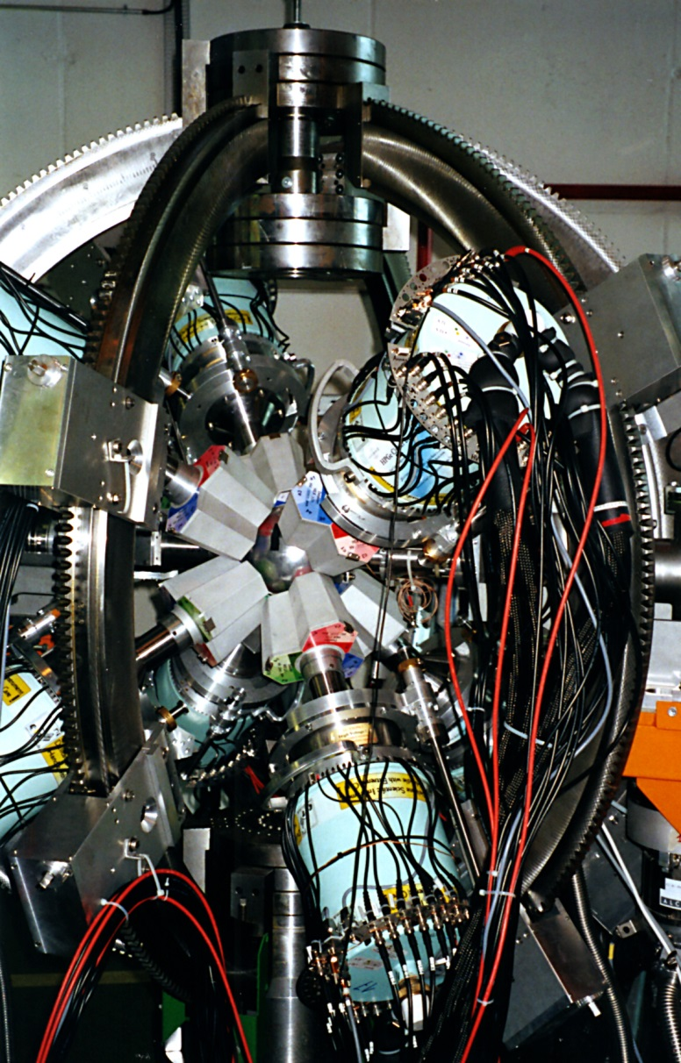
Miniball
8 x
= 168 channels
ε = 10% @ 1 MeV
A. Lagoyannis
Institute of Nuclear and Particle Physics
NCSR “Demokritos”

Slide 12
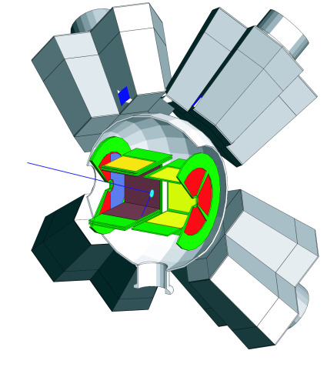
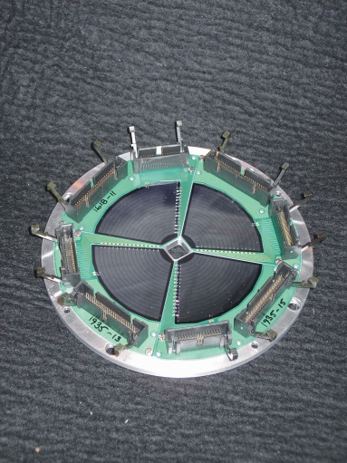
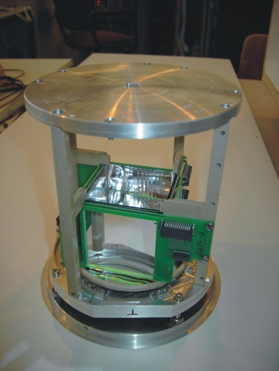
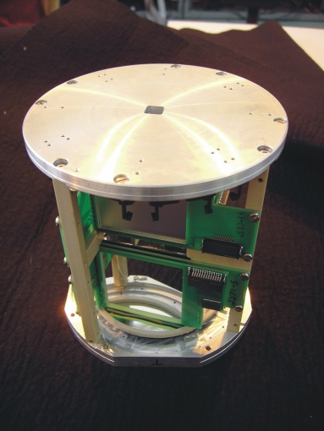
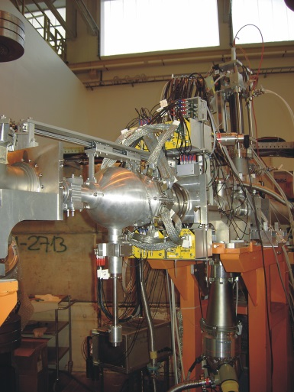

Silicon Barrel
Detector | Angles | Thickness | Segmentation
Forw. CD (ΔE) | 8-30 | 300 μm | 16 annular x 24 radial
Forw. CD (E) | 8-30 | 1.5 mm | no
Forw. Barrel (ΔE) | 30-75 | 140 μm | 16 stripes ⊥ beam + ch. Div resistive layer
Forw. Barrel (PAD) | 30-75 | 1 mm | no
Back. Barrel | 104-152 | 500 μm | 16 stripes ⊥ beam + ch. Div resistive layer
Back. CD | 152-172 | 500 μm | 16 annular x 24 radial
Particle detector: 464 channels
A. Lagoyannis
Institute of Nuclear and Particle Physics
NCSR “Demokritos”

Slide 13
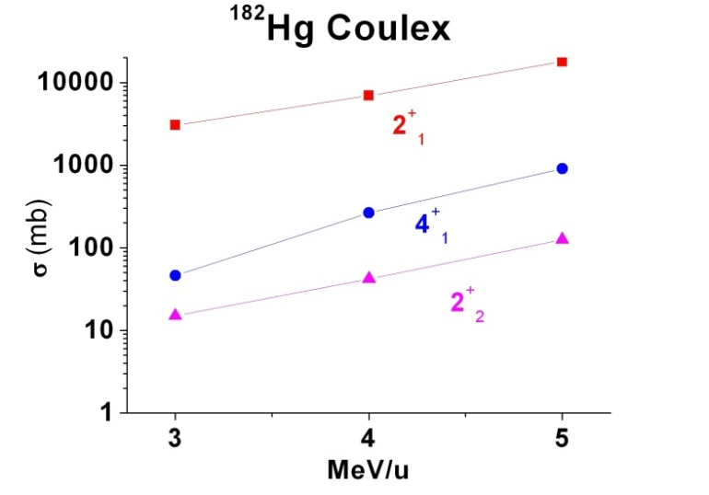
HIE - ISOLDE
Intensity
Energy
  Coulex for all RIB
  Transfer reactions
Efficiency low energy + accelerated
Selectivity
Beam “quality”
  Reduced phase space
  Bunching
Polarization .....
A. Lagoyannis
Institute of Nuclear and Particle Physics
NCSR “Demokritos”

Slide 14
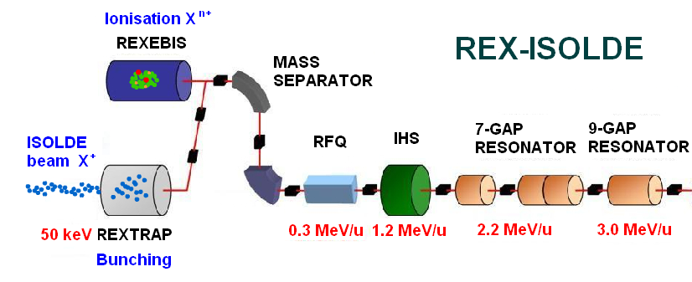
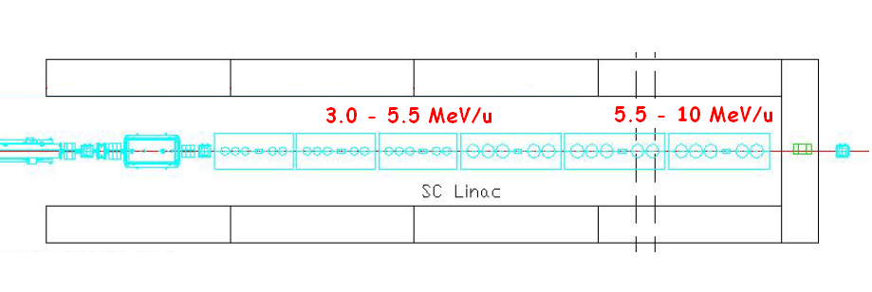
HIE - ISOLDE
Increase in REX energy from 3 to 10 MeV/u
(first step an increase to 5.5 MeV/u)
Increase proton intensity 2 → 6 μA (LINAC4, PSB upgrade) - target and front-end upgrade
RFQ cooler, REX-TRAP, REX-EBIS REX-ECR upgrades
Super-HRS for isobaric separation
RILIS upgrade & LIST
A. Lagoyannis
Institute of Nuclear and Particle Physics
NCSR “Demokritos”

