Slide 1
Nuclear Reactions for Astrophysics
&
Nuclear Data
Paraskevi (Vivian) Dimitriou
Institute of Nuclear and Particle Physics
National Center for Scientific Research “Demokritos”
Athens, Greece

Slide 2
Outline
Nuclear Reactions for Astrophysics
  Global semi-microscopic alpha-nucleus optical potential
  Systematics of proton-nucleus optical potential
Nuclear Reaction Data
  Nuclear reactions in the resolved resonance region
  Photon strength functions
  Photonuclear data library
  Ion Beam Analysis
Nuclear Structure Data Evaluation
  Beta-delayed neutron emission data
  Decay Data for Monitoring Applications
Other
  International Network of Nuclear Structure and Decay Data evaluators
  IAEA-ICTP Workshops
  7th International Workshop on Compound-Nuclear Reactions and Related Topics (CNR*20) (CALIBRA WP.1.10)

Slide 3
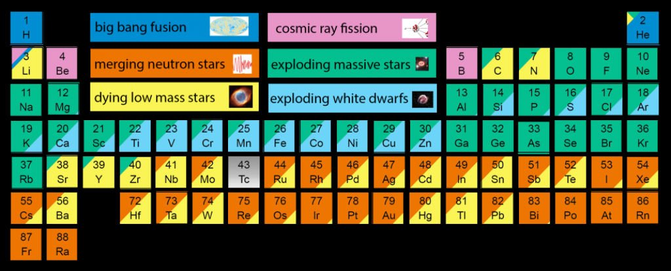
Nucleosynthesis: the origin of the solar system elements
Astro-physics scenarios
Nuclear Physics
Elemental abundances in Universe

Slide 4
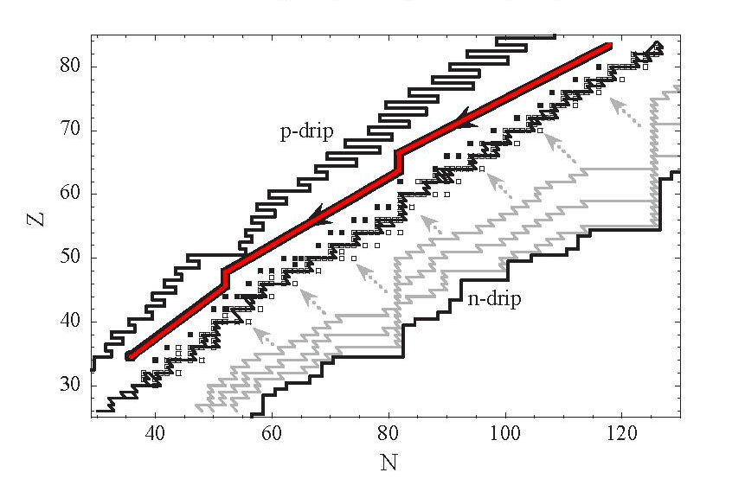
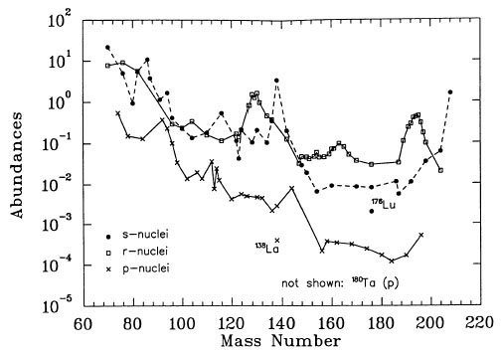
Heavy-element Nucleosynthesis
p process
s process
r process

Slide 5
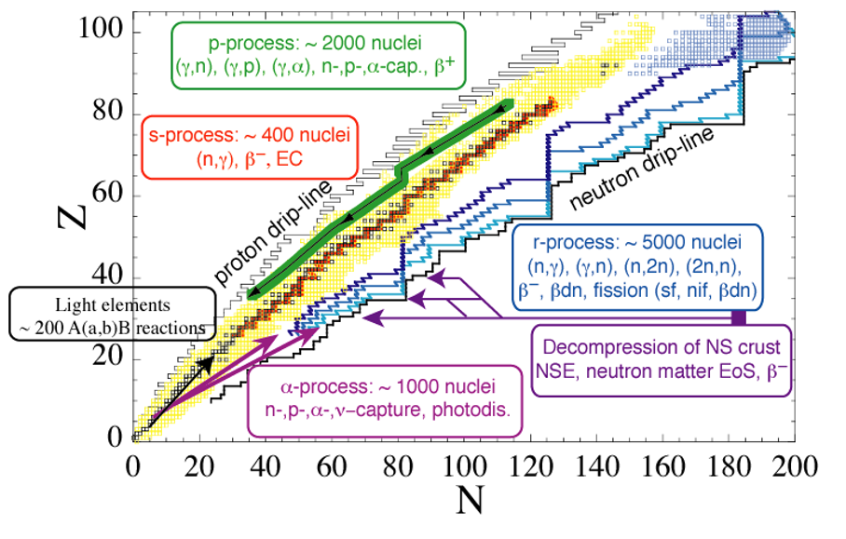
Nuclear Data Needs
Fusion reactions: CNO cycles

Slide 6

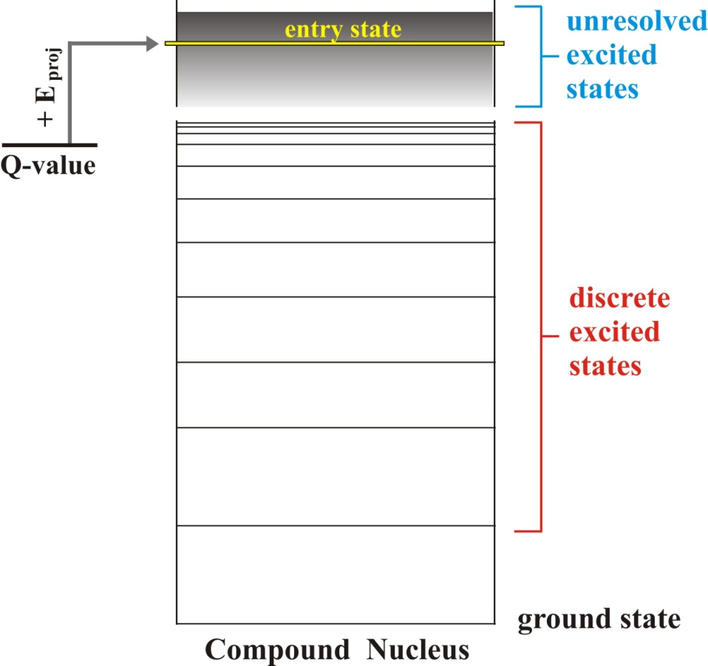





Nuclear reaction theory
particle-induced
medium-heavy nuclei
large particle separation energies
compound nucleus
reaction mechanism
Hauser-Feshbach theory
α + A → C* → b + B
average over level densities
:
Transmission through barrier –
particle-nucleus OMP
$$T_{γ}^{L}$$
:
E/M response – Dipole strength
photon strength function
:
sum of transmission probabilities over all exit channels i

Slide 7
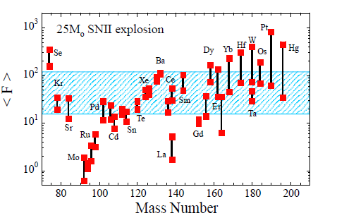
Impact of nuclear uncertainties on p-process abundances
Major nuclear uncertainties in theoretical photo-disintegration rates:
  Global alpha-nucleus optical potential (A>150)
  GLOBAL nucleon-nucleus potential, NLD, γ-strength (light A<90 p-nuclides)

Slide 8
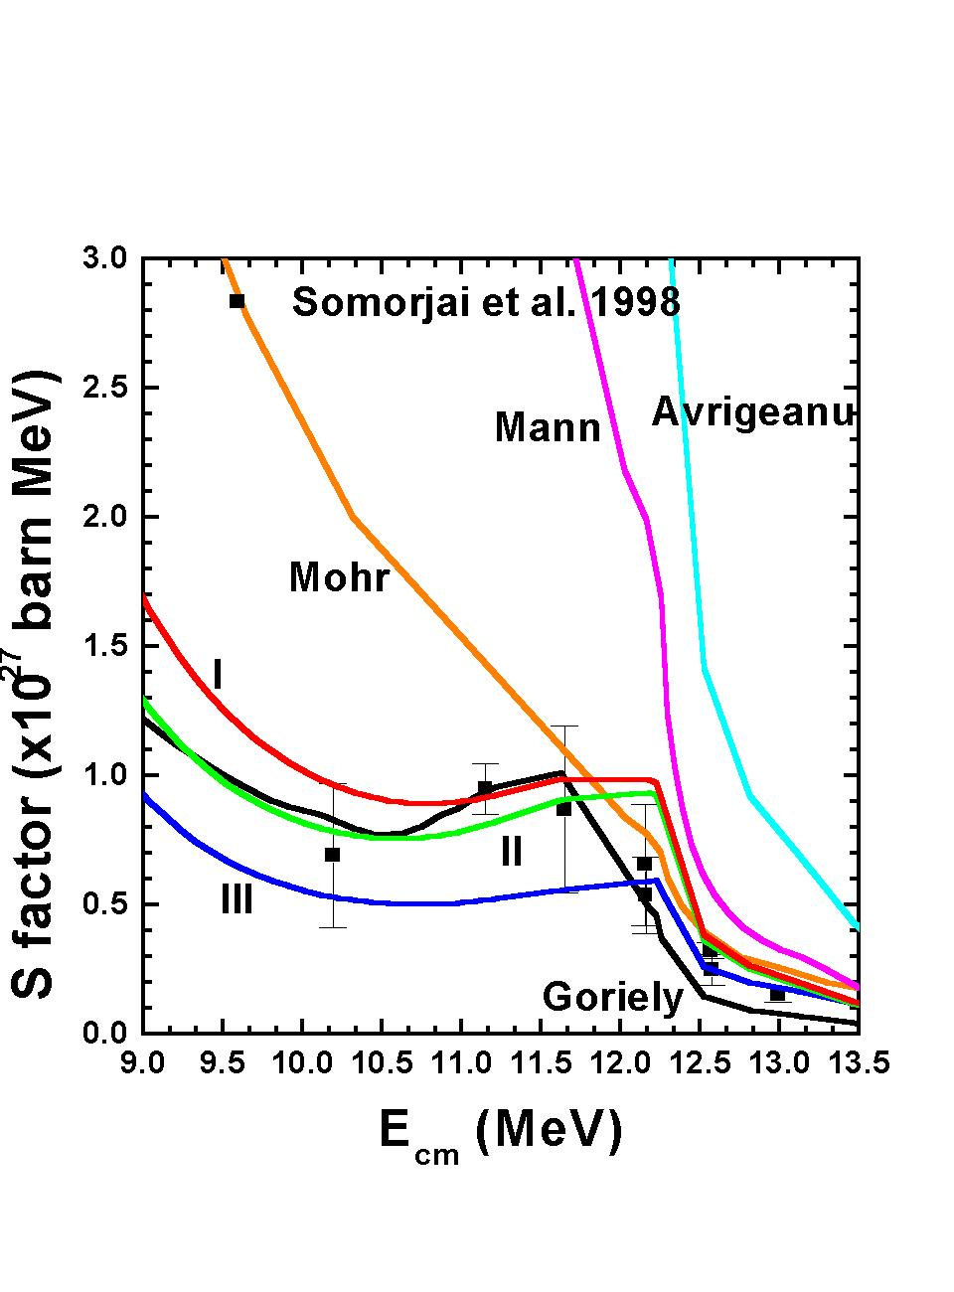
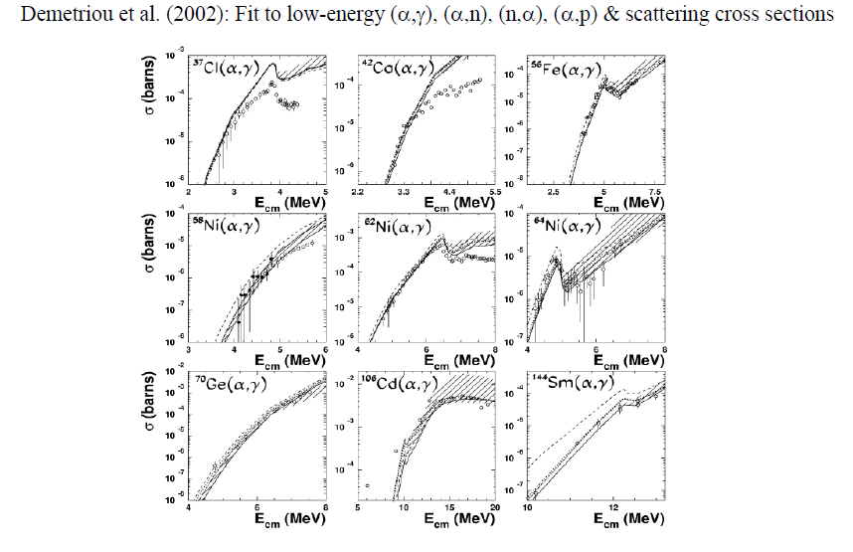
α-nucleus Optical Model Potential
New global semi-microscopic alpha-nucleus optical potential:
Demetriou, Grama and Goriely, NPA 707, 253
(2002)
  Microscopic real V + Woods-Saxon imaginary W
  W: Fermi-type energy dependence
Update of alpha-nucleus OMP:
Demetriou and Axiotis, Proc. Of Tours
Symposium, 2007 (Marie Curie ERG FP6)
Demetriou et al, NPA 707, 253 (2002)
α-OMP implemented in widely used nuclear reaction code TALYS

Slide 9
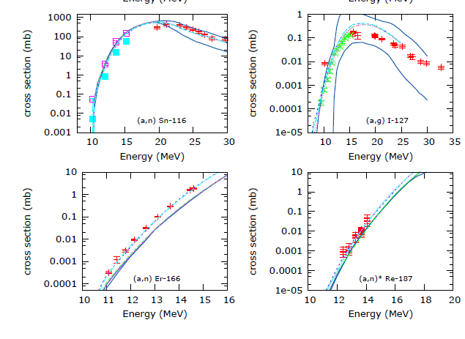
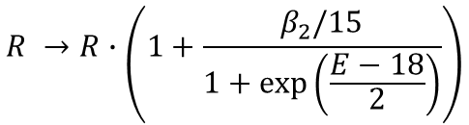
New: improved global alpha OP for deformed nuclei
New data since 2007: discrepancies observed for rare-earth nuclei
Include deformation in real double-folding potential
$$R →R∙\left(1+\frac{β_{2}/15}{1+exp⁡\left(\frac{E−18}{2}\right)}\right)$$
Average increase 30%
PD, Goriely, in preparation

Slide 10
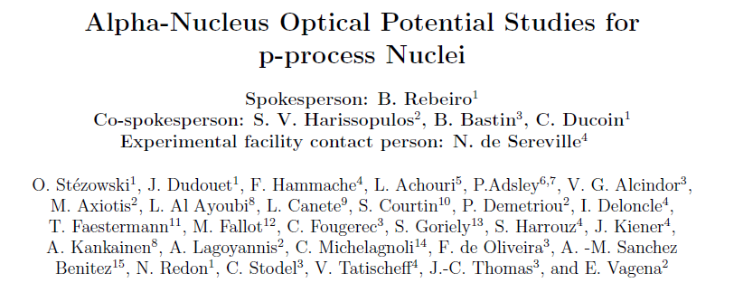
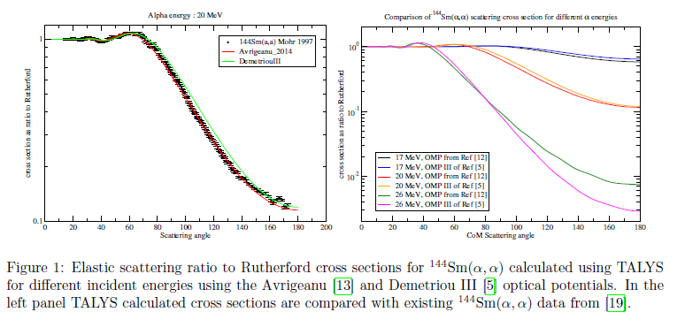
International collaboration
Project on Measurements of
alpha-elastic cross sections near
the Coulomb barrier @ GANIL
Goal: Assess the two main global
alpha-nucleus OMPs: Demetriou III
and Avrigeanu (2014)
Collaboration between GANIL, Universite de Lyon, , NCSR Demokritos , Universite Libre de Bruxelles, Subatech-Nantes, Orsay, ILL-Grenoble, iThemba LABS, Strasbourg, Univ. Surrey, Univ. Huelva, Univ. Jyvaskyla, University of the Witwatersrand
PAC approved measurements: June/July 2021

Slide 11
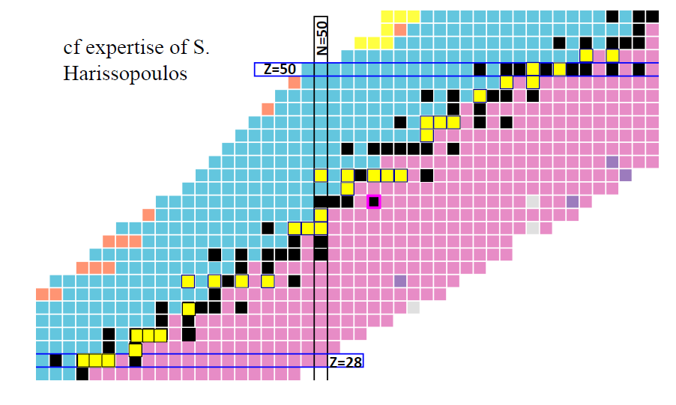
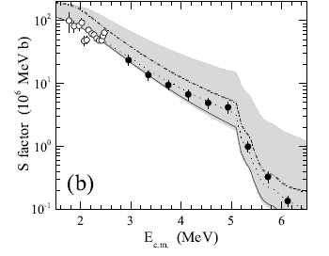
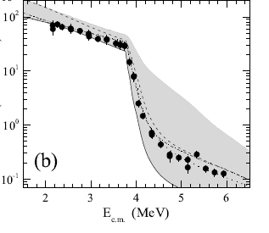
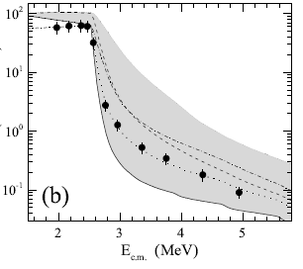
Systematics of proton-nucleus JLM/B OMP
JLM/B: Semi-microscopic nucleon-nucleus OMP of Bauge, Girod, Delaroche, PRC 63 (2001) 024607
New measurements by Demokritos groups (yellow boxes):
Spyrou, …,PD, et al., Phys. Rev. C 77, 065801 (2008)
Harissopulos, …,PD, et al., Phys. Rev. C 87, 025806 (2013)
Harissopulos, …,PD, Phys. Rev. C 93, 025804 (2016)
Foteinou, …., PD, Phys. Rev. C 97, 035806 (2018)
Foteinou,…, PD, et al., Eur. Phys. J. A (2019) 55: 67
Harissopulos, ..,PD, Phys. Rev. C, accepted for publication
V. Foteinou, PhD Thesis, 2017
V. Foteinou, PhD thesis
Foteinou, et al., Phys. Rev. C 97, 035806 (2018)
⁹⁴Mo
λ_{V} = 0.90
⁹⁶Mo
λ_{V} = 1.04
⁹⁸Mo
λ_{V} = 0.95

Slide 12
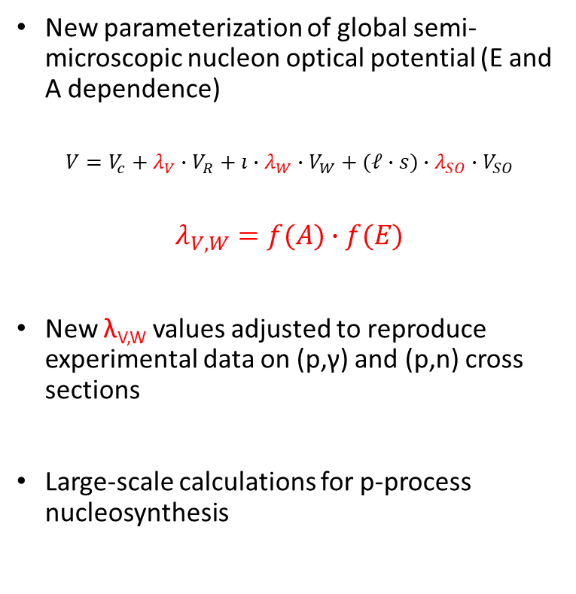
Improved proton JLM/B OMP based on systematics
All available experimental (p,γ) cross sections at astrophysically relevant energies retrieved
Criteria for using them in fitting procedure applied
Experimental uncertainties sorted
39 nuclides; A=50-150
V-51; Cr-50, Cr-54; Fe-54, Fe-56, Fe-58; Co-59; Ni-58, Ni-60, Ni-61, Ni-62, Ni-64; Cu-63, Cu-65; Zn-67, Zn-68; Sr-84, Sr-86, Sr-88, Sr-87; Y-89; Zr-90, Zr-92; Mo-92, Mo-94, Mo-95, Mo-98; Ru-99; Pd-105; In-113; Sn-112, Sn-114, Sn-116; Sb-121; Ba-130; Ce-142; Sm-144, Sn-147; Gd-152
Verification on all available (p,n) cross sections
50 nuclides; A=50-181
New parameterization of global semi-microscopic nucleon optical potential (E and A dependence)
$$V=V_{c}+λ_{V}∙V_{R}+ı∙λ_{W}∙V_{W}+(ℓ∙s)∙λ_{SO}∙V_{SO}$$
$$λ_{V,W}=f(A)∙f(E)$$
New λ_{V,W} values adjusted to reproduce experimental data on (p,γ) and (p,n) cross sections
Large-scale calculations for p-process nucleosynthesis
Vagena, Axiotis, PD, submitted to PRC

Slide 13
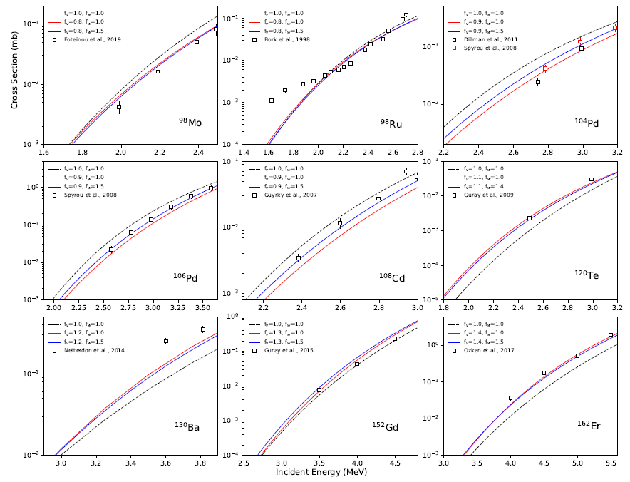
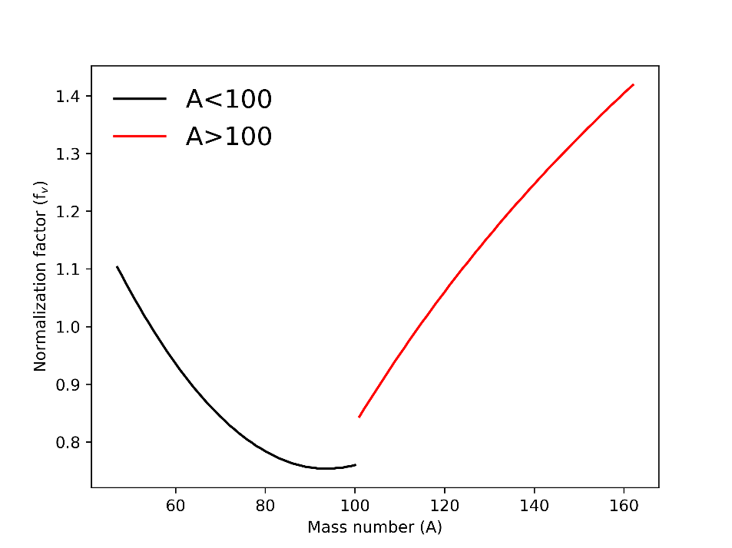
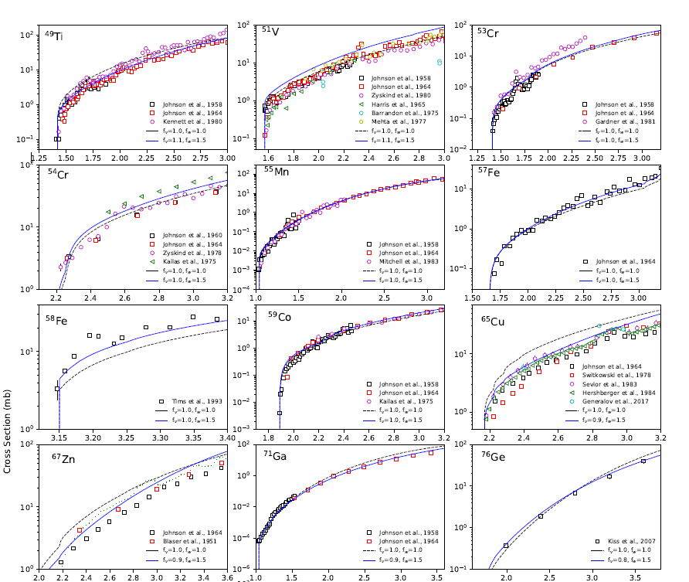
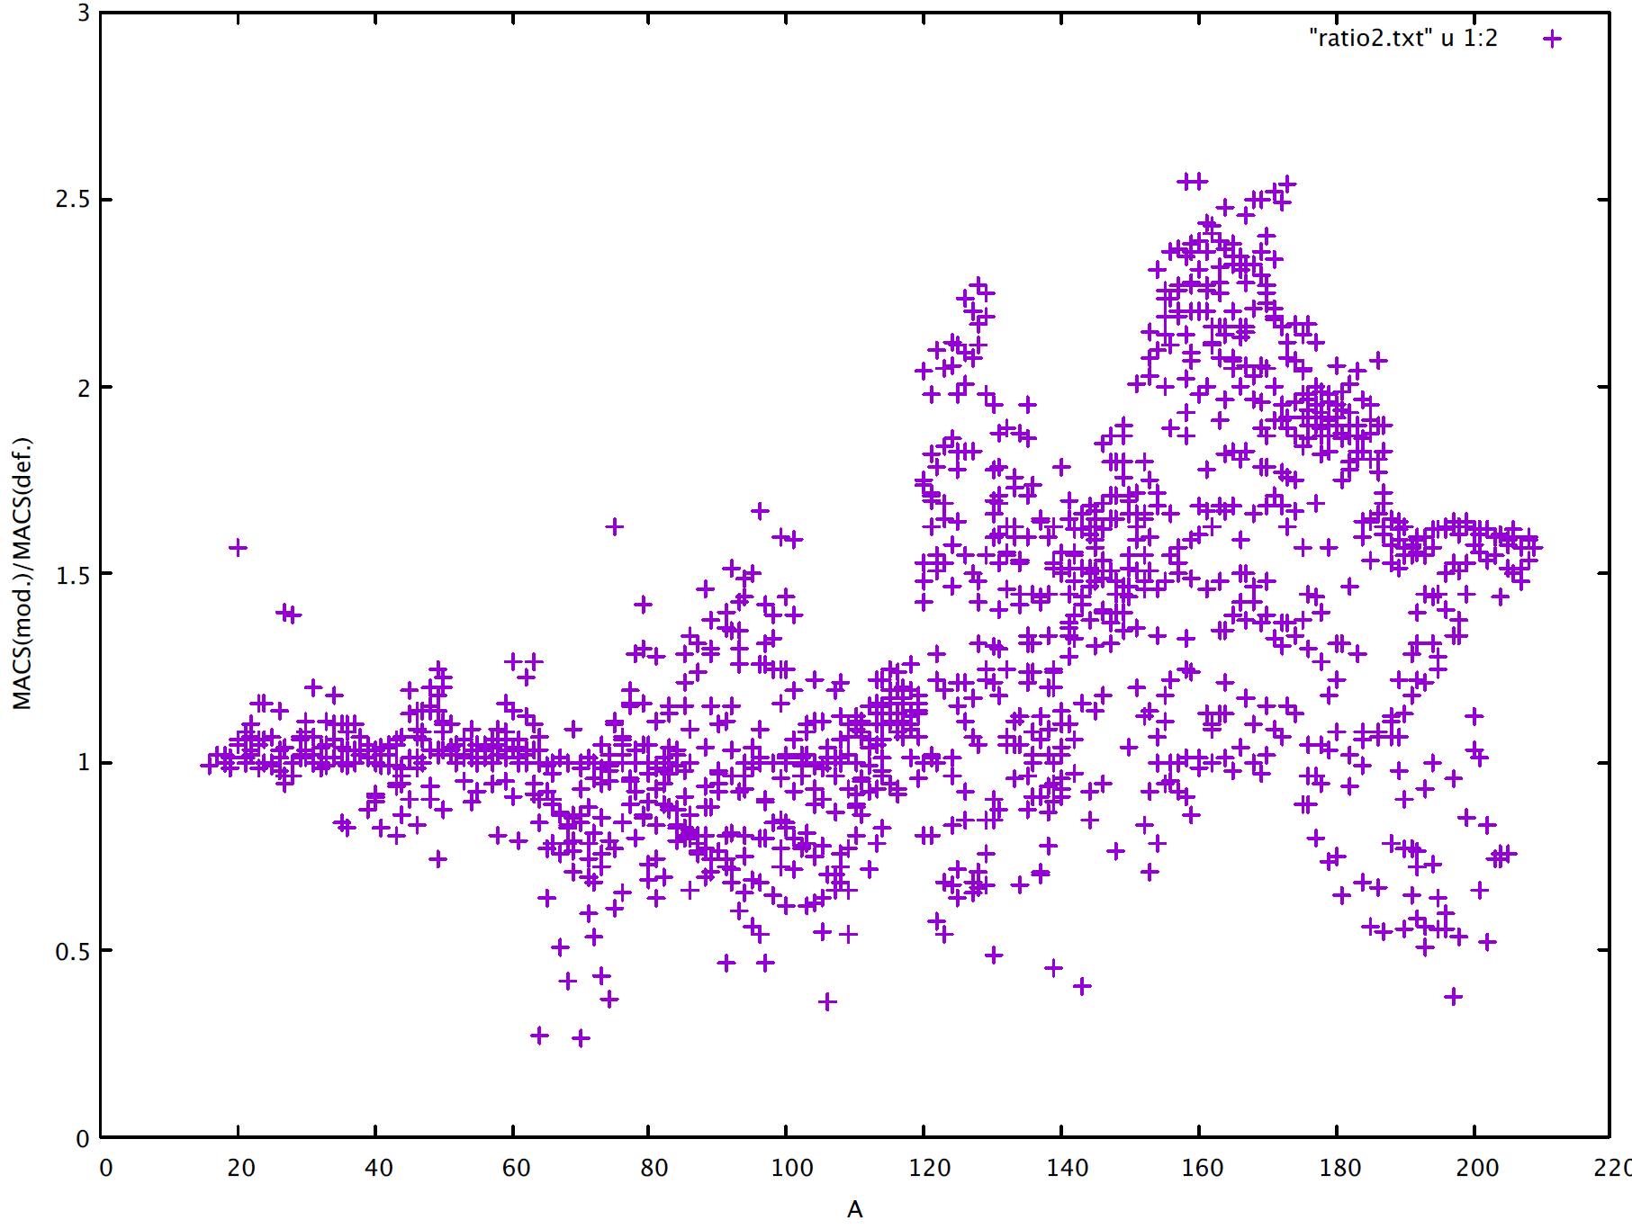
Systematics
(p,γ)
Real V vs A
MACS (mod) / MACS (def)
(p,n)
Vagena, Axiotis, PD, submitted to PRC

Slide 14
Future plans
Sensitivity studies of solar abundances with respect to nuclear data using NucNet network calculation code:
  alpha OMP
  Proton OMP
  New photon strength functions
Verification of photon strength function models
New photon strength function measurements at Tandem Laboratory; collaboration with iThemba LABS, SA

Slide 15
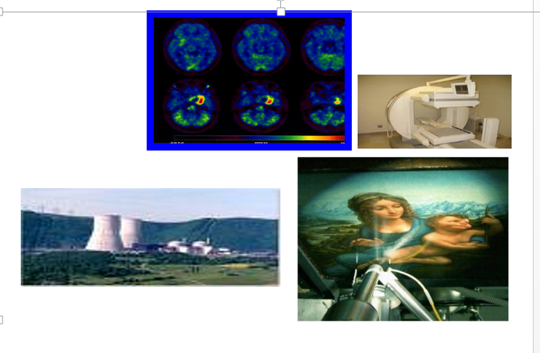
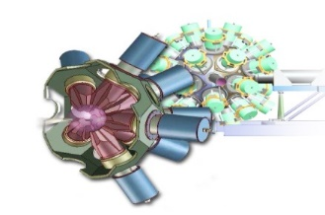
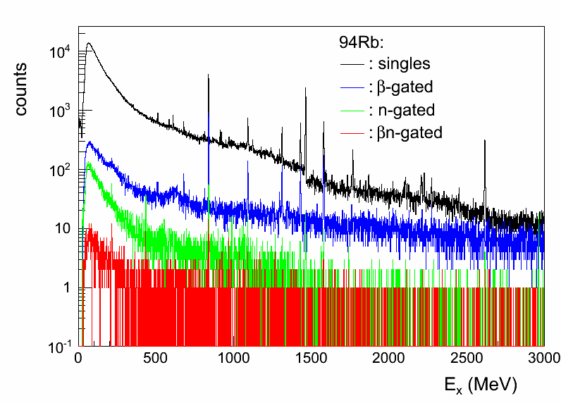
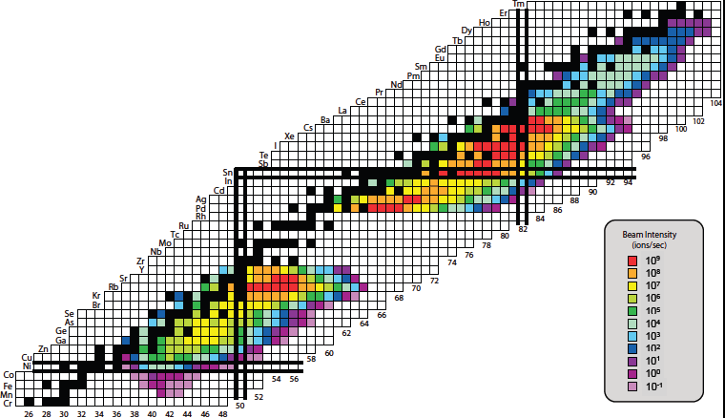
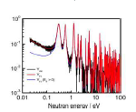
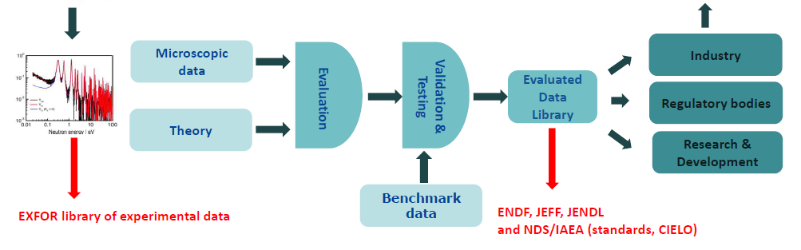
Nuclear data
Feedback, new data needs
Evaluation: recommendation of best values based on assessment of Exp. Data and reproduction by theory
ENSDF, NuDAT, LiveChart, MIRD

Slide 16
Nuclear Data @ IAEA (2012-2019)
Coordinated Research Projects (CRP): proposals + budgets evaluated by IAEA research contracts committee
  CRP on Photonuclear Data Library and Photon Strength Functions (2016-2019), budget: 200K
  CRP on beta-delayed neutron emission (2013-2018), budget: 150K
  CRP on Particle Induced Gamma ray Emission Spectroscopy (PIGE) (2011-2015), budget: 150K
Data Development Projects: proposals+budgets evaluated by Nuclear Data Section; projects ongoing
  Resolved-Resonance-Region: evaluation of reaction cross sections (2015-)
    Evaluation of charged-particle reactions in the RRR
    Ion Beam Analysis Data Library (IBANDL)
  Decay Data for monitoring applications (2019-)

Slide 17
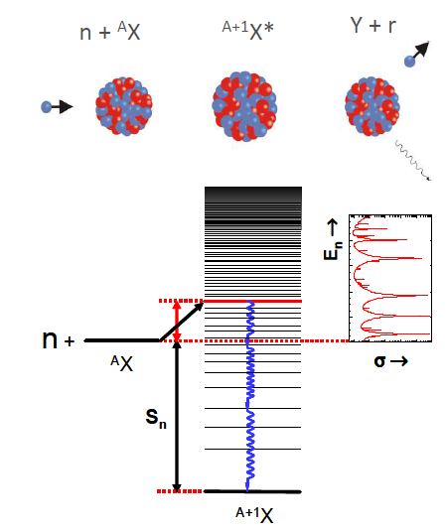
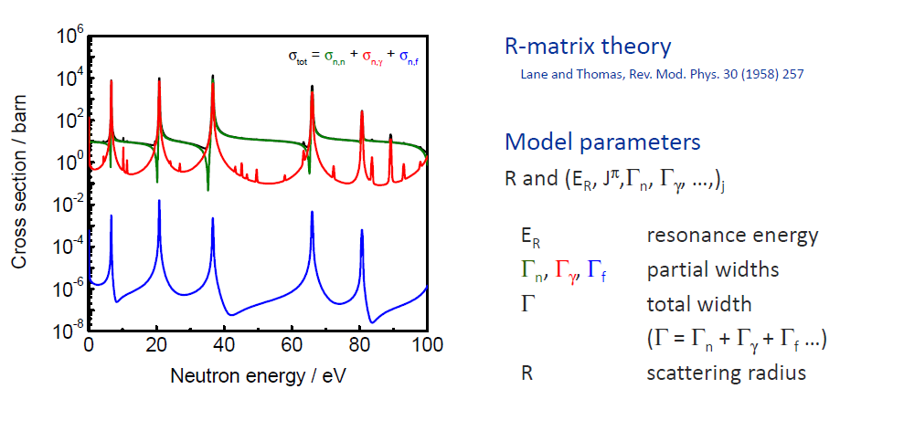
Compound nucleus –
Resonance region
Resonance parameters cannot be predicted by theory
Are adjusted to experimental data
Experimental data are required

Slide 18
IAEA Project 1: R-matrix codes for charged-particle reactions in the resolved resonance region and evaluation of cross sections
P. Dimitriou, Coordinator
H. Leeb, Technisches Universitӓt Wien
Ian Thompson, Lawrence Livermore National Laboratory
Gerry Hale, Mark Paris, Los Alamos National Laboratory
Marco Pigni, Oak Ridge National Laboratory
James deBoer, Notre Dame University
Zhenpeng Chen, Tsinghua University
Satoshi Kunieda, Japan Atomic Energy Agency
Pierre Tamagno, CEA Cadarache
Budget: 50K +
Duration: 2015 –
Output: publications, data files
Inter-comparison of R-matrix codes
Evaluation of compound system Be-7:
Incident channels: p+⁶Li, ⁴He+³He → (p,p), Reactions: (p,alpha), (p, ³He), (p,γ), (³He,p), (³He,n), etc
Compound systems N-15, N-16:
Compound system: O-17
Compoun system: Be-10

Slide 19
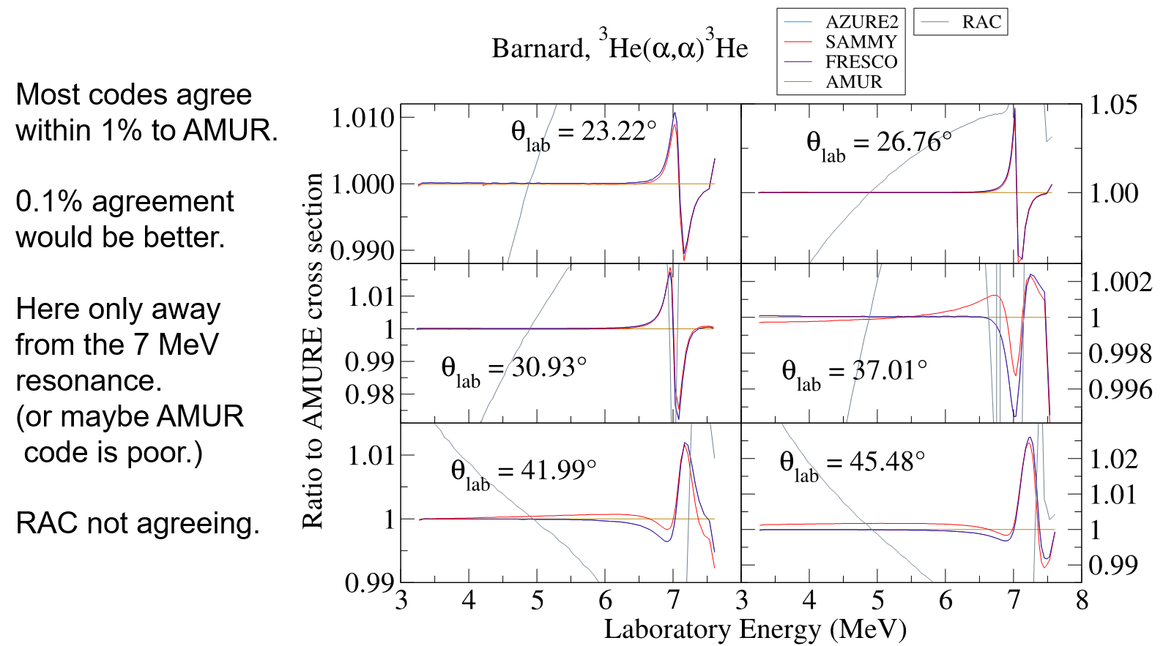
Step 1: Verification of R-matrix codes
Thompson, deBoer, Dimitriou, Chen et al, Eur. Phys. J. A (2019) 55:92

Slide 20
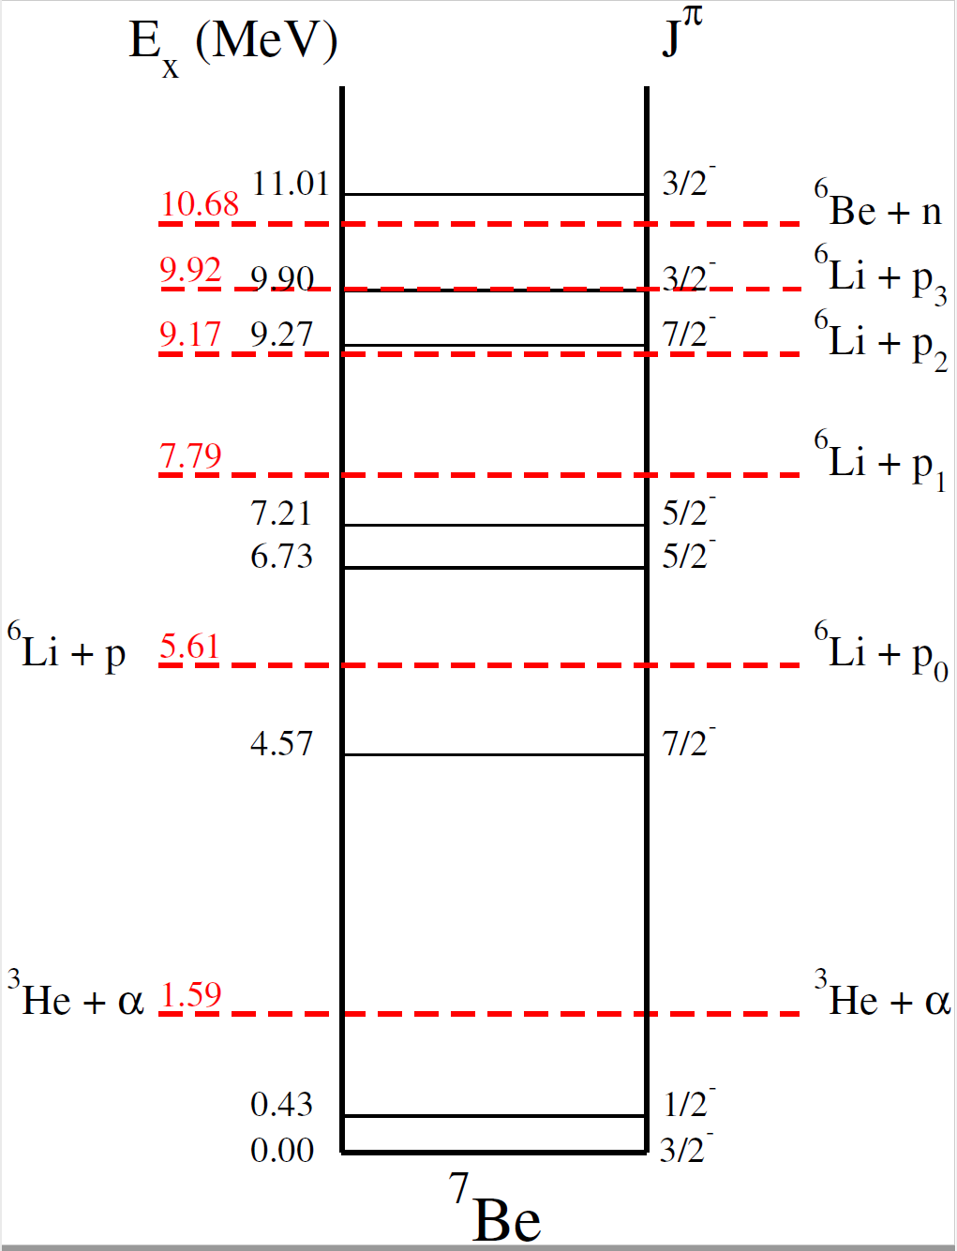
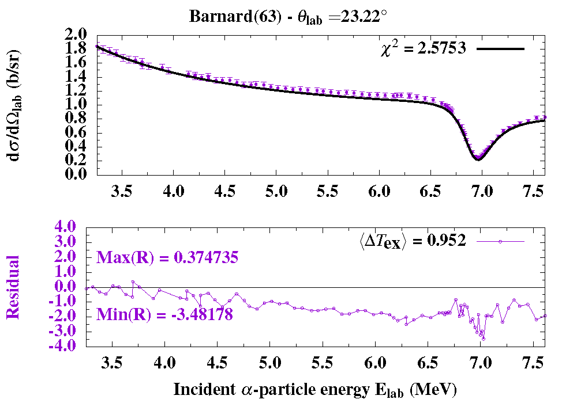
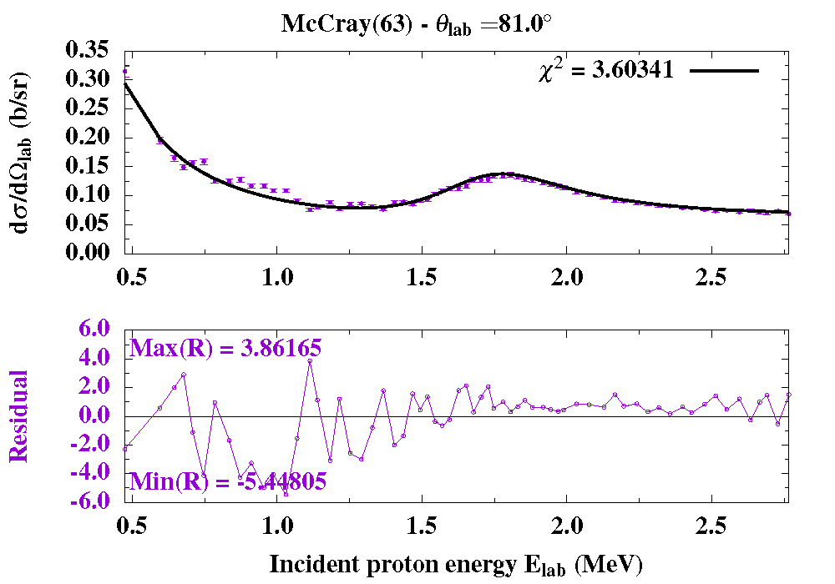
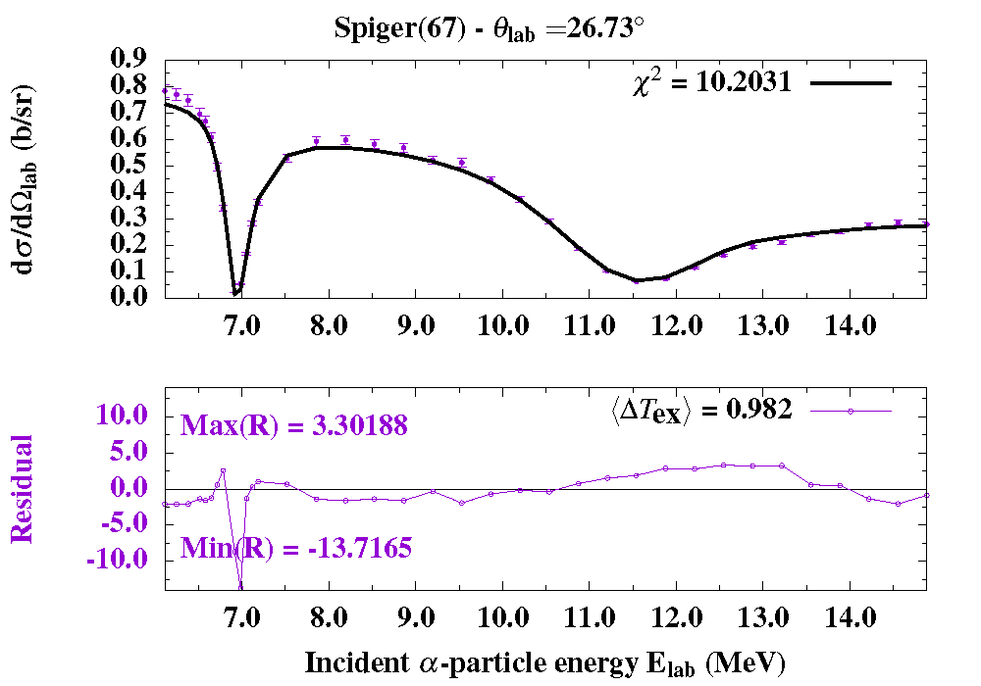
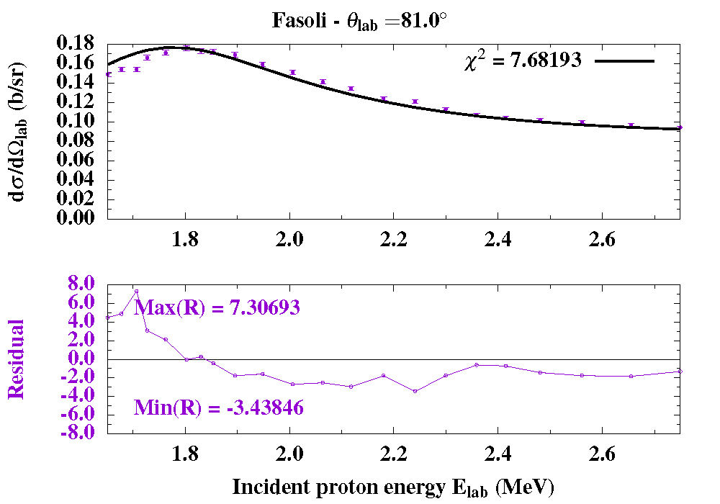
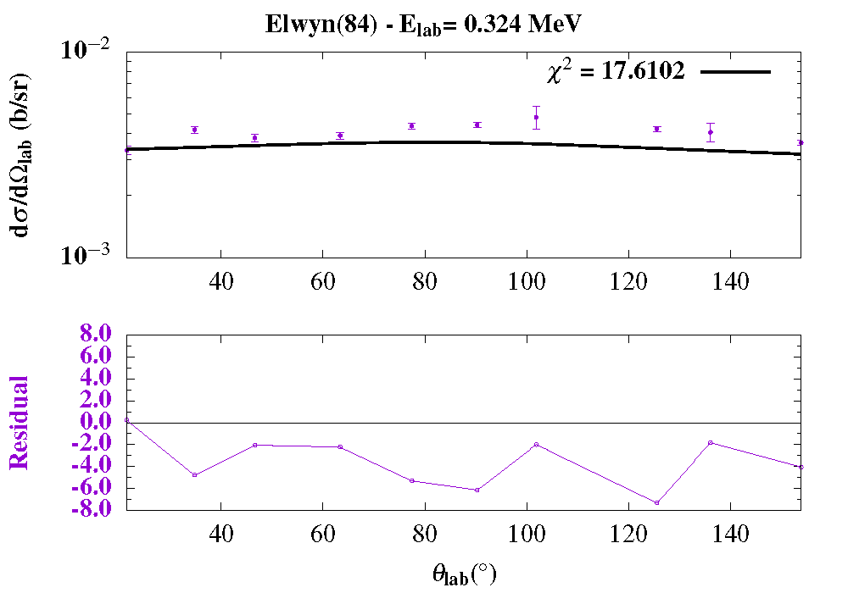
Step 2: Evaluation of Be-7
All channels and exp. data up to 20 MeV [SAMMY R-matix code]
First attempt: up to Ex=8 MeV-no correlation matrix (only statistical uncertainties)- χ²=6

Slide 21
Work in progress – IAEA collaboration
Completion of joint evaluation of Be-7 – publication
Evaluation of other compound systems (N-15,16; O-17)
Evaluations of other systems relevant to IBA
Evaluations will include full covariance matrices
Evaluations will be included in evaluated libraries (ENDF/B) and will also be made available through IBANDL

Slide 22
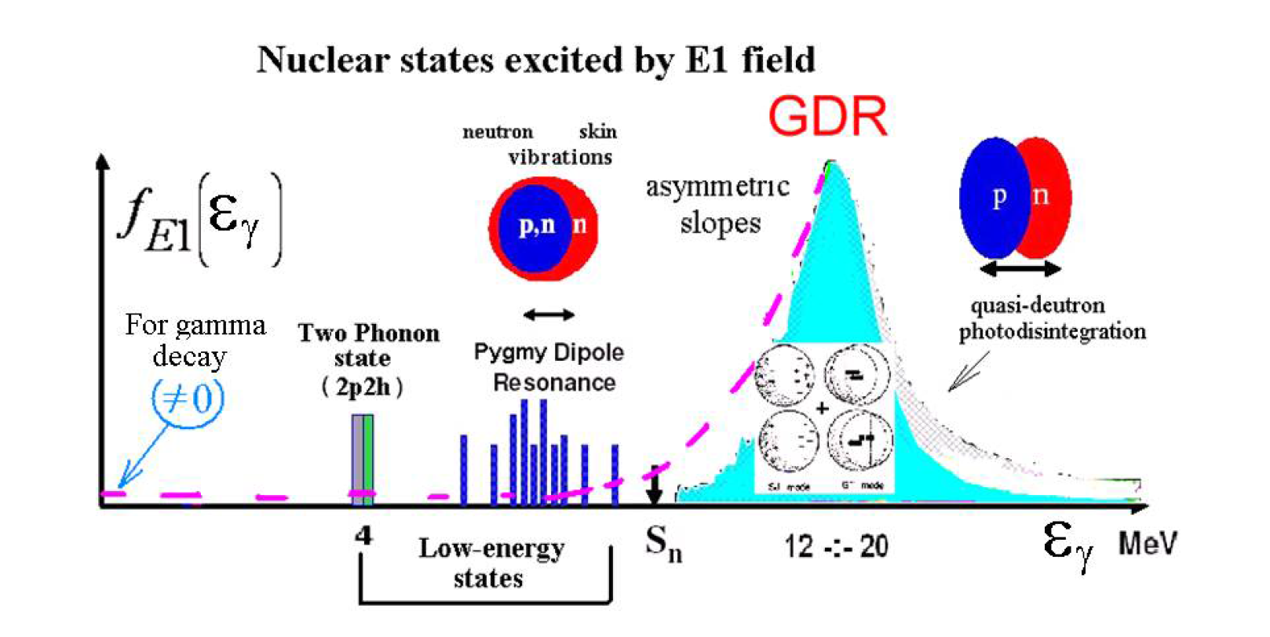
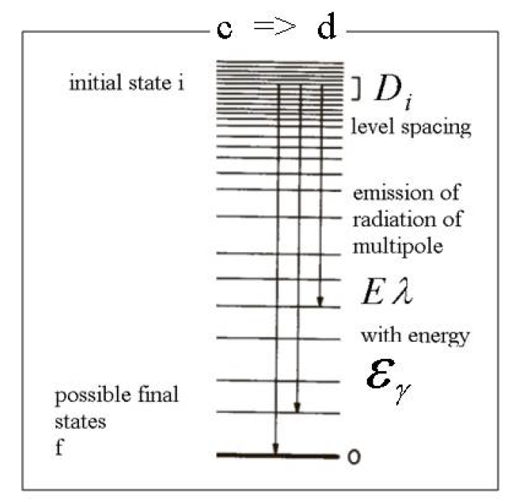
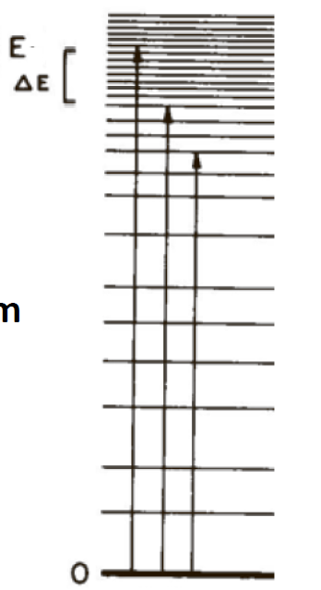
Electromagnetic response of nucleus: E1
f↓
f↑
Photo-nuclear: (γ,X) Photo-deexcitation: (X,γ), (X, γY)

Slide 23
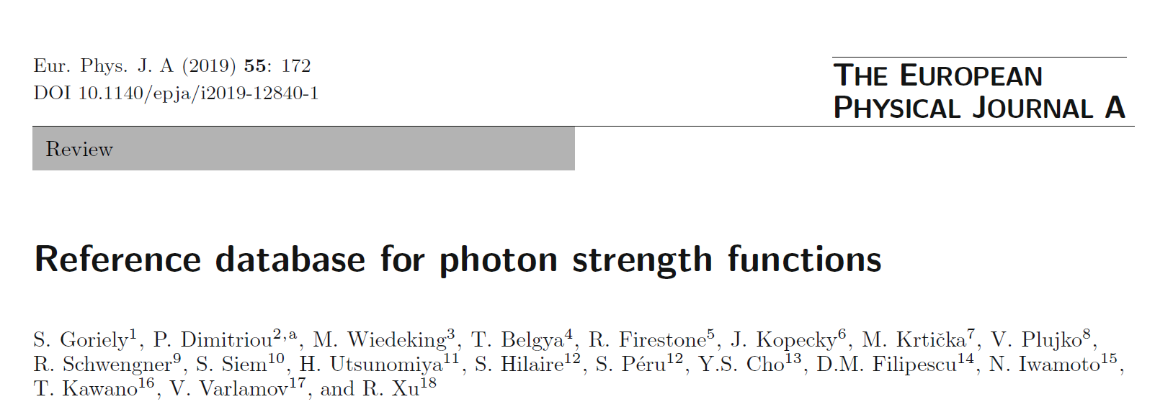
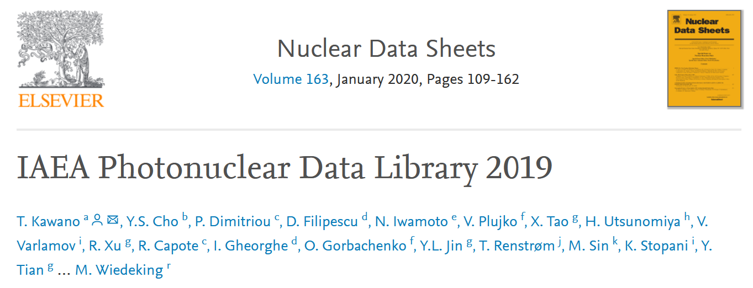
IAEA Project 2: Coordinated Research Project on Photonuclear Data Library and Photon Strength Functions
Coordinator: P. Dimitriou
16 participants/groups from 15 countries:
Konan Univ. (Japan),
IFIN-HH (Romania),
Moscow State Univ. (Russia),
CNDC (China),
JAEA (Japan),
KAERI (S. Korea),
Univ. Oslo (Norway),
iTHEMBA LABS (S. Africa),
HZ Dresden-Rosendorf (Germany),
Charles Univ. Prague (Czech Rep.),
Budapest Energy Centre (Hungary),
LBNL/UCB (USA),
Netherlands,
ULB (Belgium),
Kiev University (Ukraine),
LANL (USA)
Budget: 200K Euros
Duration: 2016-2019
Ouput
Online databases:
www-nds.iara.org/PSFdatabase
www-nds.iaea.org/
Publications:
Goriely, PD, et al., Eur. Phys. J. A, 55: 172 (2019)
Kawano, Cho, PD, et al., Nuclear Data Sheets 163, 112 (2020)

Slide 24
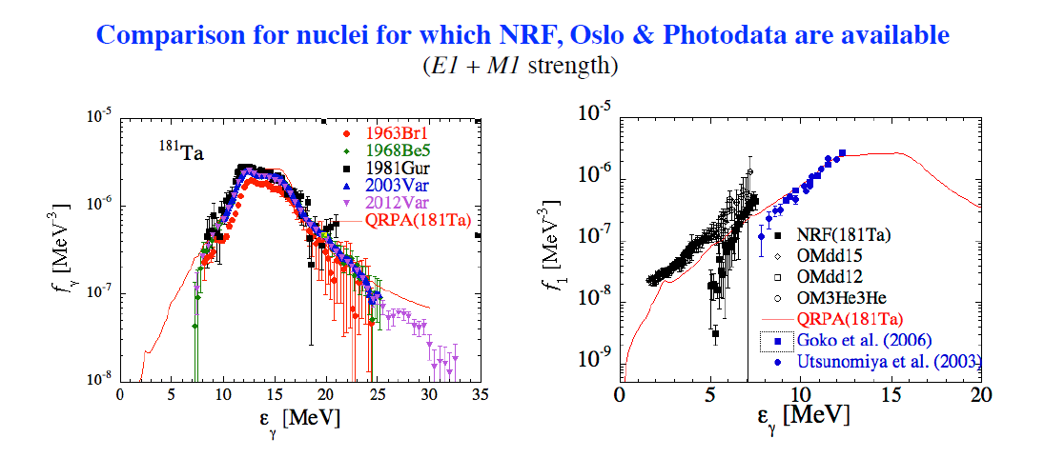
Scope: Measurements, compilation, evaluation, theory, dissemination I
Photon Strength Functions: Connecting GDR and low-energy photon strength

Slide 25
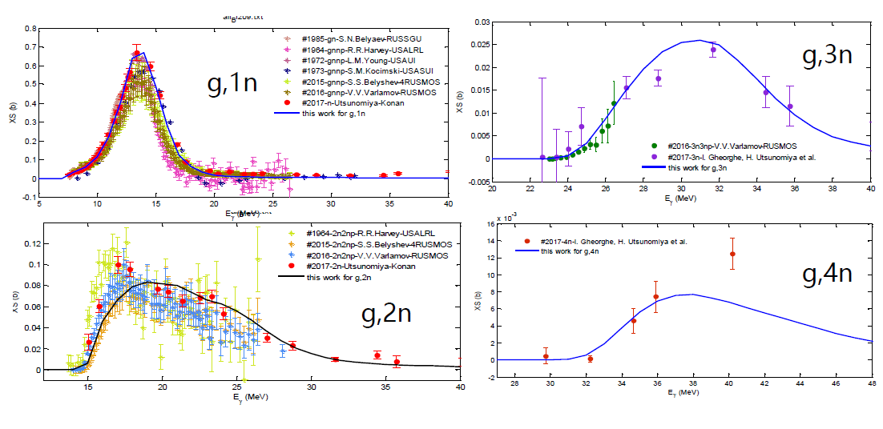
Scope: Measurements, compilation, evaluation, theory, dissemination III
New results for ²⁰⁹Bi(γ,xn): sorting photo-multi-nucleon emission channels

Slide 26
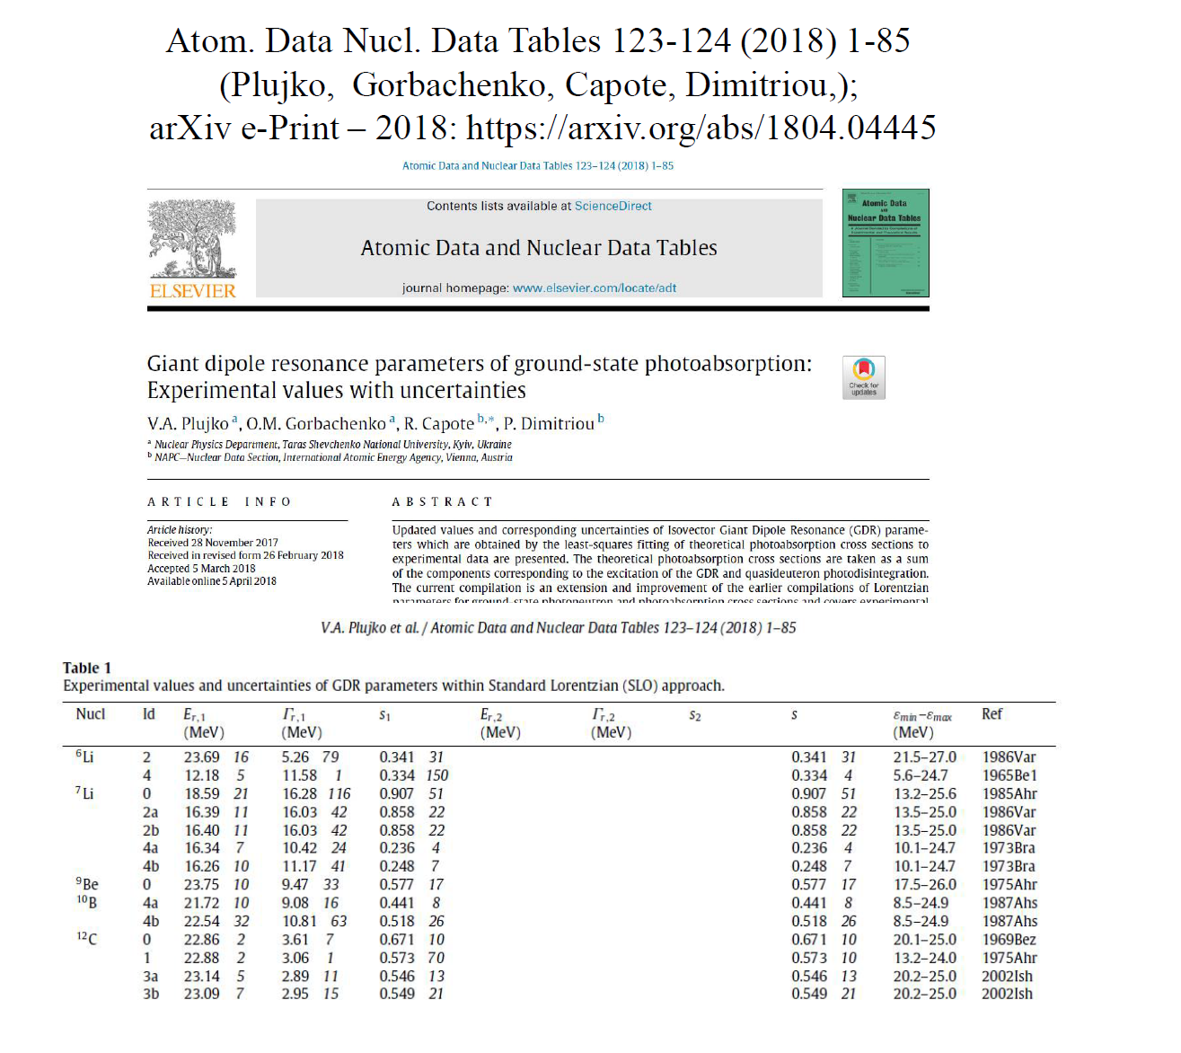
Atlas of Giant Dipole Resonance Parameters: ground state photoabsorption parameters with uncertainties

Slide 27
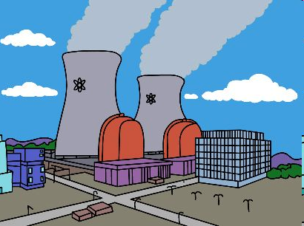
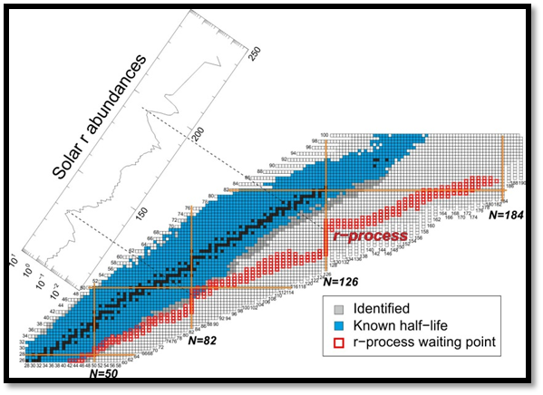
































Beta-delayed neutron emission
Nuclear Reactors kinetics and safe operation:
P_{n} determines the delayed neutron fraction β_{eff} important for reactor kinetics and safety.
Nuclear Astrophysics:
Far from the stability, β-delayed neutron emission becomes the dominant decay process and determines abundances after neutron freeze-out in r-process nucleosynthesis.

Slide 28
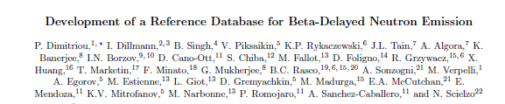
IAEA Project 3: Coordinated Research Project on beta-delayed neutron emission
Coordinator: P. Dimitriou
17 groups from 14 countries
V. Piksaikin, I. Borzov, IPPE, Kurchatov , Russia
D. Cano, CIEMAT, Spain
S. Chiba, Tokyo Inst. Techn., Japan
M. Fallot, A. Porta, SUBATECH Nantes, France
P. Garrett, I. Dillmann, B. Singh, Univ. Guelph, TRIUMF, McMaster Univ., Canada
G. Mukherjee, P. Banerjee, VECC, India
K. Rykaczewski, R. Grzywacz, ORNL, Univ. Tennesse, USA
J. Tain, A. Algora, CSIC-Univ. Valencia, Spain
X. Huang, CNDC, China
F. Minato, JAEA, Japan
T. Marketin, Univ. of Zagreb, Croatia
R. Mills, NNL, UK
A. Sonzogni, T. Johnson, E. McCutchan, BNL, USA
D. Foligno, P. Leconte, CEA Cadarache, France
Budget: 150K Euros
Duration: 2013-2017
Output:
Database: www-nds.iaea.org/beta-delayed-neutron/database.html
Publication: Nuclear Data Sheets, accepted for publication

Slide 29
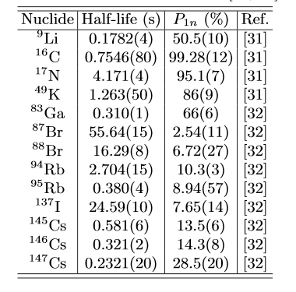
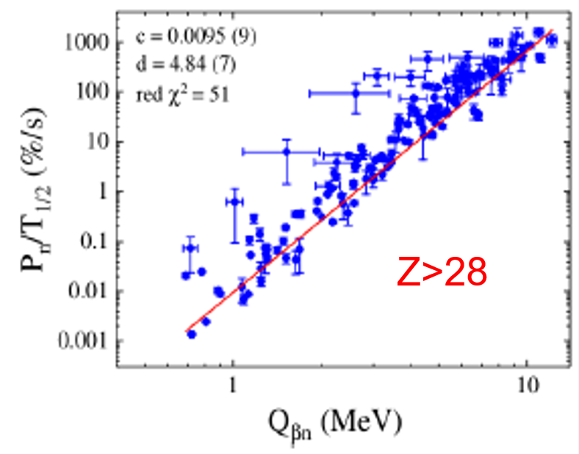
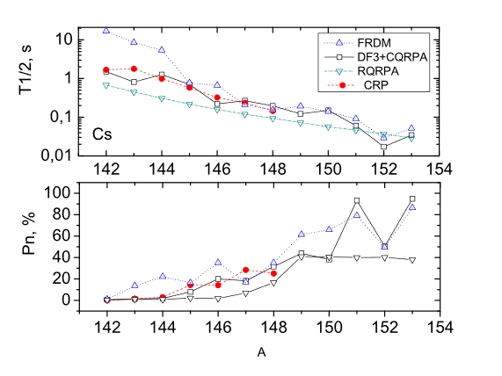
Scope: measurements,compilation, evaluation, theory, validation and dissemination I
New standards
Compilation-Evaluation
(T_{1/2}, P_{n}) data have been extracted and evaluated for 653 neutron-rich known or potential-delayed neutron emitters
from about 600 publications
New systematics: McCutchan et al 2012
New models: DF3+CQRPA, RHB+QRPA

Slide 30


Scope: measurements,compilation, evaluation, theory, validation and dissemination II
Comparison with ENDF/B-VIII.0 library and recommended values
Summation calculations of total delayed neutron yield ν_{d}
Time-dependent calculations
Integral reactor calculations
Comparisons with keff and βeff benchmarks

Slide 31

IAEA Project 4: Coordinated Research Project on Reference Database for Particle-Induced Gamma-ray Emission spectroscopy (PIGE)
Coordinator: P. Dimitriou
10 participants/groups from 10 countries
Becker, Germany
Bogdanovic-Radovic, Croatia
Chiari, Italy
Raisanen, Finland
De Jesus, Portugal
Kakuee, Iran
Kiss, Hungary
Lagoyannis, Greece
Zucchatti, Spain
Budget: 150K Euros
Duration: 2011-2015
Output:
Ion Beam Analysis Data Library (IBANDL)
IAEA-TECDOC-1822: Handbook of PIGE analysis
Over 600 new data sets in IBANDL
200 new measurements (data sets)
Comparisons with measured thick-target yields
Assessments - Recommendations

Slide 32



Ion Beam Analysis Nuclear Data Libary (IBANDL)
Number of PIGE data sets in IBANDL
(before and during CRP)
Number of data sets in IBANDL
(before and after the CRP)

Slide 33

IAEA Project 5: IAEA Inter-comparison of PIGE Analysis Codes
Coordinator: P. Dimitriou
Participants:
Barradas, IAEA
Cruz, Portugal
Lagoyannis, Greece
Meyer, Germany
Budget: 15K Euros
Recommended PIGE Analysis Codes
Publication:

Slide 34



Nuclear Data for Monitoring Applications
An International Atomic Energy Agency Project to
create a library of decay data for radionuclides relevant to CTBTO
CTBT Radionuclides:
From nuclear weapons (fission & activation products)

Slide 35



IAEA Project: Evaluation of decay data for monitoring applications
Critical assessment of all measurements and uncertainties
Averaging methods
Procedures, policies, analysis codes developed and used for the Evaluated Nuclear Structure Data File (ENSDF)
Budget: 30K Euros per year
Duration: 2019-2022
Output:
Online data library
Publication
27 top priority fission products for monitoring nuclear explosions by measuring radionuclide concentrations in air samples (CTBTO)
Under the auspices of the International Atomic Energy Agency
Paraskevi Dimitriou, NCSR “Demokritos”
Balraj Singh, McMaster University
Jagdish Tuli, University of Berkeley
Filip Kondev, Argonne National Laboratory
Tibor Kibedi, Australian National University
Alan Nichols, Surrey University
Jun Chen, NSCL, MSU
Sorin Pascu, IFIN-HH

Slide 36



Evaluated Nuclear Structure and Decay Data File: ENSDF
ENSDF

Slide 37

















International Network of Nuclear Structure and Decay Data Evaluators
17 Data Centers
JAPAN ATOMIC ENERGY AGENCY
AUSTRALIAN NATIONAL UNIVERSITY
TUNL
BNL
ATOMKI CENTER
ORNL
LBNL
ST KLIMENT
UNIVERSITY SOFIA
IFIN-HH
VECC INDIA
MSU
ORNL
PETESRBURG NUCLEAR
PHYSICS INSTITUTE
McMASTER UNIV
CHINA INSTITUTE OF ATOMIC ENERGY
Texas A&M
JILIN UNIVERSITY

Slide 38
Scientific Secretary of the NSDD network 2013-2019
Coordination: meetings, communication
Training: IAEA-ICTP workshops, Advanced workshops
Technical support: evaluation, project on analysis & checking codes, projects on horizontal evaluations (nuclear moments)
Financial: funding schemes for beginners, horizontal evaluation (nuclear moments, Atlas of Isomers)
Dissemination: Live Chart, Decay Data Portal

Slide 39





Nuclear Moments database: since 2015 on IAEA web server
Project on evaluation of Nuclear Moments (2017)
Participants: Stone, Stuchbery, Jakowski, Persson, Pykko, Kondev, Nuyens, Lloyd, Mertzimekis
Budget: 30K Euros

Slide 40




IAEA-ICTP Workshops
Workshops co-sponsored by ICTP (Trieste) and IAEA
Proposals submitted from IAEA departments are reviewed and selected by ICTP-IAEA committee
IAEA-ICTP Workshop on Nuclear Data for Analytical Applications, 21-25 October 2013
  Budget: 15K Euros
  Trainees: 20
  Lecturers: 5
IAEA-ICTP Workshop on Nuclear Structure and Decay Data, 24-28 March 2014
  Budget: 10K Euros
  Trainees: 20
  Lecturers: 5
  Publication: Nuclear Data Sheets for A=227, F. Kondev, E. McCutchan, B. Singh, J. Tuli, K. Abusalem, P. Dimitriou, et al., Nuclear Data Sheets 132, 257 (2016)
IAEA-ICTP Workshop on Nuclear Structure and Decay Data, 16-30 August 2016
  Budget: 15K Euros
  Trainees: 24
  Lecturers: 10
  Publication: Nuclear Data Sheets for A=217, F. Kondev, E. McCutchan, B. Singh, et al., Nuclear Data Sheets 147, 382 (2018)
IAEA-ICTP Workshop on Nuclear Structure and Decay Data, 15-26 October 2018
  Budget: 15K Euros
  Trainees: 21
  Lecturers: 8
  Publication: Nuclear Data Sheets for A=218, B. Singh, S.M. Basunia, M. Martin, E. McCutchan et al., Nuclear Data Sheets 160, 417 (2019)

Slide 41



Postponed to 2021
Series of international conferences: Yosemite National Park (2007), Bordeaux (2009), Prague (2011), Sao Paolo (2013), Tokyo (2015) and Berkeley (2018)
Venue: National Hellenic Research Foundation
Organised: by INPP (CALIBRA) in collaboration with Los Alamos National Laboratory
Proceedings: peer-reviewed in EPJ Web of Conferences; topical issue in EPJ Nuclear Sciences & Technologies
website: http://www.inp.demokritos.gr/cnr2020
Local Organizing Committee
  Paraskevi Dimitriou (NCSR “Demokritos”) - Chair
  Michail Axiotis (NCSR “Demokritos”)
  Anastasia Georgiadou (LANL)
  Anastasios Lagoyannis (NCSR “Demokritos”)
  Eleni Vagena (NCSR “Demokritos”)
Topics:
  Nuclear reaction mechanisms (direct, compound, pre-equilibrium, other)
  Nuclear fission
  Statistical Hauser-Feshbach theory
  Surrogate methods
  Optical model
  Level densities and photon strength functions
  R-matrix theory and connecting resolved resonances with statistical regime
  Nuclear structure for nuclear reactions
  Measurements relevant to compound-nuclear reactions (direct and indirect)
  Nuclear data
  Applications in nuclear astrophysics, energy, medical physics etc.
  Experimental facilities

Slide 42
Future
Nuclear astrophysics:
  Nuclear data needs for r-process nucleosynthesis (fission properties)
  Sensitivity analyses of abundance calculations on nuclear data input
  R-matrix analyses for nuclear astrophysics
Nuclear Data – IAEA collaboration
  Evaluation of reaction data for energy, IBA and astrophysics applications
  Evaluation of decay data for monitoring applications, decay heat, anti-neutrino spectra
Thank you!

Slide 43

Scope: Measurements, compilation, evaluation, theory, dissemination II
Photon Strength Functions: Connecting GDR and low-energy photon strength

Slide 44


Slide 45




IAEA-TECDOC-1822
PIGE Concepts and Implementation
  Bulk analysis
  Depth profiling
Minimal PIGE facility
Examples

