Slide 1

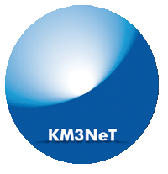
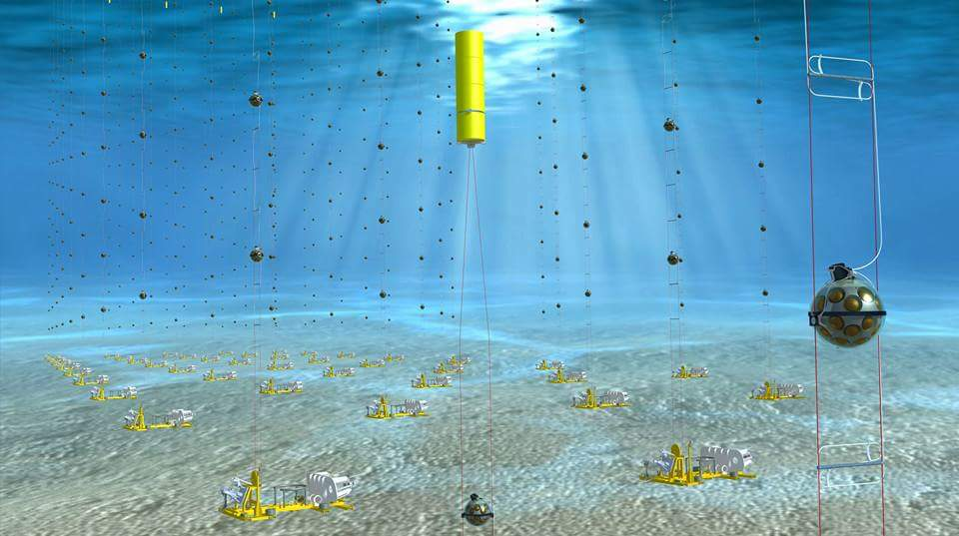
Τhe KM3NeT Neutrino Telescope
E. Tzamariudaki

Slide 2
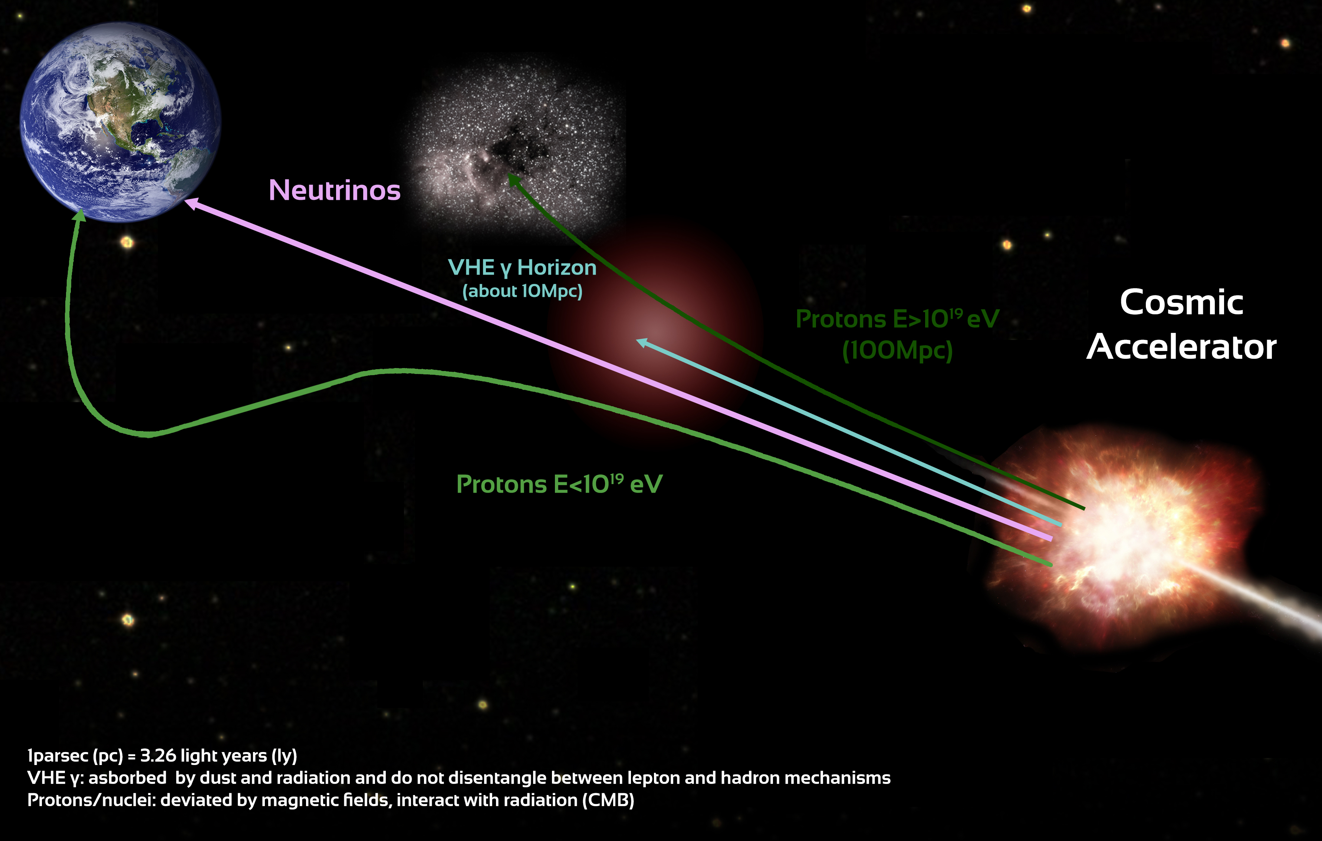
Exploring the High Energy Universe
Four Messengers
Cosmic rays Photons
Neutrinos Gravitational Waves
ν and γ produced in the interaction of high energy nucleons with matter or radiation
cosmic ray acceleration yields neutrinos and gammas with similar abundance and energy spectra
origin of UHE cosmic rays
production mechanism of HE gamma-rays (hadronic or leptonic)
no interactions with ambient matter or radiation
no deflection by magnetic fields
information on the internal processes of the astrophysical sources inaccessible through photons or cosmic rays
neutrinos:
unique messengers

Slide 3
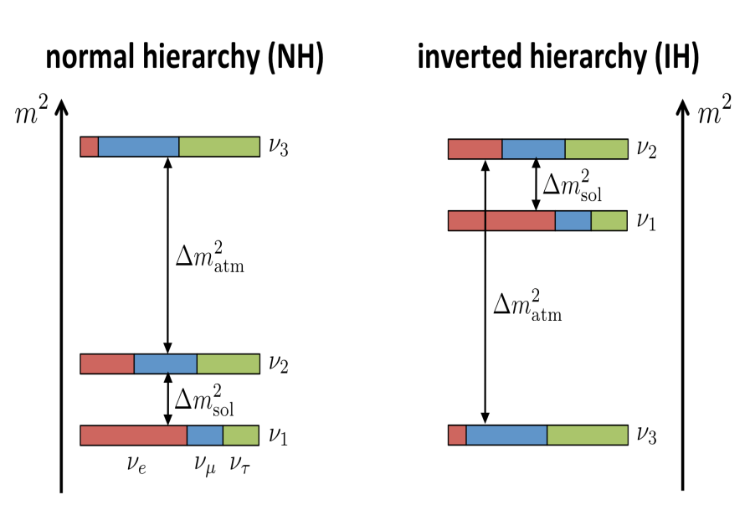

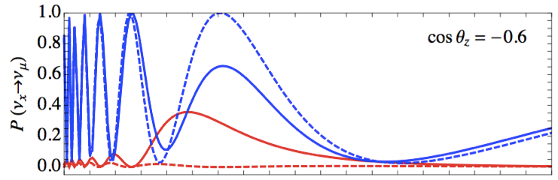
Determining the ordering of the neutrino mass eigenstates
normal ordering (NO) inverted ordering (IO)
ORCA : Oscillation Research with Cosmics in the Abyss
Atmospheric neutrinos:
"free beam" of known composition (ν_{e}, ν_{μ})
Oscillation pattern distorted by Earth matter effects
maximum difference for θ=130° (7645 km) and E_{ν} = 7 GeV
ORCA: measuring the neutrino mass ordering
(MC Simulation)
Measure θ and Ε_{ν} for upgoing atmospheric neutrinos (GeV scale)
1
IO
NO
P(νμ → νμ) for θ=130º
0.5
νμ
νe
Treatment of systematics is important
0
1
5
Eν [GeV]

Slide 4
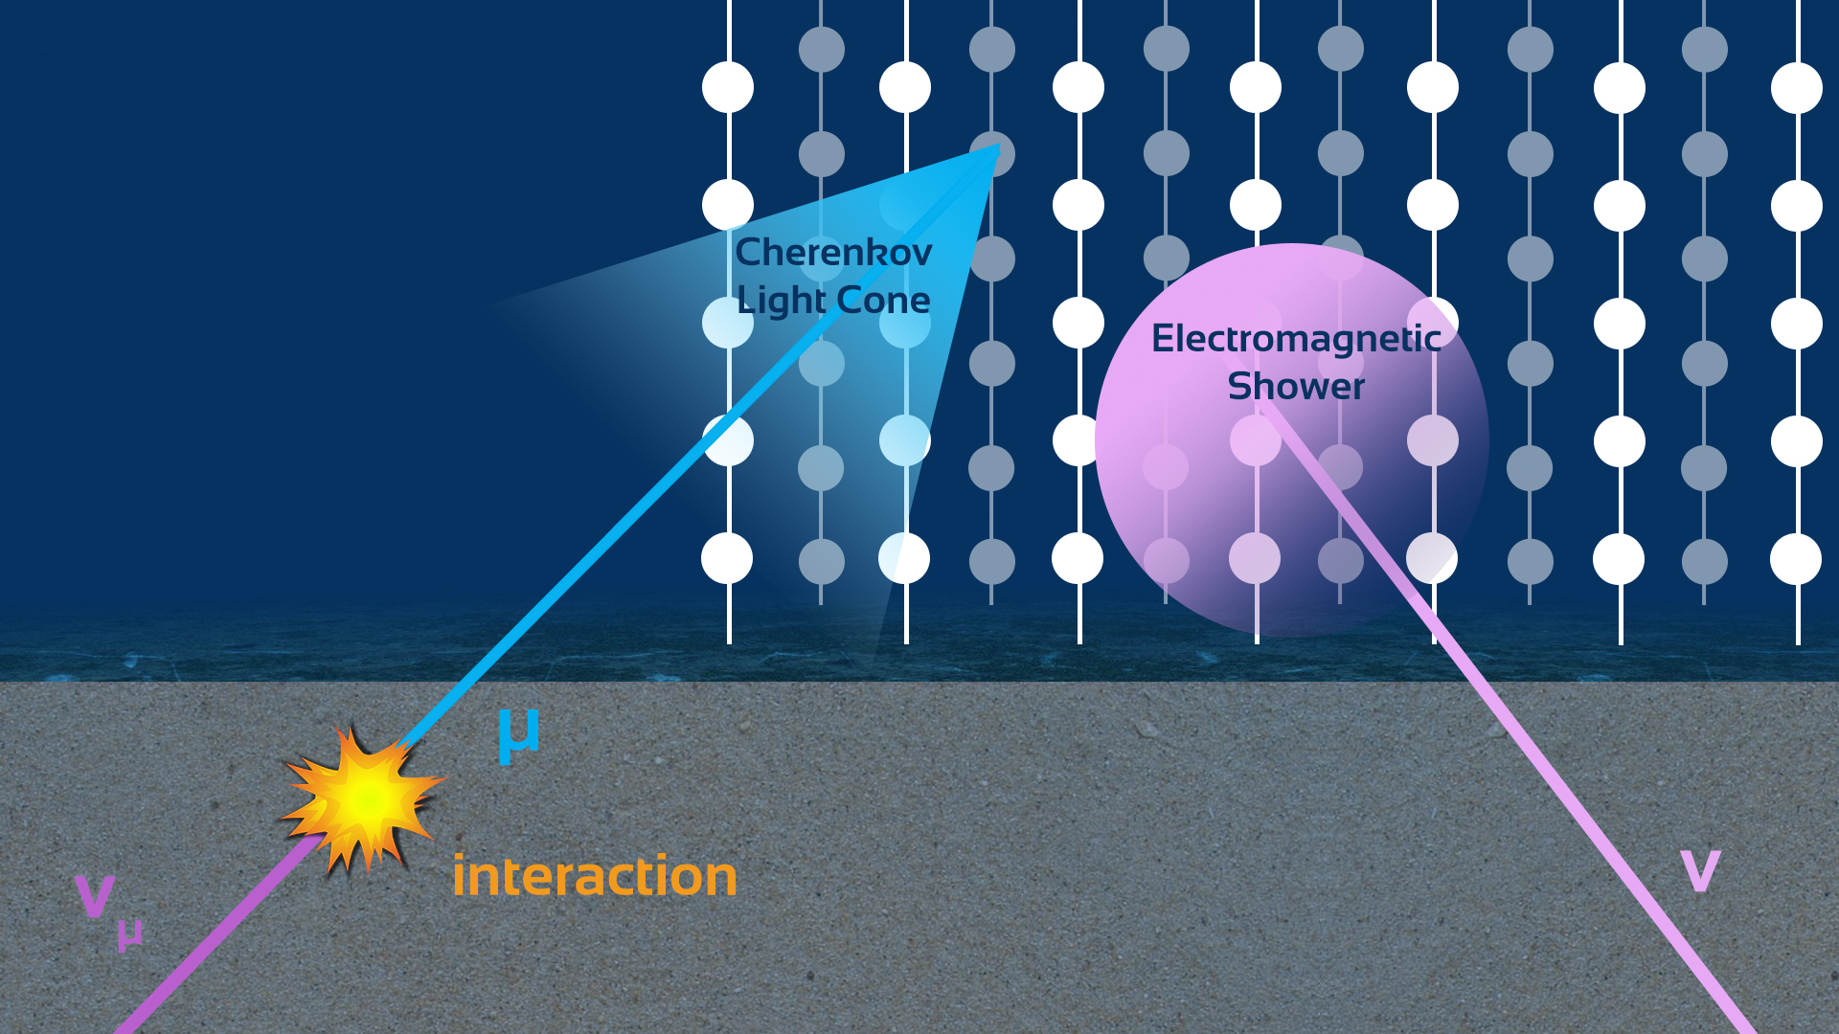
Underwater Neutrino Telescopes: Neutrino Observation
Upward-going neutrinos interact in rock or water
charged particles (in particular muons) produce Cherenkov light in water at 43° with respect to the neutrino direction
light is detected by array of photomultipliers
muon direction is reconstructed using PMT positions and photon arrival times
the Earth provides screening against all particles except neutrinos

Slide 5
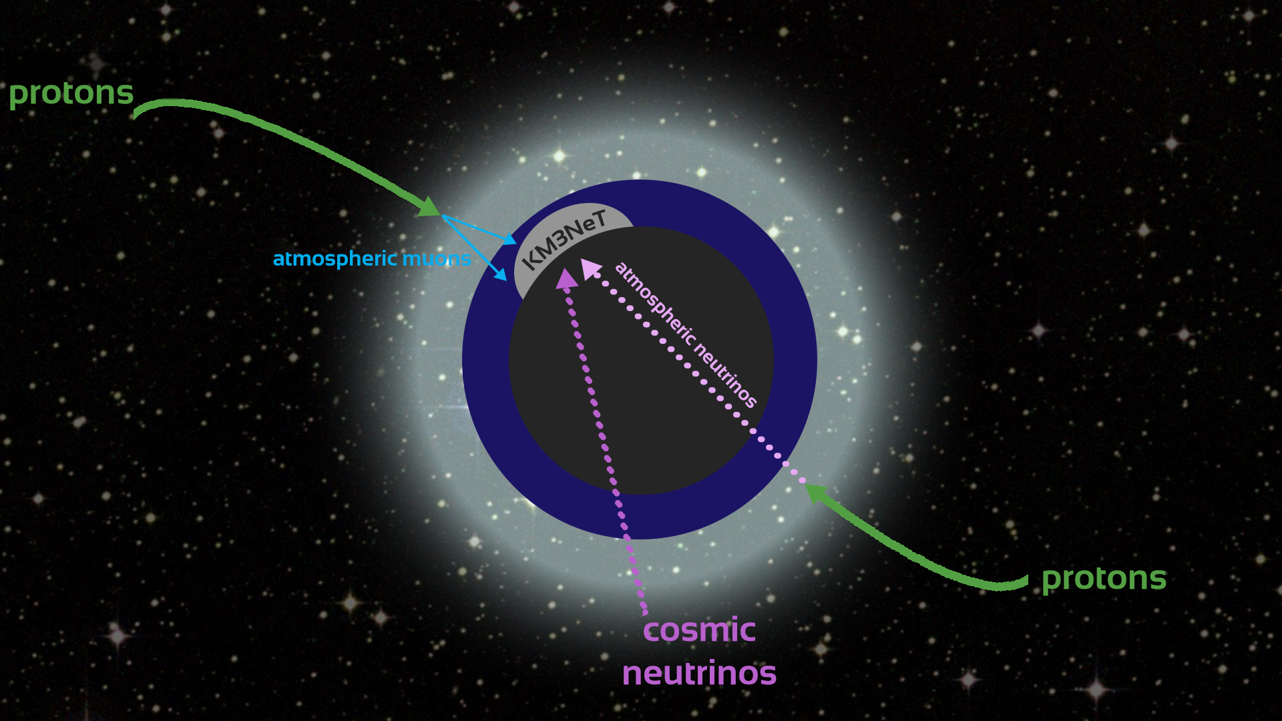
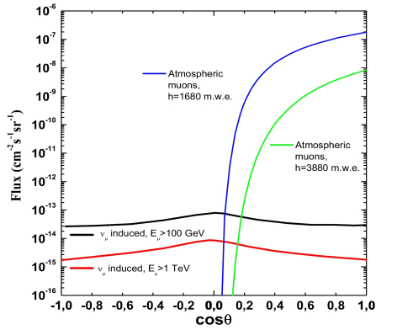
Background sources
cosmic ray interactions in the atmosphere produce π± and Κ± whose decays produce neutrinos - atmospheric neutrinos
cosmic rays entering the atmosphere produce extensive air showers; a component of which are high energy muons – atmospheric muons
noise: background from decays and from bioluminescence (life forms in the deep sea emitting light)

Slide 6
KM3NeT objectives
KM3NeT is a network of neutrino telescopes in the deep Mediterranean Sea
observe high energy (>TeV energy regime) neutrinos from astrophysical sources
ARCA
neutrino cross section is extremely low : very large active volume needed
Instrumented volume of several km3 : exceed IceCube sensitivity
determine the ordering of the neutrino mass eigenstates
ORCA
ARCA
building block:
115 DUs
18 DOMs / DU
31 PMTs / DOM
1 km
1 km
 | ARCA | ORCA
DU spacing | ~ 90 m | ~ 23 m
OM spacing | ~ 36 m | ~ 9 m
Depth | 3500 m | 2450 m
ORCA
200 m
Same collaboration, same technology
Distributed infrastructure, phased implementation

Slide 7
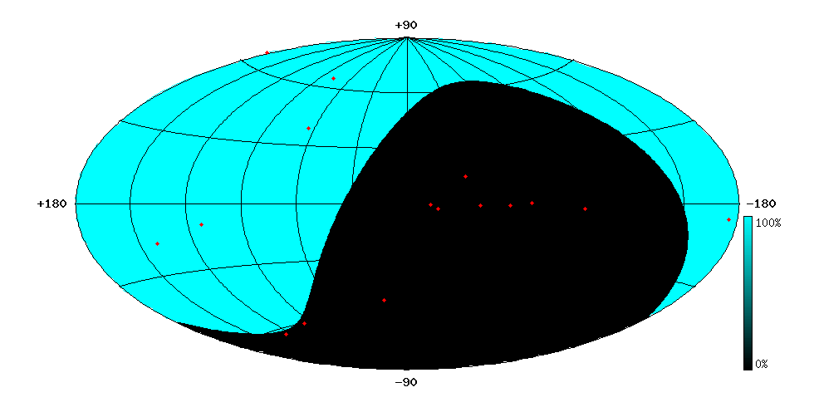
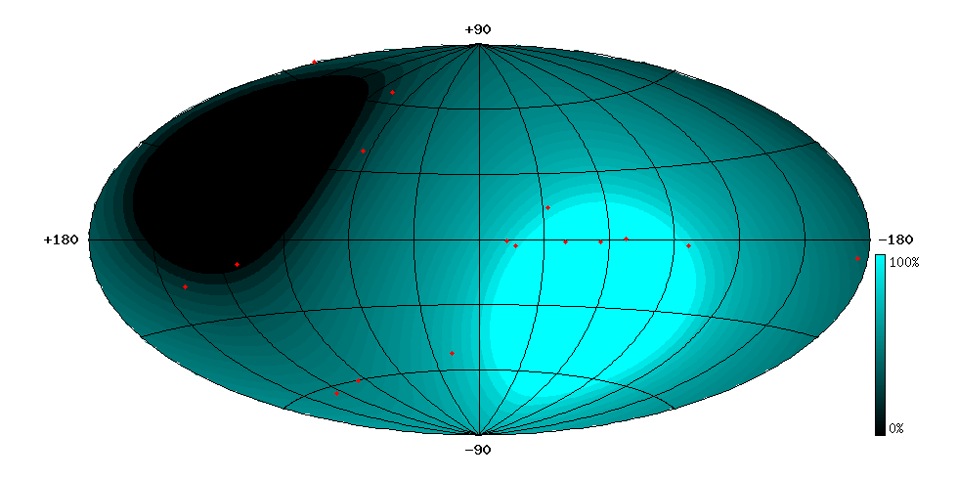
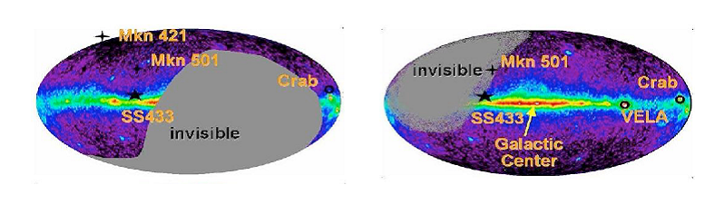
KM3NeT objectives
observe high energy (>TeV energy regime) neutrinos from astrophysical sources
Complementarity with IceCube
South Pole
Mediterranean Sea
IceCube
ARCA

Slide 8
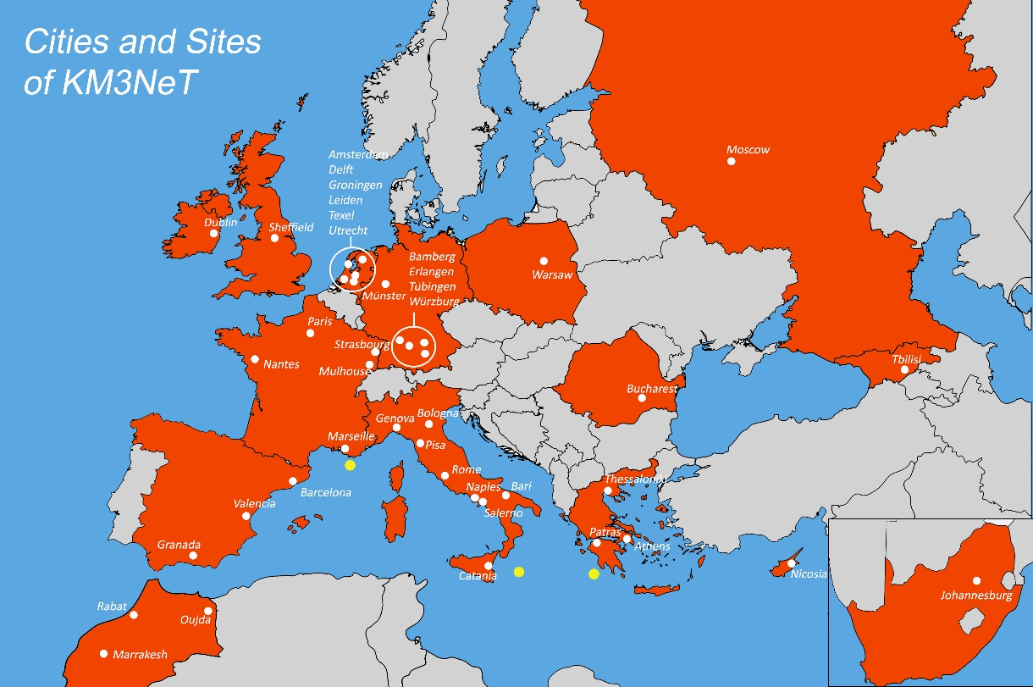
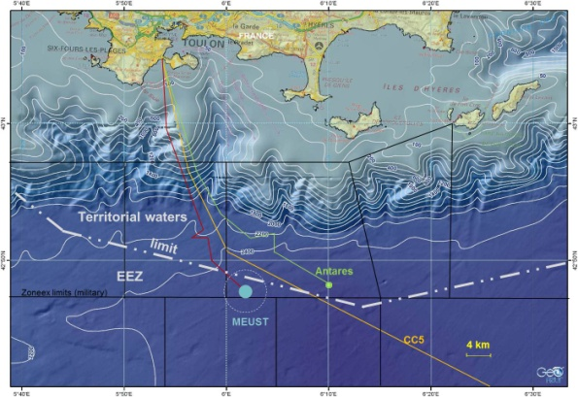
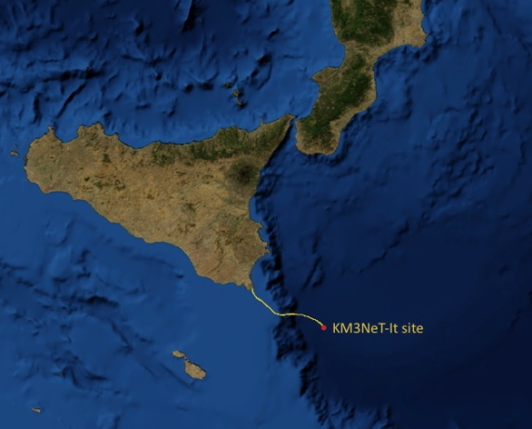
KM3NeT: A distributed research infrastructure
ORCA
> 40 Institutes
from 12 countries
Oscillation Research
with Cosmics In the Abyss
Low-energy studies of atmospheric neutrinos
ARCA
Astroparticle Research
with Cosmics In the Abyss
High-energy neutrino astrophysics
+ Since April 2017:
CIRA Perth Australia
as observer
+ Since May 2018:
Western Sydney University Australia

Slide 9
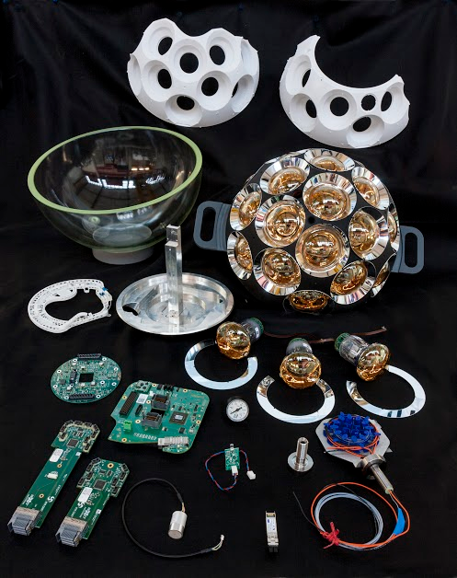
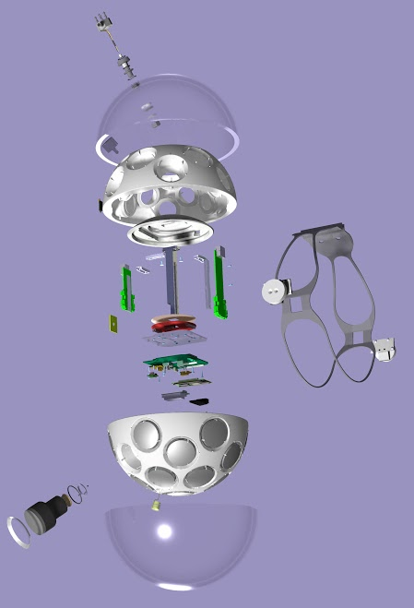
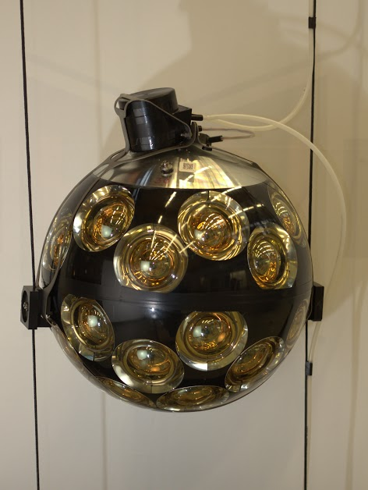
KM3NeT technology
Detection Unit
buoy
The Digital Optical Module (DOM)
17” glass sphere equipped with 31 3” PMTs
36 m
Glass sphere
Cooling system
Power Board + CLB
Pressure gauge
Nanobeacon
Octopus Boards
Acoustic sensor
PMT support structure (3D printed)
PMTs + reflector rings
Uniform angular coverage
Directional information
Digital photon counting
Wide angle of view
anchor
2 Dyneema ropes
Oil filled cables
(2 copper wires for power, 18 optical fibres data transmission)
Low drag
Base Boards
Penetrator
SFP
Fibre tray

Slide 10
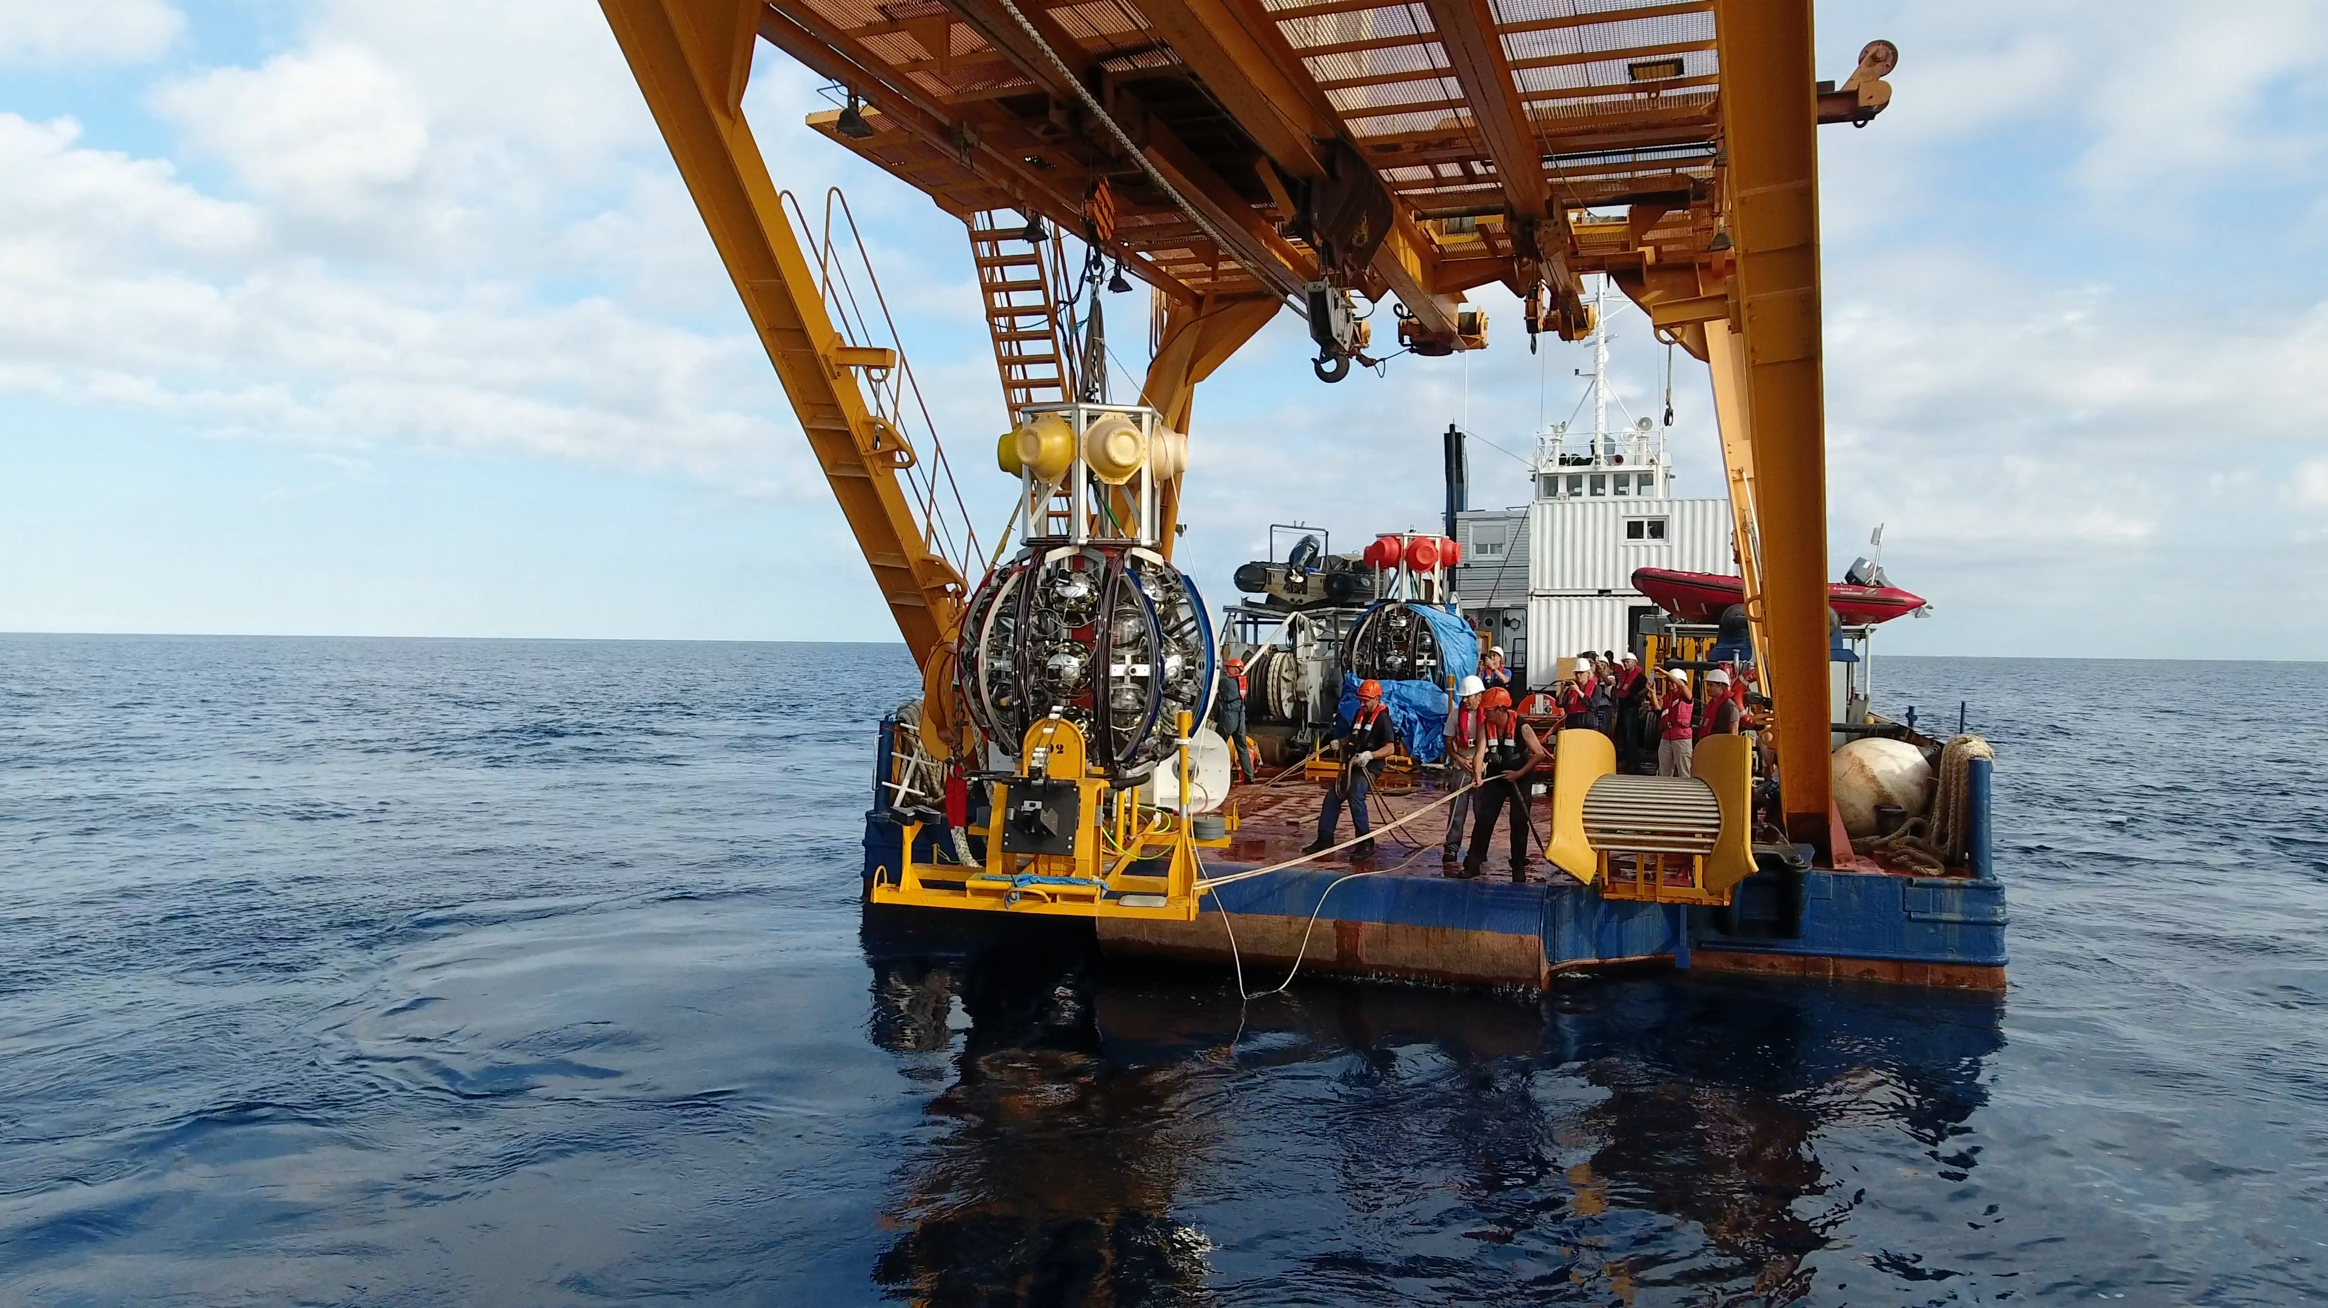
KM3NeT technology
Launcher of OMs

Slide 11
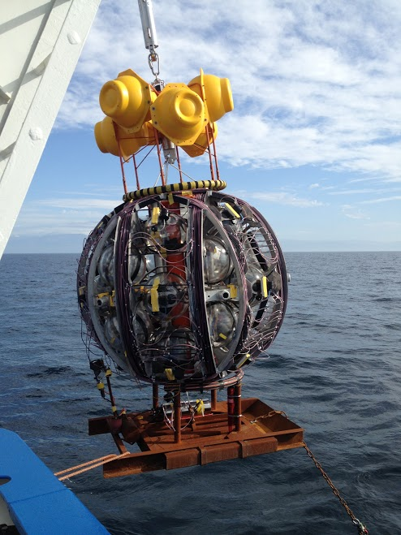
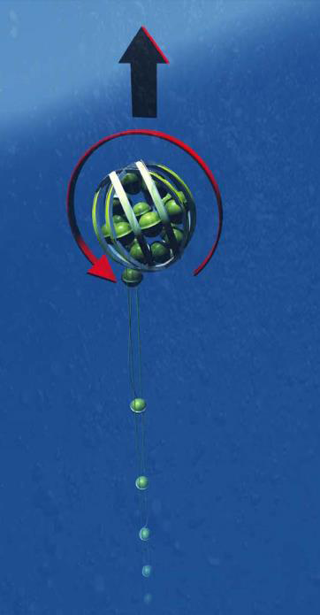
KM3NeT technology
Installation method
Launcher of OMs
DU unfurling
36 m
Rapid deployment
Autonomous unfurling
Multiple DUs per sea campaign
Easy recovery – floats to the surface for recycling

Slide 12
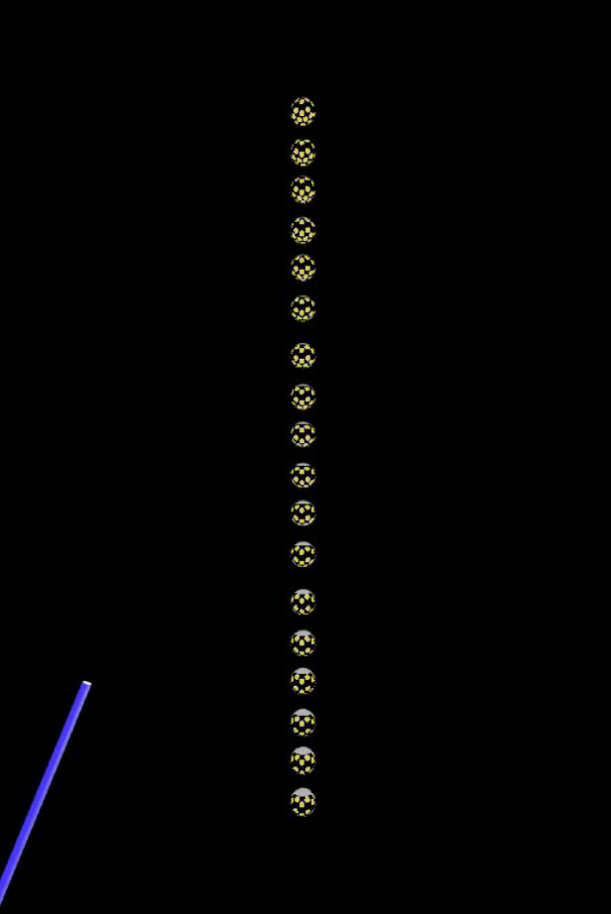
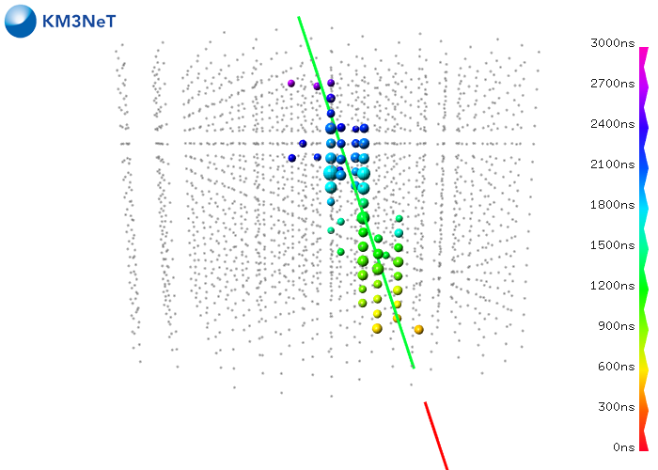
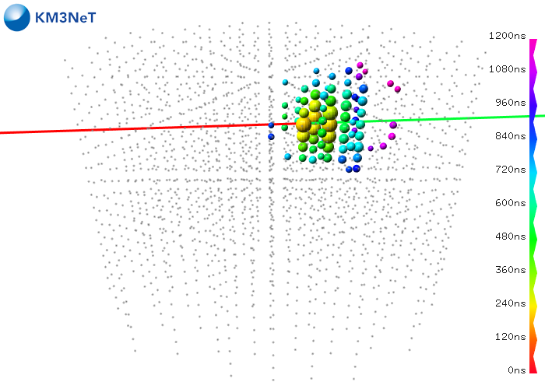
Event signatures
Expected for the full detector
(MC simulation)
from the 1st Detection Unit deployed
(real event)
track
two characteristic event topologies:
tracks: muons emitting light as they travel
linear
cascades: point-like light emission from electromagnetic and hadronic particle showers
spherical
shower

Slide 13
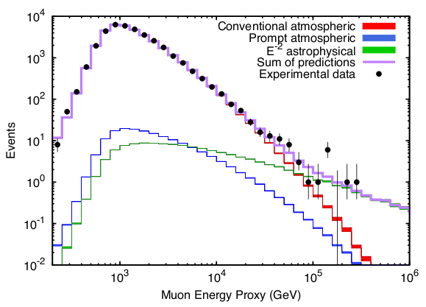
Focusing on the observation of High Energy Neutrinos
Muon Energy Reconstruction
muon energy estimation: critical for differentiating muons from neutrinos originating from astrophysical sources from muons and neutrinos generated in the atmosphere
ICECUBE
For a reliable estimation of the muon energy a containment selection is applied:
a minimum track length in the instrumented volume is required
a maximum contribution of boarder strings is allowed

Slide 14
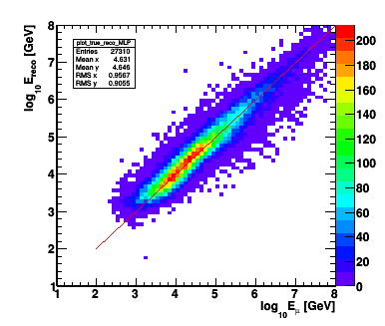
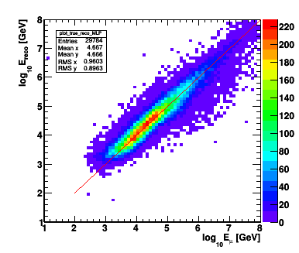
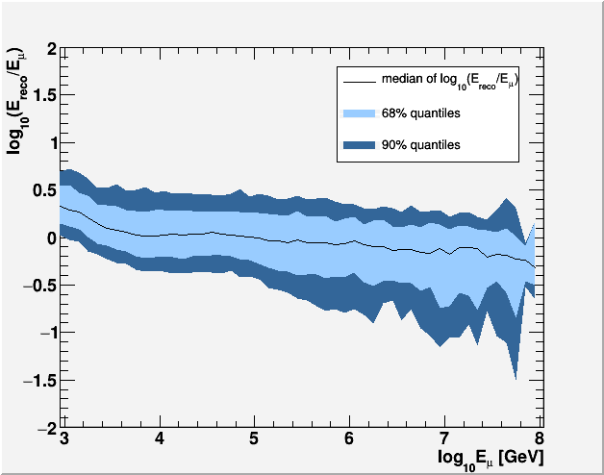
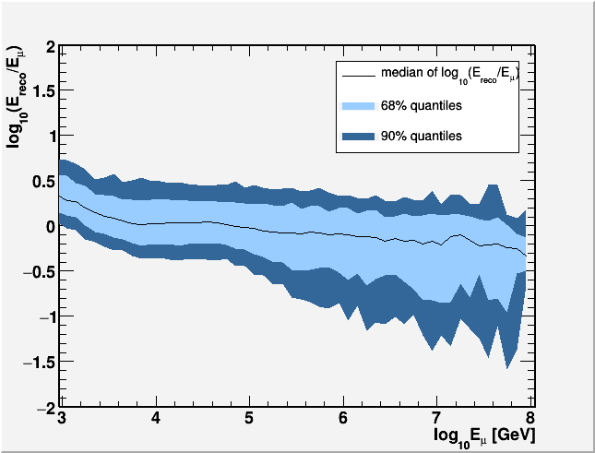
Muon Energy Reconstruction: ERENN
A MLP Neural Network has been trained using information :
number of PMTs with signal
Time over threshold in PMTs
number of OMs with signal
number of PMTs with no signal
events satisfying a containment selection
all reconstructed events
Energy Resolution: 0.27
Energy Resolution: 0.28

Slide 15
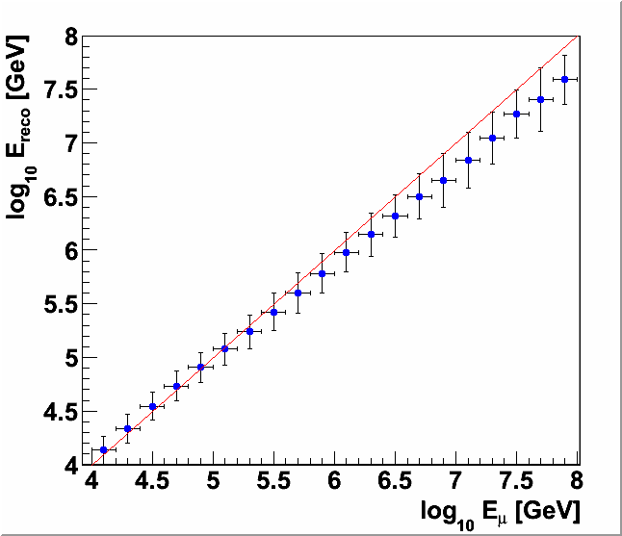
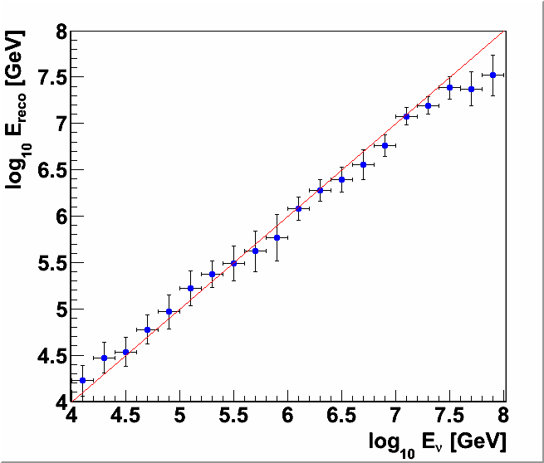
Energy Reconstruction: ERENN
Muon energy reconstruction
events satisfying a containment selection
Neutrino energy reconstruction
events satisfying a containment selection
and have the interaction vertex inside a fiducial volume (atmospheric muon background rejection is applied)

Slide 16
Energy Reconstruction: ERENN
This work:
Internal note
KM3NeT official analysis/results
PhD E. Drakopoulou
Published in :
“Letter of Intent for KM3NeT 2.0”, Published in J.Phys. G43 (2016) no.8, 084001
“Muon and neutrino energy reconstruction for KM3NeT”, Published in EPJ Web Conf. 121(2016) 05009
“Energy reconstruction of high energy muon and neutrino events in KM3NeT”, Published in EPJ Web Conf. 116(2016) 02001
“Muon track reconstruction and muon energy estimate in the KM3NeT/ARCA detector”, Published in PoS ICRC2015(2016) 1114
“Muon and Neutrino Energy Reconstruction for KM3NeT”, Published in PoS NEUTEL2015 (2015) 071

Slide 17
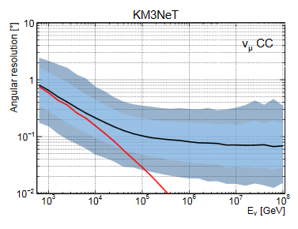
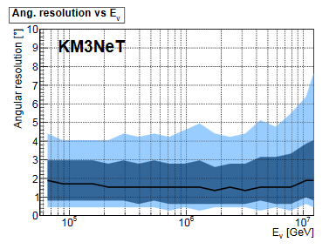
ARCA: reconstruction performance
CC νμ
NC νall
CC νe
angular resolution
< 2°
LoI
energy resolution
E_{reco} / E_{ν}
0.27 Log E (E>10 TeV)
5%
E_{ν} [GeV]

Slide 18
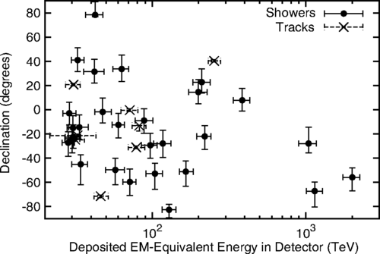
IceCube: high energy neutrino analysis
what have we learnt (so far) from IceCube
In 2013 IceCube discovered a high-energy diffuse flux of neutrino events with E 30TeV – few PeV of cosmic origin
ICECUBE
interaction vertex inside the detector used to suppress the atmospheric muon background
excess in both track and cascade channels
different spectral index for different classes of events
no prompt component from charm decays observed
Ensure that KM3NeT can detect an “ICECUBE-like” signal
How fast?

Slide 19
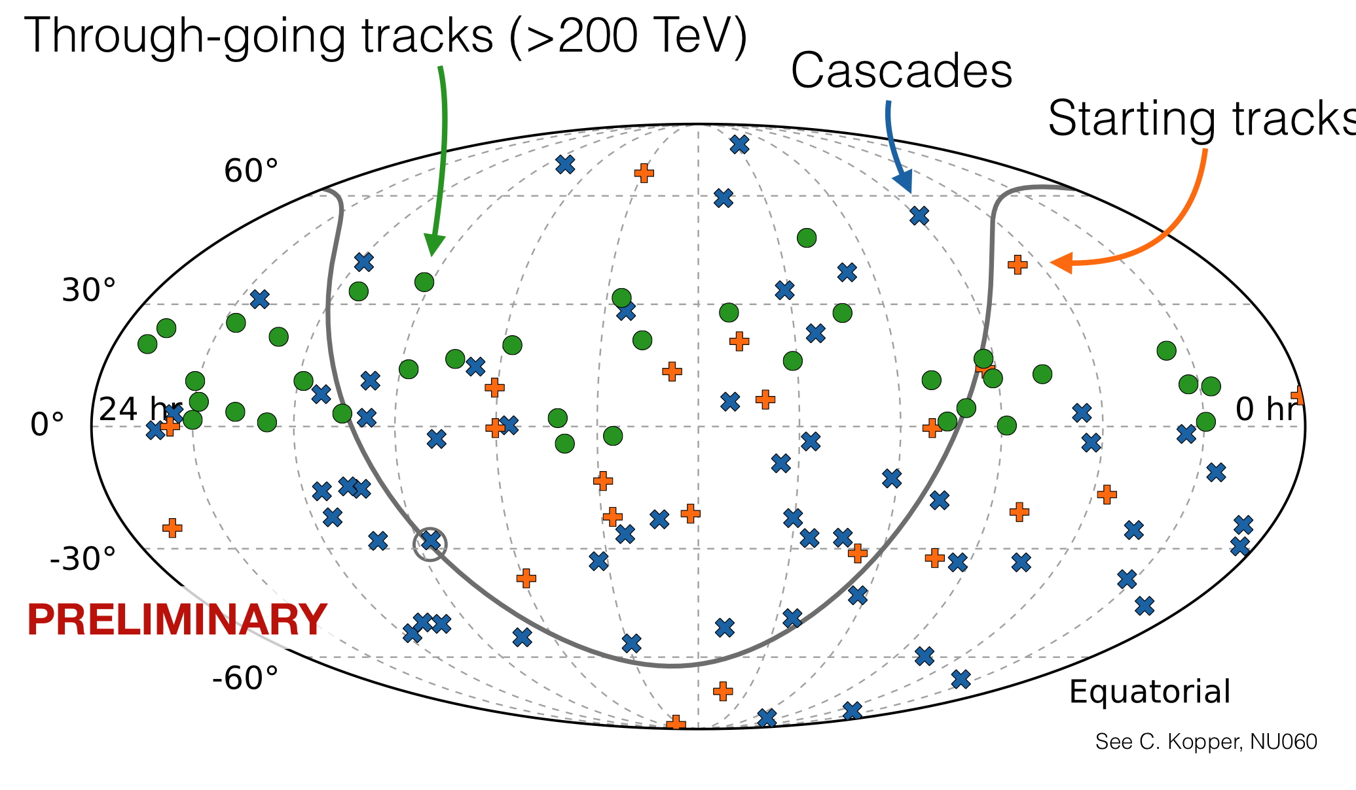
IceCube: high energy neutrino analysis
through-going tracks (Northern hemisphere). spectrum: E^{-2.13}
HESE (tracks and showers). E > 30 TeV up to 2 PeV. spectrum: E^{-2.5}
Above 100 TeV the HESE sample in agreement with the through-going tracks sample.

Slide 20
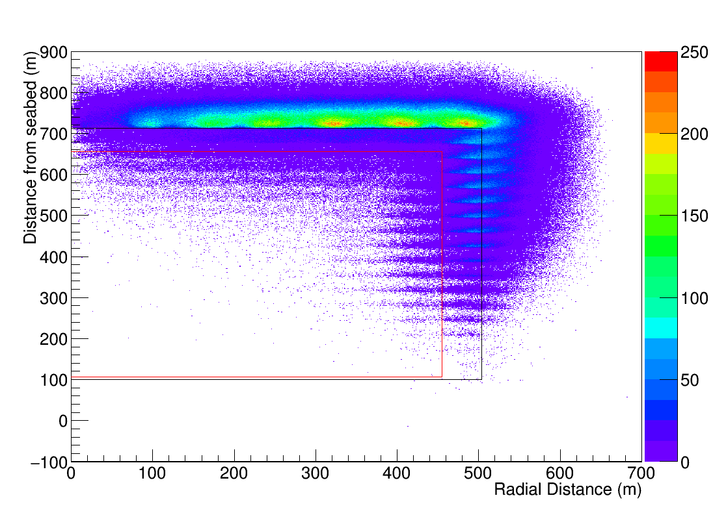
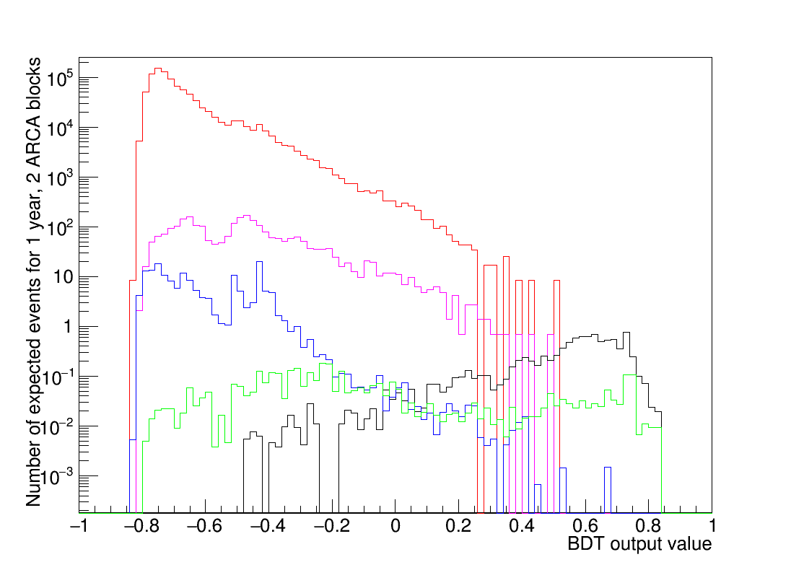
Atmospheric Muon Background Rejection
Containment requirement alone is not enough
MAMBA: BDT training
High activity in DOMs located at the border areas of the instrumented volume
Large number of DOMs with hits consistent with the reconstructed track
Activity behind the reconstructed vertex, along the reconstructed track, in an area close to the edge of the detector
High activity behind the reconstructed vertex – indication of neutrino interaction hadronic activity
MUPAGE E_{bundle} > 10 TeV
MUPAGE E_{bundle} > 50 TeV
ν_{μ} interact outside det
All ν_{μ} and ν_{e} shower events
HEST events
BDT output value for all events not used for training.

Slide 21
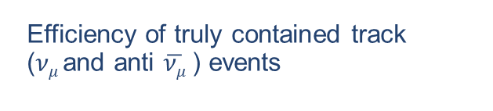
High Energy Starting Tracks
Φ₀ =2.3·10⁻¹⁸·(E_{ν}/100TeV)^{-2.5} GeV s⁻¹ cm⁻² sr⁻¹
Efficiency of truly contained track ($νμ$and anti $\overline{νμ}$) events
MUPAGE events E_{bundle} ≥ 50 TeV
ARCA (2 blocks) sensitive (90% CL) to astrophysical flux in 1.3 years:
  MRF cut at reco E ≥ 10^{5.0} GeV and BTD value ≥ 0.29
  Signal events: 5.8 (91% HEST)
  Background events: 6.6 (99% HEST)
  NO atm muon left.

Slide 22
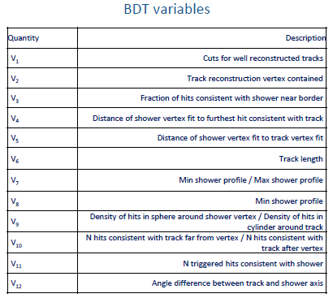
High Energy Starting Events
Shower-Track differentiation to select contained shower events

Slide 23
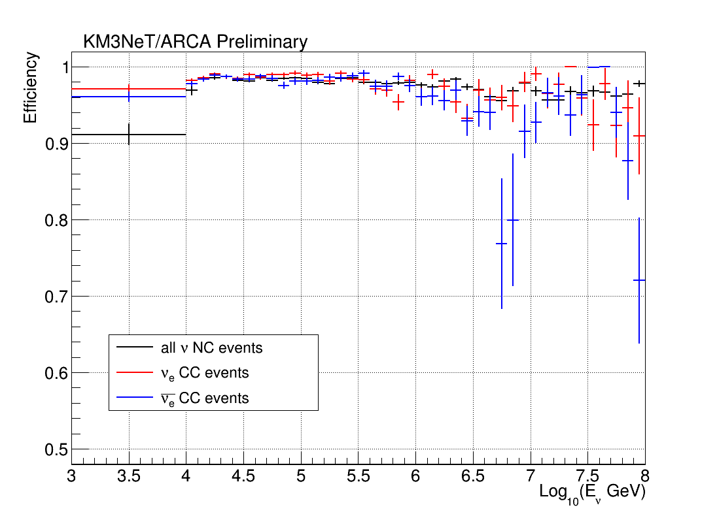
High Energy Starting Events
Shower-Track differentiation to select contained shower events
Selection efficiency

Slide 24
High Energy Starting Events
Φ₀ =2.3·10⁻¹⁸·(E_{ν}/100TeV)^{-2.5} GeV s⁻¹ cm⁻² sr⁻¹
Discovery potential
for a diffuse flux
of astrophysical neutrinos
Discovery at 5σ significance in less than one year
This work:
2 Internal notes
KM3NeT official analysis/results
PhD K. Pikounis in preparation
Presented in:
“Analysis of vertex-contained high energy neutrino events for the KM3NeT/ARCA detector”, Poster, Neutrino 2018 – International Conference on Neutrino Physics and Astrophysics, Heidelberg, DOI: 10.5281/zenodo.1300717

Slide 25
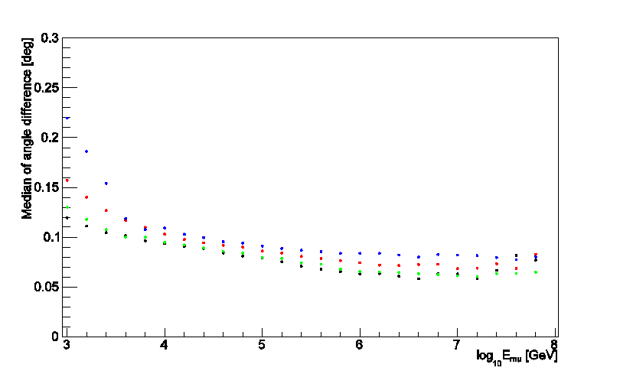
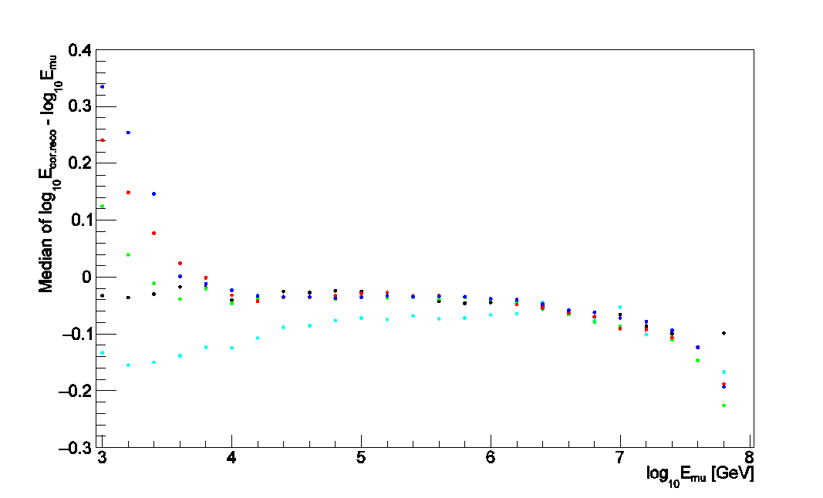
Studies of alternative detector configurations
Objective: effect of larger and sparser detector geometries on
Angular resolution
Energy resolution
Sensitivity & Discovery Potential
Angular resolution
Energy resolution
90m
120m
150m
180m
90m
90m can
120m
150m
180m

Slide 26
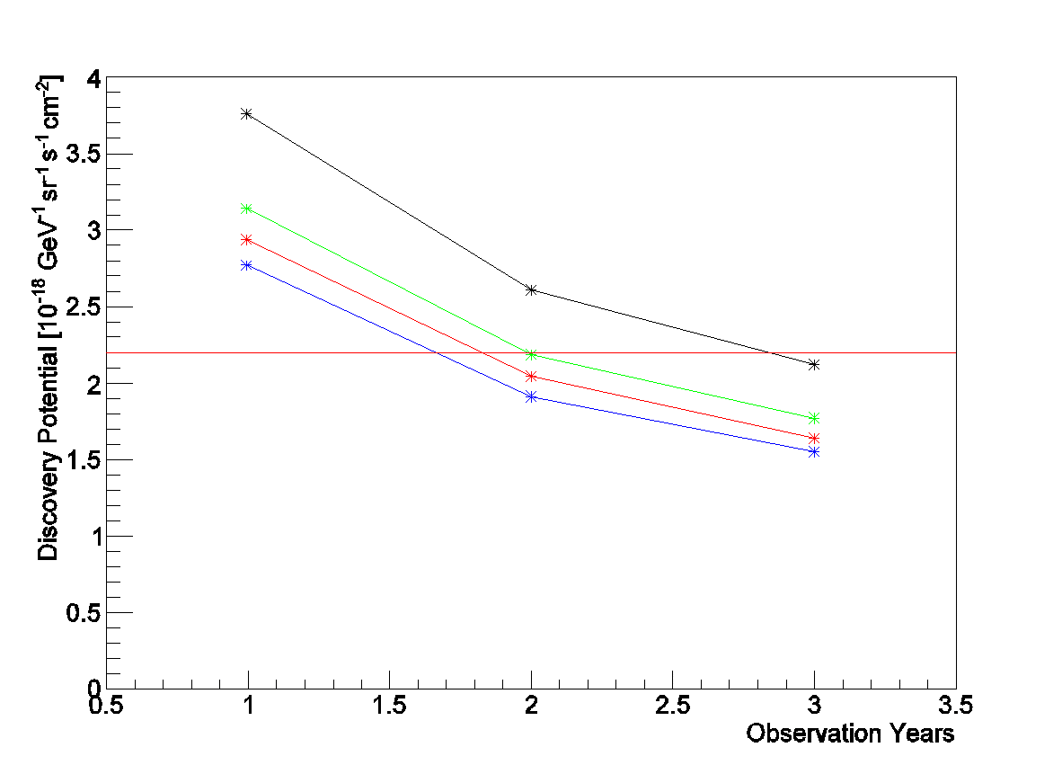
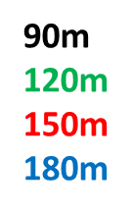
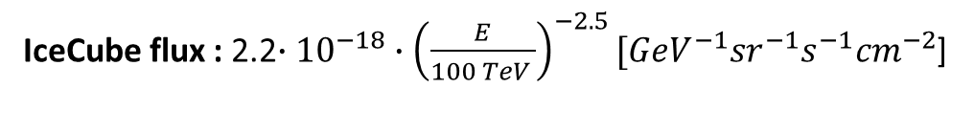
Studies of alternative detector configurations
IceCube flux : 2.2$∙{10}^{−18}∙{\left(\frac{E}{100 TeV }\right)}^{−2.5}[{GeV}^{−1}{sr}^{−1}s^{−1}{cm}^{−2}$]
Discovery potential
for a diffuse flux
of astrophysical neutrinos
This work:
Internal note
MSc A. Sinopoulou

Slide 27
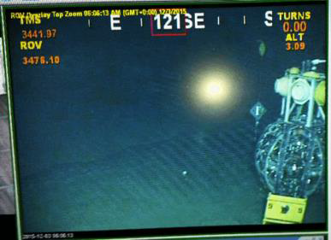
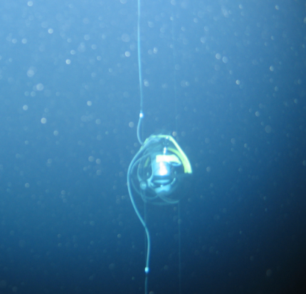
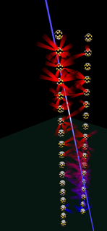
KM3NeT: Installation of the first DUs
DOM after DU unfurling
ARCA
1st DU deployed Dec 2016
2nd DU deployed May 2017
Real event recorded with the first 2 ARCA Detection Units deployed

Slide 28
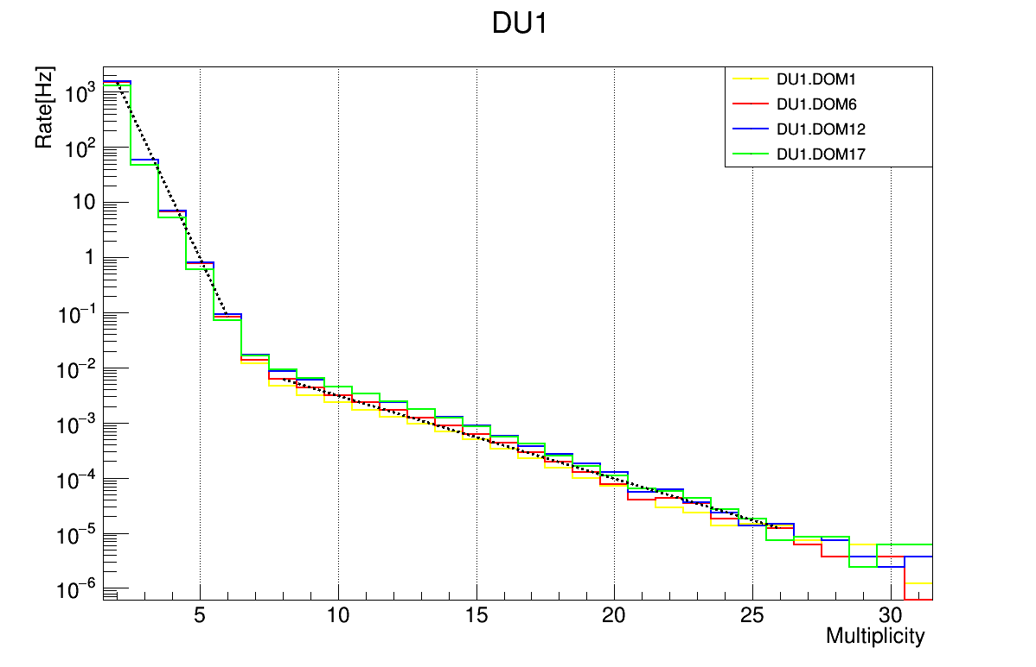
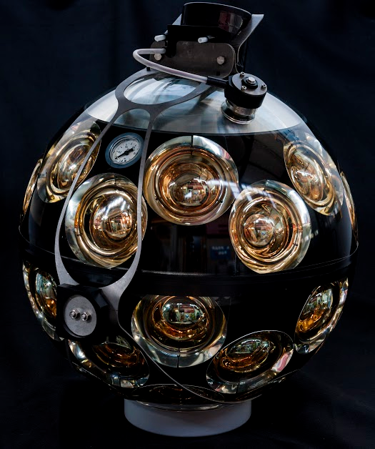
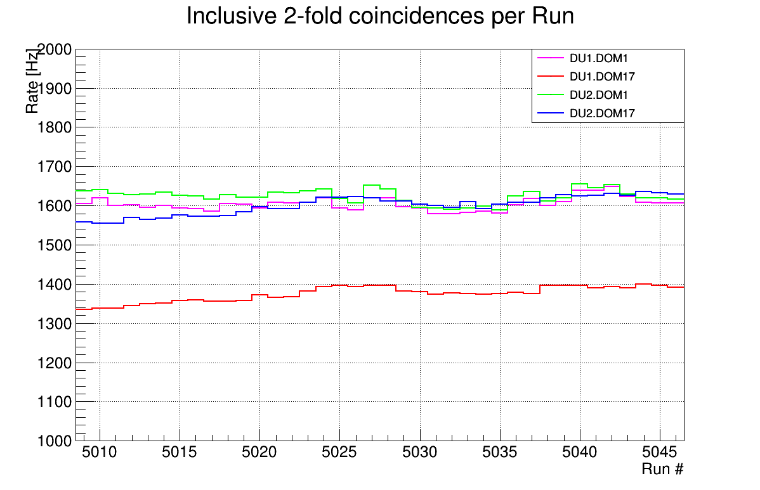

ARCA: Muon depth dependence
μ
F18
Require ≥ 8 PMTs in coincidence
  remove optical background at DOM level
Measure the atmospheric muons versus depth
F1
⁴⁰Κ (𝑚 ≥ 2) Atmospheric muons (𝑚 ≥ 8)

Slide 29

ARCA: Muon depth dependence
μ
from the first 2 DUs
F18
Require ≥ 8 PMTs in coincidence
  remove optical background at DOM level
Measure the atmospheric muons versus depth
This work:
Diploma Thesis D. Stavropoulos
F1

Slide 30
KM3NeT technology transfer
Coordination of the WP “technology transfer and innovation” of the KM3NeT-INFRADEV project
(Horizon 2020) aiming to establish a methodology for the flow of information, innovation and know-how between KM3NeT and industry
Objectives
methodology for following technological advances in key areas of interest to KM3NeT
expose developed/adapted technological choices and innovative solutions to interested parties in industry
technology transfer of services developed by KM3NeT
Covering
Technology and Innovation Panel of KM3NeT:
Software
CLB, White Rabbit
PMT related
Sea Operations
Calibration

Slide 31
KM3NeT technology transfer
Observation of technological advancements
Expose developed/adapted technological choices and innovative solutions to parties with potential interest
system for pmt testing
Positioning system and calibration
Developments related to the FIDES analysis
Software
VEOC
ROV connection tool for wetmateable connection
Hydrophones
Items identified
KM3NeT participation in exhibitions
Increase the visibility of KM3NeT to technology developers
aim:
present the science case of KM3NeT, technological challenges, solutions adopted, synergies

Slide 32

KM3NeT: Status and expectations
Construction phase has started
2 ARCA DUs installed in KM3NeT-It; Data taking for more than a year; short circuit problem
1 ORCA DU installed in KM3NeT-Fr; new electro-optic cable
Performance according to expectation
Mass production planned to start fall 2018
Data analysis ongoing
Expectations
Neutrino astronomy: almost complete sky coverage with unprecedented angular resolution
IceCube signal to be confirmed in less than one year of ARCA
Good perspectives for neutrino detection from Galactic plane and for the most intense galactic sources
ORCA: plan for completing construction by 2020
3σ significance for NMH could be reached in less than 3 years (with full detector)

Slide 33
KM3NeT: Looking ahead
Data analysis
Involvement in the monitoring of the ARCA performance - also versus time
(started G.Zarpapis, MSc D. Stavropoulos)
Triggered hits
Neighbouring DOMs
Next-to-neighbouring DOMs

Slide 34
KM3NeT: Looking ahead
Data analysis
Involvement in the DATA – MC comparisons for the understanding of the ARCA data and
Neutrinos from the ARCA data
A. Sinopoulou, D. Tzanetatos
events reco
from 1 string
Atmospheric ν MC: All events
Events that hit 2 strings
Events that hit exclusively 1 string
Atmospheric ν MC:
well reconstructed events
Data
MC
(MUPAGE)
events reco
from 2 strings

Slide 35
KM3NeT: Looking ahead
Discovery potential for a diffuse flux of astrophysical neutrinos
PhD K. Pikounis
High Energy Starting Events analysis completed
Expand the analysis to include through-going tracks
Main source of background:
Mis-reconstructed atmospheric muons
new quality criteria constructed:
Further suppression of atmospheric muons of
a factor 25 for E__{bundle} >10 TeV
a factor 50 for E__{bundle} >50 TeV
Efficiency for CC ν_{μ} events > 88%
IceCube

Slide 36

KM3NeT: Looking ahead
Acoustic Neutrino Detection
KM3NeT acoustic positioning system offers an opportunity
for acoustic neutrino detection
Piezo-electric digital acoustic receivers
Digital hydrophones on the base of the DUs

Slide 37
KM3NeT: Looking ahead
Leadership responsibilities:
Coordinator of the Work Package “Technology transfer and innovation” of the KM3NeT-INFRADEV project funded by the European Commission’s Horizon 2020 framework.
Member of the Publication Committee of KM3NeT
Member of the Conference and Outreach Committee of KM3NeT
Member of the KM3NeT Institution Board
Gr site manager and member of the KM3NeT Management Team

Slide 38
Summary
Research Activity: (end of 2012 – today)
Muon and Neutrino Energy Reconstruction for CC ν_{μ} events
Discovery potential analysis using High Energy Starting Tracks
Shower – Track differentiation
Discovery potential analysis using High Energy Contained Showers
Study of alternative (sparser) detector configurations
Analysis of ARCA data from the first DUs
Technology transfer and innovation
Future plans:
Involvement in the monitoring of the ARCA performance
Involvement in the DATA – MC comparisons for the understanding of the ARCA data
Neutrinos from the ARCA data
Discovery potential for a diffuse flux of astrophysical neutrinos including an analysis of up-coming tracks
Acoustic neutrino detection

