Slide 1
Forum on New International Research Facilities for South East Europe
Forum on New International Research Facilities for South East Europe
Jan 25-26, 2018
ICTP, Trieste, Italy
International Institute for Sustainable Technologies
WAAS Initiative for New International Research Institute in SEE
The World Academy of Art & Science is a network established by its founders to address global challenges confronting humanity.
Report by M.Barone

Slide 2


Proposal for Large-Scale Research Facilities in
South East Europe
Dr. Sanja Damjanovic
Minister of Science of Montenegro
Forum on New International Research Facilities for South East Europe,
ICTP Trieste, January 25-26, 2018

Slide 3
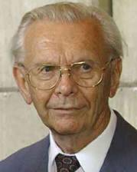







Joint South-East European International Institute for Sustainable Technologies (SEEIIST)
in the spirit of ‘Science for Peace’
Initiative proposed by Prof. Herwig Schopper, former Director General of CERN
positive reception by a number of organizations and institutions

Slide 4
The main objectives of the Project
To promote collaboration between science, technology and industry, but also to provide platforms for the development of the education of young scientists and engineers based on knowledge and technology transfer from European laboratories like CERN and others
To mitigate tensions between countries in the region
To form a research nucleus in the region of South-East Europe by bringing people from different countries to work together – not only scientists and engineers, but also industry and administration
The combination of all these tasks would imply another case of the ‘CERN model’
The goals can only be achieved with a Large Scale Facility based on the latest technologies to enable ‘first class research’ and thereby strongly revert brain drain and assure high competitiveness

Slide 5
Importance of the Project for the Region
The project would be unique in the whole region
Real international cooperation, bringing people together in the spirit
of ’Science for Peace’ could contribute to
develop the economic situation
improve the standard of living
reduce unemployment (in particular for young people)
revert brain drain
aim at excellence throughout
this would imply a certain ‘industrialization’ of the region based on sustainable technologies
These type of projects represent ‘knowledge-based economy’

Slide 6
Summary of the main mission of the SEE Project
Science for Peace
Scientific Excellence
International Collaboration
Sustainable development of society
Education
Technology Transfer and Innovation

Slide 7
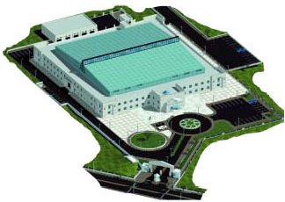
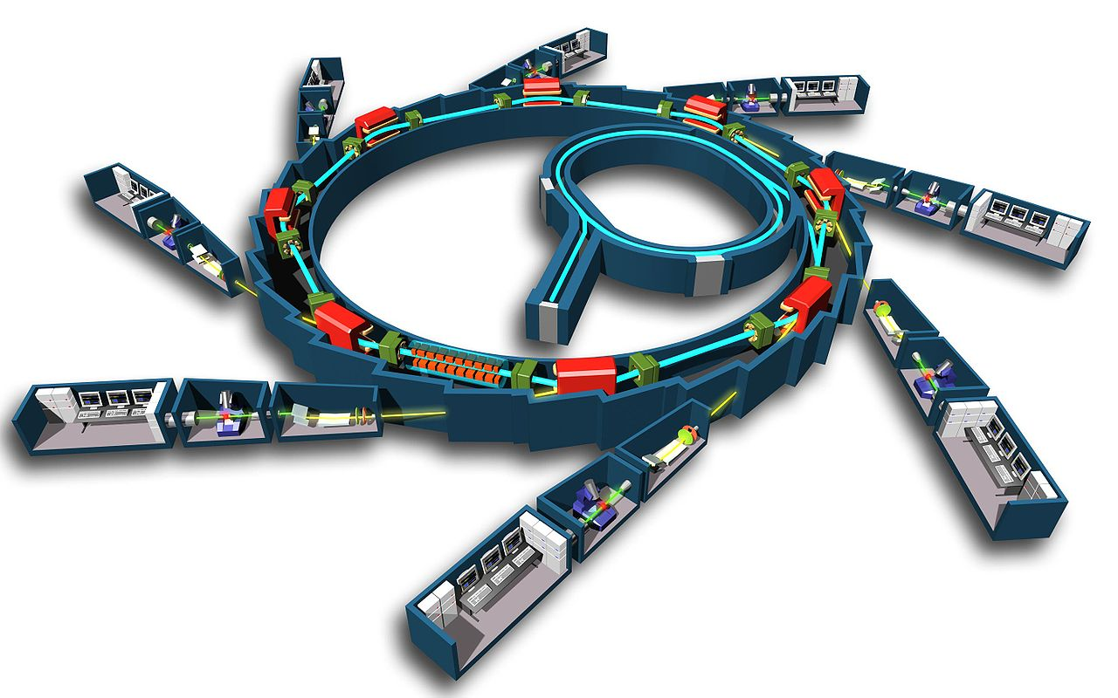

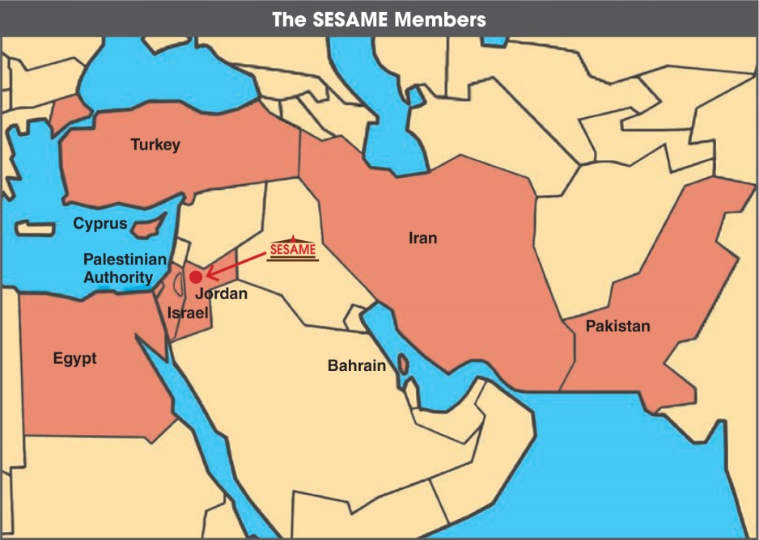
SESAME: ‘Synchrotron Light for Experimental Science and
Applications in the Middle East’
Jordan
The success of such an initiative is being demonstrated by the SESAME project:
built in Jordan, unifies nine member states of different political systems and religions in the Middle East: Bahrain, Cyprus, Egypt, Israel, Iran, Jordan, Pakistan, Palestinian Authority, Turkey; has achieved all of them to peacefully work together
The first President of Council of SESAME:
Prof. Herwig Schopper

Slide 8
The first preparatory steps during 2017 towards the
realization of a SEE Project
2016
November
2017
March | April | May | June | July | August | September | October
WAAS meeting, Dubrovnik,
proposal
H. Schopper
for a joint SEE International
Institute
Official support by
the Government of Montenegro
Visit of all Science/Corresp. Ministers of the region
First joint discussion,
Budva
Ministerial meeting at CERN – Signature of Declaration
of Intent
Initiative presented
to the EC, incl. Commissioner C. Moedas
Initiative presented to the IAEA, incl. DG Y. Amano
Political steps
2017 |  |  |  |  |  |  |  | 2018
Jun |  |  | August | Septemb. | October | November | Decemb. | January | February | March
July
Two international committees
of experts
for each of the two project options formed
Editori committees work on Concept Studies
Scientific Forum
ICTP, Trieste
Editor committee meeting at CERN
Editor committee meeting in Podgorica
Editor committee meeting at CERN
Executive Summary
of the results prepared
Scientific steps

Slide 9
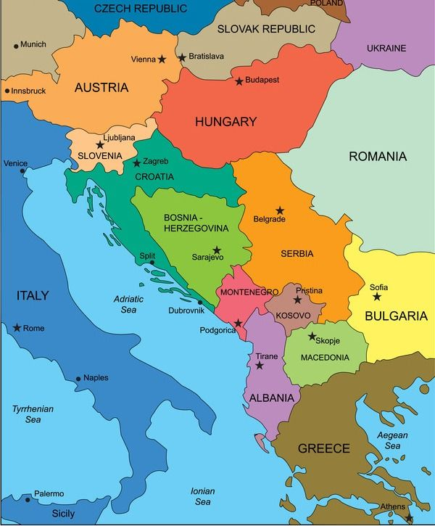
Candidate Members for the South-East European
International Institute for Sustainable Technologies
Republic of Albania
Signed a Declaration of Intent
Agreed ‘ad referendum’
Bosnia and Herzegovina
Observer
Republic of Bulgaria
Republic of Croatia
Hellenic Republic
Kosovo*
FYR of Macedonia
Montenegro
Republic of Serbia
Republic of Slovenia

Slide 10
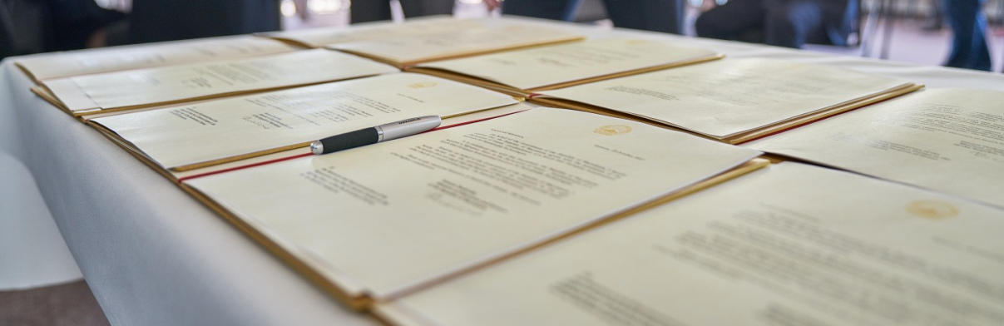
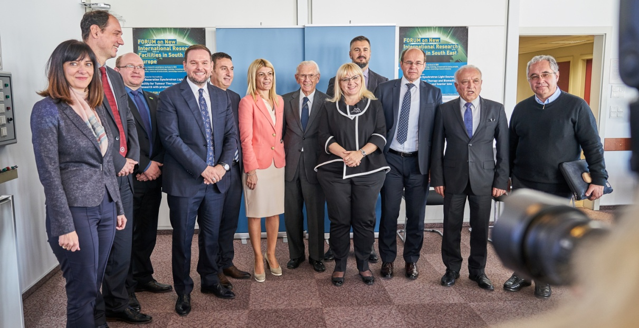
Culmination of the political development so far:
Declaration of Intent signed at CERN on October 25, 2017
Signed by eight parties:
Albania, Bosnian and Herzegovina, Bulgaria, Kosovo*, The FYR of Macedonia, Montenegro, Serbia and Slovenia.
Croatia agreed ‘ad referendum’, Greece is presently an observer
SEE Initiative now transformed into a Project with regional character
Further result: Intergovernmental Steering Committee formed for the further steps
SEE Ministers of Science/Corresponding Ministers or their representatives at CERN

Slide 11
How the common central facility would look like?
Proposed are two complementary options, both based on most advanced technologies

Slide 12
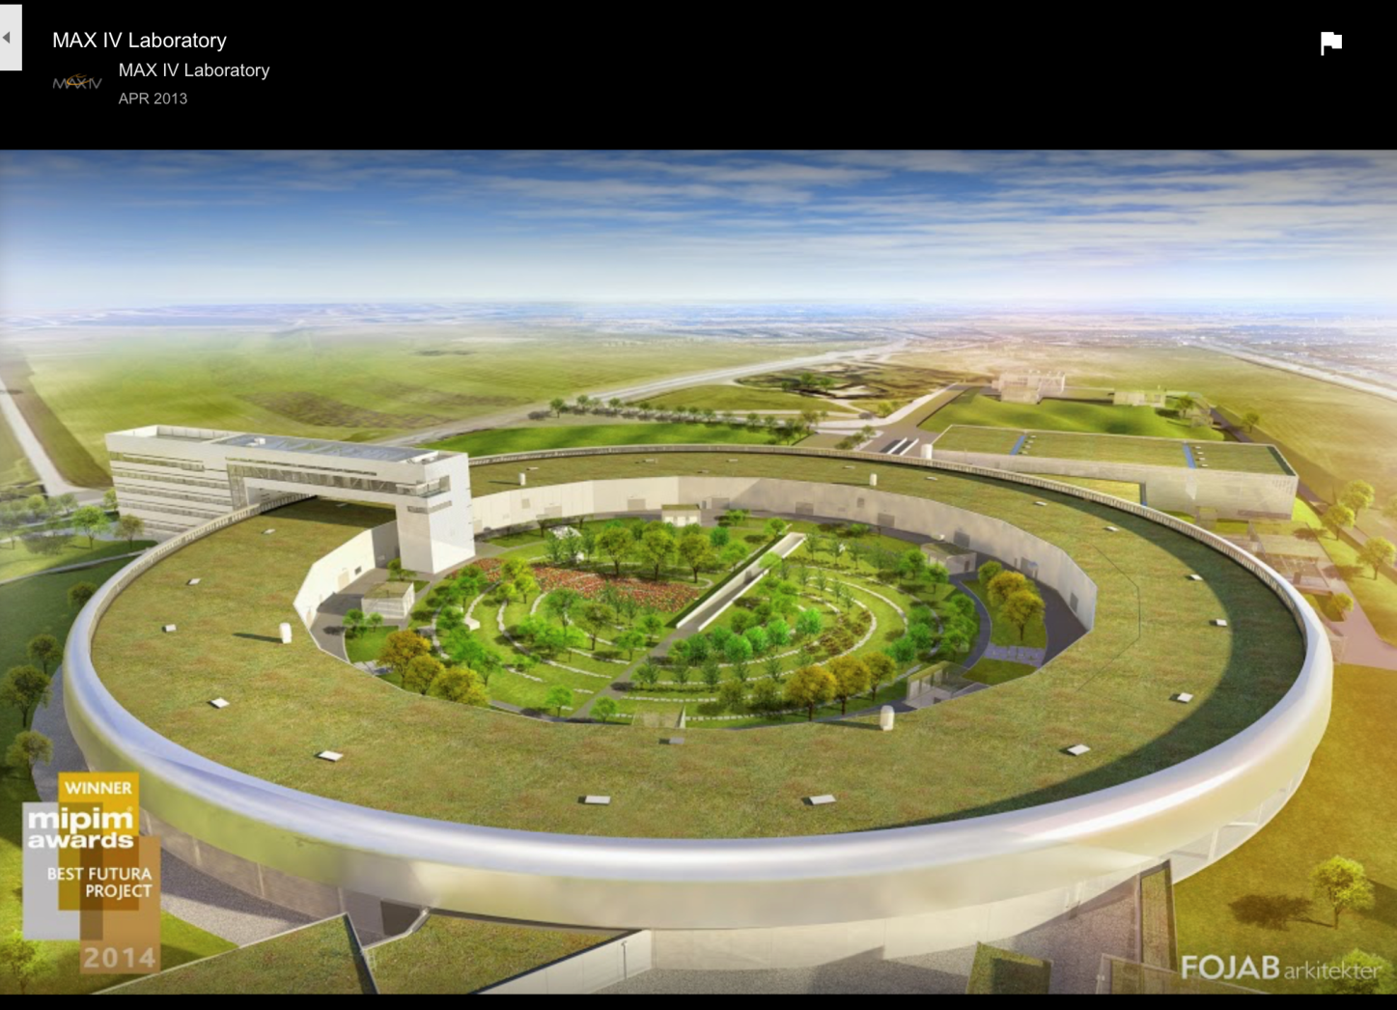
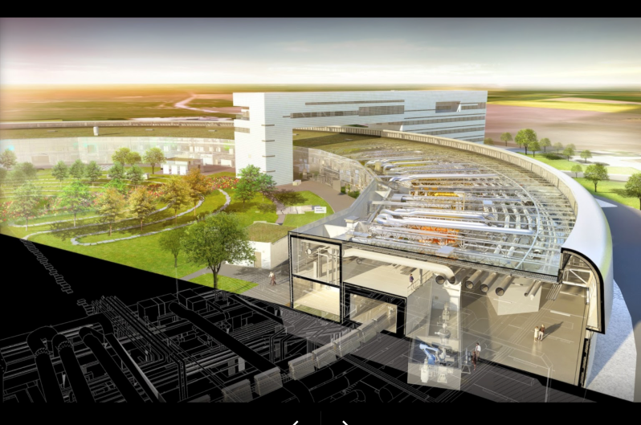
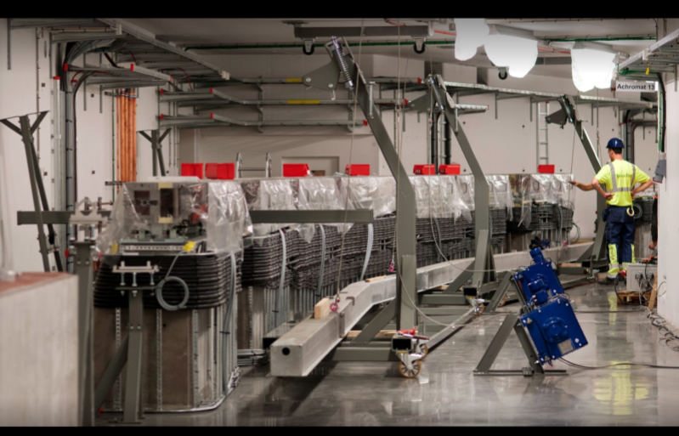
Option I: 4th Generation Synchrotron Light Source with a
new technique used for the first time in Lund, Sweden
Science community of South-East Europe would be unified, more than 1000 Users, a broad spectrum of research and applications reaching from biology up to industrial aspects
Max IV Lund
Director Dr. Christoph Quitmann

Slide 13
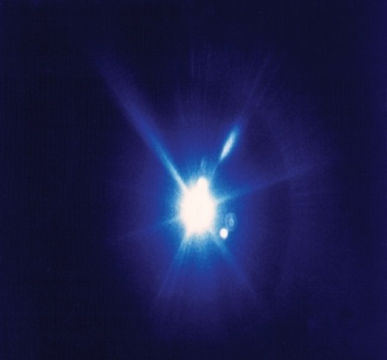
Option I: Applications of Synchrotron Light
Life Sciences
  Drug design
  Imaging
  Therapy
Synchrotron Radiation Light
Material Science
  New materials
  Energy
Synchrotron Radiation Light
Environmental
Science
  Air, soil and water
  pollution analyses
Cultural Heritage
  Non-destructive analyses
Examples of possible research domains which are relevant for the region

Slide 14
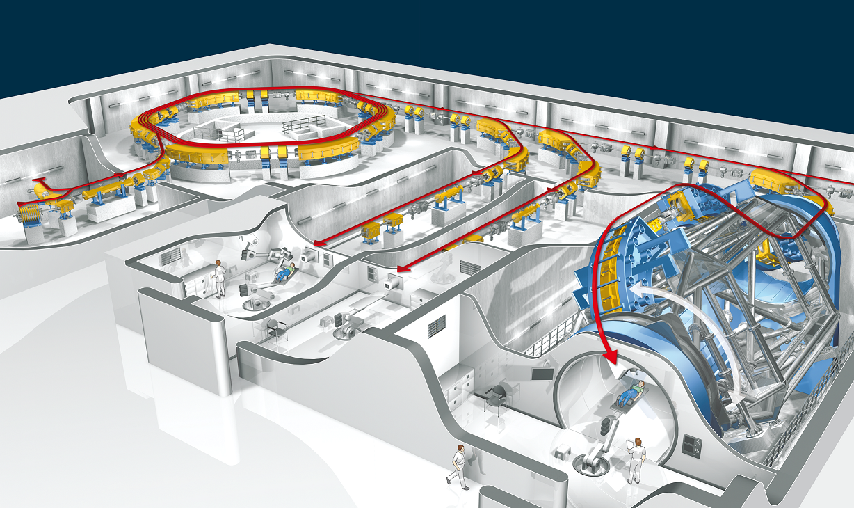
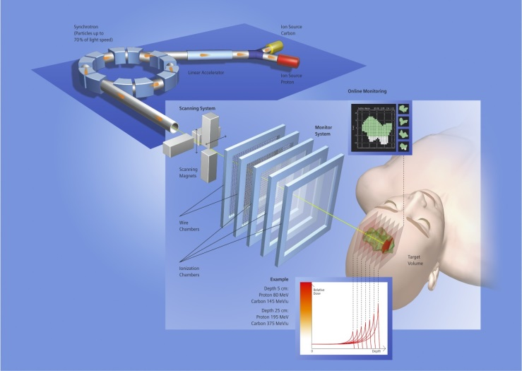
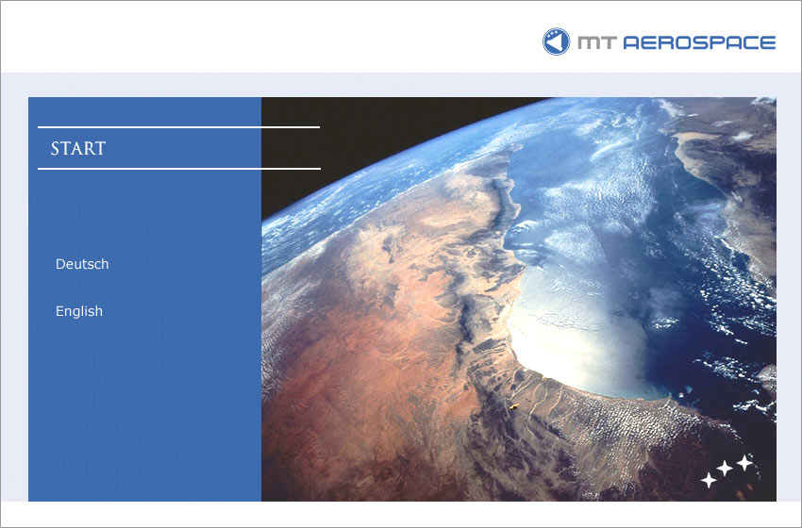

Option II: Facility for Tumour Therapy and Biomedical Research with protons and heavier ions
About 400 patients per year to be treated as needed for a population of 20M. In parallel, 50% of the beam time dedicated to biomedical research. About 1000 researchers, including a major number from outside the SEE region. Unique.
HIT Heidelberg
Med. Director: Prof. J. Debus
Tech. Director: Prof. T. Haberer

Slide 15
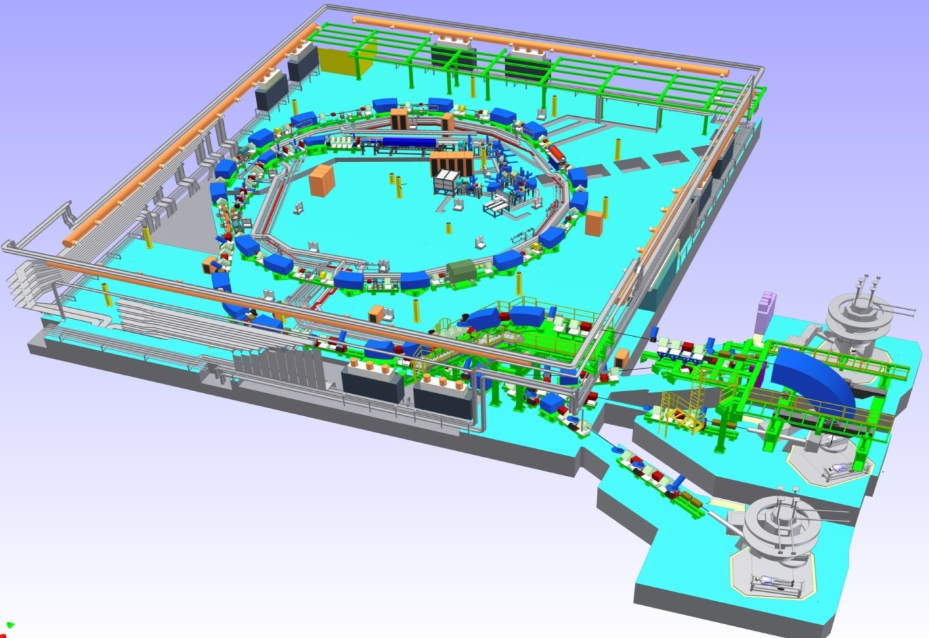
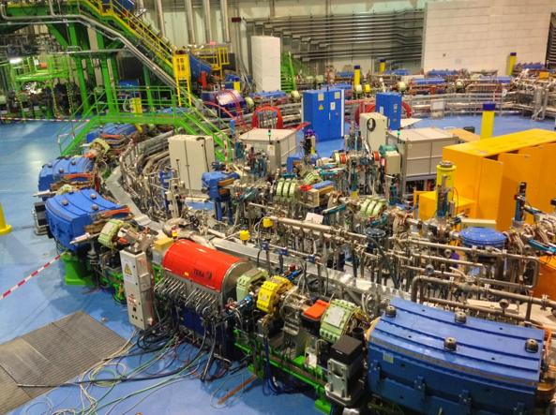
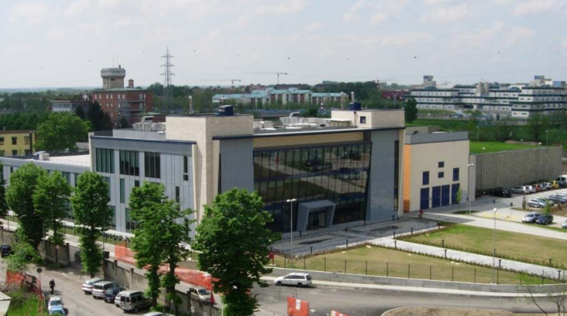
Option II: Facility for Tumour Therapy and Biomedical Research with protons and heavier ions
About 400 patients per year to be treated as needed for a population of 20M.
In parallel, 50% of the beam time dedicated to biomedical research. About 1000 researchers, including a major number from outside the SEE region. Unique.
CNAO at Pavia, Italy
Spiritus Rector Prof. Ugo Amaldi, President of TERA, Director of CNAO Dr. Sandro Rossi

Slide 16
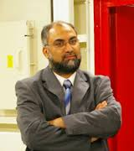
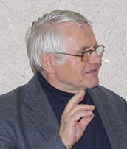
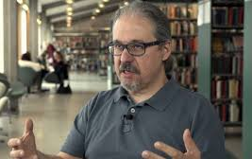
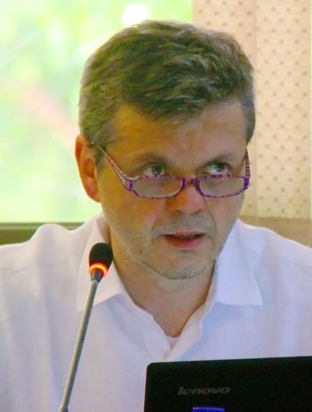
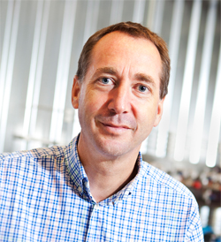
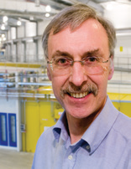
Members of the Editor Committee for Option I – 4th Generation
Synchrotron Light Source
Chairman
Dr Amor Nadji, Director of
Sources and Accelerator Division of SOLEIL, France
Dr. Pedro Fernandez-Tavarez, Machine-Director of MAX IV Lund, Sweden
Dr Dieter Einfeld, former Technical Director of
SESAME and ALBA
Prof. Riccardo Bartolini,
University Oxford and Diamond, UK
Dr. Trevor Rayment,
University of Birmingham, UK
Dr. Christoph Quitmann, Director of MAX IV, Sweden

Slide 17
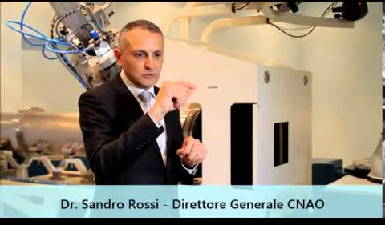
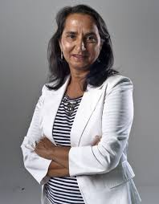
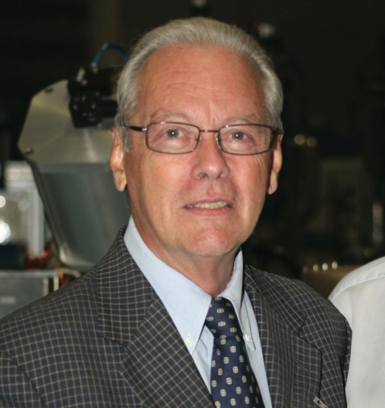
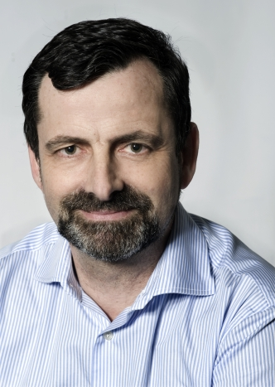
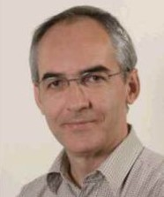
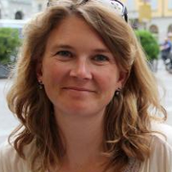
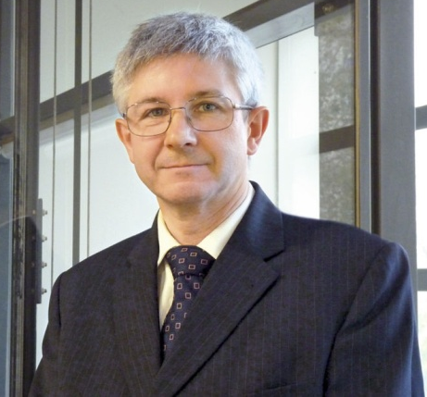
Members of the Editor Committee for Option II – Facility for Tumour Therapy and Biomedical Research with p and heavier ions
Chairman
Dr Sandro Rossi, Director
of CNAO in Pavia, Italy
Prof. Ugo Amaldi, President
of TERA, Novara, Italy
Prof. Manjit Dosanjh, Staff at CERN
Prof. Philippe Lambin,
Head of Radiation Oncology, University of Maastricht, Maastricht, Netherlands
Prof. Brita Singers Sorensen, Depar. of Clinical Medicine, Denmark
Dr. Michael Scholz,
Scientific Head of Biophysics
Departm. GSI, Darmstadt, D
Prof. Dr. Jacques Balosso,
CHU Grenoble Alpes, FR

Slide 18
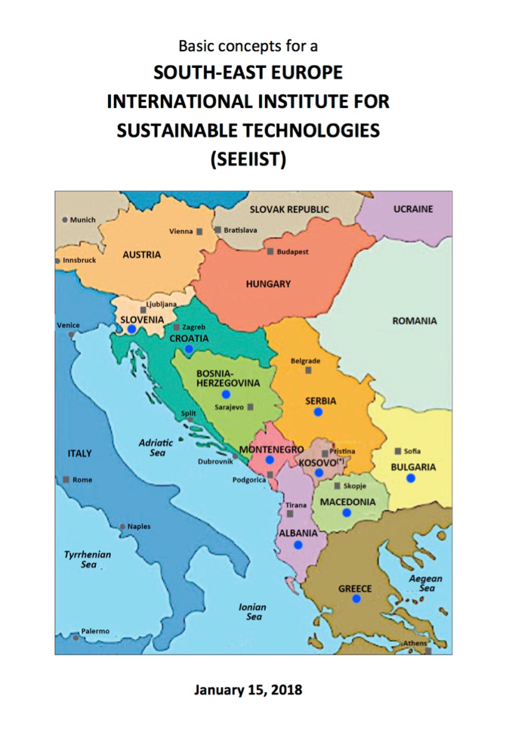
Status of the scientific developments
Concept Studies created by the Editor Committees
Main elements of
a Business Plan:
Executive Summary of the Concept Studies prepared
for the Forum
- technical parameters
of the facilities
- time schedule
- investment costs
- operation costs

Slide 19
The next political and scientific-technical steps
Develop Steering Committee to a leadership role in all future science-policy steps: ‘Council’
(first meeting scheduled in Sofia on January 30)
Prepare proposals for funding requests
Form an Executive (future Directors)
Start training programs for young people in 2018
for technical operation crew
for future Users community
Concept Design Report (CDR)
Decision on options and Selection of sites

Slide 20
Sources of funding
Politically widely accepted that the SEE region
needs economic help and further stabilization.
Europe needs SEE, and SEE needs Europe.
Hence main investment from EU programs
(EU members and Non-members)
EUR 150 - 200 million required per project
guaranteeing competitivity in Europe

Slide 21
Support for the Training Program
Establishment of an International Training Committee
mandatory to help to organize the training program
IAEA had an important role for the Training Program to help
the success of the SESAME Project
Similar support from the IAEA to the SEE Project expected both from Department of Technical Cooperation and Department of Nuclear Sciences and Applications
EU programs like Marie Curie actions through RISE and others
ICTP – support for training also expected

Slide 22




Acknowledgments
Organizers and sponsors of the FORUM:
Ministry of Science of Montenegro
ICTP, Trieste
Organizing Committee: Herwig Schopper (Chairman),
Fernano Ferroni, Christoph Quitmann, Nicholas Sammut, Hans J. Specht and Ruediger Voss
Co-sponsors of the FORUM
UNESCO
IAEA
EPS
FIT

Slide 23
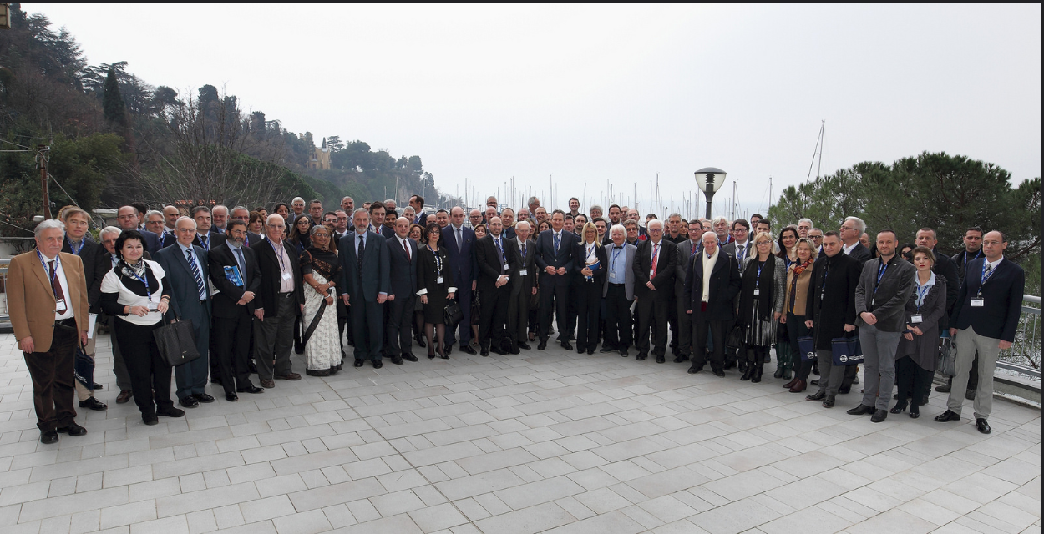

Slide 24
Follow-up
-In a meeting held in Sofia at the end of March a Panel of Experts to decide which project to select, was formed and in May the decision in favor of the Hadrotheraphy has been taken.
-In the next two years a Conceptual Design Report which will be followed by a Technical Design Report will be produce .Fellowships and dedicated contracts financed by EU and IAEA will be available.
-The final destination decision will be also taken.

Slide 25
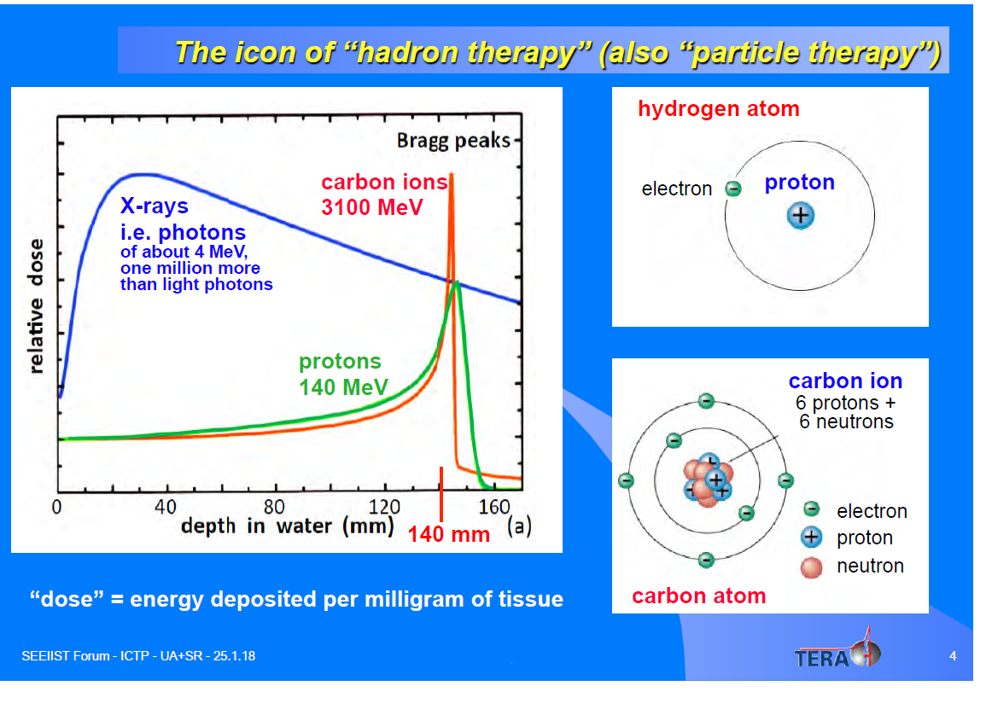

Slide 26
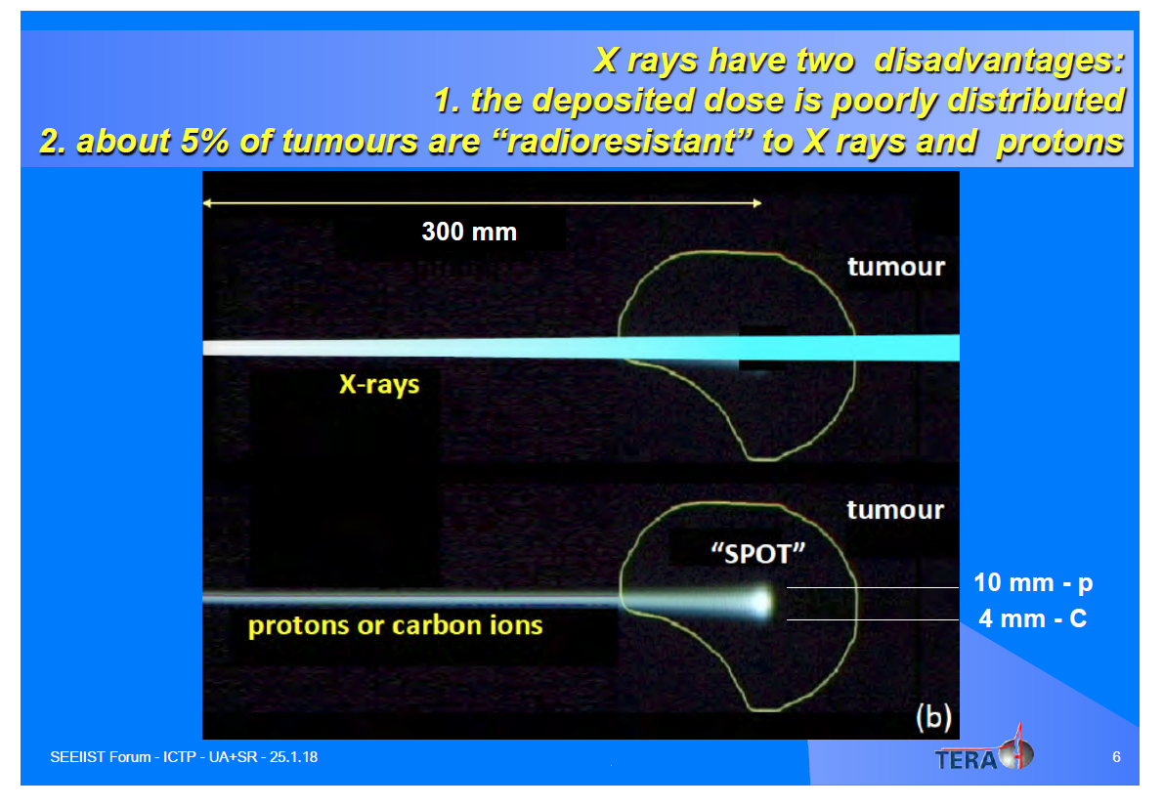

Slide 27
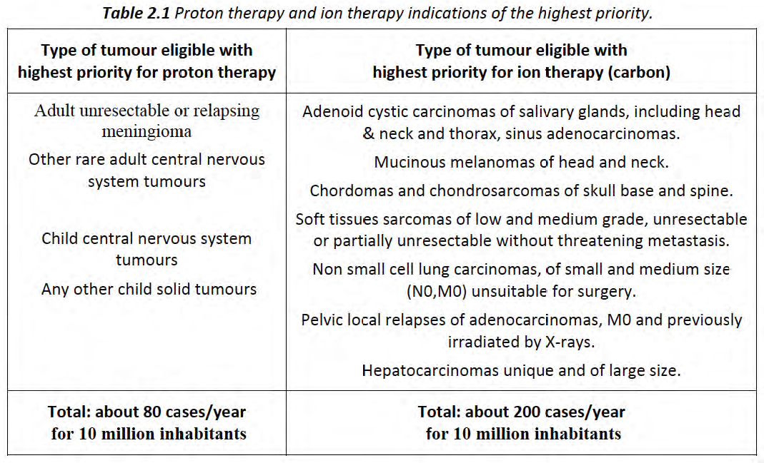
Clinical Program
Notes:
Clinical Program

Slide 28
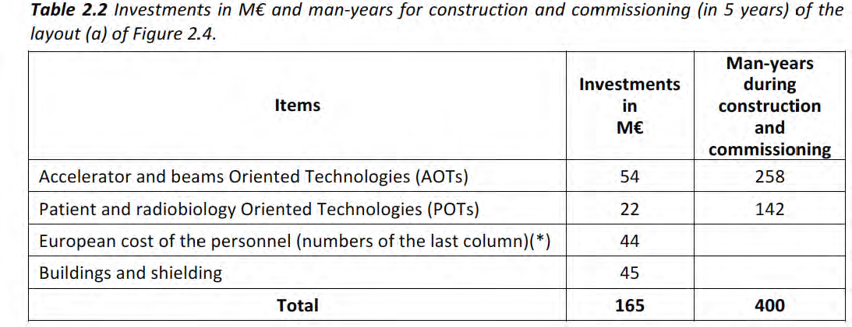

Slide 29
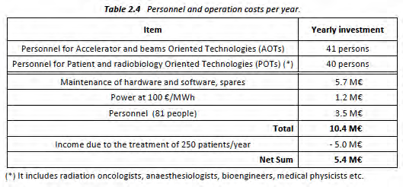

Slide 30
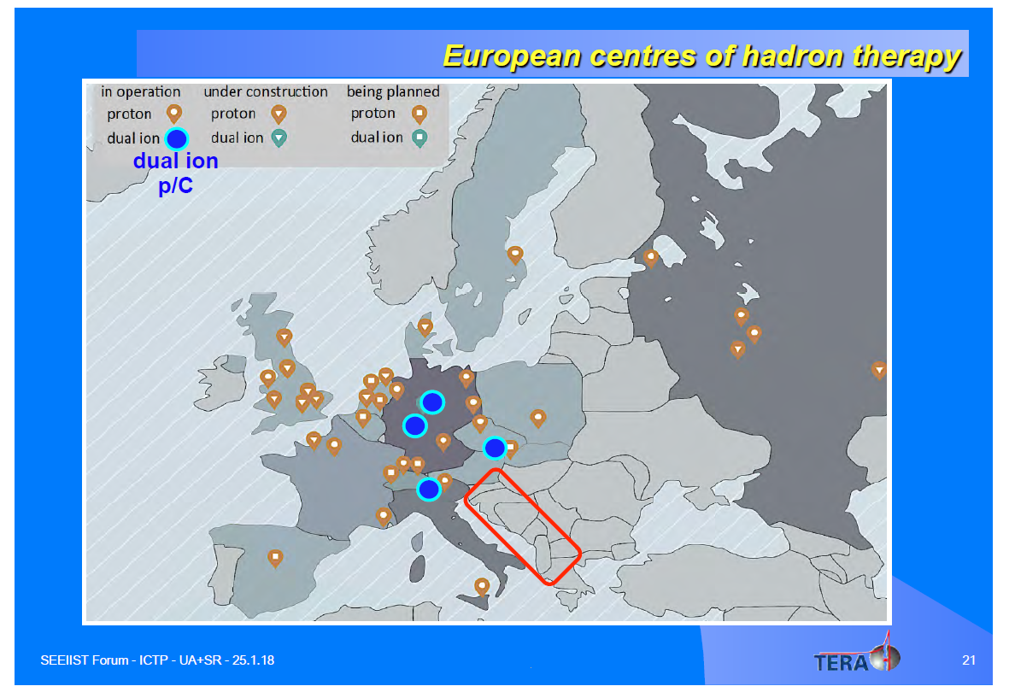

Slide 31
Hadron therapy facility -
benefits for the region
L. Litov
Sofia University

Slide 32
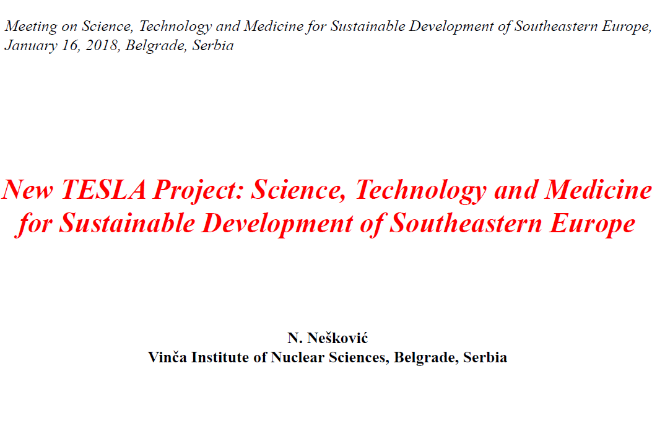

Slide 33
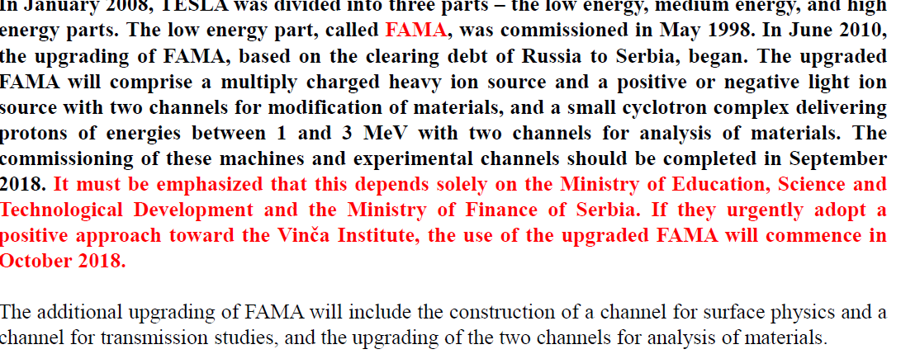

Slide 34
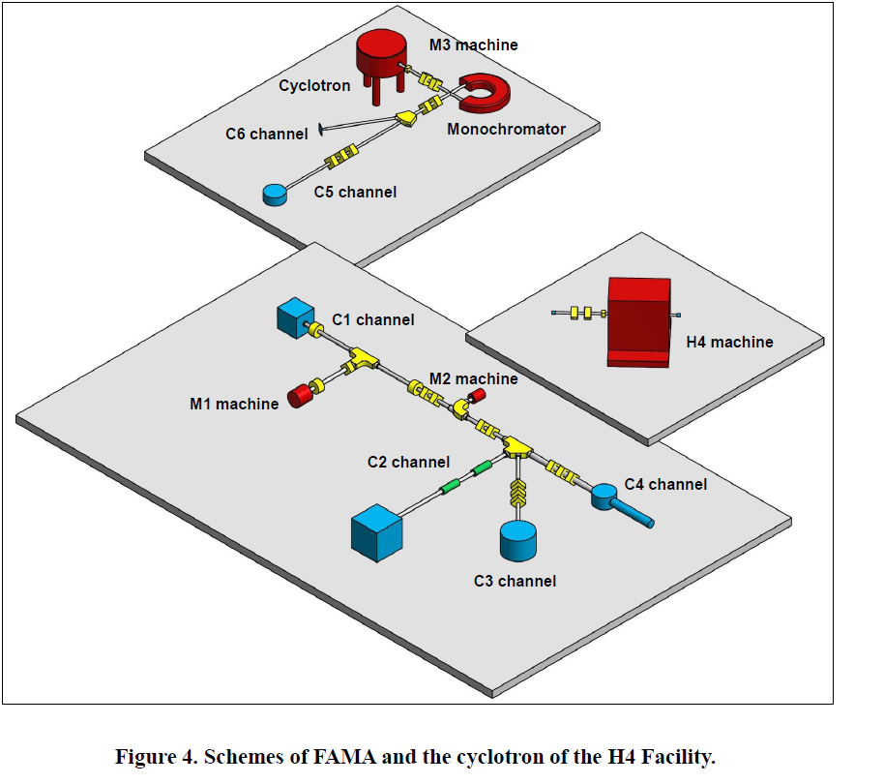

Slide 35
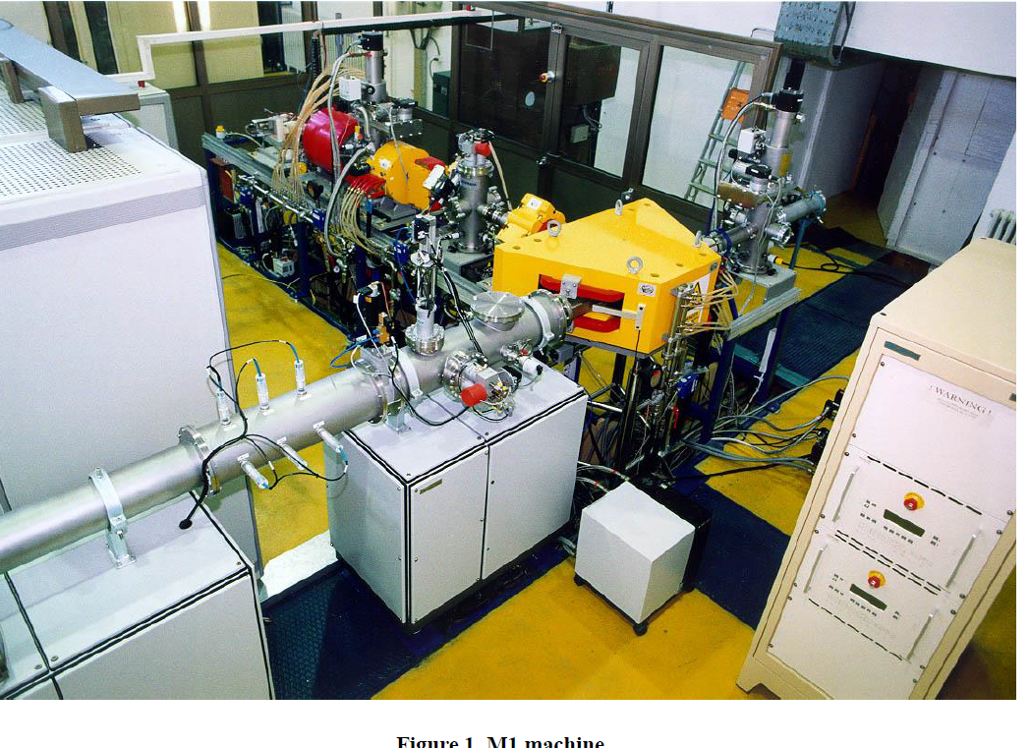

Slide 36
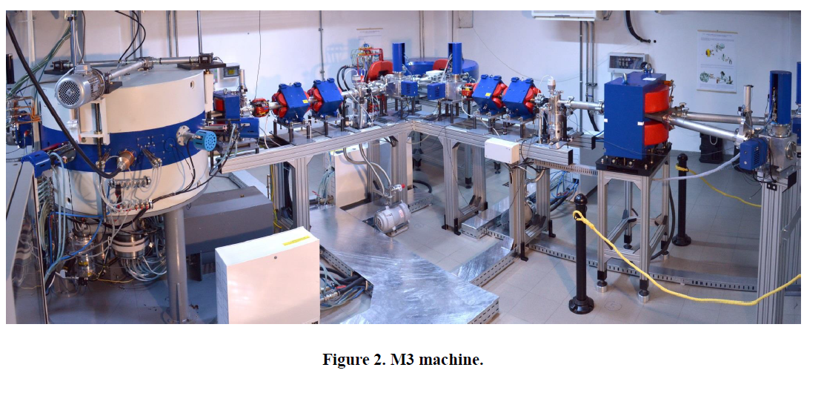

Slide 37
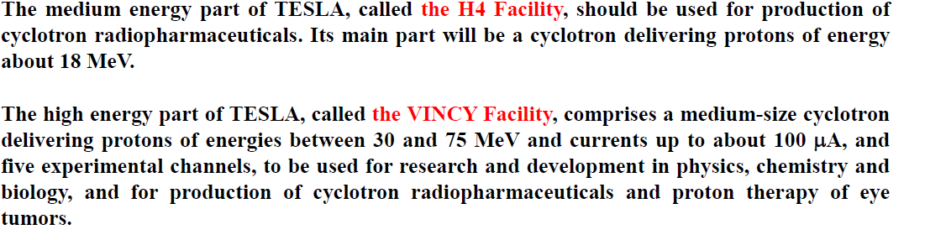

Slide 38
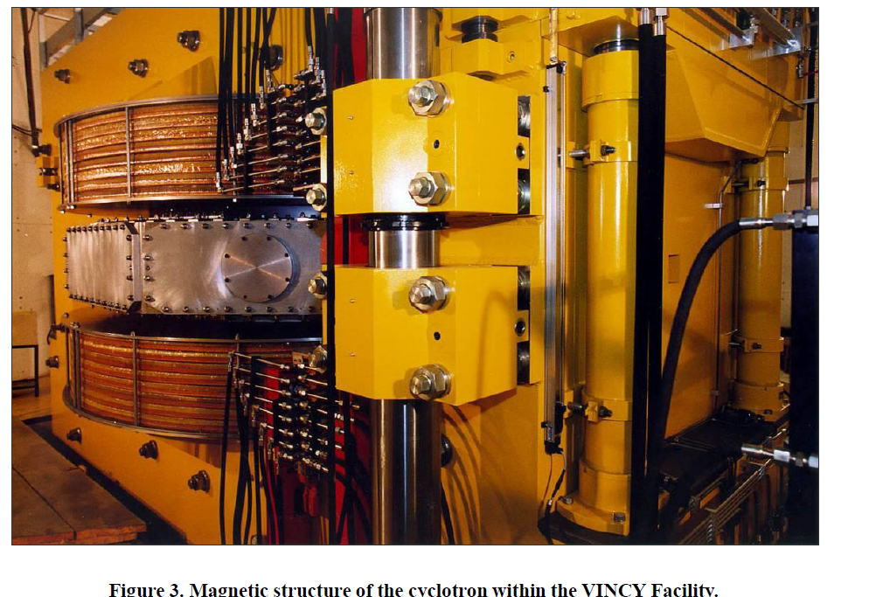

Slide 39
Thank you!

Slide 40

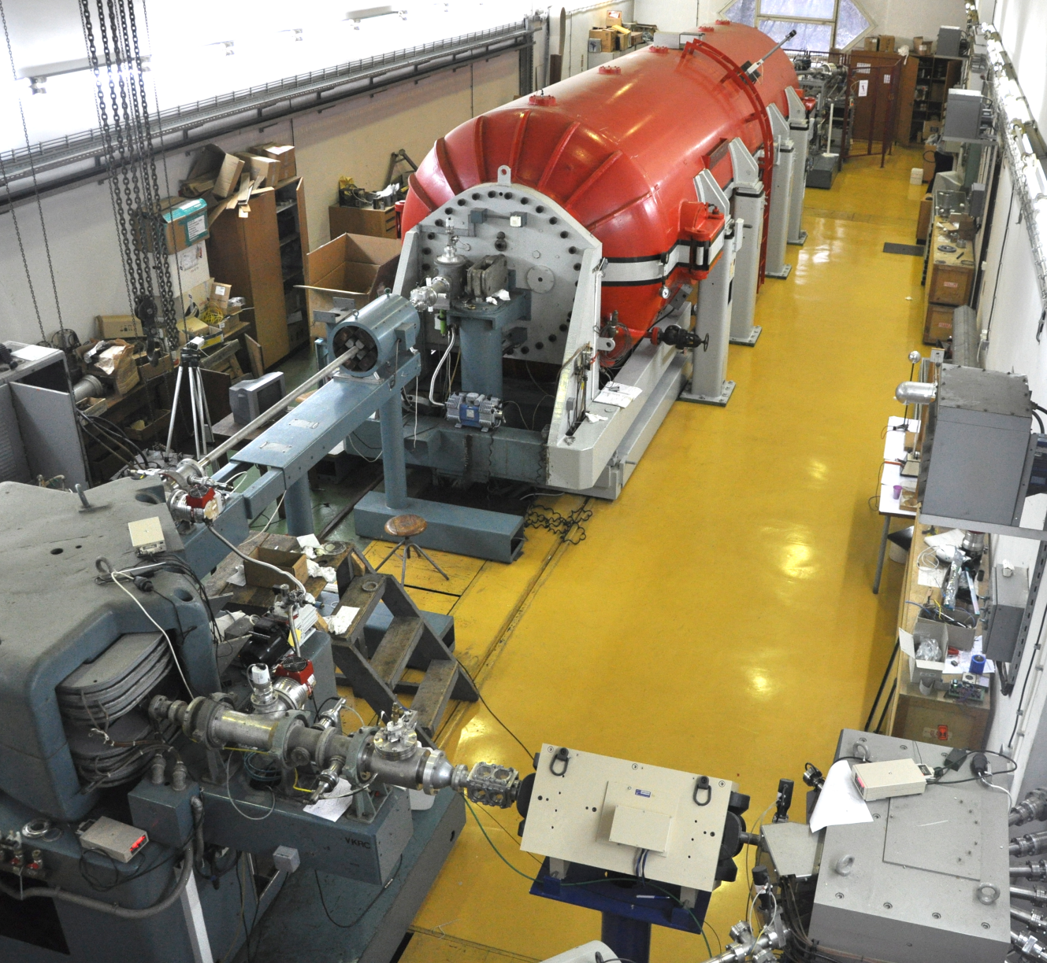
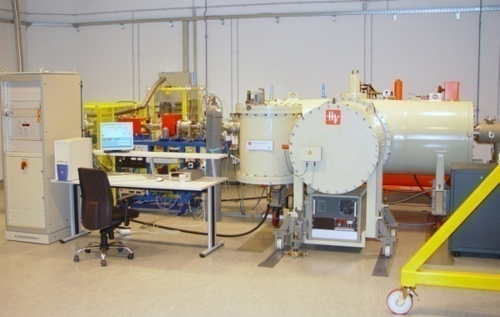
RBI Accelerator – access to facility
Milko Jakšić, Ruđer Bošković Institute, Zagreb, Croatia
6.0 MV Tandem Van de Graaff (1962/1987)
1.0 MV Tandetron (2005)

Slide 41
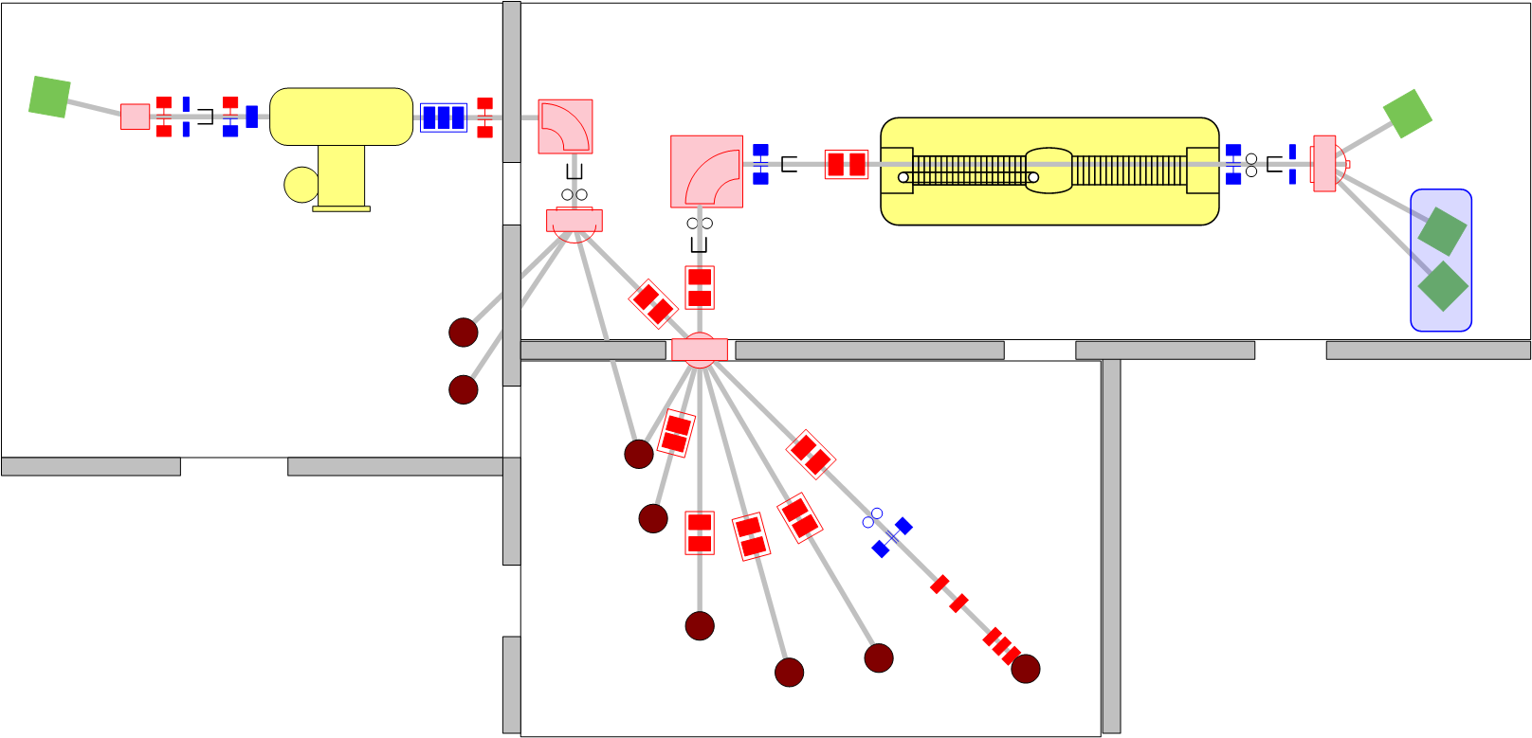
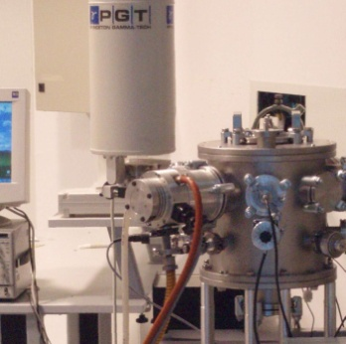
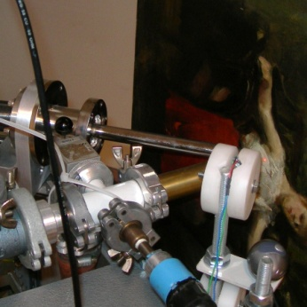






RBI Accelerator facility - layout
1.0 MV HVE Tandetron accelerator
6.0 MV EN Tandem Van de Graaff accelerator
PIXE/RBS
In-air PIXE
Ion microprobe
Dual-beam irradiation
IAEA beam line
TOF ERDA
PIXE crystal spectrometer
Nuclear reactions

