Slide 1


National Technical University of Athens
School of Applied Sciences
Department of Physics
www.ntua.gr
N.C.S.R. “Demokritos”
Nuclear and Particle Physics Institute
Tandem Accelerator Laboratory
tandem.inp.demokritos.gr
Installation of the new ToF – ERDA experimental setup at N.C.S.R. “Demokritos”
Ziagkova Anastasia

Slide 2
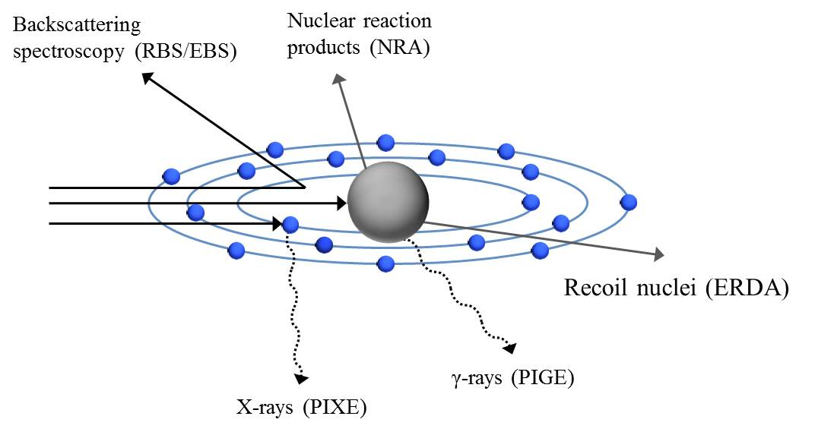
Motivation
Ion Beam Analysis (IBA) techniques for elemental analysis are based in the interaction of charged ion beams with the matter
Quantification and qualification of elements in a sample
Non destructive
High detection sensitivity
RBS (Rutherford Backscattering) – detection of the elastic backscattered ions
EBS (Elastic (non-Rutherford) backscattering spectrometry) – detection of the non-Rutherford elastic backscattered ions
PIXE (Particle-induced X-ray emission)/PIGE (Particle-induced γ-ray emission)– detection of the emitted X-rays and γ-rays
NRA (Nuclear reaction analysis) – detection of the nuclear reaction products
ERDA (Elastic Recoil Detection Analysis) - TOF-ERDA (Time Of Flight – ERDA) – detection of the recoiled elements
  Suitable for the detection of light elements in heavy matrices (H, D, Li e.t.c.)
  Suitable for the mass separation and depth profiling of light elements
  Main or Supplementary technique for integrated analysis of samples handling the handicaps of the rest of techniques
  Upgrade of the analysis techniques applied in N.C.S.R. “Demokritos”

Slide 3
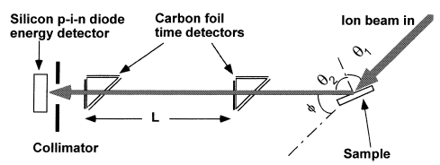


TOF – ERDA basics
SSB Detector
Heavy Ion beam impinges on a sample with incident angle θ₁ < 90º
Recoiled (and/or scattered) atoms are extracted and detected at forward exit angles with respect to the beam axis
Correlation between the time-of-flight and the energy of the recoil ion is:
$$t=\frac{L}{v}=L\sqrt{\frac{m}{2E}}$$

Slide 4
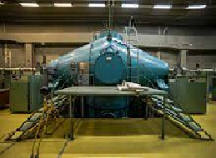
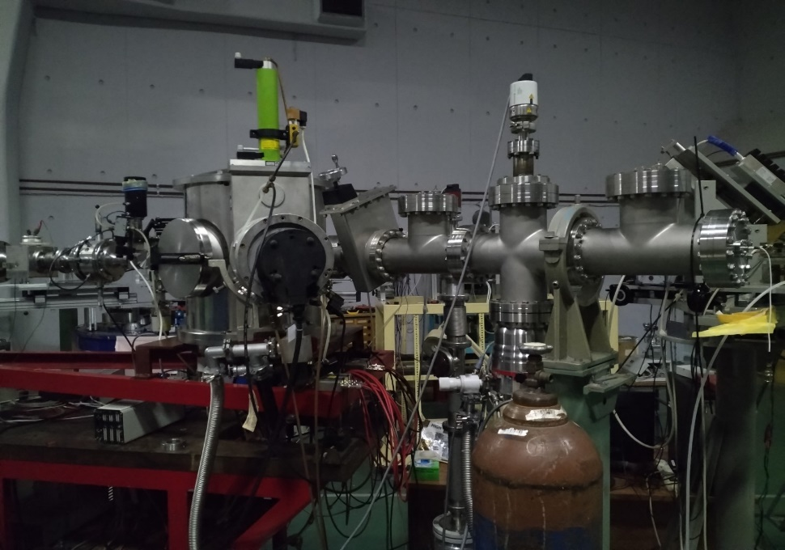
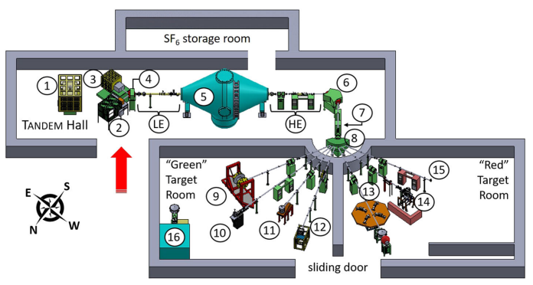
TOF – ERDA setup at N.C.S.R. “Demokritos” (I)
Beam delivered by the upgraded 5.5 MV Tandem Van de Graaf Accelerator of N.C.S.R. “Demokritos”
Chamber
TOF-ERDA setup
Beam
The spectrometer is placed at the exit of the RBS chamber
Detection angle φ = 30º with respect to the beam axis and was aligned properly
The whole setup is constantly kept under high vacuum (~ 10⁻⁶ mbar)

Slide 5
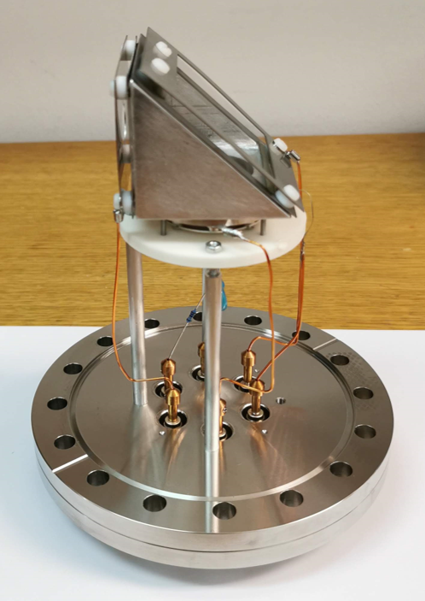
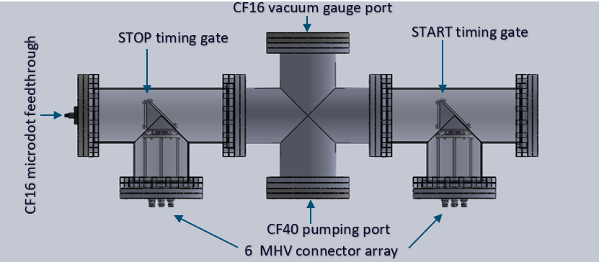
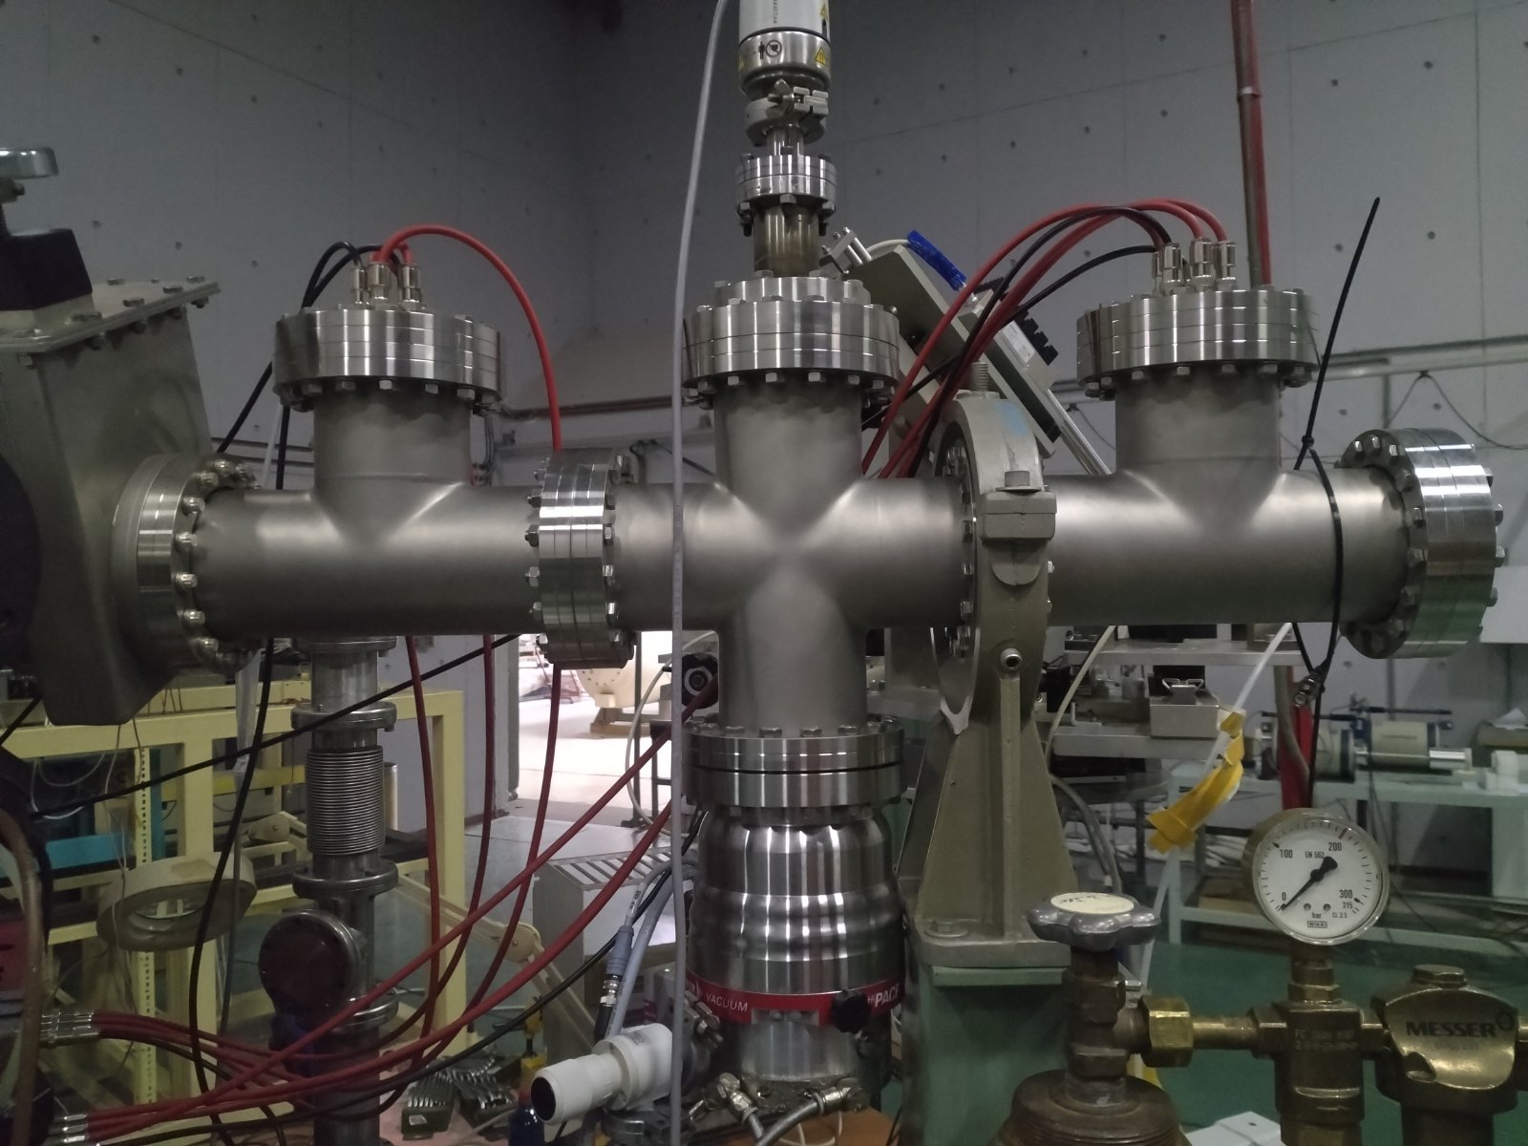
TOF – ERDA setup at N.C.S.R. “Demokritos” (II)
Start timing gate
Stop timing gate
Foil holder (-3.0kV)
Mirror grid (-4.0kV)
Direction of scattered ions
Drift region (-2.0 kV)
MCP detector
(-2.0 kV)
SSB Detector
Detection system consists of:
Two timing detectors (MCPs) using carbon foils for the detection of the recoiled ions. Distance between them: L = 540mm
One Silicon Surface Barrier Detector (SSB) placed 5mm away of the second MCP detector
Electronics:
MCP detectors: 2 CFD modules are receiving the signal from the MCPs and provide a start and stop signal for the Time to Amplitude Converter (TAC)
SSB detector: the signal passes through a pre-amplifier & an amplifier

Slide 6
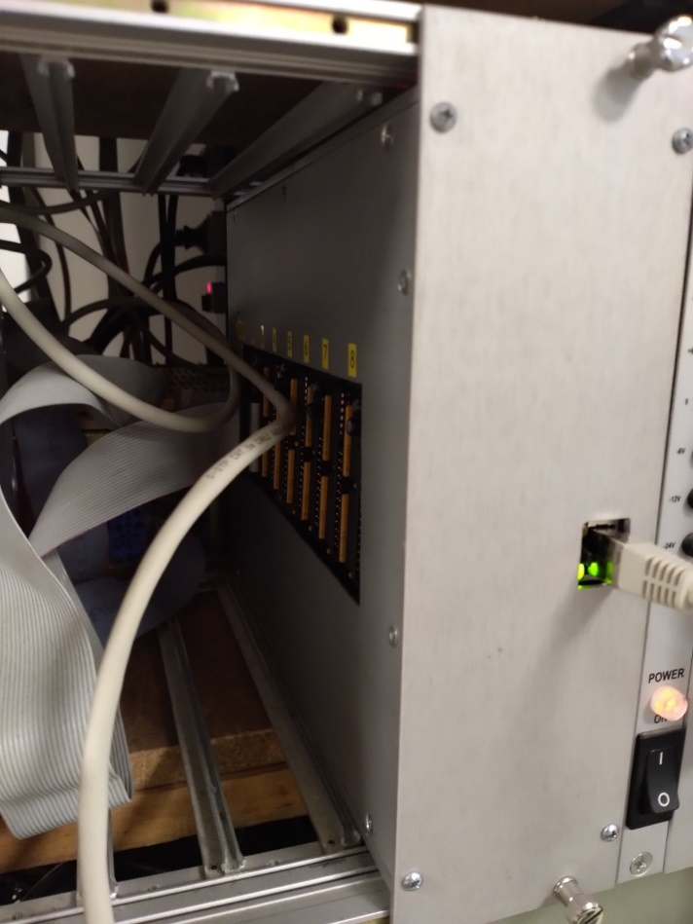
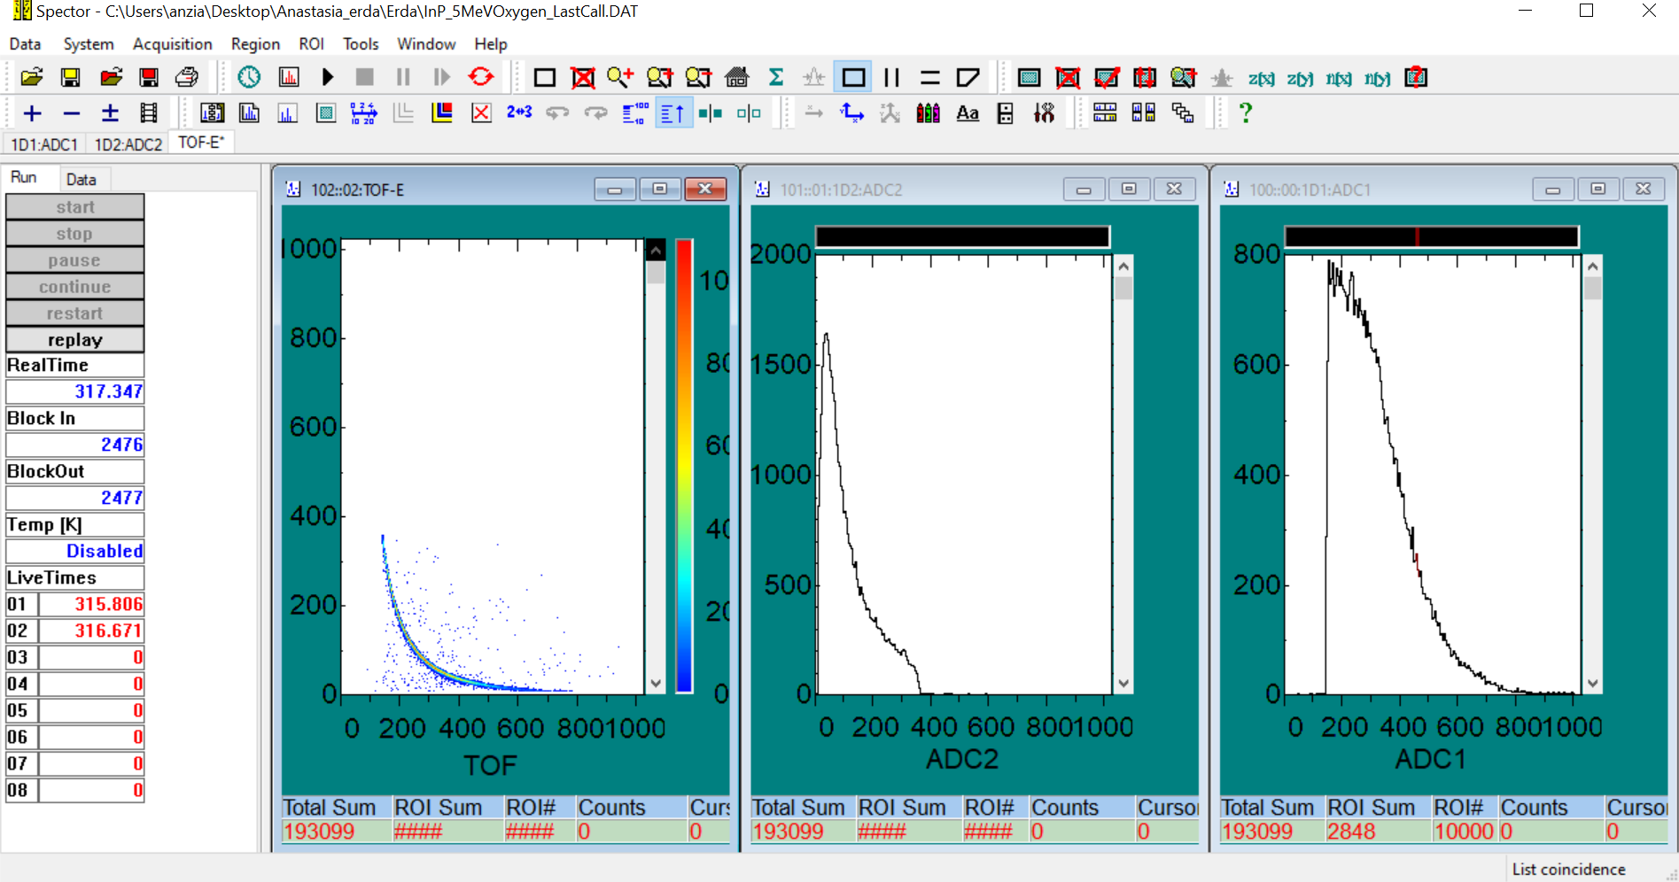
TOF – ERDA DAQ-ADC system
TAC output and energy signal are collected by the new DAQ – ADC system
Event by event acquisition - coincidence during measurement & offline with Spector software

Slide 7
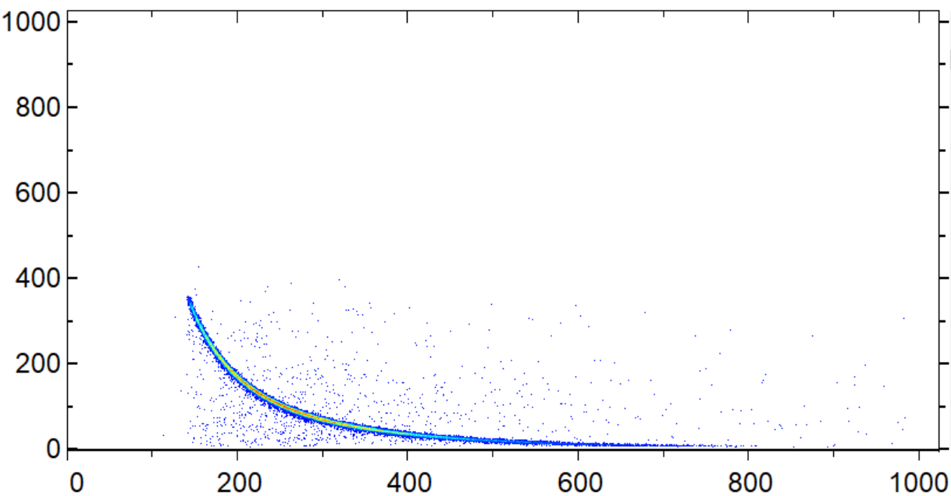
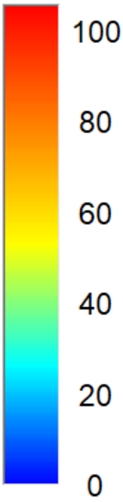
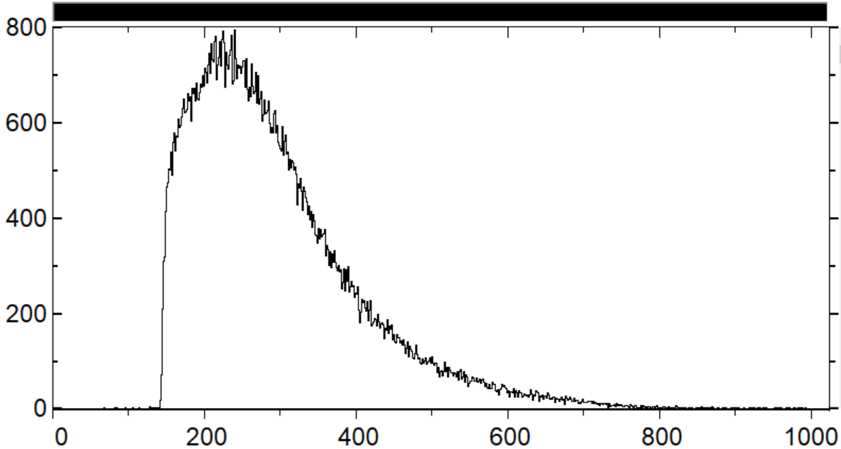
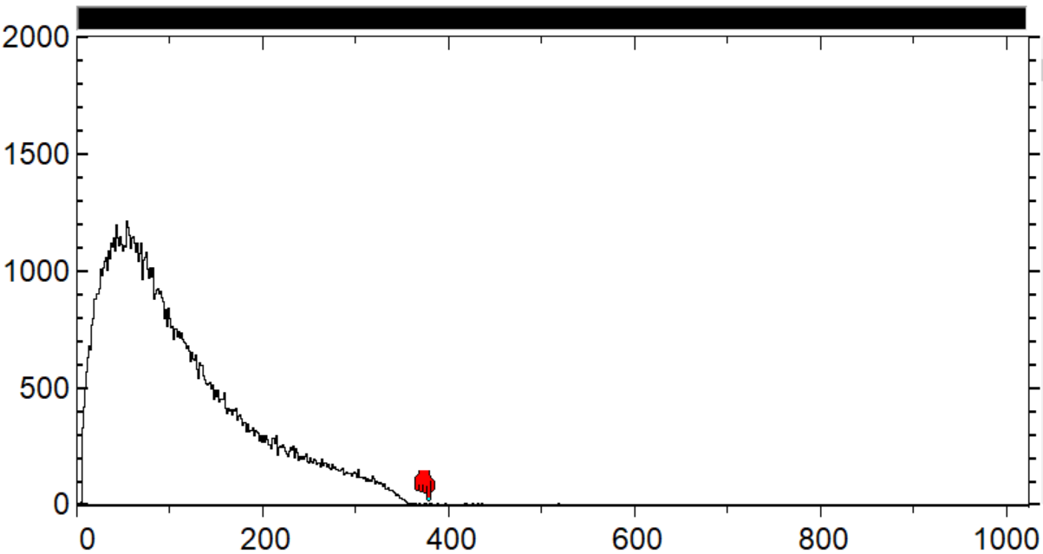
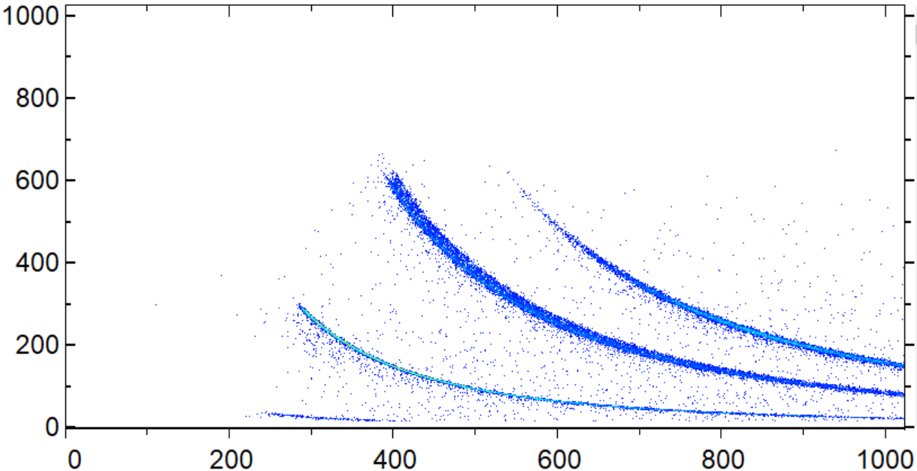
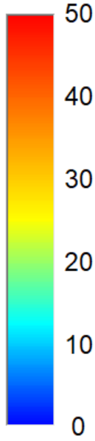
Typical coincidence spectra
Oxygen beam scattered of thick Au target – E_{beam}= 5 MeV
Scattered Oxygen
Counts
Counts
Energy (Channel)
Time of flight (channel)
Energy (Channel)
Time of flight (channel)
Scattered Iodine
23 MeV Iodine beam on a ZnO target
Zn
The signal from different atoms are well separated due to mass dependent velocity
O
Energy (Channel)
H
Time of flight (channel)

Slide 8
Efficiency of the TOF-ERDA telescope (I)
Varies with respect to the ion type and energy / Less than 100% for ions due to different energy loss values in MCP foils – 100% for energy detector
Use of heavy matrix target and the ion beam of interest in order to determine the efficiency for the specific ion
Relative detection efficiency for each ion type is given by:
Foil holder
e-
recoils
$\frac{\# of scattered ions in ToF−E coincidence spectrum}{\# of particles detected by SSB detector}×100\%$
Oxygen ion beam of different energies are scattered of thick Au target
For oxygen scattered on Au, discrepancies between the relative efficiency with respect to initial beam energy were revealed

Slide 9
Efficiency of the TOF-ERDA telescope (II)
A collimator was placed at the entrance of the spectrometer window in order to avoid multiple scattering events
Results of the relative efficiency for oxygen ions are consistent with respect to the beam energy and the target material
Preliminary results of the oxygen efficiency curve for Oxygen
Efficiency curves are used as input in Potku software for the analysis of the samples

Slide 10
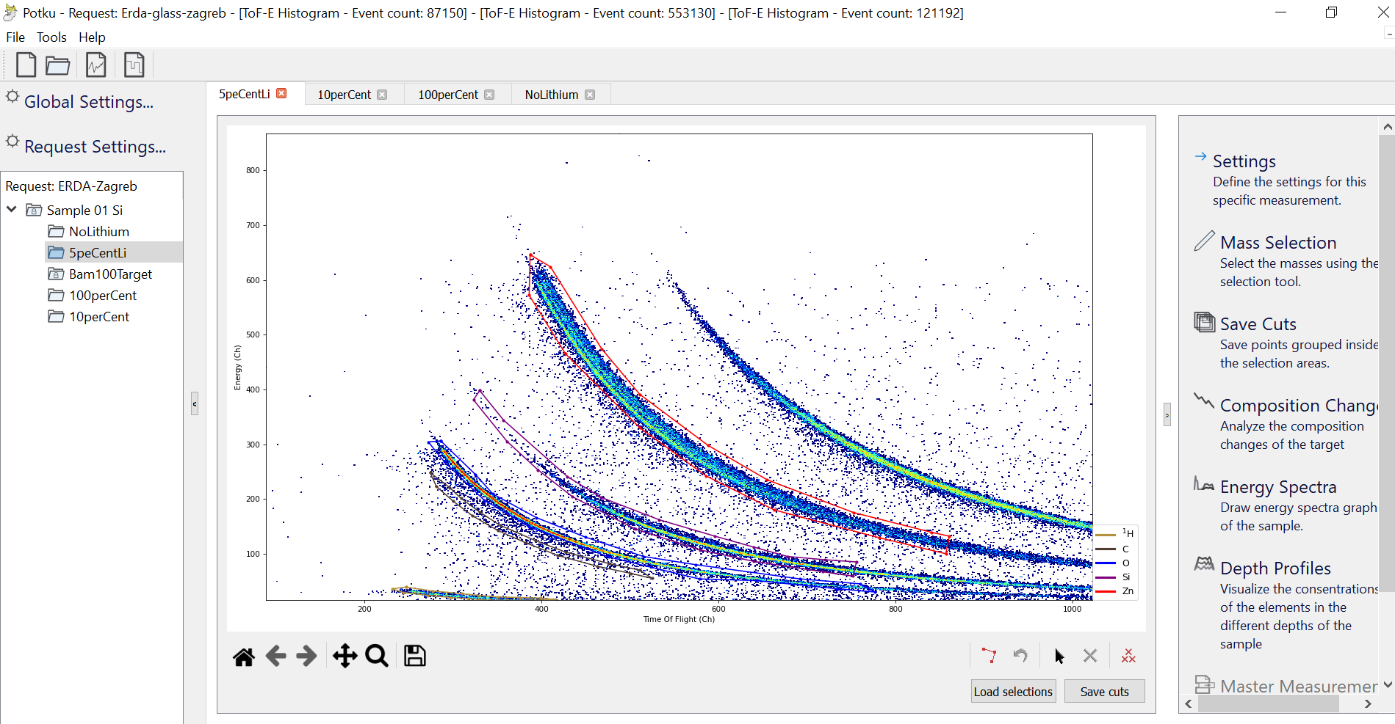
ToF-ERDA analysis
For the analysis of the coincidence spectra Potku software is used
  Open source analysis software
  Description of TOF-ERDA setup geometry
  Determination of the elemental composition
  Creates depth profiles from TOF – ERDA measurements based on stopping force values
  Returns the sample composition as relative or absolute concentrations

Slide 11
ToF-ERDA measurement in RBI
Measurement of 7 ZnO samples used as wide-bandgap semiconductors
  The measurement took place detection of Lithium at Ruđer Bošković Institute (RBI) in Zagreb detection of Lithium
  Setup similar to the one at N.C.S.R “Demokritos” – different energy detector
    23 MeV Iodine beam on a ZnO target for the detection of lithium
Scattered Iodine
Zn
O
Energy (Channel)
H
Time of flight (channel)

Slide 12
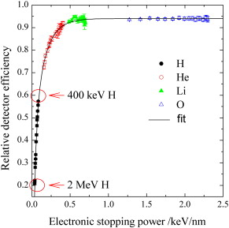
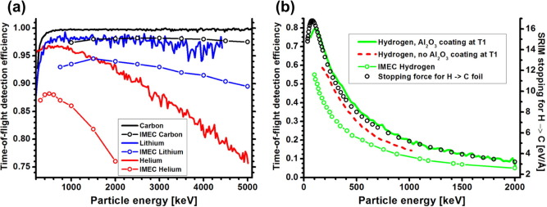
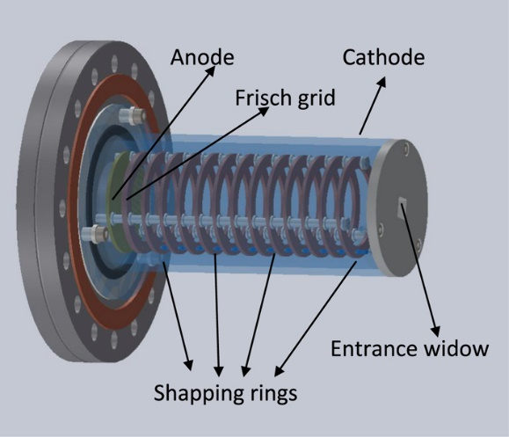
ToF-ERDA setup optimization
Using Al₂O₃ or LiF coating on carbon foils of the MCPs → Increases the efficiency of H detection from 20 up to 60-80 %
LiF coated C foils
Al₂O₃ coated C foils
Replacement of Carbon foils with C coated with LiF – evaporation
Si₃N₄ foils instead of carbon
Siketić, Z. et al., Development of a time-of-flight spectrometer at the Ruder Bošković Institute in Zagreb. Nucl. Instruments Methods Phys. Res. Sect. B Beam Interact. with Mater. Atoms 266, 1328–1332 (2008).
Laitinen, M. et al., Time-of-flight – Energy spectrometer for elemental depth profiling – Jyväskylä design. Nucl. Instruments Methods Phys. Res. Sect. B Beam Interact. with Mater. Atoms 337, 55–61 (2014).
Silicon detectors are fragile to the irradiation of heavy ions
Dead layer limitations
Worse energy resolution for heavy ions
Construction and installation of a new Gas Ionization Detector
Siketić, Z. et al., A gas ionisation detector in the axial (Bragg) geometry used for the time-of-flight elastic recoil detection analysis. Rev. Sci. Instrum. 86, (2015).

Slide 13
Thank you!

