Slide 1


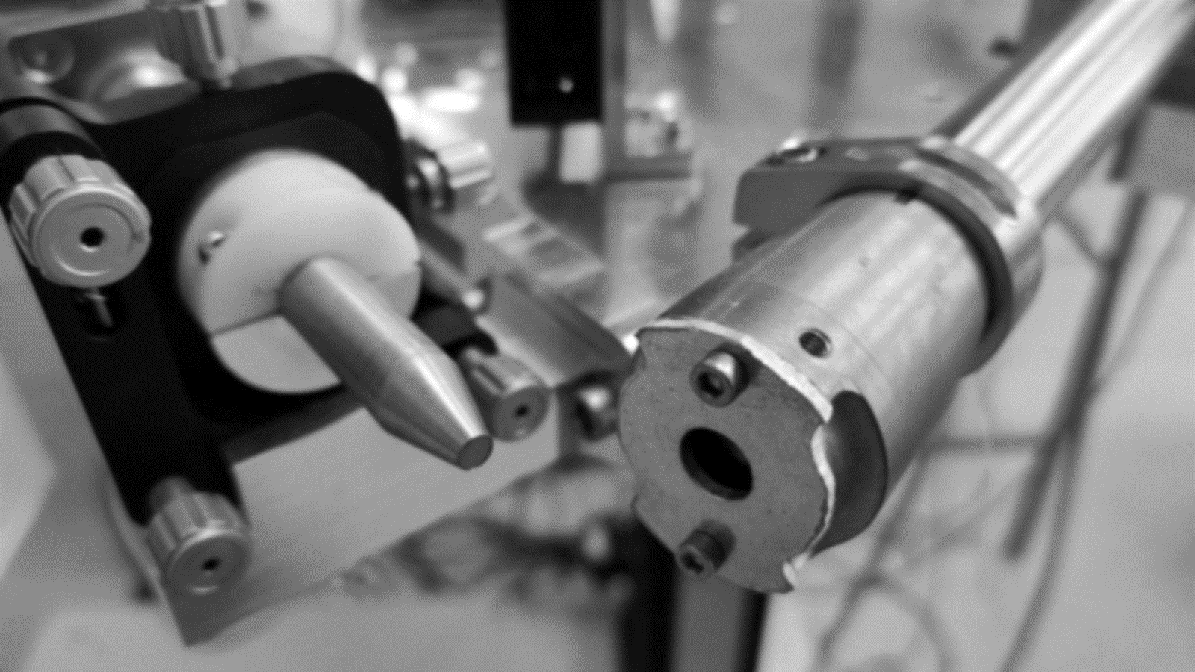
A modular custom-built Macroscopic-XRF (MA-XRF) spectrometer for Heritage Science
National Center for Scientific Research “Demokritos”
Institute of Nuclear and Particle Physics
Kalliopi Tsampa ⁽¹⁾, Effrossyni Androulakaki ⁽¹⁾, Panagiotis Assiouras ⁽¹⁾, Paweł Wróbel ⁽²⁾
and Andreas G. Karydas ⁽¹⁾⁽³⁾
Institute of Nuclear and Particle Physics, NCSR “Demokritos”, 153 41, Agia Paraskevi, Attiki, Greece
(2) Faculty of Physics and Applied Computer Science, AGH University of Science and Technology,
al. Mickiewicza 30, 30-059 Kraków, Poland
(3) CNR, Istituto per i Beni Archeologici e Monumentali (IBAM), Via Biblioteca 4, 95124, Catania, Italy

Slide 2
Aim of the research
Analytical characterization of the excitation features of the MA-XRF spectrometer by means of Monte Carlo simulations tools and dedicated experimental measurements.
More specifically,
Simulation of end window tube spectrum - PenRed code
Simulation of the optical features of X-ray polycapillary lens – Polycapillary X-ray raytracing Polycap
Under different setup configurations, experimental evaluation of the spectrometer
  Intensity through output
  Spatial resolution

Slide 3
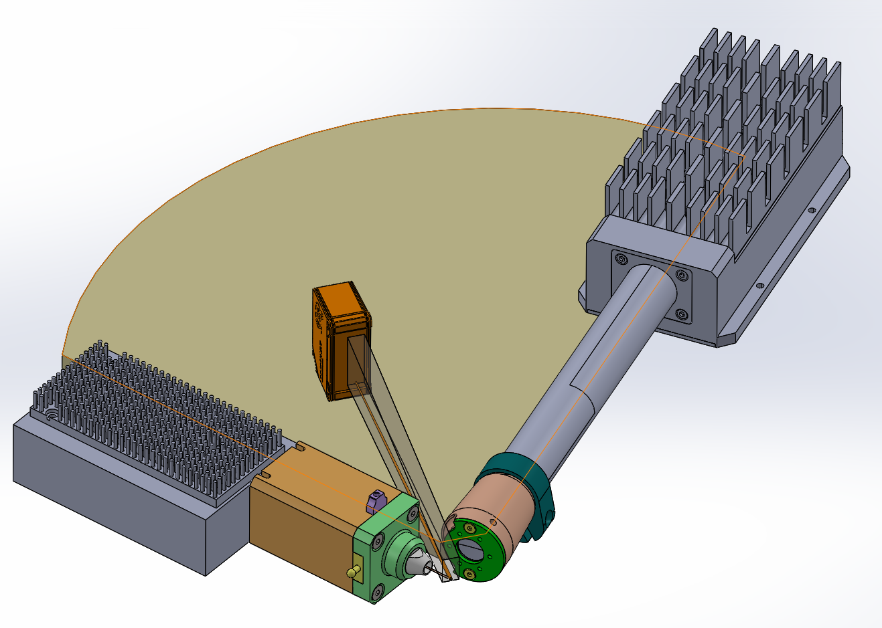
The spectrometer instrumentation
X-ray beam

Slide 4
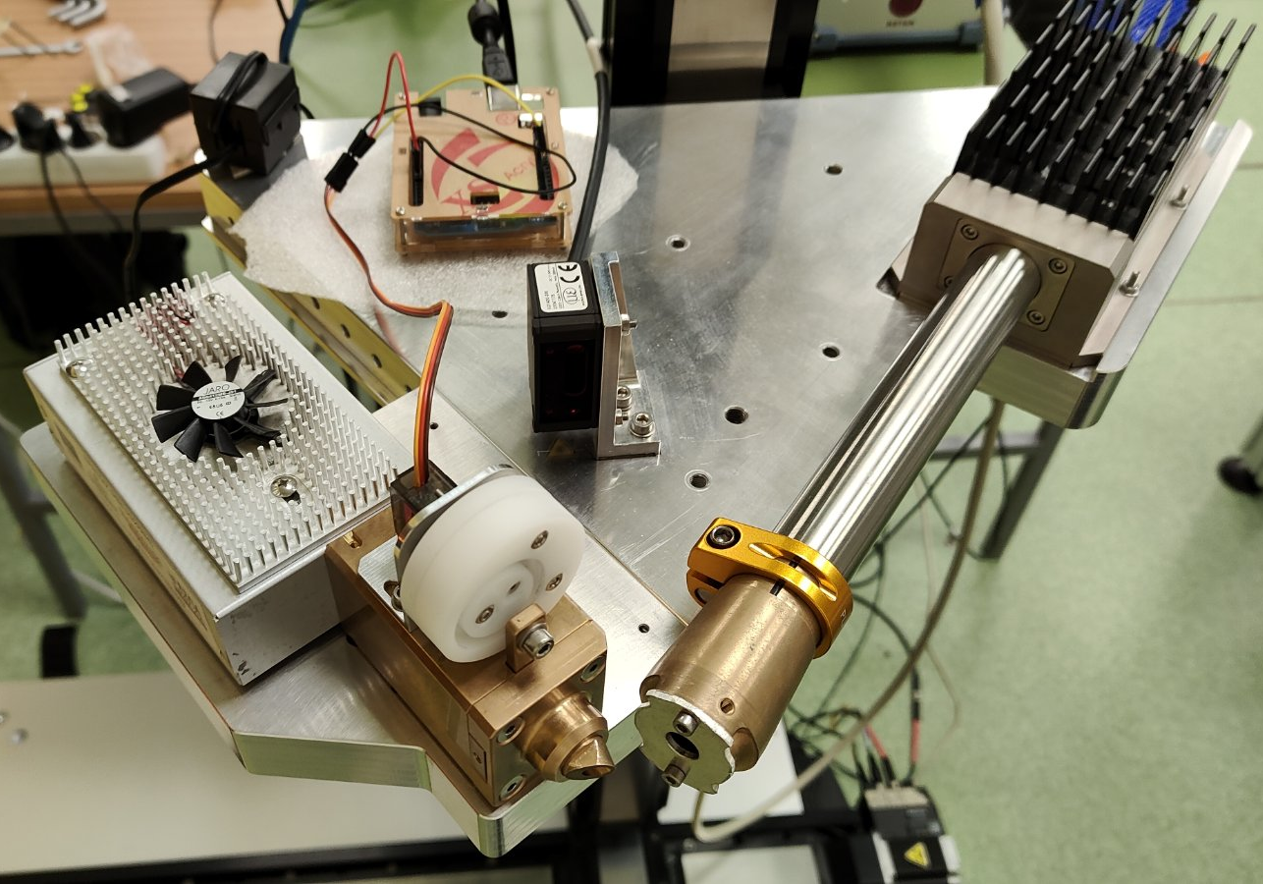
The spectrometer instrumentation
X-ray Detector SDD 150mm²
Digital Signal Processor DANTE
X-ray Tube
12W (60kV, 200uA) MagPro end window Rh-target X-ray source, 400um spot size
Laser sensor
Motorized XYZ Stage
750mm x 750mm x 250mm
Laser triangulation sensor for the sample distance measurement
Arduino (homebuilt) for the shutter control
X-ray beam
X-ray Detector
X-ray tube
X-ray tube shielding
Detector shielding

Slide 5
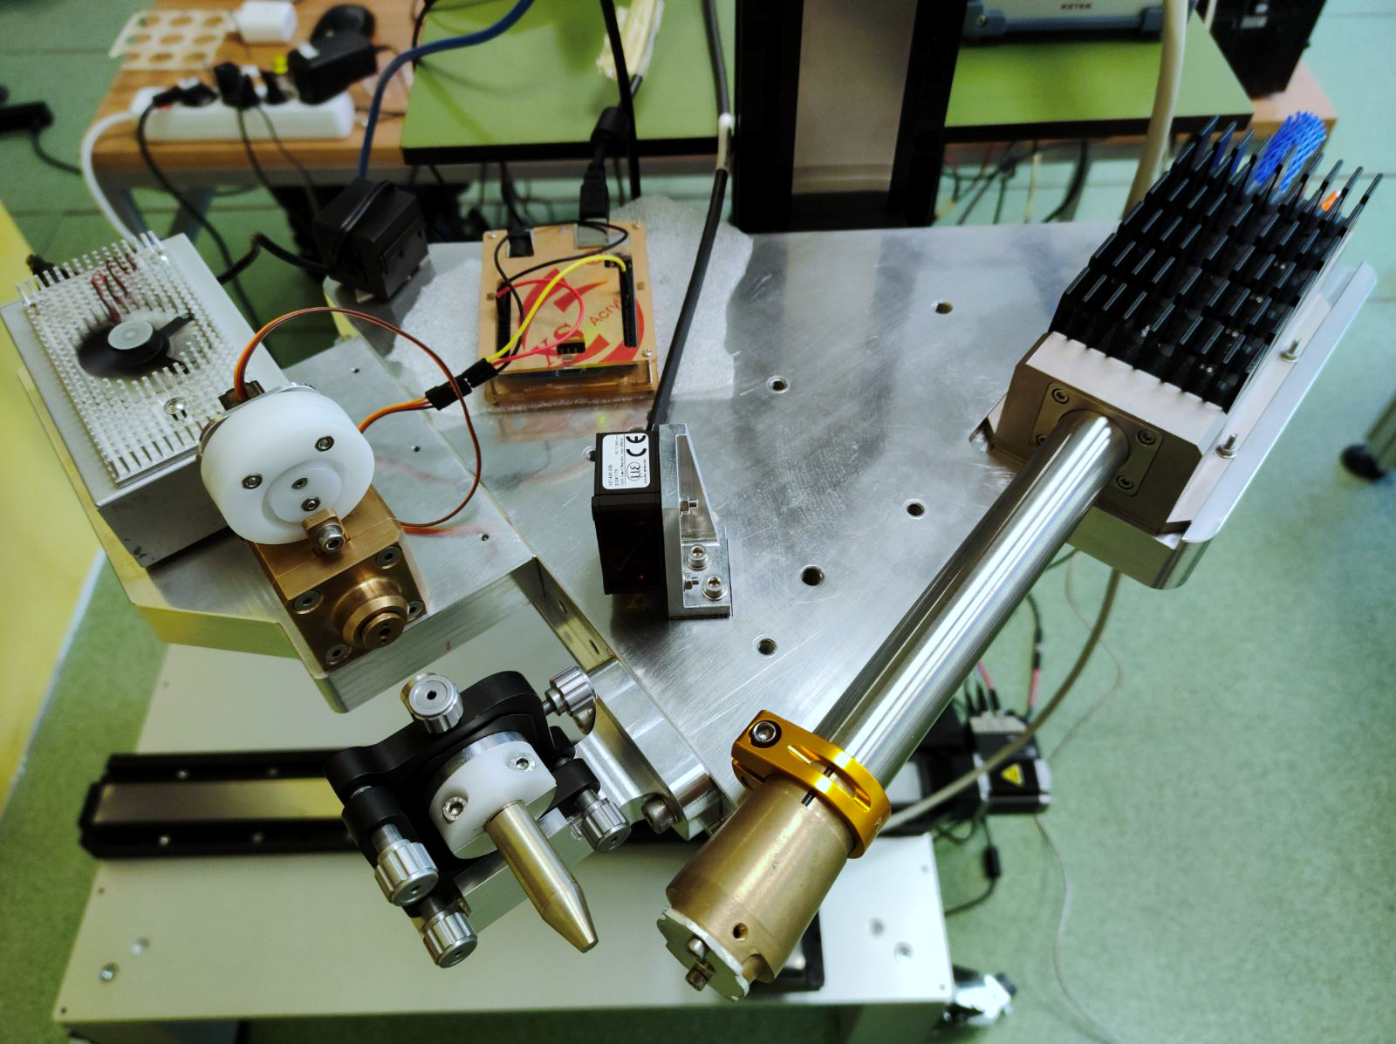
The spectrometer modularity
Pinhole configuration
Polycapillary Lens configuration
Pinholes
Polycapillary lens
Pinholes
0.5mm, 1mm, 4mm
Fixed position of the SDD
Adjustable position of the X-ray tube
Identical focus position for pinhole and lens
Polycapillary X-ray Lens
FWHM @10 keV ~ 87um

Slide 6
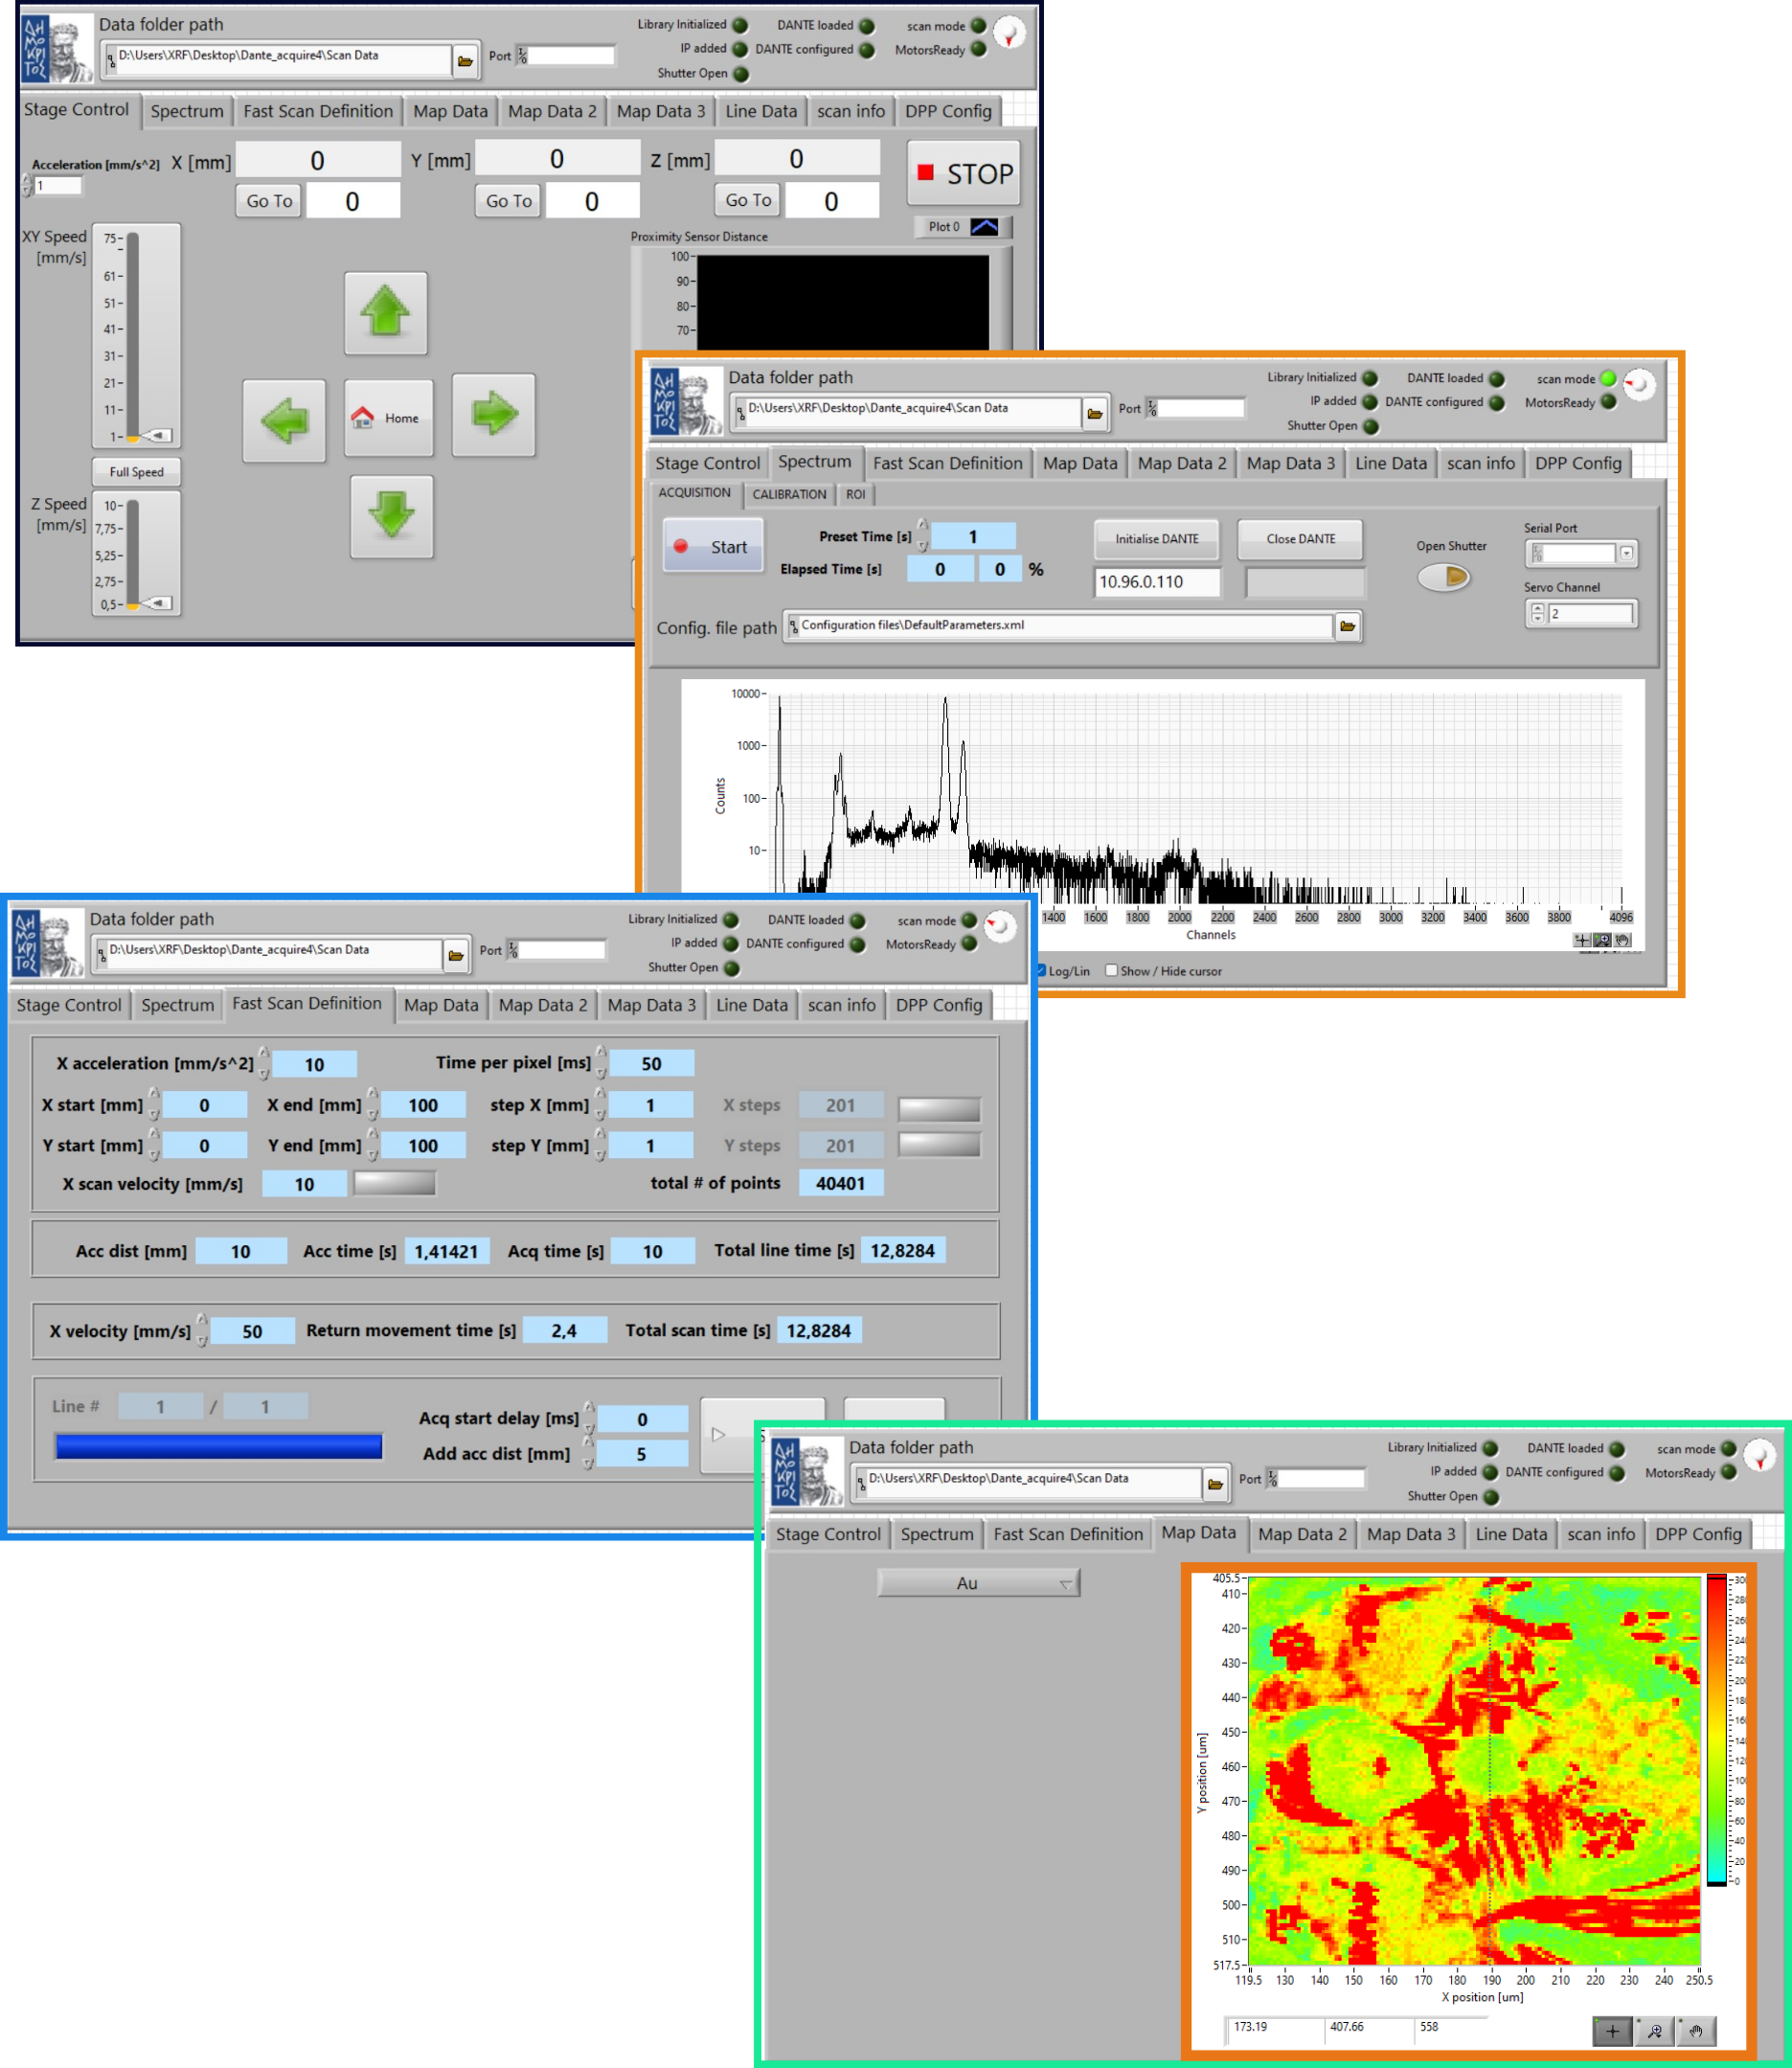
Custom-made LabView acquisition controller
  Features:
  Acquisition parameters and hardware control: velocity, acceleration of the stages, X-ray tube shutter, proximity sensor
  Stable velocity during acquisition
  minimize possible shifts
  typical scanning 6 hours for 50 x 50 cm²
  Spot and scanning measurements with
  stepping or continuous “free-running” mode
  Elemental maps (up to 4 elements) using ROIs during acquisition

Slide 7
Excitation spectrum – Monte Carlo simulation
MC simulation of end window Rh anode spectrum
Monte Carlo code PenRed *
A general-purpose, stand-alone code based on PENELOPE for Monte Carlo simulations of electron-photon transport, allows for parallel processing drastically reducing the computing time
Simulation parameters:
Tube high voltage
Thickness of the Rh anode
Computing time: 1-3 days depending on input file using multi-threading capabilities (parallel simulation using 15-40 threads), statistics ~7% - ~ 25% for low/high photon energies
Indicatively, MC results are compared to Ebel semi-empirical model
* (Giménez-Alventosa et al., 2021)

Slide 8
X-ray tube excitation spectrum using Monte Carlo (MC) simulation
case 1: side window Rh tube – 40 kV
Comparison for a side – window Rh target tube
Comparison of MC simulation (PenRed) with the Ebel semi-empirical model yielded satisfactory agreement
MC results are compared to semi-empirical model.
The Ebel semi-empirical model is validated for side window (thick anode material) tubes. Regarding end window tubes, this model is not validated.

Slide 9
X-ray tube excitation spectrum using Monte Carlo (MC) simulation
case 2: end window Rh tube
Comparison of continuous spectrum for a transmission tube 0.75um Rh target
15kV
40kV
Semi-empirical model not validated for end window (transmission) X-ray tube

Slide 10
Simulation evaluation with corresponding experimental data
Comparison of discrete spectrum for 0.75um Rh target tube – 15 to 50 kV
Rh – L lines
Rh – Kα lines
The semi-empirical model overestimates significantly the discrete intensity at high voltages
03/29/2024
Tsampa Kalliopi – INPP Annual Meeting

Slide 11
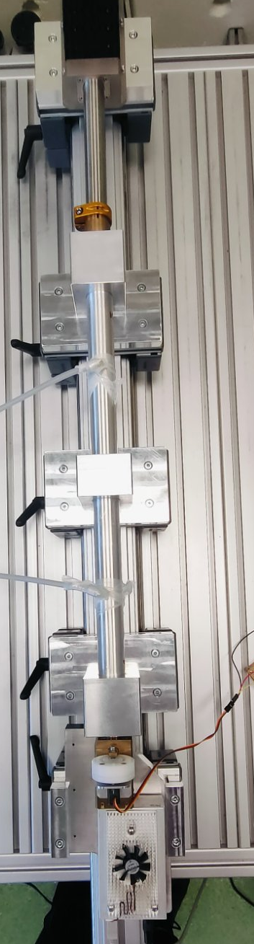
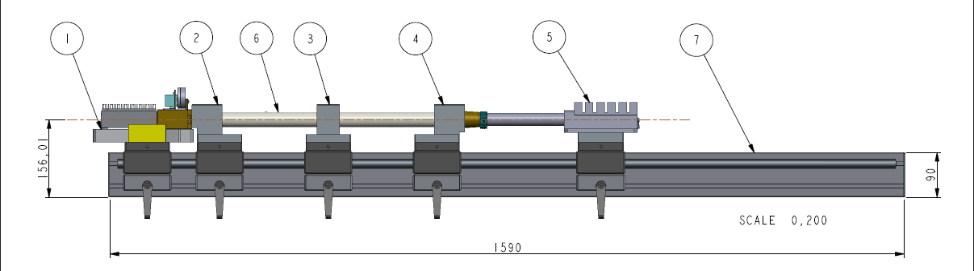
X-ray tube excitation spectrum - Experimental
Collimators
X-ray tube
X-ray Detector
Vacuum
top view
top
Length: 1m
Collimators: Cu/Sn
Voltages: 12 - 55kV
Comparison to PenRed code (in progress)
known solid angle

Slide 12
Monte Carlo based ray-tracing simulation –POLYCAP code*
Monte Carlo based polycapillary X-ray tracing code: POLYCAP1.1*
simulation of photon propagation through lens
features surface roughness
includes capillary wall transmission (important in high energies)
includes beam polarization effects
POLYCAP1.1 code produces data at a certain energy for
FWHM of the beam
* (Tack et al., 2020)

Slide 13
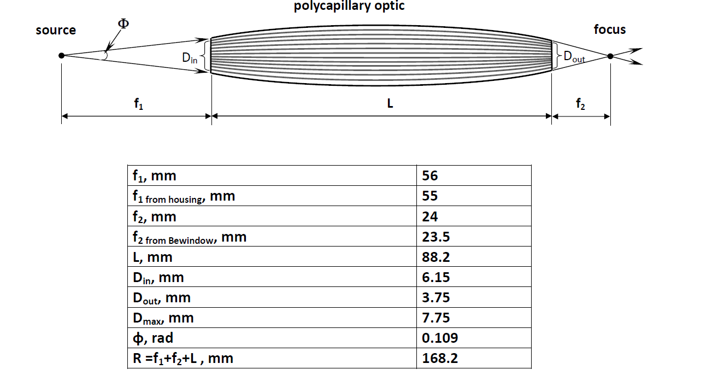
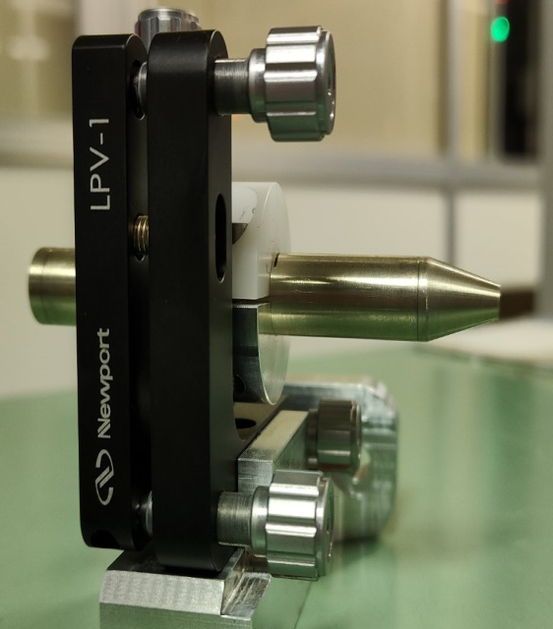
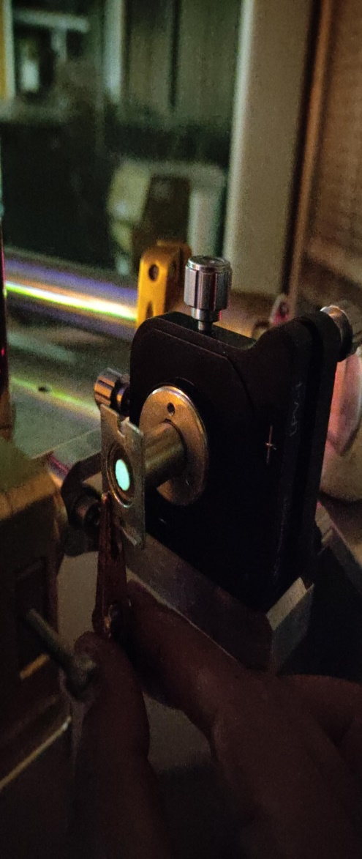
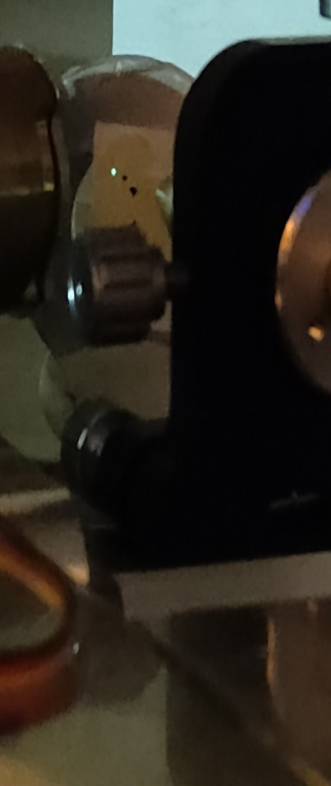
Polycapillary Lens
f₁: 55mm
f₂: 24mm
Beam diameter at entrance
(6 mm)
Beam diameter at focus
(< 100 μm)

Slide 14
POLYCAP vs Experiment: Beam size @ focus
Comparison to nominal values
Comparison to experimental data
Microbeam tube (50μm)
Tube spot size (400μm)

Slide 15
POLYCAP vs Experiment: Beam size out of focus
Experimental data
Comparison to experimental data
exp FWHM @ focus (μm)
Ti-Kα | 120 ± 2
Cu-Kα | 85 ± 1
Μο-Κα | 41 ± 2

Slide 16
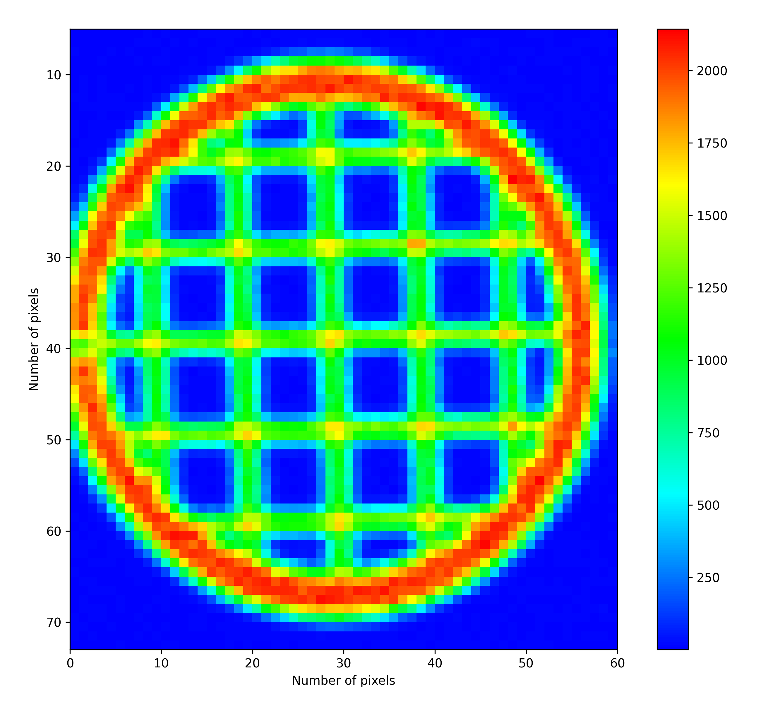
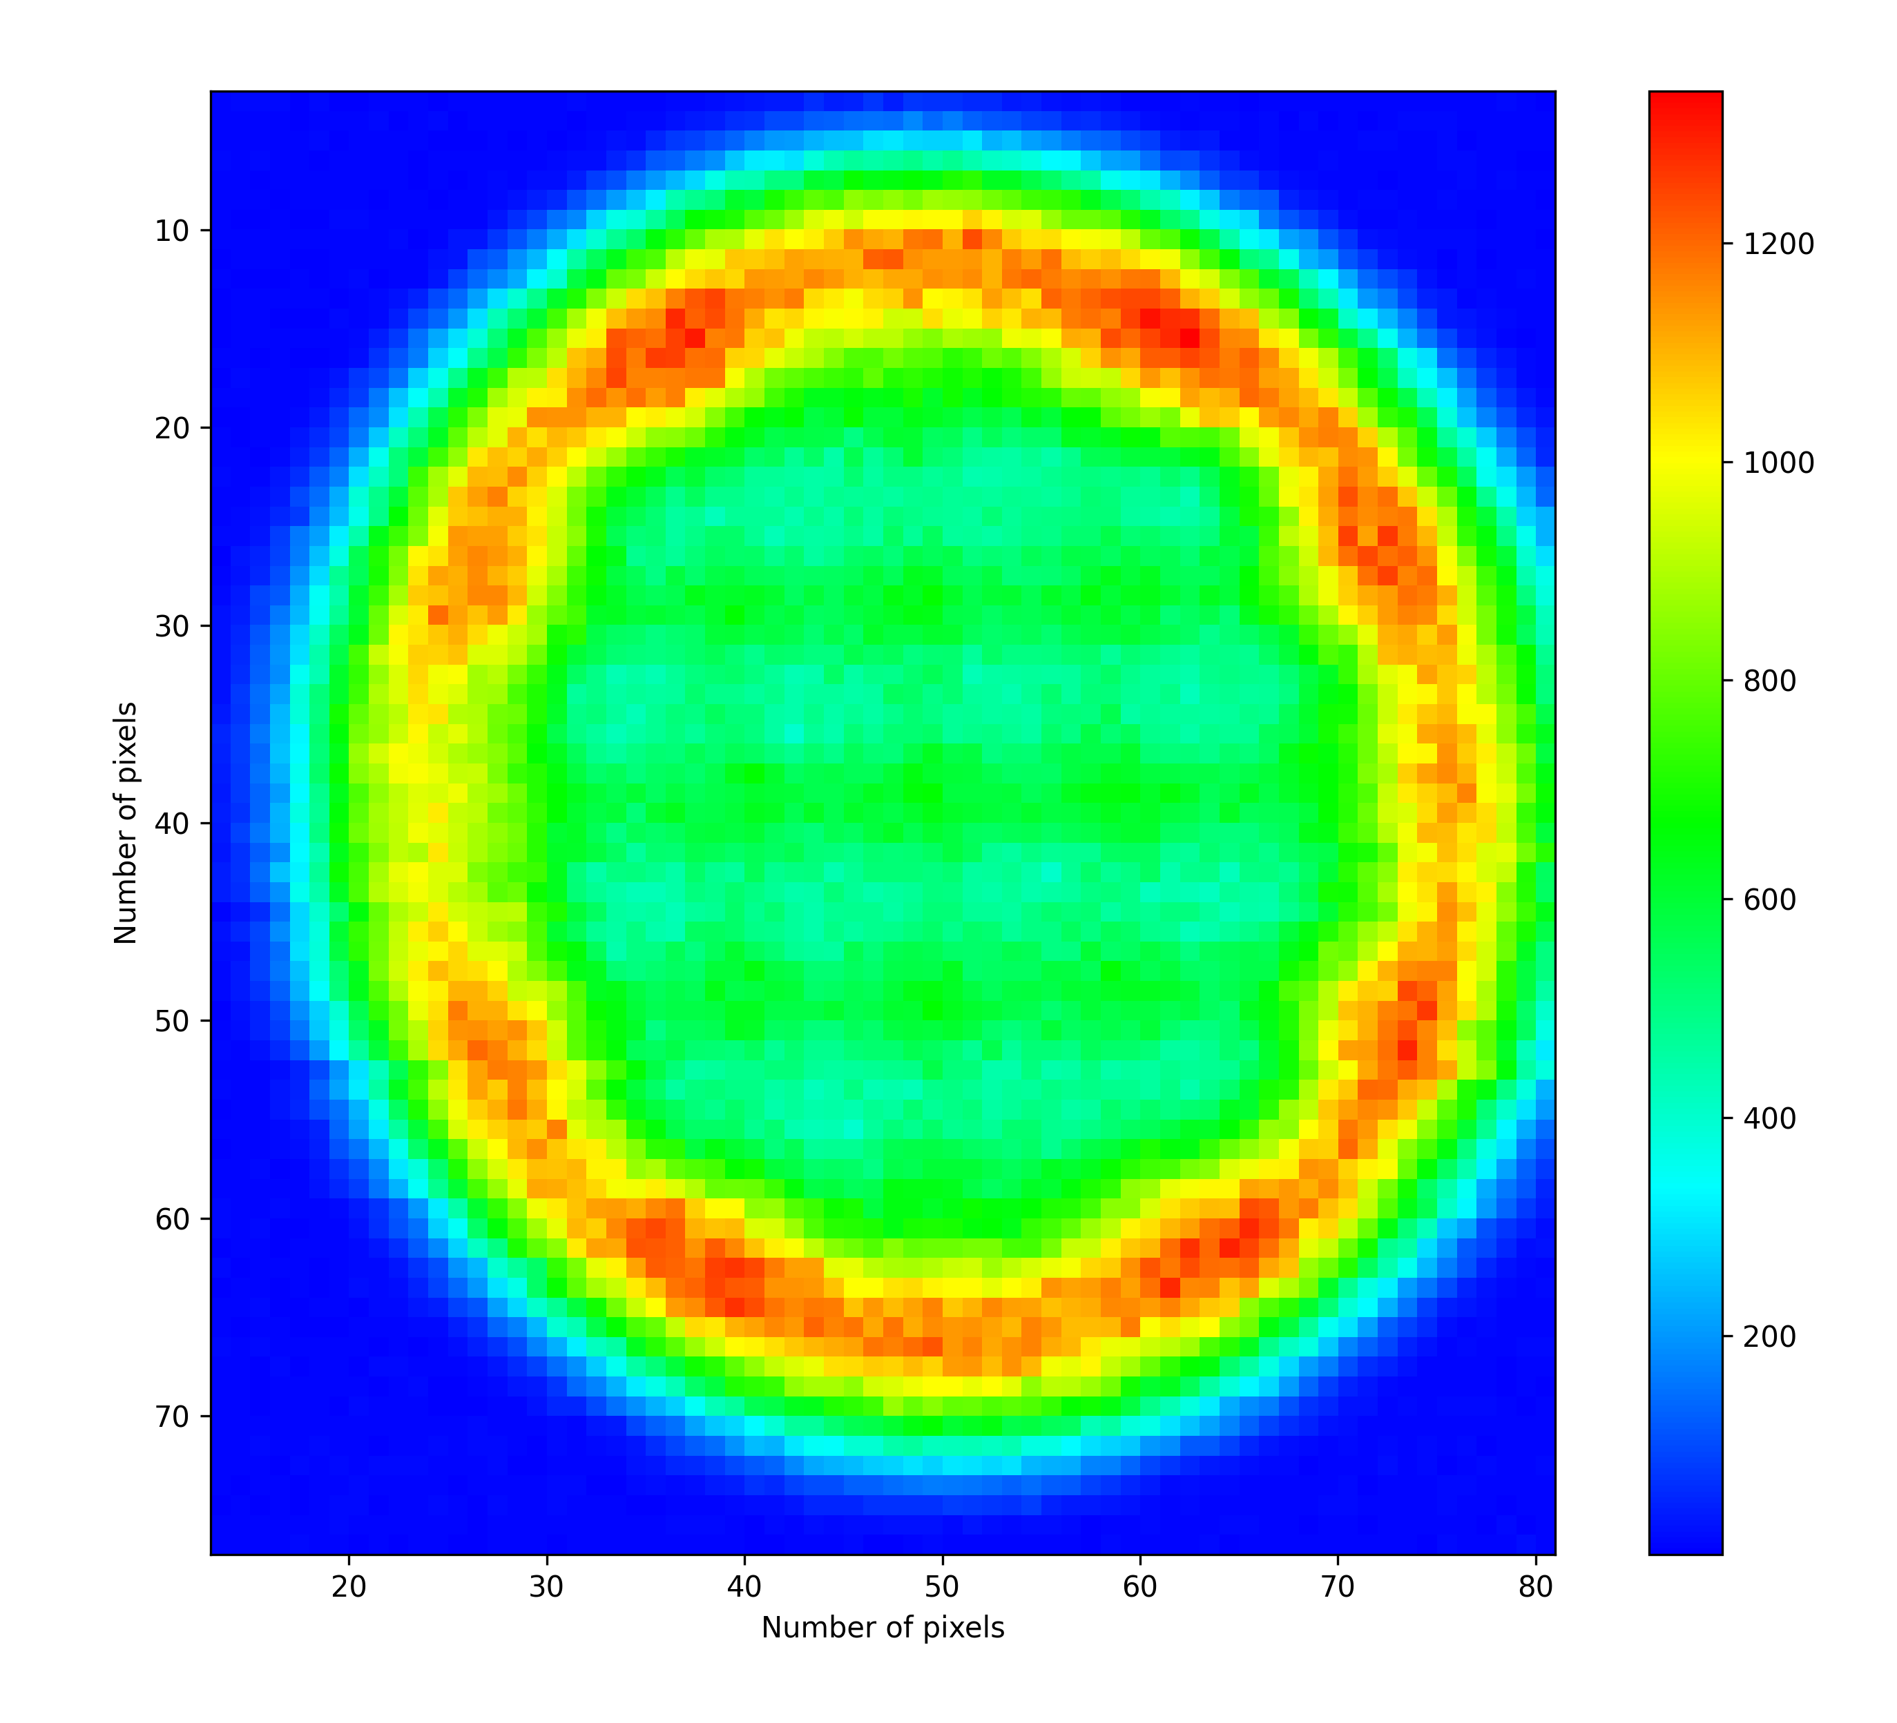
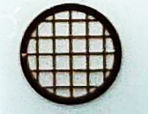
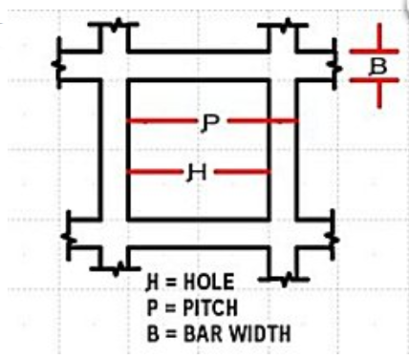
Experiment: Beam size at / out of focus
Cu grid – mesh 50
at focus
3 mm away from focus
Hole width (μm): 420
Pitch (μm): 500
Bar width (μm): 80
Rim width (mm): 0.225
Thickness (μm): 20±3
Dwell time/pixel: 100ms
Step: 50μm

Slide 17

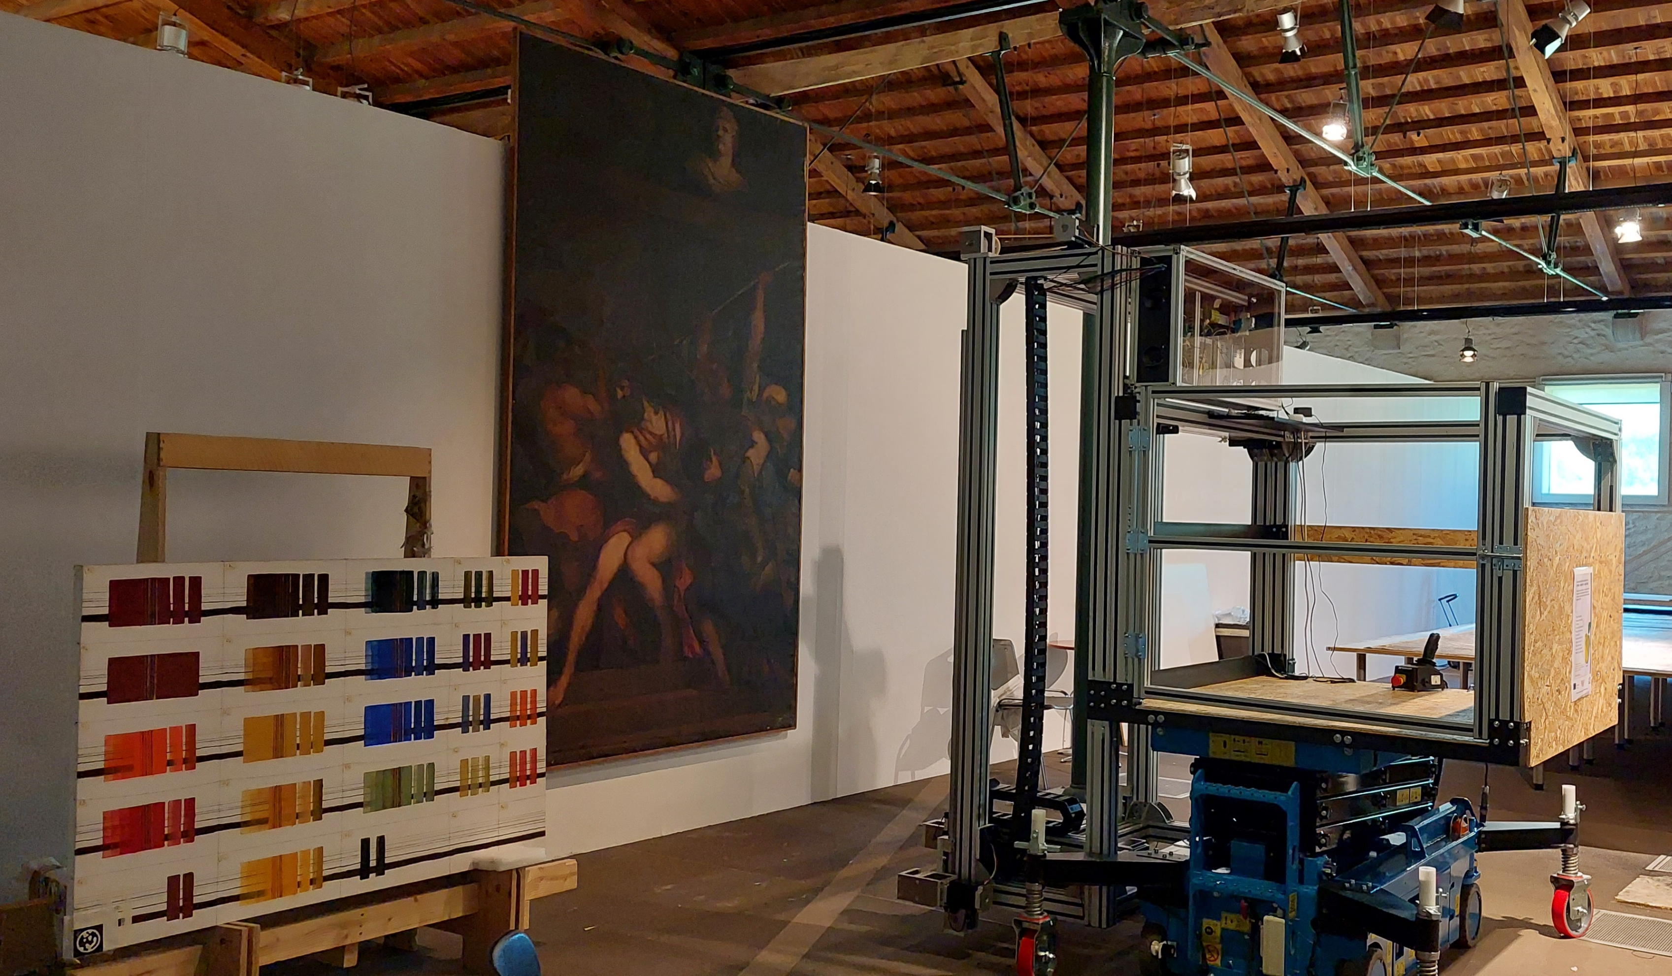




First applications
The main objective of the project is the development of an Open-Access Workshop (OAW) within the premises of the National Gallery at Athens (NGA), where analytical systems based in imaging and spectroscopic techniques will be installed for study of paintings.

Slide 18
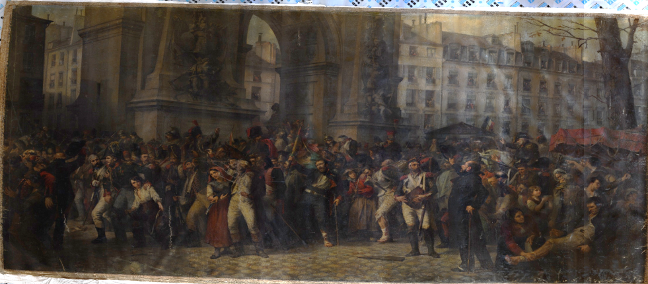



Painting “30th March 1814” – Scanned Areas

Slide 19
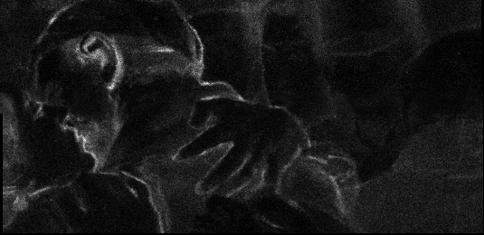
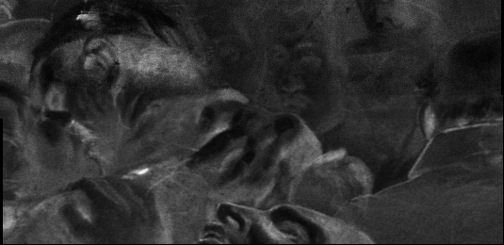
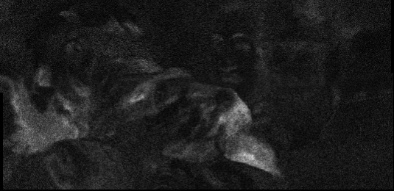
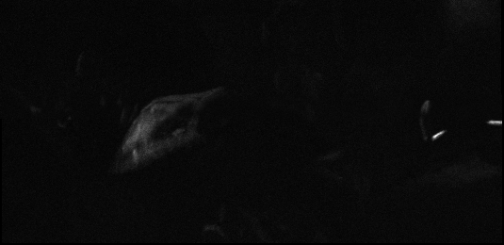
Painting “30th March 1814” – Elemental maps
Ca
Fe
Bone Black (?)
Red ochre, Mars Black (?), ….
Co
Hg
Scanning of an area:
26.7 x 13 cm²
^{total scanning time: ~1h}
Cobalt Blue
Cinnabar

Slide 20
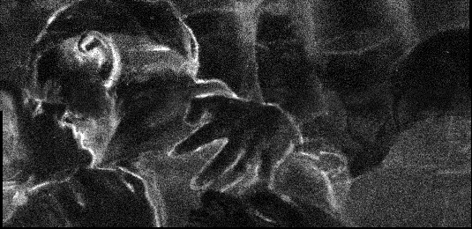
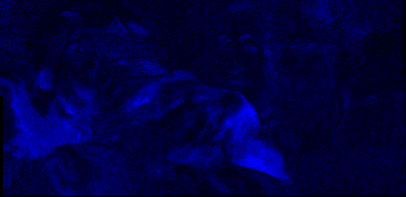
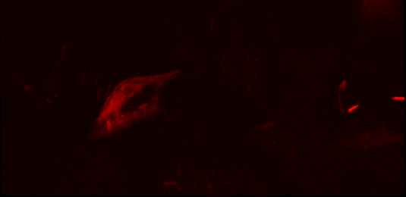
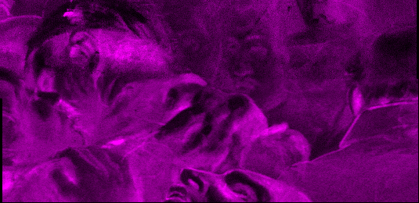
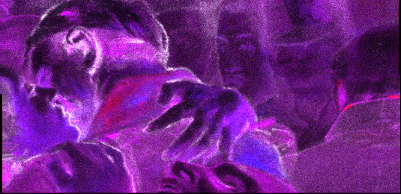
Painting “30th March 1814” – Composite elemental maps
Ca
Co
The distribution of elements can be visualized with different pseudo-colors
Hg
Fe
Ca
Fe
Co
Scanning of an area:
26.7 x 13 cm²
^{total scanning time: ~1h}
Hg
Their combination gives information on the composite distribution of the elements

Slide 21
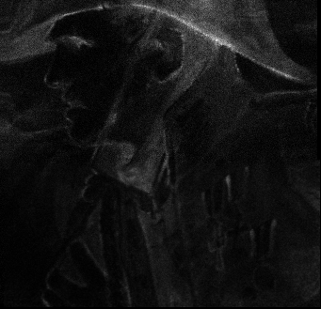
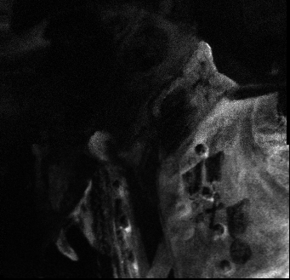
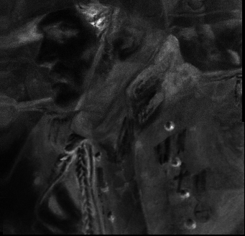
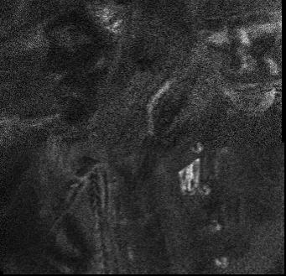
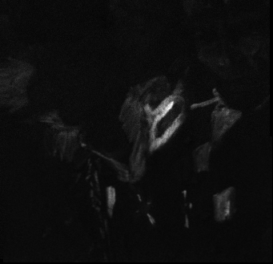
Painting “30th March 1814” – Elemental maps
Ca
Cr
Fe
Red ochre,
Mars Black (?), ….
Bone Black (?)
Viridian (?)
Co
Hg
Scanning of an area:
17 x 16.5 cm²
^{total scanning time: ~2h}
Cobalt Blue
Cinnabar

Slide 22
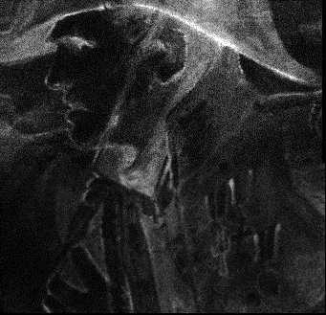
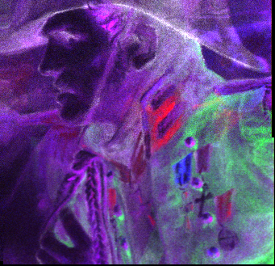
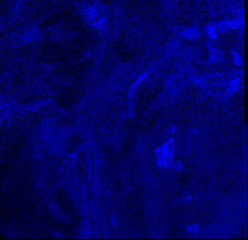
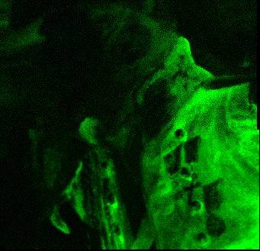
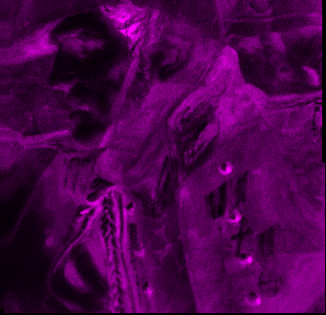
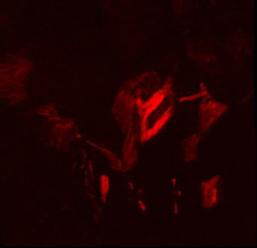
Painting “30th March 1814” – Composite Elemental maps
Ca
Ca
Co
Cr
Cr
Fe
Fe
Hg
Co
Hg
Scanning of an area:
17 x 16.5 cm²
^{total scanning time: ~2h}
The distribution of elements can be visualized with different pseudo-colors
Their combination gives information on the composite distribution of the elements

Slide 23
National Center for Scientific Research “Demokritos”
Institute of Nuclear and Particle Physics
Thank you for your attention!

