Slide 1
Heterogeneous Computing for Track Reconstruction
in the Phase-2 CMS Silicon Tracker
D. Loukas
Ετερογενής: που αποτελείται από ποικίλα στοιχεία

Slide 2
Why Heterogeneous Computer Arcitectures are important and timely :
As transistor dimensions tend to atomic scale, the Moore’s law is slowing down,
the cores per chip will also stop growing and so will this type of performance.
The only known solution to further scale performance is castomized hardware for specific applications.
Popular examples for accelerating performance are: GPUs, DSPs and FPGAs
In order to investigate the feasibility of a Heterogeneous approach in a typical
High Energy Physics experiment the Patatrack group of the CMS experiment
developed a novel vertex and track reconstruction within the official CMSSW software and the CUDA
paralel computing platform ^{[ref 1]}
[ref 1]
https://www.frontiersin.org/articles/10.3389/fdata.2020.601728/full

Slide 3
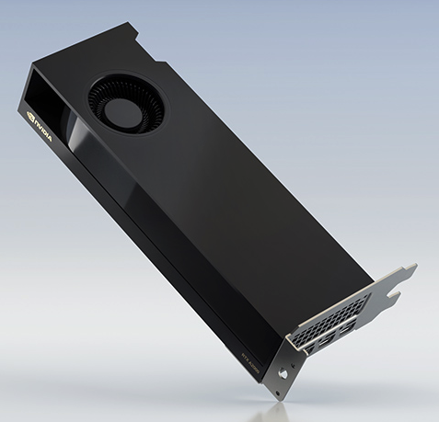
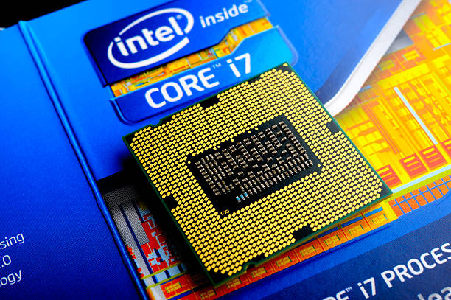
CMSSW
CPU
NVIDIA RTX A2000 12 GB
10-16 cores
3328 CUDA cores

Slide 4






What is CUDA:
The Common Unified Device Architecture (CUDA) is a parallel programming framework
and a parallel programming language thet extends C/C++ programa to run on NVIDIA GPUs.
How it works:
Allocate the host buffers
Allocate the GPU buffers
The CPU issues data tranfer from the host to the GPU
The CPU issues to launch a CUDA kernel and sets the number of CUDA threds
The CPU issues a data transfer from the GPU to the host to copy the results to the main CPU
$$host−code$$
G$PU−code(kernel)$
$$Host(CPU)$$
$$GPU−Device$$
Data Stream
$$host−memory$$
$$GPU−memory$$

Slide 5
The Phase-2 CMS Silicon Tracker
Sketch of one quarter

Slide 6
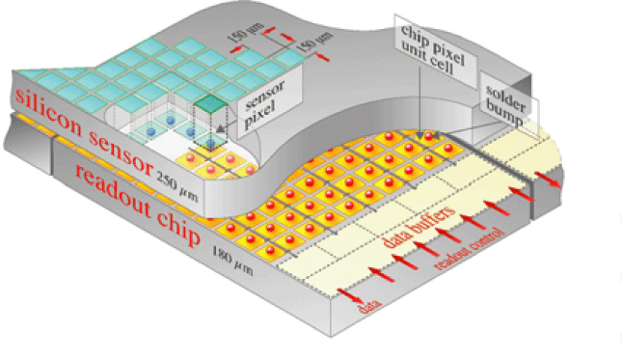
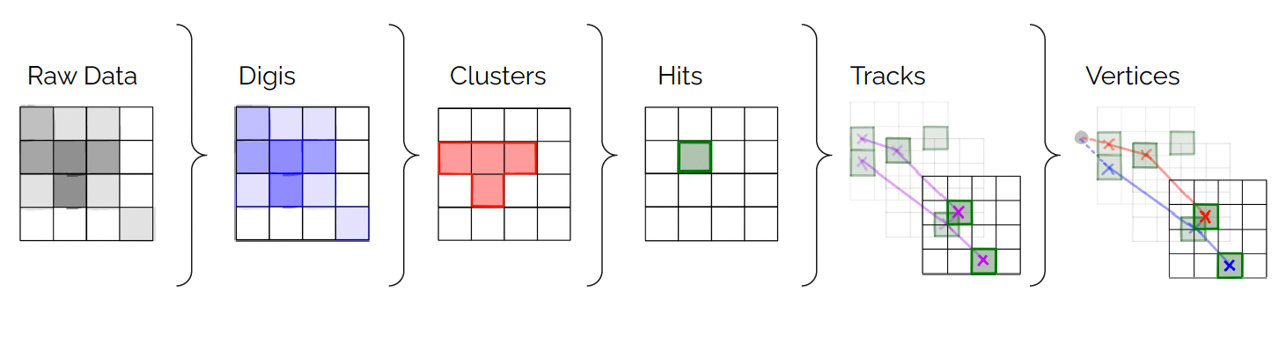
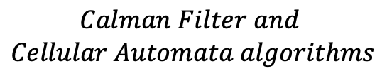

$$Calman Filter and$$
$$Cellular Automata algorithms$$
Provided by CMSSW
$$by D. Papagiannis$$

Slide 7
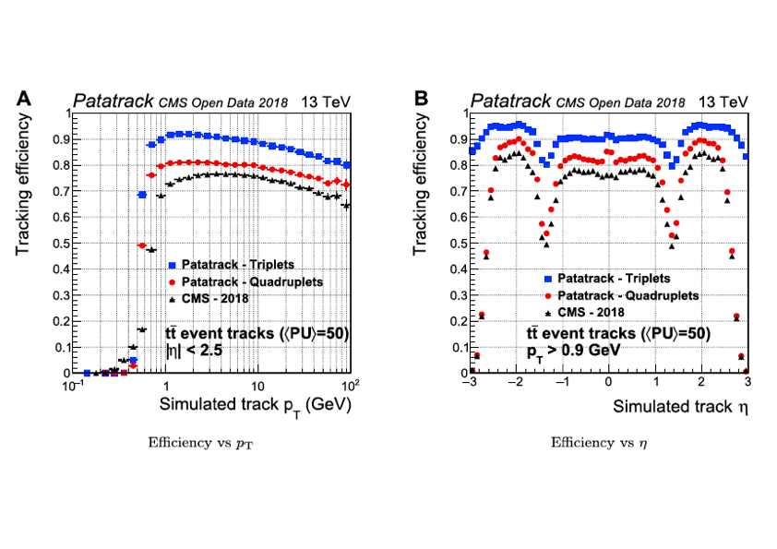
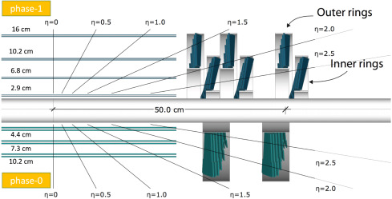

Application to Phase-1 CMS Pixel
Pixel track reconstruction efficiency for simulated events with an average of 50 superimposed pileup collisions.
Comparison of Patatrack results with the CMS-2018. (from [ref 1])
$$t\overline{t}$$

Slide 8
(by Adriano Di Florio: CMS 2022 Annual Review-DAQ&HLT)

Slide 9

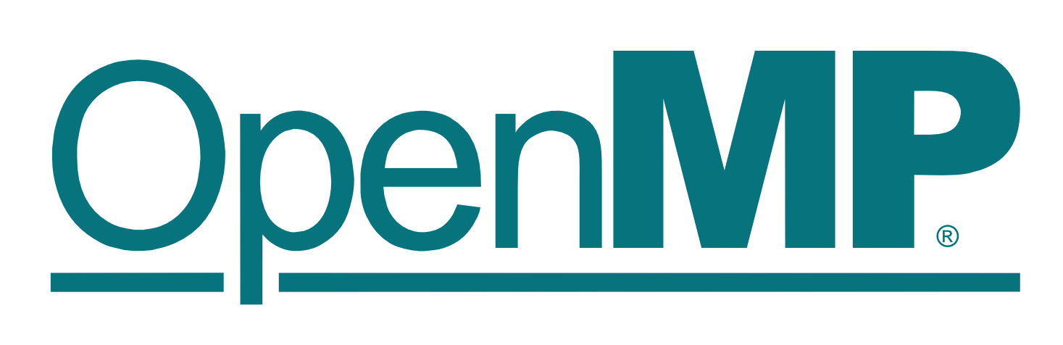
Heterogeneous computing with CUDA and more…
Nvidia CUDA is not the only parallel platform :
AMD’s Heterogeneous Interface for Portability (HIP) on AMPD GPUs:
Open Multi-Processing on multicore CPUs
There are similarities and differences with each other :
Need for a framework than supports all of them

Slide 10


What is ALPAKA:
Is a header-only C++17 abstraction library for accelerator development *
It allows to achive portability by ignoring specific unsupported leveles and
utilizing only the ones supported on a specific accelerator
Provides back-ends for CUDA, OpenMP and other methods (CPUs, GPUs, FPGAs)
Porting to Alpaka and integration into CMSSW is an ongoing project
The CMS Patatrack** group is currently supporting the transition to Alpaka
*
https://alpaka.readthedocs.io/en/0.5.0/usage/intro.html
**
https://patatrack.web.cern.ch/patatrack/

Slide 11
Involvement of the INPP CMS group
Ongoing Process Quality Control in DIL (see talk by Aris)
Our group is assuming major responsibilities in the DTC (Detector and Trigger Concentrator)
for the Phase-2 CMS Outer Tracker (Yiannis Kazas)
We extend our activities to the Vertex and Track reconstruction in the CMS Phase-2 Trcacker
with our student Alkis Papadopoulos (the foreseen work will be part of his PhD thesis)

