Slide 1
Status of the MUonE Project
Dimitris Loukas
Based manly on : arXiv:2201.13177v1. (by G. Abbiendi)

Slide 2

Purpose of the experiment
The MUonE experiment has been proposed to measure the differential
cross section of e elastic scattering, by colliding the 160 GeV muons of the CERN M2
beam with atomic electrons of thin target plates.
From a very precise measurement
of the shape one can achieve a competitive determination of the leading hadronic
contribution to the muon magnetic moment, independent from the other existing ones.

Slide 3
The g-2 anomaly
The muon magnetic moment anomaly a = (g_{μ} - 2)=2 is one of the most precisely
measured quantities as well as one of the most precisely calculable in the Standard
Model (SM), therefore it constitutes a stringent test of the theory.
For the last twenty
years the experimental measurements [1] have been pointing to a significant discrepancy from
the theory prediction
The theory prediction is a formidable
achievement of the Standard Model, including terms up to five loops of perturbation
theory for the dominant QED part, with significant contributions coming also from weak
interactions and QCD.

Slide 4
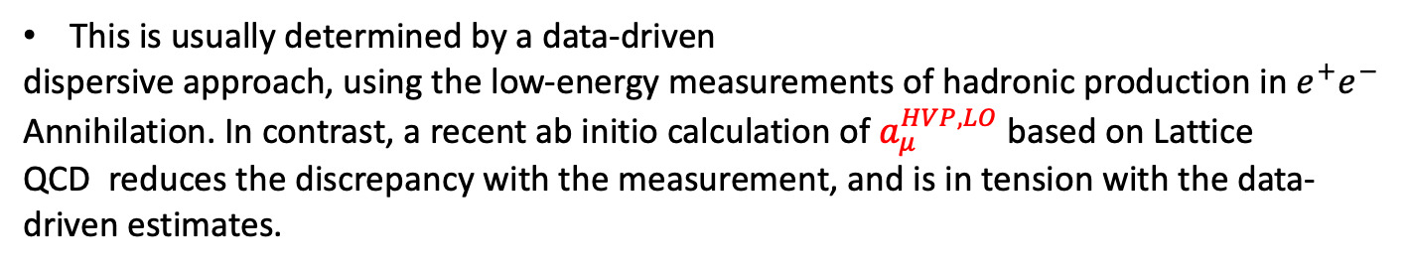
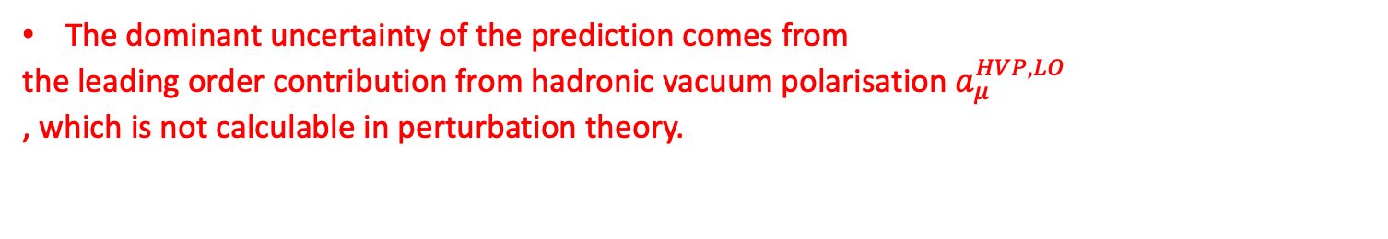
The g-2 anomaly
Many hypotheses have been put forward to explain this deviation as a quantum
effect of new exotic particles, however it is also possible that it result from a systematic
error in the calculation.
The dominant uncertainty of the prediction comes from
the leading order contribution from hadronic vacuum polarisation $a_{μ}^{HVP,LO}$
, which is not calculable in perturbation theory.
This is usually determined by a data-driven
dispersive approach, using the low-energy measurements of hadronic production in $e^{+}e^{−}$
Annihilation. In contrast, a recent ab initio calculation of $a_{μ}^{HVP,LO}$based on Lattice
QCD reduces the discrepancy with the measurement, and is in tension with the data-
driven estimates.

Slide 5
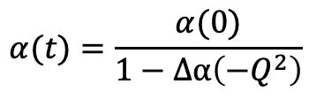
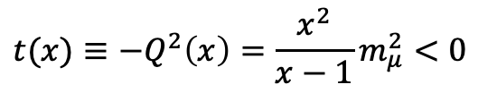
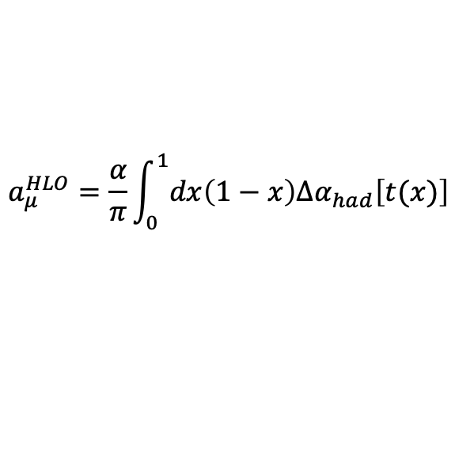
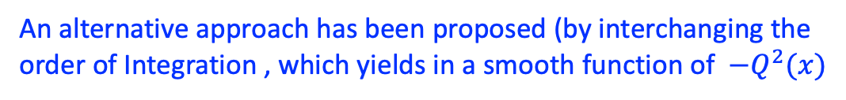
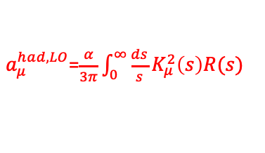

The novelty of the MuOne experiment
Difficulties in calculating:
$a_{μ}^{had,LO}$=$\frac{α}{3π}\int_{0}^{∞}{\frac{ds}{s}K_{μ}^{2}\left(s\right)R(s)}$
due to many resonances in the low energy region
An alternative approach has been proposed (by interchanging the
order of Integration , which yields in a smooth function of $−Q^{2}(x)$
$$a_{μ}^{HLO}=\frac{α}{π}\int_{0}^{1}{dx\left(1−x\right)Δα_{had}\left[t(x)\right]}$$
where:
$${t(x)≡−Q}^{2}\left(x\right)=\frac{x^{2}}{x−1}m_{μ}^{2}<0$$
Is the space-like squared momentum transfer
By measuring the running of the effective coupling,
the hadronic contribution can be extracted
by subtracting the QED and EW parts that can be
calculated to very high precision
$$α(t)=\frac{α(0)}{1−Δα\left(−Q^{2}\right)}$$
With
$$α\left(0\right)=α$$

Slide 6

The MuonE apparatus
Measure the effective electromagnetic coupling in the space like region via scattering data* :
Measure differential cross section of μe scattering with:
150 GeV muon beam on a Graphite (or Beryllium) fixed target
$$μ^{±}\left(p_{1}\right)e^{−}\left(p_{2}\right)→μ^{±}\left(p_{3}\right)e^{−}\left(p_{4}\right)$$
* C.M. Carloni Calame, M. Passera, L. Trentadue, G. Venanzoni, Phys. Lett. B 746 (2015) 325, http://dx.doi.org/10.1016/j.physletb.2015.05.020 , arXiv:1504.02228 [hep-ph].

Slide 7
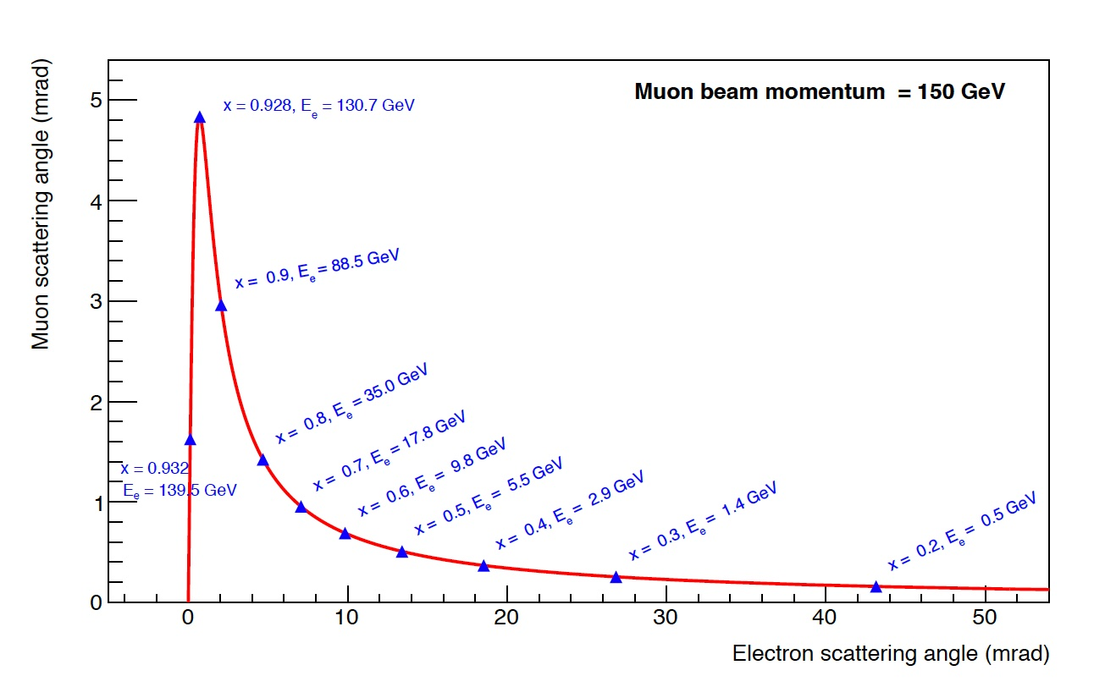



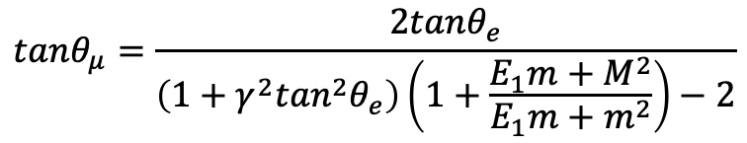


The fundamental constrain
For elastic μe scattering
$$tanθ_{μ}=\frac{2tanθ_{e}}{\left(1+γ^{2}\tan^{2}θ_{e}\right)\left(1+\frac{E_{1}m+M^{2}}{E_{1}m+m^{2}}\right)−2}$$
$$e_{out}$$
$$μ_{in}$$
$$θ_{e}$$
$$θ_{μ}$$
1. This is the fundamental constraint to discriminate elastic
scattering events from the background of radiative
events and inelastic processes.
2. At the same time, due to the small angles between the
incoming muon and the the outgoing electron, a detector of
medium to small transverse surface will suffice.
$$μ_{out}$$

Slide 8
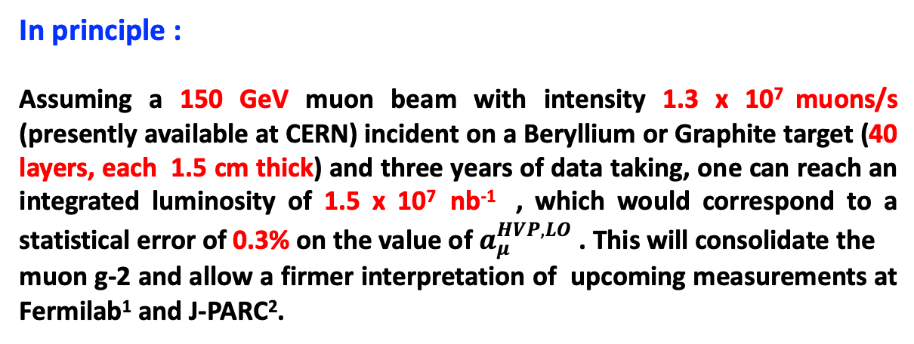
How to…
In principle :
Assuming a 150 GeV muon beam with intensity 1.3 x 10⁷ muons/s (presently available at CERN) incident on a Beryllium or Graphite target (40 layers, each 1.5 cm thick) and three years of data taking, one can reach an integrated luminosity of 1.5 x 10⁷ nb⁻¹ , which would correspond to a statistical error of 0.3% on the value of $a_{μ}^{HVP,LO}$. This will consolidate the
muon g-2 and allow a firmer interpretation of upcoming measurements at Fermilab¹ and J-PARC².
Fermilab Muon g-2 Collab, http://muon-g-2.fnal.gov
J-PARC g-2/EDM Collab, http://g-2.kek.jp

Slide 9
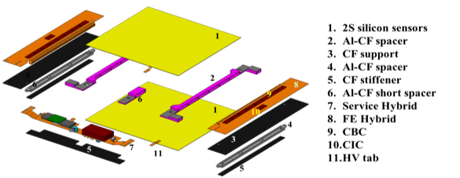
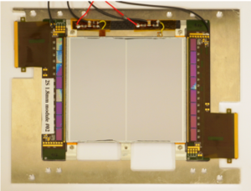
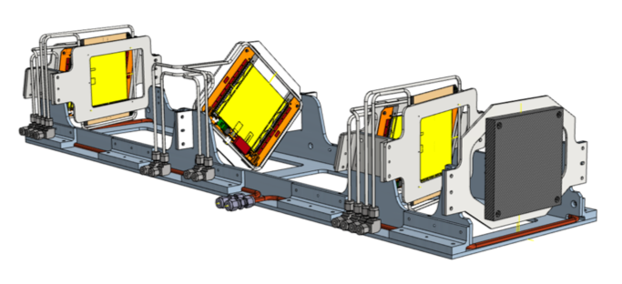
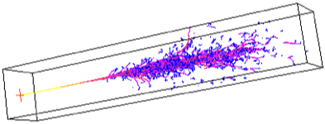
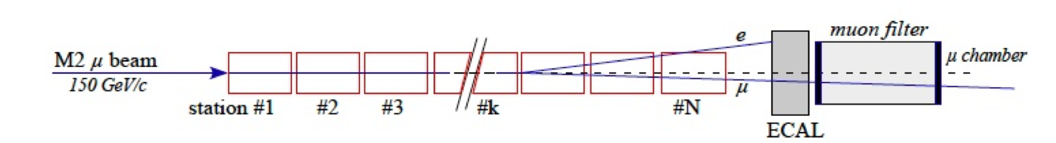
*How to…
In practice :
Get profit of current R&D for the CMS Phase II Outer Tracker
2. 40 stations: CMS modules (10 cm x 10 cm) equipped with plates of 1.5 cm Graphite each one, and spaced by 1 m
3. With an electromagnetic at the end a muon detector at the end
Letter of Indent
https://cds.cern.ch/record/2677471/files/SPSC-I-252.pdf

Slide 10
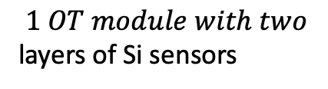
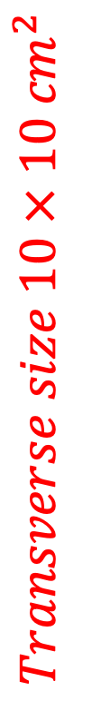
^{The experimental setup}
Scheme of one tracking station.
$$1 OT module with two$$
layers of Si sensors
$$Transverse size 10 × 10 {cm}^{2}$$
Layout of the MUonE experimental apparatus (not to scale).
$$40 stations witl 60cm segmented Graphite target$$

Slide 11
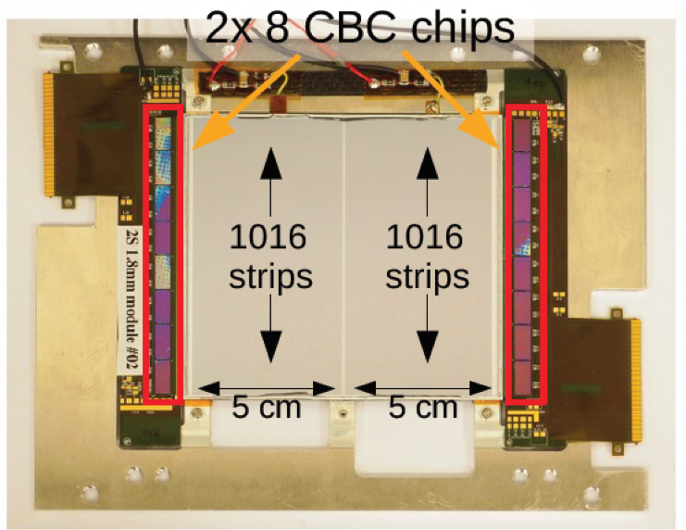
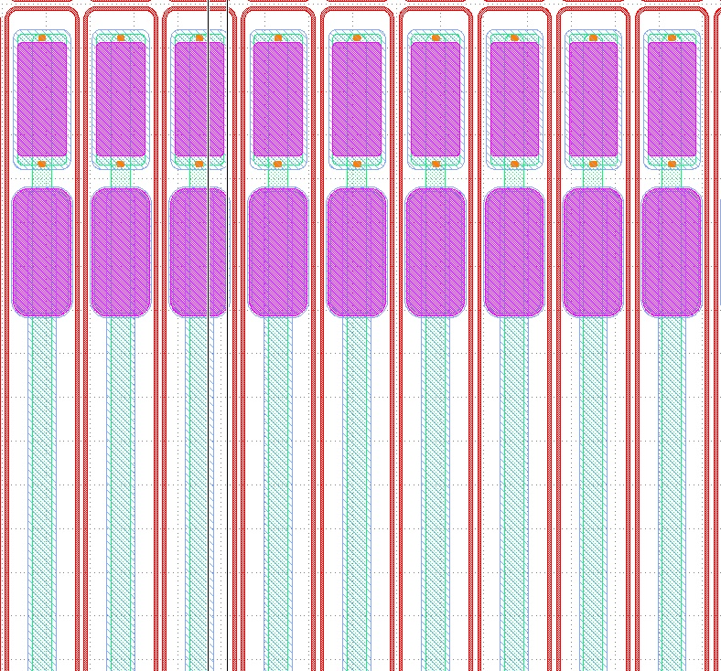
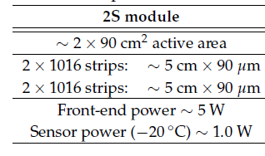
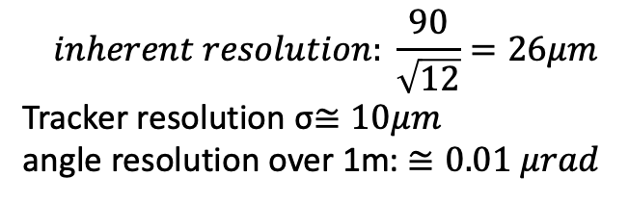
^{The Silicon Tracker}
90 μm pitch
$$inherent resolution: \frac{90}{\sqrt{12}}=26μm$$
Tracker resolution σ$≅10μm$
angle resolution over 1m: $≅0.01 μrad$

Slide 12


^{Detector optimization}
The hit intrinsic resolution of the tracking detector is particularly important.
GEANT simulation: In both cases the reconstructed events include both the signal (elastic scattering
events) and background events from e+e⁻ pair production, which can mimic elastic
events when one electron goes undetected.
$$σ\sim 7μm$$
$$σ\sim 35−40μm$$

Slide 13
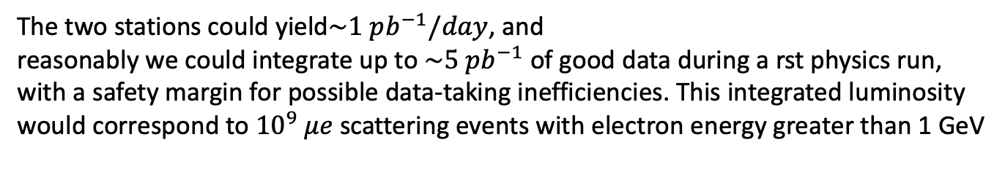
^{Test Run}
A first important milestone is a three-week Test Run at the CERN M2 beam line, with
full intensity muon beam. The MUonE setup will consist of
two tracking stations followed by the ECAL, with an additional station (without target)
upstream to track the incoming muons . Initially the Test Run was allocated in fall
2021. However there were some delays in the procurement of the module components
and a shift in the CMS preproduction timeline, so the final schedule has to be redefined.
The two stations could yield$\sim 1 pb^{−1}/day$, and
reasonably we could integrate up to $\sim 5 pb^{−1}$ of good data during a rst physics run,
with a safety margin for possible data-taking inefficiencies. This integrated luminosity
would correspond to ${10}^{9} μe$scattering events with electron energy greater than 1 GeV
The statistics achievable at the Test Run would give enough sensitivity to measure
the leptonic running of and potentially could provide initial sensitivity to the hadronic
running.

Slide 14
^{Test Run}
Event yields expected in the Test Run, for: (Left) the electron and (Right)
the outgoing muon, after the application of simple angular cuts.

Slide 15
^{Test Run}
Systematic errors
The most important systematic efects will be measured from the data
itself, in the so-called normalization region, where the hadronic running is negligible.
This corresponds to events where the muon is scattered at small angle keeping most of
its initial energy, while the emitted electron goes at relatively large angles with energy
of few GeVs. The recorded statistics in this region will be very large allowing for very
precise measurements of the detector performance.

Slide 16



The MUonE Test Run (2021)
Test run set up :
ECAL
Station 1
Station 2
µ
µ
e
µ
Target
Target
100 cm
Tracker: | 18 | CMS 2Smodule ~95 mm x 95 mm
Calorimeter: | 25 | PbWO4 crystal , ~140 x 140 mm total length ~ 4-5 m + services
the apparatus will be in a thermalized volume
will run with 2 full stations plus 3 tracking planes for the incoming µ

Slide 17
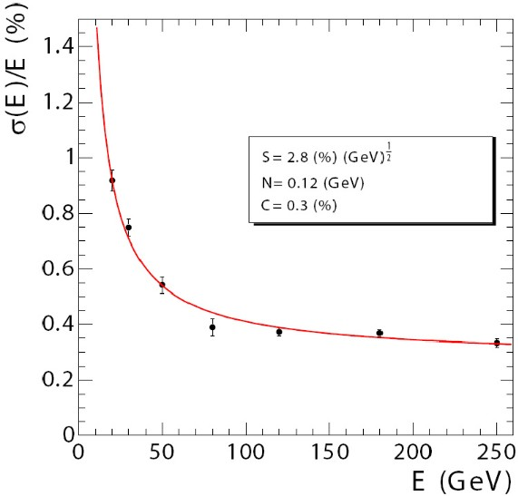


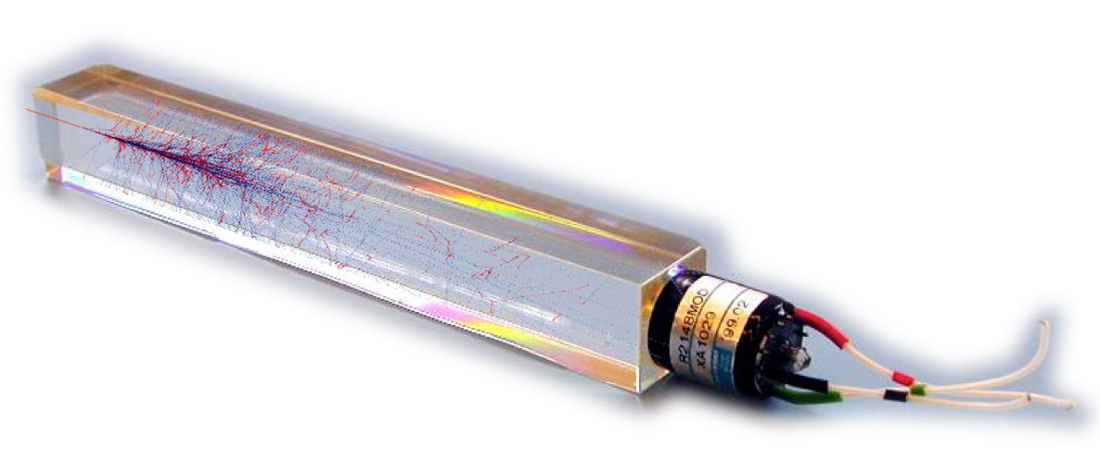
The Electromagnetic Calorimeter
Based on the CMS ECAL Crystals and readout ?
Homogeneous, high-granularity hermetic PbWO₄ crystal calorimeter
fast decay scintillation light (25 ns)
short radiation lenght (X₀ = 0.89 cm)
small Moliere radius (2.2 cm)

Slide 18
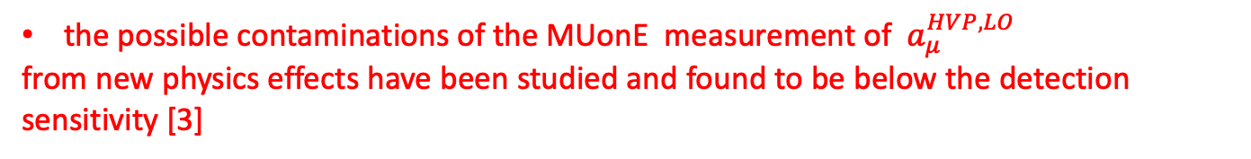
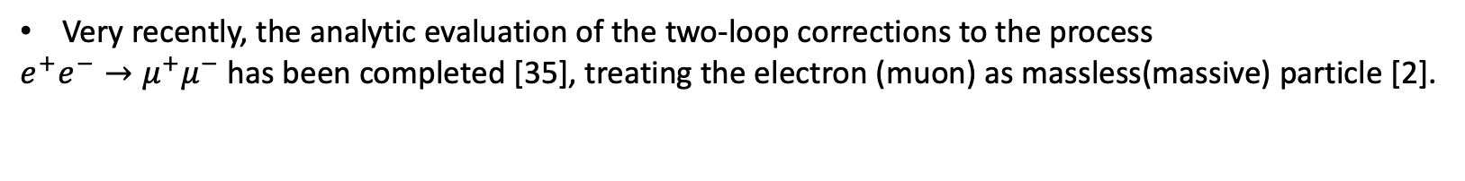
^{Theoretical Progress}
A comprehensive review [1]
describes the full NLO calculation, including both QED and electroweak corrections, also
made available in a fully exclusive MC event generator, the calculation of NNLO
hadronic corrections and the evaluation of the two-loop integrals relevant for
the NNLO QED corrections
Very recently, the analytic evaluation of the two-loop corrections to the process
$e^{+}e^{−}→μ^{+}μ^{−}$ has been completed [35], treating the electron (muon) as massless(massive) particle [2].
the possible contaminations of the MUonE measurement of $a_{μ}^{HVP,LO}$
from new physics effects have been studied and found to be below the detection sensitivity [3]
[1] P. Banerjee et al., \Theory for muon-electron scattering @ 10 ppm: A report of the MUonE theory
initiative", Eur. Phys. J. C 80 (2020) 591, [arXiv:2004.13663].
[2]R. Bonciani, A. Broggio, S. Di Vita, A. Ferroglia, M. K. Mandal, P. Mastrolia, L. Mattiazzi,
A. Primo, J. Ronca and U. Schubert, \Two-Loop Four-Fermion Scattering Amplitude in QED",
Phys. Rev. Lett. 128 (2022) 022002, [arXiv:2106.13179].
[3] P. S. B. Dev, W. Rodejohann, X. J. Xu and Y. Zhang, \MUonE sensitivity to new
physics explanations of the muon anomalous magnetic moment", JHEP 05 (2020) 053,
[arXiv:2002.04822].

Slide 19
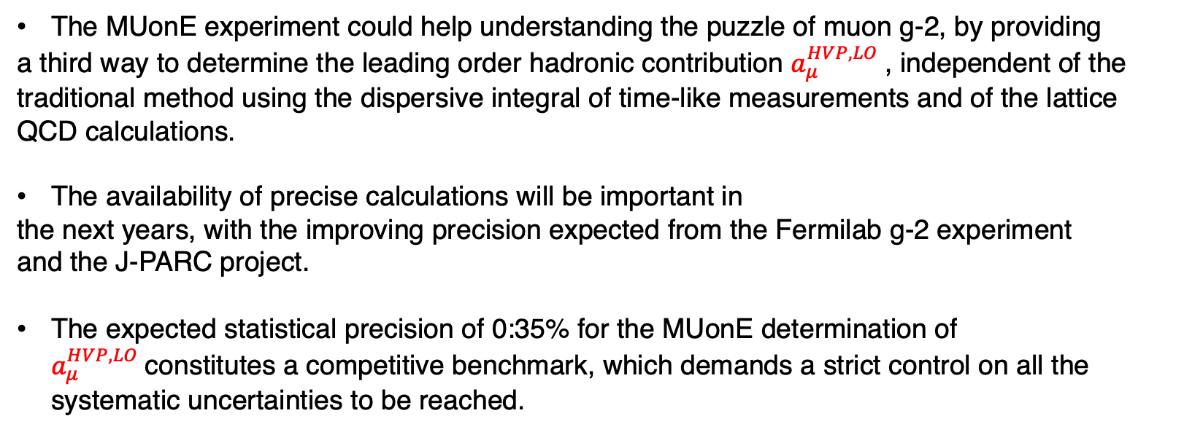
Conclusions
The MUonE experiment could help understanding the puzzle of muon g-2, by providing
a third way to determine the leading order hadronic contribution $a_{μ}^{HVP,LO}$, independent of the traditional method using the dispersive integral of time-like measurements and of the lattice QCD calculations.
The availability of precise calculations will be important in
the next years, with the improving precision expected from the Fermilab g-2 experiment
and the J-PARC project.
The expected statistical precision of 0:35% for the MUonE determination of $a_{μ}^{HVP,LO}$constitutes a competitive benchmark, which demands a strict control on all the systematic uncertainties to be reached.

