Slide 1


Deuteron induced reactions on Lithium and Fluorine
E. Taimpiri^{1,2}, M. Axiotis², K. Bosbotinis¹, M. Kokkoris¹, A. Lagoyannis², A. Ziagkova¹
¹ Department of Physics, National Technical University of Athens, Zografou campus, 15780 Athens, Greece
² Tandem Accelerator Laboratory, Institute of Nuclear and Particle Physics, N.C.S.R. “Demokritos”, Aghia Paraskevi, 15310 Athens, Greece

Slide 2
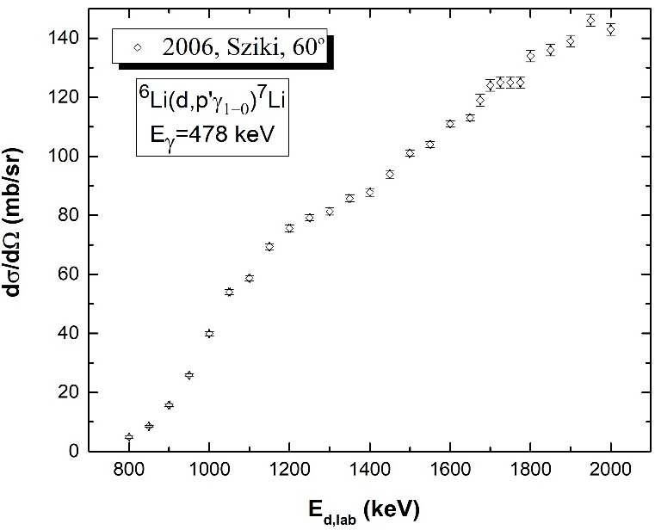
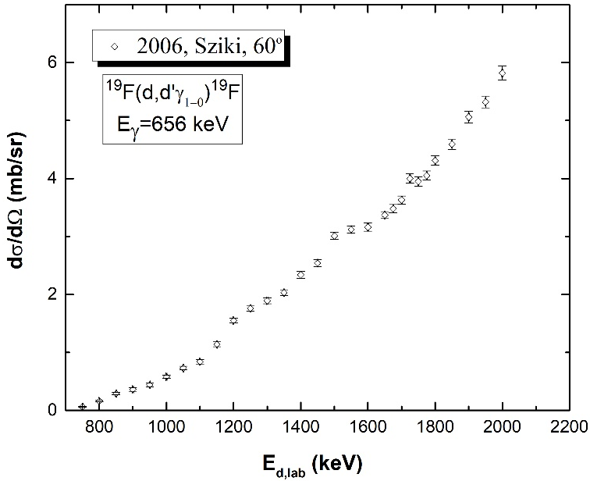
Motivation
Lithium (natural abundance: 92.5% ⁷Li, 7.5% ⁶Li)
Need for detection and quantification via d-PIGE technique
widely used in industry
Fluorine (monoisotopic: 100% ¹⁹F)
Deuteron beams : necessary for the case of ⁶Li
Reliable differential cross sections needed (without the use of standards)
Existing literature:
Complete lack of data for ⁷Li
One published work for ⁶Li & ¹⁹F (by G.A. Sziki (2006) for Εd= 0.8 – 2 MeV and θ=60°)
Aim: Differential cross section data for the
⁶Li(d,n’γ₁₋₀)⁷Be, ⁶Li(d,p’γ₁₋₀)⁷Li, ⁷Li(d,d’γ₁₋₀)⁷Li & ¹⁹F(d,p’γ₁₋₀)²⁰F

Slide 3
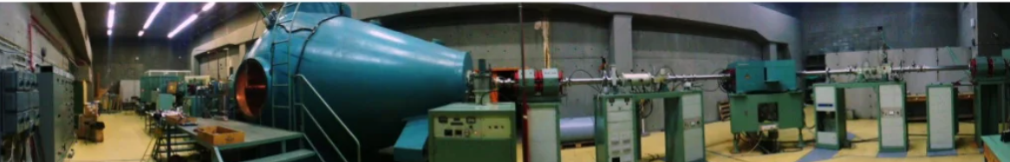
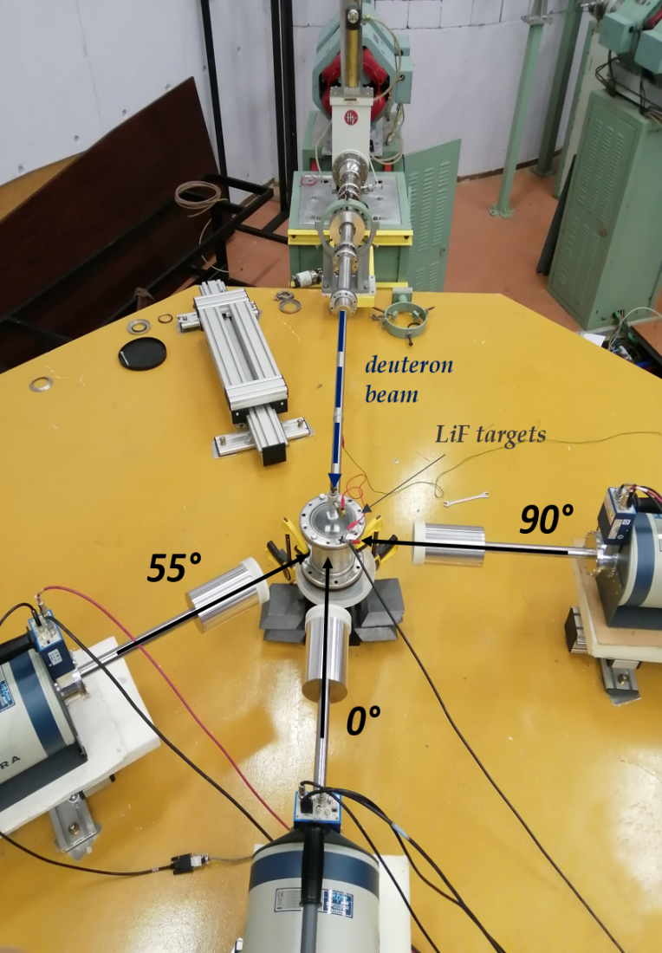

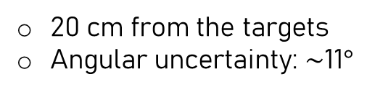
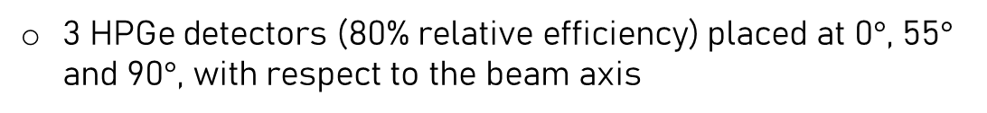
Experimental setup
5.5 MV Tandem Van de Graaff Accelerator of N.C.S.R. “Demokritos”
Deutron energy range: 1 – 2.2 MeV
20 keV step
Beam current $<$ 20 nA
Targets
Thin layer of ^{nat}LiF (92.5% ⁷Li, 7.5% ⁶Li) evaporated on a thick ^{nat}Ta layer
Thin ⁶LiF (5% ⁷Li, 95%⁶Li) layer was evaporated on top of a ^{nat}C substrate, with a top layer of ¹⁹⁷Au
Faraday cup
Detection systems
3 HPGe detectors (80% relative efficiency) placed at 0$°$, 55$°$ and 90$°$, with respect to the beam axis
20 cm from the targets
Angular uncertainty: $\sim$11$°$
Standard NIM (Nuclear Module Instrumentation) electronics

Slide 4
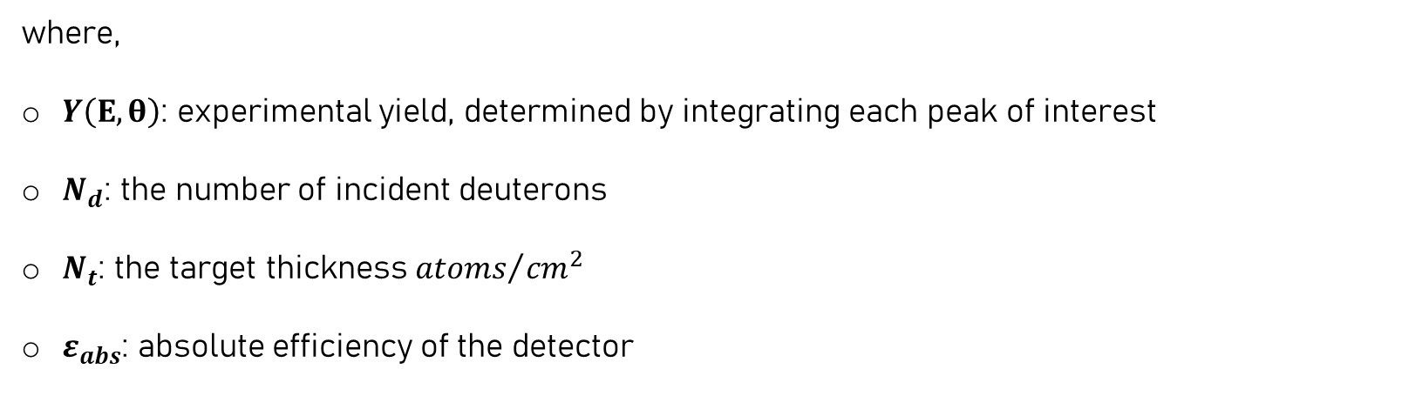
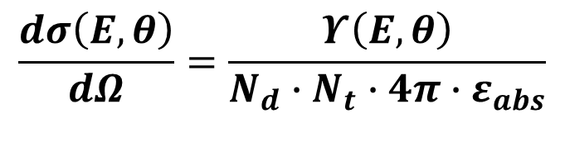
Data Analysis
Absolute measurement
$$\frac{dσ\left(Ε,θ\right)}{dΩ}=\frac{Υ\left(Ε,θ\right)}{Ν_{d}∙N_{t}∙4π∙ε_{abs}}$$
[barn/sr]
where,
$Y\left(Ε, θ\right)$: experimental yield, determined by integrating each peak of interest
$N_{d}$: the number of incident deuterons
$N_{t}$: the target thickness ${atoms}/{{cm}^{2}}$
$ε_{abs}$: absolute efficiency of the detector

Slide 5
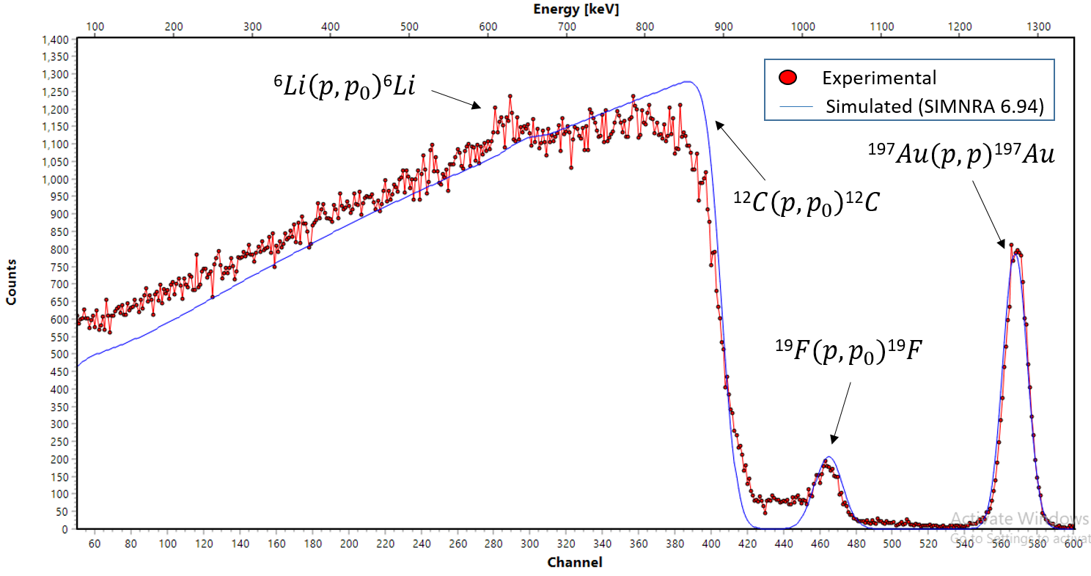

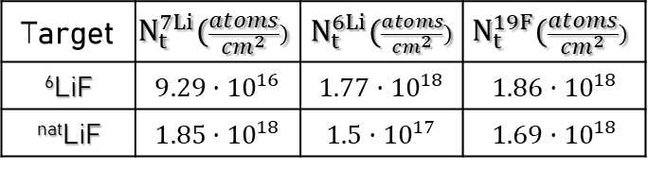
Data Analysis : $N_{t}$
^{nat}LiF target: via EBS, RBS & NRA techniques
⁶LiF target: via EBS (Elastic Backscattering Spectroscopy) technique
Proton beam: 1.3 MeV,
Surface Silicon Barrier detector placed at 170$°$
Use of the ¹⁹F(p,p₀)¹⁹F reaction (evaluated data from IBANDL)
Ratio 1:1 for lithium and fluorine
Target | $$N_{t}^{7Li}(\frac{atoms}{{cm}^{2}})$$ | $N_{t}^{6Li}(\frac{atoms}{{cm}^{2}})$ | $$N_{t}^{19F}(\frac{atoms}{{cm}^{2}})$$
⁶LiF | $$9.29·{10}^{16}$$ | $$1.77·{10}^{18}$$ | $$1.86·{10}^{18}$$
^{nat}LiF | $$1.85·{10}^{18}$$ | $$1.5·{10}^{17}$$ | $$1.69·{10}^{18}$$
Uncertainty: 7%, for both measurements

Slide 6
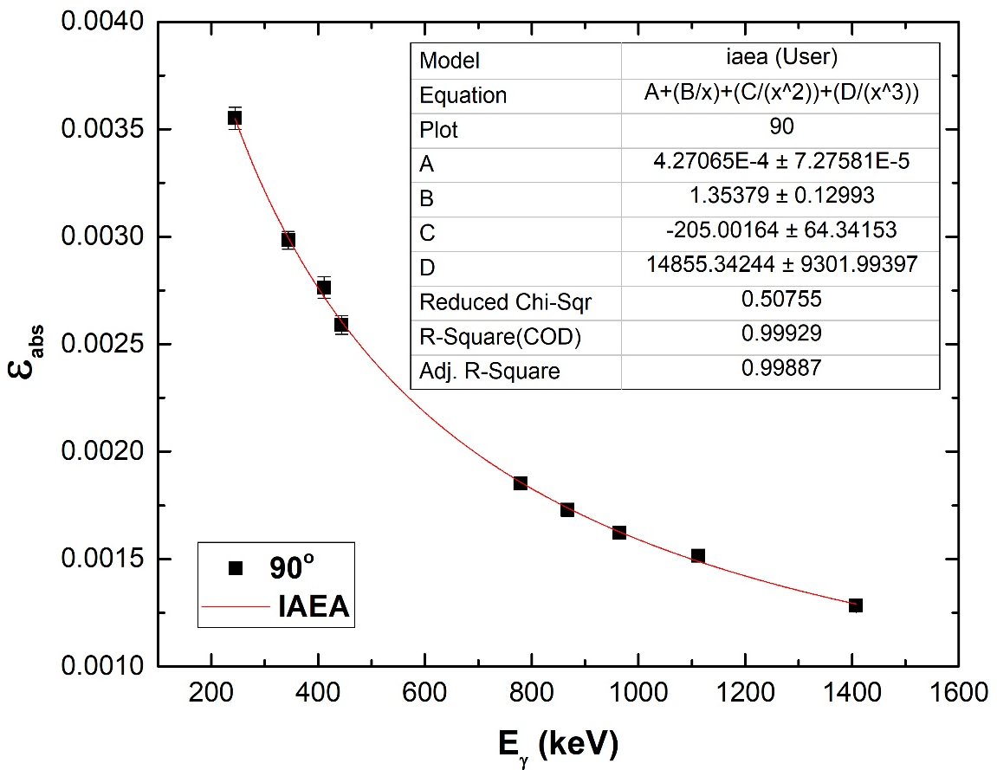



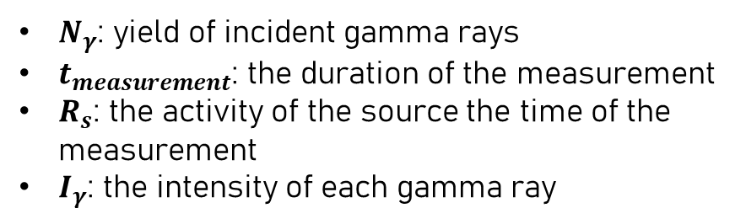
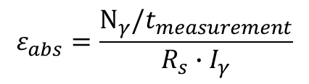

Data Analysis : $ε_{abs}$
¹⁵²Eu calibrated point source of R₀=(217$±$3) kBq
$$ε_{abs}=\frac{Ν_{γ}/t_{measurement}}{R_{s}∙I_{γ}}$$
εabs of HPGe (80%) detector at 90$°$
where,
$Ν_{γ}$: yield of incident gamma rays
$t_{measurement}$: the duration of the measurement
$R_{s}$: the activity of the source the time of the measurement
$I_{γ}$: the intensity of each gamma ray
Fitting function : $ε_{abs}=A+\frac{B}{E_{γ}}+\frac{C}{{E_{γ}}^{2}}+\frac{D}{{E_{γ}}^{3}}$
Uncertainty: $\sim$ 5.4%

Slide 7
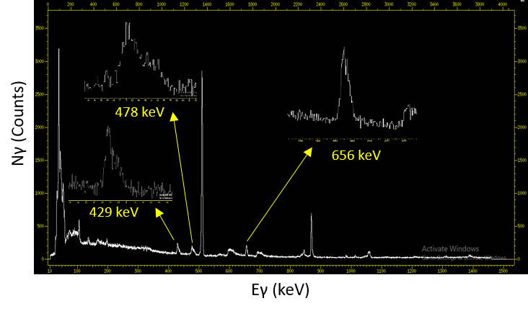

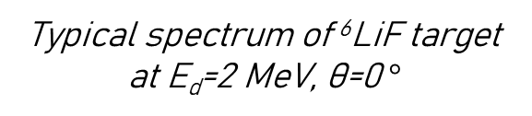
Data Analysis : $N_{d}$ & $Y\left(E,θ\right)$
Number of incident deuterons N_{d}
Beam charge collected with the Faraday cup setup
Uncertainty: $\sim$ 3.5%
Experimental yield Y(E,θ)
Peaks of interest integrated via the Tv code
Statistical uncertainty: < 3%, for all spectrums
Typical spectrum of ⁶LiF target at E_{d}=2 MeV, θ=0$°$

Slide 8
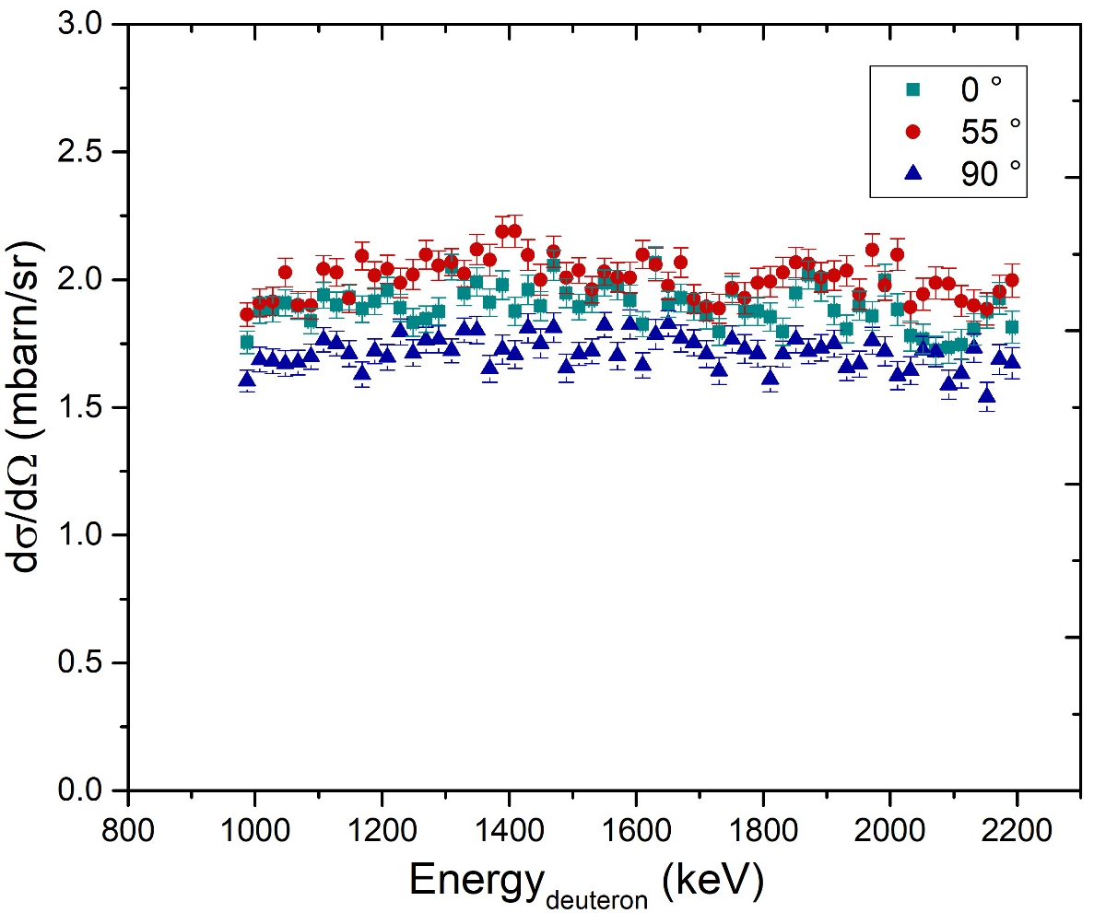
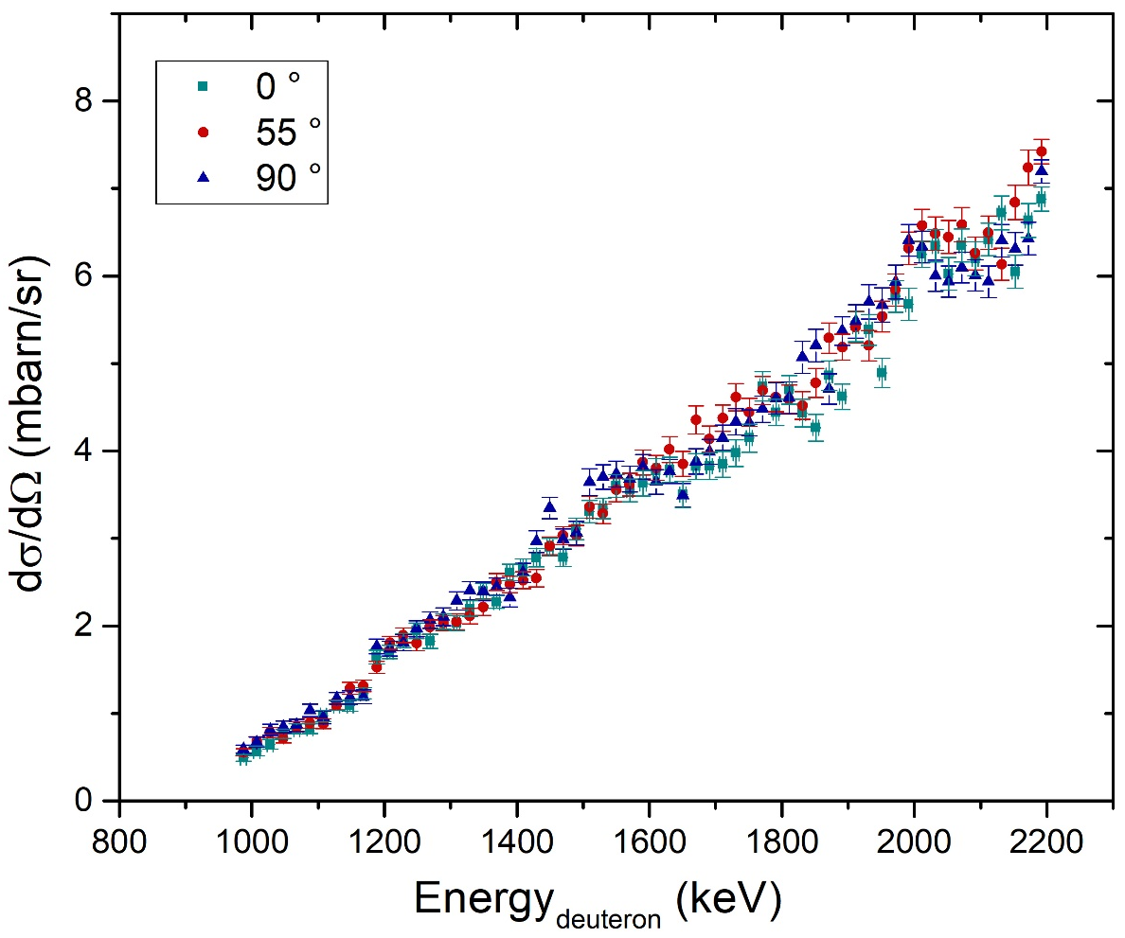
Results: Differential cross sections
⁶Li(d,n’γ₁₋₀)⁷Be Eγ=429 keV
¹⁹F(d,p’γ₁₋₀)²⁰F Ε_{γ}=656 keV
Uncertainties :
Energy : ~ 4.5%
Statistical : ~ 3%, for all spectrums
Total systematic: ~ 9.5% (due to N_{d} , N_{t} & ε_{abs})

Slide 9
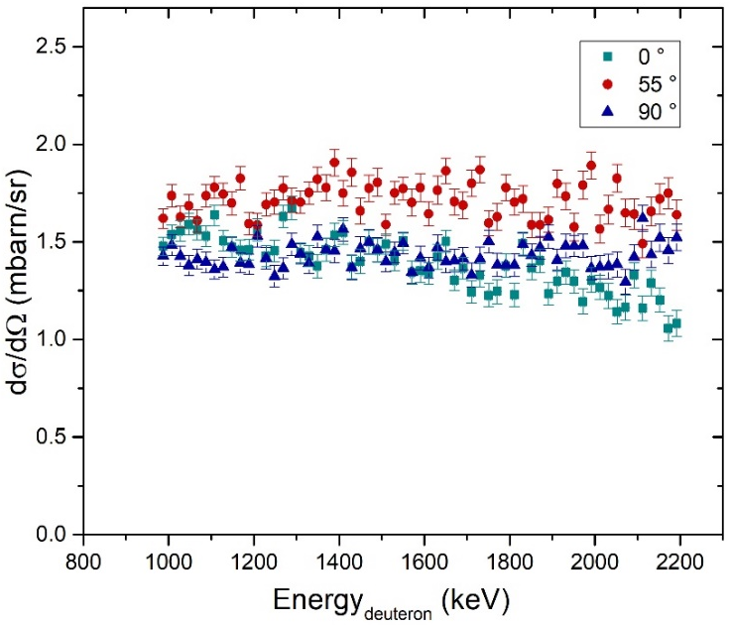
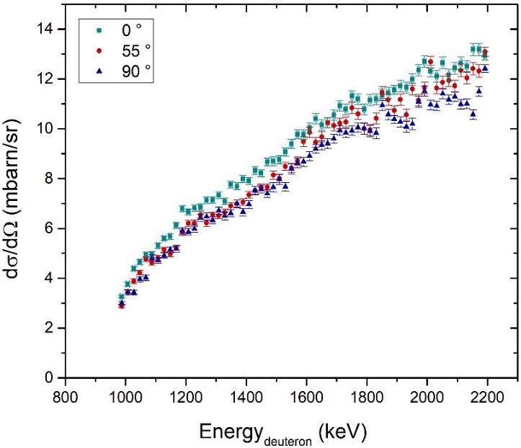

Results : Differential cross sections
The 478 keV case
⁶Li(d,p’γ₁₋₀)⁷Li & ⁷Li(d,d’γ₁₋₀)⁷Li Ε_{γ}=478 keV
Via the absolute measurement formula :
⁶LiF target (5% ⁷Li, 95%⁶Li)
⁶Li(d,p’γ₁₋₀)⁷Be
$$Υ_{6LiF}\left(Ε,θ\right)=\left\{{\left[\frac{dσ\left(Ε,θ\right)}{dΩ}\right]}_{6}∙0.95∙N_{t}^{6LiF}+{\left[\frac{dσ\left(Ε,θ\right)}{dΩ}\right]}_{7}∙0.05∙N_{t}^{6LiF}\right\}∙4π∙ε_{abs}∙N_{p}^{6LiF}$$
^{nat}LiF target (92.5% ⁷Li, 7.5% ⁶Li)
$$Υ_{natLiF}\left(Ε,θ\right)=\left\{{\left[\frac{dσ\left(Ε,θ\right)}{dΩ}\right]}_{6}∙0.075∙N_{t}^{natLiF}+ {\left[\frac{dσ\left(Ε,θ\right)}{dΩ}\right]}_{7}∙0.925∙N_{t}^{natLiF}\right\}∙4π∙ε_{abs}∙N_{p}^{natLiF}$$
⁷Li(d,d’γ₁₋₀)⁷Li
2 equations $⟹$ 2 unknown terms

Slide 10
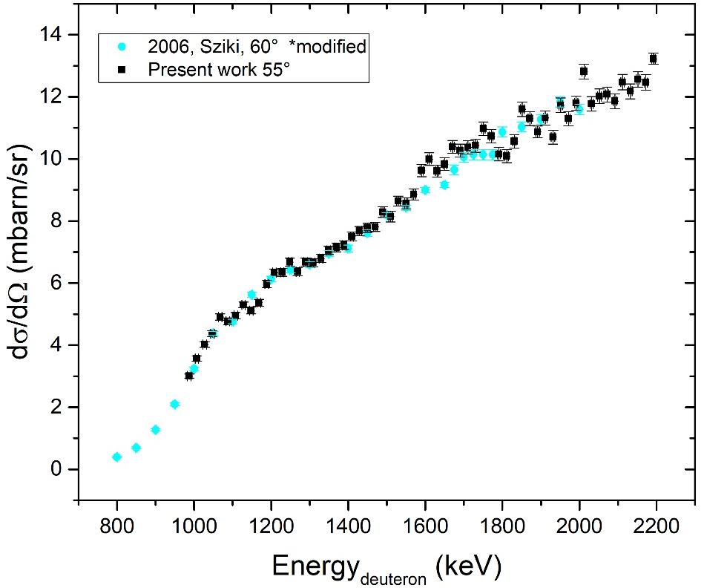
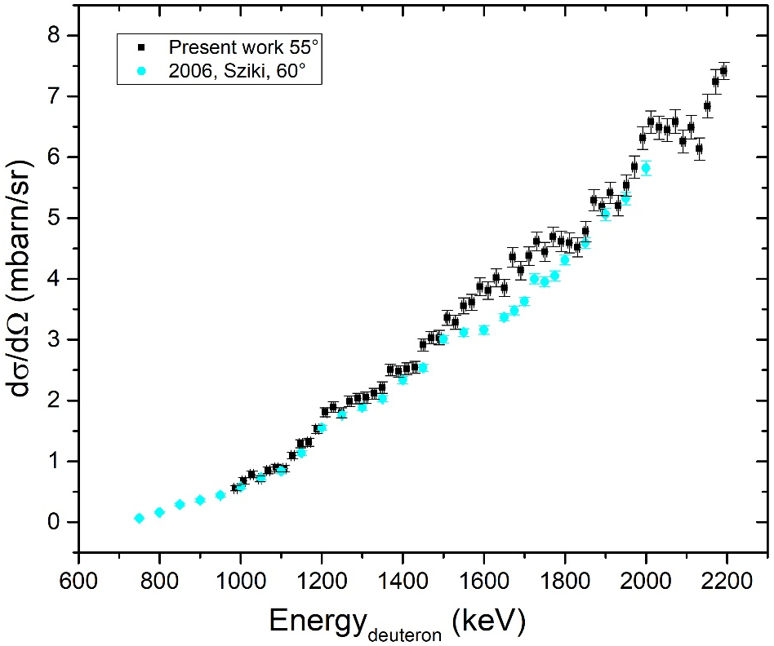
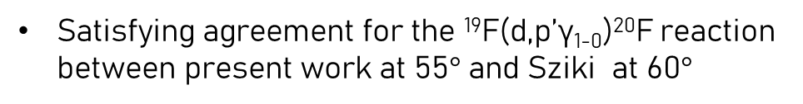
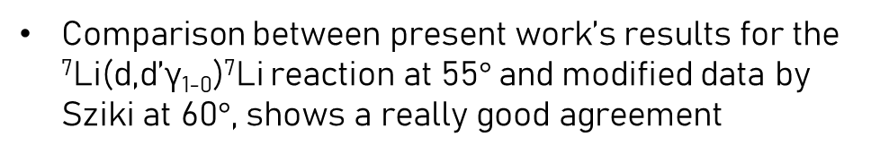
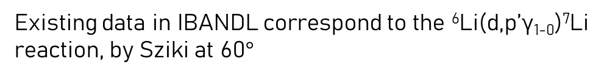

Results: Comparison with literature
Existing data in IBANDL correspond to the ⁶Li(d,p’γ₁₋₀)⁷Li reaction, by Sziki at 60$°$
$$!$$
Looking back in the publication it is clear that the contribution of the ⁷Li(d,d’γ₁₋₀)⁷Li reaction, at the 478 keV peak, has been totally ignored
G.A. Sziki’s data for the ⁷Li(d,d’γ₁₋₀)⁷Li have been modified
⁷Li(d,d’γ₁₋₀)⁷Li
¹⁹F(d,p’γ₁₋₀)²⁰F
Comparison between present work’s results for the ⁷Li(d,d’γ₁₋₀)⁷Li reaction at 55$°$and modified data by Sziki at 60$°$, shows a really good agreement
Satisfying agreement for the ¹⁹F(d,p’γ₁₋₀)²⁰F reaction between present work at 55$°$ and Sziki at 60$°$

Slide 11
Conclusions and Future perspectives
Differential cross section measurements of the ⁶Li(d,n’γ₁₋₀)⁷Be, ⁶Li(d,p’γ₁₋₀)⁷Li, ⁷Li(d,d’γ₁₋₀)⁷Li & ¹⁹F(d,p’γ₁₋₀)²⁰F reactions
Deuteron energy range : 1 MeV – 2.2 MeV, θ=0°, 55°, 90°
Good agreement with existing data for the differential cross sections of the ⁷Li(d,d’γ₁₋₀)⁷Li & ¹⁹F(d,p’γ₁₋₀)²⁰F reactions
Clarification of the 478 keV case
Benchmarking experiment for the validation of the obtained differential cross sections

Slide 12
Thank you for your attention!

