Slide 1

The CMS INPP Group
Members:
Anagnostou | George | Physicist
Assiouras | Panagiotis | PhD student
Daskalakis | George | Physicist
Dizis | Αngelos | ΜsC student
Gotsis | Konstantinos | Student
Kazas | Ιoannis | ΕLE
Kyriakis | Αristoteles | Physicist
Loukas | Dimitrios | Physicist
Papadopouloas | Αlkiviadis | PhD student
Papafilippou | Dimitrios | Student
Stakia | Αnna | PhD student
A. Dizis obtained his MsC degree in 2021

Slide 2


G. Daskalakis
OVERVIEW
DATA : Full RUN-2 ( 2016, 2017, 2018)
13 TeV , 140 fb⁻¹
Published in JHEP
DOI : 10.1007/JHEP07(2021)208
http://dx.doi.org/10.1007/JHEP07(2021)208
EXOTICA: Z'→e⁺e⁻ , μ⁺μ⁻ Searches
TOP: W Helicity measurement
Analysis Ongoing
AN-2019-066
TOP-21-002
HIGGS: ttH (H→bb)
AN-19-097, AN-20-047
ttH (H→bb)
@14 TeV MC only HL-LHC (3000 fb⁻¹)
Analysis Ongoing
AN-2021-166
FTR-21-002

Slide 3
G. Daskalakis
Other activities
ARC Chair for the EXO-19-017 :
“Search for new physics in the lepton plus missing transverse momentum final state”
ARC Chair for the EXO-21-009 :
“Search for new physics in the tau + MET final state (full Run 2)”
Institutional Reviews :
CMS-GEN-17-002 entitled ‘Extraction and validation of a new set of CMS tunes with new color reconnection models in PYTHIA8 from underlying-event measurements’
CMS-TOP-20-001 entitled ‘Differential tt cross sections in the full kinematic range in lepton jets (full Run2)’
66 CMS journal papers in 2021

Slide 4
Acceptance Studies (CMS L1 Trigger Menu team) Anna Stakia
Service Work of Anna Stakia in the CMS “L1 Trigger Menu” group.
GOAL : Study the "acceptance" of L1 Trigger (L1T) seeds wrt High Level Trigger (HLT)
i.e. fraction of events passing an HLT path triggered exclusively by a particular L1 trigger seed, compared to those passing the same HLT path also triggered by other L1 trigger seeds.
Anna contributed in the development of a L1T+HLT acceptance tool :
“Stage 1” Goal: Provide results using NanoAOD samples as input
● fix & test the code,
● develop a streamlined, user-friendly workflow
“Stage 2” Goal: Provide results using L1Ntuples as input
● modify & upgrade the “Stage 1” code for this case
FINISHED & DELIVERED
during 2021
ongoing work
during 2022

Slide 5
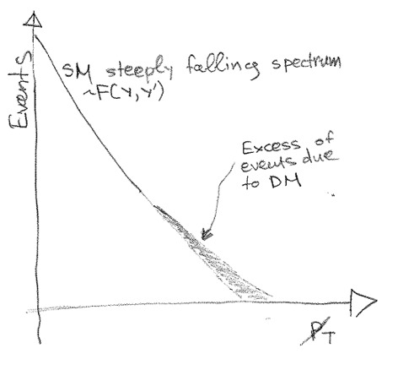

How to search for final states with missing energy @
the LHC?
G. Anagnostou
Discovery with missing energy difficult to be established (tail of a rapidly falling distribution).
Even if established what can we say about the model?
Instead perform bump hunting by reconstructing events with 2 invisible particles
More details on possible applications later:
Search for heavy top partner
Dark matter @ LHC
Dihiggs physics
Toponium (?)
Anagnostou, G. Searching in 2-Dimensional mass space for final states with 2 invisible particles. J. High Energ. Phys. 2021, 112 (2021)

Slide 6


Quality control, radiation studies and simulation of silicon sensors for the Phase-2 upgrade of the CMS Tracker
P. Assiouras, I. Kazas, A. Kyriakis, D. Loukas
National Center of Scientific Research Demokritos Institute of Nuclear and Particle Physics
Detector Instrumentation Laboratory
INPP annual meating 2021
. . . . . . . . . . . . . . . . . . . . . .
. . . . . . . . . . . . . . . . . . . . . .
2022 6 / 15

Slide 7
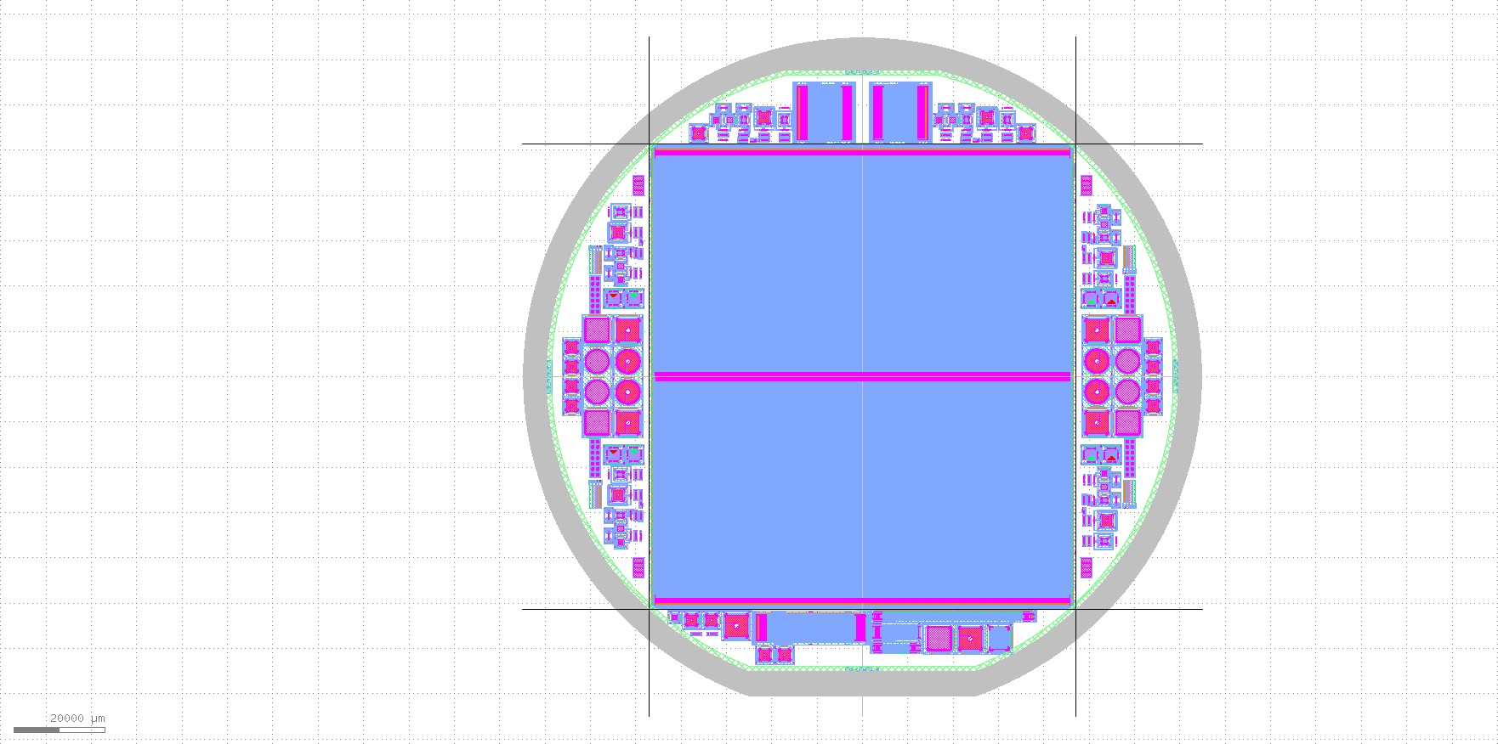
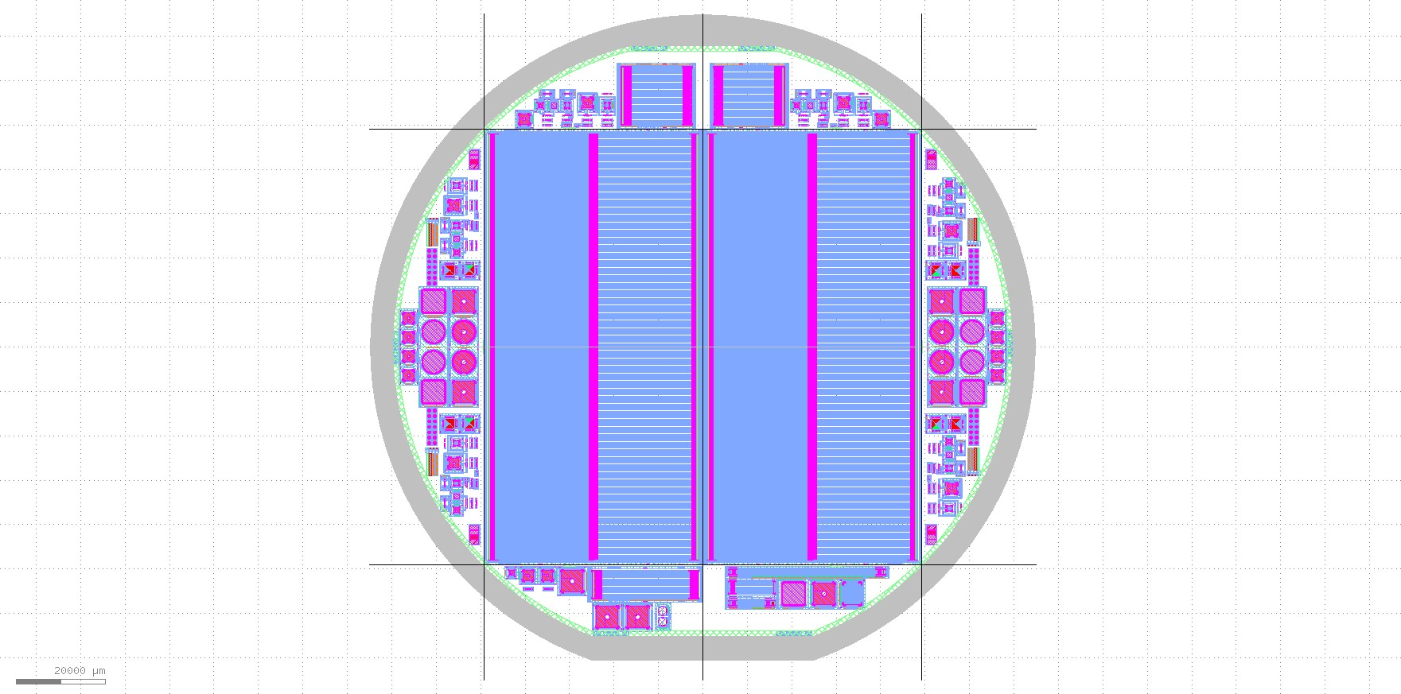
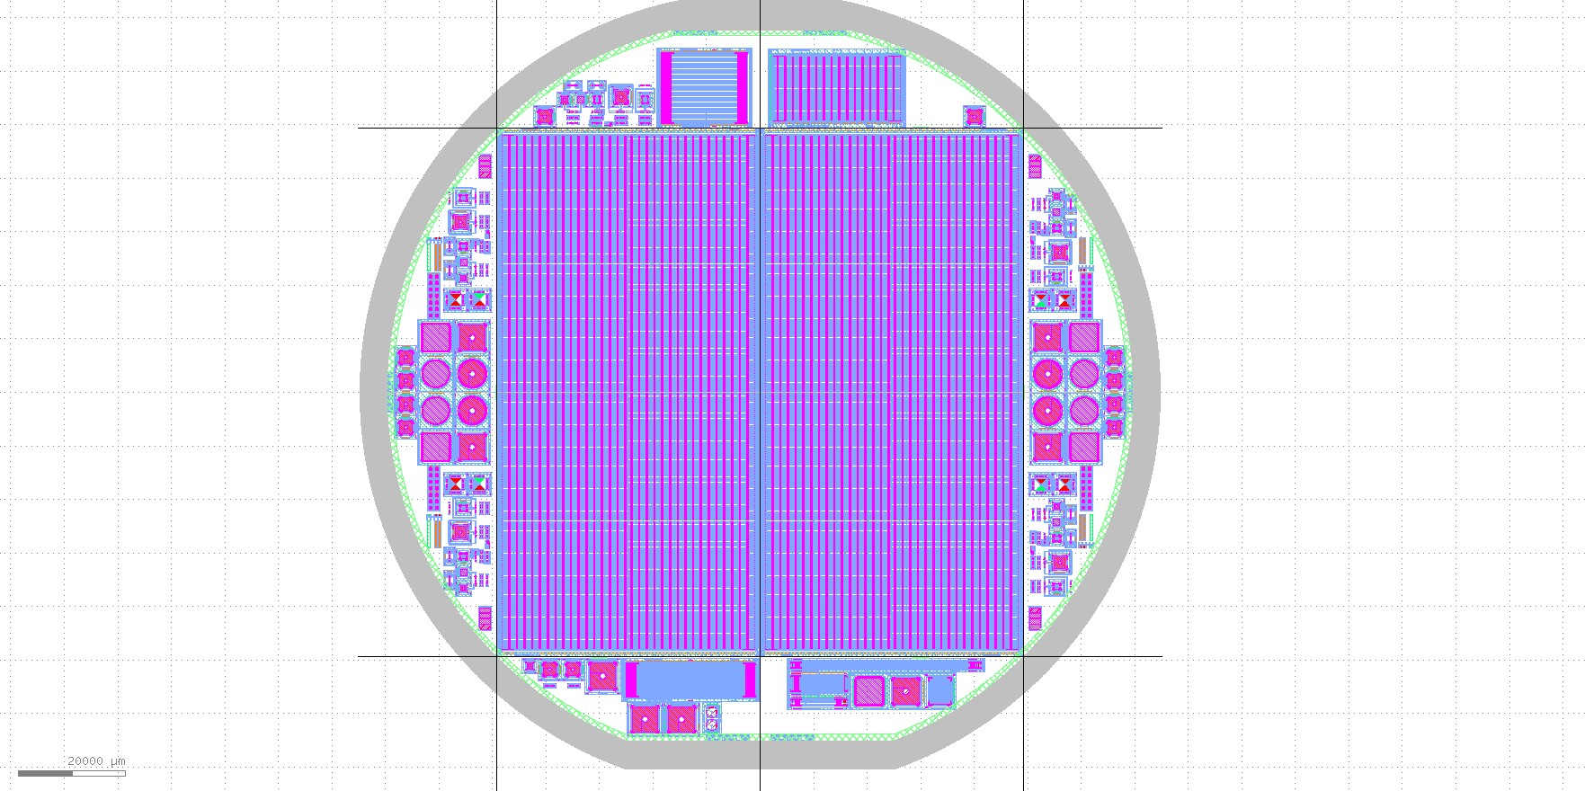
Outer Tracker sensors
Outer Tracker will encompass 200 𝑚²
Consisting of 24000 sensors
Two different modules with three different sensors
2S sensors
″
6 wafers
n-on-p sensors
Float-zone technique Active thickness 290 um
AC coupled with
Poly-silicon biasing
PS-s sensors
″
6 wafers
n-on-p sensors
Float-zone technique Active thickness 290 um
AC coupled with
Poly-silicon biasing
PS-p sensors
″
6 wafers
n-on-p sensors
Float-zone technique Active thickness 290 um
DC coupled
Biased with punch-through structures
Figure: Design of the 2S, PS-s and PS-p wafers ¹
¹GDS files made by Institute of High Energy Physics (HEPHY), Austria
Panagiotis Assiouras (NCSR ”Demokritos”)

Slide 8
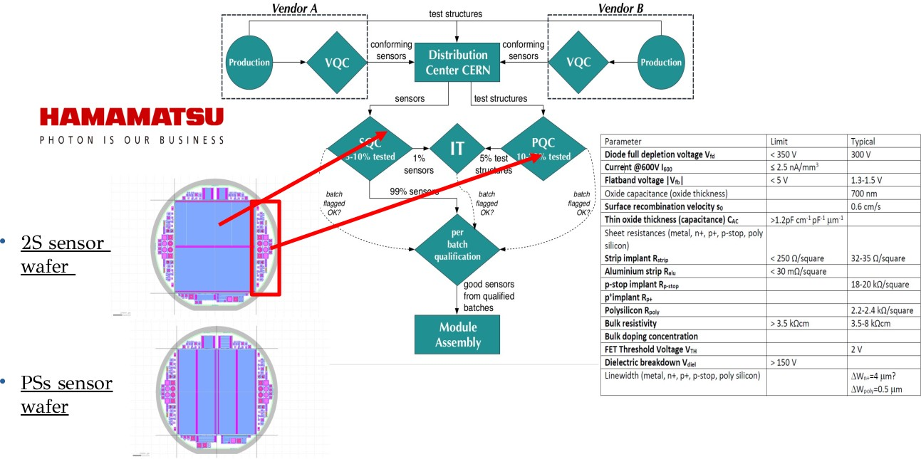
Sensor and process quality control
Sensor quality control
Direct measurement of subset of sensors which will be made into modules
Directly verify that
HPK is producing sensors within our specs
Takes a lot of time.
Less samples in the same batch can be
Irradiation tests
Irradiate mini sensors and test structures from same wafer as diced sensors
Verify that the silicon
will behave within spec after expected radiation doses of HL-LHC
Process quality control
Measurement of test structures located on the same wafer constructed with the same properties as the main sensors, utilizing the empty space on the edges of the wafers.
Verify silicon quality without the
need to handle sensors
Takes less time. More samples in the same batch can be measured
measured.
Panagiotis Assiouras (NCSR ”Demokritos”)

Slide 9
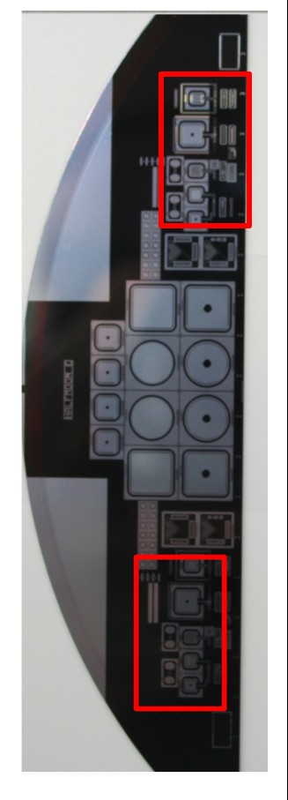
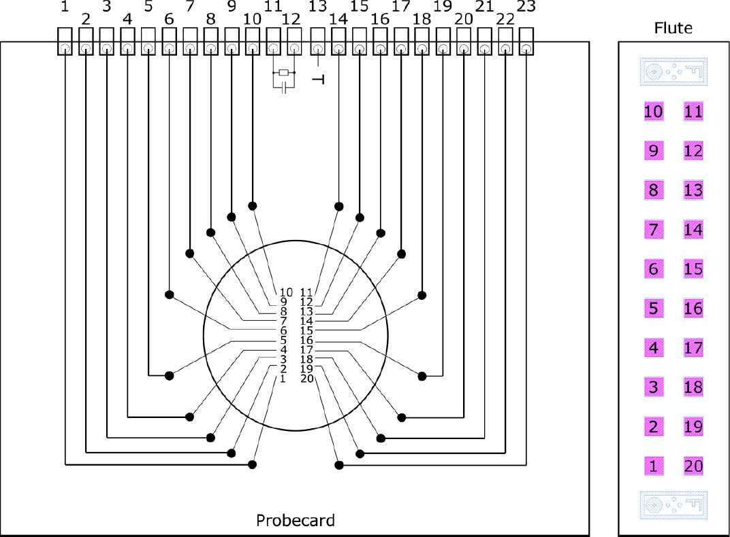
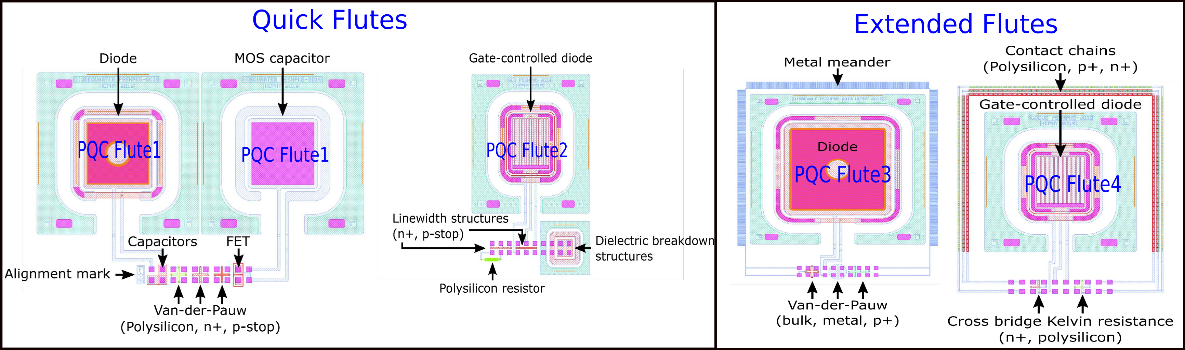
PQC mesurments: Flute structures
Test structures that are arranged around an array
of 20 contact pads, called ”flute”
Automated measurements by using a 20 needle probe card and a switching matrix
Each Half Moon contain 2 sets of 4 flutes in each side. They are separated in
seperated in
Quick Flutes (Quick evaluation of most important parameters. Takes about 30 min)
Flute 1: MOS, VDP (P-stop, n+, Poly), FET
Flute 2: GCD, Rpoly, Diel Breakdown, Linewidth(n+, p-stop)
Extended Flutes (Providing additional parameters. Performed in a smaller number of wafers. Takes about 50 min)
Flute 3: Diodes Half, VDP(Bulk, Edge(p+), Metal(Al)) Flute 4: GCD05, CBKR(n+, Poly)
Additional flute and standard test structures to be contacted with needles.

Slide 10
Irradiation Studies

Slide 11
Μελέτη Ταχύτητας Γένεσης Επιφανειακών Φορέων και Πυκνότητας Παγίδων Διεπιφάνειας στο Πυρίτιο, με Χαρακτηρισμό Διατάξεων Διόδων με Έλεγχο Πύλης (GCD) και Προσομοίωση TCAD
Σ.Ε.Μ.Φ.Ε. Ε.Μ.Π.
Δ.Π.Μ.Σ. «Μικροσυστήματα και Νανοδιατάξεις»
ΔΙΠΛΩΜΑΤΙΚΗ ΕΡΓΑΣΙΑ
του
Άγγελου Β. Δίζη
Επιστημονικός Επιβλέπων:
Παναγιώτης Ασσιούρας
Ακαδημαϊκός Επιβλέπων:
Καθ. Δημήτριος Τσουκαλάς
Τριμελής Επιτροπή:
Καθ. Δημήτριος Τσουκαλάς
Καθ. Θεόδωρος Αλεξόπουλος
Dr. Pascal Normand

Slide 12
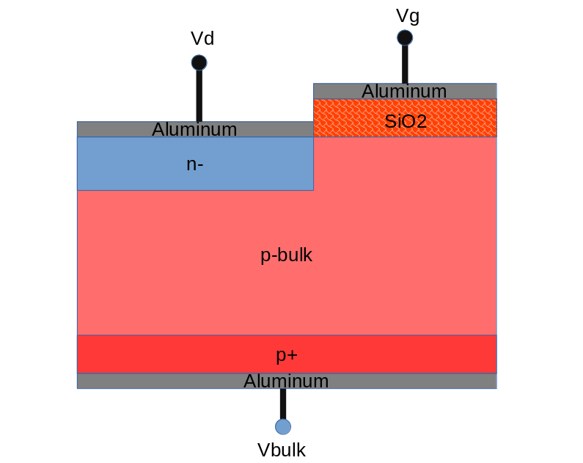
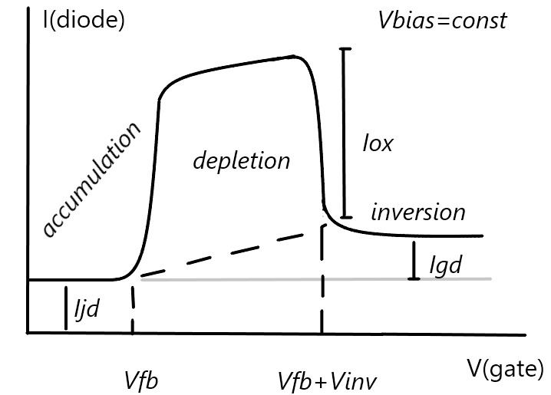
Φυσική-Μετρήσεις GCD
Gate Controlled Diode
Η δίοδος πολώνεται σταθερα σε ανάστροφή
Η τάση gate μεταβάλλεται
Παίρνουμε την καμπύλη Vg-Id
Τρεις περιοχές λειτουργίας σαν το MOS
Συσσώρευση
Απογύμνωση
Αναστροφή
Συσσώρευση:
Ρεύμα Depletion pn
Απογύμνωση
Ρεύμα Depletion pn-Surface-Depletion MOS
Αναστροφή
Ρεύμα Depletion pn-Depletion MOS

Slide 13

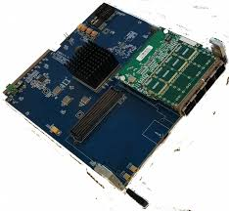
Introduction to uDTC DAQ System
The readout and control of the future front-end modules of the CMS Tracker, will be performed by the DAQ, Trigger and Control (DTC) System.
The μDTC project was established to perform these tasks in the prototyping and production phases.
Common framework for Outer Tracker (OT) and Inner Tracker (IT) based on FC7 board and IPBus* - this presentation focuses mostly on Inner Tracker implementation (IT-μDTC).
Software Suite
Firmware Suite
Hardware
OT: INFL + DESY
IT: Milano + CERN + Demokritos
(A.Papadopoulos)
OT: DESY
IT: Demokritos
(Y.Kazas)
FC7 Board,
Developed by CERN
Demokritos has undertaken the responsibility to develop and maintain the DAQ for the Inner Tracker System Tests
*IPBus: Ethernet-based communication protocol, developed by CERN.
Y. Kazas

Slide 14
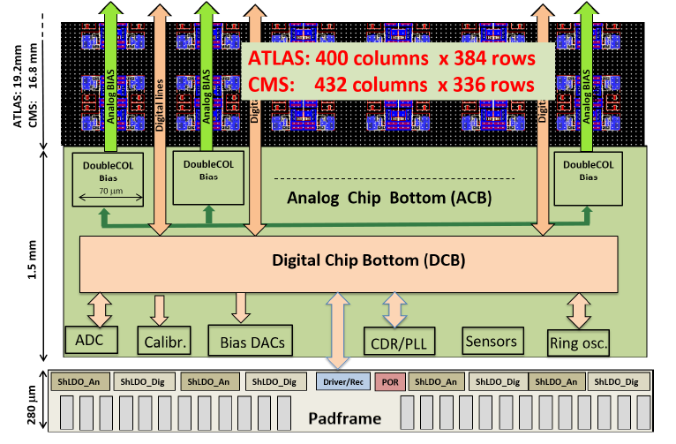
CROC_v1 Characterization
For the new version of the CMS readout chip, Demokritos is leading the team for the characterization of the ASIC.
Pixel Matrix & Analog Front End:
CERN + Demokritos
(A. Papadopoulos)
Analog Chip Bottom:
University of Zurich
Digital Chip Bottom:
Demokritos (Y. Kazas)
Power Supply Circuits:
Universita e INFN, Firenze
Coordinating the team:
Demokritos (Y. Kazas)
Y. Kazas, A. Papadopoulos

Slide 15

Summary and Outlook
Demokritos has undertaken significant responsibilities related to the CMS Phase-2 Upgrade of the Inner Tracker
Development of the DAQ for the prototyping and production stages
  Hardware validation and extensive tool-set for signal integrity studies → X-talk studies, elink characterization, BER tests, eye scans
  Beam Tests and Irradiation Campaigns
  Wafer Probing for production testing of ASIC
  Available framework for co-simulation of DAQ + RTL of past and future chips
Leading the team for the characterization of CROC
  Coordinating groups from CERN, INFN and University of Zurich
Next Steps
  Actively maintain and upgrade the DAQ system
  Conclude with ASIC characterization campaign by Q3 of 2022
  Prepare for next (final) version of CROC and production tests
Y. Kazas, A.Papadopoulois

Slide 17
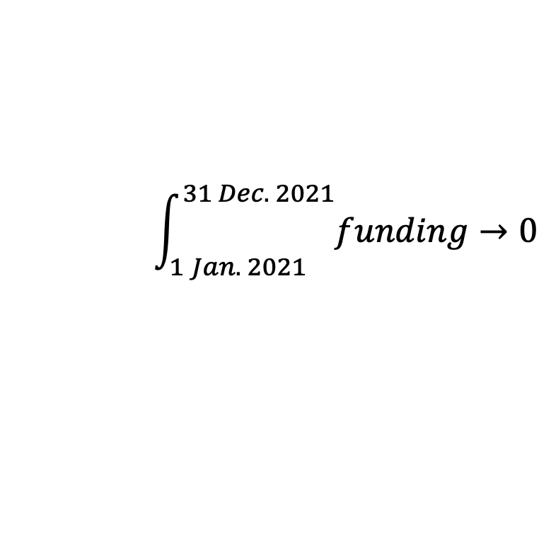
$$\int_{1 Jan. 2021}^{31 Dec. 2021}{funding→0}$$

