Slide 1
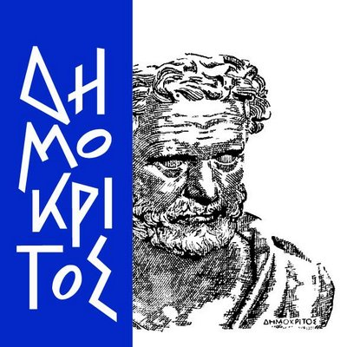
Advanced XRF Tools and Methodologies for the Revisualization of Vanished Ancient Polychrome
Eva Eleftheriou, MSc Student
INPP Annual Meeting, 2021

Slide 2
Introduction
The two research projects
XRF experimental equipment and methodologies
Results
Conclusions

Slide 3
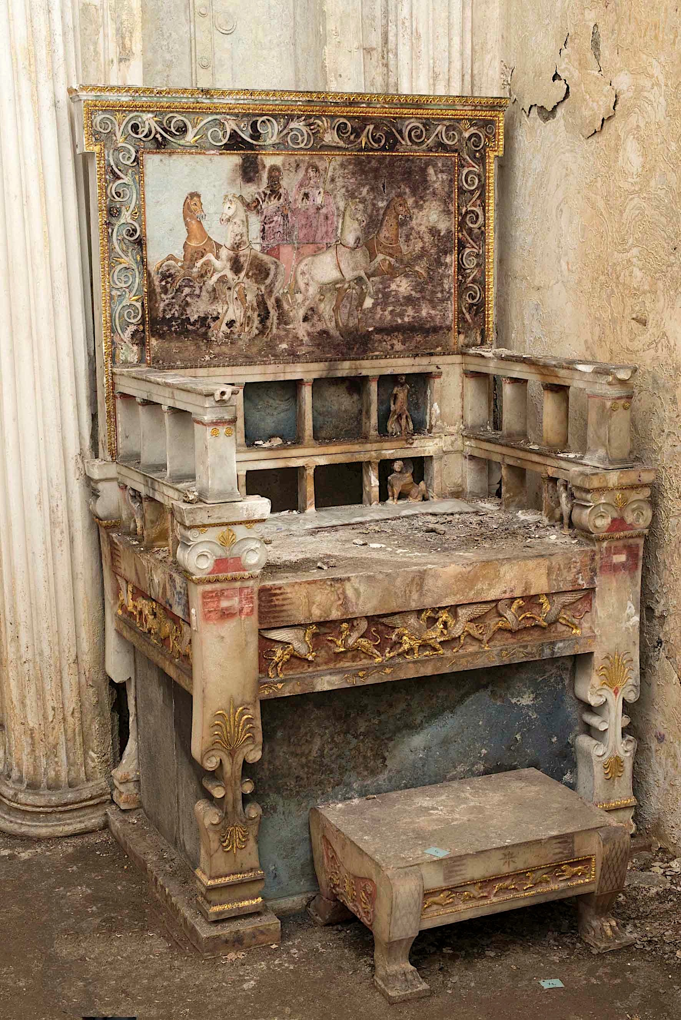
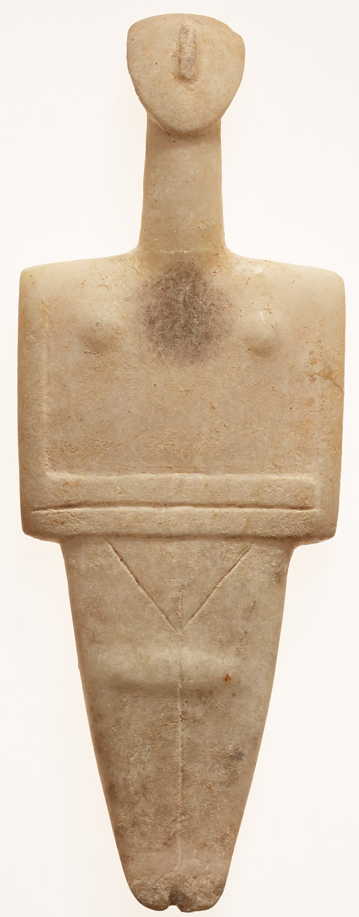
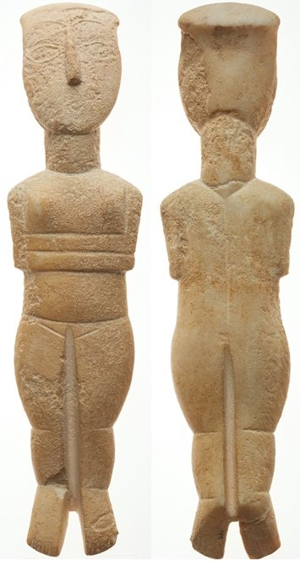
Research Projects
Aim of the research
The marble throne at the tomb of Queen Eurydice I at Aigai
Identification of the pigments used on the throne
Characterization of the throne’s gold leafs
Cycladic Figurines
(National Archaeological Museum, Museum of Cycladic Art)
Investigation of the existence of patterned polychrome on Early Cycladic marble figurines
Characterization of the pigments’ chemical composition
NAM 6165
NG252, MCA

Slide 4
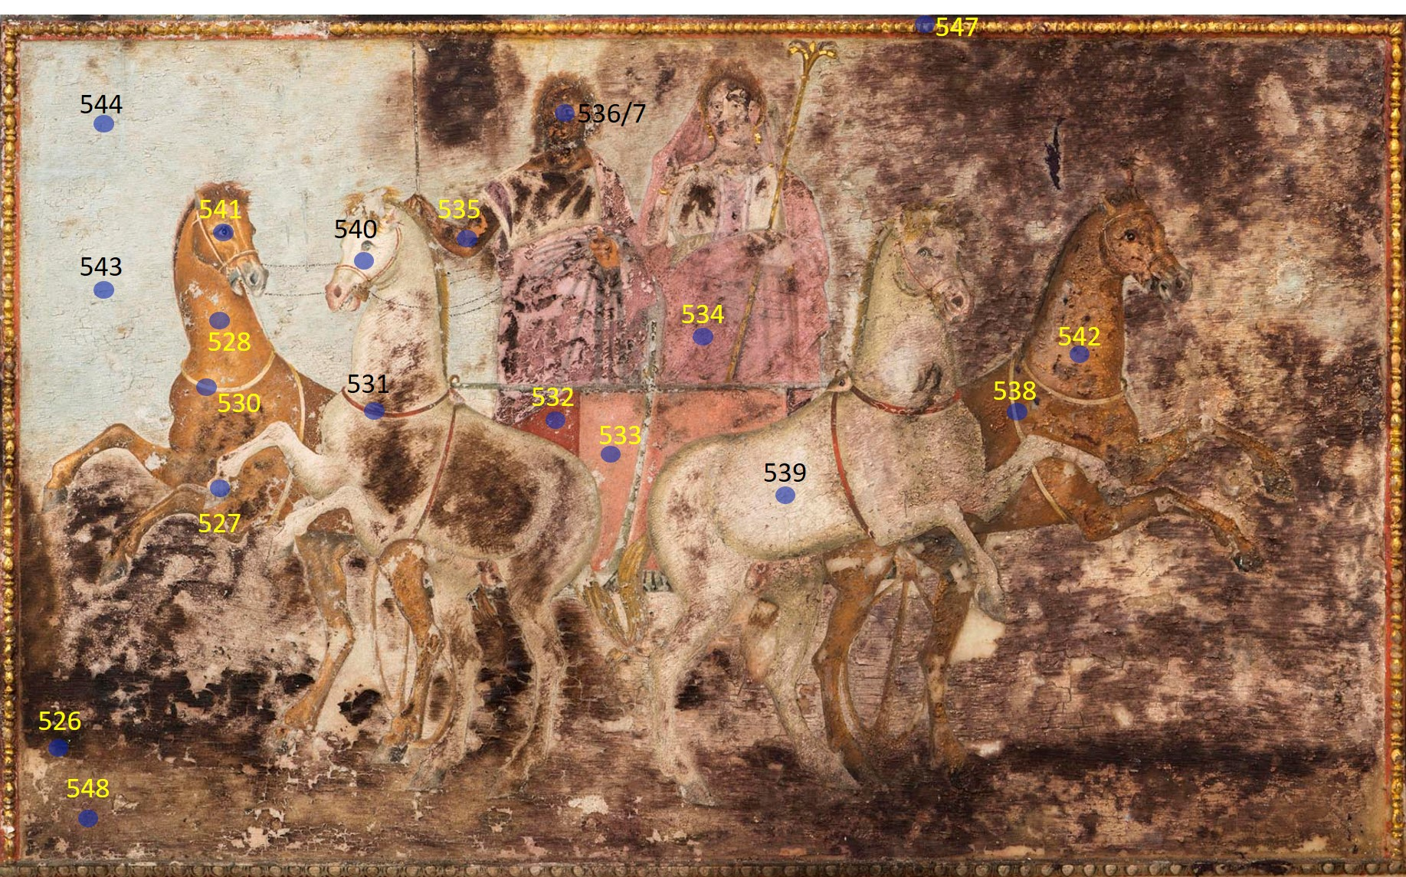
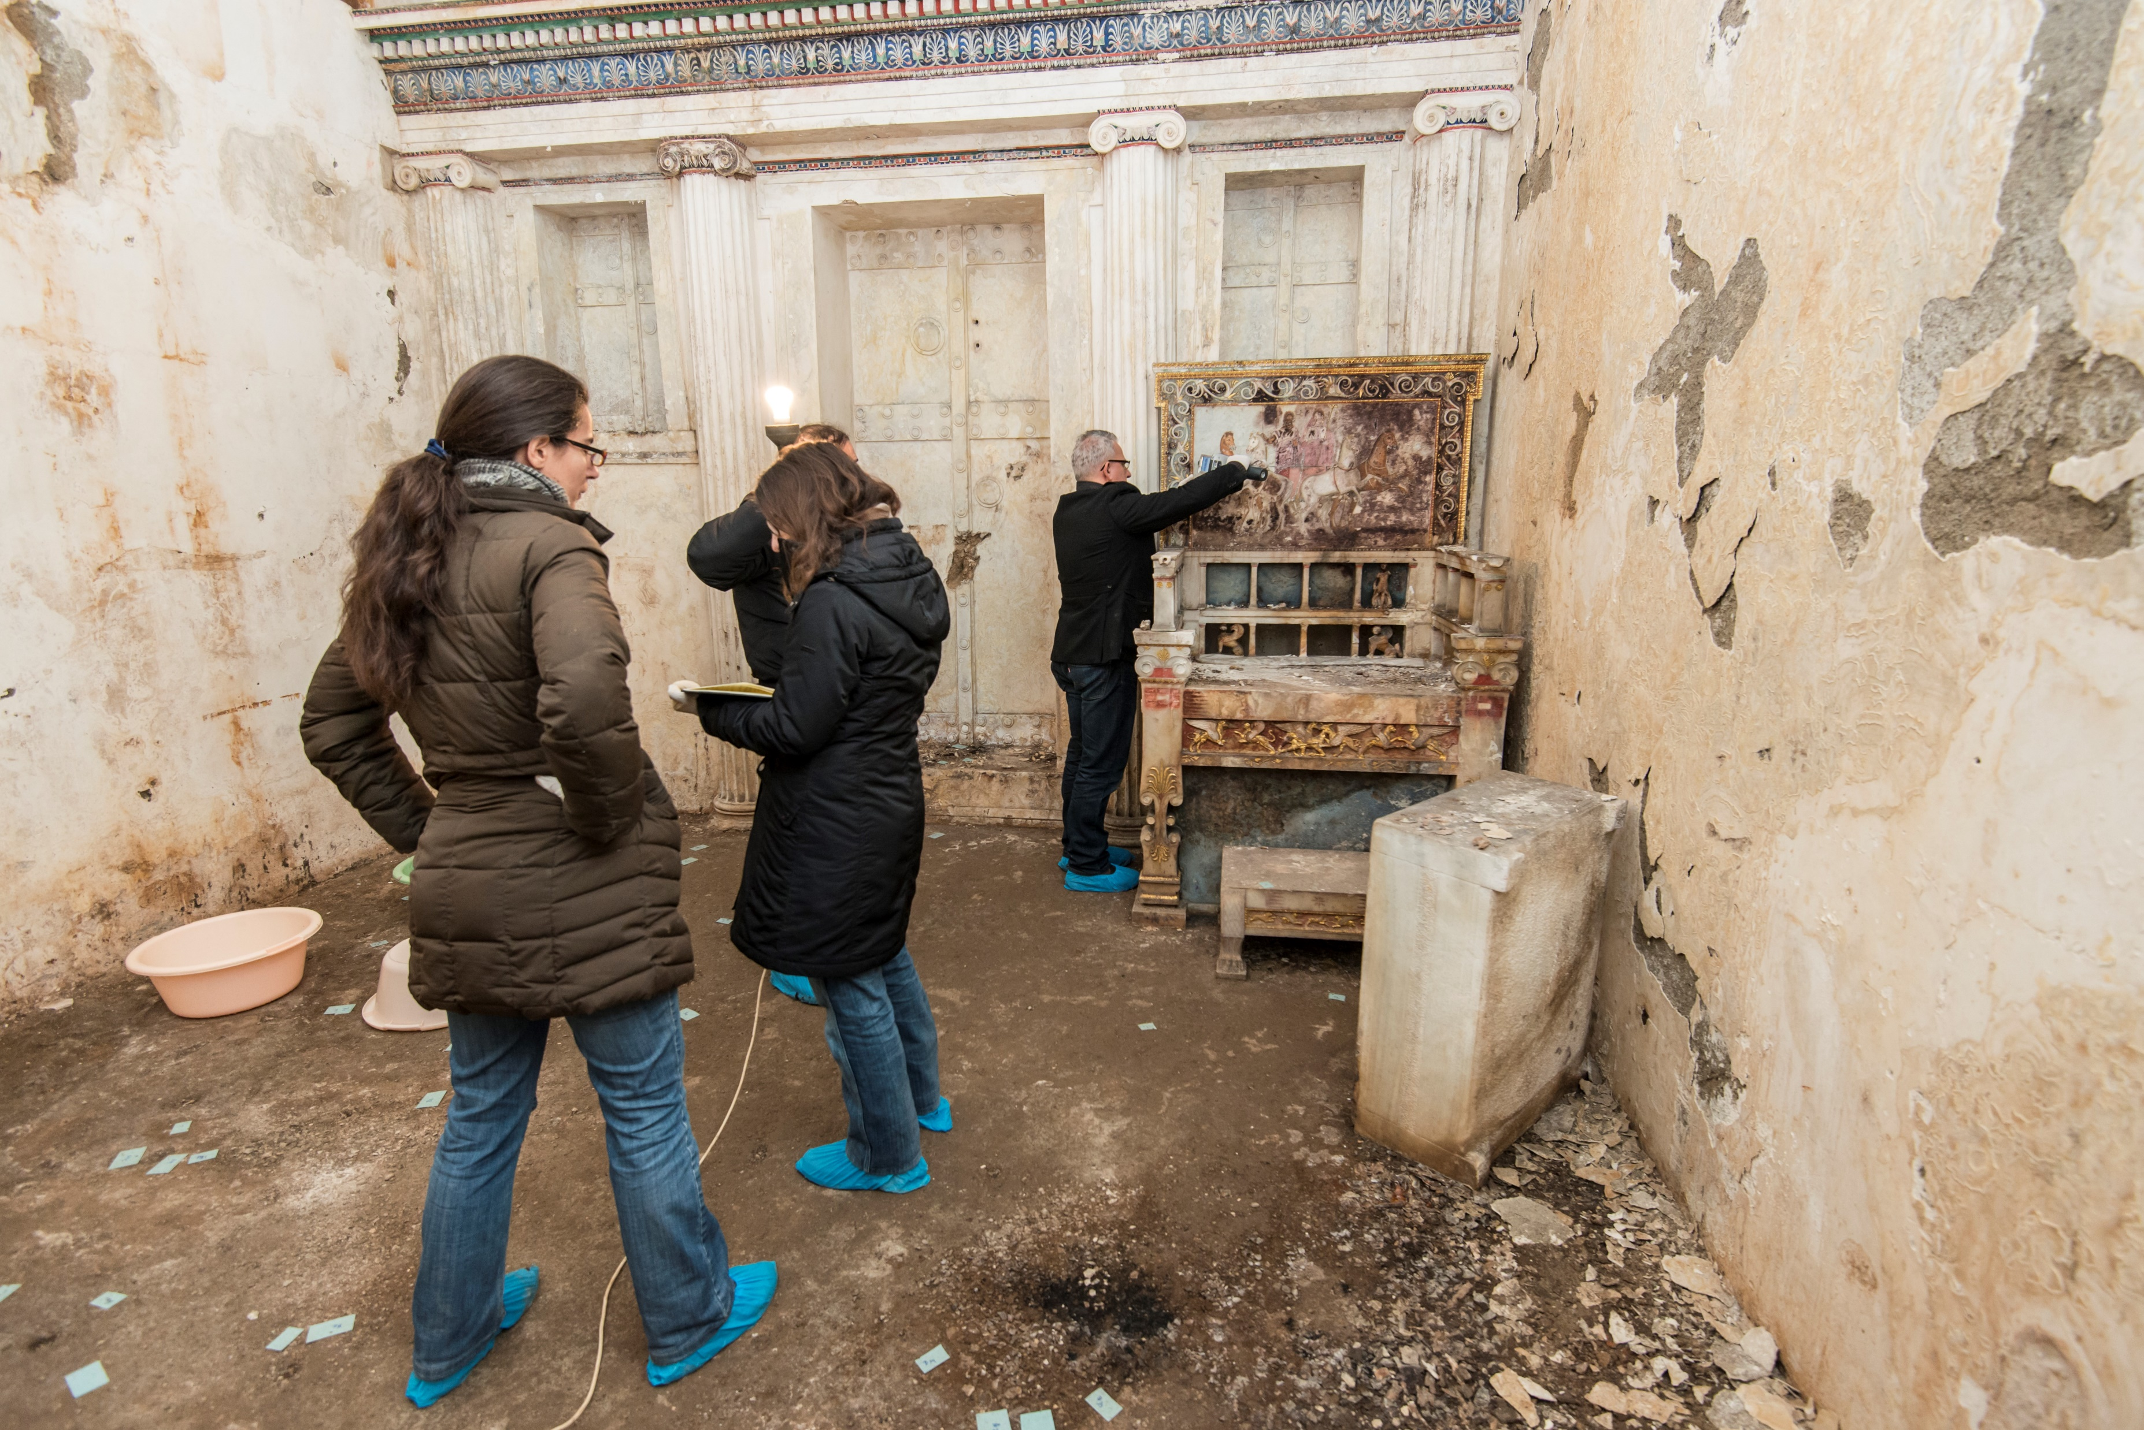

Methods
Handheld XRF Spot Analysis of the marble throne
29 selected spots of interest (dark blue area at the front bottom, right side & painted panel)
Two measurement conditions: 50 kV, 40 μA (Main)
8 kV, 200 μA (Light)
About 20 sec per measurement
HH-XRF analyzer (Niton XL3t GOLDD+)
Ag-target X-ray transmission tube
50 kV max voltage & 200 μA max current
SDD 30 mm2 active area
Energy resolution 178 eV at 5.9 keV
Offers different excitation conditions for elemental sensitivity optimization
Choice of spot size (3 mm / 8 mm)
Spot #532

Slide 5
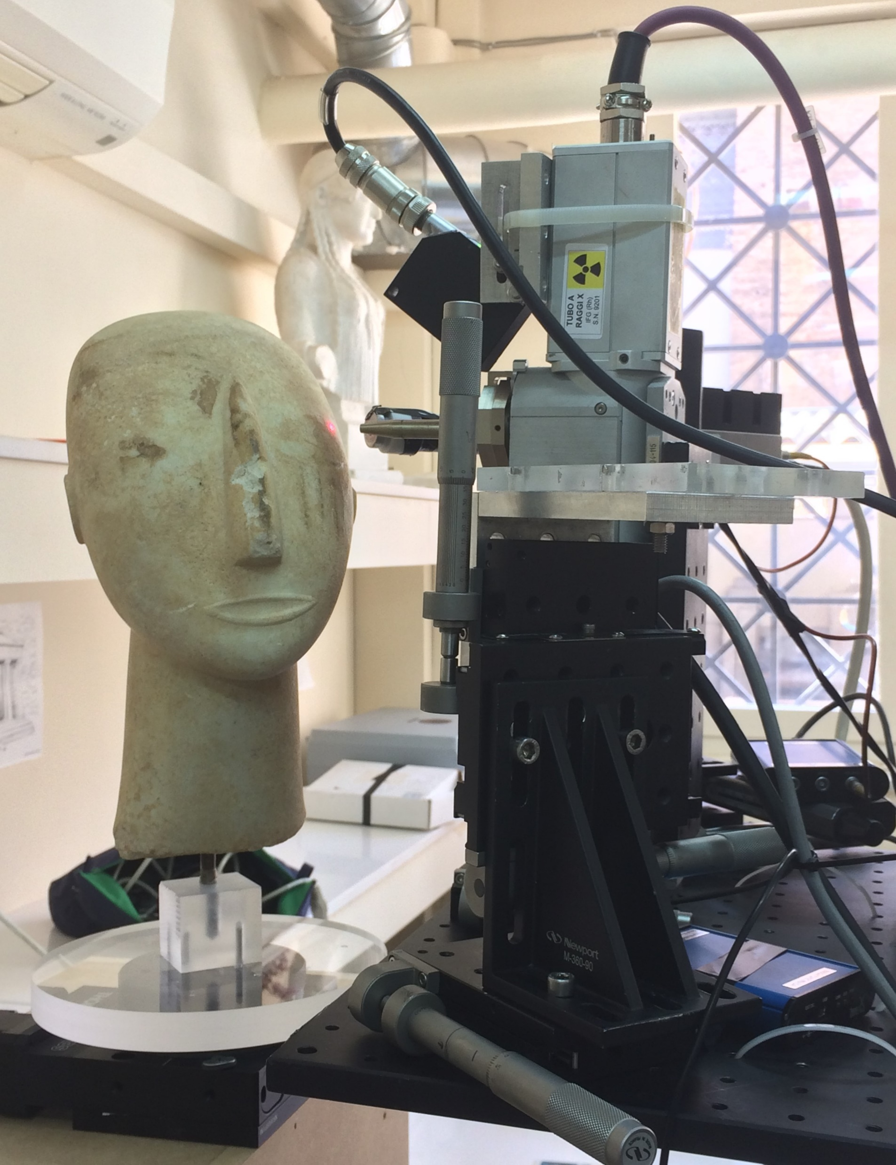
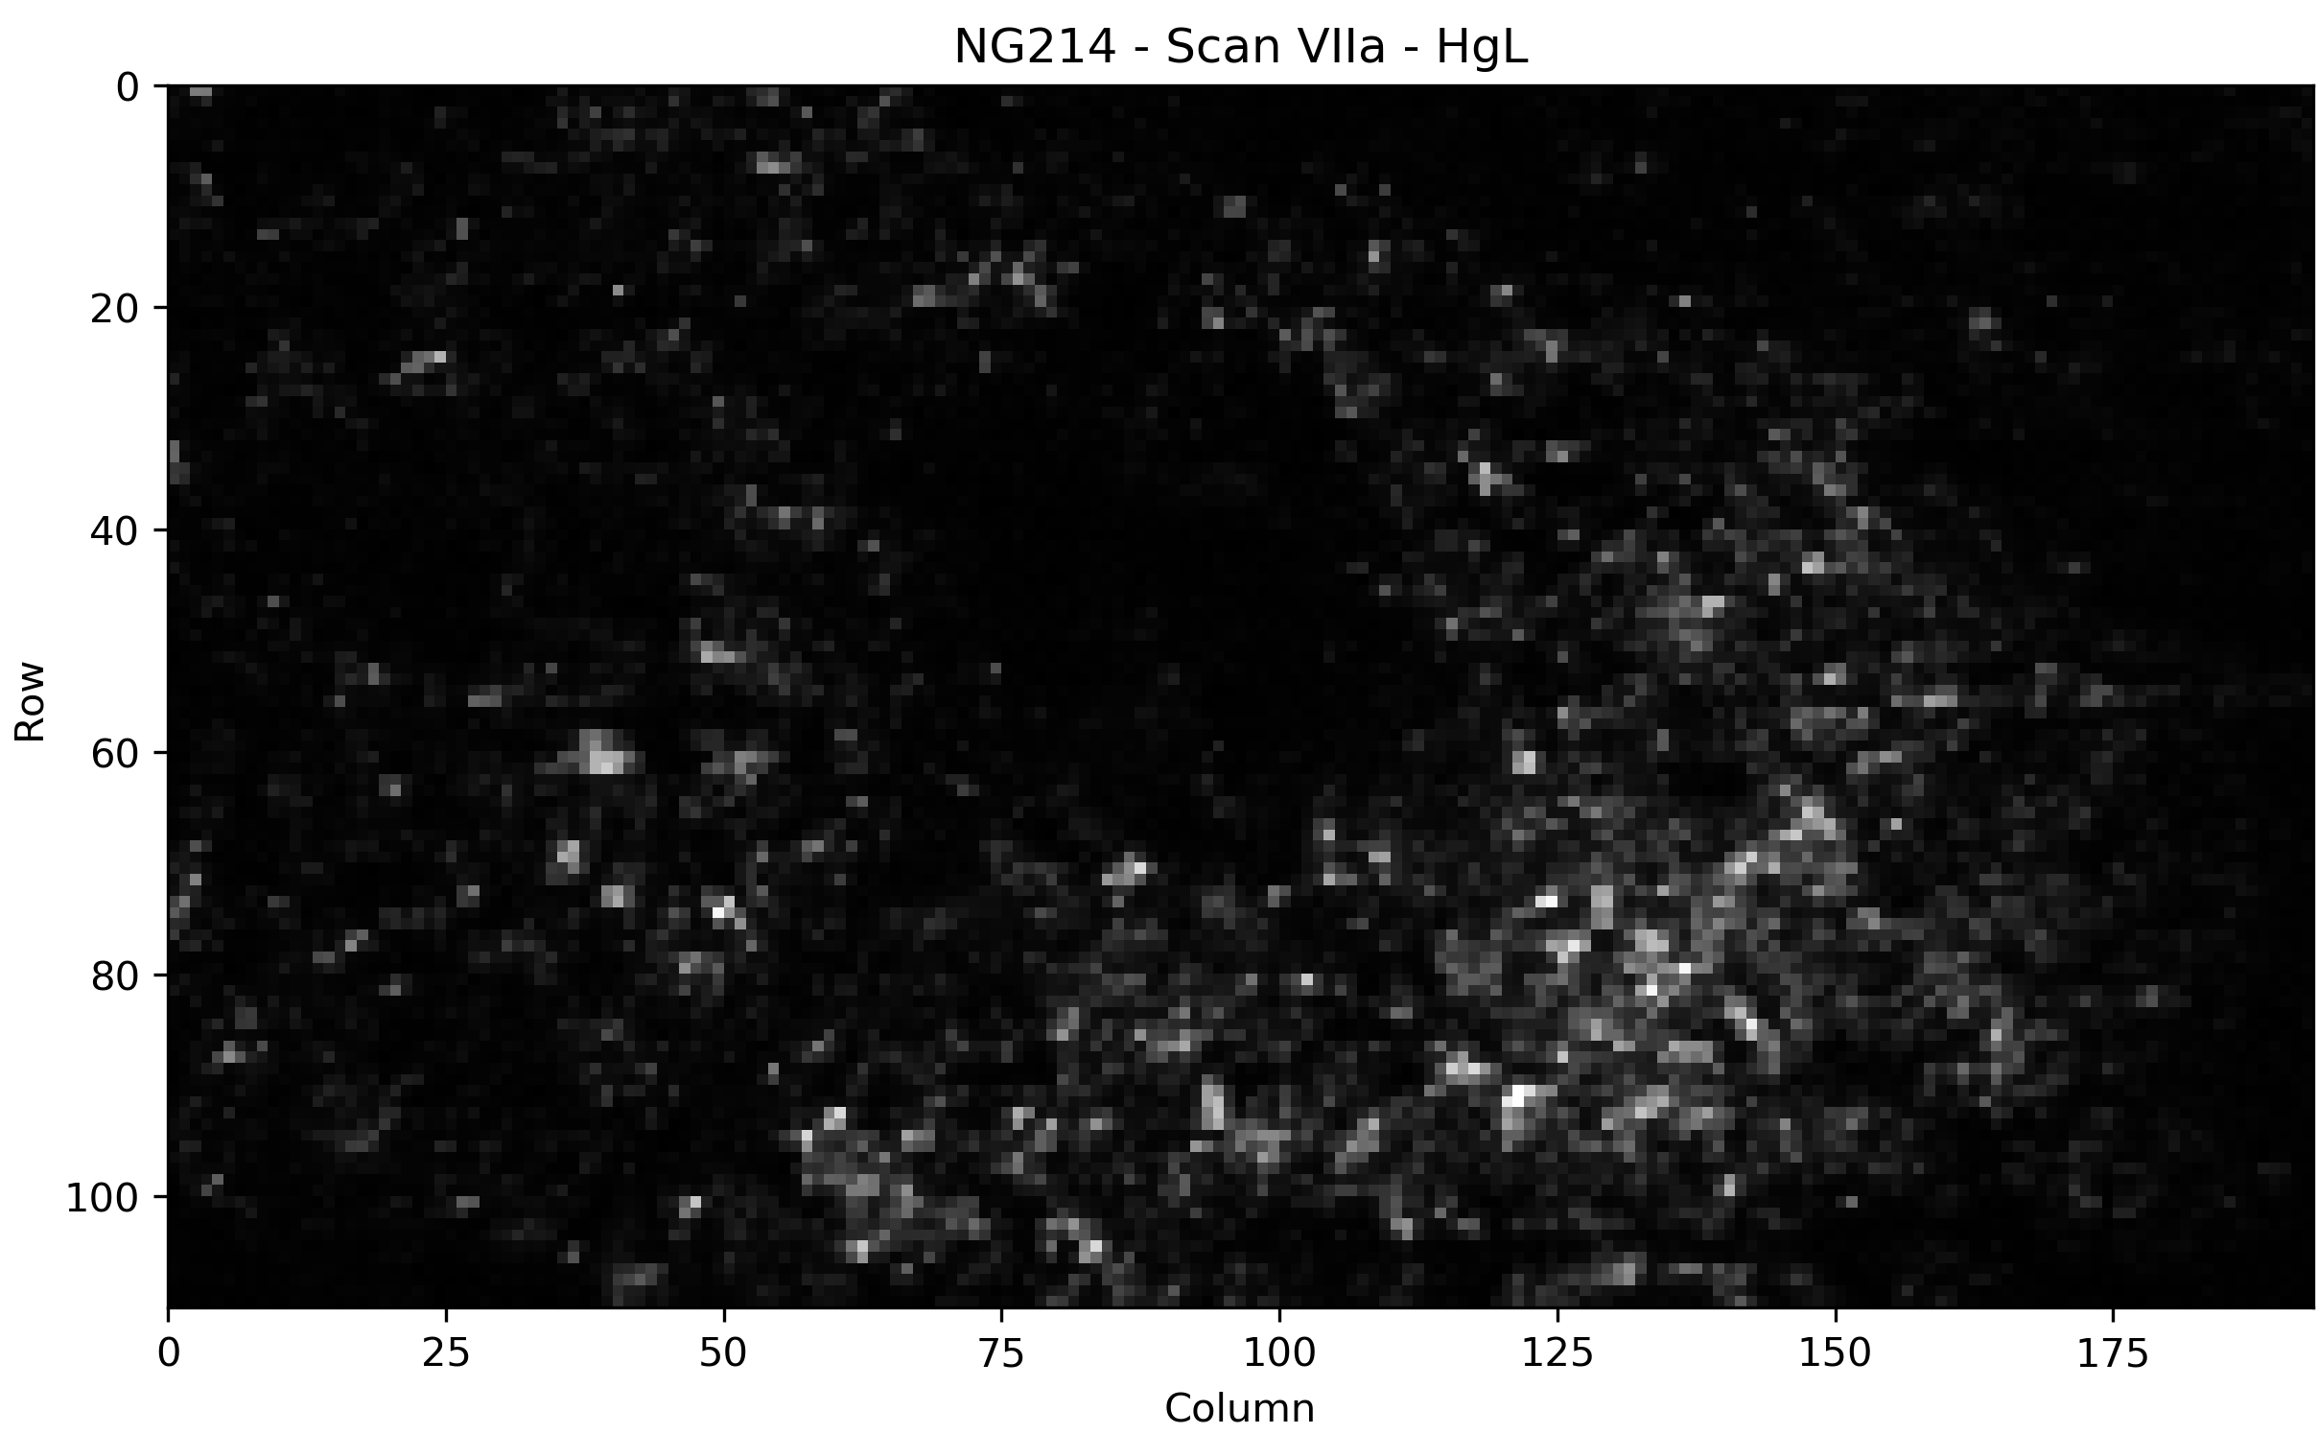
Methods
Macro-XRF Imaging of the Cycladic Figurines
The MA-XRF Imaging Technique
LANDIS-X Scanner
Non-invasive
Detailed mapping of the elemental distribution of samples
Capability of visualizing the distribution of chemical elements on the entire surface in images of easy understanding and interpretation
30W Rh-target X-ray tube coupled to a polycapillary lens
26μm spot diameter at Rh Kα-line, 1cm focus distance
two 50 mm2 active area SDDs
energy resolution 133eV at 5.9keV
time-list event mode
Two digital X-ray Processors
DSP with 40ns time resolution
3-axis fast scanner
30 scans on coloured areas from 14 figurines and vessels
Unfiltered 40kV excitation at 400μA
NAM3909

Slide 6
Results
The marble throne
Identified pigments: cinnabar, HgS
iron-based ochres, FexOy
Egyptian blue, CaCuSi₄O₁₀
lead white, 2PbCO3·Pb(OH)2
murex purple, C16H8Br2N2O2
Gold leafs analysis – Thickness estimation using the Au Lα/Lβ intensity ratios
Gold leafs on marble throne
XRF Reading | Thickness(μm) | Live time (s) | Current (μA) | Lα | Lβ | Lα/Lβ | σ(Lα/Lβ)
519 | 1.08 | 11.22 | 40.04 | 6057.57 | 5607.70 | 1.08 | 0.02
547 | 0.76 | 20.59 | 39.98 | 21772.10 | 19718.50 | 1.10 | 0.01
IAEA Reference Gold foils
Thickness (μm) | Lα/Lβ | σ(La/Lb)
0.0238 | 1.155 | 0.011
0.162 | 1.130 | 0.002
1.1 | 1.055 | 0.002
2.2 | 1.020 | 0.002
3.3 | 0.989 | 0.001
3.58 | 0.982 | 0.001
5.4 | 0.935 | 0.001
6.5 | 0.909 | 0.001
7.2 | 0.902 | 0.001
7.89 | 0.886 | 0.001
19.6 | 0.811 | 0.001
39.2 | 0.799 | 0.001

Slide 7
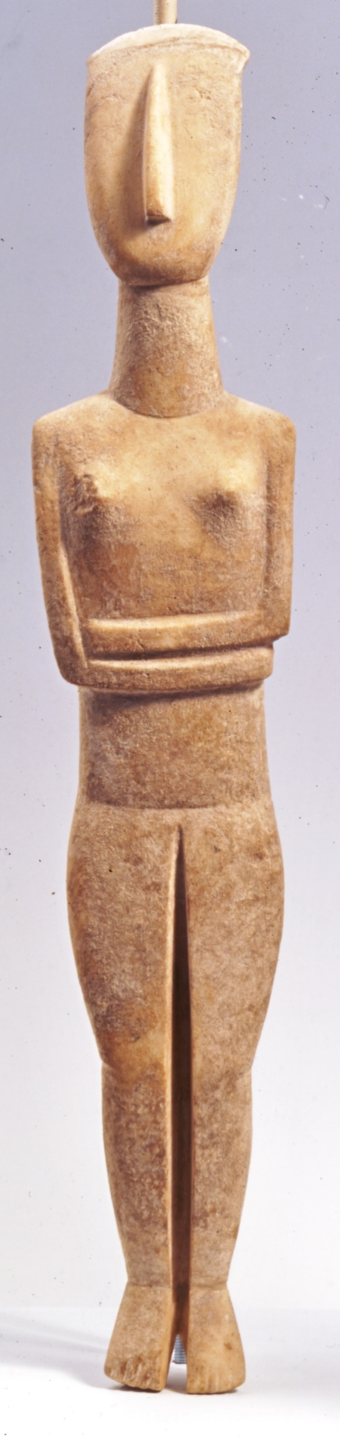


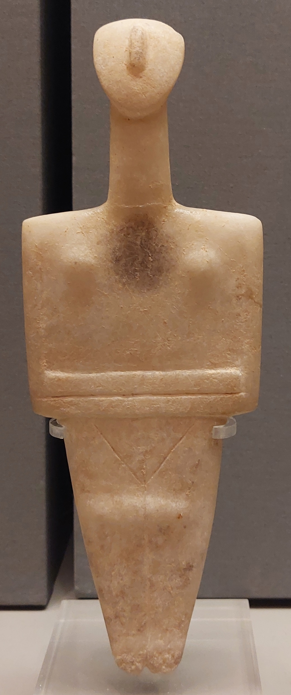
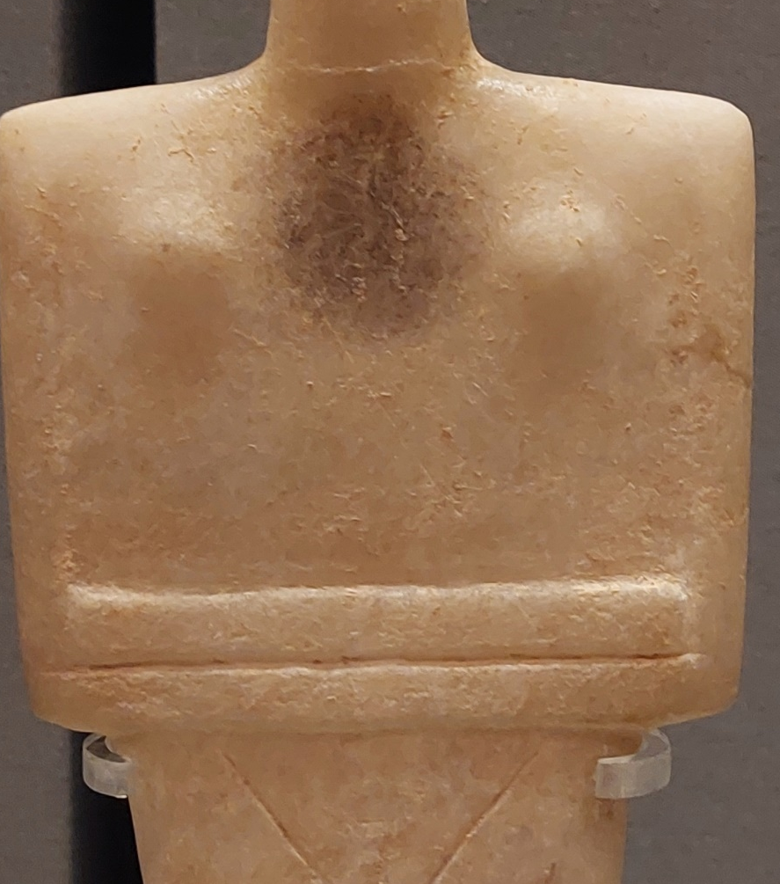
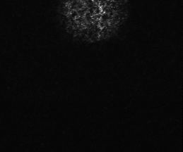
Results
Cycladic Figurines
Detection of an arsenic-based pigment; orpiment (As₂S₃) or realgar (As₄S₄).
Earliest occurrence in Greek polychrome!
As
NG304, MCA
Identification of degraded cinnabar (HgS).
Phase transition to metacinnabar (α’-HgS)
(R. Nöller, 2015, Birtacha, 2016)
Conversion into corderoite (Hg₃S₂Cl₂)
(Da Pieve et al., 2013)
Hg
6165, NAM

Slide 8
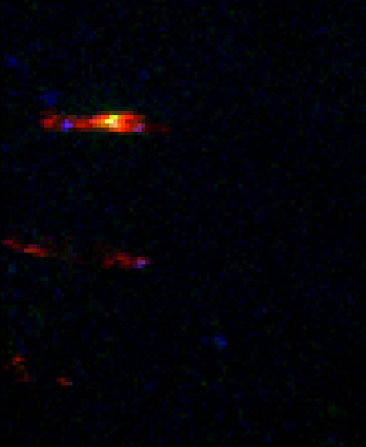


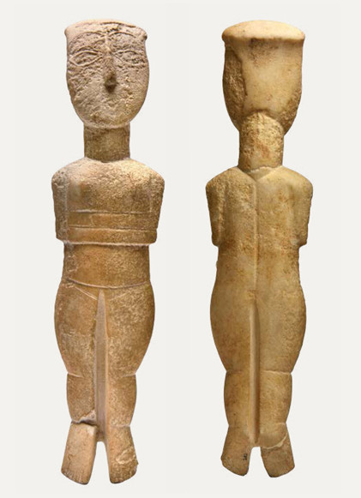
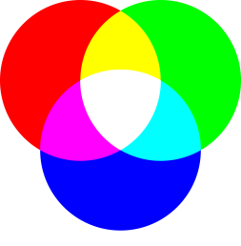


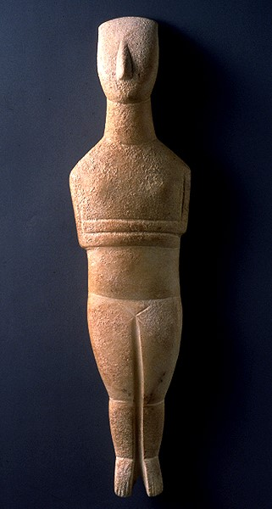
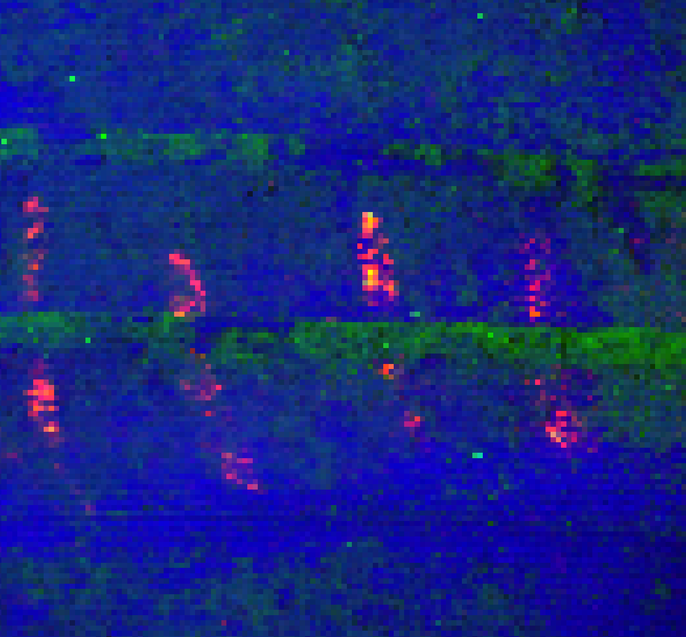
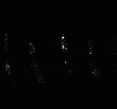
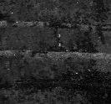
Results
Cycladic Figurines
Evidence of mixing of pigments or forming
a paint layer stratigraphy!
Hg
Pb
Mn
Hg
Pb
Mixing or overpainting of cinnabar (HgS), lead white (Pb-2PbCO₃·Pb (OH)₂) and umber (Fe₂O₃·MnO₂)
Fe
Mn
NG252, MCA
NG251, MCA
Hg
Fe
Ca
Mixing or overpainting of cinnabar (HgS) and red ochre
Hg
Fe

Slide 9

Results
Monte Carlo Simulations
Concentration estimation for gold leaf #547: 86.63% Au, 9.33% Ag, 4.04% Cu
Gold leaf thickness determined at 0.7 μm via MCS - 8% difference with the one calculated via the Au Lα/Lβ ratios
Simulated stratigraphy for #547
0.7 μm Gold leaf layer
Spot #547
0.16 μm Cinnabar layer
1.75 μm Red ochre layer
5 cm Marble layer

Slide 10
Conclusions
Pigments identified by HH-XRF on the marble throne:
Cinnabar (HgS)
Iron-based ochres (Fe_{x}O_{y})
Lead white (2PbCO3·Pb(OH)2)
Possible identification of organic Murex purple (C₁₆H₈Br₂N₂O₂)
Egyptian blue (CaCuSi₄O₁₀)
Determination of the gold leafs’ thicknesses at
1.08 μm & 0.76 μm via the Au Lα/Lβ ratios
MC Simulations suggest gold leaf concentrations at
88.88% Au, 10.32% Ag, 0.80% Cu, 0.4 μm thick
86.63% Au, 9.33% Ag, 4.04% Cu, 0.7 μm thick
Pigments identified by MA-XRF imaging of Cycladic Figurines and Vessels:
Cinnabar (6/11 Figurines, 1/3 Vessels)
Iron-based ochre (3/11 Figurines, 3/3 Vessels)
Lead white (3/12 Figurines, 1/3 Vessels)
Possible identification of Murex purple (1/3 Vessels)
Umber (Fe₂O₃·MnO₂) (4/11 Figurines, 1/3 Vessels)
Orpiment (As₂S₃) or Realgar (As₄S₄) (1/11 Figurines)
Contaminants: Lithopone (BaSO₄∙ZnS) (2/11 Figurines)
Indication that various pigments (cinnabar, lead white, umbra and iron-based ochre) were not only applied as single paint layers, but also by following a more complex elaboration (mixing or forming a paint layer stratigraphy)

Slide 11
Collaborators
Dr. Hariclia Brecoulaki, archaeologist
Dr. Claudia Caliri, Dr. Fransesco Paolo Romano, Kalliopi Tsampa, Dr. Sofia Sotiropoulou, Dr. Andreas G. Karydas
Dr. Katia Manteli, curator of the Collection of Prehistoric Antiquities of the National Archaeological Museum
Dr. Nikolas Papadimitriou, curator of Cycladic and Ancient Greek Art Collections of the Museum of Cycladic Art
Dr. Kiki Birtacha, archaeologist

Slide 12
Thank you for your attention!

