Slide 1


National Technical University of Athens
School of Applied Sciences
Department of Physics
N.C.S.R. “Demokritos”
Nuclear and Particle Physics Institute
Tandem Accelerator Laboratory
Differential cross section measurements of the ⁷Li (p,p’γ₁₋₀) ⁷Li reaction suitable for PIGE applications
Ziagkova Anastasia
Collaborators:
M. Axiotis², S. Harissopoulos², M. Kokkoris¹, A. Lagoyannis², F. Maragkos¹, E. Ntemou^{1,2}
¹Department of Physics, National Technical University of Athens, Zografou campus, 15780 Athens, Greece
²Tandem Accelerator Laboratory, Institute of Nuclear and Particle Physics, N.C.S.R. “Demokritos”, Aghia Paraskevi, 15310 Athens, Greece

Slide 2
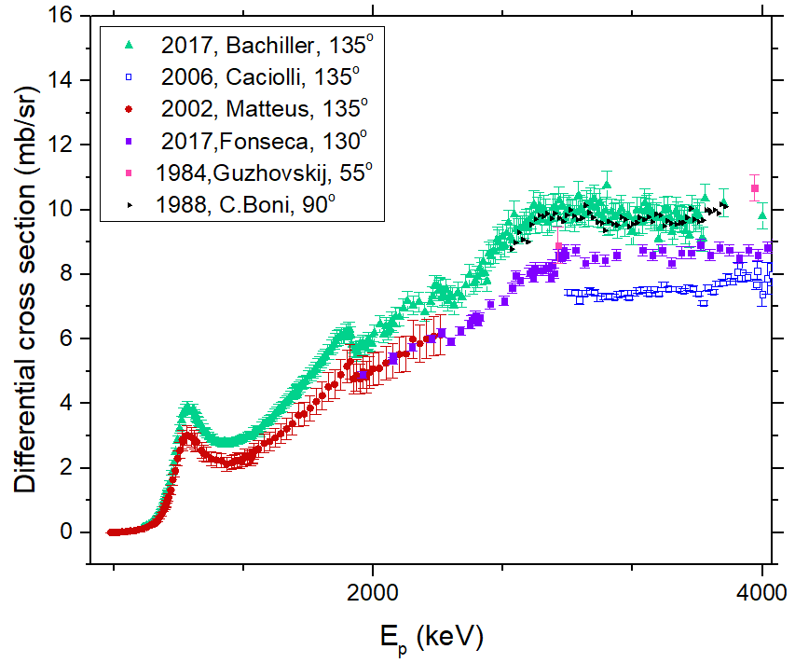
Motivation
one of the lightest elements in nature
⁷Li most abundant (92.5%) isotope of natural Lithium
widely used in many applications
PIGE technique: suitable for quantification via the ⁷Li (p,p’γ₁₋₀) ⁷Li reaction – E_{γ} = 477.6 keV
Lithium
Prerequisite: the accurate calculation of the differential cross section
discrepancies between older experimental datasets
considerable lack of results corresponding to different angles

Slide 3
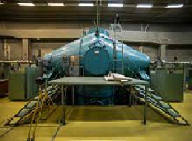
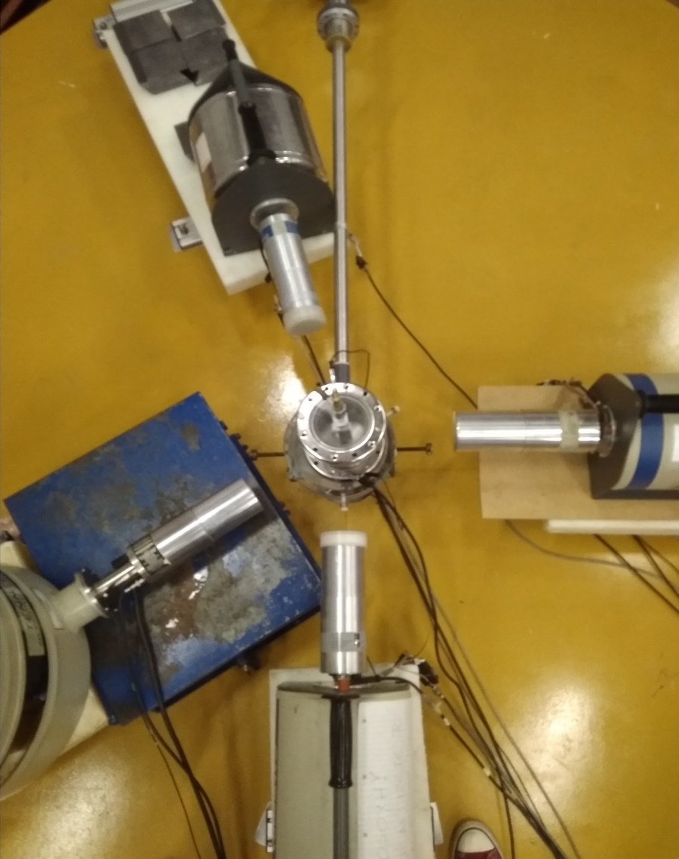
Experimental setup
Evaporated LiF powder on a ^{nat}Ta thick layer
Proton beam
4 High Purity Germanium detectors mounted on a table at the angles of 0º, 55º, 90º, 165º
Target:
LiF
165⁰
90⁰
55⁰
Angle | Angular uncertainty | Relative efficiency
0^{ο} | 11.71^{ο} | 18%
55^{ο} | 11.94^{ο} | 20%
90º | 11.00º | 80%
165^{ο} | 10.08^{ο} | 16%
Proton beam delivered by the 5.5 MV Tandem Van de Graaf Accelerator of NCSR “Demokritos”
0⁰
Proton energy range: 1010 – 4000 keV in steps of 10-20 keV

Slide 4
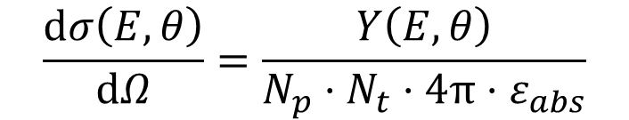
Data Analysis
Absolute measurement by using the following formula
$$\frac{ⅆσ\left(E,θ\right)}{ⅆΩ}=\frac{Y\left(E,θ\right)}{N_{p}⋅N_{t}⋅4π⋅ε_{abs}}$$
[barn/sr]
where
Y(E,θ): experimental yield, determined by integrating the peak of interest at each spectrum
N_{p}: number of incident protons
N_{t}: target thickness (atoms/cm²)
ε_{abs}: detector absolute efficiency

Slide 5
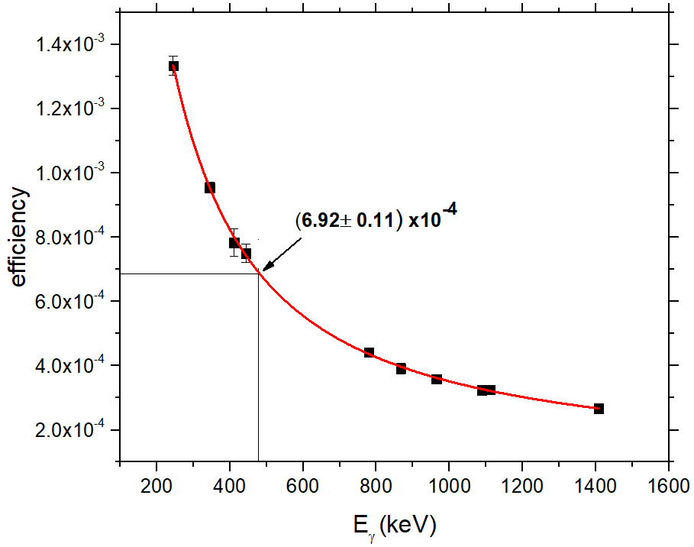
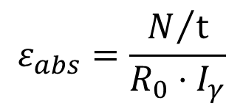
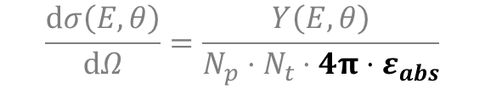
Data Analysis – Detector efficiency
$$\frac{ⅆσ\left(E,θ\right)}{ⅆΩ}=\frac{Y\left(E,θ\right)}{N_{p}⋅N_{t}⋅4π⋅ε_{abs}}$$
By using an ¹⁵²Eu (R = (217 ± 3) kBq - 01/Jan/2011)
$$ε_{abs}=\frac{N/t}{R_{0}⋅I_{γ}}$$
Ν: yield of incident gamma rays
t: measurement duration
R₀: source radioactivity at the time of the measurement
Ι_{γ}: gamma ray intensity
Absolute efficiency of the 18% HPGe – 0º

Slide 6
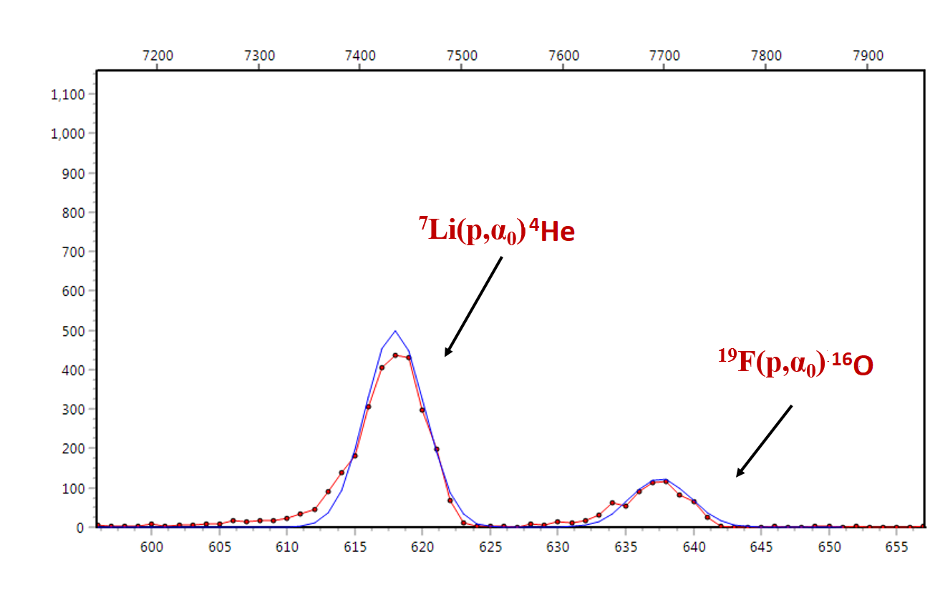
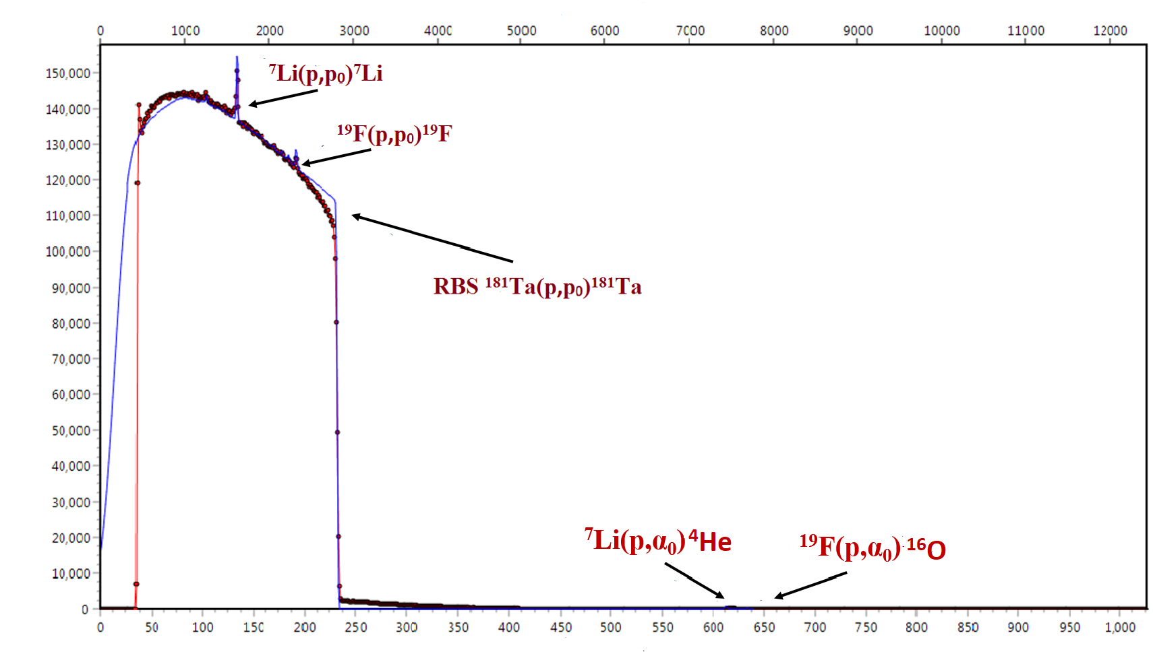


Data Analysis – Number of incident protons and target thickness
$$\frac{ⅆσ\left(E,θ\right)}{ⅆΩ}=\frac{Y\left(E,θ\right)}{N_{p}⋅N_{t}⋅4π ·ε_{abs}}$$
$$\frac{ⅆσ\left(E,θ\right)}{ⅆΩ}=\frac{Y\left(E,θ\right)}{N_{p}⋅N_{t}⋅4π ·ε_{abs}}$$
Energy (keV)
Energy (keV)
Ν_{p} via Faraday Cup
RBS – EBS - NRA
Experimental spectra
Simulation (SIMNRA)
Experimental spectra
Simulation (SIMNRA)
via the ⁷Li (p,a₀) ⁴He reaction
E_{p} = 2899 keV
Silicon Surface Barrier detector at 170^{ο}
Counts
Counts
Ν_{t} = 1850·10¹⁵ atoms/cm²
Cross section data for (p,a₀) reactions: V.Panetta et al.
channel
channel

Slide 7
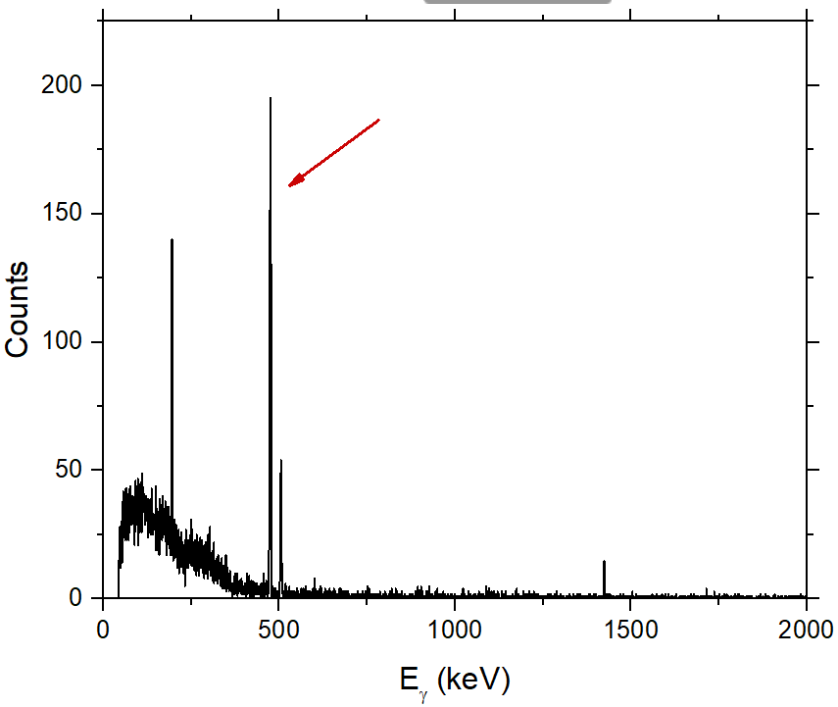
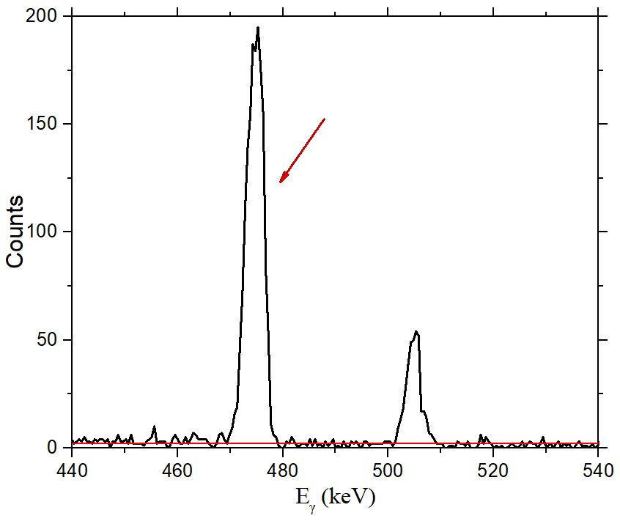
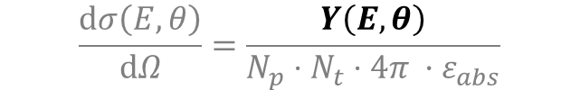
Data Analysis – Experimental Yield
$$\frac{ⅆσ\left(E,θ\right)}{ⅆΩ}=\frac{Y\left(E,θ\right)}{N_{p}⋅N_{t}⋅4π ·ε_{abs}}$$
477.6 keV
477.6 keV
Peak of interest – E_{γ} = 477.6 keV
The integration of each peak was carried out using SPECTRW code.
Typical experimental spectrum at 0º and proton beam energy E_{p} = 1140 keV
Statistical uncertainty: < 4% in all cases

Slide 8
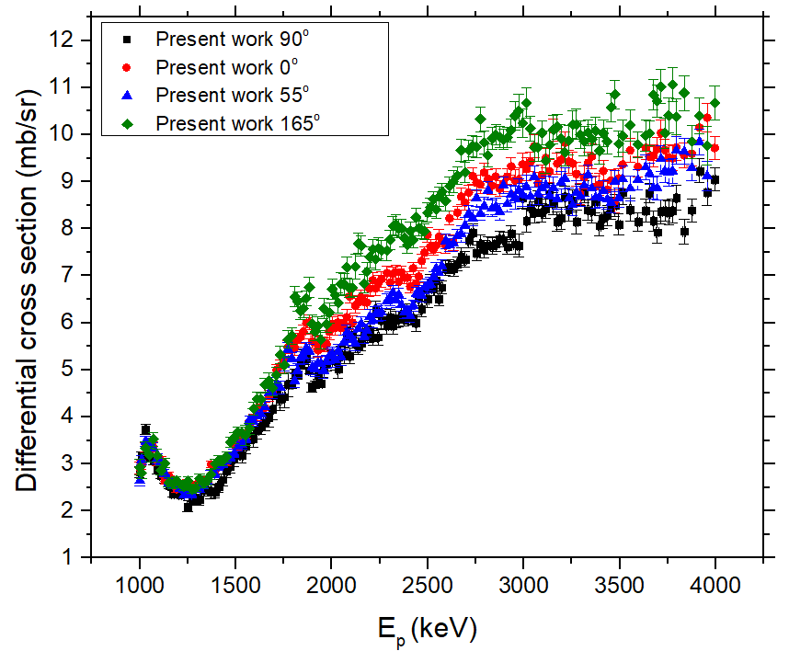
Results
Energy uncertainty: ~6 keV
Statistical uncertainty: < 4% in all cases
Total systematic uncertainty: ~8.0%

Slide 9
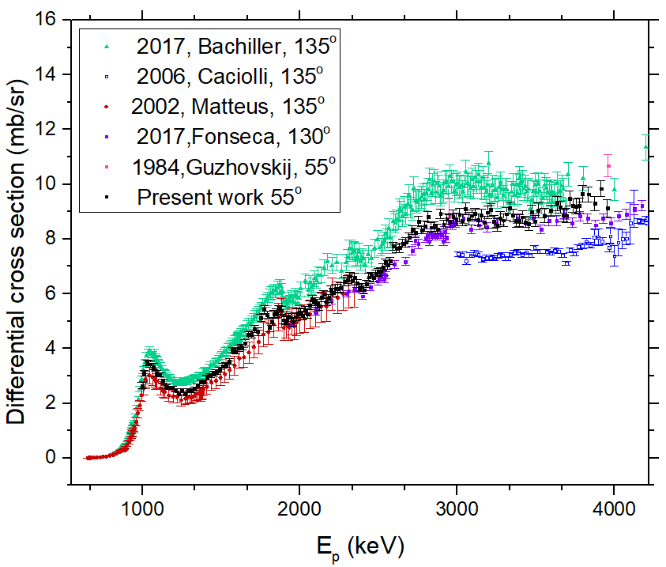
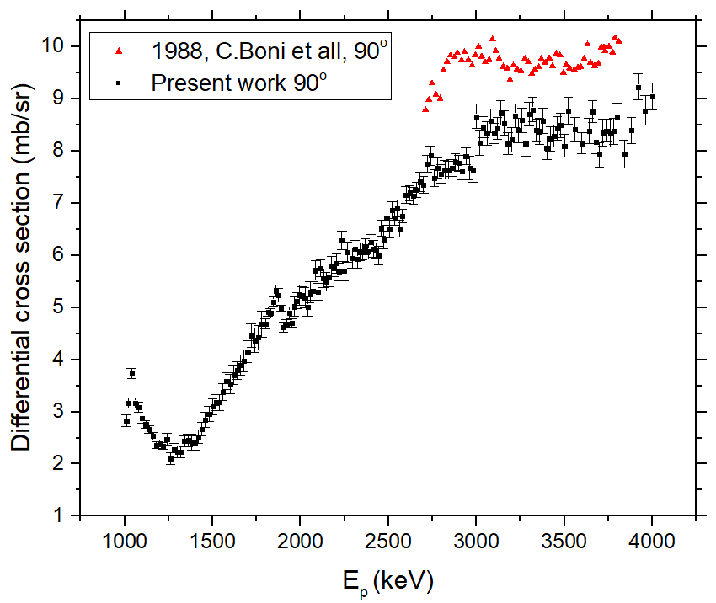
Comparison with older datasets
Results follow the trend of older experimental datasets
There is a quite satisfactory agreement between the results obtained in the present work at 55º and the datasets measured at 135º and 130º by Matteus and Fonseca respectively. Comparison between the specific angles is considered to be accurate as they cover almost complementary angles
Noticeable overestimation of Boni’s et all. results at 90º

Slide 10
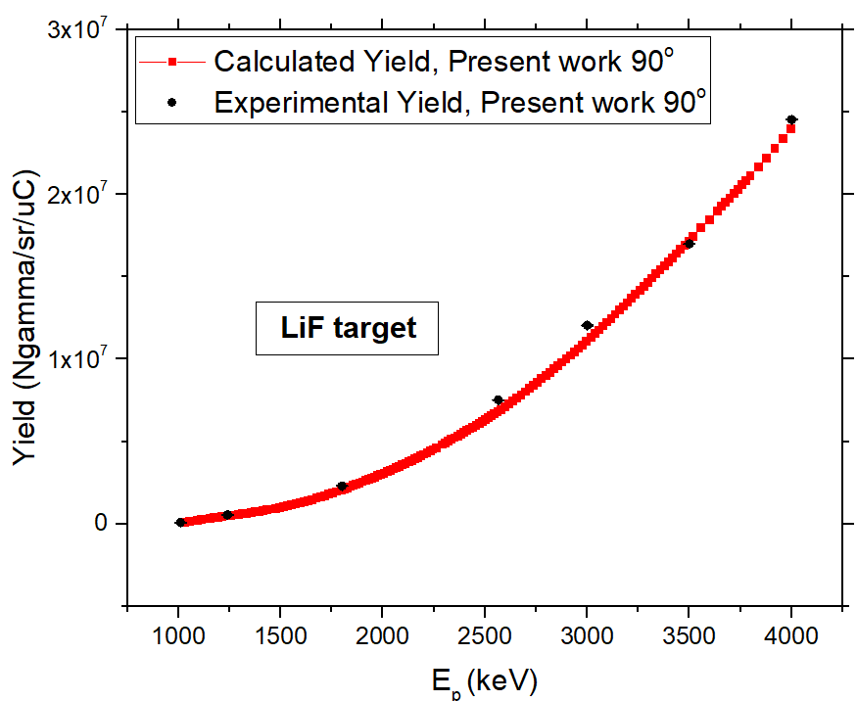
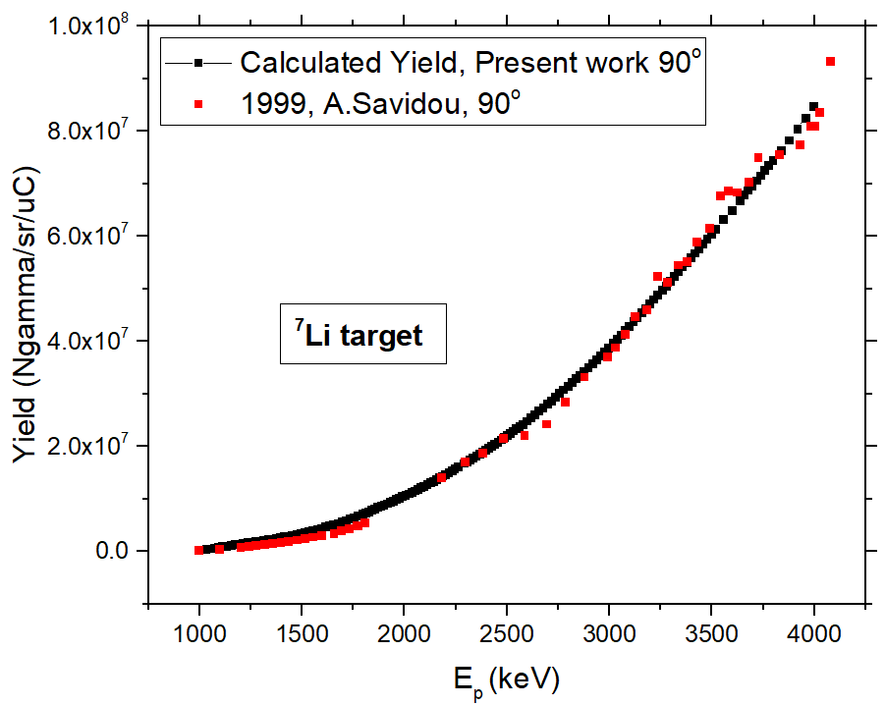
Benchmarking experiment
Experimental Yields are in a good agreement with the calculated results obtained using measured differential cross sections at 90º.
Results from the present work and from A.Savidou’s exhibit discrepancies less than 7%.

Slide 11
Summary and Conclusions
Differential cross section measurements of the ⁷Li (p,p’γ₁₋₀) ⁷Li reaction at the angles of 0º, 55º, 90º, 165º
The obtained results follow the general trend of previous measurements – a quite good agreement with two of the previously obtained datasets
Validation of the obtained results via benchmarking experiment

Slide 12
Thank you for your attention!

