Slide 1
Tandem Accelerator Laboratory
research activities
Anastasios Lagoyannis
Tandem Accelerator Laboratory
Institute of Nuclear and Particle Physics
N.C.S.R. “Demokritos”

Slide 2
Who we are
3 permanent researchers
S. Harissopulos (Head), A.G. Karydas, A. Lagoyannis, M. Axiotis
3 post – docs
P. Chatzispyroglou, Z. Kotsina, E. Vagena
Students
M. Peoviti, K. Preketes-Sigalas, A. Laoutaris, S. Nanos, A. Ziagova, E. Taimpiri
K. Tsampa (w/w A. Karydas), S. Papayiannis ( w/w A.Karydas & K. Eleftheriadis)
Technicians
A. Andrianis (Head operator), V. Andreopoulos, E. Tsopanakis
A. Lagoyannis
I.N.P.P. Annual Meeting
Thursday 03/02/22

Slide 3
Scientific Outcome
9 publications in peer reviewed journals
Several conference proceedings
PhD Students
E. Georgali (f), K. Preketes-Sigalas (p), A. Laoutaris (p),
I. Madesis (f), S. Nanos (p)
Master Thesis
A. Ziagova (p), M. Peoviti (f), E. Taimpiri (p)
Diploma Thesis
A. Ziagova (f), A. Kotsovolou (f), C. Andrikopoulos (p)
(f: finished, p: in progress)
A. Lagoyannis
I.N.P.P. Annual Meeting
Thursday 03/02/22

Slide 4
Funding
Cluster of Accelerator Laboratories for Ion-Beam Research and Applications - CALIBRA
ΕΣΠΑ, S. Harissopulos, Ends 2021, 3.440 kEuro
Geant4-based Particle Simulation Facility in Greece for Future Science Mission Support
European Space Agency, A. Lagoyannis, Ends 2022 , 120 kEuro
ENSAR 2 - European Nuclear Science and Application Research 2
Horizon 2020, S. Harissopulos, Ends 2021, 26 kEuro
EuroFusion – Tandem Lab
Partner, Started in 2021 , 30 kEuro
Fluorescence and Reactive oxygen Intermediates by Neutron Generated electronic Excitation as a foundation for radically new cancer therapies
Horizon 2020, Partner, Ends 2023, Budget: 100 kEuro
Access to Ion and Neutron Beams at NCSR “Demokritos”
IAEA, A. Lagoyannis, Ends 2024 , Budget: 15 kEuro
Differential Cross Section Measurement of proton reactions on fusion related light elements
IAEA, M. Axiotis, 4 years, Budget: 16 kEuro
A. Lagoyannis
I.N.P.P. Annual Meeting
Thursday 03/02/22

Slide 5
Situation
CALIBRA
New external beam setup (see. K. Tsampa)
BGO detector setup
Arrival of Cyclotron
Design of the new goniometric table
AMS Packaging
Cross section measurements
Nuclear Astrophysics measurements (see. E. Vagena)
Light elements deuteron induced reactions
Proton induced gamma – ray reactions
Applications
Geological Sample Analysis
Test of Neutron Detectors (n-TOF related)
WEST (fusion) and JET measurements
Continue collaboration within the G4G ESA project
A. Lagoyannis
I.N.P.P. Annual Meeting
Thursday 03/02/22

Slide 6
Tandem Statistics
30 experiments conducted in 2021 (23 @ 2020, 26 @ 2019)
1052 belt hours (600 @ 2020, 961 @ 2019)
Covid 19
NMR failure
A. Lagoyannis
I.N.P.P. Annual Meeting
Thursday 03/02/22

Slide 7
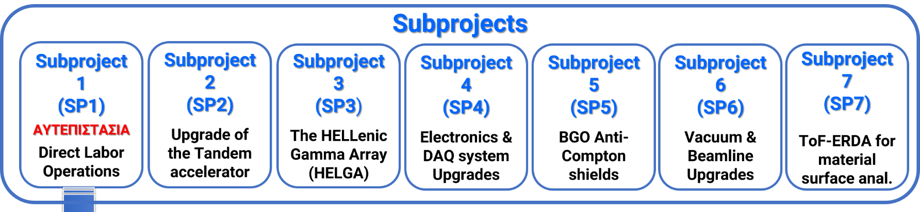
Calibra
New Subproject
Upgrade of External Beam
SP2: Contract signed
SP3: Delivered
SP4: Delivered
SP5: Delivered
SP6: Delivered
SP7: Delivered
SP8: Delivered
A. Lagoyannis
I.N.P.P. Annual Meeting
Thursday 03/02/22

Slide 8
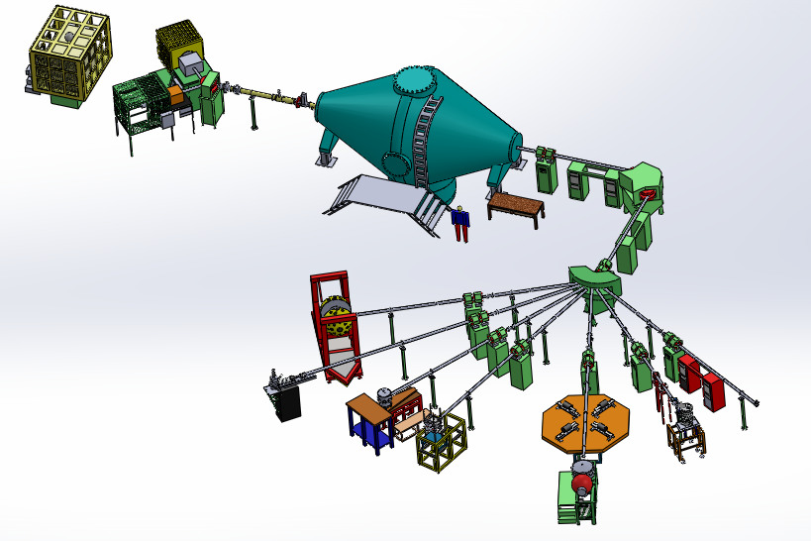
Tandem Layout
A. Lagoyannis
I.N.P.P. Annual Meeting
Thursday 03/02/22

Slide 9
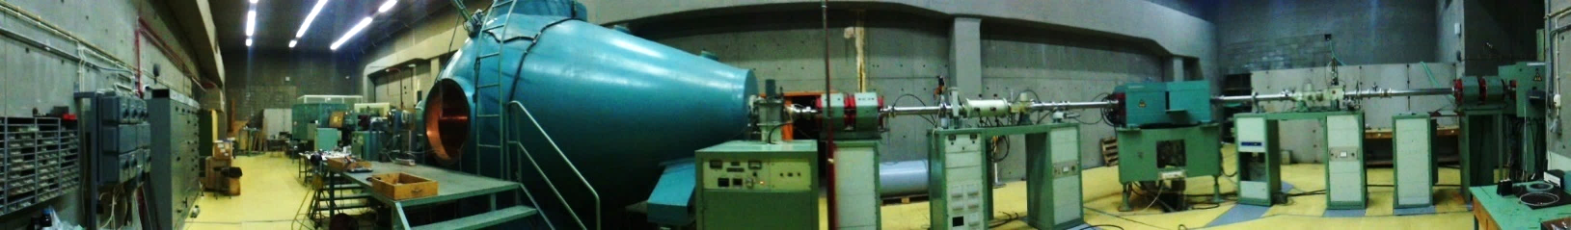
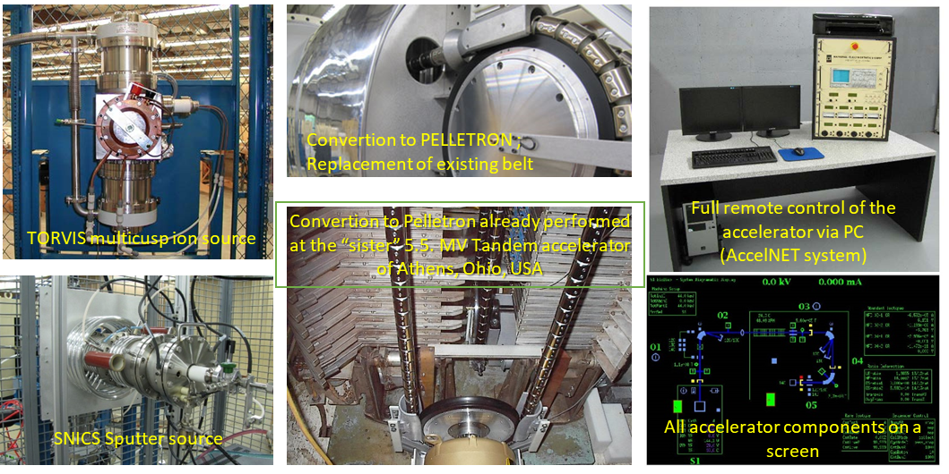
Tandem Upgrades – SP2
5.5 MV Tandem Accelerator
Tandem hall
A. Lagoyannis
I.N.P.P. Annual Meeting
Thursday 03/02/22

Slide 10
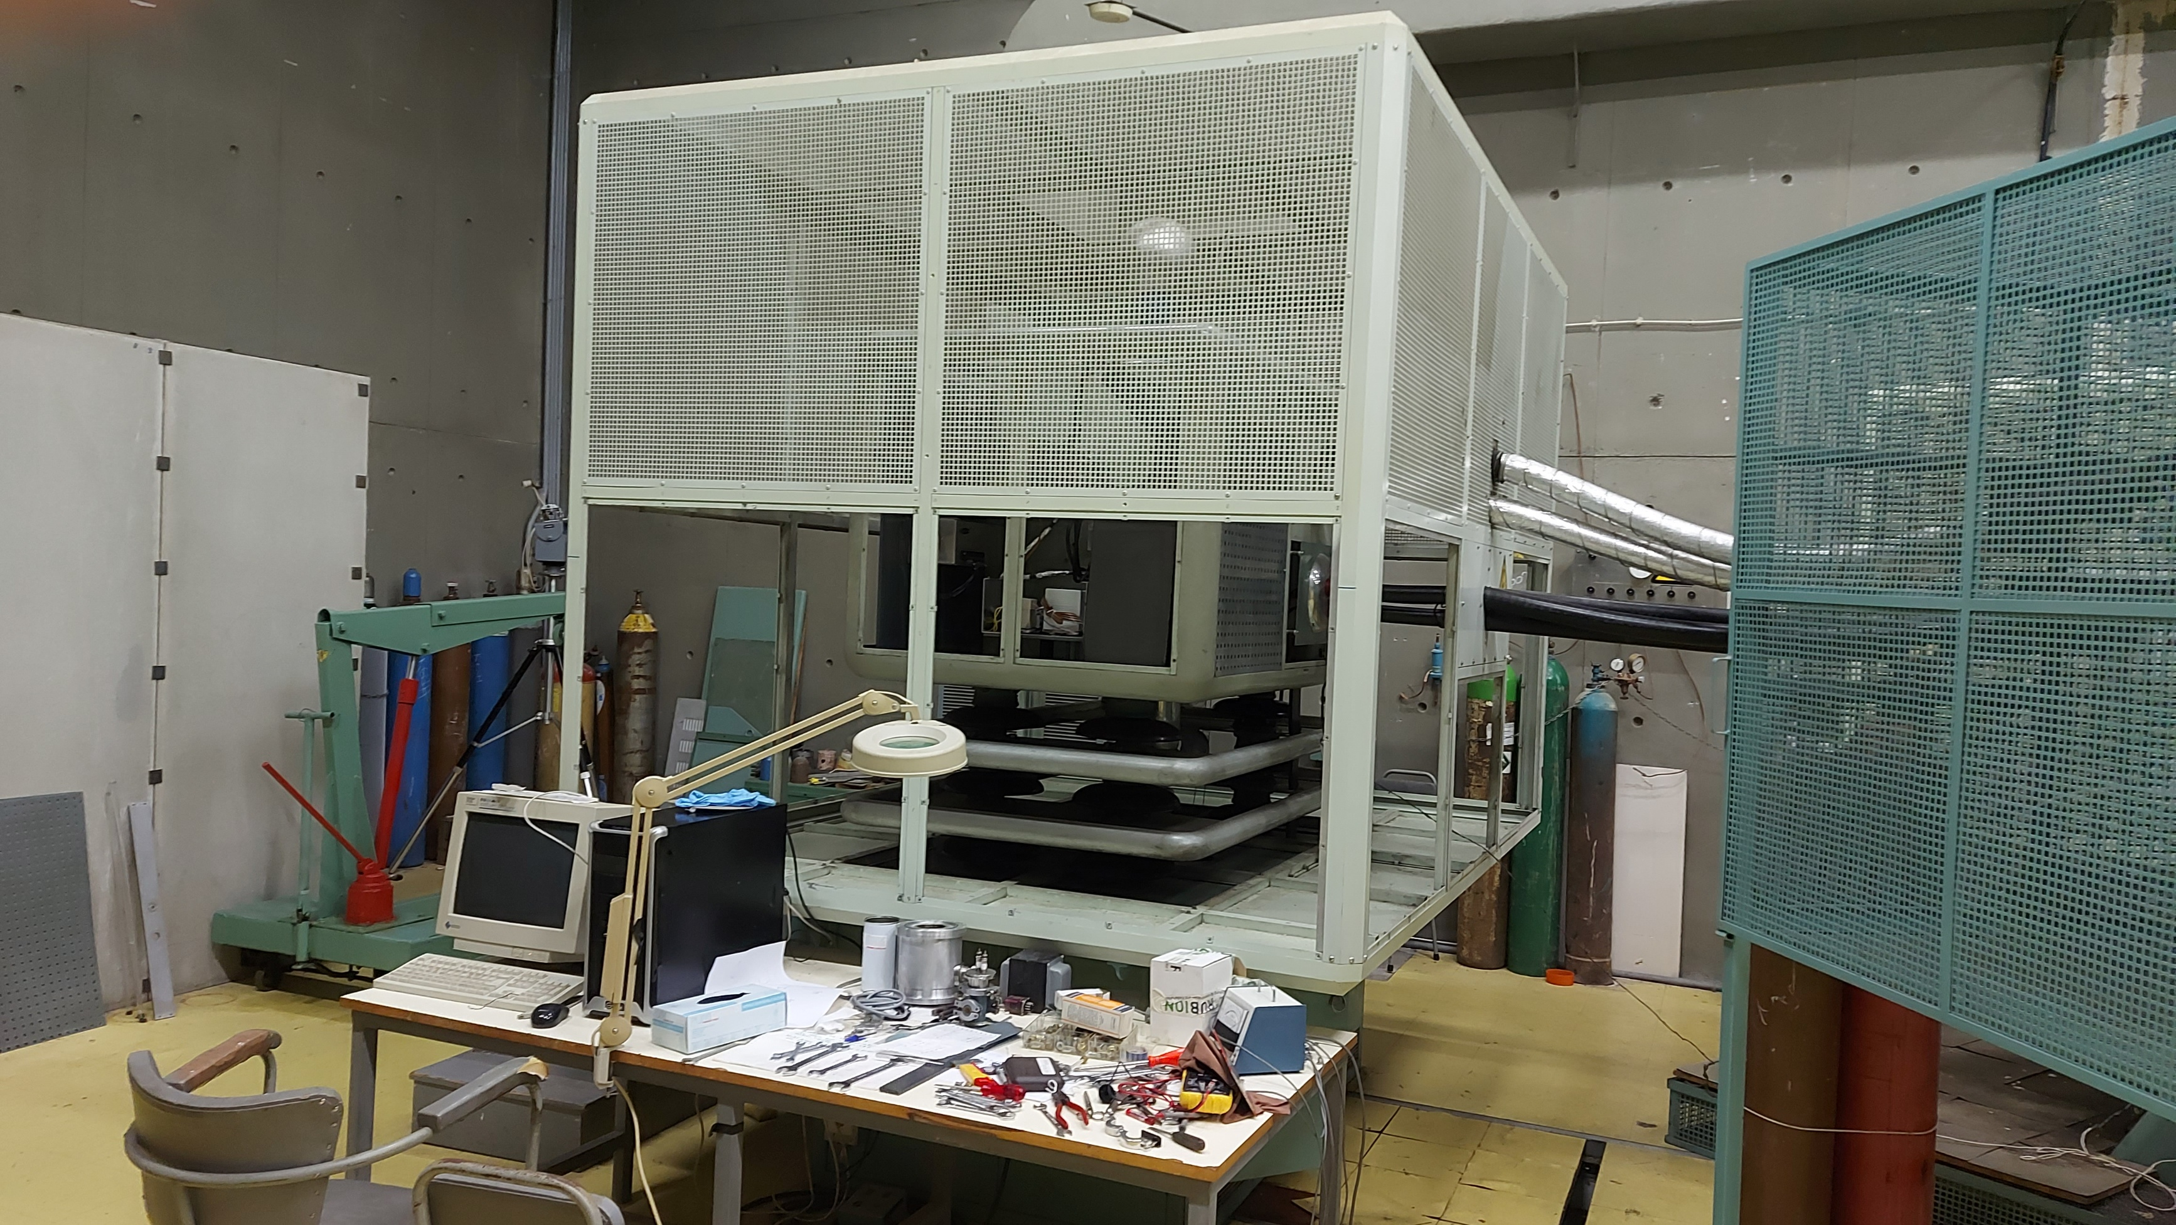
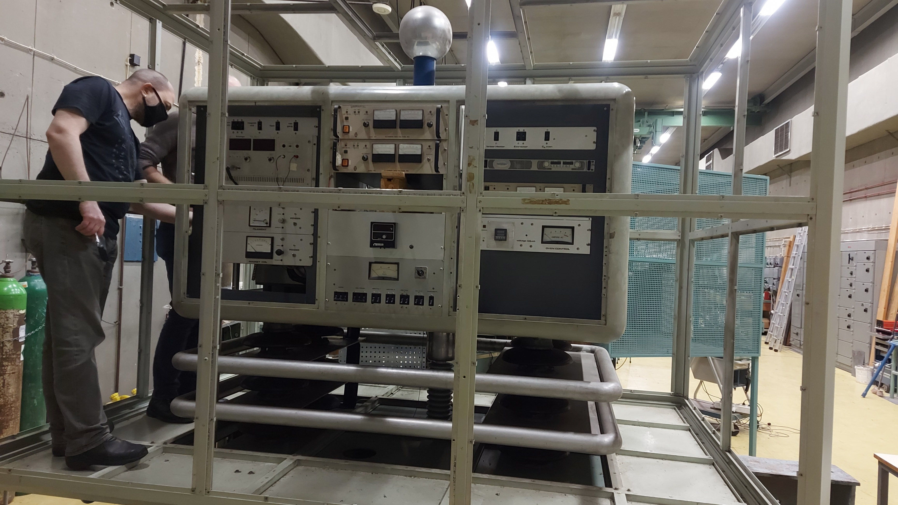
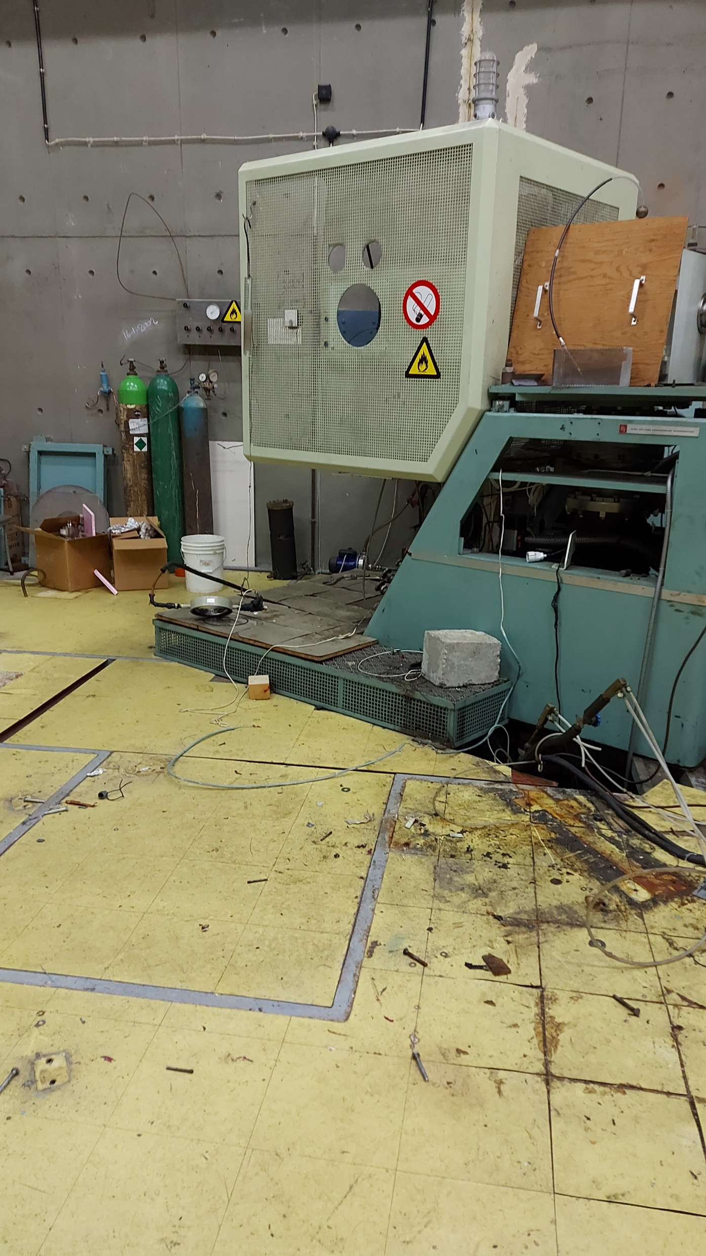
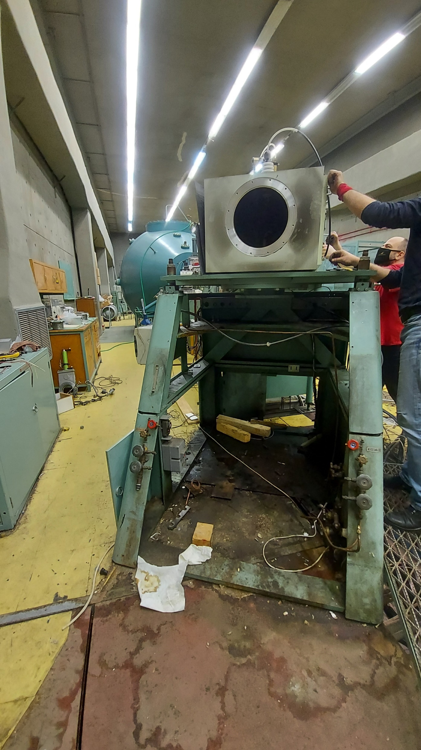
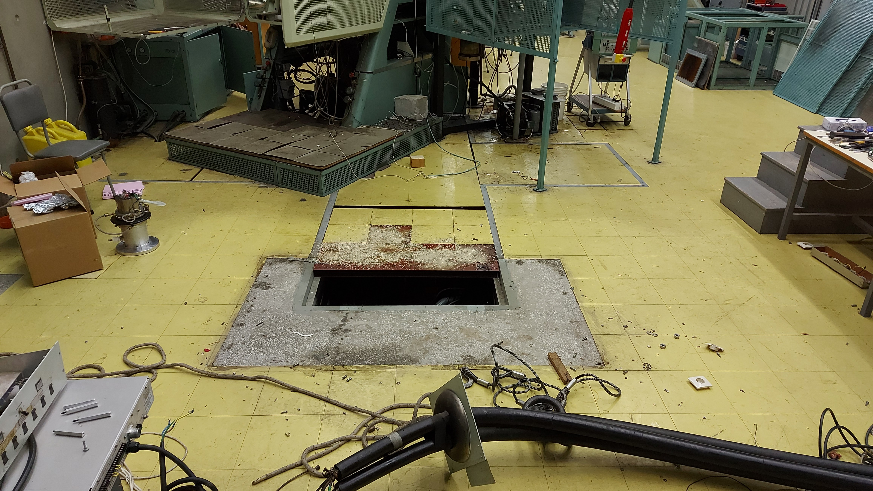
Tandem Upgrades (SP2)
A. Lagoyannis
I.N.P.P. Annual Meeting
Thursday 03/02/22

Slide 11
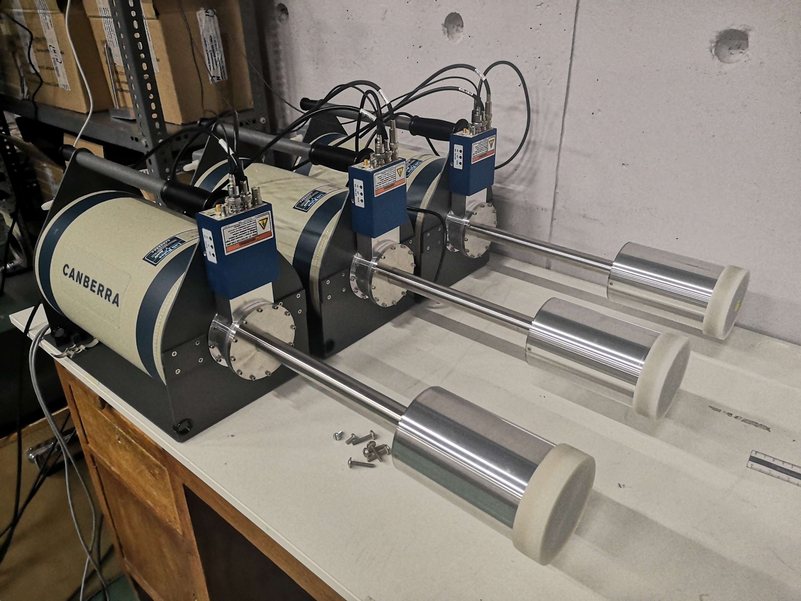
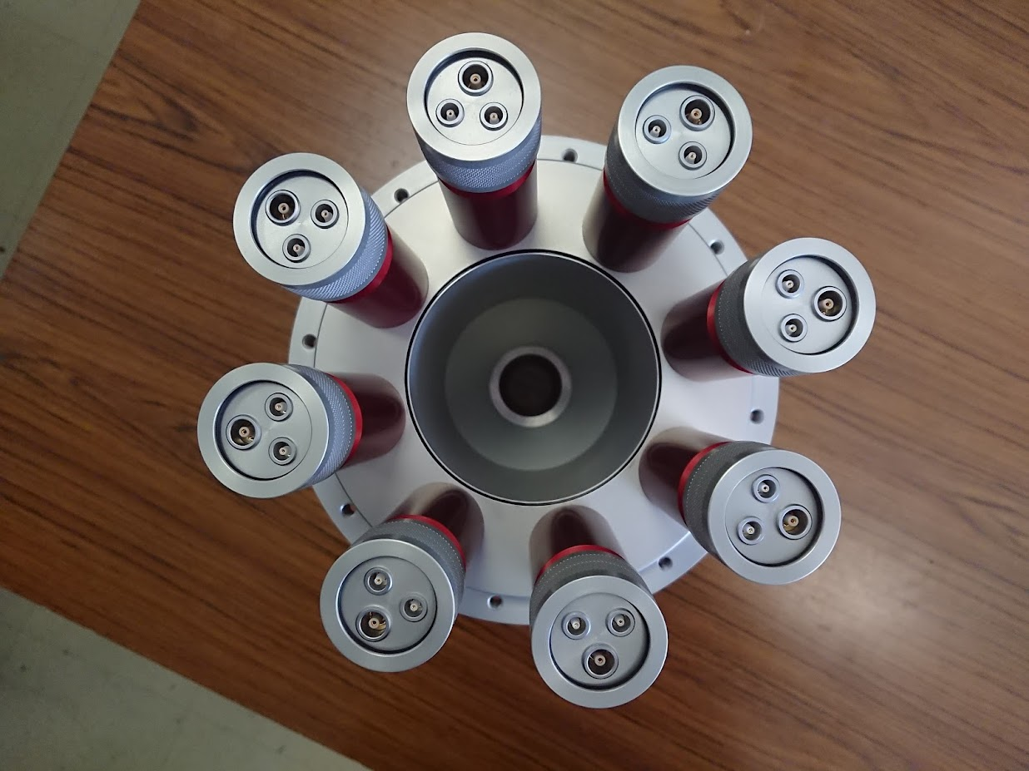
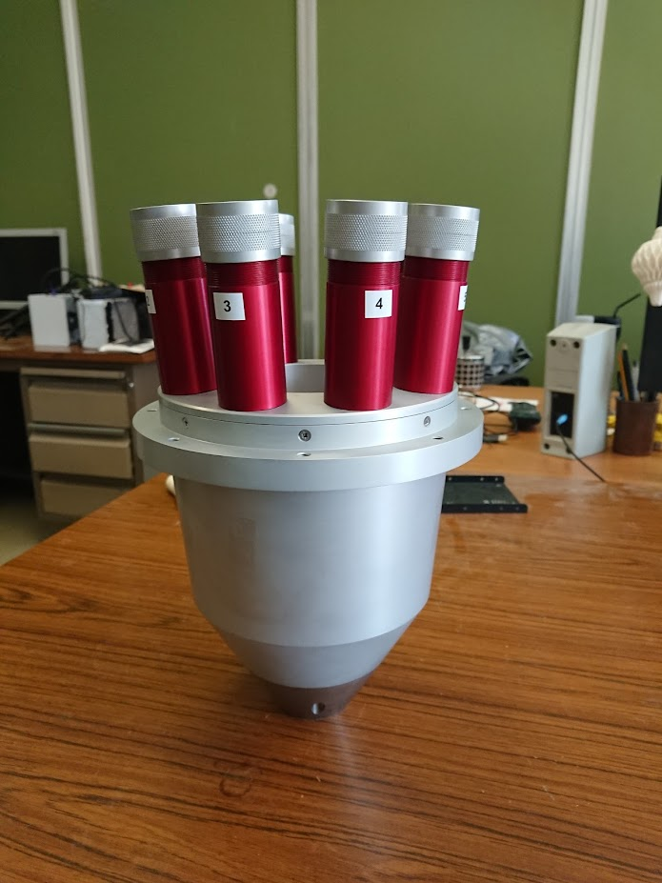
Tandem Upgrades (SP5)
Anti-Compton Detectors
3 BGO Detectors
8 PM tubes each (chain configuration)
Associated Electronics
Collimated Entrance
A. Lagoyannis
I.N.P.P. Annual Meeting
Thursday 03/02/22

Slide 12
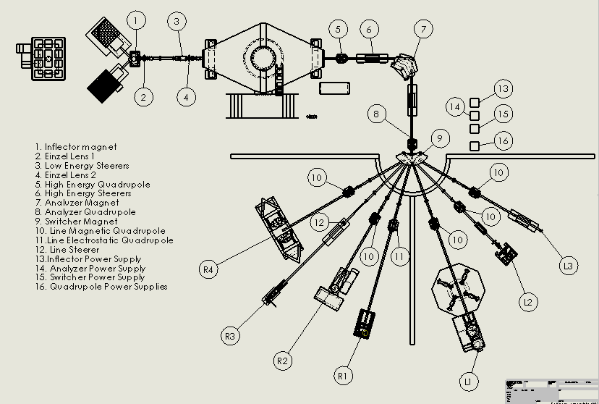
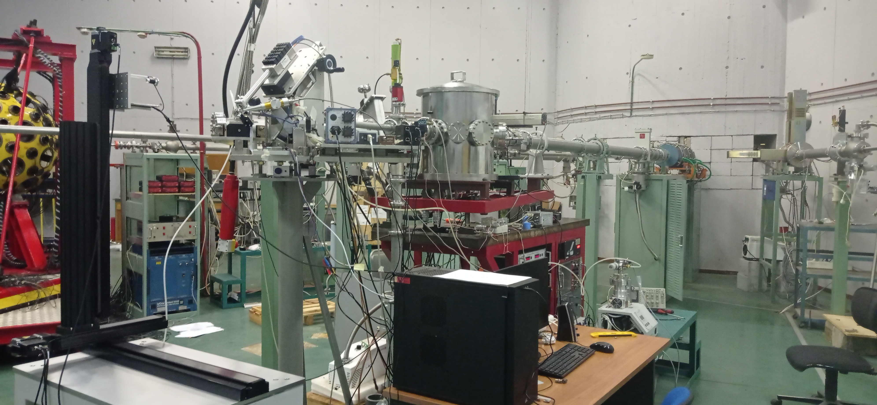
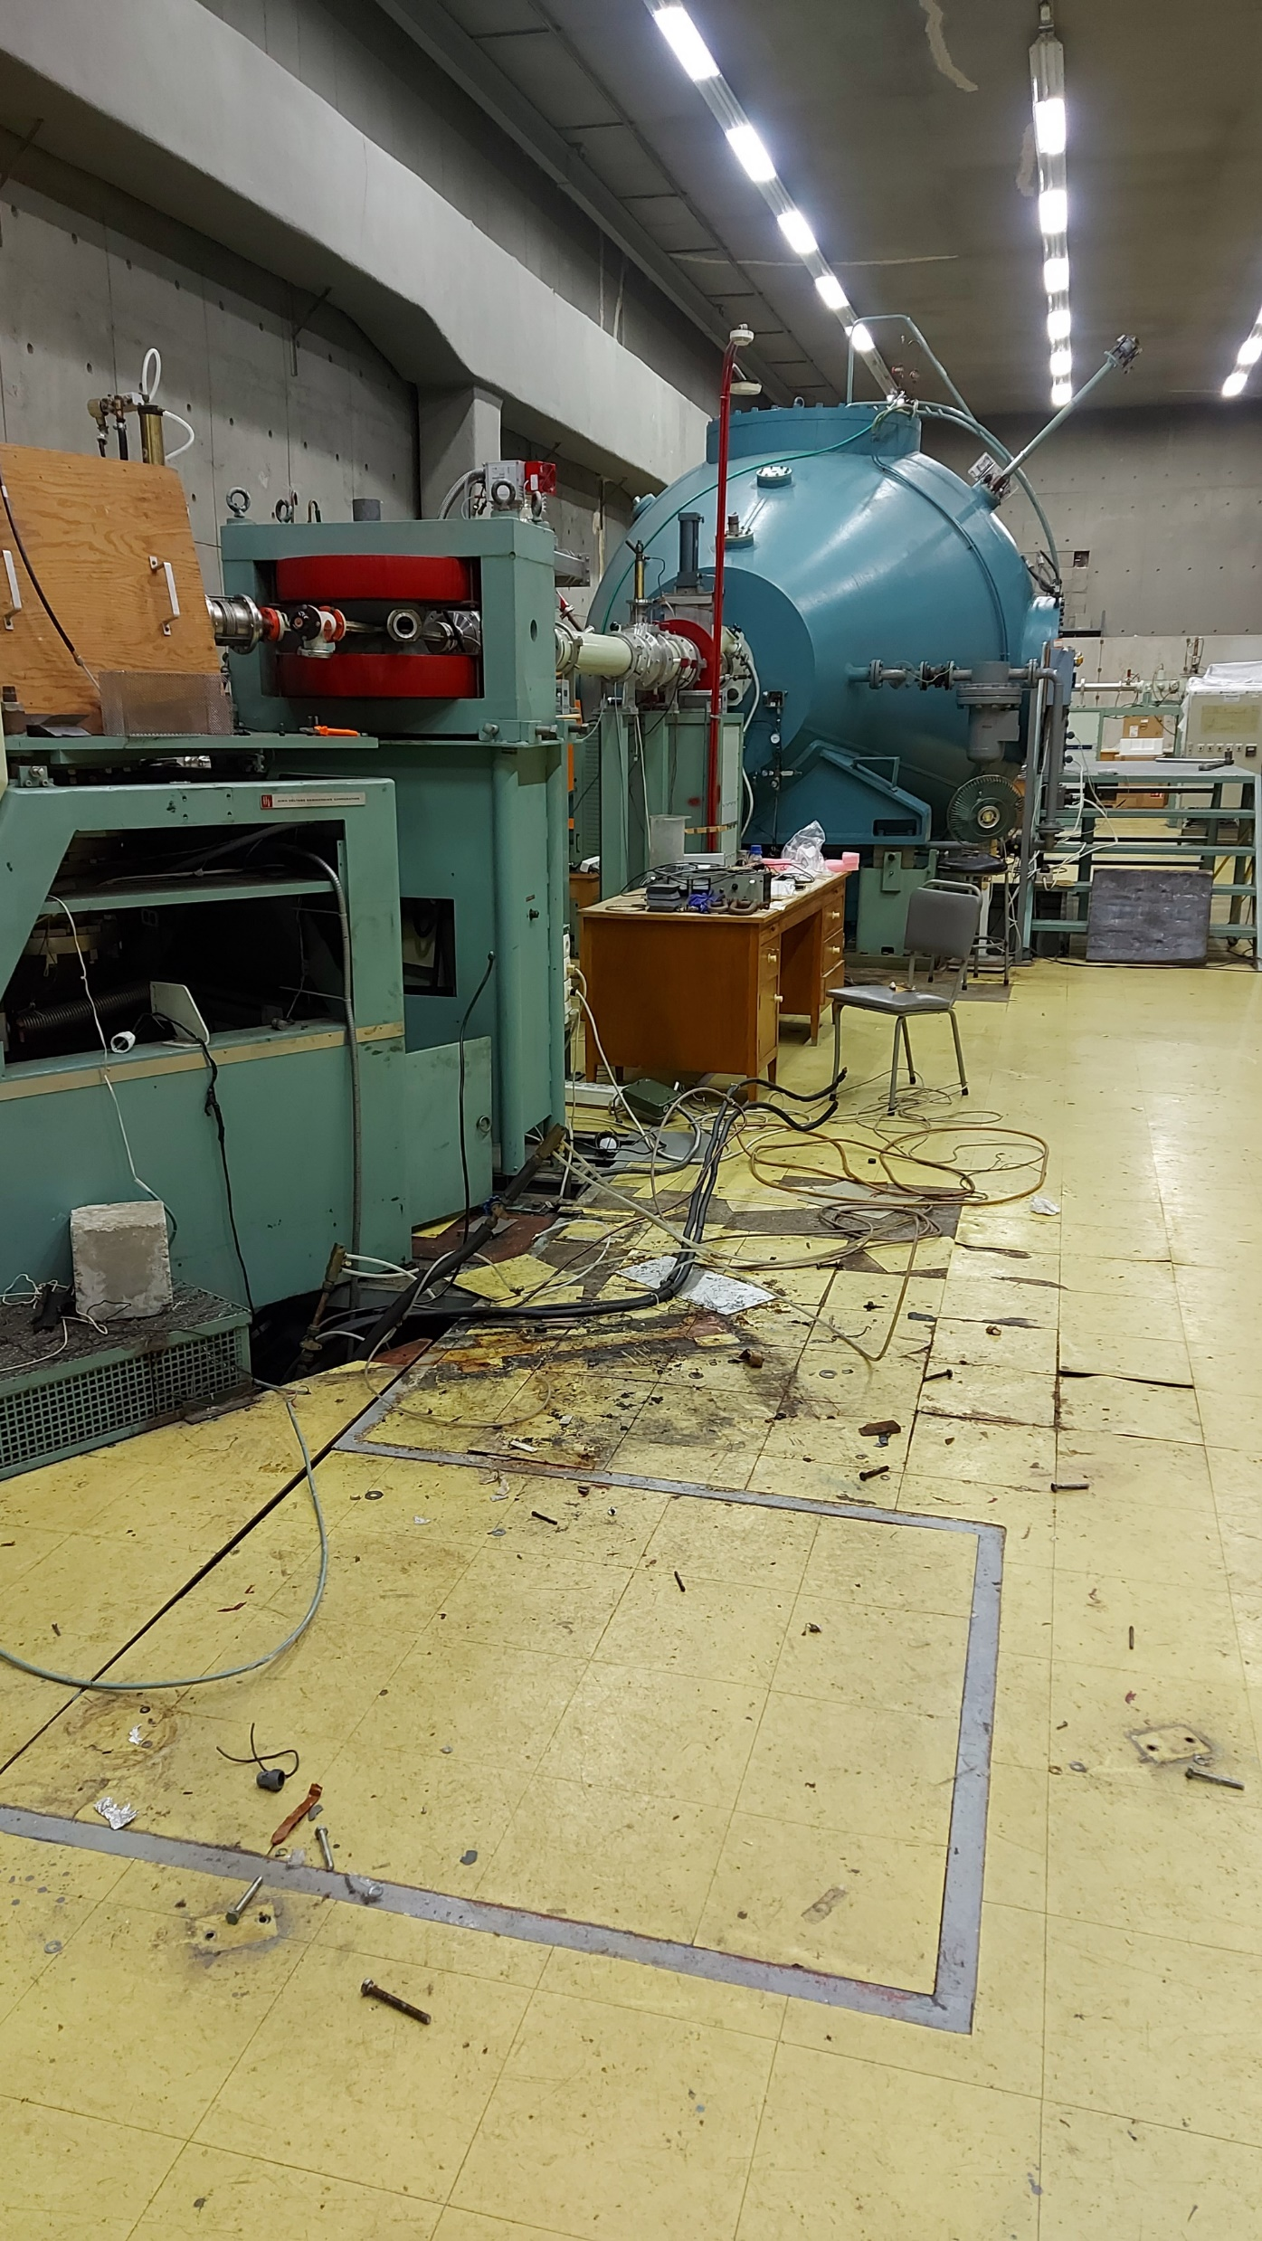
Tandem Upgrades (SP8)
A. Lagoyannis
I.N.P.P. Annual Meeting
Thursday 03/02/22

Slide 13
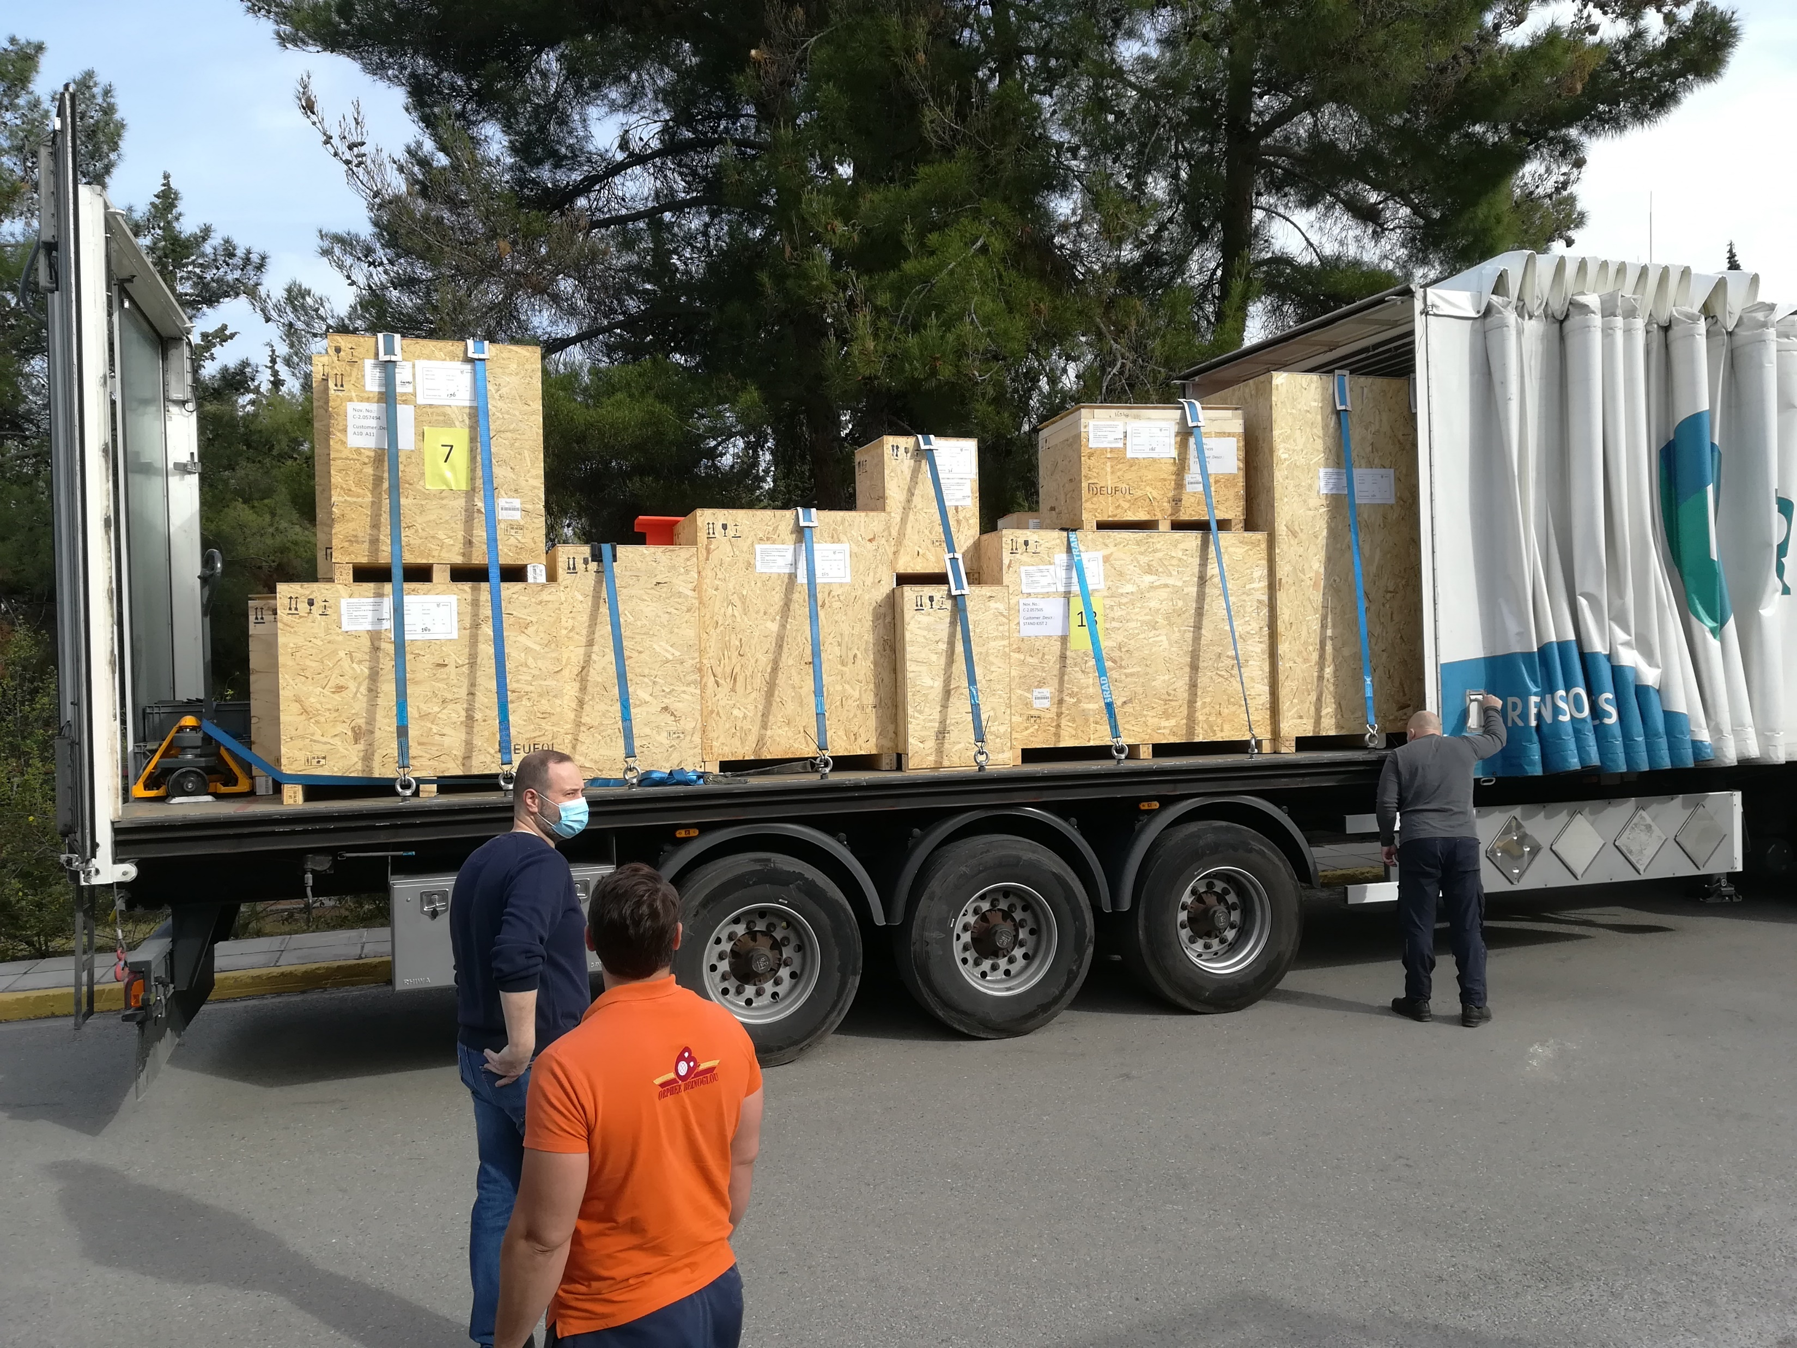
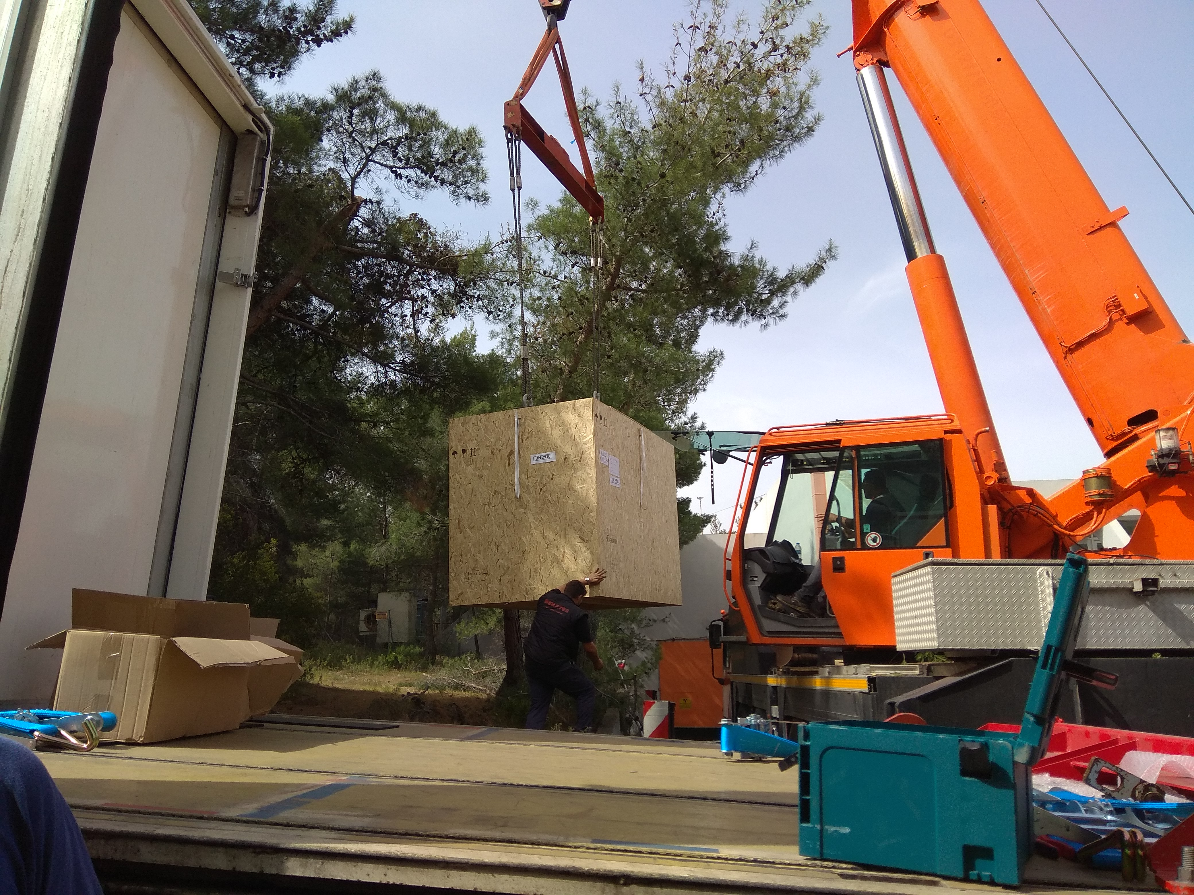
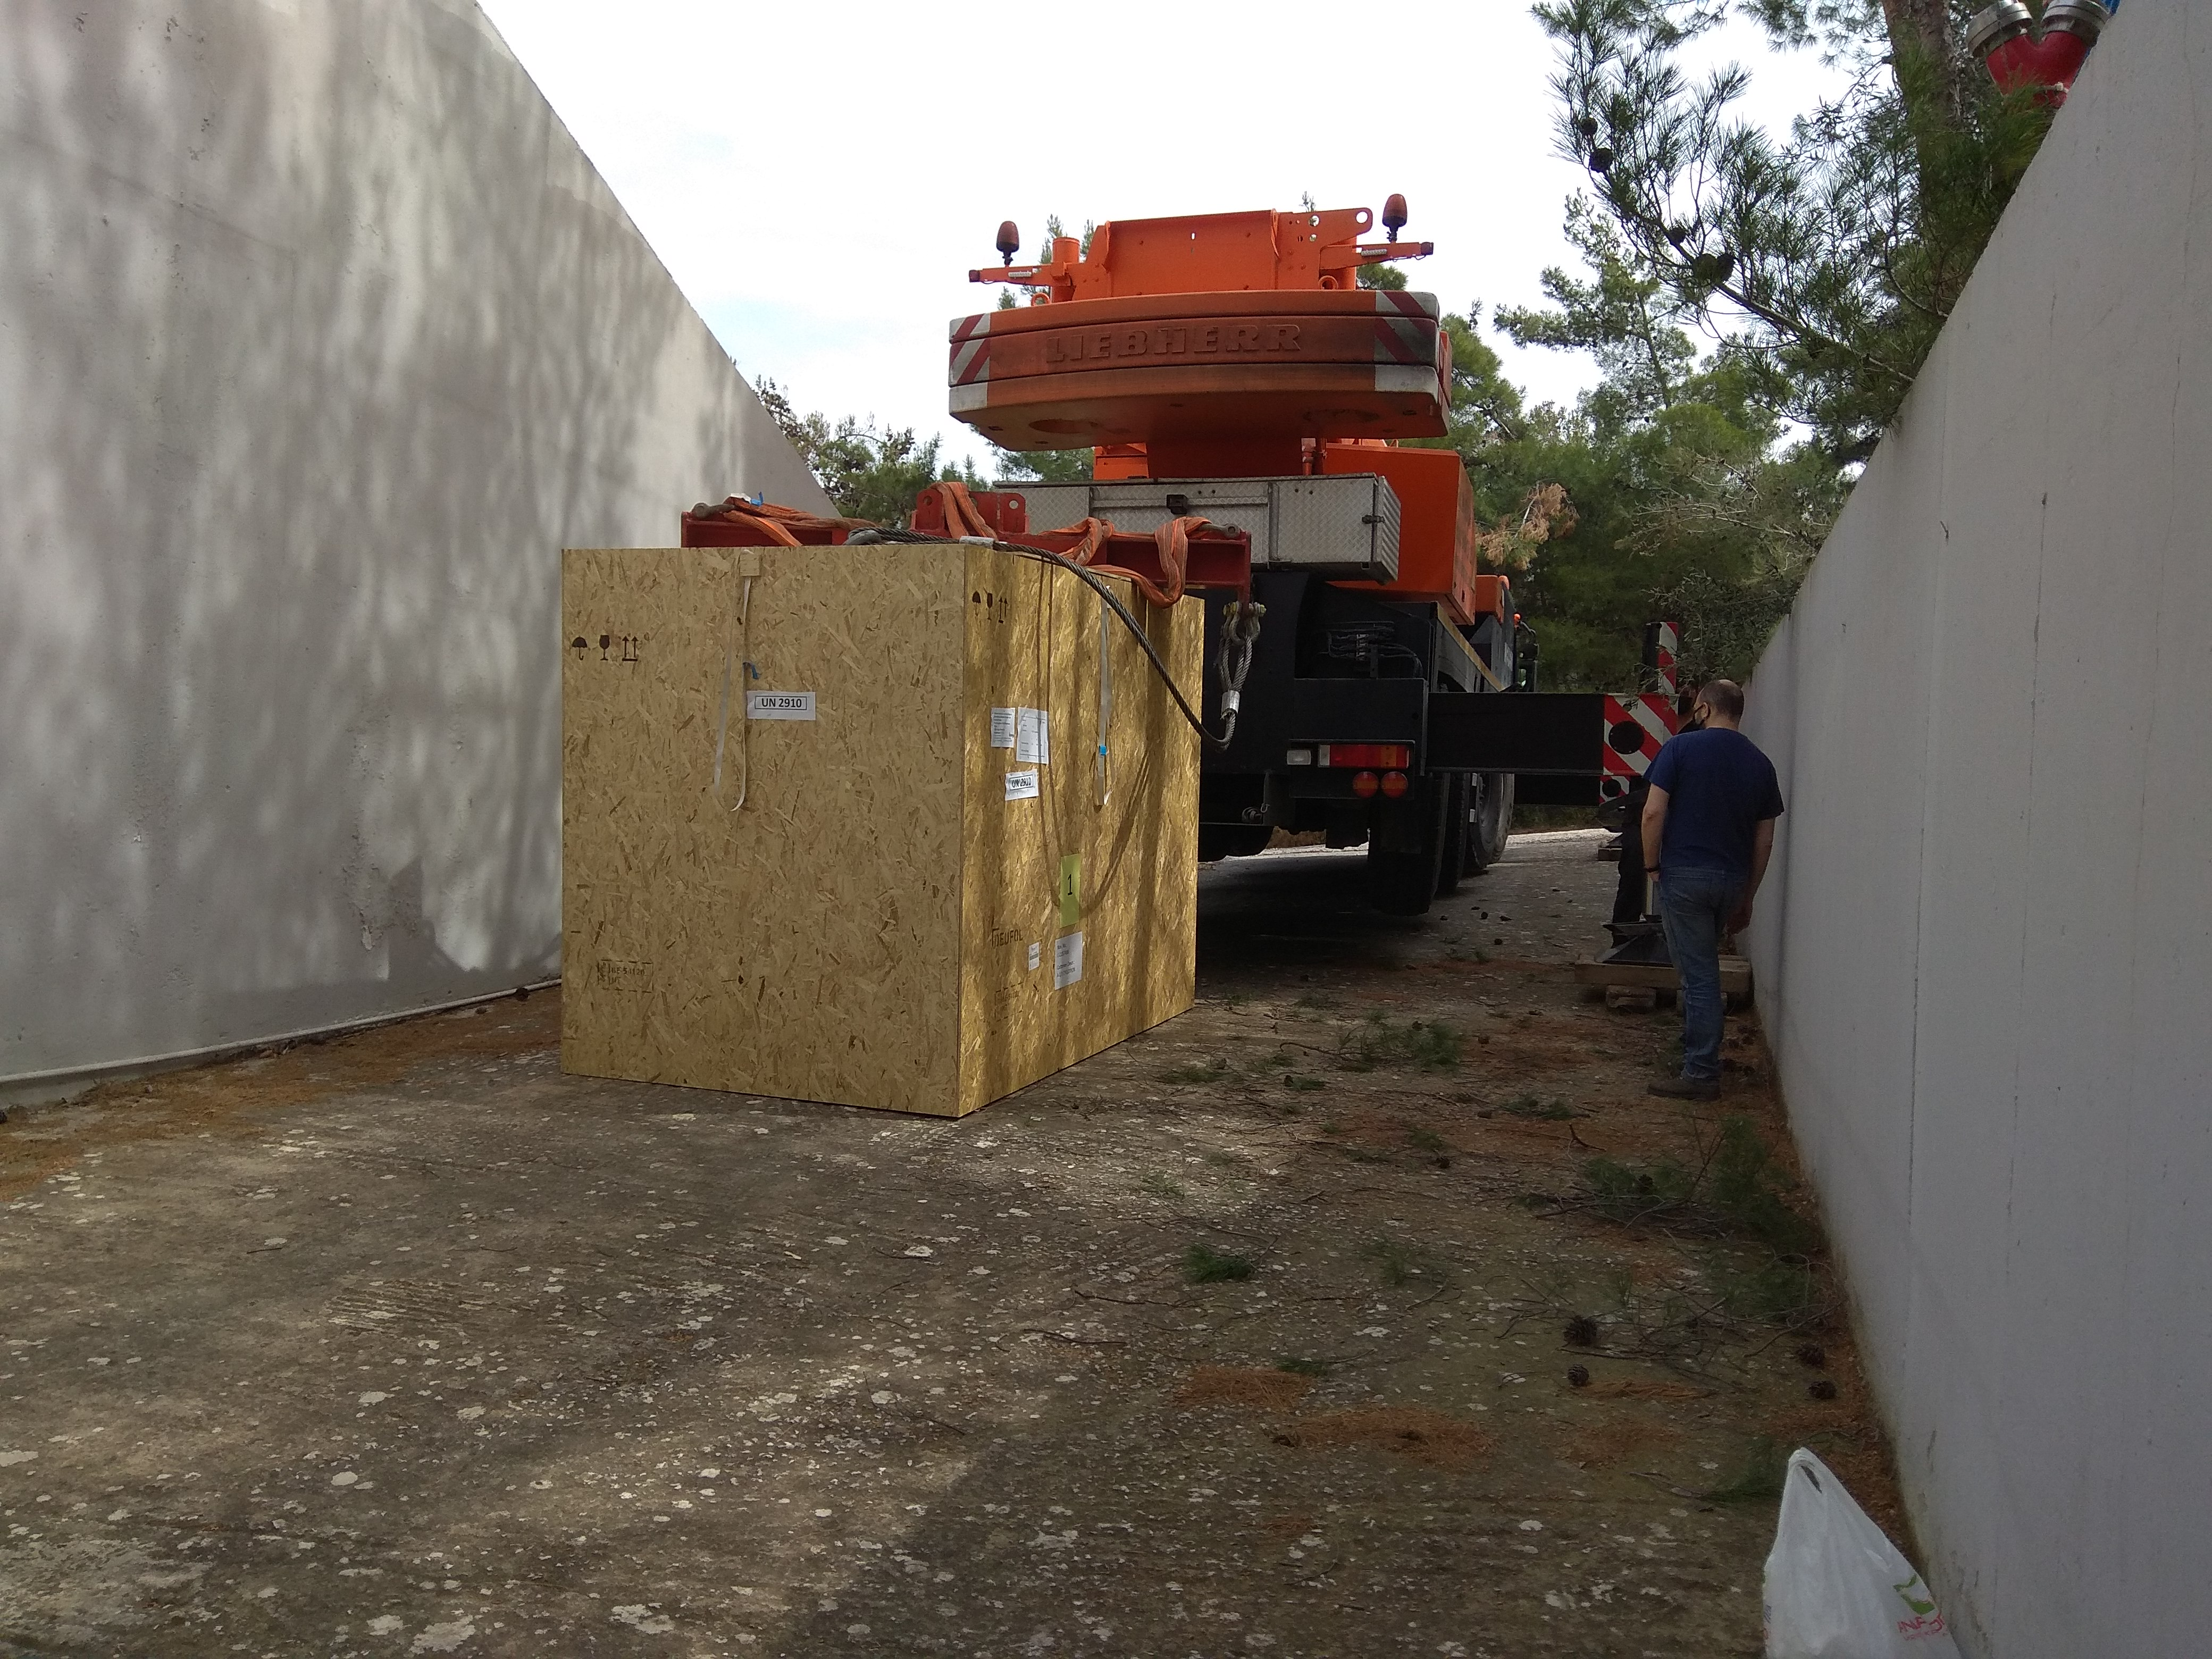
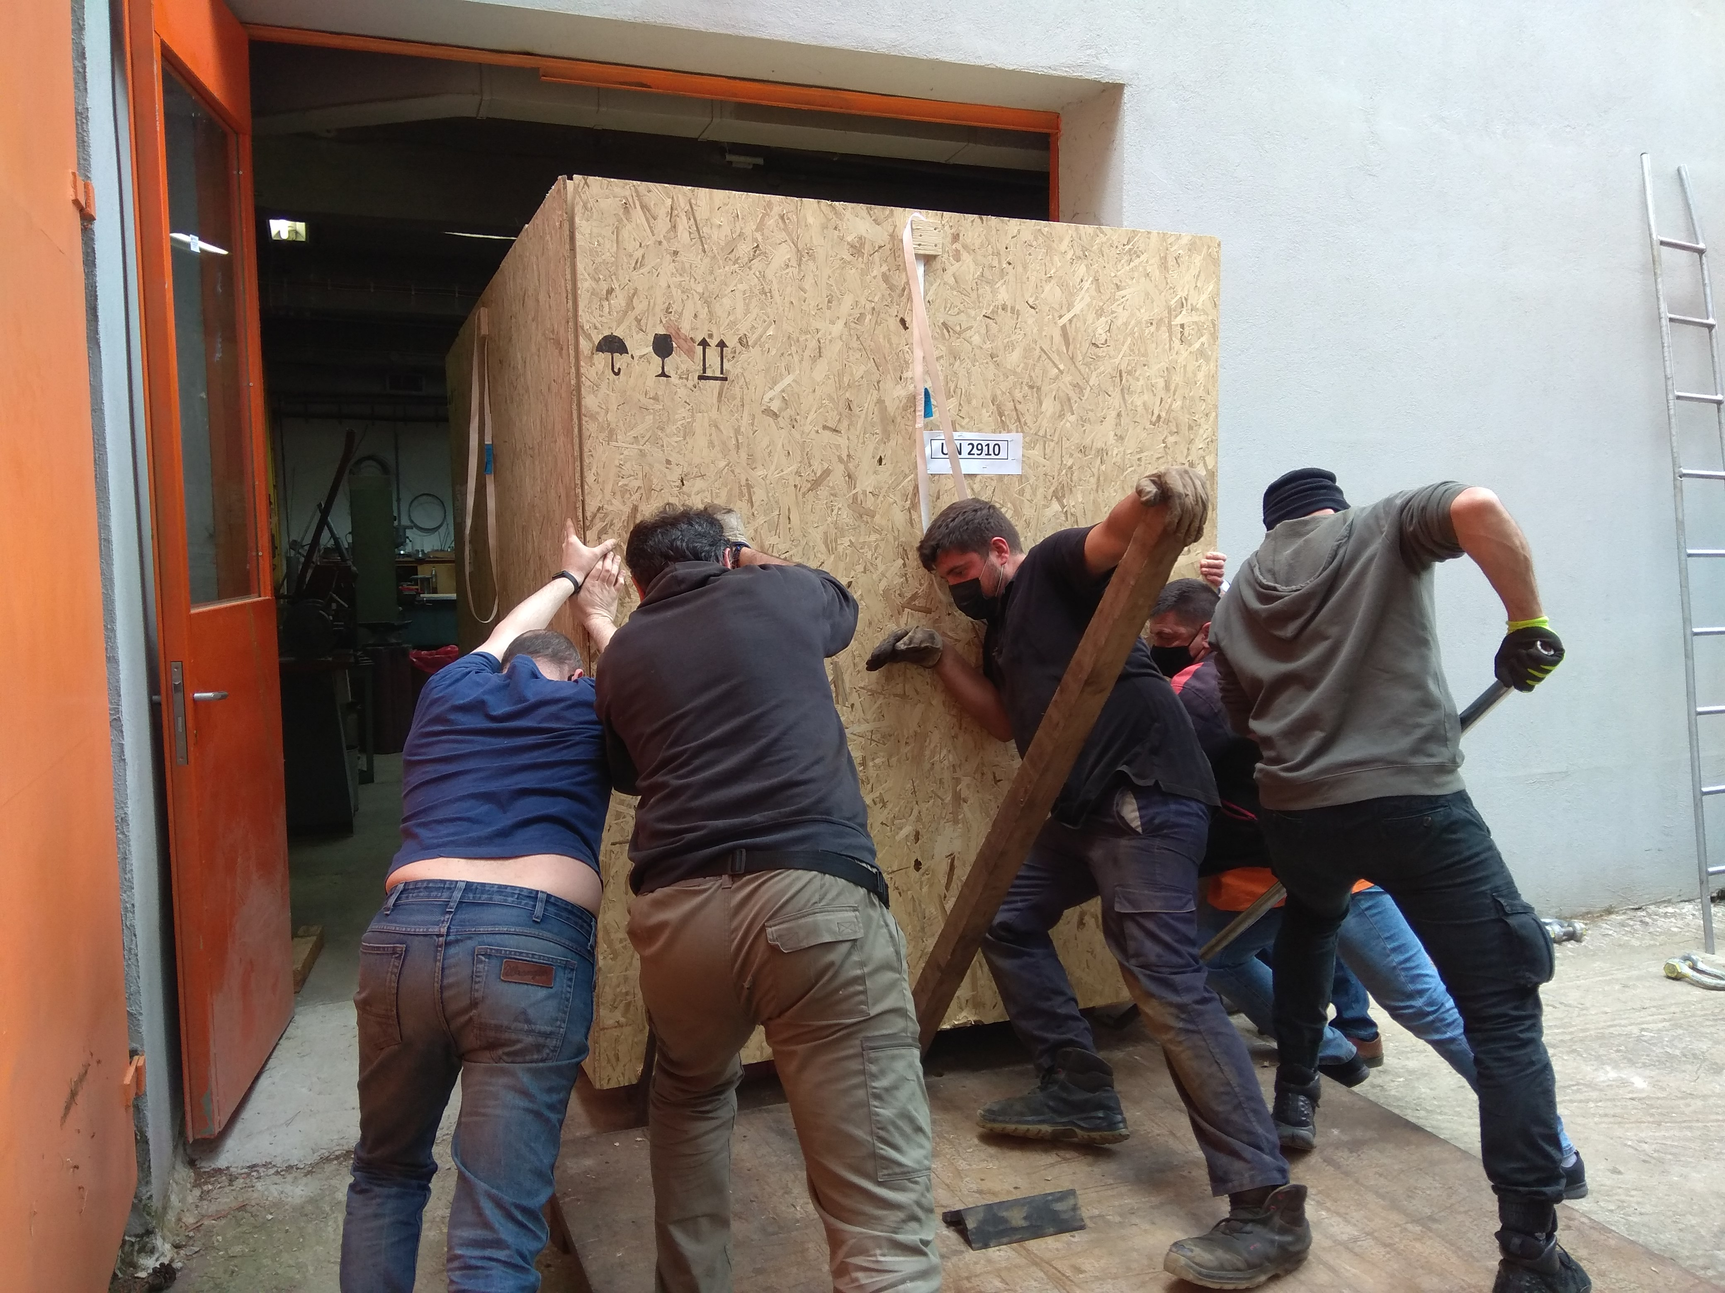
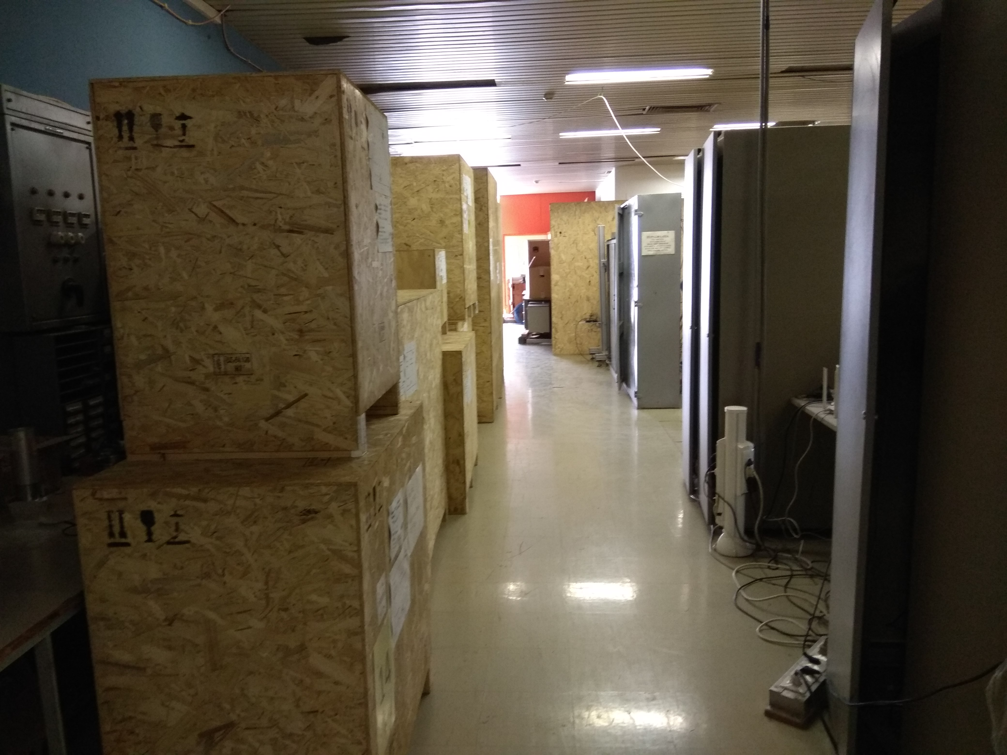
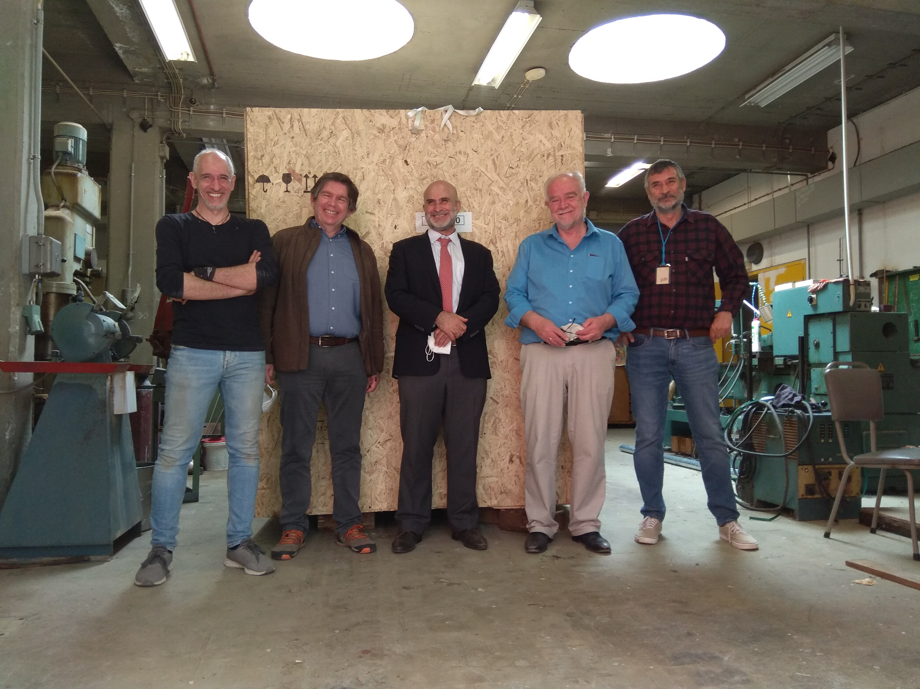
Cyclotron Transportation
A. Lagoyannis
I.N.P.P. Annual Meeting
Thursday 03/02/22

Slide 14
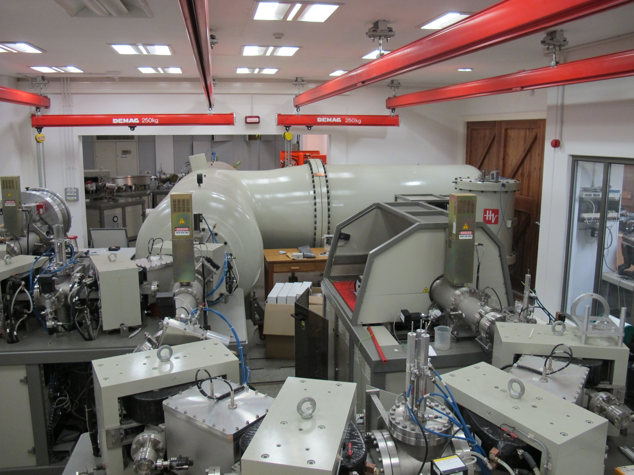
Accelerator Mass Spectroscopy
A. Lagoyannis
I.N.P.P. Annual Meeting
Thursday 03/02/22

Slide 15
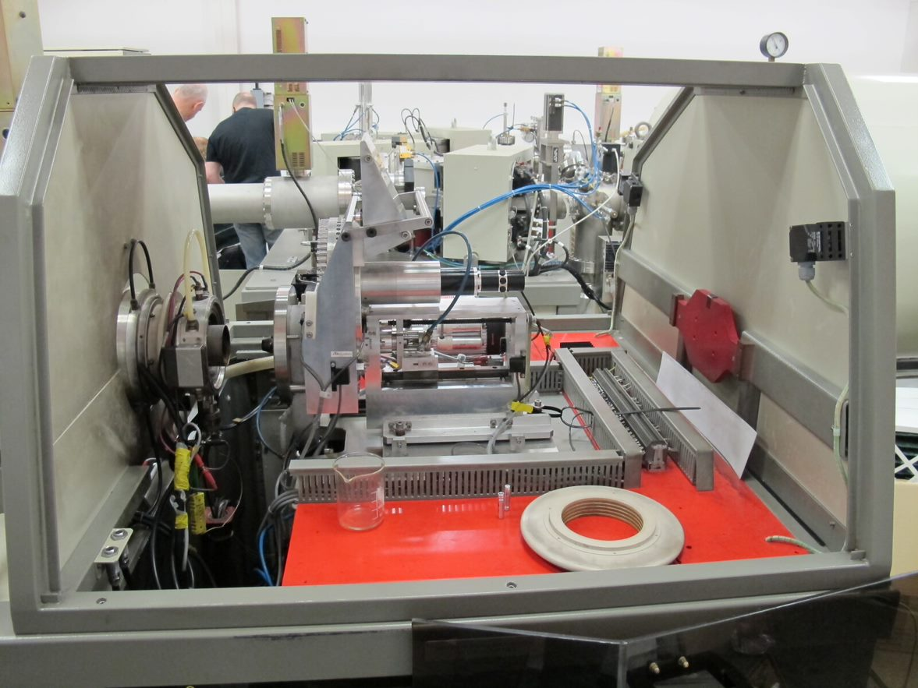
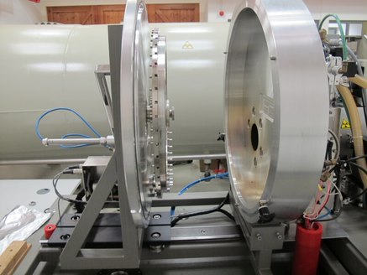
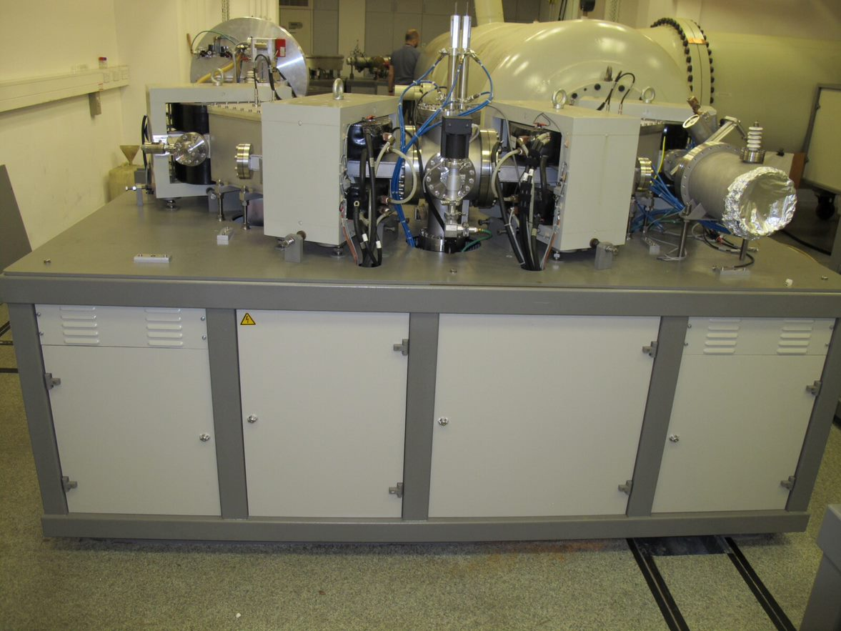
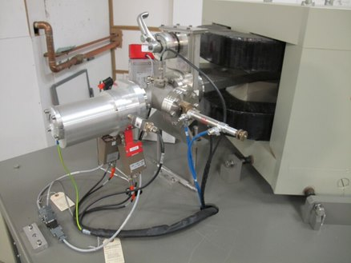
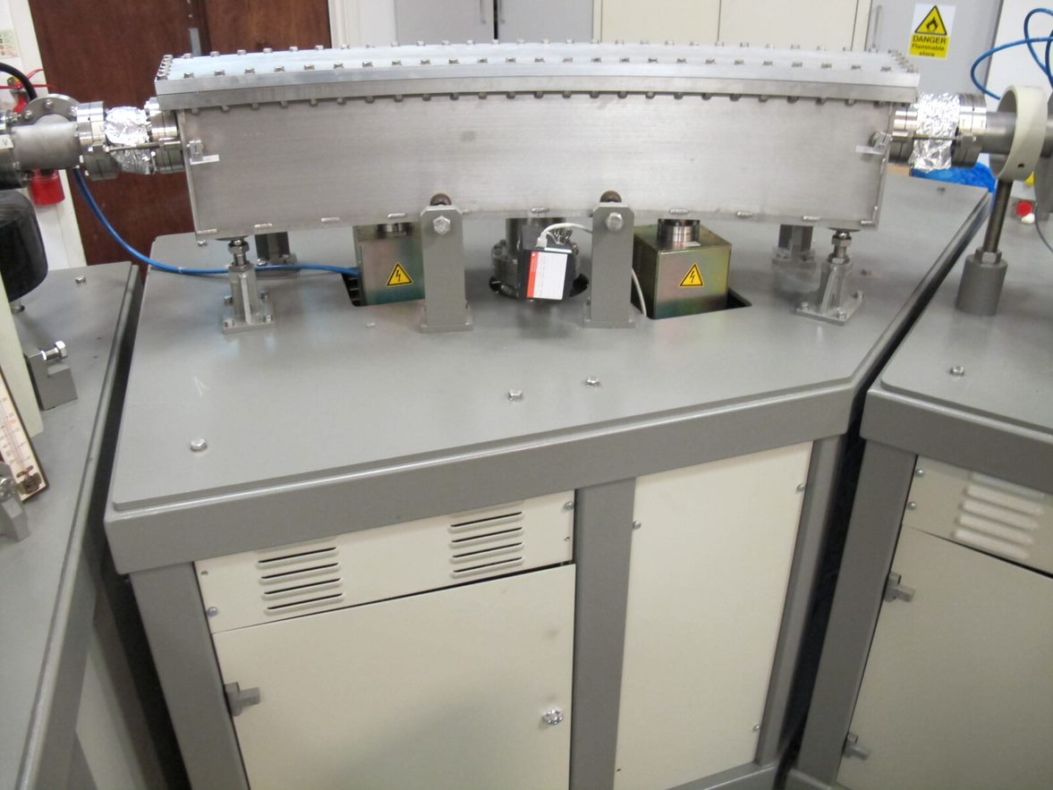
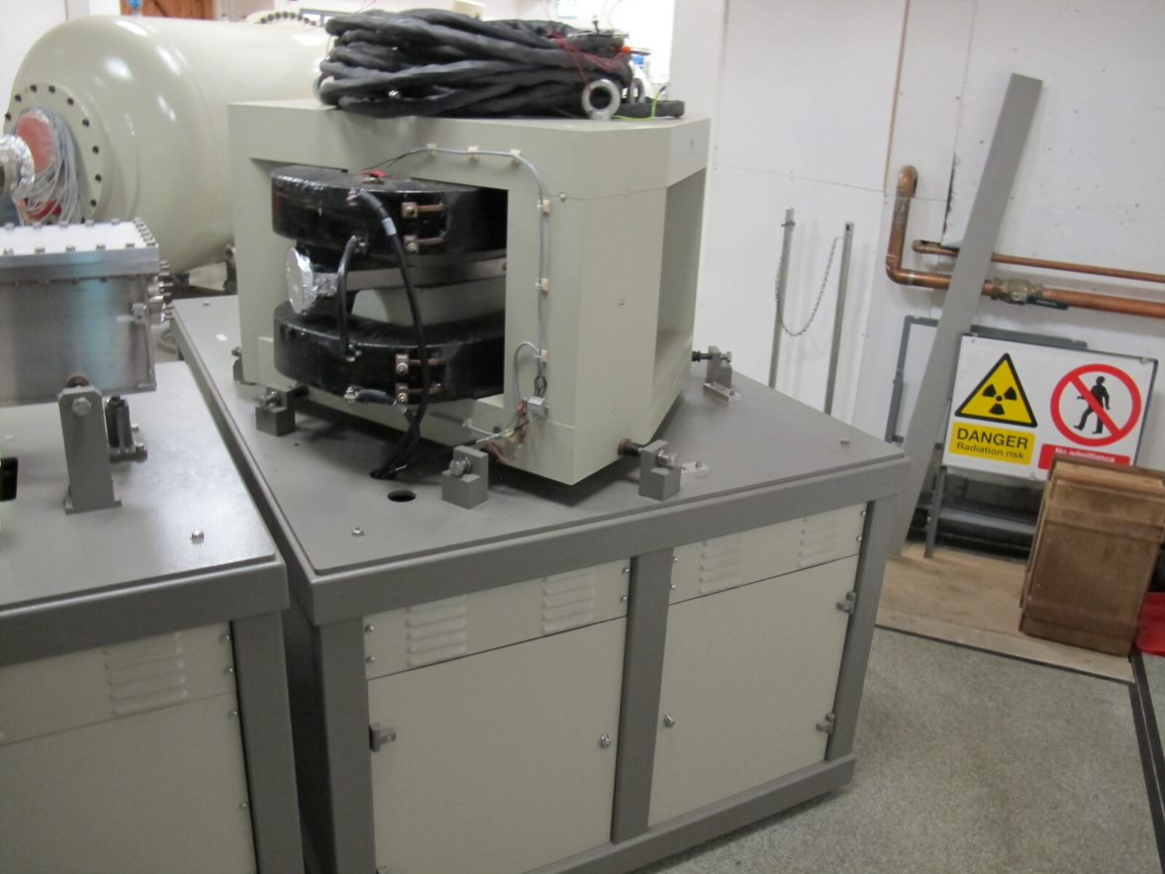
Accelerator Mass Spectroscopy
A. Lagoyannis
I.N.P.P. Annual Meeting
Thursday 03/02/22

Slide 16
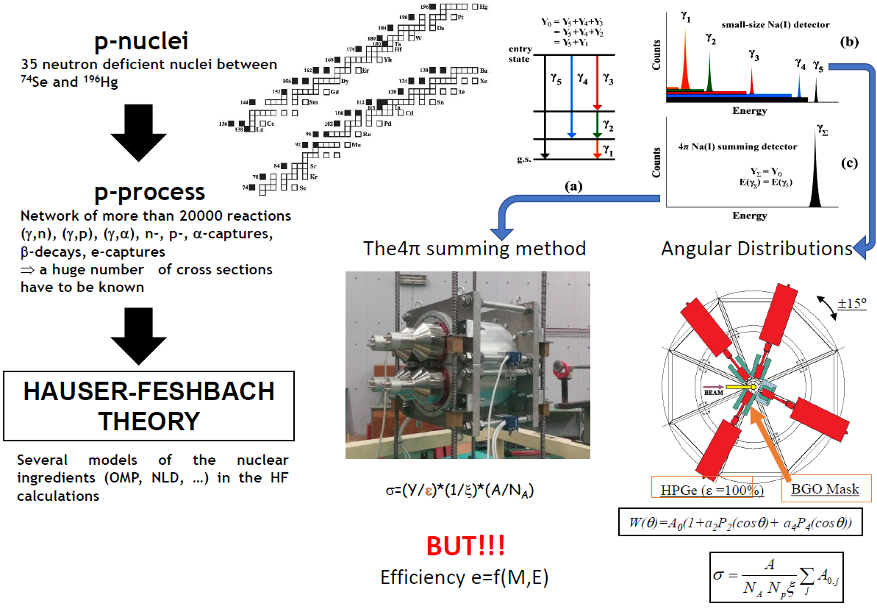
Nuclear Astrophysics Cross-Section Measurements
See E. Vagena presentation
A. Lagoyannis
I.N.P.P. Annual Meeting
Thursday 03/02/22

Slide 17
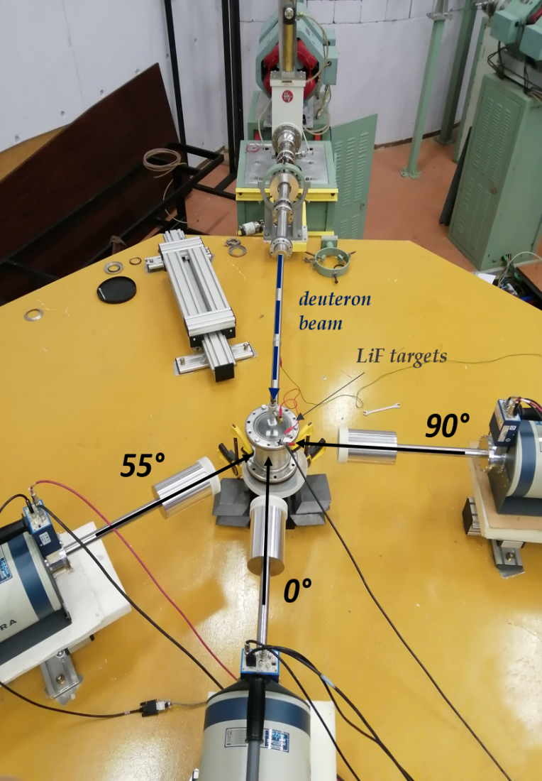
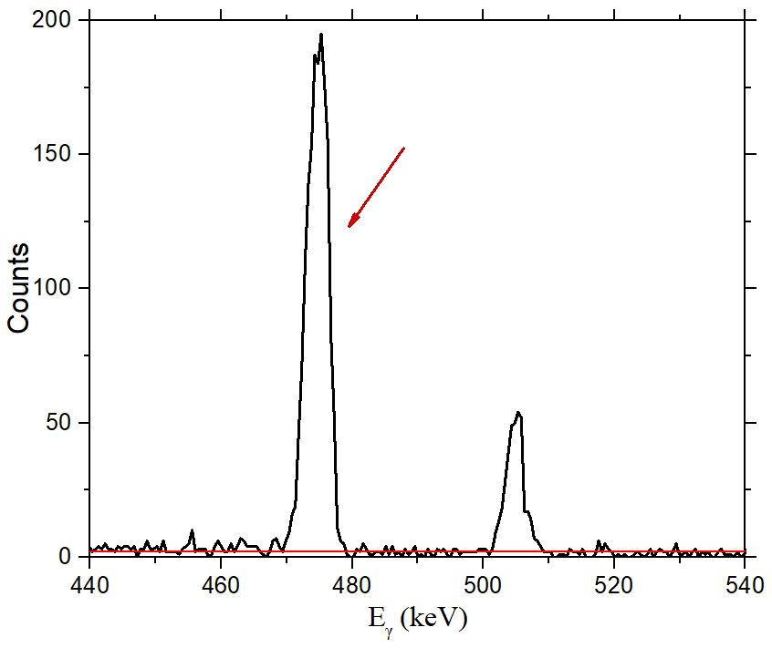
Differential CS Measurement - PIGE
Electronically controlled turntable
Initial angles: 0º – 55º – 90º
3 HPGe detectors (80%)
placed between 25 and 30 cm from target
Air cooled target
477.6 keV
A. Lagoyannis
I.N.P.P. Annual Meeting
Thursday 03/02/22

Slide 18
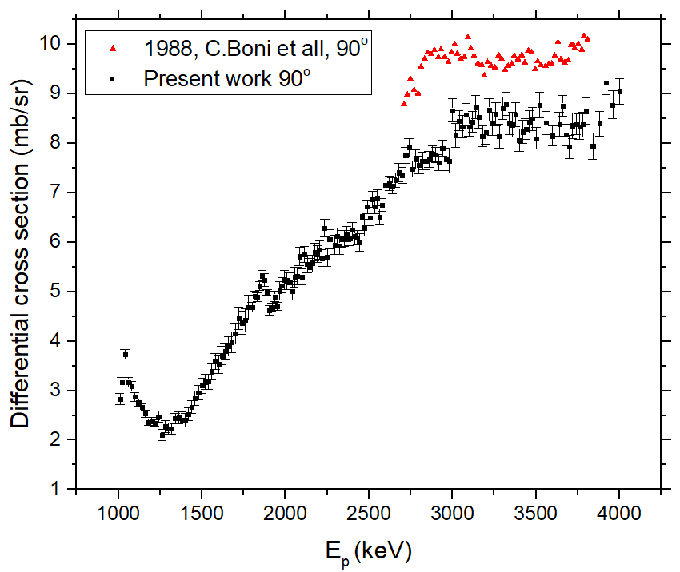
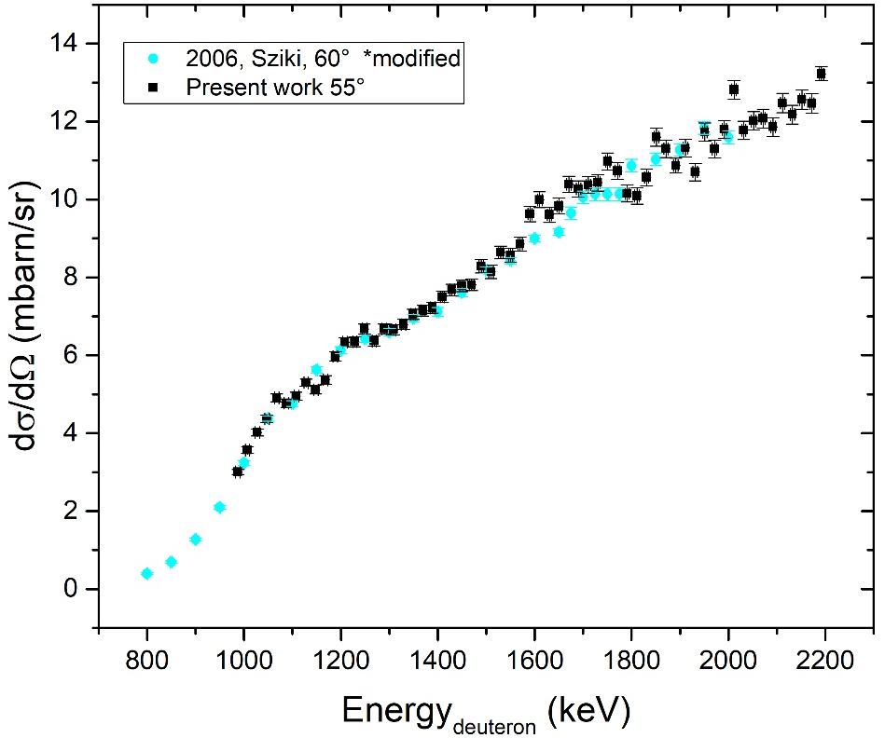
Differential CS Measurement - PIGE
⁷Li(p,p΄γ) ⁷Li
⁷Li(d,d΄γ) ⁷Li
E_{p} = 2600 – 4050 keV
Angles = 0º - 55º - 90º - 165º
E_{p} = 1000 – 2200 keV
Angles = 0º - 55º - 90º
⁷Li(d,d’γ₁₋₀)⁷Li
See A. Ziagova & E. Taimpiri presentation
A. Lagoyannis
I.N.P.P. Annual Meeting
Thursday 03/02/22

Slide 19
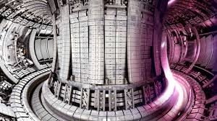
WEST Measurements
Experimental Details
The surface of the noted samples was measured using the ¹²C(d,p) reaction
For milli- & micro- beam
Beam type: deuteron
Beam energy: 1.35 MeV
Detection angle: 170º
For micro-Beam
Mapping area: 1000 x 1000 μm²
Beam diameter spot < 100 μm
A. Lagoyannis
I.N.P.P. Annual Meeting
Thursday 03/02/22

Slide 20
Thank you for your attention

