Slide 1






Latest developments at the Atomic Physics beamline of Tandem Laboratory
Stefanos Nanos
PhD Candidate
INPP Annual Meeting
3/2/2022
S. Nanos – INPP Annual Meeting, 3/2/2022

Slide 2
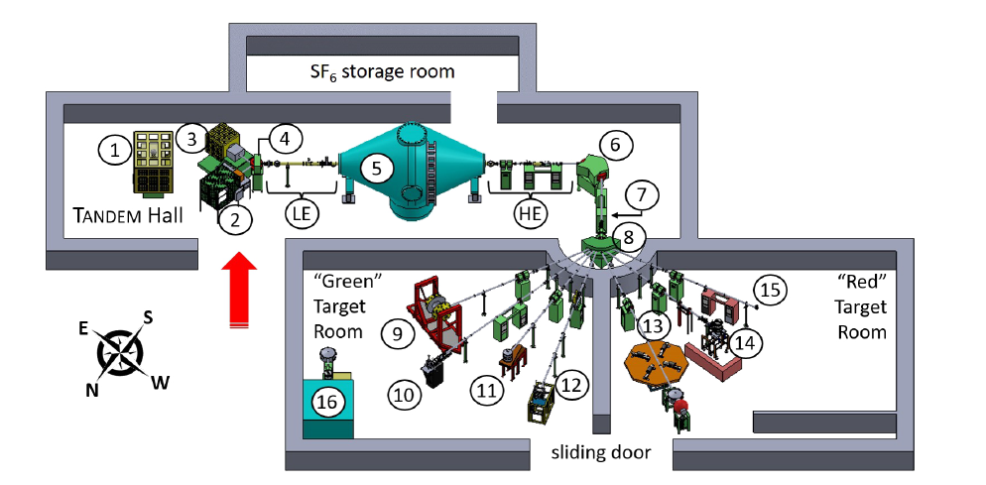
NCSR «Demokritos», Athens
Tandem Van de Graaff 5.5MV, INPP
APAPES:
Atomic Physics with Accelerators–
Projectile Electron Spectroscopy
https://sites.google.com/uoi.gr/manolis-benis/projects/apapes?authuser=0
S. Nanos – INPP Annual Meeting, 3/2/2022

Slide 3
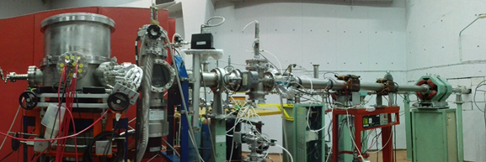
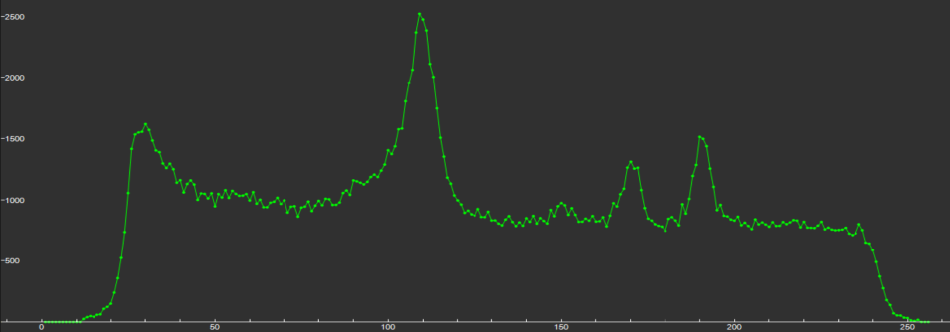
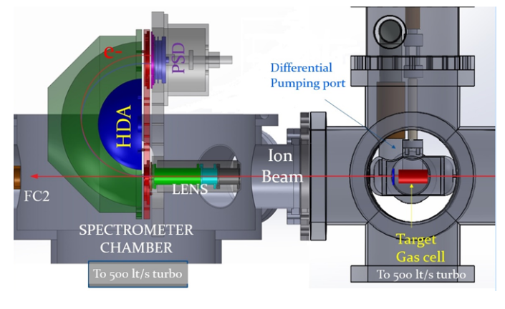
APAPES setup
Zero-degree Auger Projectile Spectroscopy – ZAPS setup
Typical KLL Auger e⁻
I. Madesis et al., J. Phys: Conf. Ser. 583, 012014 (2015)
A. Dimitriou et al., J. Atom. Mol. Cond. Nano Phys. 3,125-131(2016)
S. Nanos – INPP Annual Meeting, 3/2/2022

Slide 4
Utilizing mixed-state ionic beams
Negative Ion
Stripping
Charge-state
selector
E.P. Benis et al., Phys Rev. A, 65, 064701(2002)
High resolution Auger electron spectroscopy
Continuum electron spectroscopy
He-like
(1s², 1s2s ³S)
S. Nanos – INPP Annual Meeting, 3/2/2022

Slide 5
Utilizing mixed-state ionic beams
1s² → 1s2snl [Resonant Transfer and Excitation - RTE]
1s2s ³S → 1s2s2l ^{2,4}P [Single Electron Capture - SEC]
Auger spectroscopy
1s2s ³S → 1s2snl ²L [Single Electron Capture - SEC]
1s2s ³S → 2s2p ³P [Excitation]
[Electron Capture to the Continuum – ECC]
1s² → 1s² + e_{cusp}
1s2s ³S → 1s2s ³S + e_{cusp}
Cusp electrons
[Electron Loss to the Continuum – ECC]
1s² → 1s + e_{cusp}
1s2s ³S → 1s + e_{cusp}
S. Nanos – INPP Annual Meeting, 3/2/2022

Slide 6
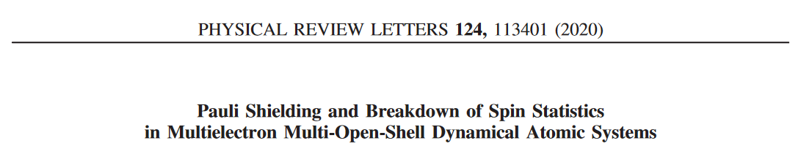

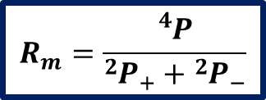
Auger electron spectroscopy
Three active electron calculations
$$C^{4+}\left(1s2s^{ 3}S\right)+He →C^{3+}\left(1s2s2p{}_{}^{4}P, {{}_{}^{2}P}_{±}\right)+{He}^{+}$$
$$R_{m}=\frac{{}_{}^{4}P}{{{}_{}^{2}P}_{+}+{{}_{}^{2}P}_{−}}$$
correlation effects
Statistical population of the states
One active electron theories
S. Nanos – INPP Annual Meeting, 3/2/2022

Slide 7

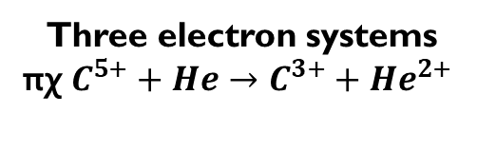
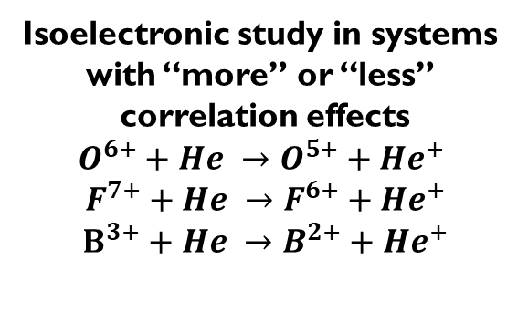
Auger electron spectroscopy
Three active electron calculations
Limits of the new theory
Isoelectronic study in systems
with “more” or “less”
correlation effects
$$Ο^{6+}+He →O^{5+}+{He}^{+}$$
$$F^{7+}+He →F^{6+}+{He}^{+}$$
$$Β^{3+}+He →B^{2+}+{He}^{+}$$
Three electron systems
πχ $C^{5+}+He→C^{3+}+{He}^{2+}$
7
S. Nanos – INPP Annual Meeting, 3/2/2022

Slide 8
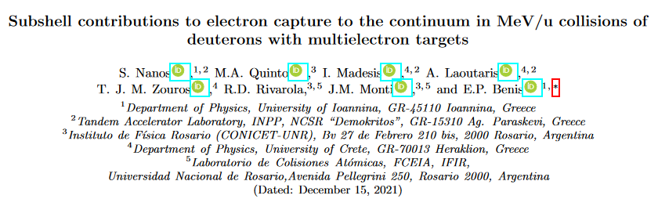
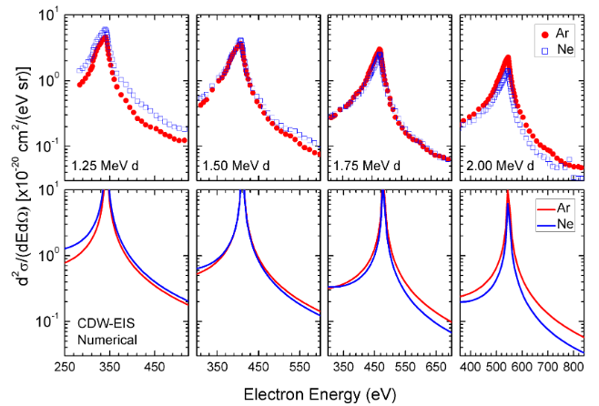
Cusp electron spectroscopy
S. Nanos – INPP Annual Meeting, 3/2/2022

Slide 9


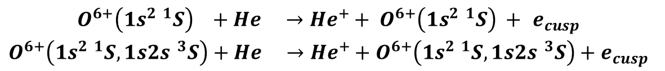
Cusp electron spectroscopy
Collision systems with pre-excited
Ionic beams:
E.P. Benis et al., Atoms, 6, 66 (2018)
E.P. Benis and T.J.M. Zouros, J. Phys. B, 49, 235202 (2016)
$$\left(1s^{2 1}S\right)$$
$$\left(1s2s^{ 3}S\right)$$
Cusp electron studies:
$$\begin{aligned}O^{6+}\left(1s^{2 1}S\right) +He →{He}^{+}+ O^{6+}\left(1s^{2 1}S\right) + e_{cusp} \\ O^{6+}\left(1s^{2 1}S, 1s2s^{ 3}S\right)+He →{He}^{+}+O^{6+}\left(1s^{2 1}S, 1s2s^{ 3}S\right)+e_{cusp}\end{aligned}$$
$$O^{6+}\left(1s2s^{ 3}S\right)+He →{He}^{+}+ O^{6+}\left(1s2s{}_{}^{3}S\right)+ e_{cusp}$$
S. Nanos – INPP Annual Meeting, 3/2/2022

Slide 10
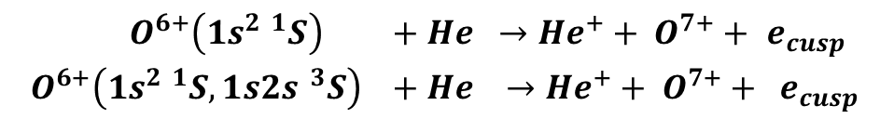
Cusp electron spectroscopy
Collision systems with pre-excited
Ionic beams:
E.P. Benis et al., Atoms, 6, 66 (2018)
E.P. Benis and T.J.M. Zouros, J. Phys. B, 49, 235202 (2016)
$$\left(1s^{2 1}S\right)$$
$$\left(1s2s^{ 3}S\right)$$
Cusp electron studies:
$$\begin{aligned}{ O}^{6+}\left(1s^{2 1}S\right) +He →{He}^{+}+ O^{7+}+ e_{cusp} \\ { O}^{6+}\left(1s^{2 1}S, 1s2s^{ 3}S\right) +He →{He}^{+}+ O^{7+}+ e_{cusp}\end{aligned}$$
$${ O}^{6+}\left(1s2s^{ 3}S\right) +He →{He}^{+}+ O^{7+}+ e_{cusp}$$
! Experiments utilizing coincident techniques
S. Nanos – INPP Annual Meeting, 3/2/2022

Slide 11
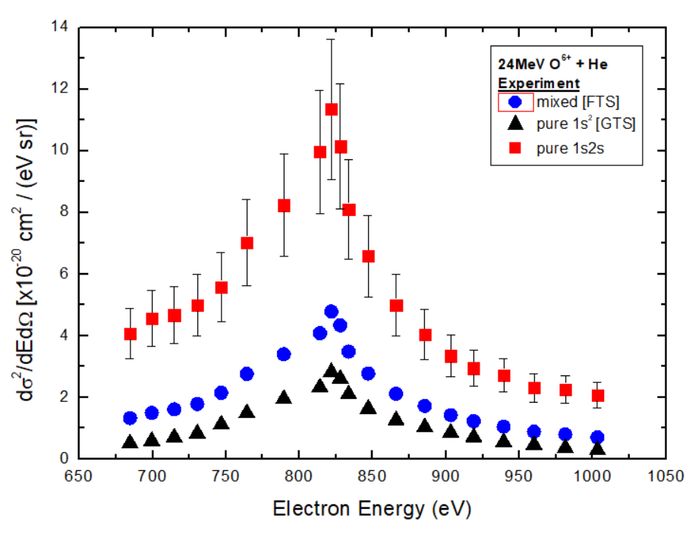
Utilizing pre-excited ionic beams
Preliminary
Σ. Νάνος – Tandem Jr. Meetings, 16/12/2021

Slide 12

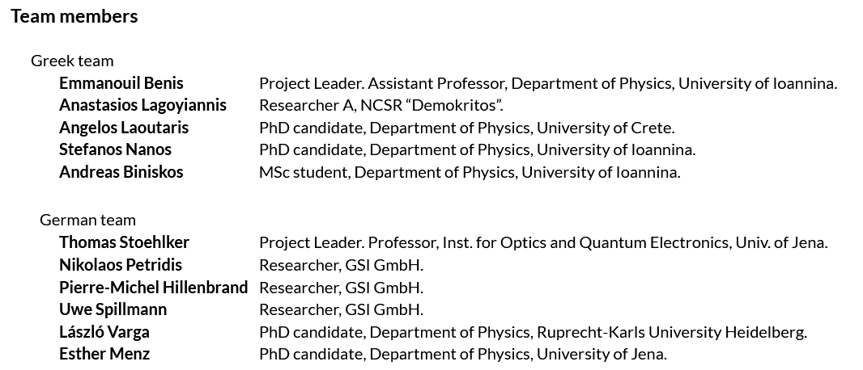
Cusp electron spectroscopy
https://sites.google.com/uoi.gr/manolis-benis/projects/ikyda-2020?authuser=0
S. Nanos – INPP Annual Meeting, 3/2/2022

Slide 13
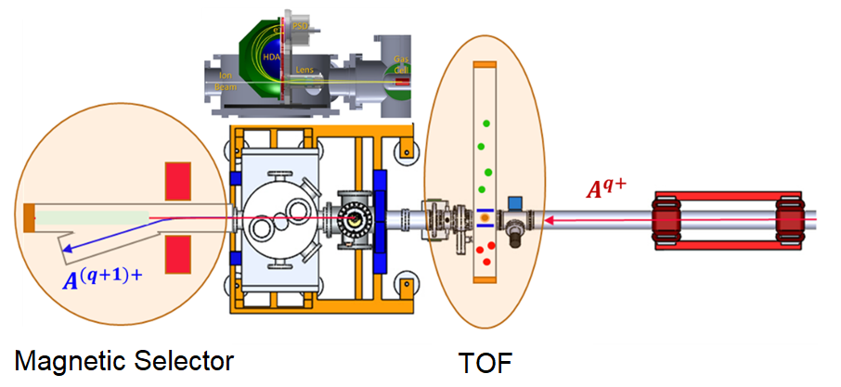

Upgrading the APAPES setup
Magnetic Selector: Coincidences between electrons-ion beam charge state
TOF: Coincidences between molecular fragments/target charge state-ion beam charge state
S. Nanos – INPP Annual Meeting, 3/2/2022

Slide 14
APAPES milestones 2020-2021
3 beamtimes at the Atomic Physics beamline of Tandem Laboratory
Contribution in 2 papers in refereed journals
1 paper in Physical Rev. A
I. Madesis defended his PhD
2 Invited talks in international / local conferences
3 oral presentations in international / local conferences
2 poster presentations in international / local conferences
1 visit (one week) of the German team at INPP (IKYDA 2020)
1 visit (two weeks) of the Greek team at GSI research center (IKYDA 2020)
Considerable progress on upgrading the Atomic Physics beamline
S. Nanos – INPP Annual Meeting, 3/2/2022

Slide 15
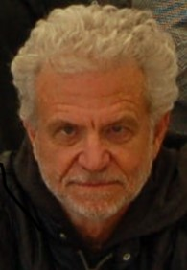
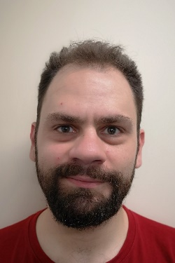
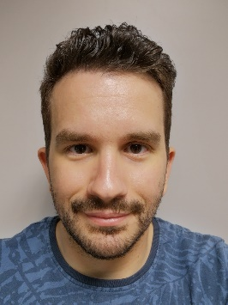
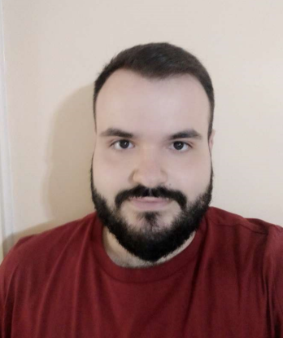
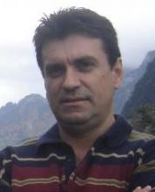
APAPES team and collaborators
Prof. Theo Zouros
(Univ. of Crete - retired)
Dr. I. Madesis
Laoutaris
(PhD Student -
Univ. of Crete)
Biniskos
(MSc Student -
Univ. of Ioannina)
Asso. Prof.
Manolis Benis
(Univ. of Ioannina)
S. Nanos – INPP Annual Meeting, 3/2/2022

Slide 16
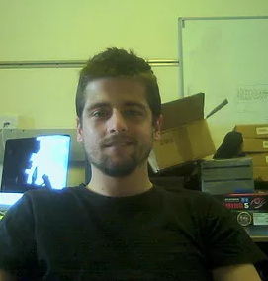
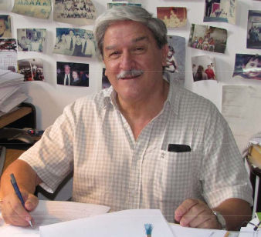

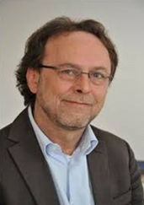
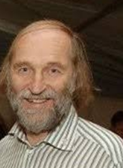

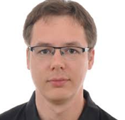
APAPES team and collaborators
Prof. Alain Dubois
(CNRS, Sorbonne Univ.)
Dr. S. Passalidis
Prof. Roberto Rivarola
(Rosario Nat. Univ.)
Asso. Prof. Juan Monti
(Rosario Nat. Univ.)
Prof. T.. Stoehlker
(Univ. of Jena)
Prof. S. Hagmann
Dr. P.-M.
Hillenbrand
Dr. N. Petridis
S. Nanos – INPP Annual Meeting, 3/2/2022

Slide 17
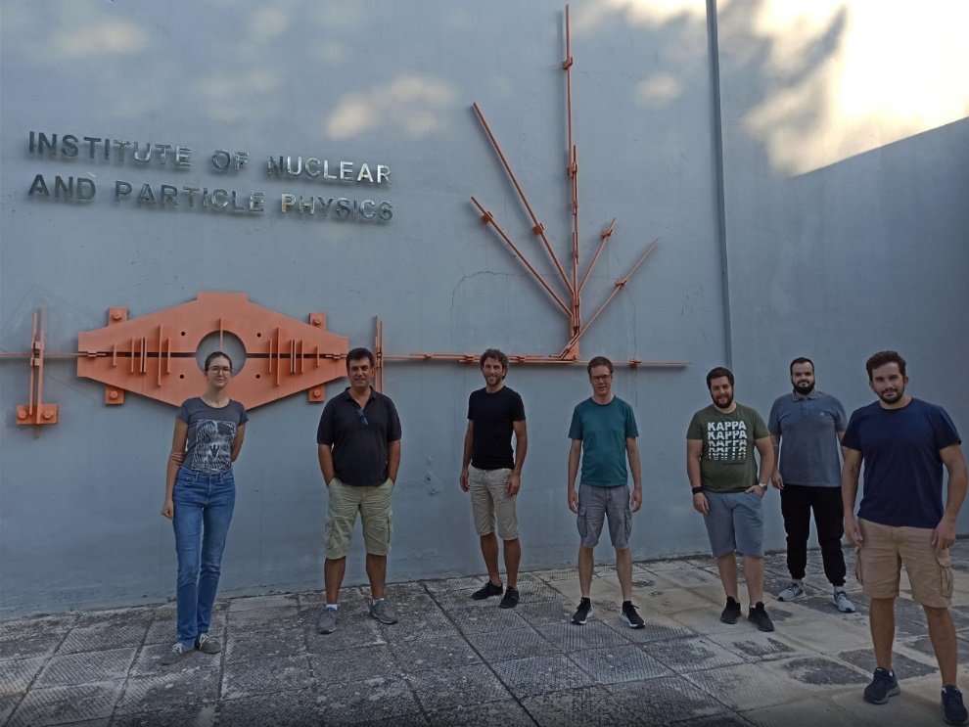
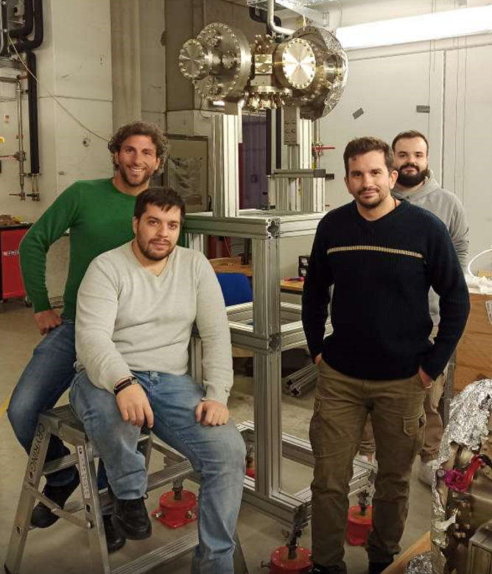
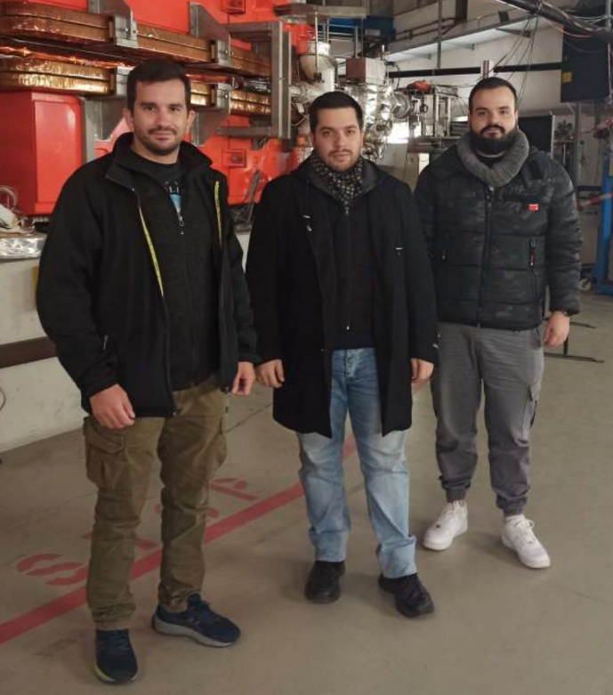
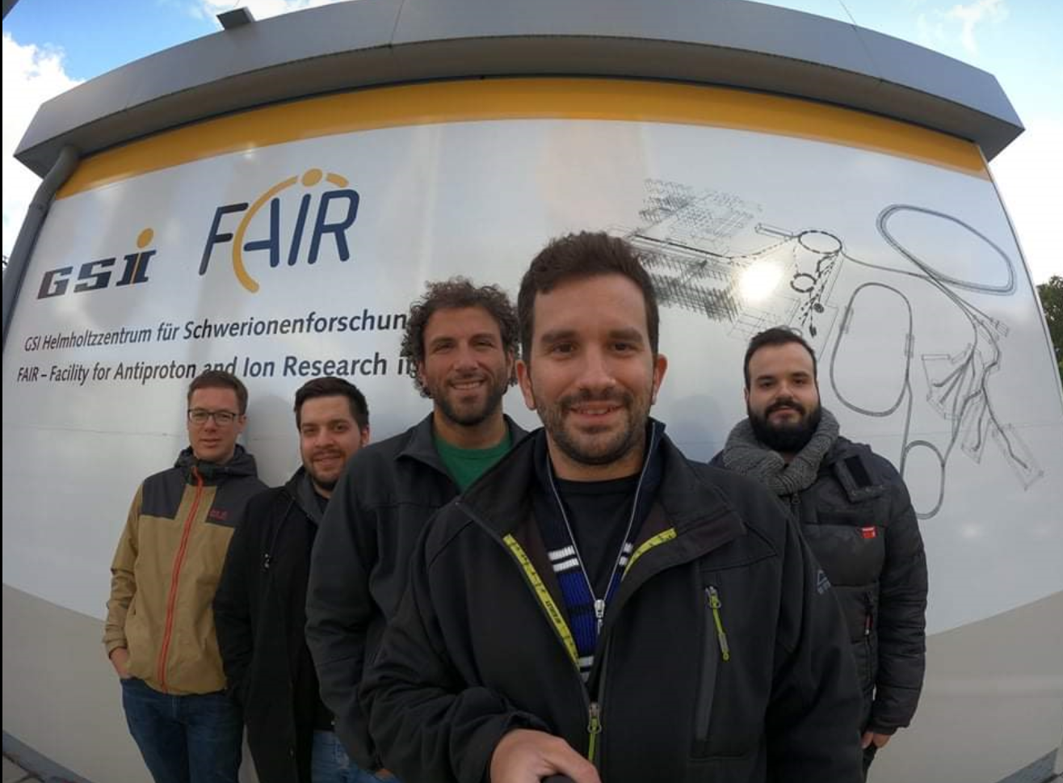

Slide 18
Auger electron spectroscopy
Auger e⁻
L
K
KLL Auger
process
Σ. Νάνος – Tandem Jr. Meetings, 16/12/2021

Slide 19
Cusp electron spectroscopy
ELC
Τ
P
P
Σ. Νάνος – Tandem Jr. Meetings, 16/12/2021

Slide 20
Cusp electron spectroscopy
ECC
Τ
P
P
Σ. Νάνος – Tandem Jr. Meetings, 16/12/2021

Slide 21
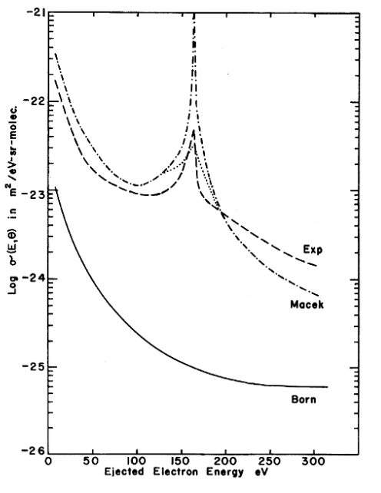
Φασματοσκοπία Cusp ηλεκτρονίων
ECC
Τ
P
G.B. Crooks and M.E. Rudd, Phys. Rev. Let. 25, 1599 (1970)
A. Salin, J. Macek, R. Shakeshaft, L. Spruch
Σ. Νάνος, M.Sc. “Ηλεκτρονική σύλληψη στο συνεχές σε ταχείες κρούσεις πρωτονίων με αέριους στόχους”
Σ. Νάνος – Tandem Jr. Meetings, 16/12/2021

Slide 22
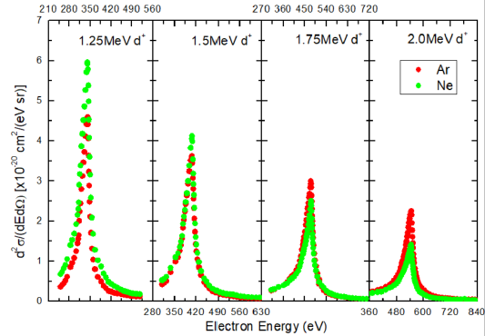
Φασματοσκοπία Cusp ηλεκτρονίων
Σ. Νάνος – Tandem Jr. Meetings, 16/12/2021

Slide 23
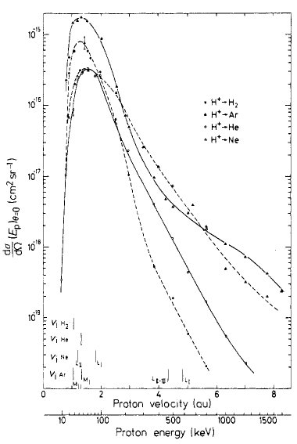
Φασματοσκοπία Cusp ηλεκτρονίων
M. Rodbro and F.D. Andersen, J. Phys. B 12, 2883 (1979)
Σ. Νάνος – Tandem Jr. Meetings, 16/12/2021

Slide 24
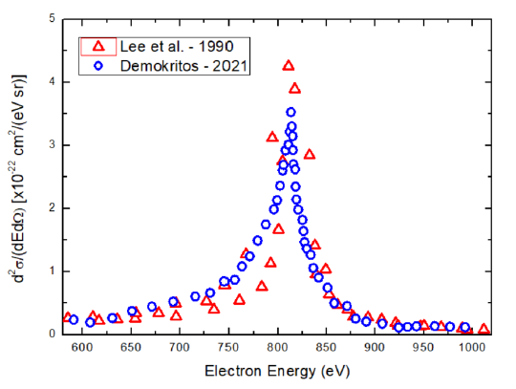
Cusp electron spectroscopy
1.5MeV p + He
S. Nanos – INPP Annual Meeting, 3/2/2022

