Slide 1
Brief Overview of 2021
Christos Markou
INPP Annual Meeting
3/2/2022

Slide 2
Another difficult COVID 19 year, better than 2020, but still…
  Several COVID 19 cases
  Bureaucracy
  Lack of funding
  Balance between personal and professional life
  Scientific output and successes on the rise
  Increased numbers of activities
  Increased numbers of students
  Diversification and extroversion

Slide 3
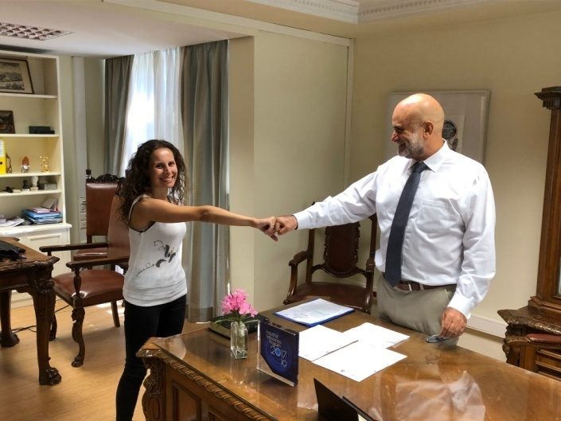
Personnel
16 Ερευνητές, 1 SSO
  E. Drakopoulou joined INPP in September
  We just (last Monday) selected A. Psallidas
  as Researcher C’ grade in the remaining
  vacancy.
9 Permanent Administrative, Technical and Support Personnel
10 Post Docs
8 Scientific Support (M.Sc. or B.Sc.)
31 Ph.D. candidates (2 dropped out)
29 M.Sc. and Undergraduate students

Slide 4
Funding 1/2
Again the BIG problem!
  No Matching funds – support activities are not supported
  Delays in existing programs
In 2021 4 ΕΣΠΑ-ΕΔΒΜ projects were completed + 1 ΕΛΙΔΕΚ
2 new projects started:
  “Intelligent specialized environmental observatory” (ISEO) funded by the Peloponnese Prefecture.
  “Development and Application of Ion Beam Techniques for Materials Irradiation and Characterization relevant to Fusion Technology” funded by EU.

Slide 5
CALIBRA
The project is in its final stage with the dismantling of the old sources, etc already well under way.
Two major breakthroughs in 2021
  Cyclotron – arrived on the 28th April
  AMS – packed in Oxford and soon to be shipped to Athens

Slide 6
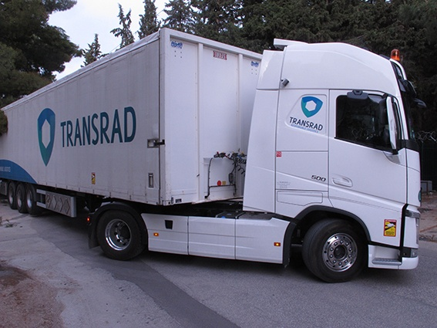
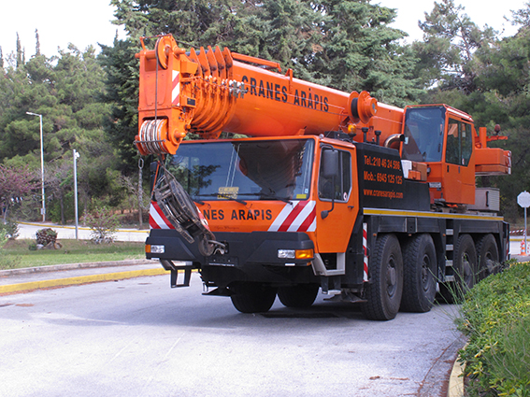
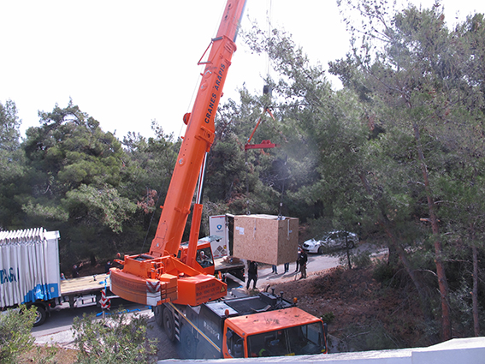
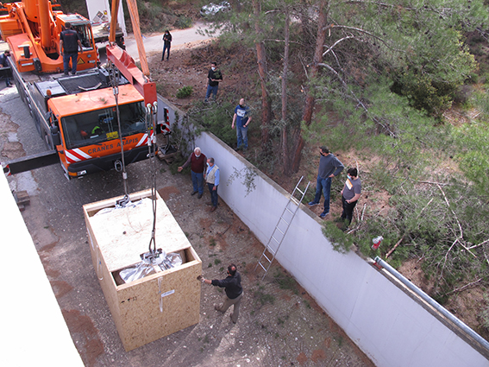
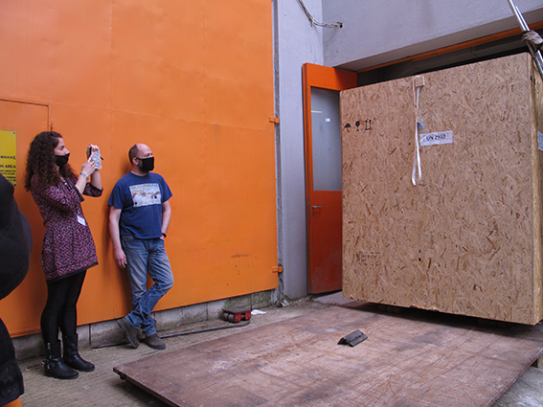
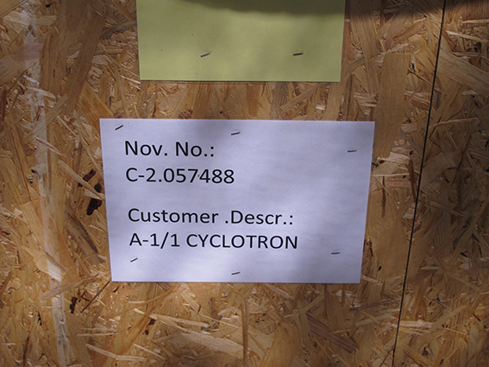

Slide 7
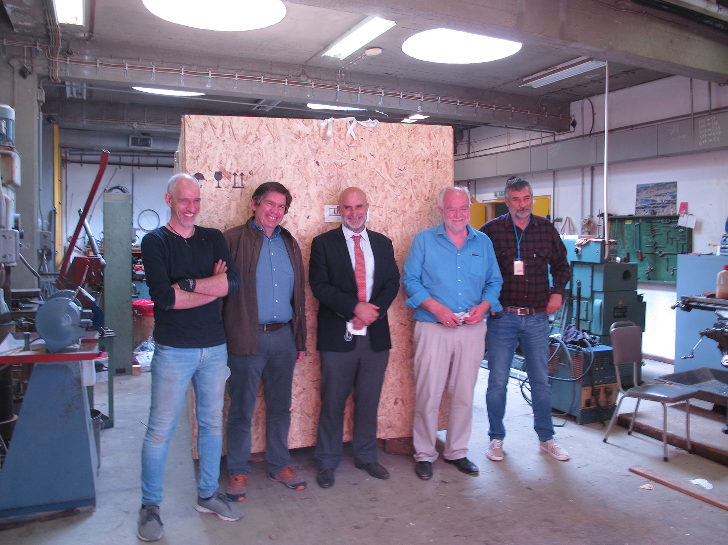

Slide 8
Collaborations
  MoU University of Thessaly – Educational and research common activities
  Updated MoU with Kalamata Mayor – in the final stages
  MoU with Benaki Museum – in preparation
Prof. M. Hammad from Egypt will spend 9 months at INPP on sabbatical leave to work with Dennis Bonatsos

Slide 9
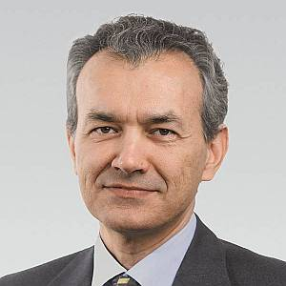
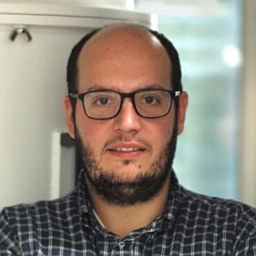
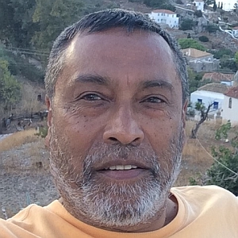
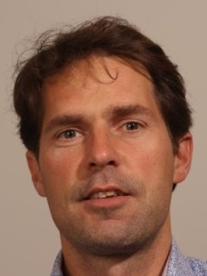
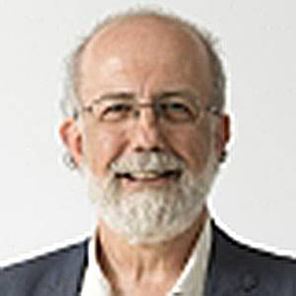
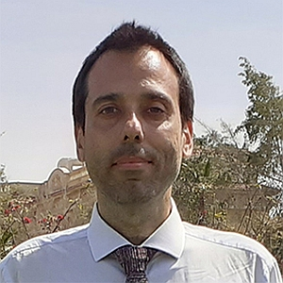
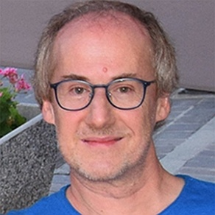
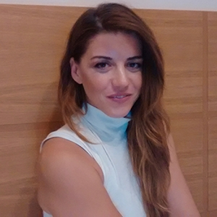
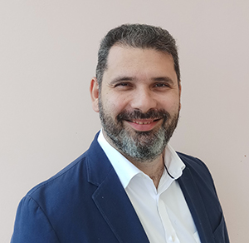
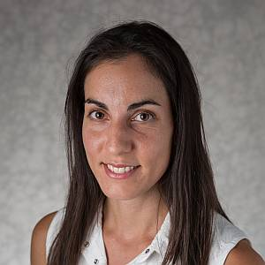
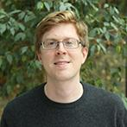
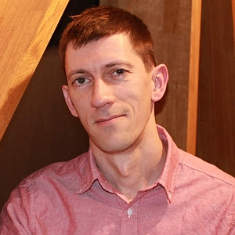
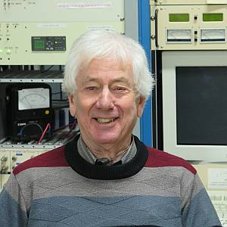
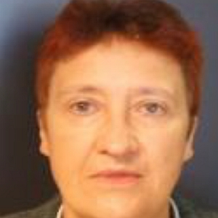
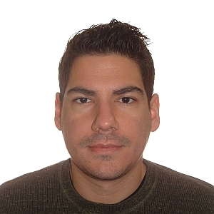
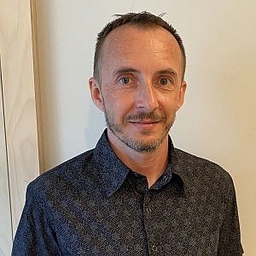
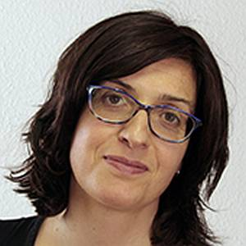
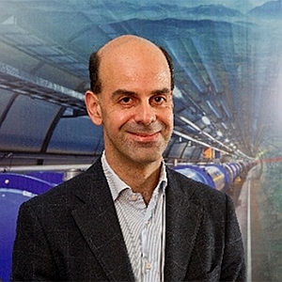
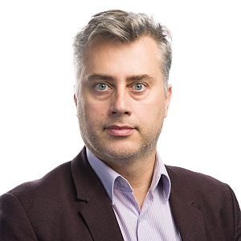
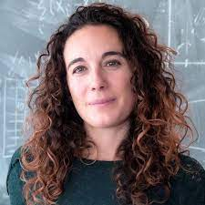
Colloquia series
Excellent speakers in all aspects of our research interests.
OpenLab QTI initiative session
+ Seminars by E. Drakopoulou, A. Psallidas, S. Aggelidakis, I. Manthos, T. Lagouri and G. Karapostoli.

Slide 10
Challenges for 2022
FUNDING !!!!
  New proposals, National, private, EU and beyond…
New research positions
Postgraduate scholarships
Evaluation 2018-2021

Slide 11
Finally…
A huge “Thank you”
to Georgia,
Manolis and
Dakis
for their work and dedication.

